Slide 1
Drift Properties of Noble Gases in Negative Ion Drift TPCs
Elizabeth Tilly – Wellesley College
Work carried out during PhD at the University of New Mexico
CPAD – OCtober 2026
et117@wellesley.edu

Slide 2
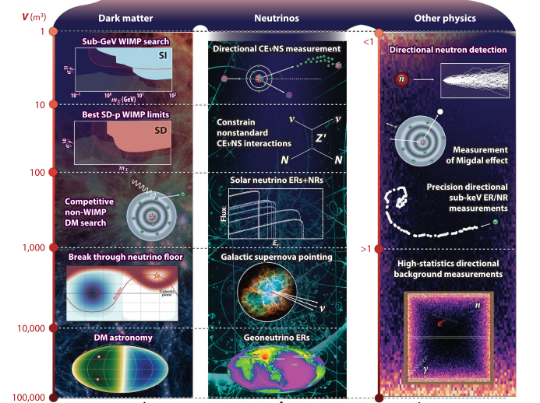
Directionality for Rare-Event Searches
S. Vahsen et al Annu. Rev. Nucl. Part. Sci. 2021. 71 189-224 [2102.04596 (arxiv.org)]

Slide 3


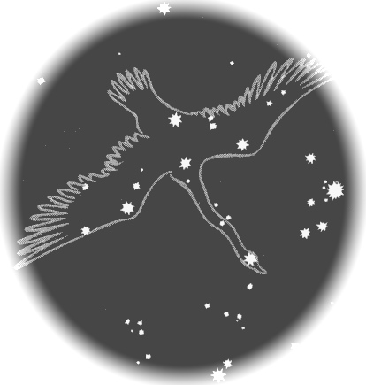
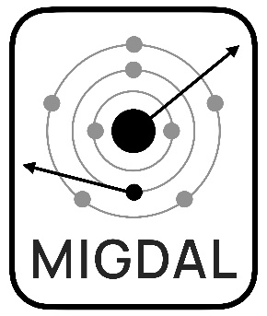


Noble Gases as Targets
Far from a comprehensive list…
Gaseous He, Ar, Xe and CF₄ for WIMP DM searches
  J.F. Castel et al. JINST 19 C05029 (2024)
  F.D. Amaro et al. Particles 4 343-353 (2021)
  S.E. Vahsen et al. (2020) arxiv:2008.12587
  C. Deaconu et al. Phys. Rev. D 95 122002 (2017)
  K. Nakamura et al. JINST 7 C02023 (2012)
Gaseous Xe for neutrinoless double beta decay
  K. Mistry, D. R. Nygren, (2025) arxiv:2512.19290
  I.G. Irastorza et al. JCAP 01 033 (2016)
Gaseous He, Ar, Xe, CF₄ in Migdal Effect searches
  D. Yi et al. Nature 649, 580–583 (2026)
  H.M. Araújo et al. (MIGDAL collaboration), Astropart. Phys. 151 102853 (2023)
  K.D. Nakamura et al. PTEP 1 013C01 (2021)
Gaseous Ar in collider-based neutrino experiments
  R.M. Amarinei, et al. JINST 18 P12001 (2023)
  A. Abed Abud, et al. (2022) arXiv:2203.06281
And the list goes on…

Slide 4
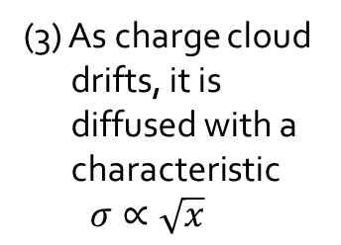
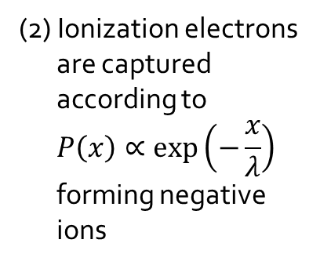
Negative Ion Drift Low-Pressure Gas TPCs
+V
Amplification Plane
Lower diffusion
Longer Tracks
Better Directional Resolution
(1) Recoiling particle ionizes gas creating track
(4) In order to amplify, the ions must be stripped of their electrons
(2) Ionization electrons are captured according to
$$P\left(x\right)∝\exp\left(−\frac{x}{λ}\right)$$
forming negative ions
(3) As charge cloud drifts, it is diffused with a characteristic
$$σ∝\sqrt{x}$$
(5) Resulting track is read out via optical or charge readout
-V
Cathode

Slide 5
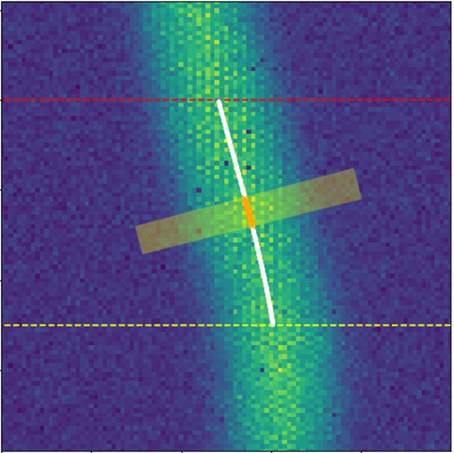
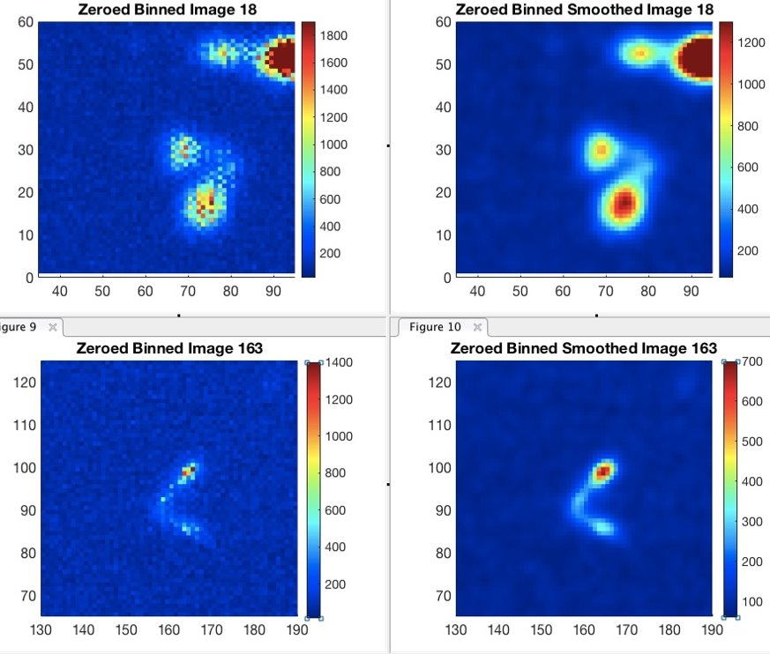
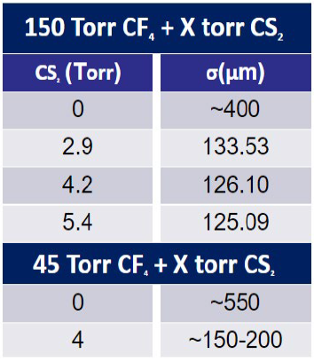
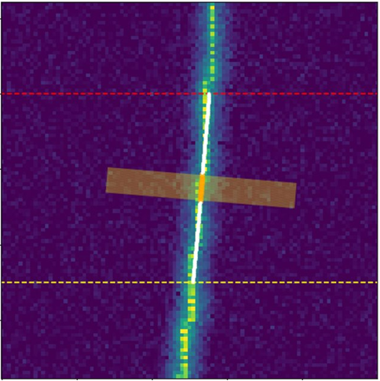
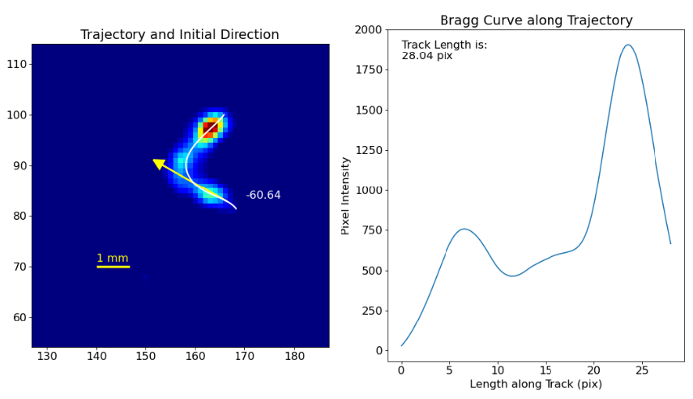
Advantages of Negative Ion Drift (NID)
CF₄
CF₄
CF₄+CS₂
CF₄+CS₂
Gains for these tracks are on the order of 10⁵!
Notes:
Comparable gas gains but the light is lower so the G is a good estimate using two gGEMs like in MIGDAL ** mention MPII

Slide 6
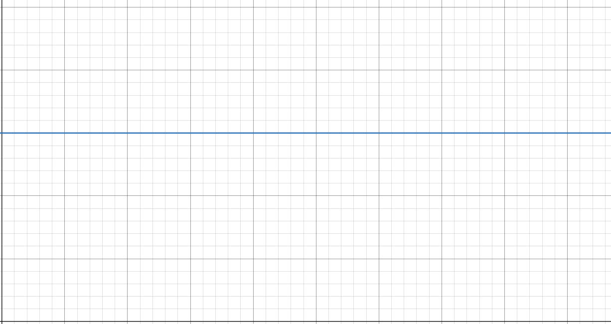
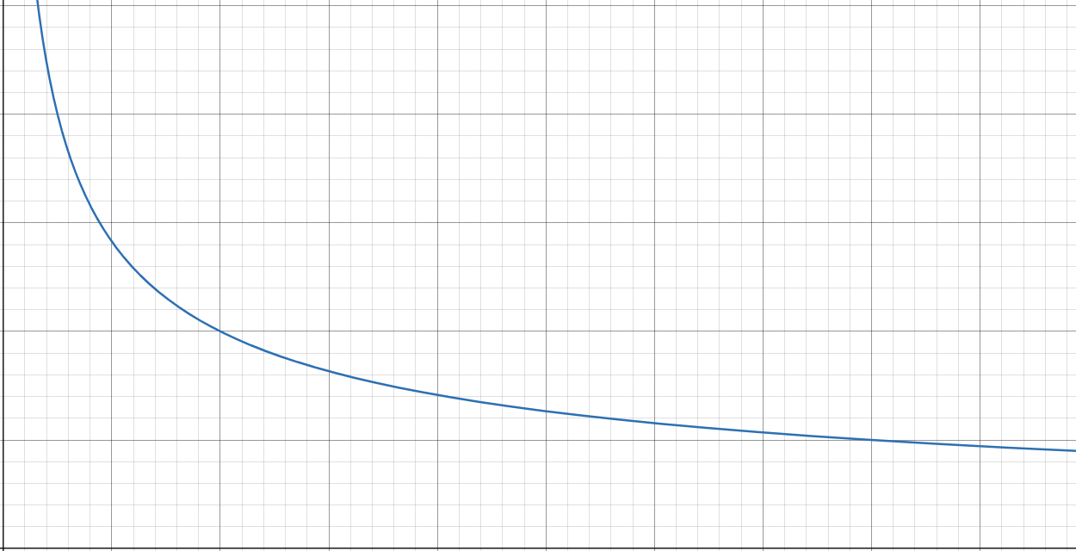

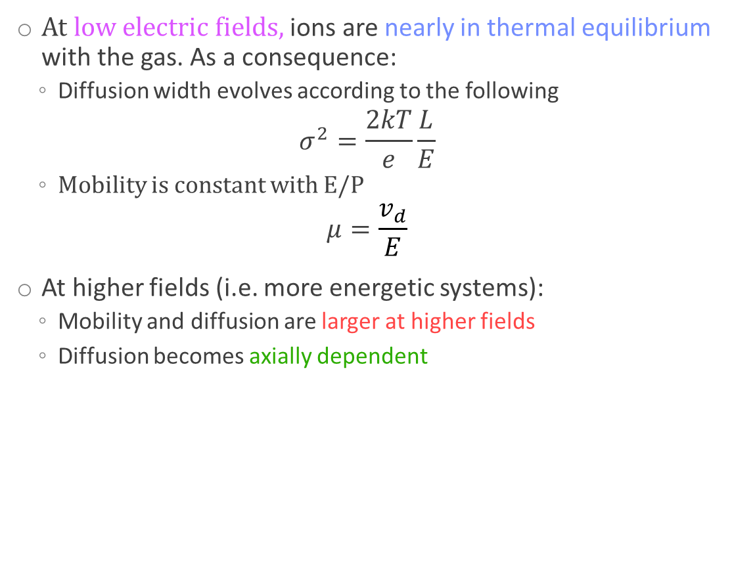

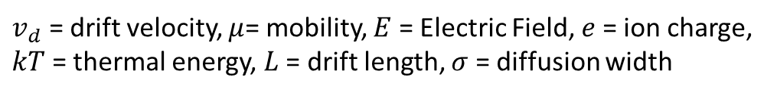
Thermal Drift
At low electric fields, ions are nearly in thermal equilibrium with the gas. As a consequence:
  Diffusion width evolves according to the following
$$σ^{2}=\frac{2kT}{e}\frac{L}{E}$$
  Mobility is constant with E/P
$$μ=\frac{v_{d}}{E}$$
At higher fields (i.e. more energetic systems):
  Mobility and diffusion are larger at higher fields
  Diffusion becomes axially dependent
$$μ$$
σ
E-field
$v_{d}$ = drift velocity, $μ$= mobility, $E$ = Electric Field, $e$ = ion charge, $kT$ = thermal energy, $L$ = drift length, $σ$ = diffusion width
Electric Field
Plots created using desmos.com

Slide 7
Optimizing/Testing Different Gas Mixtures
GOAL: Explore gas mixtures with high quantities of the target gas maintaining negative ion benefits
Target Gases: Xe, Ar, He, CF₄ NID gases: SF₆ and CS₂
  Of interest to Migdal searches, Directional Dark Matter searches, Neutrino Studies, etc
Properties of interest for Noble Gas NID TPCs:
  Diffusion = Track broadening from stochastic motion within the gas → NID is narrower
  Mobility = Proportionality constant between drift velocity and field → NID is slower
  Gain = Stable operation and amplification capability → electron stripping is required for avalanche amplification in NID but NID gases increase stability
  Attachment Length = Mean distance before electrons are captured in the gas → Must have short attachment length

Slide 8
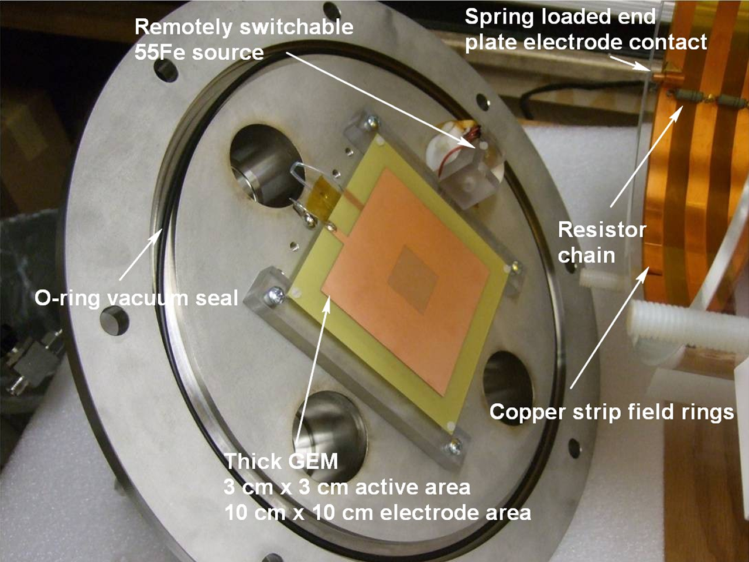
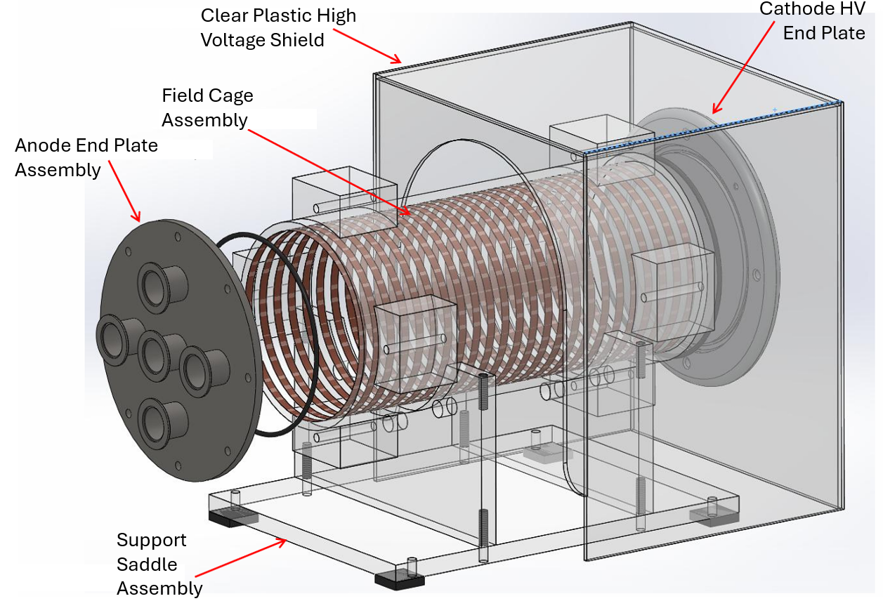
The Detector
**
N.S. Phan et al 2017 JINST 12 P02012
** THGEM we used is 400 um thick and has 10x10 cm active area, a pitch of 0.5mm, and a hole diameter of 0.3mm

Slide 9
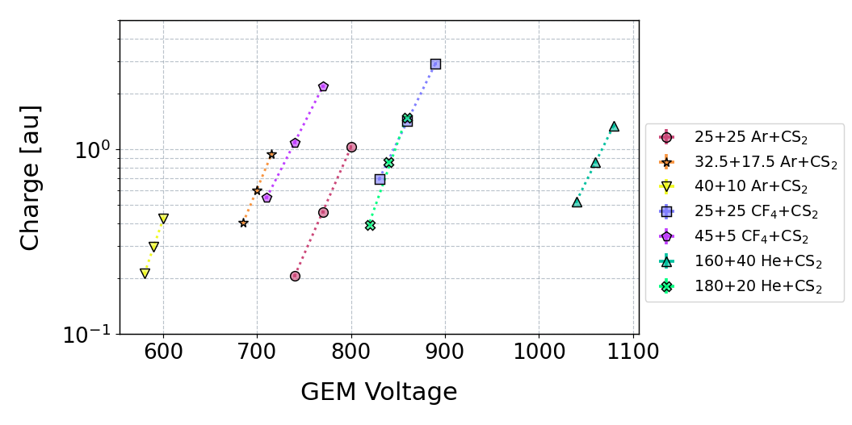
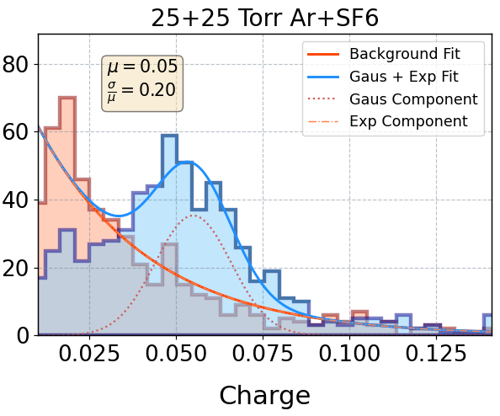
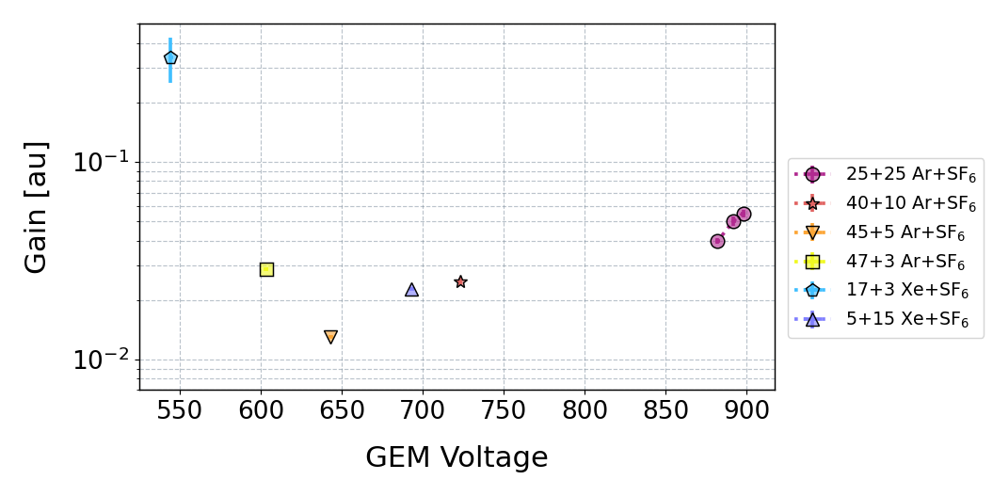
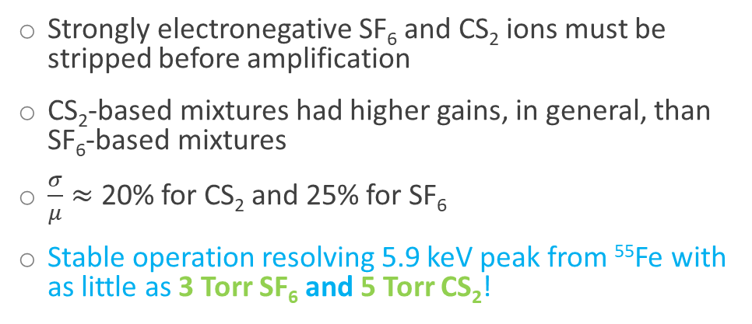
Relative Gains
Peak lies at 5.9 keV
All numbers in labels are in Torr
Strongly electronegative SF₆ and CS₂ ions must be stripped before amplification
CS₂-based mixtures had higher gains, in general, than SF₆-based mixtures
$\frac{σ}{μ}≈$ 20% for CS₂ and 25% for SF₆
Stable operation resolving 5.9 keV peak from ⁵⁵Fe with as little as 3 Torr SF₆ and 5 Torr CS₂!
All numbers in labels are in Torr
Notes:
Pitch 0.5mm hole diam 0.3mm

Slide 10
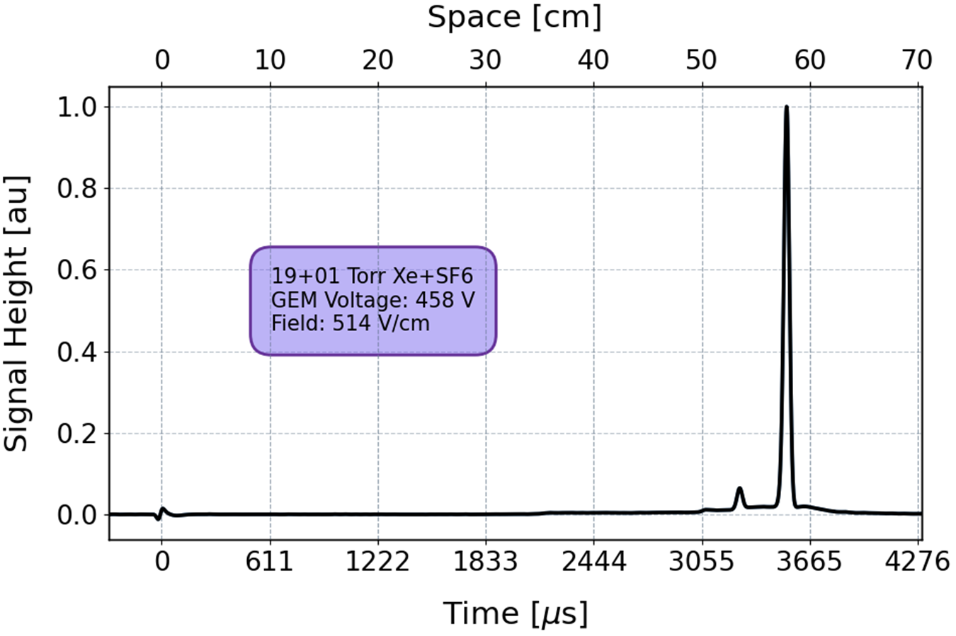
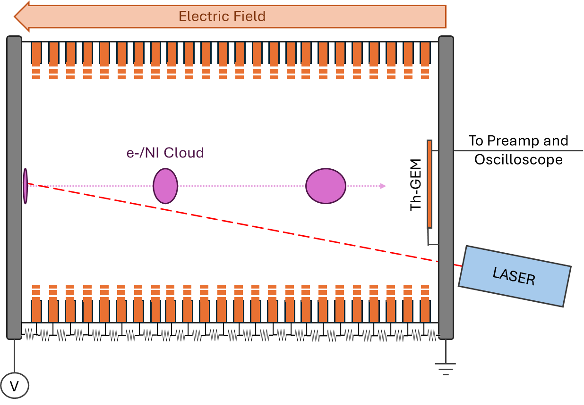
Laser-based Measurements
SF₆⁻
⁵⁵Fe
19+1 Torr Xe+SF₆
Current [au]
N₂
SF₅⁻
60 cm
RFI Signal induced by Laser firing → t₀
Signal from charge cloud → t_{a}

Slide 11
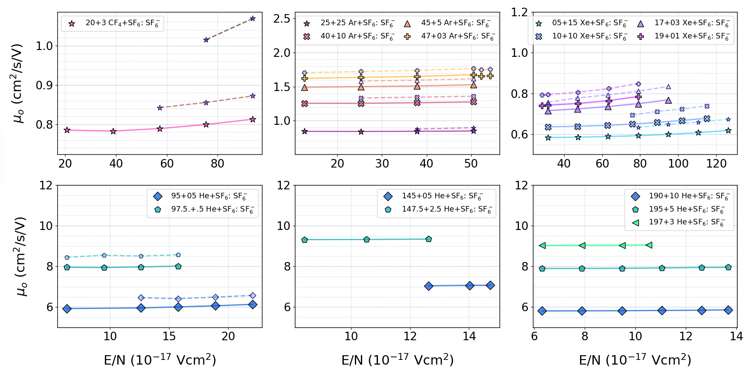
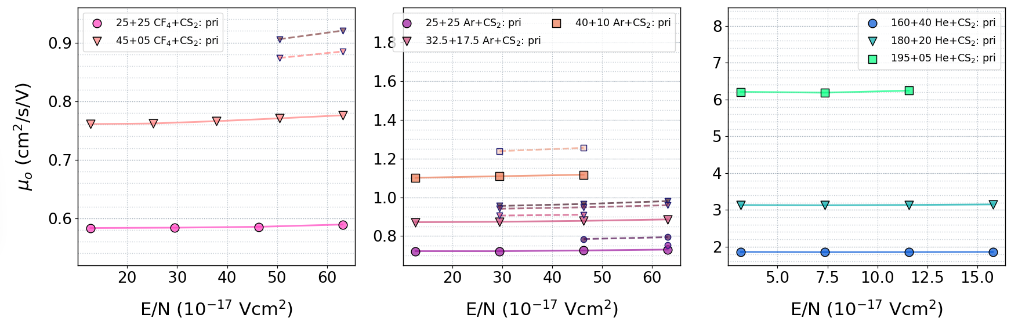
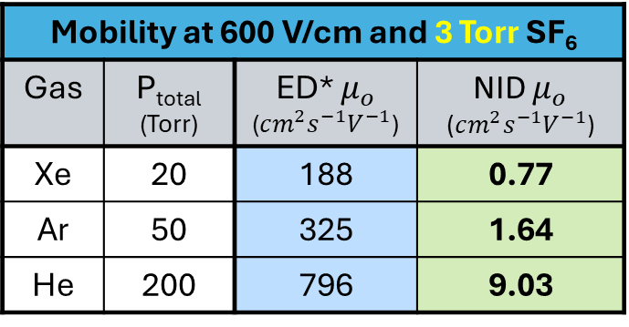
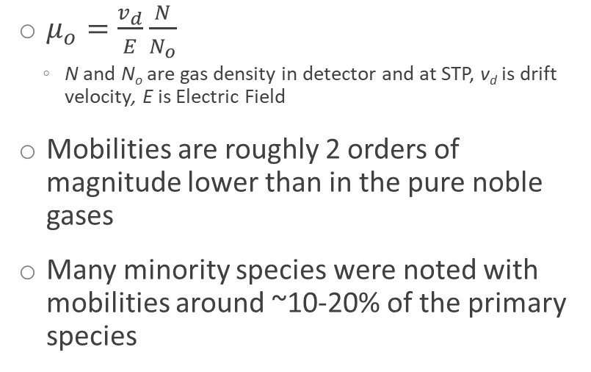
Mobility
$μ_{o}=\frac{v_{d}}{E}\frac{N}{N_{o}}$
  N and N_{o} are gas density in detector and at STP, v_{d} is drift velocity, E is Electric Field
Mobilities are roughly 2 orders of magnitude lower than in the pure noble gases
Many minority species were noted with mobilities around ~10-20% of the primary species
Preliminary
Mobility at 600 V/cm and 3 Torr SF₆
Gas | P_{total} (Torr) | ED* $μ_{o}$ ($cm^{2}s^{−1}V^{−1}$) | NID $μ_{o}$ ($cm^{2}s^{−1}V^{−1}$)
Xe | 20 | 188 | 0.77
Ar | 50 | 325 | 1.64
He | 200 | 796 | 9.03
* S. Biagi (1995). https://magboltz.web.cern.ch/magboltz/

Slide 12


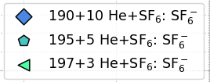

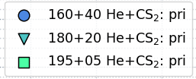
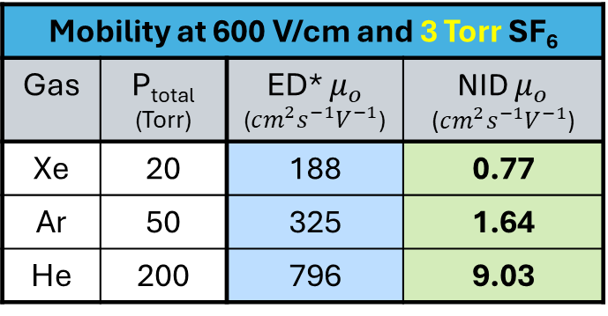

Mobility
$μ_{o}=\frac{v_{d}}{E}\frac{N}{N_{o}}$
  N and N_{o} are gas density in detector and at STP, v_{d} is drift velocity, E is Electric Field
Mobilities are roughly 2 orders of magnitude lower than in the pure noble gases
Many minority species were noted with mobilities around ~10-20% of the primary species
Preliminary
Mobility at 600 V/cm and 3 Torr SF₆
Gas | P_{total} (Torr) | ED* $μ_{o}$ ($cm^{2}s^{−1}V^{−1}$) | NID $μ_{o}$ ($cm^{2}s^{−1}V^{−1}$)
Xe | 20 | 188 | 0.77
Ar | 50 | 325 | 1.64
He | 200 | 796 | 9.03
* S. Biagi (1995). https://magboltz.web.cern.ch/magboltz/
12

Slide 13
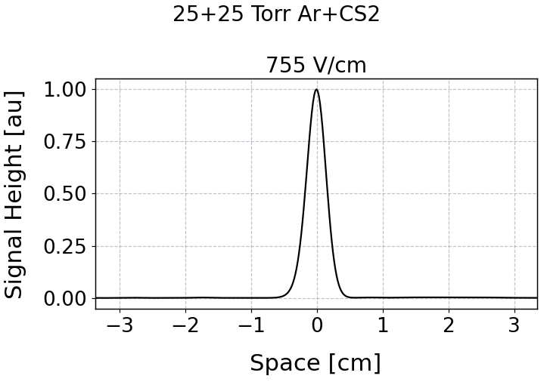
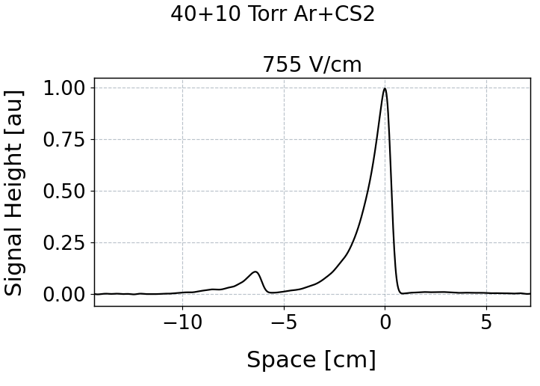
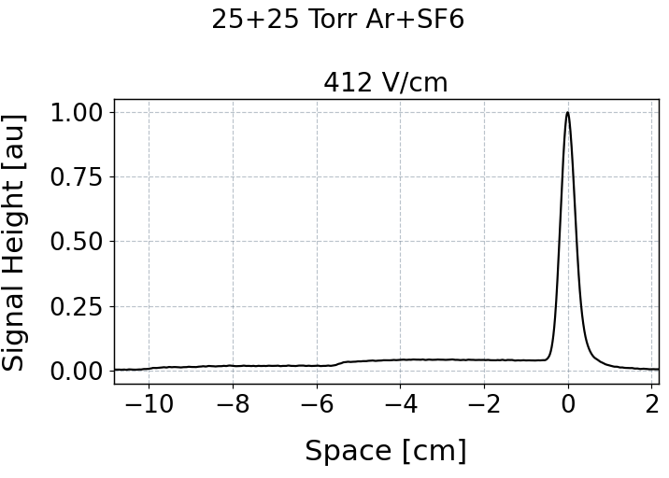
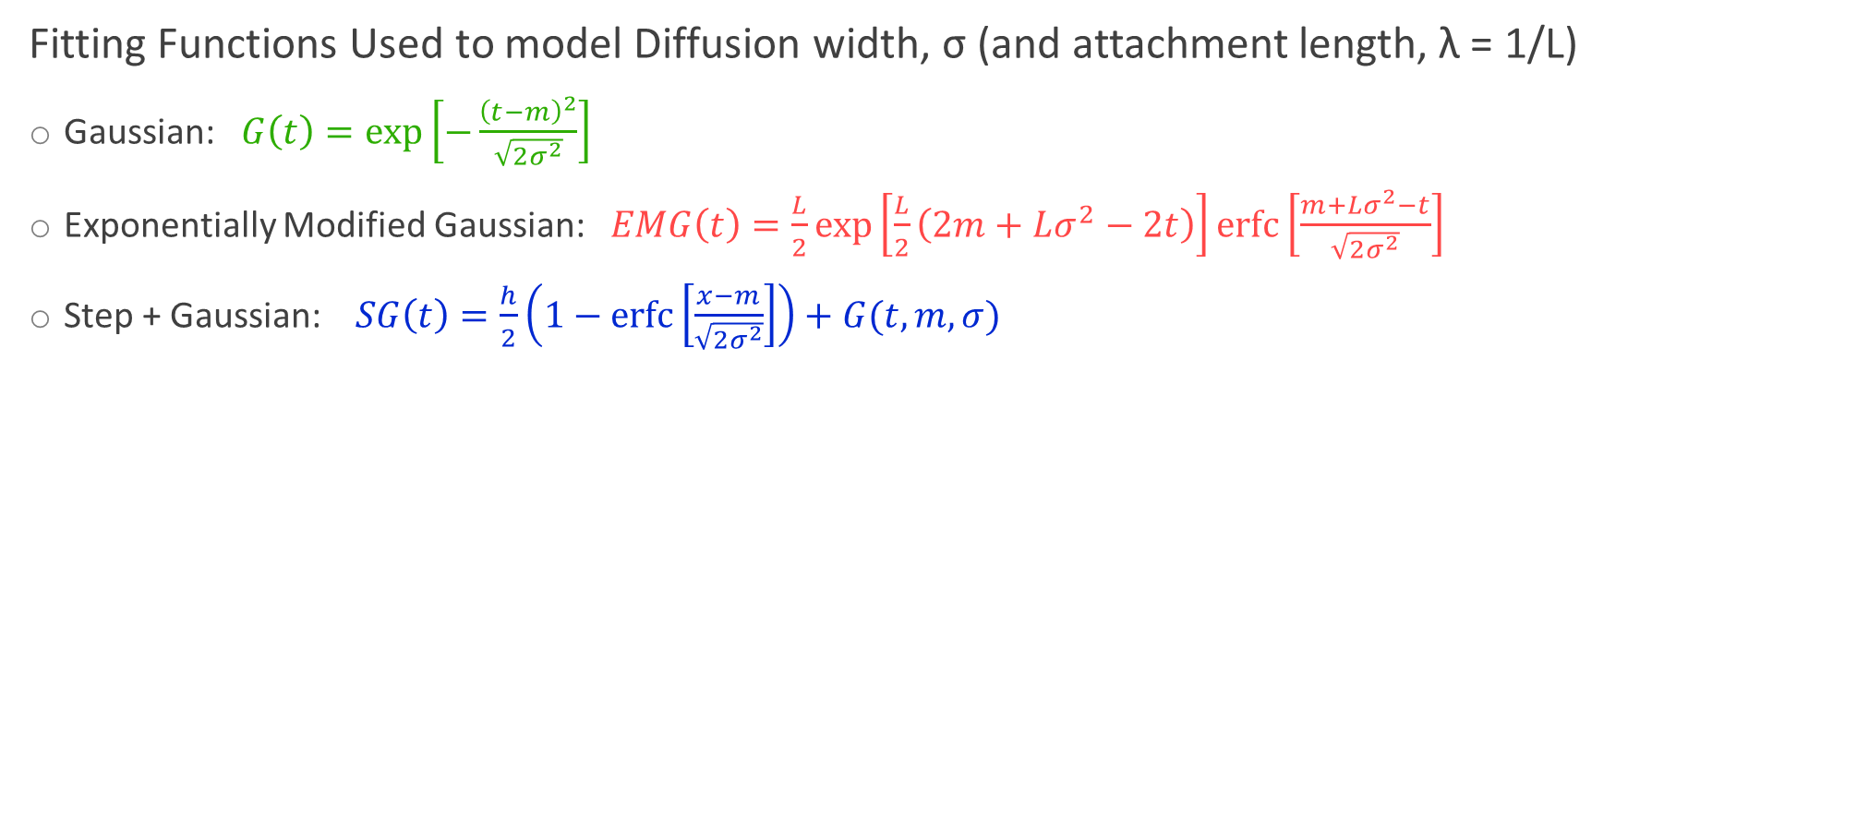
Waveform Shape
Fitting Functions Used to model Diffusion width, σ (and attachment length, λ = 1/L)
Gaussian: $G\left(t\right)=\exp\left[−\frac{{\left(t−m\right)}^{2}}{\sqrt{2σ^{2}}}\right]$
Exponentially Modified Gaussian: $EMG\left(t\right)=\frac{L}{2}\exp\left[\frac{L}{2}\left(2m+Lσ^{2}−2t\right)\right]\operatorname{erfc}\left[\frac{m+Lσ^{2}−t}{\sqrt{2σ^{2}}}\right]$
Step + Gaussian: $SG\left(t\right)=\frac{h}{2}\left(1−\operatorname{erfc}\left[\frac{x−m}{\sqrt{2σ^{2}}}\right]\right)+G(t, m,σ)$
Current [au]
Current [au]
Current [au]

Slide 14
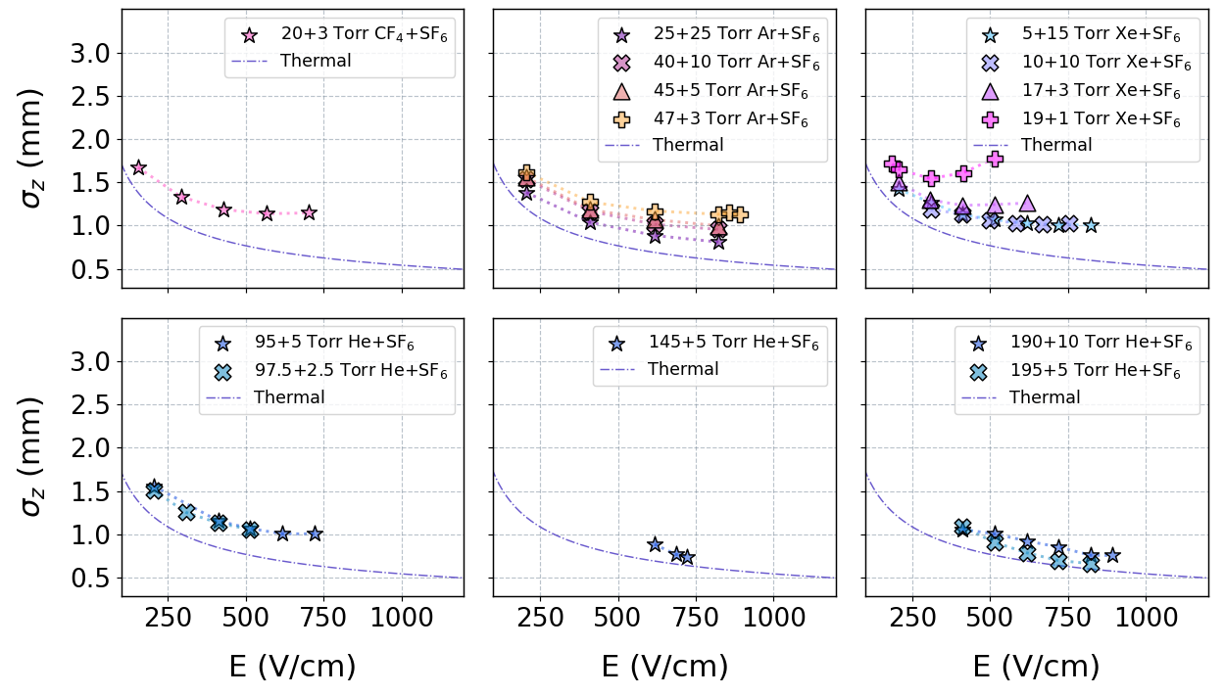
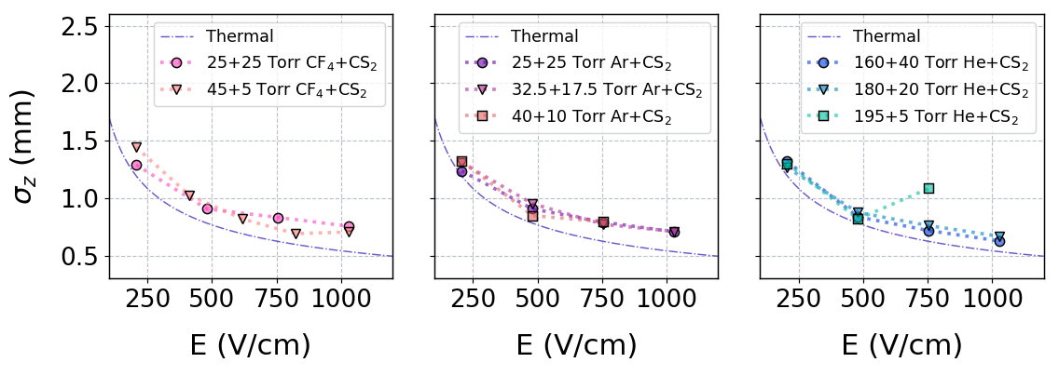
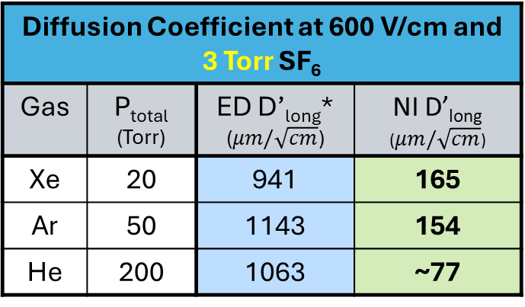
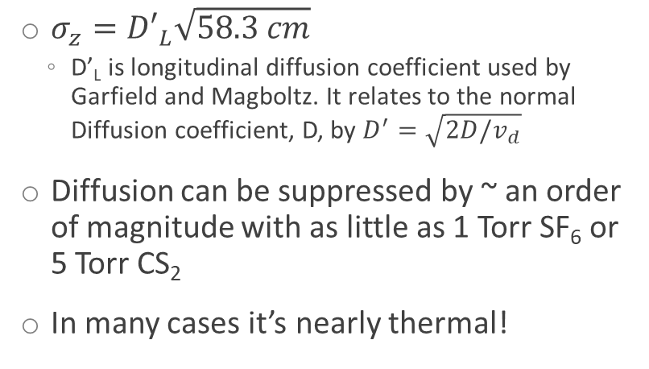
Longitudinal Diffusion
$σ_{z}={D′}_{L}\sqrt{58.3 cm}$
  D’_{L} is longitudinal diffusion coefficient used by Garfield and Magboltz. It relates to the normal Diffusion coefficient, D, by $D^{′}=\sqrt{2D/v_{d}}$
Diffusion can be suppressed by ~ an order of magnitude with as little as 1 Torr SF₆ or 5 Torr CS₂
In many cases it’s nearly thermal!
Preliminary
Diffusion Coefficient at 600 V/cm and 3 Torr SF₆
Gas | P_{total} (Torr) | ED D’_{long}* ($μm/\sqrt{cm}$) | NI D’_{long} ($μm/\sqrt{cm}$)
Xe | 20 | 941 | 165
Ar | 50 | 1143 | 154
He | 200 | 1063 | ~77
* S. Biagi (1995). https://magboltz.web.cern.ch/magboltz/
14

Slide 15
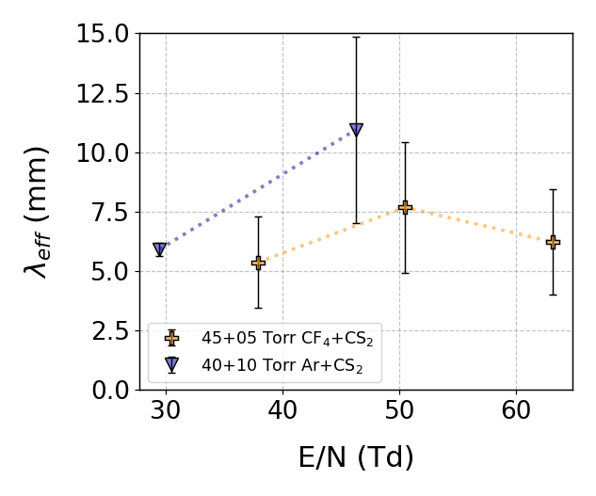
Attachment Length in CS₂ Mixtures
Attachment could only be measured in a subset of the data
CS₂ + Ar and CF₄ mixtures had large attachment lengths!
Consequences of high attachment for tracking detectors:
Exponentially modified waveforms along drift axis
“Mixed Drift” waveforms if drift length too short
  Leads to waveform distortion
  Leads to mixed gain for ED and NID components of the waveform
Preliminary

Slide 16




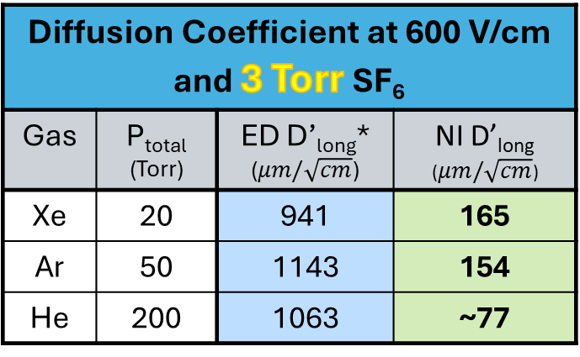
Conclusions
Negative ion drift properties in mixtures of Xe, Ar, He, and CF₄ with either SF₆ or CS₂ have been measured with very low partial pressures of the NID component
Stable gain for Fe-55 peak noted in many of the mixtures
Diffusion was suppressed by ~1 order of magnitude
Mobility was slowed by 2 orders of magnitude
In some cases, attachment length could also be measured!
Special thanks to my collaborators on this project:
Dinesh Loomba and Drew Gibson and the UNM group
Diffusion Coefficient at 600 V/cm and 3 Torr SF₆
Gas | P_{total} (Torr) | ED D’_{long}* ($μm/\sqrt{cm}$) | NI D’_{long} ($μm/\sqrt{cm}$)
Xe | 20 | 941 | 165
Ar | 50 | 1143 | 154
He | 200 | 1063 | ~77
* S. Biagi (1995). https://magboltz.web.cern.ch/magboltz/
Fermilab/DOE
GIRA Award
Awarded to E.Tilly

Slide 17
Backups

Slide 18
Notable Papers Regarding NID
C.J. Martoff et al 2000 NIMA 440 335 (https://doi.org/10.1016/S0168-9002(99)00955-9)
  The original NID Paper
N.S. Phan et al 2017 JINST 12 P02012 (https://doi.org/10.1088/1748-0221/12/02/P02012)
  Established SF₆ as an ideal NID gas
J.B.R. Battat et al 2017 AstroPart Phys 91 65 (https://doi.org/10.1016/j.astropartphys.2017.03.007)
  DRIFT Experiment results using minority NI species to fiducialize leading to 54 day zero-background run

Slide 19
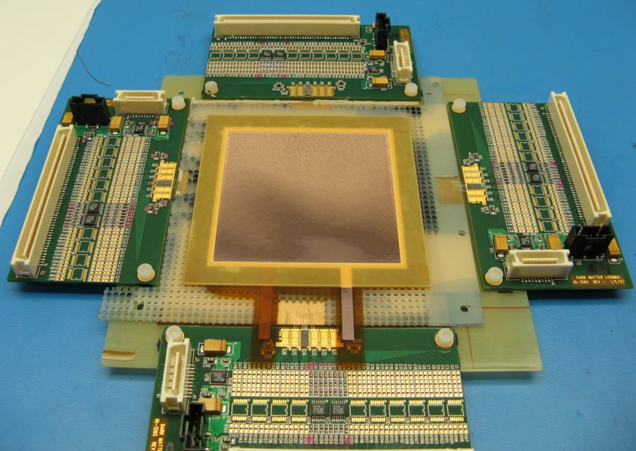
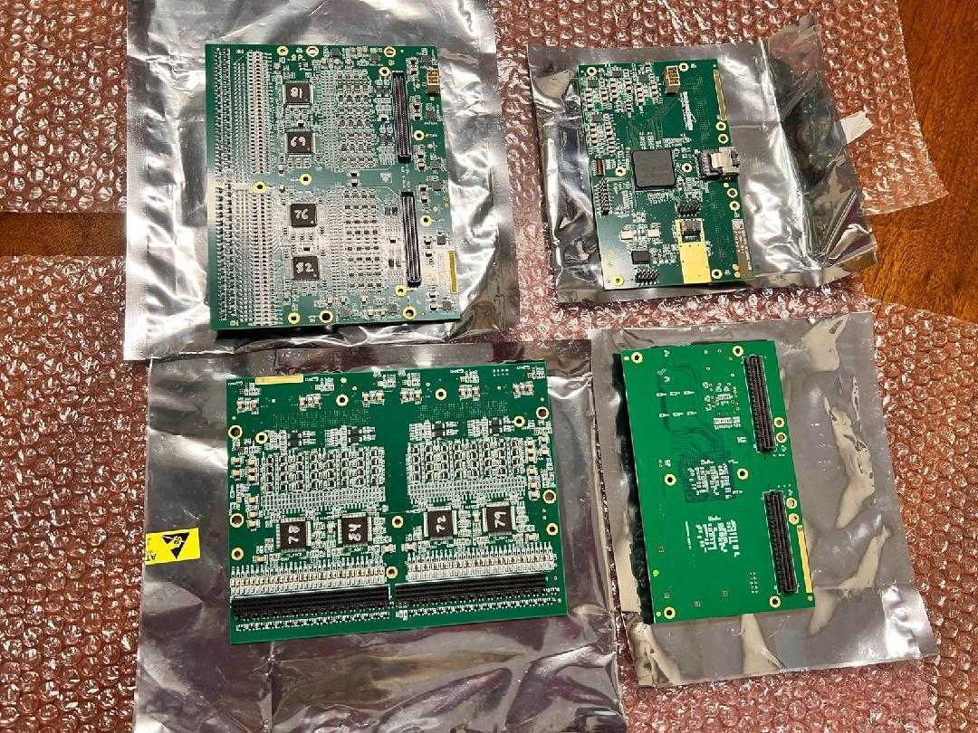
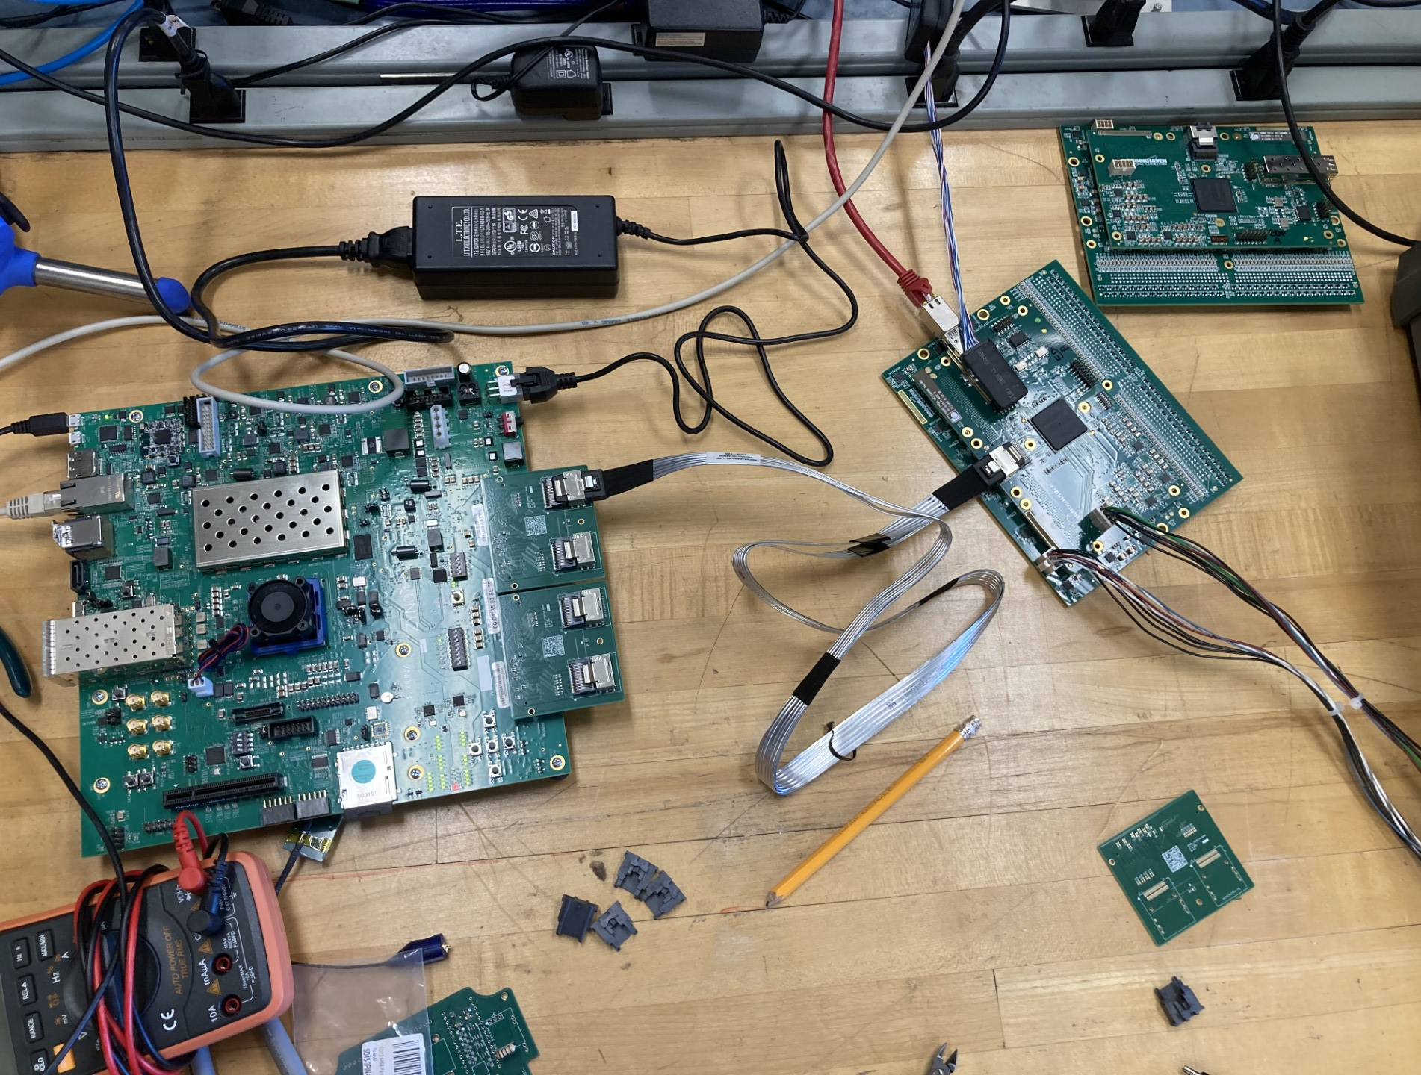
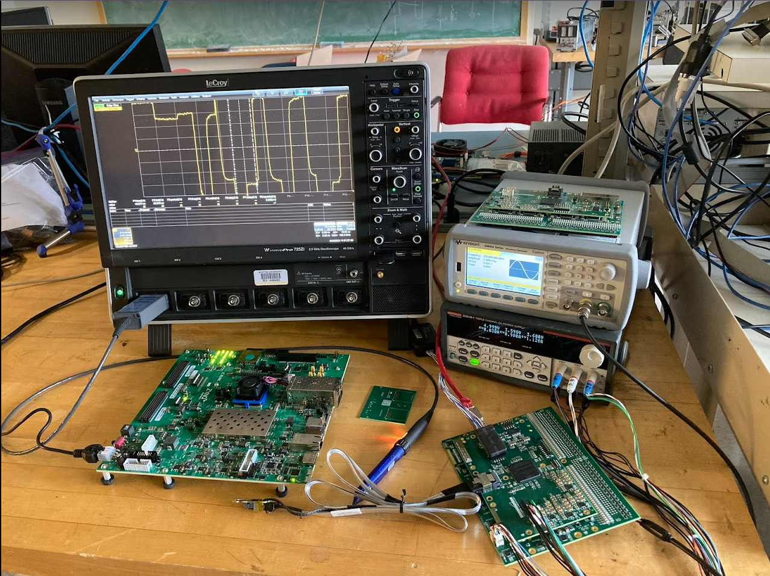



The Future of these studies
Paper coming soon!
Development of a novel low-pressure NI TPC
  10cm x 10cm 2D strips at 200 μm pitch
    Gas Electron Multiplier (GEM) at 140 μm pitch to amplify the signal from the tracks
  Front-end electronics assembled, adapted, tested and characterized with collaborators at Boston University
Ed Kearns
Alex Madorsky
Lila Smith

Slide 20
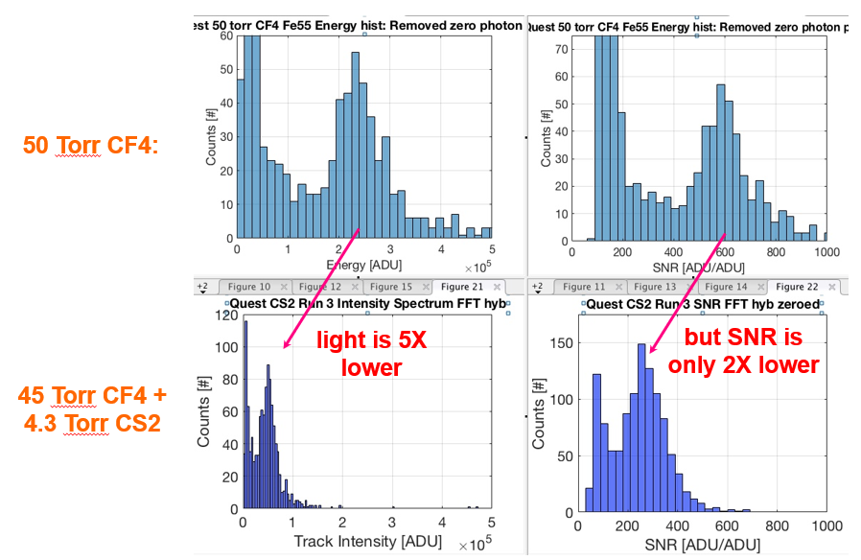
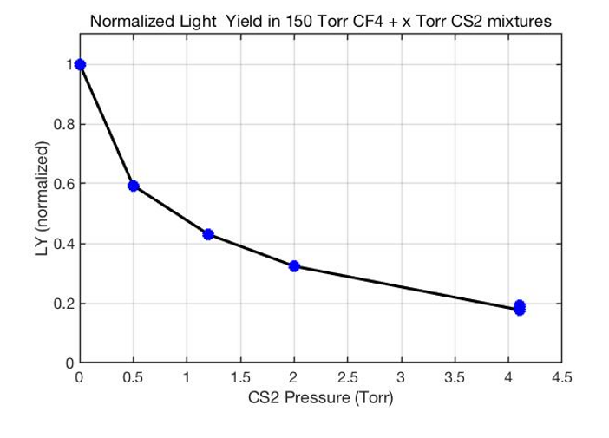
Light Yield in NID
Courtesy of D. Loomba RD51 Collab. Meeting 6/14/22

Slide 21
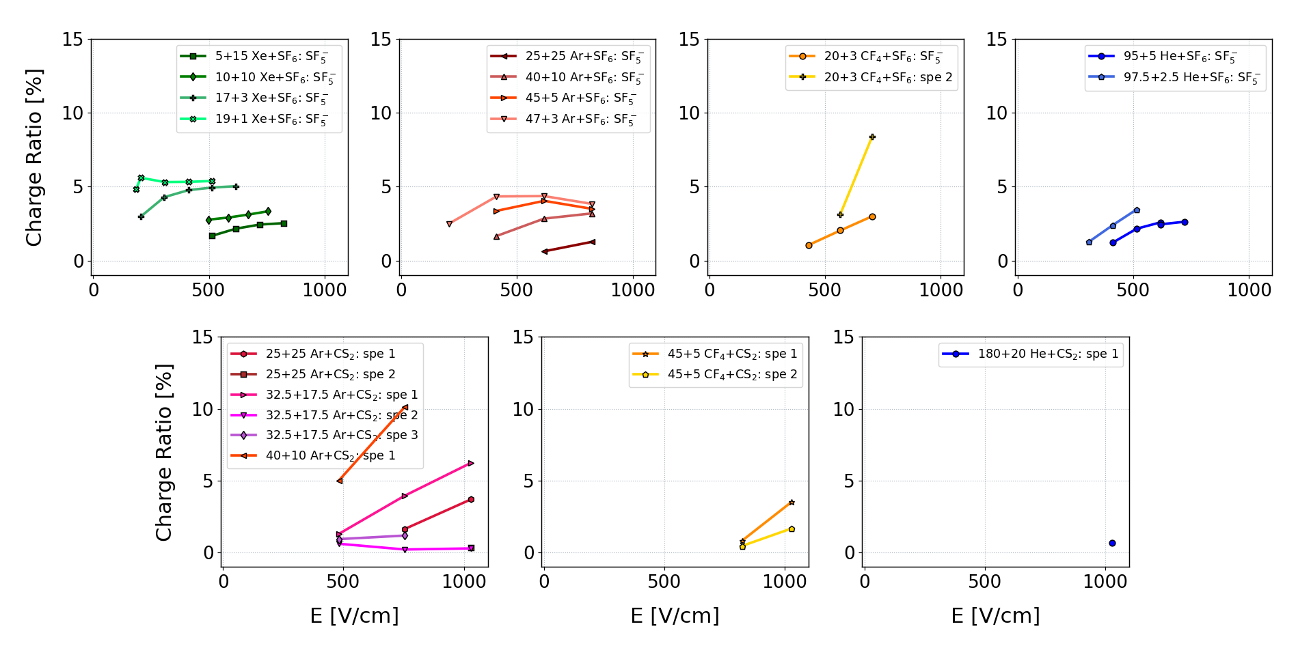
Minority Species Area
Preliminary
Charge Ratio is defined as the area under the minority peak divided by the area under the primary peak

Slide 22
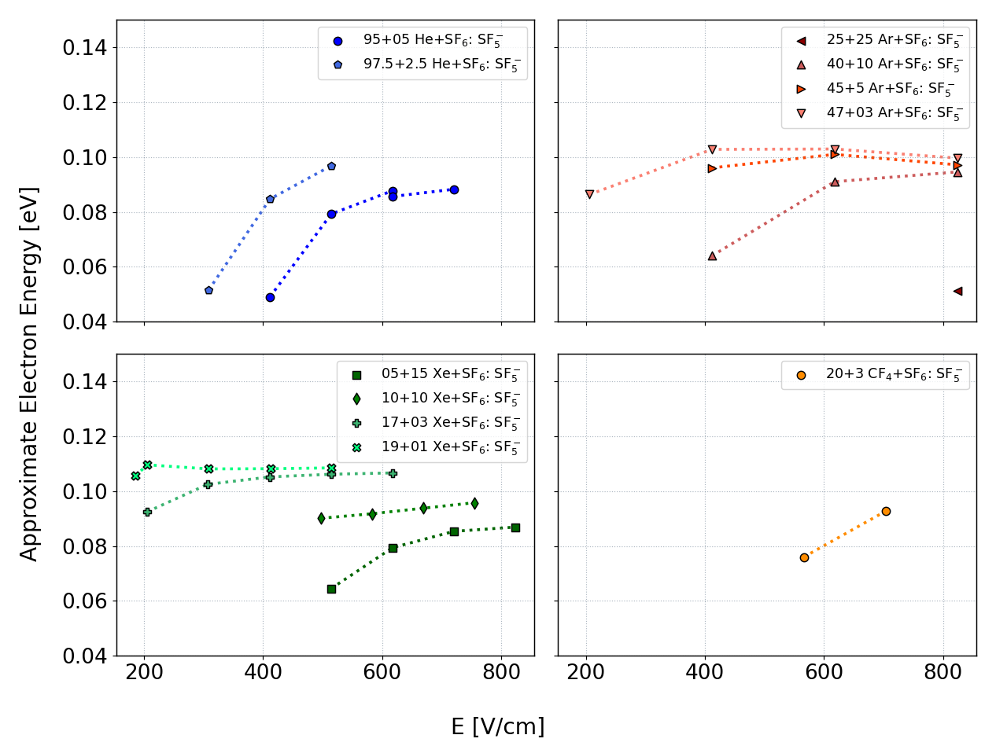
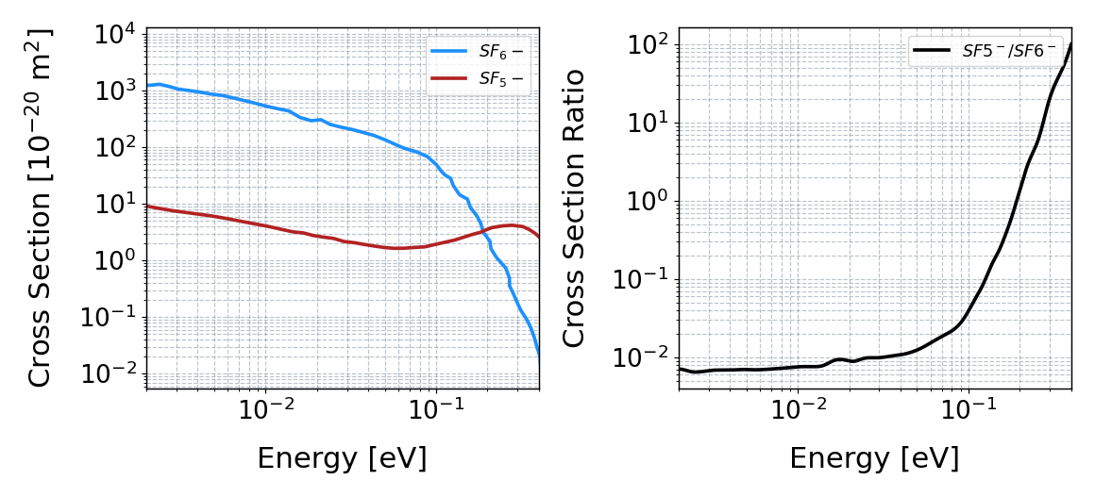
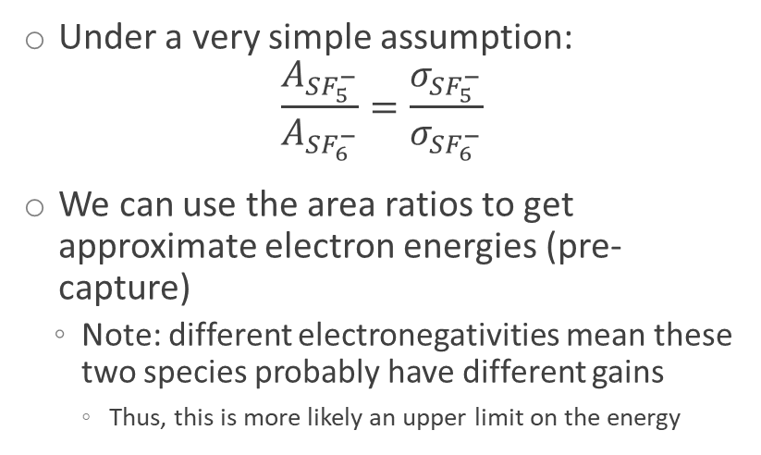
Measuring Electron Energy
Under a very simple assumption:
$$\frac{A_{SF_{5}^{−}}}{A_{SF_{6}^{−}}}=\frac{σ_{SF_{5}^{−}}}{σ_{SF_{6}^{−}}}$$
We can use the area ratios to get approximate electron energies (pre-capture)
  Note: different electronegativities mean these two species probably have different gains
    Thus, this is more likely an upper limit on the energy
Preliminary

Slide 23
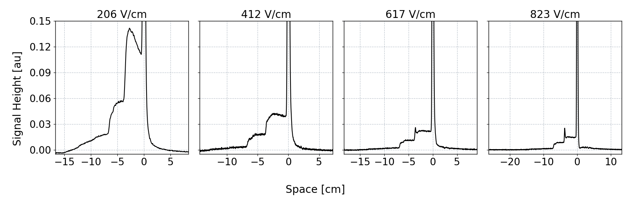


Dealing with Water
Small amounts of water in detector lead to ‘water-shelves’ on left side of waveform
Compromises measurement of minority area and diffusion sigma of main peak
Include 1 or 2 step functions in fit:
$$S_{±}\left(x\right)=A\frac{h_{±}}{2}\left(1 −\operatorname{erf}\left(±\frac{x−μ}{\sqrt{2σ^{2}}}\right)\right)$$
$$G\left(x\right)=A exp\left(−\frac{{\left(x−μ\right)}^{2}}{\sqrt{2σ^{2}}}\right)$$
  For minority area:
  $$F\left(x\right)=S_{+}\left(x\right)+S_{−}\left(x\right)+G\left(x\right)$$
  For main peak diffusion:
  $$F\left(x\right)=S_{+}\left(x\right)+G\left(x\right)$$

Slide 24





Exponentially Modified Gaussian
$$F\left(x\right)=\frac{Aλ}{2}\exp\left(\frac{λ}{2}\left(2μ+λσ^{2}−2x\right)\right)\operatorname{erfc}\left(\frac{m+λσ^{2}−x}{\sqrt{2σ^{2}}}\right)$$
Has a fairly small ‘good-fit’ region
λ = mean free path of attachment (i.e. attachment length)
σ = diffusion
Fit Residuals
Fits well at all $λ/σ$ measured

Slide 25


Negative Ion Species Cross Sections
Standard capture and dissociation process for SF₆:
$$e^{−} + SF_{6}^{−}→ SF_{6}^{−∗} \\ S{F_{6}^{−}}^{∗}+ SF_{6} → SF_{6}^{−}+ SF_{6} \\ SF_{6}^{−∗} → SF_{5}^{−} + F$$
Standard dissociation processes for CF₄:
$$CF_{4}^{−}→F^{−}+CF_{3} \\ CF_{4}^{−}→CF_{3}^{−}+F$$
CS₂ likely forms NI in a similar process as SF₆.
L. G. Christophorou, J. K. Olthoff, Int. J. of Mass Spectrom. 205 (1) 27–41 (2001)
I. Iga, M. V. V. S. Rao, S. K. Srivastava, and J. E. Nogueira, Z. Phys. D 24, 111 (1992).

Slide 26


Select Averaged Waveforms with Attachment
40 + 10 Torr Ar + CS₂
40 + 5 Torr CF₄ + CS₂

Slide 27


Energy Resolution
Preliminary
Preliminary

Slide 28



Aside: Attachment in CF₄
By measuring the exponential portion of the waveform, we reconstruct measured attachment to within 80%
Preliminary
Preliminary
L. G. Christophorou, J. K. Olthoff, M. V. Rao, J. Phys. Chem. Ref. Data 25, 1341–1388 (1996)
S. Biagi (1995). https://magboltz.web.cern.ch/magboltz/

Slide 29


Bridging the Gap Between Exponential Fit and EMG
Exponential fits on CF₄ waveforms reproduced Christophorou’s recommended attachment length to within 8%
Measurements made in Ar+CS₂ found very good agreement between exponential and EMG fits →
EMG fits were chosen instead of exponential fits in order to measure both attachment and diffusion width
  Exponential fits could not be verified on waveforms with $λ<5mm$
    This region falls roughly in our EMG ‘good-fit’ region, thus it was straightforward to use EMG results

