Slide 1

A Low-Gain, Integrated-Grid,
Pixelated MPGD
Tanner Polischuk | University of Hawaii
CPAD 2026 | UW
October 21, 2026

Slide 2


The Flexible, Ideal MPGD System
(FIMS) Team
At Lawrence Berkeley National Laboratory
Peter Sorensen, Aikaterini Papadopoulou, Tarun Prakash, Will Wright, Craig Tindall, Yichen Liu, Carl Grace, Nowzesh Hasan
At The University of Hawai’i at Mānoa
Peter Lewis, Tanner Polischuk,
James Harrison IV, Haider Abbas,
Nai’a Nyza, Sven Vahsen
Roots in a CPAD 2023 coffee break!
At The University of Texas at Arlington
Yuan Mei, Peng Miao
Tanner Polischuk | CPAD 2026

Slide 3
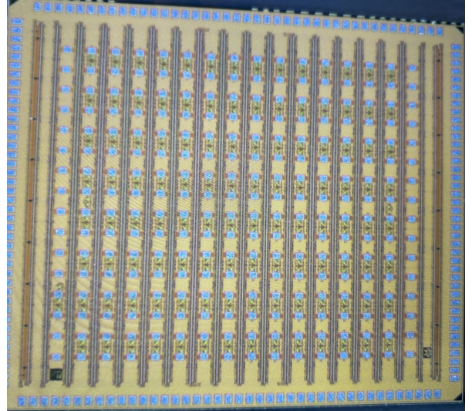
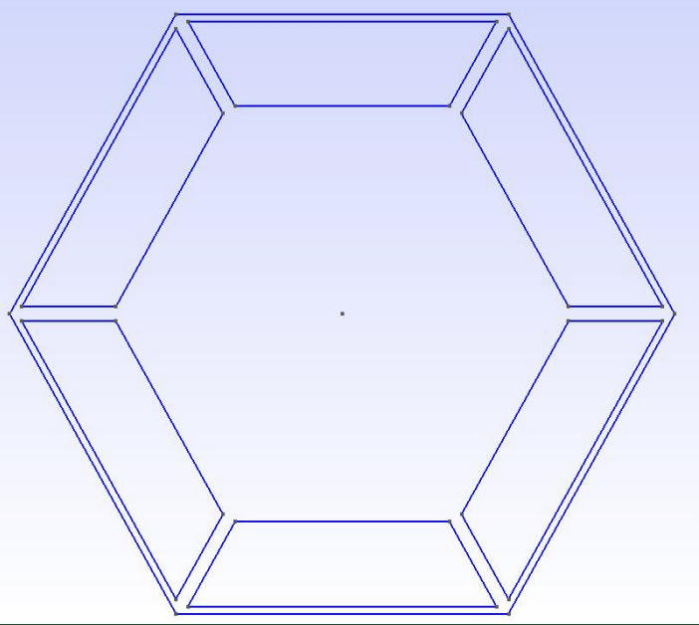
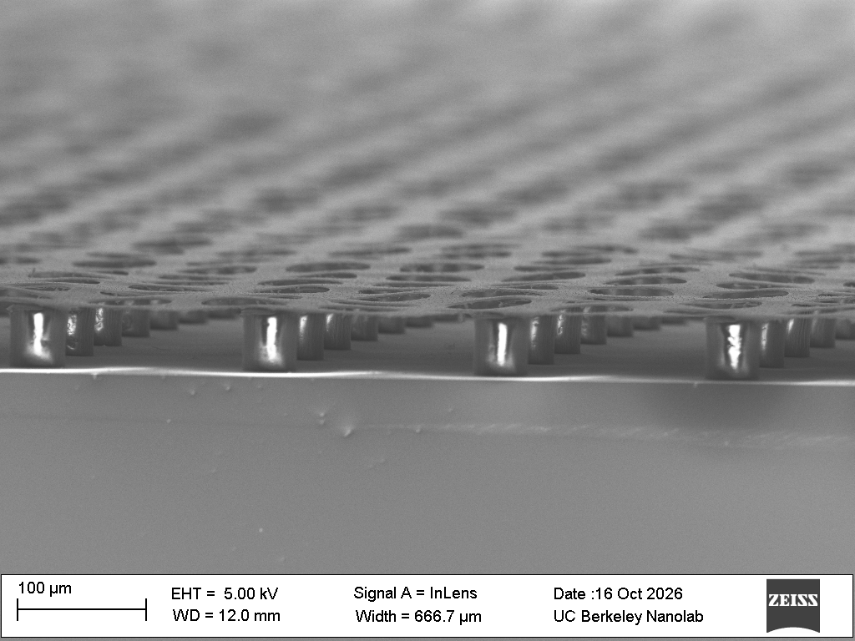
RDC6 Priorities that FIMS Addresses
Advancing gaseous detectors to the fundamental sensitivity limit.
Developing new gas amplification structures for challenging environments.
Establishing production facilities in the United States.
Intelligence in the front-end electronics.
Tanner Polischuk | CPAD 2026

Slide 4
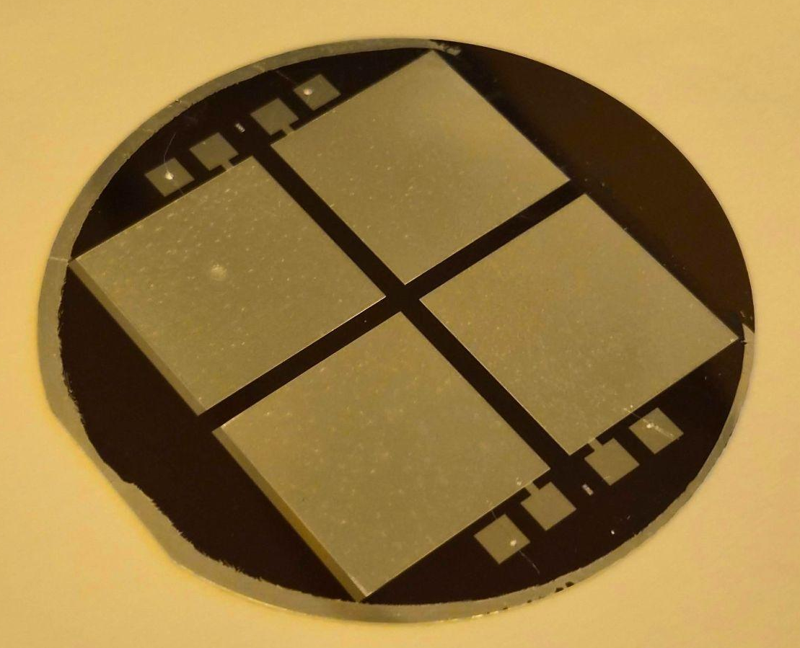
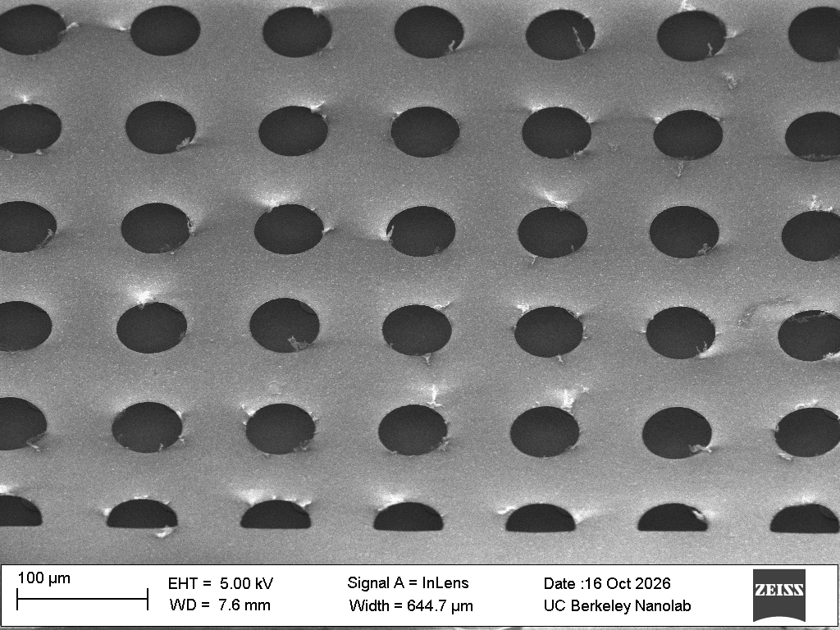
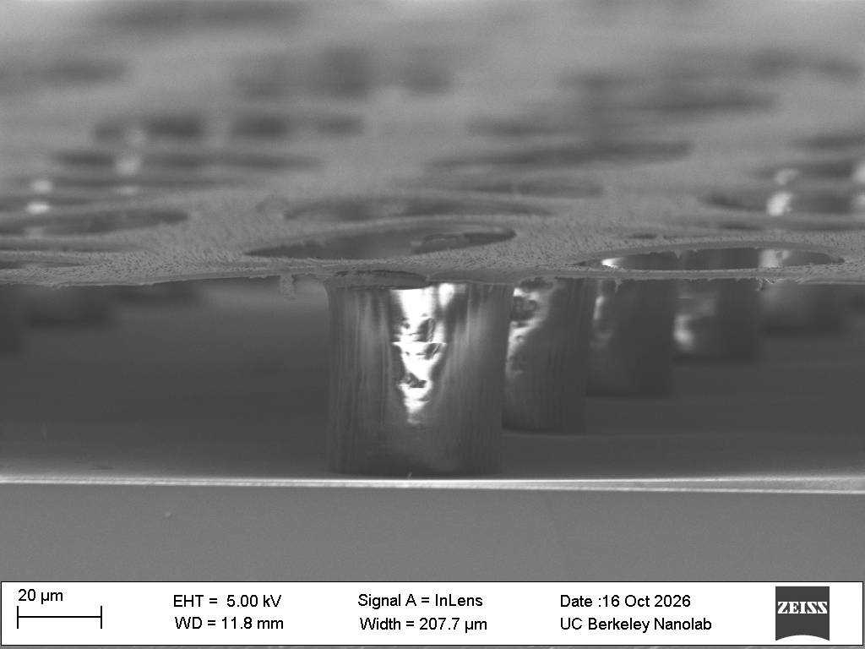
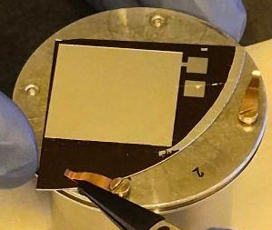
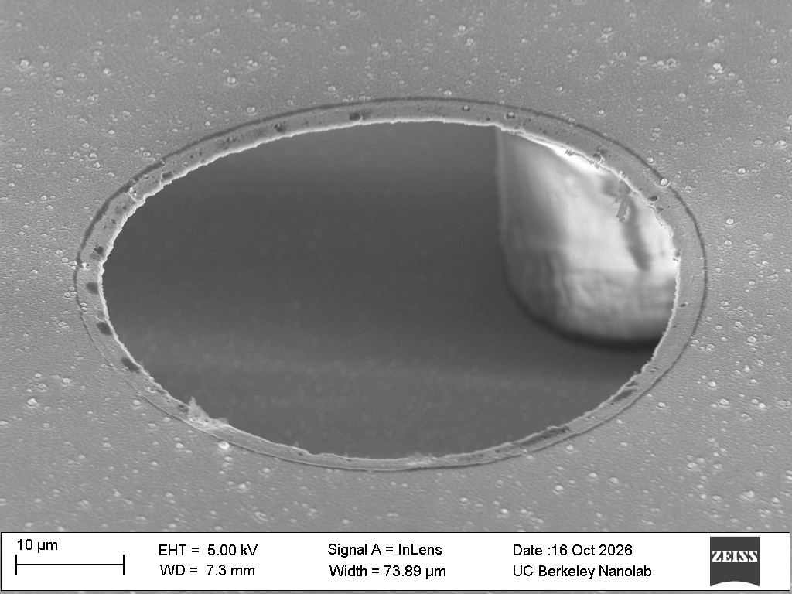
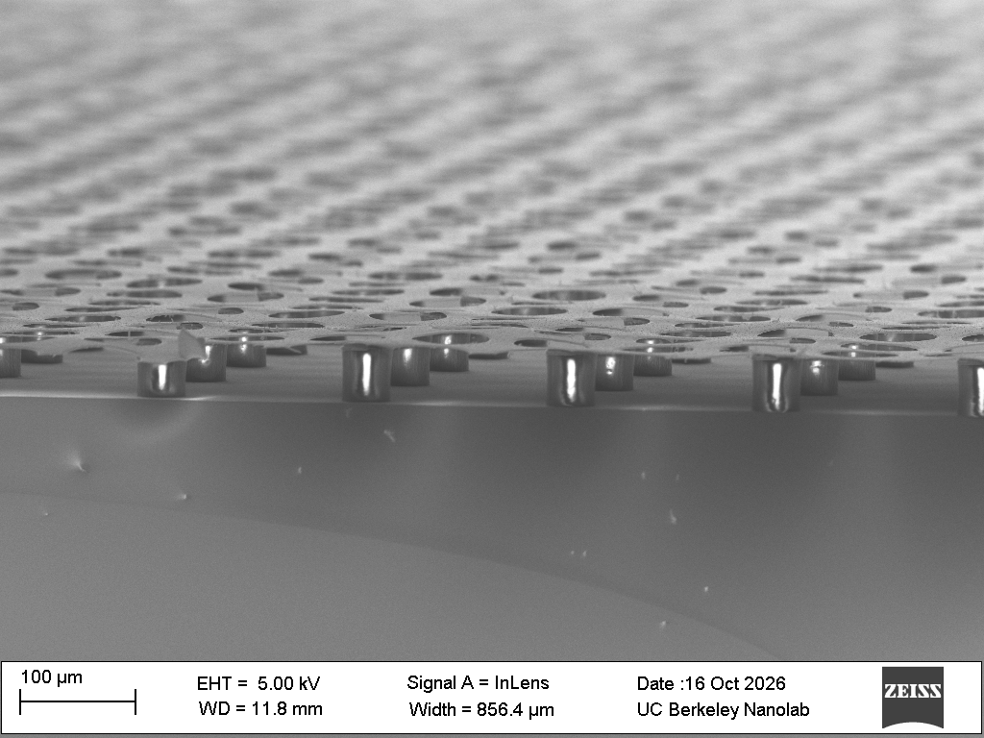
Microstructure Fabrication
Tanner Polischuk | CPAD 2026

Slide 5
Single-Charge Detection
Making every primary charge count.
Targeting the high-precision limit of MPGDs.
Utilizing low noise to push charge collection and detection to the single-electron limit with low thresholds and low gas gains.
In practical terms:
  Optimal resolution.
  Maximum efficiency.
  Minimum IBF.
  Optimal readout.
Tanner Polischuk | CPAD 2026

Slide 6
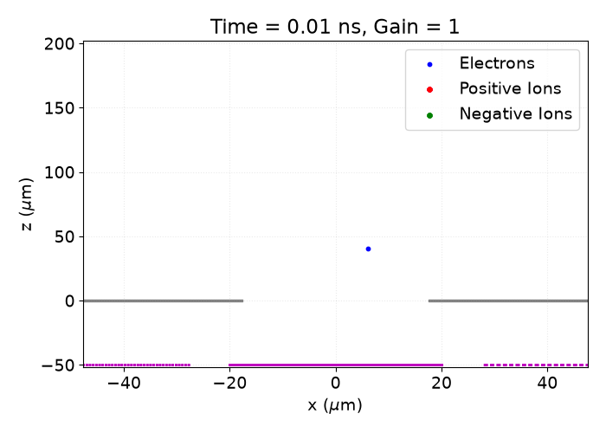
Low-Gain, Integrated-Grid, Pixelated MPGDs
Electric fields collect charge and cause avalanches.
Grid
Pixels
Tanner Polischuk | CPAD 2026

Slide 7

Low-Gain, Integrated-Grid, Pixelated MPGDs
Electric fields collect charge and cause avalanches.
Grid
Grid must be transparent to primary charges.
Gas gain needs to be higher than the pixel threshold.
More gain means more ions.
Ion trajectories should terminate on the grid.
Otherwise is back-flowing.
Pixel noise needs to be as low as possible, enabling low thresholds.
Pixels
Tanner Polischuk | CPAD 2026

Slide 8
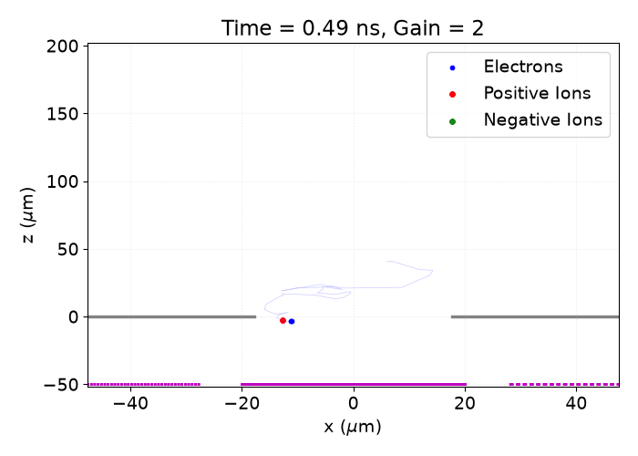
Low-Gain, Integrated-Grid, Pixelated MPGDs
Electric fields collect charge and cause avalanches.
Grid
Grid must be transparent to primary charges.
Gas gain needs to be higher than the pixel threshold.
More gain means more ions.
Ion trajectories should terminate on the grid.
Otherwise is back-flowing.
Pixel noise needs to be as low as possible, enabling low thresholds.
Pixels
Tanner Polischuk | CPAD 2026

Slide 9
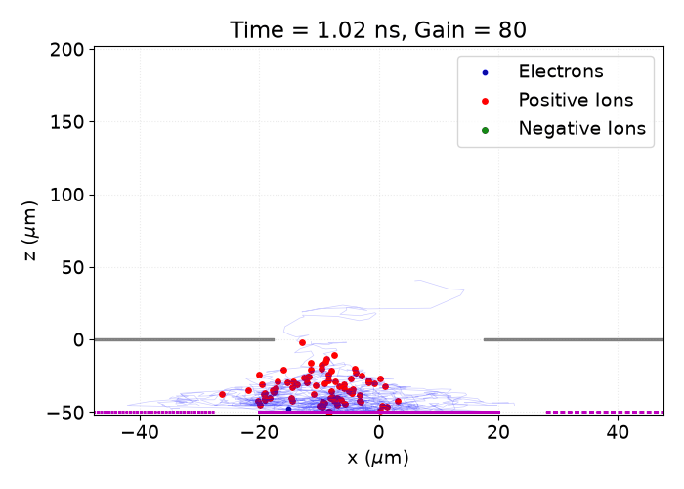
Low-Gain, Integrated-Grid, Pixelated MPGDs
Electric fields collect charge and cause avalanches.
Grid
Grid must be transparent to primary charges.
Gas gain needs to be higher than the pixel threshold.
More gain means more ions.
Ion trajectories should terminate on the grid.
Otherwise is back-flowing.
Pixel noise needs to be as low as possible, enabling low thresholds.
Pixels
Tanner Polischuk | CPAD 2026

Slide 10
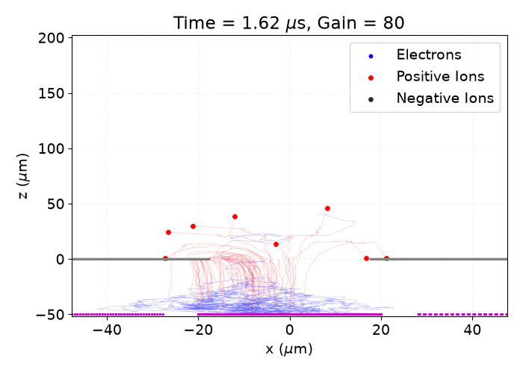
Low-Gain, Integrated-Grid, Pixelated MPGDs
Electric fields collect charge and cause avalanches.
Grid
Grid must be transparent to primary charges.
Gas gain needs to be higher than the pixel threshold.
More gain means more ions.
Ion trajectories should terminate on the grid.
Otherwise is back-flowing.
Pixel noise needs to be as low as possible.
Pixels
Tanner Polischuk | CPAD 2026

Slide 11
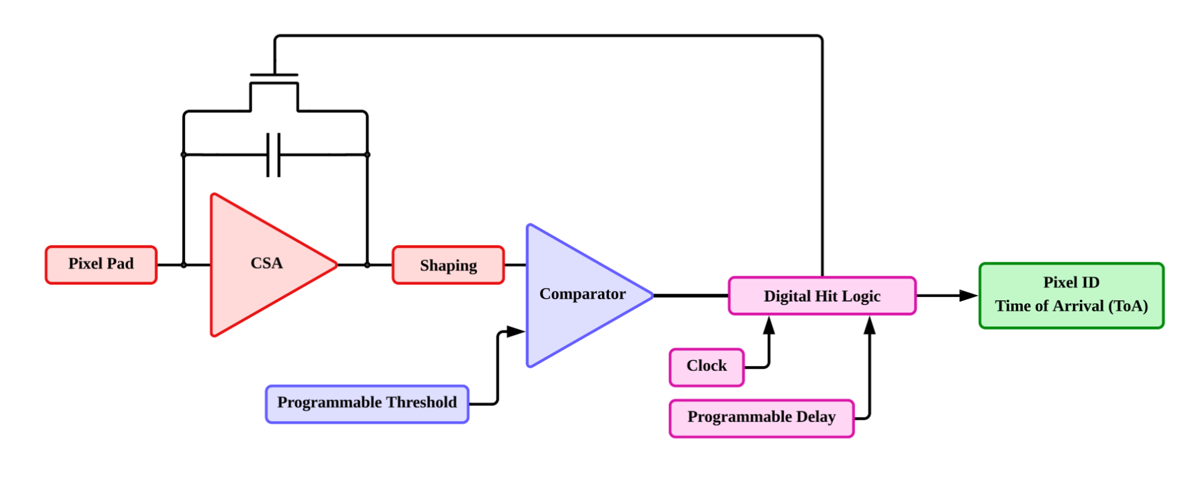
G3Pix – A Low-Noise ASIC
Minimal capacitance pixel
Low-noise amplifier
Ideal shaping times
Design Specs:
2 μs shaping with 3 ENC
Tanner Polischuk | CPAD 2026

Slide 12
Maximizing Efficiency
Making every primary charge count.
To get ideal efficiency:
  Collection of all primary charges.
  Detection of all avalanches.
  No losses in readout.
Considerations:
  Field strengths and geometry.
  Thresholds and noise.
  Signal development and front-end electronics.
Tanner Polischuk | CPAD 2026

Slide 13
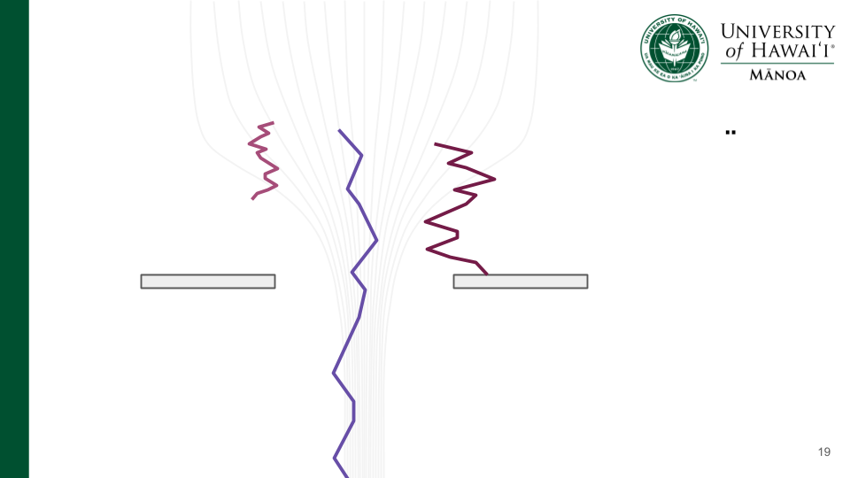
Collecting Charges
Hits Grid
Cannot generate an avalanche
Attachment
Creates a negative ion
Transferred Through Grid
Can generate an avalanche
Negative Ion Drift
Can generate an avalanche
Thanks to Kentaro Muichi for a version of Garfield++ that allows this.
Tanner Polischuk | CPAD 2026

Slide 14
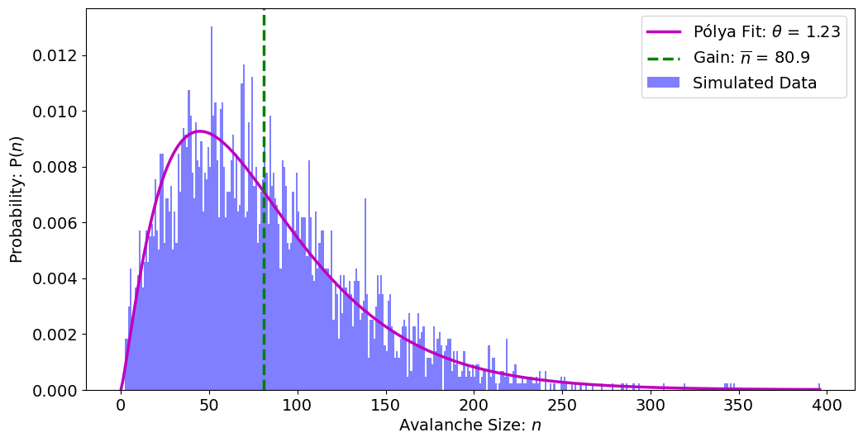
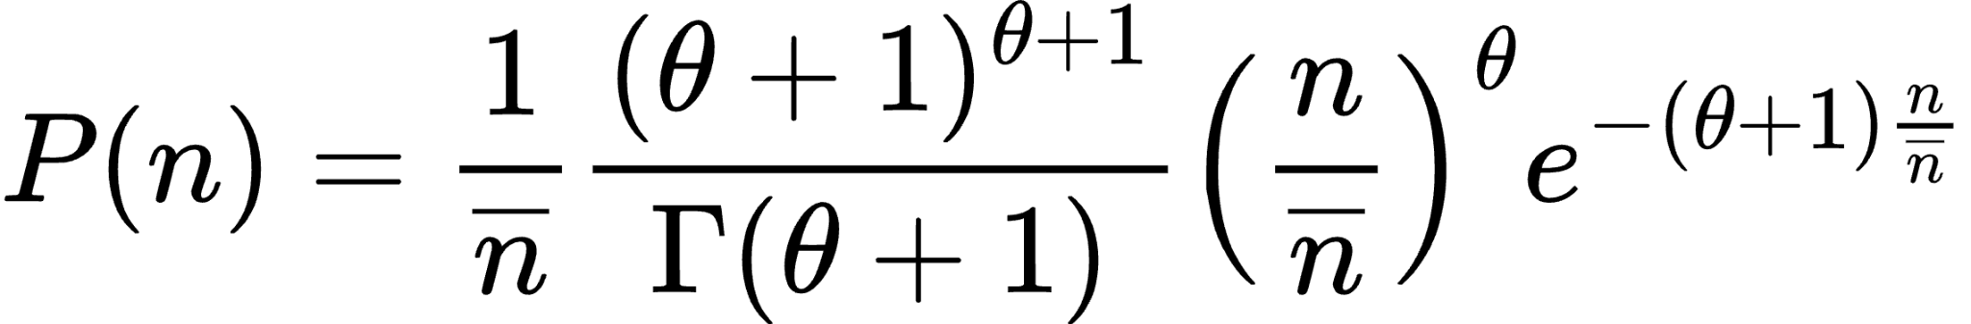
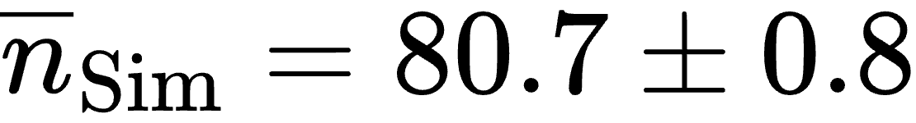
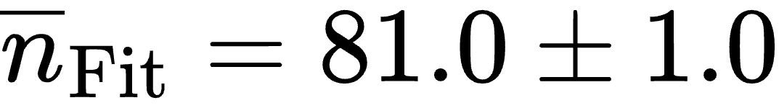
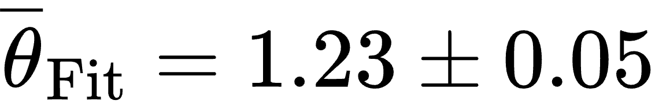
Many Single-Electron Avalanches
Tanner Polischuk | CPAD 2026

Slide 15
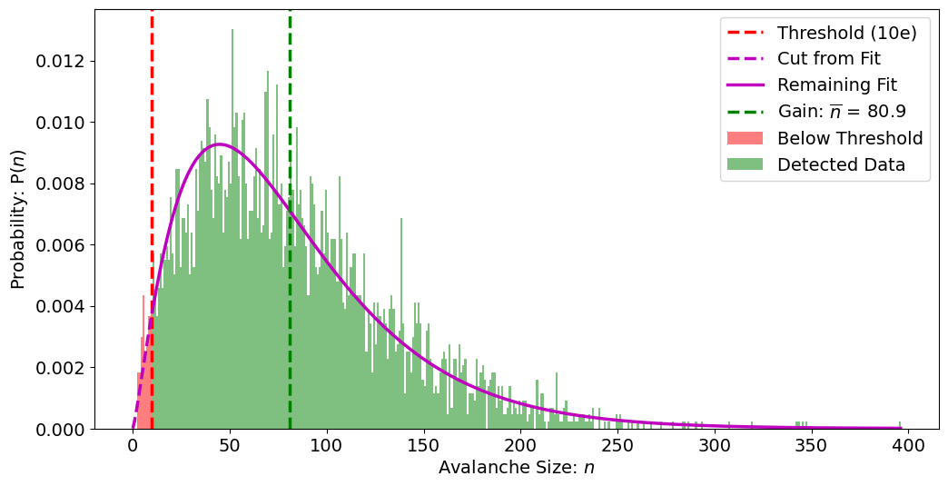
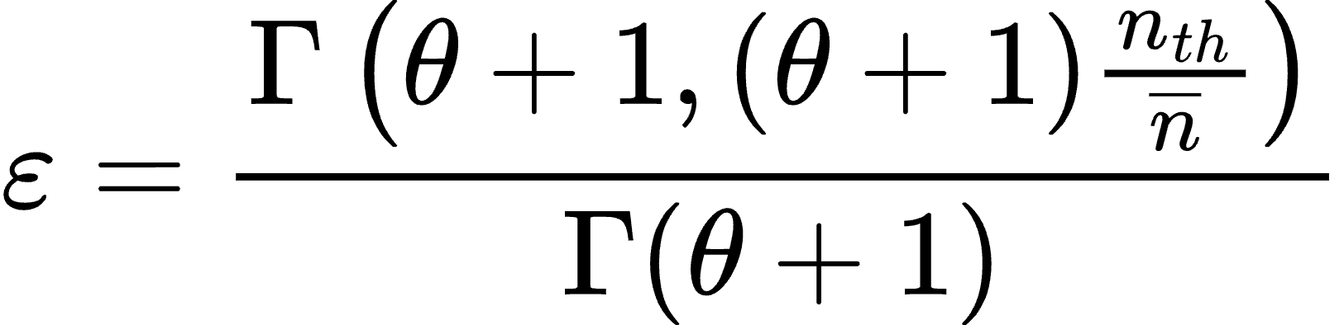
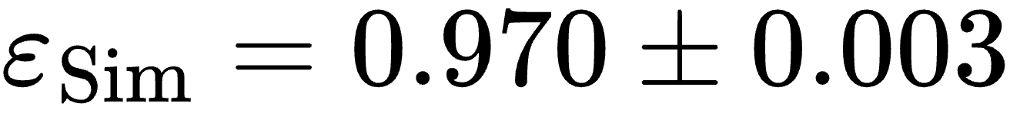
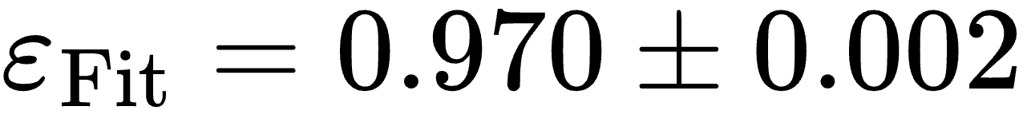
Applying a 10e Threshold
Tanner Polischuk | CPAD 2026

Slide 16
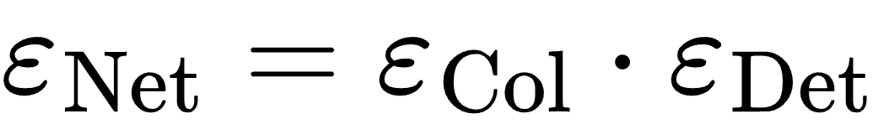
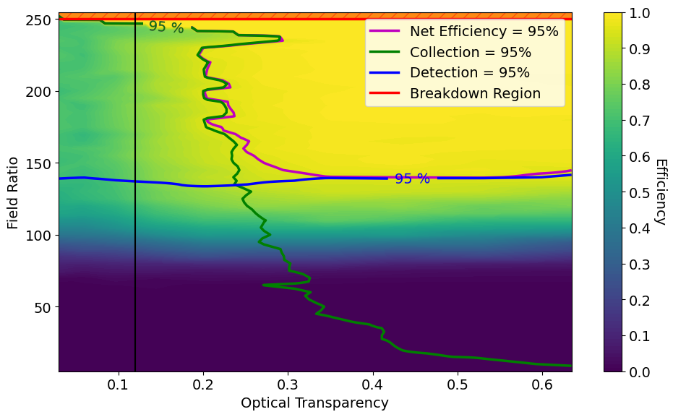
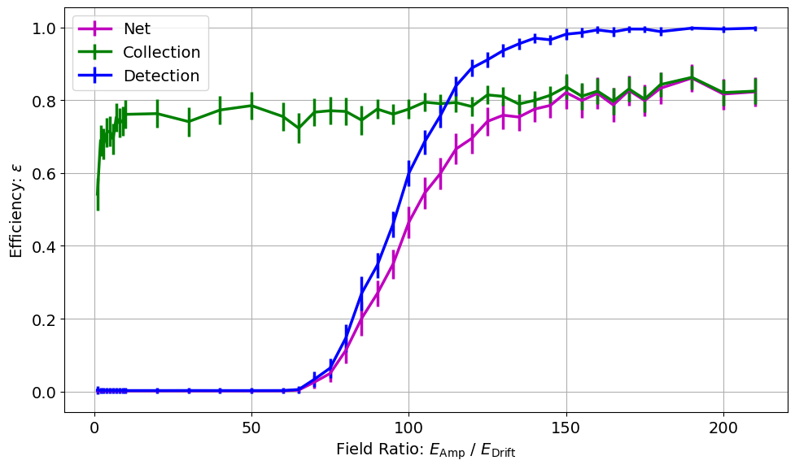
Mapping Efficiencies
Detection-limited
Collection-limited
Net Efficiency of 95%
Tanner Polischuk | CPAD 2026

Slide 17
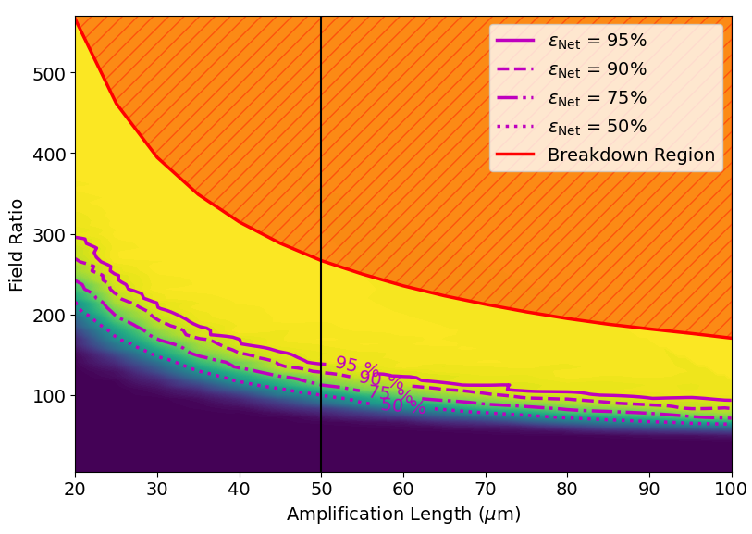
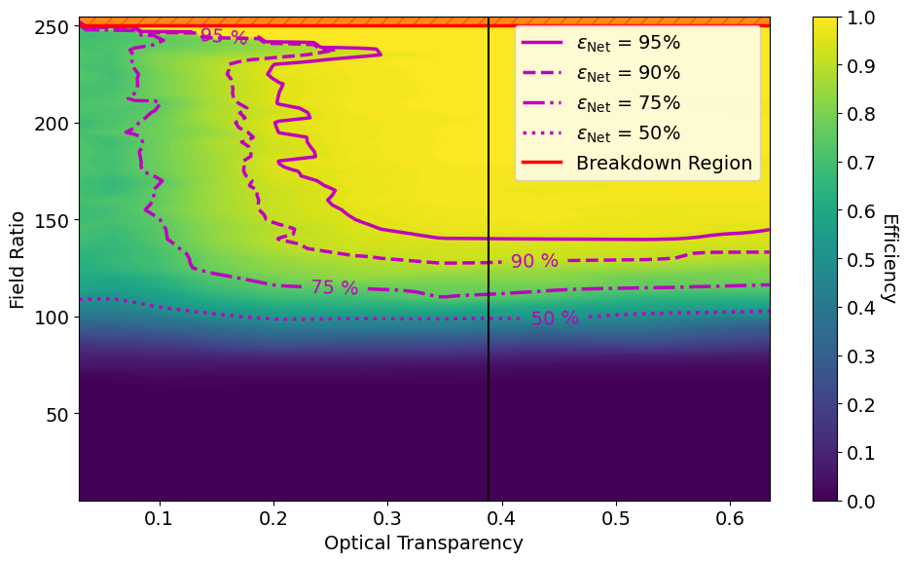
Net Efficiency Contours
Tanner Polischuk | CPAD 2026

Slide 18
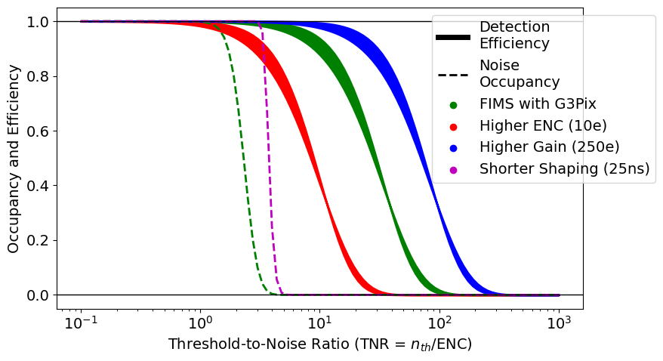
Noise and Occupancy
FIMS with G3Pix:
ENC = 3 e
Gain = 100 e
Shaping = 2 μs
Noise Occupancy (Rice)
Unaffected by
gain or ENC
Detection Efficiency (1 ≤ θ ≤ 2)
Unaffected by shaping time
Tanner Polischuk | CPAD 2026

Slide 19
Front-End Electronics Concept
Instant Reset
Immediate ready-state
Output Data
Signal Amplification and Shaping
Tuned for low noise
Low Threshold
Tuned for efficiency
Reset Logic
Tuned for minimal deadtime
Tanner Polischuk | CPAD 2026

Slide 20
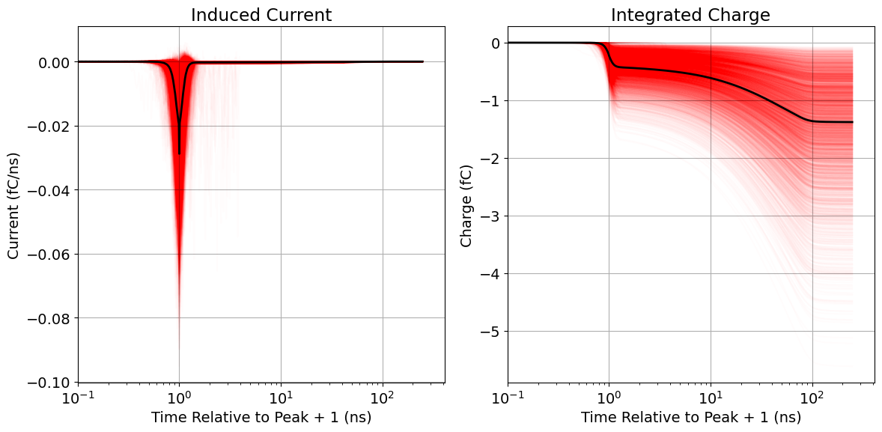
Signal Development
Fast electron signal (< 1 ns)
Slow ion tail (~ 100 ns)
Exploring interesting reset patterns to negate this tail.
Tanner Polischuk | CPAD 2026

Slide 21
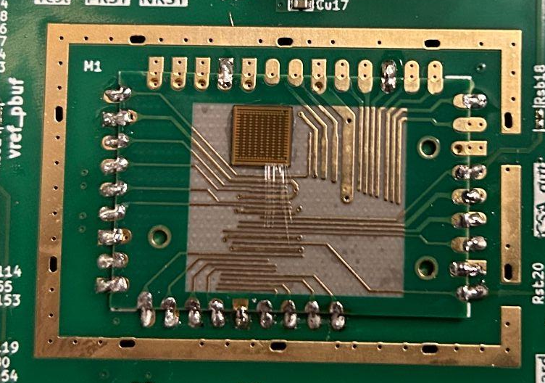
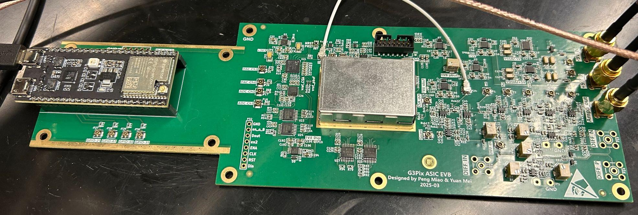
G3Pix – A Low-Noise ASIC
Design Specs:
2 μs shaping with 3 ENC
TSMC 180
Tanner Polischuk | CPAD 2026

Slide 22
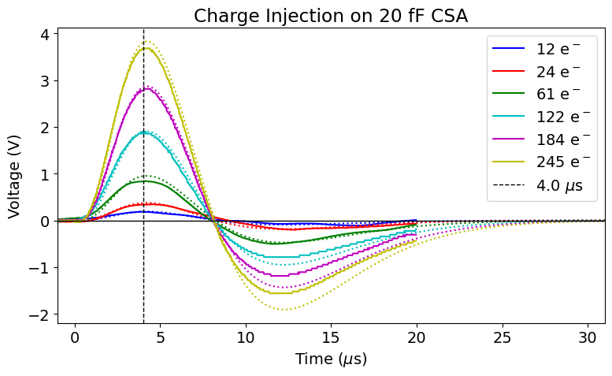
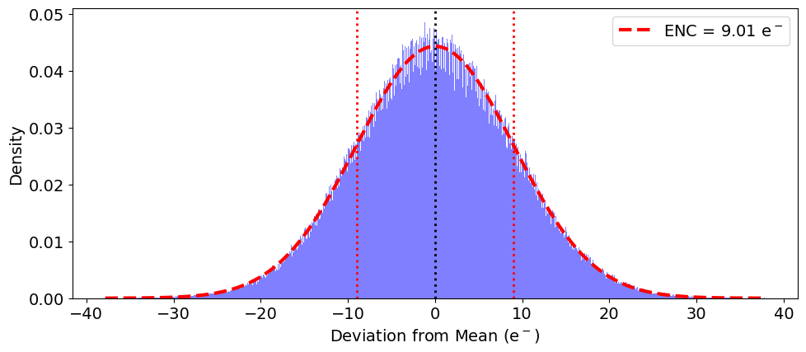
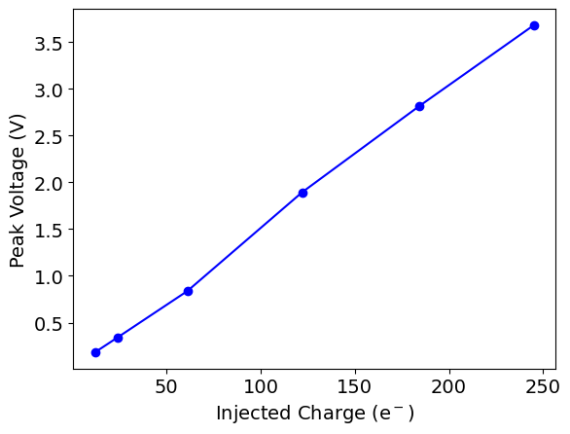
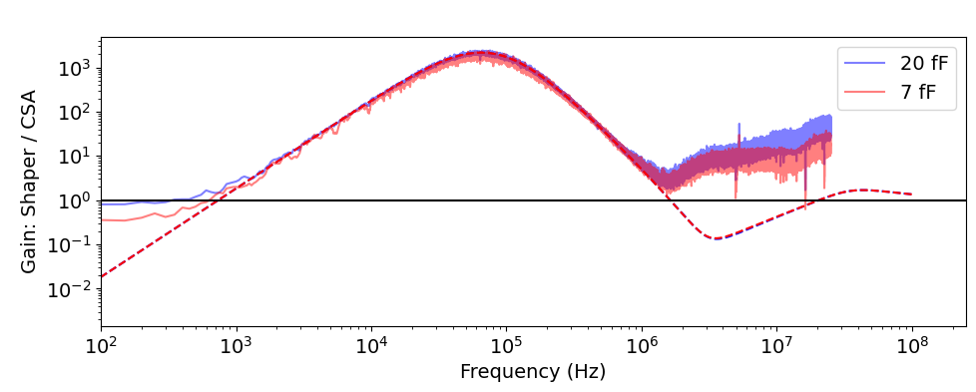
Testing G3Pix
9 ENC
Peak at ~4 μs.
Linear gain response.
Consistent shaper gain.
Measuring 9 ENC.
Why not 3 ENC?
We’re working on this…
Tanner Polischuk | CPAD 2026

Slide 23
The Flexible, Ideal MPGD System
An ultra-low noise ASIC.
  Measuring 9 ENC.
With an integrated-grid amplification structure.
  Geometry chosen to maximize efficiency.
With instant-reset capability.
  Interesting pattern to negate ion tail.
Making every primary charge count.
Tanner Polischuk | CPAD 2026

Slide 24
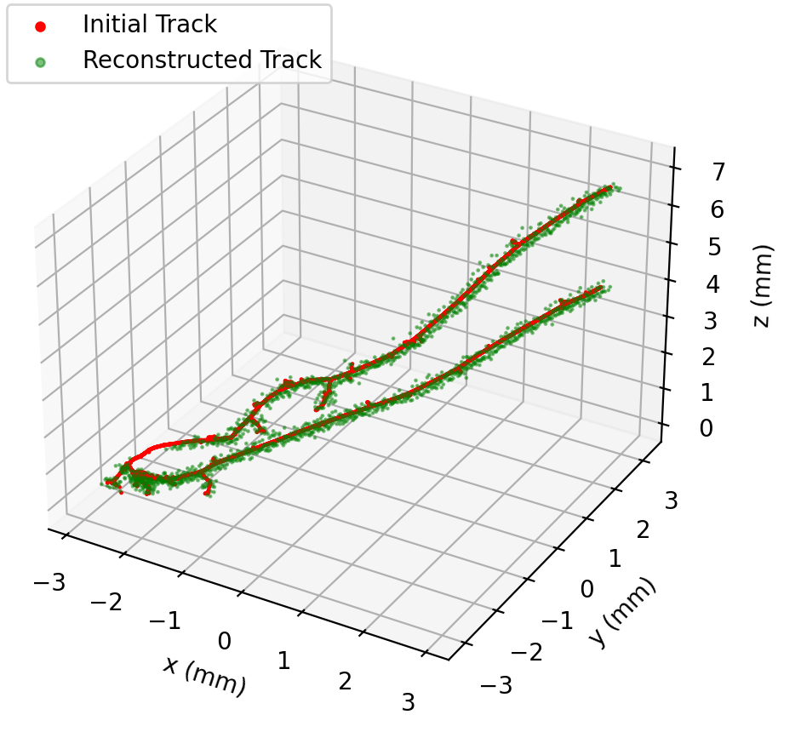
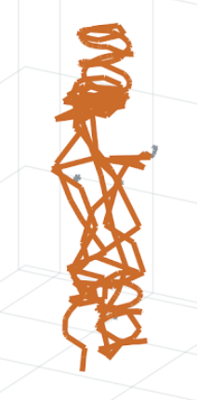
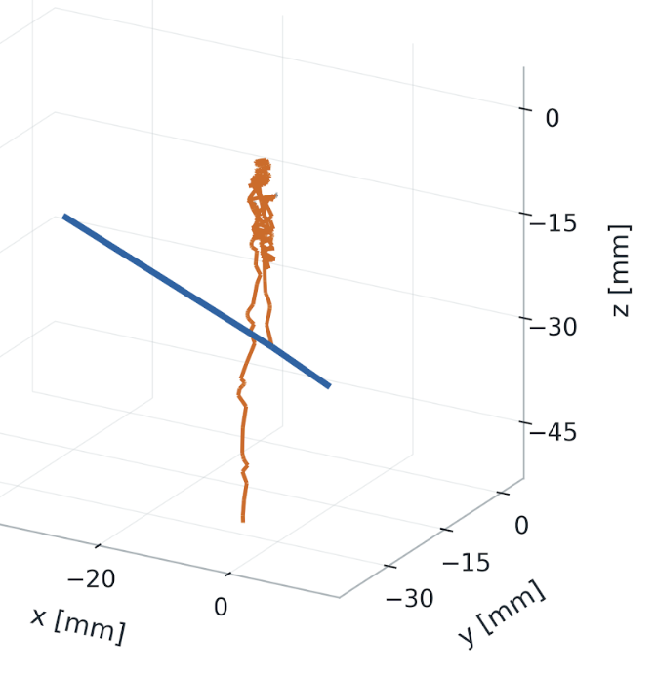
Summary
Operational Limits:
  Efficiency targets (detection and/or collection).
  Gas breakdowns / discharges.
  Noise occupancy.
Signals and Front-End:
  Fast electron and slow ion contributions.
  Instant reset, with interesting pattern.
  Event rejection at the hit level through machine-learning (not covered here).
G3Pix:
  An ultra-low-noise ASIC.
  Measuring 9 ENC (but might be less).
Tanner Polischuk | CPAD 2026

Slide 25
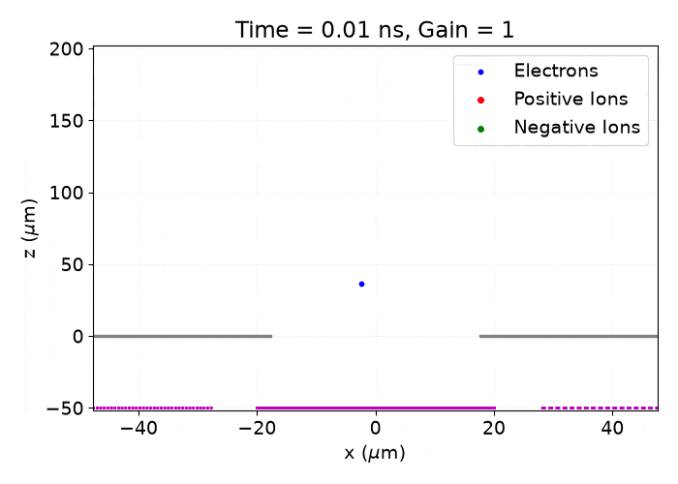
Thank you!
Peter Lewis:
peter.mandeville.lewis@hawaii.edu
Tanner Polischuk:
tanner.polischuk@hawaii.edu
Check out James Harrison’s poster:
A Complete Ion Screening
Amplification Structure
Tanner Polischuk | CPAD 2026

Slide 26
Backups
Tanner Polischuk | CPAD 2026

Slide 27
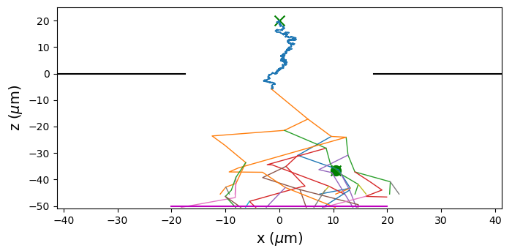
Simulating Negative Ion Drift
Populate with electron
  Immediate attachment
Negative ion drift
Electron detachment
Electron avalanche
  Re-attachment/detachments
This uses a threshold-based model for detachment. Verification of a scattering-based model is ongoing.
Tanner Polischuk | CPAD 2026

Slide 28
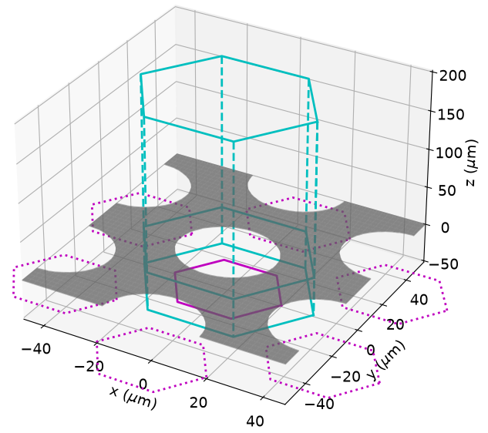
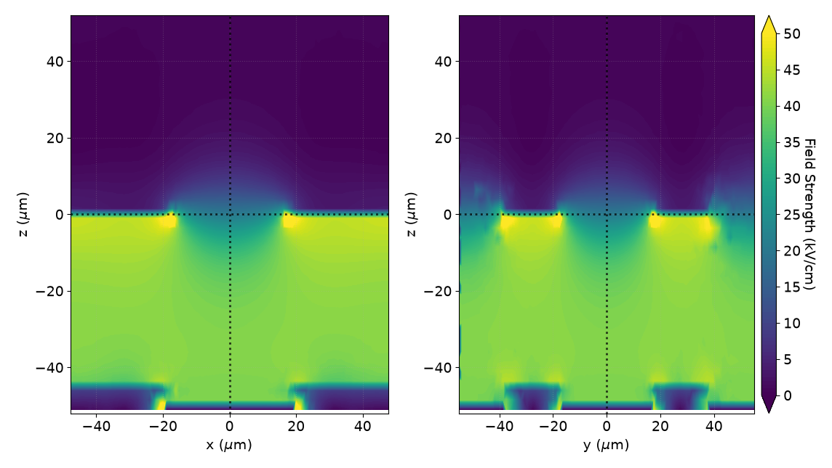
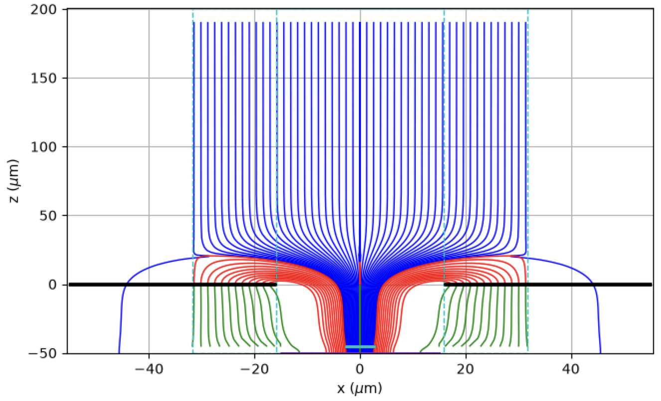
Simulation Workflow
Gmsh → Elmer → Garfield++
Tanner Polischuk | CPAD 2026

Slide 29
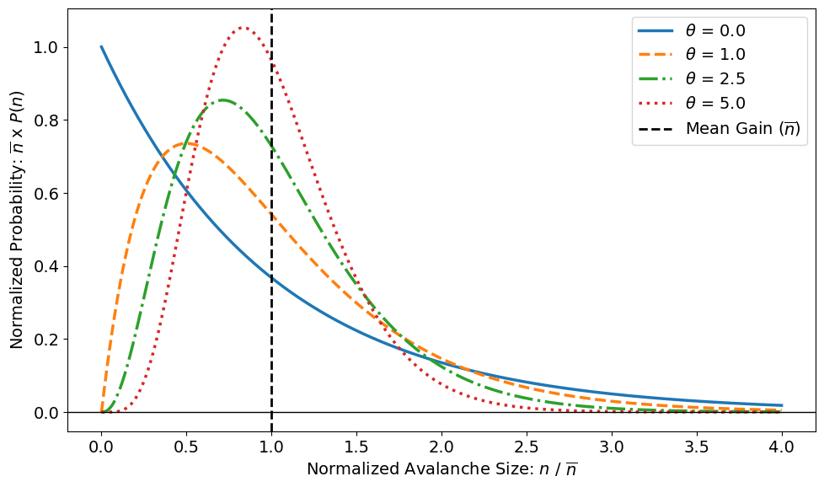
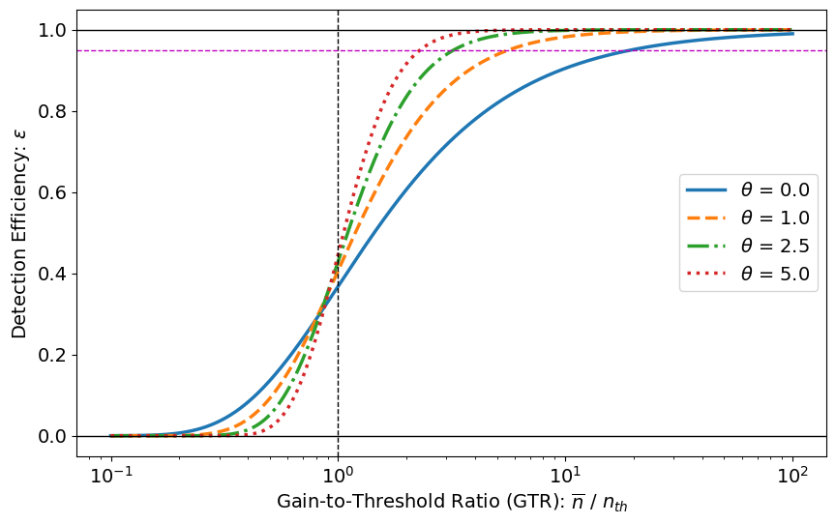
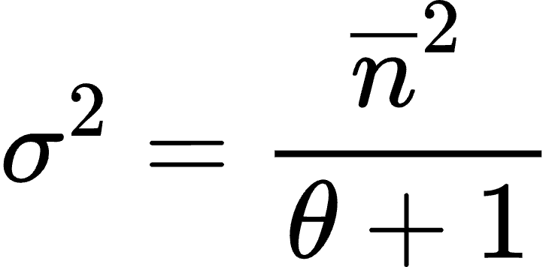
Pólya Parameterizations
Tanner Polischuk | CPAD 2026

Slide 30
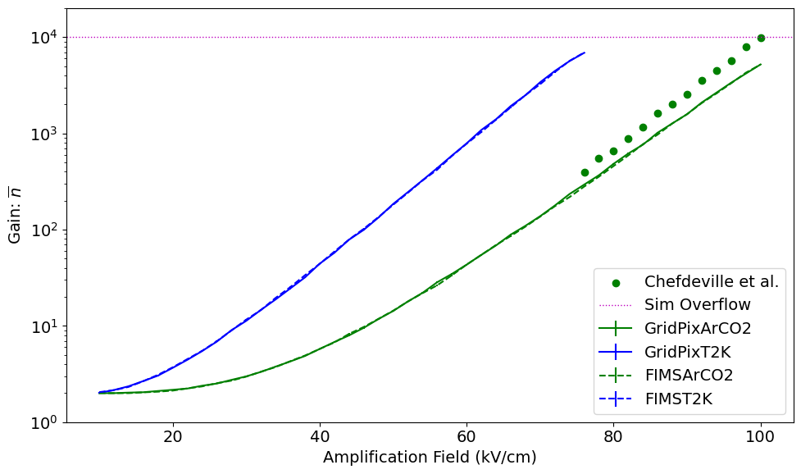
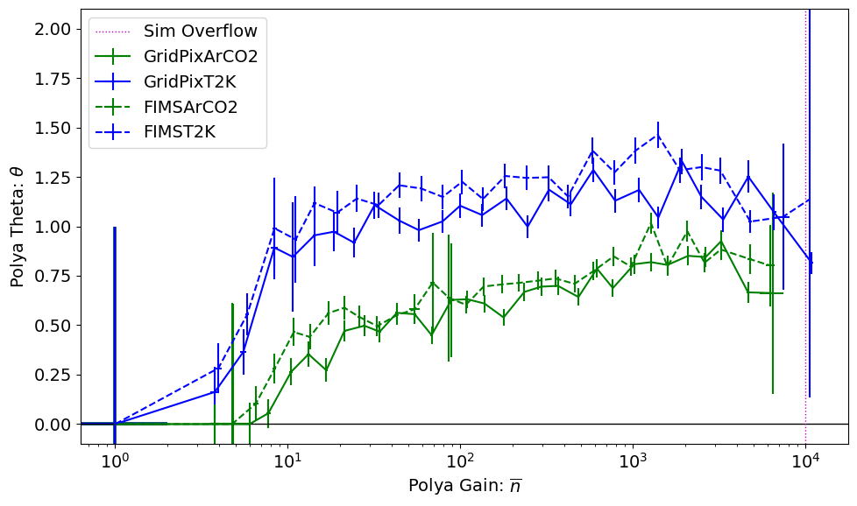

Different Geometries and Gases
GridPix: Square unit cell, circular holes, octagonal pads.
FIMS: Hexagonal unit cell, circular holes, hexagonal pads.
Data: 10.1016/j.nima.2005.11.065
ArCO2: Ar/CO₂ – 80/20 (Penning = 0.51)
T2K: Ar/CF₄/isobutane – 95/3/2 (Penning = 0.385)
Tanner Polischuk | CPAD 2026

Slide 31


Efficiency Contours
Collection
Detection
Tanner Polischuk | CPAD 2026

Slide 32


Net Efficiency and Gain Contours
Tanner Polischuk | CPAD 2026

Slide 33






Reset Time and Pileup
Diffusion-limited floor
Nuclear recoils in T2K gas (95/3/2 Ar/CF4/Isobutane).
Tanner Polischuk | CPAD 2026

Slide 34


Induced Signals
Ion Signal
Electron Signal
Total Signal
For primary pad:
Rapid, negative electron signal.
Long, negative ion signal.
For neighbor pads:
Rapid, positive electron signal.
Long, negative ion signal.
Tanner Polischuk | CPAD 2026

Slide 35



Transient Signals
All Induced Signals
These change baselines.
Can be solved by also resetting neighbours
Weighting Field for Individual Pad
Relative Strength of Neighbor Pad
For neighbor pads:
Rapid, positive electron signal.
Long, negative ion signal.
Tanner Polischuk | CPAD 2026

Slide 36

FIMS with G3Pix Operational Regime
FIMS with G3Pix:
ENC = 3 e
Gain = 100 e
Shaping = 2 μs
Occupancy bound
( < 10⁻⁶ )
Efficiency bound
( > 95% )
Tanner Polischuk | CPAD 2026

Slide 37

G3Pix – More Testing Results
Tanner Polischuk | CPAD 2026

Slide 38


CMOS ENC and Shaping
No Series Noise
Tanner Polischuk | CPAD 2026

