Slide 1
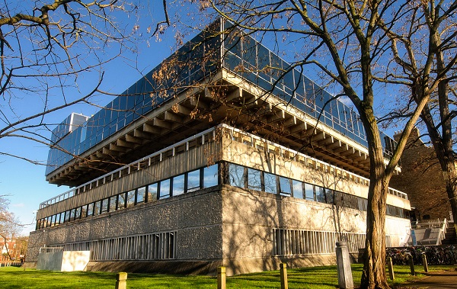
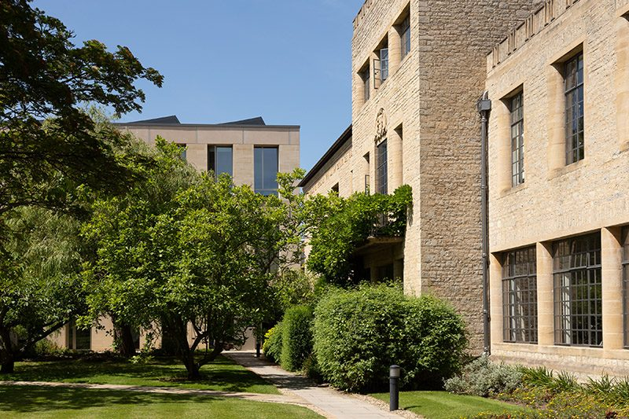
Neville and teaching
1989 - 2022
St Anne’s College
Denys Wilkinson Building, Department of Physics
Patrick Irwin, AOPP and St Anne’s College

Slide 2
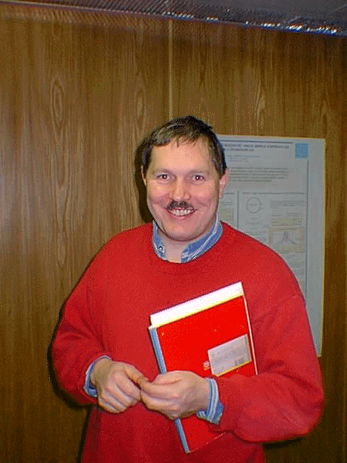
St Anne’s College
33 years since a fresh-faced young Neville took up his post!
Has taught something like 200 students in physics, who have gone on to become academics, teachers, business people, soldiers, sailors, …
Notes:
Sneha 2
Sneha 1
Sneha 5
Michael 2
Sneha 4

Slide 3
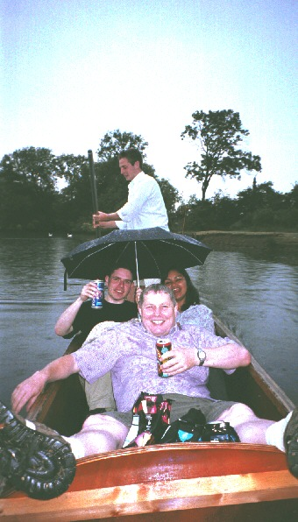
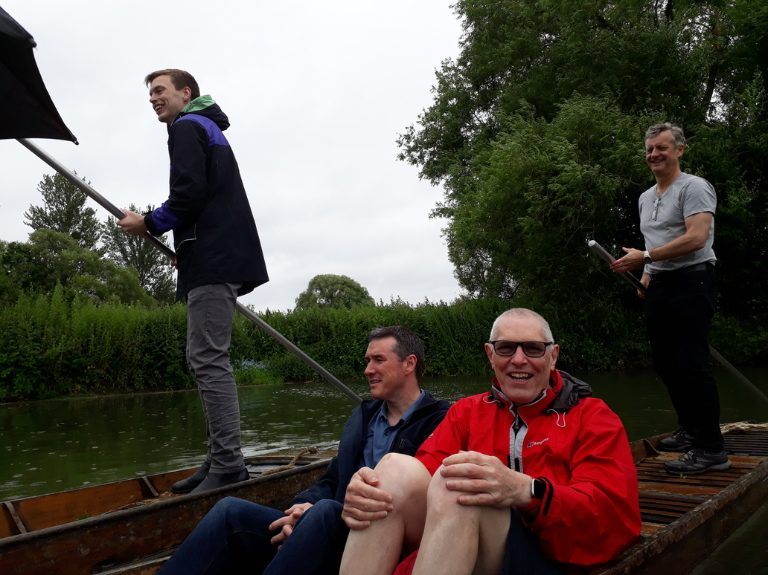
Entertaining the students
2003
Schools Dinners
2022
Notes:
Selfless rescuing of students in distress.

Slide 4
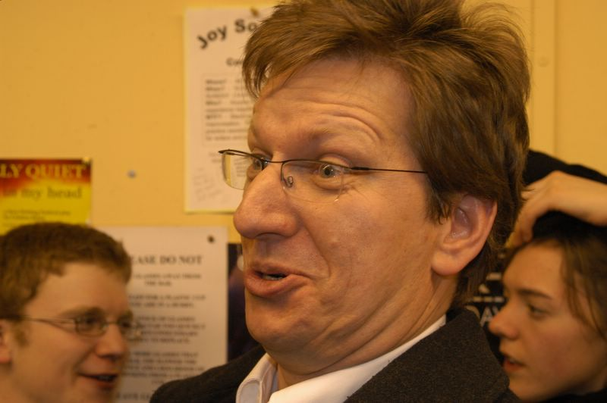
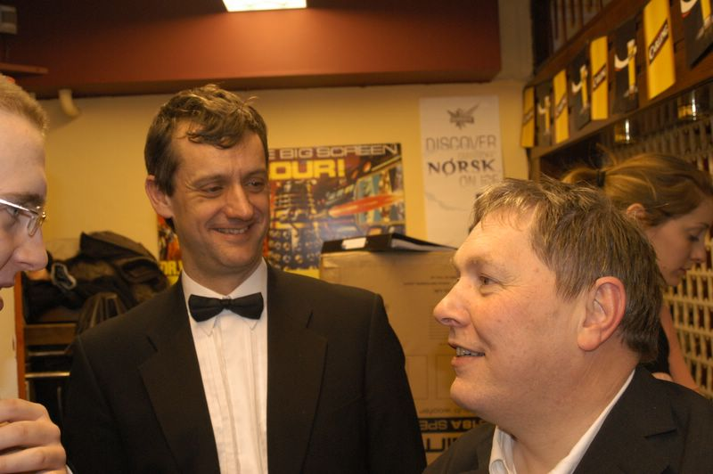
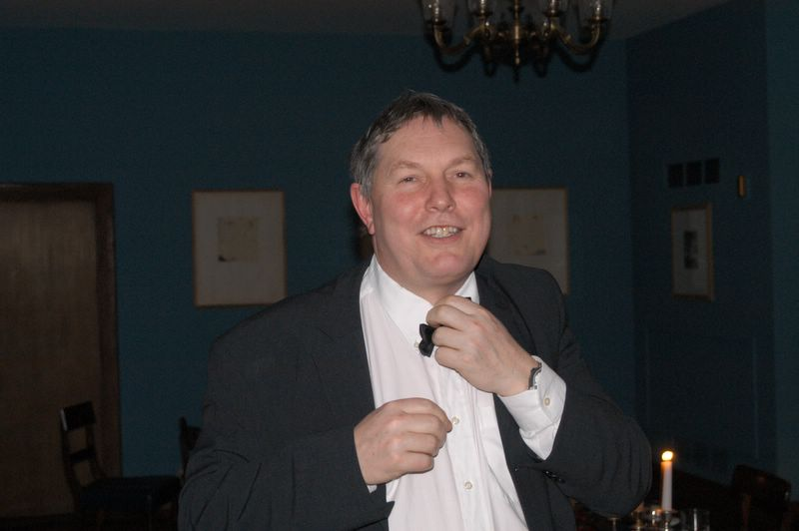
Entertaining the students
Schools Dinners
Physics Dinners
Notes:
Physics Jokes.

Slide 5
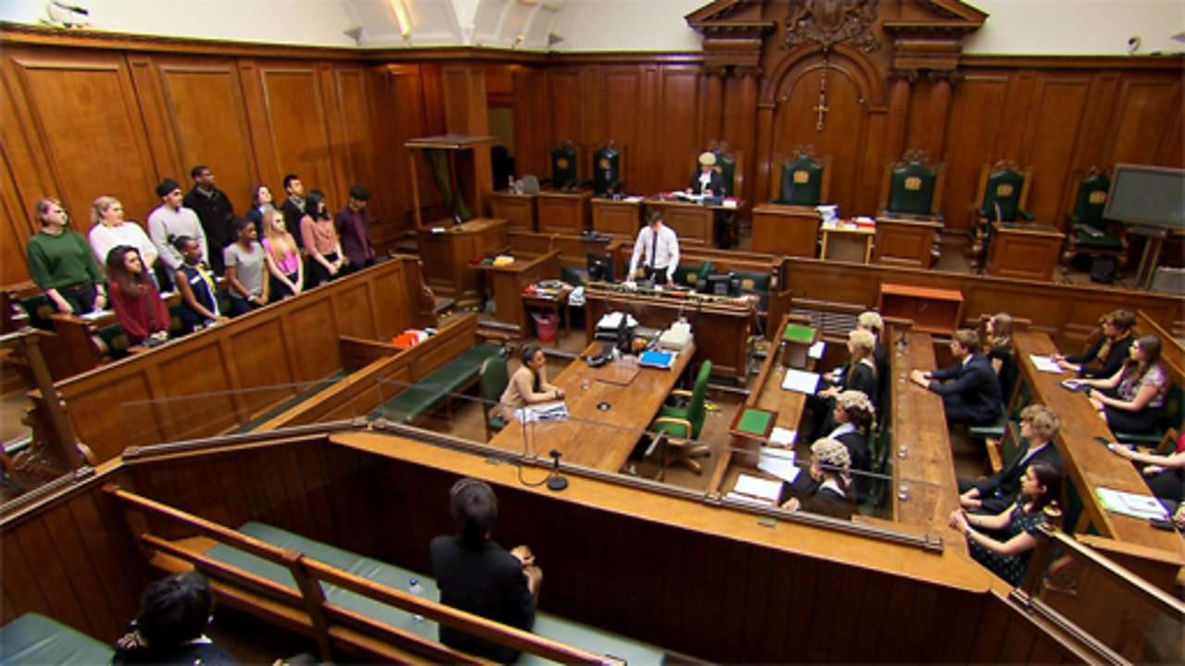
Disciplining Students
College Dean …
Notes:
Michael 1
Scaling Wolfson…

Slide 6
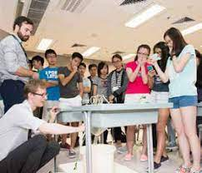
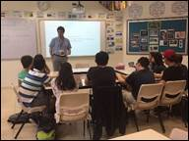
Summer Schools
Annual trip to Far East to engage with summer school programmes.
  Hong Kong
  Singapore
  Kuala Lumpur…
Notes:
On a plane.

Slide 7
Demonstrating
1st Year Electronics
1st Year General Physics Lab?
Examining
Prelims Examiner twice (4 years total)
External Examiner for 6 years for Birmingham
Notes:
Where’s your experiment?

Slide 8
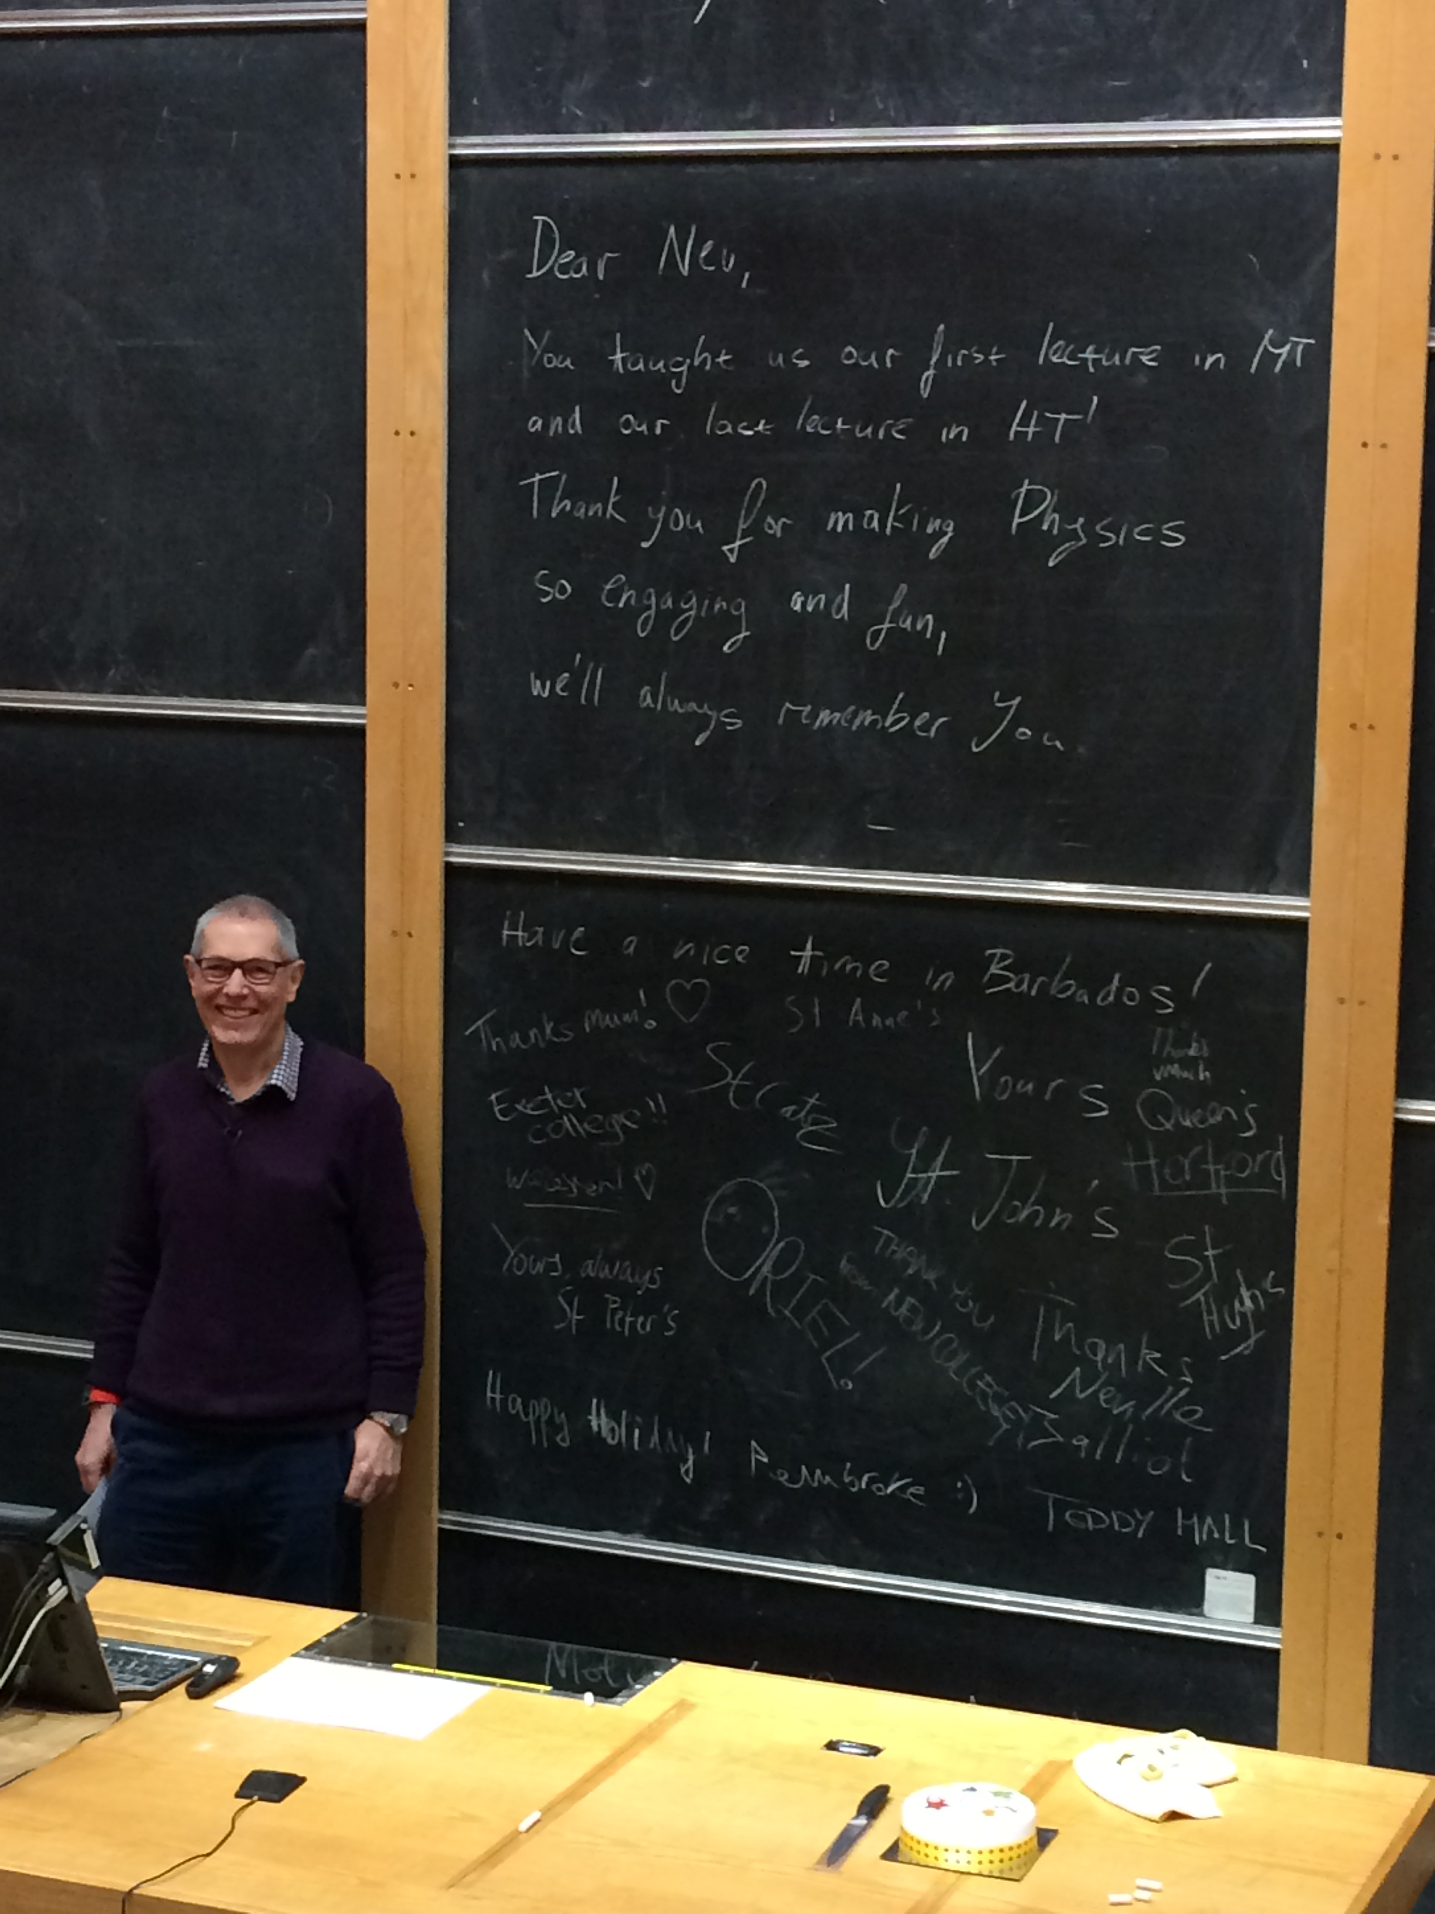
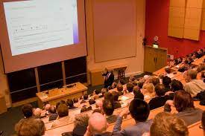
Lecturing
Circuit Theory in 2003
Vectors & Matrices from 2007 to 2012
Classical Mechanics from 2014 to 2016
Electromagnetism from 2018 to 2021
Notes:
Darth Vader
Chalk
Mother
Mother’s Day Card
Final photo from 2017.

Slide 9
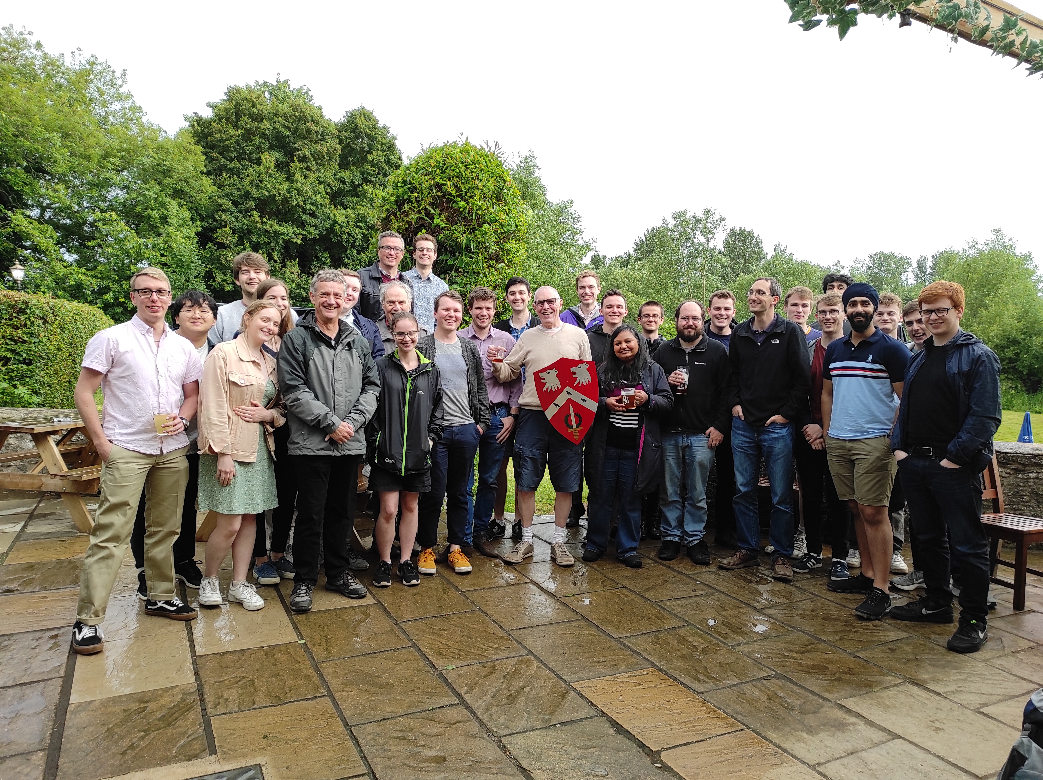
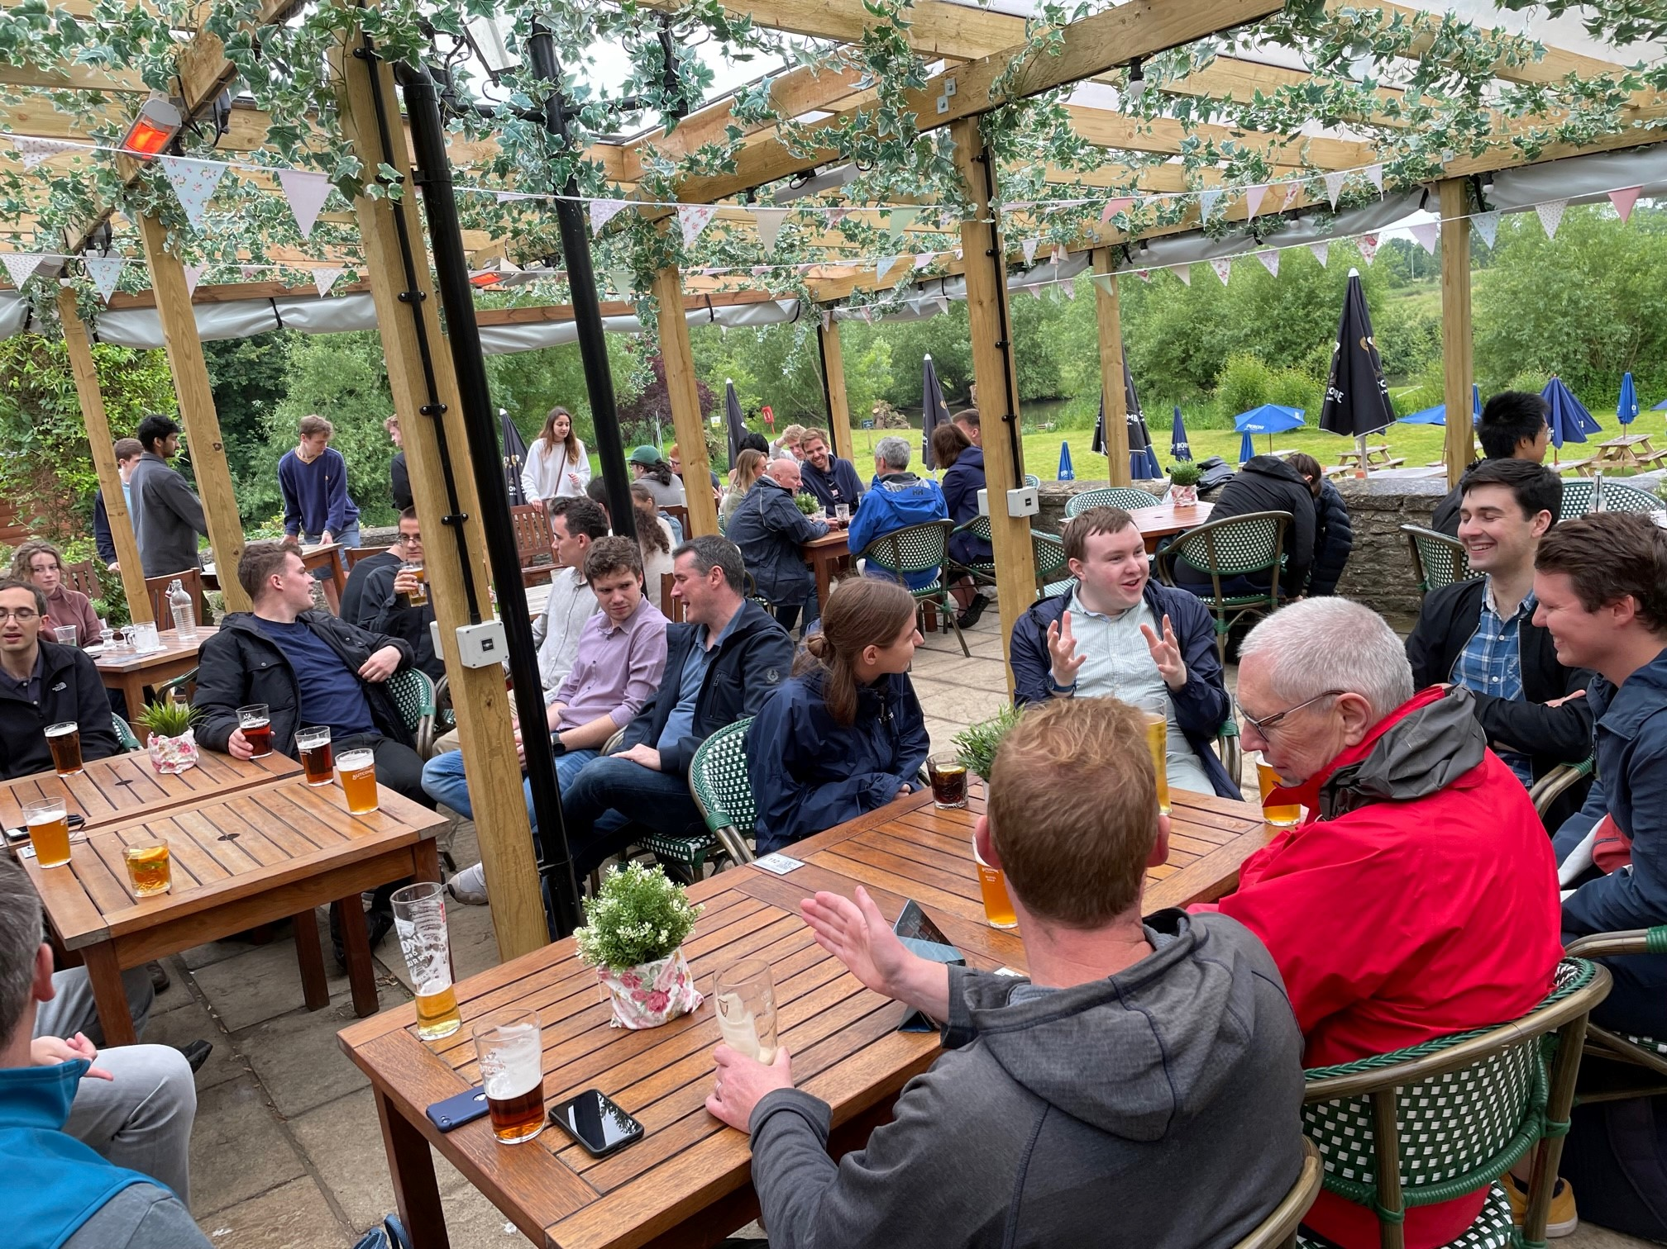
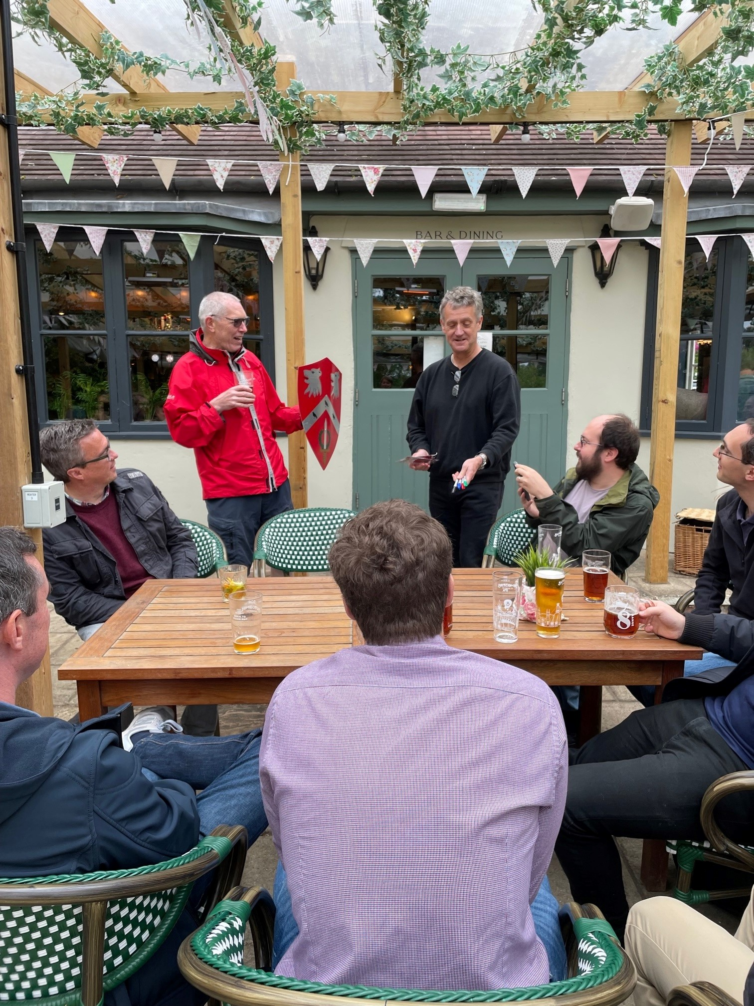
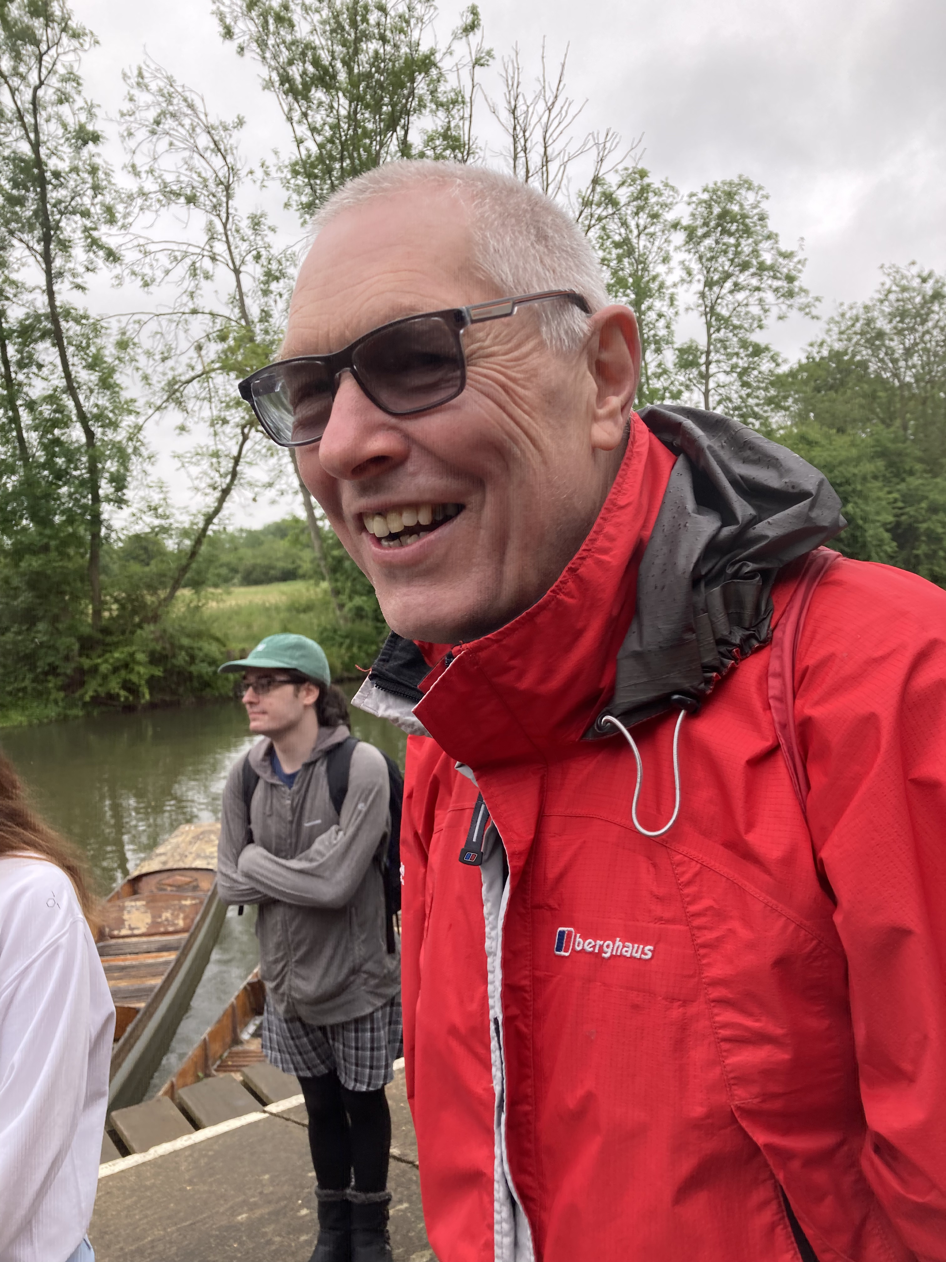
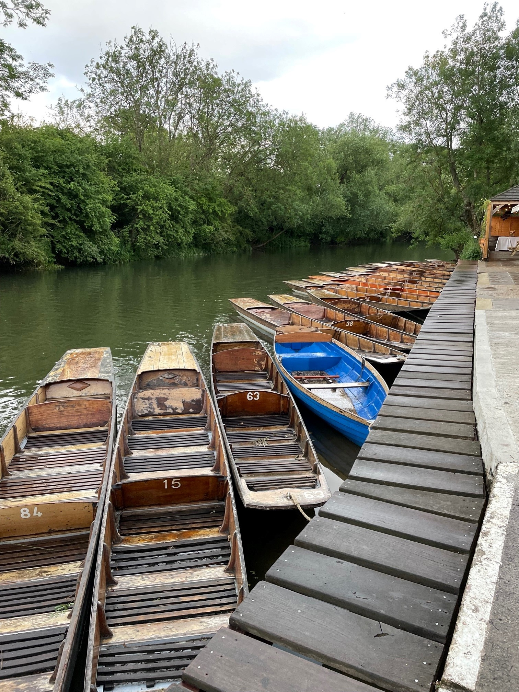
Surprise Punt Party 18th June 2022
40+ people came, covering many years of college teaching.
Notes:
Scaling Wolfson.

Slide 10
Filling Neville’s Shoes
2003
Notes:
Valediction
Sneha 3

Slide 11
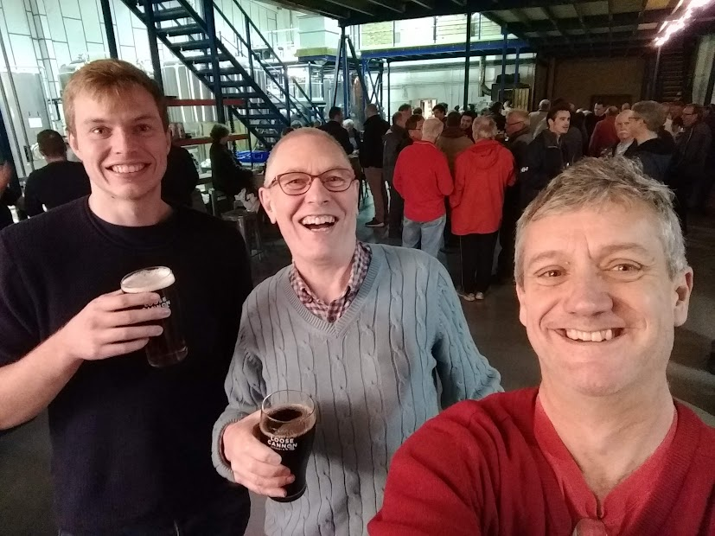
Notes:
Valediction

