Slide 1


First indications of a rare Higgs decay in 2020
Miha Zgubič
(miha.zgubic@gmail.com)
on behalf of the ATLAS Collaboration
on my own behalf, I now optimise electricity grids
The Higgsversary extravaganza
Oxford, July 2, 2022

Slide 2
Higgs discovery in 2012 a major triumph of the Standard Model
Observed in main production modes and many decay channels
H->µµ has sensitivity to coupling to second generation fermions

Slide 3
From ATLAS Public Event Displays

Slide 4
Why is it hard?

Slide 5
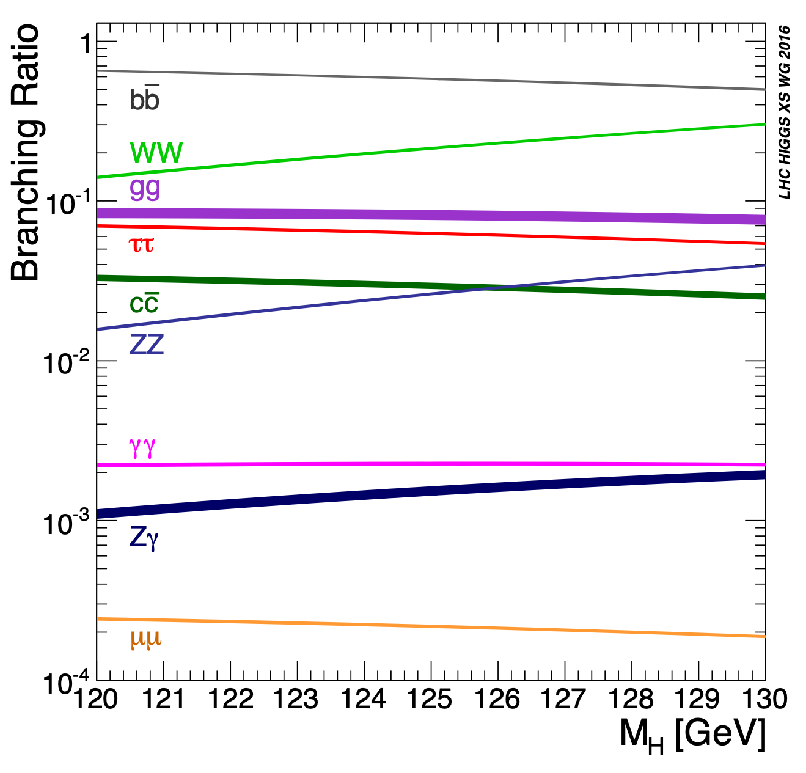
Muons are light
(as in, not heavy)
~1300 expected events

Slide 6
…and there’s this pesky
Drell-Yan process…

Slide 7
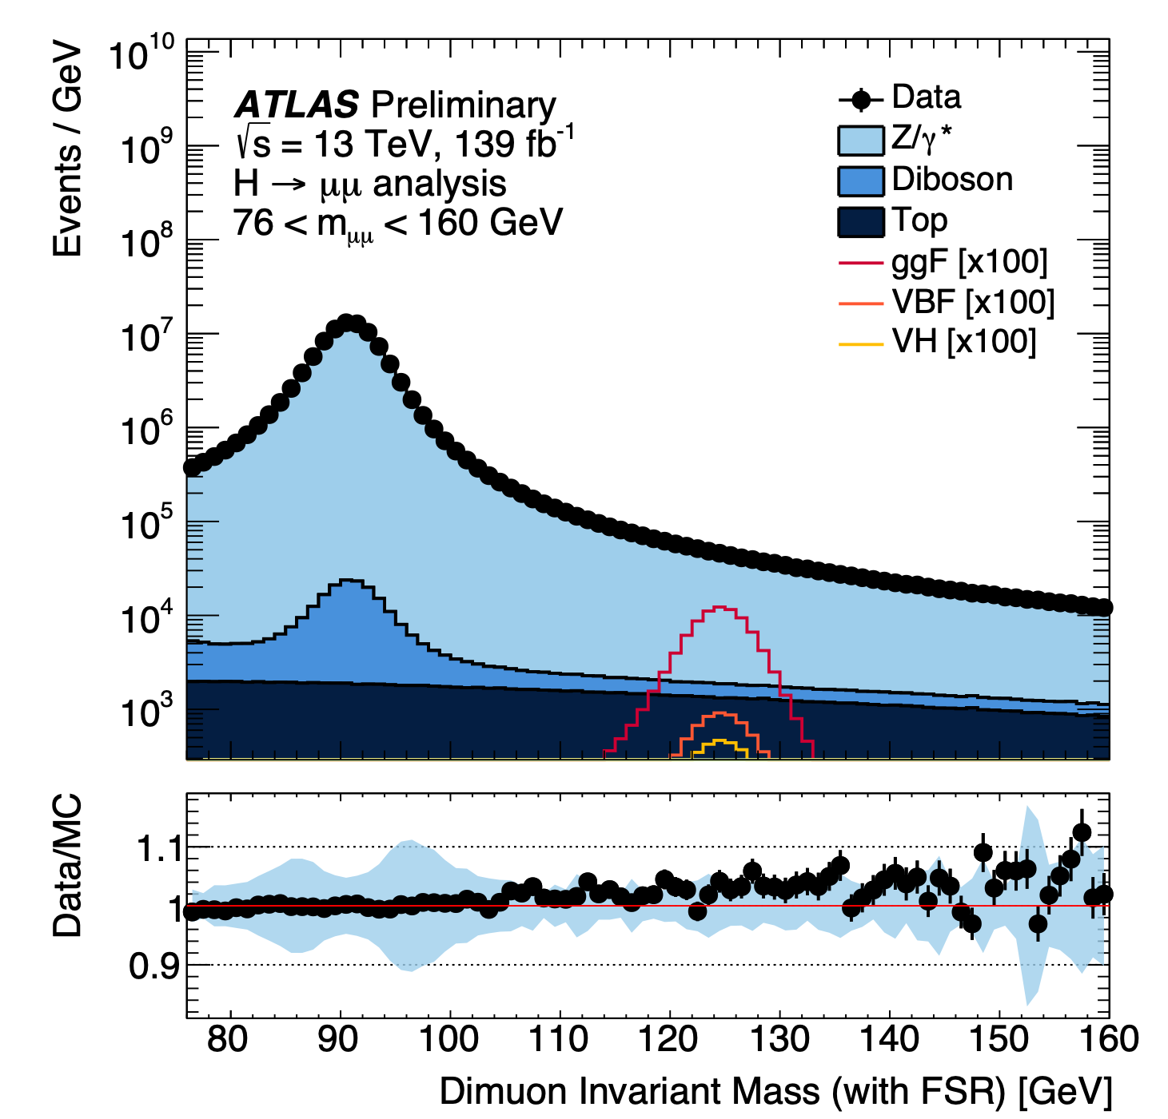
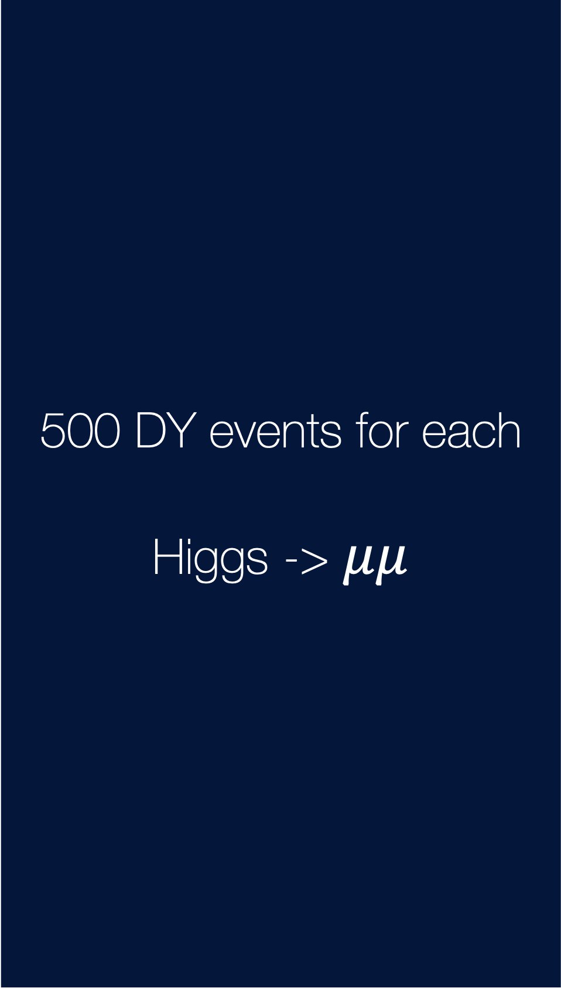
500 DY events for each
Higgs -> $μμ$

Slide 8
Strategy

Slide 9
Very loose selection
Essentially if we have two muons…
we keep the event

Slide 10

Event categorisation

Slide 11
Fit the invariant mass

Slide 12
Biggest challenge

Slide 13
TRUE BACKGROUND
# events
m_{μμ}

Slide 14
TRUE BACKGROUND
BACKGROUND MODEL
# events
m_{μμ}

Slide 15
TRUE BACKGROUND
BACKGROUND MODEL
SPURIOUS SIGNAL
# events
m_{μμ}

Slide 16
Results

Slide 17
ATLAS
Significance
Measurement
Upper limit
2.0σ (1.7σ expected)
µ = 1.2 ± 0.6
2.2 × SM @ 95% CL

Slide 18
CMS
3.0σ (2.5σ expected)

Slide 19
Thank you!

