Slide 1

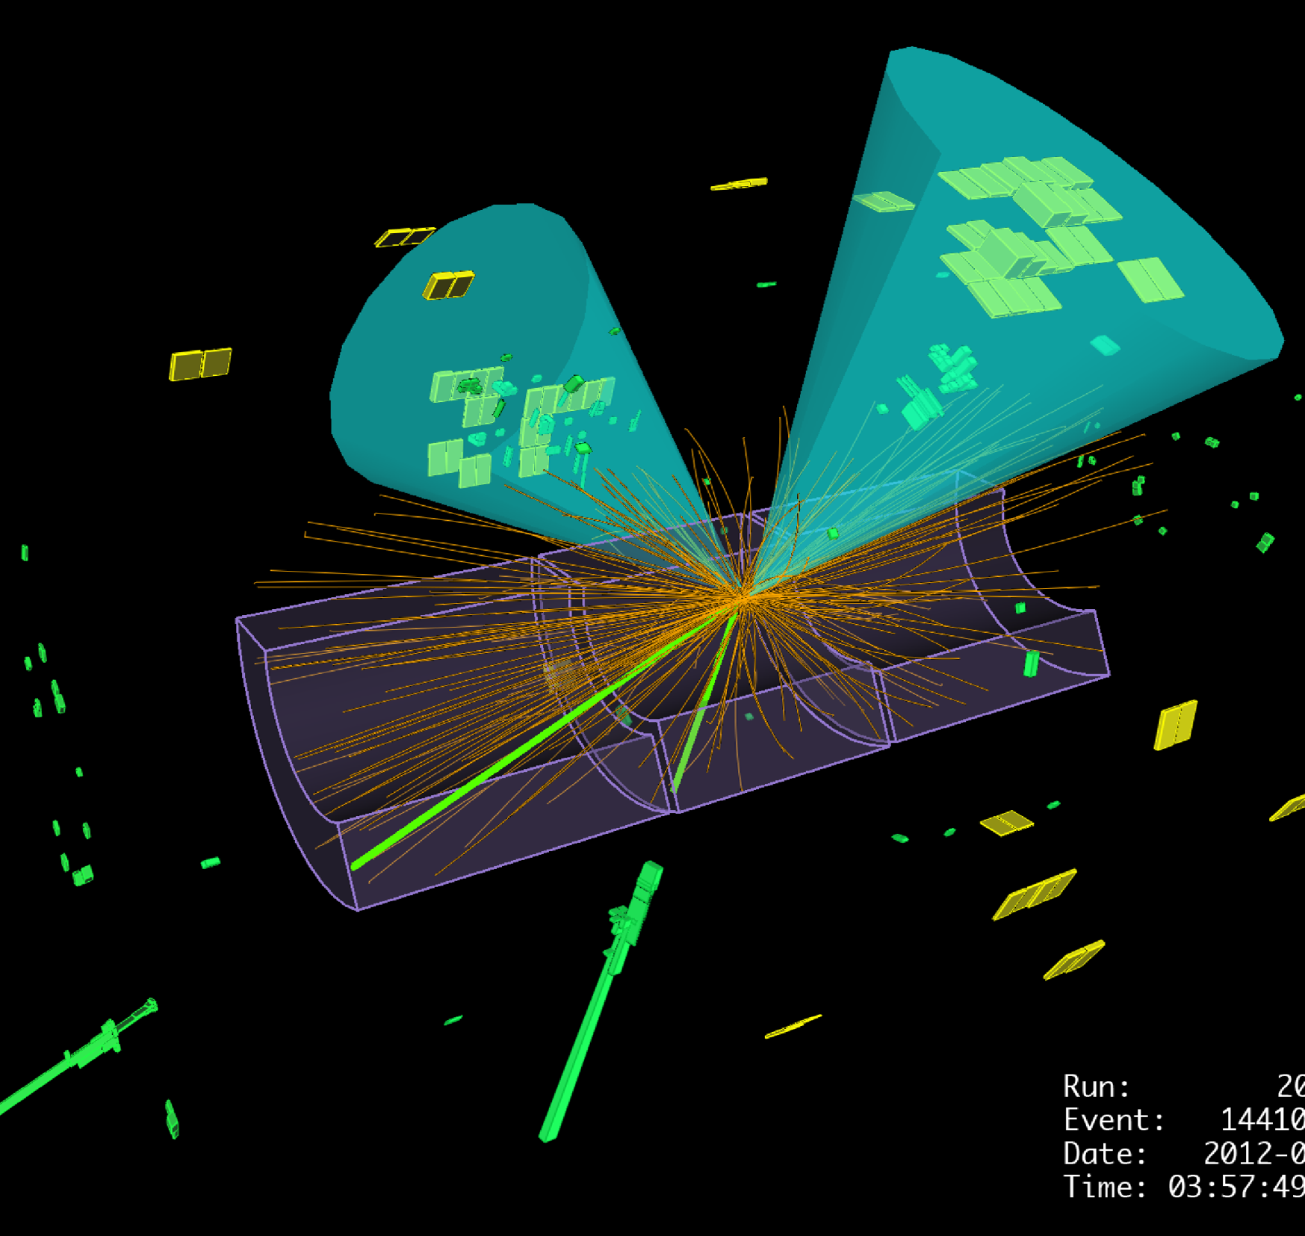

Observation of Higgs boson decays to bottom quarks
Elisabeth Schopf
Oxford Physics Alumni Garden Party 2022

Slide 2
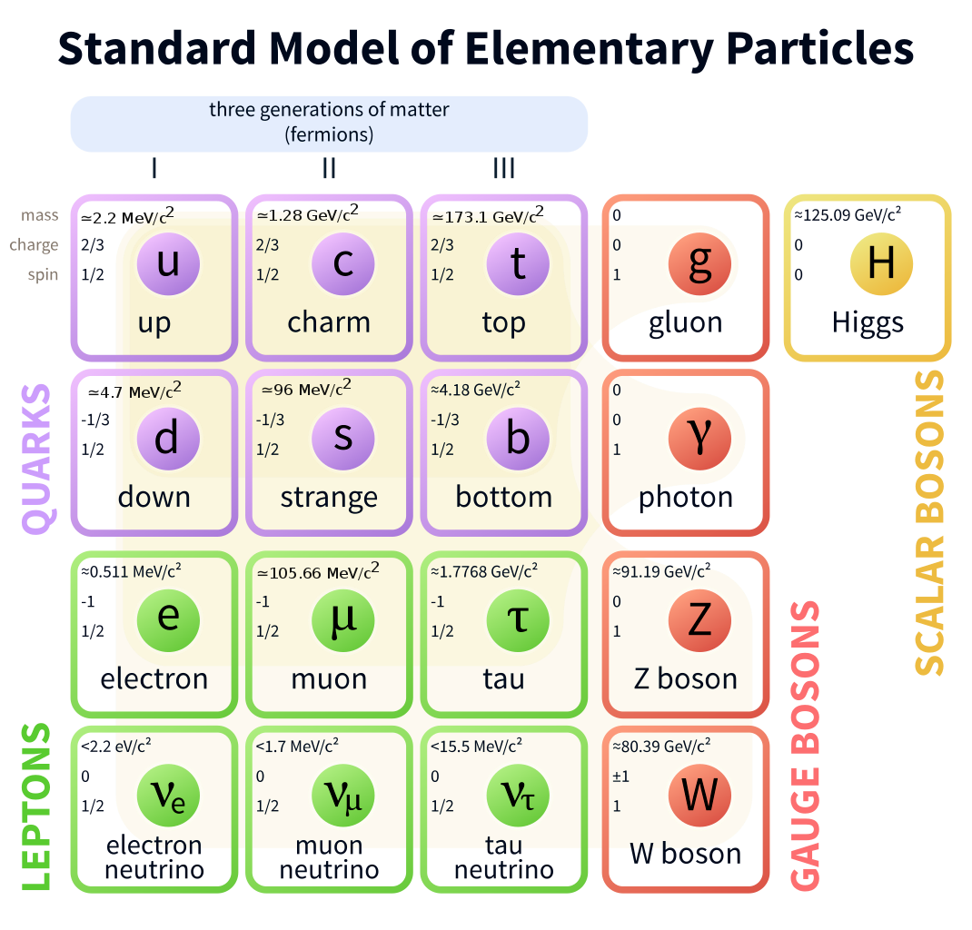
Higgs Boson’s most probable decay
H→bb is “largest piece of the pie”
Important ingredient to establish mass generation of matter particles
Narrow down window for “secret” ingredients in the pie
Higgs decay probabilities
Matter particles

Slide 3
What is the challenge of finding H→bb decays?
Observed decays end of 2017: H→𝜸𝜸 (0.2%), H→ZZ (3%), H→WW (21%), H→𝝉𝝉 (6%)
Experimental signature of b-quarks are “jets” and “at the LHC it’s just jets everywhere” (my friend Luis in 2016)
→ For every H→bb event generated in a collision there are approximately 1 billion non-Higgs di-jet events generated

Slide 4

What is the challenge of finding H→bb decays?
Observed decays end of 2017: H→𝜸𝜸 (0.2%), H→ZZ (3%), H→WW (21%), H→𝝉𝝉 (6%)
Experimental signature of b-quarks are “jets” and “at the LHC it’s just jets everywhere” (my friend Luis in 2016)
→ For every H→bb event generated in a collision there are approximately 1 billion non-Higgs di-jet events generated

Slide 5
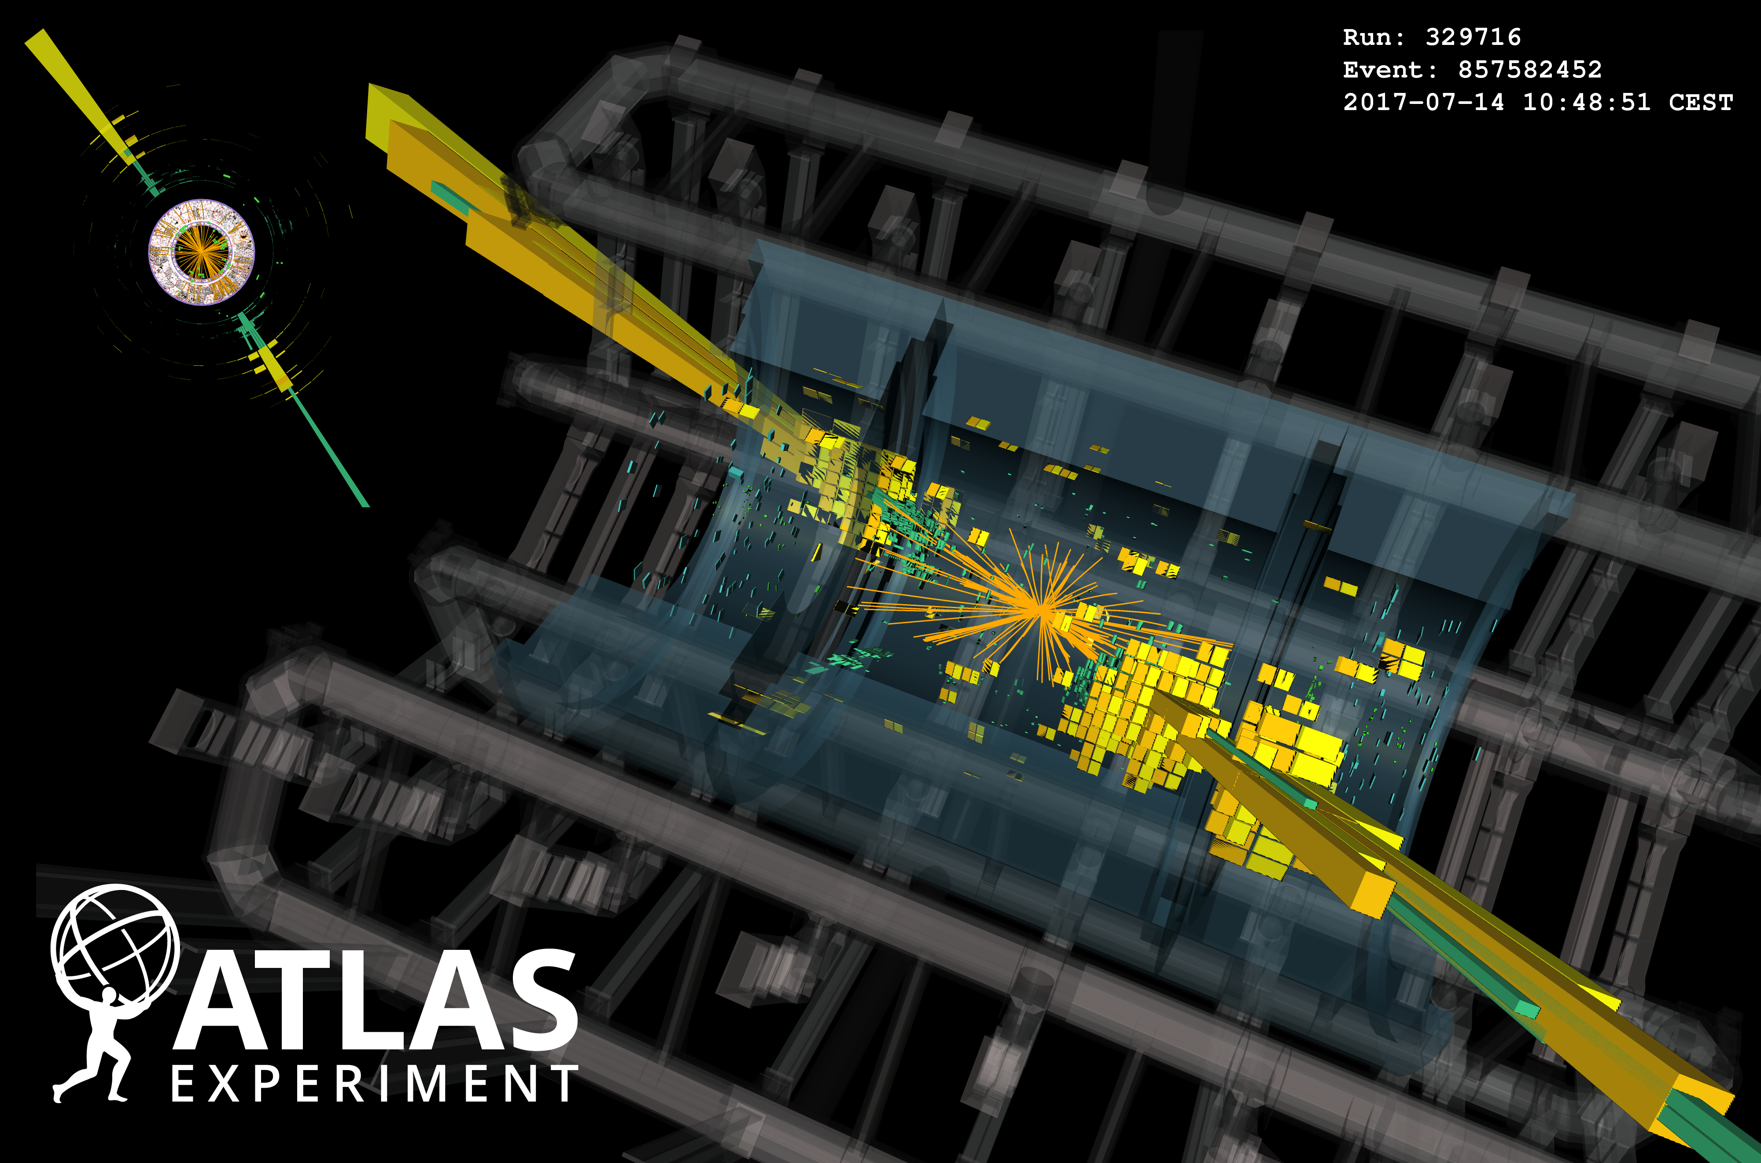
What is the challenge of finding H→bb decays?
Observed decays end of 2017: H→𝜸𝜸 (0.2%), H→ZZ (3%), H→WW (21%), H→𝝉𝝉 (6%)
Experimental signature of b-quarks are “jets” and “at the LHC it’s just jets everywhere” (my friend Luis in 2016)
→ For every H→bb event generated in a collision there are approximately 1 billion non-Higgs di-jet events generated

Slide 6
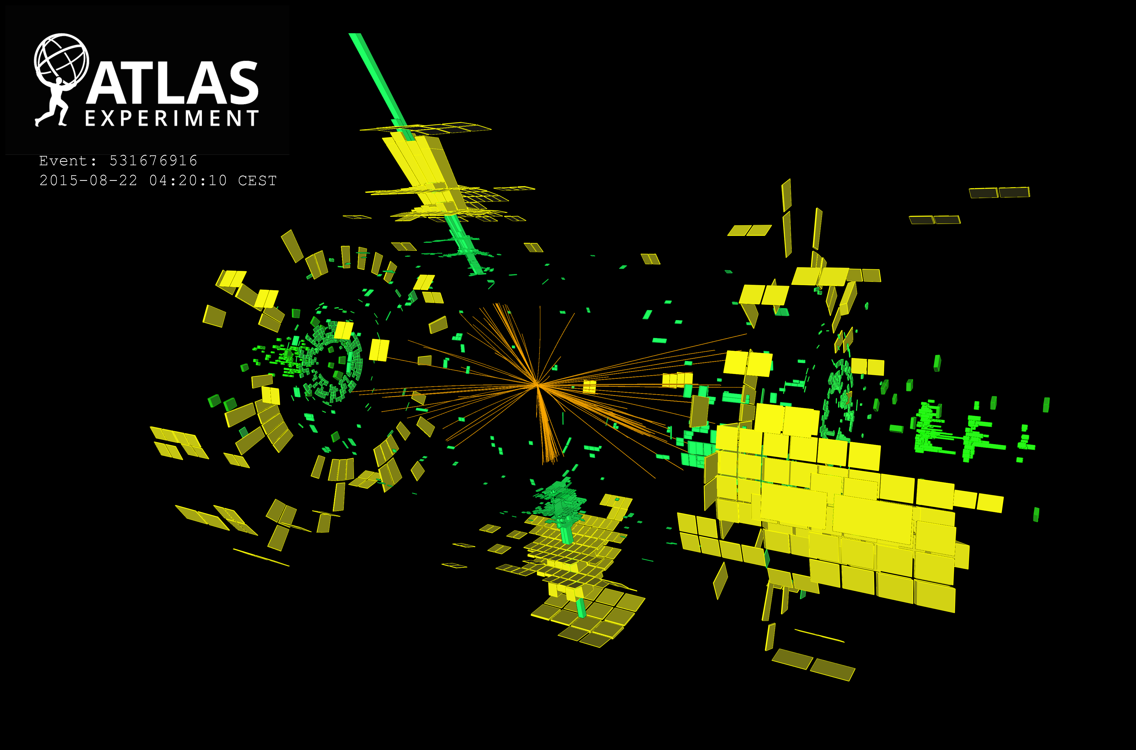
What is the challenge of finding H→bb decays?
Observed decays end of 2017: H→𝜸𝜸 (0.2%), H→ZZ (3%), H→WW (21%), H→𝝉𝝉 (6%)
Experimental signature of b-quarks are “jets” and “at the LHC it’s just jets everywhere” (my friend Luis in 2016)
→ For every H→bb event generated in a collision there are approximately 1 billion non-Higgs di-jet events generated

Slide 7
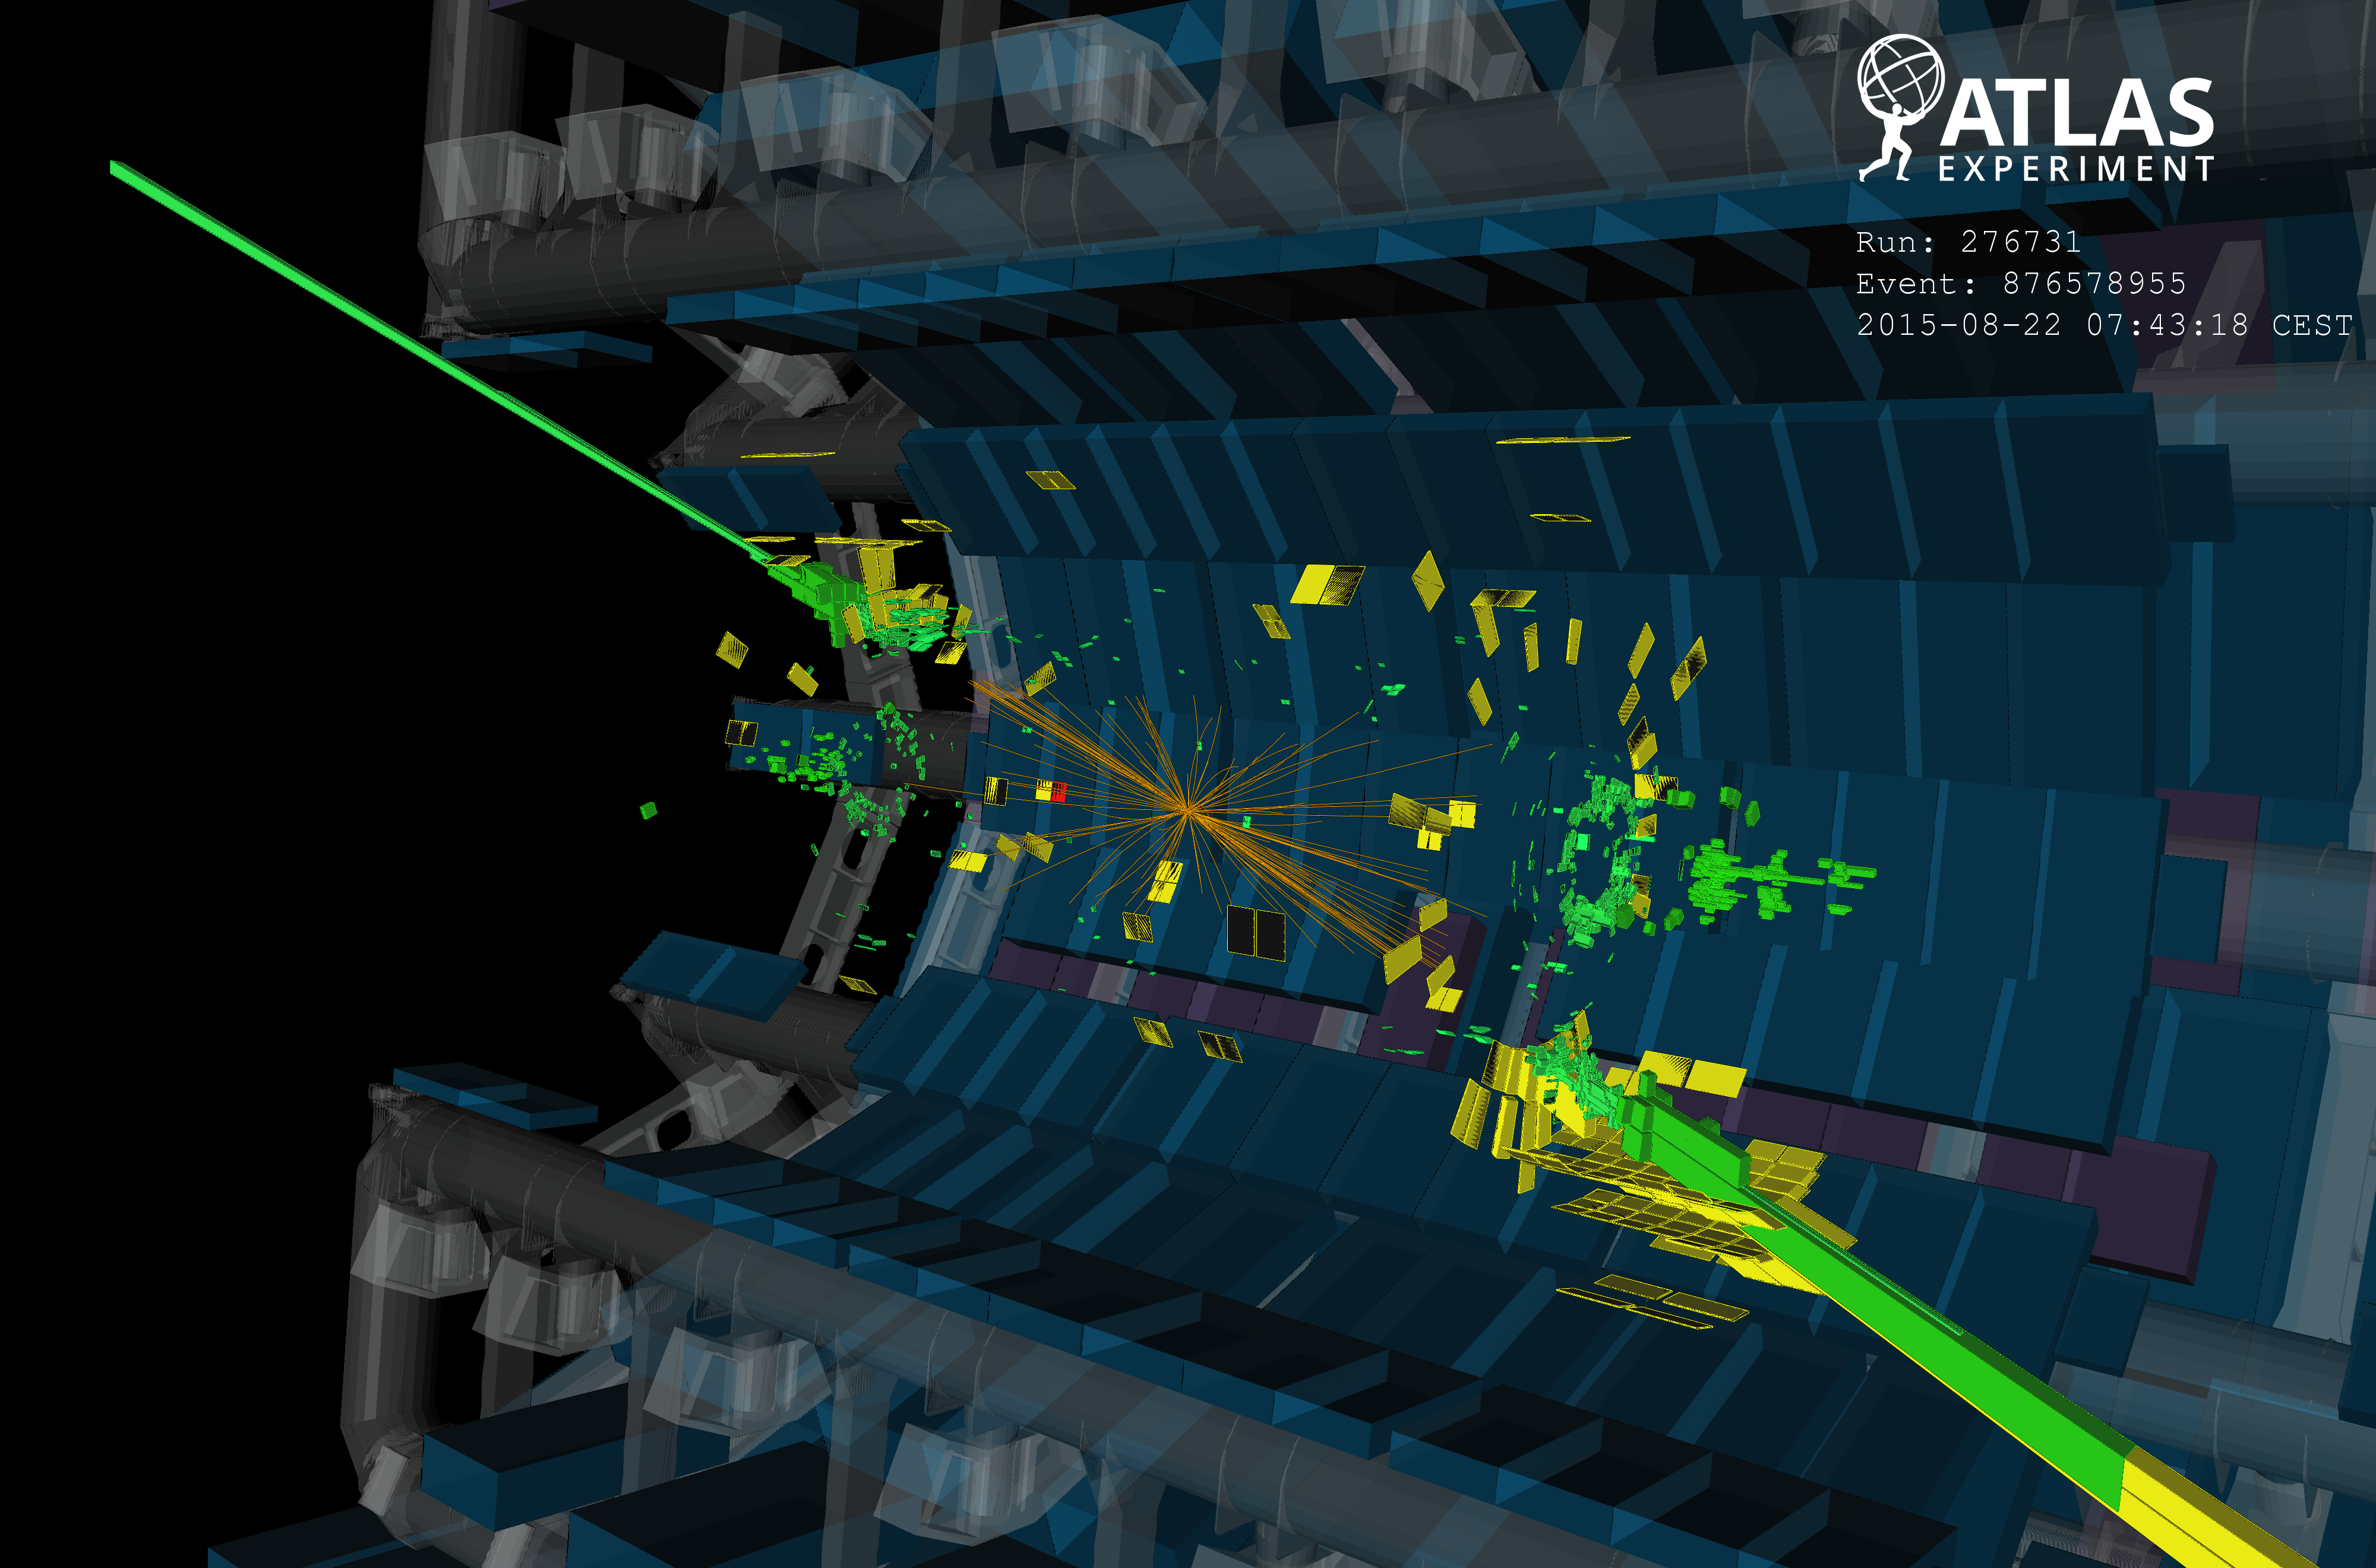
What is the challenge of finding H→bb decays?
Observed decays end of 2017: H→𝜸𝜸 (0.2%), H→ZZ (3%), H→WW (21%), H→𝝉𝝉 (6%)
Experimental signature of b-quarks are “jets” and “at the LHC it’s just jets everywhere” (my friend Luis in 2016)
→ For every H→bb event generated in a collision there are approximately 1 billion non-Higgs di-jet events generated

Slide 8
What is a jet?
Experimentalist: “Collimated bundle of particles”
Theorist: “Consequence of the strong force growing with distance”

Slide 9

What is a jet?
Experimentalist: “Collimated bundle of particles”
Theorist: “Consequence of the strong force growing with distance”
b
b

Slide 10
What is a jet?
Experimentalist: “Collimated bundle of particles”
Theorist: “Consequence of the strong force growing with distance”
b
b
b
b

Slide 11
What is a jet?
Experimentalist: “Collimated bundle of particles”
Theorist: “Consequence of the strong force growing with distance”
b
b
b
q
b
b
q
b

Slide 12
What is a jet?
Experimentalist: “Collimated bundle of particles”
Theorist: “Consequence of the strong force growing with distance”
b
b
b
b
q
q
b
b
q
q
b
b

Slide 13
What is a jet?
Experimentalist: “Collimated bundle of particles”
Theorist: “Consequence of the strong force growing with distance”
b
b
b
q
b
b
q
q
q
q
b
b
q
q
q
b
q
b
q
b

Slide 14
What is a jet?
Experimentalist: “Collimated bundle of particles”
Theorist: “Consequence of the strong force growing with distance”
b
b
b
q
b
b
q
q
q
q
b
…
b
q
q
q
b
q
b
q
b

Slide 15
What is a jet?
Experimentalist: “Collimated bundle of particles”
Theorist: “Consequence of the strong force growing with distance”
q
b
q
b
q
b
q
q
b
q
q
q
b
q
q
b
q
q
q
q
b
…
b
q
q
q
q
q
b
q
q
q
b
q
q
q
b
b
q

Slide 16
What is a jet?
Experimentalist: “Collimated bundle of particles”
Theorist: “Consequence of the strong force growing with distance”
q
b
q
b
q
b
q
q
b
q
q
q
b
q
q
b
q
q
q
“jet”
q
b
…
b
q
q
q
q
q
“jet”
b
q
q
q
b
q
q
q
b
b
q

Slide 17
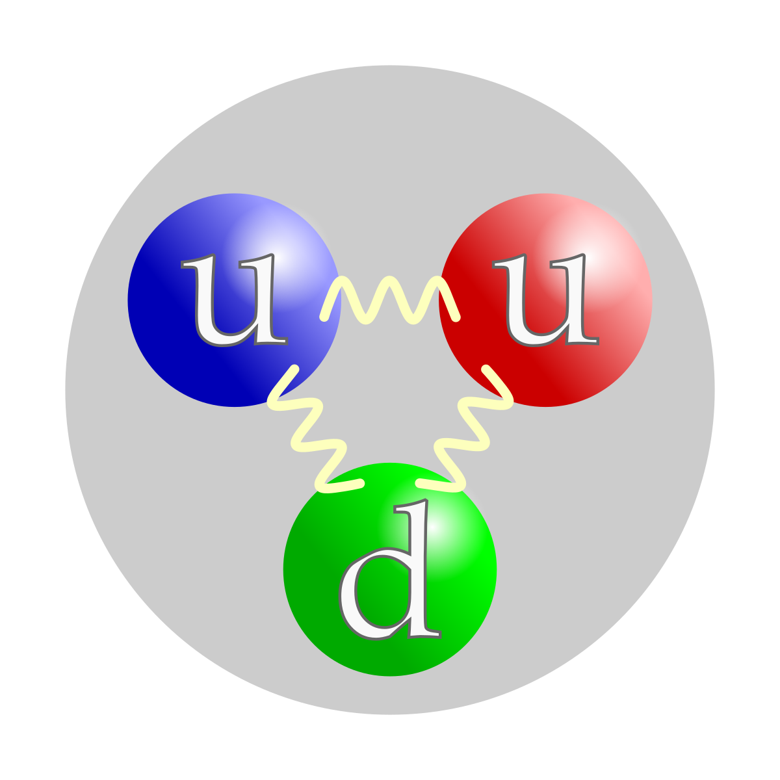
What is a jet?
Experimentalist: “Collimated bundle of particles”
Theorist: “Consequence of the strong force growing with distance”
→ Quarks cannot exist as free particles
jet
jet
jet
Proton-proton collision
(no Higgs)
jet

Slide 18
How to find H→bb Decays?
125 GeV
Number of events (N)
Higgs (H)
Background (B)
di-jet mass (m_{jj})
Mass of the Higgs gets converted into energy of the jets (E=mc²)
→ m_{jj} = mass of Higgs

Slide 19
How to find H→bb Decays?
Statistical significance of rejecting the background only hypothesis:
Number of events (N)
Higgs (H)
Background (B)
di-jet mass (m_{jj})
For H→bb: m_{jj} = mass of Higgs

Slide 20
How to find H→bb Decays?
Statistical significance of rejecting the background only hypothesis:
Number of events (N)
Higgs (H)
Background (B)
di-jet mass (m_{jj})
…we can just wait and collect more data*
For H→bb: m_{jj} = mass of Higgs
*e.g. doubling the data set:

Slide 21
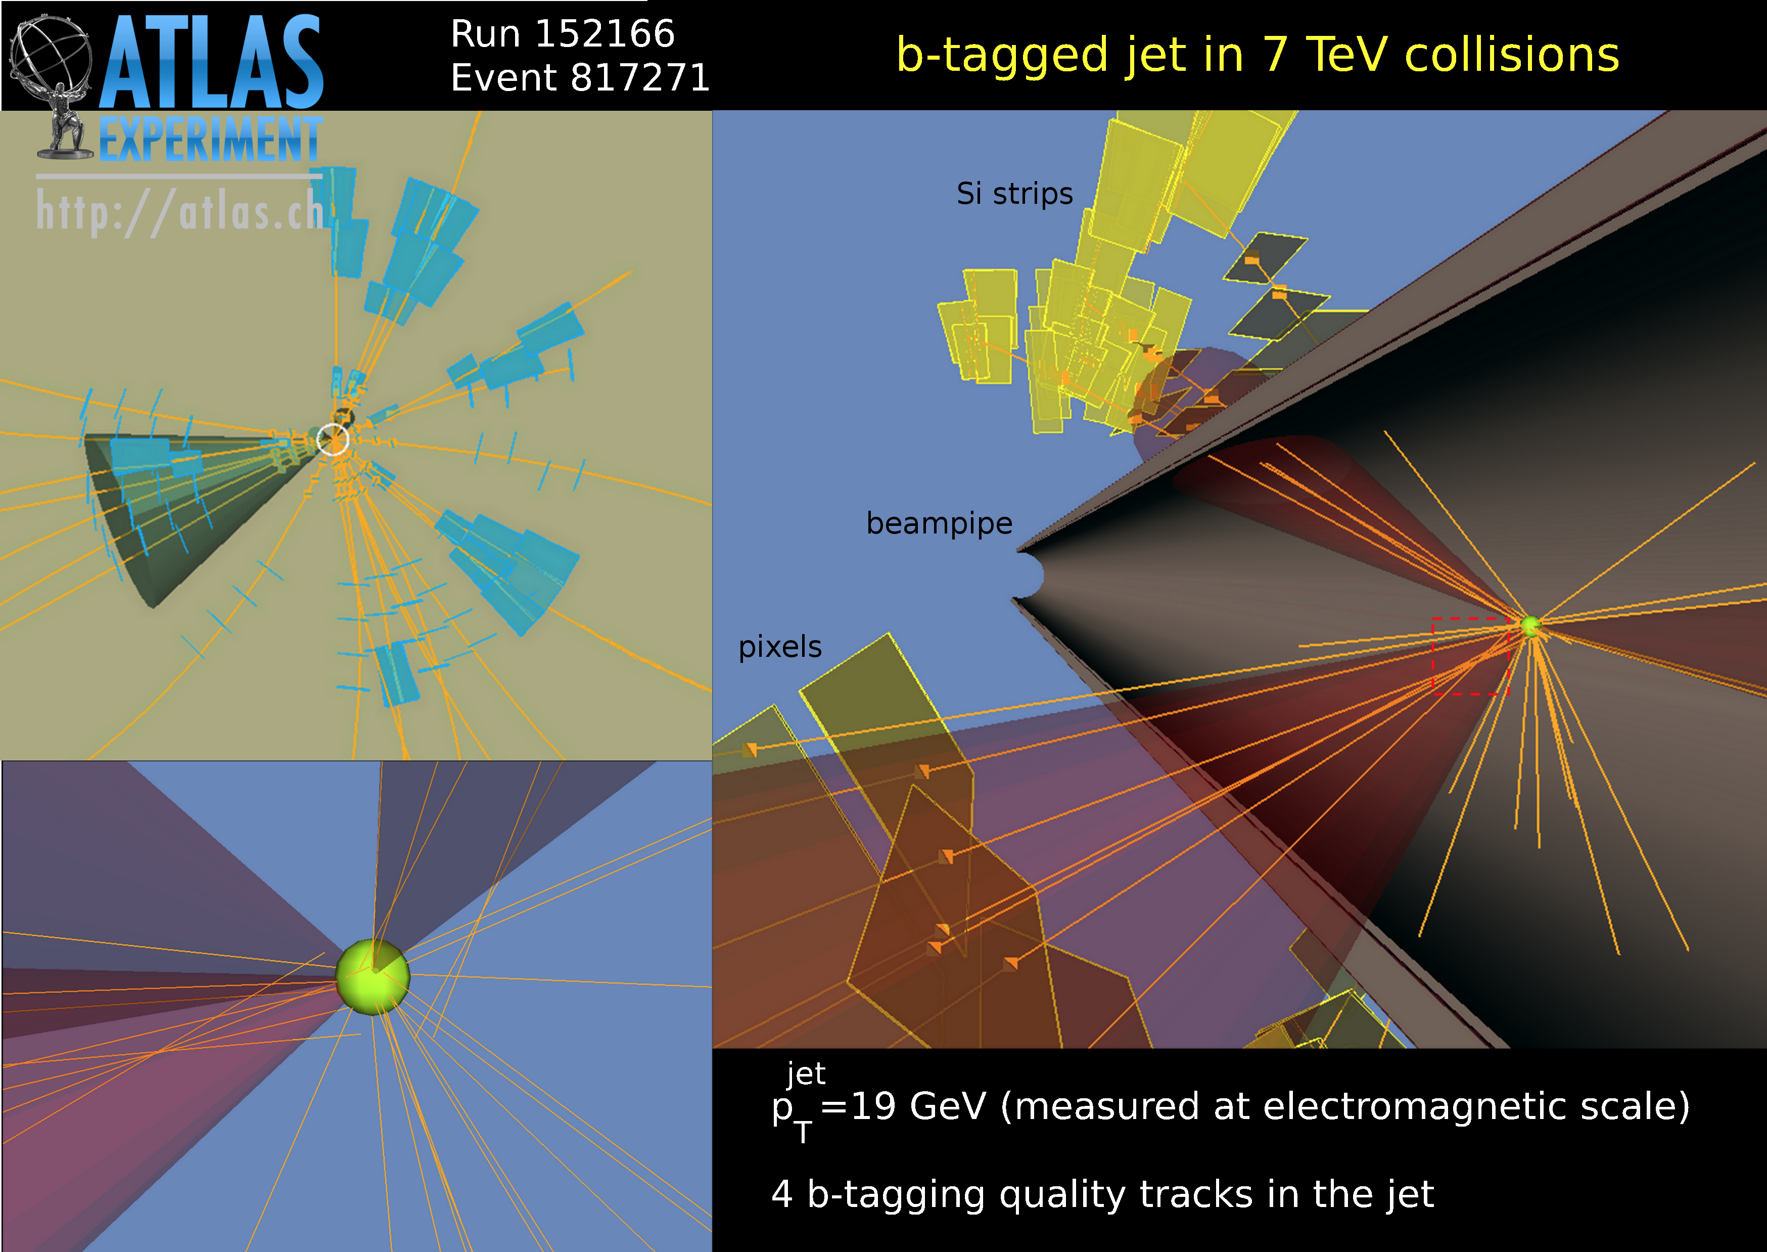
If you are impatient: trick 1
Production of b-quarks is less frequent than lighter quarks
→ Identify the bound state particle (“B-hadron”) it has formed using the B-hadron life time
q
b
q
q
q
q
q
q
q
q
pp-collision
25mm
q
q
q
q
q
q
b
q
B-hadron decay

Slide 22
If you are impatient: trick 1
Production of b-quarks is less frequent than lighter quarks
→ Identify the bound state particle (“B-hadron”) it has formed using the B-hadron life time
pp-collision
q
b
q
q
q
q
q
q
q
q
q
q
q
q
q
q
B-hadron decay
b
q

Slide 23
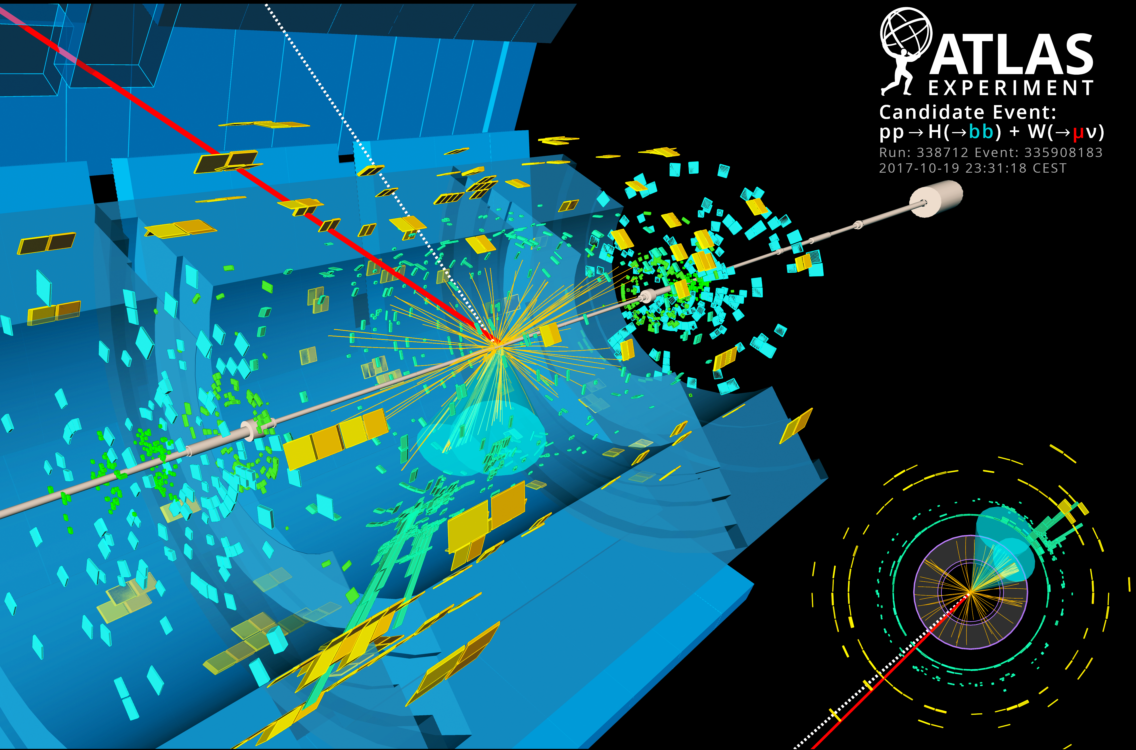

If you are impatient: trick 2
We know Higgs decays to W/Z-bosons and those bosons decay to leptons (electrons, muons, neutrinos)
Leptons are very rare in proton-proton collisions
Search for Higgs produced in association with a W or Z
W
W
Higgs
rotate
W
W
Higgs

Slide 24
If you are impatient: trick 3
Expected mass and kinematic properties of Higgs known
→ Make use of all information and correlations amongst them with machine learning
angular distance b b
mass
Machine learning
Higgs momentum
angular distance H W

Slide 25
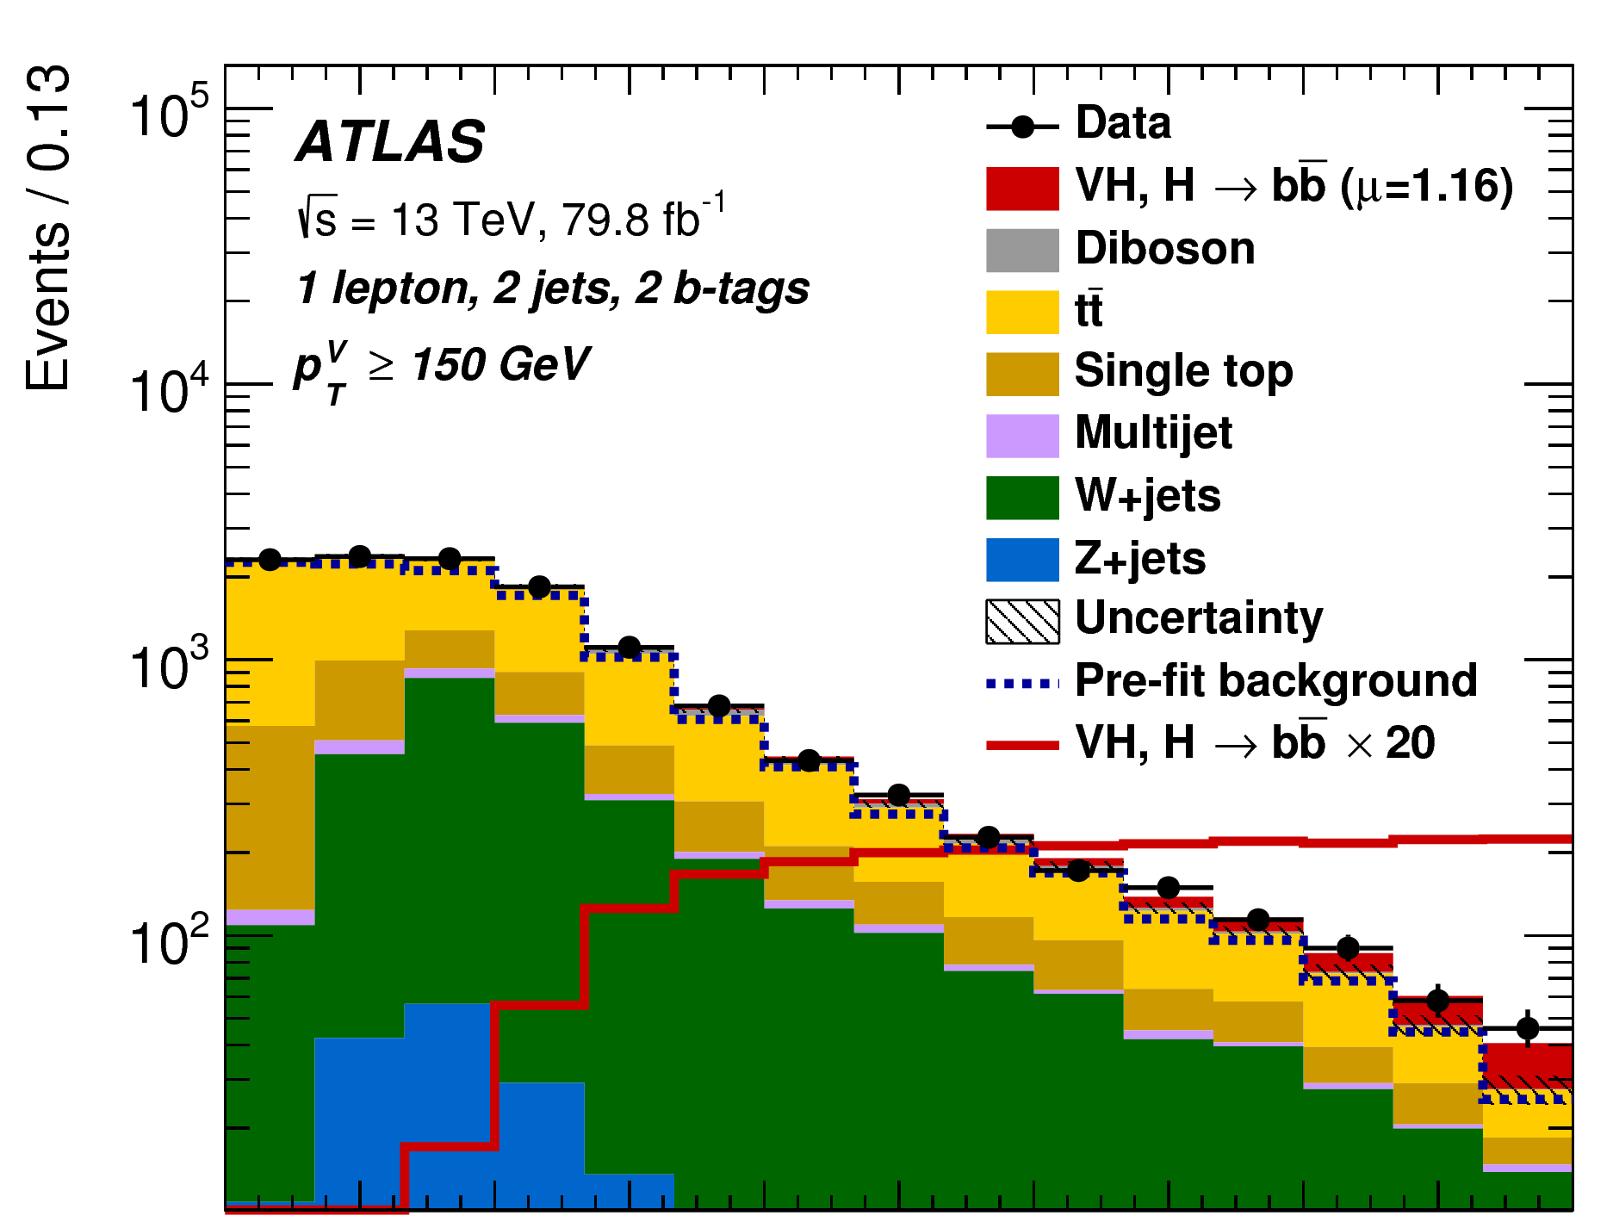
If you are impatient: trick 3
Expected mass and kinematic properties of Higgs known
→ Make use of all information and correlations amongst them with machine learning
Expected WH,H→bb
Data
angular distance b b
Expected backgrounds
mass
Machine learning
Higgs momentum
0
0.5
1
Signal probability
angular distance H W

Slide 26
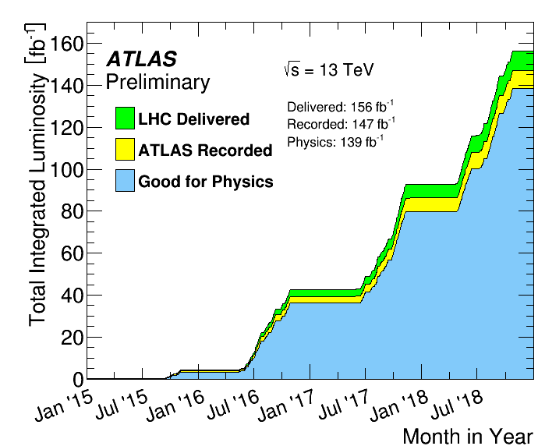
May 2018…
2017 data taking significantly increased data set
Can we observe, i.e. significance>5𝝈, H→bb decays now?
Let’s work hard and try!
Size of data set

Slide 27
May 2018…
2017 data taking significantly increased data set
Can we observe, i.e. significance>5𝝈, H→bb decays now?
Let’s work hard and try!
Size of data set
Extrapolation
Significance
*
VH(bb) Measurements
*from an earlier data taking period
Size of data set

Slide 28
May 2018…
2017 data taking significantly increased data set
Can we observe, i.e. significance>5𝝈, H→bb decays now?
Let’s work hard and try!
?
Size of data set
Extrapolation
Significance
VH(bb) Measurements
Size of data set

Slide 29
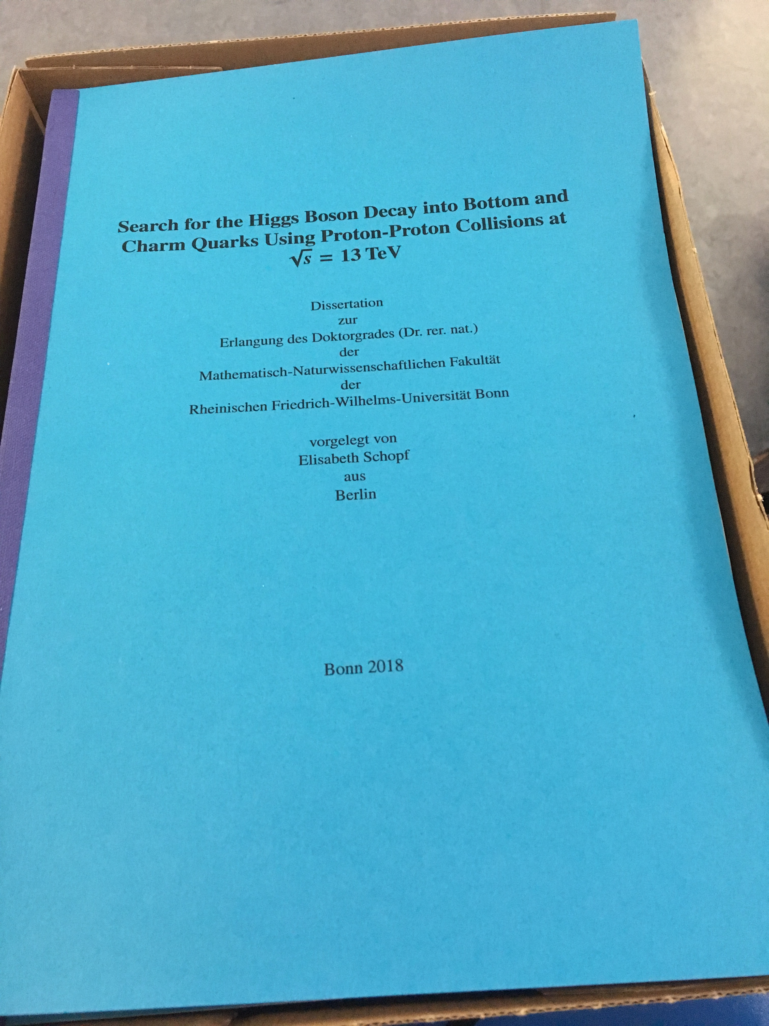
May 2018…
2017 data taking significantly increased data set
Can we observe, i.e. significance>5𝝈, H→bb decays now?
Let’s work hard and try!
?
Size of data set
Extrapolation
Significance
VH(bb) Measurements
…I had also just finished my PhD and started my Postdoc in Oxford
Size of data set

Slide 30
What I thought I would be doing…

Slide 31

What I thought I would be doing…

Slide 32

What I thought I would be doing…
…this is actually in Cambridge

Slide 33

What I thought I would be doing…

Slide 34

What I thought I would be doing…

Slide 35

What I thought I would be doing…

Slide 36
What I and many others were doing instead…

Slide 37
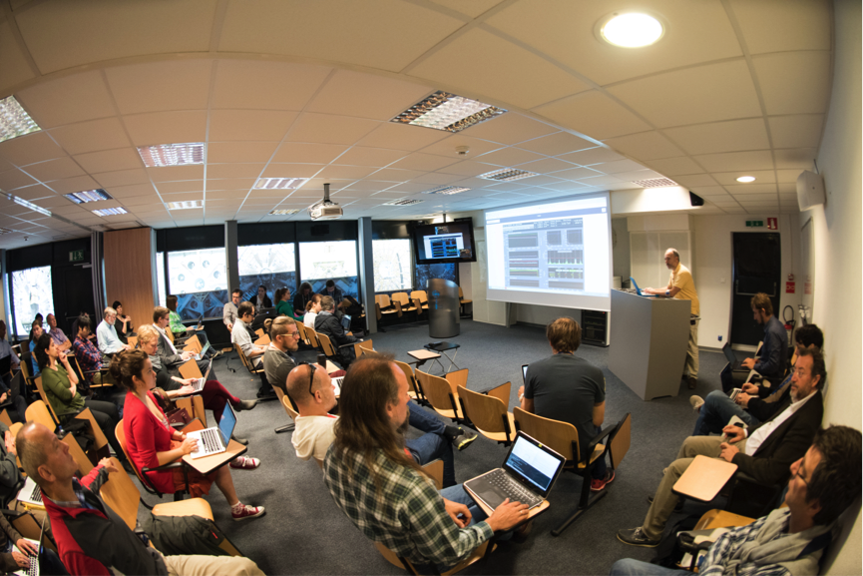
What I and many others were doing instead…

Slide 38
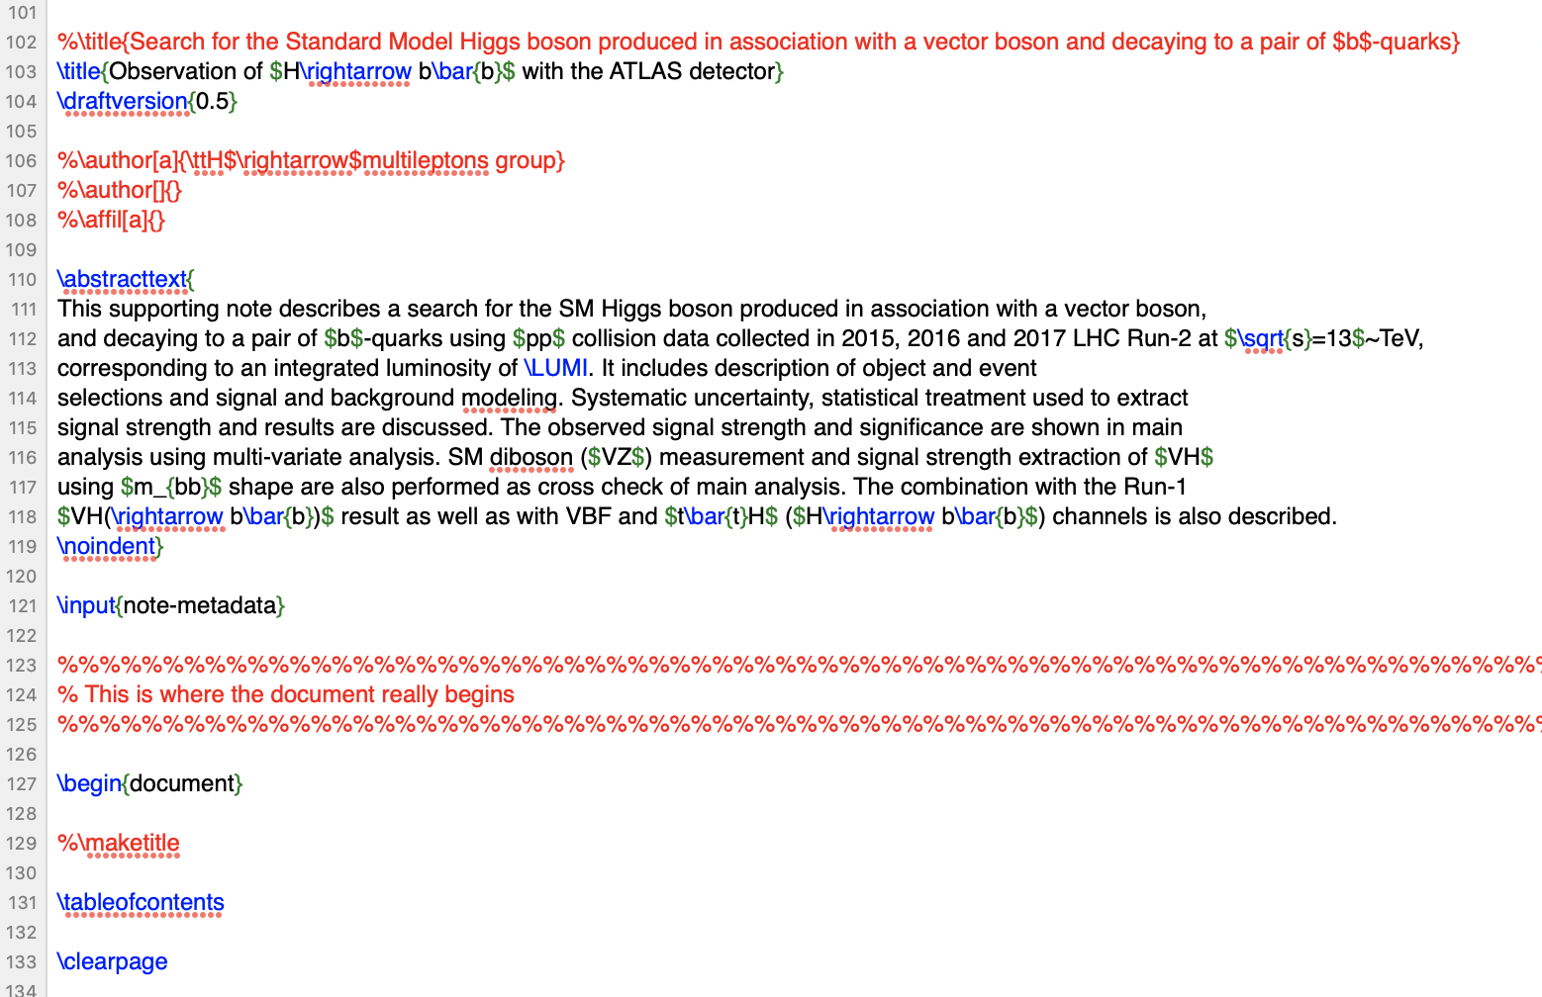
What I and many others were doing instead…

Slide 39
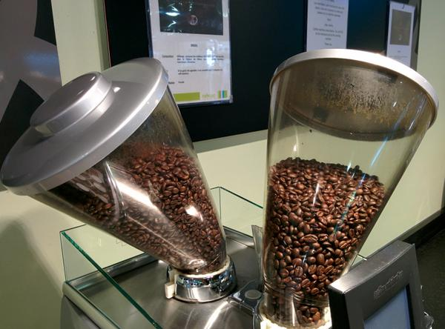

What I and many others were doing instead…

Slide 40

What I and many others were doing instead…

Slide 41
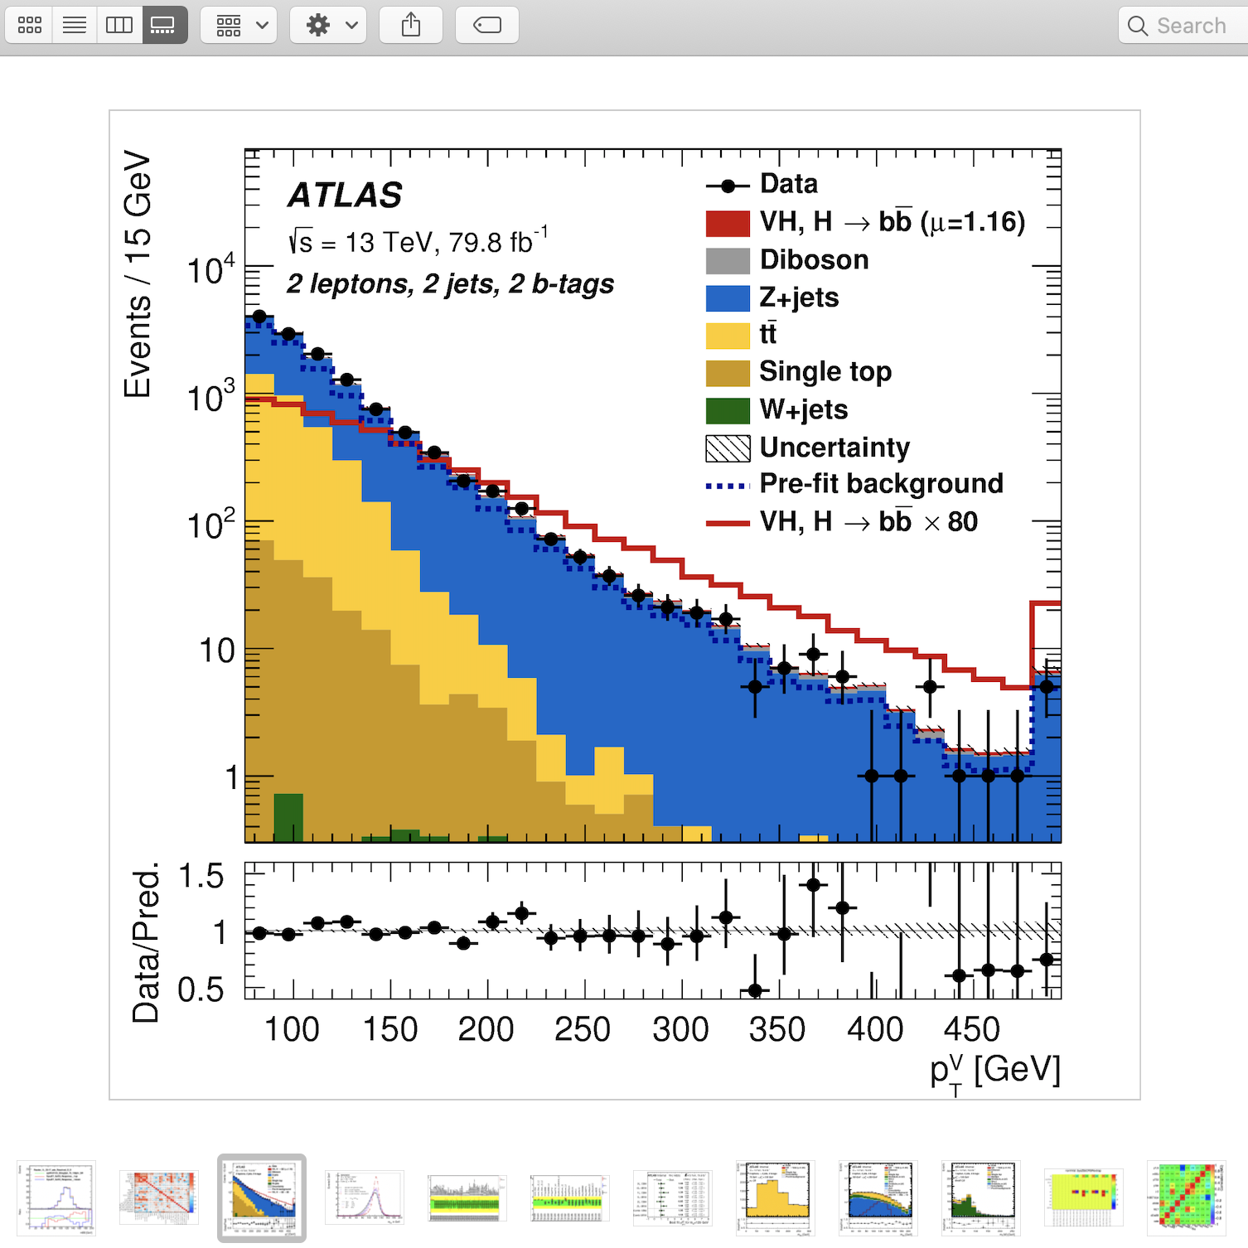
What I and many others were doing instead…

Slide 42
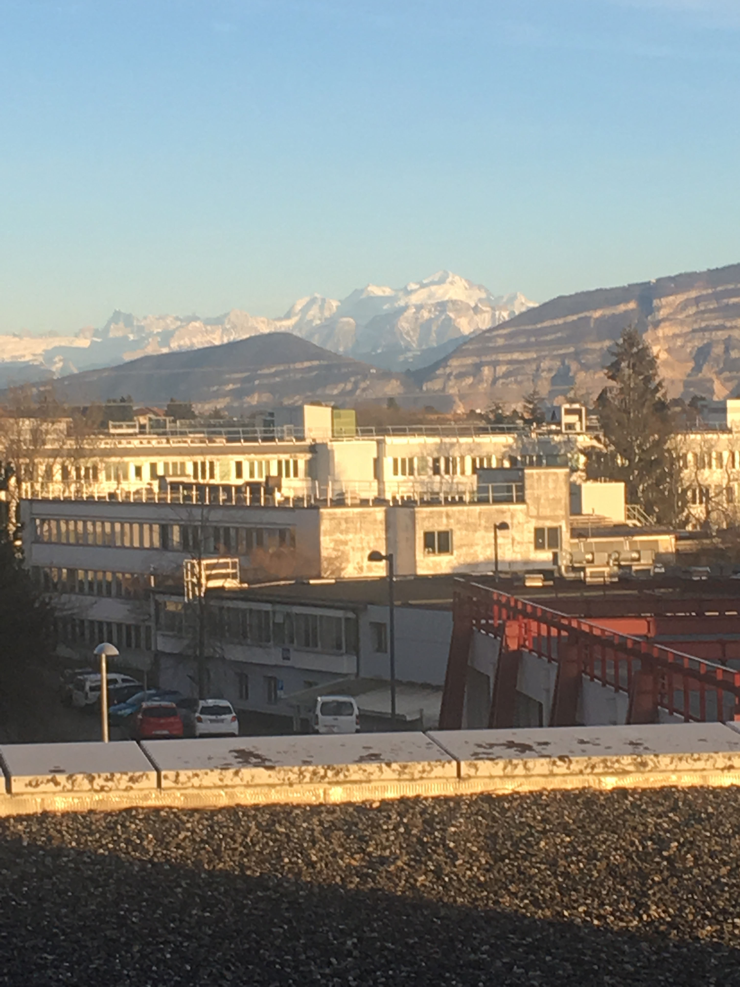
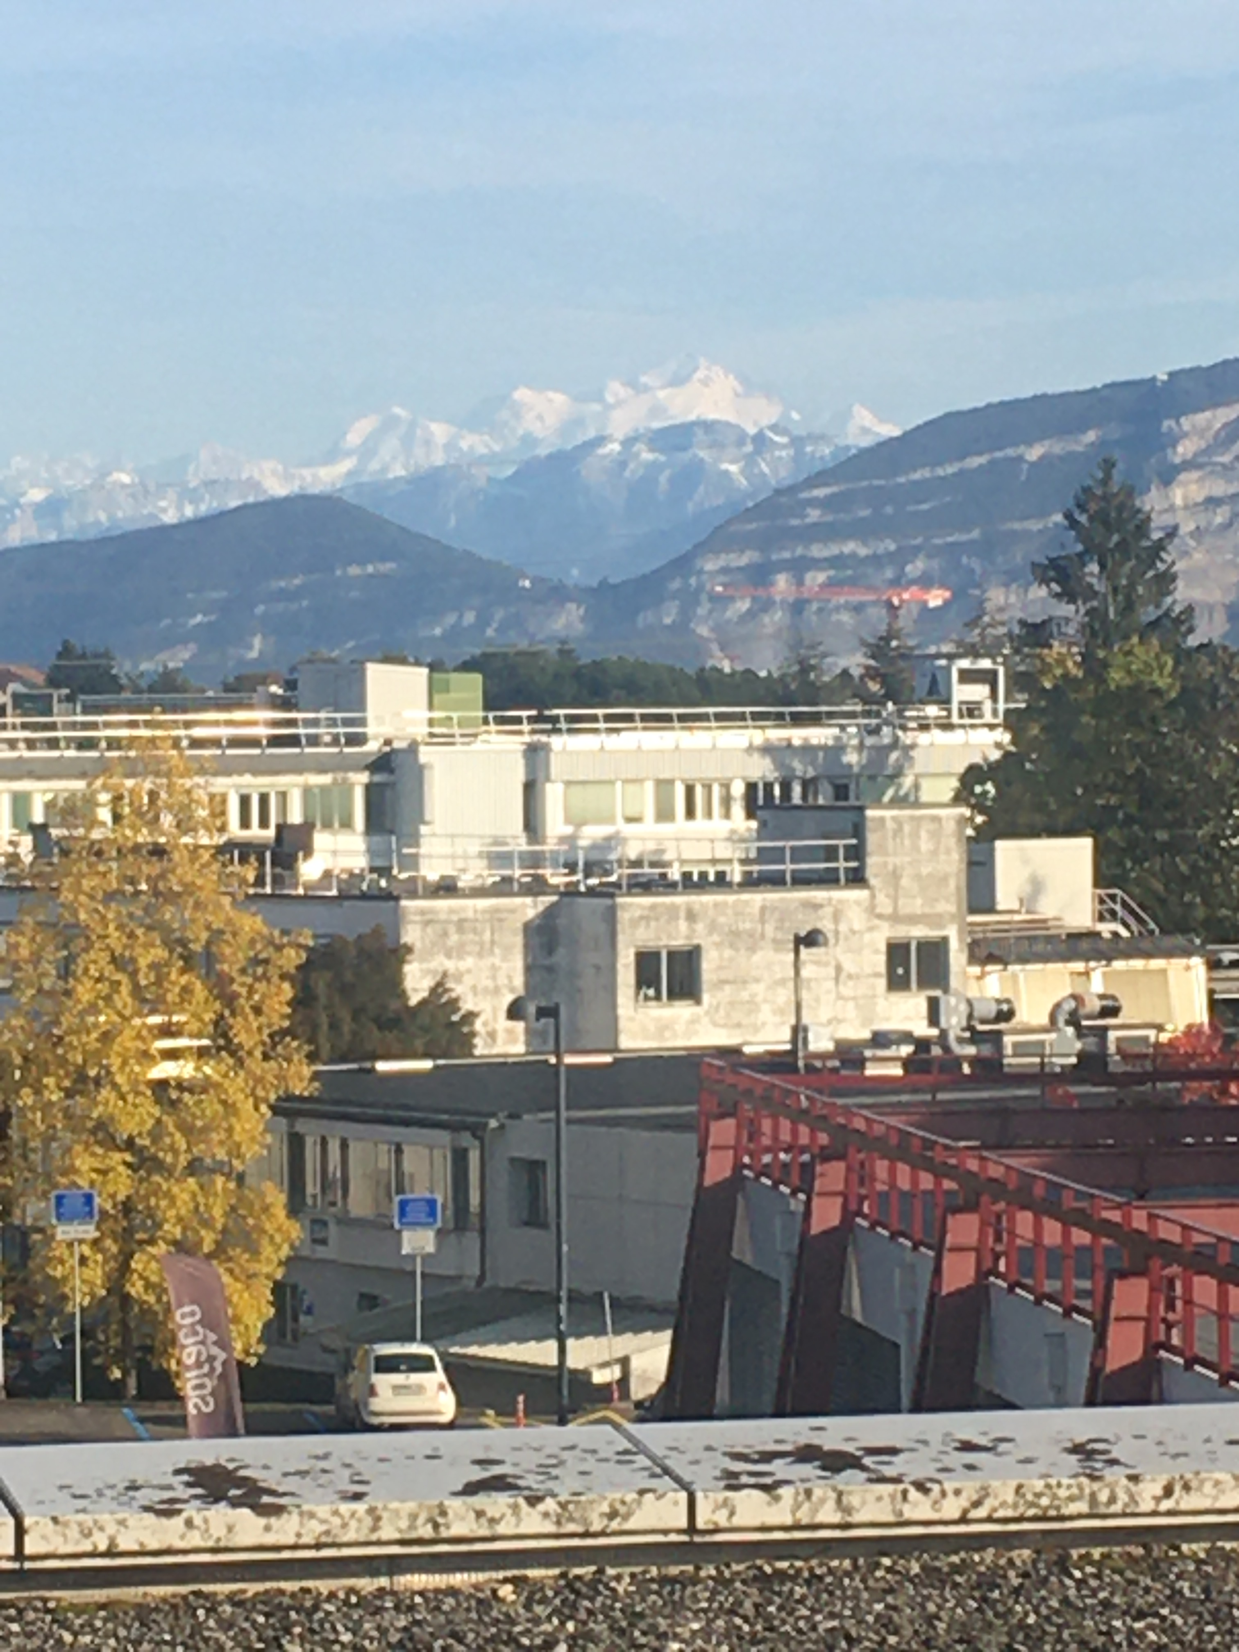
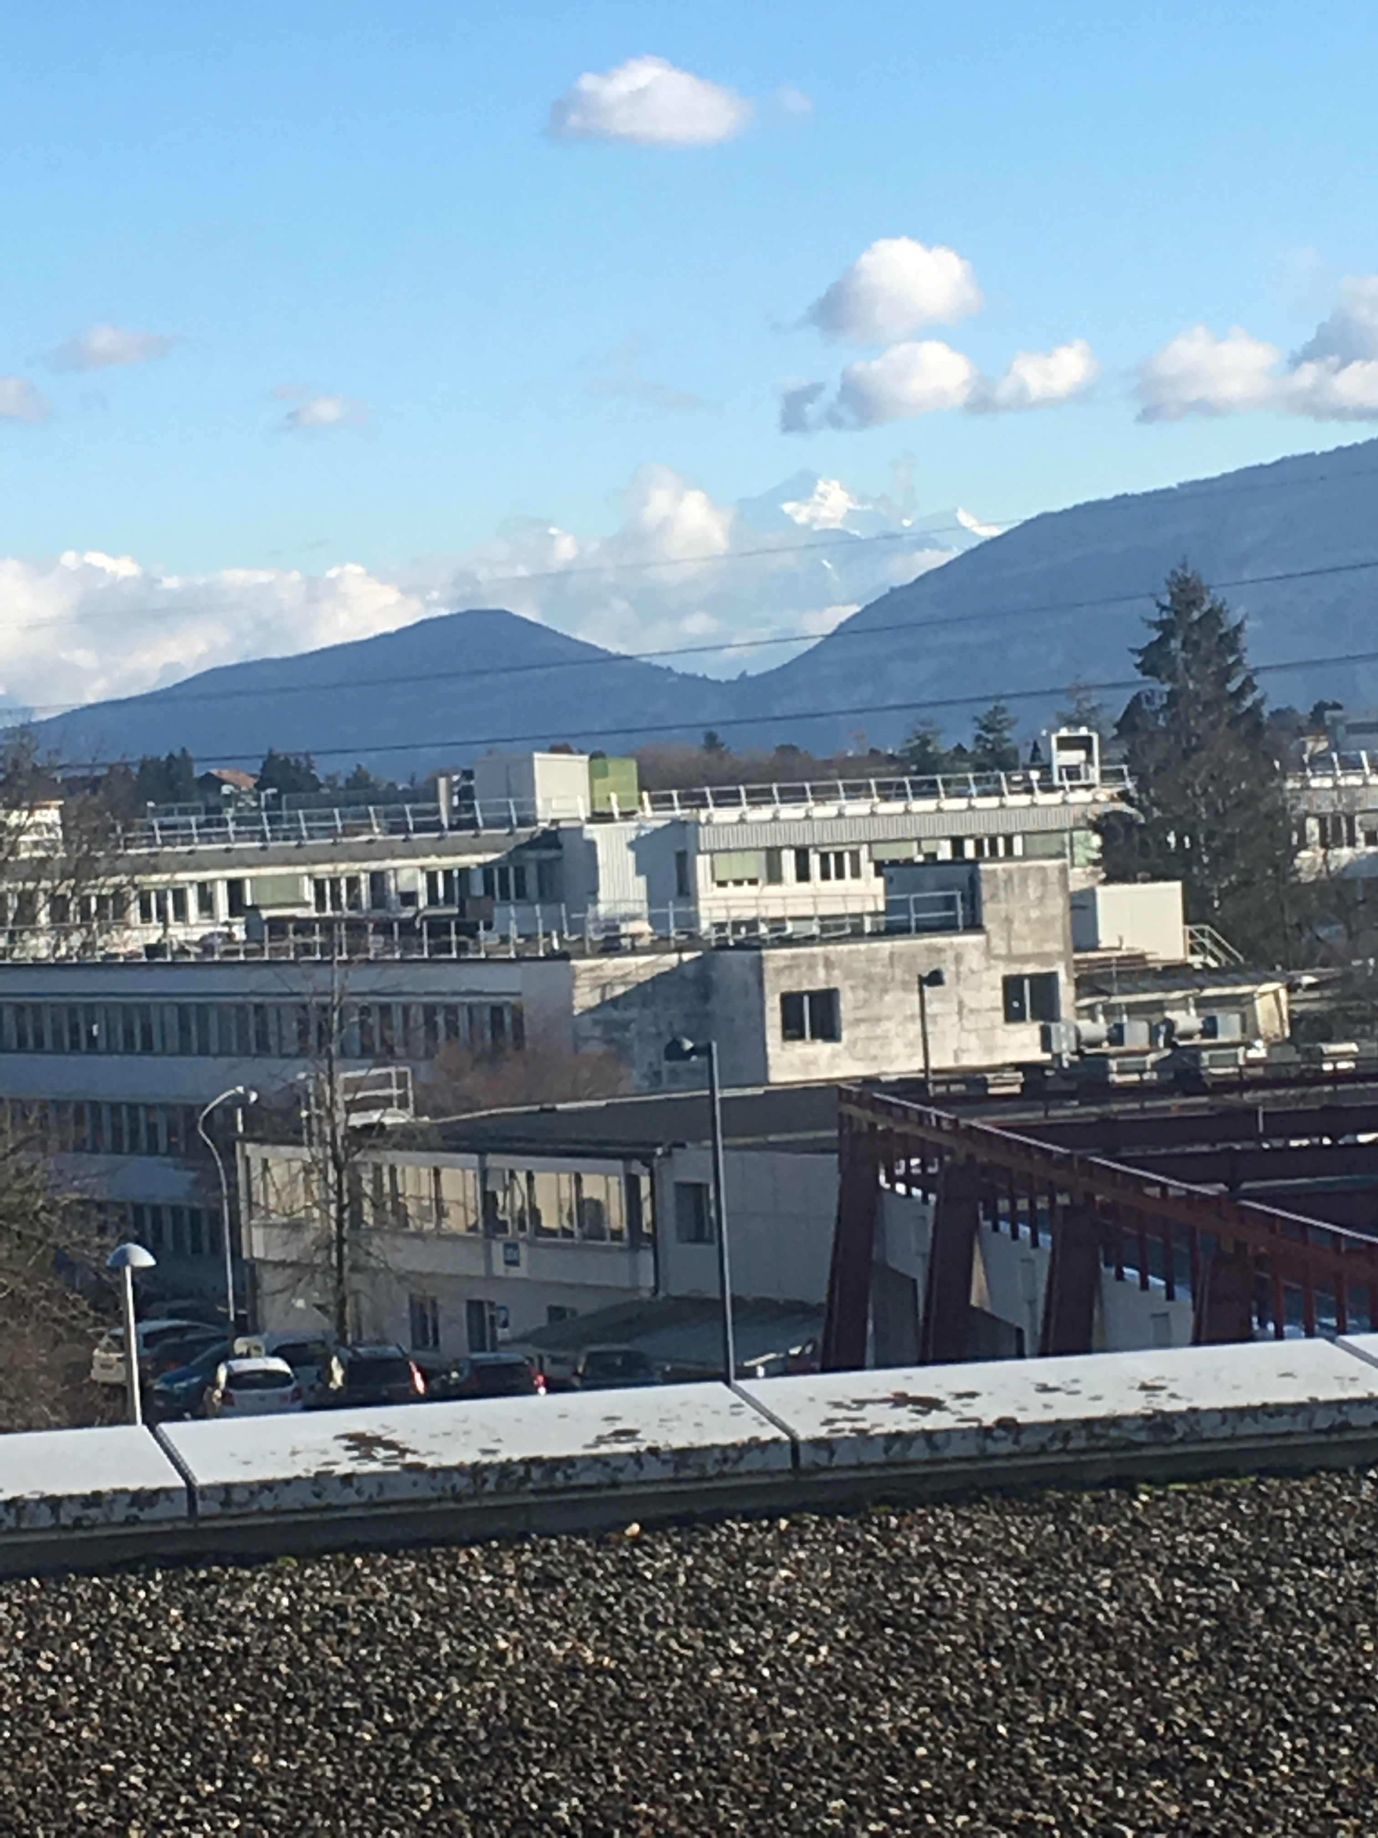


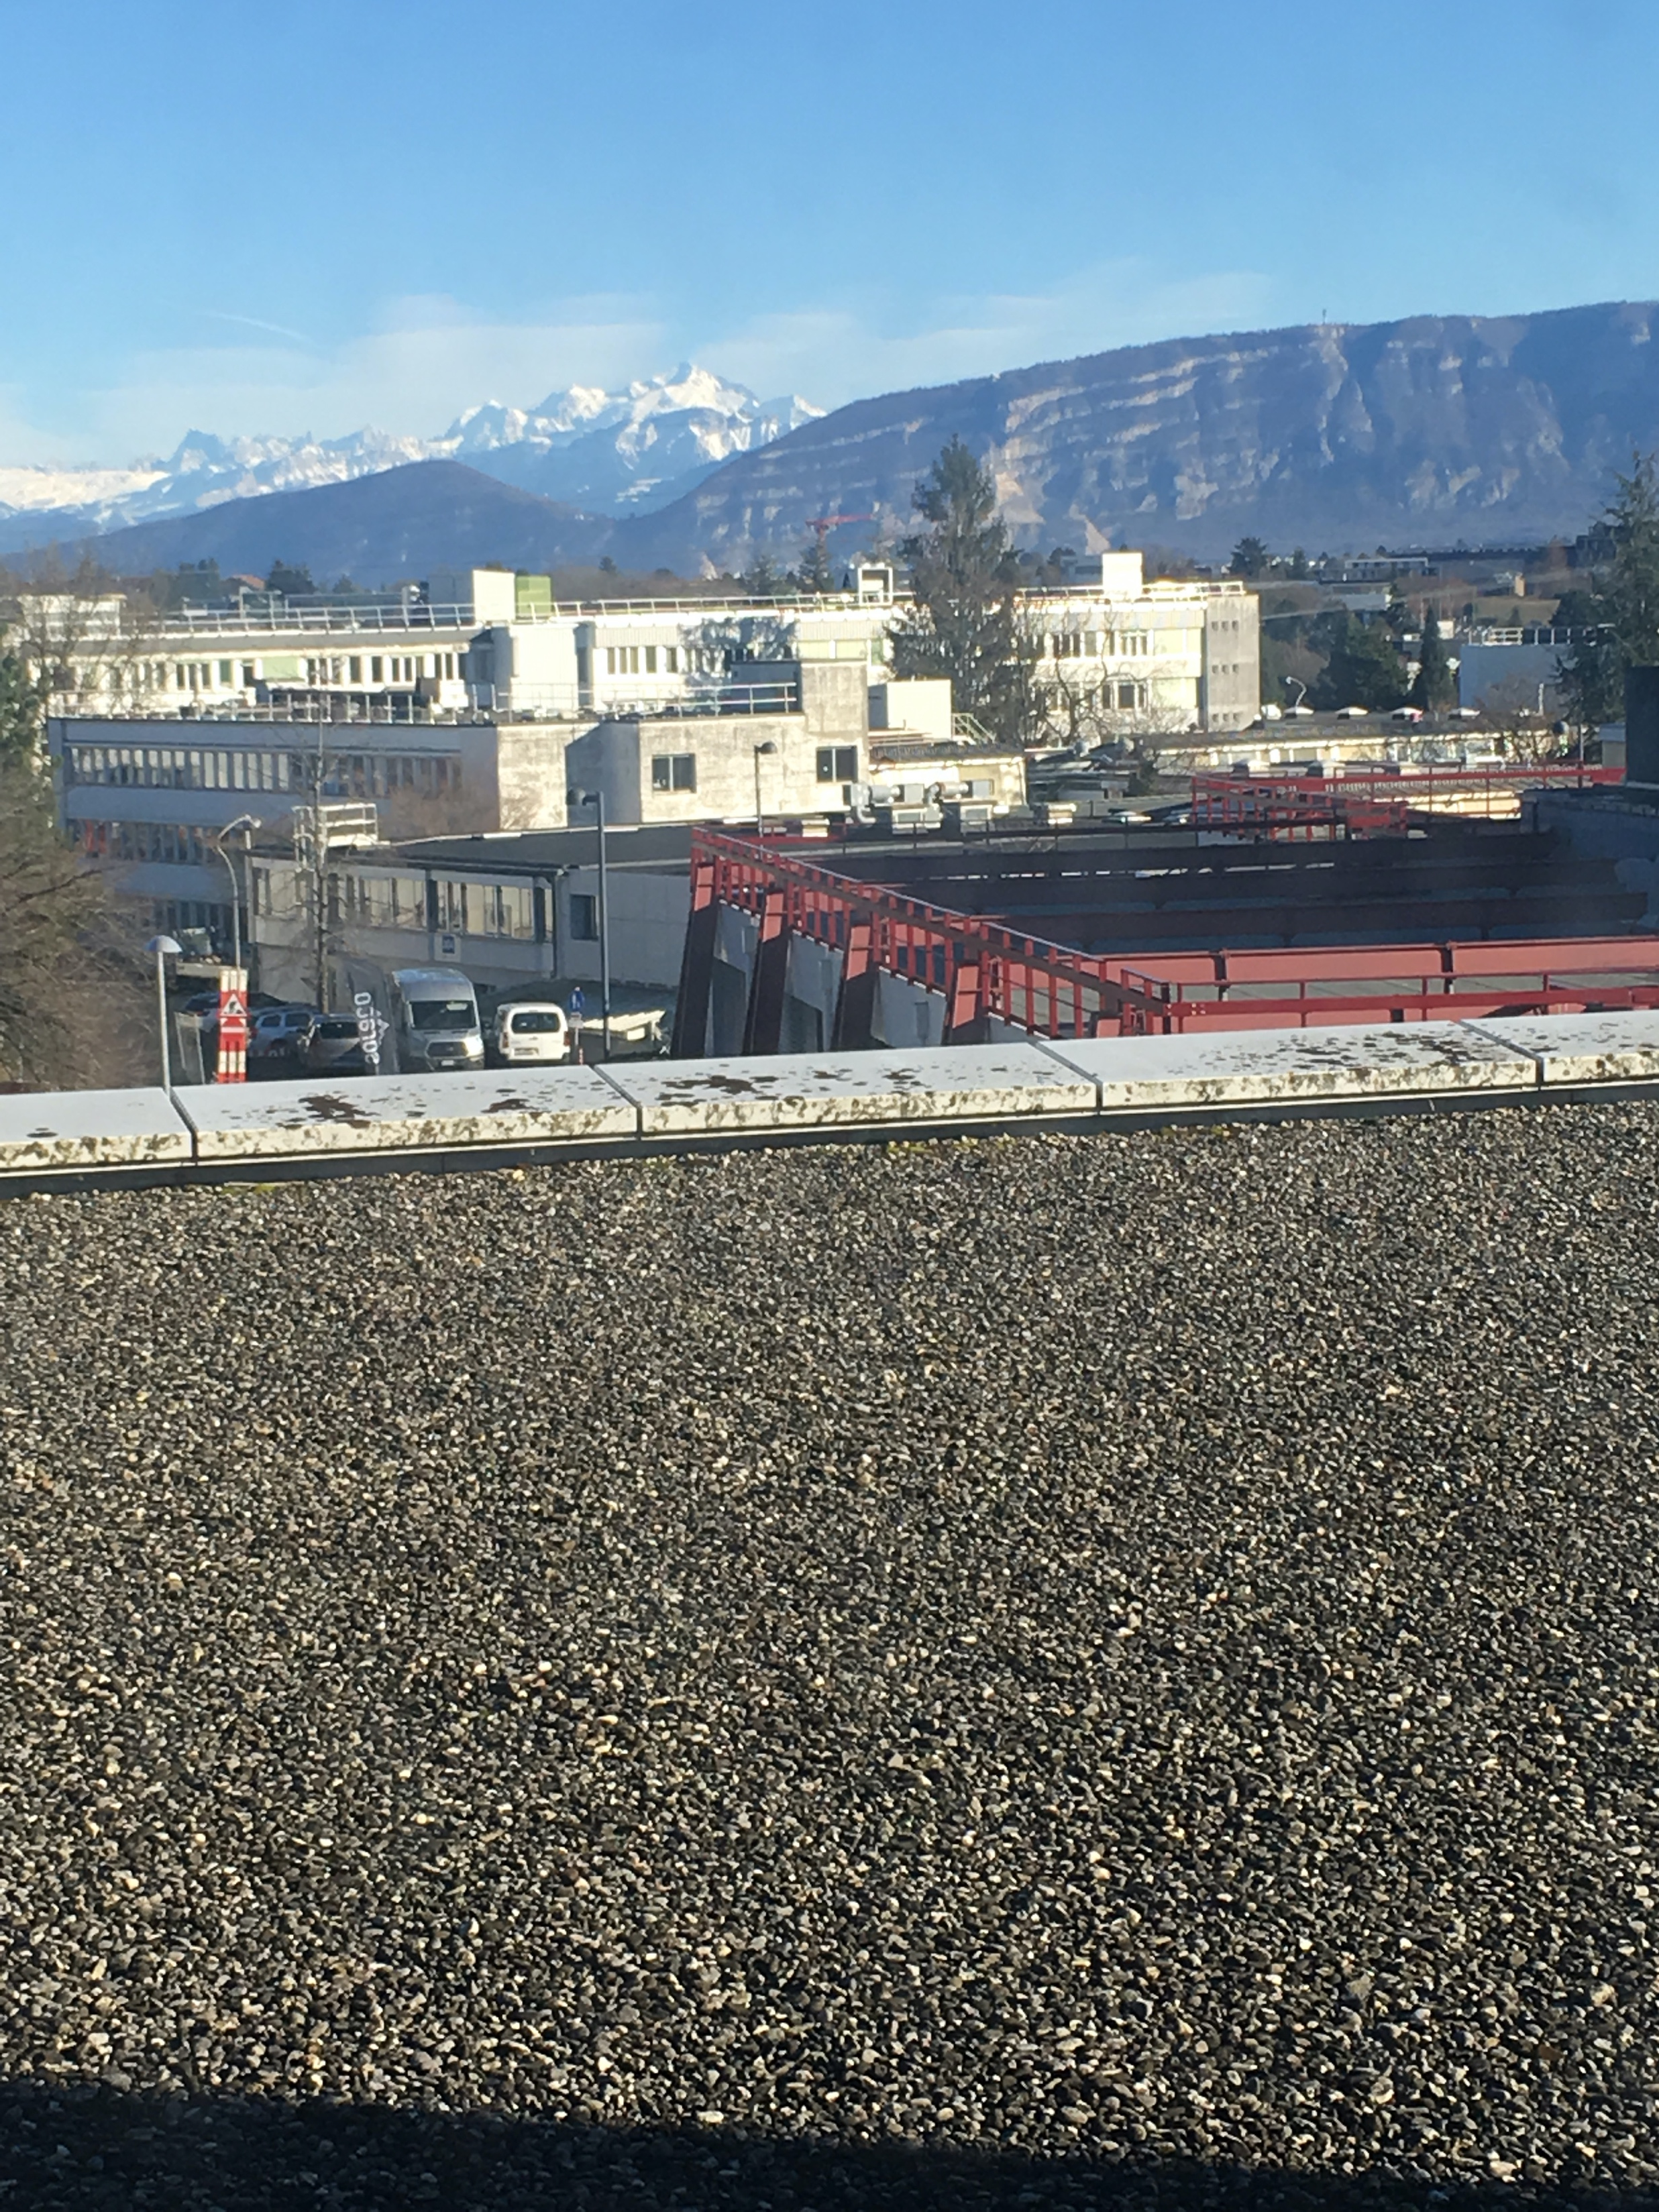


But CERN has offices with a view…
Seeing Mont Blanc during all phases of the day...

Slide 43
9th July 2018

Slide 44
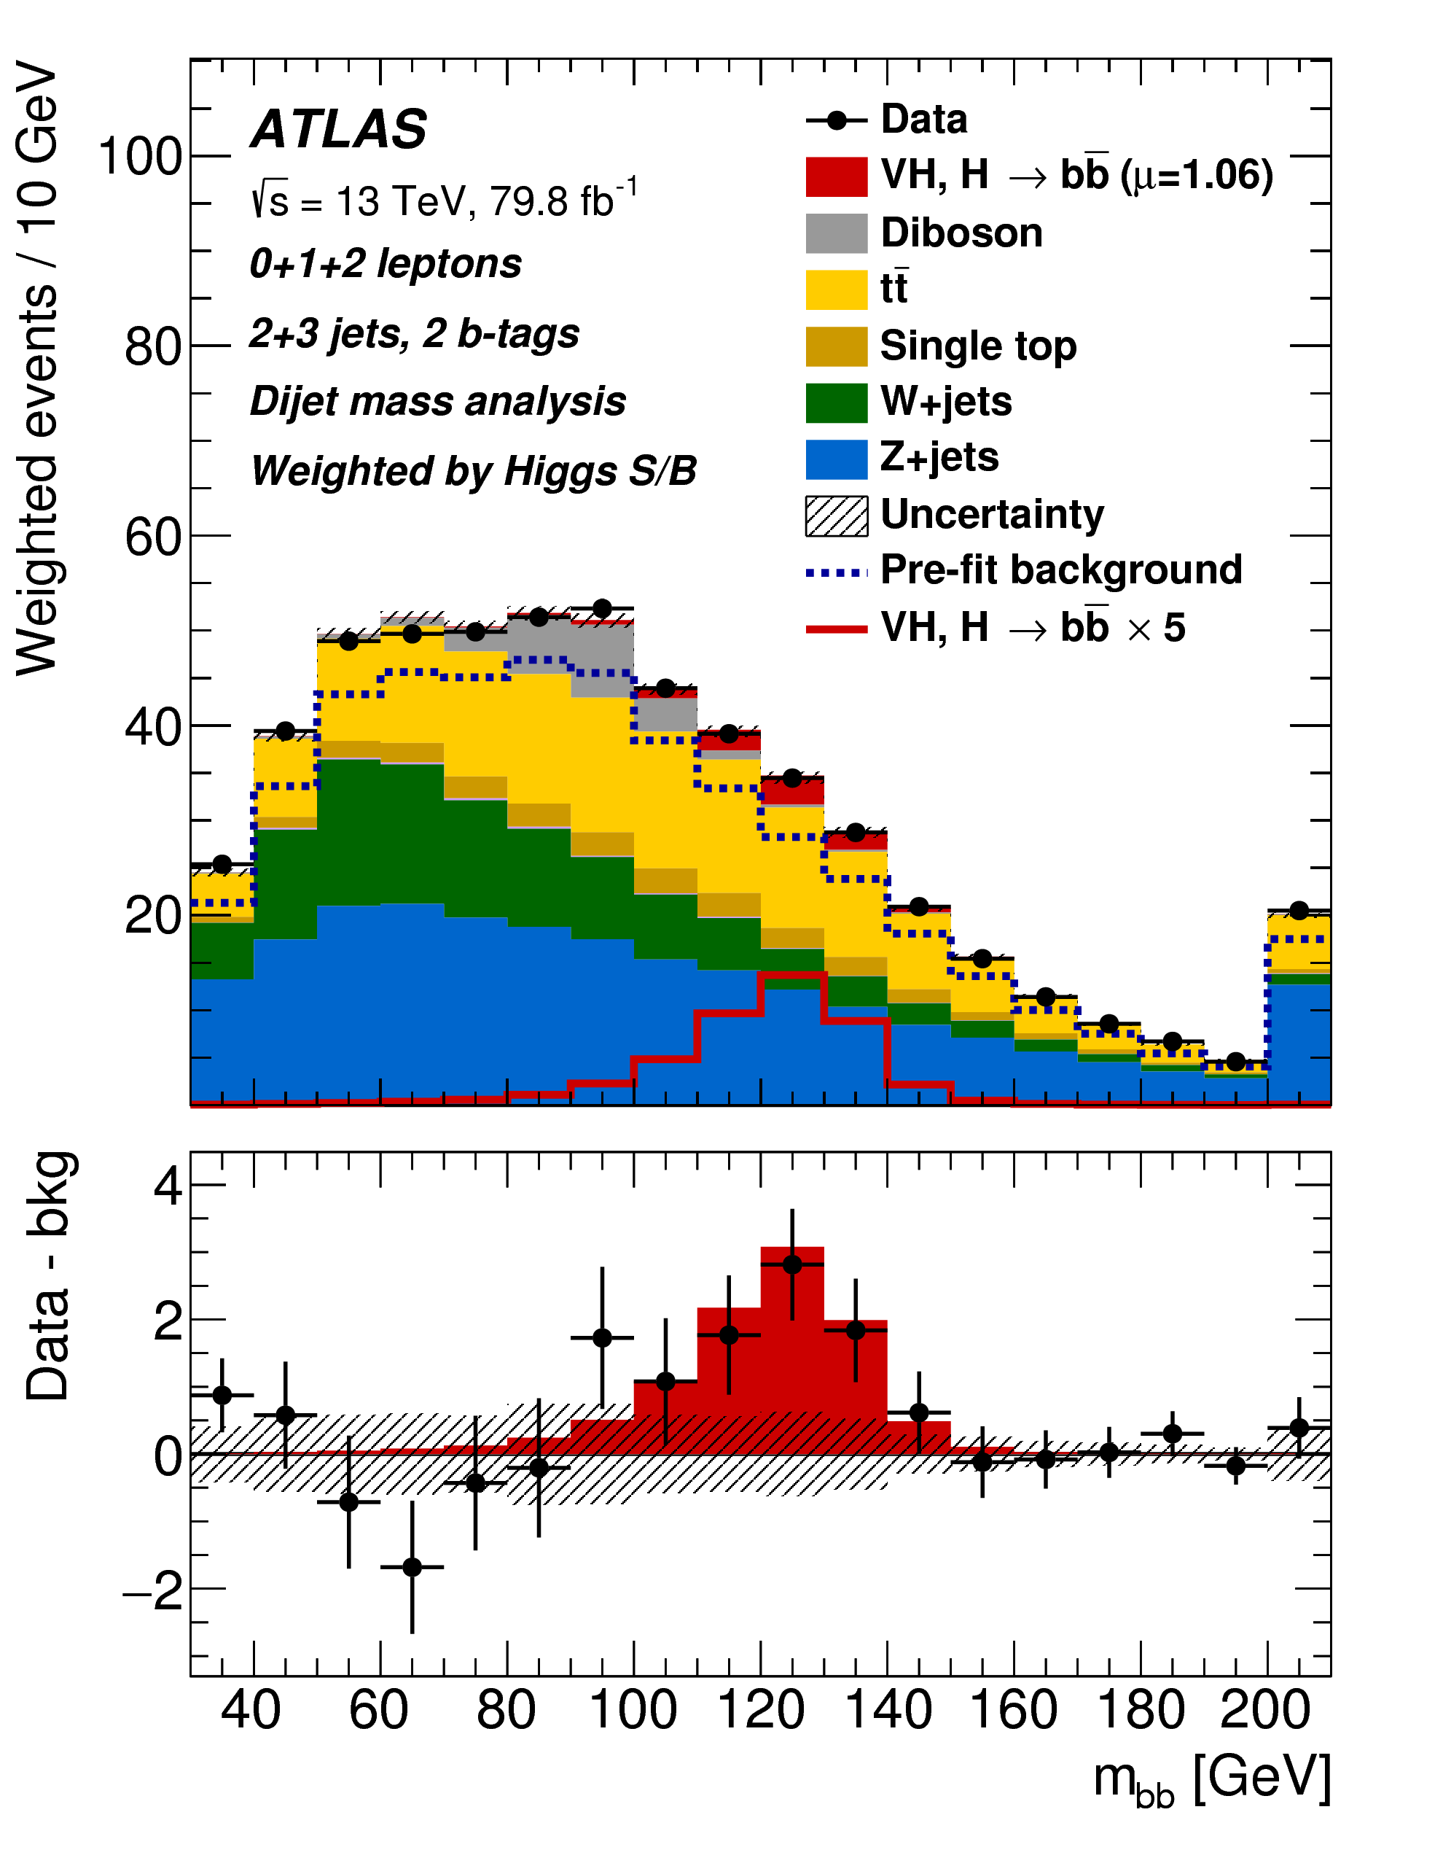
9th July 2018
First H→bb observation*!
*with the help of other non-WH/ZH H→bb measurements; WH+ZH standalone =4.9𝝈

Slide 45
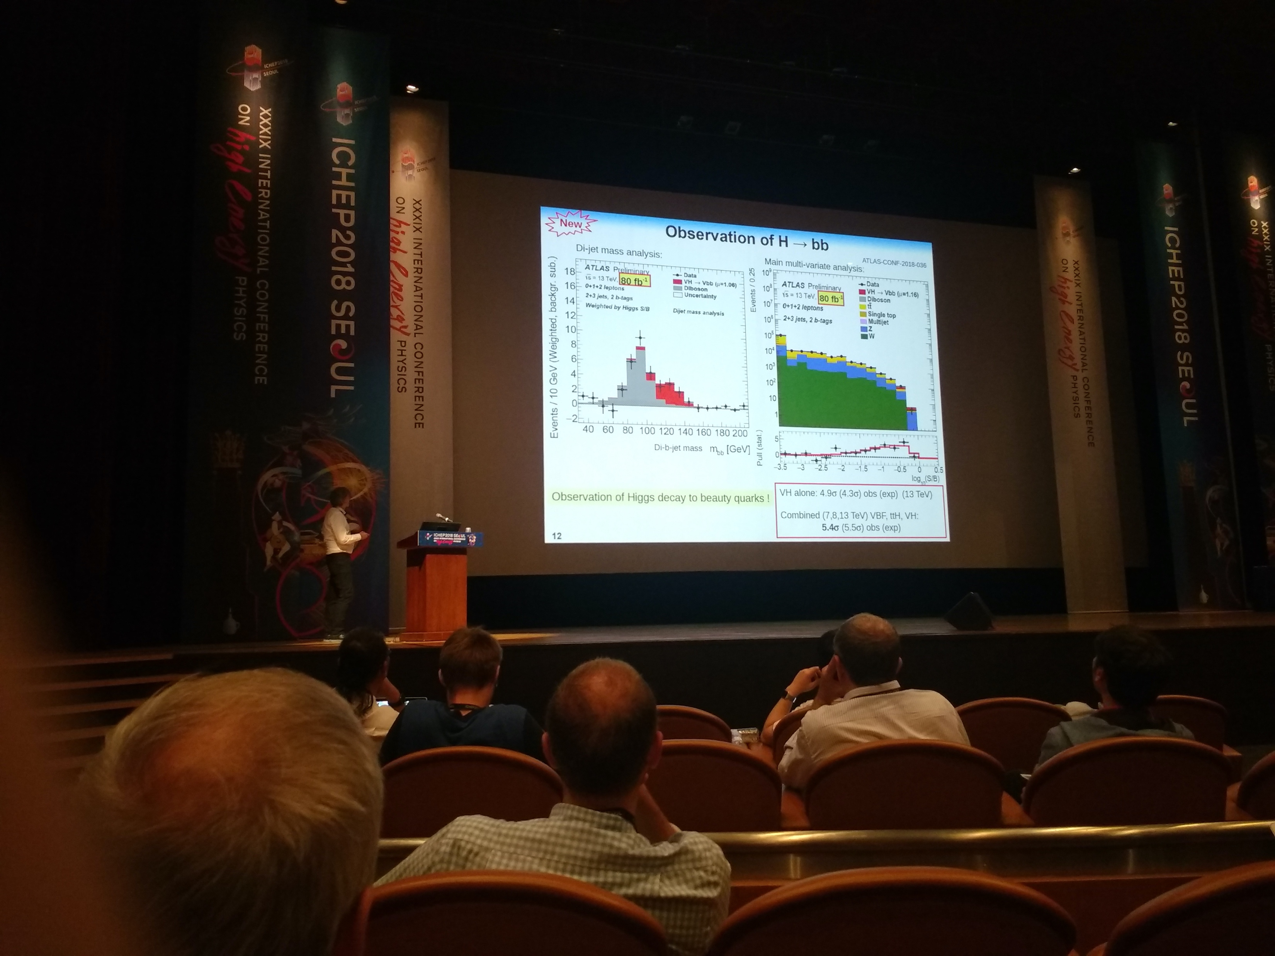
9th July 2018
First H→bb observation*!
Presented to audience of ~1000 particle physicists at ICHEP conference
*with the help of other non-WH/ZH H→bb measurements; WH+ZH standalone 4.9𝝈

Slide 46







The Oxford H→bb team: present, past and future

