Slide 1
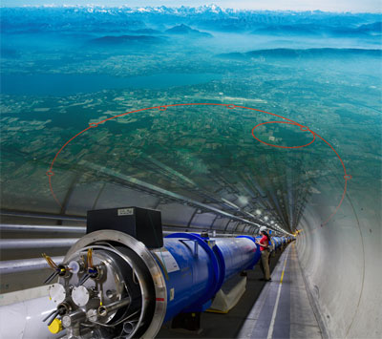
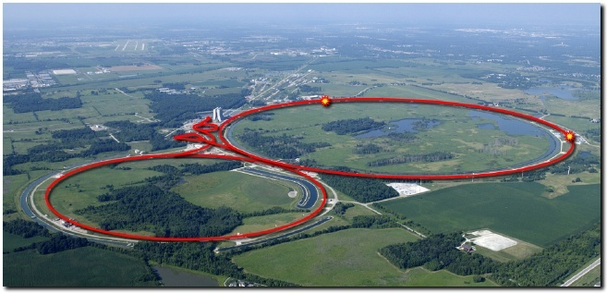
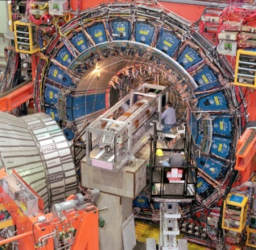
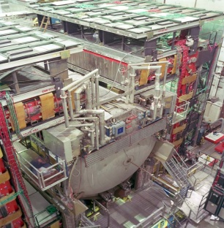
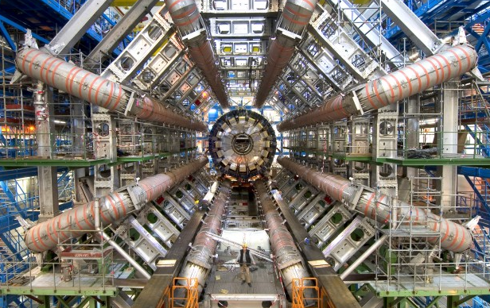
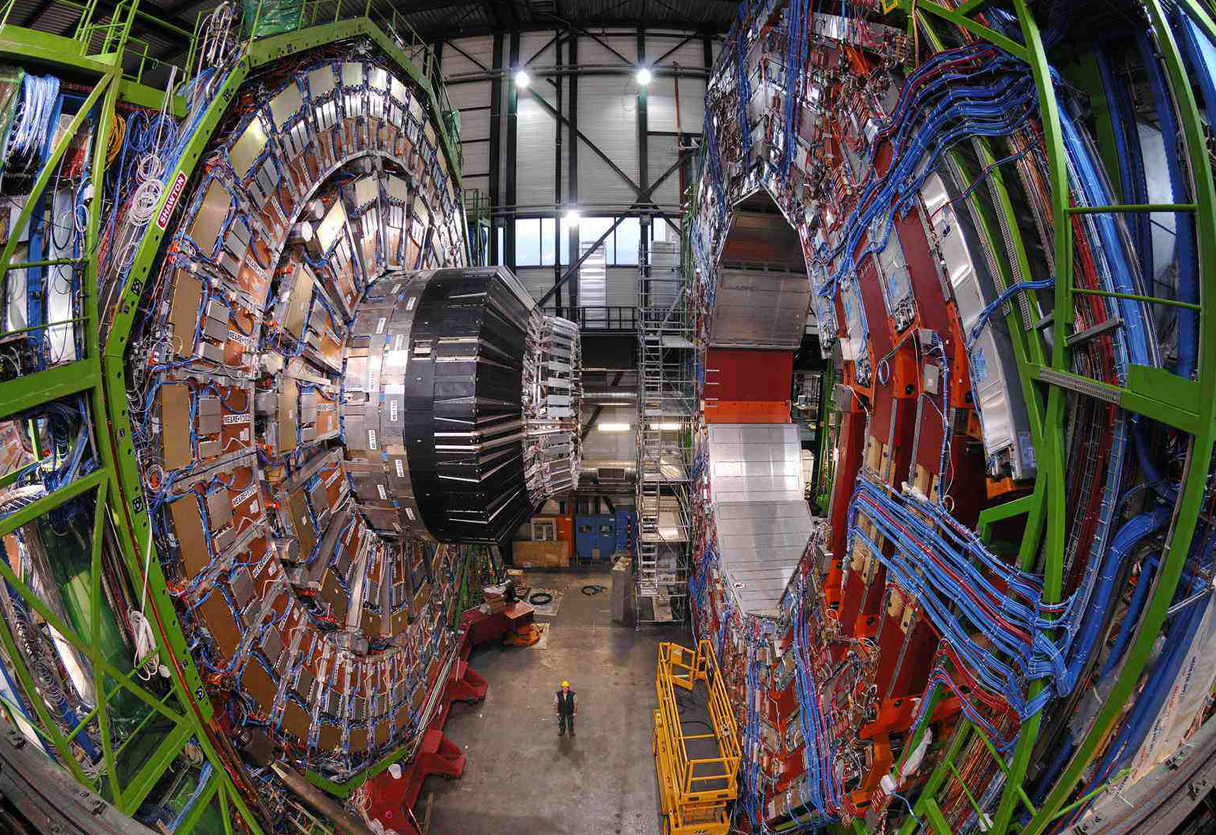

The Road to the Higgs discovery: from the Tevatron to the LHC
Daniela Bortoletto
University of Oxford
LHC at CERN
Tevatron in the US
CDF
D$∅$
ATLAS
CMS
CMS

Slide 2
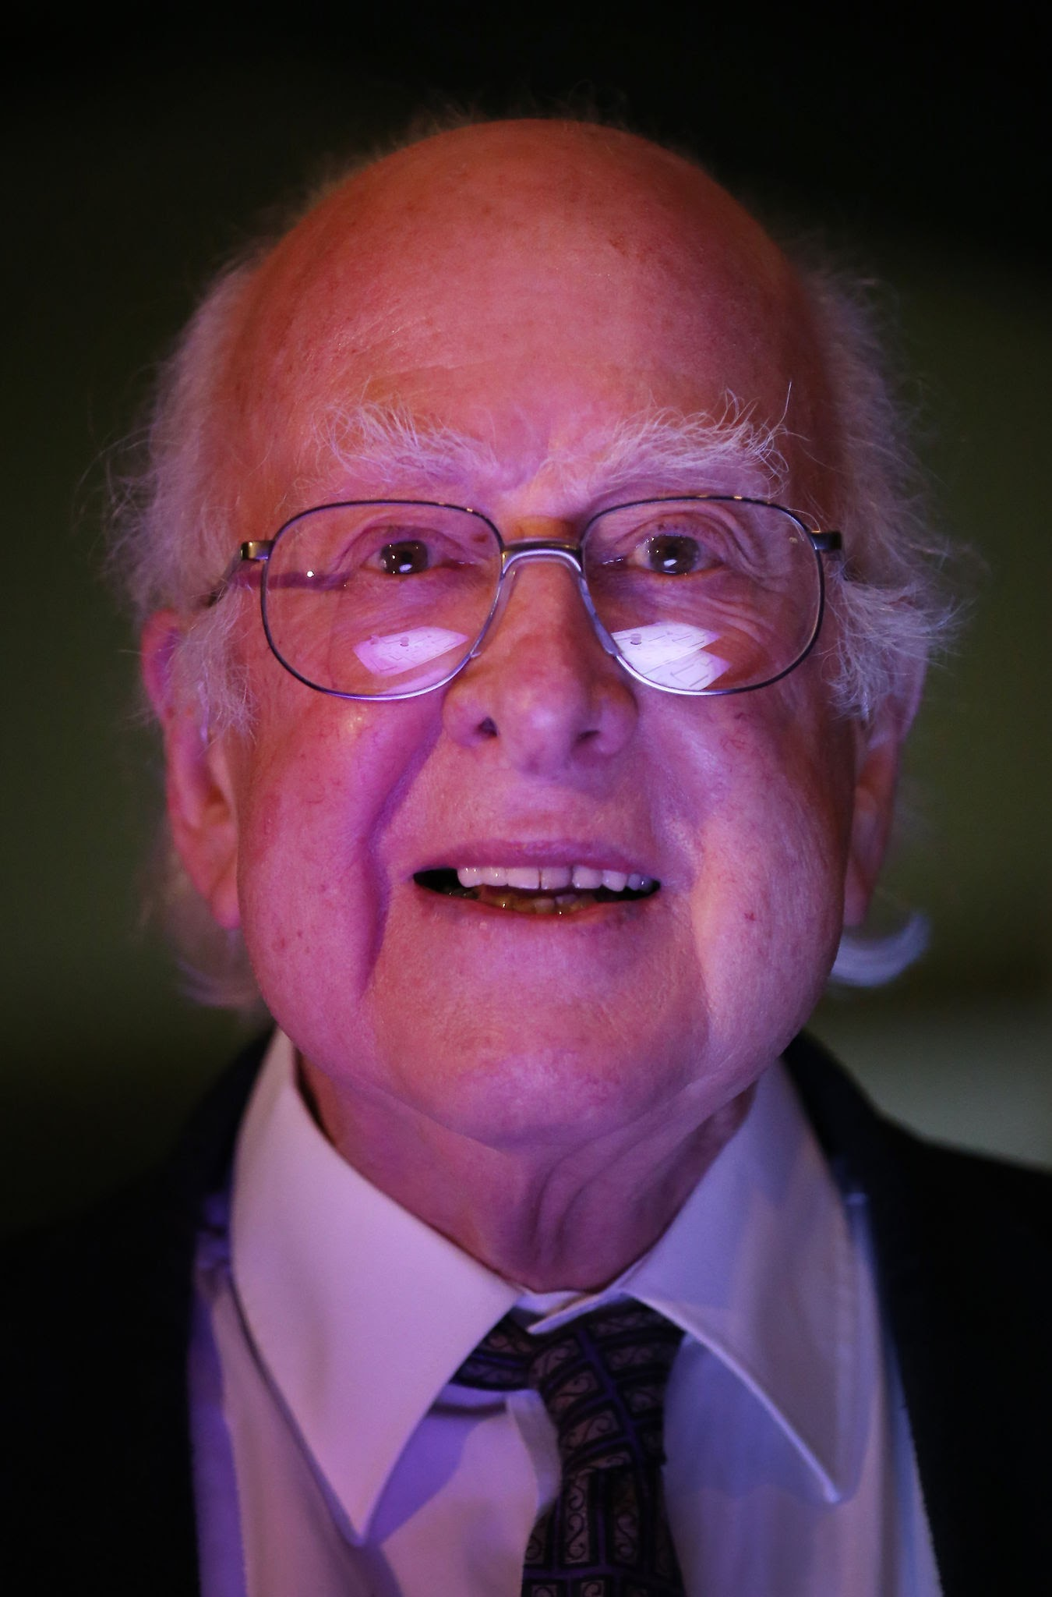

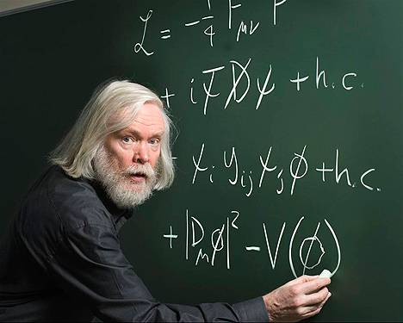
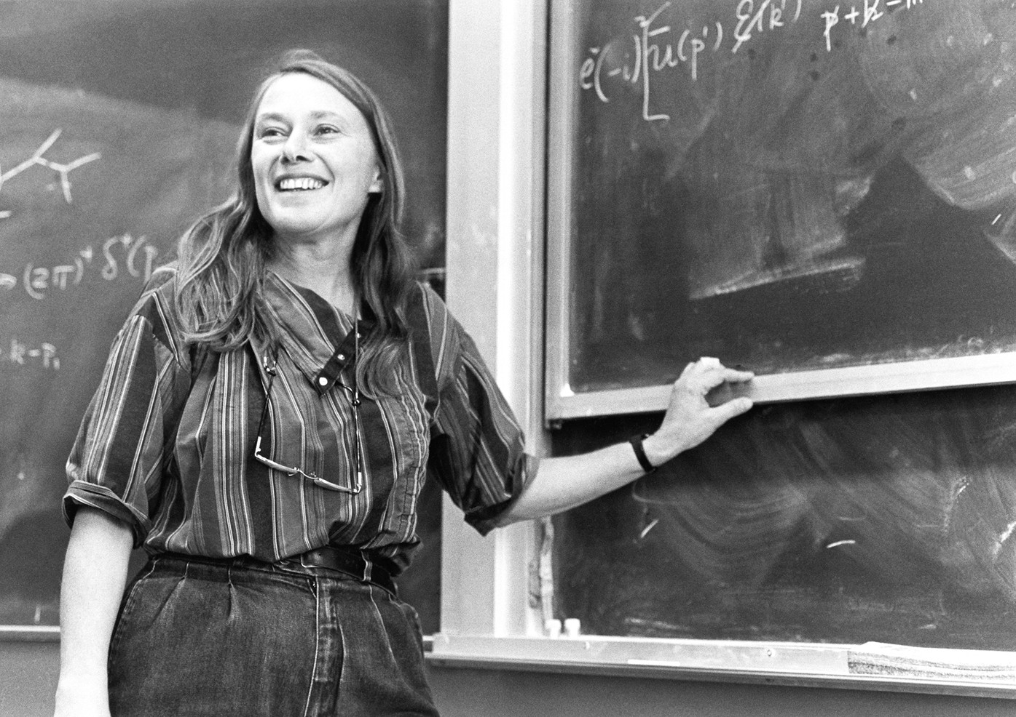
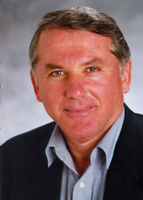
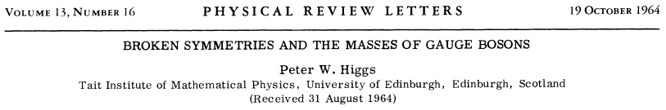
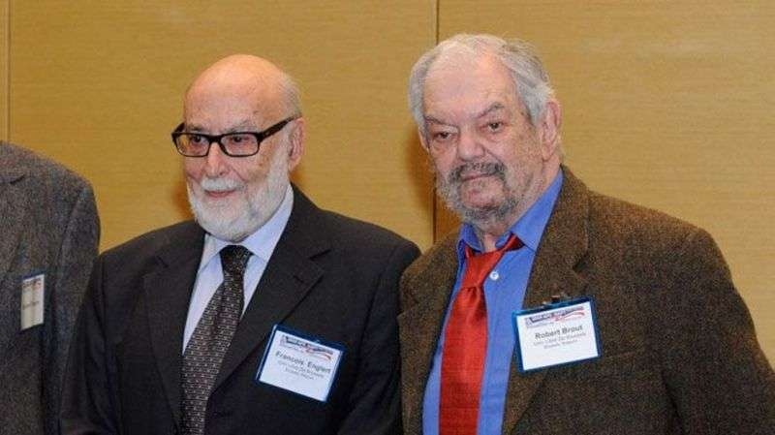

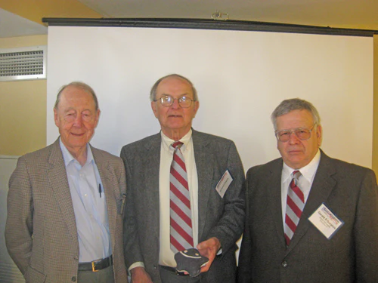

The beginning of the road
Notes:
The road toward the discovery of the Higgs Started in 1964 when Higgs and other theorists introduced the Higgs field. Higgs was the first to point out that the existence of this field could be confirmed by finding the quanta of this filed, the Higgs boson.
By 1975 theorists like John Ellis, Marie claire Gaillard and Dimitri Nanopolus also indicated the experimental aspects of the existence of this particle

Slide 3
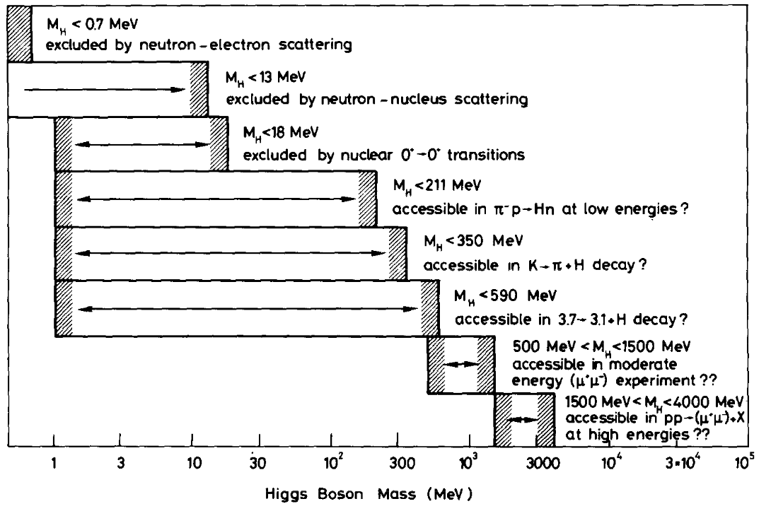
The beginning of the road
Masses about 40 times smaller than the Higgs mass
Notes:
The region of higgs masses on this paper cover up to 4 GeV – a range of mass much lower than where eventually the Higgs was found

Slide 4
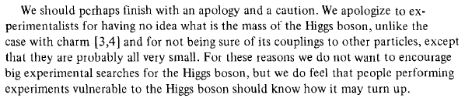
The beginning of the road
Notes:
Quite interestingly say said:
Of course experimentalists did not follow this advice

Slide 5
The Road
EUROPE: In the 1980 CERN builds a 27 Km tunnel hosting and e⁺e⁻ machine (LEP) and then a proton proton collider (LHC) to discover the Higgs boson
LEP (202 GeV) few Higgs-like events (115 GeV) but shutdown- 2000
LHC-start up 2008
LHC 8 TeV- Higgs boson discovery 2012
LEP Start up
1989 (92 GeV)
LHC 13 TeV- 2015-2018
1964-1975
LHC-3.5 TeV 2010
189
LHC restarting@ 13.6 GeV
1995
Top quark
1982
Collisions at 1.92 TeV
1986
First p-pbar collisions
2011
Tevatron shutdown
1983
Tevatron start up
US: End of 1970 and beginning of the 1980 Fermilab builds a 6.3 km tunnel for a proton-anti-proton collider reaching 1 TeV/beam (TEVATRON)
Notes:
I will focus on the competition between the Teavtron and the LHC

Slide 6
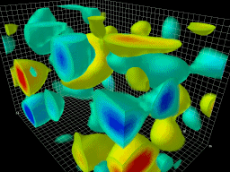
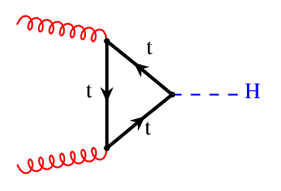
Why was it difficult to find the Higgs ?
Creating the Higgs boson in a collider is a rare process
Heisenberg principle Δt⋅ΔE~h

Slide 7
Why was it difficult to find the Higgs ?
1 in 10 billion at the LHC (13 TeV)
1 in 1 trillion at the Tevatron (2 TeV)
Creating the Higgs boson in a collider is a rare process
Notes:
It is easier to look for a friend’s face in a concert in a stadium filled with 100,000 people than to search for a Higgs-like event among trillions of collisions.”

Slide 8
Why was it difficult to find the Higgs?
1.6 x 10⁻²² s
Creating the Higgs boson in a collider is a rare process
Once you create the Higgs boson it decays very rapidly

Slide 9
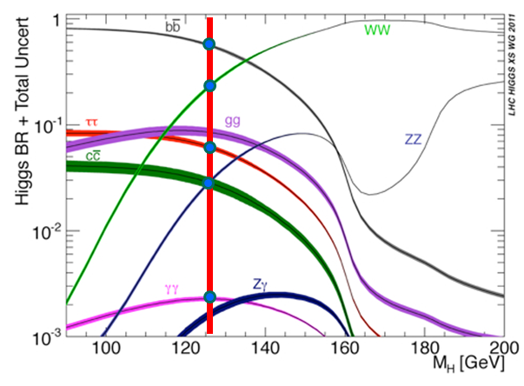
Why was it difficult to find the Higgs?
DIFFICULT
EASIER
Creating the Higgs boson in a collider is a rare process
Once you create the Higgs boson it decays very rapidly
The SM predicts the Higgs production cross section and its decay modes if the mass of Higgs is known. But until we found it, we had to look everywhere (up to 1 TeV)
Notes:
Easy to find the Higgs is the mass was around 170 GeV since it decay more about WW – more about this decay mode of the higgs in the next talk
It I more difficult to find the higgs if it has a mass below 12=35 GeV sine is main deday more is to b –quark – more about this in ophilipp talks

Slide 10
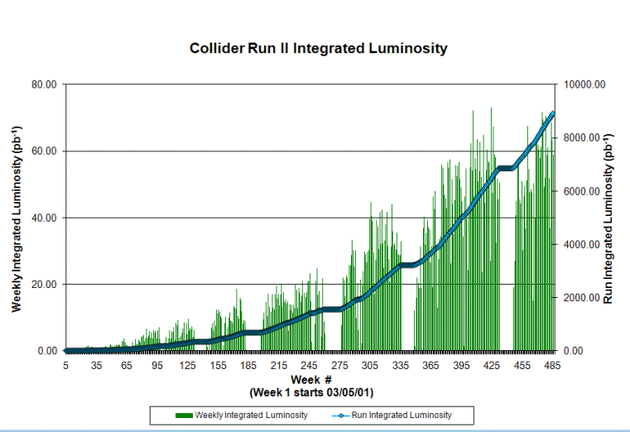
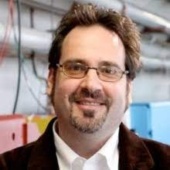

CDF @ Tevatron – My experience
Joined CDF as an assistant professor at Purdue University in 1992
Run1: Discovery of the top quark in 1995
Low collision rates until 2004, but on track to collect 10 or more fb⁻¹ by October 2011
One of the channels was the thesis of my student M. Kruse (Professor at Duke)
9 fb⁻¹
Report in 2000 showed prospects for 3-𝜎 (evidence) evidence for a 125 GeV Higgs boson with ~10 fb⁻¹ of data
CDF created Higgs discovery group (co-lead by M. Kruse)
I became the convener of one of the H$→$bb subgroups until the Tevatron shutdown in 2011
Developed passion for silicon (Worked on SVX’ and built SVX II for Tevatron Run II )
2001
2003
2010
What if the Tevatron would have reached its top performance as quickly as the LHC did ?
Notes:
A 3-sigma detection event has a 0.3% probability of occurring by chance, and a 5-sigma event has just a 0.00006% probability (1 in 1 in 3.5 million)
Run 2 of the tevatron started poorly – the p anti-p collision rate was very low – iut started to improve on I n 2004 and by 2010 we ahd 9 fb-1 and we were on tracj to get 10 fb-1
LHC started in 2008 and there was an accidednt that cause a stop for one year – but after that it worked beautifcully
You can imagine that history might have been different if the tevatron would have reached its perofmranc equickly,

Slide 11
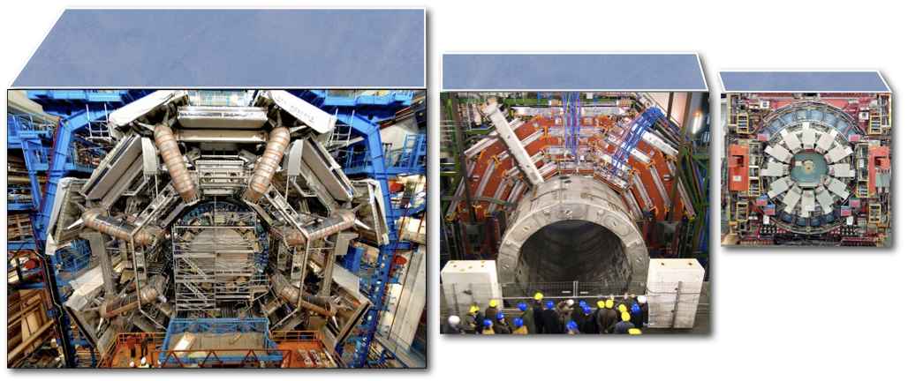
David vs Goliath
Diameter = 25 m
Length = 46 m
Diameter = 16 m
Length = 21 m
ATLAS
Diameter = 12 m
Length = 12 m
CMS
ATLAS
CDF

Slide 12
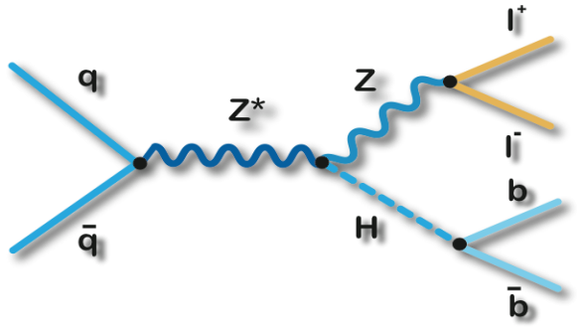
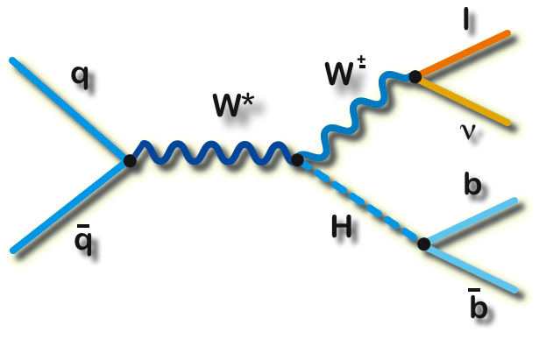
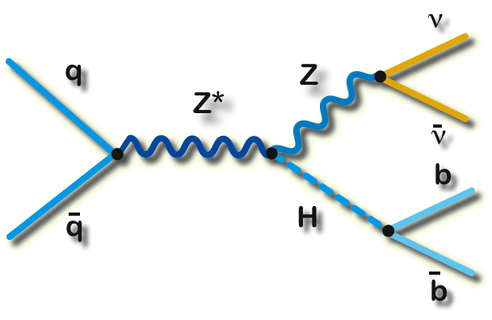


H $→$bb @ CDF
ZH→llbb
WH→lνbb
ZH→ννbb
Focus on ZH$→$bb$ν\overline{ν} −$considered very challenging at the time.
  Neutrinos undetected in the experiment – only missing transverse energy
Introduced many improvements:
  Machine Learning to improve b-tagging and signal over background discrimination (Philipp will explain later on why it is essential for H→bb)

Slide 13
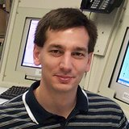
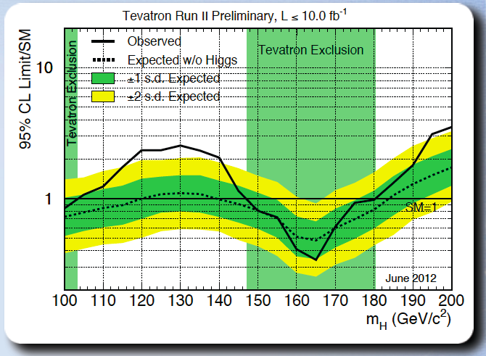


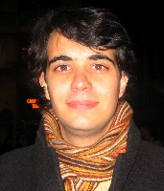
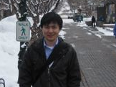

Tevatron final result
V. Veszpremi Ph. D. 2007
A. Apresyan, Ph. D. 2009
K. Potamianos, Ph. D 2011
Expected to exclude m_{H}<120 GeV, but found a broad excess
Excluded 147 <m_{H} < 180 GeV mainly with H $→$WW
Evidence for Higgs boson from the Tevatron around 125 GeV
Q. Li, Ph. D 2012
Notes:
he Tevatron results indicate that the Higgs particle, if it exists, has a mass between 115 and 135 GeV/c2, or about 130 times the mass of the proton.
has a statistical significance of 2.9 sigma. This means there is only a 1-in-550 chance that the signal is due to a statistical fluctuation.

Slide 14
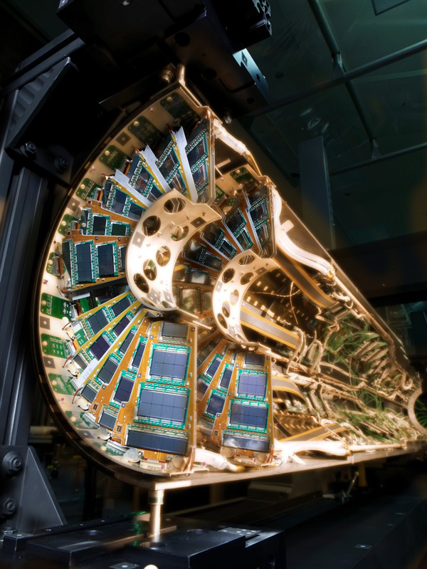

CMS @ LHC - My experience
Joined CMS in 1996
Building the CMS silicon vertex detector (Ian also joined in 2001)
Important to keep analysis in CMS and CDF well separated.
Joined H $→$ ZZ around 2010
Worked on most channels:
  H $→$ ZZ $→$ eeee, $μμμμ, eeμμ$ (4-lepton channel)
  H $→$ ZZ $→$ ee$ν\overline{ν}$, $μμν\overline{ν}$
  H $→$ ZZ $→$ eeqq, $μμqq$

Slide 15
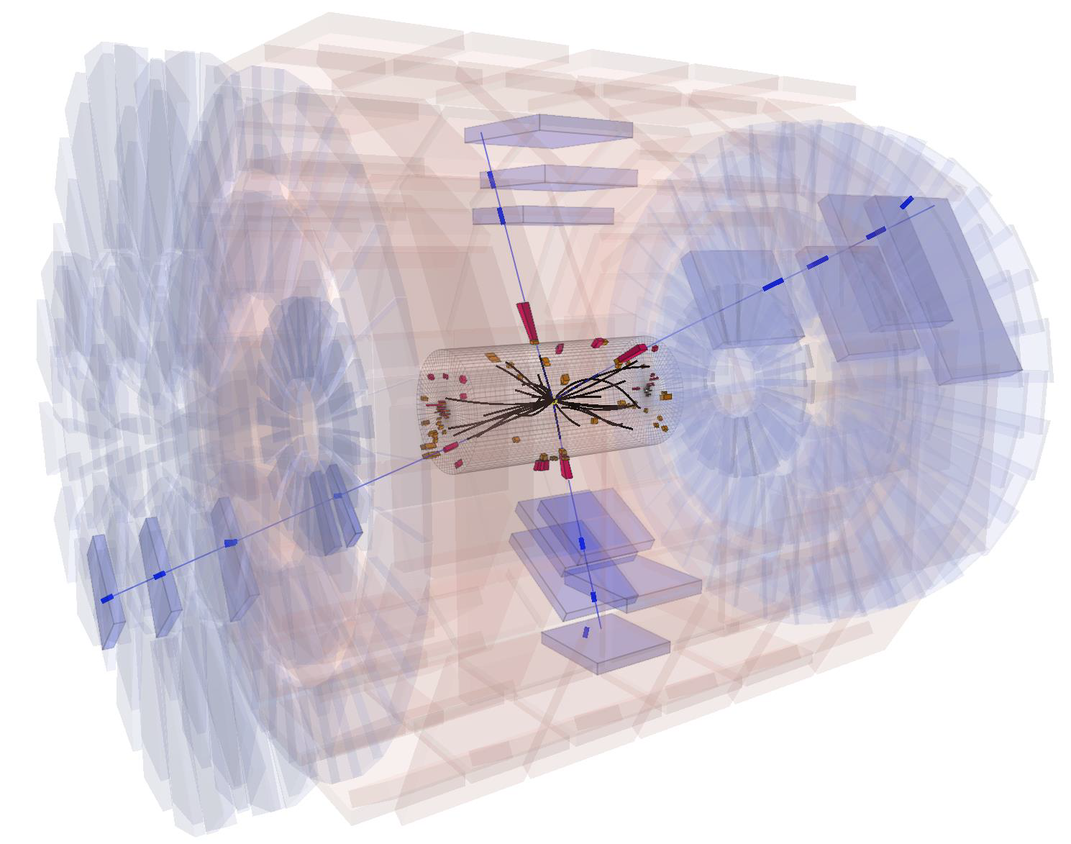



4-lepton channel
$$μ$$
A simple search:
Clean signature
Accurate reconstruction of lepton kinematics
ZZ background is well known
Instrumental background is tiny
$$μ$$
$$μ$$
$$μ$$
Notes:
The only particles that reach the muon chambers (which are large and iconic) are the muons- other particle should be measured and and leave all their energy in other detector element

Slide 16
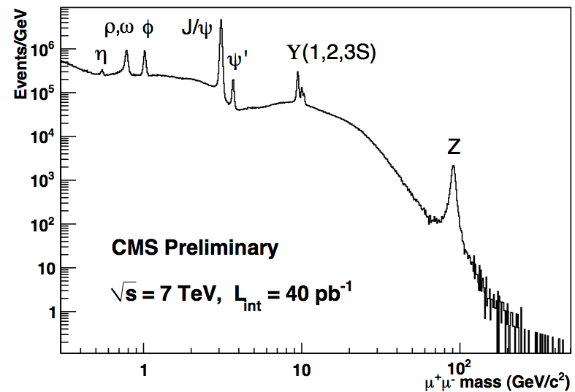
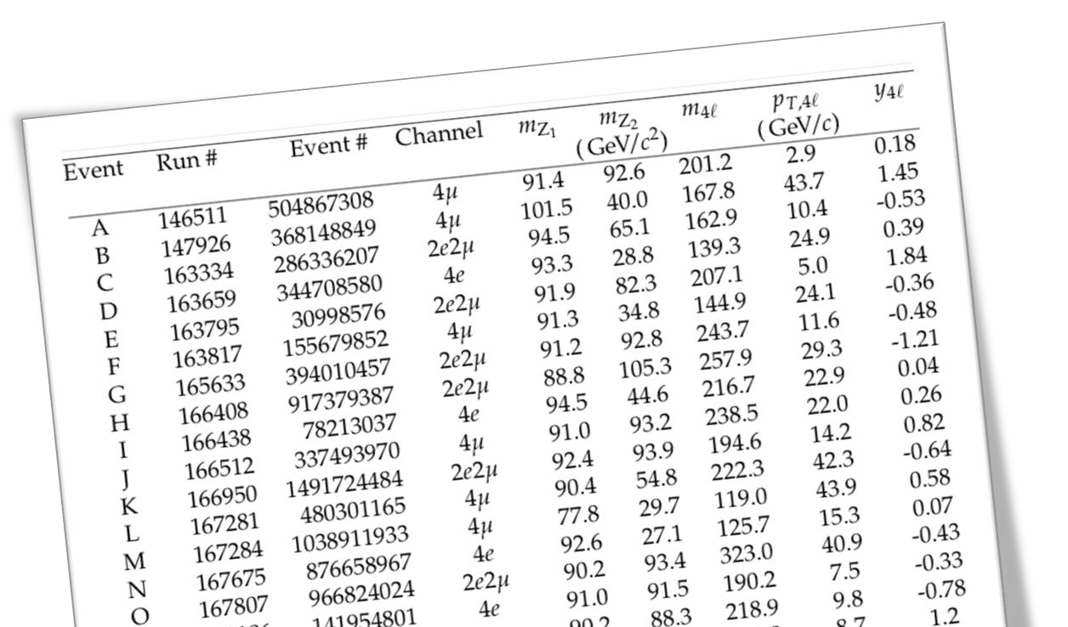
4-lepton channel
This was the Iconic plot of the first LHC run
But:
  Still understanding the detector
  Worried about unexpected instrumental errors
  Every candidate event was scrutinized
  Huge amount lot of internal collaboration & competition
  Established to maintain a common reference between the groups
  Synchronization exercises
Ian Shipsey
Notes:
Our understanding of the detector was working well led to this iconic plot – showing the rediscovery of the Standard Model using 2 muons

Slide 17
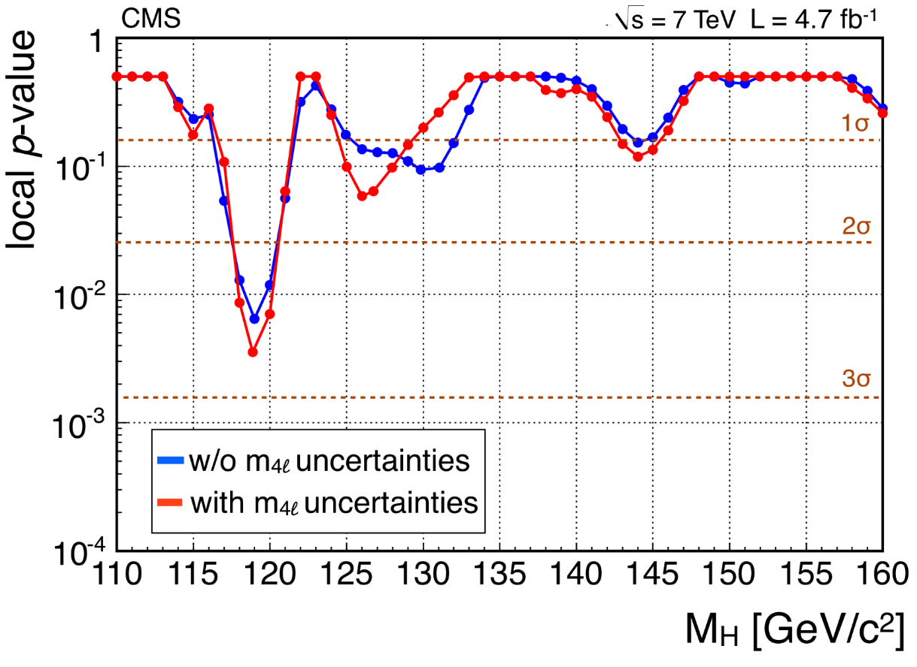
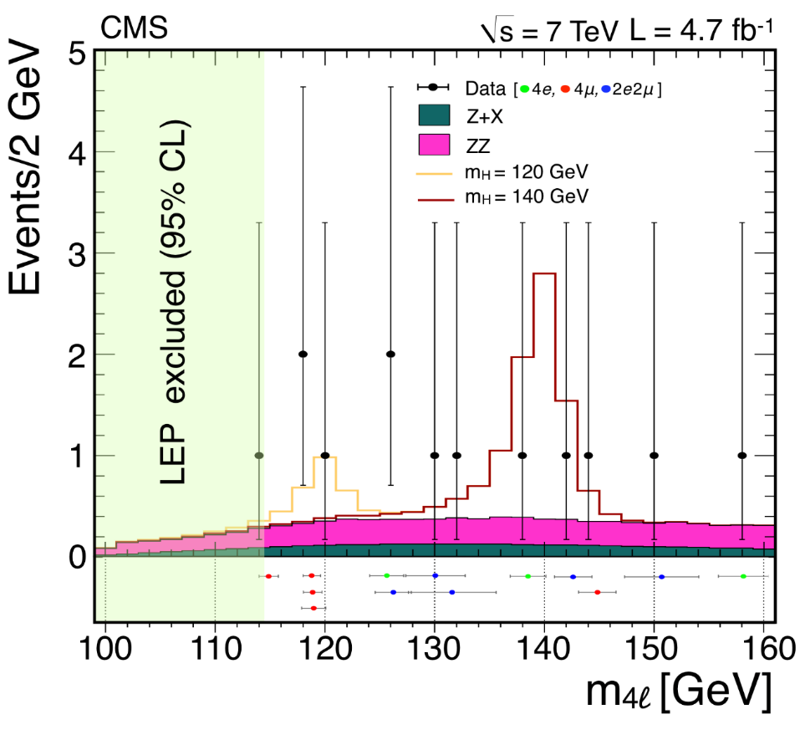

December 2011
Ian chaired the Analysis Review Committee
In December 2011 we started to see some discrepancies with null hypothesis, and a 2 $σ$ excess around 120 GeV
The combination of all CMS analyses excluded the range [127-600]
LEP Analysis excluded m_{H}< 114.4 GeV
Exclusions from the Tevatron
Reconstructed mass from Higgs decay products

Slide 18
June 13, 2012
In Spring 2012
  Accelerator restarted at 8 TeV (more H produced)
  Evident that if H existed we should observe it in 4l
  Aggressive approach:
    Improve physics objects and statistical approach
    Blind analysis
  My postdoc Daniele Benedetti worked day and night to improve electron reconstruction
Unblinding was planned for June 13
The Analysis Review Committee had to give us the green light to report to the Collaboration the next day or we were out from the combination
The actual unblinding happened in a closed meeting in the evening
I still get butterflies in the stomach recalling the moment
D. Bortoletto, TCD Seminar
Notes:
Blind analysis- fully establish procedures for a measurement before we look at the data so we can’t be swayed by intermediate results

Slide 19
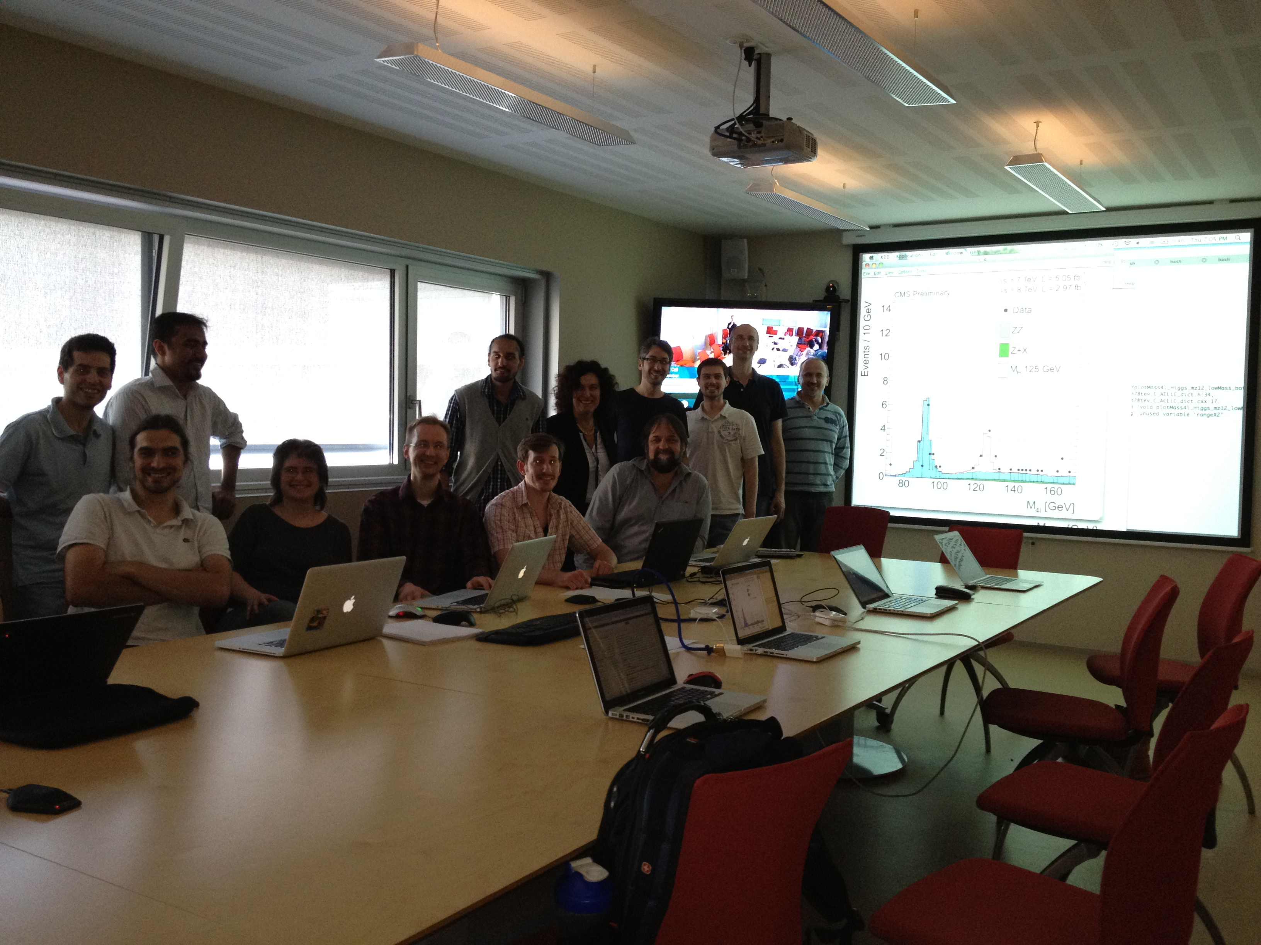
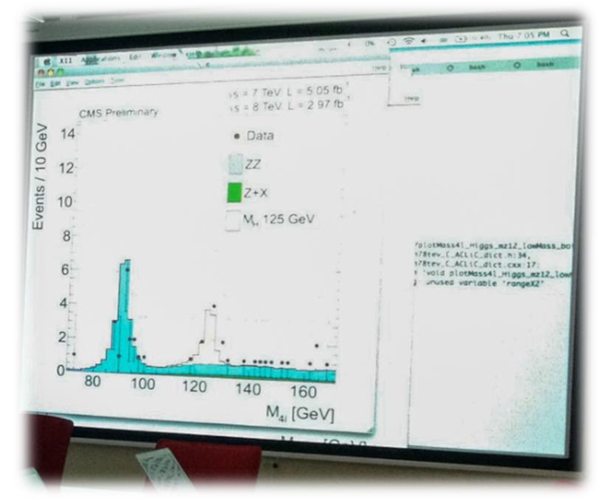
June 13, 2012

Slide 20
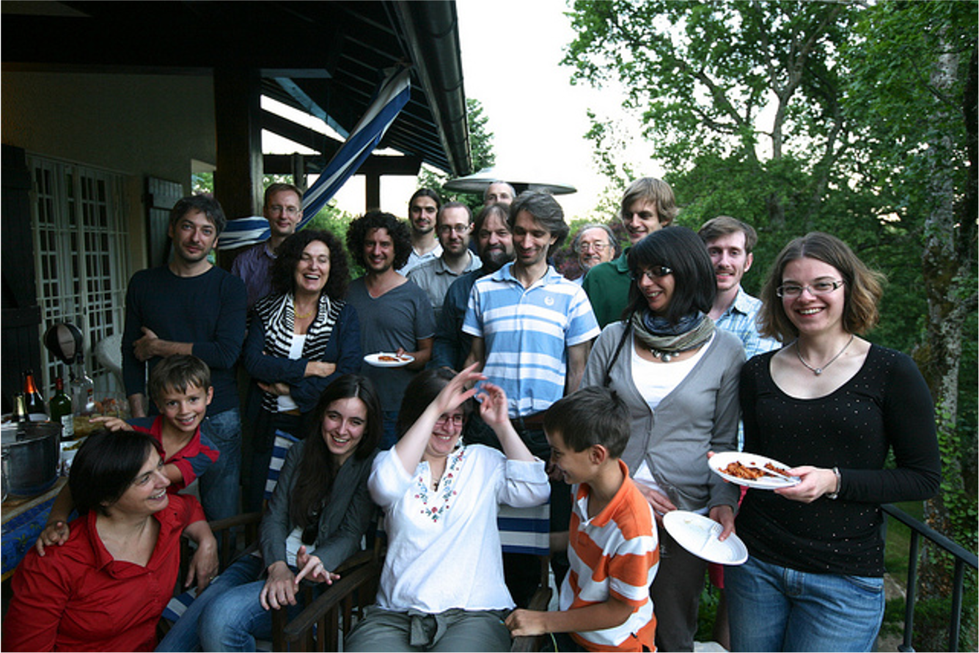
June 13, 2012

Slide 21
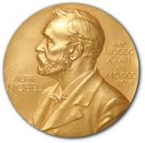
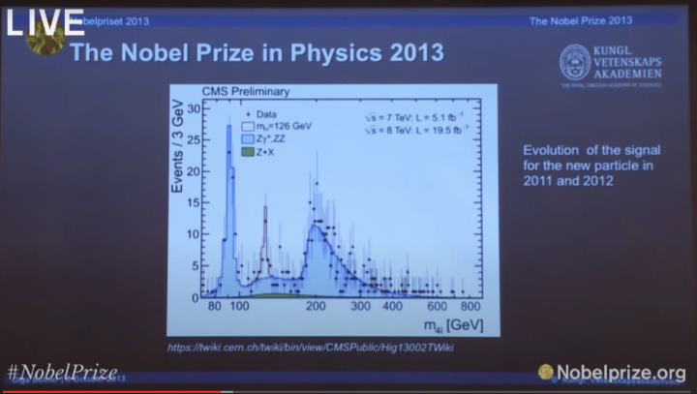
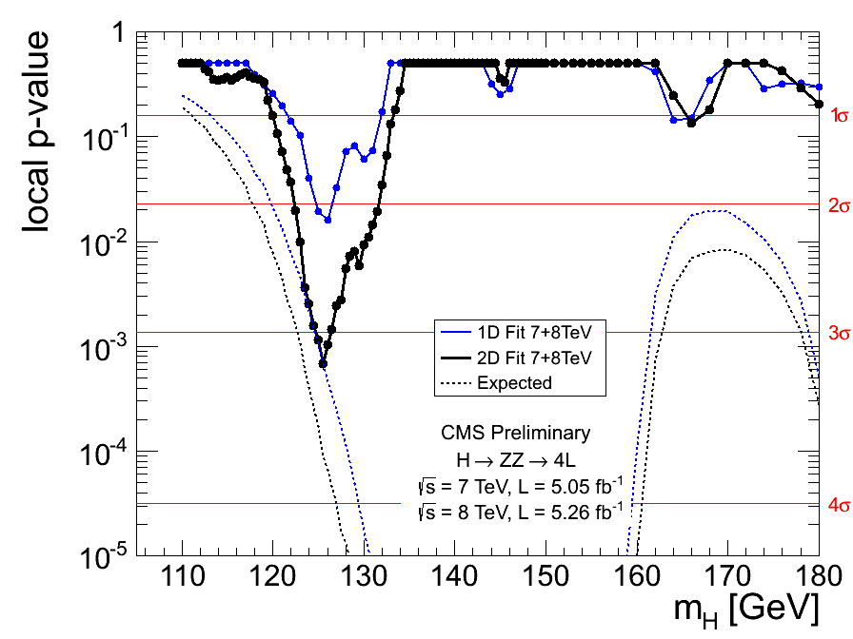
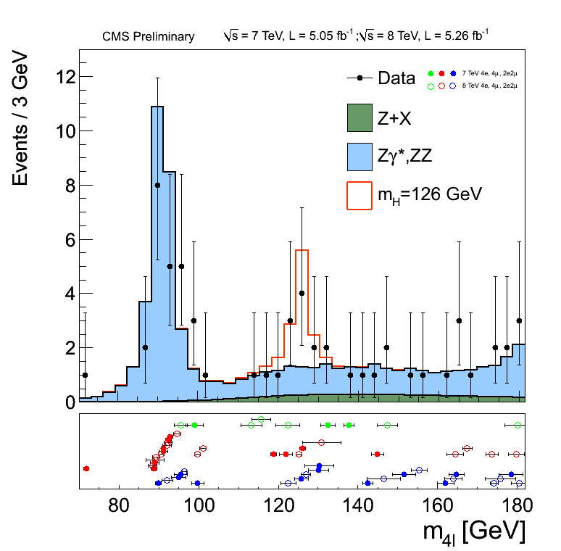
The history
Analysis featured in the Nobel Prize talk

Slide 22
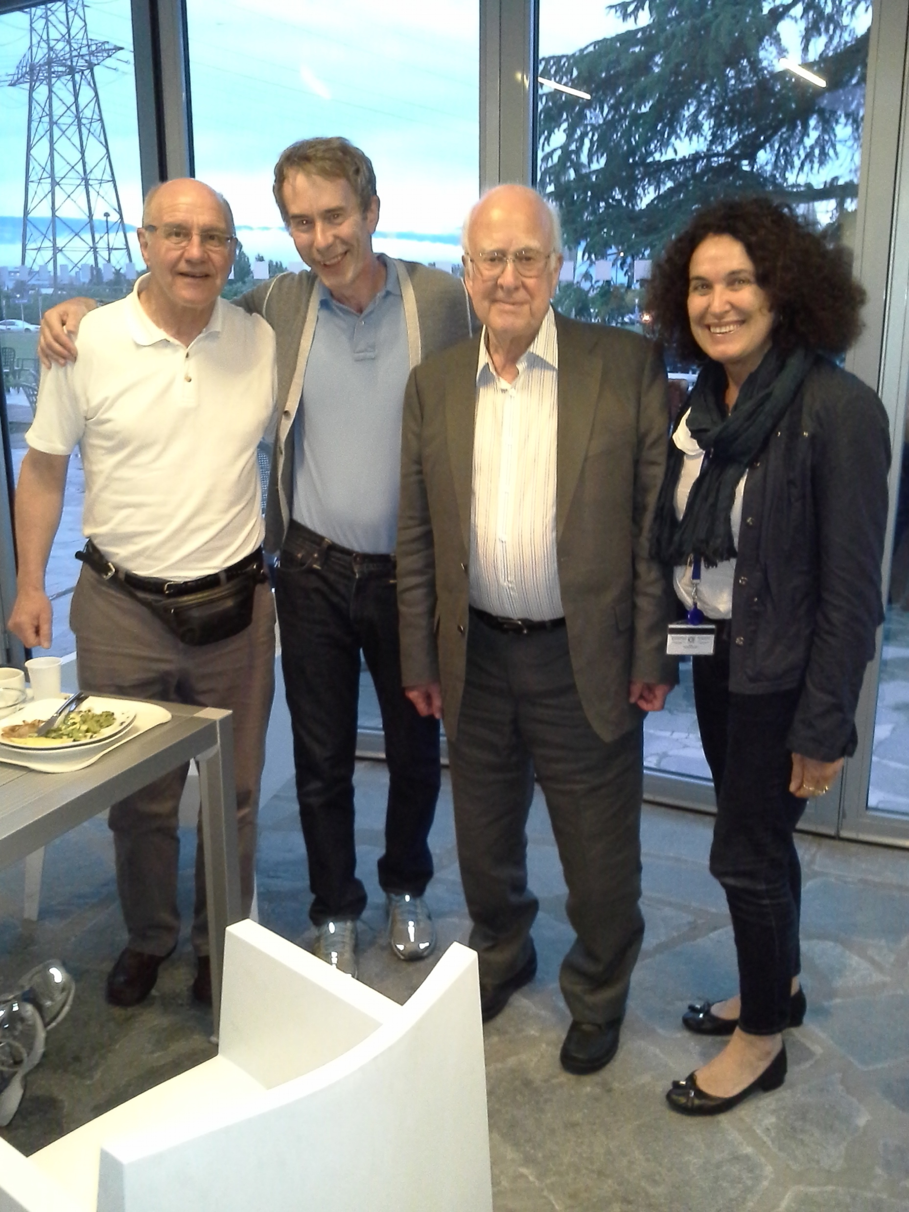
July 2, 2012

Slide 23
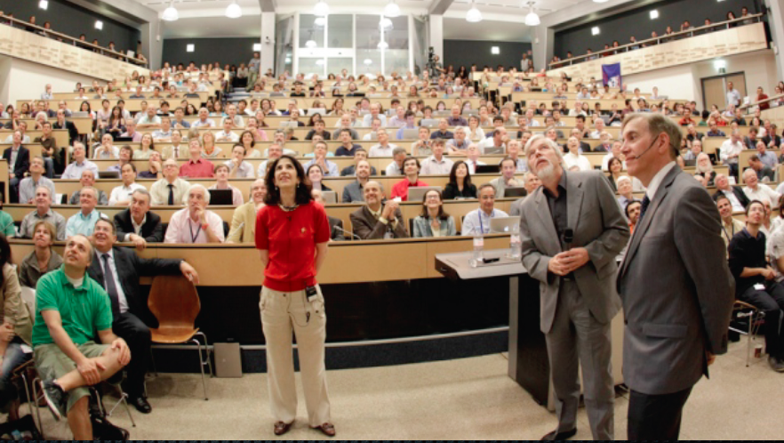
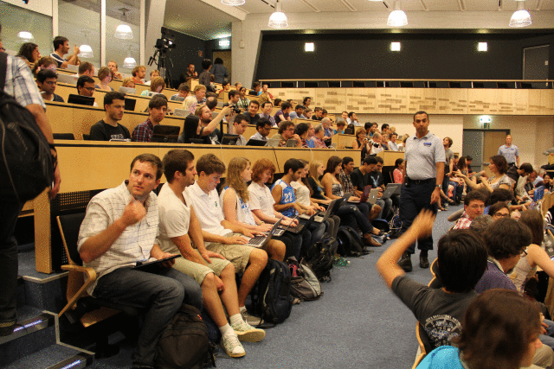
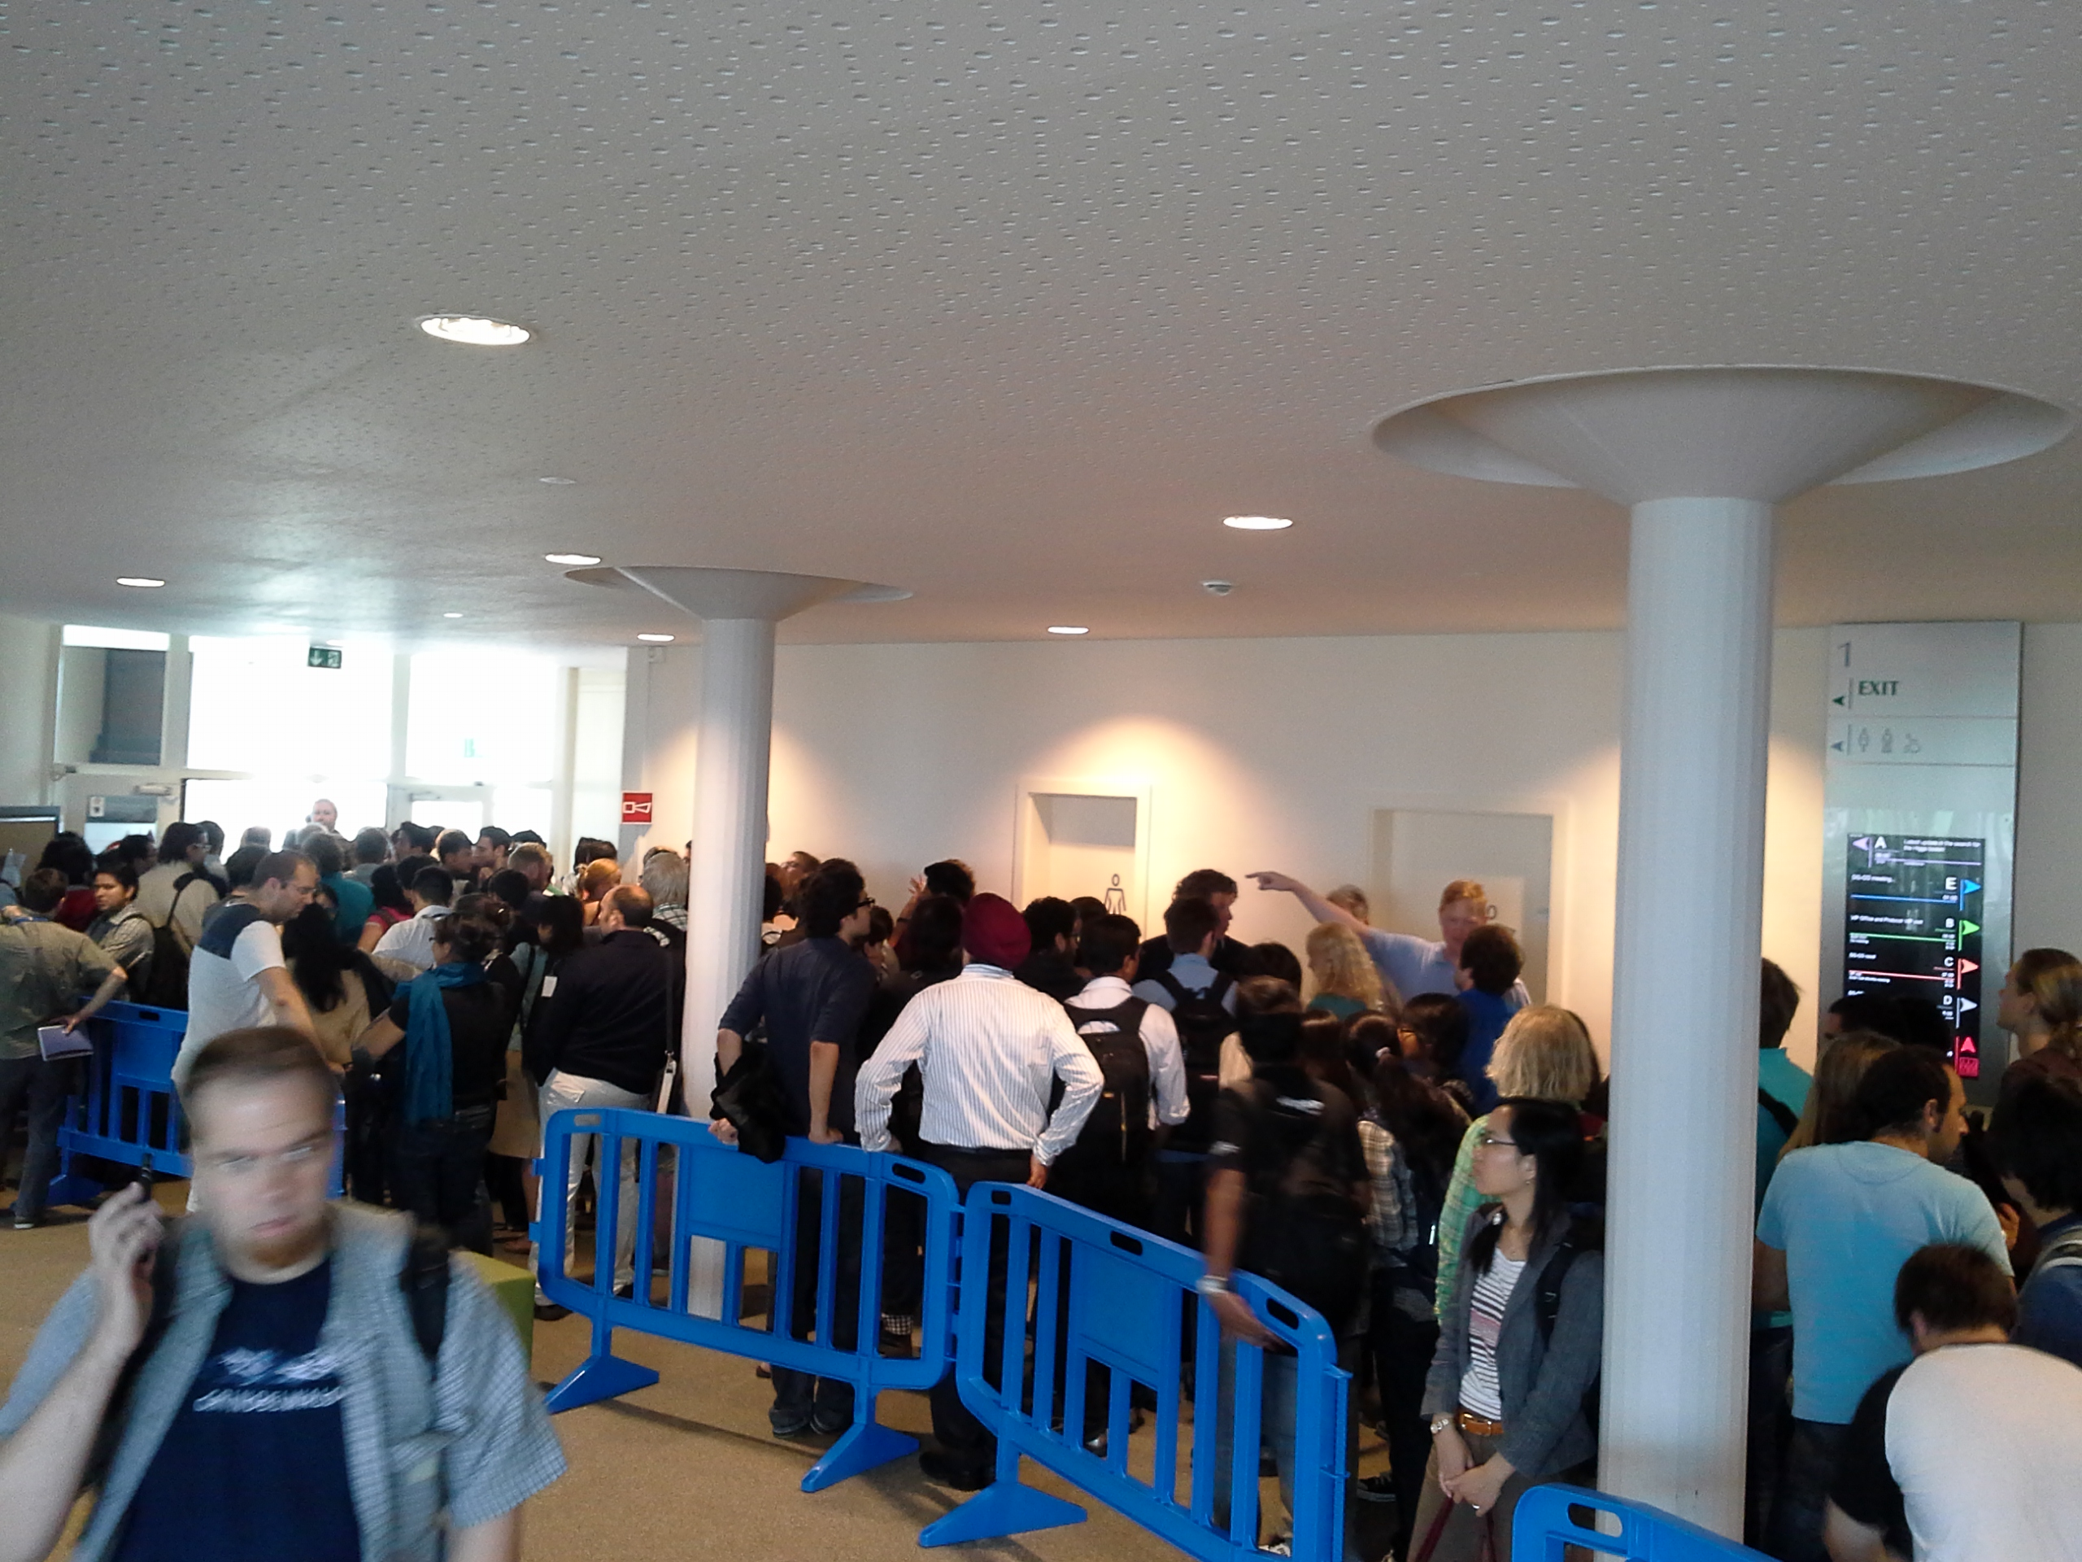
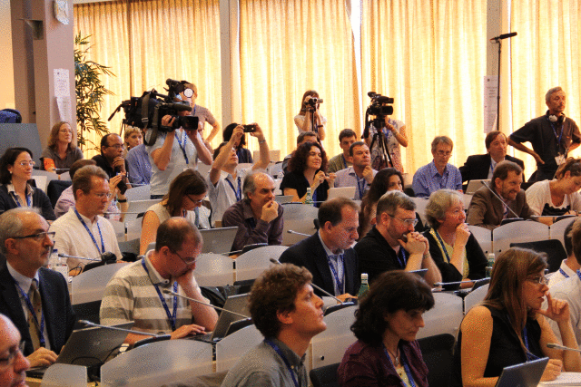
July 4, 2012
Notes:
July the 4th was total happiness -

Slide 24
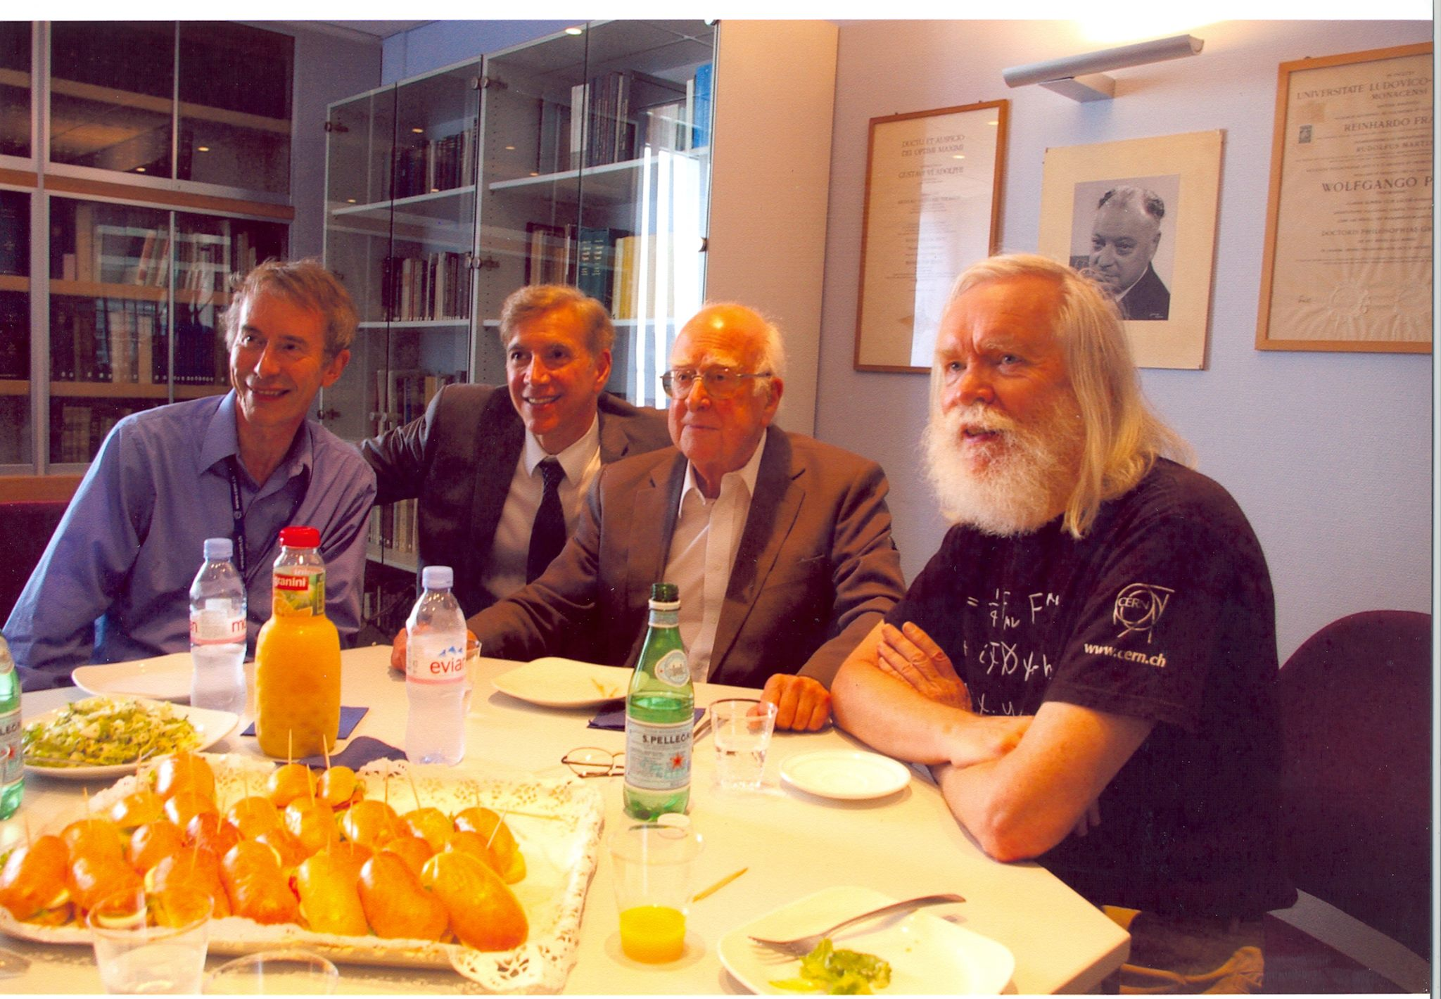
July 4, 2012

Slide 25
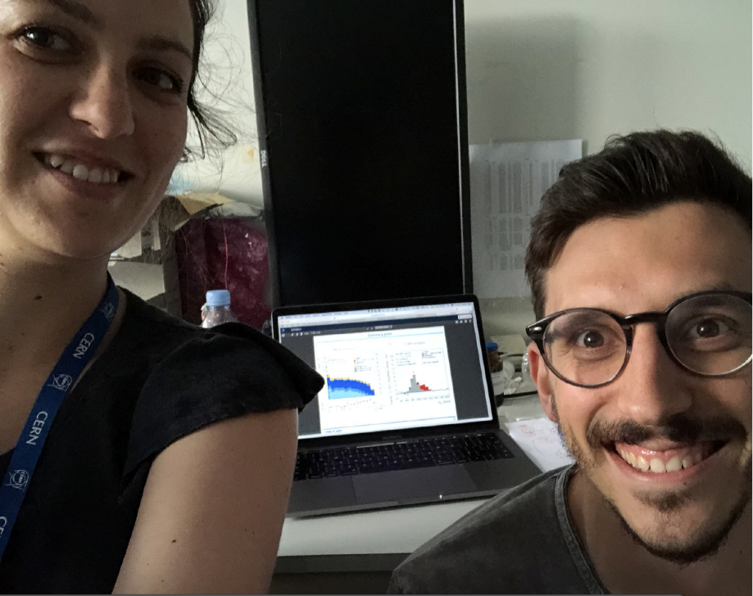

July 4, 2012
IOP
PHYSICS WORLD
Prelude to 2018 when my students Cecilia Tosciri and Luca Ambroz (with Elisabeth Schopf) unblinded the H$→bb analysis$
Thanks to Ben Kilminster & Nicola Amapane, who provided some of the slides

