Slide 1
Berlin – Oxford
Joint Studentships!
Great ways to help!

Slide 2
More things
Sell topic
International training network

Slide 3
An Opportunity for Graduates!
Humboldt University – DESY Zeuthen
  Areas of research excellence
Oxford University – World-wide reputation
  Seeking Research Partnerships with Berlin
Establish Joint studentship programme
Working on proposal this year

Slide 4
German Funding opportunity
From Deutsche Forschungsgemeinschaft
  DFG
  Research Training Groups (RTG’s)
  RTG provide outstanding supervision and research opportunities to early career researchers
  Support up to 30 doctoral research students
    5-10 per year supported from DFG
    Support component of international research
    Expect matching studentships from paired country
Oxford and Berlin research already aligned
  Particle Physics
  Astrophysics
  Accelerator physics
  Additional areas forming
Preparing a Proposal
With support; why wait?!

Slide 5
Would like to start something for 2020/2021
No reason to wait for proposal + response
With support from Oxford, HU, DESY and Alumni begin a programme now!

Slide 6
Oxford-DESY Studentship
DESY can support students
  Home/EU fees
  Stipend
  Limited travel to/from Oxford
Additional support required
  Summer school
  Research workshop (in EU)
  Conference funding if speaking or presenting poster
  £10k-5k makes all the difference
Other areas:
Research @ CERN or remote site
College fees

Slide 7
STFC studentship travel support
Joint studentships need to be competitive
Example - STFC Long Term attachment (LTA) support
  CERN - £4438 p.a. up to 548 days – accommodation covered
  DESY - £2930 p.a. up to 548 days - €1000 towards accommodation expenses
  £200 additional travel/personal trips
  £1300 removal costs
  £200 travel
Matching or equivalent levels to attract best students

Slide 8
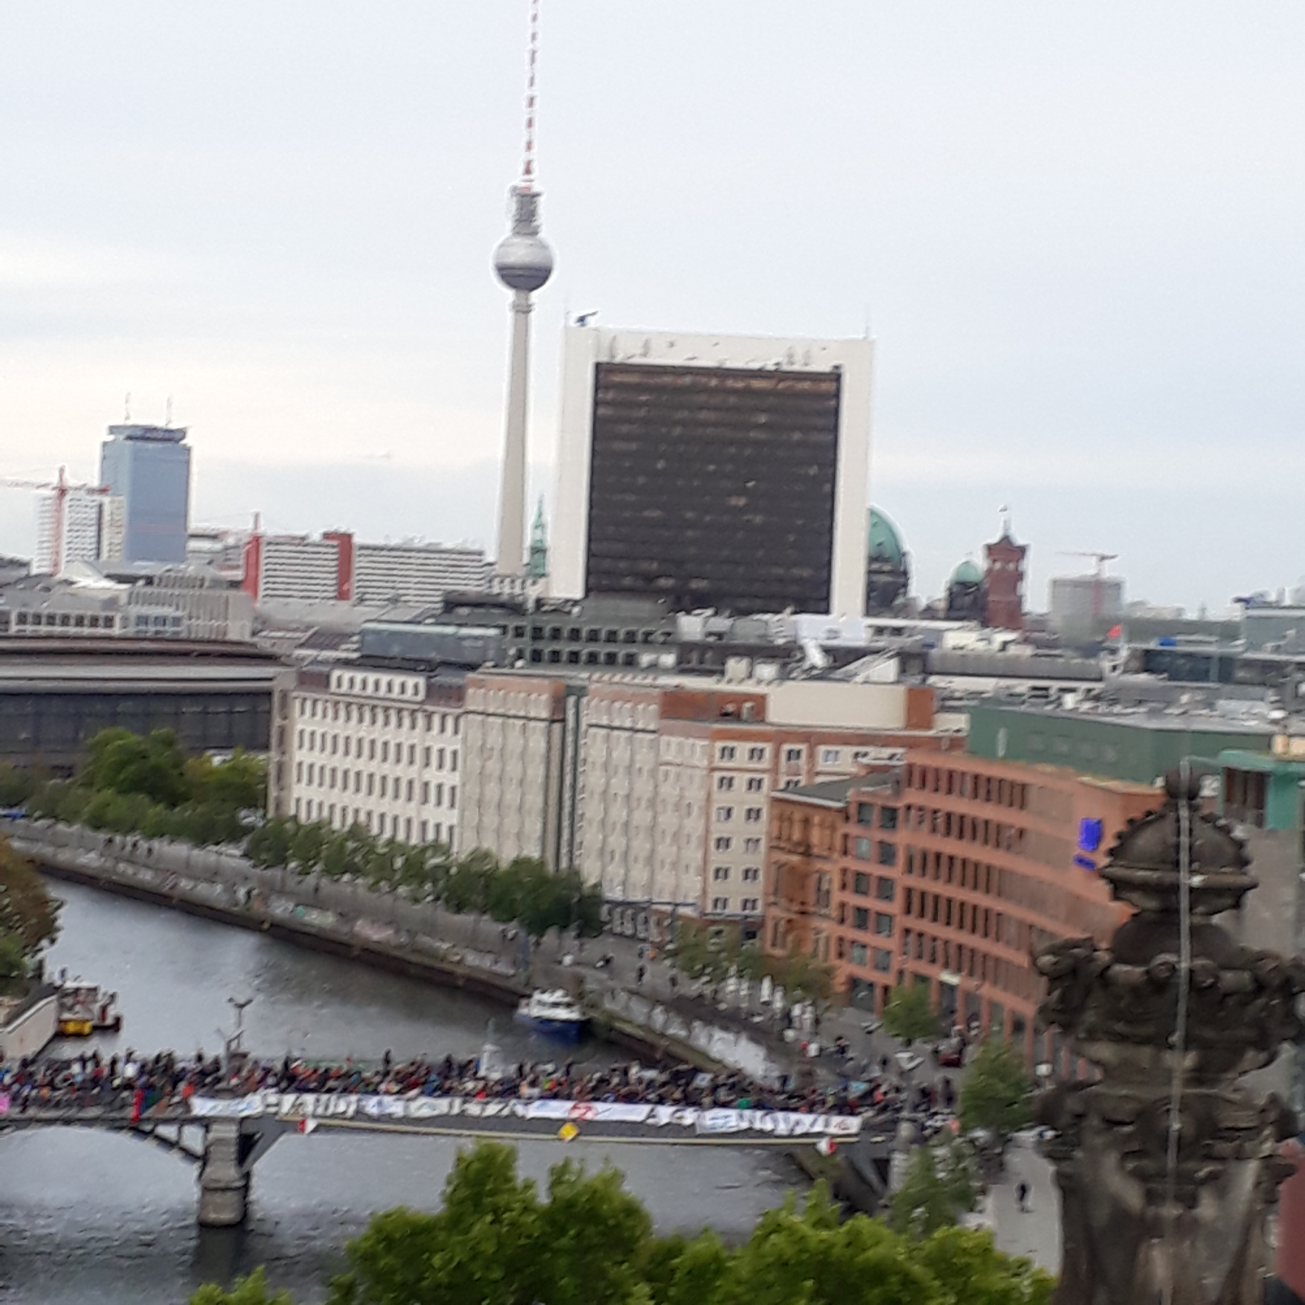
Alumni Event in Berlin 19-23 March
19 March - British Embassy
  5pm – Press conference of OX/BER researchers
  ~6pm – reception
20, 21 March – Dinners with college alumni
  LMH and Lincoln (Todd, Cigdem)
  Quite a few other colleges as well
22 & 23 March – Further events/talks with Oxford alumni
  Garrett, Todd

Slide 9
Develop preliminary curriculum for International Training network
Basic idea for final submission to DFG - UK
the slides follow.

Slide 10

Joint studentships Oxford students
Academic Year 1
  Formal Course work
    Attach course Cirricula
  Qualification/Service Projects
    Part of research skills
  Identify joint thesis research project
  Regular joint meeting schedule with supervisors
  1st year transfer of status
I want to put nice pictures on this side on each slide.

Slide 11
The Vision
Academic Year 2
  Continue joint meeting sched.
  Research field work
    Programatically driven; but can include →
      LTA at experimental site
      LTA at Berlin w. Berlin supervisor
      Additional experience (Laboratory/telescope)
    Mix components of both driven by research necessity and approval of supervisors.
This Continues into Year 3

Slide 12
The Vision
Academic Year 3
  Continue joint meeting sched.
  Complete remote laboratory work
    Paper/poster/report outcome
  Research field work
    Continue LTA: based on established programme
  Confirmation of status
    Thesis timeline review

Slide 13
The Vision – full 4 year funding
Academic Year 4
  Complete Research field work
    Continue limited LTA if needed
    Complete 3-4 months or earlier into year 4
    Return to home institution
  Final research activity
  Thesis writing, submission during latter ½ of 4th year

Slide 14
Joint programme – Adds Value
Experience in Berlin/Zeuthen
  Top institutions and laboratories
  Additional contacts: students, professors, laboratory physicisits
  Unique Research projects:
    Test beams
    Accelerator operations
    Telescopes (?)
    Instrumentation
    Laboratory systems development
Opportunity
Additional experience
More exposure
Opportunities post-graduation
Additional 6 months adds this value.

Slide 15
Clarity required
Supervision arrangements
Time spent where
  Example: 6 months HU, 1 year CERN
Expenses paid and by whom
  Travel to and from location
  Travel to Experimental/Internal Workshops
  Summer school
  Stipend
  Additional living allowances while abroad.
  Fees (Home fees – Scholarships from Oxford?)
  Cannot over-emphasize the import of clarity here

