Slide 1





OX/BER/DESY IRTG Meeting
Instrumentation, Methods and Applications
PP Task Force
  Çiğdem İşsever
  17.03.2020
  Video Conference

Slide 2
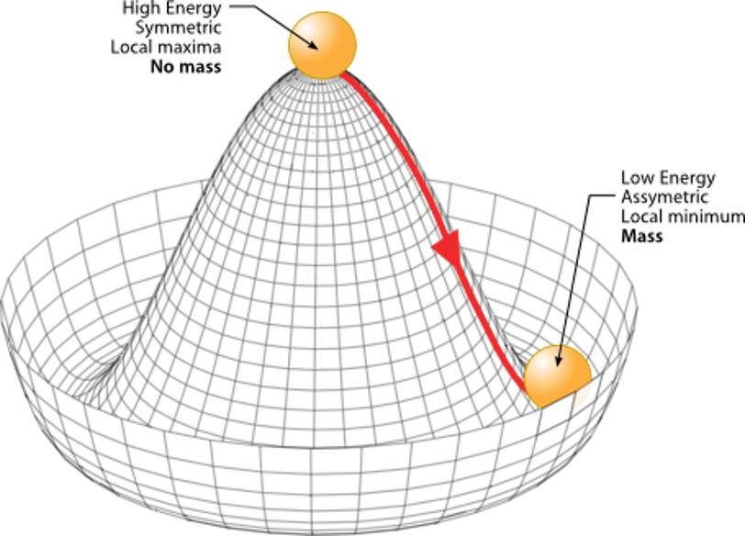
PP Common Projects btw OX/HU/DESY
Existing Connections →
  Bortoletto (OX), Issever (HU/DESY), Huffman (OX), Frost (OX)
  Joint Student supervision
    Migle S., Federico C., Beojan S., Santiago P. S.
  Team up on three analyses (So far)
    HH→4b,
    X→bb + jet,
    Phenominological study on HH prospects in future colliders
Continue into future → Joint interests.
Much Oxford PP on ATLAS involves Higgs studies.
  SUSY and SM Higgs in many channels

Slide 3
PP Common Projects btw PP and AP and QT
Proton-oxygen beam collisions at the LHC for air shower physics
  Collaboration with CTA
  atmospheric neutrino flux calculations using cosmic muon flux and charge ratio measurements → IceCube
Share analysis methods?
  Statistical analysis
  Machine Learning
PP Experiments with quantum sensors

Slide 4
PP Common Training Modules
German students could participate in PP Graduate Lectures?
Or the ML Workshops at Oxford? (AP and PP students)
What courses at HU or DESY would be interesting for Oxford Students?

Slide 5
Action Items for PP Task Force
5. Action: Make a list of methods, instrumentation and laboratory facilities in Particle Physics
  Not complete
6. Action: Identify possible collaborations/projects (thesis topics) or training modules in PP across Oxford, DESY and HU
  Have some ideas, could there be other collaborations outside the context of Higgs?
7. Action: List possible collaborations/projects (thesis topics) or training modules between PP and AP, QO and Detector R&D or Accelerator Science
  Have two ideas. More?
8. Action: Identify possible internship topics that could lead to papers → Not much progress made.

