Slide 1
Astroparticle Physics
David Berge (DESY, HU), Garret Cotter (Oxford), Rob Fender? (Oxford), Marek Kowalski (DESY, HU, on sabbatical), Jakob Nordin (HU), Dan Parsons (HU), Jason Watson (DESY), Steven Worm (DESY, HU)

Slide 2
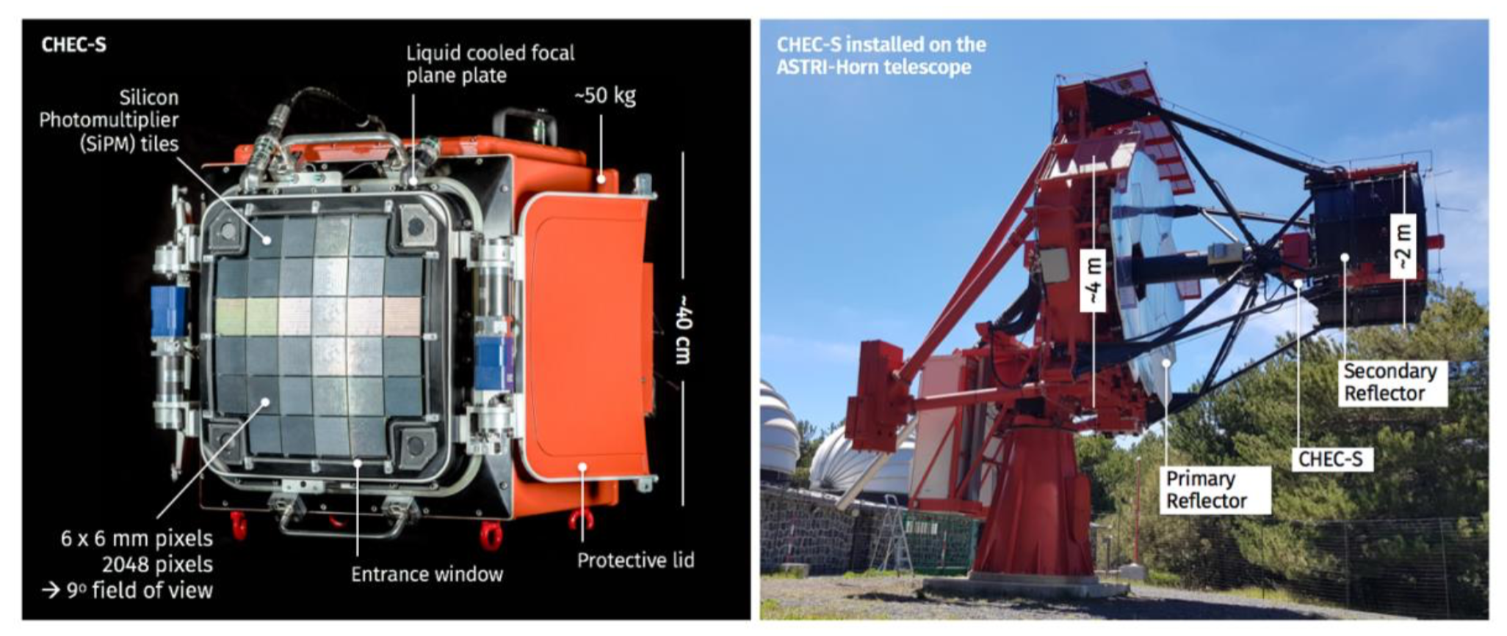
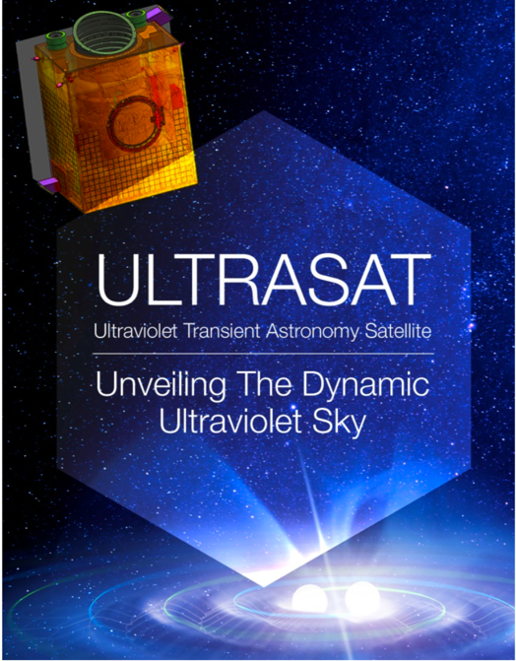
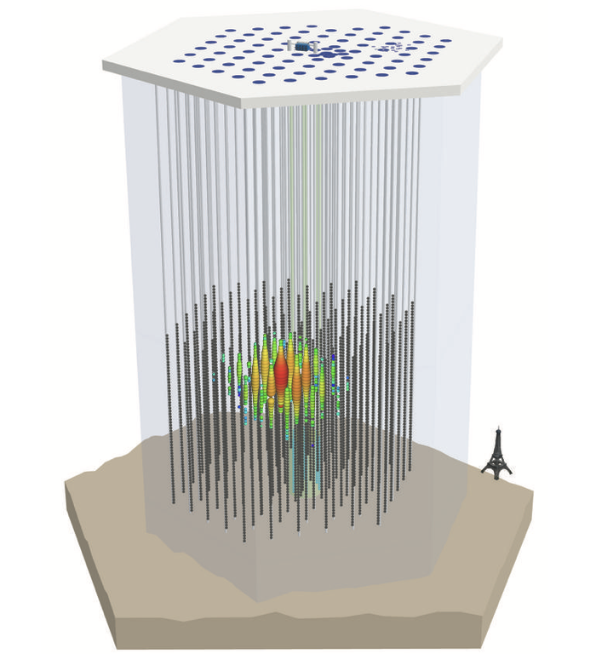
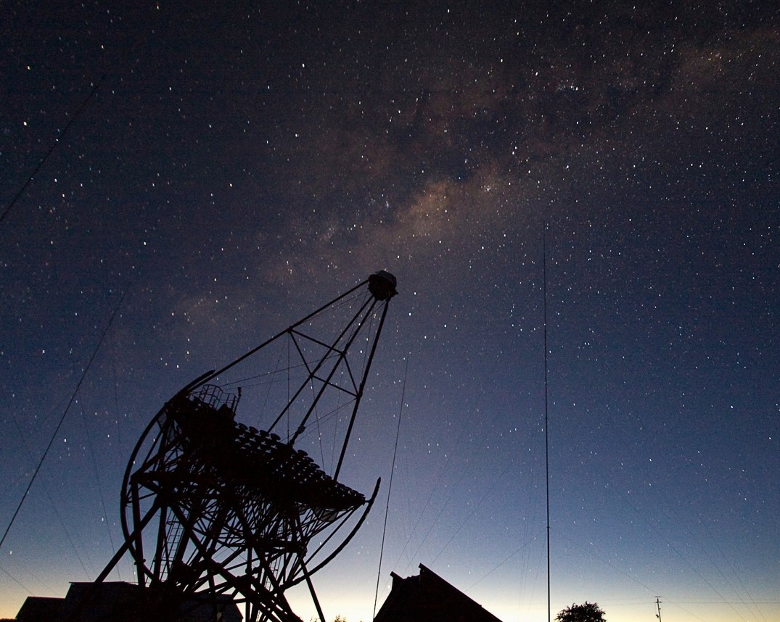
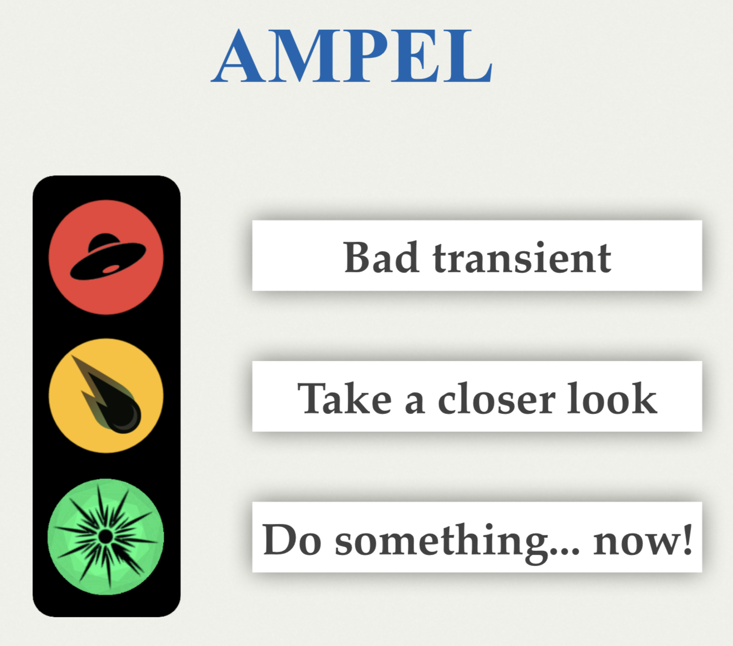
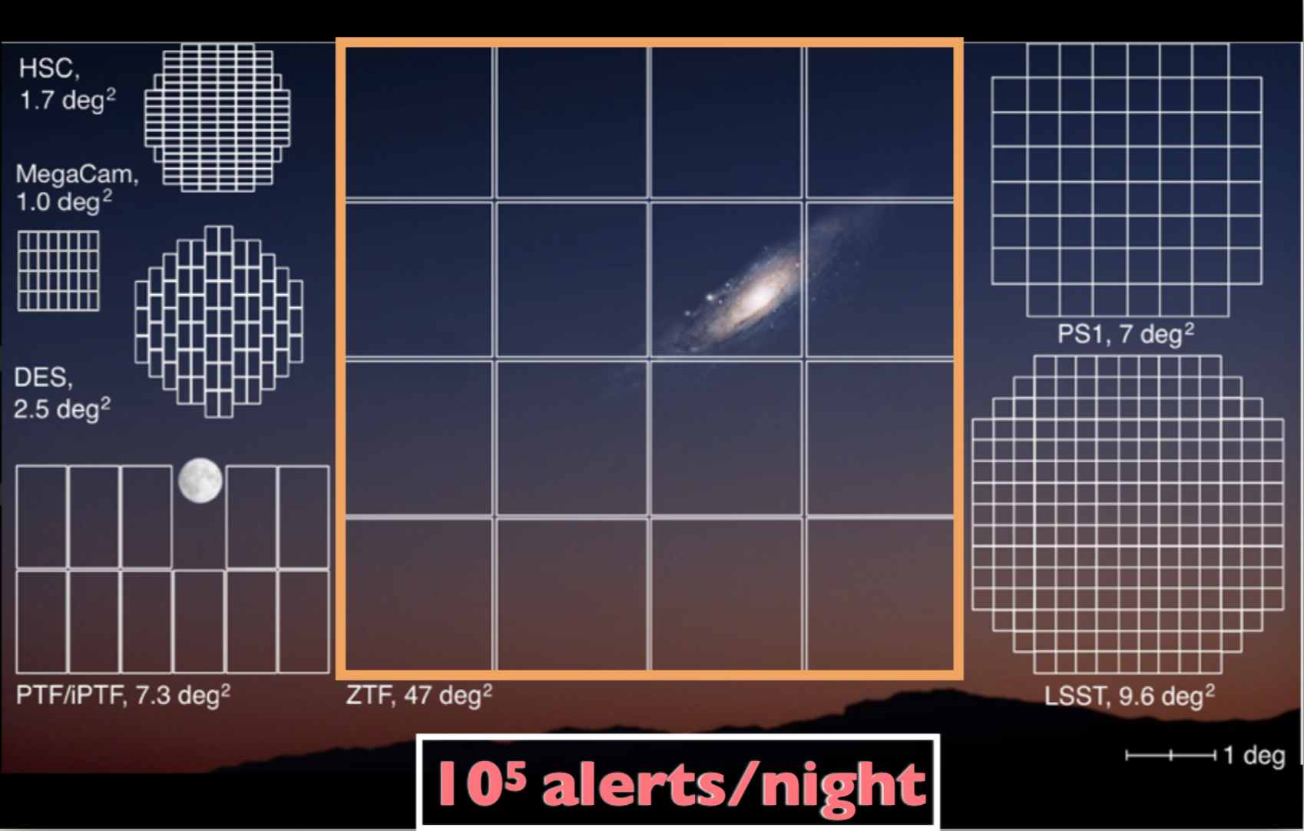
CTA Camera Prototype
UV survey satellite for GW follow-up and SNe
AMPEL software filter infrastructure
H.E.S.S.
IceCube
ZTF optical survey telescope

Slide 3
Collaboration topics
Machine learning for astroparticle physics (CTA, H.E.S.S., probably others, too)
Real-time frameworks for astronomy (AMPEL, 4-pi-sky)
Detectors (Si photo sensors, e.g. SiPMs or UV CMOS)

