Slide 1





OX/BER/DESY IRTG Meeting
Instrumentation, Methods and Applications
Updates
  Çiğdem İşsever, Todd Huffman, Steve Worm
  17.03.2020
  Video Conference

Slide 2
Since last meeting in Zeuthen in Dec 19
German PIs and UK PIs met independently
  See minutes attached to agenda
Discussions about UK Funding ongoing -> Todd’s update
HU Material science groups invited to join
DFG confirmed we can have up to 15 PIs on the German side

Slide 3
Action Items Pending
Action: It was suggested to invite Craig Sawyer from RAL to the Oxford meeting in March. (Cigdem)
Action: Initiate a seminar or lecture series at HU that covers instrumentation, methods and applications. This should be discussed in the professorium. (Heiko)
Cigdem brought up if it would be possible to exchange Master students with Oxford and start working on projects with Oxford PIs. The question of funding came up. Following action items arose:
Action: Contact International Office at HU and ask for advice. (Cigdem)
Action: Investigate DAAD funding for exchange of HU undergraduates with Oxford. (Cigdem)

Slide 4
Action Items
Action a: Todd will try to find out when the next call for CDTs will be. (progress)
Action b: Follow transient astronomy with Rob Fender up (Garret Cotter and David Berge)
  Rob is coming to Oxford meeting in March
Action c1: It should be checked if for participating in the PhD Accelerator Physics Course at Oxford fees have to be paid by the outside students, what is the limit in the number of students participating from outside and what has to be foreseen for accommodation and living costs for a 3 month stay (e.g. is there a cheap hostel or residential school (D: Internat) that can be used ?) (Phil? or ???)
Action c2: We should investigate how PITZ and JAI could collaborate on medical applications. (Phil and Frank)

Slide 5
Action Items AP (DB, GC, SW)
1. Action: Make a list of methods, instrumentation and laboratory facilities in Astroparticle Physics
2. Action: Identify possible collaborations/projects (thesis topics) or training modules across AP in Oxford/DESY and HU
3. Action: List possible collaborations/projects (thesis topics) or training modules across AP, PP, QO, Detector R&D and/or Accelerator Science
4. Action: Identify possible internship topics that could lead to papers

Slide 6
Action Item PP (JF, TH, CI, TK, SW)
5. Action: Make a list of methods, instrumentation and laboratory facilities in Particle Physics
6. Action: Identify possible collaborations/projects (thesis topics) or training modules in PP across Oxford, DESY and HU
7. Action: List possible collaborations/projects (thesis topics) or training modules between PP and AP, QO and Detector R&D or Accelerator Science
8. Action: Identify possible internship topics that could lead to papers

Slide 7
Action Items Accelerators (PB, FS, TK, AJ)
9. Action: Make a list of methods, instrumentation and laboratory facilities
10. Action: Identify possible collaborations/projects (thesis topics) or training modules in Accelerator Science across Oxford/DESY and HU
11. Action: List possible collaborations/projects (thesis topics) or training modules between Accelerator Science and Astroparticle Physics, Particle Physics, Detector R&D and/or Quantum Optics
12. Action: Identify possible internship topics that could lead to papers

Slide 8
Action Items QT (AP, HL,CI,ST, IS)
13. Action: Make a list of methods, instrumentation and facilities
14. Action: Identify possible collaborations/projects (thesis topics) or training modules in Quantum Technologies across Oxford and HU and DESY
15. Action: List possible collaborations/projects (thesis topics) or training modules between Quantum Technologies and Astroparticle Physics, Particle Physics, Detector R&D and/or Accelerator Science
16. Action: Identify possible internship topics that could lead to papers

Slide 9
Generic Detector R&D (IB, SW, DB, IS, TH)
17. Action: Make a list of methods, instrumentation and facilities
18. Action: Identify possible collaborations/projects (thesis topics) or training modules in generic detector R&D across Oxford and HU and DESY
19. Action: List possible collaborations/projects (thesis topics) or training modules between generic detector R&D and Astroparticle Physics, Particle Physics, Quantum Optics and/or Accelerator Science
20. Action Identify possible internship topics that could lead to papers

Slide 10
Action Item UK Funding (TH, PB, GC)
Action: How could an Alumni funding scheme be setup?(potentially target German alumni)
Action: Contact Colleges via fellows who are in the list of participants
  Brasenose
  Cats
  Lincoln
  LMH
  Exeter
  Jesus
Action: When will the next CTD run?
Action: Could we get other funded STFC studentships?

Slide 11
Development of Curriculum (CI,HL,TH,GC)
Action: Define Training Program (Remote placements, schools, …etc.)
Action: Define potential internship topics (and also point out which ones could lead to papers)
Action: What Research topics shall we cover (this depends on input from other tasks forces)
Action: How will the supervision be organized
Action: How do we ensure gender equality?

Slide 12
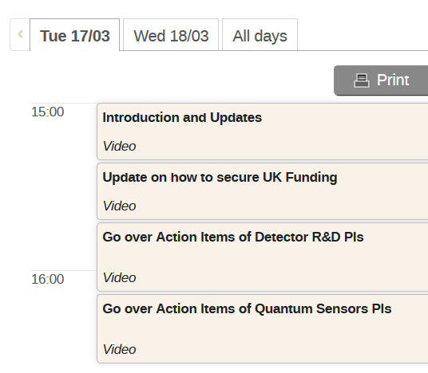
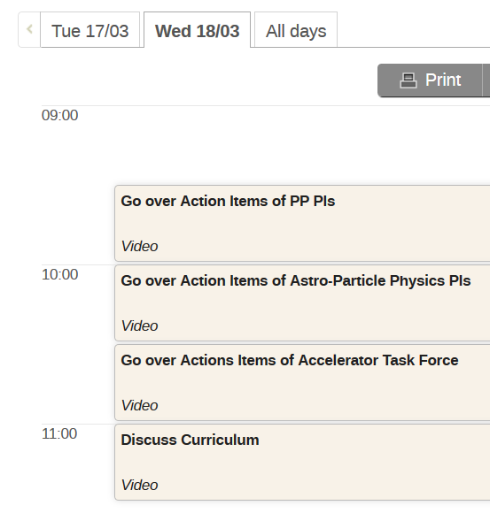
Agenda

