Slide 1
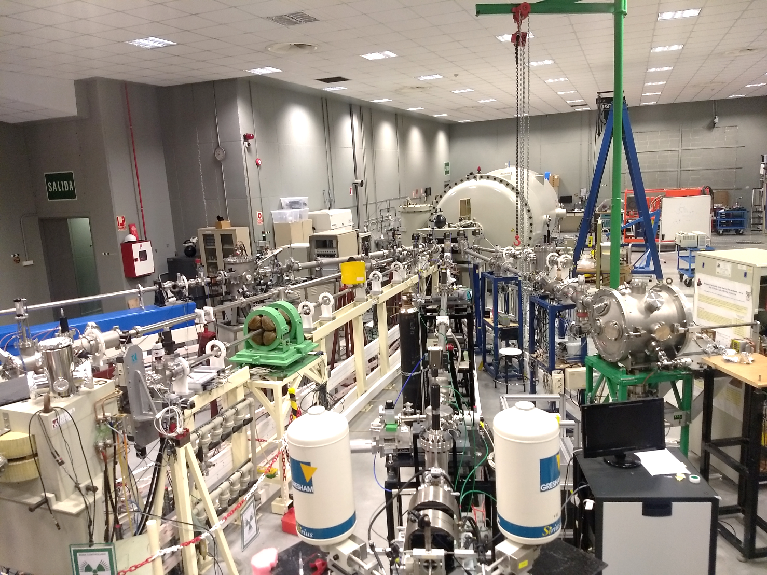
CMAM for Nuclear Physics
10th March 2026
Gastón García

Slide 2
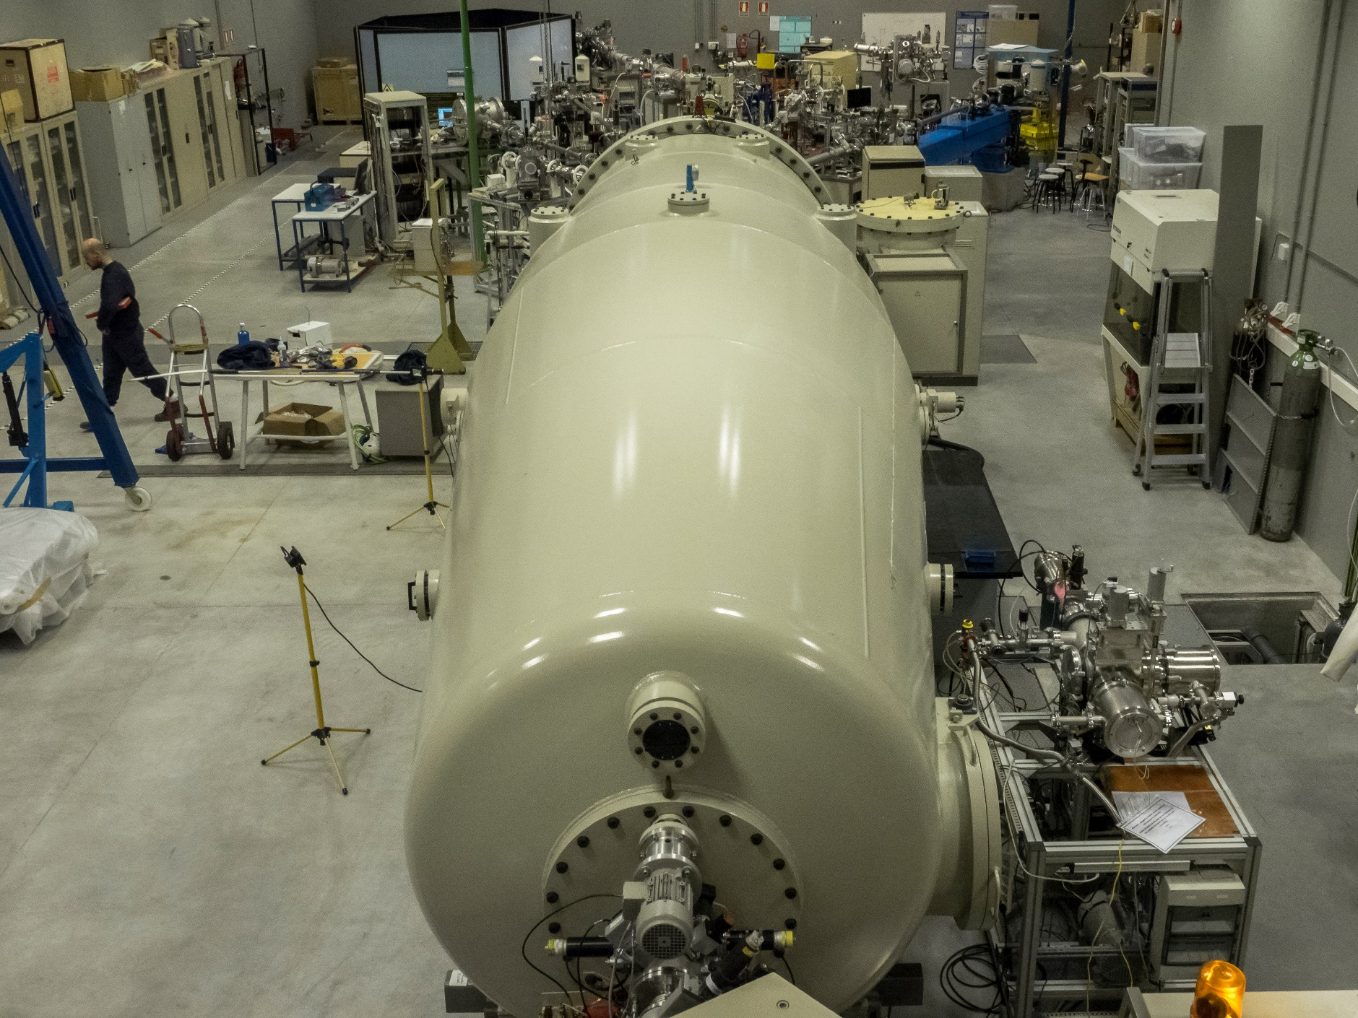
Contents
Accelerator, beamlines
Nuclear Physics BLs
Pulsed beam

Slide 3
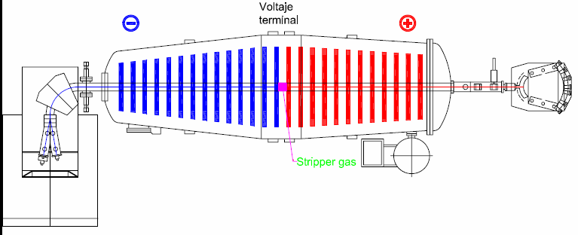
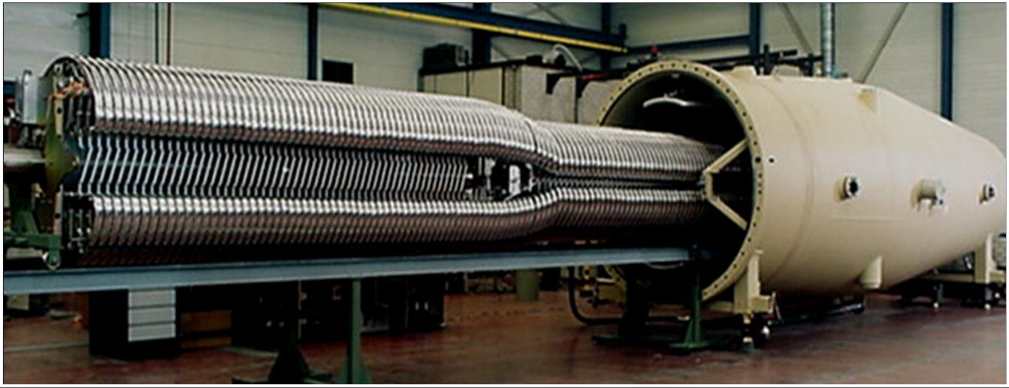
Accelerator
E_{max}=E_{ext}+VT·(q+1)·e
E₁ (MeV)=1·VT·e
E₂ (MeV)=q·VT·e
q= charge state
E_{ext} =V_{ext}·1·e
High stability (ripple below 1E-5)
Ion sources
Four sources:
Duoplasmatron: He
2 x pulsed duoplasmatron (He and H)
Sputtering: Solid targets, many beam species used & molecular beams posible, energy 10´s of MeV

Slide 4
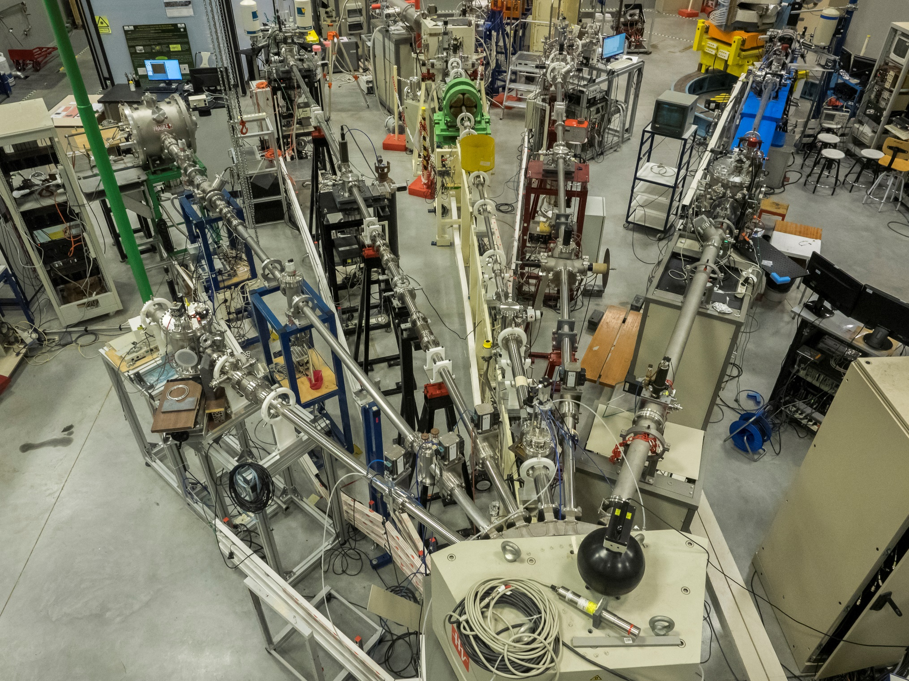
Beamlines
Implantation
BL (+fs laser)
Internal
μBL
External
μBL
ERD-TOF
BL
Nuclear
physics
BL
Standard
BL

Slide 5
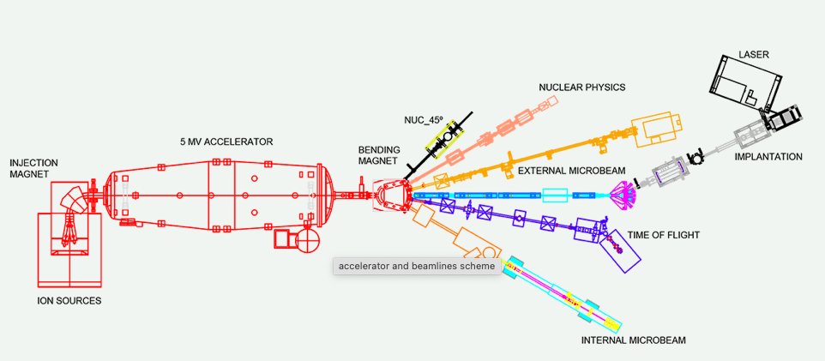

Nuclear Physics: NUC-30 & NUC-45º beamlines
5

Slide 6
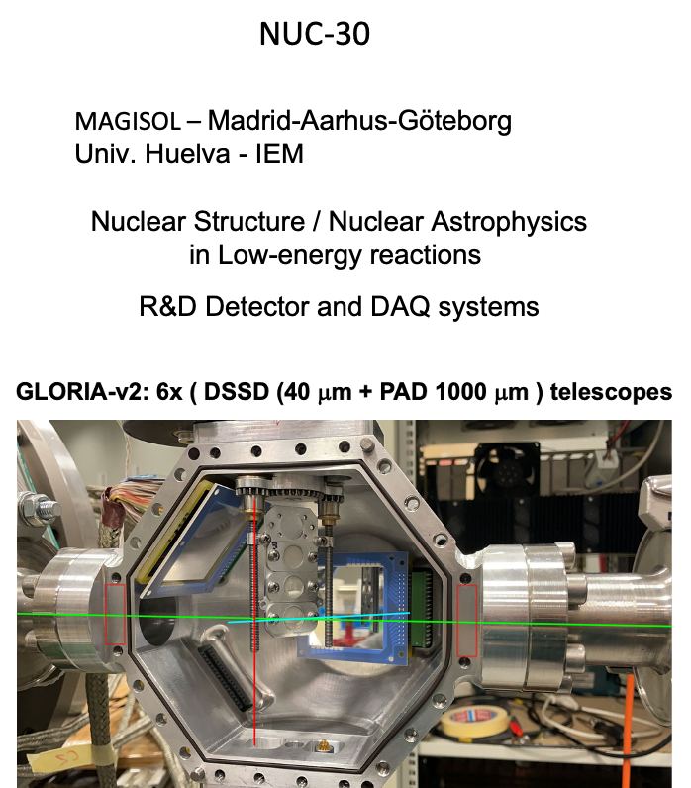
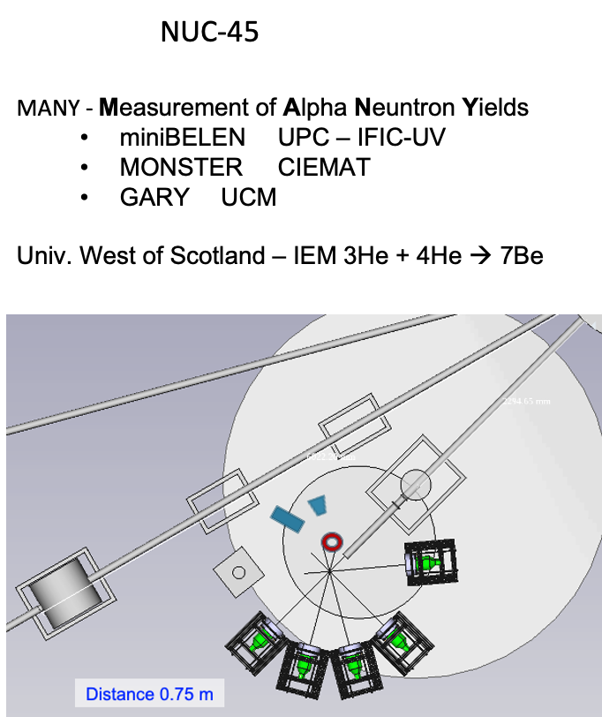
NUCLEAR BeamLines

Slide 7
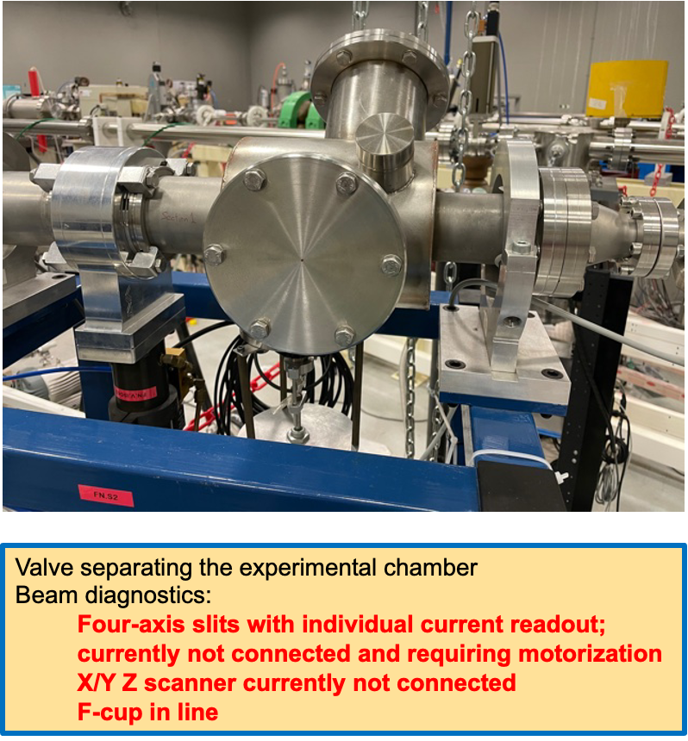
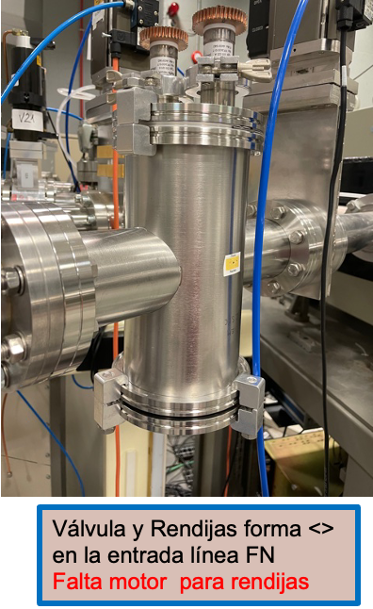

NUC30 Upgrade 2026
F-cup
X/Y Z scanner
4‑axis collimator slits.
Collimator <>

Slide 8
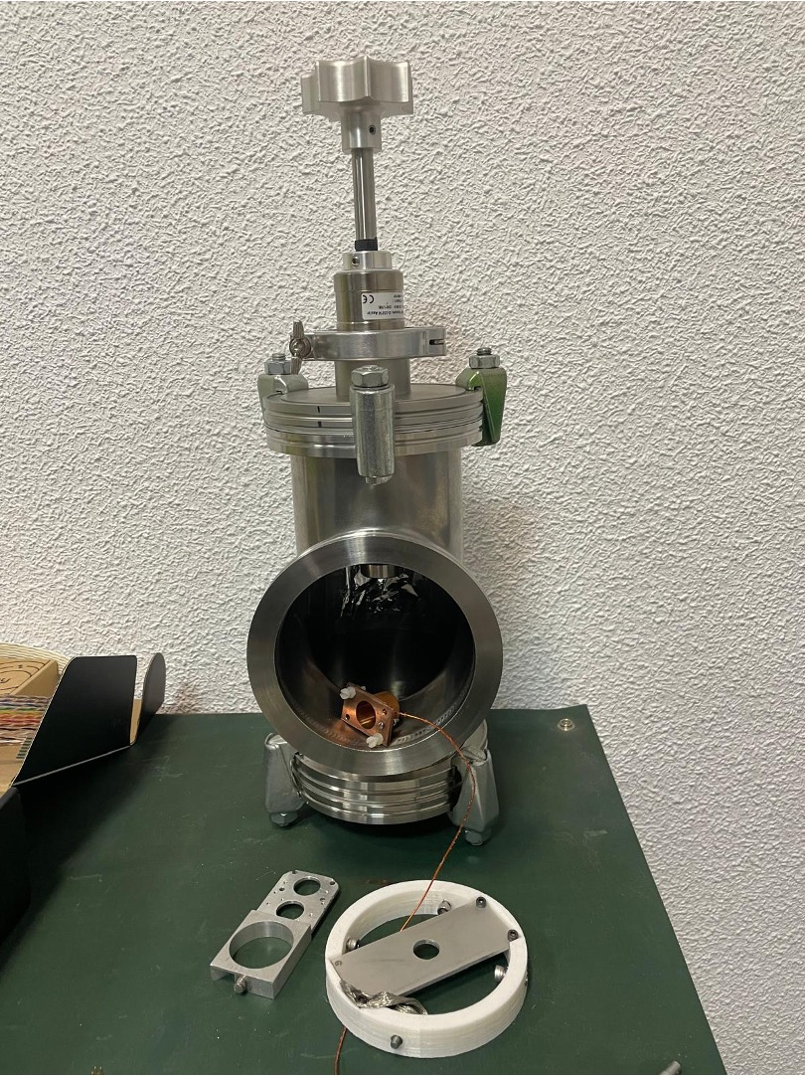
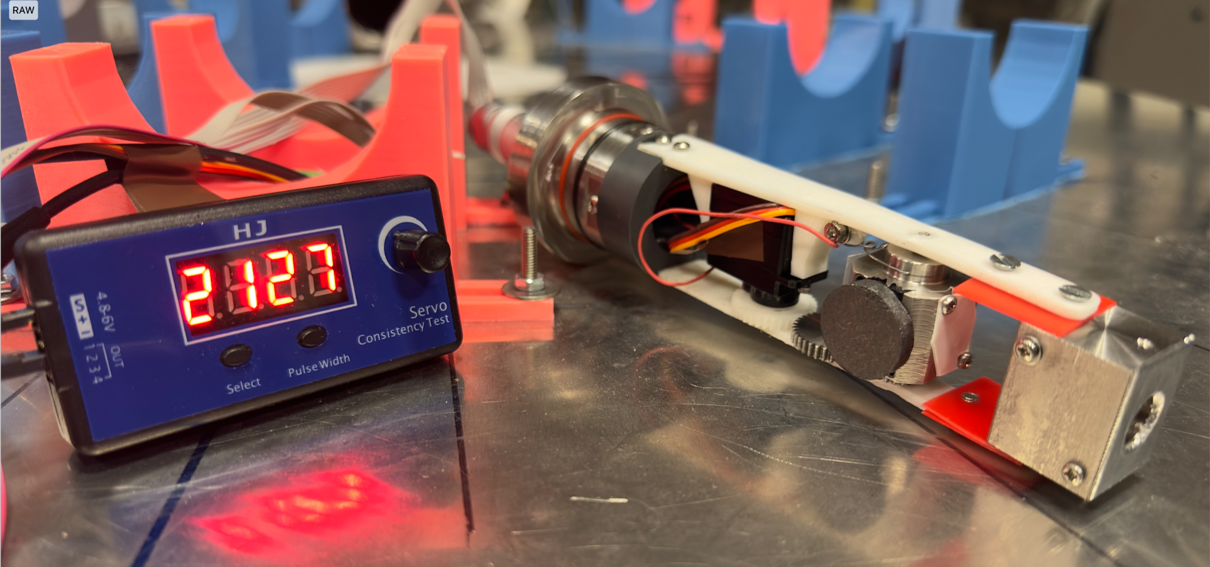
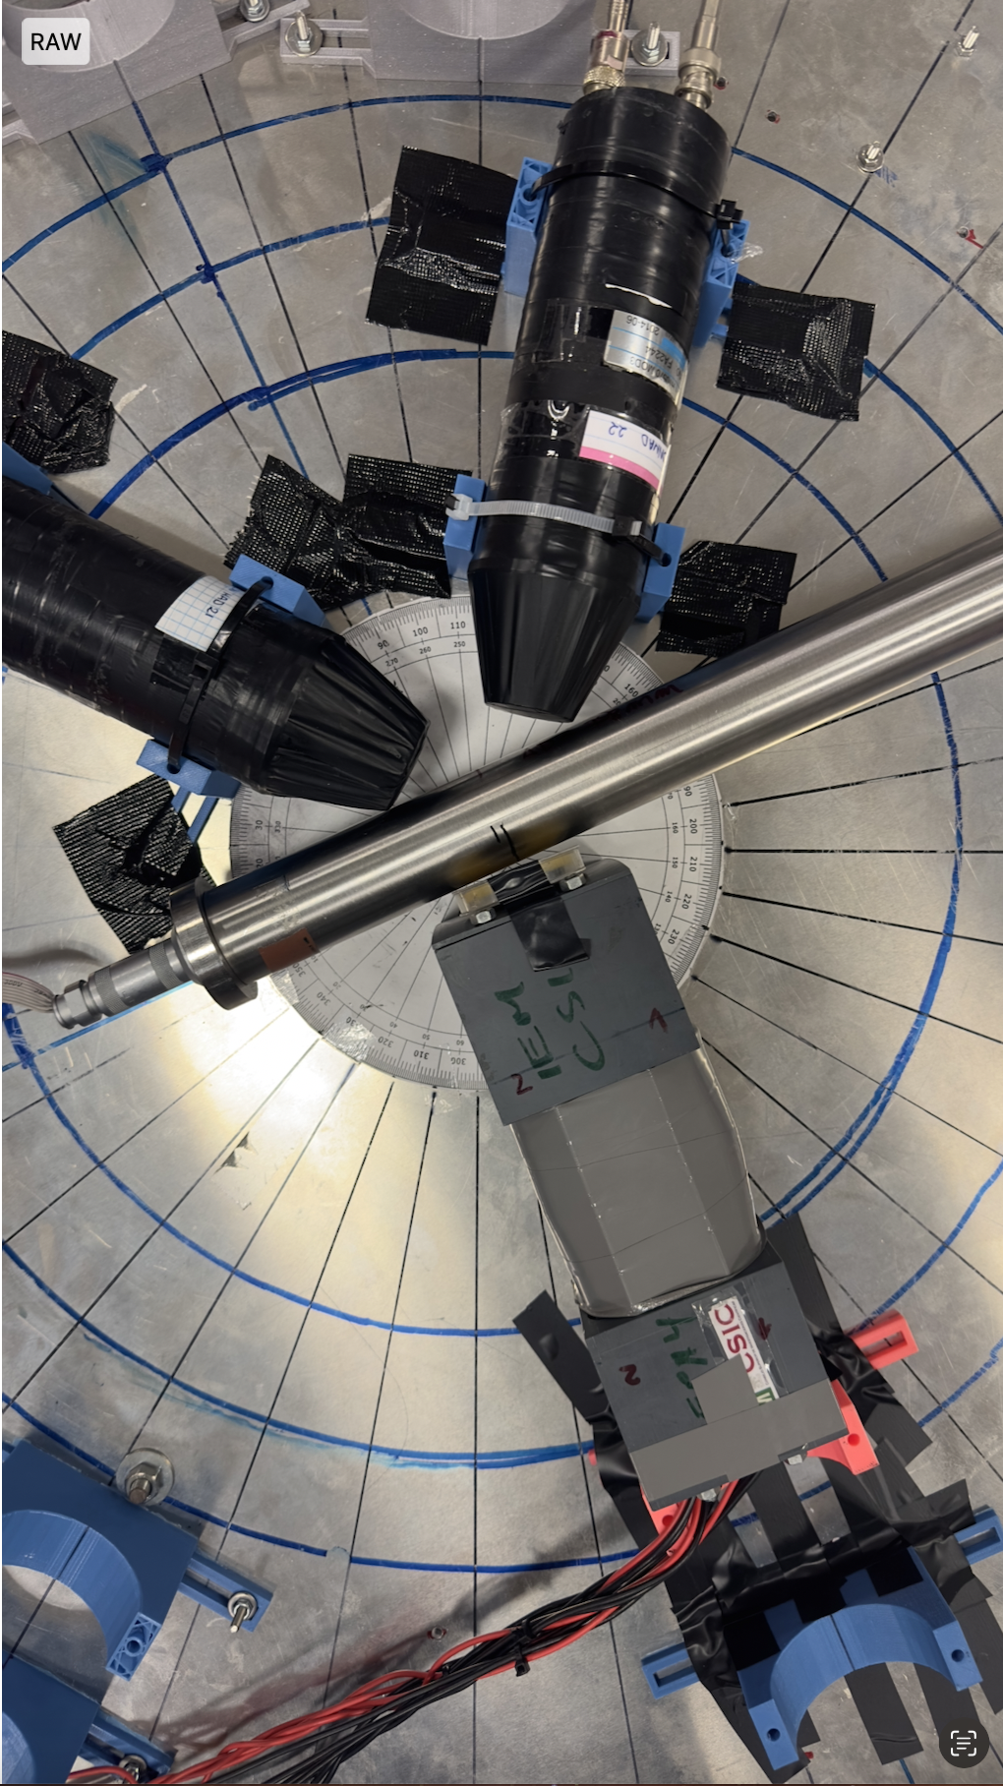
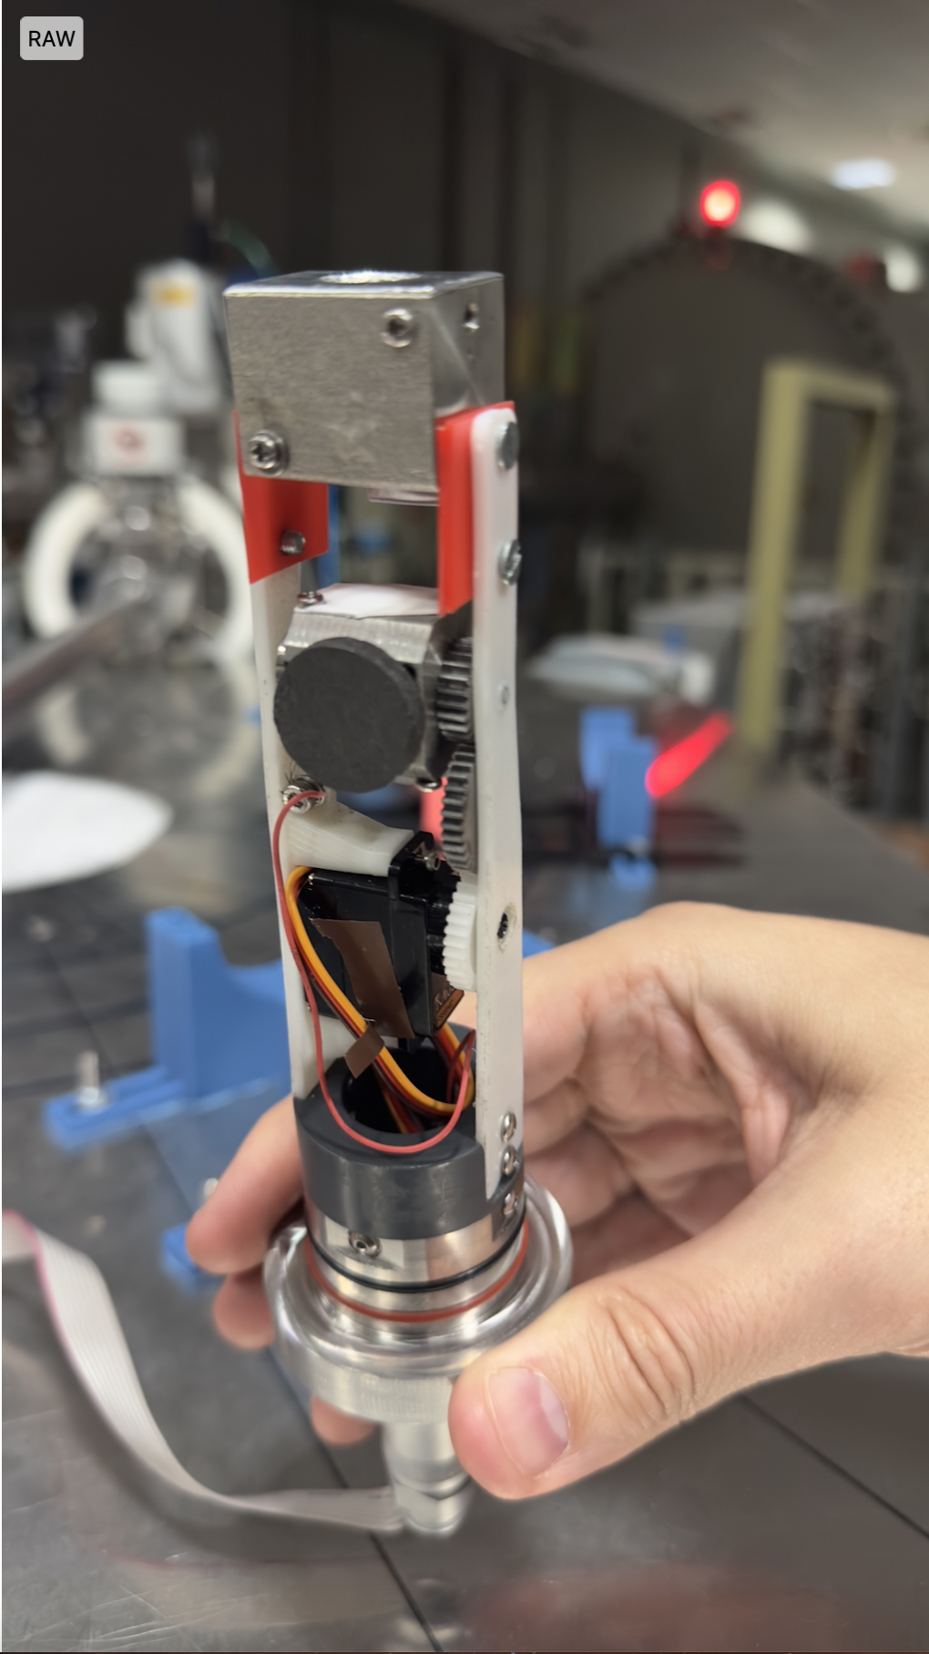
NUCLEAR BeamLines R&D
Computer controlled Rotary target developed for NUC-45
remotly & automatic change of different targets and F-cup without breaking vacuum
automatic cyclic change in/off beam and current measurement.
Rotatory target holder
teflon (pos. 2127)
graphite (pos. 1474)
nylon (pos. 871)
Target for:
Minibelen & GARRY
Target for Monster

Slide 9
Summary status of NUC BLs
NUC30 needs some refurbishment, but is a flexible tool for NUC experiments
NUC45 has very limited diagnostics and strong optics limitations, but is very flexible for ad-hoc setups

Slide 10
Pulsed beam
Ion sources
Chopper
Buncher
Continuous beam
Chopped bunch
Cumpressed bunch

Slide 11
Pulsed beam: phase space
t
E
E
t
t
After chopper
After buncher
E
E
After optimum drift space
t
t
After some drift space
t

Slide 12
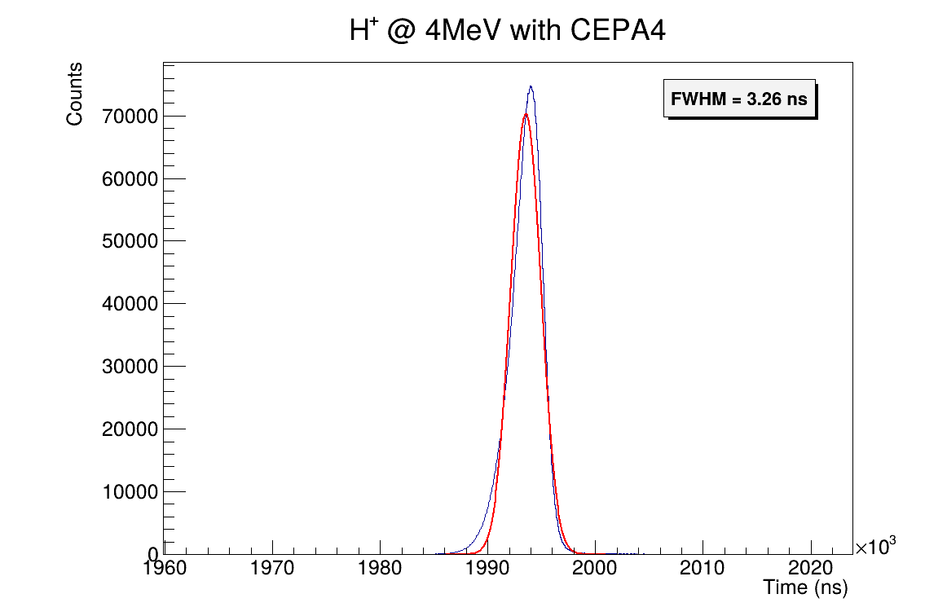
Pulsed proton beam
Commissioning on NUC-45: (27/01/2026)
²⁷Al(p,γ)²⁸Si
Beam energy: 4 MeV
FWHM ≈ 3.26 ns
Latest commissioning: (17/02/2026)
NUC-45: FWHM ≈ 2 ns
0º degrees: FWHM < 1.5 ns

Slide 13
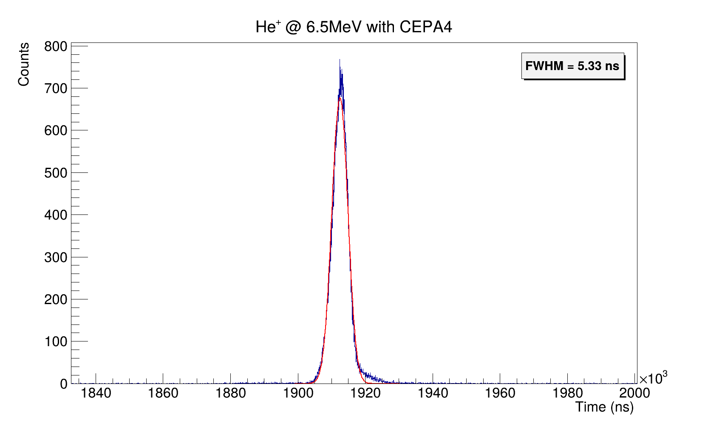
Pulsed alpha beam
Commissioning on NUC-45: (29/01/2026)
²⁷Al(α,γ)³⁰Si
Beam energy: 6.5 MeV
FWHM ≈ 5.3 ns

Slide 14
Pulsed beam: status
Pulsed beam with protons optimized (Δt < 2 ns)
Pulsed beam for alphas limited to Δt ~ 5ns
Most likely explanation is dispersive contribution of magnet at large angles (30-45deg)
Investing efforts in understanding better these limitations

