Slide 1


Contribution of IEM-CSIC to the IABA meeting
Luis Acosta
IEM-CSIC

Slide 2
The IEM-CSIC research lines for CNA-CMAM facilities
Nuclear instrumentation (ISRS Project, NUMEN Project)
Nuclear Physics (astrophysical reactions, charge state distributions, calibrations for nuclear emulsion).
Applied physics AMS for geophysical studies.

Slide 3
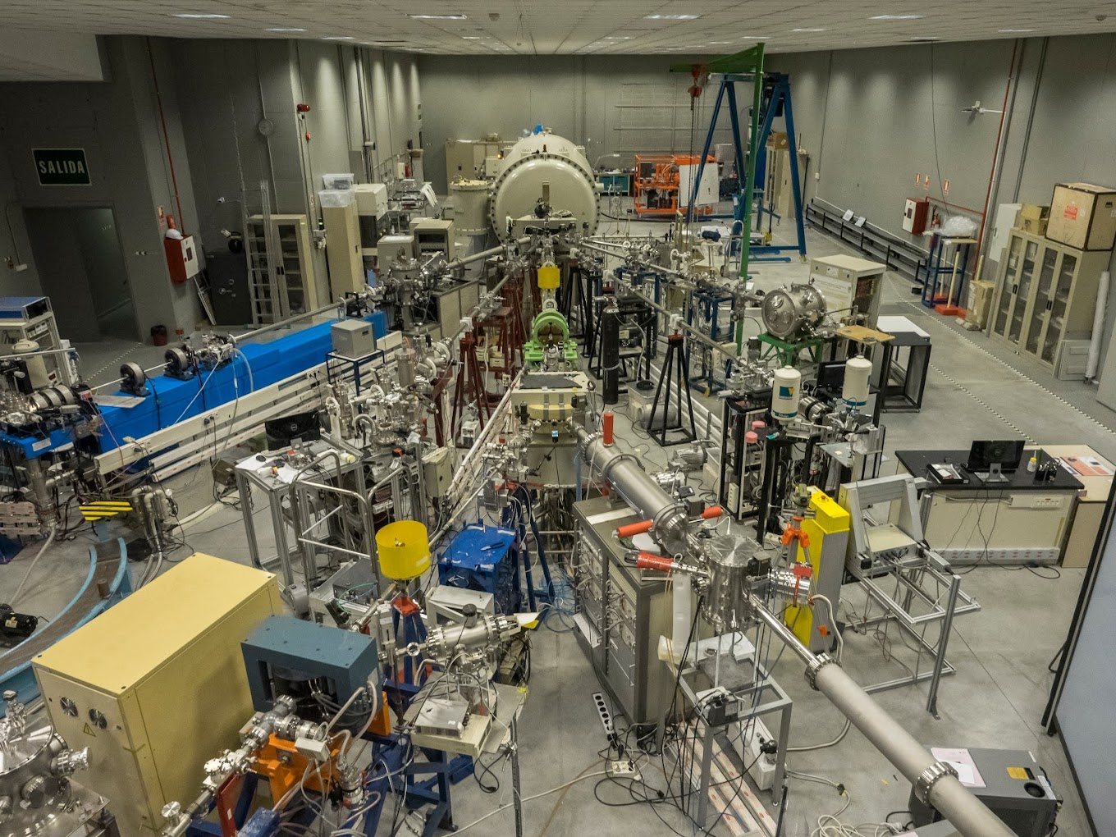
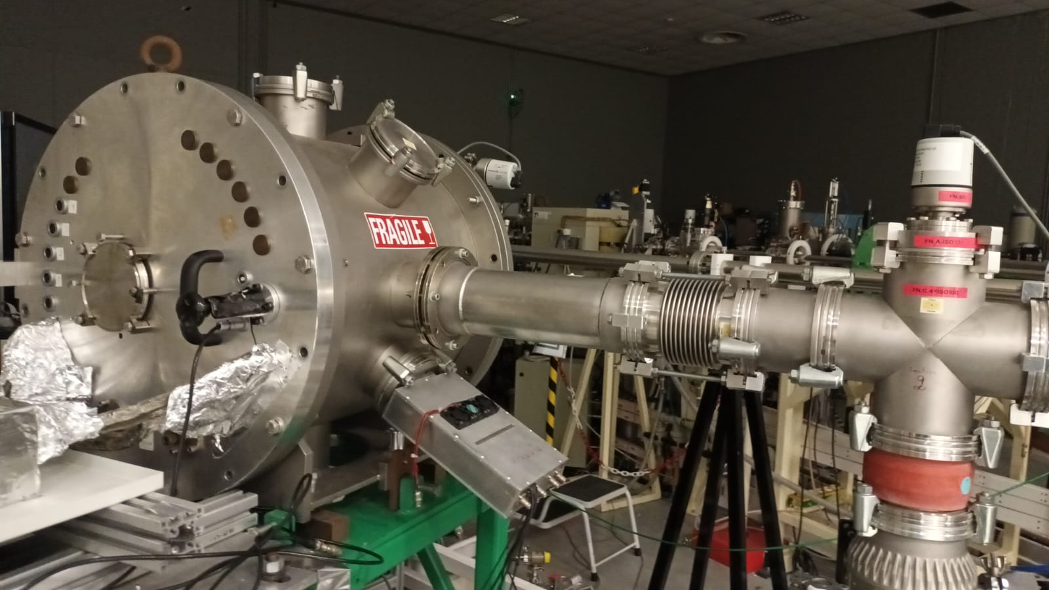
The ISRS focal plane elements T. Kurtukian, L. Acosta, O. Tengblad, MJG. Borge
The main part from IEM-CSIC regarding ISRS project is related to the focal plane elements:
Quadrupoles, Focal plane chamber, Focal plane detectors.
With the aim to probe all these elements, we are planning to make our “demonstrator” in the Nuclear Physics Line of CMAM.
30 deg beamline

Slide 4
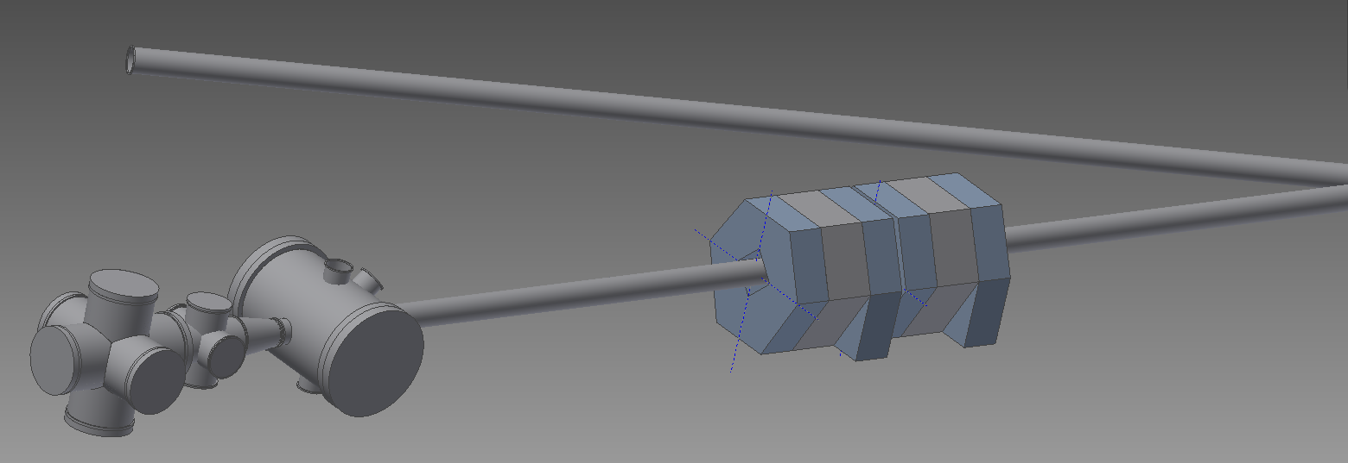
Planned layout
Nuclear Physics line Chamber
30deg
ISRS chambers
ISRS quadrupoles

Slide 5
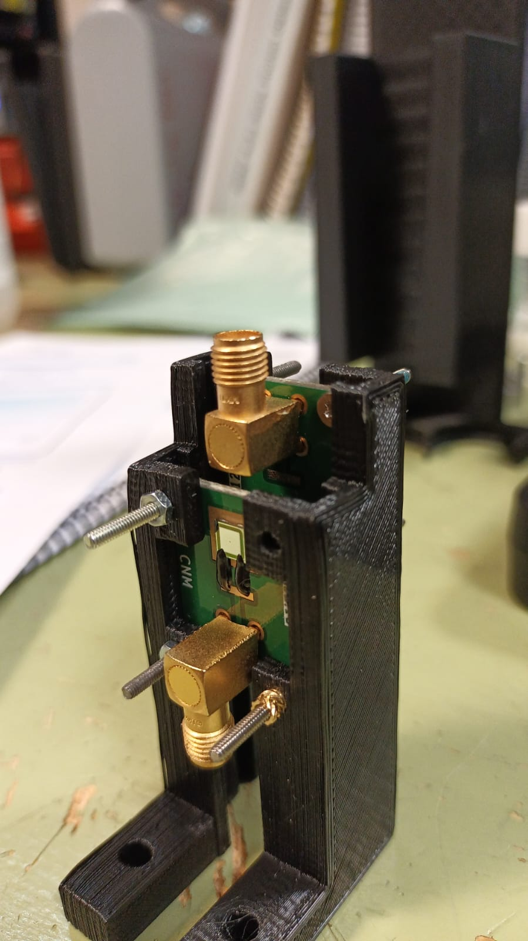
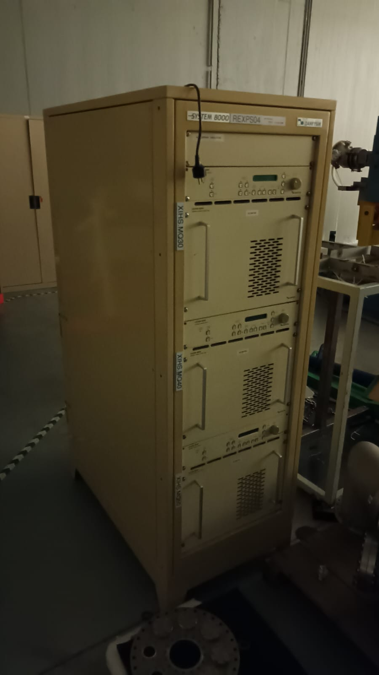
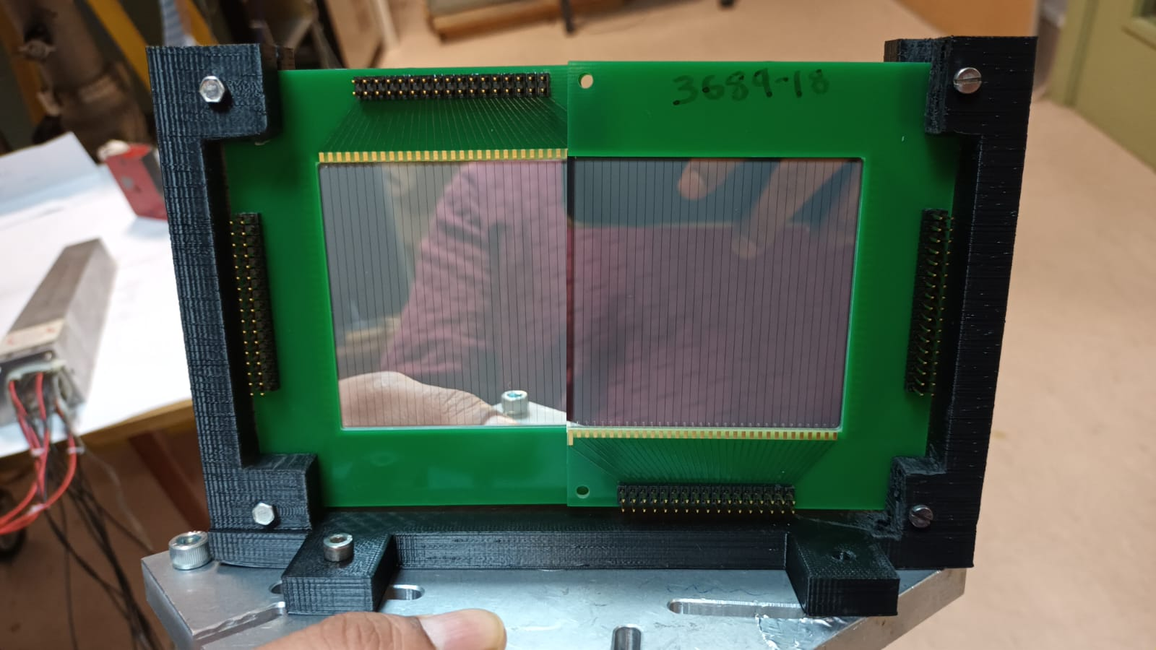
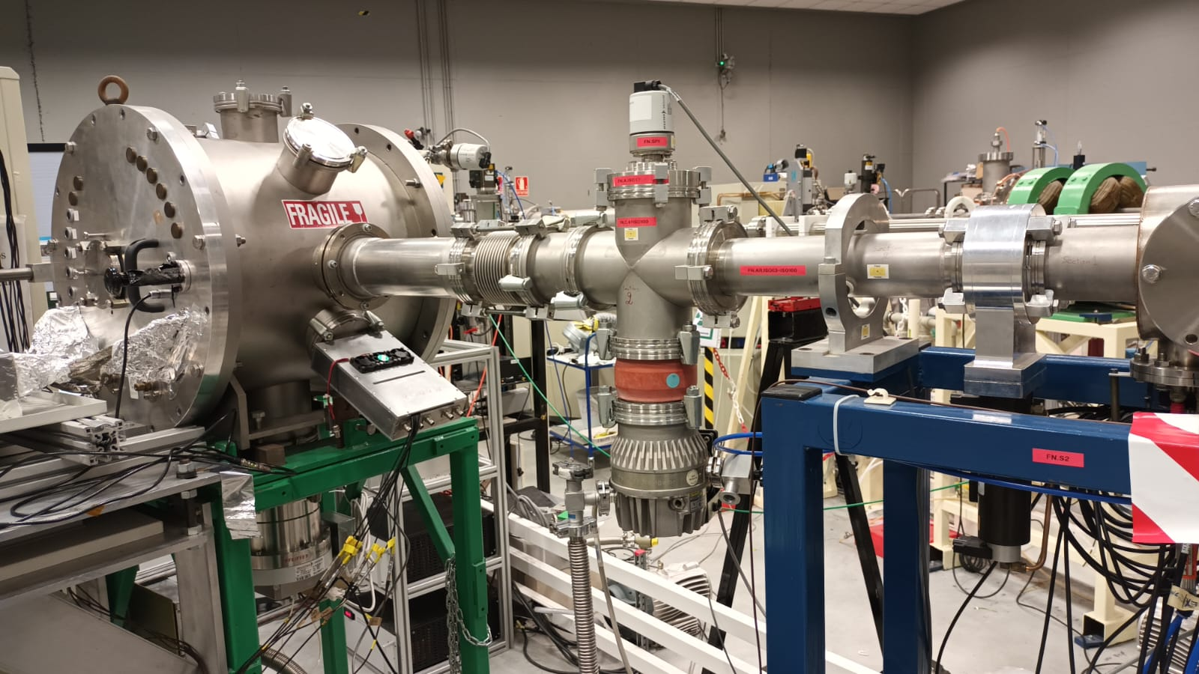
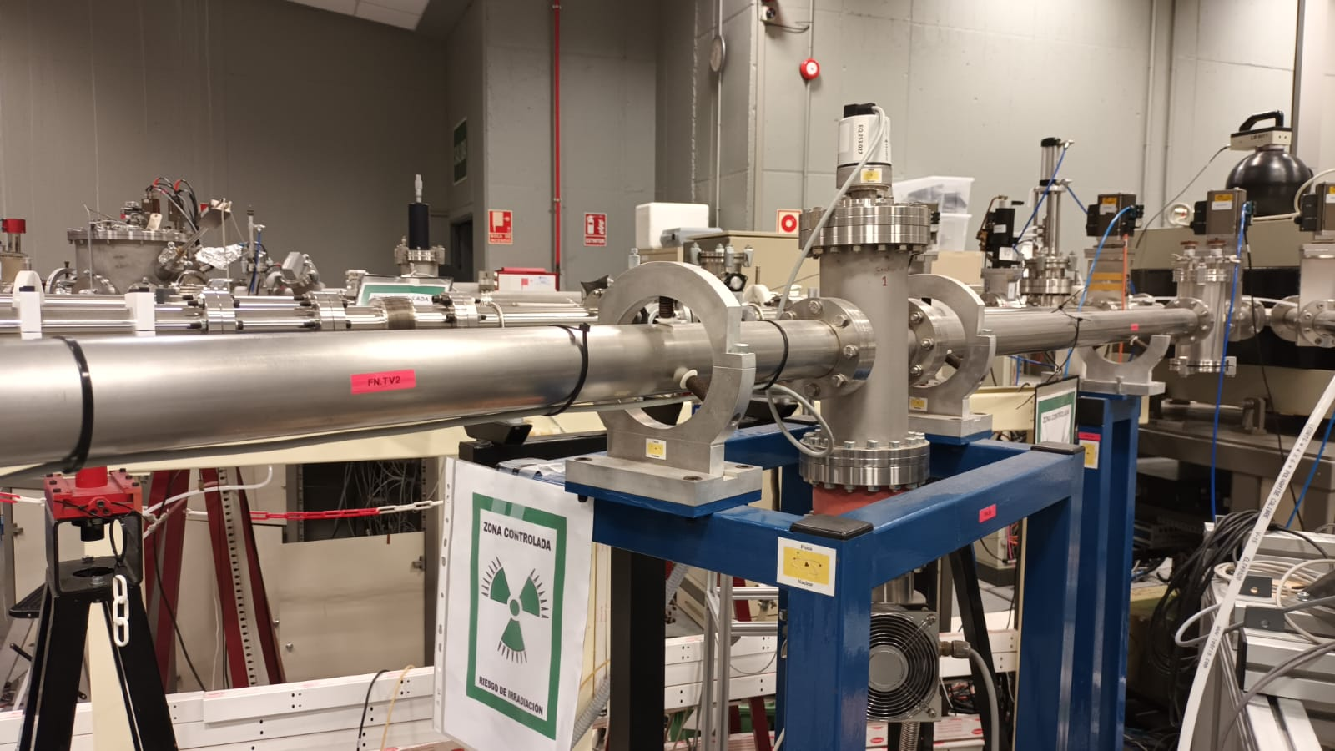
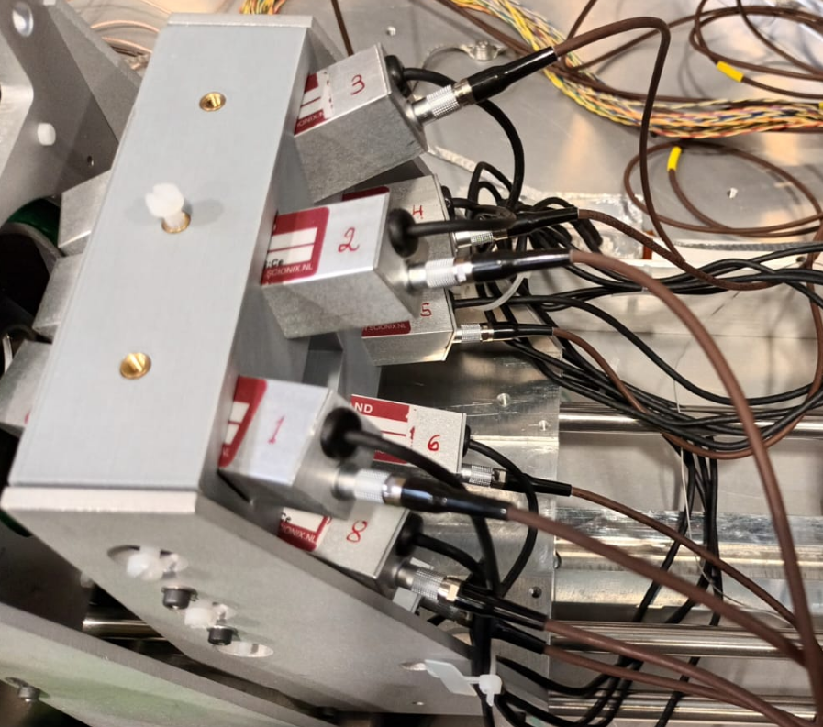
Nuclear Physics line Chamber
30deg
ISRS chambers
ISRS quadrupoles

Slide 6
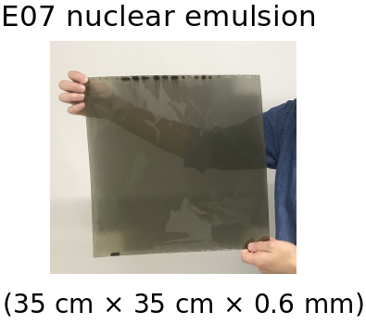
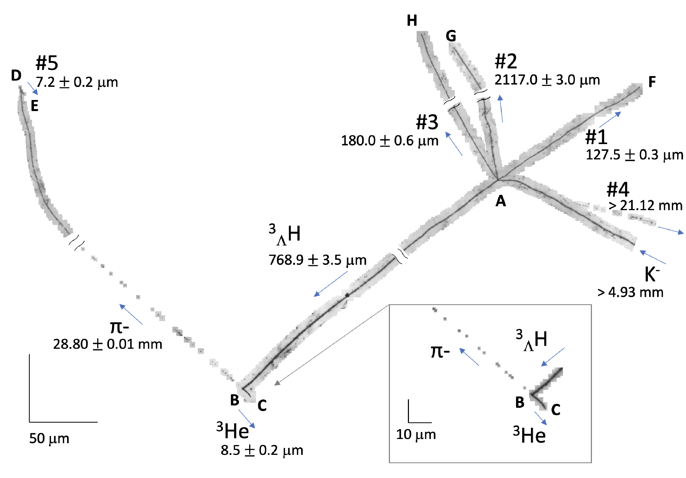
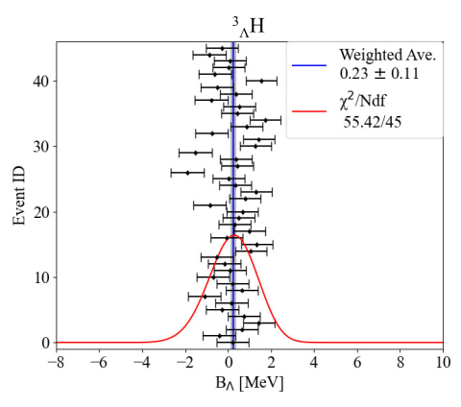
CMAM – Nuclear Emulsion calibration (C. Rappold)
Nuclear Emulsion E07 experiment JPARC: Search hypernuclei with AI
Only possible thanks to Range ↔ Ek relation calibration
alpha decay of U-chain or Th-chain impurity → He isotope calibration
→ Applied to π- : more 2 MeV/c shift / yet we aim a ±14 keV in systematics
Precise H isotope calibration: CMAM beam very energy stable
→ stack of emulsion + irradiation of emulsions
→ Range measurement ↔ Energy = R-Ek very precise calibration
[T. Saito et al., Nat. Rev. Phys. 3, 803 (2021)]
[A Kasagi et al., Prog. Theor. Exp. Phys. 8, 083D01 (2025)]
→ 50 more events
in 0.6% of 150PB
of data
± 50 keV (Sys)
Notes:
The E07 experiment used a hybrid method combining a silicon tracker, a kaon spectrometer, and nuclear emulsions. The idea is to use a (K-, K+) reaction to produce a Ξ- particle from a diamond target. This Ξ- is tracked with the silicon trackers and goes through the nuclear emulsion stacks (35 cm × 35 cm × 0.6 mm), in which the Ξ- is captured by a nucleus of the nuclear emulsion film. The captured Ξ- can then form a Ξ hypernucleus or a double-Λ hypernucleus. The purpose of the detectors is to determine, more or less, where the Ξ- entered the nuclear emulsions, which helps to find them in the emulsions. With this technique, the E07 collaboration has found 33 double-strangeness hypernuclei.

Slide 7
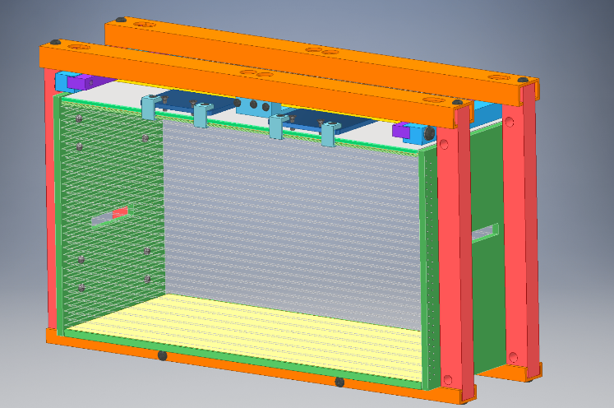
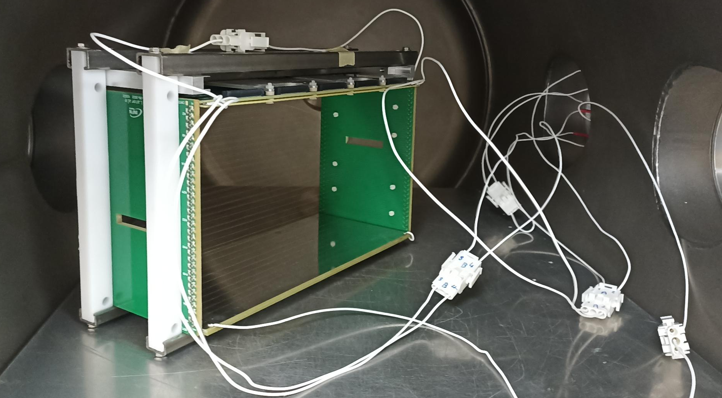
Test for the NUMEN tracker
(M. Cavallaro, Y. Ayyad, L. Acosta)
Thick Gas Electron Multiplier (THGEM)
Manufactured by standard PCB techniques of precise drilling in G-10/FR-4 (and other materials) and Cu etching
Characterization of the particle identification properties of the gas tracker coupled to a part of NUMEN-SiC detectors.
We need a beam impinging on a target and the scattering particles will reach a chamber containing the tracker at low pressure (10-50 mbar) gas (typically isobutane, or possibly Ar-Co2).
The tracker should be tilted around the vertical axis with respect to
the scattering particles at an average angle of around 50-60 degrees
(which is the typical geometry of the MAGNEX focal plane detector).
In this test we would use the gas tracker not only to track particles,
but also to measure the energy loss in the low pressure gas.
The SiC array will measure the residual energy.
17 cm
30 cm
13 cm

Slide 8
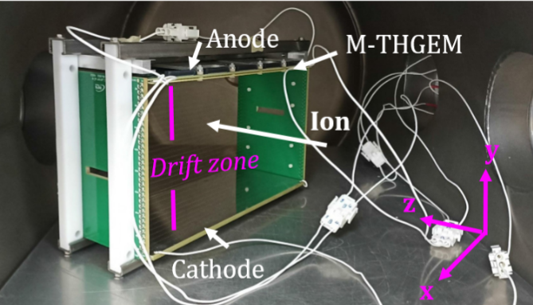
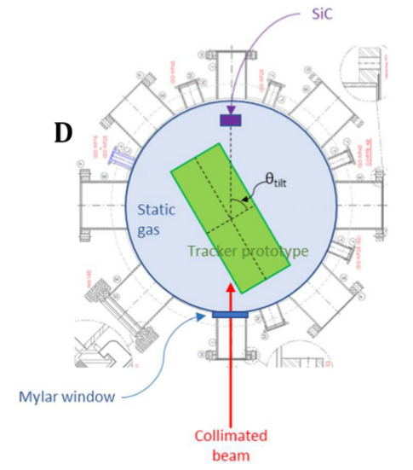
Determination of the resolution and accuracy in the measurement of the absolute position and angles extracted by the tracker.
In this case we would need a pencil beam hitting the tracker (tilted at 60 degrees).
The important and challenging aspect of this measurement is the alignment.
The absolute position of the tracker (of the segmented anode) should be known with an accuracy of about 0.1-0.2 mm.
Chambers will be provided by IEM and USC/IGFAE. A tracker prototype is been finished at USC/IGFAE.
LNS-INFN NUMEN collaboration will provide detectors, electronics and DAQ, all the present ones performed for NUMEN-project.
EPJ Web of Conferences 333, 03006 (2025)

Slide 9


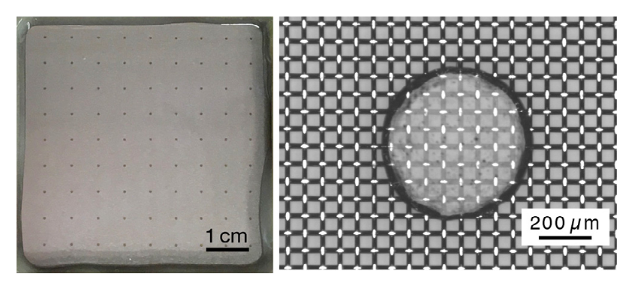
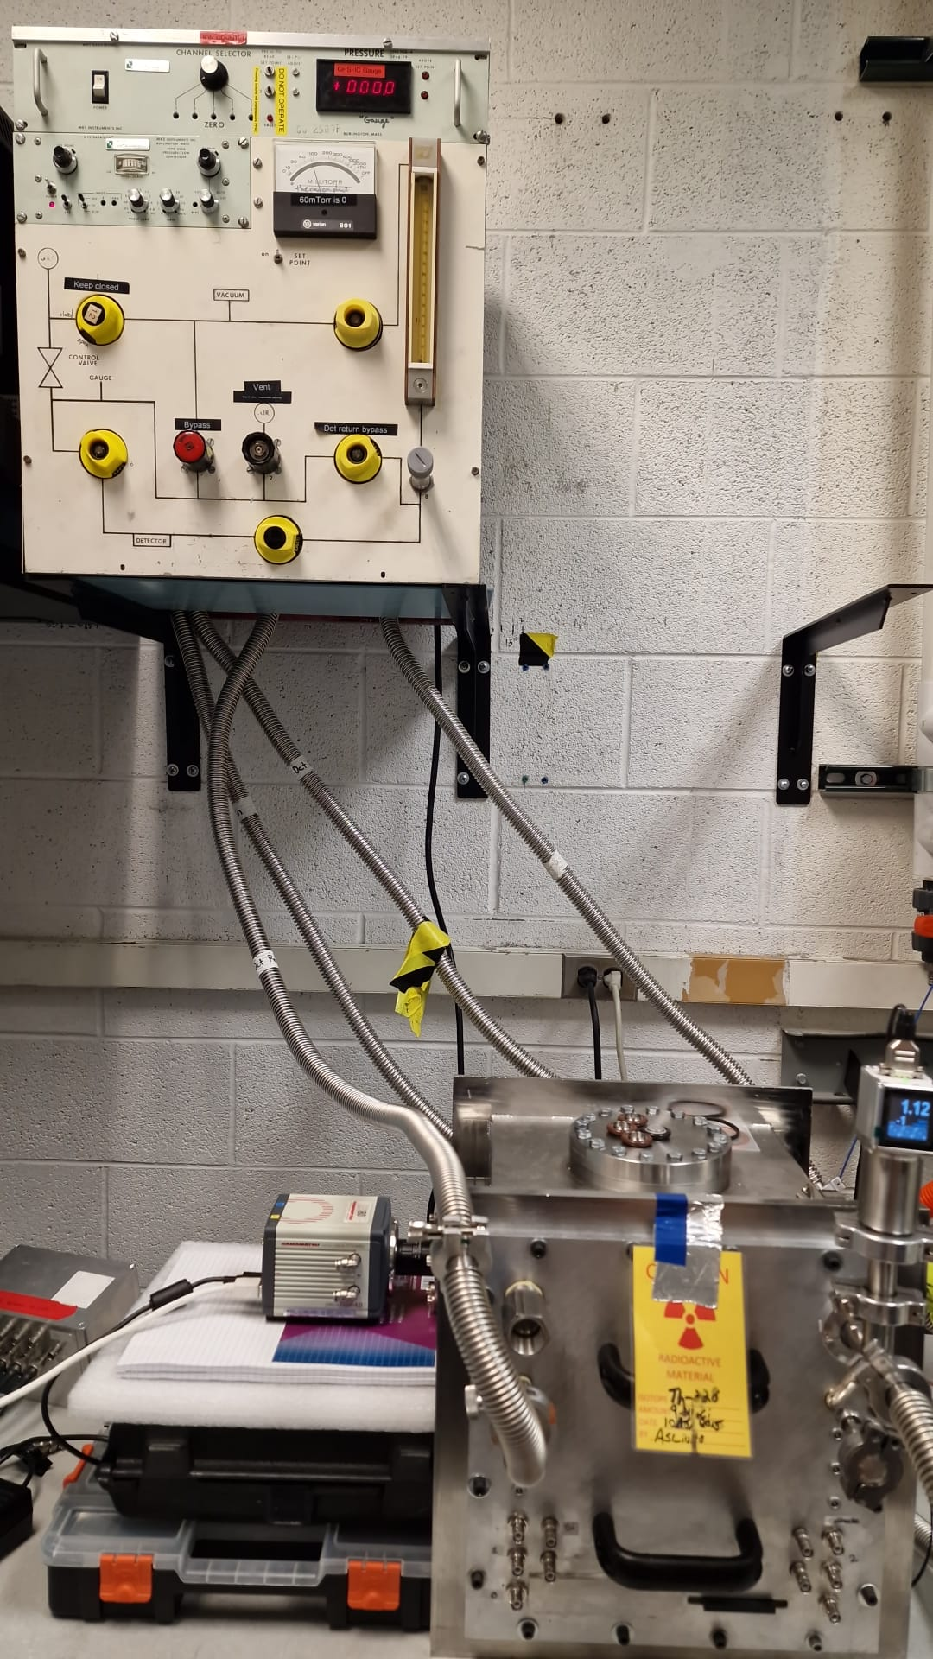
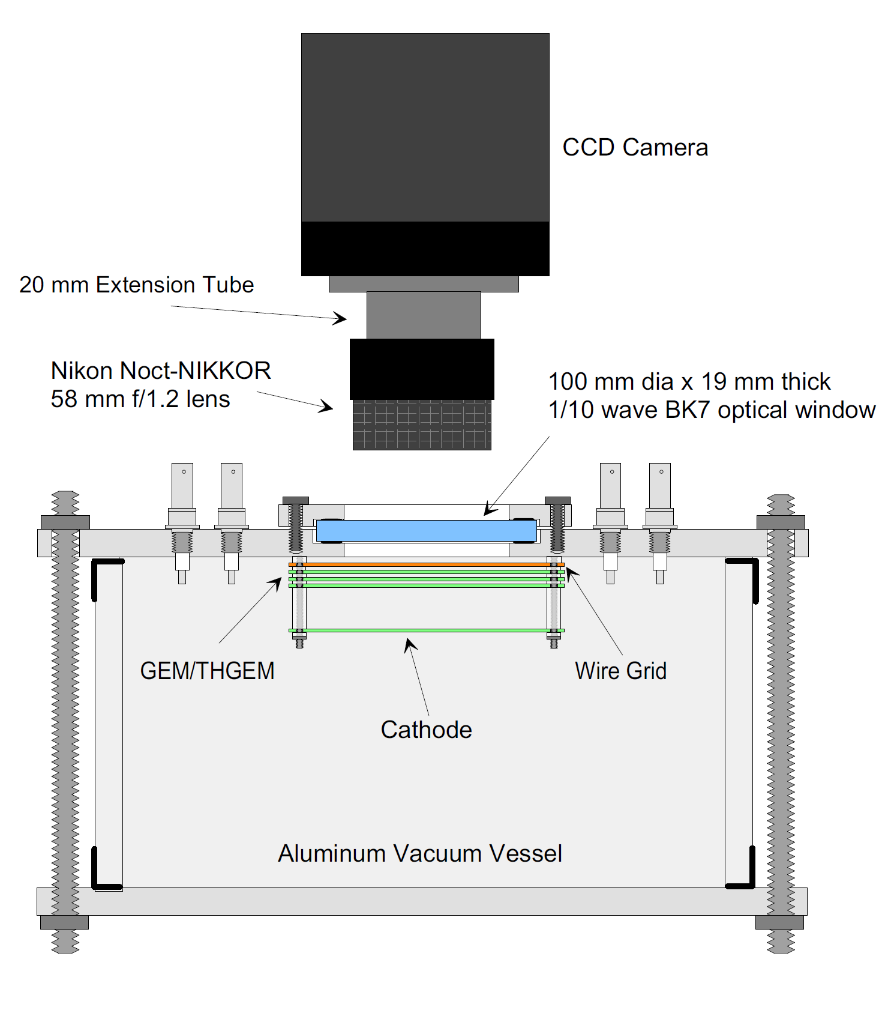
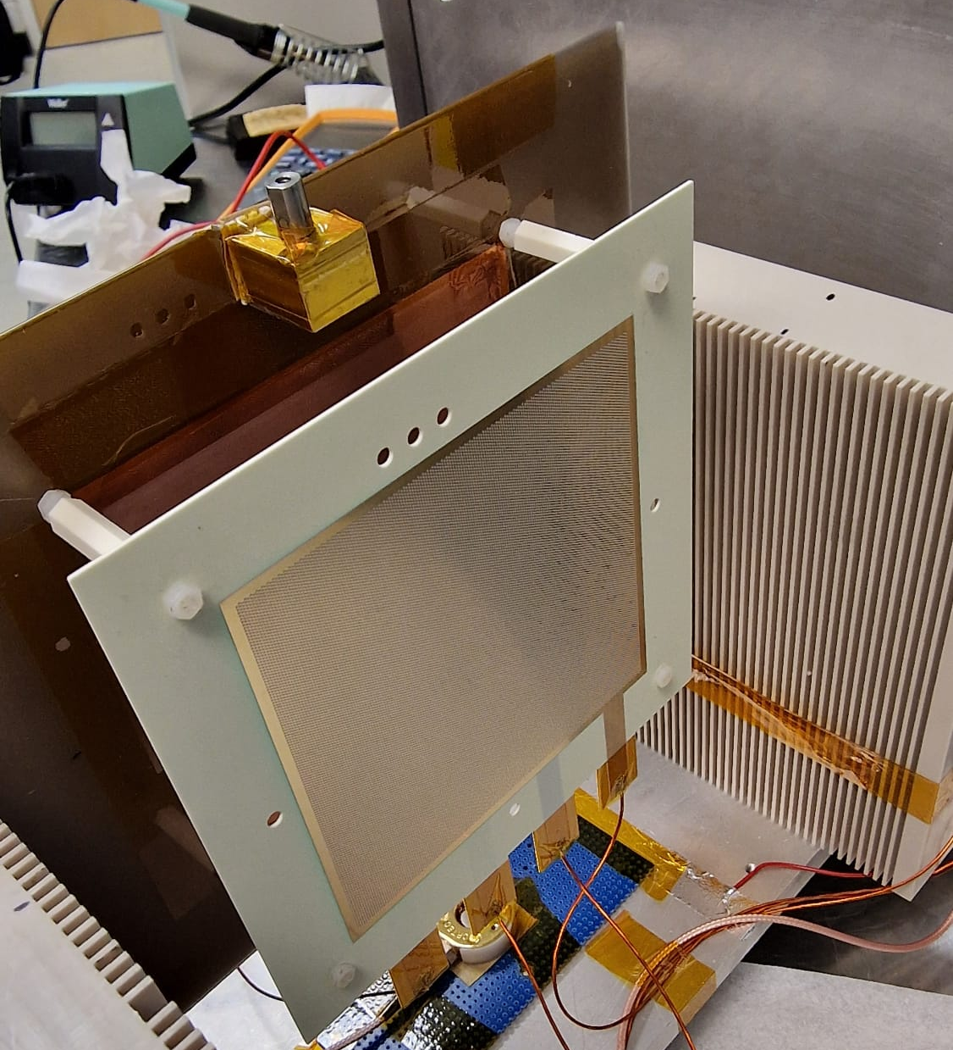
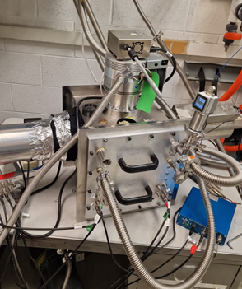
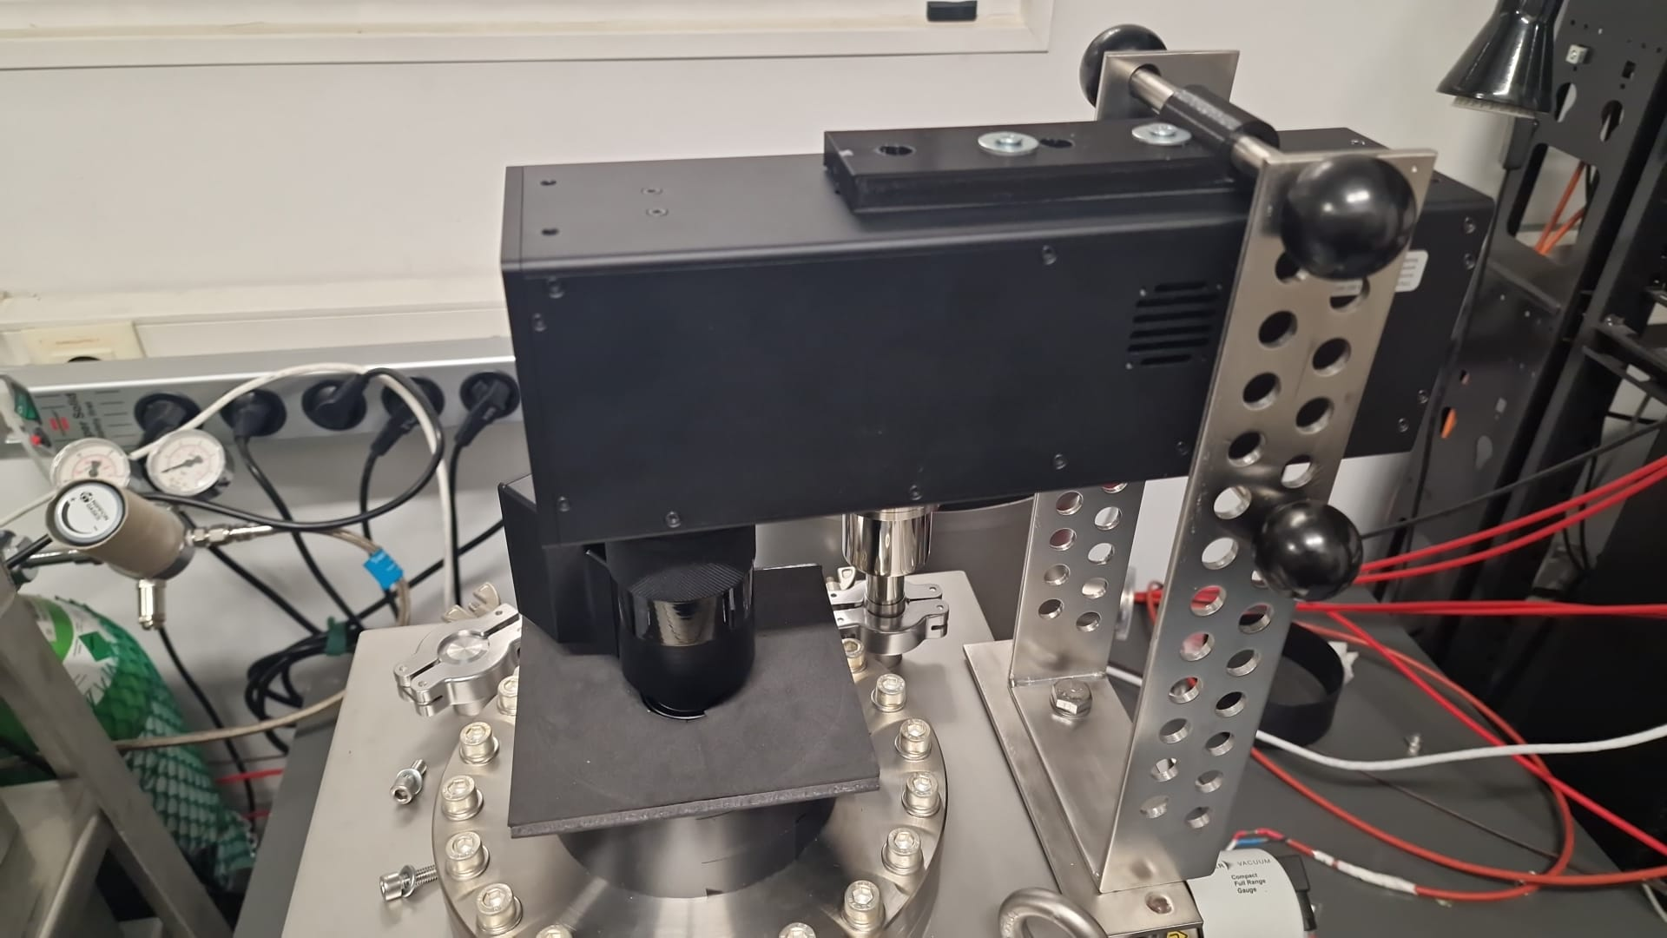
Optical TPCs and Active Target
(Y. Ayyad and IEM-staff)
Camera
F. Brunbauer et al., NIM, A 955 (2020) 163320
Lens
Viewport
GlassMM
MThGEM
Amplification
structure
Cathode
Vacuum vessel
9

Slide 10
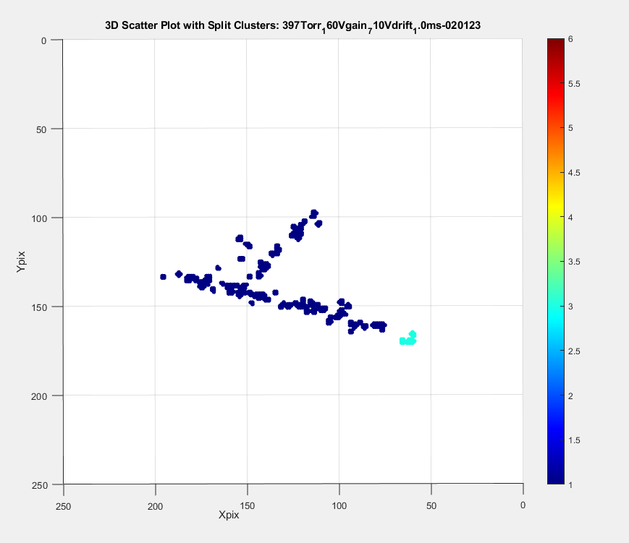
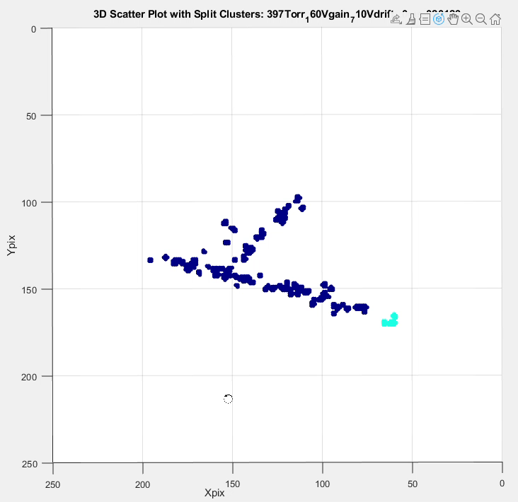
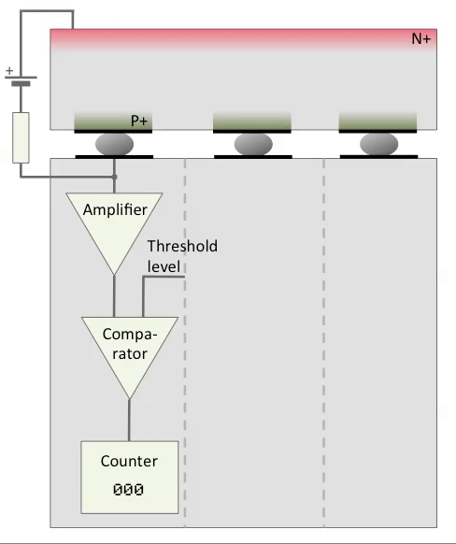
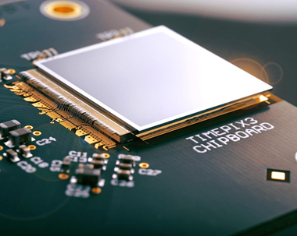
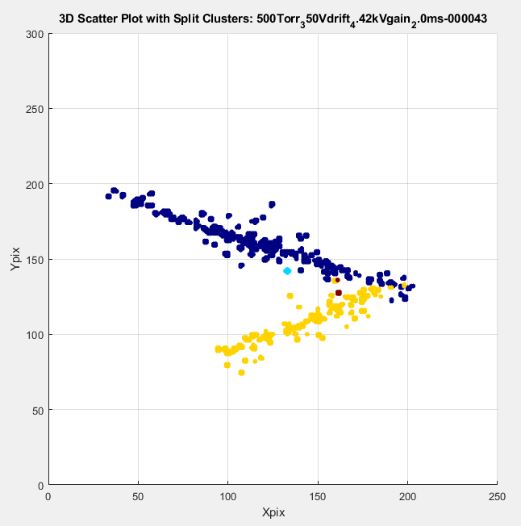
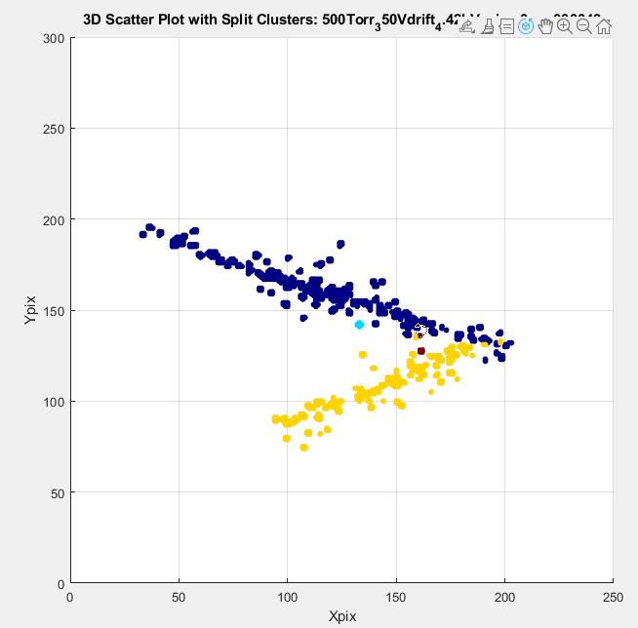
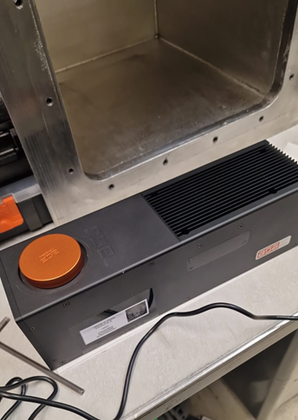

Optical TPC results
Low pressure He alpha scattering
Timepix 3D reconstruction
Experimental campaign at FRIB (April 2024)
10

Slide 11

Measure of charge state distributions
(C. Ruiz, M. Alcorta + CMAM+IEM-Staffs)
The main idea is to measure different stable beams on H and He target to obtain charge state distributions. The interest is particularly required for Mg beams.
The problem appears considering the simulation with commercial programs give non reliable results for beam charge stage distribution with gas targets (the plan for this experiments is to use windowless jet targets), when the goal is to measure cross sections.
Looking the developing of this concept into a larger campaign to measure charge state distributions of various beams and energies.
The goal would be to create a compilation and simulation tool for the wider user community. This would require a grant to e.g. build a purpose-built windowless gas target with associated infrastructure (pumps), as well as associated diagnostics and an analysing magnet.

Slide 12
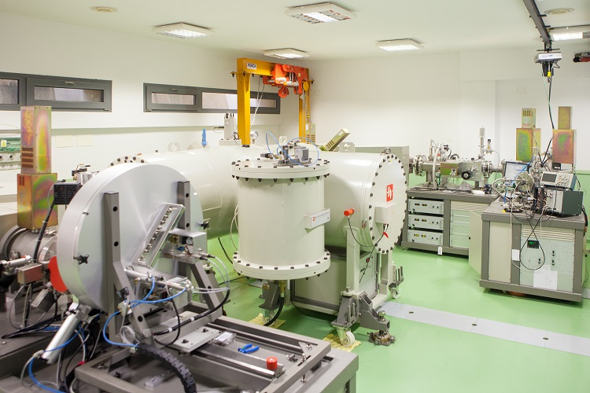
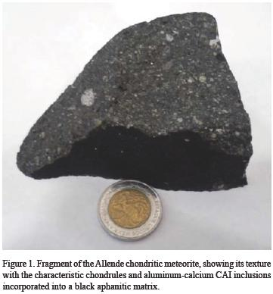
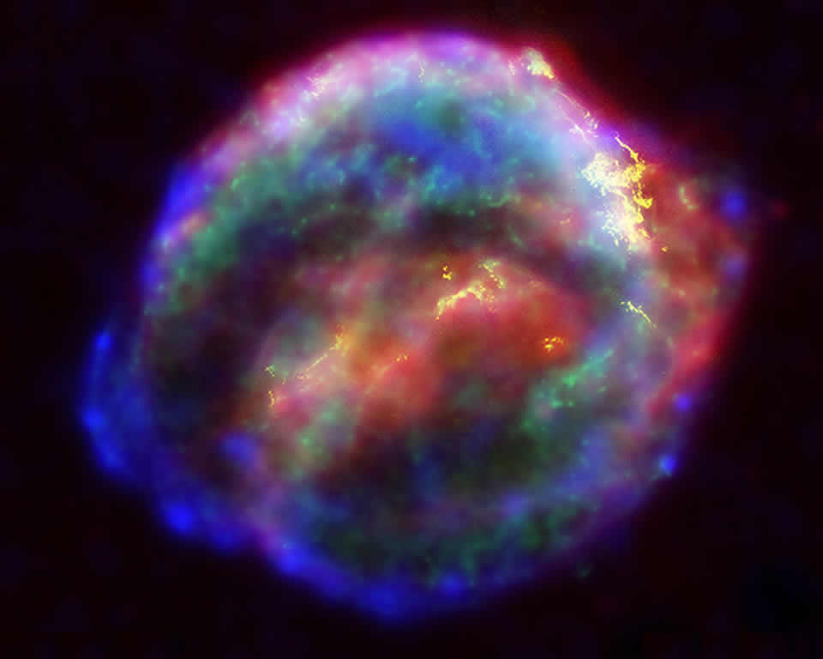
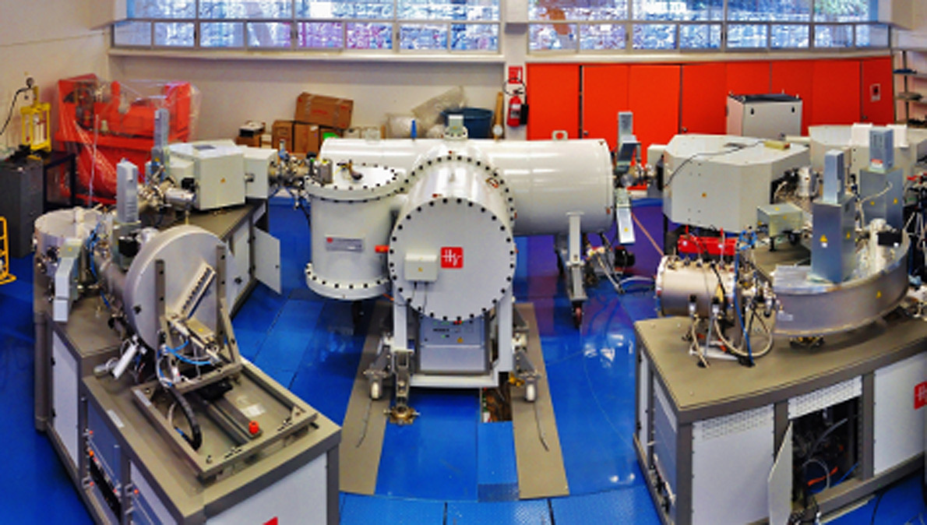
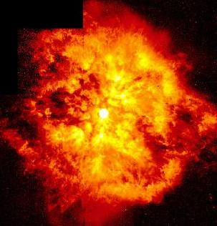
Intercomparison SARA-LEMA (AMS studies)
(L. Acosta and LEMA/SARA staff)
Astrophysical studies with ²⁶Al
Though many studies regarding ²⁶Al has been carried out, still exist some discrepancies about its production in the interstellar medium.
²⁸Si(d,α)²⁶Al
could contribute to explain the fraction of ²⁶Mg found in meteorites, considering that not all ²⁶Mg found, for instance in Allende meteorite, may be related to the previous presence of ²⁶Al.
²⁵Mg(p,γ)²⁶Al
It is not totally known which starts make the most important contribution (W-R, novae, AGB, supernovae explosion, etc.).

Slide 13
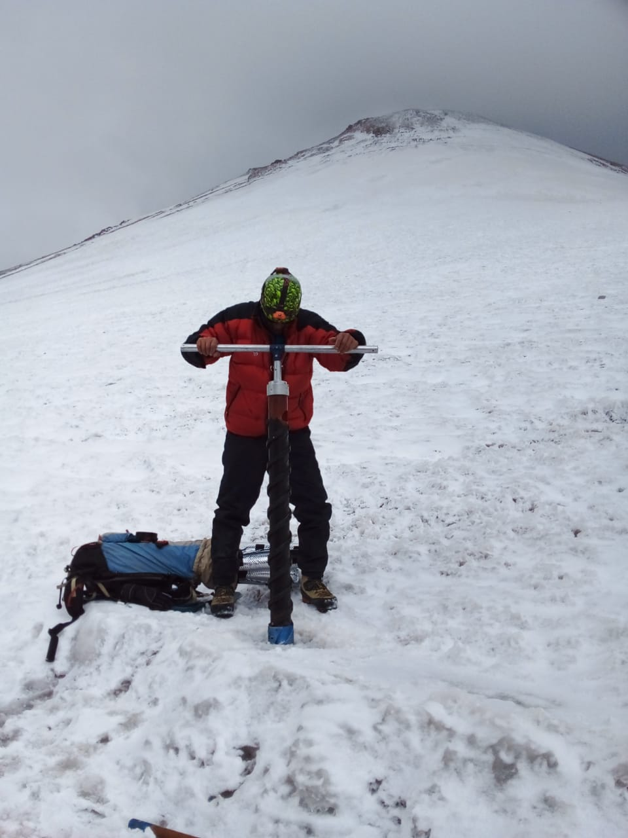
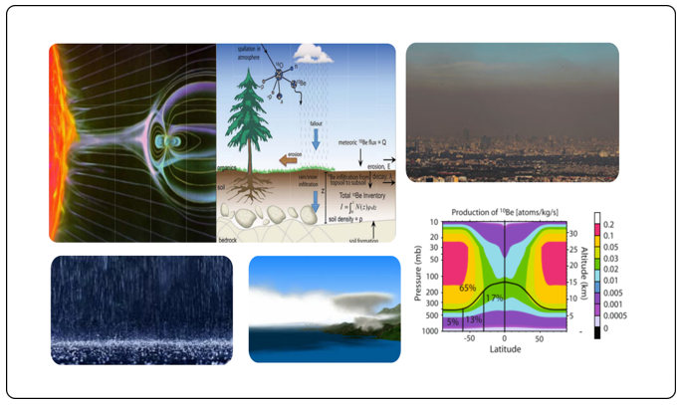
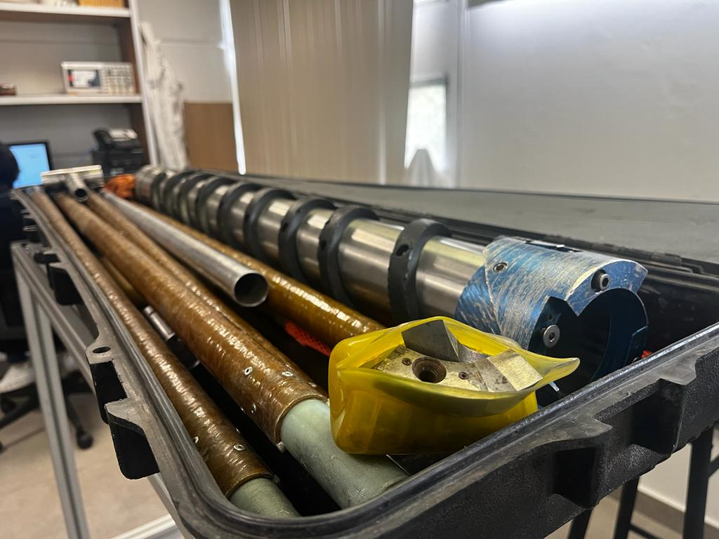
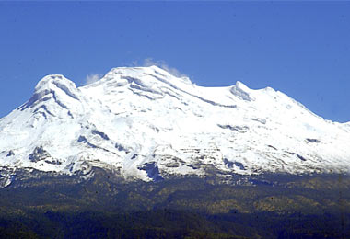
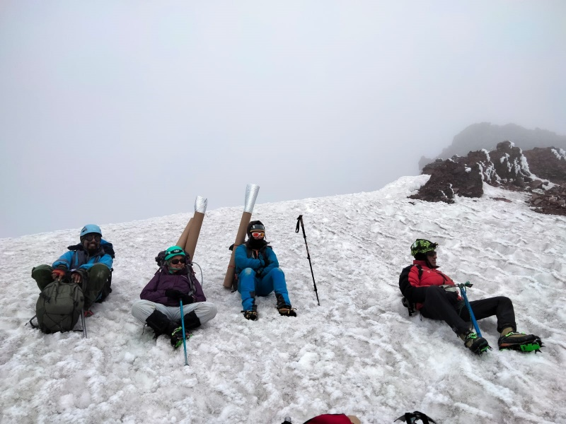
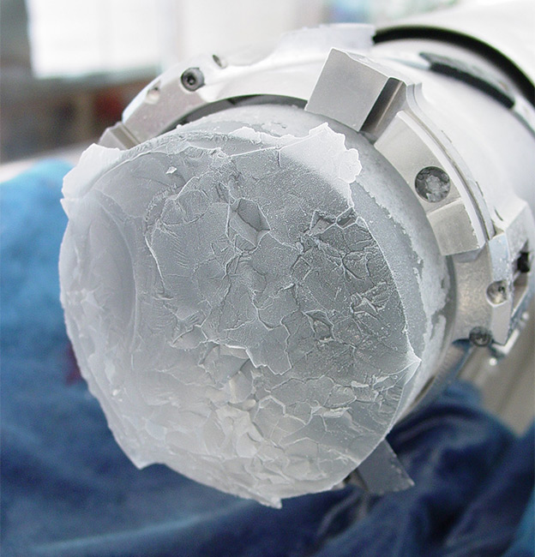
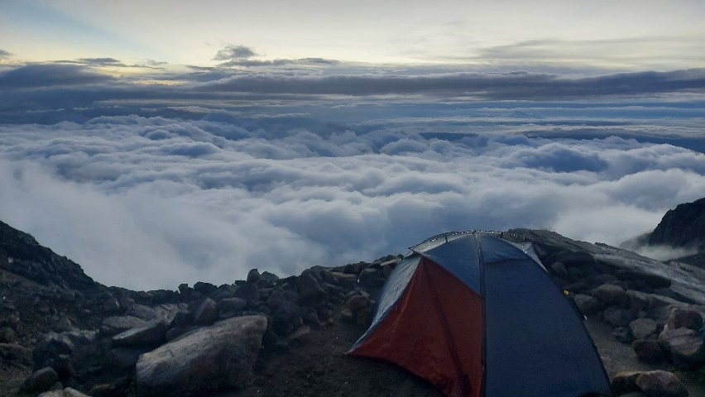
¹⁰Be as a proxy for climate variability
(L. Acosta and LEMA/SARA staff)
Intensity of primary cosmic rays
Solar modulation
Magnetic modulation
Can be found in high mountain as tropical volcanos

