Slide 1
UCM programme @ CMAM
Andrés Illana Sisón (former UCM)
On behalf of Grupo de Física Nuclear (EMFTEL, UCM)

Slide 2
Outlook
NRA45 beamline
GARRY γ-ray detector setup
Commissioning of the beamline
Alpha-induced reactions
Proton-induced reactions
Isomer-decay studies

Slide 3
NRA45 beam line
Effort ongoing since 2020 (!)
Commissioning proposals Nov ’20
NRA45:
Commissioning of CMAM beamline and gamma detection setup
Issues with reproducibility of beam focussing, positioning, stability
Identified improvements
Current monitoring seems to be working

Slide 4
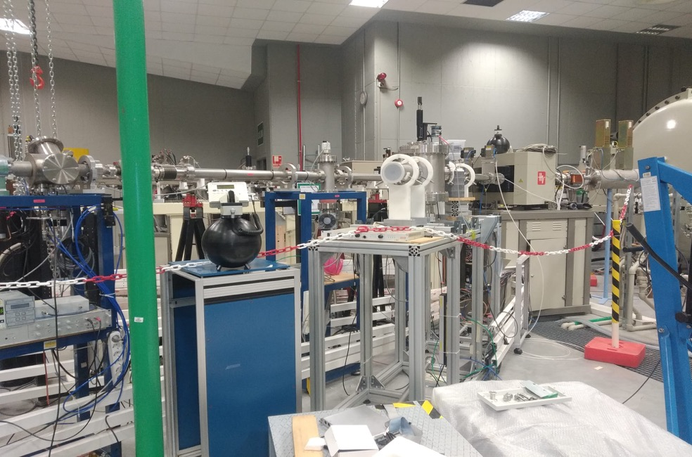
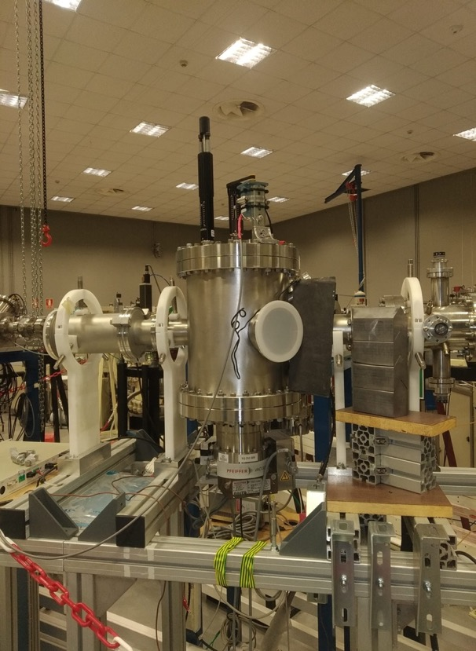
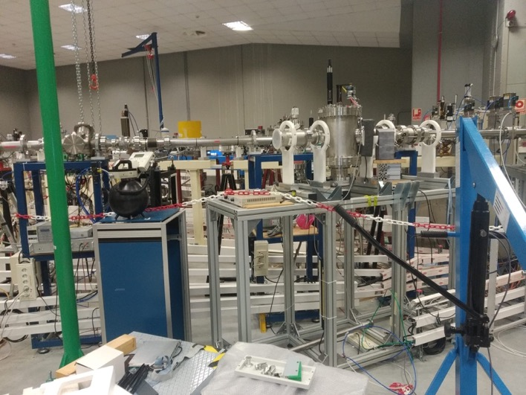
NRA45 beam line

Slide 5
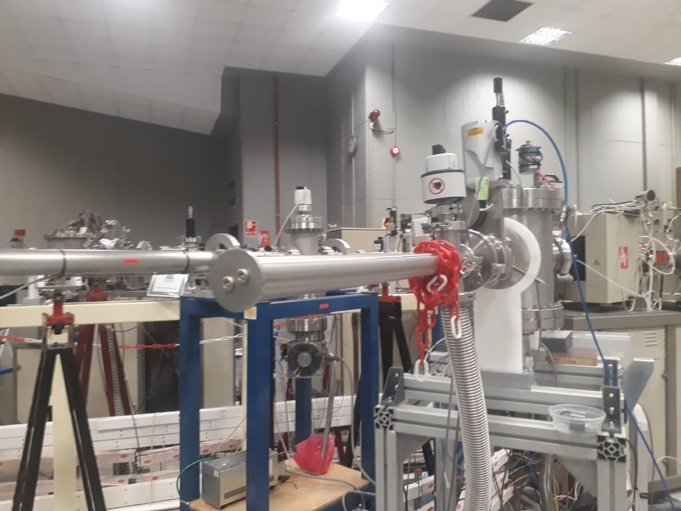
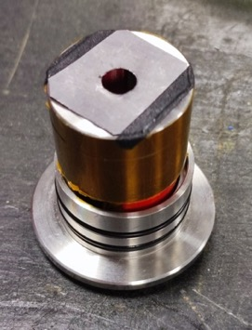
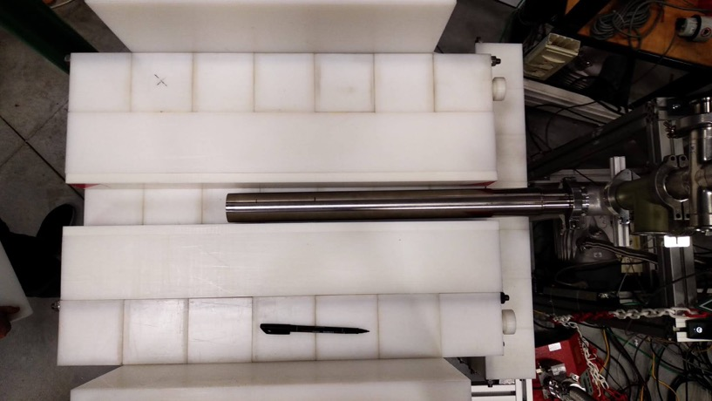
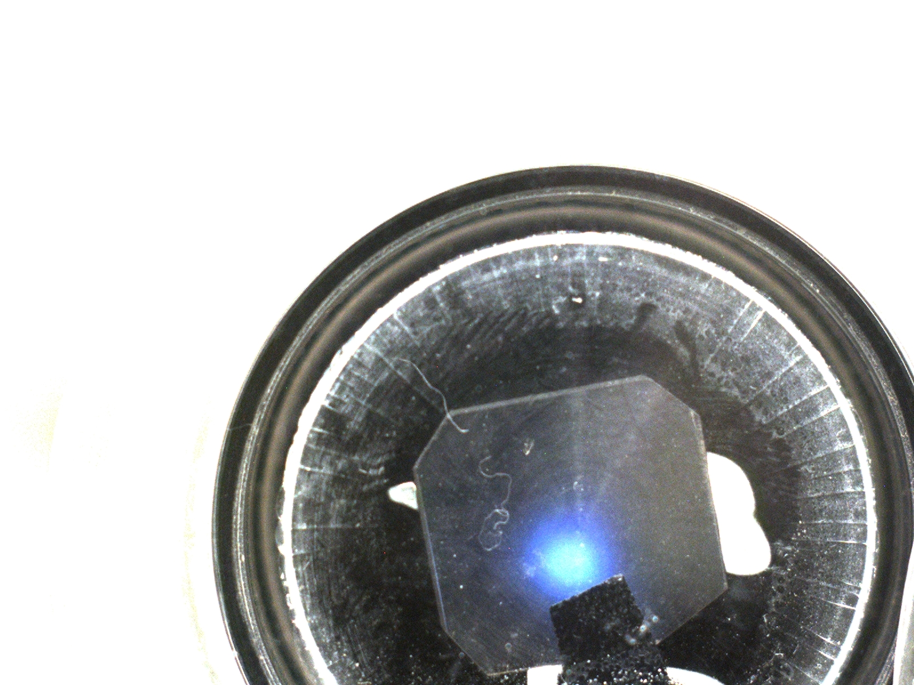
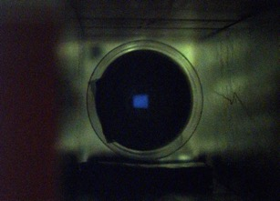
NRA45 beam line
Instrumentation and methods to be described in a technical paper, being drafted.
Contributors?

Slide 6
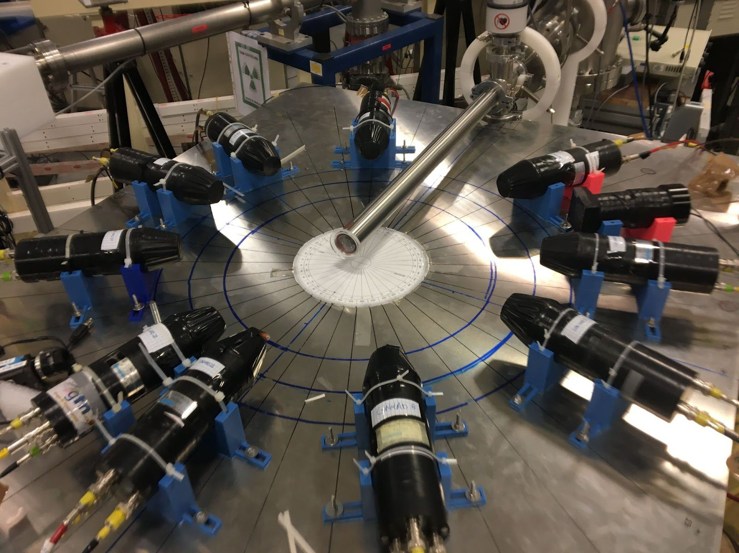
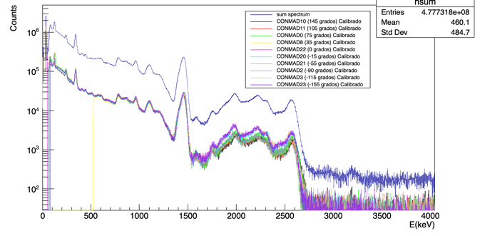
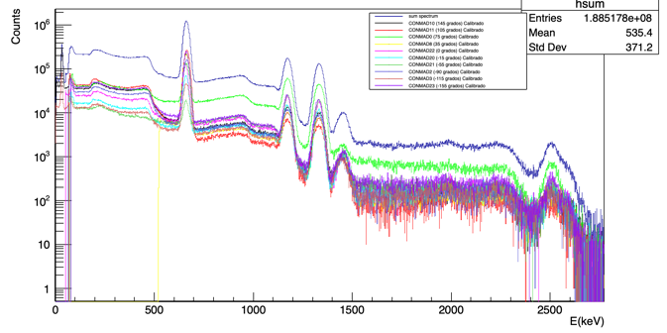
GARRY γ-ray detector setup
LaBr₃(Ce)
HPGe very valuable for ID
Neutron monitor gives relative count rate and helps monitoring fluctuations

Slide 7
Commissioning of the beamline
Measurement of ²⁷Al(α,nγ)³⁰P reaction yields
MOTIVATIONS
Reference reaction: benchmarking
Test new beamline at CMAM
Develop and optimize new setup
Crosscheck MANY measurements: direct neutrons, gamma rays and activation

Slide 8
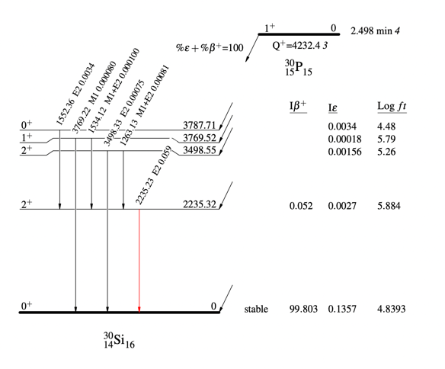
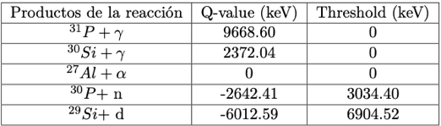
Commissioning of the beamline
Up to 15 MeV, reaction channels open and identified

Slide 9
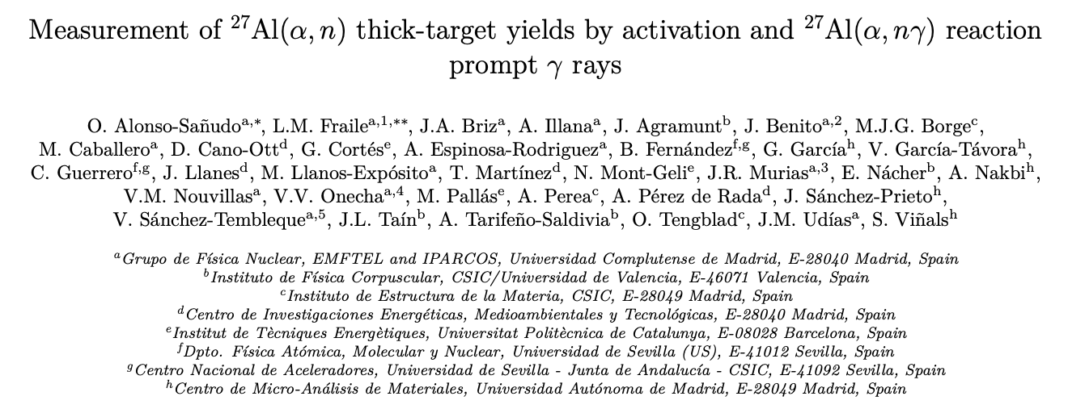
Commissioning of the beamline
Total Yield: using decay of 511 keV when possible, total rate (activation and decay) or activation time
Gamma-ray yields and angular effects
Alonso-Sañudo et al., Radiation Physics and Chemistry 2026, under revision
LaBr₃(Ce) array
HPGe

Slide 10
Commissioning of the beamline
Commissioning of CMAM beamline and gamma detection setup, stable design after a few iteractions
Current monitoring reliable, will require a study of systematic effects
Re-measurement of ²⁷Al(α,n)³⁰P reaction by activation. Measurement during irradiation and decay consistent. Extended energy range to 15 MeV
First (α,nγ) measurement, gamma yields (thick target) and angular dependence
Dead time effects do not seem to affect measurements even at high energies, prompt gamma-rays
We often face issues with reproducibility of beam focussing, positioning, stability…
New target system with movable faces developed by A. Perea

Slide 11
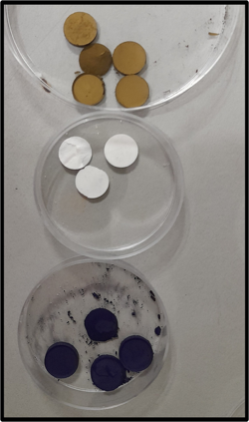
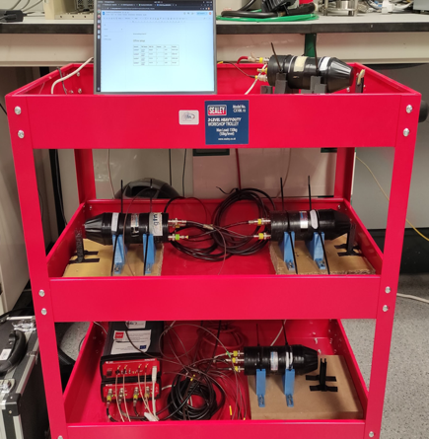
(more) Alpha-induced reactions
Titanium Nitride/¹⁴N
for fusion monitoring
MOTIVATIONS
3.5 MeV alpha particles from D–T fusion provide self-heating of magnetically confined plasmas, enabling reactor ignition without external heating.
Loss of alpha particles reduces plasma heating efficiency and can damage reactor components, making monitoring essential.
Diagnostics under study include FILD, gamma-ray spectrometry, and activation monitors, with activation foils offering a promising real-time alpha (and possible neutron) monitoring method.
Lithium fluoride/¹⁹F
Offline detection system
Lanthanum hexaboride/¹⁰B
Activation measurements (511-keV γ rays) both online and offline
GOALS
Identify alpha-induced suitable nuclear reactions
Measure the thick-target yields of these reactions

Slide 12
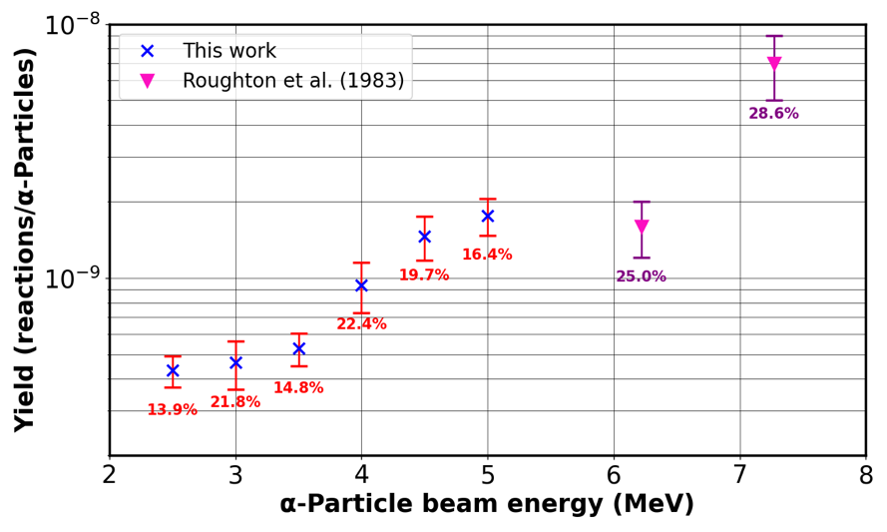
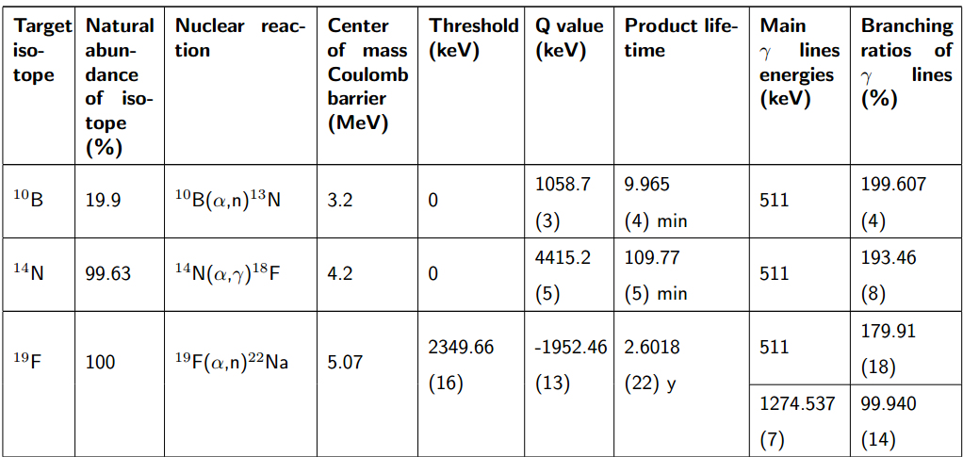
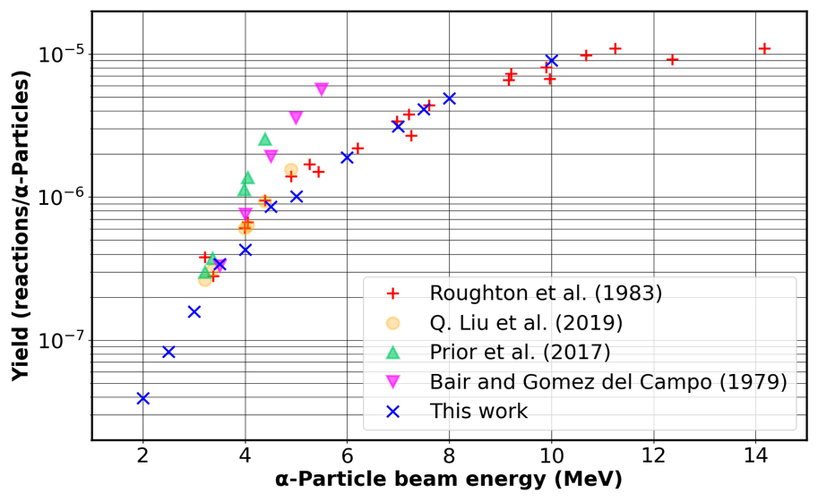
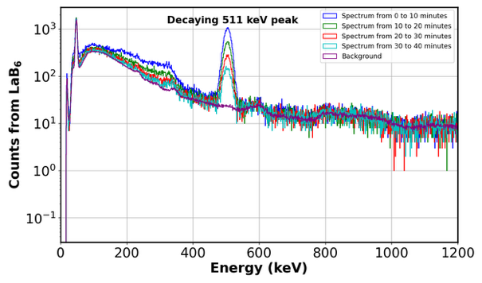
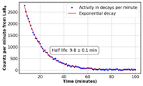
(more) Alpha-induced reactions
¹⁴N(α,γ)¹⁸F
estimate
Or emission probabilities
First measurements
¹⁰B(α,n)¹³N
Ali et al., in preparation
10B(α,n)13N
First time

Slide 13
(more) Alpha-induced reactions
for yield measurements
-> “Light” neutron-rich nuclei Weak r-process
Impact of (α,n) reaction rate uncertainties on the abundances
Theoretical x-sections Optical potentials

Slide 14
(more) Alpha-induced reactions
for yield measurements
-> “Light” neutron-rich nuclei Weak r-process

Slide 15
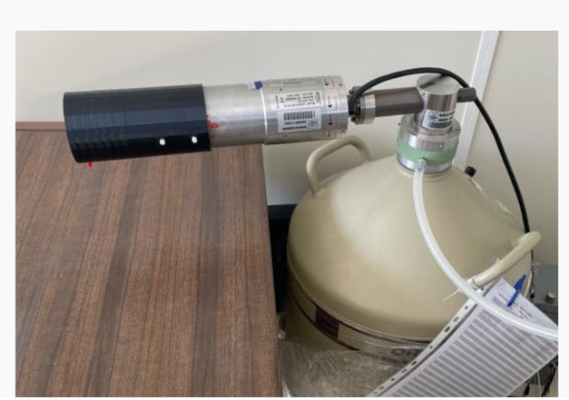
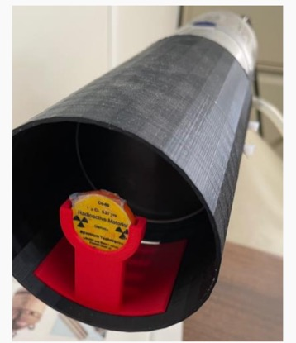
(more) Alpha-induced reactions
for yield measurements
-> Measurement of total yield for ⁹⁶Zr(α,n)⁹⁹Mo
Natural Zn: 2.8% ⁹⁶Zr
100 µm foils
Bottleneck for 44 ≤ Z ≤ 47.
By activation
Q value: –5115.2 keV
E_{thres}= 5290 keV
Subbarrier
Natural Zr thick target
Decay of ⁹⁹Mo
^{99m}Tc in equilibrium with ⁹⁹Mo, as in generators for medical applications
Irradiation at STD beam line
Offline measurements at UCM

Slide 16
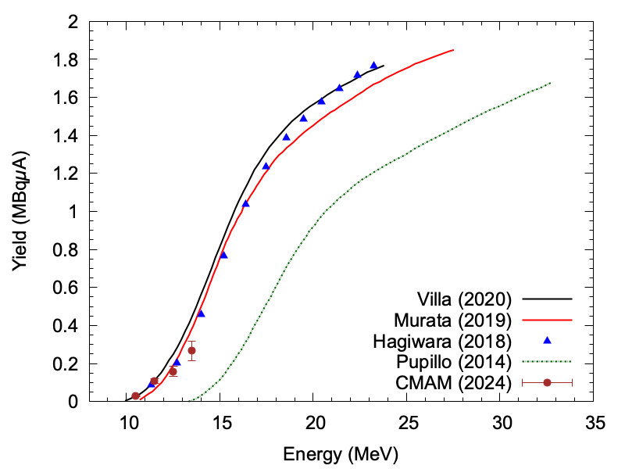
(more) Alpha-induced reactions
for yield measurements
-> Measurement of total yield for ⁹⁶Zr(α,n)⁹⁹Mo
A. Mayor,
A. Illana et al.
Neutron yield per 10⁷ alphas
Lab alpha energy (MeV)
Results consistent with literature
Higher intensities (new source) may allow to extend measurement to low energies, but open other potential issues
Mapping of the yields in smaller steps both at higher and lower E

Slide 17
(more) Alpha-induced reactions
for yield Isomer tagging using pulsed beams
Fast isomer tagging -> via the ⁹¹Zr(α,nγ)⁹⁴Mo reaction
Approved… scheduled soon

Slide 18
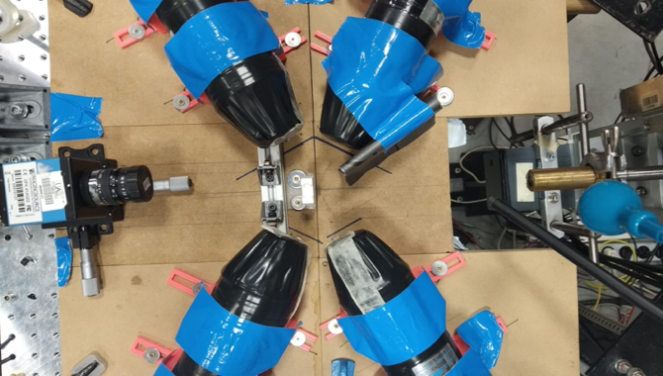
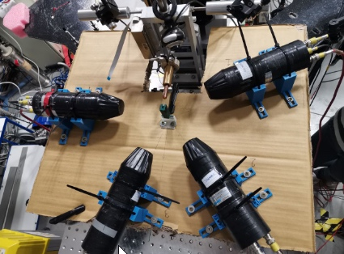
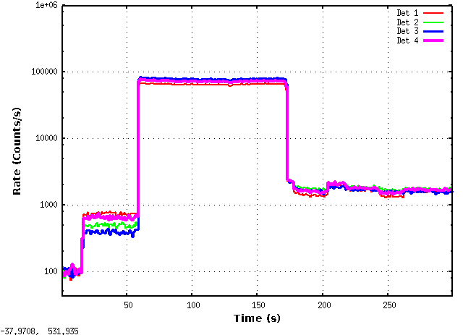
Proton-induced reactions
Measurement of ¹⁸O(p,x) reaction yields
Contrast agents for protontherapy
Experimental knowledge of absolute production yields
Measure yields and angular distributions
Derive the PG emission cross sections
Count rate profile at 6 MeV (up to 80 kHz)
p⁺ beam
H₂¹⁸O target
5-MV tandetron at CMAM in Madrid
On-line LaBr₃(Ce) setup based on detectors described in V. Vedia et al., NIM A 857 (2017) 98
Irradiation of H₂¹⁸O by 2 to 10 MeV protons
Fast detectors & CAEN 5751 1-Gs/s digitizer

Slide 19
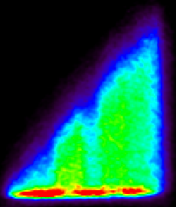
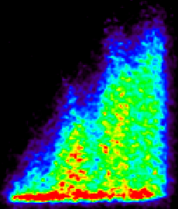
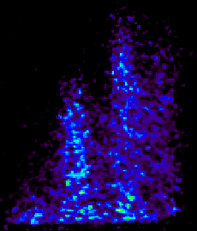
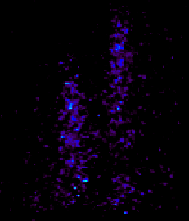
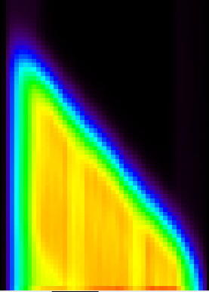
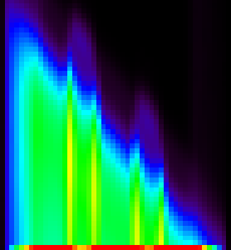
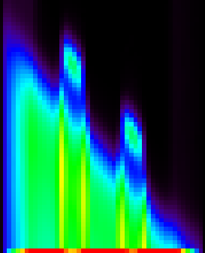
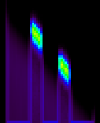
Proton-induced reactions
Measurement of ¹⁸O(p,x) reaction yields
1 hour after irradiation
2 hour after irradiation
3 hour after irradiation
4 hour after irradiation
Range 80 MeV
Range 40 MeV
Real PET Image
Simulation Activation Image
Recommended cross sections for ¹⁸O(p,n)¹⁸F reaction
F.T. Tarkanyi et al., J. Radioanalytical and Nucl. Chem. (2019) 319. 533-666
IAEA Charged-particle cross section database for medical radioisotope production and beam monitor reactions

Slide 20
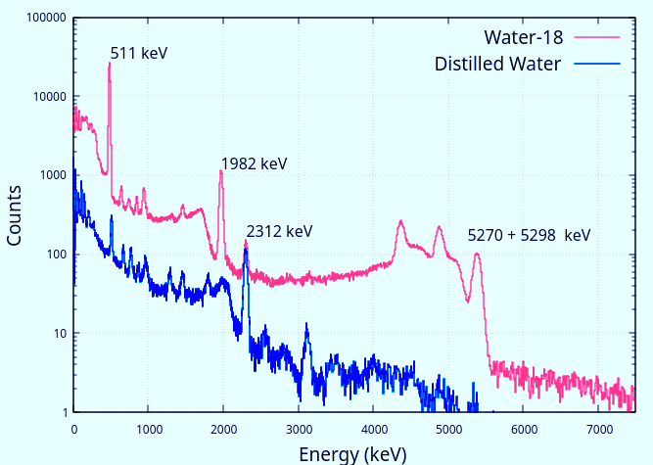
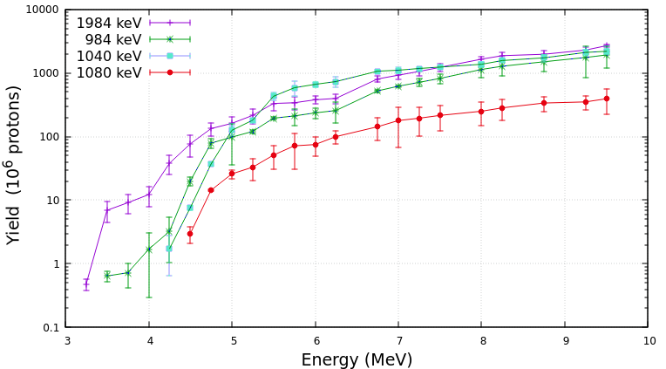
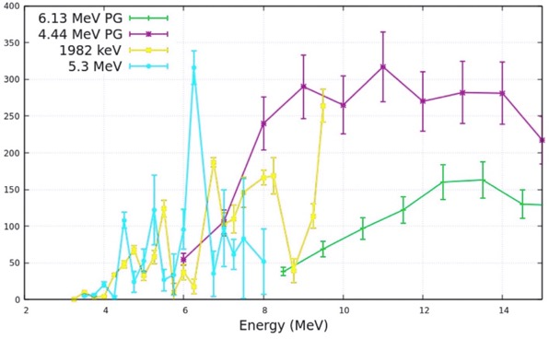
Proton-induced reactions
Measurement of ¹⁸O(p,x) reaction yields
4 MeV
Water-18 proposed as PG contrast agent
Measured the PG emission yields of prompt 𝛾-ray emissions up to 10 MeV.
A tenfold increase in the efficiency of current PG detection systems is feasible based on PG energies and cross sections, potentially leading to smaller and more compact detection systems.
Deduced cross sections
Cross sections (mb)
V.V. Onecha et al.,
Radiat. Phys. Chem. 217 (2024) 111485
Prompt 𝛾-ray yields

Slide 21












Thank you
This work was funded by Comunidad de Madrid, Spain under projects PRONTO-CM B2017/BMD-3888 and ASAP-CM S2022/BMD- 7434. We acknowledge support by Spanish MCIN/AEI/10.13039/ 501100011033 under grants TED2021-130592B-I00 PROTOTWIN and PID2021-126998OB-I00. This work was supported by the European Union’s Horizon 2020 research and innovation programme under the Marie Skłodowska-Curie grant agreement No 847635. This is a contribution for the Moncloa Campus of International Excellence, ‘‘Grupo de Física Nuclear-UCM’’, ref. 910059. The support of the scientific and technical staff of CMAM is greatly acknowledged.

