Slide 1

Unidad de Física Nuclear Básica (FNB) del CNA: actividades en IABA
J. Espino, B. Fernández, J. P. Fernández-García, J. Ferrer, J. Gómez-Camacho, C. Guerrero, T. Rodríguez-González and J.M. Quesada
PhD students: A. Vegas, J. Bartolomé-Sarsa and G. Auñón
Others: C. Muñoz, A. Reina@CERN + former PhD students M.A. Millán-Callado @PTB, P. Pérez-Maroto@CERN
Dpto. Física Atómica, Molecular y Nuclear (FAMN), Universidad de Sevilla, 41012 Seville, Spain
Centro Nacional de Aceleradores (CNA), 41092 Seville, Spain
1st IABA meeting, Madrid 10/3/2026

Slide 2
Introduction of the group

Slide 3
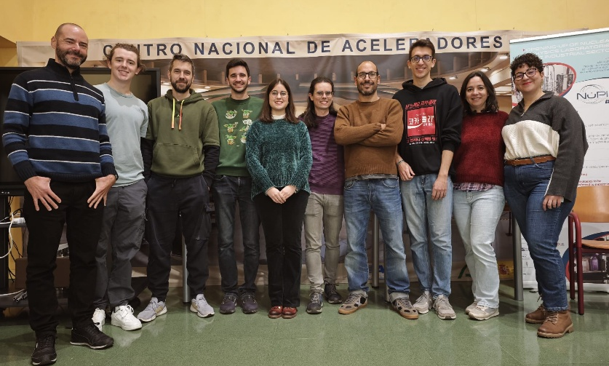
Introduction of the group
Composition:
J. Espino, B. Fernández, J. P. Fernández-García, J. Ferrer, J. Gómez-Camacho, C. Guerrero, T. Rodríguez-González and J.M. Quesada
PhD students: A. Vegas, J. Bartolomé-Sarsa and G. Auñón
Others: C. Muñoz, A. Reina@CERN + former PhD students (M.A. Millán-Callado @PTB, P. Pérez-Maroto@CERN)
Research lines:
Nuclear reaction measurements and instrumentation at CNA and international laboratories (INFN-LNS, ISOLDE, TRIUMPH,, …)
Neutron reaction measurements and instrumentation at CNA and international laboratories (n_TOF, NFS, HZDR, CLPU, PTB, JRC-MONNET, …)
Funding
Plan Nacional AEI (…., PID2024, …) y regionals (last in 2018)
Infraestructuras ICTS and AEI
Planes de Recuperación, Transformación y Resiliencia (MRR)
EC projects: CHANDA, EUROLABS, ARIEL, SANDA, OFFERR and APRENDE
Education and Learning
Masters: Interuniversitario en Física Nuclear + Erasmus Mundus en Física Nuclear + Tecnologías Físicas para la Medicina y la Biología
HiSPANoS School on the Production, Detection and Use of Neutrons [2022, 2026]
Basic Training School on Accelerator Applications in Nuclear Physics (BTS25) [2025]
Most of the FNB Unit

Slide 4
Overview of work carried out at international facilities

Slide 5
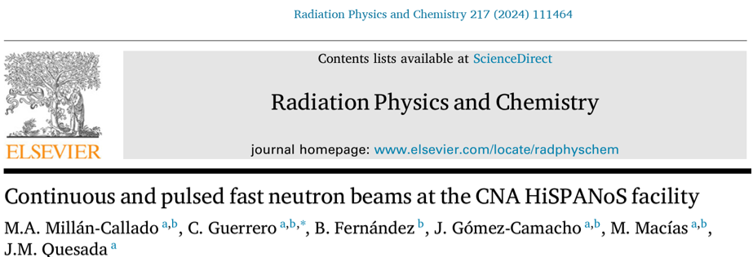
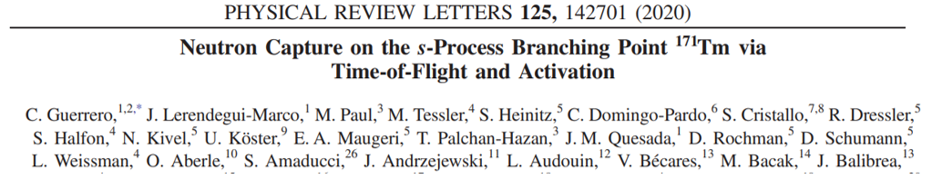
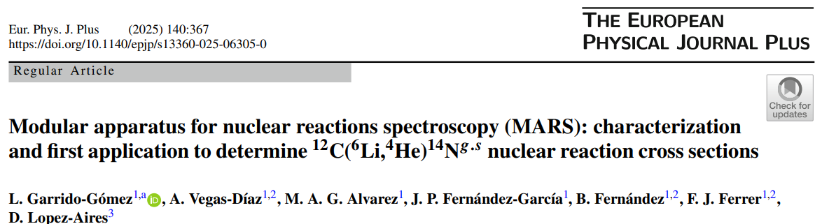
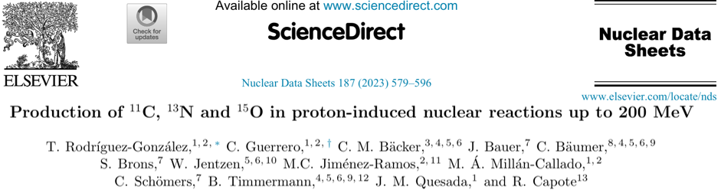
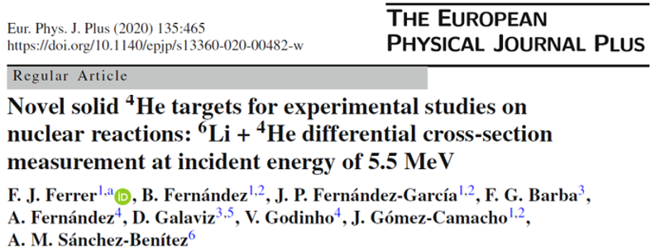
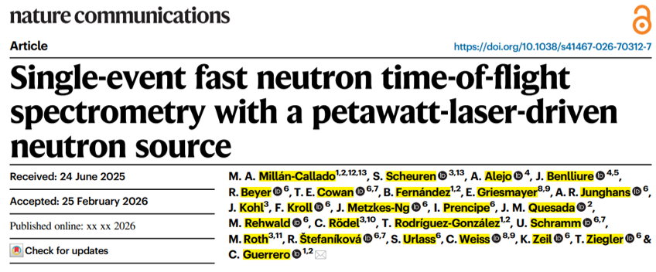
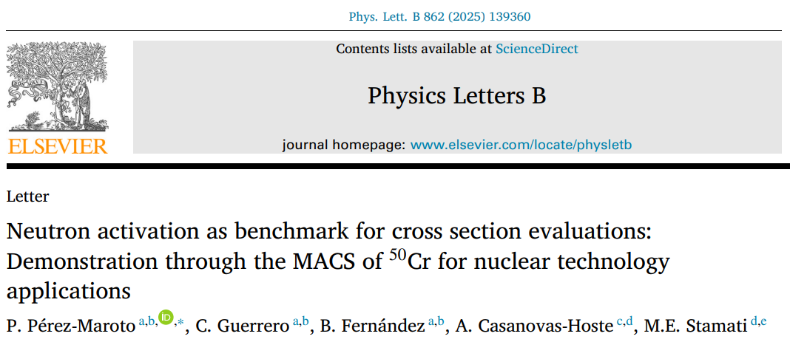
Overview of work carried out at international facilities

Slide 6
Previous and planned work at CNA / CMAM:
nuclear reactions at FNB beam line

Slide 7
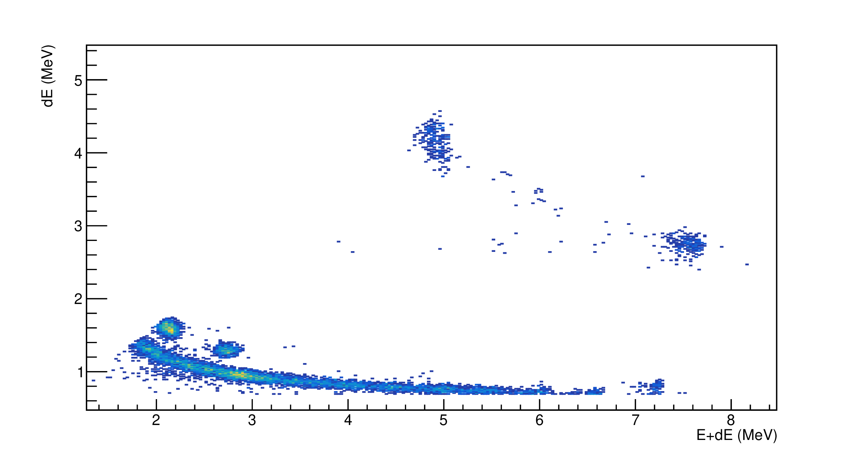
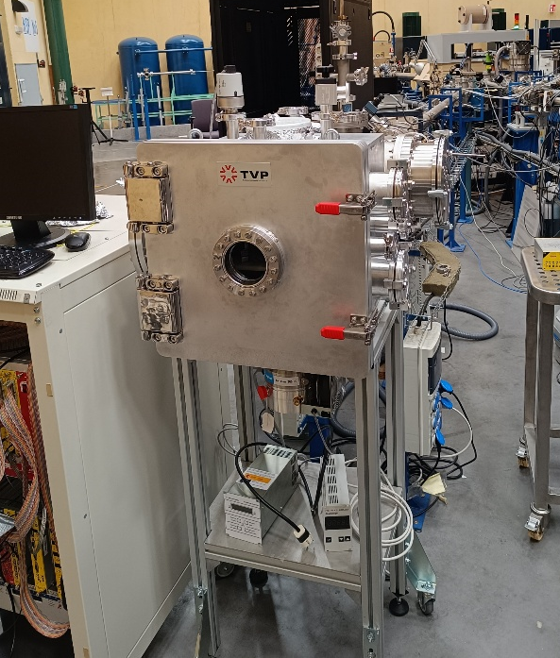
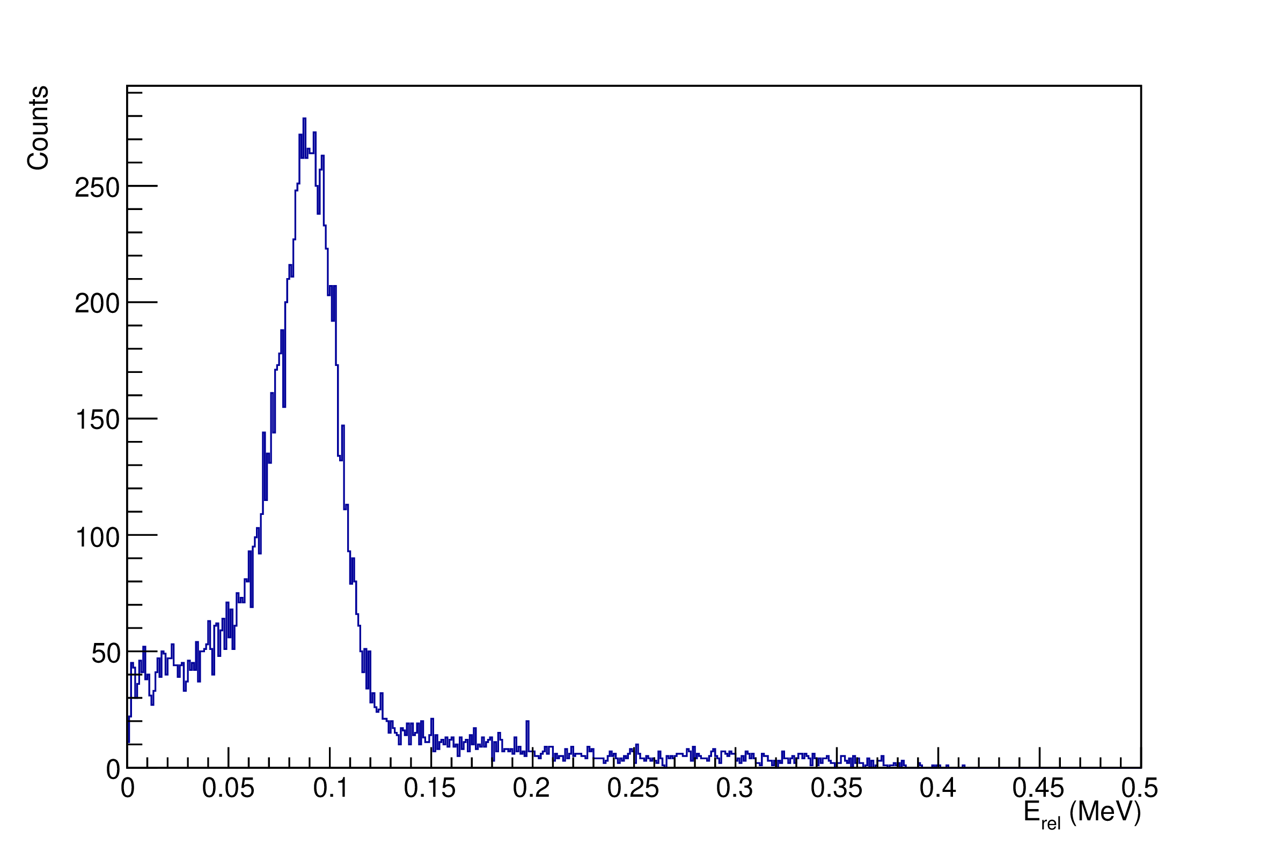
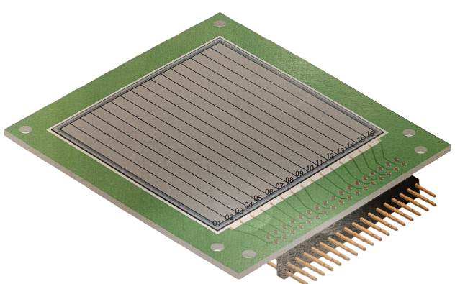
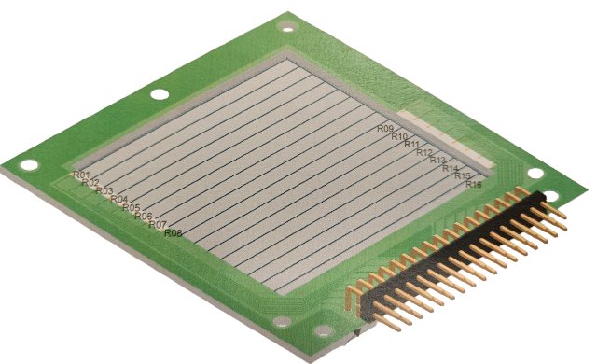
Nuclear reactions at FNB beam line of CNA
New setup!
Setup validation
¹²C(⁶Li,⁴He)¹⁴N
¹²C(⁶Li,²H)¹⁶O
Measurement of ⁶Li+¹²C reaction around Coulomb Barrier (4.5 MeV).
Fragment separation capability with telescopes.
Determination of excitation function and angular distribution for different reaction channels.
⁴He
²H
¹H
Currently: collaboration with ASFIN (LNS-INFN)
Collaboration with the ASFIN group to measure α – α in coincidence from ⁶Li(⁴He,²H)⁸Be.
Relative energy distribution centred in 91 keV (⁸Be dissociation energy).
Coincidence measurements capability.
91 keV
- New 40 cm³ Aluminium chamber reaction.
- Large active area (50cm²) segmented (20, 40 and 500 µm) & PAD (300 µm) detectors.
Next: ⁹Be + ¹²C measurement
Experiment with beam energies around the Coulomb barrier (7 MeV) at CNA and ¿CMAM?
Reaction fragments and coincidences measurements.

Slide 8
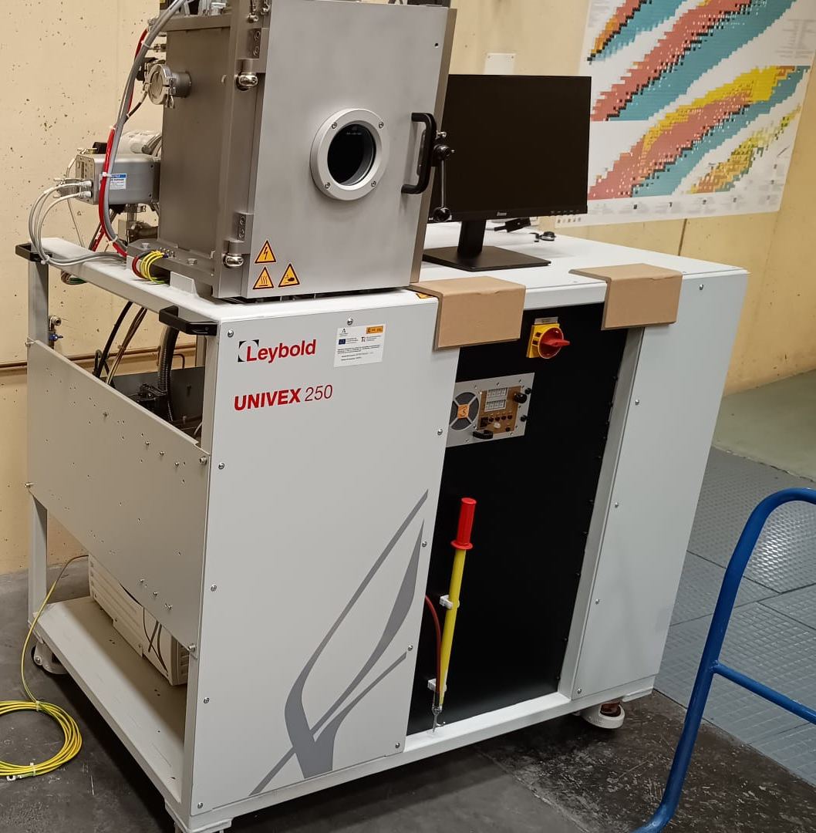
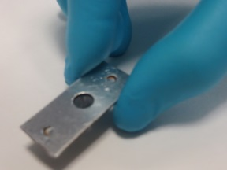
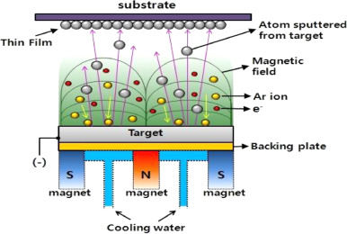
Magnetron-Sputtering to make solid-gas targets for CNA and CERN
Many of the isotopes of interest in nuclear (and neutron) reactions correspond to geaseous elements, which poses a serious problem.
=> A solution is to “grow” samples that incorpórate the gas into the sustrate in sufficient amounts, which has been demosntrated by our group and now at CNA we will be able to make such targets for nuclear physics experiments at CNA, CERN/ISOLDE, TRIUMPH, LNS, etc.
solid
matrix
Gas
element
Gas
element
Gas
element
Gas
element
Magnetron Sputtering
Industrially well established
Large areas feasible
Wide range of substrates
Control of microstructure
Control of composition
UNIVEX 250 for RF sputtering by Leybold
Self supported Si-He target

Slide 9
Previous and planned work at CNA / CMAM:
neutron (in/out) reactions at CNA HiSPANoS
Research lines of CNA
Collaborations with other groups (besides MANY)

Slide 10
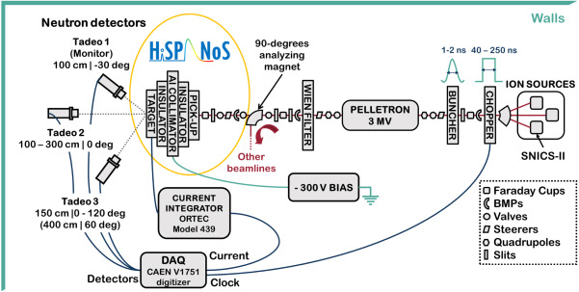
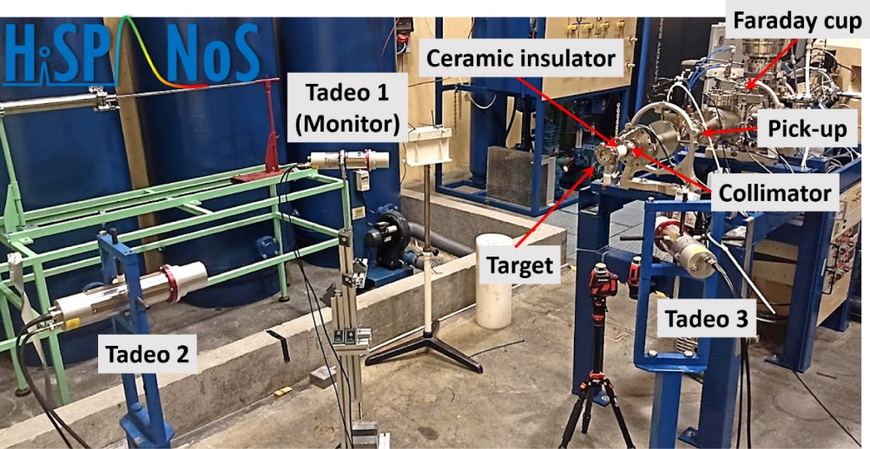
HiSPANoS neutron beam line at CNA
Time domain: Continuous & Pulsed (1 MHz, 2 ns)
Energy domain:
  Thermal via moderated ⁹Be(p,n) → 25 meV
  Epithermal via ⁷Li(p,n) → 1-100 keV
  Fast monoenergetic via ²H(d,n) → 2,5 to 5 MeV
  Fast white beam via ⁹Be(d,n) → 1 to 10 MeV

Slide 11
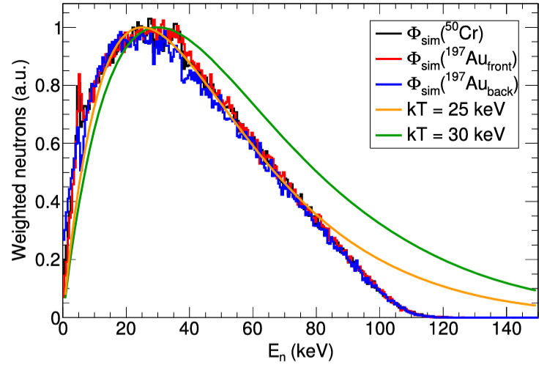
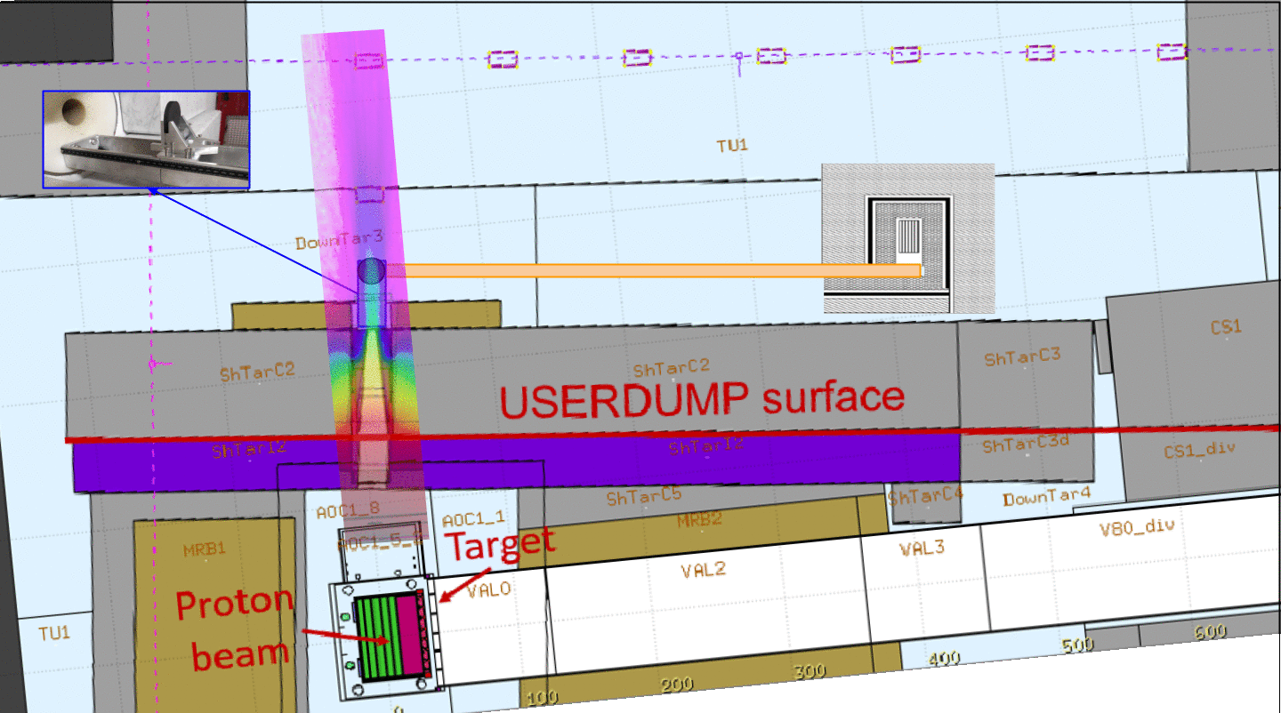
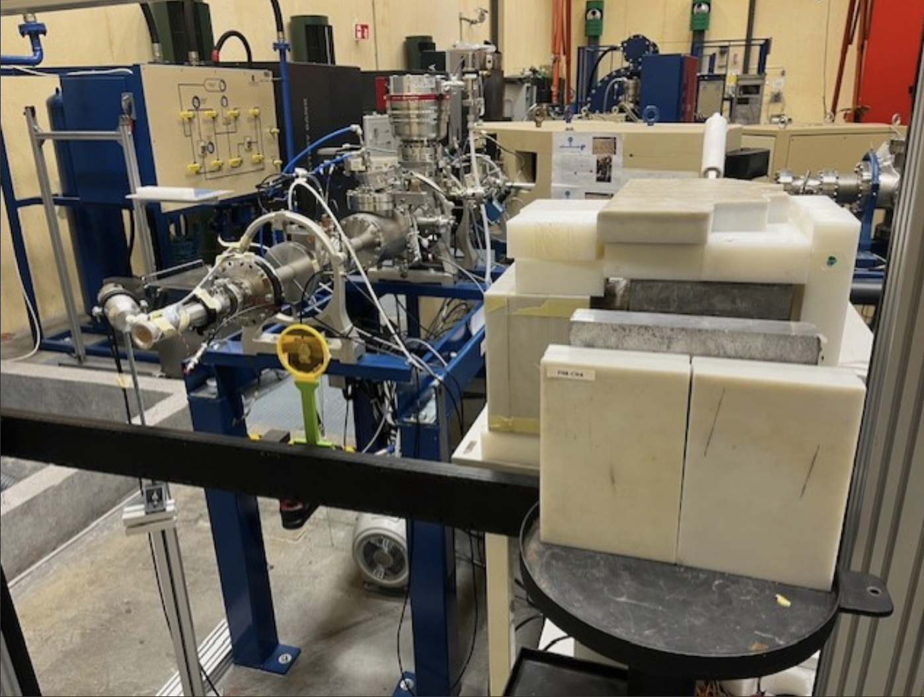
Measurements of 30 keV Maxwellian Averaged Cross Sections (MACS_{30keV})
The ⁷Li(p,n) reaction at 1912 keV produces neutrons similar to those of the s-process: a 30 keV Maxwell-Boltzman distribution
→ Nuclear astrophysics
→ Nuclear technology
CNA research line for the exploitation of MACS activation measurements:
2025: ⁵⁰Cr for nuclear technology applications
2026: ⁵⁹Co, ¹⁰⁹Ag, ¹⁸⁶W and ²³²Th within EC-APRENDE
(requested by the International Reactor Dosimetry and Fusion File IRDFF-II)
2027: Short–lived isotopes with the HiSPANoS/CERN-NEAR CYCLIC
P. Pérez-Maroto et al., Neutron activation as benchmark for cross section evaluations: Demonstration through the MACS of 50Cr for nuclear technology applications, Physics Letters B 862 (2025)

Slide 12
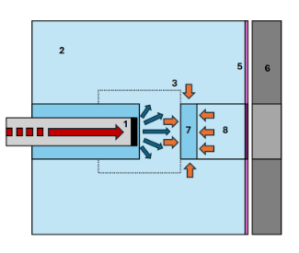
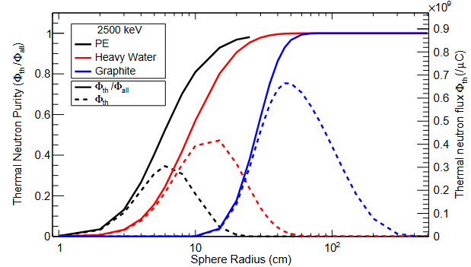
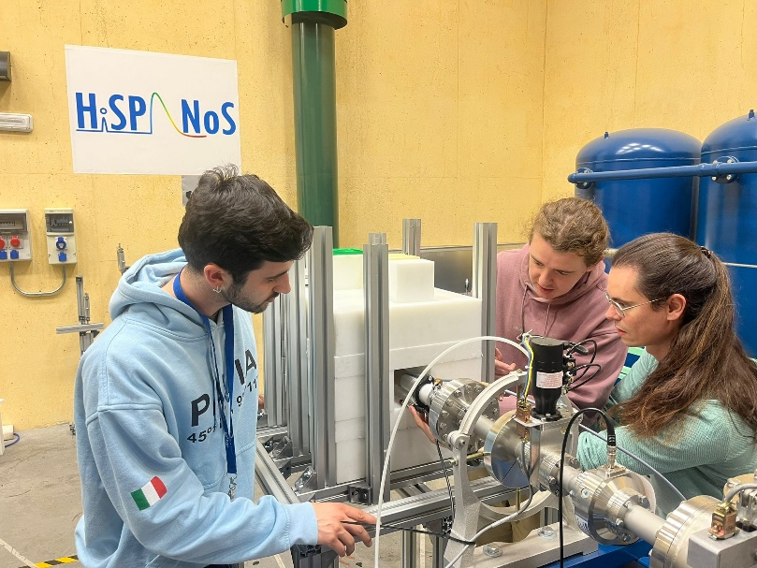
Production and use of thermal neutrons
Thermal neutron beams are key to many applications of science and industry.
Situation in Spain
Experimental fission reactors (JEN-1, ARGOS) dismanteled decades ago. [Φ_{field}=10¹³, Φ_{field}=10⁹ n/cm²/s]
UPM opperates an Am/Be moderated neutron source
CIEMAT has designed a new Am/Be moderated neutron source
CANS represent a intermediate solution in terms of flux
[Φ_{field}=---, Φ_{field}=10² n/cm²/s]
Prospects:
Thermal XS
Neutron-imaging
NAA (heritage & industry)
Detector characterization
….
CNA HiSPANoS_{thermal}: Φ_{field}=10⁷, Φ_{beam@50cm}=10⁴ n/cm²/s
→ in between reactors and radioactive sources

Slide 13
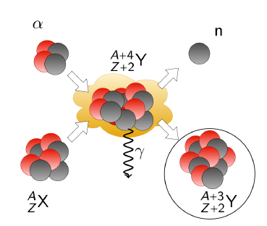
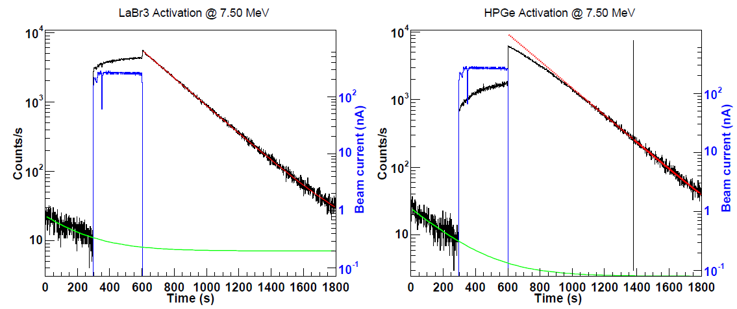
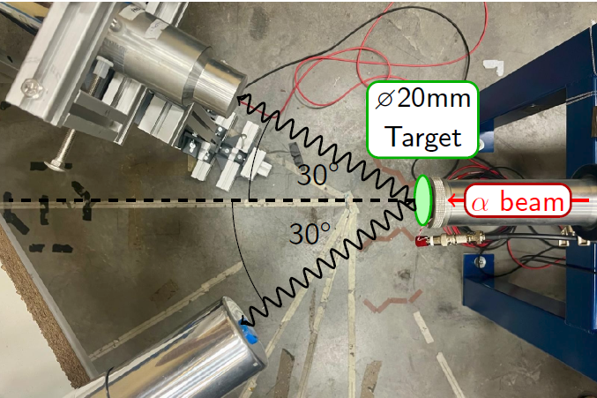
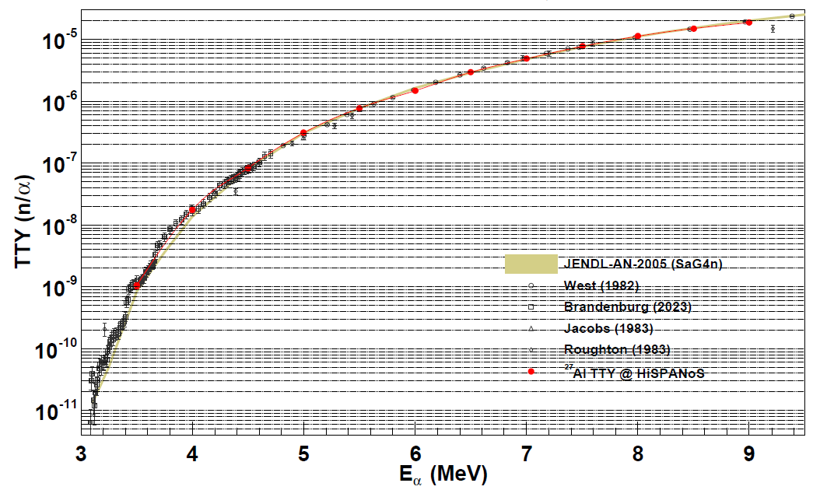
Measurements of (α,n) reactions within MANY (via activation)
Neutron counting
Neutron ToF spectroscopy
Activation if radioactive
AMS always
PαAA
Validation with ²⁷Al(α,n)³⁰P

Slide 14
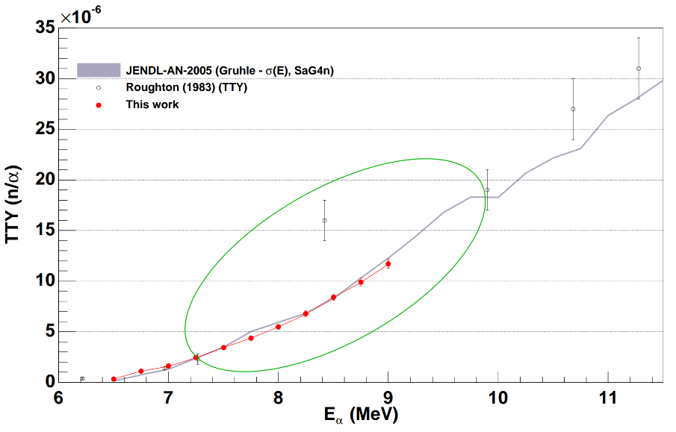
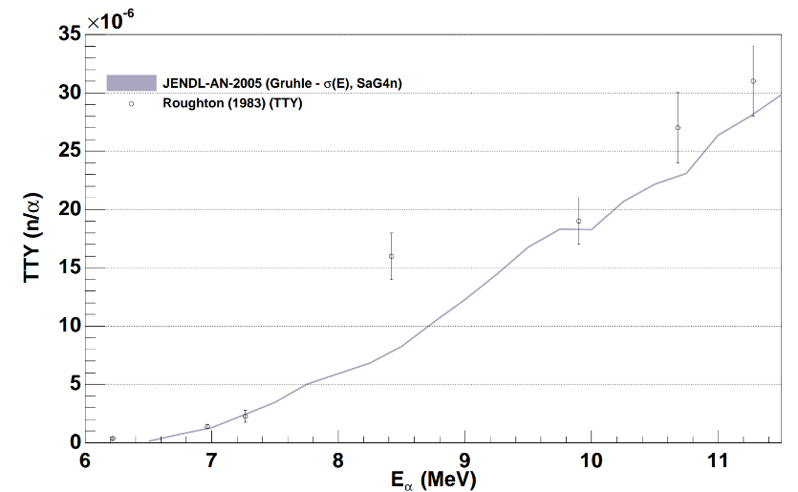
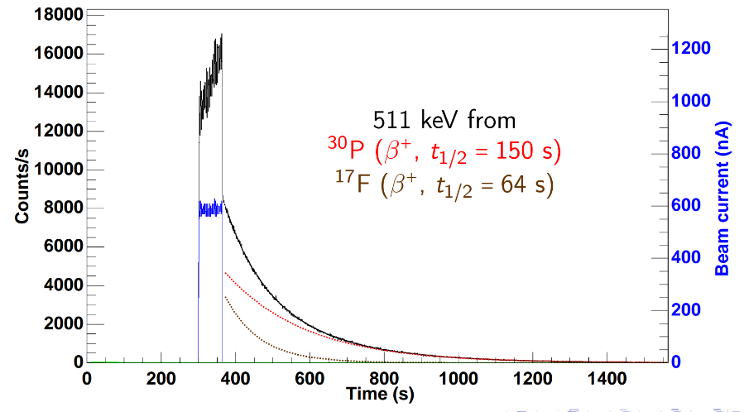
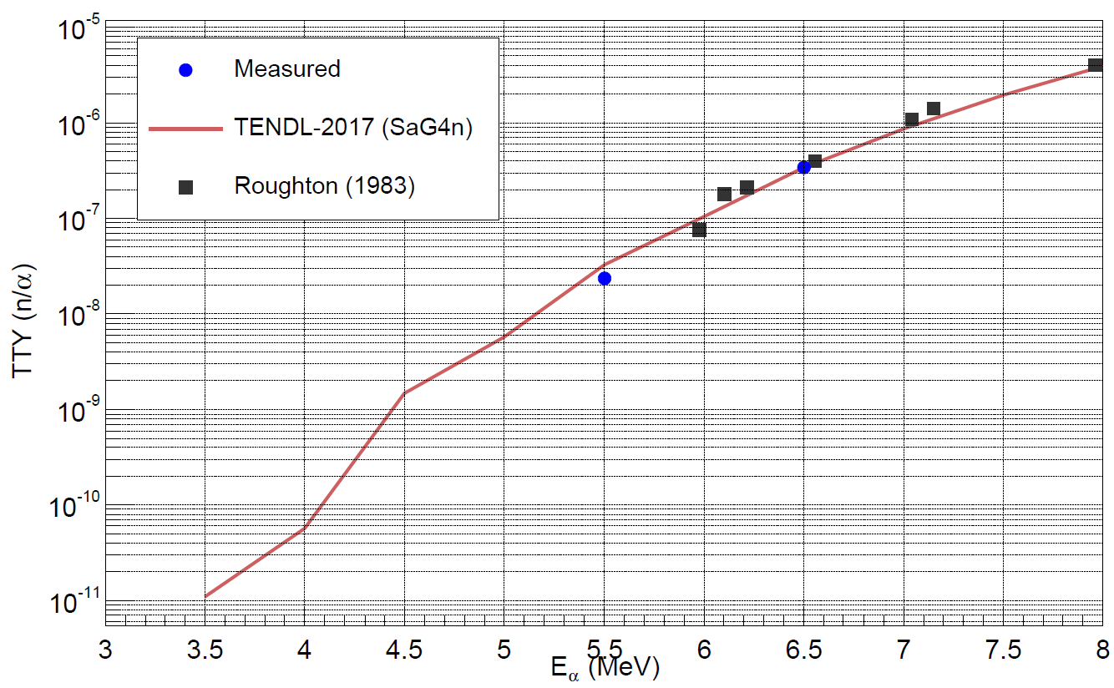
Measurements of (α,n) reactions within MANY (via activation)
Neutron counting
Neutron ToF spectroscopy
Nitrogen often used as inert buffer gas and present in some plastics
→ discrepancies between two only measurements at 7-10 MeV
Issues: N is gas + N compounds are insulators
¹⁴N(α,n)¹⁷F @9 MeV
Activation if radioactive
AMS always
PαAA
Ti and Ge candidates for fusion diagnostics by foil activation Bonheure et al., Fusion Engineering and Design 88 (2013) 533

Slide 15
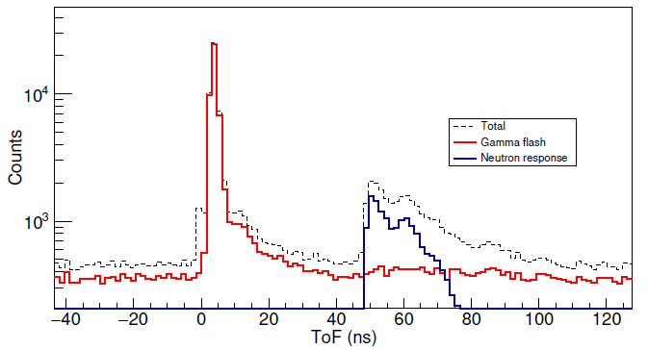
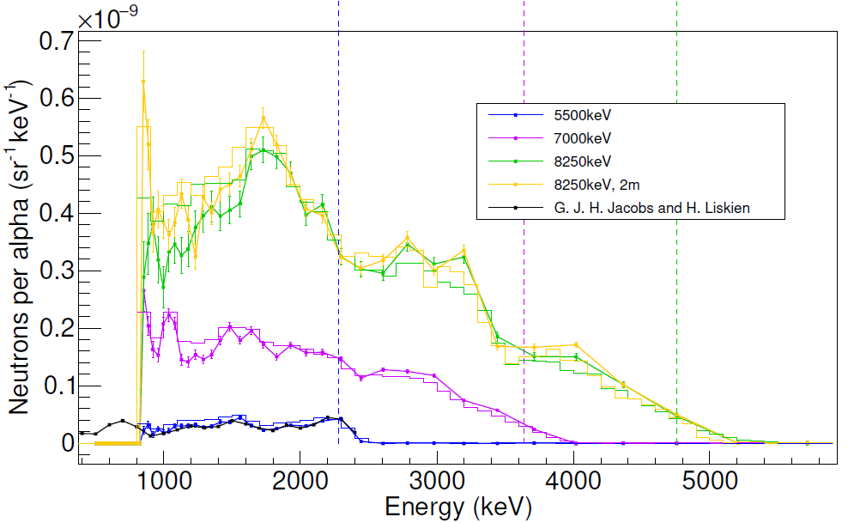
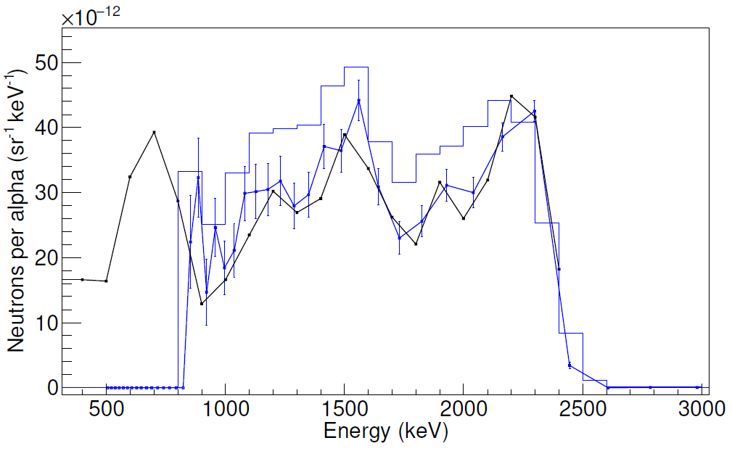
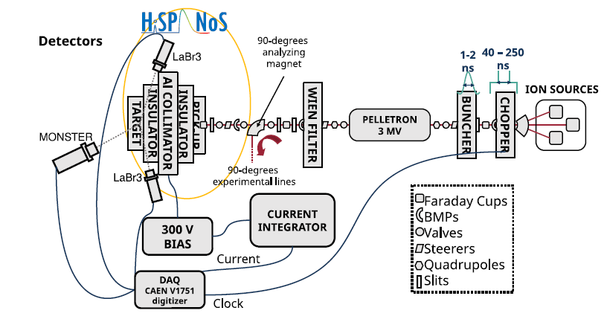
Measurements of (α,n) reactions within MANY via neutron spectroscopy
Neutron counting
Neutron ToF spectroscopy
PαAA

Slide 16
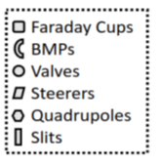
Measurements of (α,n) reactions within MANY via neutron spectroscopy
Neutron counting
Neutron ToF spectroscopy
5 Li-glass 2”x0,5” detectors for epitermal neutrons (1-800 keV)
New ion source
(2 → 20 μA)
New buncher
(ΔT=2ns)
PαAA
5 EJ309 5”x2” detectors for fast neutrons (500 keV to 15 MeV)
By end of 2026:
Our own array of detectors, compatible with MONSTER
A 16 channel 12 bits digitizer (old one was 8 channels, 10 bits)
A high performance buncher α beams (2 ns)
A high intensity ion source for α beams (from 2 to 20 μA)
Detector calibration and methodology validated at PTB (Sc.V)
A high performance and well trained PhD student
After demonstrating the fasibility of (α,n) ToF specroscopy, we’ve waited three years to become fully productive and realiable

Slide 17
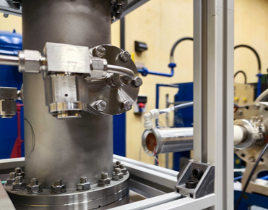
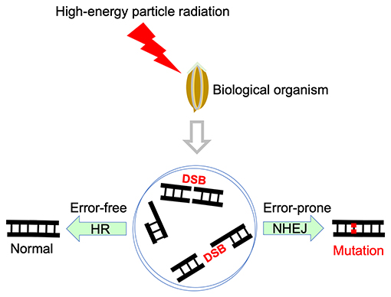

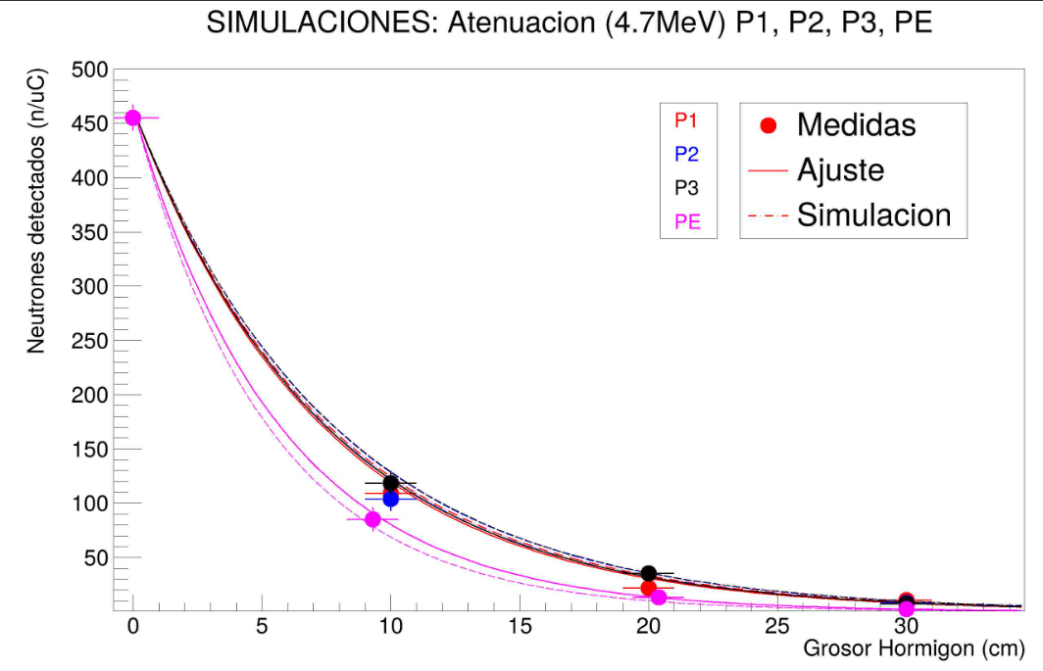
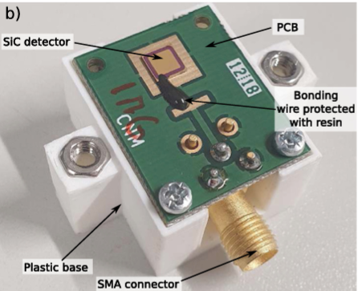

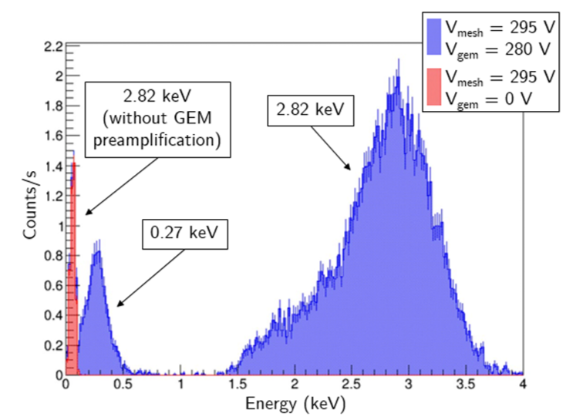

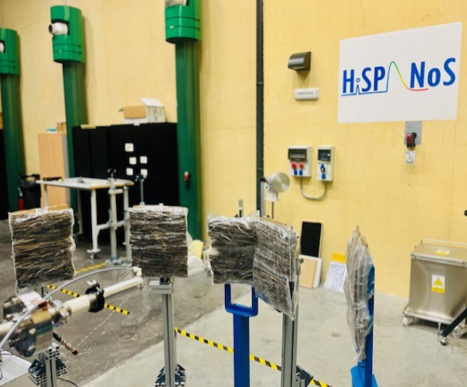

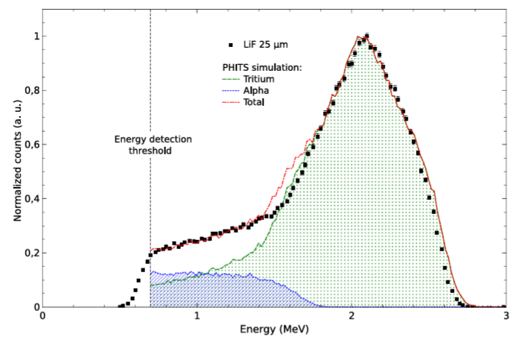

Collaborations with research groups & industry (besides MANY activities)
Characterization of concrete for shielding @IFMIF-DONES
Mutagenesis for improved crops
³⁷Ar production for dark matter
Innovative SiC neutron detector
Kaki buds were irradiated with fast neutrons in a range 0,1 to 1 Gy, achieveing the LD=50 @ ~1Gy.
Irradiation of CaO powder for 5h with 3×10¹⁰n/sr/s from Be(d,n) at 1.2 µA:
The CSIC-IMB-CNM have developed their own technology of solid-state SiC radiation. When loaded with ¹⁰B, ⁶LiF and PE converters, become suitabile for thermal/fast neutron detection.
The construction of IFMIF-DONES requires efficient shielding to neutrons, for which new concrete compositions are being developed.
Fast neutrons
⁴⁰Ca(n,a)³⁷Ar (t_{1/2}=35d)
³⁷Ar source: E_{K}=2,8 keV, E_{L}=270 eV
50μm thick p-n diode built in a 4H-SiC wafer
Response of the detector thermal neutrons
(LiF convcerter)
Transmission measurements with fast monoenergetic neutron beams are carried out to validate the GEANT4 Monte Carlo calculations.
Demonstration of TREX-DM reaching O(10eV) thresholds, at the level of single-electron ionization in Ar.
Now the fruit trees are monitored at ANECOOP facilities in Valencia.
J. Castel et al., JCAP (2026)
M. Pérez et al., NIM-A 1069 (2024)

Slide 18









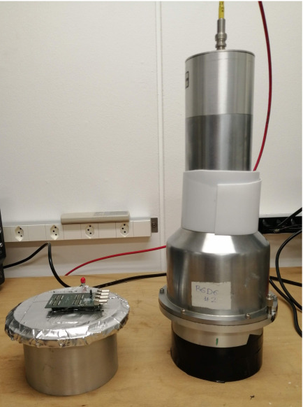
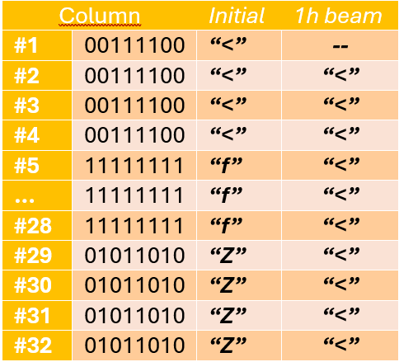
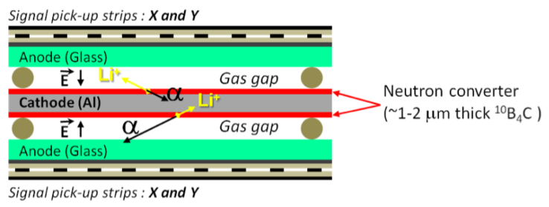

Collaborations with research groups & industry (besides MANY activities)
RPC based neutron detectors
Irradiation of electronics
n-sensitivity of CERN detectors
In addition:
Neutron imaging
(USC and Neutron Insights)
Fission s(f,n) with MGAS
(NTUA via EC-EUROLABS)
- Quenching of Skipper CCD
(UBA via EC-EUROLABS)
- Radiobiology with neutrons
(U. Lisboa via EC-OFFERR)
- NAA of roman coins
(USE and IAPH)
and more.
Resistive Plate Chambers (RPCs) are simple, cheap and good timing (sub-ns) and spatial resolution.
At CNA there is a well established program on Radiation-to-Electronics (R2E) using MeV photons (⁶⁰Co from RadLab) and ions (3 MV tandem and 18 MeV cyclotron).
The measurement of (n,γ) reactions at the CERN n_TOF facility requires radiation detectors insensitive to neutrons. They are made of C₆D₆ and can be mounted on carbon fiber housings.
A new design with ¹⁰B neutron converter is under development at LIP and has been tested successfully at HiSPANoS.
SEUs candidate in a FPGA irradiated with fast neutrons for 1 h.
Conventional and innovative (SiPM, lower volumes), have been recently tested against epithermal neutrons at HiSPANoS.
A.C Vilas-Bôas et al., Journal of Integrated Circuits and Systems (2026)

Slide 19
Thank you
This work has receieved funding from Plan Complementario de I+D+i de Astrofísica y Física de Altas Energías (MRR) ASTRO21/1.3/3 project and from Agencia Estatal de Investigación (AEI) through PID2021-123879OO, PID2024-155965OB-I00 and EQC2024-008842-P

