Slide 1
CYGNUS-Oz ANU Weekly
18 Feb 2026

Slide 2
General News
DECRA 2027
HARD DEADLINE - Wednesday 25 February 2026 ⚠️
Full application submitted in RMS
Announcement schedule has been postponed and bigger window
24 September - 10 October 2026 → 10 December 2026 to 9 March 2027 😤
AEA IGNITE Grant
HARD DEADLINE - Wednesday 25 February 2026 ⚠️
Ali, Lindsey, Greg and Rob away WC: 23 Feb for CYGNUS & CYGNOz

Slide 3
Upcoming Events
Focus talk 17th February – Linda Truong
9th edition of the international CYGNUS Workshop on Directional Recoil Detection 🇯🇵
Mon 23rd 14:25 - Negative ion formation in pure CF4 via dissociative electron attachment
Tue 24th 09:30 - Direct in-chamber radon-220 (thoron) emanation measurements for directional dark matter experiments)
Tue 24th 11:05 - Ali (Micromesh structures for Charge Amplification and Readout in Negative Ion Gases)
Wed 25th 09:40 - Eddie (Machine Learning methods for Directional Recoil Detection reconstruction at CYGNUS-Oz)
CYGNO x CYGNUS-Oz Workshop 2026 (Feb 26)
Marks Australian involvement with CYGNO Experiment 🇦🇺🤝🇮🇹

Slide 4

CYGNO x CYGNUS-Oz (CYGNOz)
https://indico.global/event/16685/

Slide 5
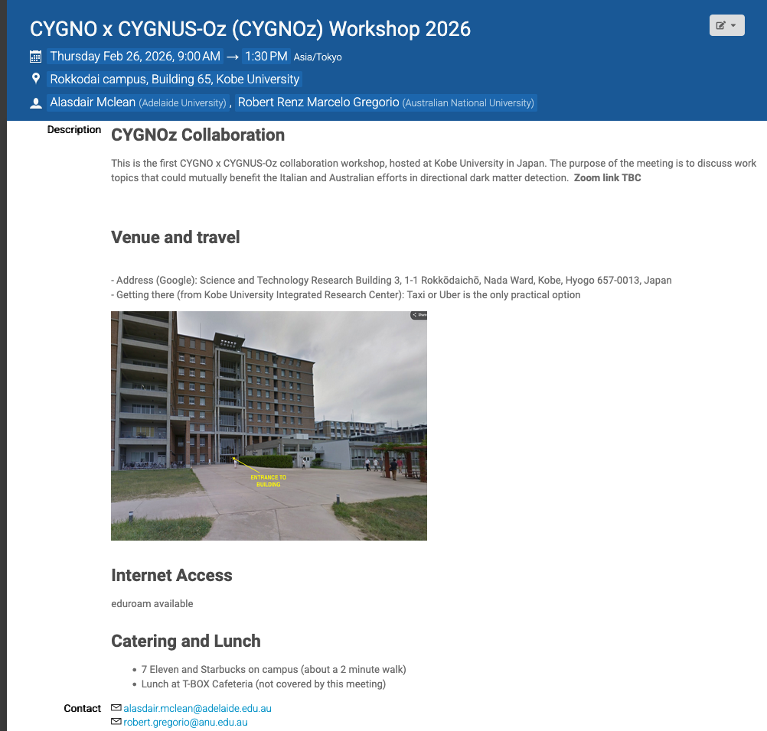

CYGNO x CYGNUS-Oz (CYGNOz)
https://indico.global/event/16685/

Slide 6
Publication Plan
In progress
Direct in-chamber radon-220 (thoron) emanation measurements for rare-event physics experiments
Submitted to JINST( arXiv:2601.12622) – R.R. Marcelo Gregorio
High Negative Ion Gain MMThGEM-Micromegas Detector for Directional Dark Matter Searches
Submitted to JINST( arXiv: 2602.12658) – A. G. Mclean 🎉
Negative ion formation in pure CF4 via dissociative electron attachment
Writing but requires more data
Improving accuracy of in-gas radon assay electrostatic detectors and application to He, CF4 and SF6 for directional dark matter experiments
Awaiting N2/Air radon measurement
LARD: Low-Cost Amplification Readout Devices (LARD)
Awaiting data analysis

Slide 7
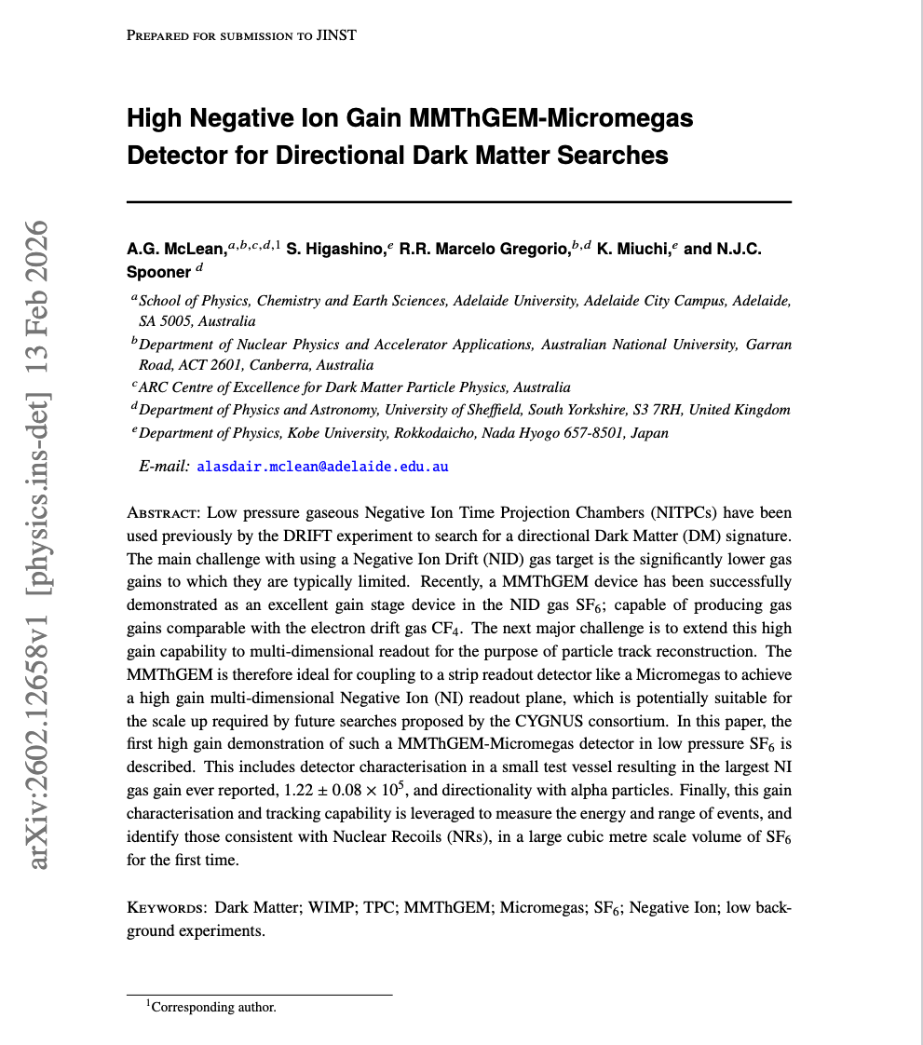
Publication Plan
In progress
Direct in-chamber radon-220 (thoron) emanation measurements for rare-event physics experiments
Submitted to JINST( arXiv:2601.12622) – R.R. Marcelo Gregorio
High Negative Ion Gain MMThGEM-Micromegas Detector for Directional Dark Matter Searches
Submitted to JINST( arXiv: 2602.12658) – A. G. Mclean 🎉
Negative ion formation in pure CF4 via dissociative electron attachment
Writing but requires more data
Improving accuracy of in-gas radon assay electrostatic detectors and application to He, CF4 and SF6 for directional dark matter experiments
Awaiting N2/Air radon measurement
LARD: Low-Cost Amplification Readout Devices (LARD)
Awaiting data analysis

Slide 8
AGENDA
FOCUS Talk – SUPL Radon Reduction
Radon Group Updates
LARD Group Updates
CYGNET Detector Development
ML Track Reconstruction & CYGNO Tasks Updates

Slide 9
CYGNUS-Oz Radon Group
SUPL Project
VSA Project
Electroplating Project
Radon in Different Gases Project
CYGNO Radon Tagging Project

Slide 10

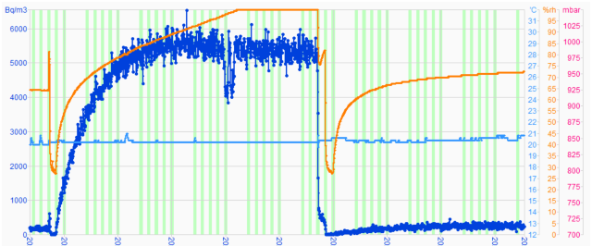
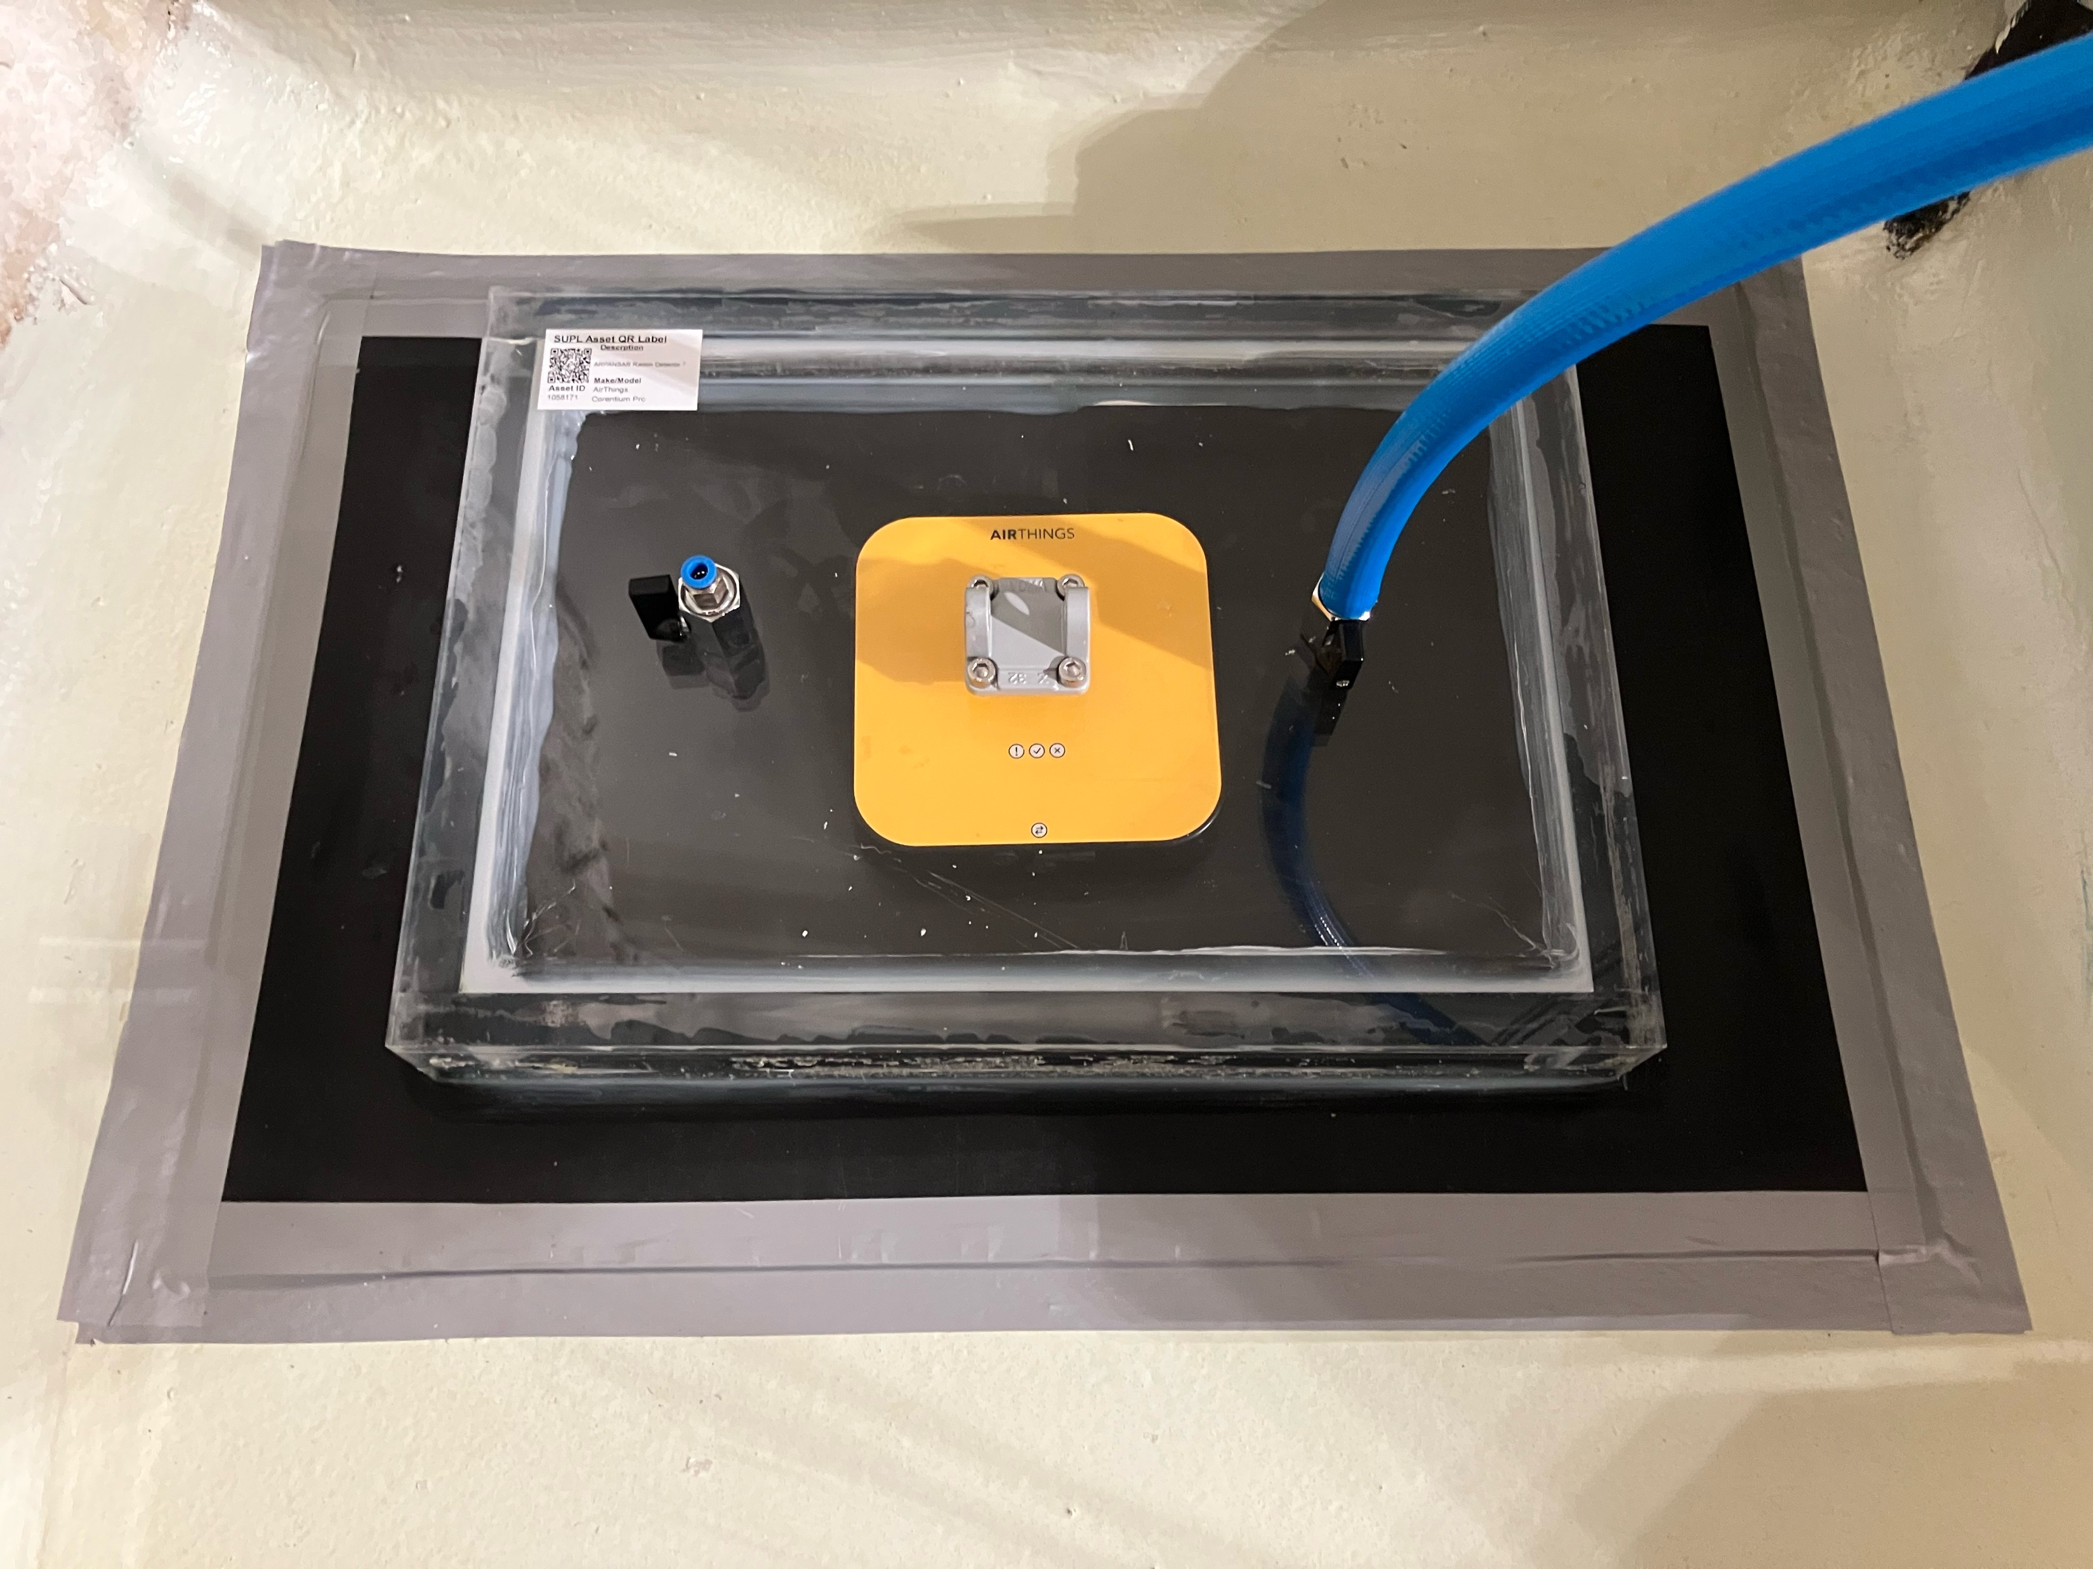
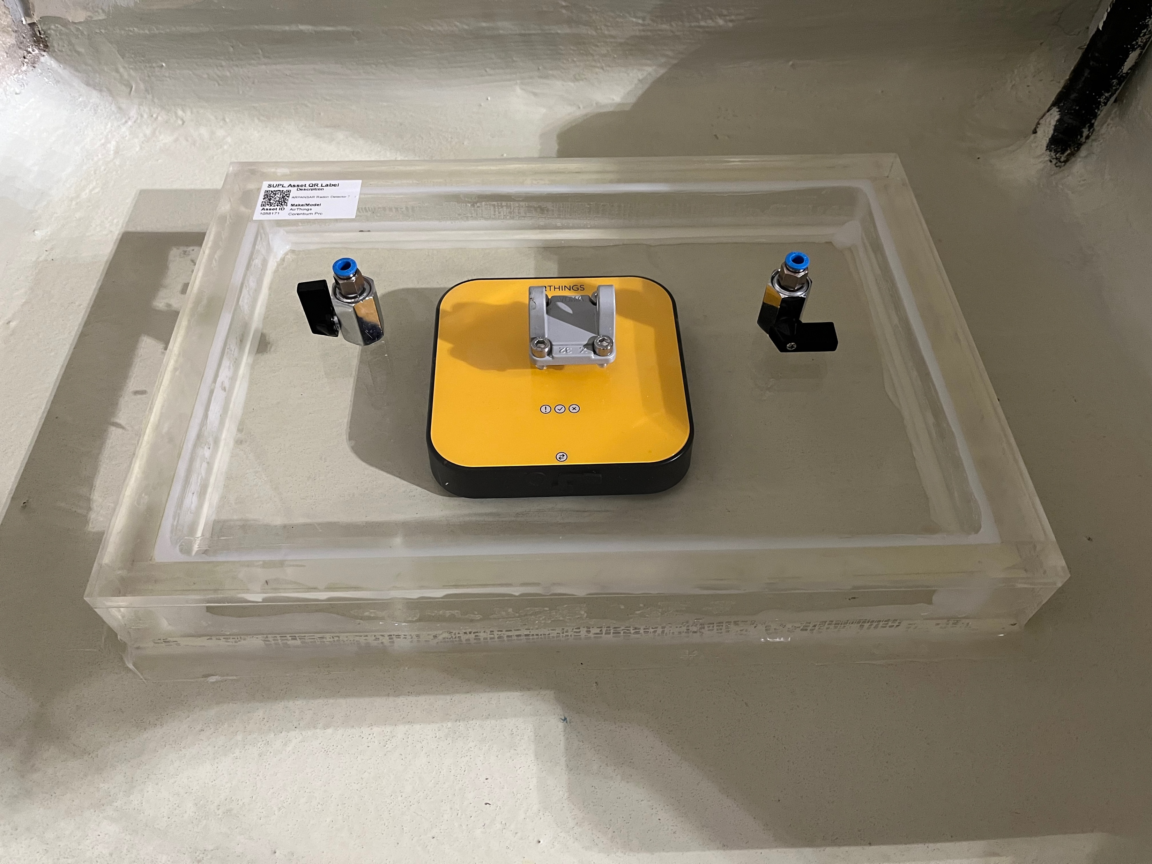
SUPL Project Updates
Radon mitigation at Stawell Underground Physics Laboratory
Prevention of entry with barriers
Dilution with ventilation
Filtration with radon capturing materials (Linda Talk Feb 18th)
Floor emanation (With barrier)
~250 Bq/m3
Floor emanation (no barrier)
~6000 Bq/m3

Slide 11
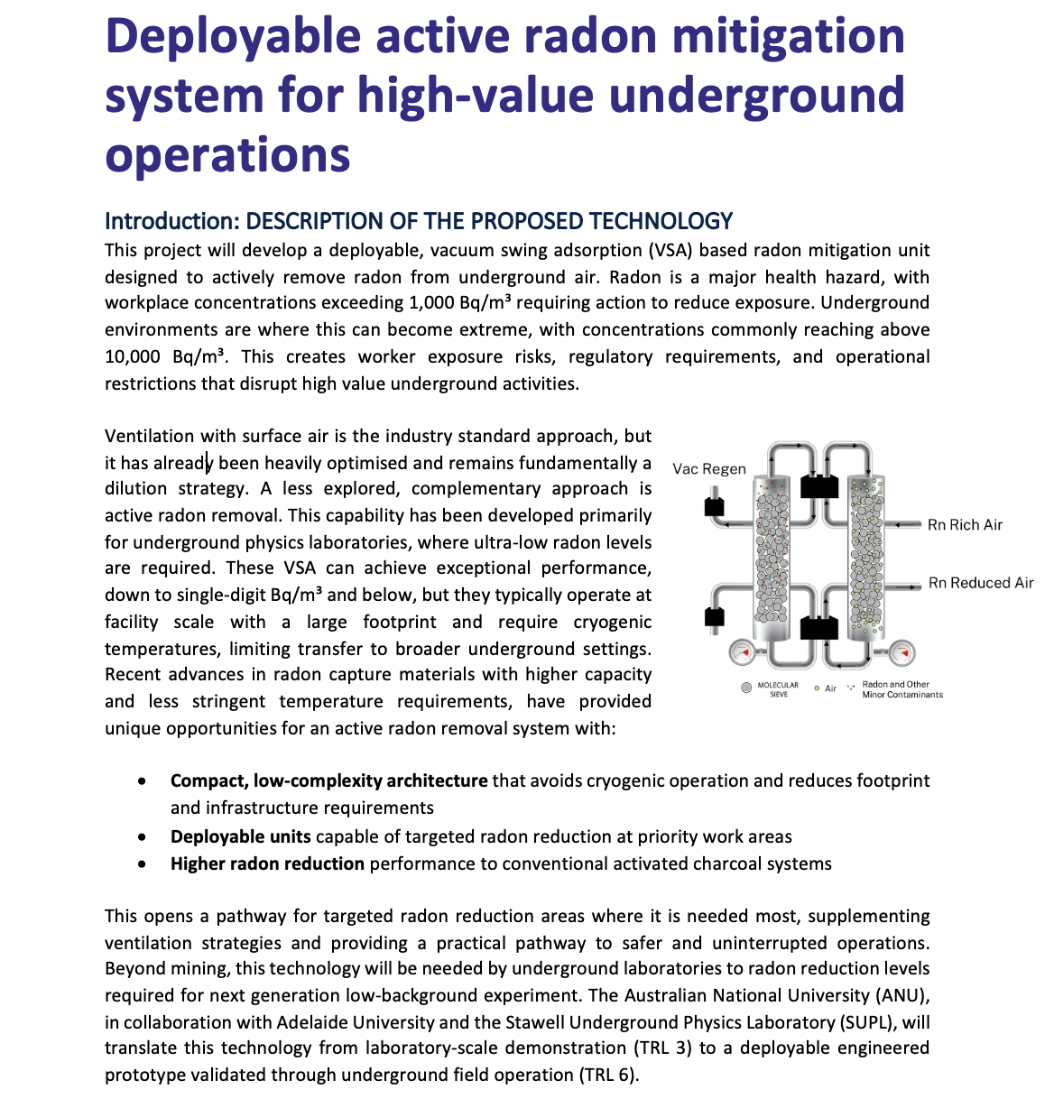
Vacuum Swing Adsorption (VSA) Project

Slide 12
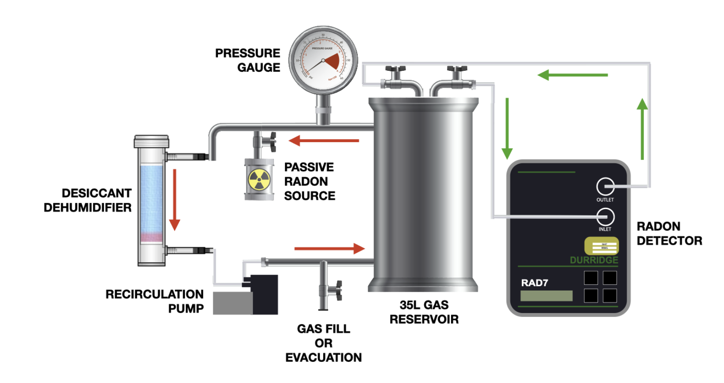
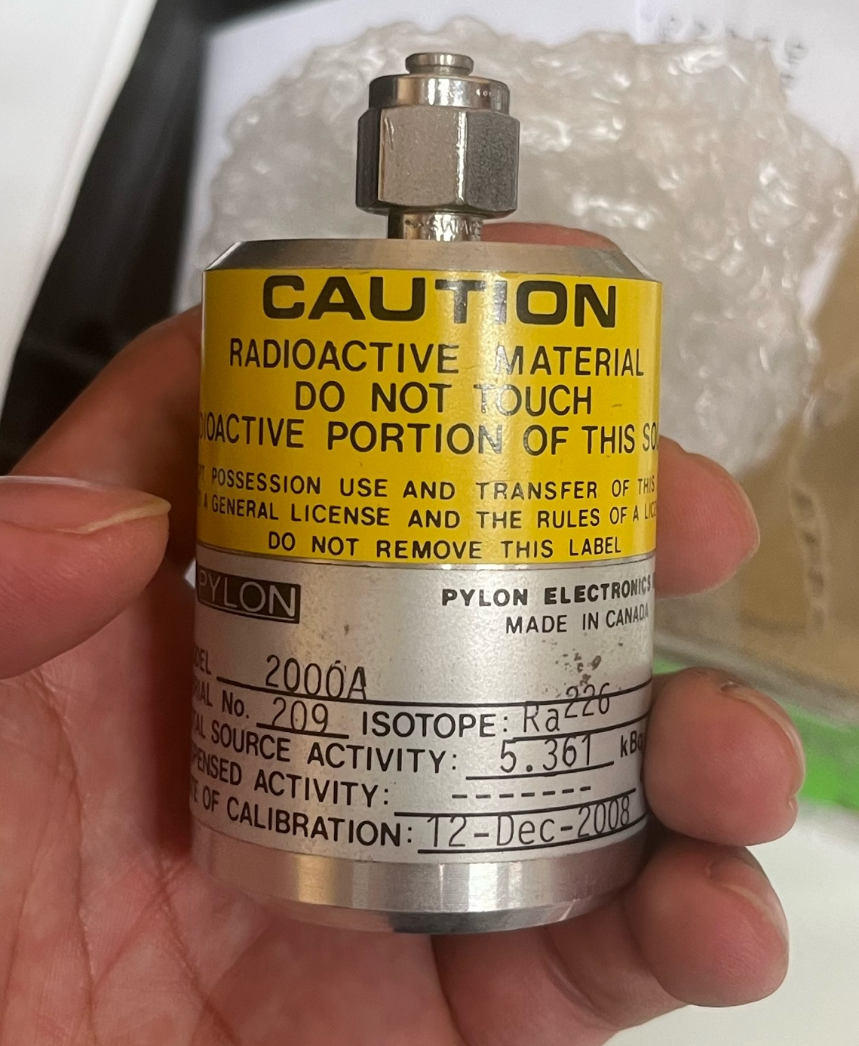
Radon in Different Gases Updates
Original setup take 6 weeks for one measurement
Flow-though radon source method reducing measurement time to ~ 5 days
Natasha is working on making a flow through source with uranium sand
Challenges with pressure buildup
Consulted Dr Michaela Froehlich about Inert solutions
→ Explore different ratios (beads : sand)
→ Different size beads
Original setup
5.6 kBq passive radon source has arrived

Slide 13
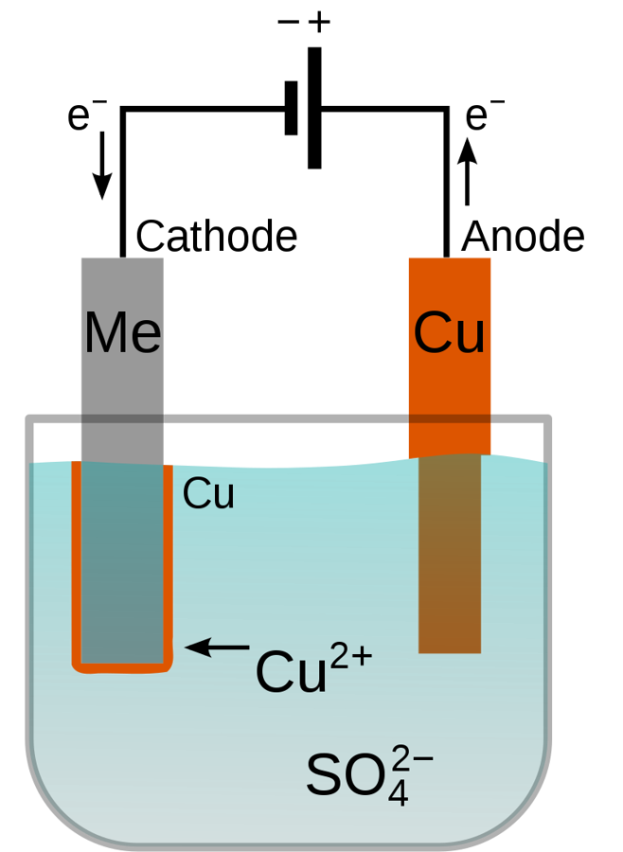
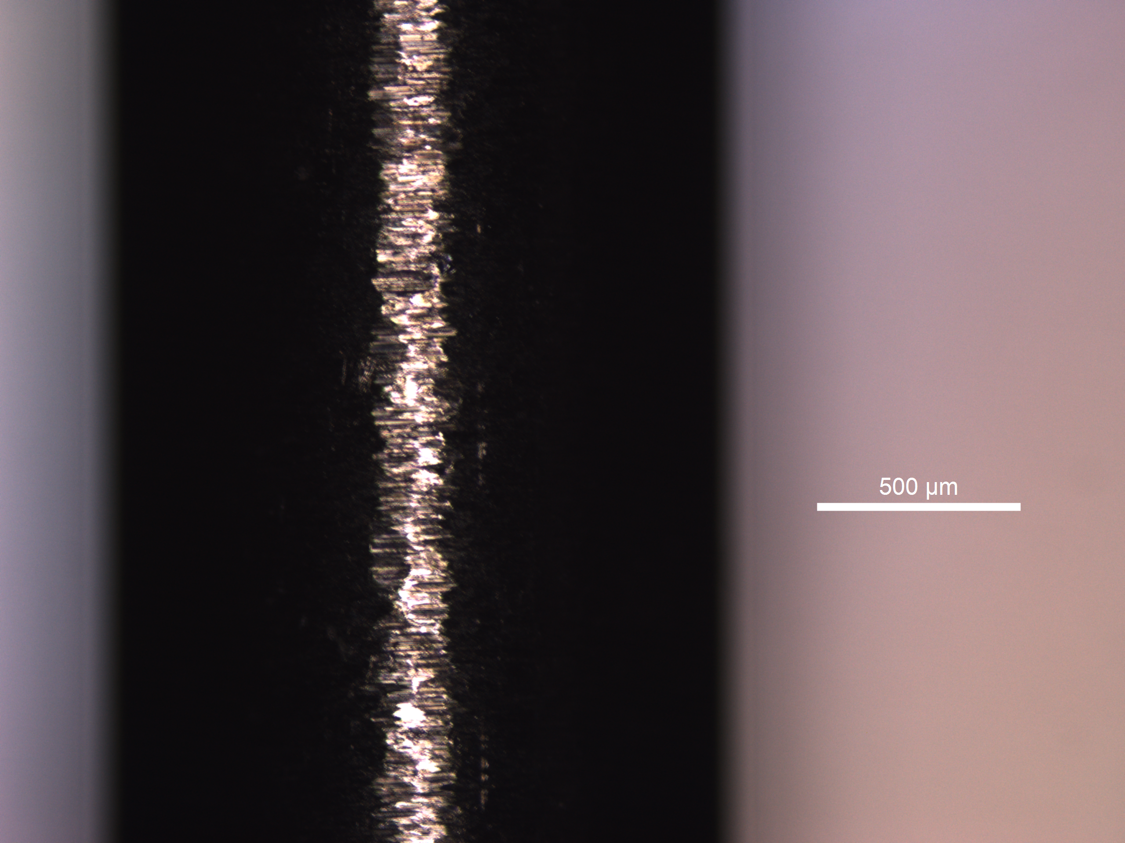
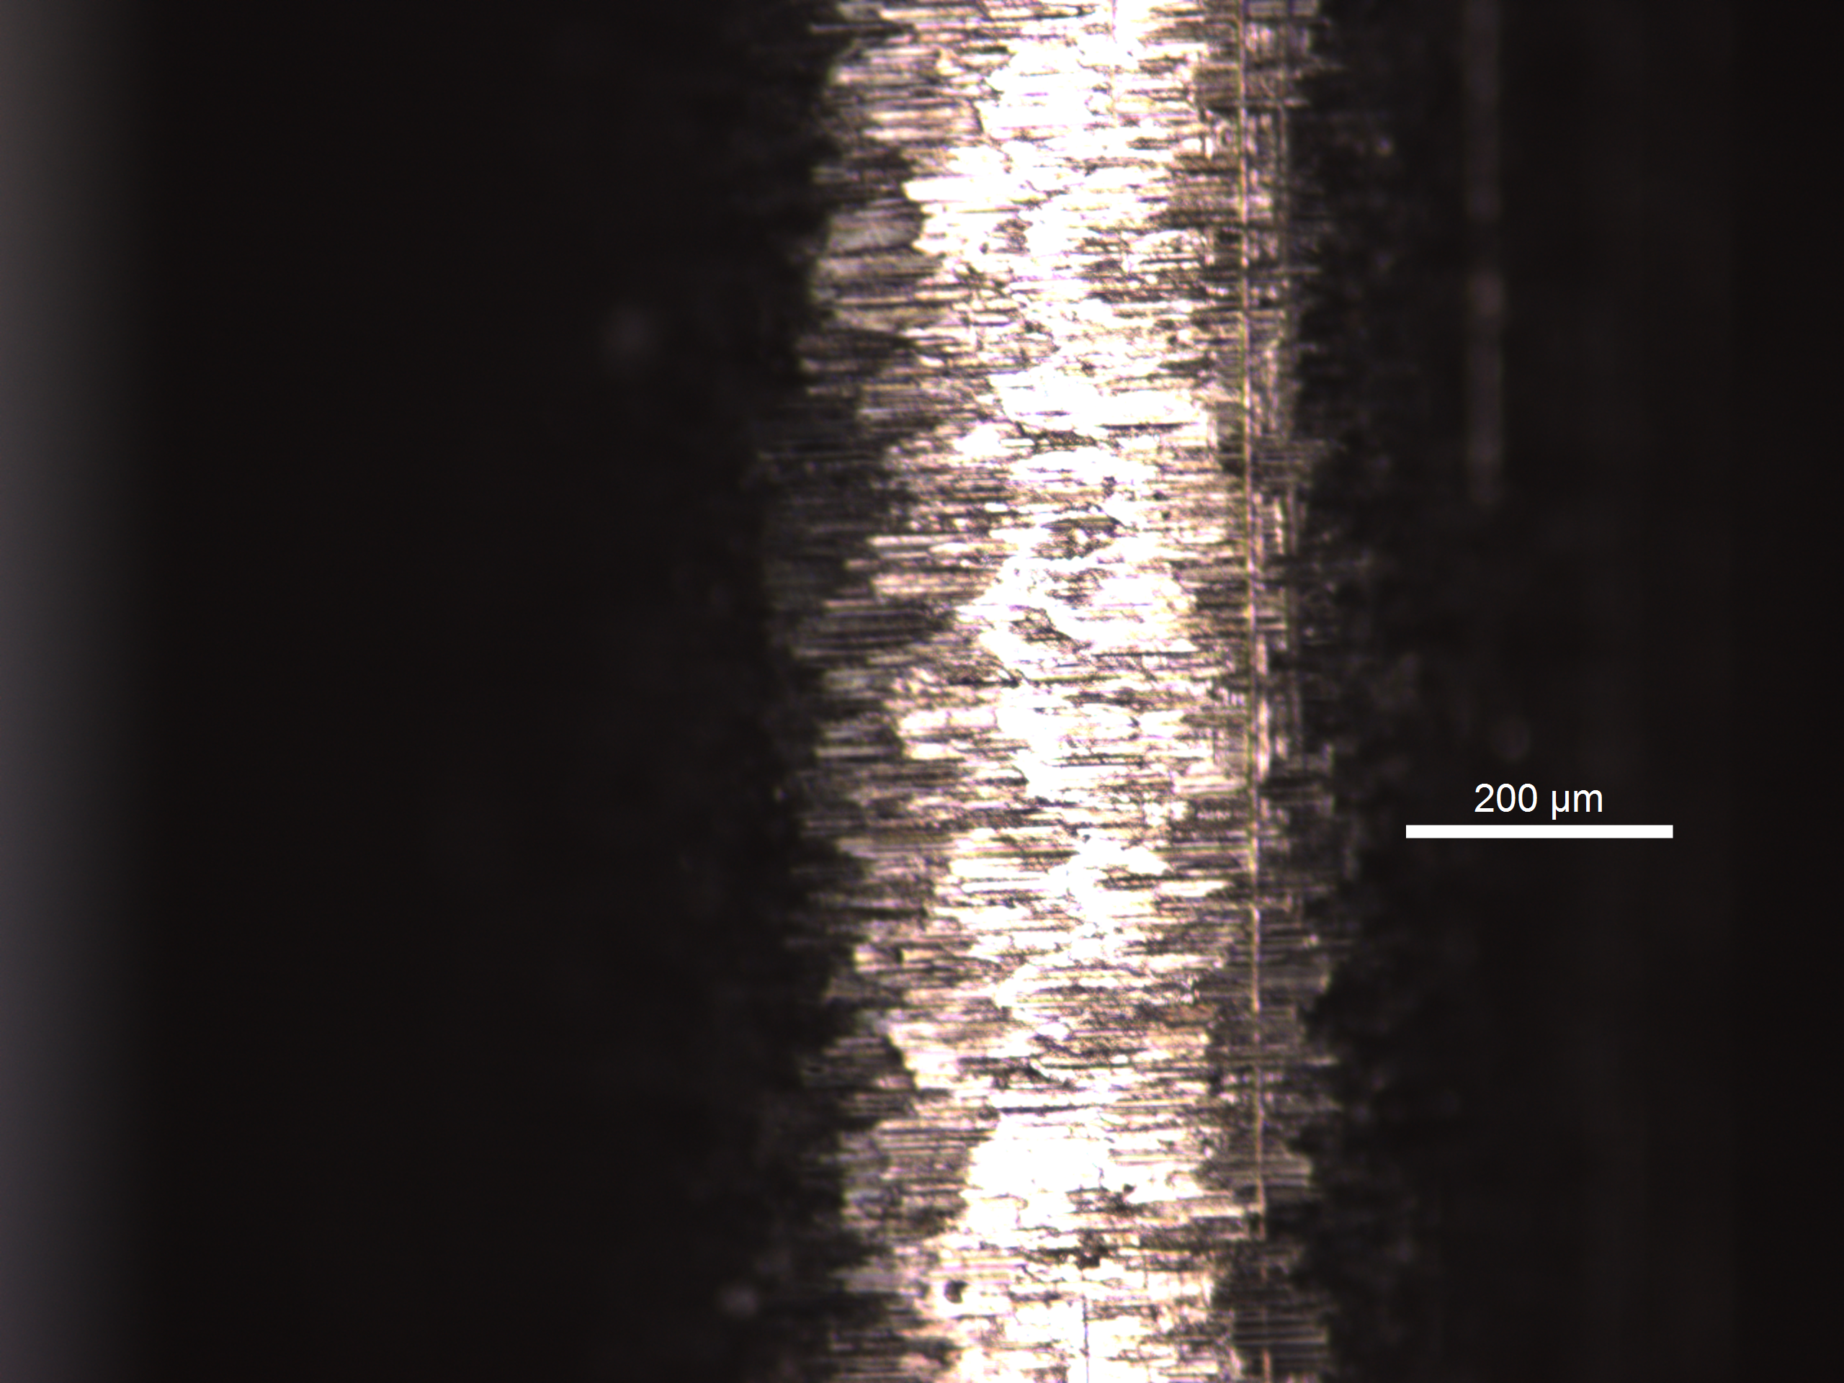
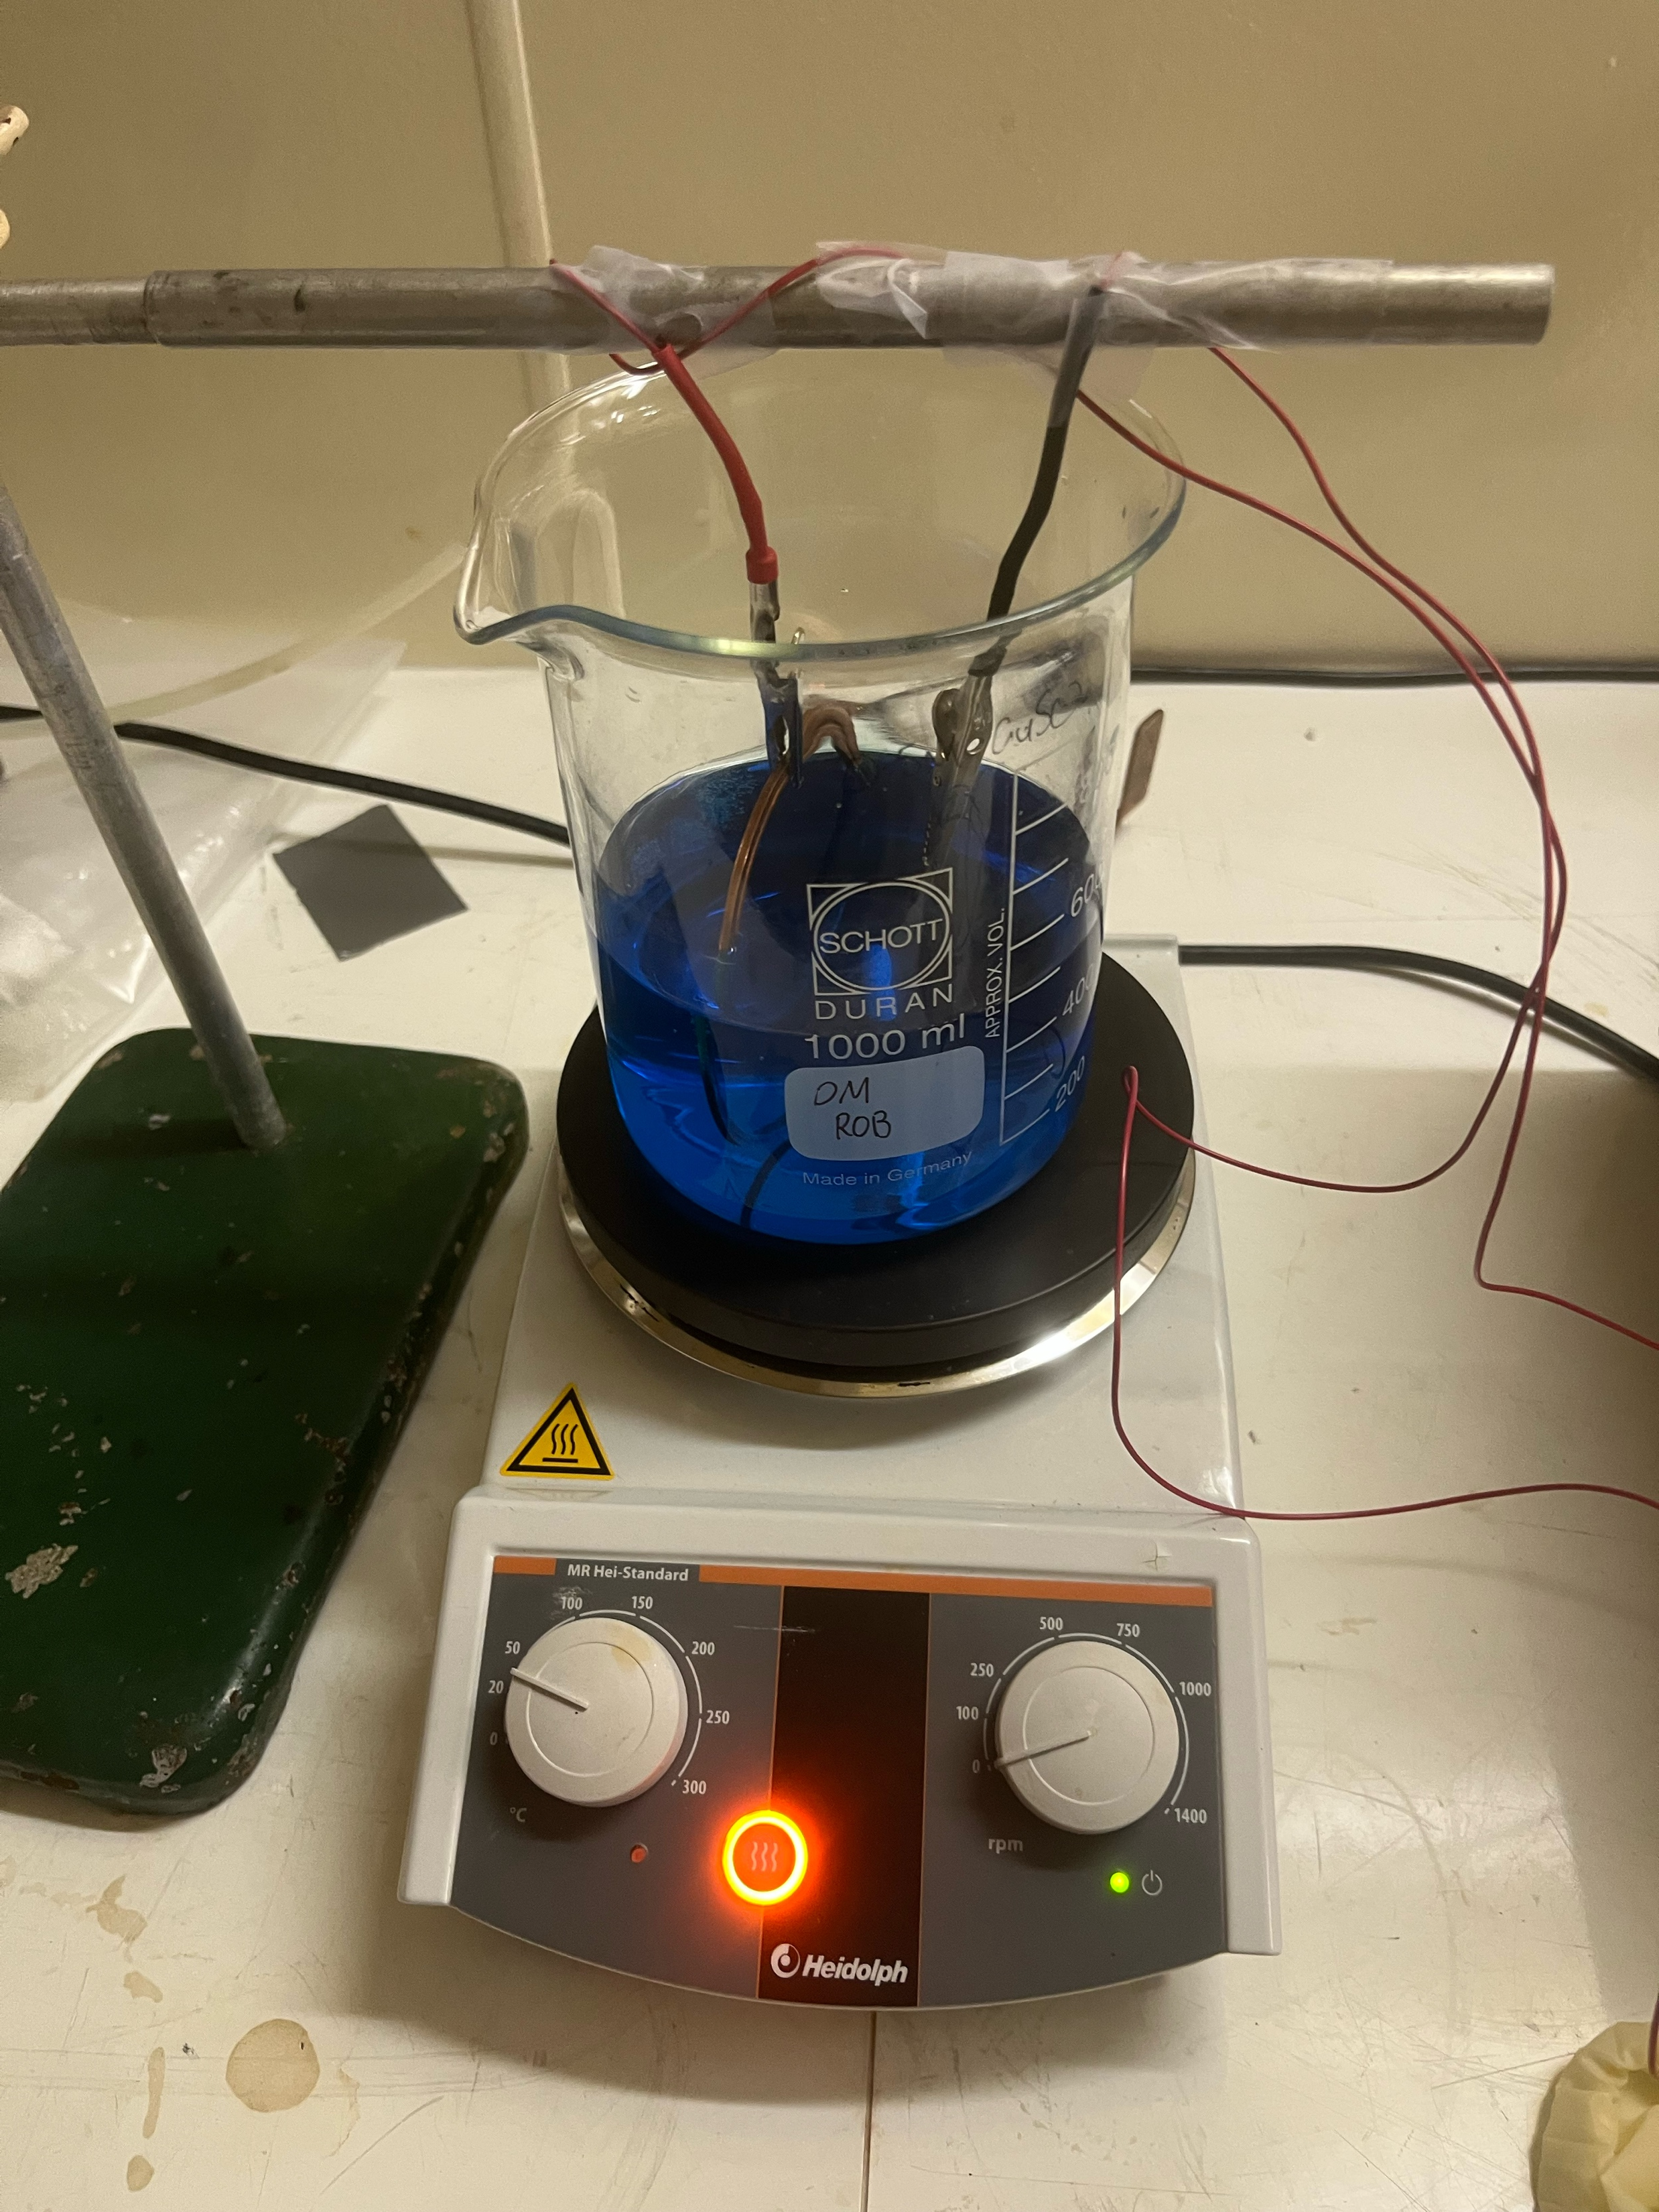

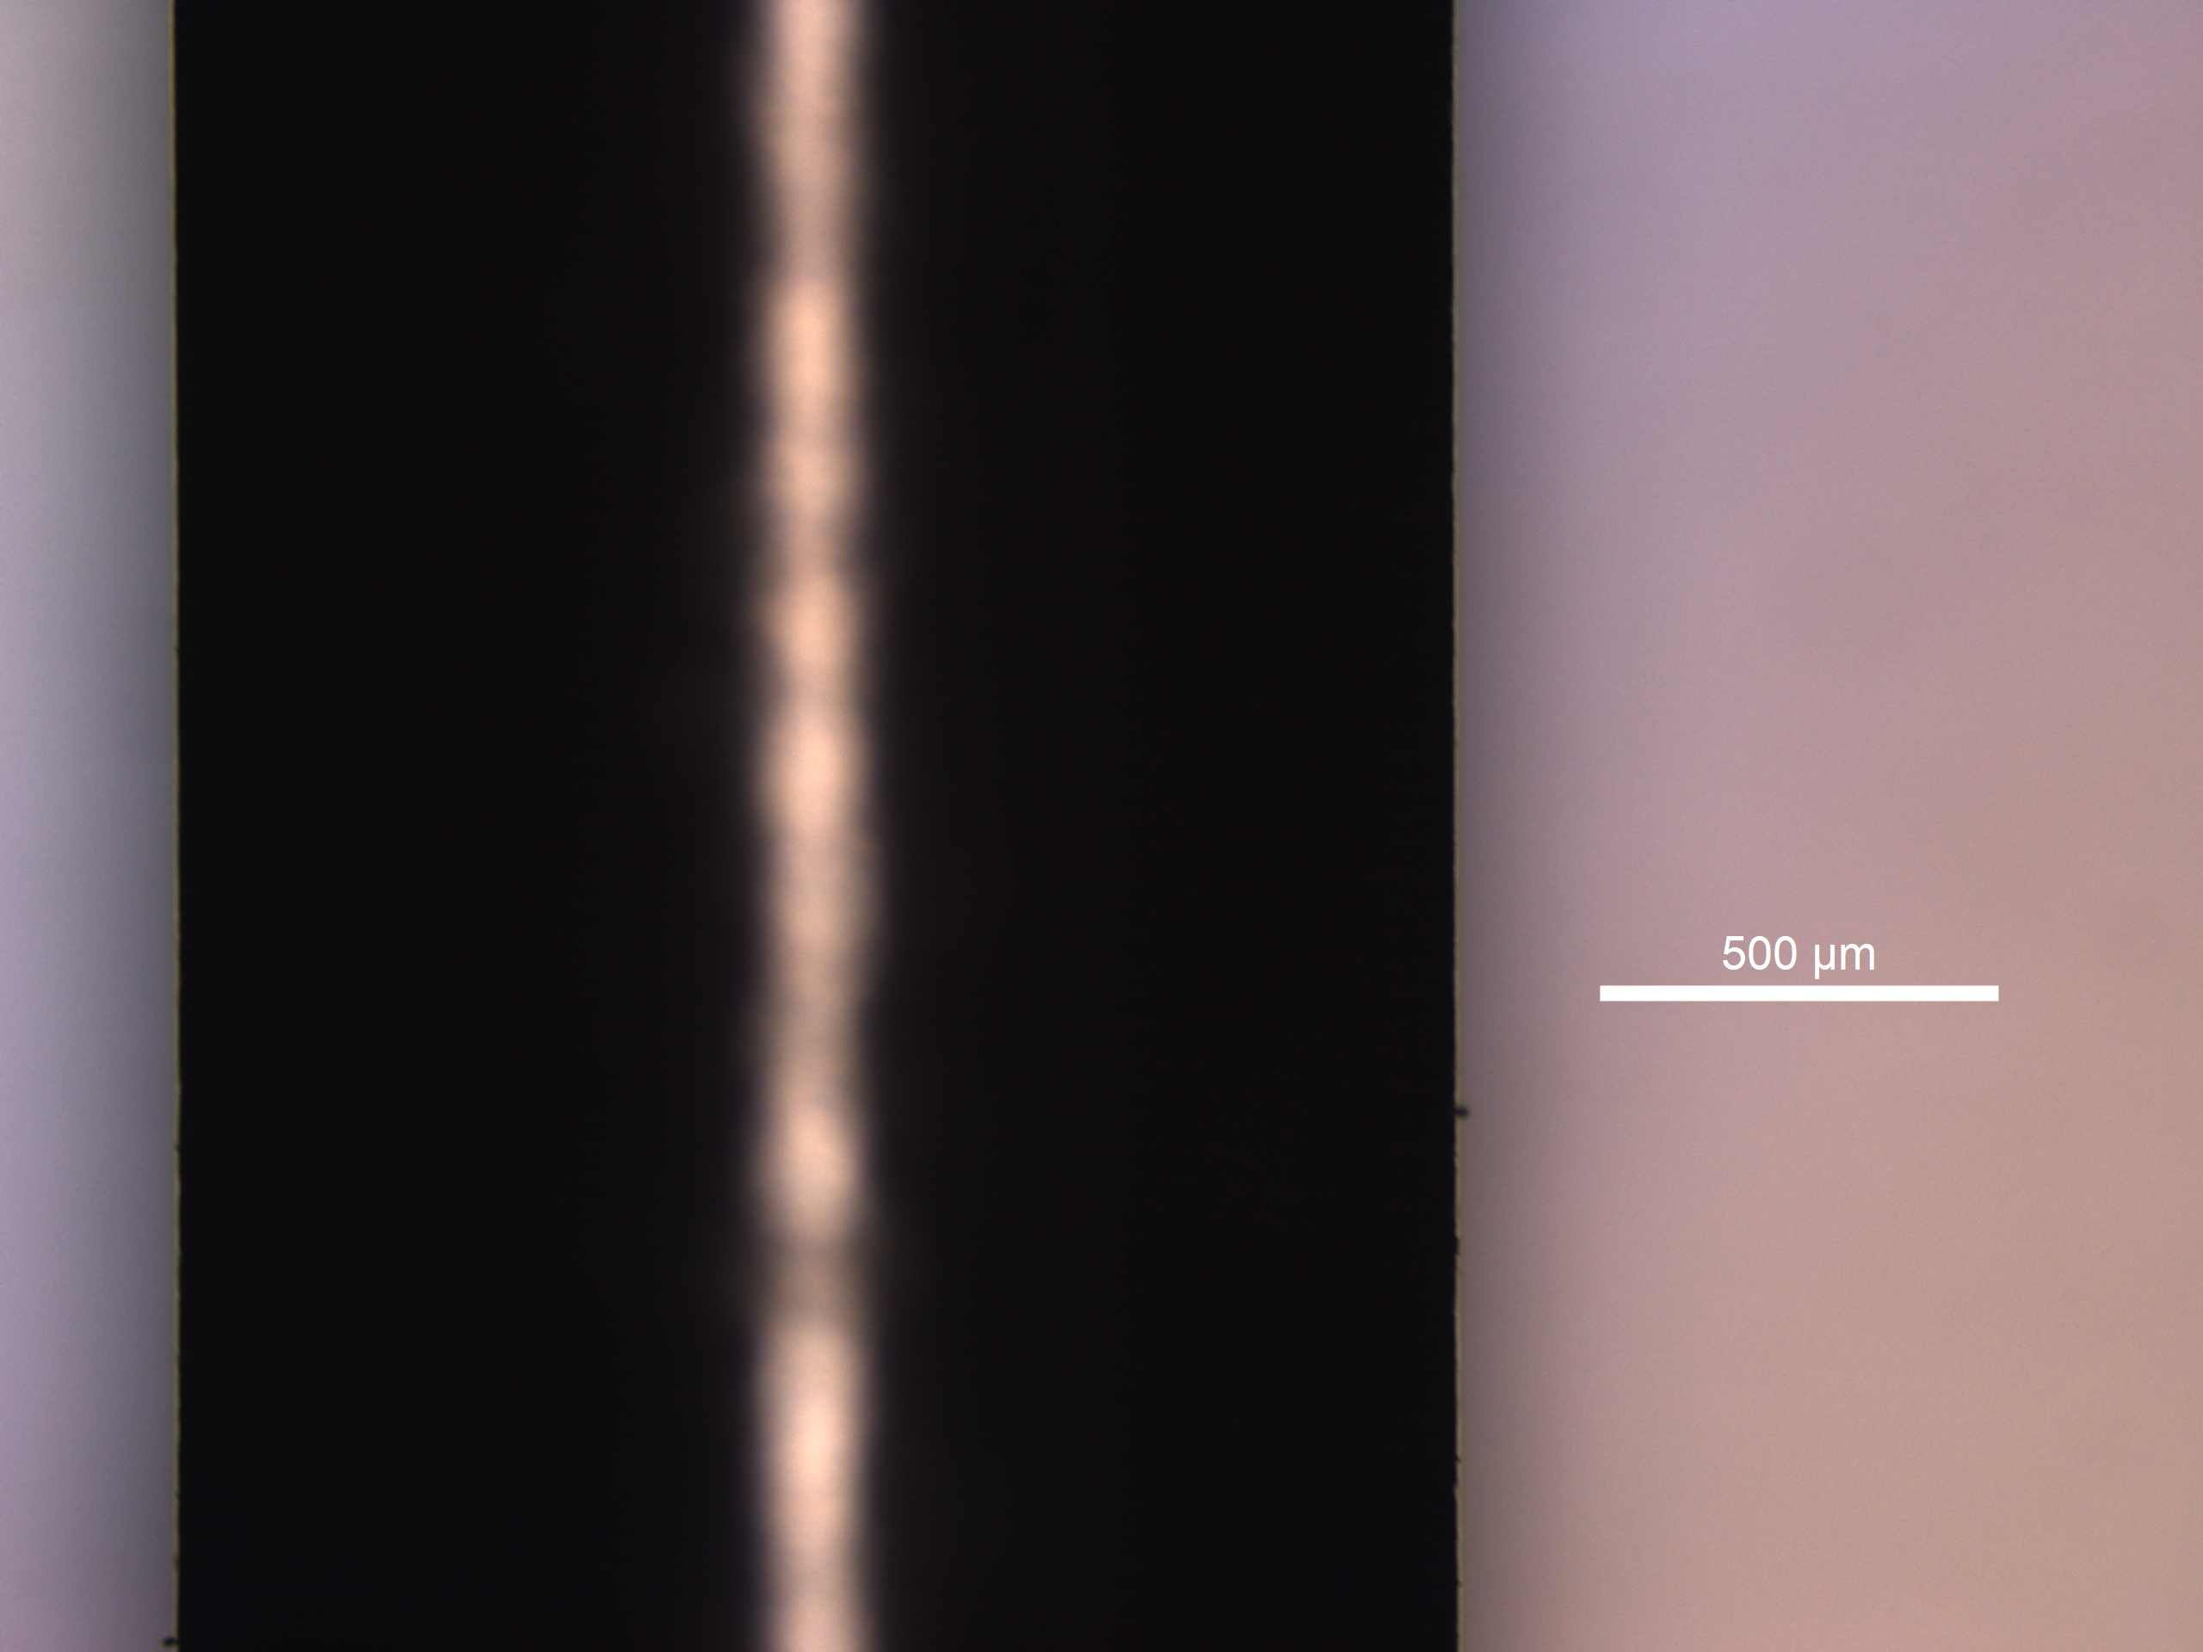
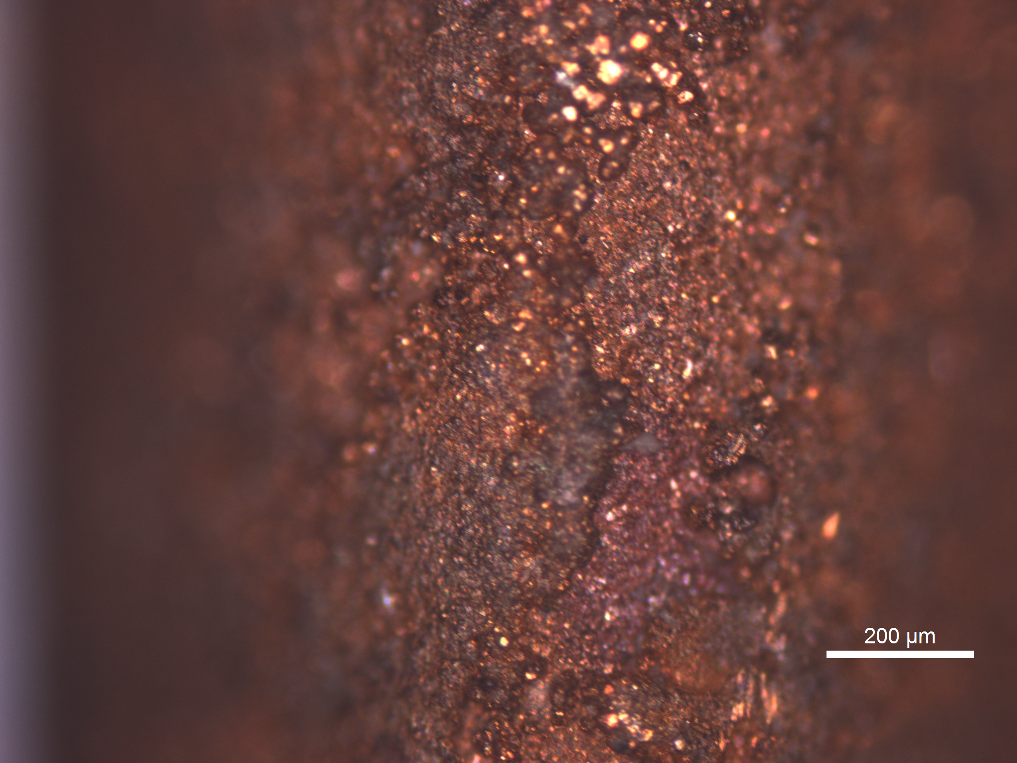
Electroplating Project
Copper Platting Setup Ready in ‘Pb Plating lab’
Leica Stellaris 8 @John Carver Building
²²⁰Rn_{Ema}
Thickness/Quality
Incoming student: - Laurent Bechteler-Weickhardt

Slide 14
Back Up

Slide 15
Electroplating Project Updates
²²⁰Rn_{Ema}
Thickness/Quality
Focus middle
Focus edge

Slide 16
Electroplating Project Updates
²²⁰Rn_{Ema}
Thickness/Quality

Slide 17
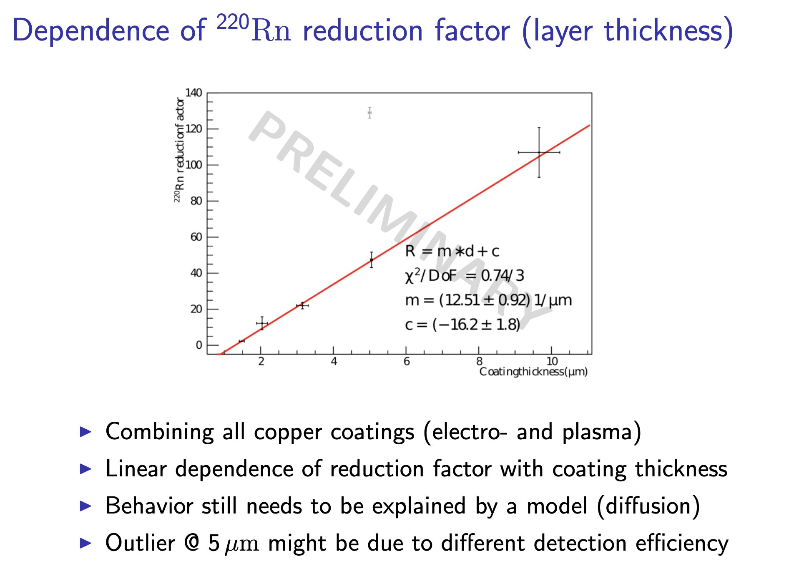
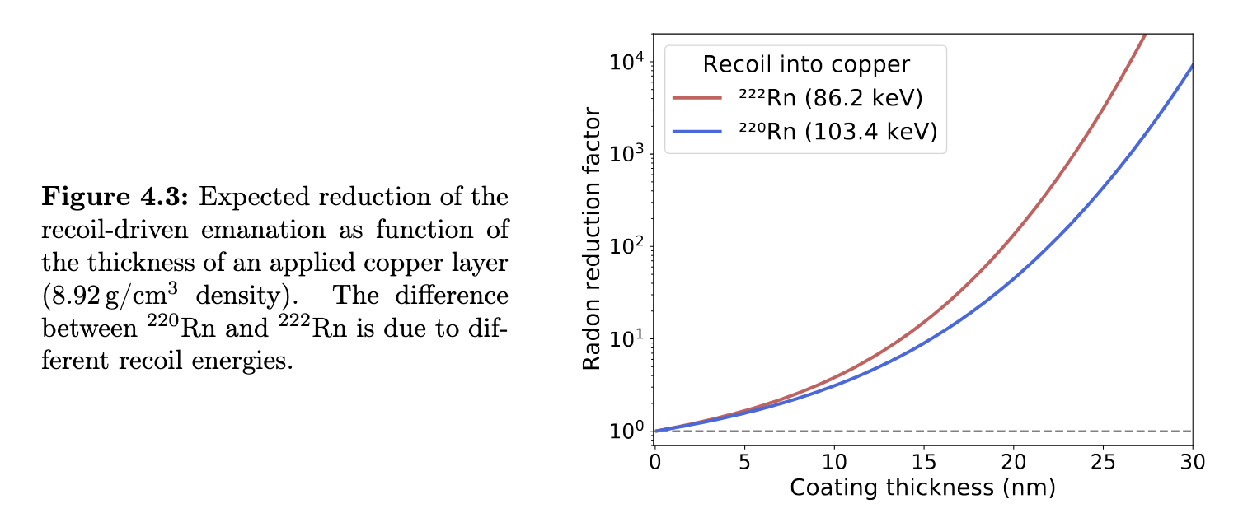
Copper Plating Literature Review
From 222Rn measurements in XENONnT and HeXe to radon mitigation in future liquid xenon experiments (PhD Thesis University of Heidelberg, 2022 Florian Jörg)
Simulation SRIM Simulation
Coating thickness of 10um reduction factor x 100

