Slide 1
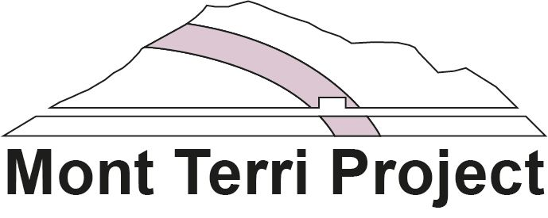
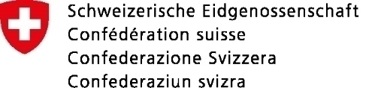







Numerical simulation of damage evolution around the PF/PF-A experiment borehole in faulted Opalinus Clay
Muhammad Raharsya Andiva¹, Chenxi Zhao², Qinghua Lei¹, and Martin Ziegler³
¹ Department of Earth Sciences, Uppsala University, Sweden
² CCTEG Coal Mining Research Institute, Beijing, China
³ Federal Office of Topography, Mont Terri Underground Rock Laboratory, St-Ursanne, Switzerland
Federal Office of Topography
Federal Nuclear Safety
Inspectorate ENSI

Slide 2
Numerical modelling strategy
Short-term (hours to days)
Long-term (months to years)
Ventilation and resaturation
Drilling
Not to scale
Pore pressure diffusion
Poroelasticity
Saturation evolution
Suction
Swelling
Creep
Damage
…
Free surface creation
Mechanical unloading
Stress redistribution
Rock mass deformation
Damage evolution
…
Geomechanical modelling
Hydromechanical modelling
2

Slide 3
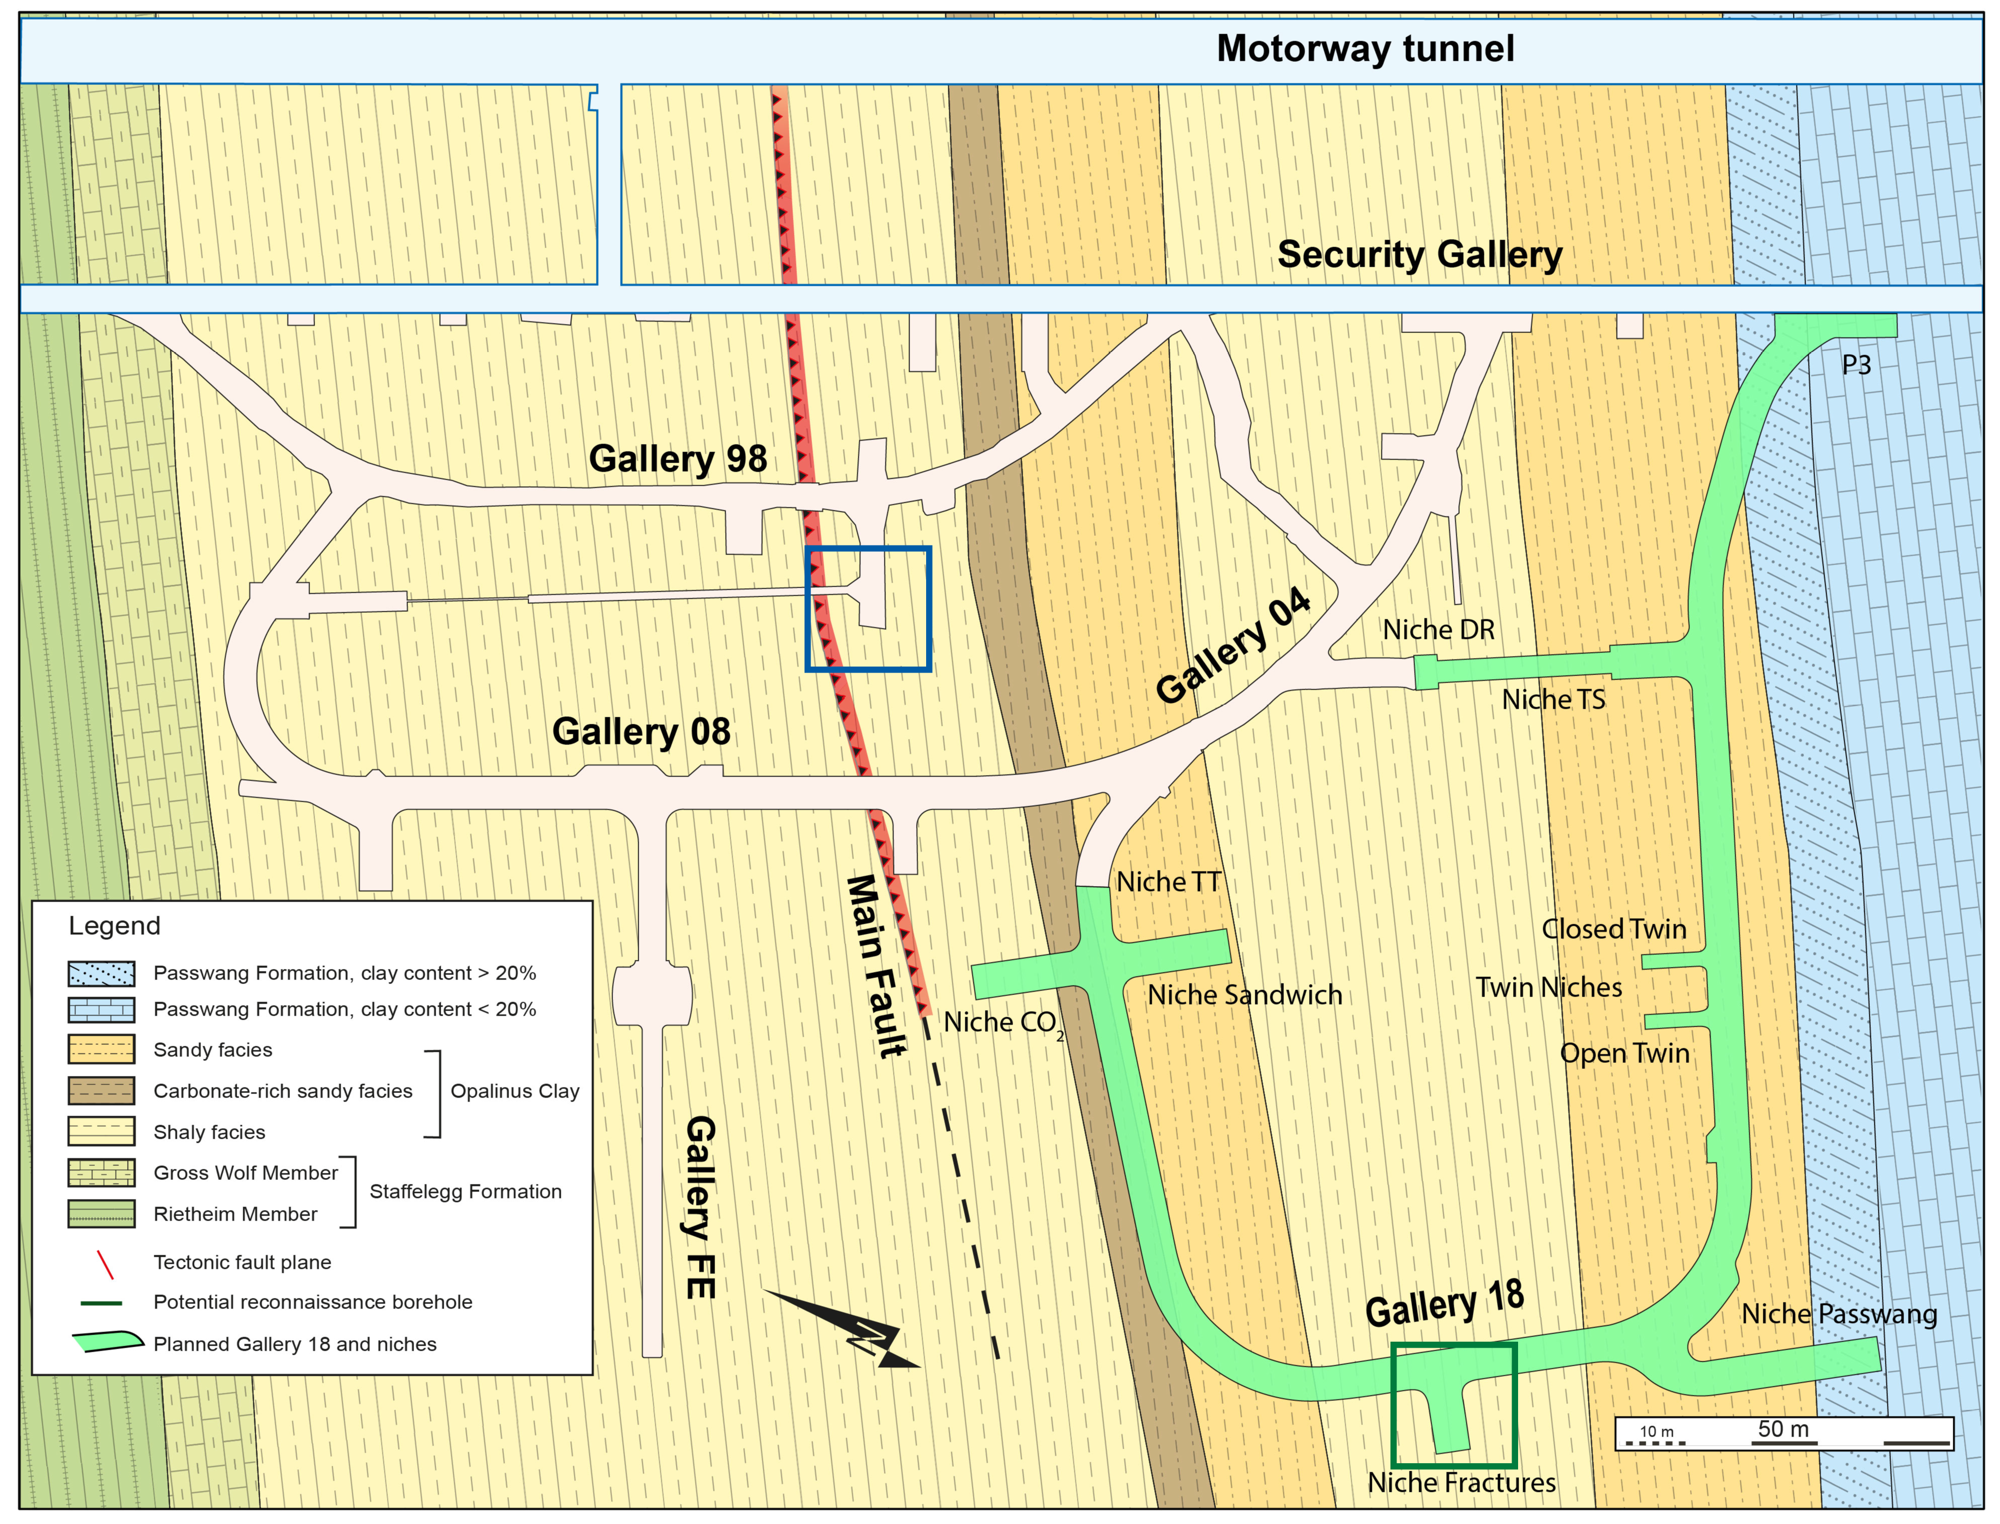
PF/PF-A experiment
Located in Mont Terri Rock Laboratory
1 experiment borehole
6 monitoring boreholes
Structurally-controlled overbreaks
Jaeggi (2019)
Martin and Loew (2021)
Martin and Loew (2021)
3

Slide 4
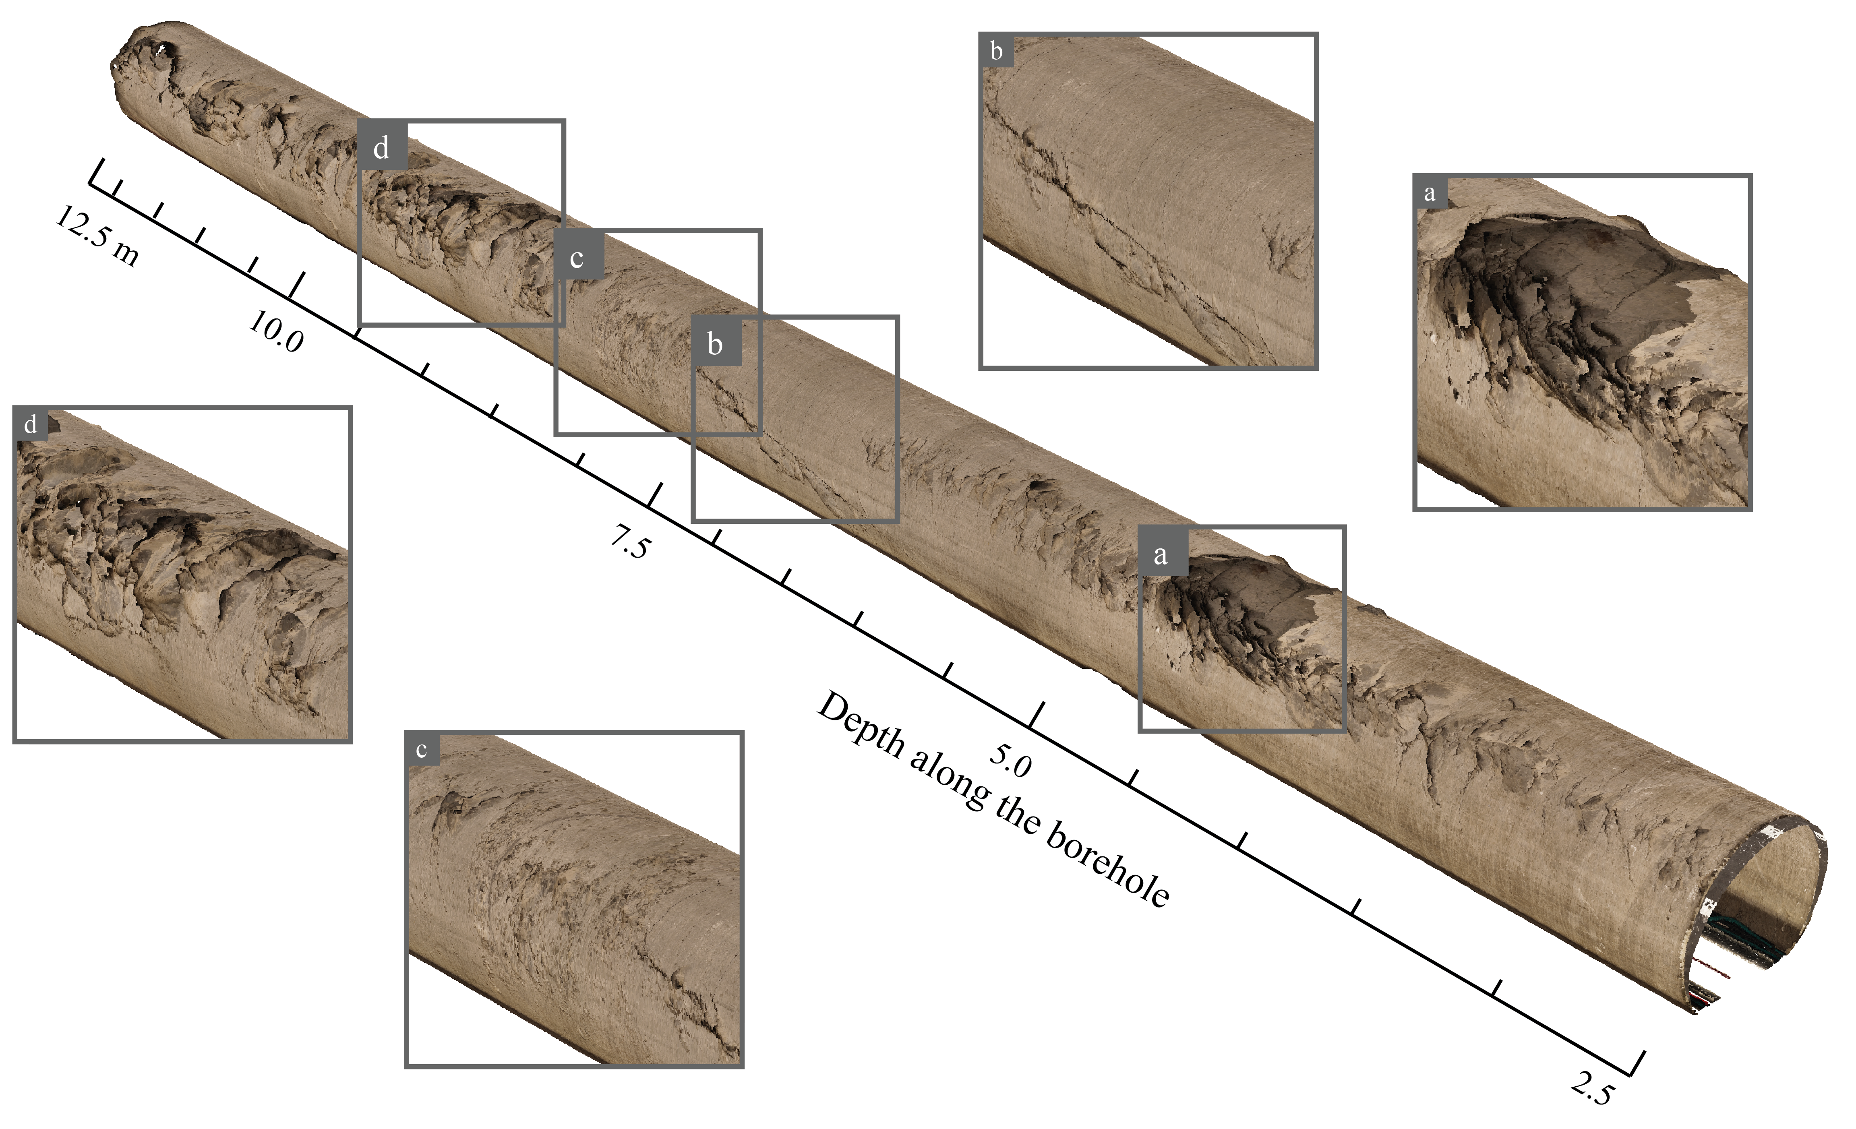
Overbreak pattern (shortly after drilling)
Zhao, Lei, Ziegler, Loew (2024) IJRMMS

Slide 5
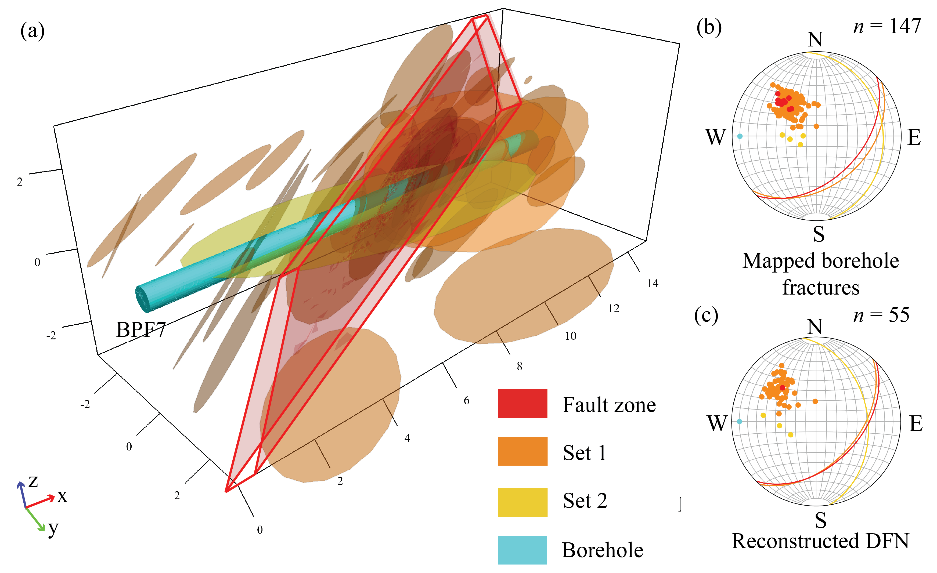
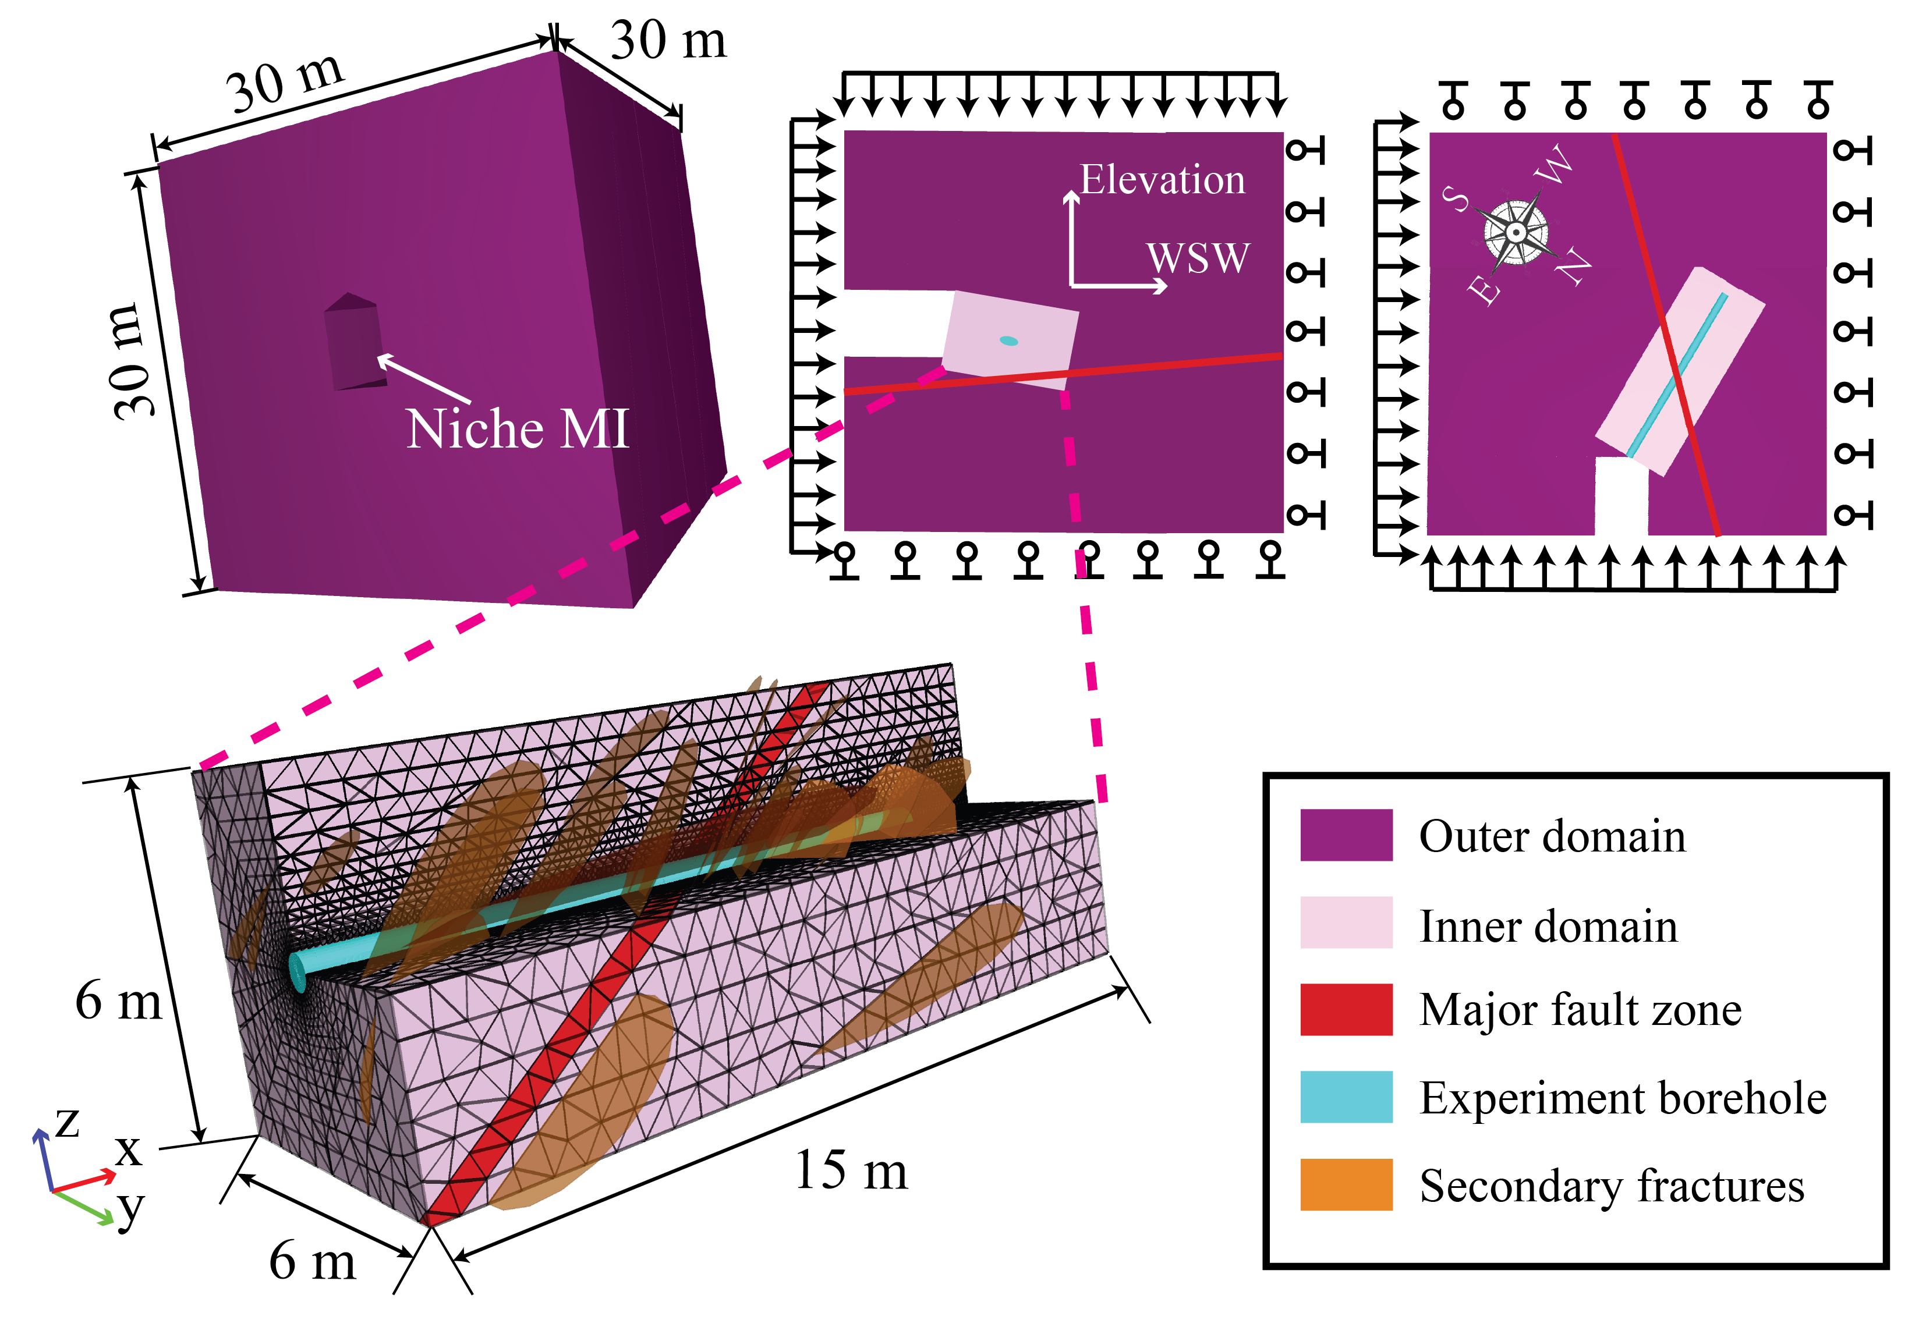
Model setup (geomechanical model)
Fracture network reconstruction
Numerical model construction
Generated using Fracman
Simulated using 3DEC
Zhao, Lei, Ziegler, Loew (2024) IJRMMS
5

Slide 6
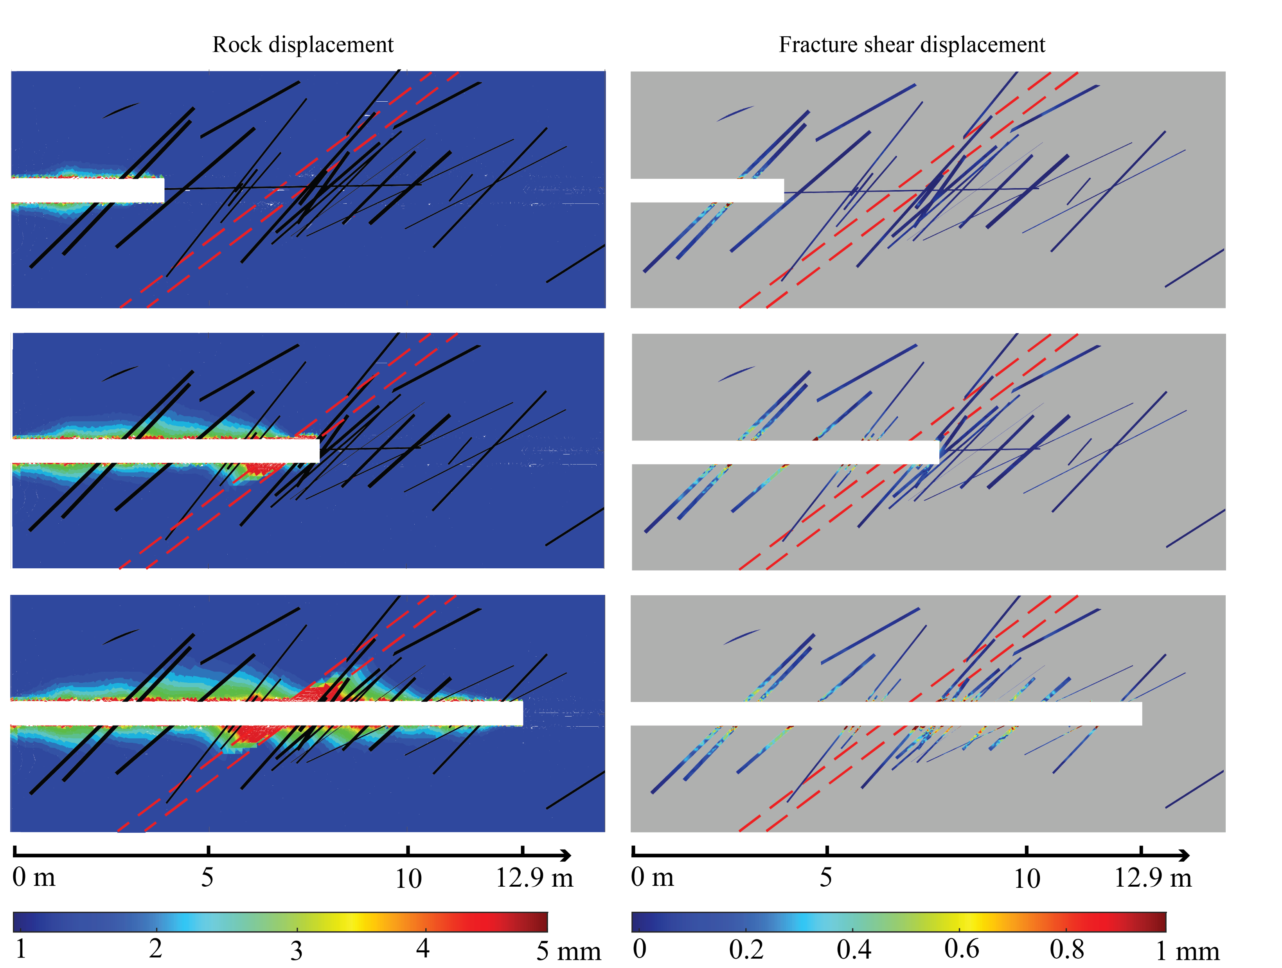
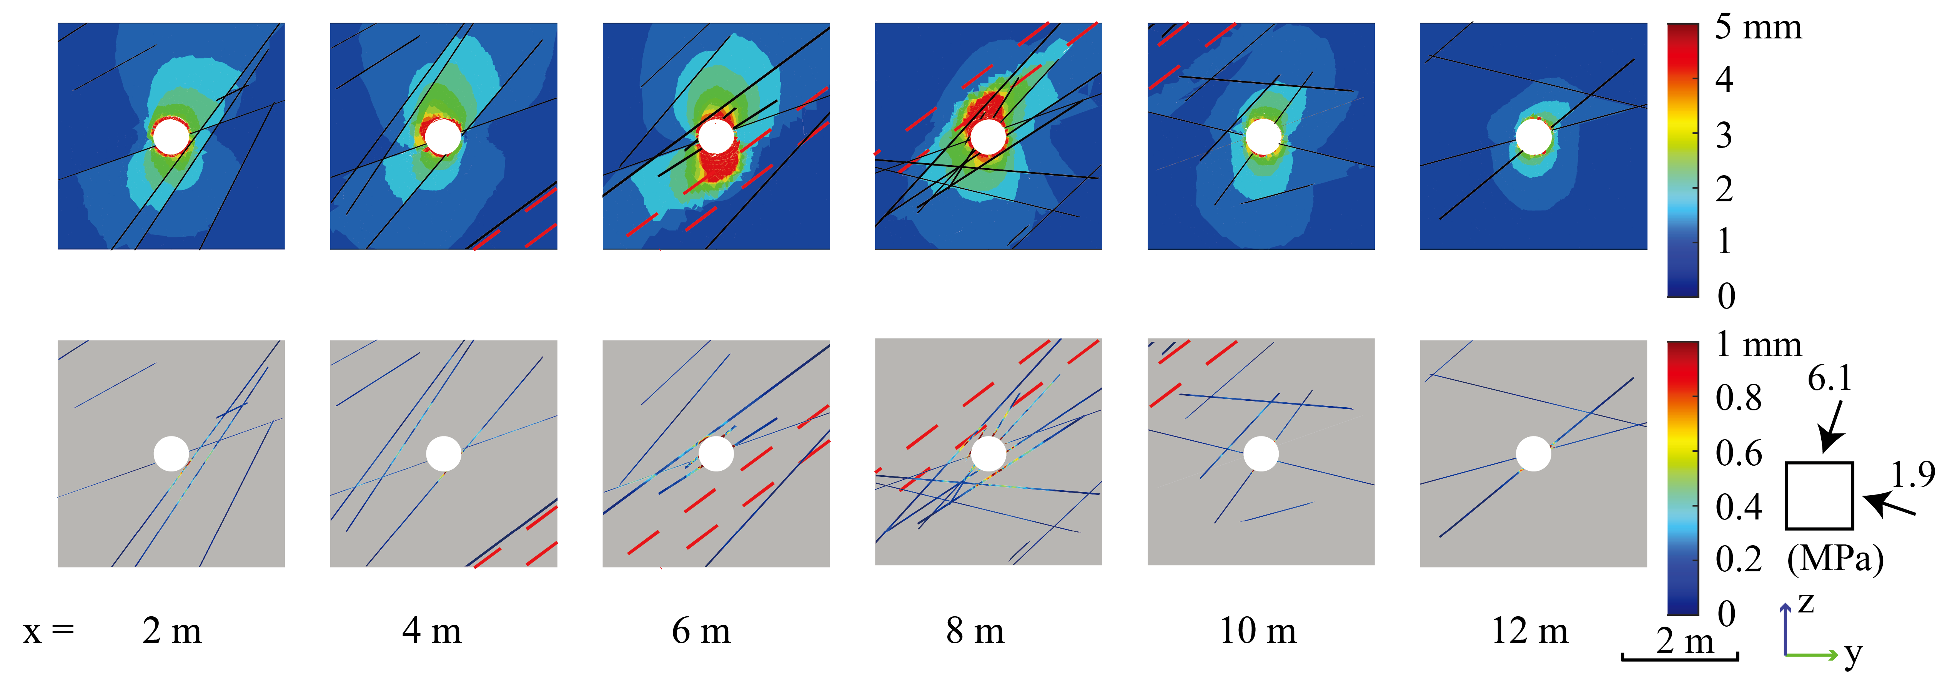
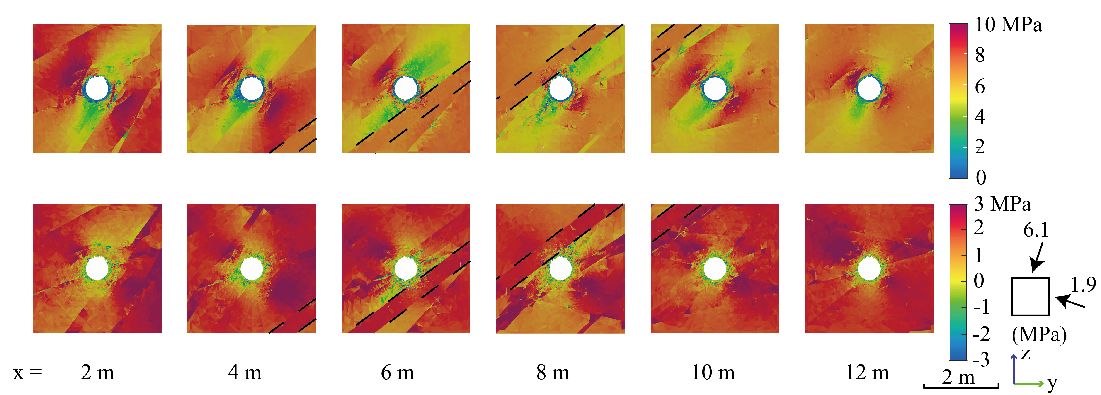
Simulation results
Displacement field
Stress field
Zhao, Lei, Ziegler, Loew (2024) IJRMMS
6

Slide 7
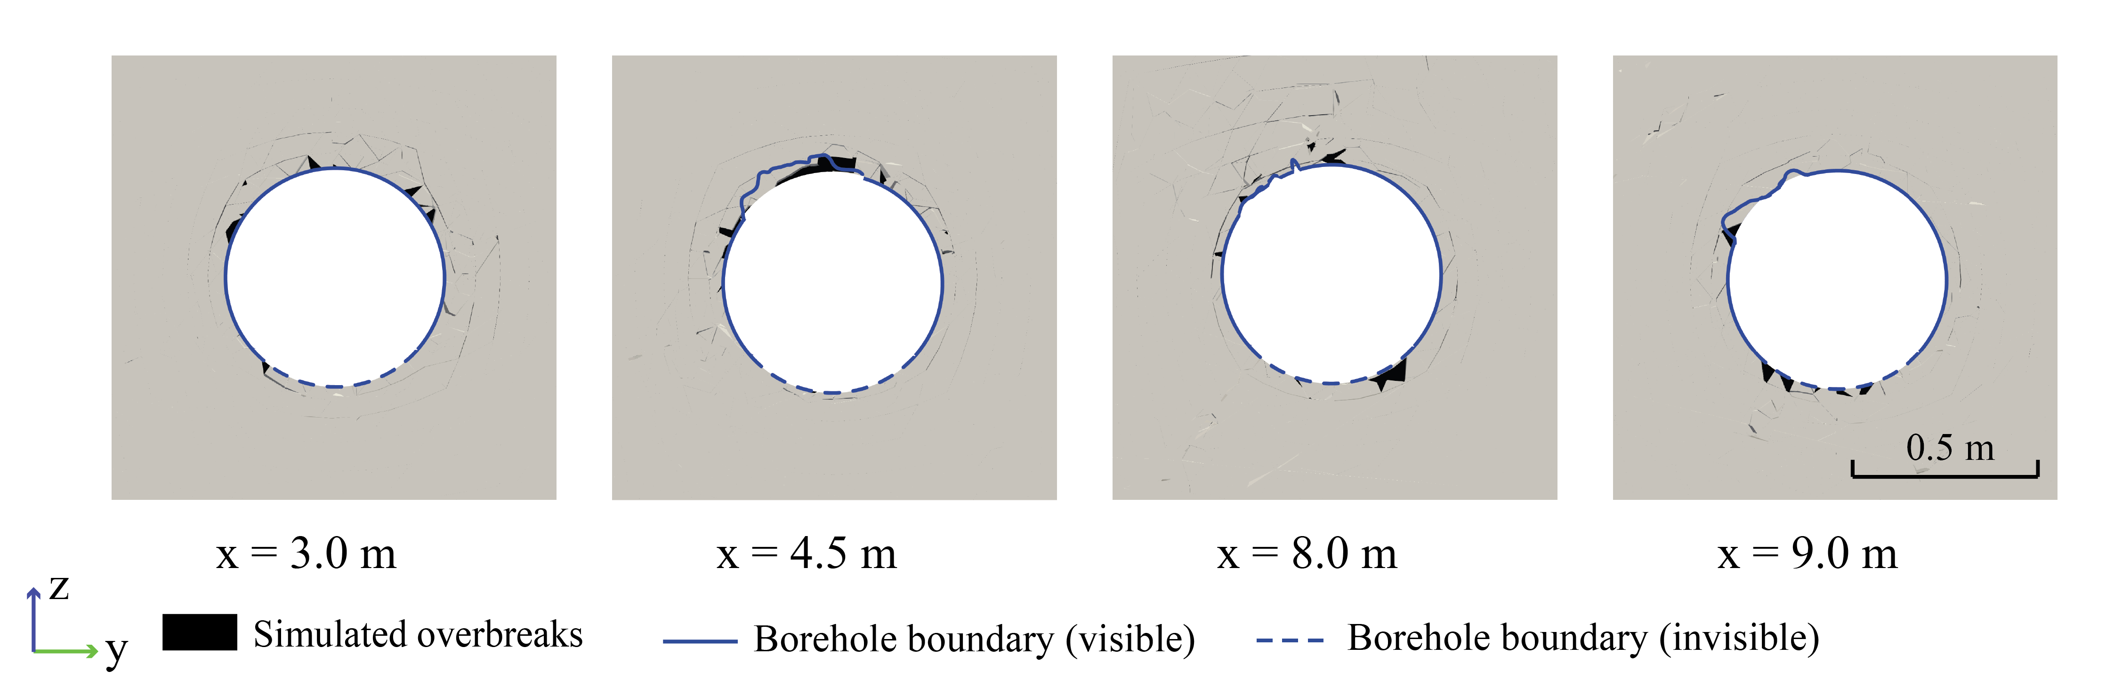
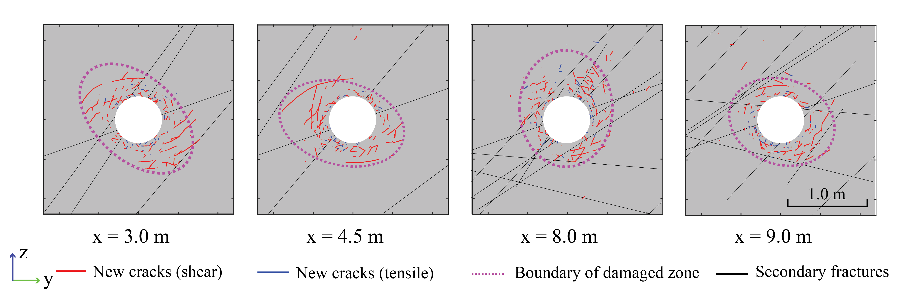
Simulation results
Zhao, Lei, Ziegler, Loew (2024) IJRMMS
7

Slide 8
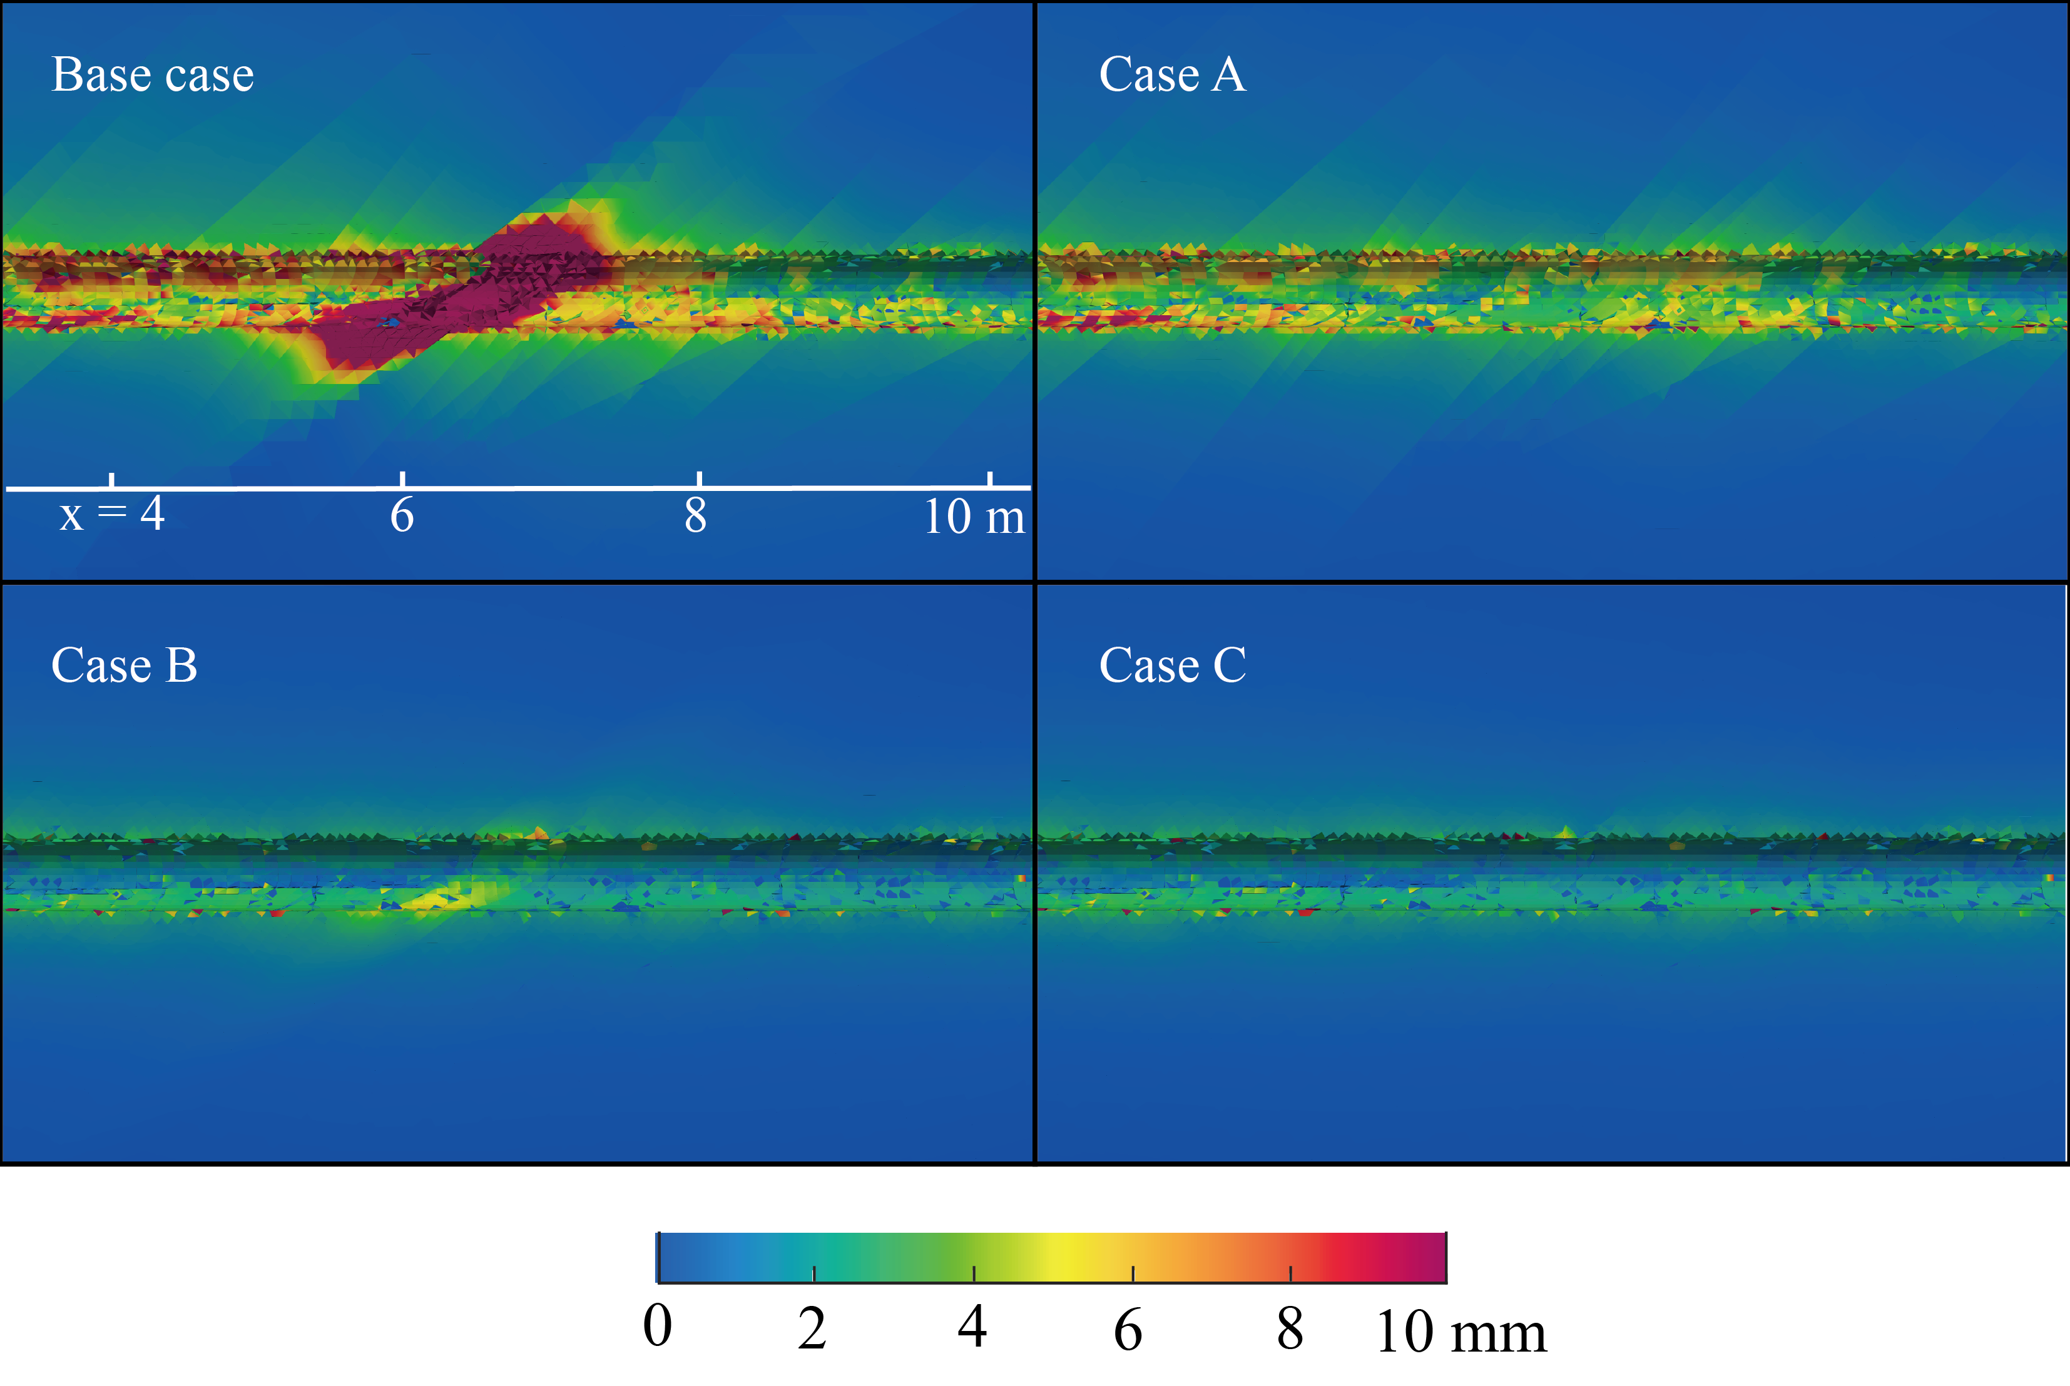
Simulation results
Base case: with fractures and fault zone; Case A: with fractures but without fault zone
Case B: with fault zone but without fractures; Case C: without fault zone and fractures
Zhao, Lei, Ziegler, Loew (2024) IJRMMS
8

Slide 9
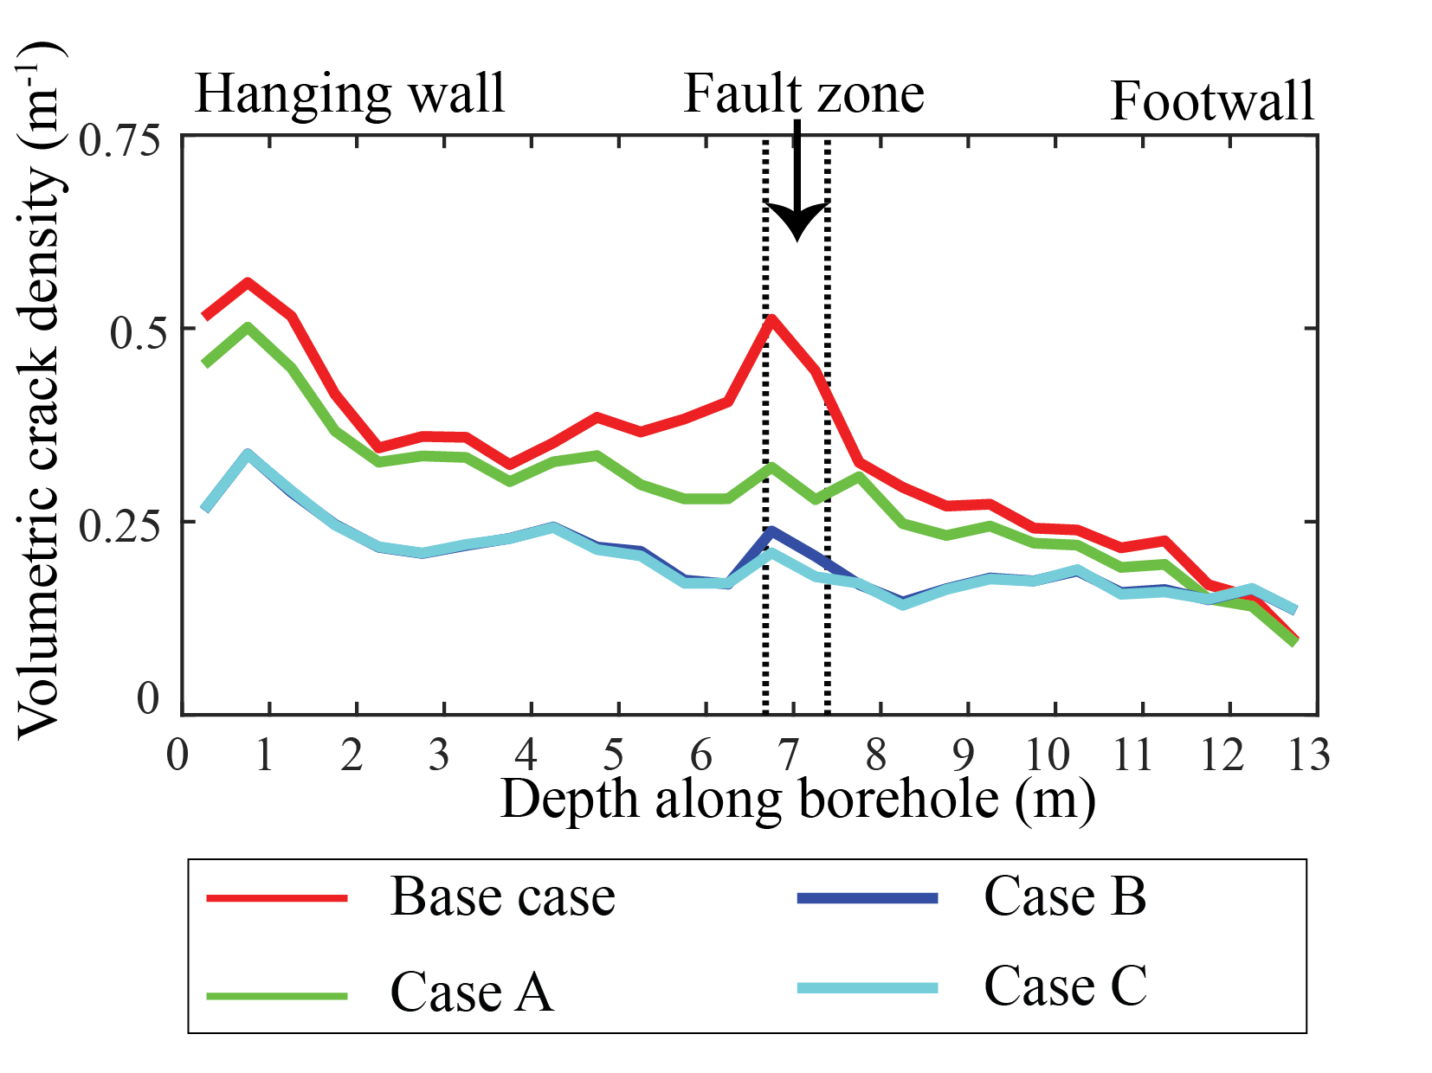
Simulation results
Base case: with fractures and fault zone; Case A: with fractures but without fault zone
Case B: with fault zone but without fractures; Case C: without fault zone and fractures
Zhao, Lei, Ziegler, Loew (2024) IJRMMS
9

Slide 10
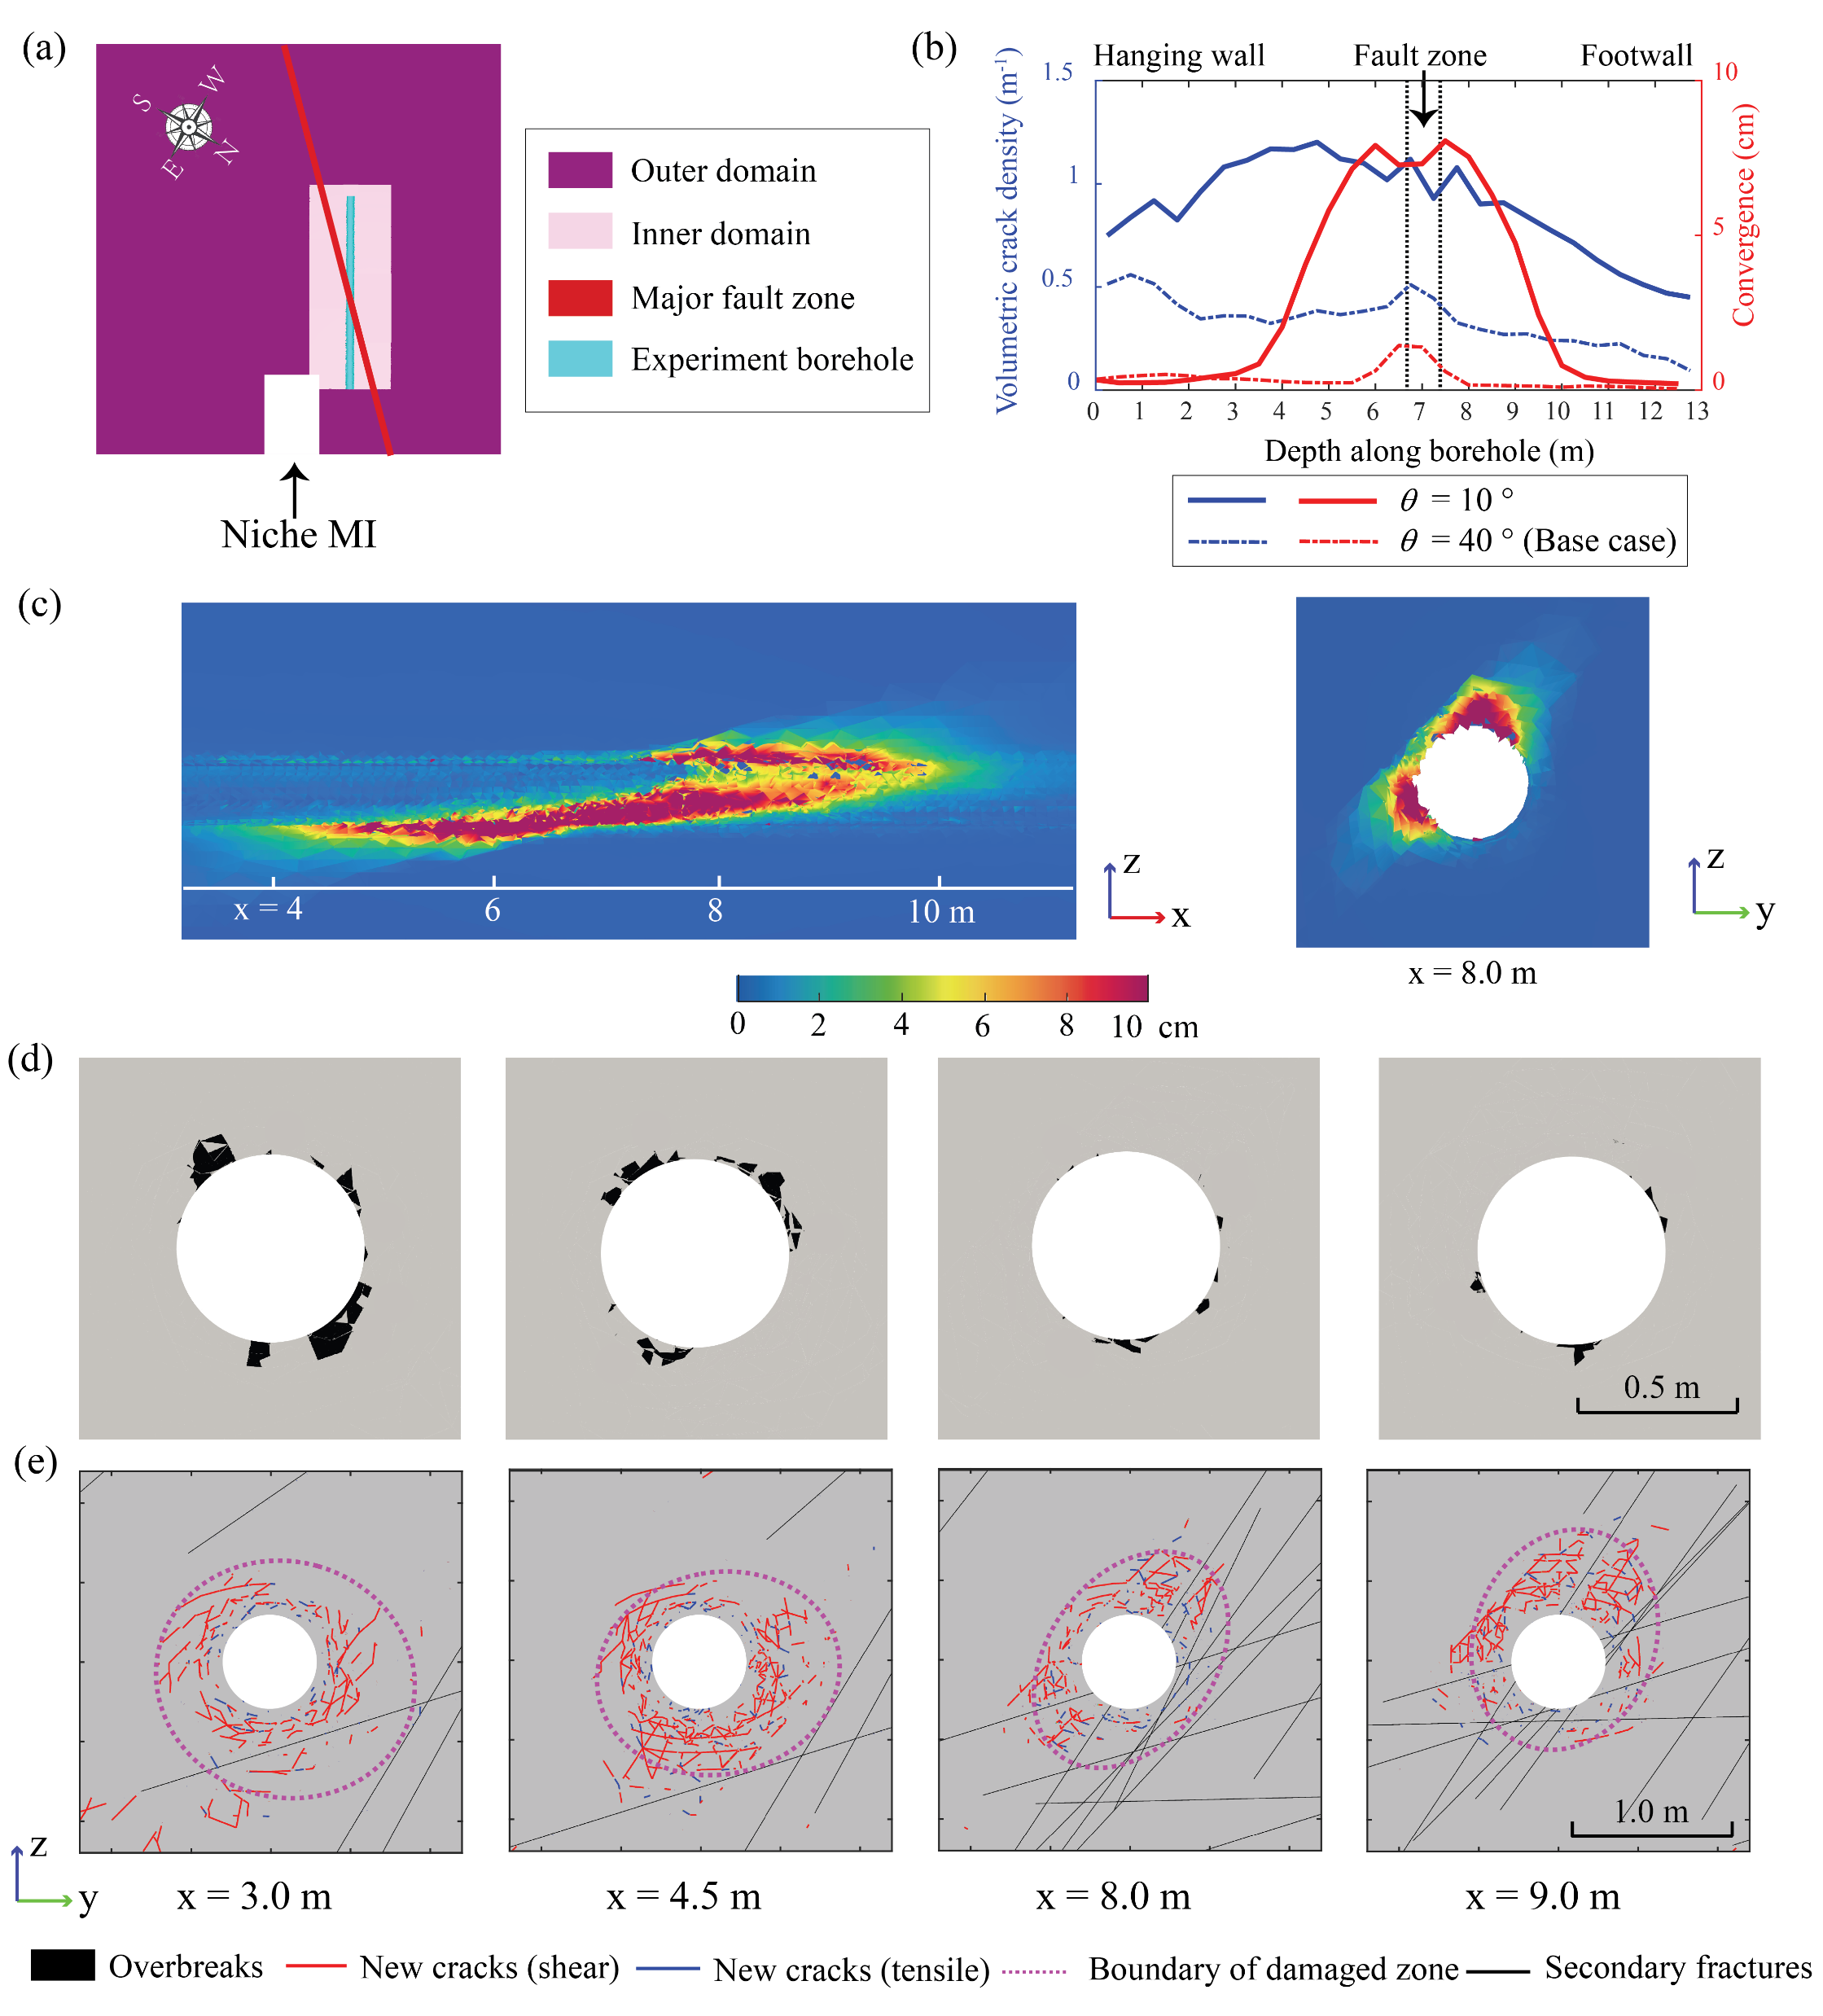
Simulation results
Acute intersection angle (10 deg) between fault zone and borehole
Stronger overbreaks, more new cracks and squeezing ground behaviour are observed
Zhao, Lei, Ziegler, Loew (2024) IJRMMS
10

Slide 11
Simulation results
Acute intersection angle (10 deg) between fault zone and borehole
Stronger overbreaks, more new cracks and squeezing ground behaviour are observed
Zhao, Lei, Ziegler, Loew (2024) IJRMMS
11

Slide 12
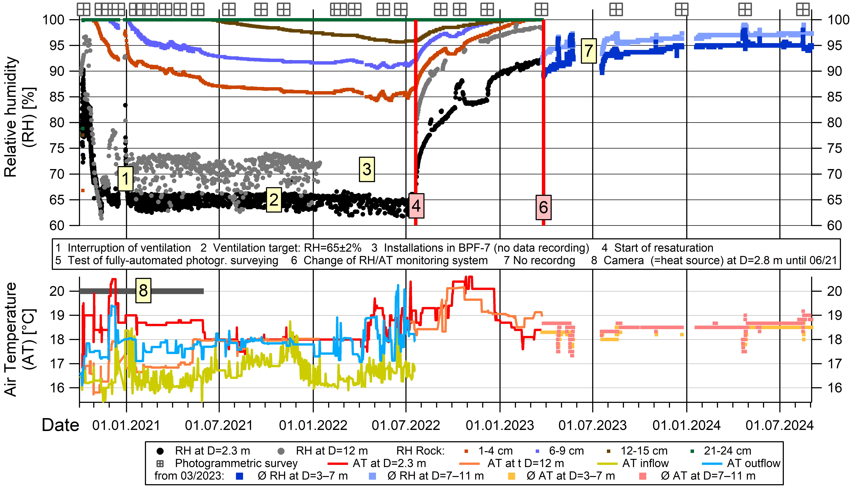
Long-term overbreak evolution in the PF-A experiment
Borehole relative humidity and temperature evolution
Evolution of overbreaks along the experiment borehole
Start of ventilation phase
End of ventilation phase
After ~3 years of resaturation
Ventilation
Resaturation
Resaturated

Slide 13
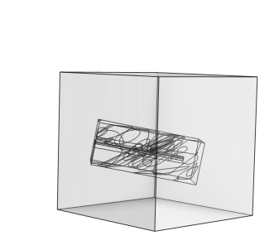
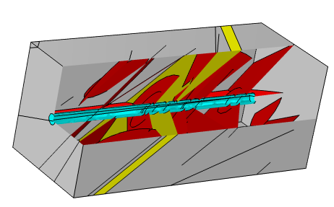
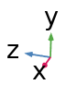
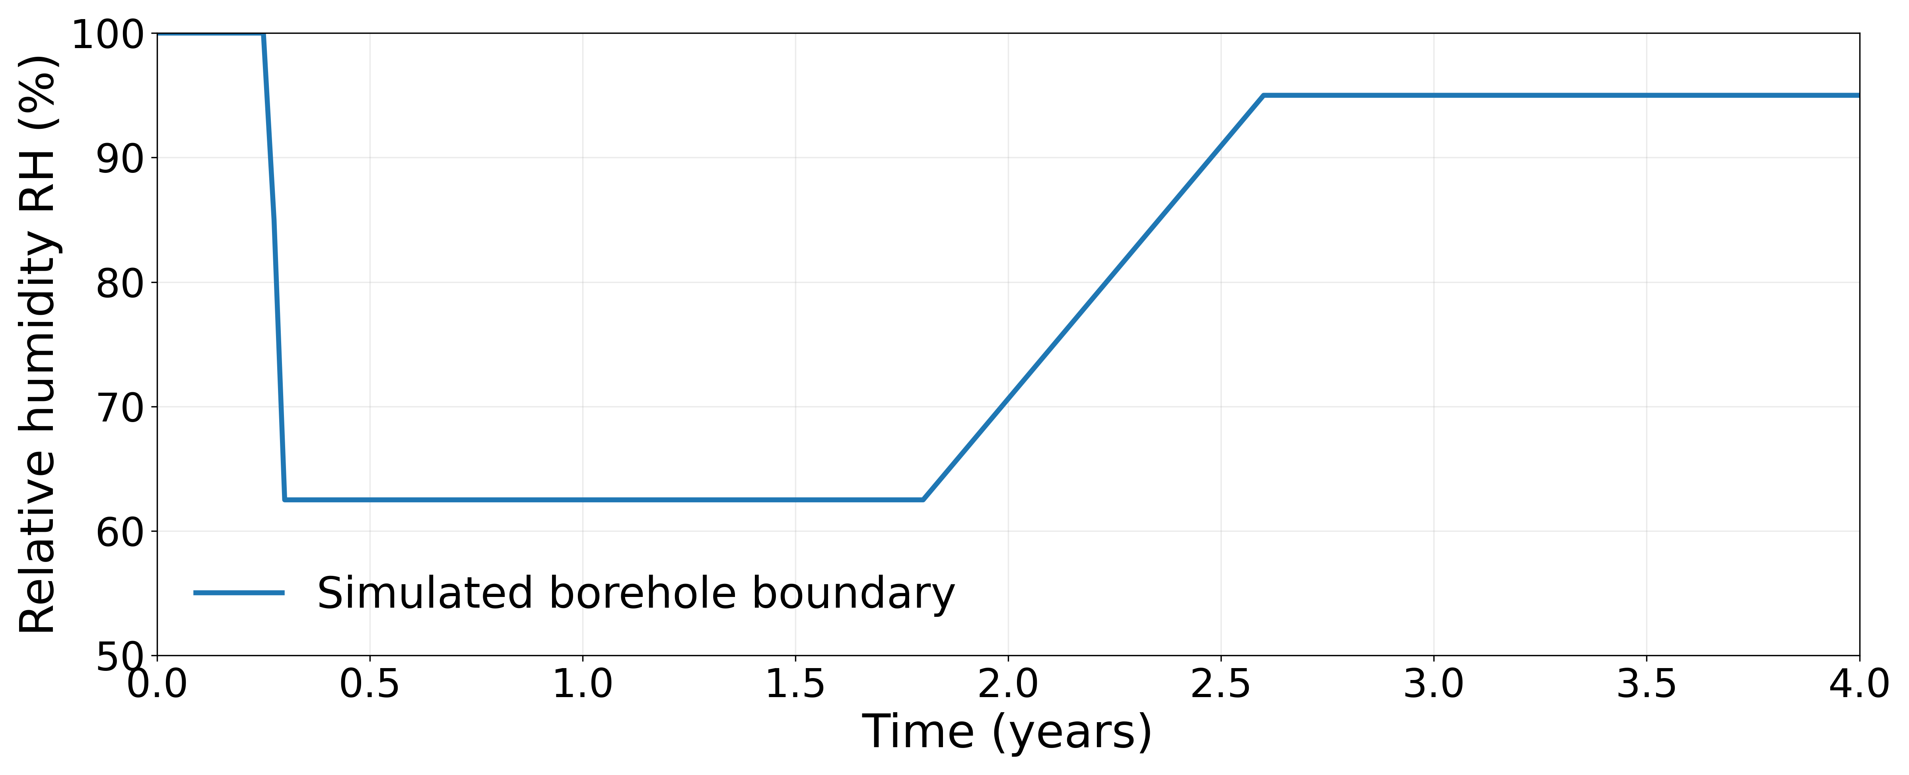



Model setup (hydromechanical model)
$$σ_{1}$$
Simulated using COMSOL
Solid deformation
$$σ_{3}$$
$$σ_{2}$$
Poroelasticity ✓
Damage ✓
Swelling✓
Fracture deformation✓
Creep✗
Plasticity✗
Matrix
Secondary fractures
Fault zone
Experiment borehole
Fluid flow
Unsaturated and saturated flow✓

Slide 14
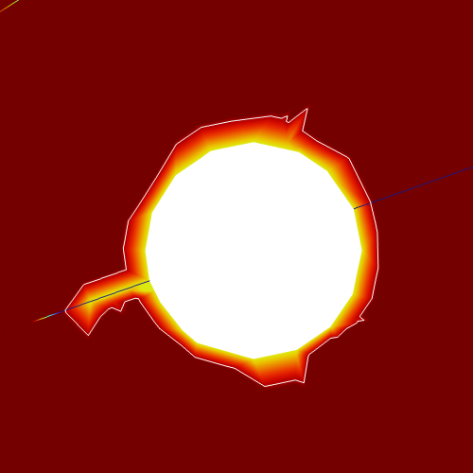
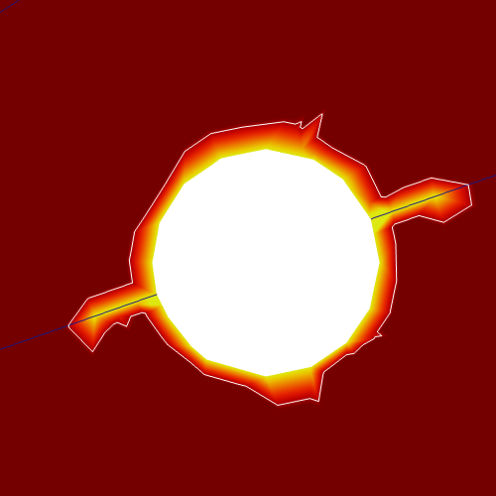
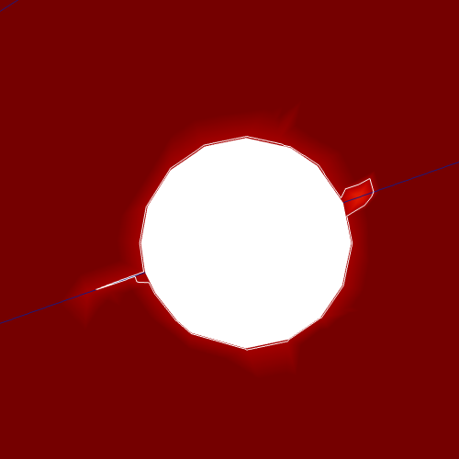
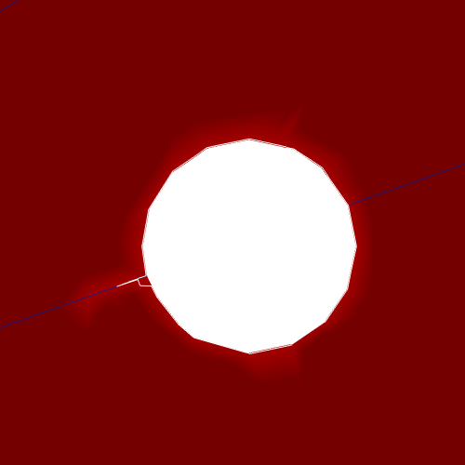
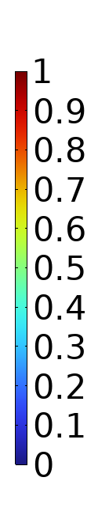
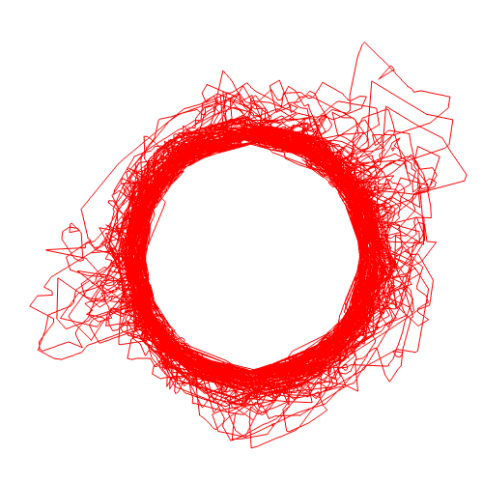
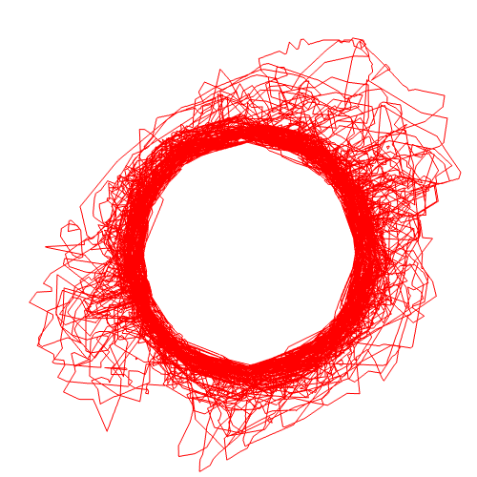
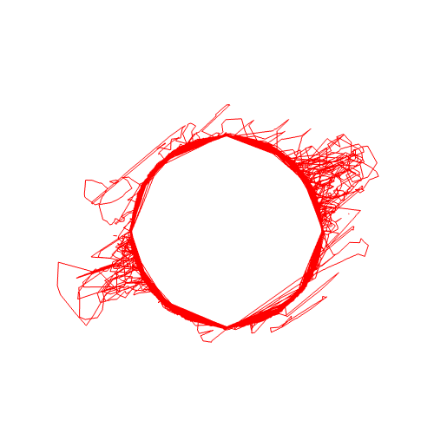
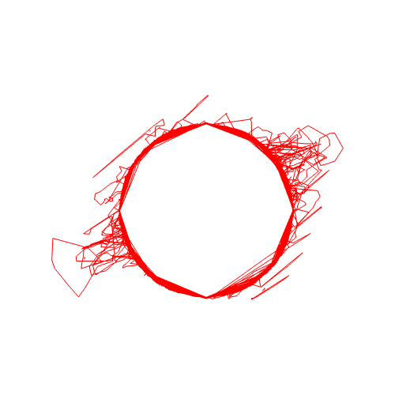
Preliminary simulation results
Unsaturated zone evolution
RH
L = 4 m
Variation of unsaturated zone
0.5 m
Start of ventilation
End of ventilation
Start of resaturated
End of resaturated

Slide 15
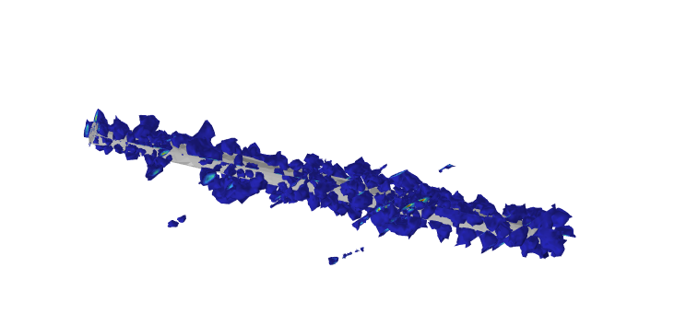
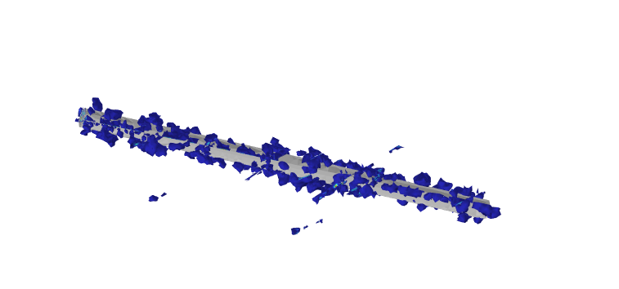
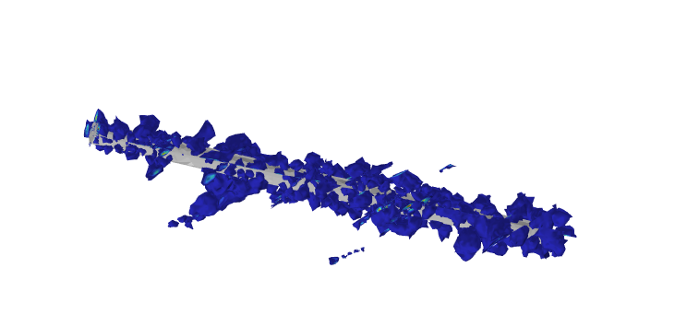
Preliminary simulation results
Damaged zone evolution
2
1
3
1
3
2

Slide 16
Next step plan (hydromechanical modelling)
Generating new DFN with conditioned simulation.
Adjusting parameters based on the current updates from the lab team.
Benchmarking of key model components.
Validation against experimental observation data (e.g. strain measurements, overbreak pattern and evolution).
Use the model to understand the interplay and relative importance of different processes (suction, swelling, poroelasticity, creep, etc.) in driving time-dependent overbreak and damage evolution.
16

Slide 17
Concluding remarks
A 3D framework has been developed to simulate progressive failure around the PF/PF-A borehole in faulted Opalinus Clay
The geomechanical model captures short-term damage and overbreak formation, highlighting the effects of fault zone and fracture networks
The hydromechanical model incorporates realistic hydraulic boundary conditions and coupled processes including unsaturated flow, swelling, suction, and damage
Future work will extend the framework to drift-scale modelling
Acknowledgement
We are grateful for the financial support from Swisstopo, ENSI, BGR, ETH, and Uppsala University
Federal Office of Topography
Federal Nuclear Safety
Inspectorate ENSI
17

Slide 18
18

Slide 19
Backup slides
19

Slide 20
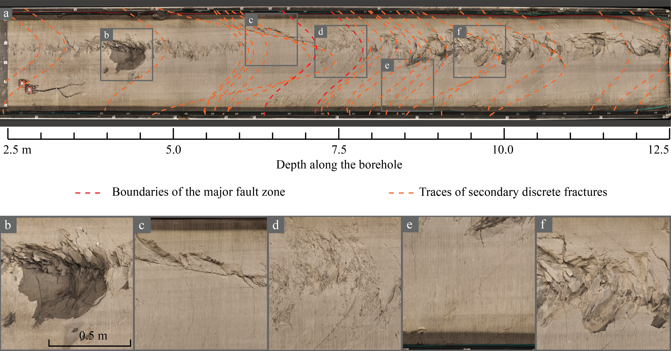
Overbreak pattern along the experiment borehole
Zhao, Lei, Ziegler, Loew (2025) IJRMMS

Slide 21
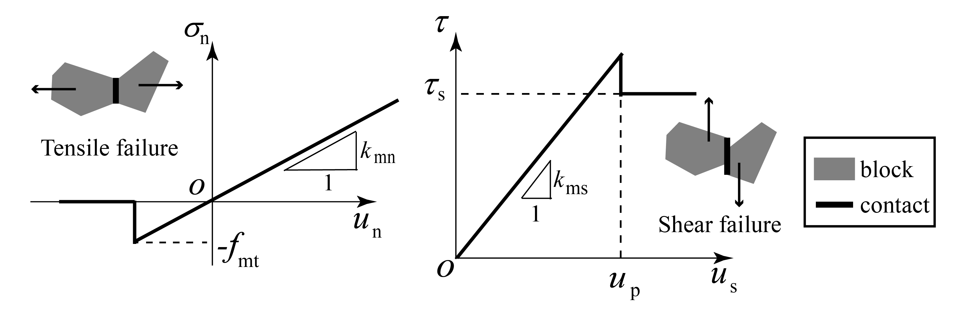
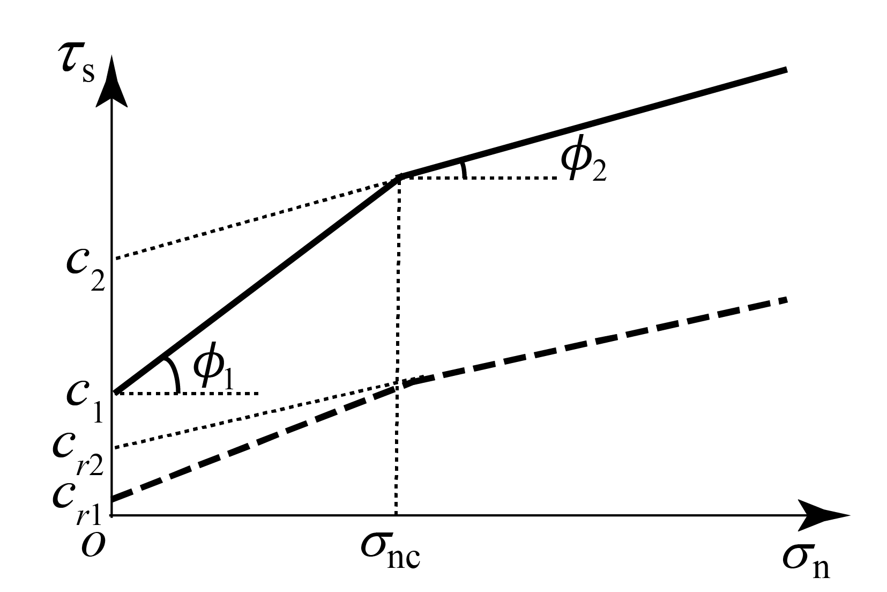
Constitutive models
Crack growth driven by tensile or shear failure
Bilinear Mohr-Coulomb criterion
Zhao, Lei, Ziegler, Loew (2025) IJRMMS
21

Slide 22
Borehole relative humidity and temperature evolution
RH during ventilation between 62 and 74 %
Time-dependent rock desaturation
Resaturation from 07/2022
Since 01/2024, the experiment borehole is at >95 % RH
The unsaturated zone was observed at a distance of 15–21 cm from the tunnel.
The boundary condition for the tunnel in the model was set based on observed relative humidity data.
Ventilation
Resaturation
Ziegler et al. 2025

Slide 23
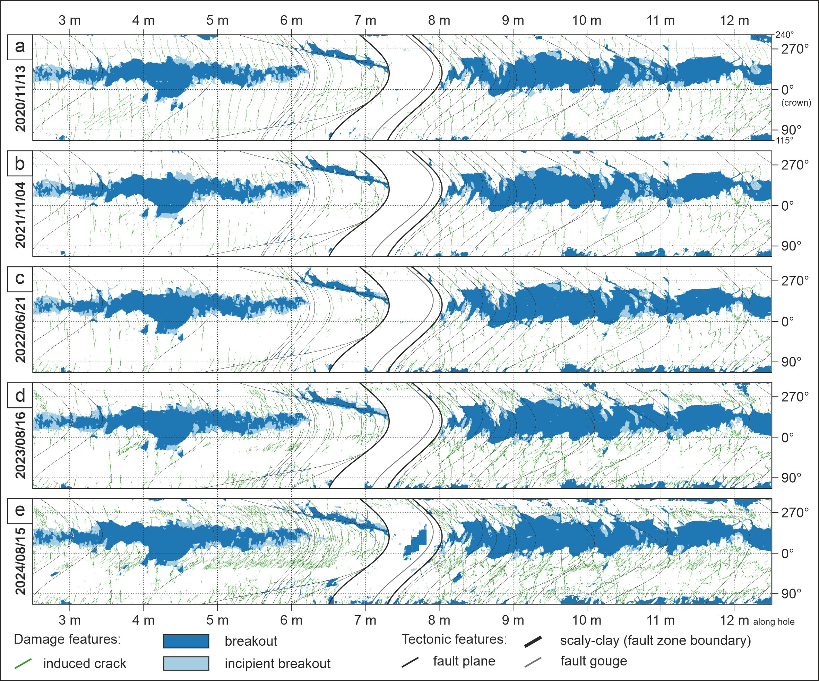
Evolution of induced cracks and breakouts
New cracks and breakouts developed during the ventilation period and grew extensively during the resaturation period.
a = before the ventilation start
b = halfway through the ventilation period
c = end of ventilation period
d = after resaturation ramp
e = end of resaturation period
Ziegler et al. 2025

Slide 24





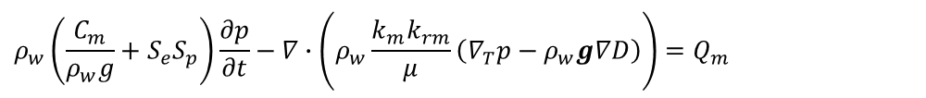
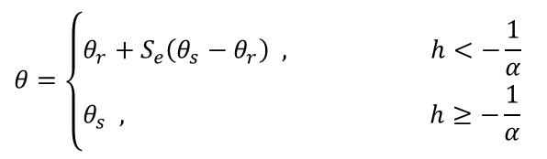

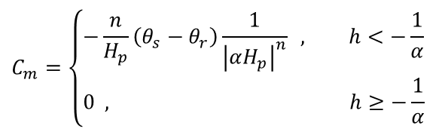

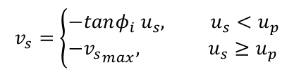

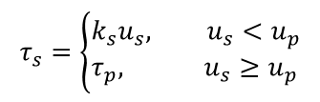



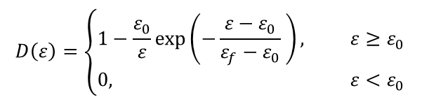

Governing equations
Mechanical equilibrium
Richard’s equation (matrix)
$$∇σ+F=0$$
$$ρ_{w}\left(\frac{C_{m}}{ρ_{w}g}+S_{e}S_{p}\right)\frac{∂p}{∂t}−∇∙\left(ρ_{w}\frac{k_{m}k_{rm}}{μ}\left(∇_{T}p−ρ_{w}g∇D\right)\right)=Q_{m}$$
Total stress
$$\left.σ= (1−D)C:(ε−ε_{hs}\right)−αpI$$
Richard’s equation (fracture)
Damage
$${{bρ}_{w}\left(\frac{C_{m}}{ρ_{w}g}+S_{e}S_{p}\right)\frac{∂p}{∂t}−∇}_{τ}∙\left(−bρ\frac{k_{f}k_{rf}}{μ}∇_{τ}p\right)=ρ\left(q^{+}+q^{−}\right)$$
$$D\left(ε\right)=\left\{\begin{aligned}&1−\frac{ε_{0}}{ε}\exp\left(−\frac{ε−ε_{0}}{ε_{f}−ε_{0}} \right), ε≥ε_{0} \\ &0, ε<ε_{0}\end{aligned}\right.$$
Fracture permeability
$$ε_{f}=\frac{G_{f}}{σ_{ts}h_{cb}}+\frac{ε_{0}}{2}$$
$$k_{f}=\frac{b^{2}}{12}$$
Swelling
Brooks-Corey retention model
$$ε_{hs}=β_{h}\left(c_{m}−c_{m,ref}\right)$$
$$S_{e}=\left\{\begin{aligned}&\frac{1}{{\left|αh\right|}^{n}} , h<−\frac{1}{α} \\ &1, h≥−\frac{1}{α}\end{aligned}\right.$$
$$k_{r}=\left\{\begin{aligned}&S_{e}^{\frac{2}{n}+l+2}, h<−\frac{1}{α} \\ &1, h≥−\frac{1}{α}\end{aligned}\right.$$
$$c_{m}=ρ_{w}θ$$
Fracture deformation
$$v_{n}=\frac{k_{n0}v_{m}^{2}}{k_{n0}v_{m}+σ_{eff}}$$
$$C_{m}=\left\{\begin{aligned}&−\frac{n}{H_{p}}\left(θ_{s}−θ_{r}\right)\frac{1}{{\left|αH_{p}\right|}^{n}} , h<−\frac{1}{α} \\ &0 , h≥−\frac{1}{α}\end{aligned}\right.$$
$$α_{f}=\frac{b}{2σ_{w}\cos{θ}}ρg$$
$$τ_{s}=\left\{\begin{aligned}&k_{s}u_{s}, u_{s}<u_{p} \\ &τ_{p}, u_{s}≥u_{p}\end{aligned}\right.$$
$$v_{s}=\left\{\begin{aligned}&−tanφ_{i} u_{s}, u_{s}<u_{p} \\ &−{v_{s}}_{max}, u_{s}≥u_{p}\end{aligned}\right.$$
$$θ=\left\{\begin{aligned}&θ_{r}+S_{e}\left(θ_{s}−θ_{r}\right) , h<−\frac{1}{α} \\ &θ_{s} , h≥−\frac{1}{α}\end{aligned}\right.$$
$$b=b_{0}−v_{n}−v_{s}$$

Slide 25
Unsaturated zone

Slide 26
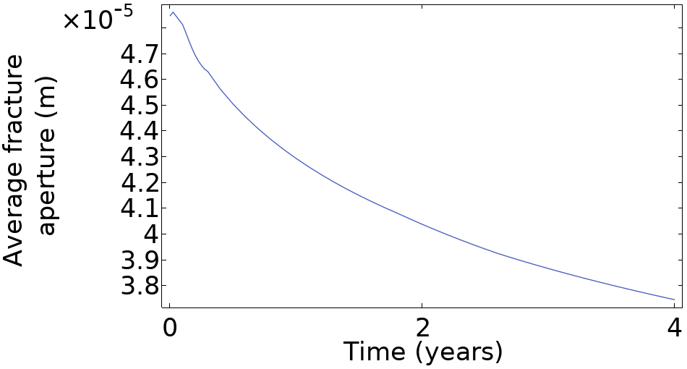
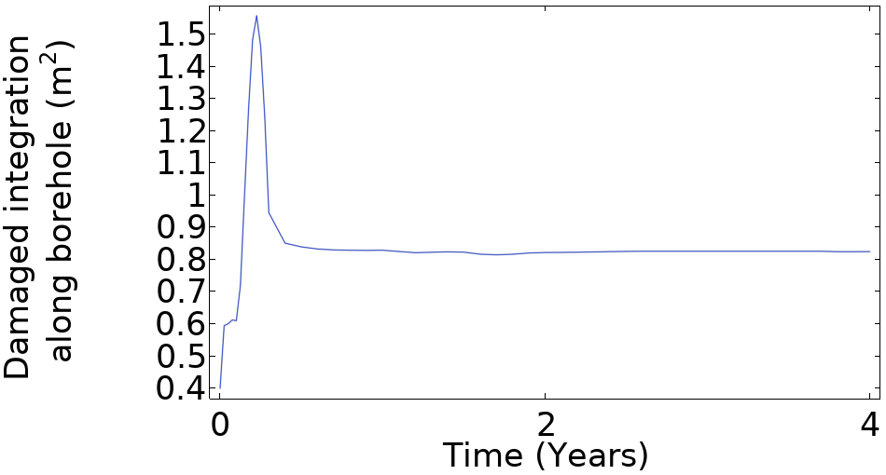
Evolution of damage
Aperture evolution mostly driven by the suction effect.
Damage integration along borehole is almost constant along the borehole during the ventilation and resaturation period.

