Slide 1


^{177,178}Yb ground-state lifetimes
Margarita Efstathiou
National and Kapodistrian University of Athens

Slide 2
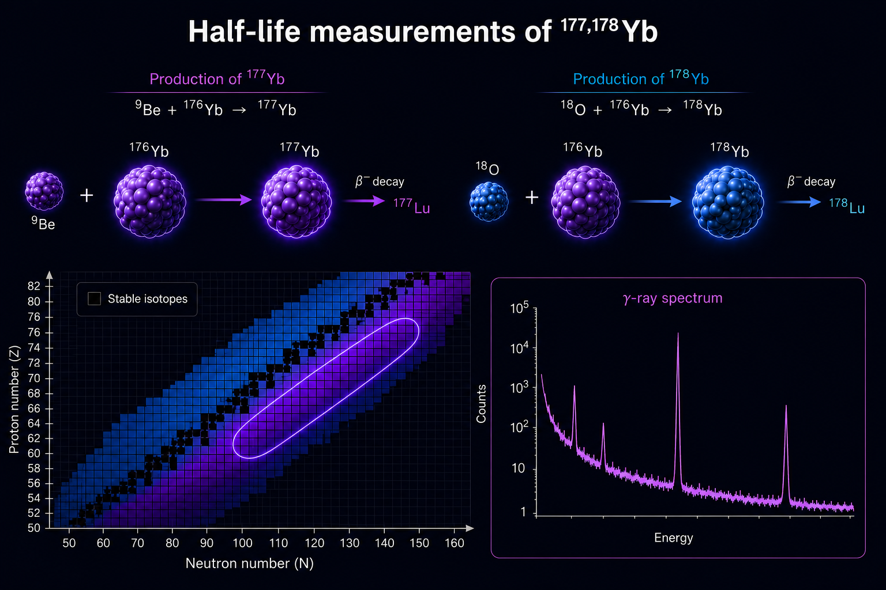
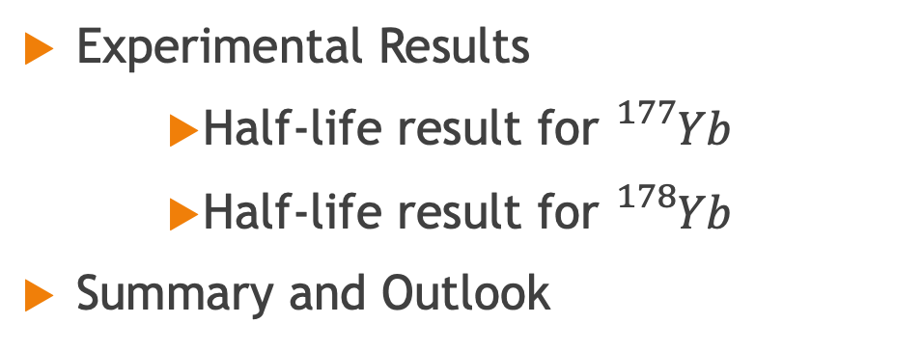
Outline
Introduction & Motivation
Activation Method
Experimental Setups
  ROSPHERE array at IFIN-HH
  CATHEDRAL spectrometer at IKP Cologne
Experimental Results
    Half-life result for ${}_{}^{177}{Yb}$
    Half-life result for ${}_{}^{178}{Yb}$
Summary and Outlook

Slide 3
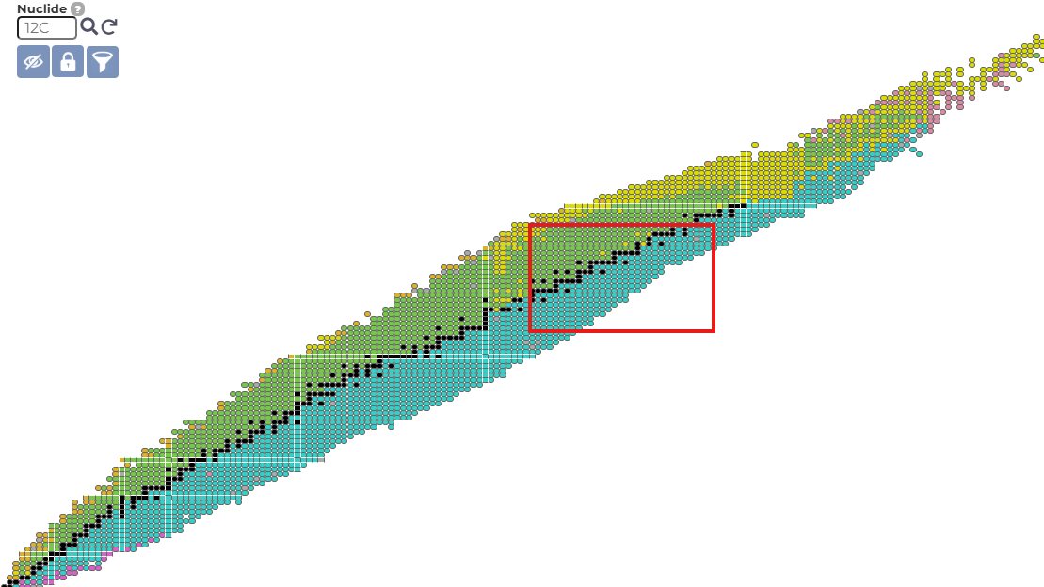
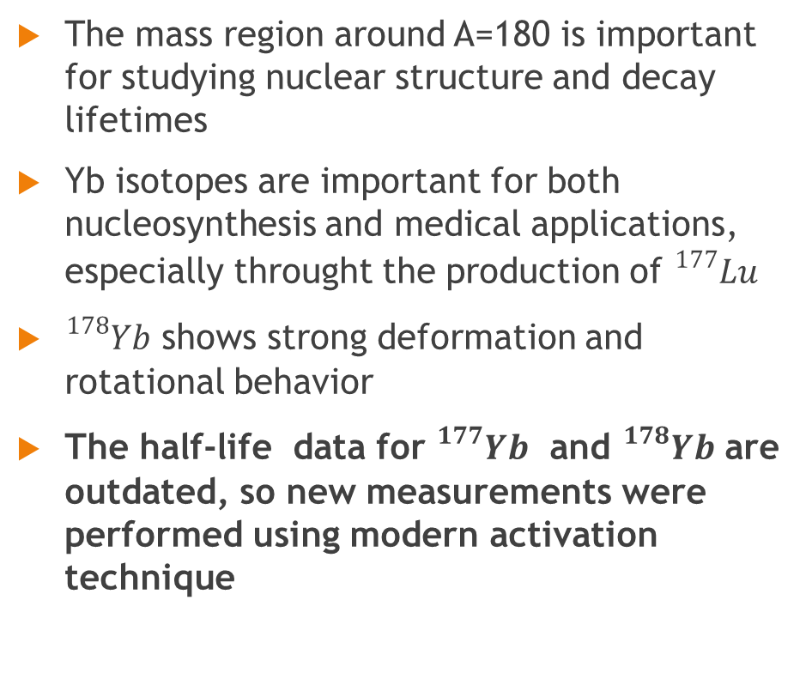
Introduction and Motivation
The mass region around A=180 is important for studying nuclear structure and decay lifetimes
Yb isotopes are important for both nucleosynthesis and medical applications, especially throught the production of ${}_{}^{177}{Lu}$
${}_{}^{178}{Yb}$ shows strong deformation and rotational behavior
The half-life data for ${}_{}^{177}{Yb}$ and ${}_{}^{178}{Yb}$ are outdated, so new measurements were performed using modern activation technique

Slide 4
Activation Method

Slide 5
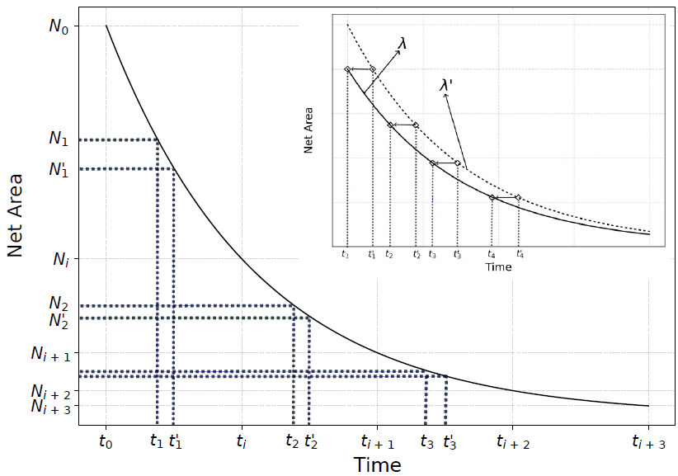
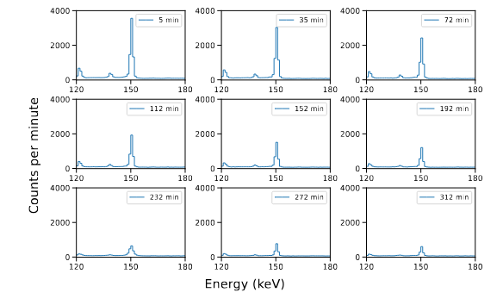

Decay Time Correction Procedure
Irradiation: The sample is irradiated for 5–6 half-lives to ensure measurable activity post-beam.
Time Assignment: Each data point is initially placed at the midpoint of its acquisition window.
Uncertainty: This midpoint approximation introduces significant timing error (±½ duration).
Initial Fit: A first estimate of the decay constant (λ’) is obtained by fitting the decay using midpoint times.
Timing Correction: Accurate timing is calculated by solving:
$$t=−\frac{1}{λ′}∙\ln\left(\frac{e^{−λ^{′}t_{i+1}}+e^{−λ^{′}t_{i}}}{2}\right)$$
Error Refinement: Updated time uncertainties account for λ and the interval endpoints via error propagation.
Final Result: The corrected decay curve shifts slightly earlier, yielding a more accurate half-life.
M. Efstathiou et al. Nuclear Physics A (2026): 123338
M. Efstathiou et al. HNPS Advances in Nuclear Physics Vol. 32, 25–31 (2025)

Slide 6


Decay Time Correction Procedure
Irradiation: The sample is irradiated for 5–6 half-lives to ensure measurable activity post-beam.
Time Assignment: Each data point is initially placed at the midpoint of its acquisition window.
Uncertainty: This midpoint approximation introduces significant timing error (±½ duration).
Initial Fit: A first estimate of the decay constant (λ’) is obtained by fitting the decay using midpoint times.
Timing Correction: Accurate timing is calculated by solving:
$$t=−\frac{1}{λ′}∙\ln\left(\frac{e^{−λ^{′}t_{i+1}}+e^{−λ^{′}t_{i}}}{2}\right)$$
Error Refinement: Updated time uncertainties account for λ and the interval endpoints via error propagation.
Final Result: The corrected decay curve shifts slightly earlier, yielding a more accurate half-life.
$t_{2}^{}$, half of the decays
$t_{2}^{′}$=($t_{i+1}^{}−t_{i}^{}$)/2
M. Efstathiou et al. Nuclear Physics A (2026): 123338
M. Efstathiou et al. HNPS Advances in Nuclear Physics Vol. 32, 25–31 (2025)

Slide 7
Decay Time Correction Procedure
Irradiation: The sample is irradiated for 5–6 half-lives to ensure measurable activity post-beam.
Time Assignment: Each data point is initially placed at the midpoint of its acquisition window.
Uncertainty: This midpoint approximation introduces significant timing error (±½ duration).
Initial Fit: A first estimate of the decay constant (λ’) is obtained by fitting the decay using midpoint times.
Timing Correction: Accurate timing is calculated by solving:
$$t=−\frac{1}{λ′}∙\ln\left(\frac{e^{−λ^{′}t_{i+1}}+e^{−λ^{′}t_{i}}}{2}\right)$$
Error Refinement: Updated time uncertainties account for λ and the interval endpoints via error propagation.
Final Result: The corrected decay curve shifts slightly earlier, yielding a more accurate half-life.
$t_{2}^{}$, half of the decays
$t_{2}^{′}$=($t_{i+1}^{}−t_{i}^{}$)/2
M. Efstathiou et al. Nuclear Physics A (2026): 123338
M. Efstathiou et al. HNPS Advances in Nuclear Physics Vol. 32, 25–31 (2025)

Slide 8
Decay Time Correction Procedure
Irradiation: The sample is irradiated for 5–6 half-lives to ensure measurable activity post-beam.
Time Assignment: Each data point is initially placed at the midpoint of its acquisition window.
Uncertainty: This midpoint approximation introduces significant timing error (±½ duration).
Initial Fit: A first estimate of the decay constant (λ’) is obtained by fitting the decay using midpoint times.
Timing Correction: Accurate timing is calculated by solving:
$$t=−\frac{1}{λ′}∙\ln\left(\frac{e^{−λ^{′}t_{i+1}}+e^{−λ^{′}t_{i}}}{2}\right)$$
Error Refinement: Updated time uncertainties account for λ and the interval endpoints via error propagation.
Final Result: The corrected decay curve shifts slightly earlier, yielding a more accurate half-life.
$t_{2}^{}$, half of the decays
$t_{2}^{′}$=($t_{i+1}^{}−t_{i}^{}$)/2
M. Efstathiou et al. Nuclear Physics A (2026): 123338
M. Efstathiou et al. HNPS Advances in Nuclear Physics Vol. 32, 25–31 (2025)

Slide 9
Experiments

Slide 10
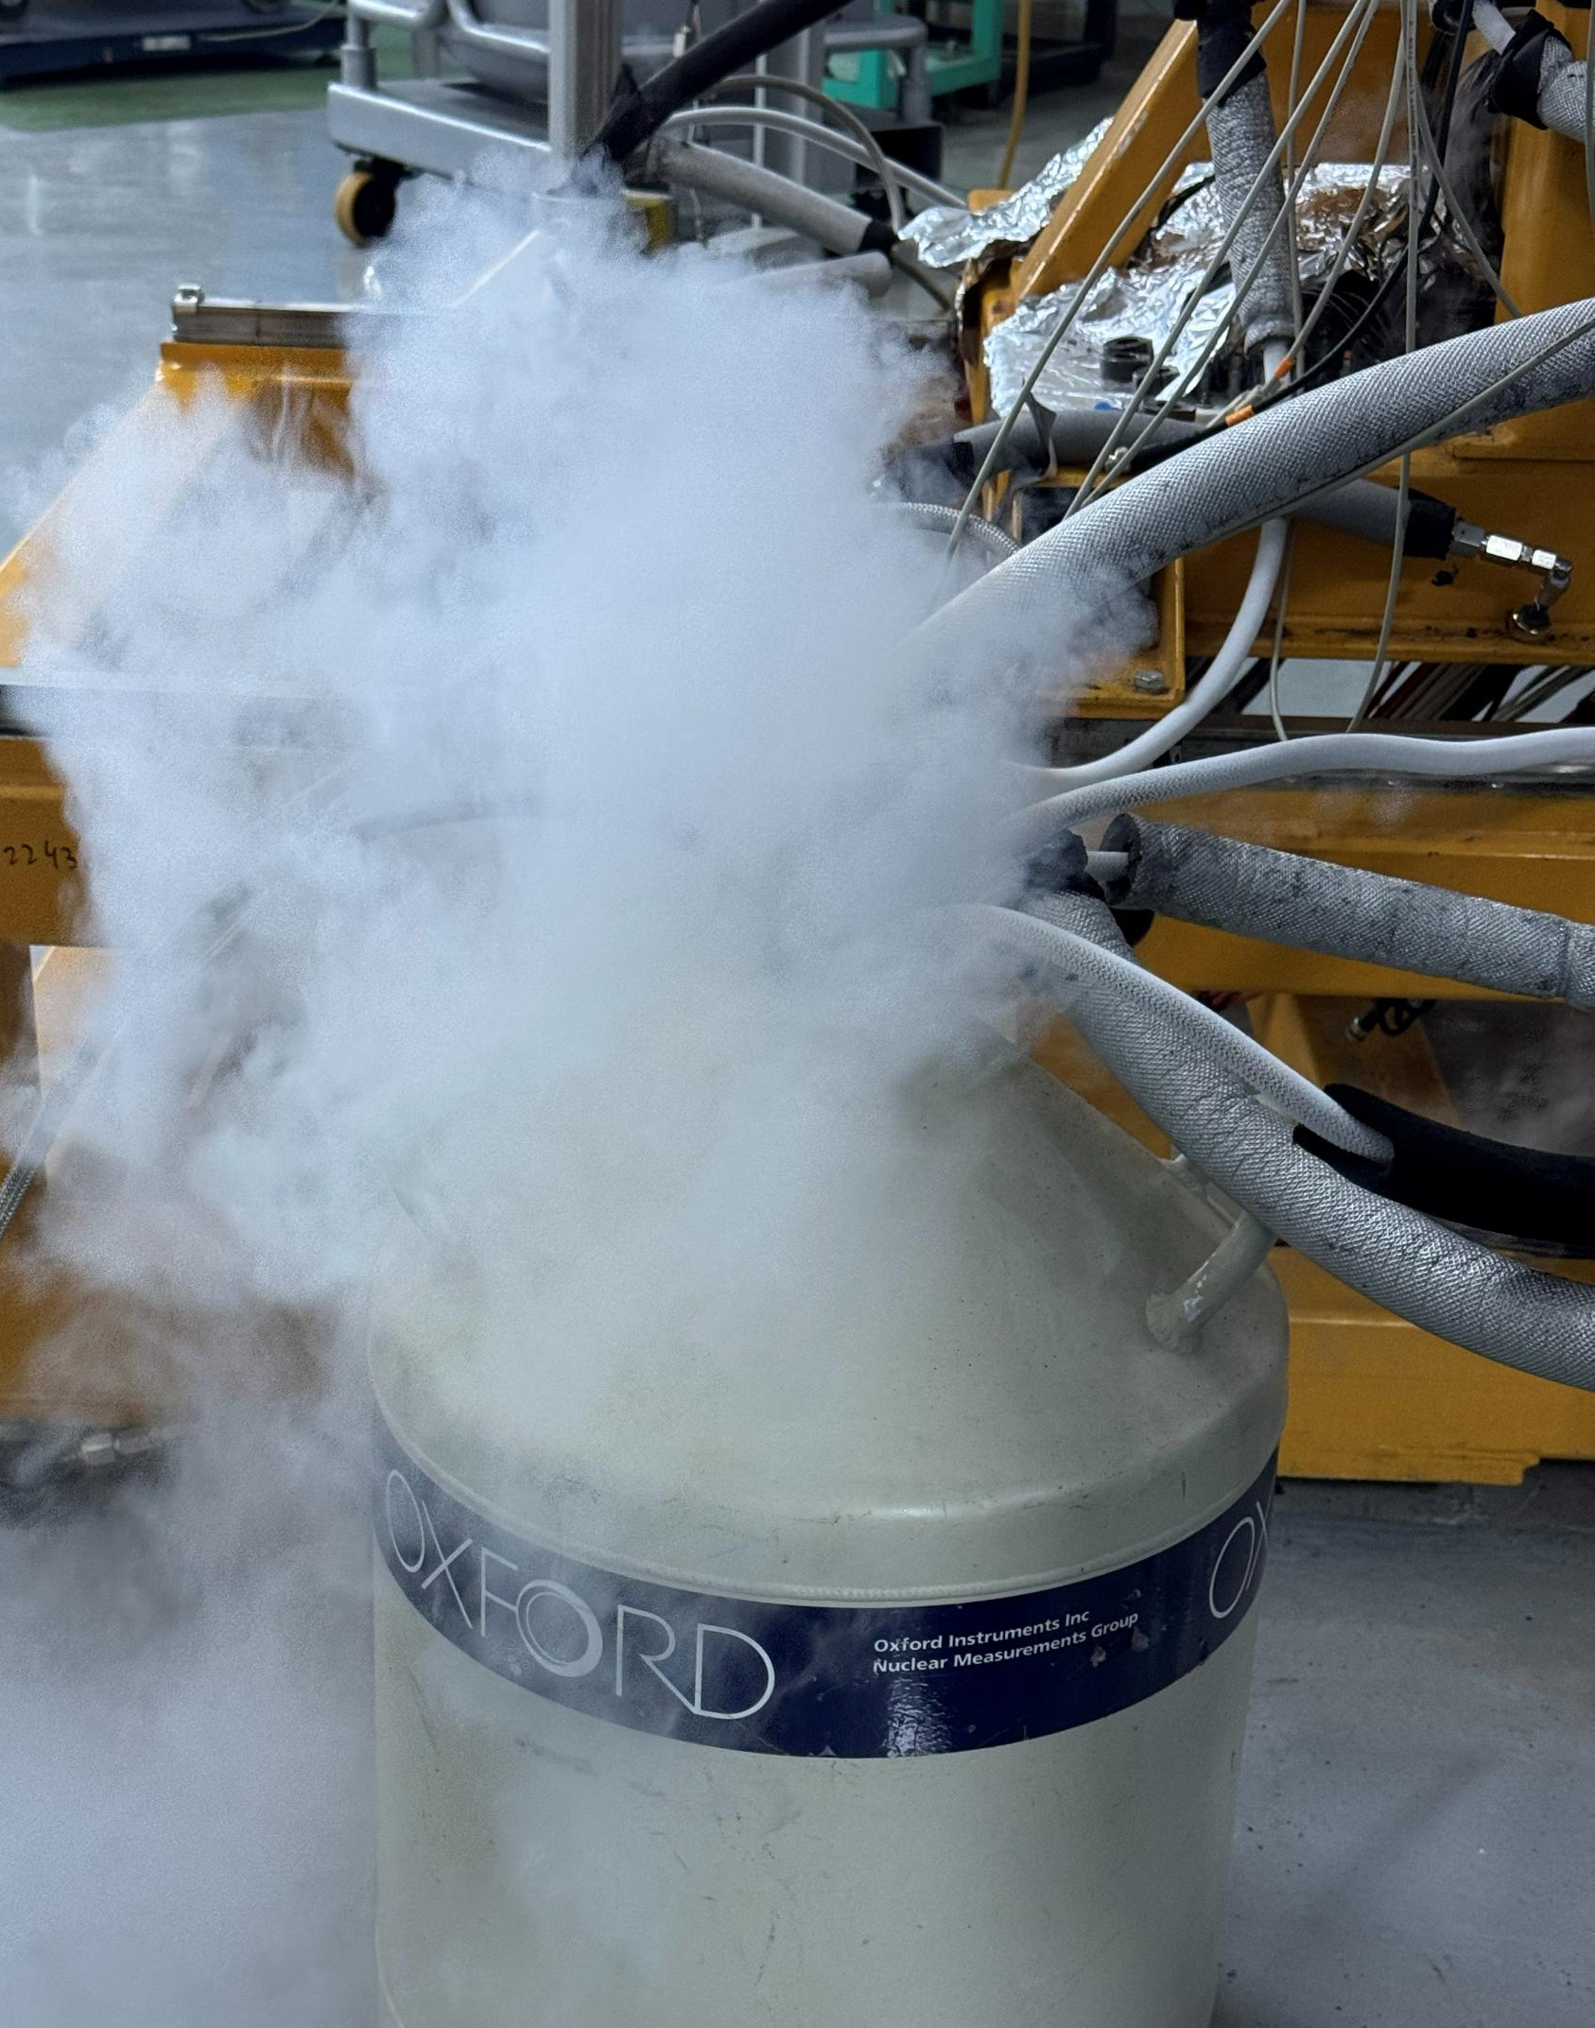
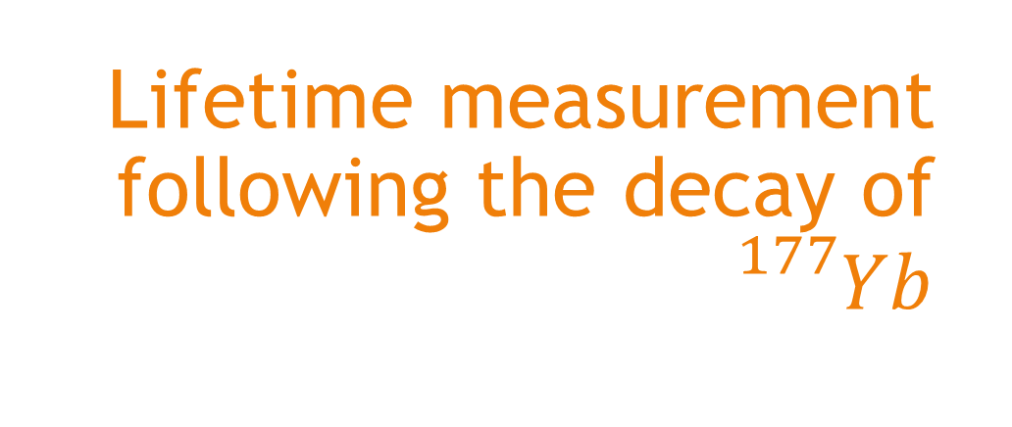
Lifetime measurement following the decay of ${}_{}^{177}{Yb}$

Slide 11
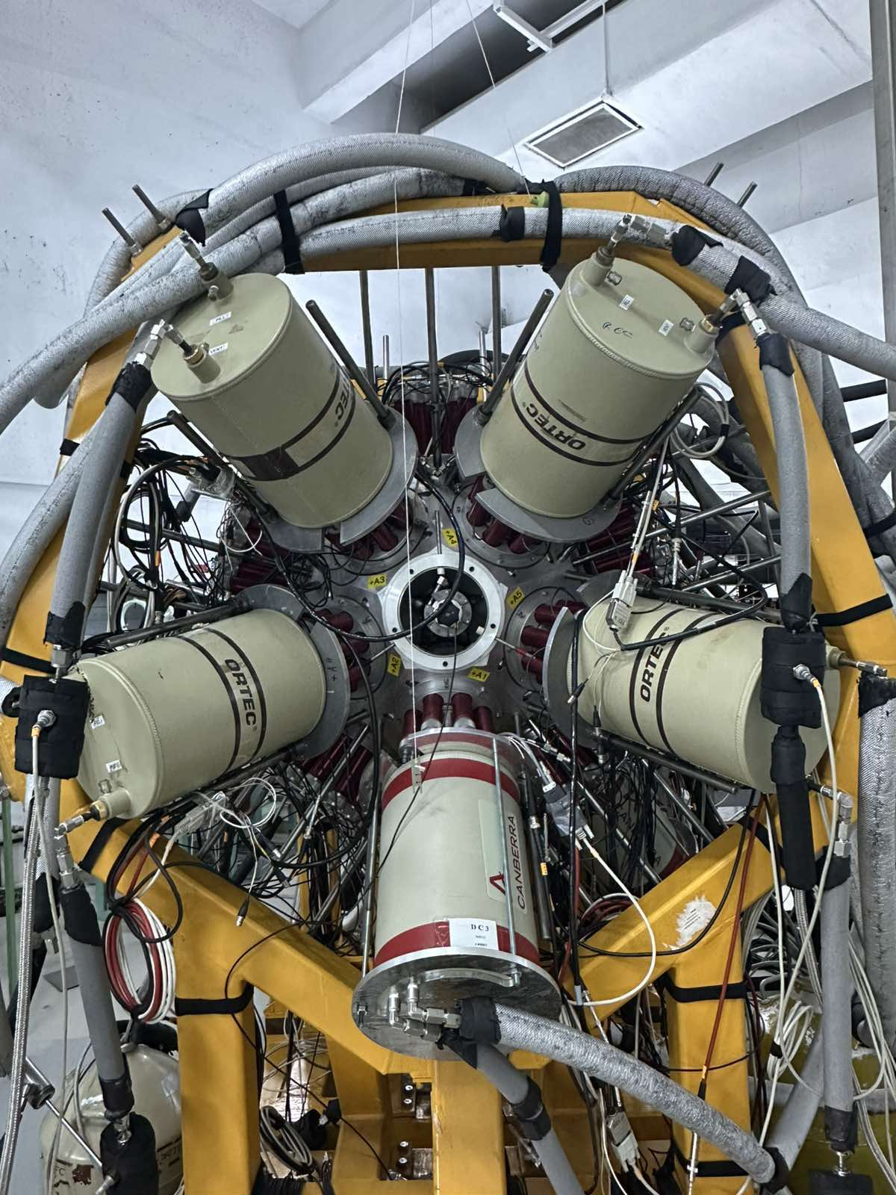
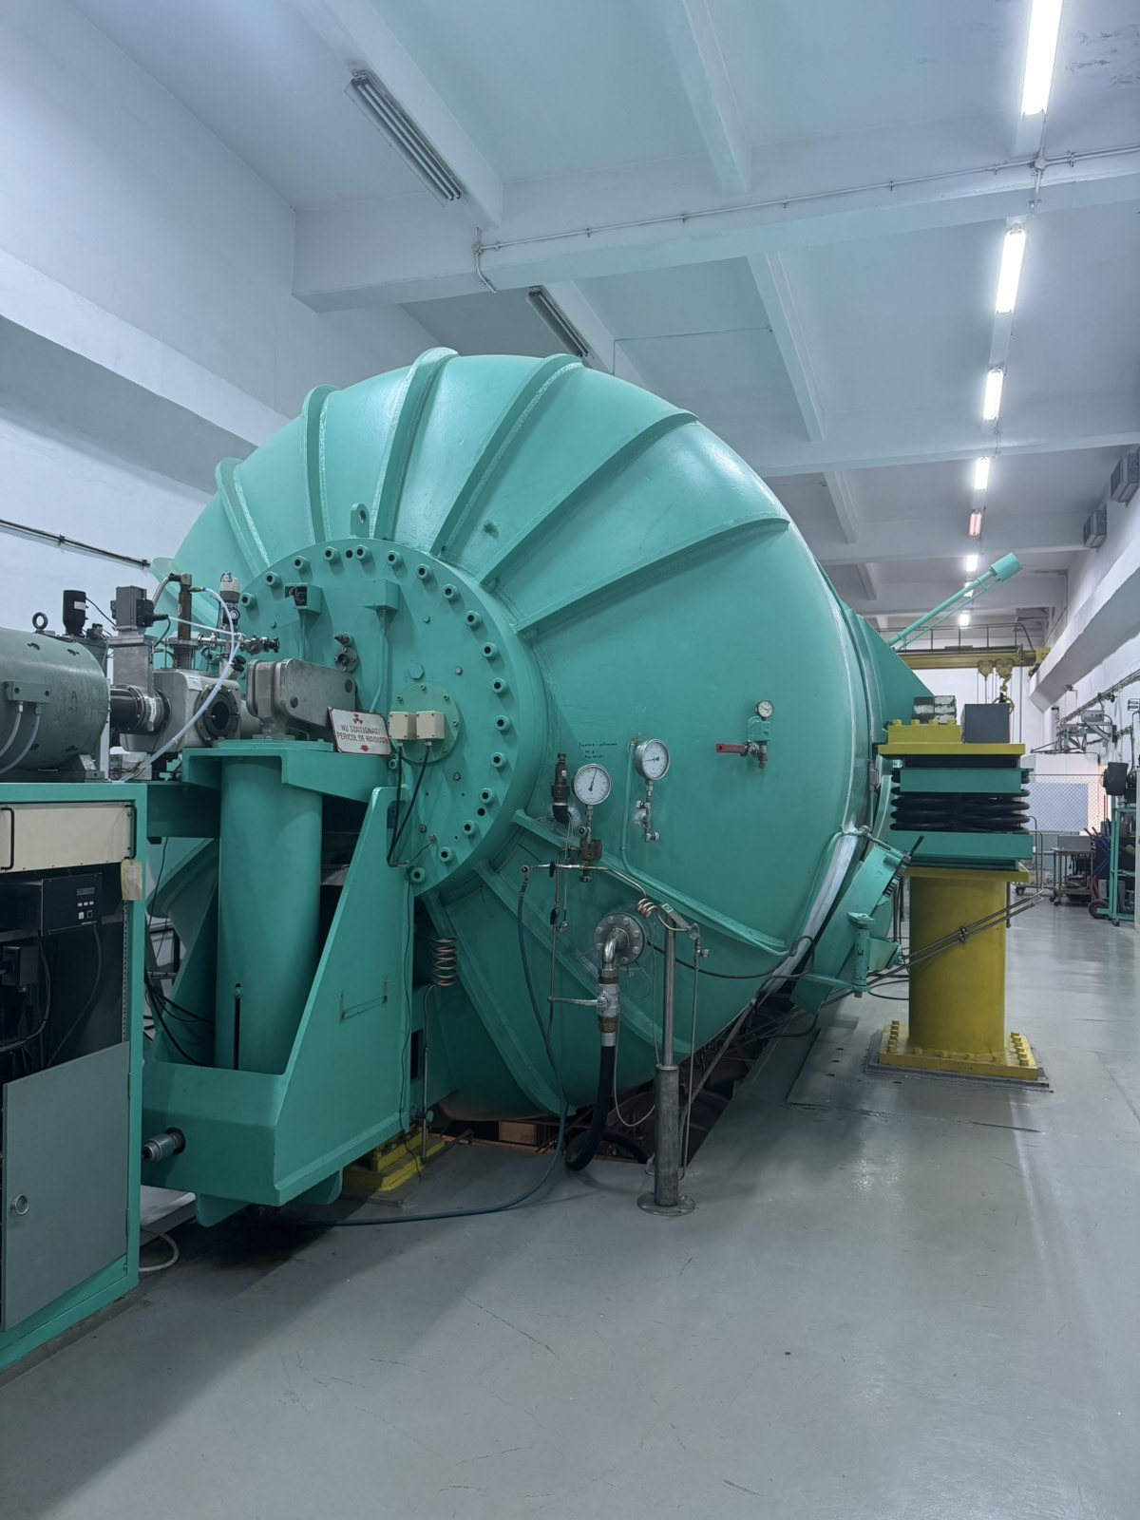
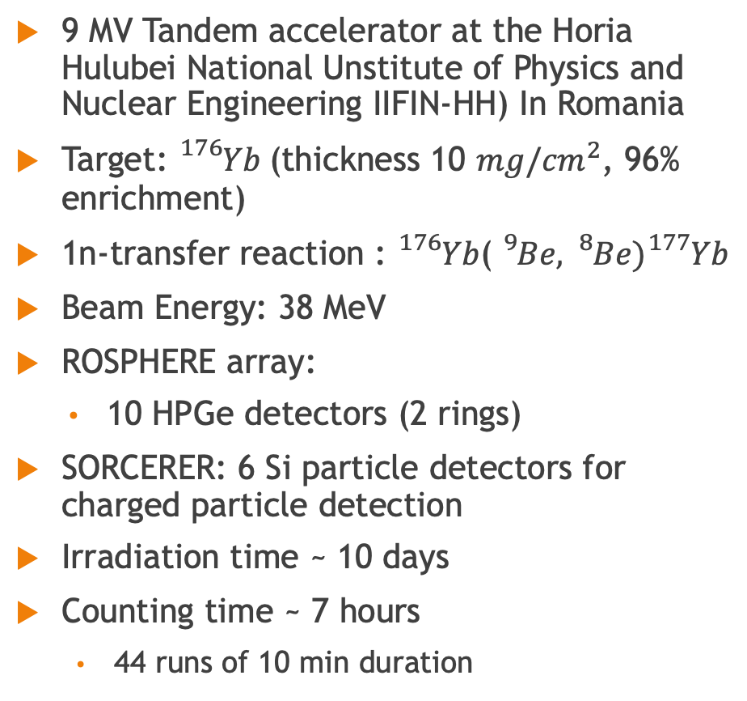
Setup and measurements
9 MV Tandem accelerator at the Horia Hulubei National Unstitute of Physics and Nuclear Engineering IIFIN-HH) In Romania
Target: ${}_{}^{176}{Yb}$(thickness 10 ${mg/cm}^{2}$, 96% enrichment)
1n-transfer reaction : ${}_{}^{176}{Yb}$(${}_{}^{9}{Be},{}_{}^{8}{Be}){}_{}^{177}{Yb}$
Beam Energy: 38 MeV
ROSPHERE array:
  10 HPGe detectors (2 rings)
SORCERER: 6 Si particle detectors for charged particle detection
Irradiation time ~ 10 days
Counting time ~ 7 hours
  44 runs of 10 min duration

Slide 12
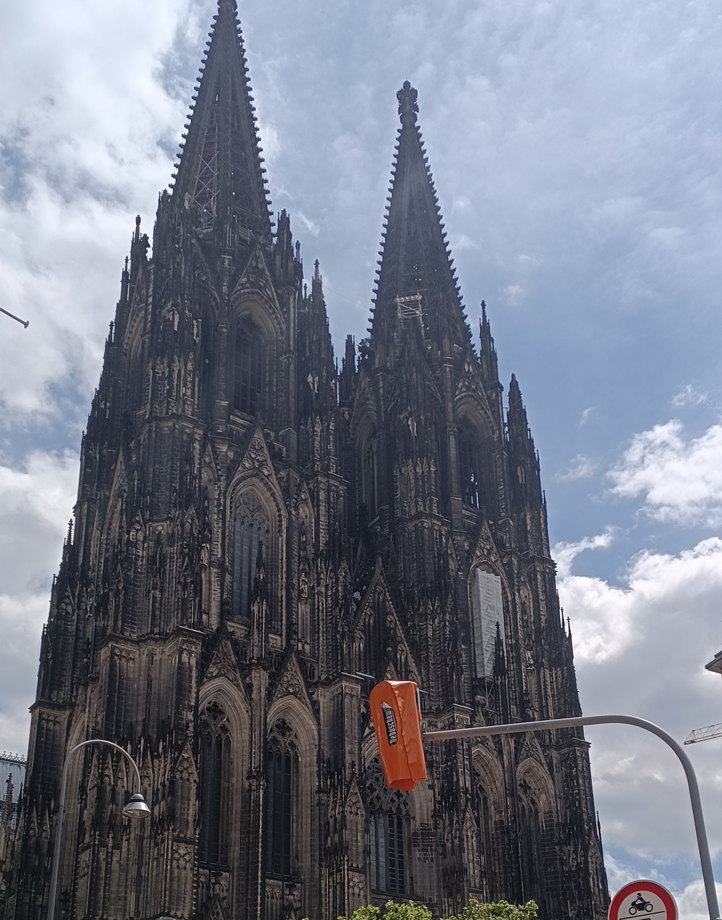
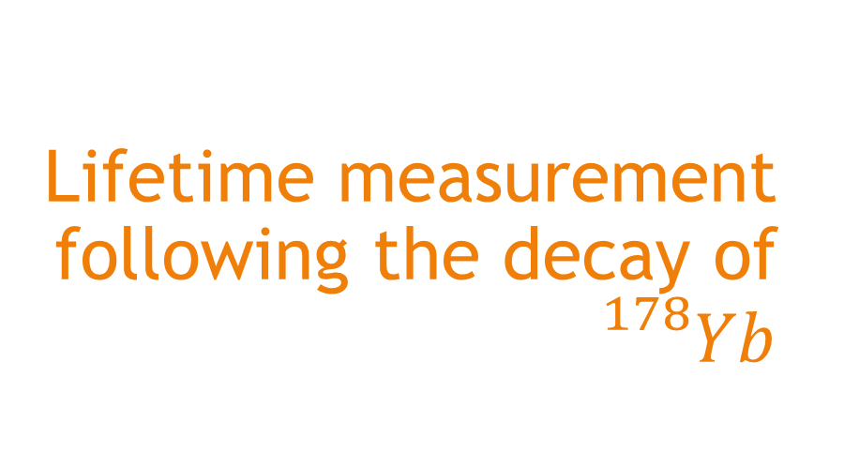
Lifetime measurement following the decay of ${}_{}^{178}{Yb}$

Slide 13
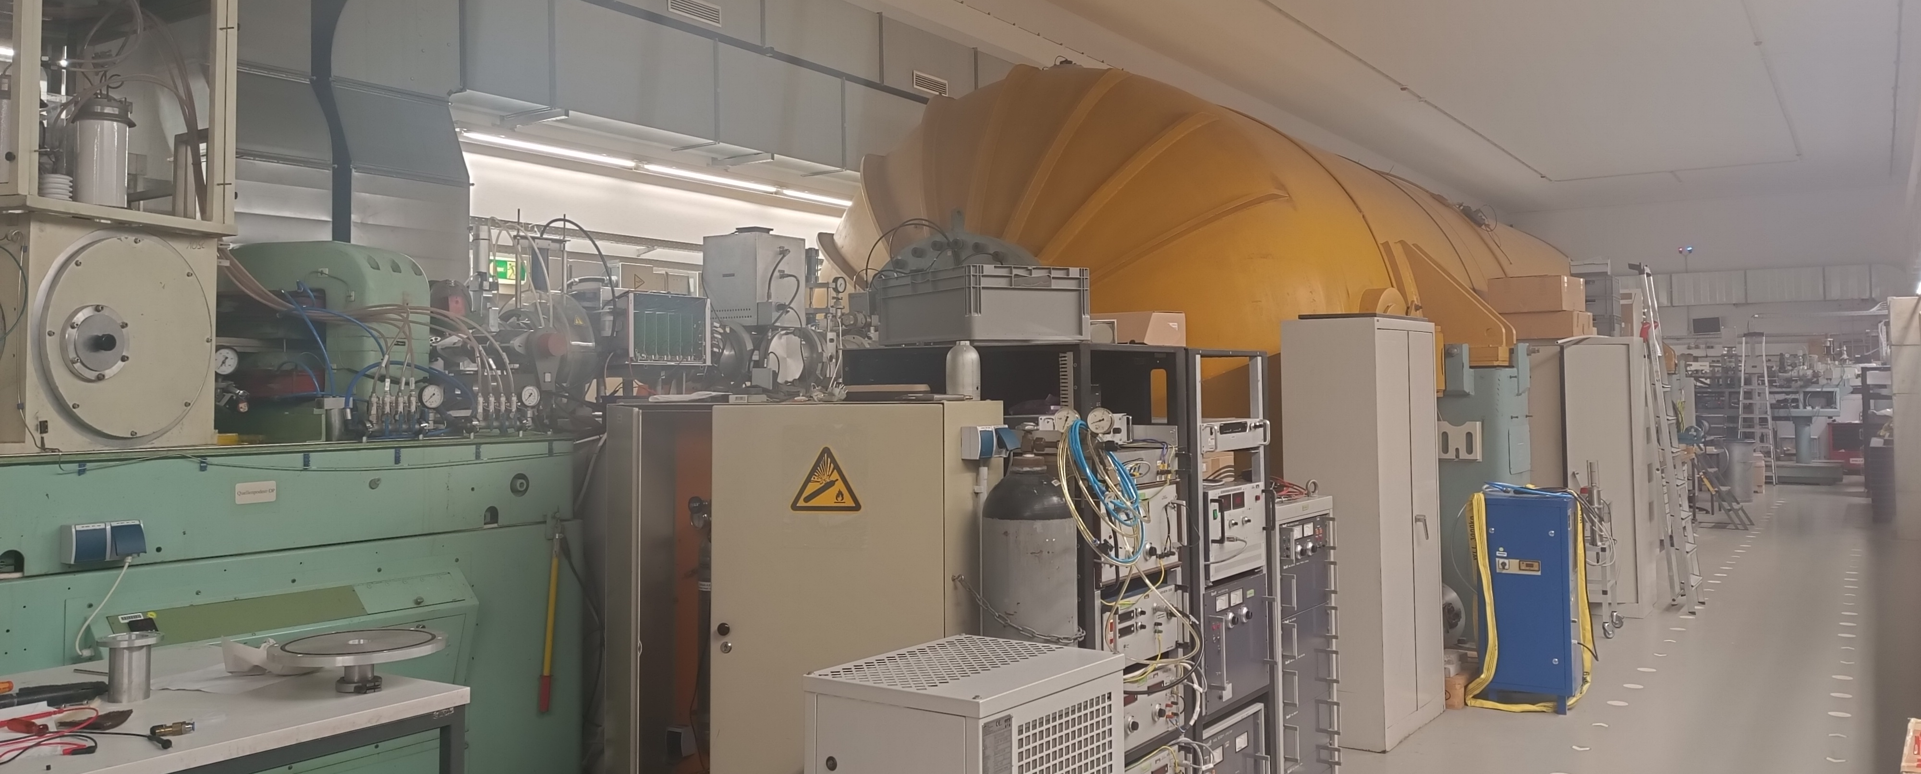
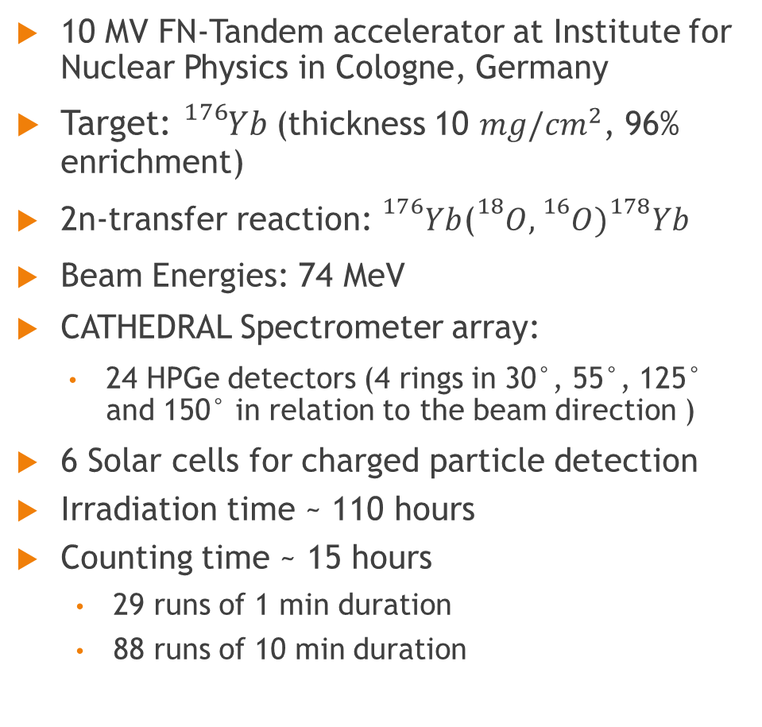
Setup and measurements
10 MV FN-Tandem accelerator at Institute for Nuclear Physics in Cologne, Germany
Target: ${}_{}^{176}{Yb}$(thickness 10 ${mg/cm}^{2}$, 96% enrichment)
2n-transfer reaction: ${}_{}^{176}{Yb}$(${}_{}^{18}O,{}_{}^{16}O){}_{}^{178}{Yb}$
Beam Energies: 74 MeV
CATHEDRAL Spectrometer array:
  24 HPGe detectors (4 rings in 30°, 55°, 125° and 150° in relation to the beam direction )
6 Solar cells for charged particle detection
Irradiation time ~ 110 hours
Counting time ~ 15 hours
  29 runs of 1 min duration
  88 runs of 10 min duration

Slide 14
Experimental Results

Slide 15
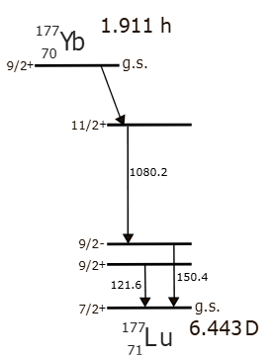
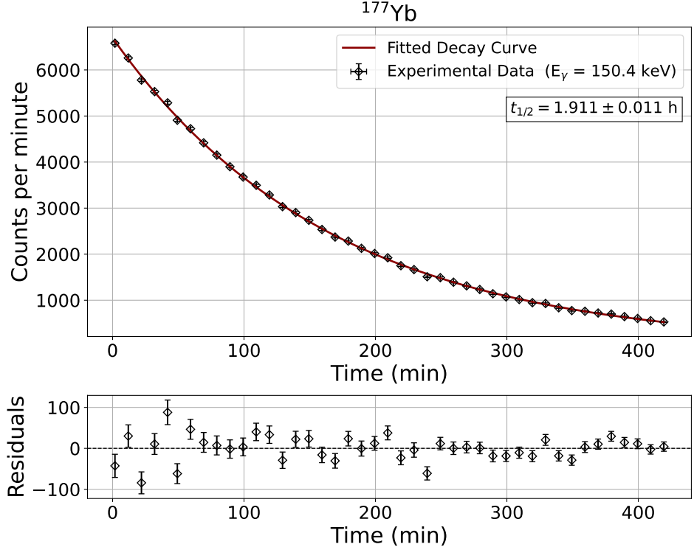
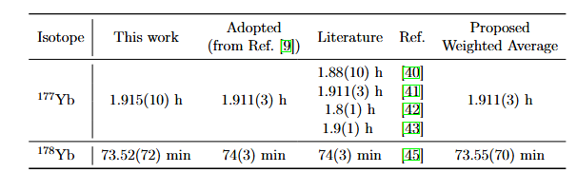

Half-live result for ${}_{}^{177}{Yb}$

Slide 16
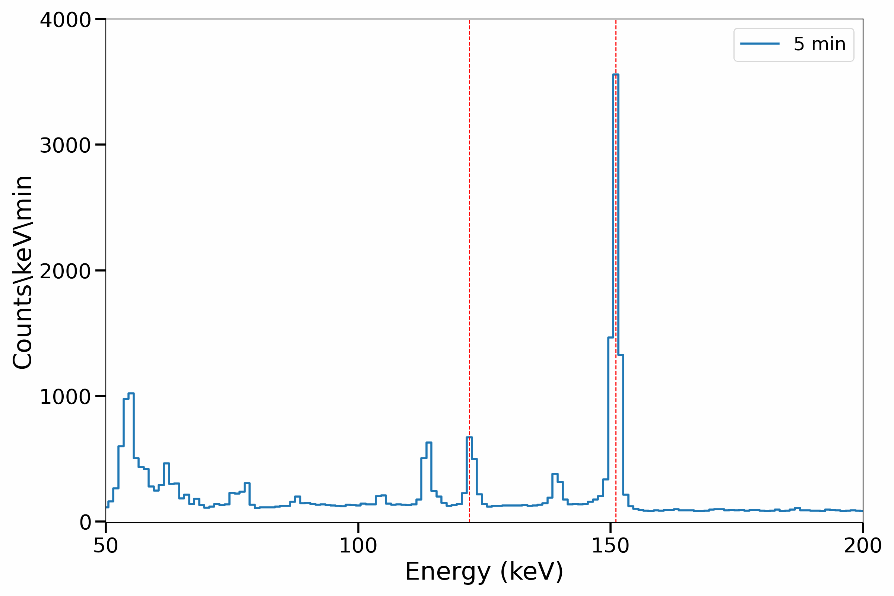
Half-live result for ${}_{}^{177}{Yb}$

Slide 17
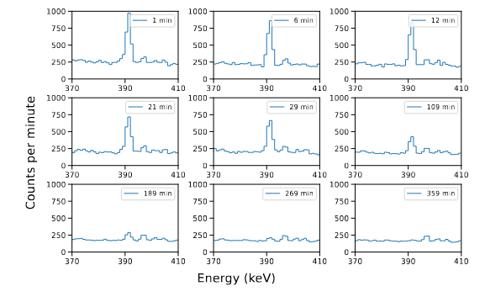
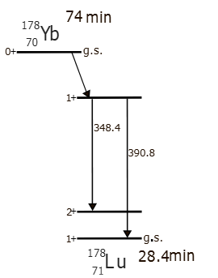
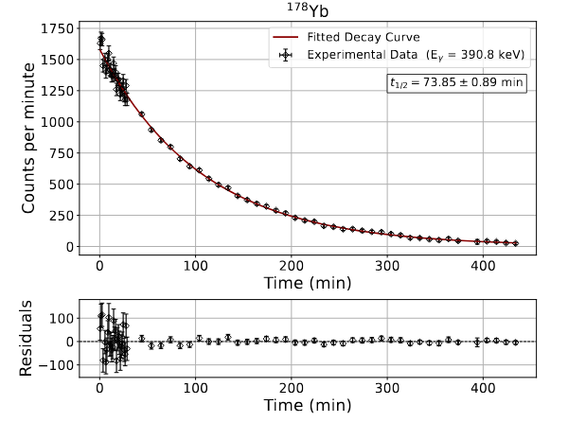

Half-live result for ${}_{}^{178}{Yb}$

Slide 18
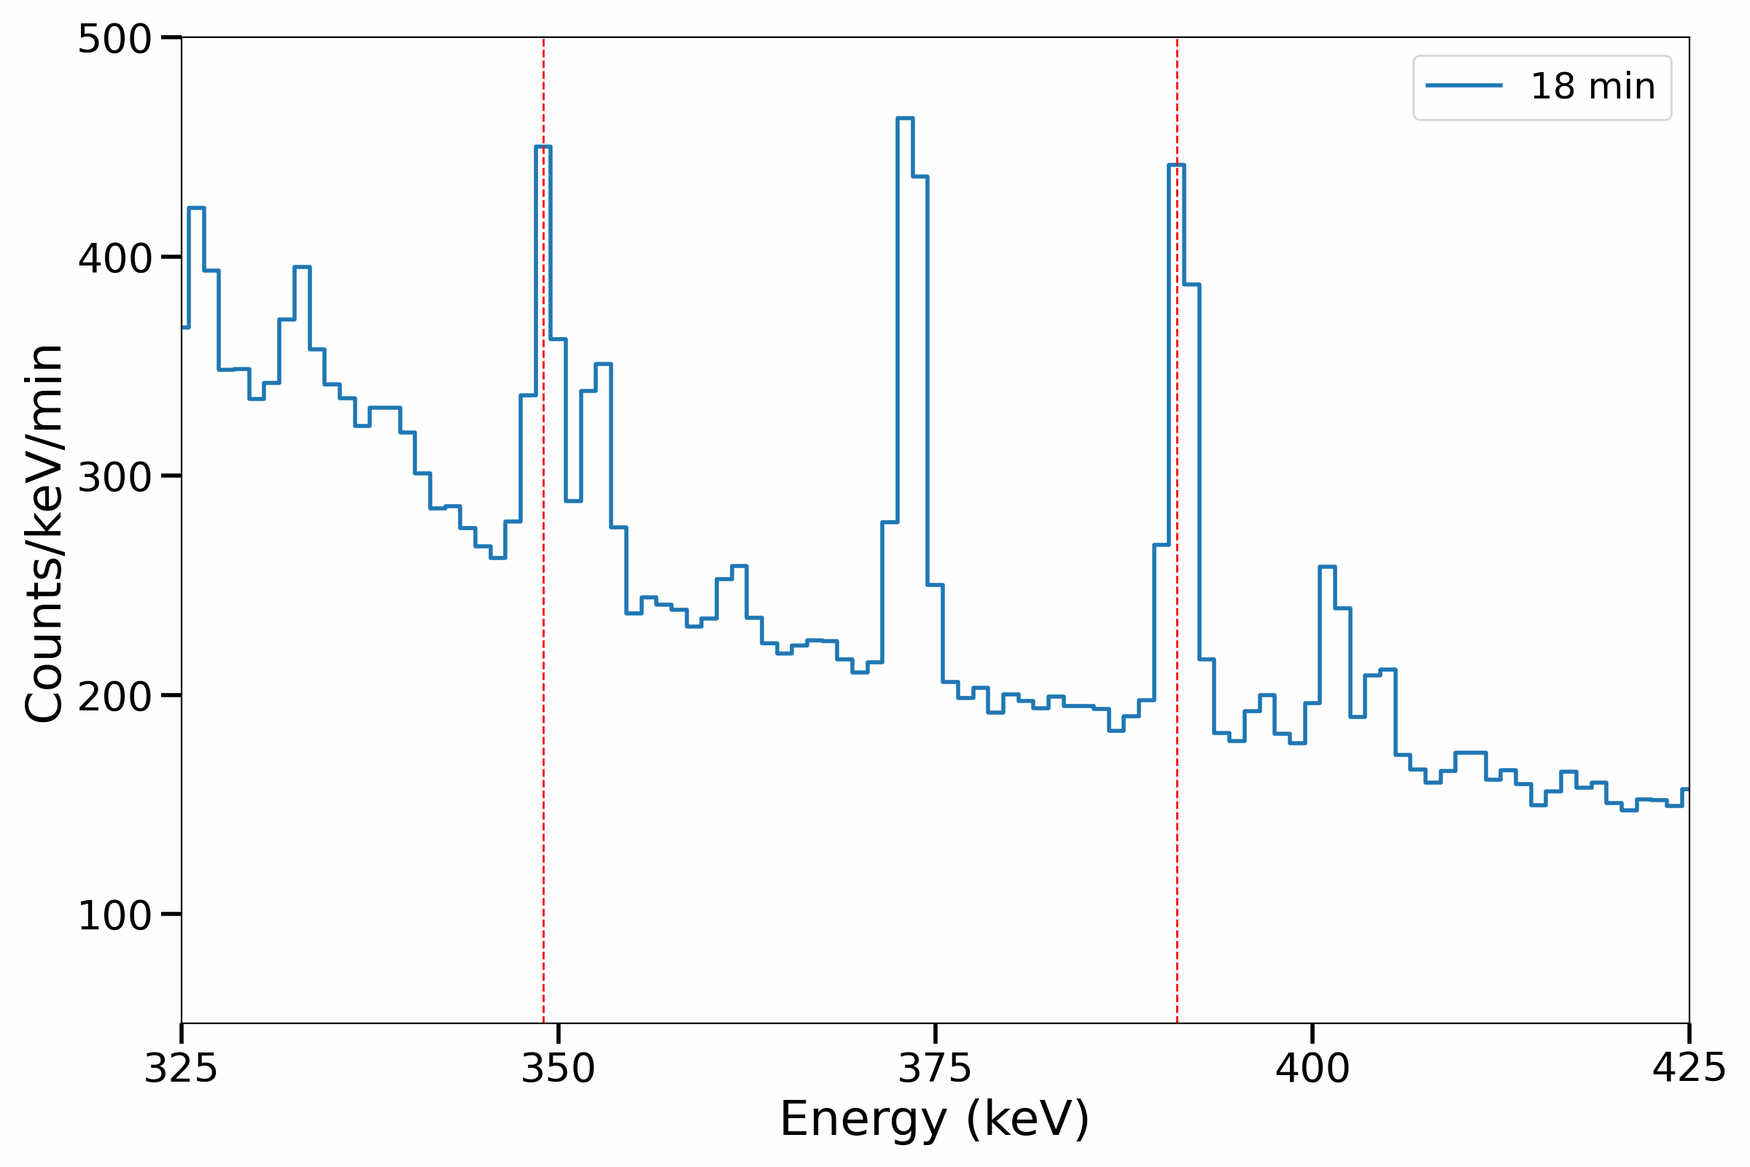
Half-live result for ${}_{}^{178}{Yb}$

Slide 19
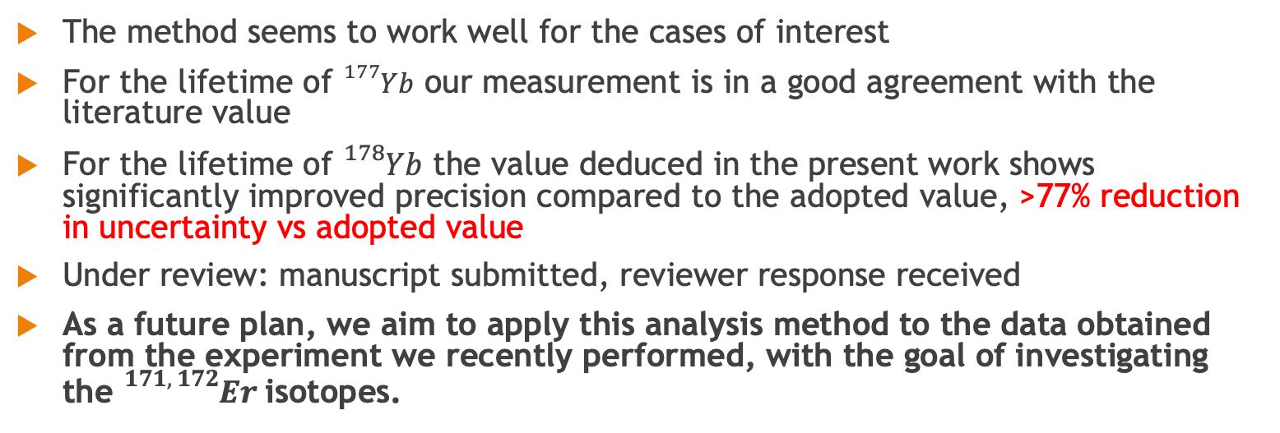
Summary & Outlook
The method seems to work well for the cases of interest
For the lifetime of ${}_{}^{177}{Yb}$ our measurement is in a good agreement with the literature value
For the lifetime of ${}_{}^{178}{Yb}$ the value deduced in the present work shows significantly improved precision compared to the adopted value, >77% reduction in uncertainty vs adopted value
Under review: manuscript submitted, reviewer response received
As a future plan, we aim to apply this analysis method to the data obtained from the experiment we recently performed, with the goal of investigating the ${}_{}^{171, 172}{Er}$isotopes.

Slide 20
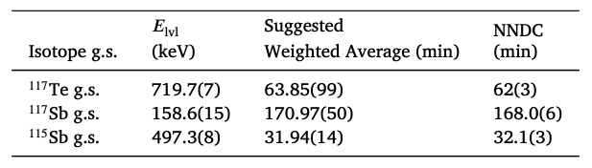
Summary & Outlook
🔻67%
🔻17%
🔻53%
M. Efstathiou et al. Nuclear Physics A (2026): 123338
The method seems to work well for the cases of interest
For the lifetime of ${}_{}^{177}{Yb}$ our measurement is in a good agreement with the literature value
For the lifetime of ${}_{}^{178}{Yb}$ the value deduced in the present work shows significantly improved precision compared to the adopted value, >77% reduction in uncertainty vs adopted value
Under review: manuscript submitted, reviewer response received
As a future plan, we aim to apply this analysis method to the data obtained from the experiment we recently performed, with the goal of investigating the ${}_{}^{171, 172}{Er}$isotopes.

Slide 21
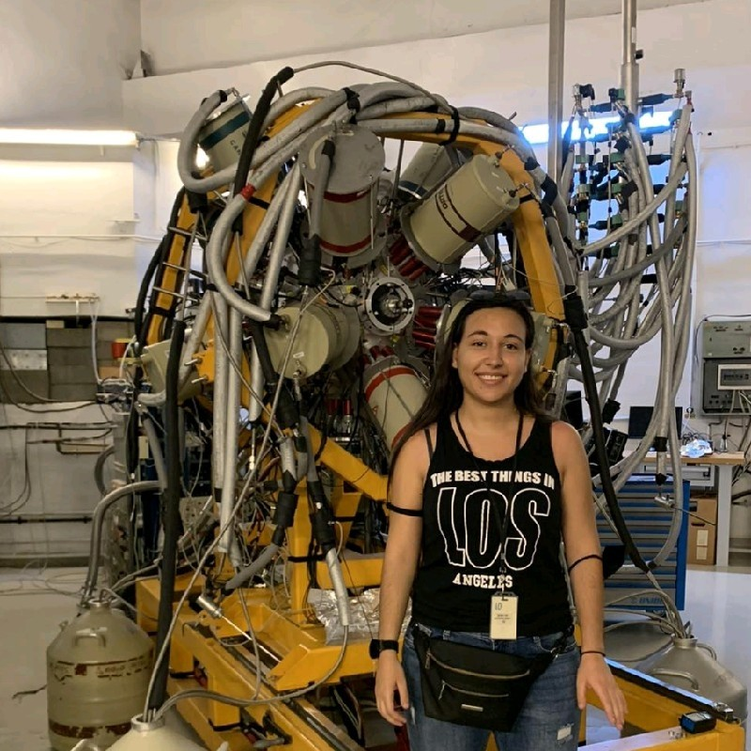


Acknowledgements
Thank you for the attention!
M. Efstathiou¹, P. Koseoglou¹, T.J. Mertzimekis¹, P. Vasileiou^{1,3}, A. Blazhev⁶, R. Borcea², A. Chalil^{1,5},
C. Costache³, A. Esmaylzadeh⁶, J. Fischer⁶, N. Florea³, S.T. Florian², C. Fransen⁶, H. Mayr², J. Jolie⁶,
C.-D. Lakenbrink⁶, R. Lica³, N. Marginean³, C. Mihai³, R.E. Mihai^{3,4}, C. Nickel², A. Turturica³,
V. Werner², A. Zyriliou¹
¹ National and Kapodistrian University of Athens, Zografou Campus, Athens, GR-15784, Greece
² Technische Universität Darmstadt, Department of Physics, Institute for Nuclear
Physics, Schlossgartenstr. 9, 64289, Darmstadt, Germany
³ Horia Hulubei National Institute of Physics and Nuclear
Engineering, Magurele, R-77125, Romania
⁴ Institute of Experimental and Applied Physics, Czech Technical University in
Prague, Husova 240/5, Prague 1, 110 00, Czech Republic
⁵CEA, DES, IRESNE, DTN, Nuclear Measurement Laboratory, Saint
Paul-lez-Durance, 13108, France
⁶Institut für Kernphysik, Universität zu Köln, Cologne, 50937, Germany
This project has received funding from the European Union’s Horizon Europe Research and Innovation programme under Grant Agreement No 101057511 (EURO-LABS) and from the German Research Foundation – Project number: 539757749

Slide 22
Back-up slides

Slide 23
