Slide 1
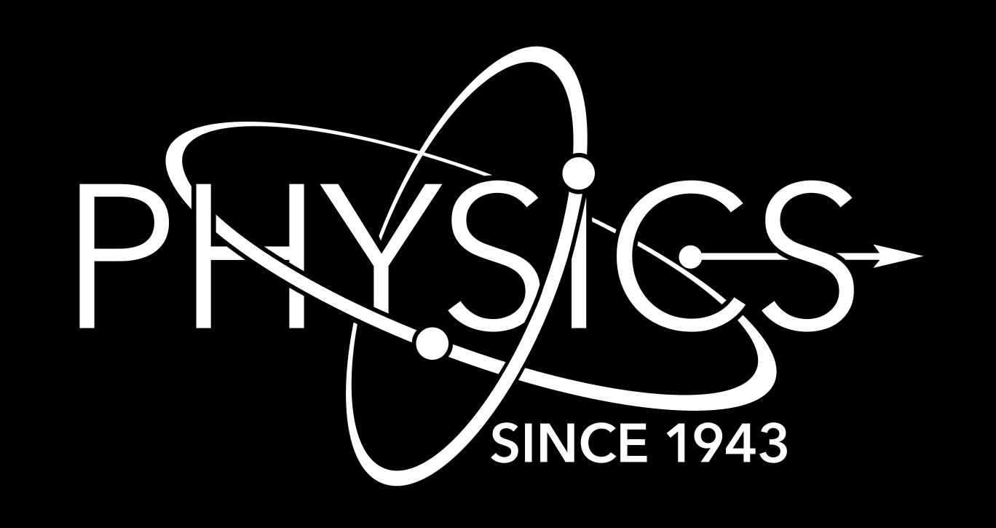
Statistical Evidence for Oscillatory Components in Neutron-Induced Cross Sections*
Experiendo cognoscitur
Th. Stamatopoulos, P. Koehler
Physics Division, Los Alamos National Laboratory, 87545, NM, USA
*Partially Funded by the US Nuclear Criticality Safety Program
34th Annual Hellenic Nuclear Physics Society Symposium
Lamia, Greece June 5th – 6^{h} , 2025
LA-UR-26-24567

Slide 2
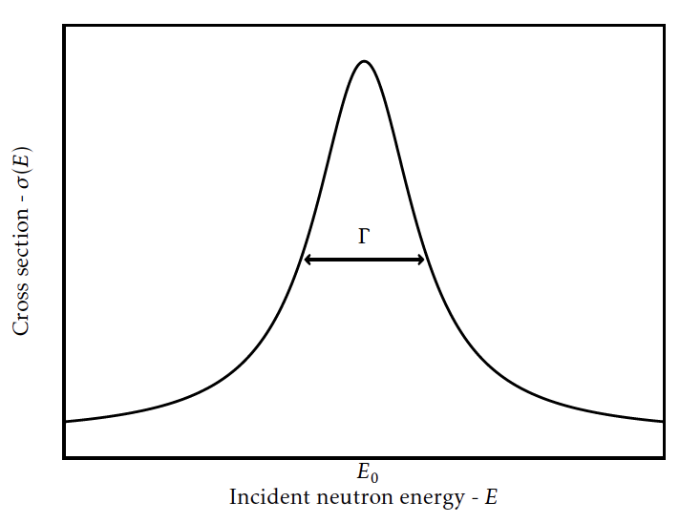
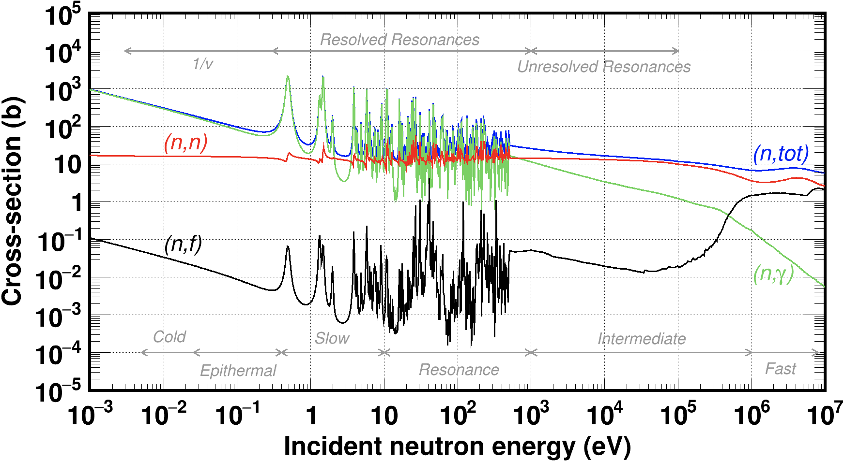
Neutron-induced cross sections
Q-values are of the order of MeV
At low neutron energies, cross sections exhibit large fluctuations: resonances
Resonance is characterized by its mean energy (Ε) and reaction width (Γ_{i}: Γ_{γ} for capture, Γ_{n} for scattering, Γ_{f} for fission, Γ for total, etc)

Slide 3
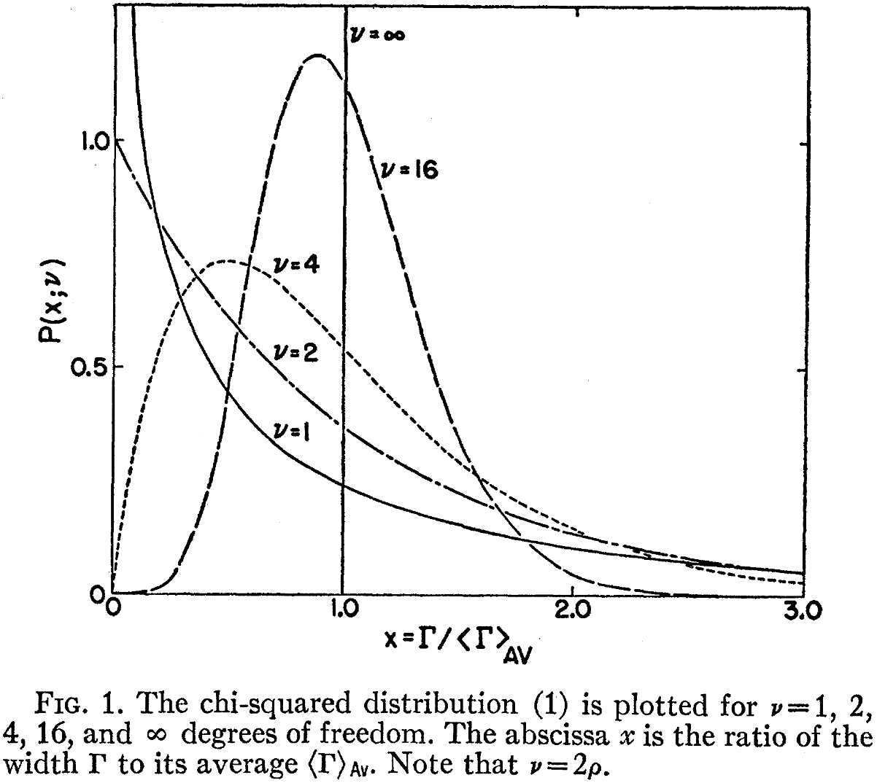
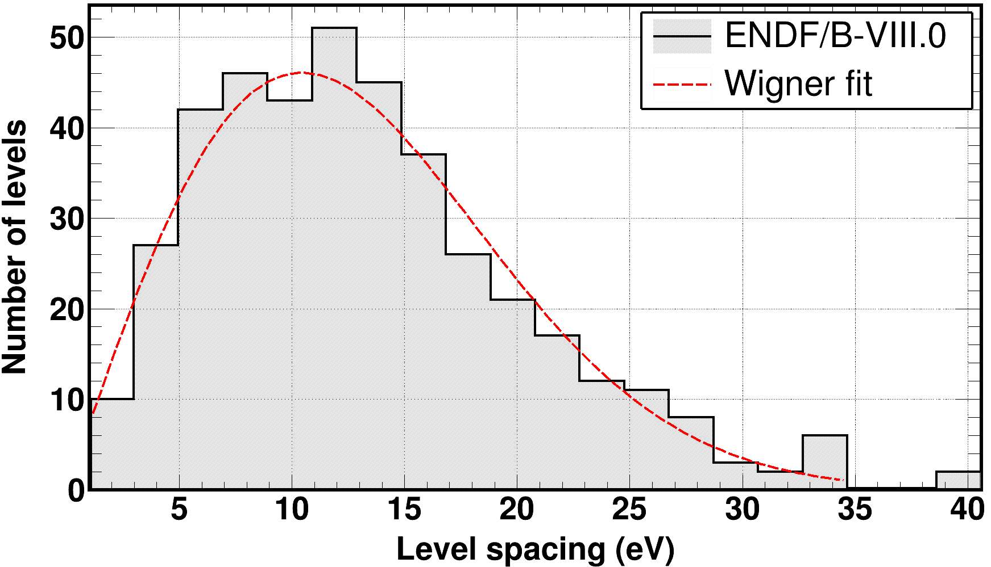
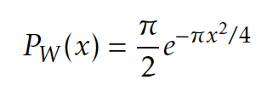
Random Matrix Theory - RMT
Theory cannot predict the position and width of each resonance
RMT can, however, predict:
  Width distributions
    Porter-Thomas for neutron widths (chi-square distribution with 1 degree of freedom)
    Gamma width distributions are narrow and don’t change with energy
  Energy spacings follow the Wigner distribution
  Widths and energies are uncorrelated
RMT predicts that fluctuations in cross sections are entirely random
Phys. Rev. 104 2 (1956)
x: level spacing

Slide 4
Why testing RMT is important ?
RMT pervades the physics of virtually all complex systems*
  Equilibrium and transport properties of disordered quantum systems, two-dimensional gravity, conformal field theory, chiral phase transition in quantum, chromodynamics, nuclear resonances, …
RMT is “fundamental”
  Very few assumptions
RMT underpins the nuclear statistical model, which is used to predict cross sections that are beyond the reach of current measurement techniques for applications such as radiochemical diagnostics, nuclear energy applications, nuclear astrophysics, …
Difficult to understand how RMT could be wrong: the few observed deviations from RMT (in neutron resonances) remain unexplained
*T. Guhr et al, Phys. Reports 299, 189 (1998)

Slide 5
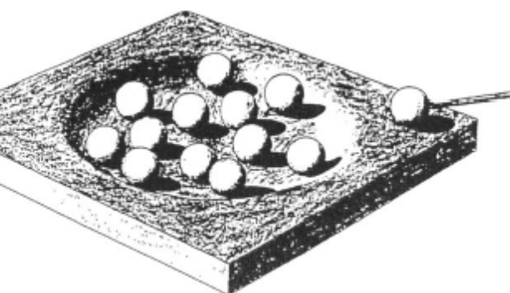
A Taste of RMT: A (Very Loose) Derivation of the Porter-Thomas Distribution (PTD)*
The PTD is based on the following assumptions
  The reaction is a single-channel process: Elastic scattering only and time-reversal invariance holds
  The compound-nucleus (CN) model applies
The matrix elements between the CN states and the incoming neutron are very complex (many many components) and essentially unrelated to each other.
As a result, the central-limit theorem applies and hence these matrix elements are Gaussian distributed with zero mean
Experimental Reduced widths Γ⁰𝑛 (Γn/√E) are proportional to the squares of the matrix elements, which leads to Γ⁰𝑛 having a 𝜒-2 distribution with one degree of freedom, 𝜈= 1, which is called the PTD
Simple assumptions
Bohr’s wooden toy model
Science 86 2225 (1937)
*E. Porter and R. G. Thomas, “Fluctuations of Nuclear Reaction Widths”, Phys. Rev. 104, 483 (1956)

Slide 6
Testing RMT with Neutron Resonance Data
Consensus is that neutron resonance data are consistent with RMT, but there are a few cases where RMT (ν=1) is rejected with high confidence
  ²³²Th, ν=2, Forman et al., Phys. Rev. Lett. 27, 117 (1971)
  ²³²Th, ν changes from 2 to 1 as energy increases, Rahn et al, Phys. Rev. C 6, 1854 (1972)
  ¹⁴⁷Sm, ν changes from 1 to 2.7 (2.9σ) as energy increases, Koehler et al., Phys. Rev. C 76, 025804 (2007)
  ^{192,4}Pt, ν = 0.5 (99.997% Confidence Level), Koehler et al., Phys. Rev. Lett. 105, 072502 (2010)
  ¹⁵⁰Nd, v = 1.93(12), Papst et al., Phys. Rev. Lett. 135 052501 (2025)
  Systematic study, Koehler and Stamatopoulos, Phys. Rev. Lett. 135 112501 (2025)
  ¹⁴⁷Sm, v >2 (99.997% CL)/Γγ distribution changes as energy increases, Amberger et al., to be submitted to Phys. Rev. Lett. and C (2026)
  ¹⁴⁹Sm, Γ_{γ} distribution changes abruptly as energy increases, Stamatopoulos et al., to be submitted to Phys. Rev. Lett and C (2026)
Only a few investigated the validity of RTM. Interest is-hopefully-growing

Slide 7
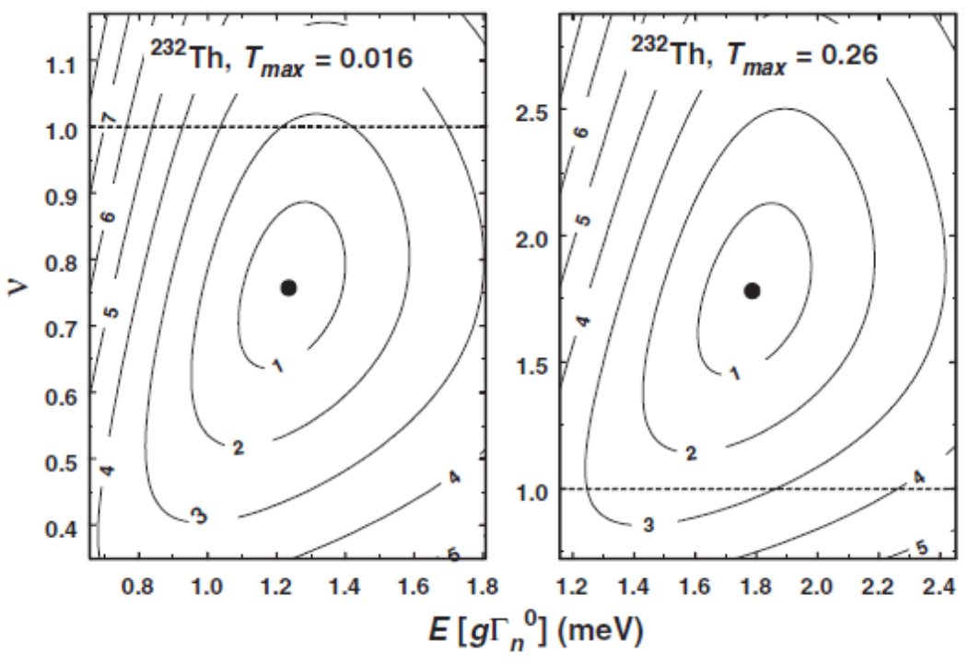
Problems Testing RMT using Neutron Resonance Data
Precision limited by small number of resonances in resolved resonance range
  Typical number of resonances for medium weight+ nuclei = 50-300
Both neutron capture (Γ_{γ}) and total cross-section data (Γ_{n}, Γ) are needed
Requires careful resonance analysis: time-consuming
The most stringent tests compare neutron widths of s-wave resonances (angular momentum = 0) to the Porter-Thomas distribution (PTD)
Requires careful corrections for missed resonances and elimination of p-wave resonances (angular momentum = 1)
Koehler, Phys. Rev. C (84) 034312 (2011)
p-waves eliminated
ν=1 within 3σ
(is it really 1 degree of freedom?)
With p-wave
Contamination
ν=1 within 2σ

Slide 8
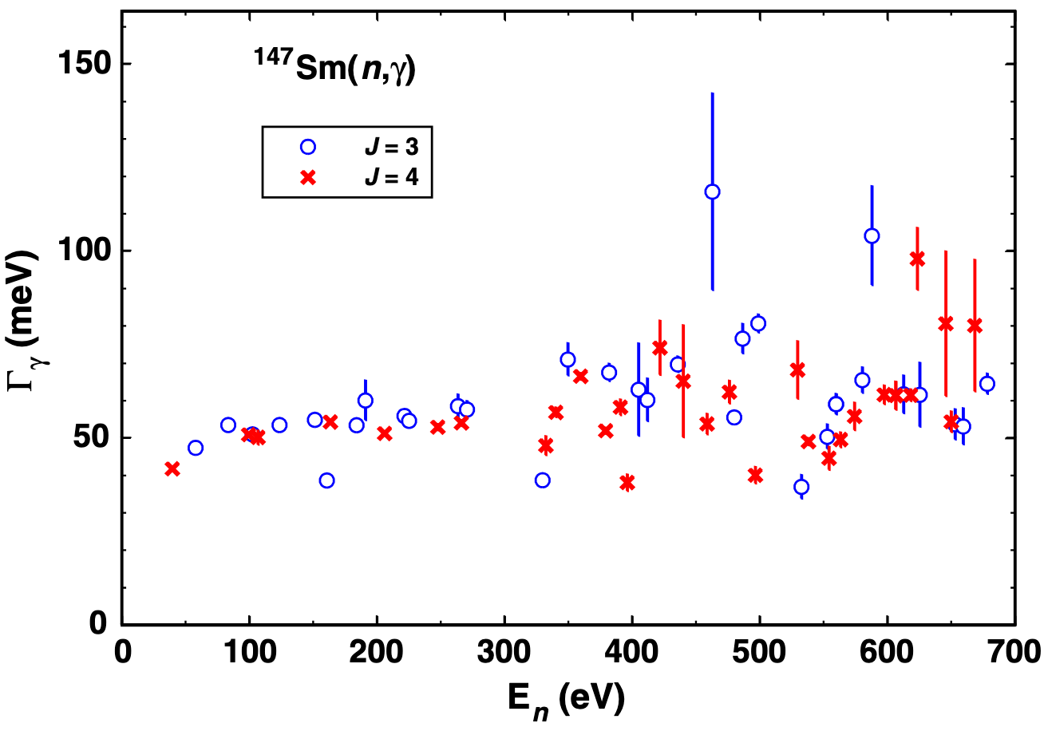
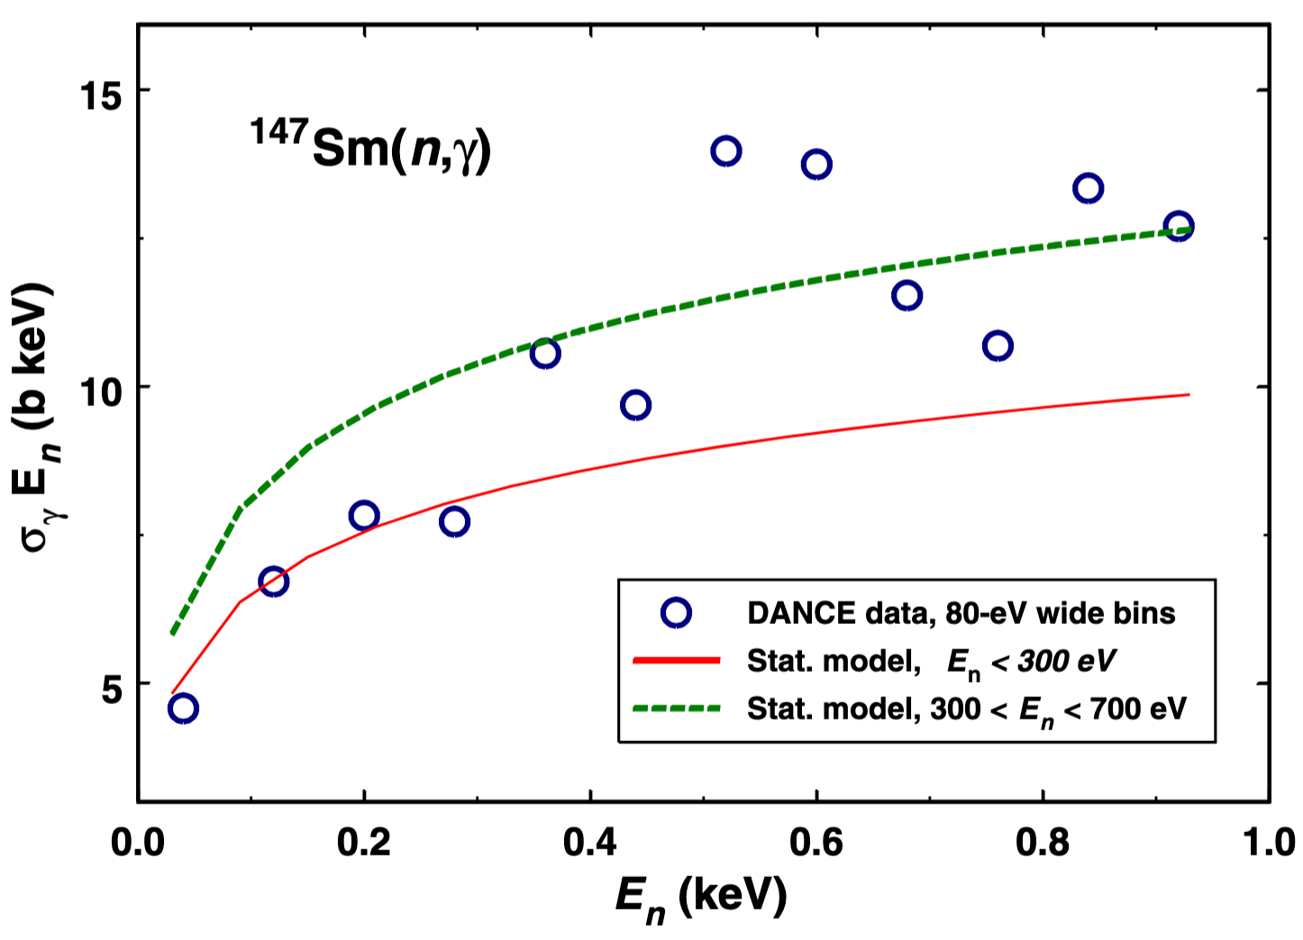
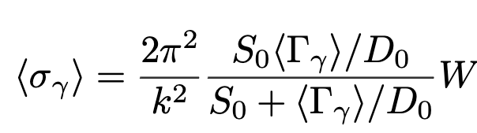

Can we use cross sections instead of resonances?
In Koehler et al., Phys. Rev. Lett. 108 142502 (2012), there is a hint that the average capture cross section changes at 300 eV
TALYS calculations with statistical properties (Level spacing – D0, Average <Γ_{γ}>, Gamma strength function – S₀) extracted from resonance data below and above 300 eV, yield different cross sections
An unusual cross section behavior was observed in 2012 in data where the PTD is rejected with high confidence. Coincidence?
$$=f(\text{Γ},\text{Γ}\text{n}, D_{0})$$
k : Wave number
W : Width fluctuation factor

Slide 9
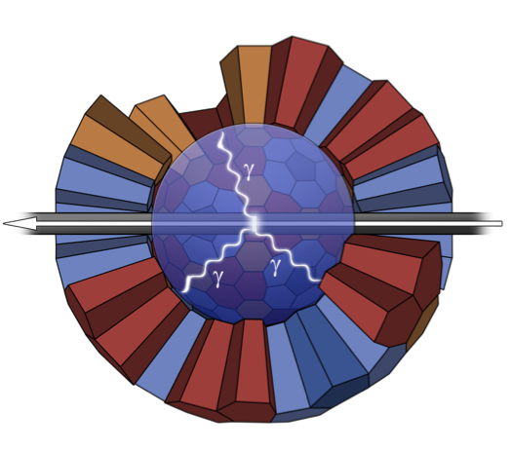
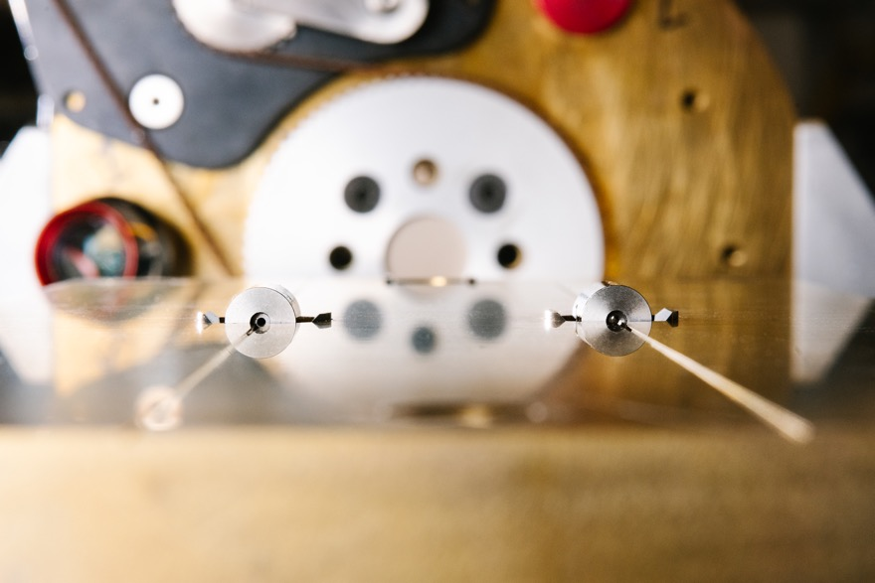
New (n,tot) and ”new-old” (n,γ) cross section data on ¹⁴⁹Sm at the Los Alamos Neutron Science CEnter - :LANSCE
(n,tot) data taken with the new DICER instrument (Device for Indirect Capture Experiments on Radionuclides)
Instrument mainly developed to constrain capture rates on radionuclides, where direct measurements are impossible
First ever binocular neutron transmission instrument: tiny samples >0.1 mm/10s ng
Detector for Advanced Neutron Capture Experiments – DANCE
Gamma calorimeter with 160 BaF₂ detectors
¹⁴⁹Sm data were taken in the early 2000s
DANCE can extract capture cross sections and resonance spins.
A. Stamatopoulos et al., NIMA (1025) 166166, 2022
A. Stamatopoulos et al., IEEE Trans. Nucl. Science 70, (2023)
A. Stamatopoulos et al., Neutron News 33, 12 – 14 (2022)
A. Matyskin et al, Scientific Reports 13, 1736 (2023)
A. Stamatopoulos et al., EPJ., Conf. 260, 03006 (2022)
A. Stamatopoulos et al., J. Rad. Nucl. Chem. 331, (2022)
A. Stamatopoulos et al. Phys. Rev. Lett. 134 112702 (2025)
A. Stamatopoulos et al. Phys. Rev. C 11 034613 (2025)
DICER and DANCE data were analyzed, resonance parameters and cross sections were extracted.
An interesting observation followed an interesting observation…

Slide 10

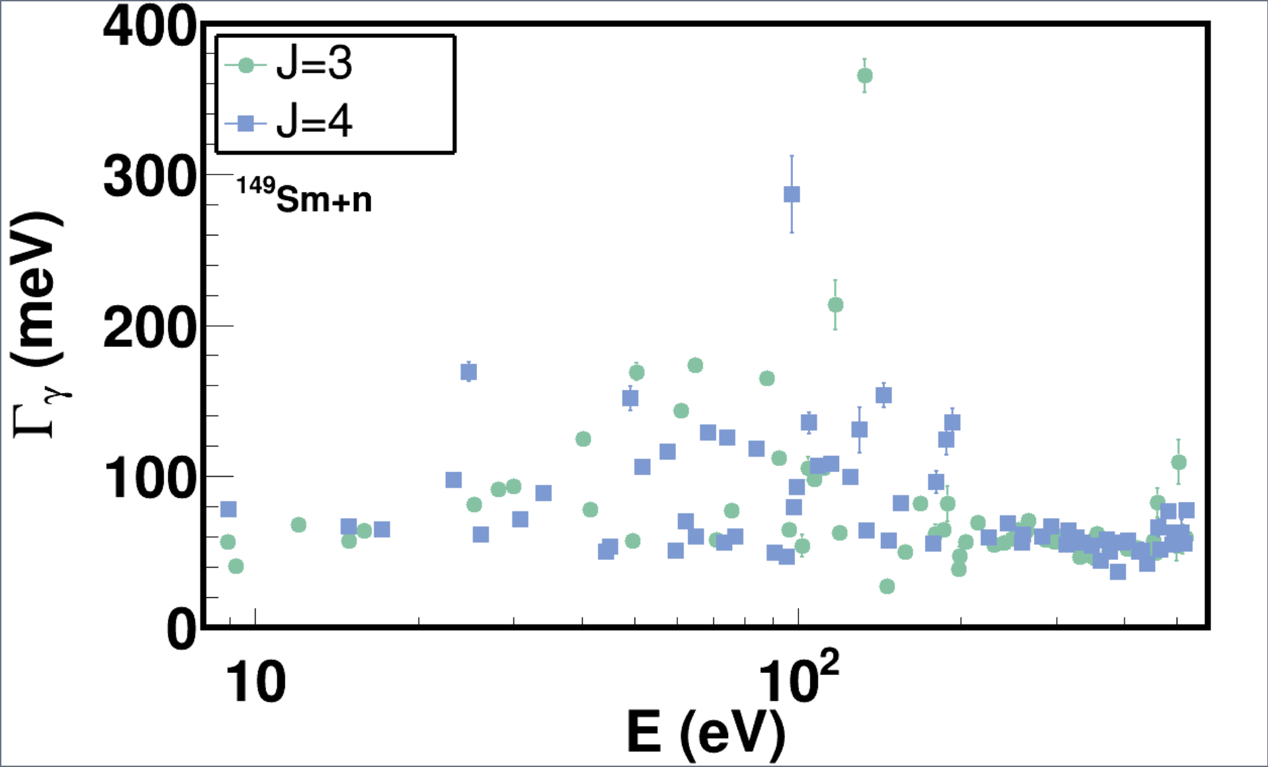
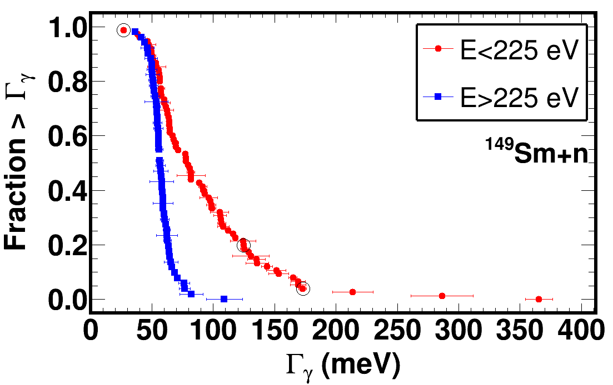
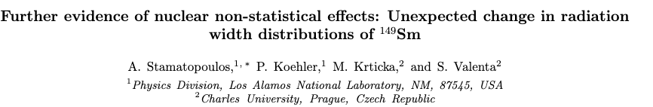
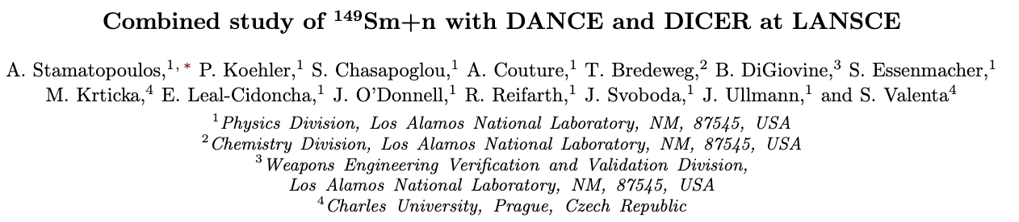
Non-Statistical behavior
Statistically significant change in the Γ_{γ} distributions around 200 eV was observed.
Findings will be submitted for publication to Phys. Rev. Lett. (similar findings in ¹⁴⁷Sm)
Phys. Rev. Lett.
Phys. Rev. C

Slide 11
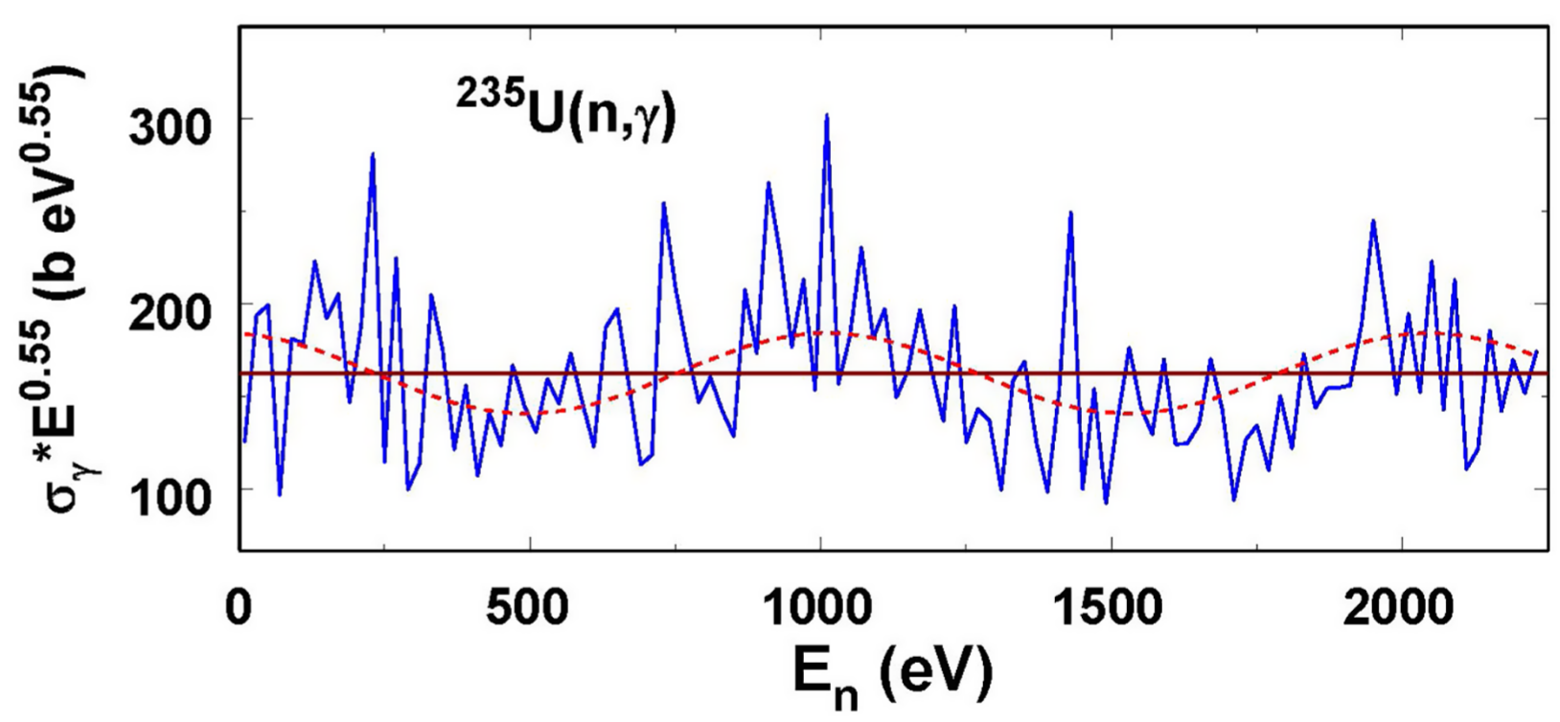
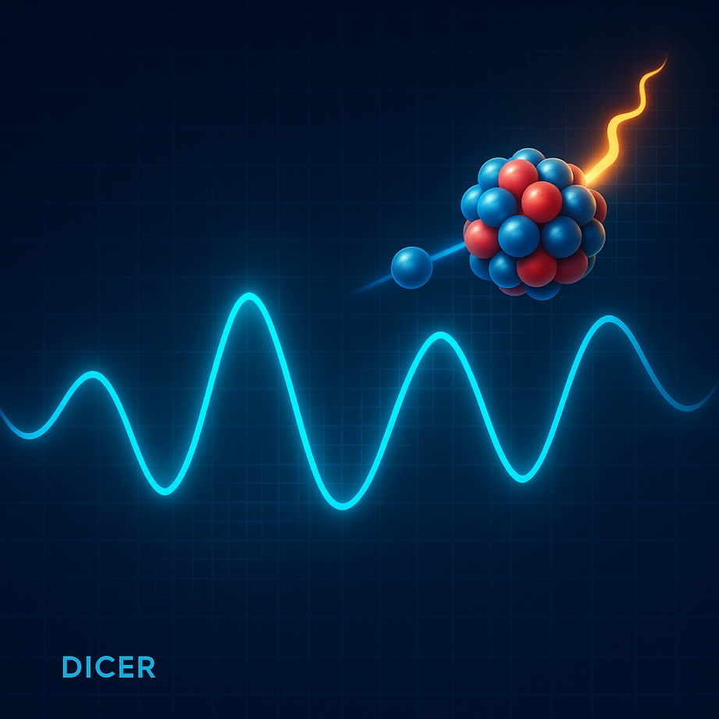
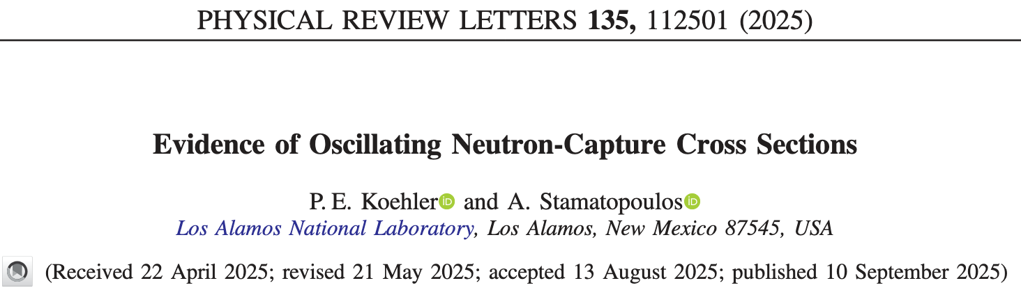
Non-Statistical behavior - more
Sm work gave rise to an interesting observation
Neutron-capture cross sections are exhibiting a statistically significant oscillating behavior

Slide 12
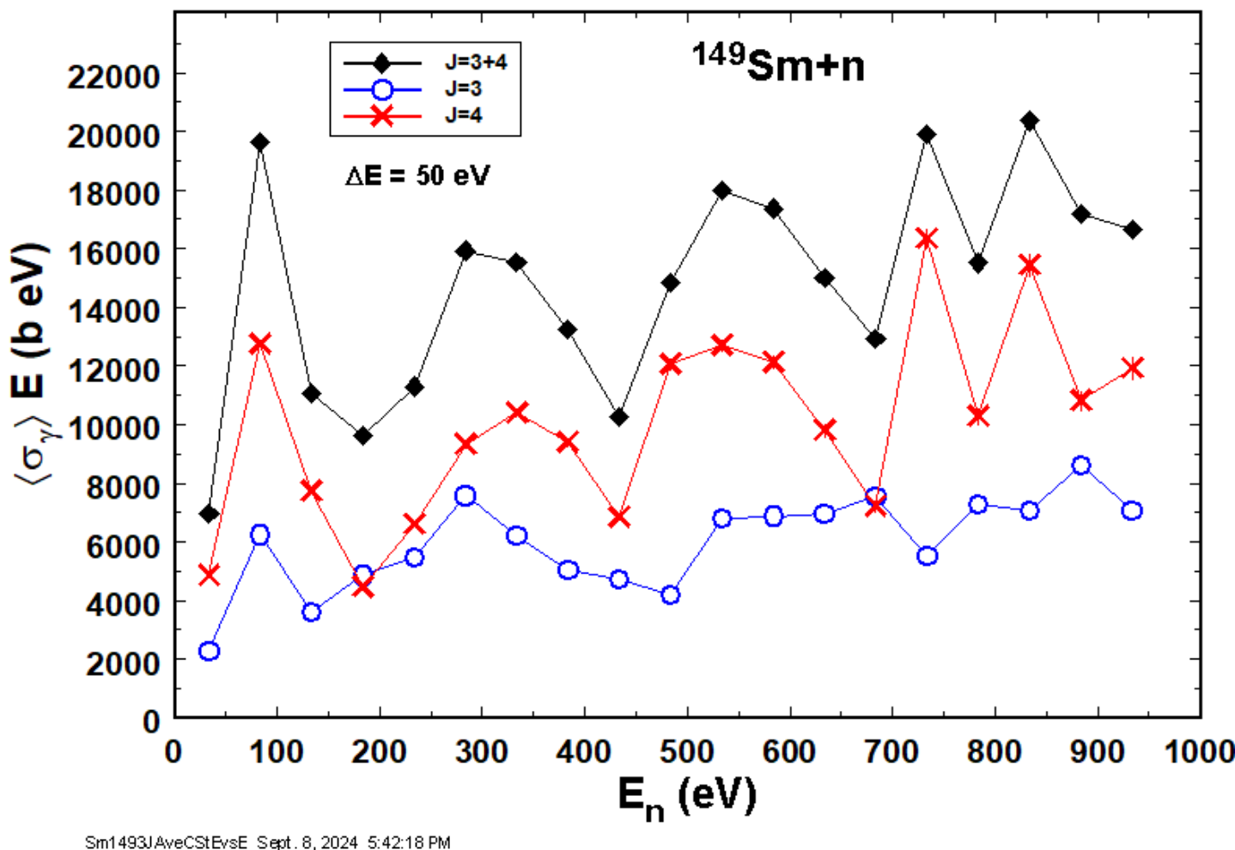
Non-statistical behavior - More
The average capture cross section, if binned coarsely enough to smooth resonances (i.e. 10 x D₀, D₀ = level spacing i.e. the average distance between consecutive resonances), exhibits oscillations
Are they statistically significant?

Slide 13
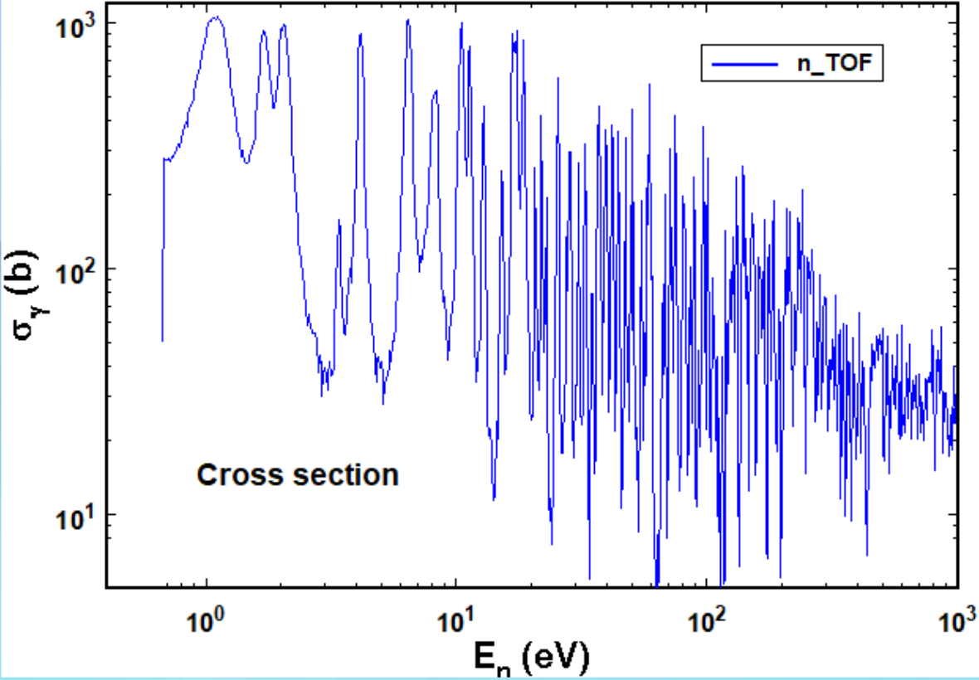
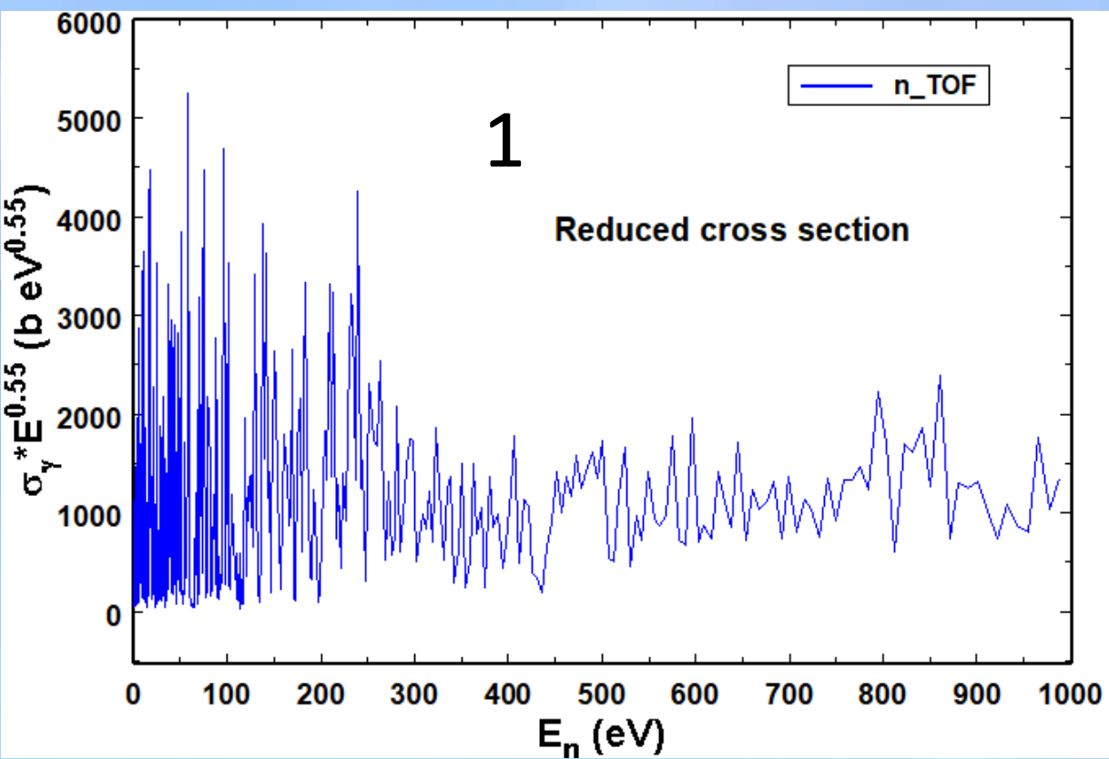
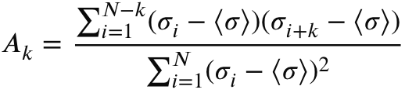
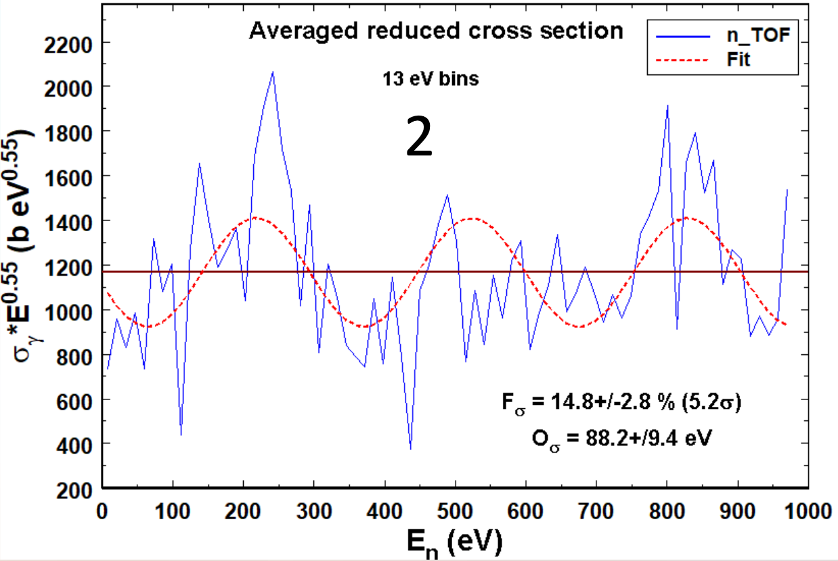
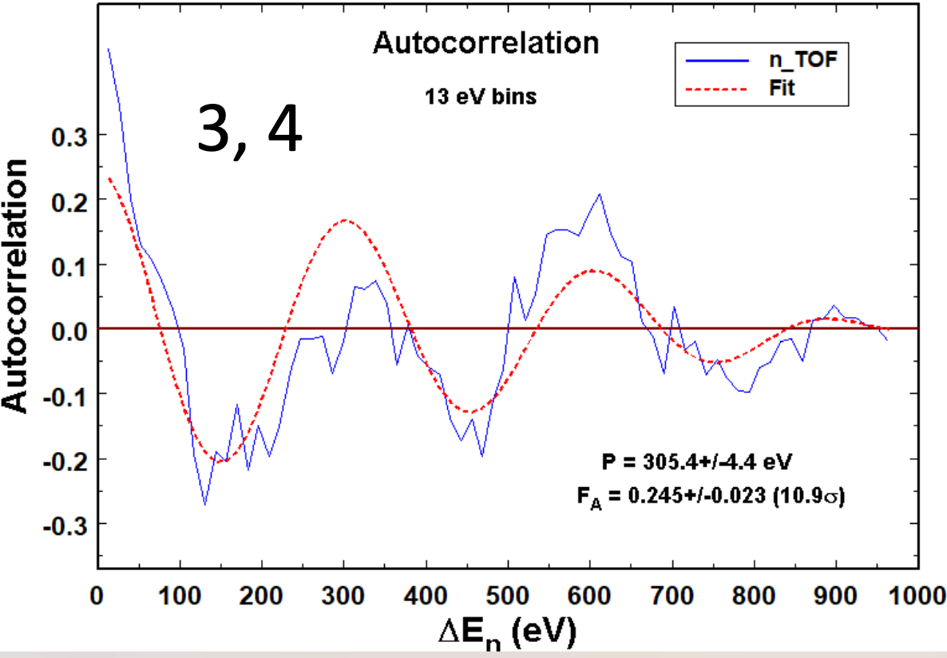
Chasing significance
Remove long-range correlation by multiplying by E^{x}
Average over 10x𝐷₀ bins to equalize resolution
Calculate autocorrelation (𝐴) : Think of it as a Fourier transformation when there aren’t enough periods in the “signal”
𝑁: total bins, 𝜎_{𝑖} : cross section in bin 𝑖, 𝑘 is the lag (1 to 𝑁 − 1), <𝜎>: average cross section over the entire range, Δ𝐸 = 𝑘 x 10𝐷₀
Fit to 𝐴 for cosine to determine statistical significance of oscillations and extract period
𝐴_{𝑓𝑖t} (𝐹_{𝐴}, 𝑃) = 𝐹_{𝐴} cos(2𝜋Δ𝐸/𝑃) ( 1 − Δ𝐸/𝐸_{𝑚})
𝐹_{𝐴} is a normalization factor, 𝑃 is the period, Δ𝐸 is the lag energy, and 𝐸_{𝑚} the maximum lag energy

Slide 14
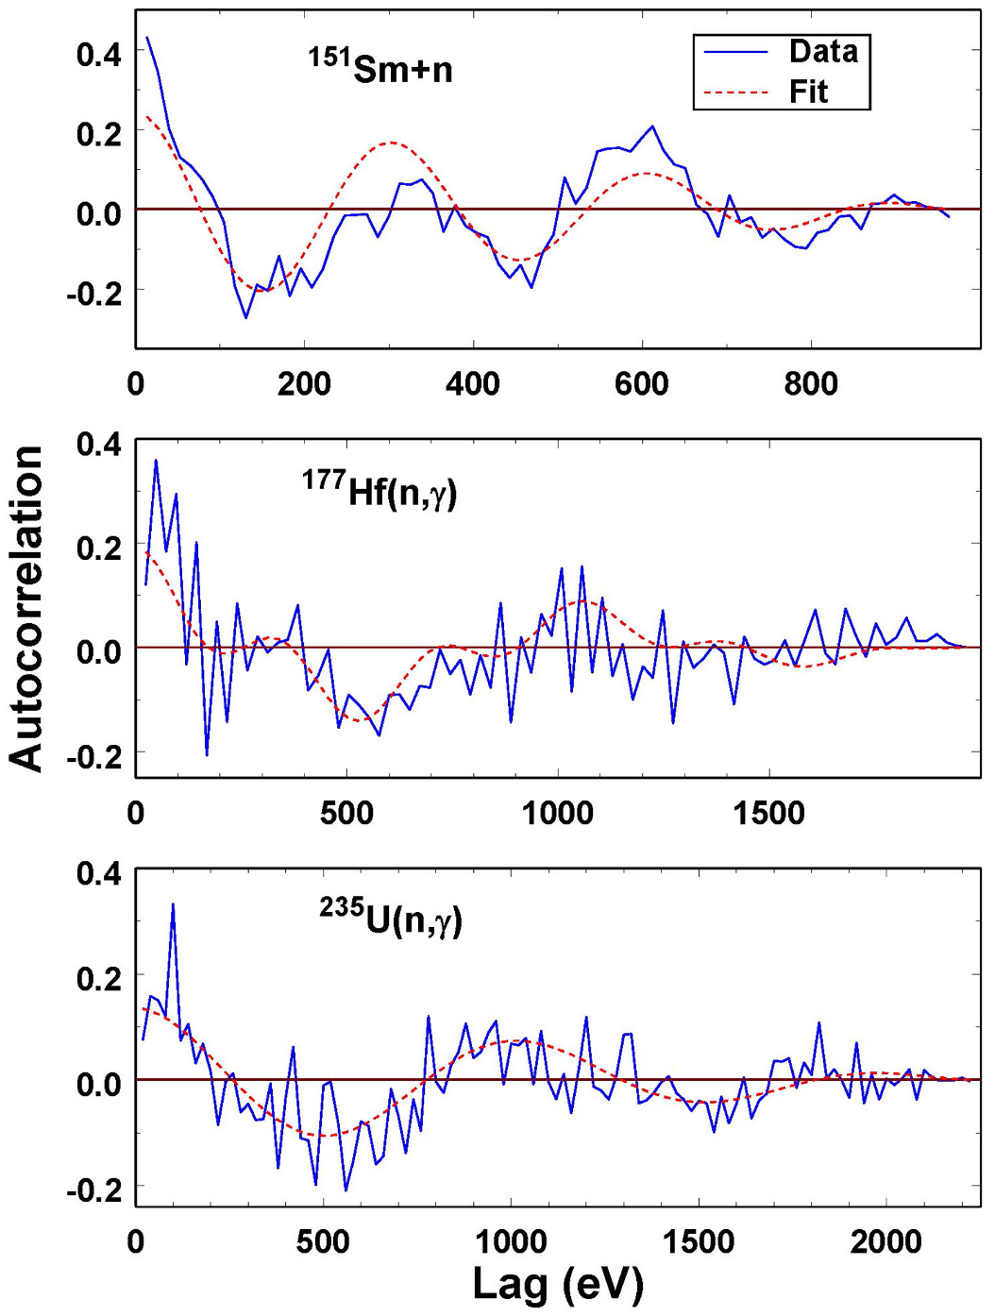
Results
Performed the analysis in many cross sections (either evaluations or literature data)
Restricted to 𝐷₀ < 8 eV to discern periods as short as ~100 eV (30 cases)
9 cases not analyzed because energy range of data was too short (21 left)
Three cases, (^{147,149}Sm and ¹⁷⁷Hf), required 2 periods to obtain accurate fits
Highly significant deviations from RMT are widespread
  𝐹_{𝐴} > 3.2𝜎 (99.9% sig. level) in 18 cases
  𝐹_{𝐴} > 5𝜎 in 9 cases
Periods range from 68.2 to 2380 eV

Slide 15
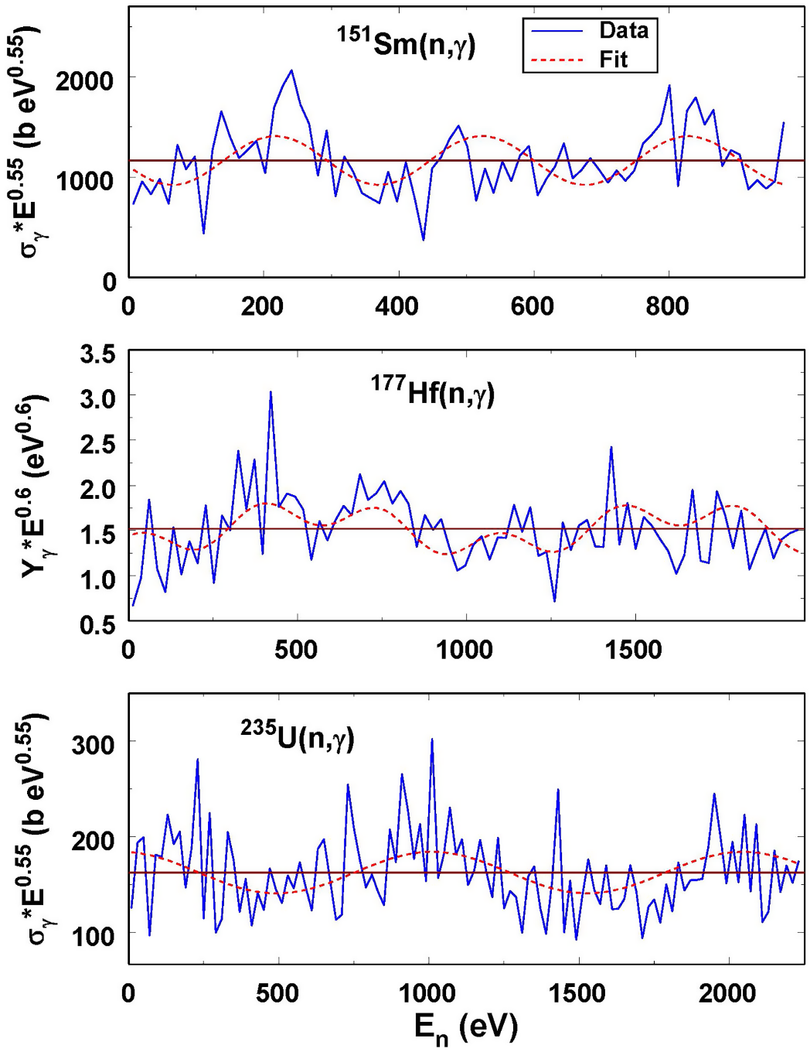
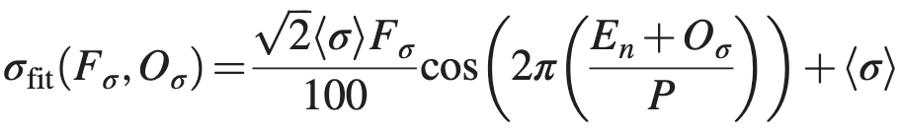
And then what?
𝐹_{𝐴} is difficult to relate to a physically meaningful quantity.
Can we find the fraction of the cross section due the oscillation i.e. how much the reduce cross section oscillates around an average value
𝐹_{𝜎} is the rms percentage of the average reduced cross section due to oscillations,
𝐸_{𝑛} the neutron energy
𝑂_{𝜎} the cosine offset or phase,
𝑃 the period determined by fitting 𝐴 in the previous step

Slide 16
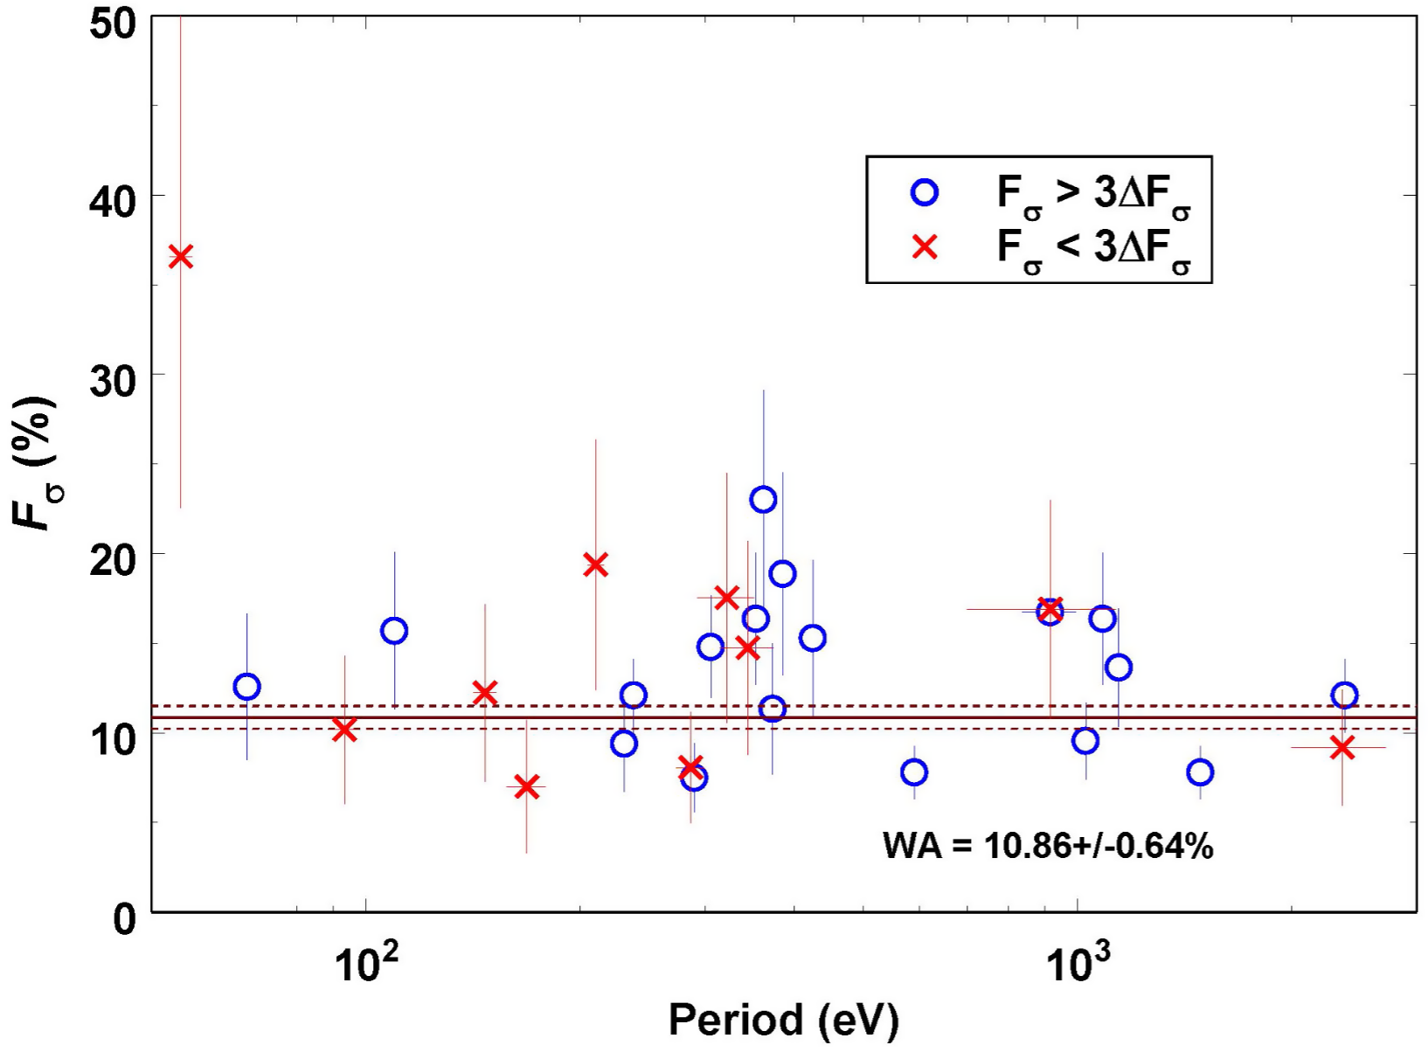
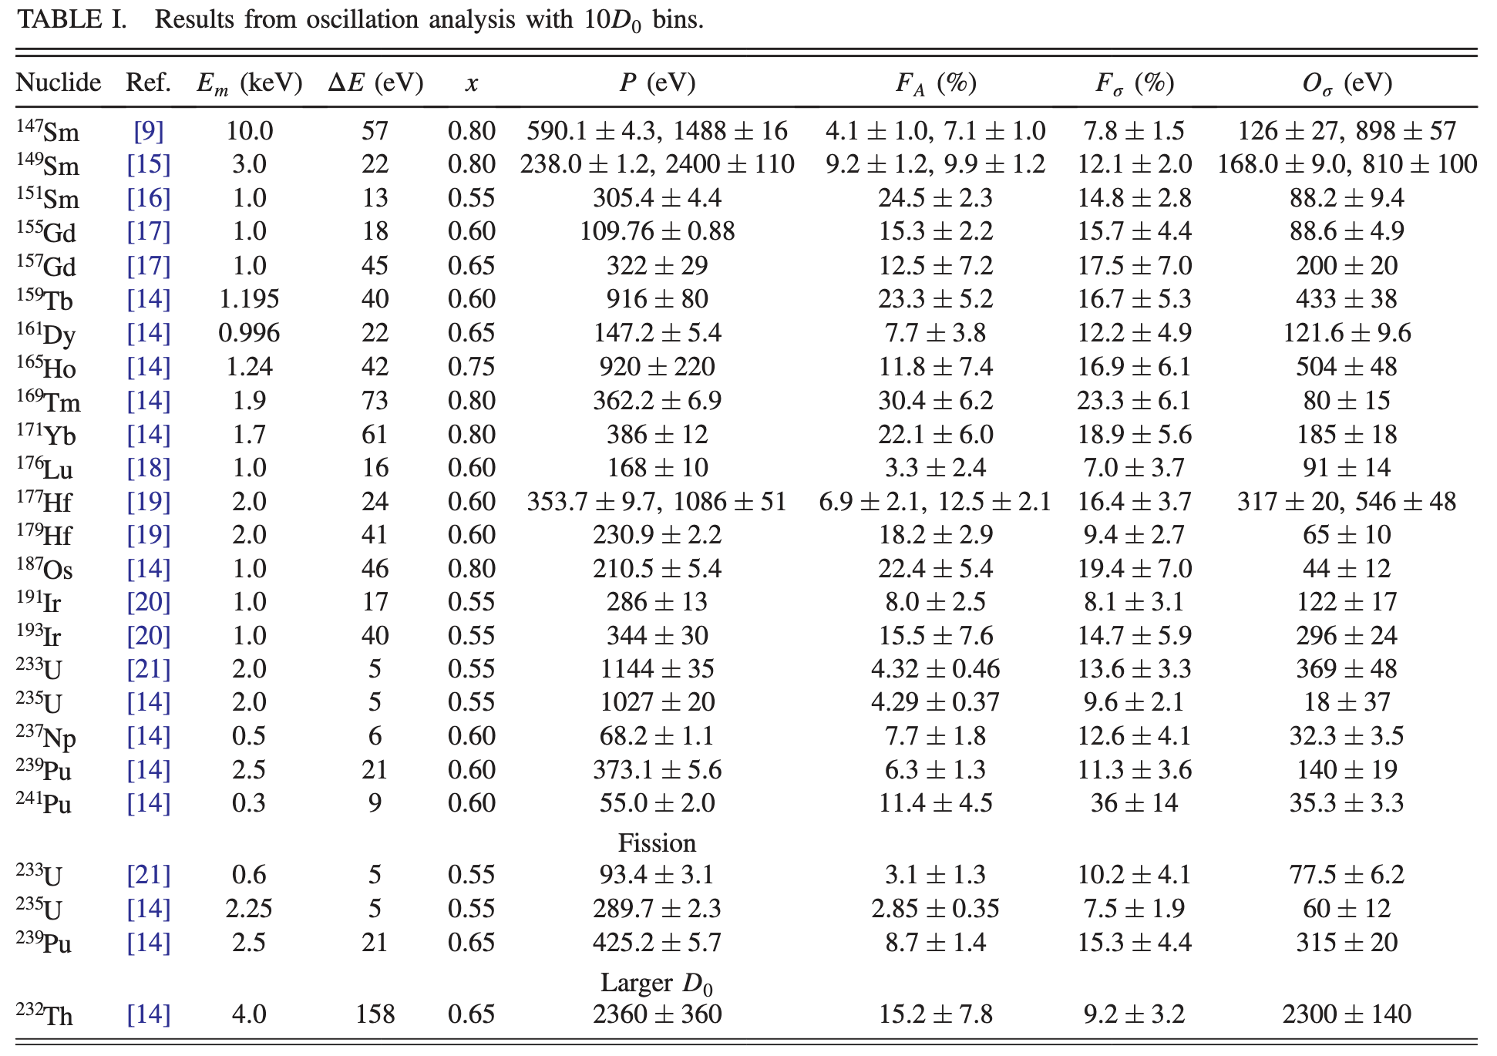
And then what?
𝐹_{σ} is practically the % of the oscillation around the average value
It seems that this is a “constant” fraction and period independent
Spoiler alert: There seems to be a correlation between fissile/non-fissile nuclei and perhaps deformation has something to do.
Currently there is no explanation as to why it happens. As of recently we are exploring a multi-well potential for n-induced reactions (fission background helps)

Slide 17
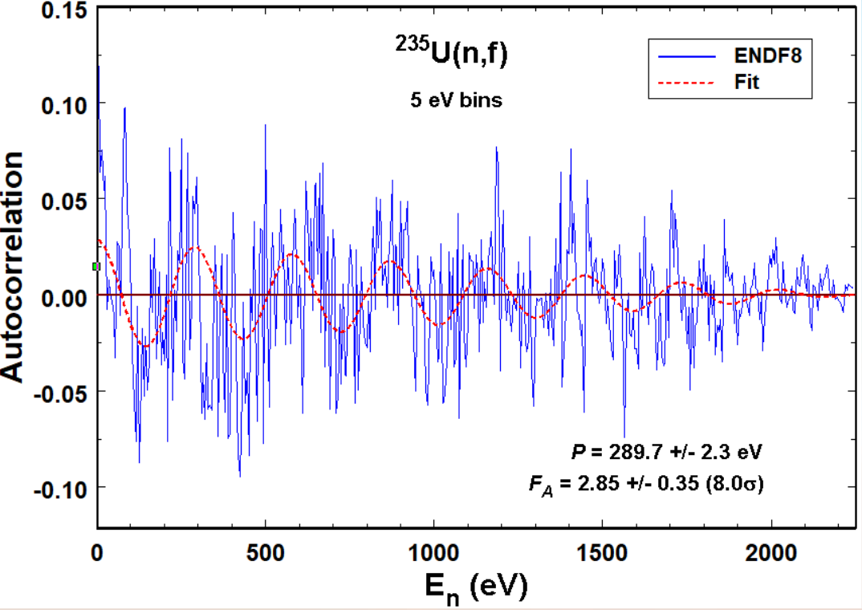
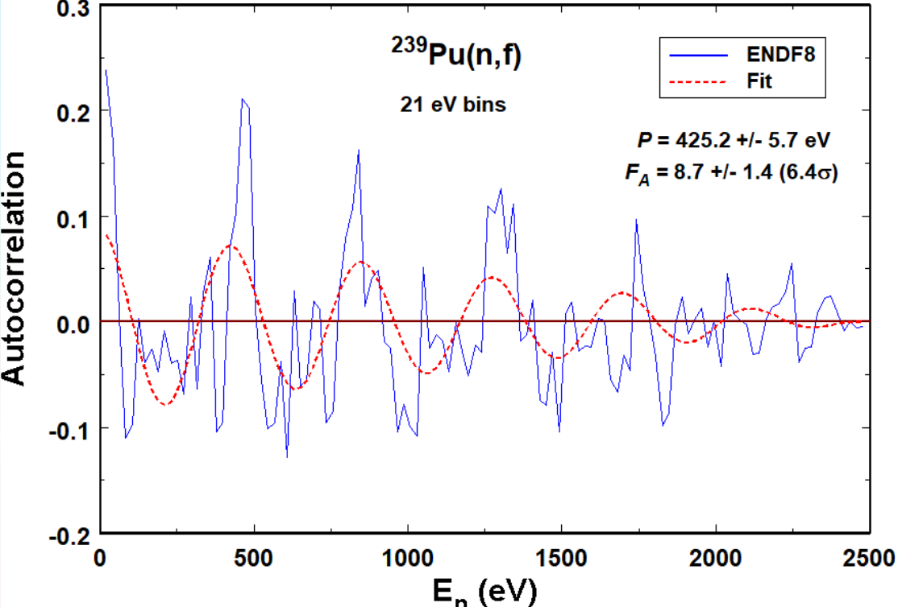
What about fission?
Oscillations highly significant for 235U (8.0σ) and 239Pu (6.4σ) fission
Fission periods different from capture periods
Oscillations questionable for 234U(n,f) (2.4σ) and 232Th(n,γ) (2.0σ)

Slide 18
Are we the first to observe it?
No other known reports of oscillating neutron capture or fission cross sections
Autocorrelation function analysis of 235U(n,f), G. F. Bertsch, D. Brown, and E. D. Davis, Phys. Rev. C 98, 014611 (2018)
Energy intervals analyzed were much too small to observe oscillations with periods on the order of 100 eV as seen in the present work
Some works on (n,tot) cross section in 10s MeV range: Ramsauer effect.
Developed theory does not apply at the low energies of the present work
Theory predictions do not agree with present data
  J. M. Peterson, Phys. Rev. 125, 955 (1962)
  I. Angeli and J. Csikai, Nucl. Phys. A158, 389 (1970)

Slide 19
Does it matter?
Greatly expands the number of highly significant deviations from RMT
Oscillations are common: Of the 22 neutron-capture plus 3 neutron fission cross sections analyzed, 10 (15) exhibit oscillations at the 5σ (3σ) level or greater
Suggests that there is something missing from the theory of neutron capture and fission reactions in the resolved resonance range
Could oscillations impact criticality calculations?
235U and 239Pu(n,γ) and (n,f) cross sections have highly significant oscillations
Oscillations are an autocovariance
Is this autocovariance information preserved in cross-section processing for criticality applications?

Slide 20
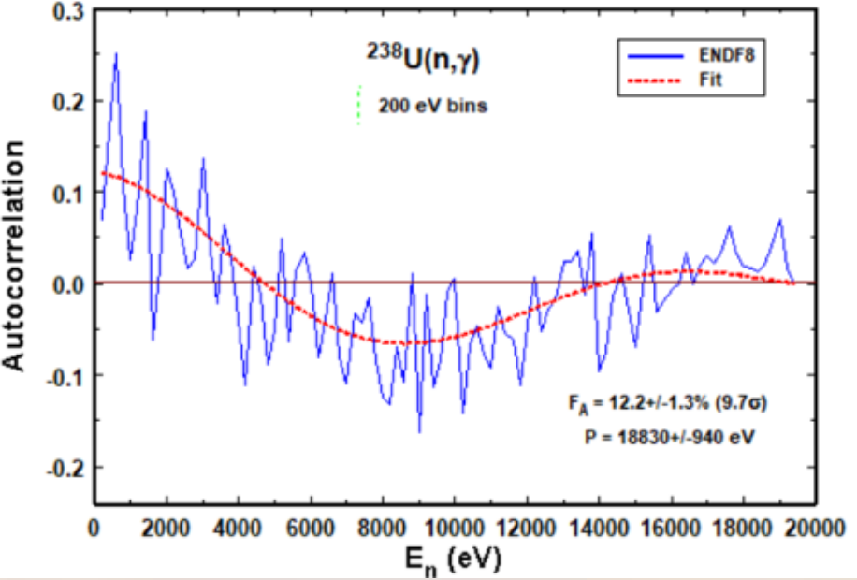
What’s next?
Need neutron-capture data for 9 nuclides with 𝐷₀ < 8 eV: ^{151,153}Eu, ¹⁶³Dy, ^{173,175}Lu, ¹⁸¹Ta, ¹⁸⁹Os, ²²⁹Th, and ²³¹Pa
Search for oscillations in neutron resonance parameters? Might shed light on what’s causing oscillations. Parameters of sufficient quality are lacking in most cases.
Apply technique to more nuclides with larger 𝐷_{0.} Larger lower limit on period that can be detected.

Slide 21
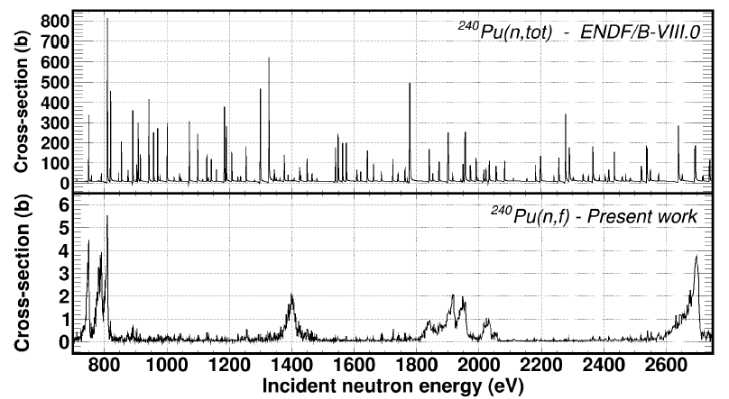
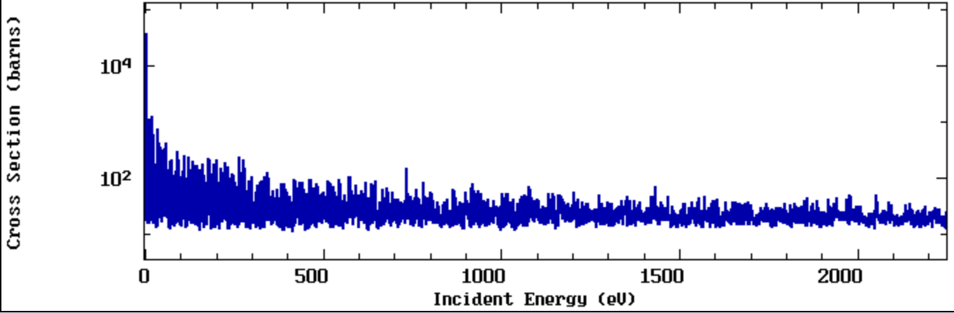
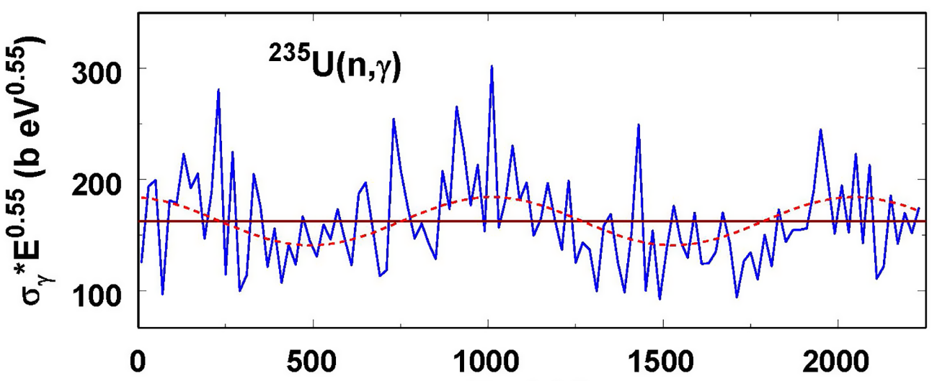
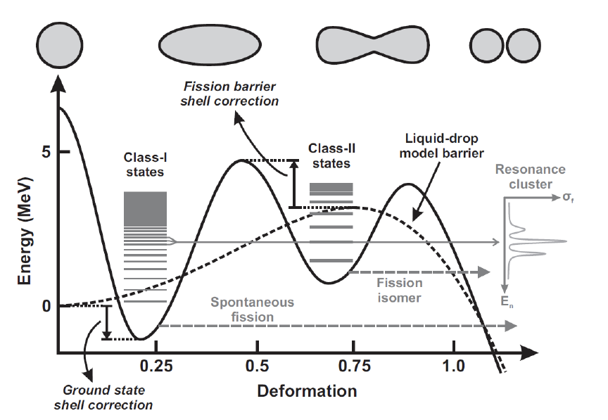
What’s next?
Is there any physics related to it ?
Reminds me of coupling between Class-I and Class-II states in fission
235U(n,tot)
Coupling
?

Slide 22
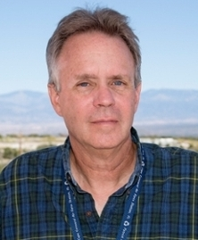

The team
Paul Koehler
Thanos Stamatopoulos

Slide 23

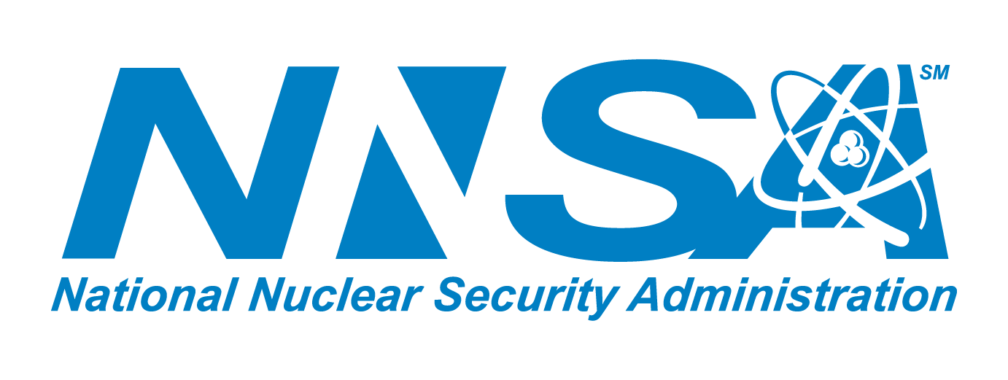
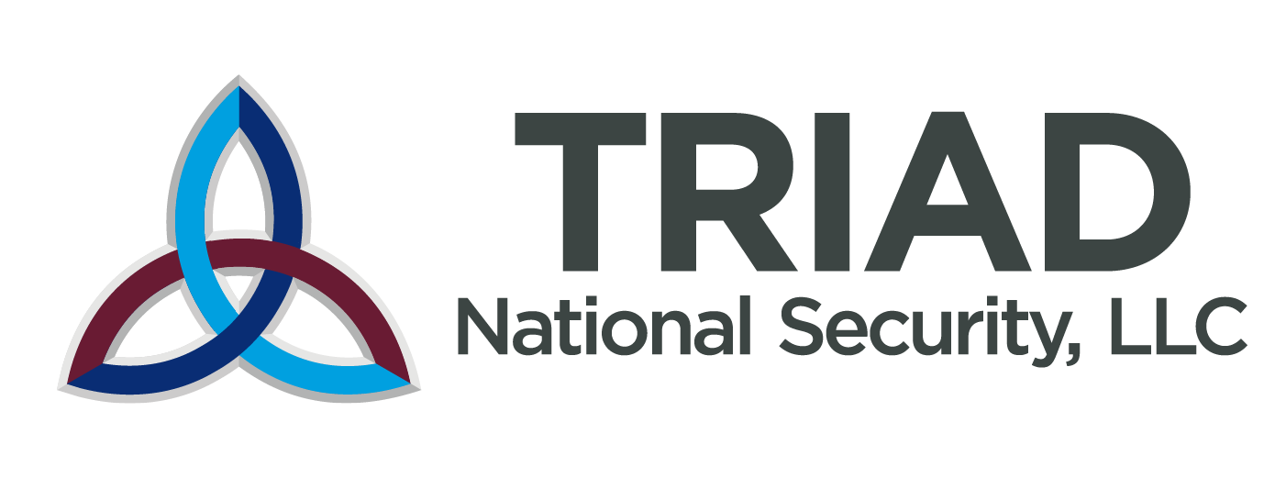


Acknowledgements
This work was supported by the U.S. Department of Energy through the Los Alamos National Laboratory. Los Alamos National Laboratory is operated by Triad National Security, LLC, for the National Nuclear Security Administration of U.S. Department of Energy (Contract No. 89233218CNA000001). This work was performed at the Los Alamos Neutron Science Center (LANSCE), an NNSA User Facility operated for the U.S. Department of Energy (DOE) by Los Alamos National Laboratory (Contract No. 89233218CNA000001).
This work was supported by the Nuclear Criticality Safety Program, funded and managed by the National Nuclear Security Administration for the Department of Energy.
The isotopes used in this research was supplied by the U.S. Department of Energy Isotope Program, managed by the Office of Isotope R&D and Production.

Slide 24
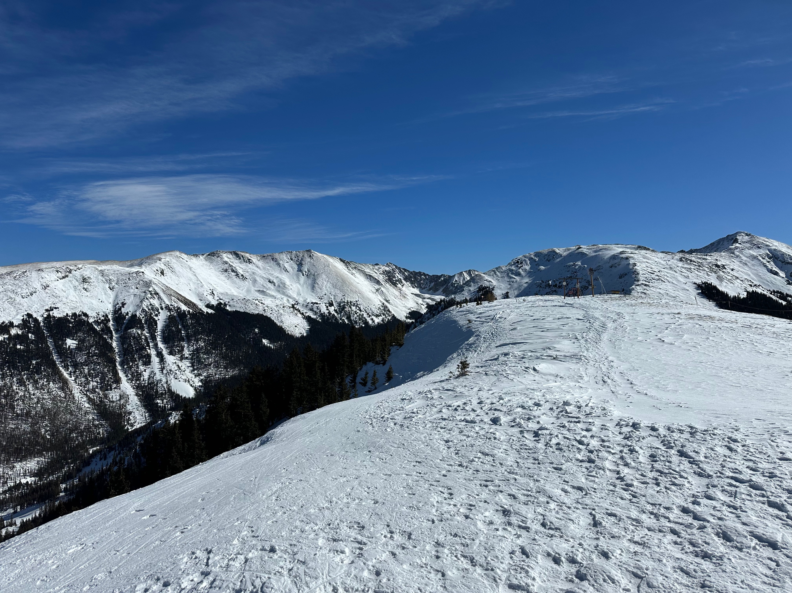
Thank you for your attention!

Slide 25
⁹Back-up slides

Slide 26
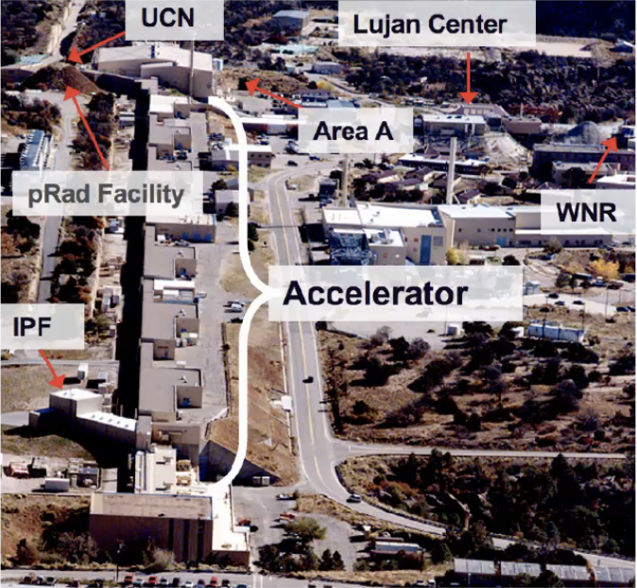
The Los Alamos Neutron Science Center

Slide 27
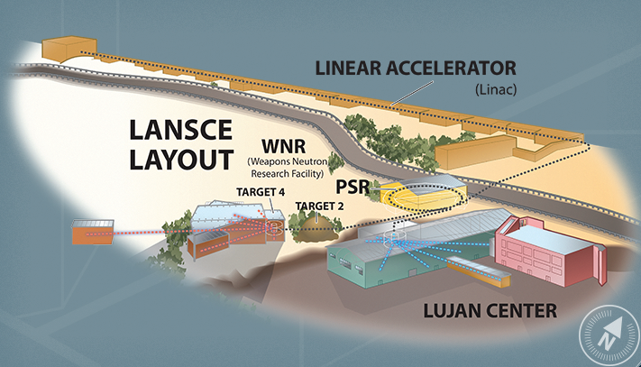
The Los Alamos Neutron Science Center - LANSCE
500-800 MeV protons
keV – MeV neutrons
meV – keV neutrons

Slide 28
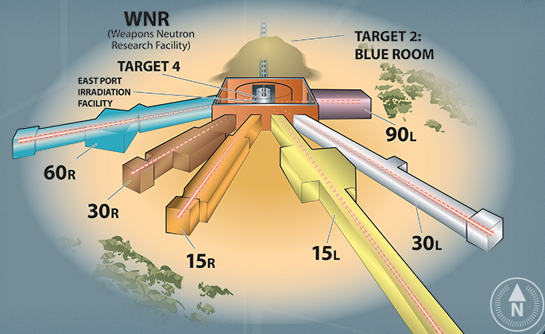
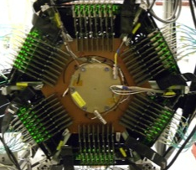
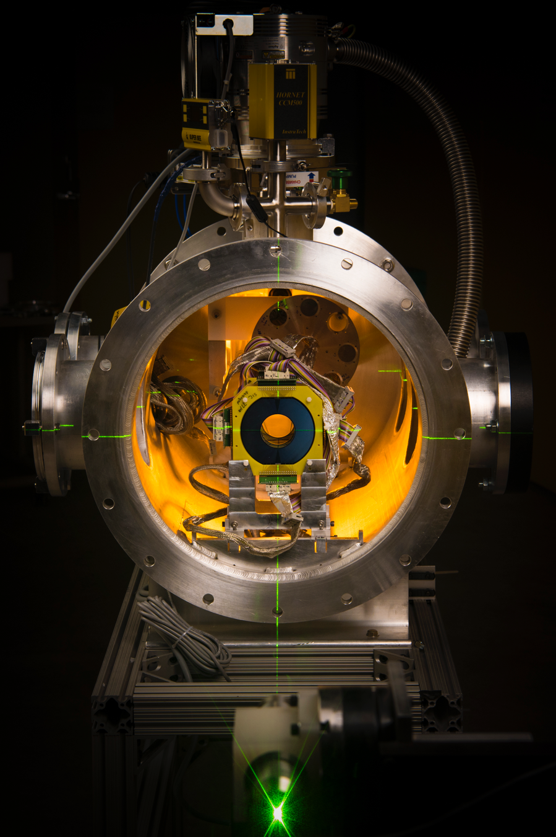
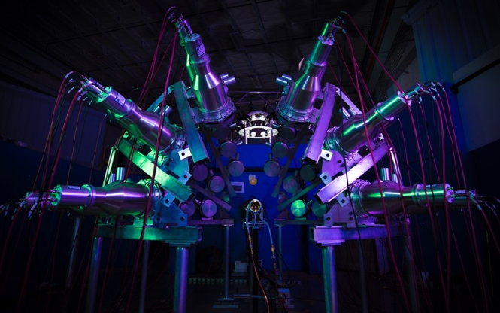
The Los Alamos Neutron Science Center – LANSCE
WNR – High energy neutrons
(n,f), (n,z)
General purpose
TPC, SREFT and LENZ
PFNS
Scattering
Irradiation of Chips
Electronics
(n,z)
Irradiation of Chips
Electronics
Chi-nu, CoGNAC
LENZ

Slide 29
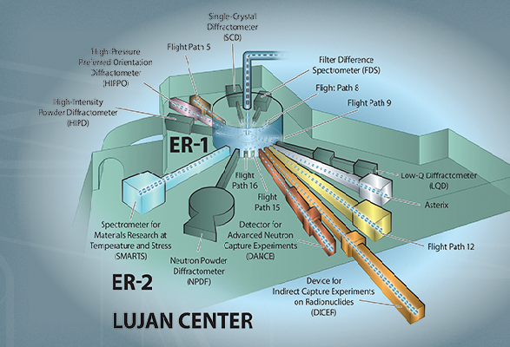
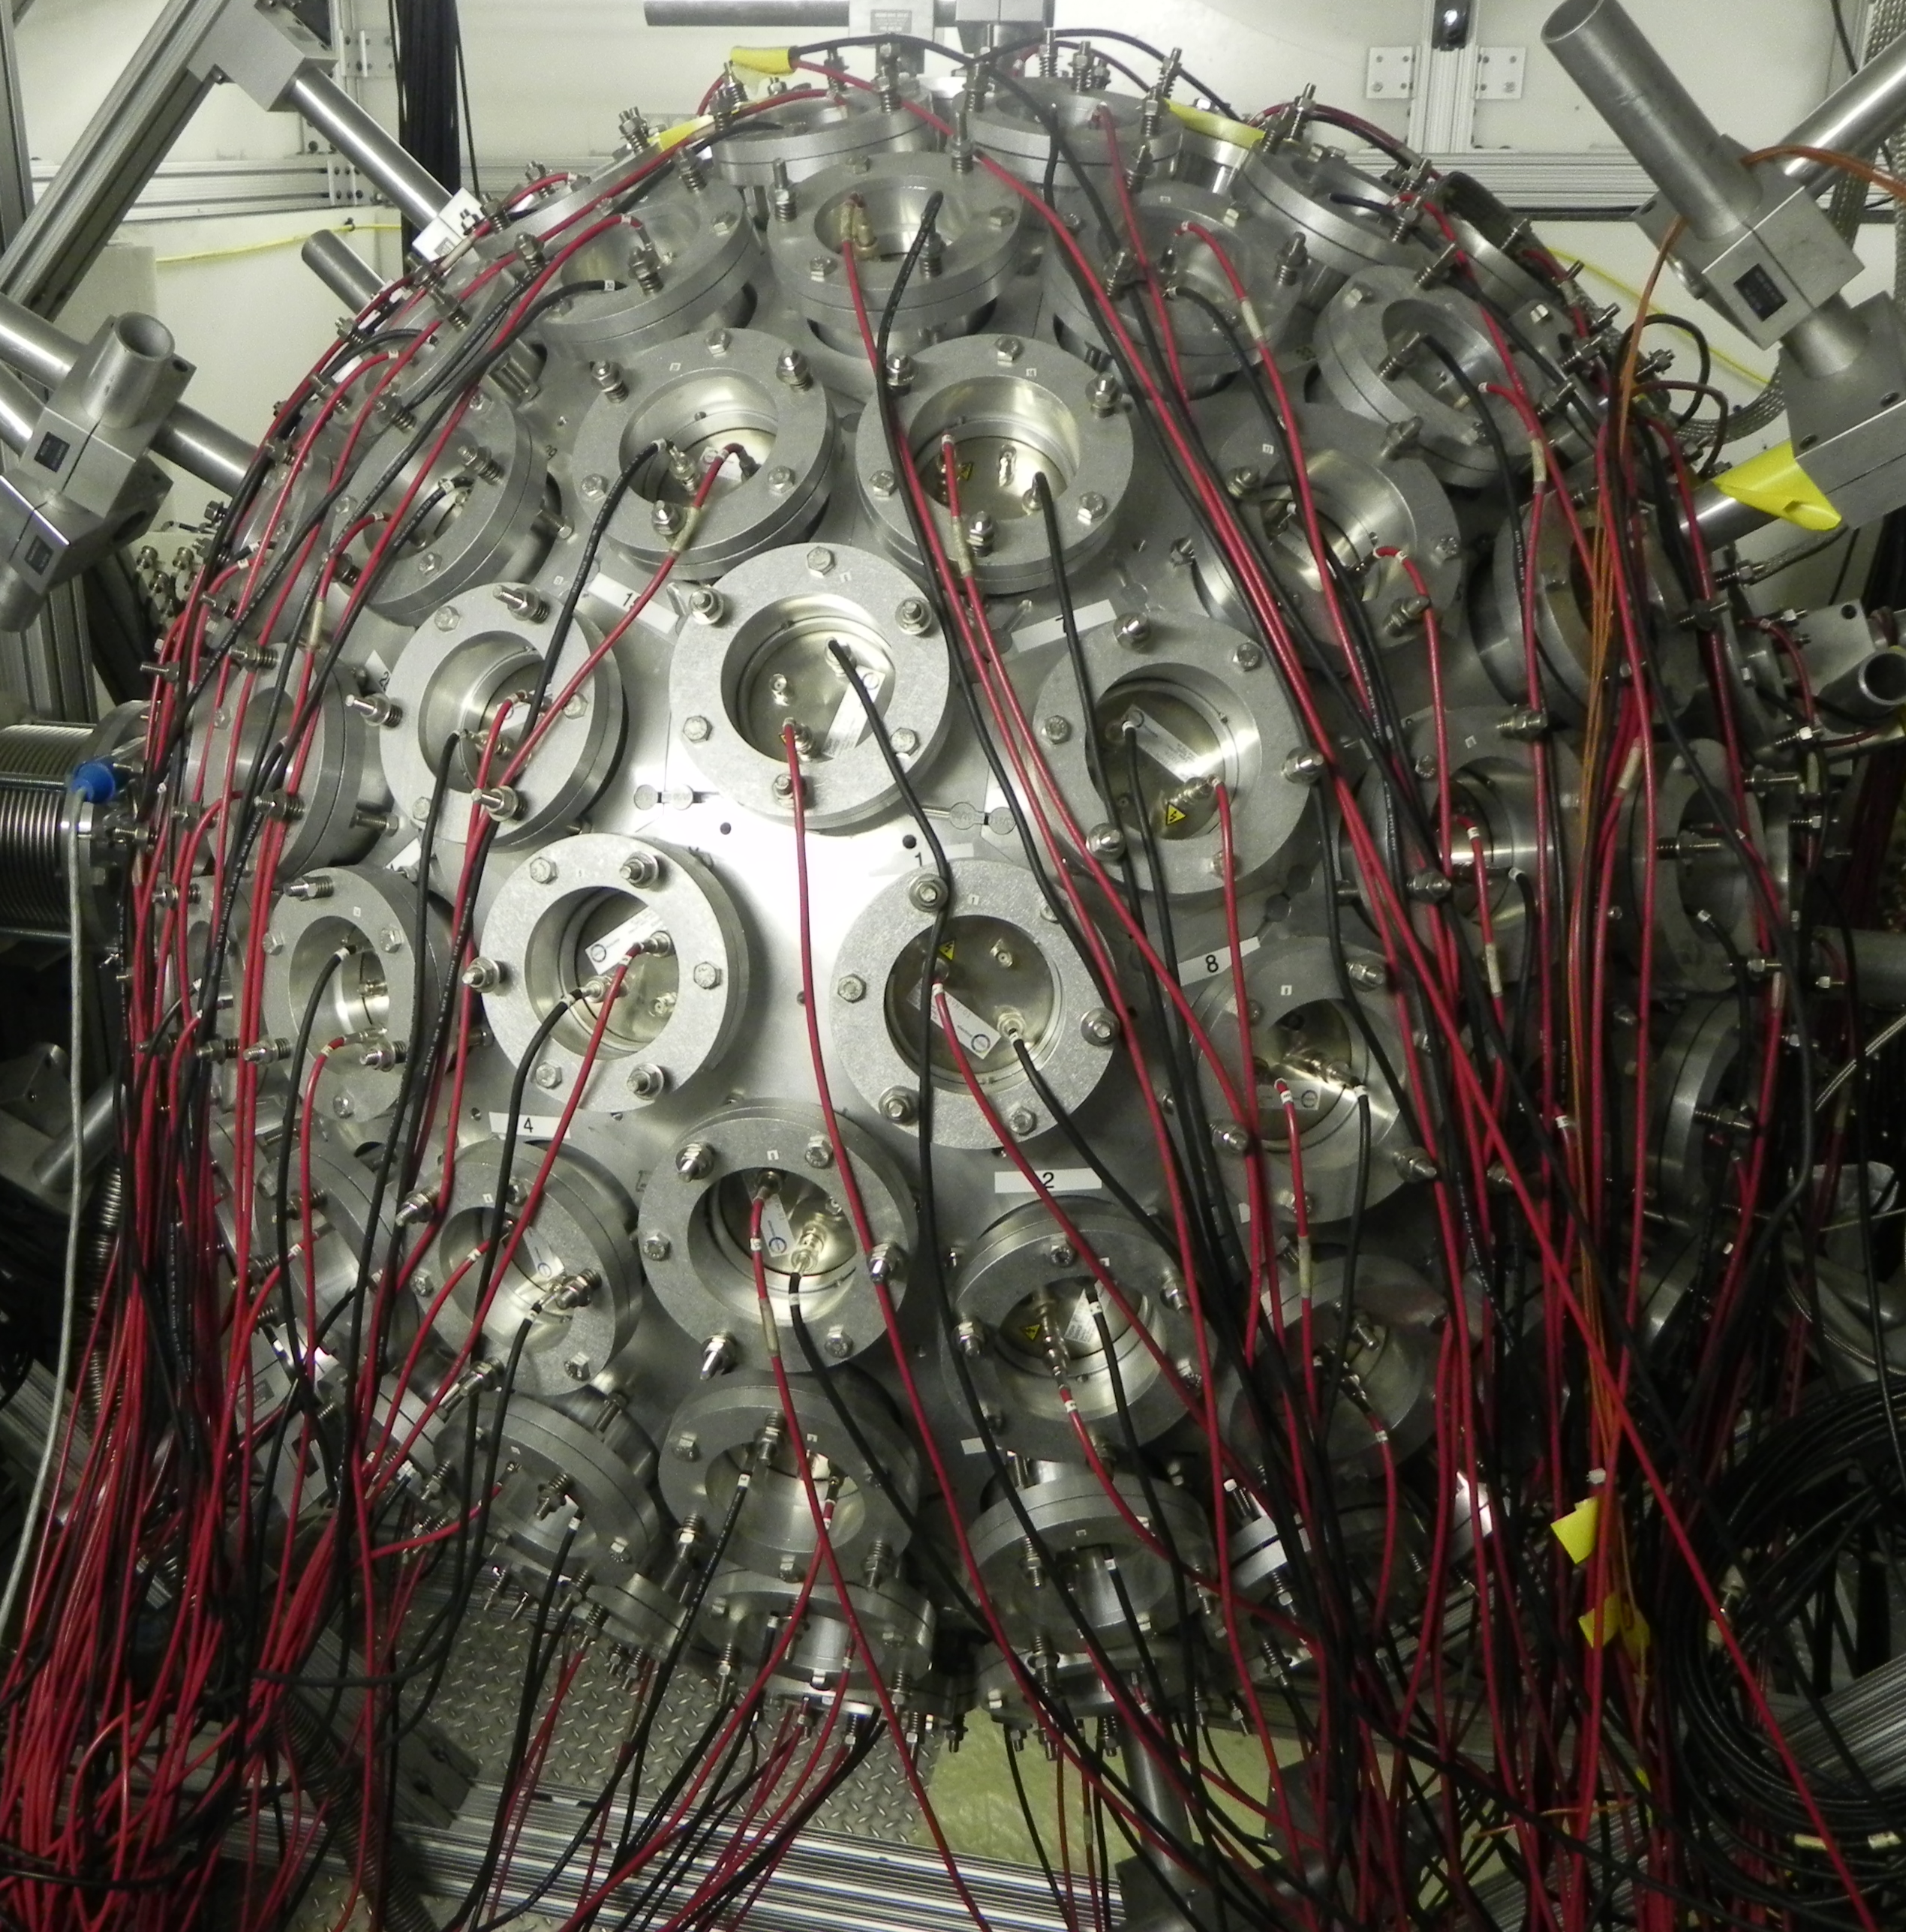

The Los Alamos Neutron Science Center – LANSCE
Lujan Center – Low energy neutrons
Lujan Center

Slide 30

Description of the apparatus: Lujan@LANSCE@LANL
The Los Alamos Neutron Science Center (LANSCE) is LANL’s accelerator complex
DICER belongs to the Lujan Center instruments which serve material and nuclear science studies.
Neutrons are spallation products
800MeV protons impinge on a split W target at a 20 Hz duty cycle.
DICER points to the liquid hydrogen moderator
DICER flux spans from 0.2 meV – 100 keV
Total: ~6x10⁷ n/s/cm²
Mark-III

Slide 31

Description of the apparatus: Neutron spectrum
Mark-IV provides an enhanced keV spectrum compared to Mark-III
Mark-IV is expected to improve the neutron energy resolution
Preliminary

Slide 32


n+¹⁴⁹Sm : Capture and transmission – Nuclear Criticality Safety Program
Neutron poison that doesn’t decay away
Detector for Advanced Neutron Capture Experiments (DANCE)
~4π calorimeter
DANCE to get the capture yields
DANCE also provides multiplicities
Different multiplicity distributions
for different spins
DANCE is used as a spinometer

Slide 33


R-Matrix analysis : Resonance parameters
Fits in capture and transmission data using SAMMY
About 40 spins were incorrectly assigned
Resolved 58 new resonances (215 vs 157 in evaluations)
Resolved doublet @ 15 eV
Evaluated Γ_{n} is too large

