Slide 1
Probing Explosive Stellar Nucleosynthesis through (α,n) and (p,n) Reactions Using SECAR
Pelagia Tsintari
Postdoctoral Research Associate
34th Annual Symposium of the Hellenic Nuclear Physics Society

Slide 2
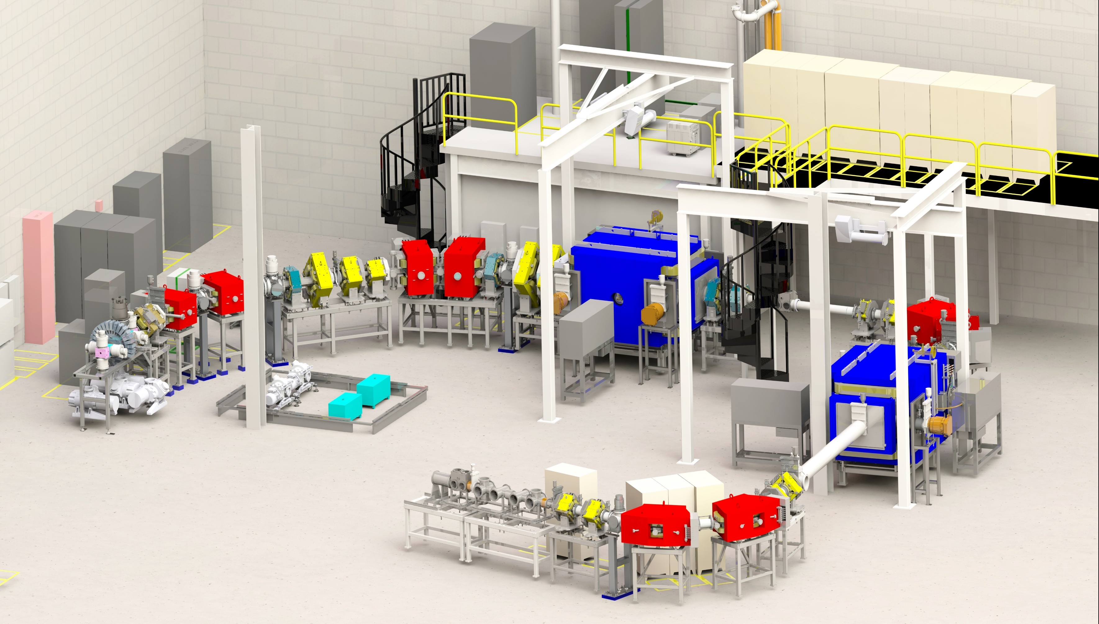
SECAR (SEparator for CApture Reactions)
Completed commissioning in 2021
Primarily designed for the study of (p,γ) and (α,γ) reactions in inverse kinematics and for masses up to A=65
Charge State selection
Recoil Separation
Target Chamber
B3
B4
Q6
Q7
WF1
H1
Q3
Q4
Q5
H2
B1
B2
H3
O1
Q2
Q8
Q9
B5
B6
Q1
ReA3 can deliver at SECAR radioactive and stable isotope beams at energies of
300 keV/u – 6 MeV/u
WF2
Q10
Q11
Beam
Q12
Q15
Q13
Q14
B8
B7
Recoil Detection
Final Cleanup

Slide 3
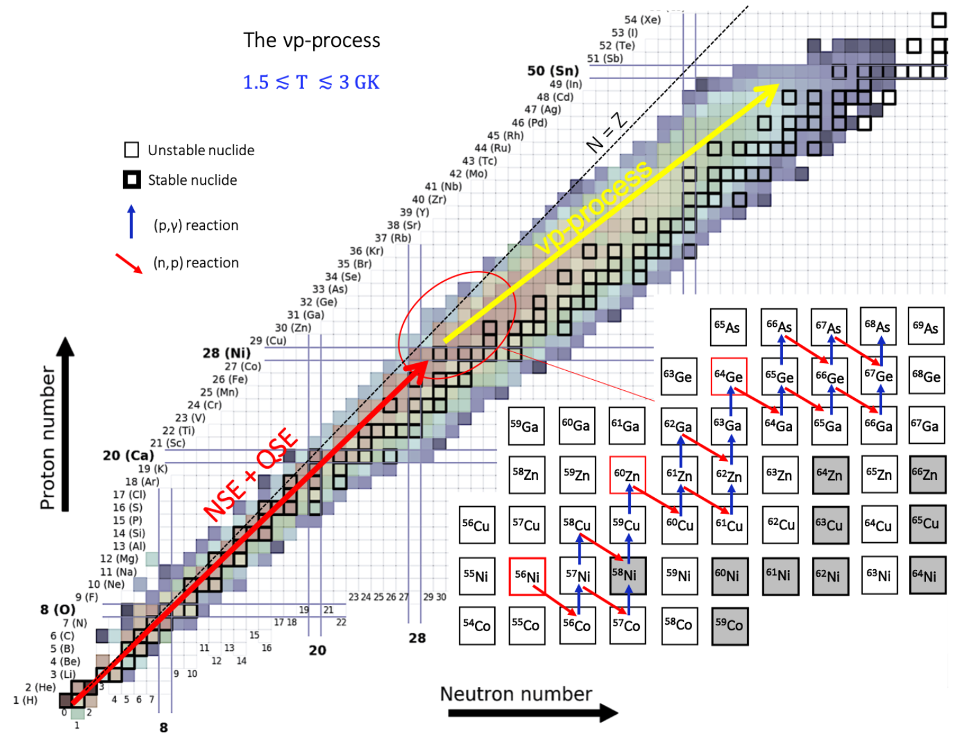
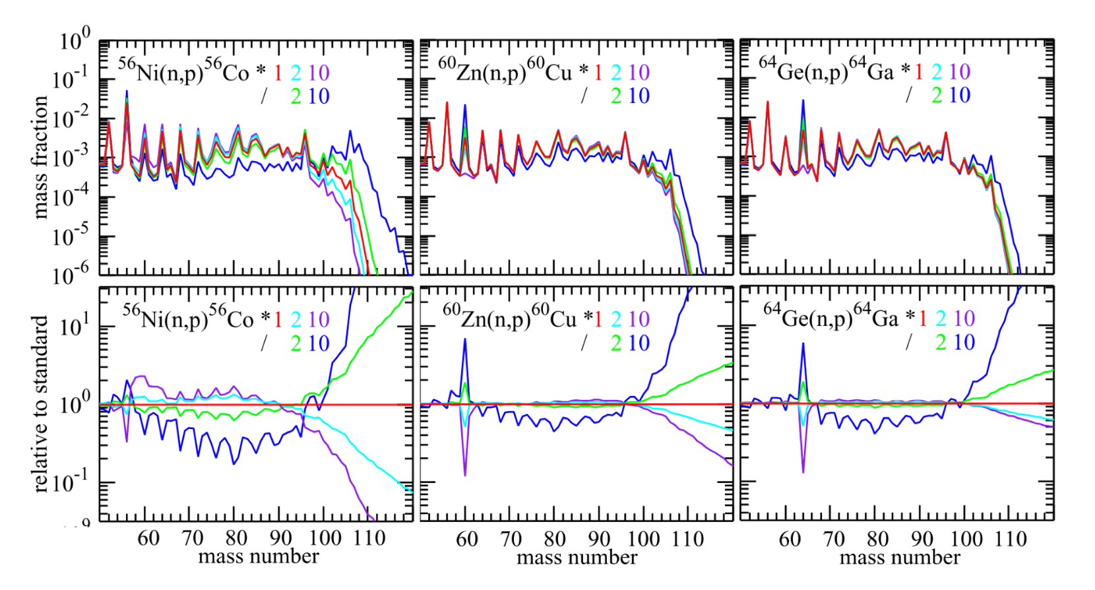
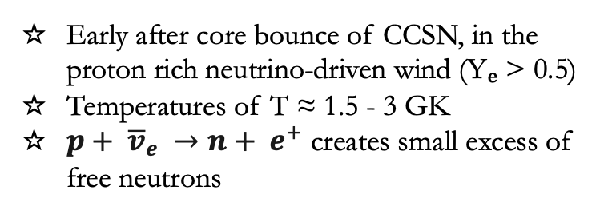
vp – process Nucleosynthesis
P. Gastis CMU Dissertation (2020)
Early after core bounce of CCSN, in the proton rich neutrino-driven wind (Yₑ > 0.5)
Temperatures of T ≈ 1.5 - 3 GK
$p+ {\overline{v}}_{e} →n+ e^{+}$ creates small excess of free neutrons
S. Wanajo et al., The Astr. Journ. 729(1):46 (2011)
Measurements of reverse (p,n) reactions with available radioactive beams can constrain the (n,p) bottlenecks

Slide 4
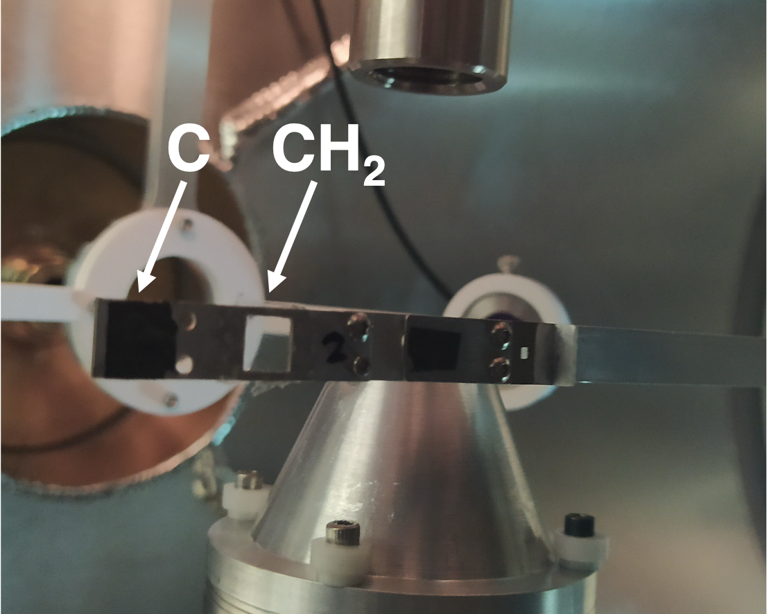
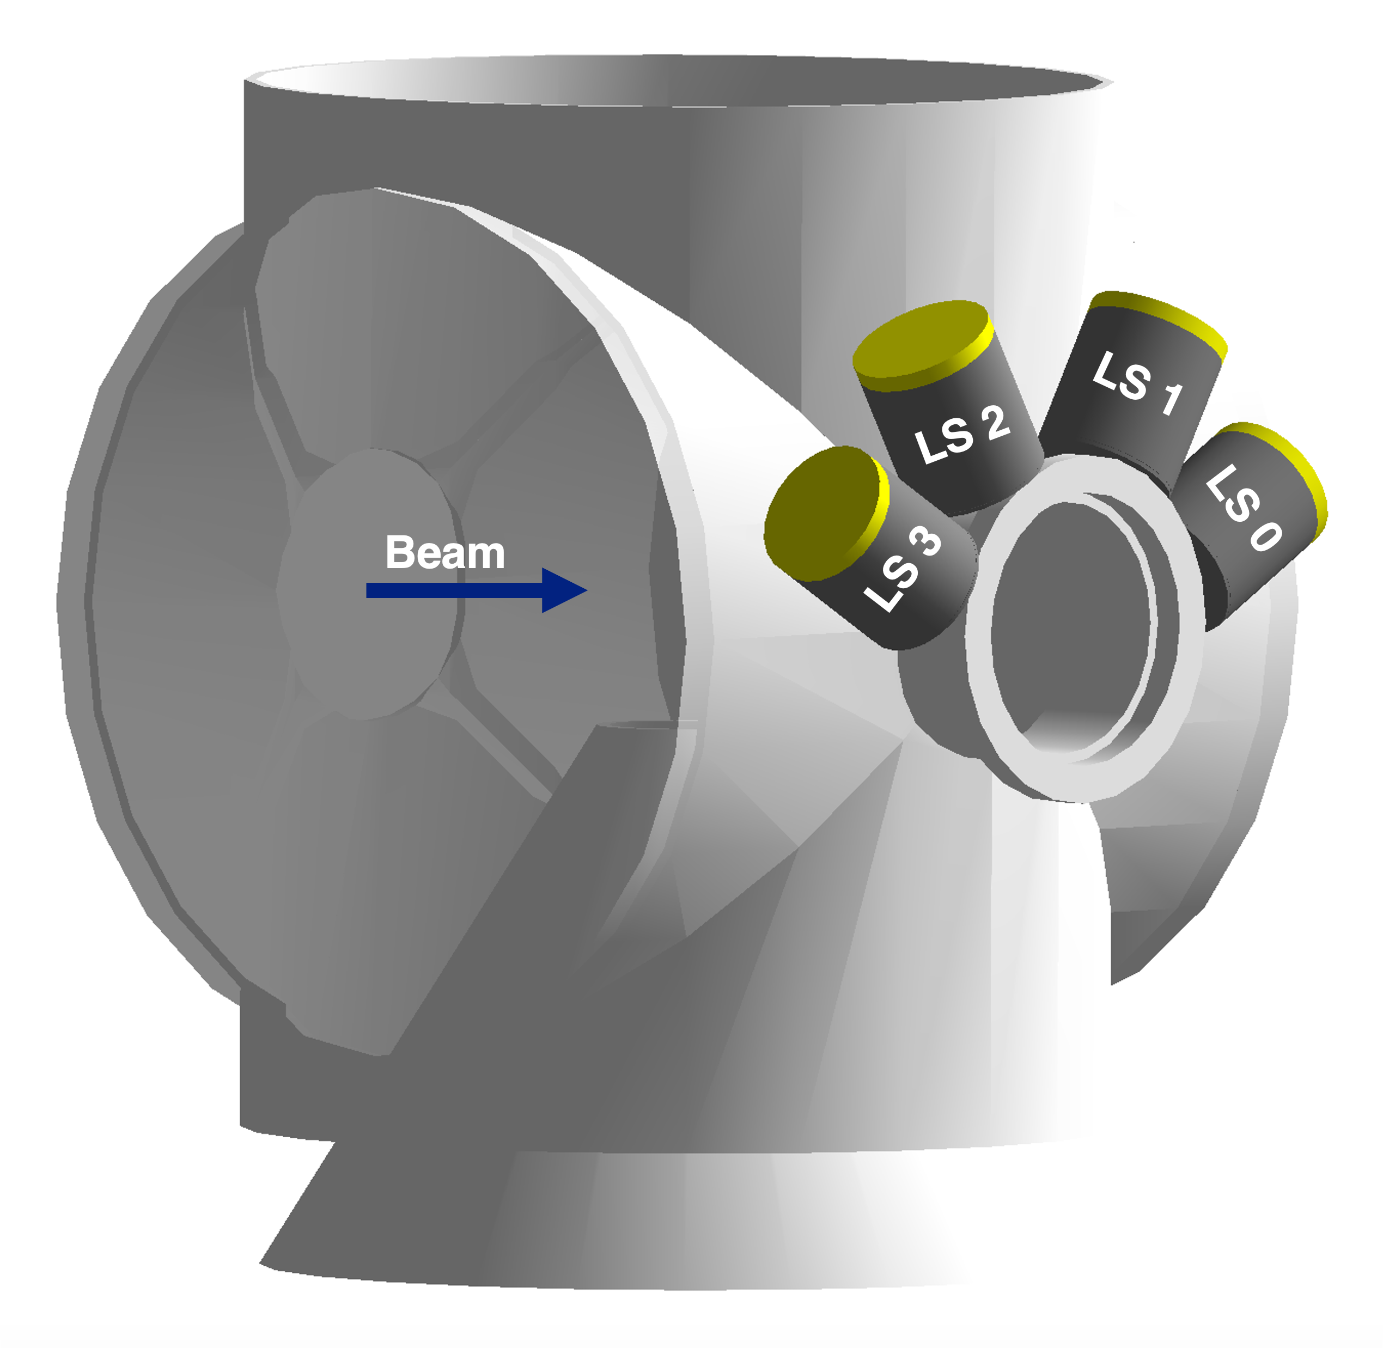
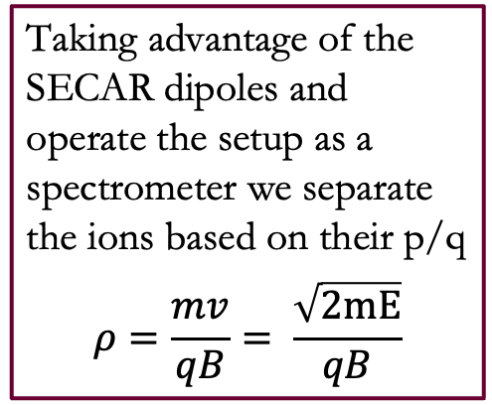
⁵⁸Fe(p,n) Reaction Measurement with SECAR
3.5 MeV/u
n
3.3 – 3.5 MeV/u
⁵⁸Fe
p
⁵⁸Fe
⁵⁸Co
3.79 MeV/u
Charge State selection
Recoil Separation
Target Chamber
Taking advantage of the SECAR dipoles and operate the setup as a spectrometer we separate the ions based on their p/q
$$ρ=\frac{mv}{qB}= \frac{\sqrt{2mE}}{qB}$$
B3
B4
Q6
Q7
WF1
H1
Q3
Q4
Q5
H2
B1
B2
H3
O1
Q2
Q8
Q9
B5
B6
Q1
WF2
Q10
Q11
Beam
Neutron Detection
Q12
Q15
Q13
Q14
B8
B7
4 Liquid Scintillators
EJ301
Recoil Detection
Final Cleanup

Slide 5
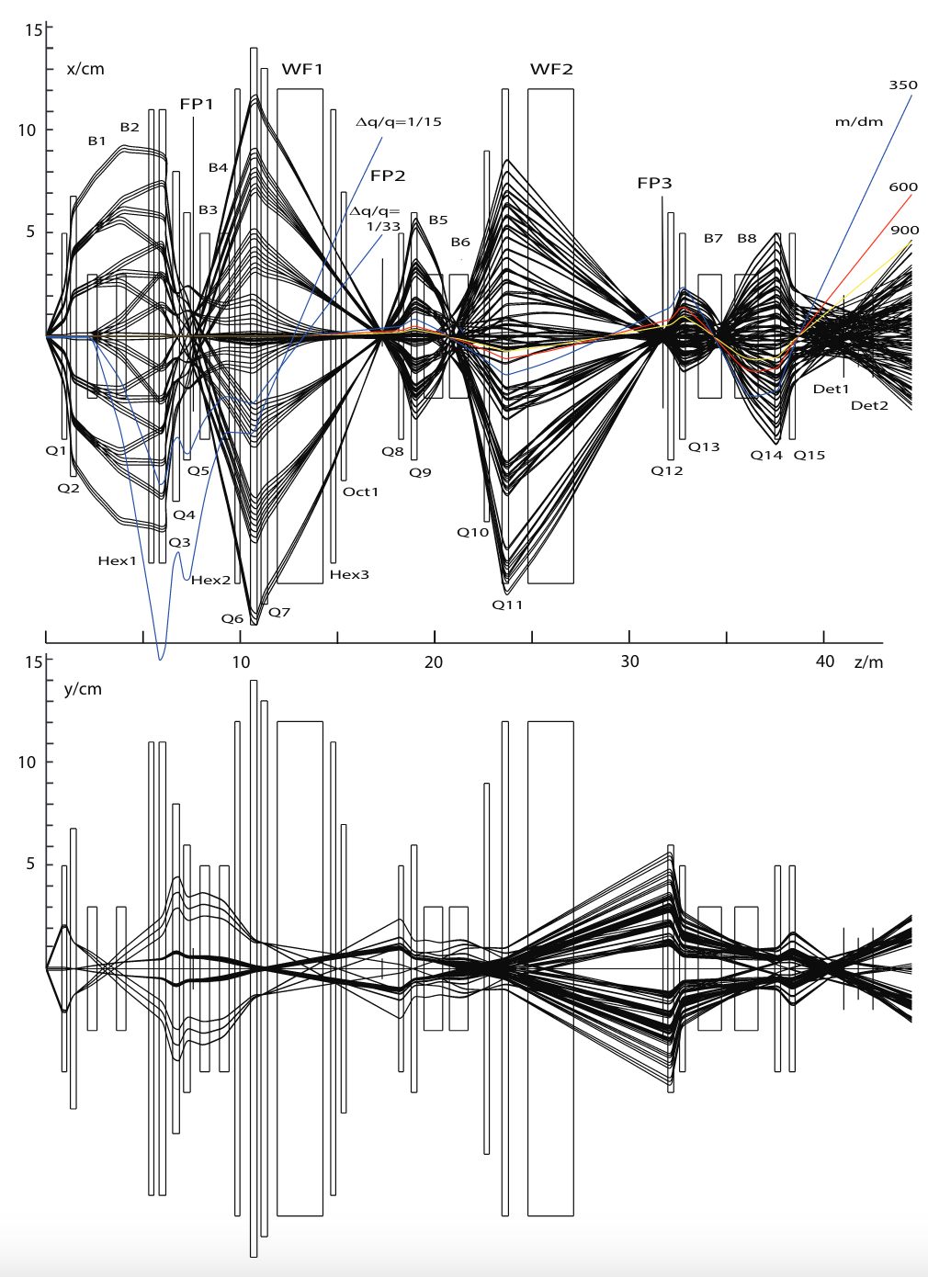
Beam Optics Development with Machine Learning
Beam Direction
Standard optics
Large angular and energy acceptance
Mass separation
Beam rejection from separator 10⁻¹³ - 10⁻¹⁴
Achromatic focus FP2 and zero dispersion focus FP3
FP1
FP2
FP3
FP4
G. P. A. Berg., et al., NIMA 877, 87–103 (2018)

Slide 6
Beam Optics Development with Machine Learning
Beam Direction
New optics for (p,n)
using machine learning*
Standard optics
Maximization of the physical separation of recoil and unreacted beam at the original locations of FP2 and FP3
Minimization of the beam width at each ion-optical element and at the final focal plane detectors
Large angular and energy acceptance
Mass separation
Beam rejection from separator 10⁻¹³ - 10⁻¹⁴
Achromatic focus FP2 and zero dispersion focus FP3
FP1
FP2
FP3
FP4
Slits
Slits
Slits
CH₂
⁵⁸Co
Slits
Slits
Slits
Beam rejection from separator 10⁻³
⁵⁸Fe²²⁺ beam – blue
⁵⁸Co²²⁺ recoils - red
*K. Hermansen et al. (In preparation)

Slide 7
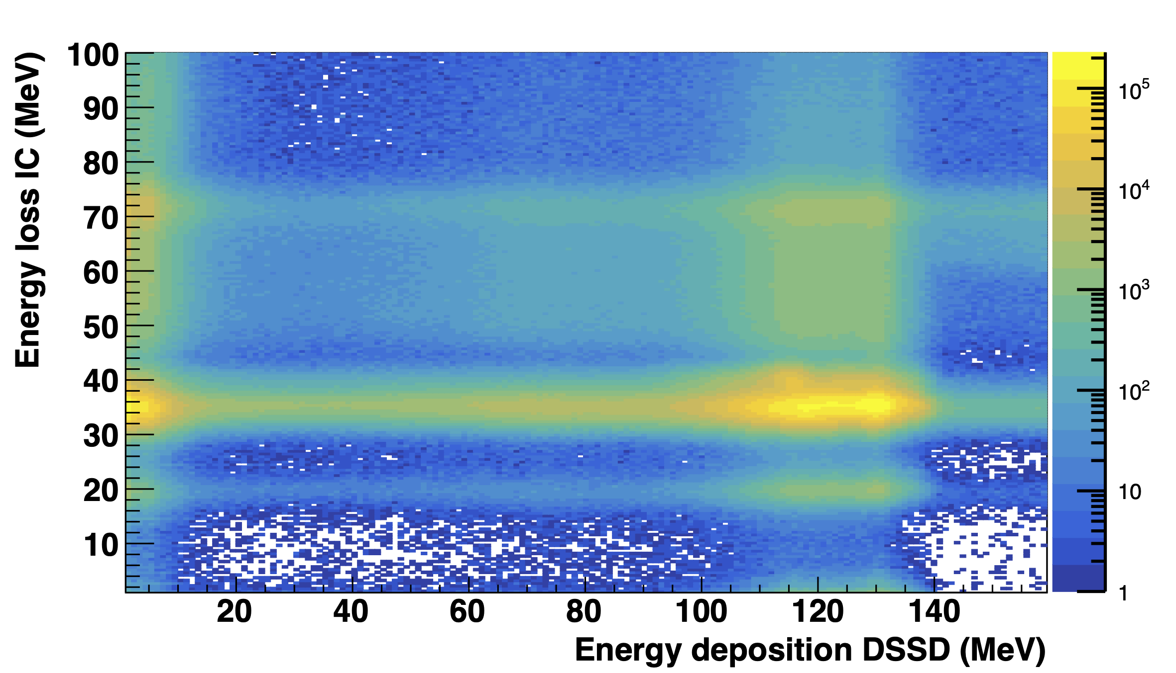
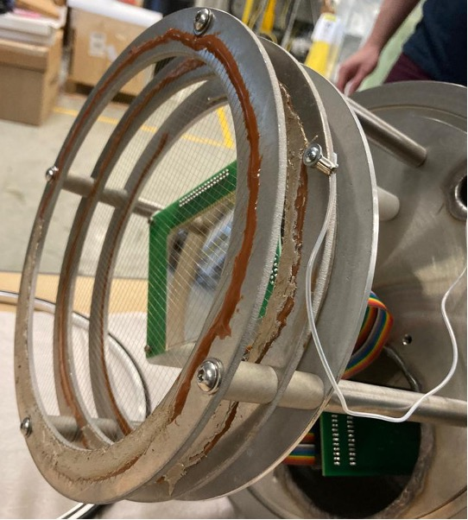
Particle Identification and Detection
⁵⁸Fe(p,n)⁵⁸Co
ΔE - E
Recoil Detection
P. Tsintari et al. PRR (2025)

Slide 8
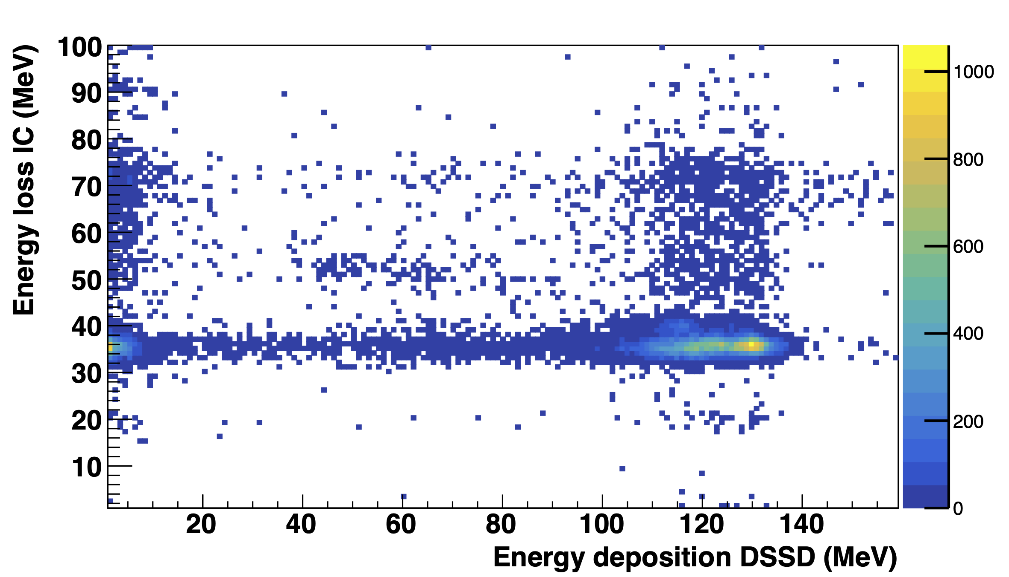
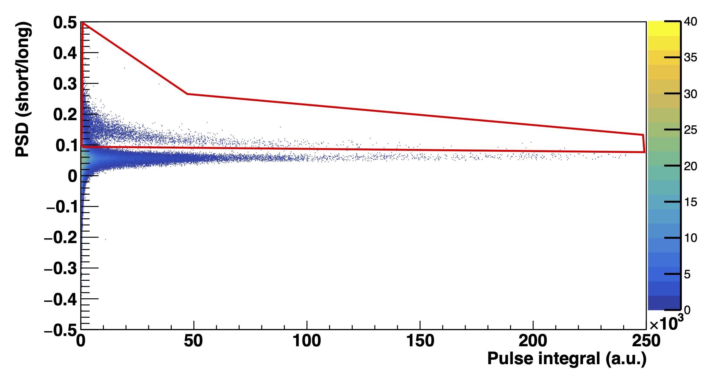
Particle Identification and Detection
⁵⁸Fe(p,n)⁵⁸Co
Gated on neutron detection
Fusion Evaporation
⁵⁸Ni
n
⁵⁸Fe
γ
P. Tsintari et al. PRR (2025)

Slide 9
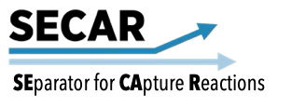
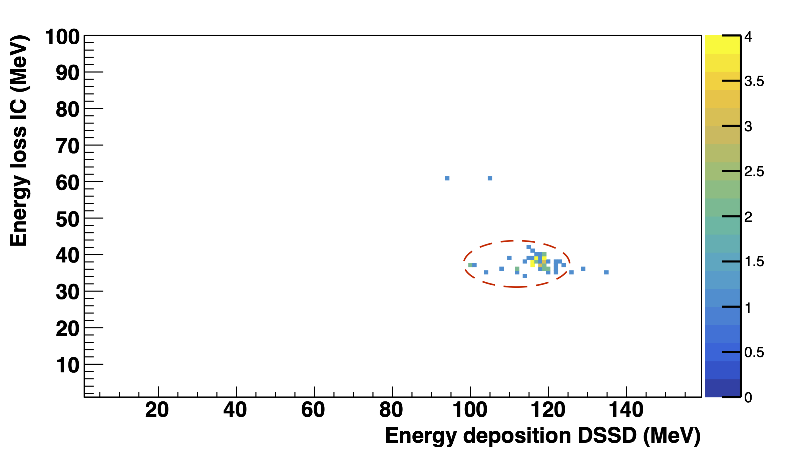
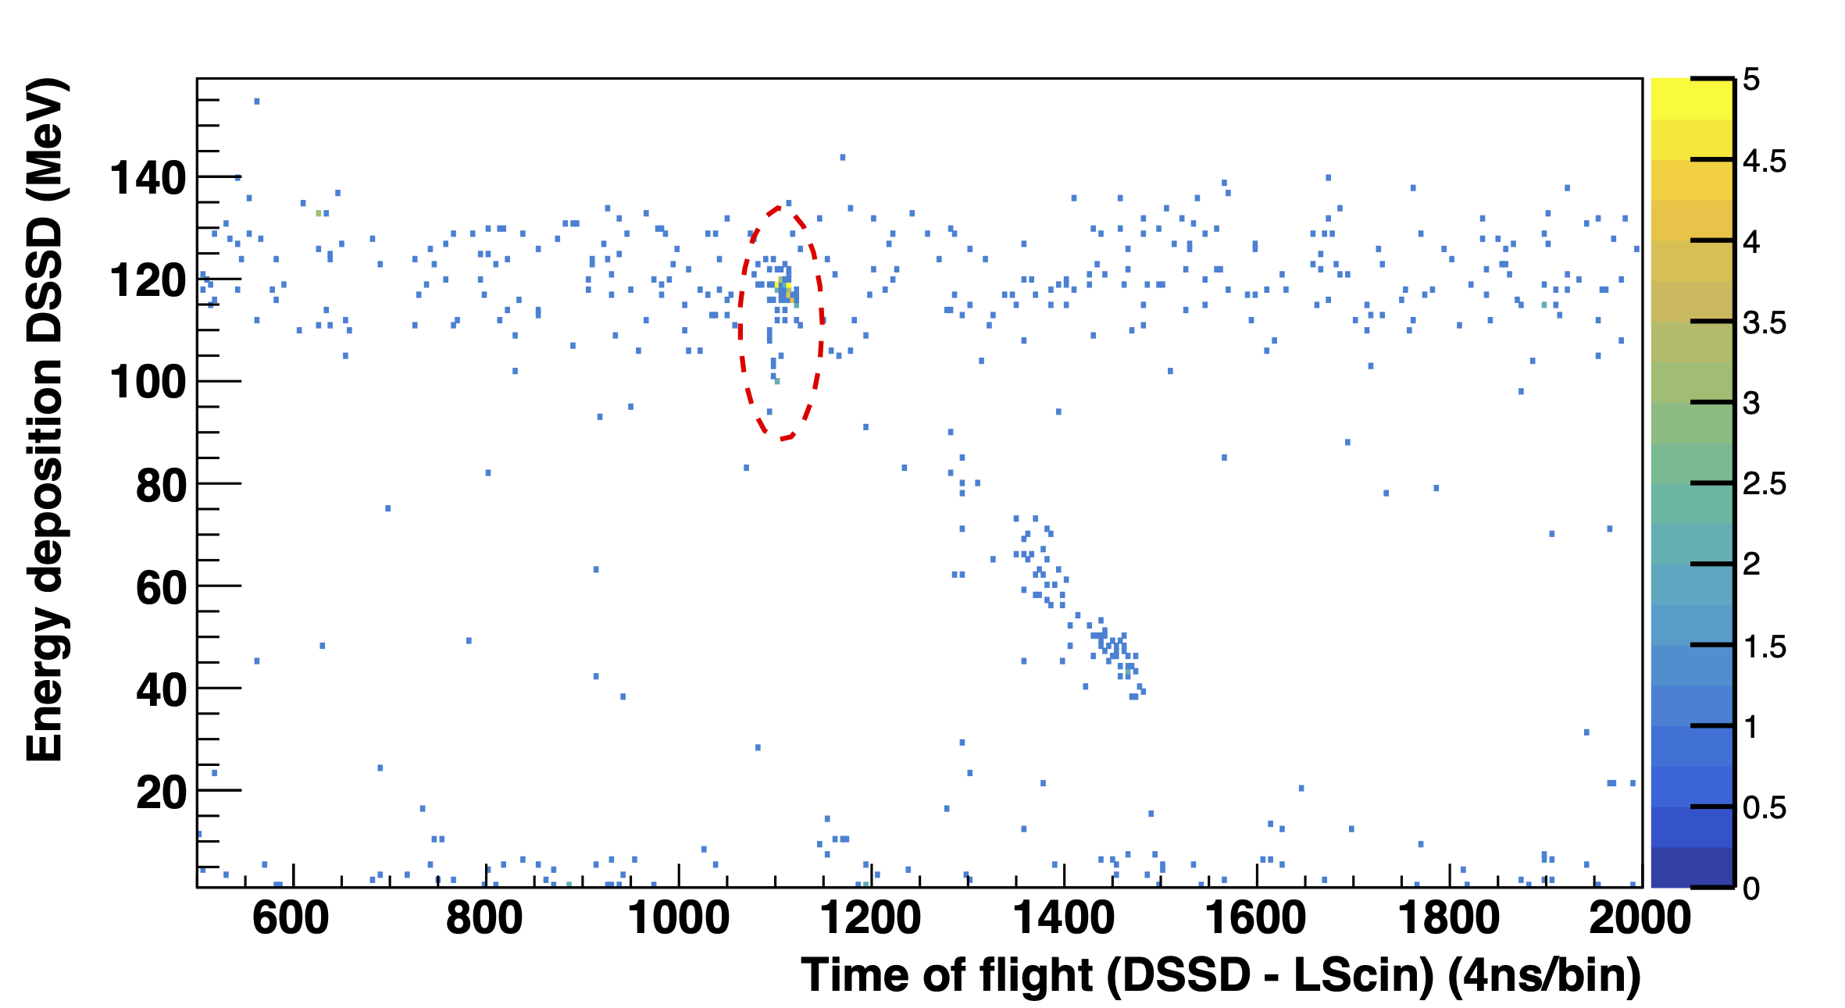
Recoil Identification and Detection
Neutron Detection
Recoil Detection
⁵⁸Fe(p,n)⁵⁸Co
Neutron – ⁵⁸Co ToF
⁵⁸Co
⁵⁸Co
P. Tsintari et al. PRR (2025)

Slide 10
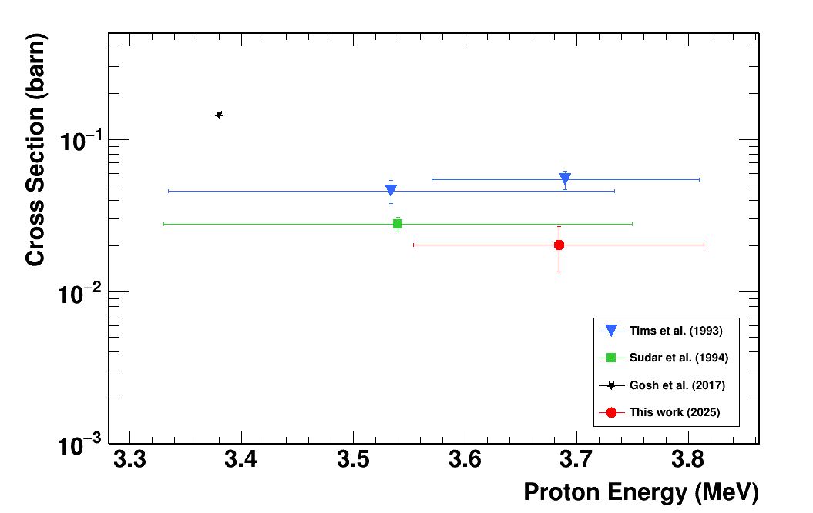
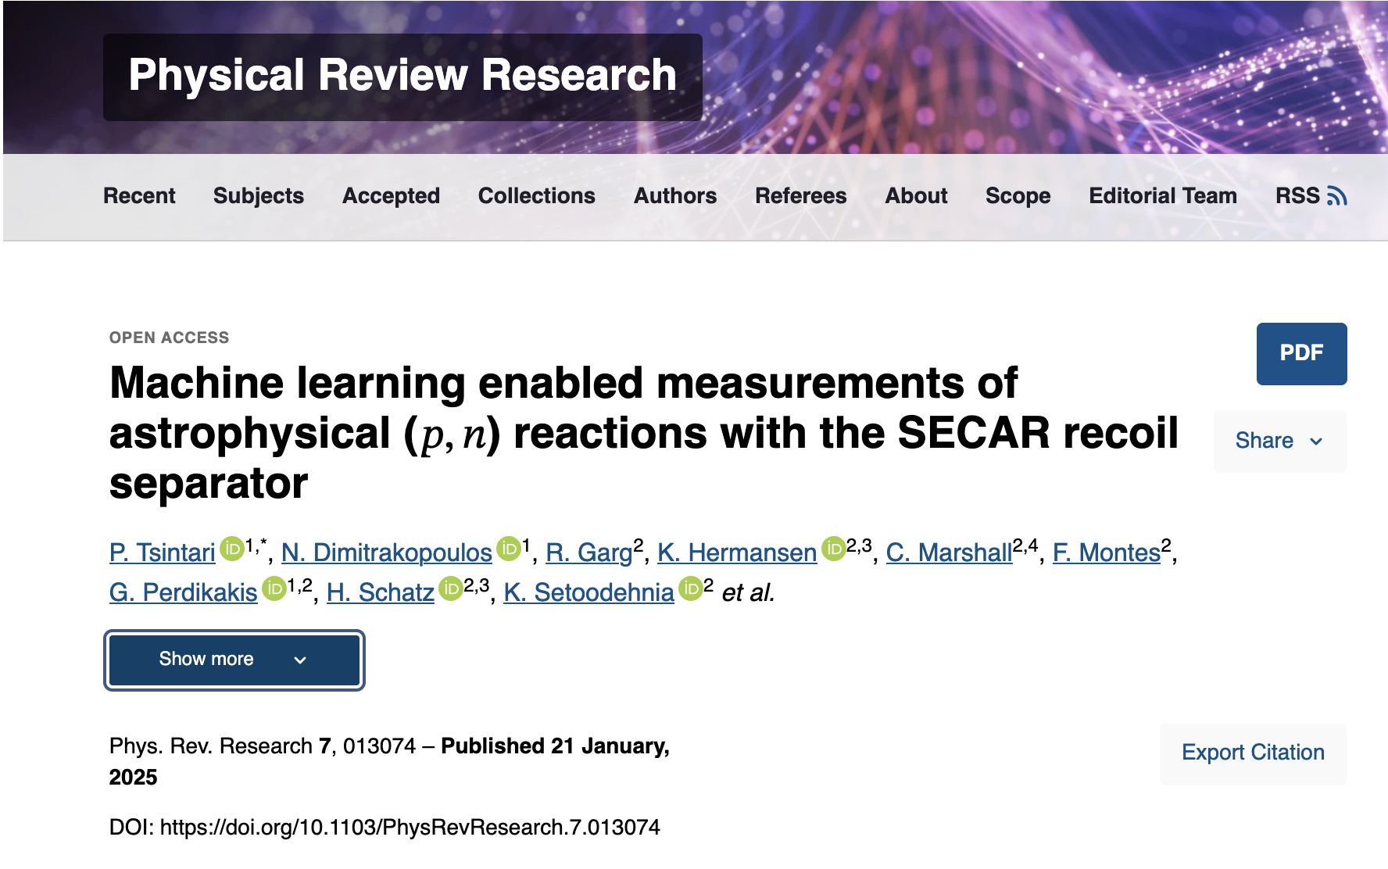


⁵⁸Fe(p,n)⁵⁸Co – Measurement Result
P. Tsintari et al. PRR (2025)
First Science Publication of SECAR
$$σ_{total}=20.3 ±6.3 mb$$

Slide 11
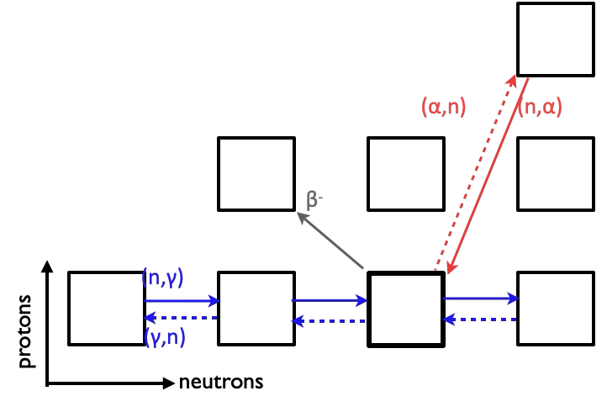
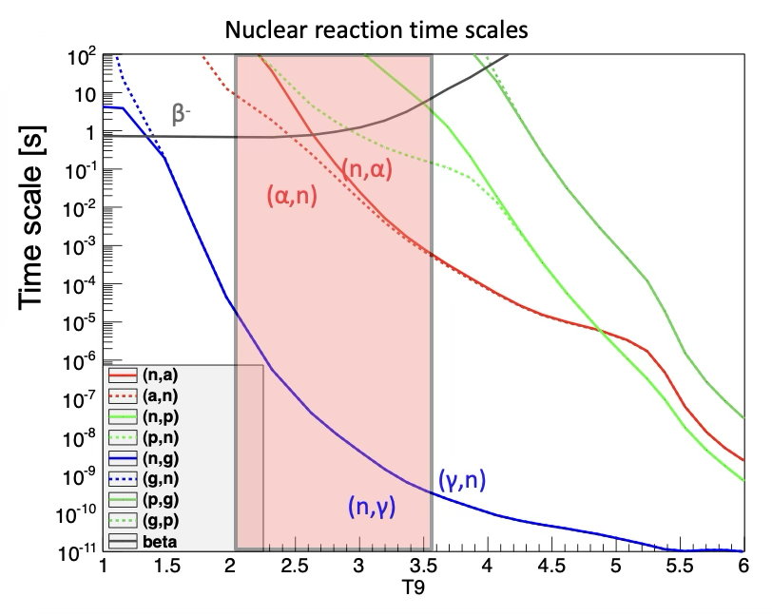
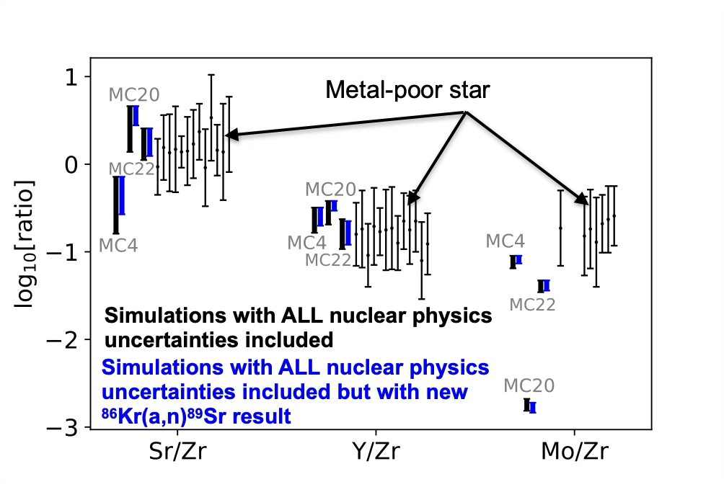
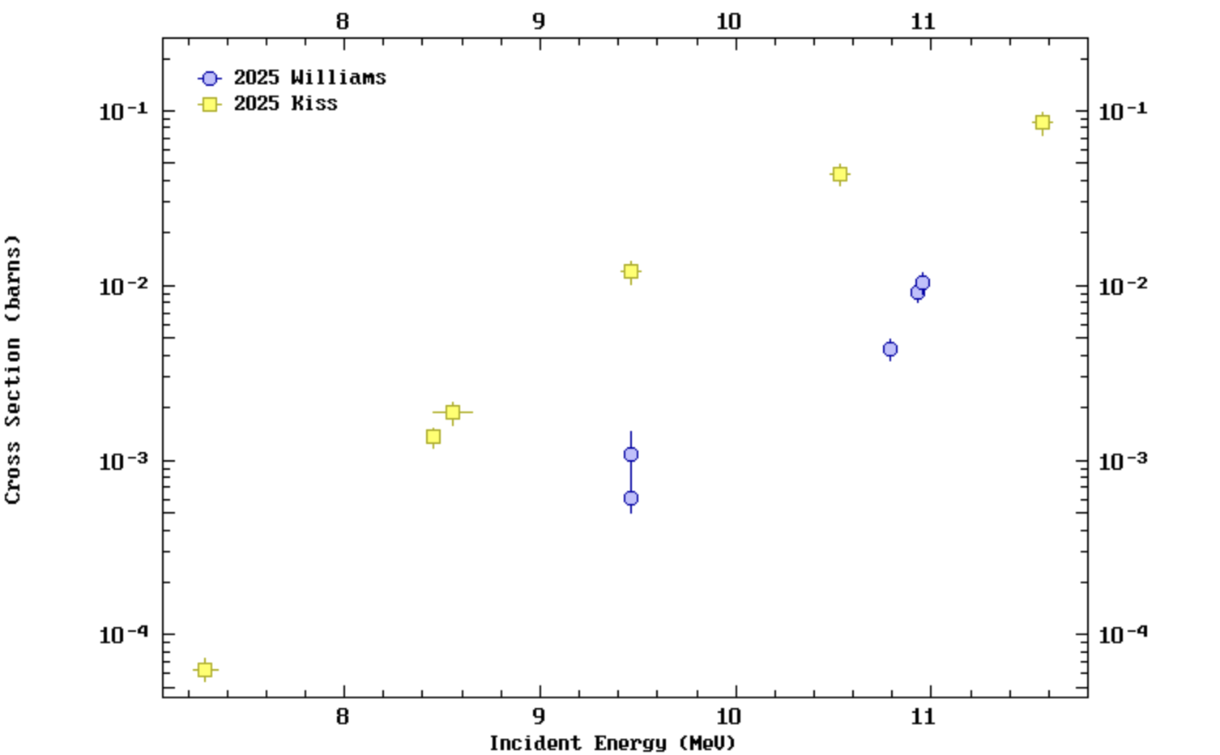
Weak r-process Nucleosynthesis
Occurs in neutron-rich outflows (Yₑ < 0.5)
Temperatures of T ≈ 2.0 – 3.5 GK
(α,n) reactions become faster than (n,α) below ~3.5 GK
The case of ⁸⁶Kr(a,n)
Kiss, Arcones, Montes et al. ApJ (2025)
Bliss, Arcones, Montes & Pereira, J. Phys. G (2017)
Notes:
The weak r-process occurs in neutron-rich outflows at temperatures around 2 to 3.5 GK. In this temperature range, neutron captures remain very efficient, but importantly the (α,n) reactions become faster than the reverse (n,α) reactions. As a result, the reaction flow can move both horizontally through neutron captures and vertically through alpha-induced reactions on the chart of nuclides. These (α,n) reactions effectively bridge isotopic chains and help drive the synthesis of nuclei beyond the iron peak before β decays shift the material back toward stability.

Slide 12
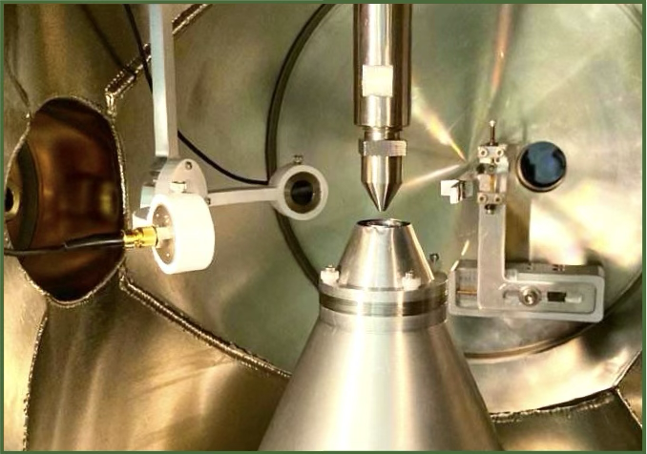
⁸⁶Kr(α,xn) Reaction Measurement with SECAR
⁸⁶Kr beam at three incident energies:
2.50, 2.75 and 3.00 MeV/u
Charge State selection
Recoil Separation
Target Chamber
B3
B4
Q6
Q7
WF1
H1
Q3
Q4
Q5
H2
Helium target:
JENSA gas jet target
B1
B2
H3
O1
Q2
Q8
Q9
B5
B6
At these energies (a,n) and (a,2n) reactions are open and competing channels
Q1
WF2
Q10
Q11
Beam
Q12
Q15
Q13
Neutron Detection
Q14
B8
B7
4 Liquid Scintillators
EJ301
Recoil Detection
Final Cleanup

Slide 13
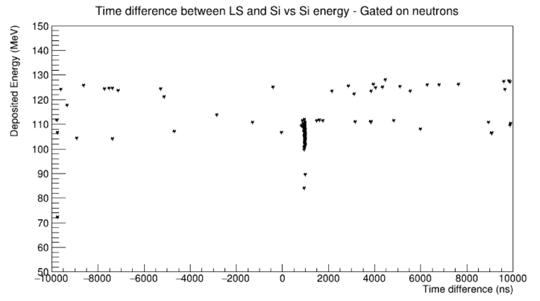
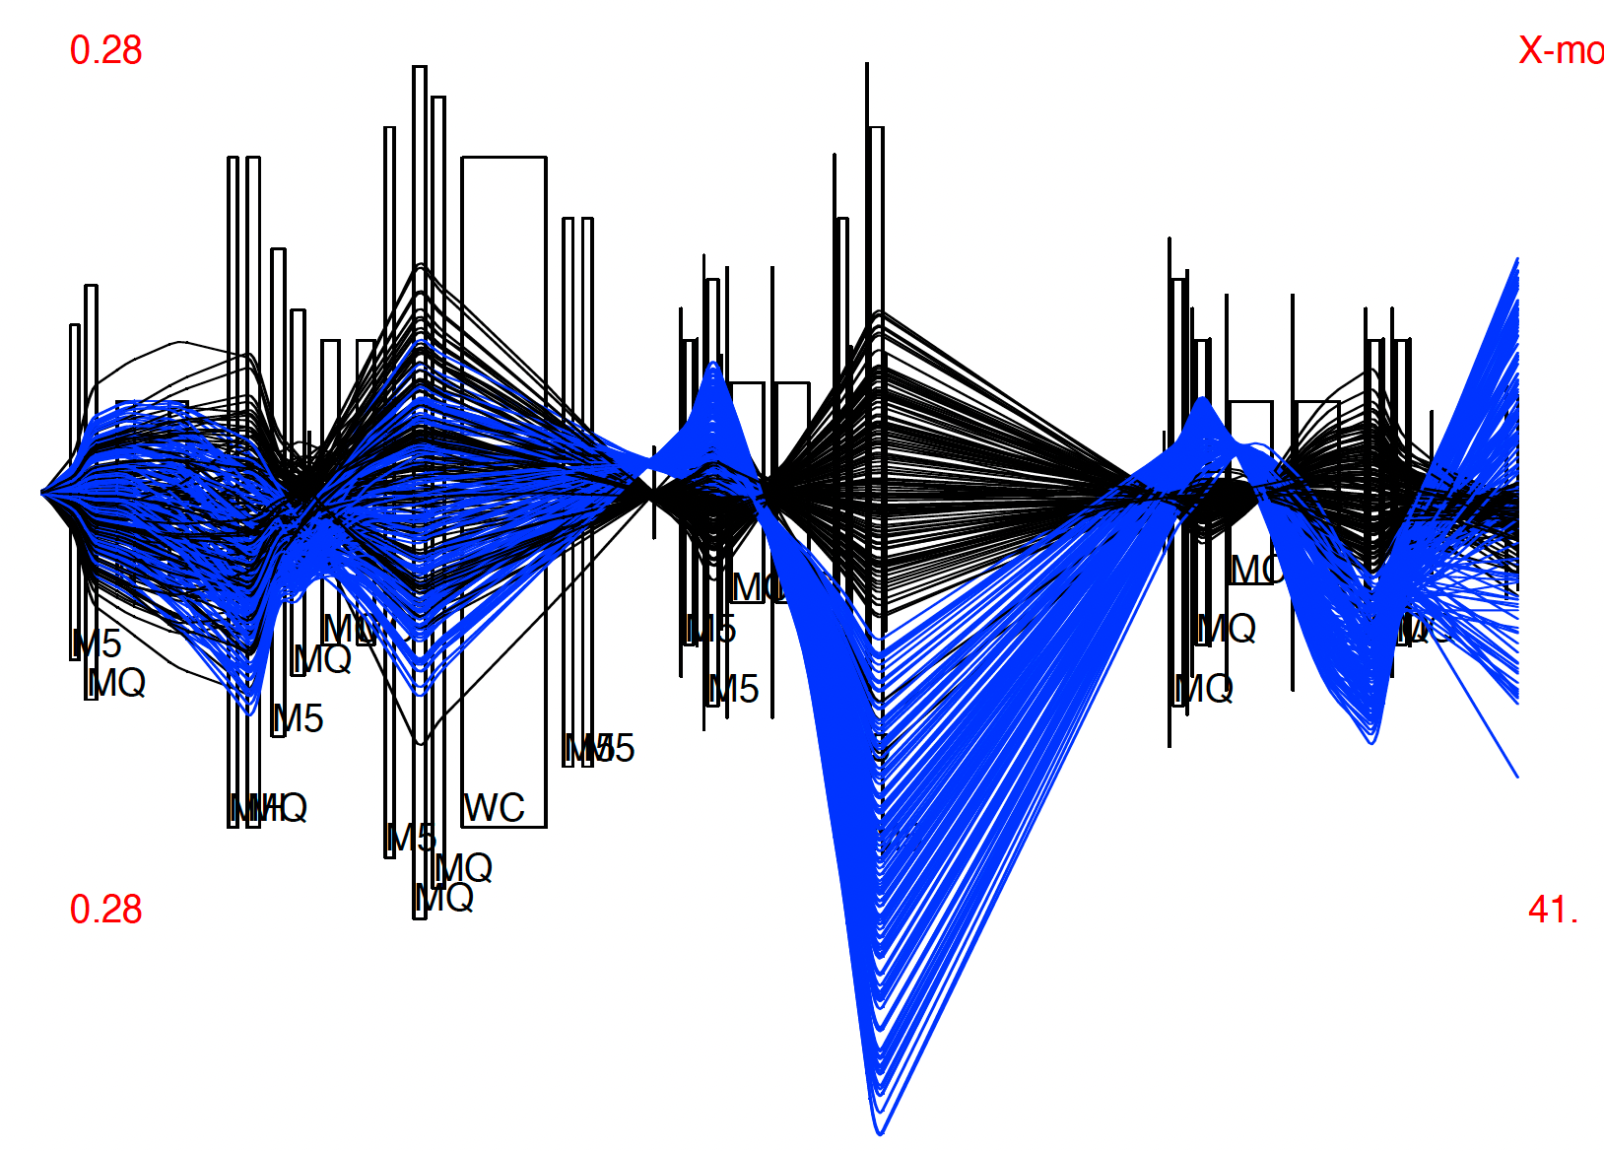
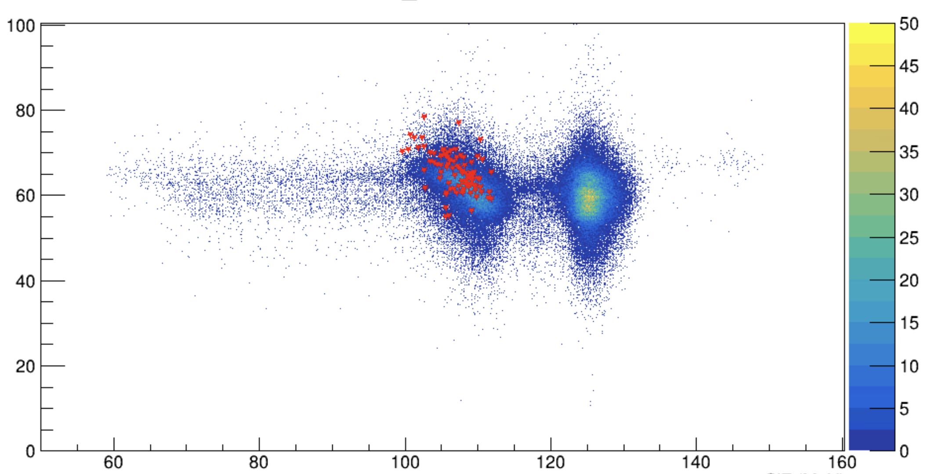
Preliminary Results for ⁸⁶Kr(α,n)⁸⁹Sr Reaction
⁸⁶Kr(α,n)⁸⁹Sr - ⁸⁸Sr
Deposited Energy (MeV)
⁸⁹Sr recoils
Time Difference (ns)
Energy Loss ΔΕ (MeV)
⁸⁹Sr recoils
Deposited Energy (MeV)

Slide 14
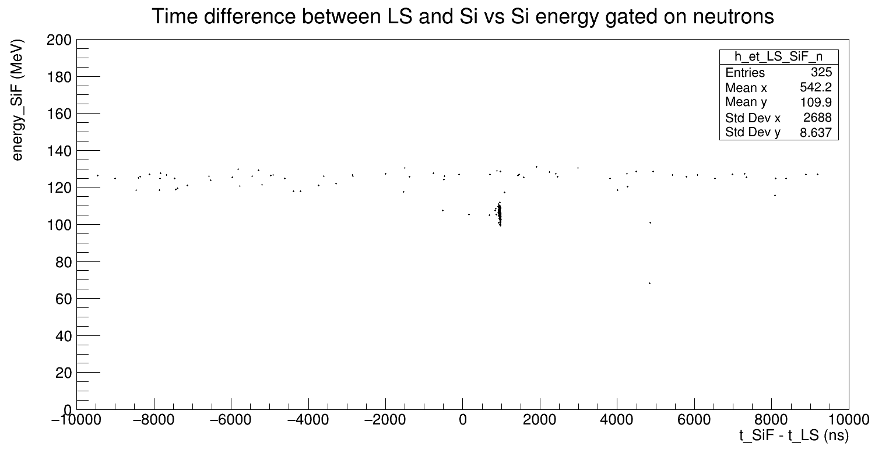
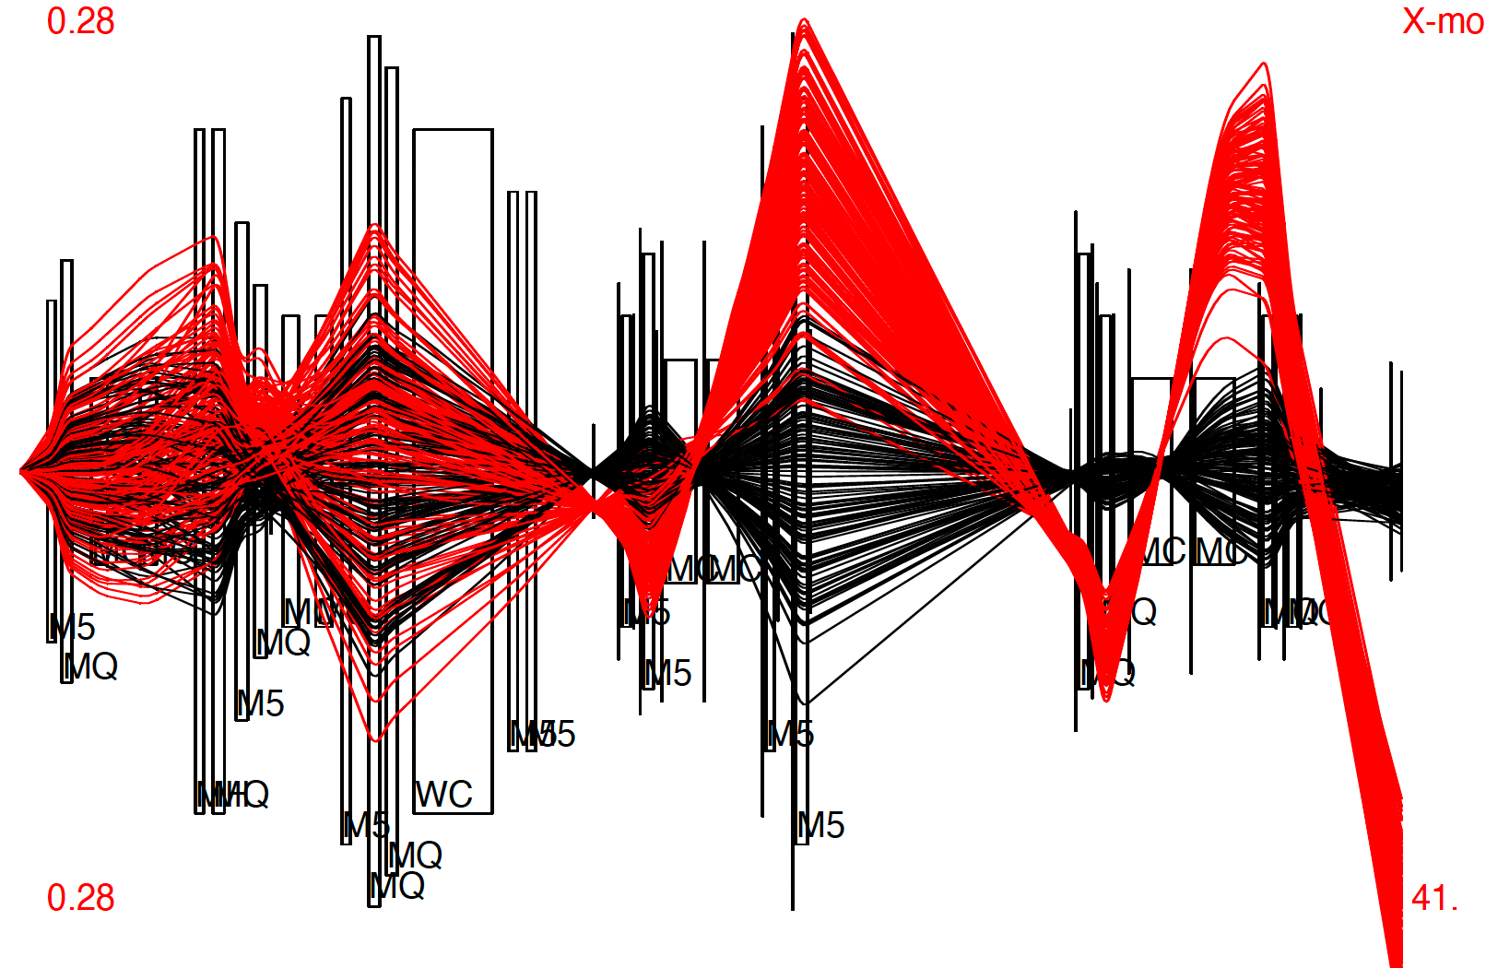
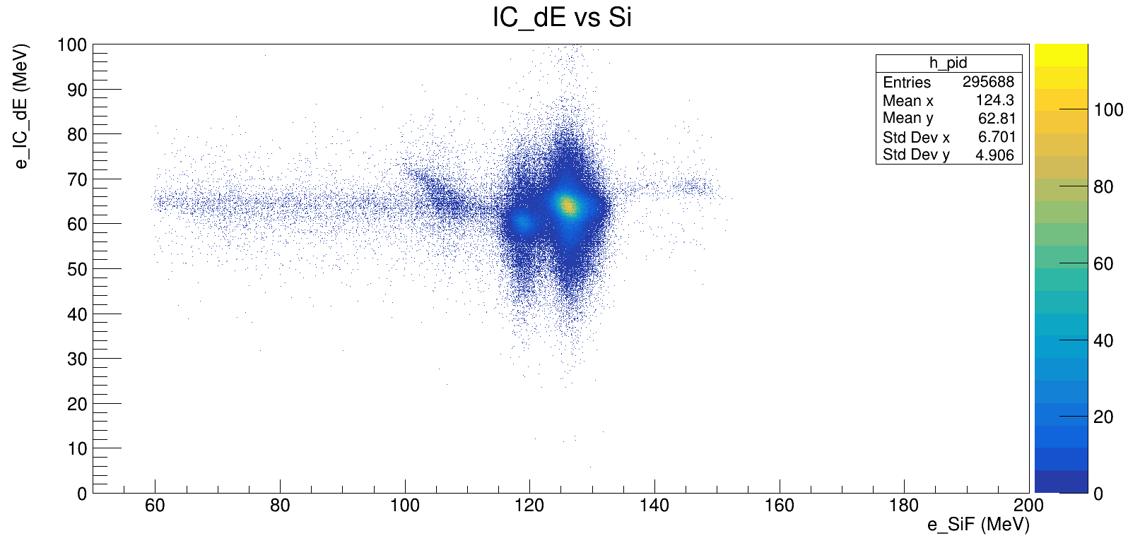
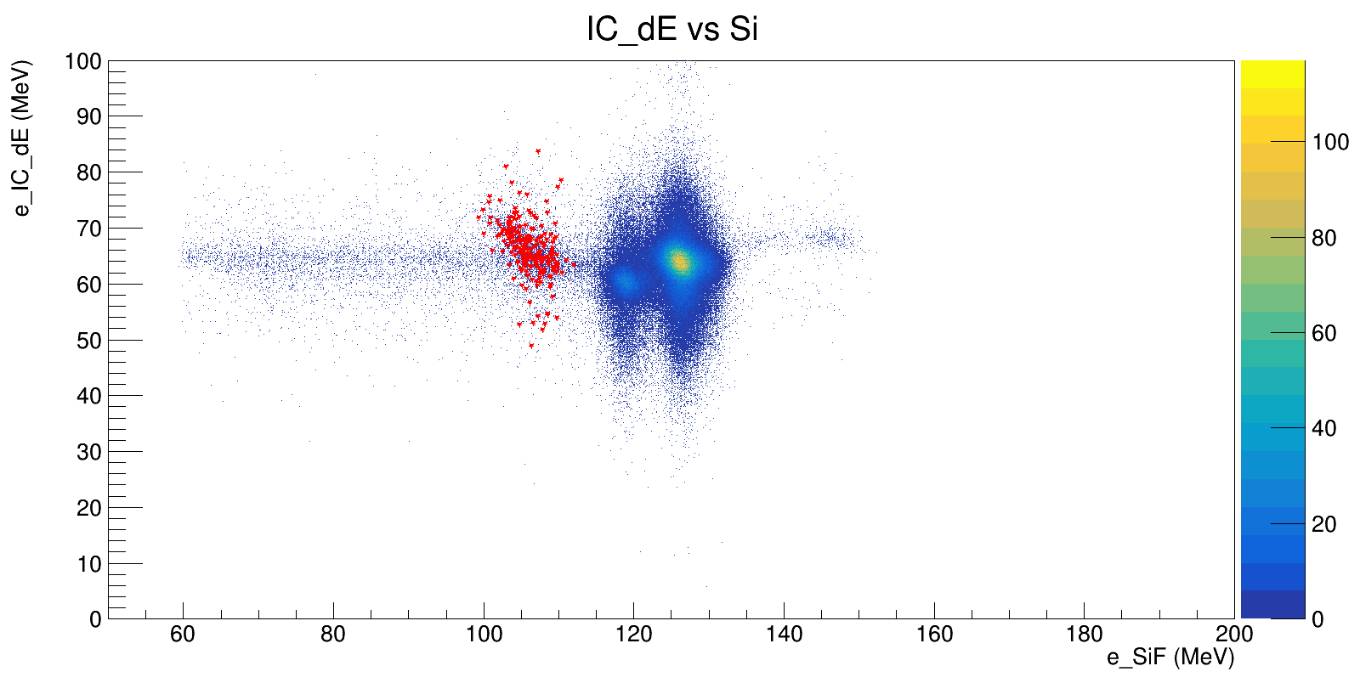
Preliminary Results for ⁸⁶Kr(α,2n)⁸⁸Sr Reaction
⁸⁶Kr(α,2n)⁸⁸Sr - ⁸⁹Sr
Deposited Energy (MeV)
⁸⁸Sr recoils
Time Difference (ns)
Energy Loss ΔΕ (MeV)
Energy Loss ΔΕ (MeV)
Deposited Energy (MeV)
Deposited Energy (MeV)

Slide 15
In Conclusion
Demonstrated remarkable adaptability of the SECAR recoil separator
  Performed the ⁸⁶Kr(a,xn)⁸⁹Sr,⁸⁸Sr measurement using jet helium target and neutron tagging. (Publication of final results coming soon!)
  Developed a novel experimental technique for direct (p,n) reaction measurements with a separator, and validate it with a new measurement of ⁵⁸Fe(p,n)⁵⁸Co reaction cross section
SECAR is ready for receiving radioactive beams starting with the first direct measurement of the ⁵⁶Co(p,n)⁵⁶Ni reaction a key reaction for vp-process in Fall 2026 (PIs: Perdikakis, Tsintari & Montes)
Performed successfully first (p,γ) measurement using the windowless extended gas target with SECAR

Slide 16











Acknowledgements
G. Perdikakis
N. Dimitrakopoulos
H. Arora
U. Greife
P. Tsintari
H. Schatz
F. Montes
L. Wagner
K. Setoodehnia
J. Pereira
R. Zegers
A. Villari
K. Smith
C. Tinson
C. Frantzis
J. Huffman
L. Balliet
K. Hermansen
S. Miskovich
R. Garg
J. Blackmon
C. Deibel
M. Couder
G. P. Berg
C. Brune
Z. Meisel
C. Marshall
K. Chipps M. S. Smith
Thank you!

