Slide 1



Tof-Bρ Mass Measurements with the S800 Spectrometer
Justin Placido
Central Michigan University
Nuclear Masses in Astrophysics for the Next 25 Years – 2026

Slide 2
Outline
Principle of TOF-Bρ technique
Experiments at the National Superconducting Cyclotron Laboratory
Outlook for experiments at the Facility for Rare Isotope Beams

Slide 3
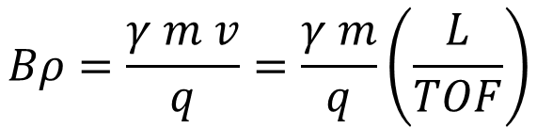
Principle of Time-of-flight Bρ Mass Measurement Experiments
FRAGMENT SEPARATOR
production target
time
Bρ
time
Technique pioneered with SPEG at GANIL
Sarazin et al., PRL 84, 5062 (2000)
Experimental programs with SHARAQ in RIKEN
Michimasa et al, Phys. Rev. Lett. 125 12, 122501 (2020)
and with S800 at NSCL/FRIB
M. Matos et al, NIM 696, 171 (2012)
$$Bρ=\frac{γ m v}{q}=\frac{γ m}{q}\left(\frac{L}{TOF}\right)$$

Slide 4
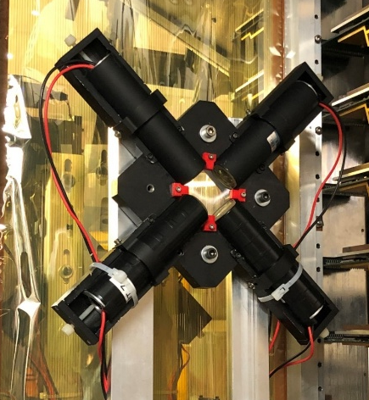
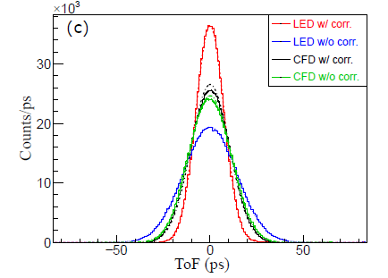
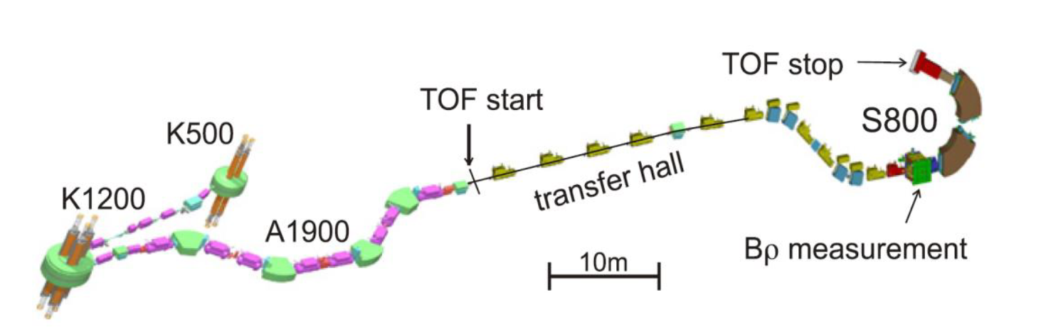
TOF-Bρ setup at the S800 spectrometer
Test with ⁴⁸Ca beam at NSCL: resolution of σ_{TOF}=7.5 ps for LED w/walk correction
TOF: timing scintillator
Scintillator: Eljen 228, 4x4 cm
4 Hamamatsu H6533 PMTs
TAC-ADC for data acquisition
M. Matos et al, NIM 696, 171 (2012).

Slide 5
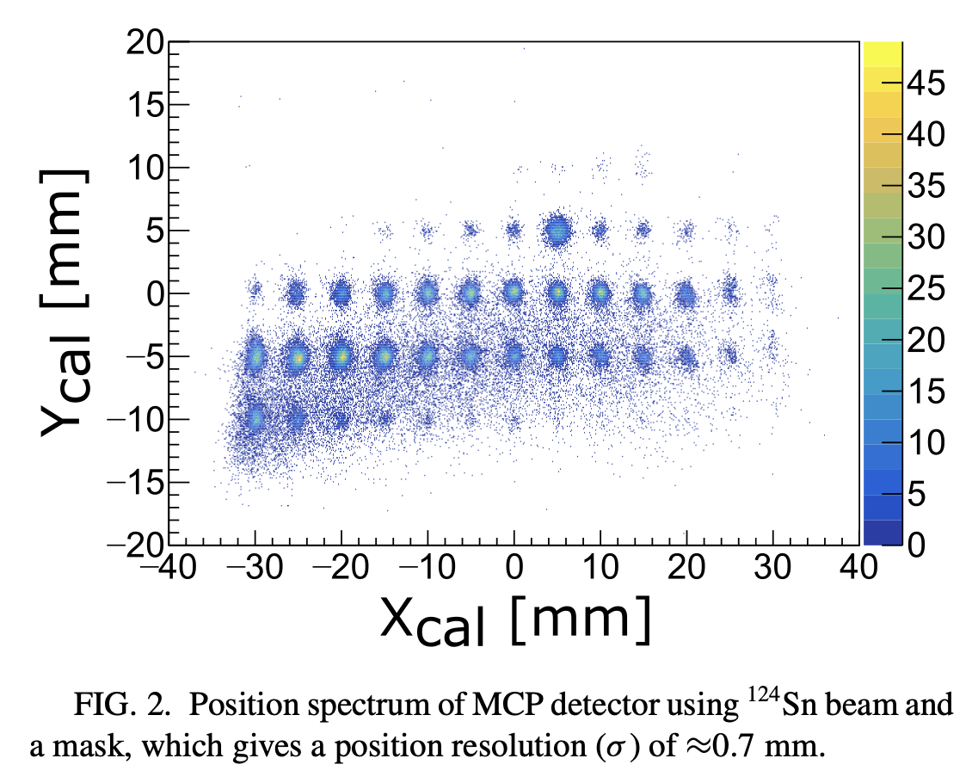
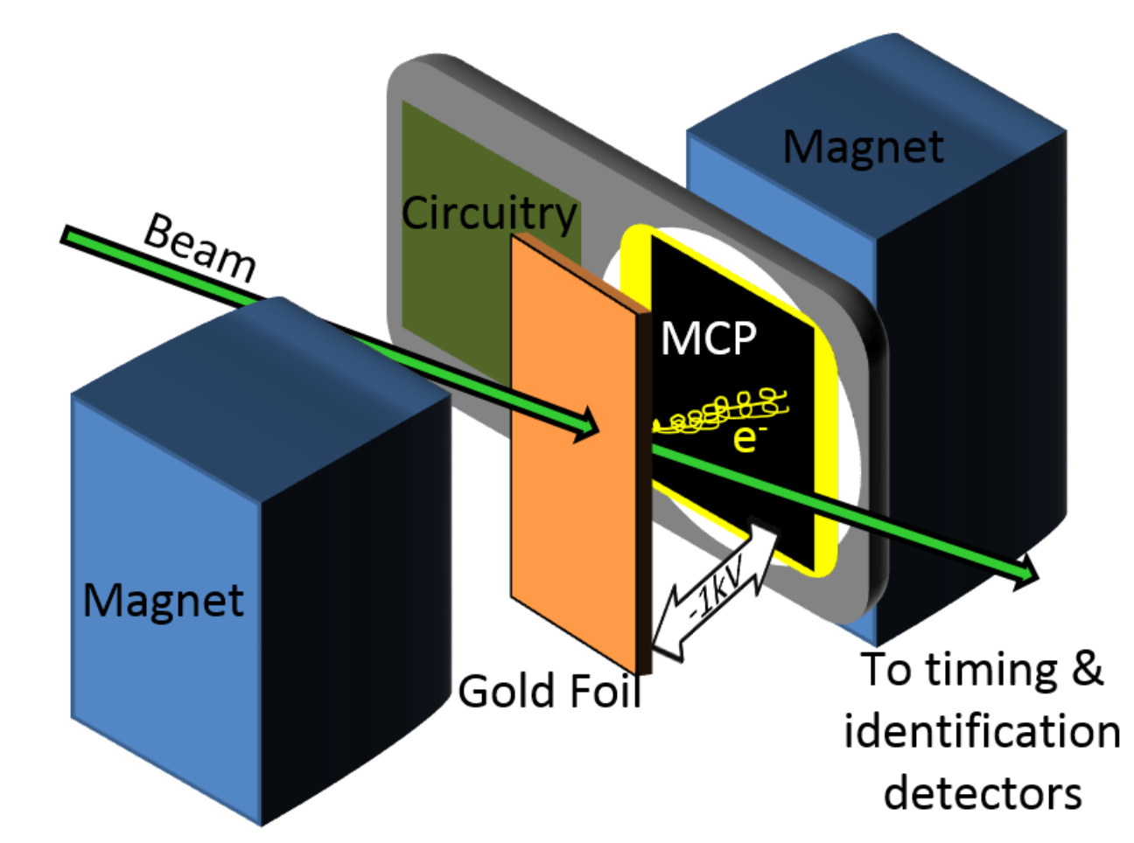
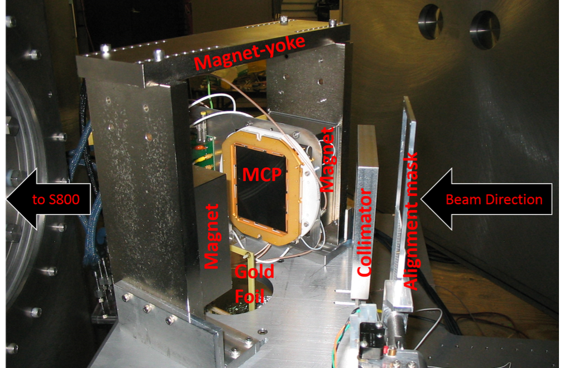
TOF-Bρ setup at the S800 spectrometer
Bρ: MCP detector at S800 dispersive plane:
MCP: 8 x 10 cm, 2 plates in chevron config.
2 rectangular NdFeB magnets
Foil: 70 ug/cm² polypropylene with sputtered gold
Resistive plate readout
M. Matos et al, NIM 696, 171 (2012).

Slide 6
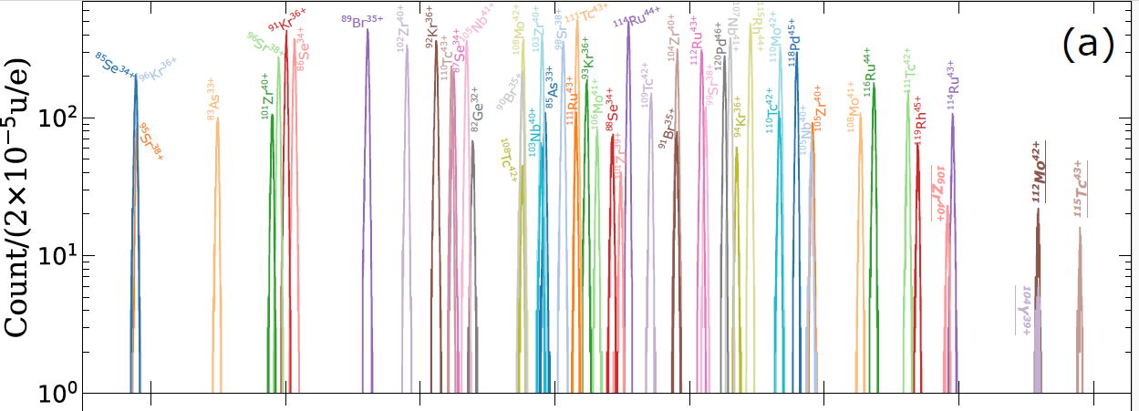

TOF-Bρ setup at the S800 spectrometer
m/q spectra – N=70 region
Mass resolution: $R≈10 000$
K. Wang et al, PRC 109, 035806 (2024)
M. Matos et al, NIM 696, 171 (2012).

Slide 7
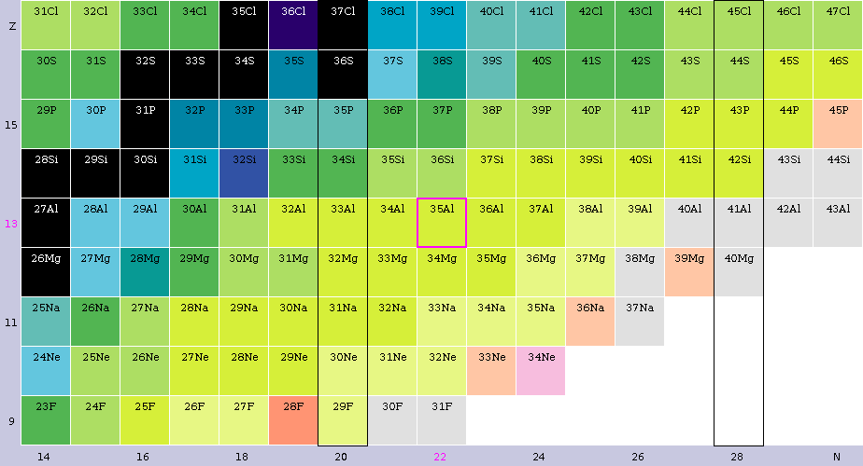
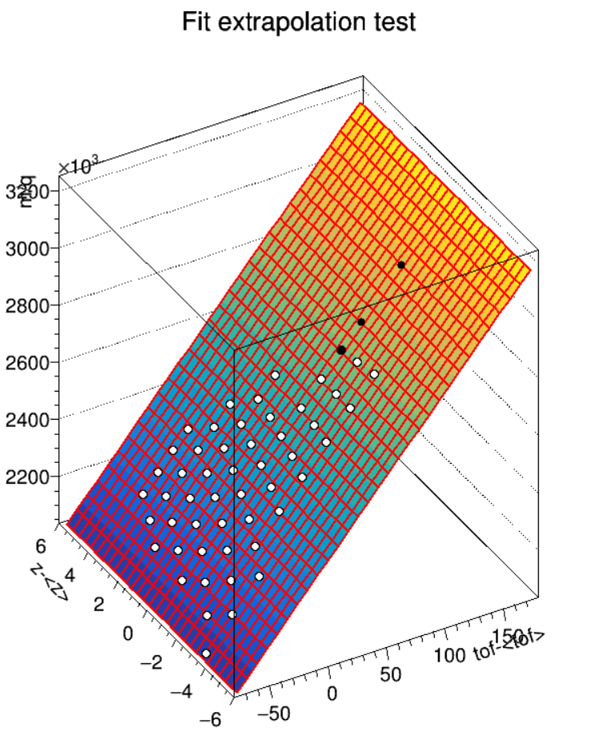
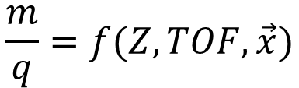
TOF-Bρ Experiments at FRIB
Estimated uncertainties for Mg isotopes
e23047 proposal
Reference mass
Known mass
Unknown mass
δm <30 keV
τ_{1/2} < 10 ms
The experimental setup is calibrated with reference isotopes with well-known mass:
$$\frac{m}{q}=f(Z,TOF, \vec{x})$$

Slide 8
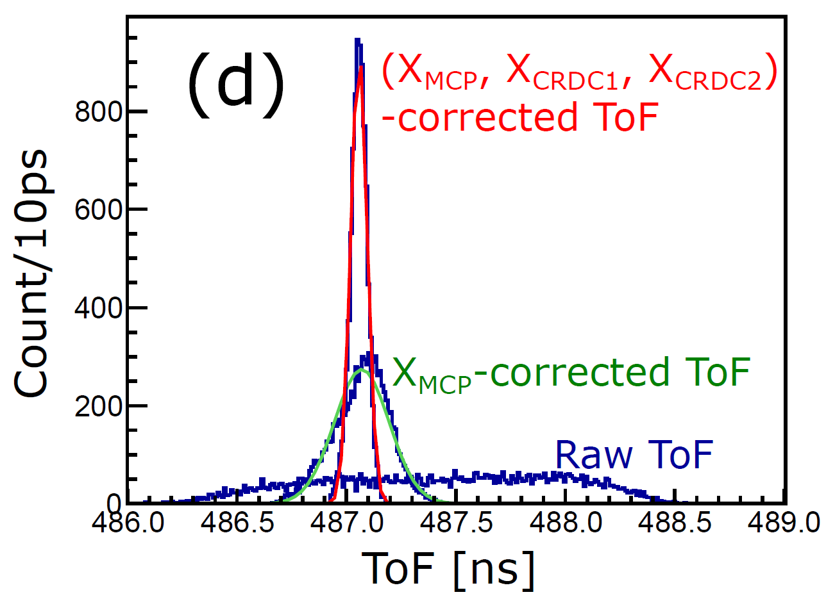
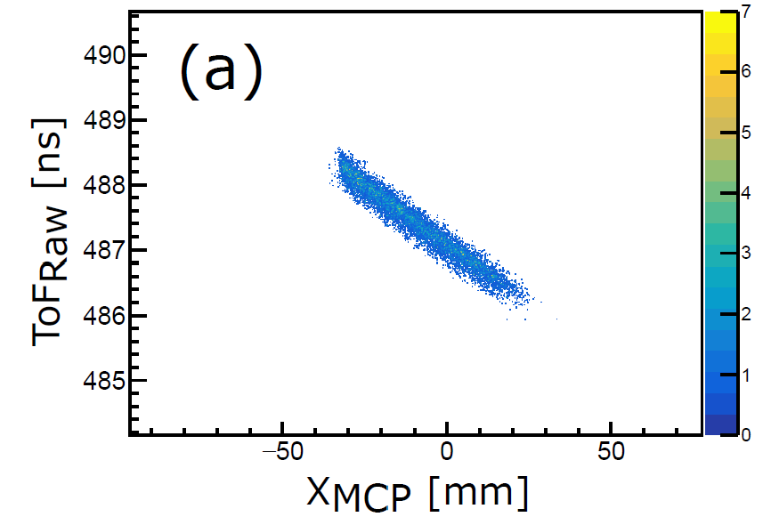
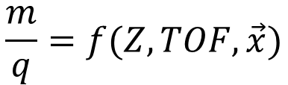
TOF corrections
The experimental setup is calibrated with reference isotopes with well-known mass:
$$\frac{m}{q}=f(Z,TOF, \vec{x})$$
K. Wang et al, PRC 109, 035806 (2024)

Slide 9
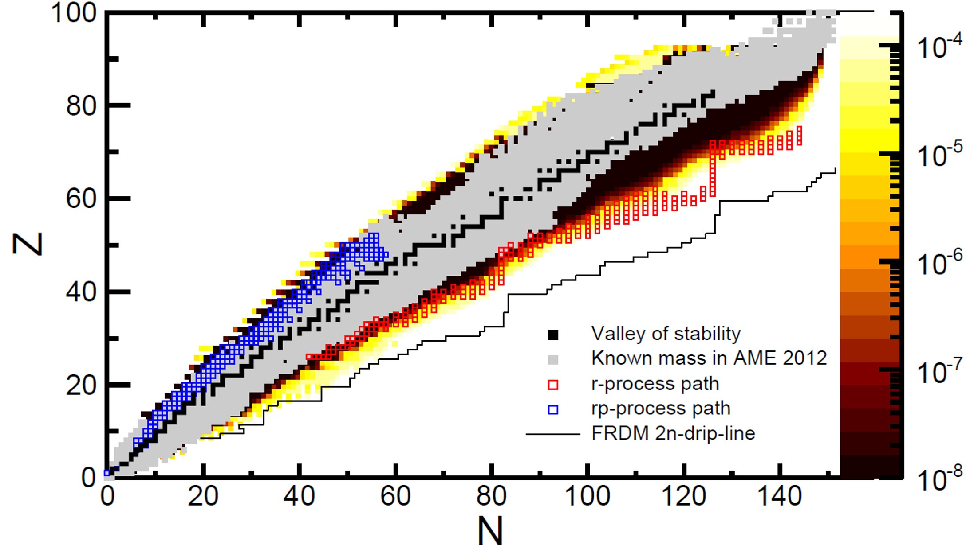
TOF-Bρ Program with the S800 Spectrometer at NSCL
Potential reach at FRIB
δm/m
Z. Meisel et al, PRC (2016)
Z. Meisel et al, PRL (2015)
A. Estrade et al, PRL (2011)
K. Wang et al, PRC (2024)
I. Sultana et al
Meisel 2020, arXiv:2004.14113

Slide 10
TOF-Bρ Program with the S800 Spectrometer at FRIB
Potential reach at FRIB
δm/m
J. Pereira et al.
Disentangling the R-process Rare-Earth Peak Abundances: New Mass Measurements of Neutron-Rich Cs-Er Nuclei with the mass-ToF technique in the S800
Z. Korkulu et al.
Mass measurements on the r-process path relevant for the first r-process peak
A. Estrade et al.
Mass measurement along the neutron dripline
Meisel 2020, arXiv:2004.14113

Slide 11
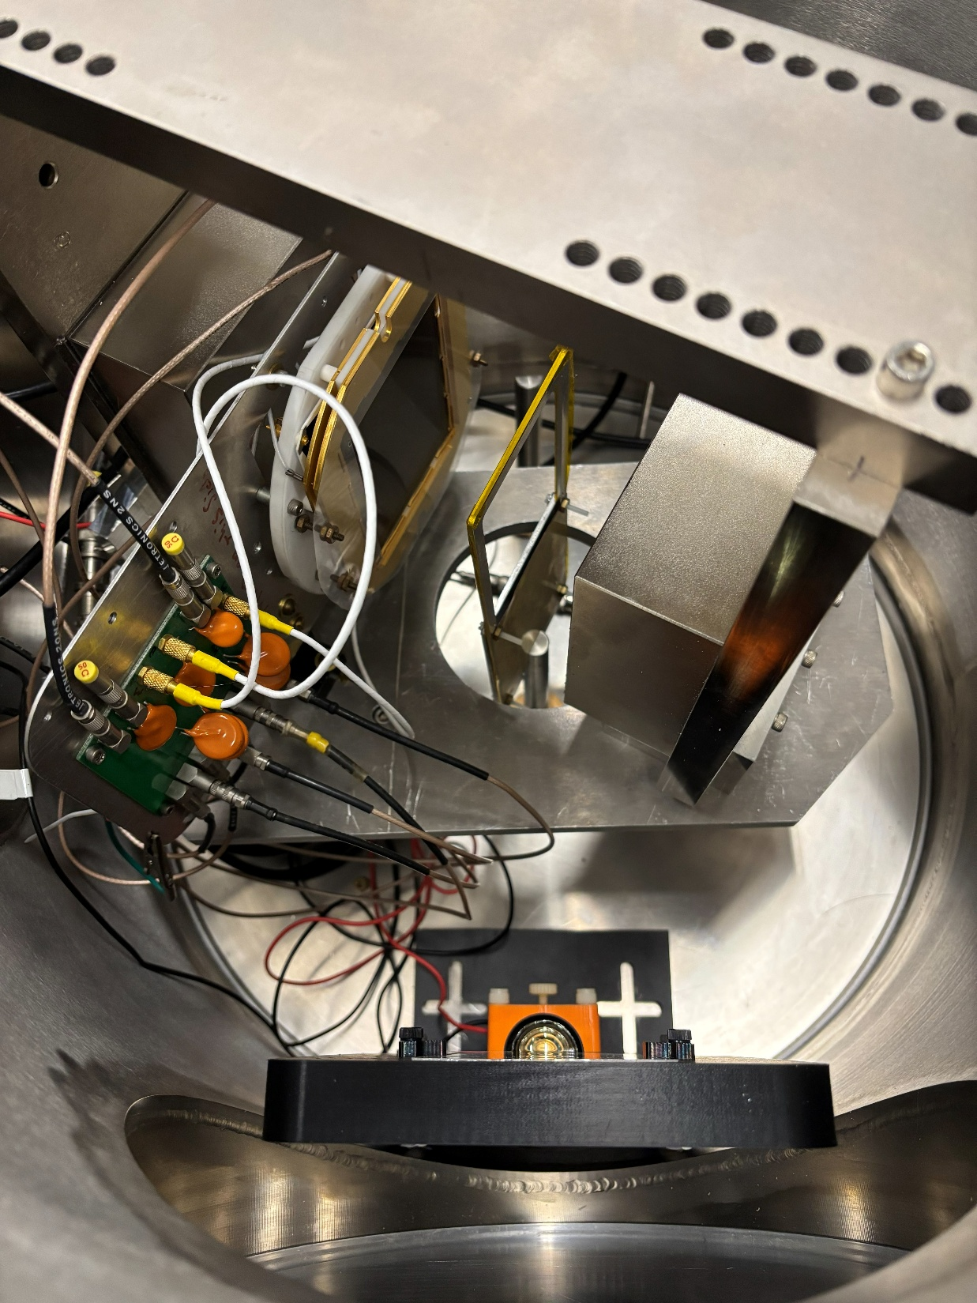
Beam path
MCP setup and testing
Magnet
MCP
Magnet
Foil and mask

Slide 12
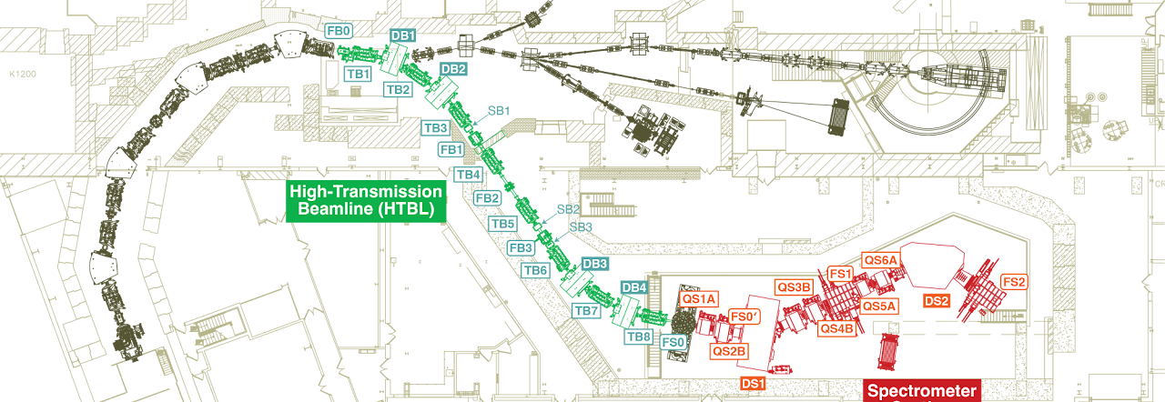
Flight path extended with ARIS fragment separator and (from ~2030) with High Rigidity Spectrometer (HRS)
TOF-Bρ Experiments at FRIB
TOF start at ARIS
S800
HRS

Slide 13
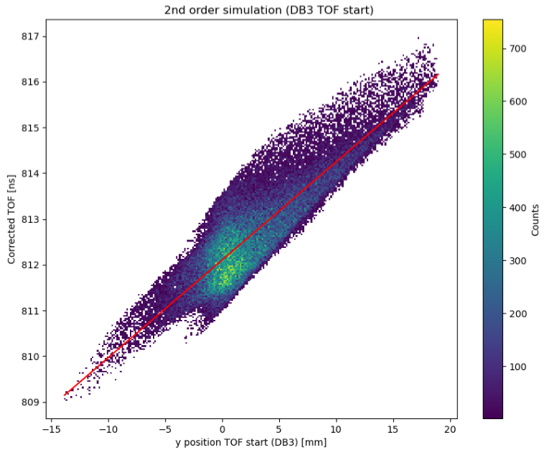
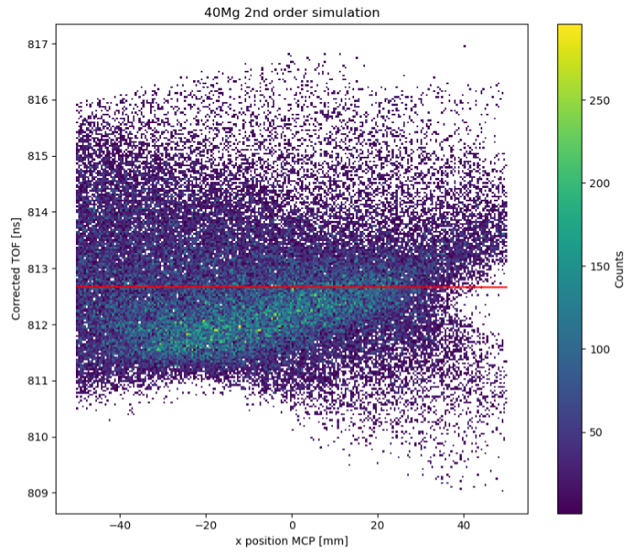
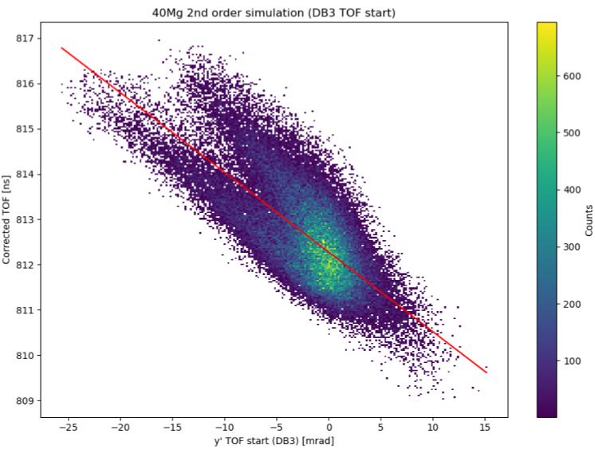

Beam Optics Simulations
Momentum-corrected TOF vs y position at TOF start
Momentum-corrected TOF vs x position at MCP detector. TOF of 812.667 $±$ 1.067 ns
Momentum-corrected TOF vs y’ angular trajectory at TOF start

Slide 14
Conclusions
TOF-Brho offers reach far from stability: efficient coupling to fast beams and short measurement time
Experiments at the NSCL focused on neutron-rich isotopes between N=28 and N=25; program at FRIB will expands towards cases relevant to r-process nucleosynthesis
FRIB offers opportunities to improve resolution (tracking, flight path) and high-rates for unstable ions

Slide 15
Thank you!
Central Michigan University:
A. Estrade, H. Arora, N. Dimitrakopoulos, A. Estradé, N. Nepal, G. Perdikakis, M. Redshaw, S. Samaranayake, I. Sultana, P. Tsintari, G. Zimba
Air Force Institute of Technology
Z. Meisel
Bucknell University:
A. M. Amthor
Oak Ridge National Laboratory
S. Pain
Center for Exotic Nuclear Studies, Institute for Basic Science:
T. Ahn, Z. Korkulu, S. Choi, K. Kim, K. Hahn, D. S. Ahn, S. Cha, L. stuhl, J. Park
St. Mary’s University and TRIUMF:
R. Kanungo
Facility for Rare Isotope Beams, Michigan State University:
H. Schatz, T. Baumann, D. Bazin, A. Gade, T. Ginter, R. Jain, E. Kwan, W. Mittig, F. Montes, S. Noji, J. Pereira, M. Portillo, N. Rijal, S. Liddick, E. Rubino(LLNL), B. Sherrill, O. Tarasov
University of Jyväskylä:
A. Kankainen, O. Beliuskina, M. Mougeot
GSI Helmholtzzentrum für Schwerionenforschung:
Y. Litvinov
University of Massachusetts Lowell:
A. Rogers, J. Dopfer, M. Giles
Institute for Modern Physics, Lanzhou:
K. Wang
Wako Nuclear Science Center, IPNS, KEK:
P. Schury
Los Alamos National Laboratory:
A. Lovell, M. Mumpower, T. Sprouse
Western Michigan University:
M. Famiano, K. Bhatt (ANL), J. Jenkins, L. Kankowski
Max-Planck-Institut Für Kernphysik:
S. George
Nuclear Science Division, Lawrence Berkeley National Laboratory:
P. Fallon , H. L. Crawford, C. M. Campbell, R. M. Clark, M. Cromaz, C. Porzio, E. Rice
work supported in part by DoE grants DE-SC0022538 and DE-SC0020406 and by NSF grant OISE-1927130

