Slide 1




Nuclear Masses in Astrophysics for the Next 25 Years
Facility for Rare Isotope Beams, May 2026
Welcome Hotel, Darmstadt, August 2025
Organizers:
  Klaus Blaum
  Alfredo Estrade
  Anu Kankainen
  Yuri Litvinov
  Zach Meisel
  Sam Porter
  Nicolai Shchechilin
FRIB Support:
  Ana Becerril
  Anna Swartz
GSI Sekretariat:
  Lea Wunderlich
Sponsors:

Slide 2
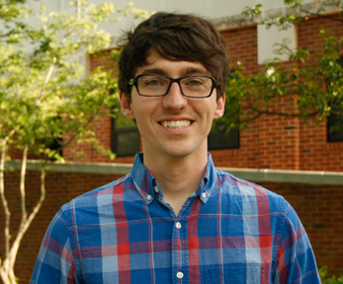
Nuclear Masses in Astrophysics for the Next 25 Years
This workshop has the ambitious goal of training and showcasing the next generation of nuclear mass spectrometrists, summarizing the state-of-the-art in nuclear mass measurement and theory, and charting a course for the next 25 years of nuclear masses for nuclear astrophysics.
The nuclear astrophysics community has convened in each decade of the 21st century to discuss the importance of nuclear masses and the path forward. […] Previous meetings have helped build connections between techniques, continents, and experiment to theory. This workshop will leverage these connections to transform the global network of nuclear masses for nuclear astrophysics and chart the path forward for the next quarter century.
Zach Meisel
Air Force Institute of Technology (USA)

Slide 3

Goal: bring the community together and review state and outlook for our field
This workshop has the ambitious goal of training and showcasing the next generation of nuclear mass spectrometrists, summarizing the state-of-the-art in nuclear mass measurement and theory, and charting a course for the next 25 years of nuclear masses for nuclear astrophysics.
The nuclear astrophysics community has convened in each decade of the 21st century to discuss the importance of nuclear masses and the path forward. […] Previous meetings have helped build connections between techniques, continents, and experiment to theory. This workshop will leverage these connections to transform the global network of nuclear masses for nuclear astrophysics and chart the path forward for the next quarter century.

Slide 4
Goal: feature early career researchers
This workshop has the ambitious goal of training and showcasing the next generation of nuclear mass spectrometrists, summarizing the state-of-the-art in nuclear mass measurement and theory, and charting a course for the next 25 years of nuclear masses for nuclear astrophysics.
The nuclear astrophysics community has convened in each decade of the 21st century to discuss the importance of nuclear masses and the path forward. […] Previous meetings have helped build connections between techniques, continents, and experiment to theory. This workshop will leverage these connections to transform the global network of nuclear masses for nuclear astrophysics and chart the path forward for the next quarter century.
ECR participants

Slide 5
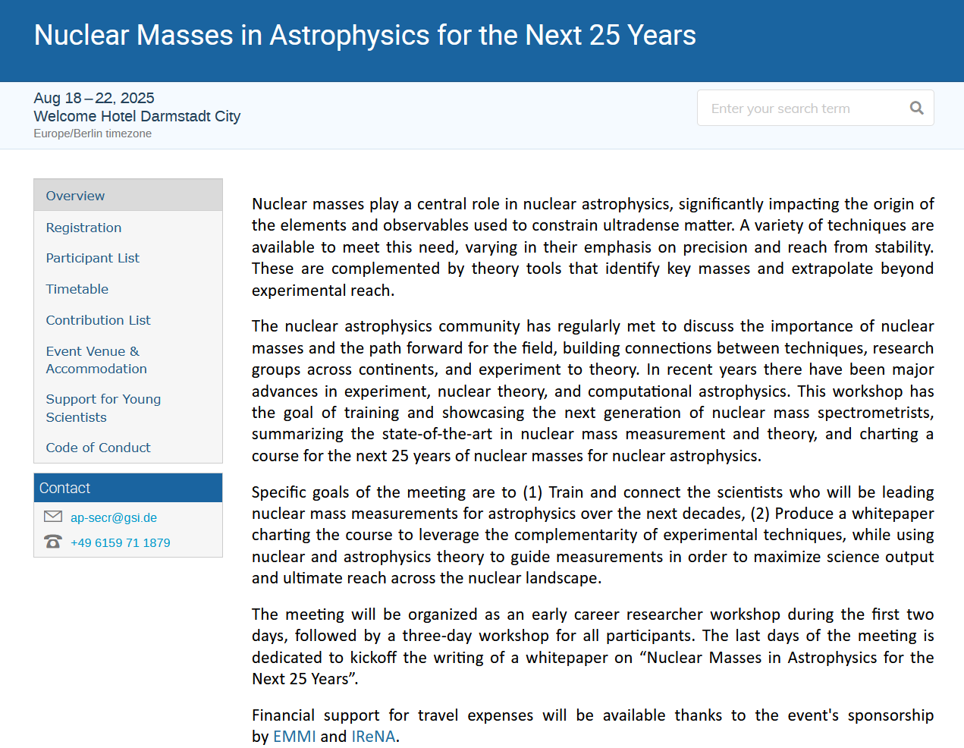
https://indico.gsi.de/event/22417

Slide 6
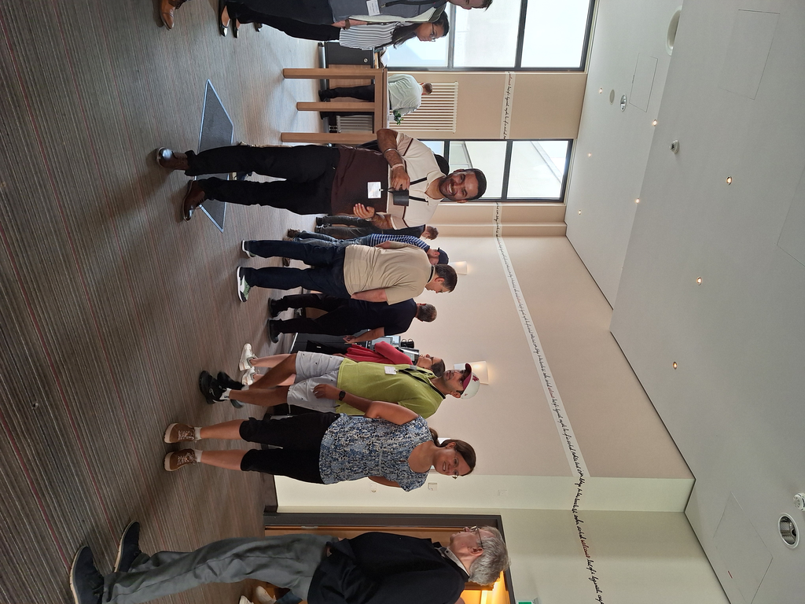
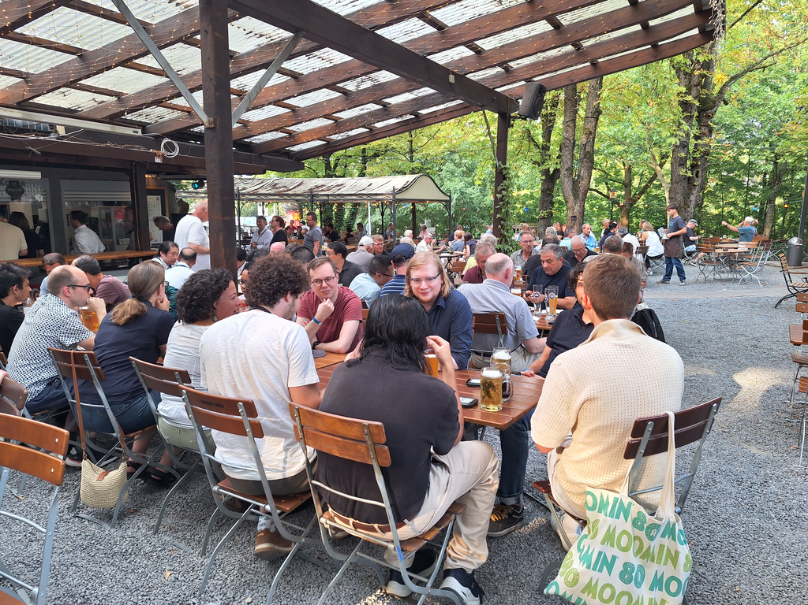
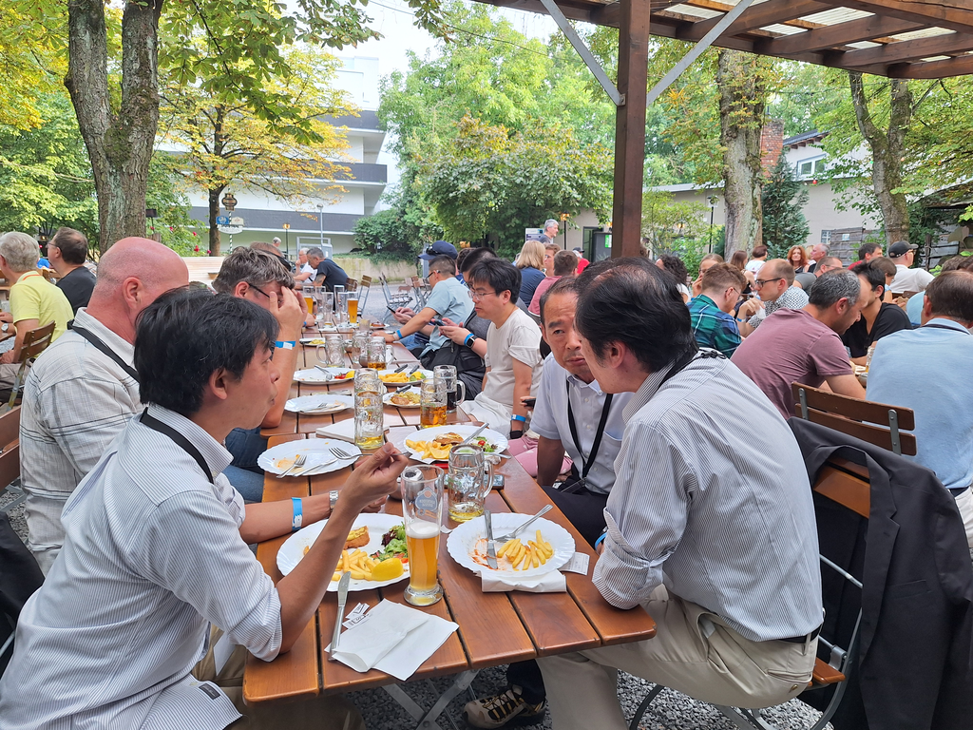
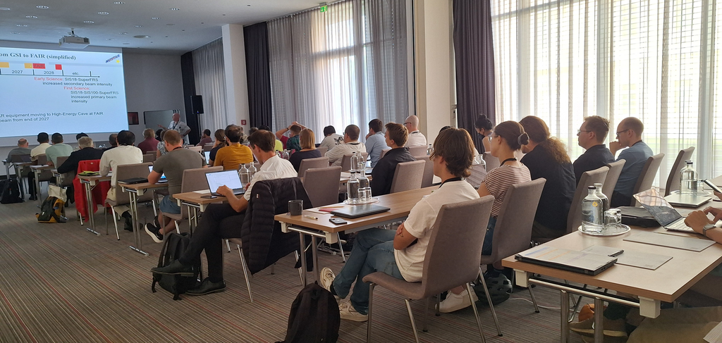
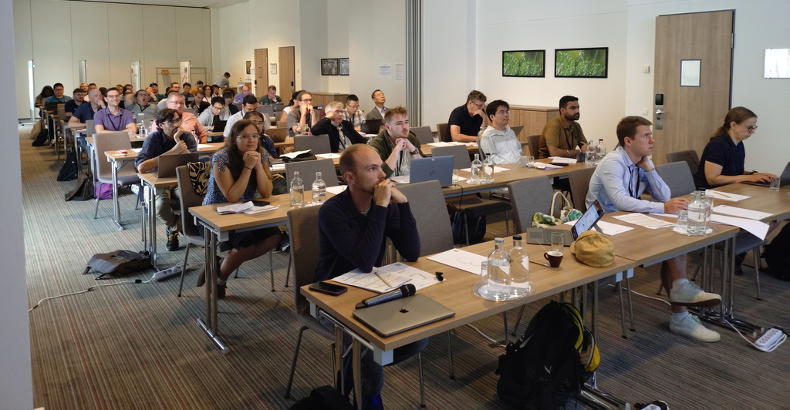
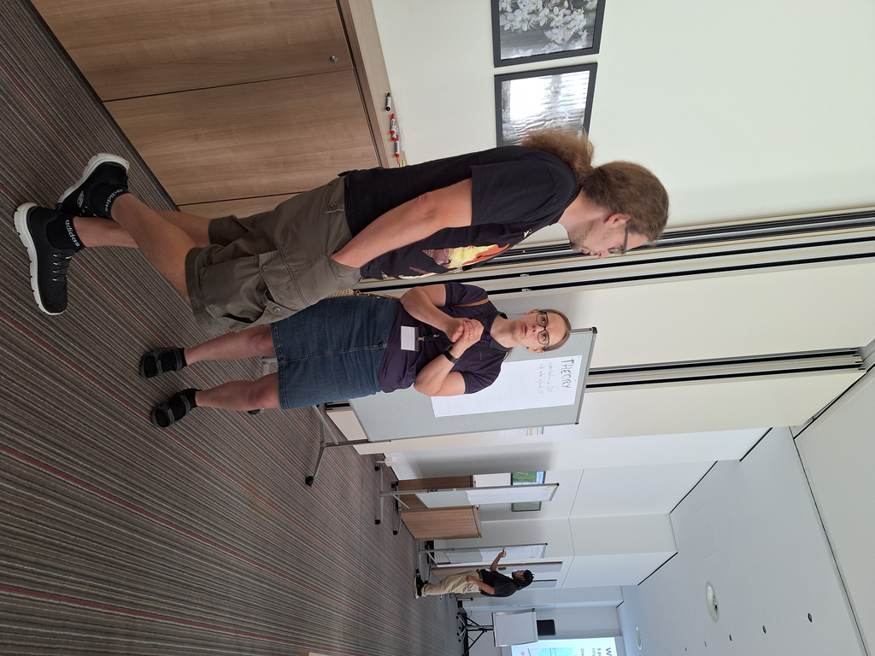
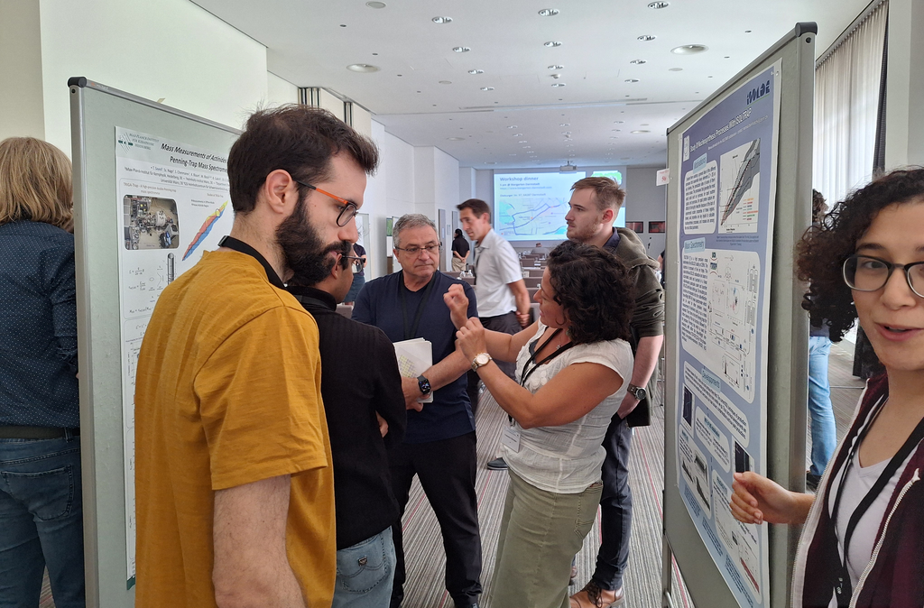
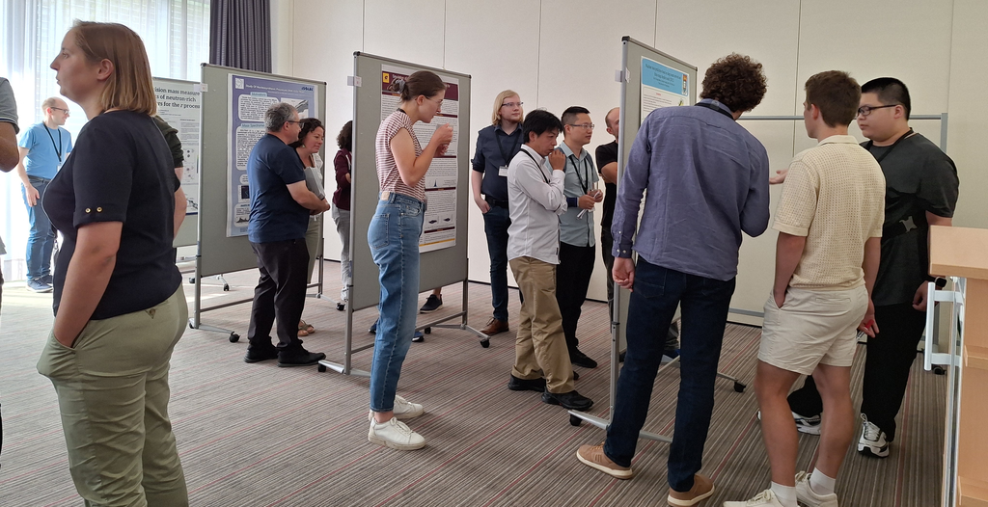

Slide 7
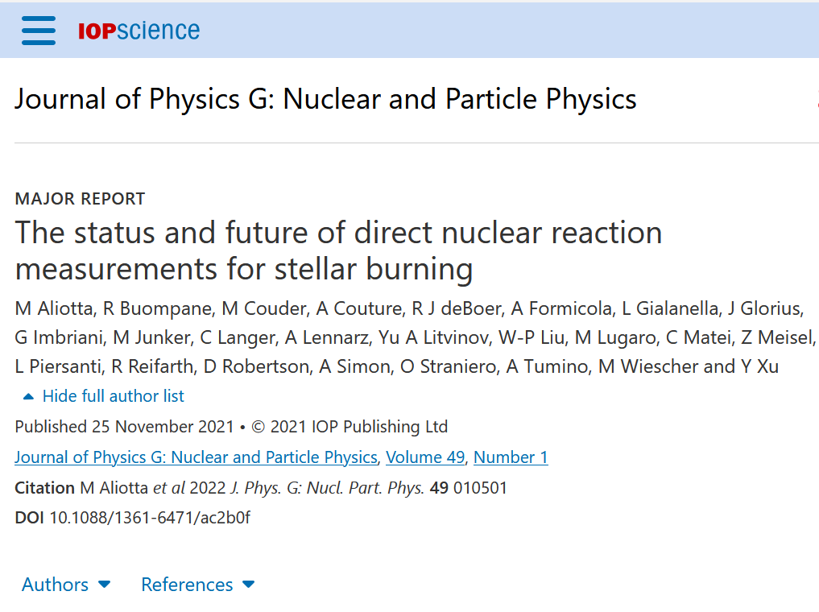
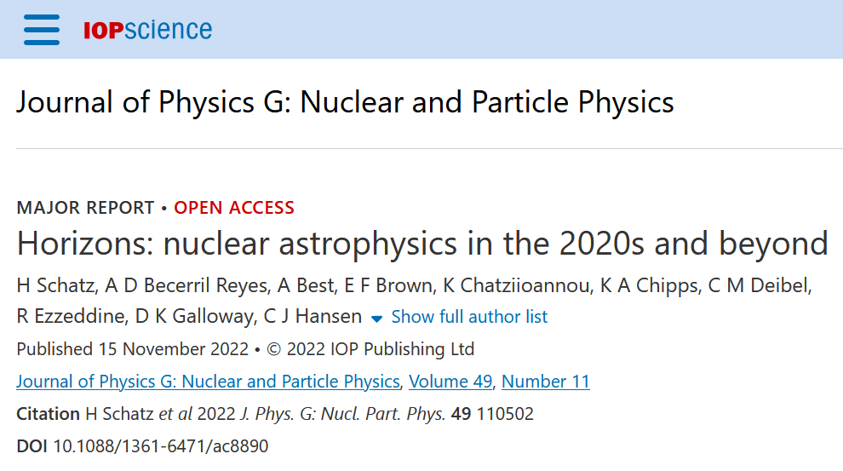
Goal: produce a white paper
This workshop has the ambitious goal of training and showcasing the next generation of nuclear mass spectrometrists, summarizing the state-of-the-art in nuclear mass measurement and theory, and charting a course for the next 25 years of nuclear masses for nuclear astrophysics.
The nuclear astrophysics community has convened in each decade of the 21st century to discuss the importance of nuclear masses and the path forward. […] Previous meetings have helped build connections between techniques, continents, and experiment to theory. This workshop will leverage these connections to transform the global network of nuclear masses for nuclear astrophysics and chart the path forward for the next quarter century.

Slide 8
White Paper: Nuclear Masses in Astrophysics for the Next 25 Years
Concisely describe important questions for the next ~25 years
Briefly review the current status of the field.
Propose methods to solve open questions, and the connections between different approaches and sub-fields
Articulate needs to implement those solutions

Slide 9
Goal: produce a white paper
This workshop has the ambitious goal of training and showcasing the next generation of nuclear mass spectrometrists, summarizing the state-of-the-art in nuclear mass measurement and theory, and charting a course for the next 25 years of nuclear masses for nuclear astrophysics.
The nuclear astrophysics community has convened in each decade of the 21st century to discuss the importance of nuclear masses and the path forward. […] Previous meetings have helped build connections between techniques, continents, and experiment to theory. This workshop will leverage these connections to transform the global network of nuclear masses for nuclear astrophysics and chart the path forward for the next quarter century.
White paper goals for this workshop
wordstack
concept map
outline
[collect ideas and content for paper]
[connections between ideas]
[detailed structure for white paper]
(define writing team | follow-up workshop)

Slide 10
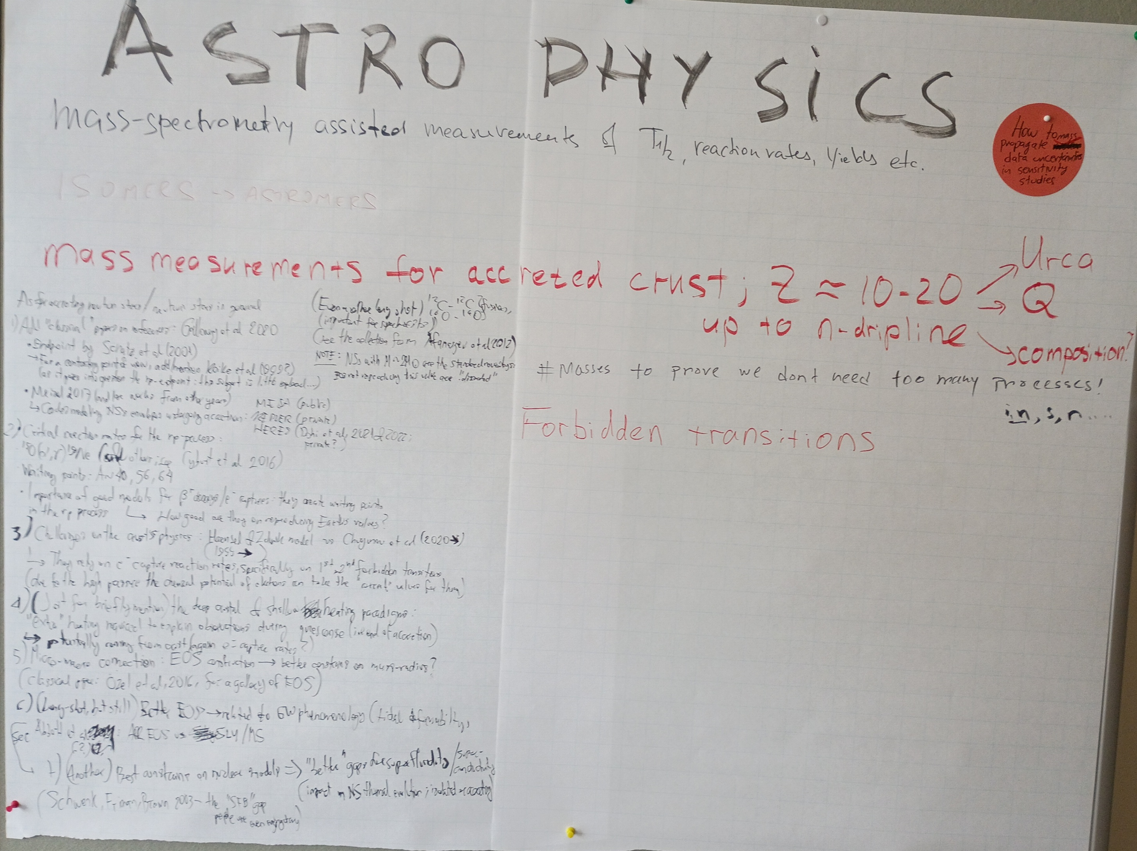
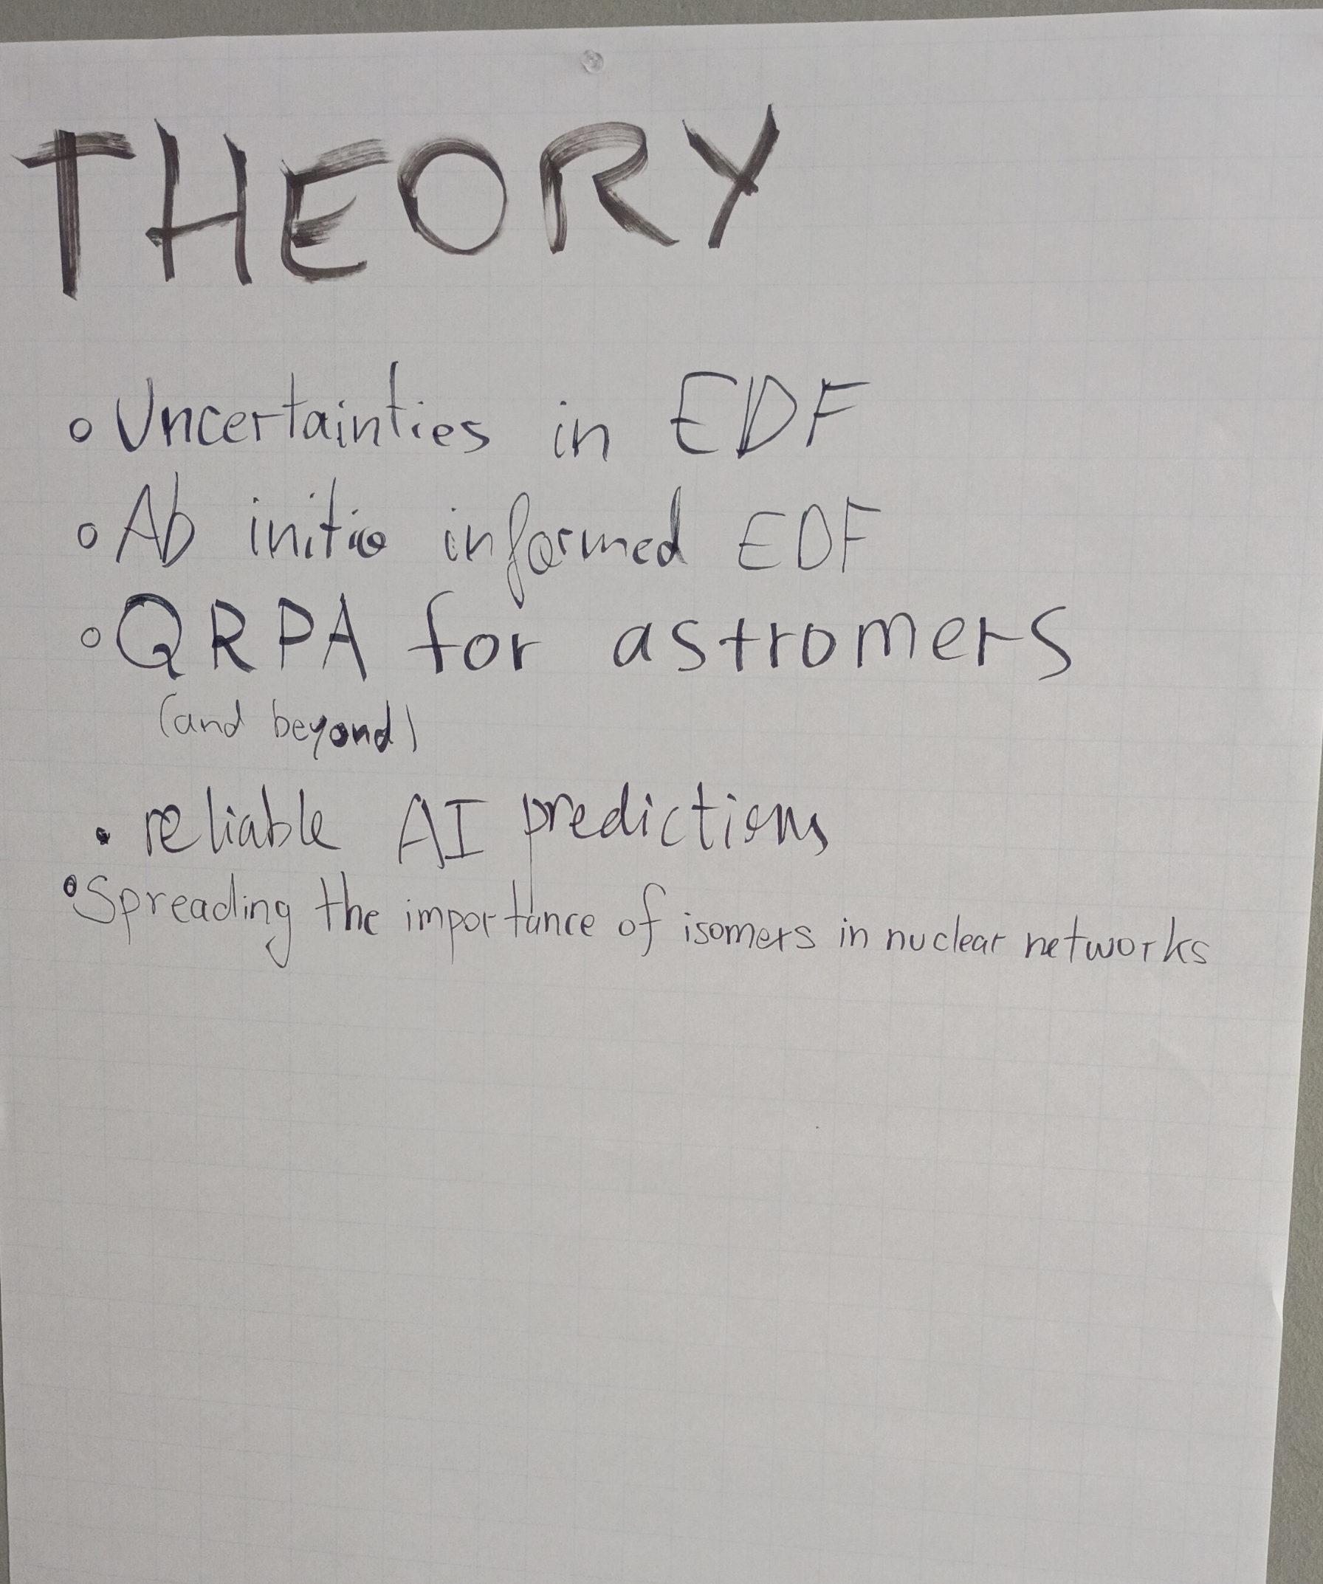
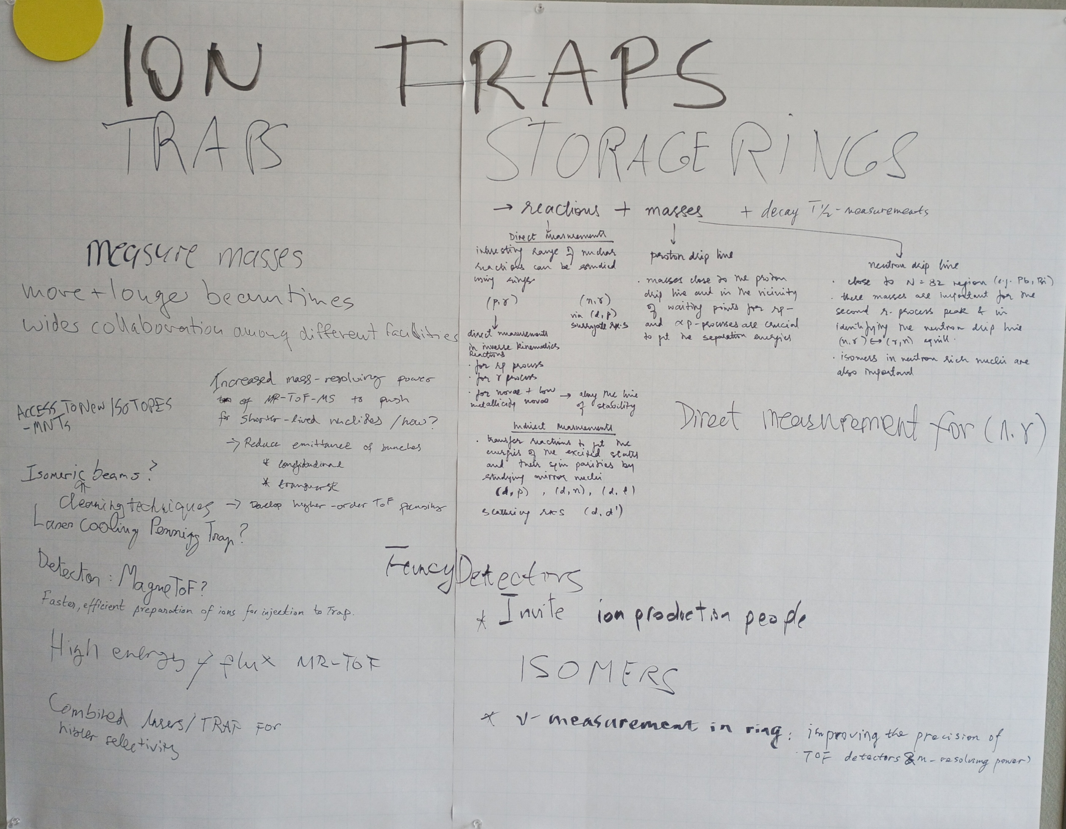
Word-stacks

Slide 11
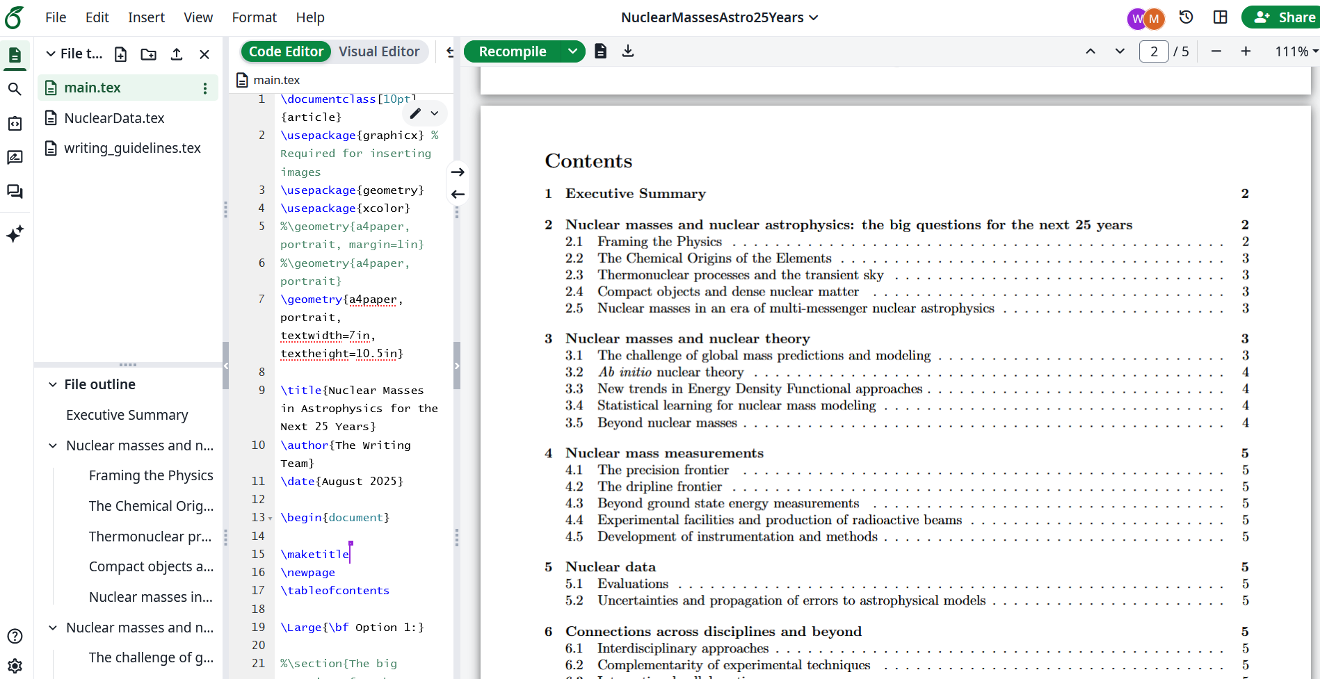
Outline

Slide 12
Writing Teams (preliminary)
Experiments: Klaus Blaum, Riujiu Chen, Alfredo Estrade, Anu Kankainen, Ania Kwiatkowski, Yuri Litvinov, Jorge Pereira, Sam Porter, Ryan Ringle, Marco Rosenbusch, Guy Savard, Pete Schury, Ragandeep Singh Sidhu, Xing Xu
Astrophysics: Almudena Arcones, Erika Holmbeck, Zach Meisel, Matt Mumpower, Wei Jia Ong, Hendrik Schatz, Nicole Vassh
Theory: Kyle Godbey, Sudhanva Lalit, Mengke Li, Luis González Miret Zaragoza, Martin Nava-Callejas, Nikolai Shchechilin
Nuclear Data: F. Kondev, R. Chakma (ANL), W. Huang & M. Wang (IMP), S. Naimi (IJCL)

Slide 13
Goal of the white paper
Audience
Timeline
Begin the production of a whitepaper charting the course to leverage the complementarity of experimental techniques, while using nuclear and astrophysics theory to guide measurements in order to maximize science output and ultimate reach across the nuclear landscape.
The whitepaper will provide a roadmap […] for future nuclear mass measurements.
funding agencies
nuclear astrophysics community
ECRs
astrophysics
experiments
techniques
nuclear theory
~<1 yr
Follow up workshop in spring or summer 2026 (North America)

Slide 14
Goals for this Nuclear Masses workshop at FRIB
Revisit goals of the White Paper?
Detailed outline for each section
  a bullet point per ~few paragraphs
Define writing teams and assign tasks
Create on timeline to finish white paper
Agree on consistency between sections of white paper
  Scope and length, overlap of content, etc

Slide 15
Method
BREAK-OUT GROUPS
CONVENE and DISCUSS
BREAK-OUT GROUPS
CONVENE and DISCUSS
BREAK-OUT GROUPS
CONVENE and DISCUSS

Slide 16
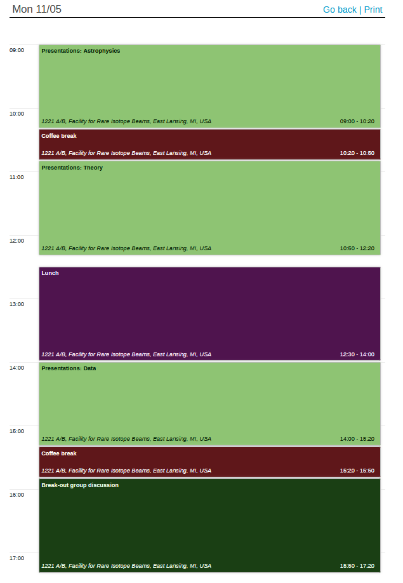
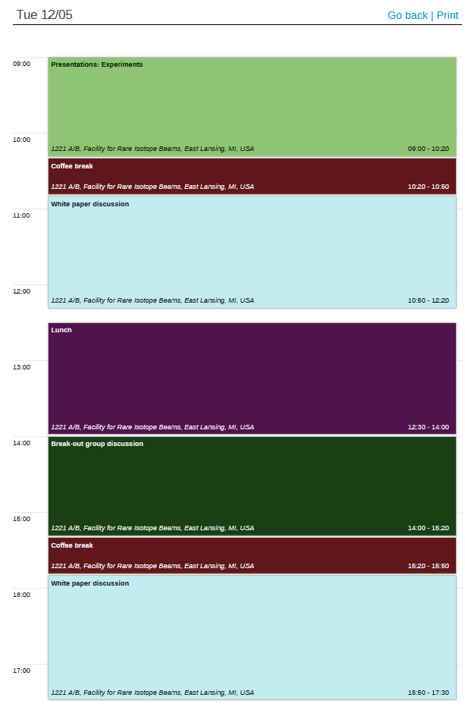
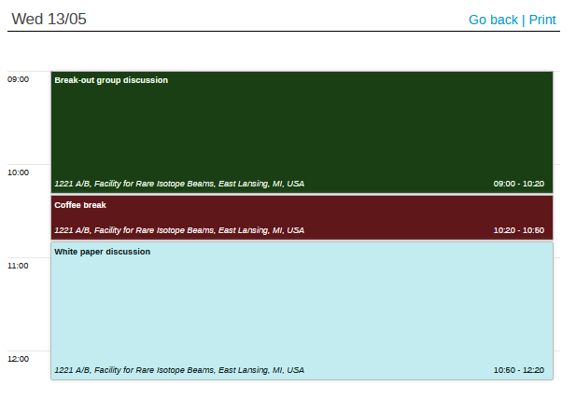
Nuclear Masses in Astrophysics for the Next 25 Years
Timetable
https://indico.global/event/17142

