Slide 1
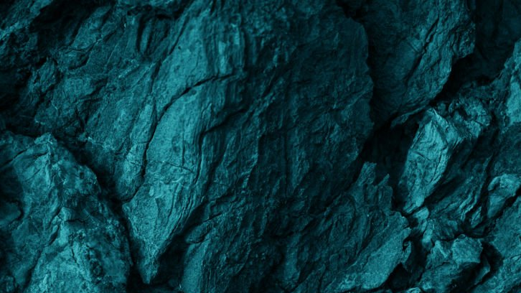
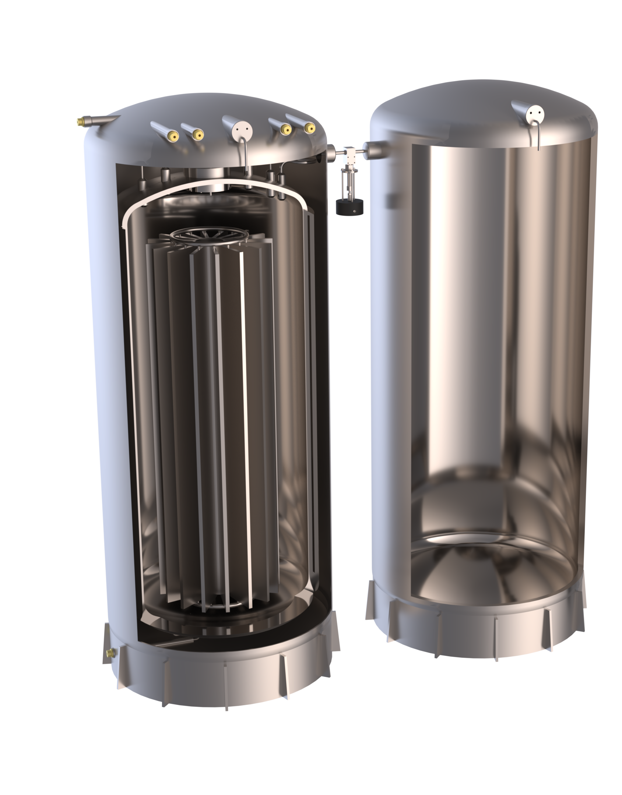


Exploring Concepts for ReStoX at SNOLAB
Frédéric Girard, McGill University
David Hawkins, SNOLAB
Chris Jillings, SNOLAB
XLZD Collaboration Meeting
Zürich, 2026

Slide 2
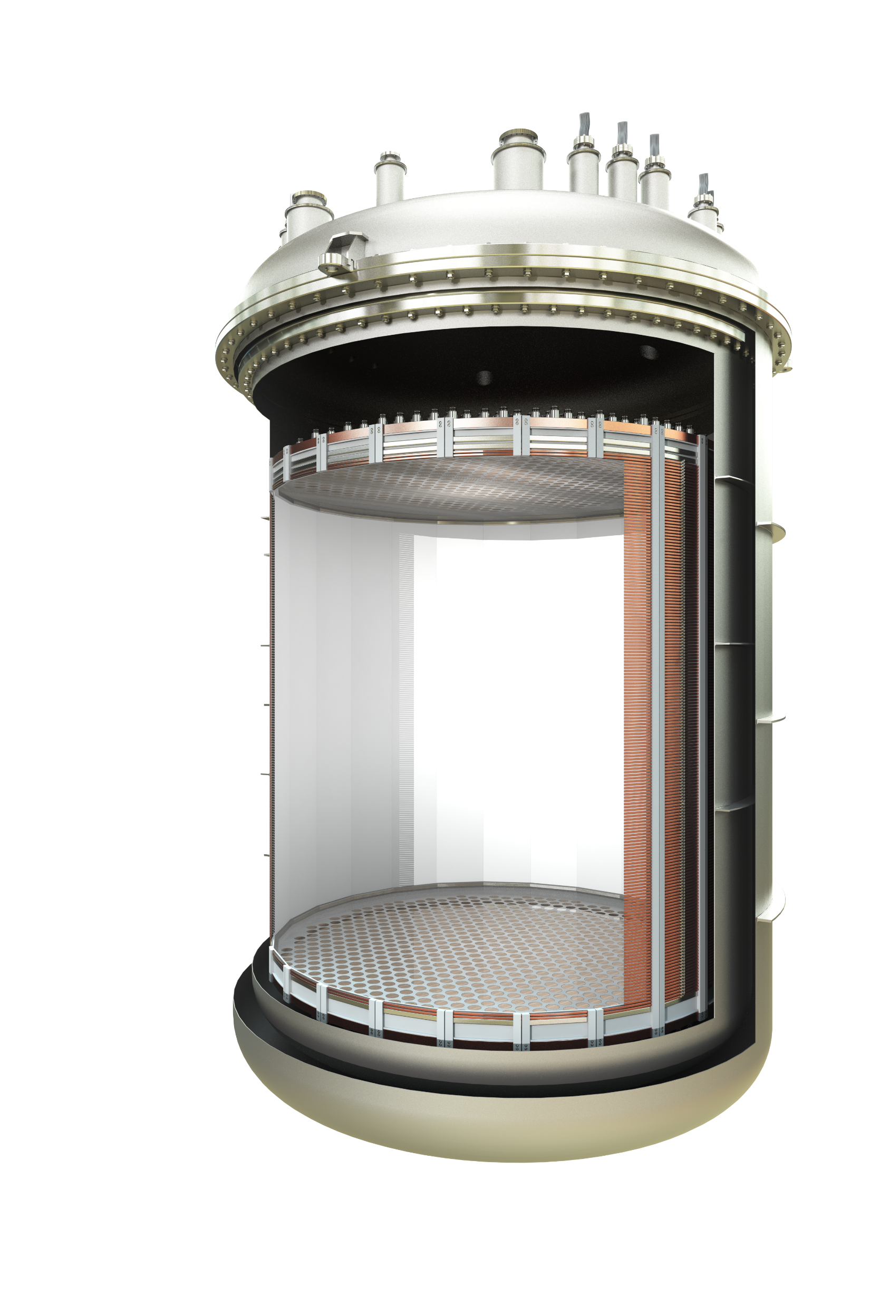
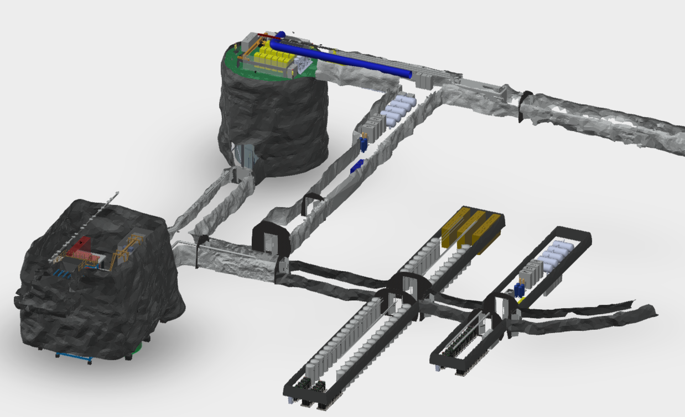
XLZD at SNOLAB
Cryopit
Upper level
Lower level
STAC
Bottom Access Drift (BAD)
Upper Drifts
CUBE-Hall
Bottom Access Ramp (BAR)
CUD
Purification and distillation columns
Xe Storage
Airlock or “Goods In”
(*Future)
BAR Expansion Drifts (*Future)
Frédéric Girard
XLZD Collaboration Meeting - Zürich 2026
Notes:
The short answer is: "we don't know". The wrong answer is: "we have no idea".
In fact it’s existence is supported by cosmological and astrophysical observations. For example, during the merger of galaxy clusters, the intergalactic gasses highlighted in pink, interacted, slowing down and warming up, emitting x-ray radiation. Stars and dark matter on the other hand passed through unaffected. The technique of weak gravitational lensing can be used to determine the mass distribution of non-luminous matter, highlighted in blue. With this we can show that dark matter accounts for 85% of the total mass of the clusters.
In fact it is known from cosmic microwave background models that there should exist 5x more dark matter than baryonic matter.

Slide 3
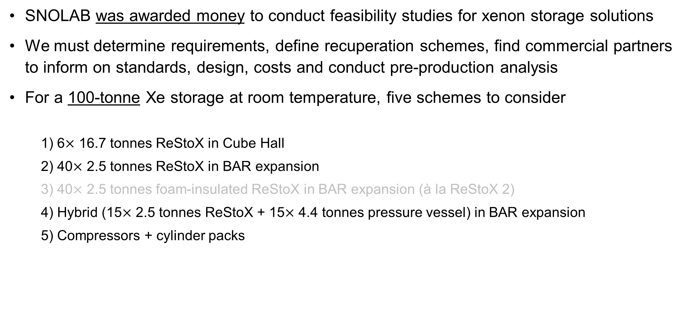
Xenon Recovery and Storage at SNOLAB
SNOLAB was awarded money to conduct feasibility studies for xenon storage solutions
We must determine requirements, define recuperation schemes, find commercial partners to inform on standards, design, costs and conduct pre-production analysis
For a 100-tonne Xe storage at room temperature, five schemes to consider
  1) 6$×$ 16.7 tonnes ReStoX in Cube Hall
  2) 40$×$ 2.5 tonnes ReStoX in BAR expansion
  3) 40$×$ 2.5 tonnes foam-insulated ReStoX in BAR expansion (à la ReStoX 2)
  4) Hybrid (15$×$ 2.5 tonnes ReStoX + 15$×$ 4.4 tonnes pressure vessel) in BAR expansion
  5) Compressors + cylinder packs
Frédéric Girard
XLZD Collaboration Meeting - Zürich 2026
Notes:
The short answer is: "we don't know". The wrong answer is: "we have no idea".
In fact it’s existence is supported by cosmological and astrophysical observations. For example, during the merger of galaxy clusters, the intergalactic gasses highlighted in pink, interacted, slowing down and warming up, emitting x-ray radiation. Stars and dark matter on the other hand passed through unaffected. The technique of weak gravitational lensing can be used to determine the mass distribution of non-luminous matter, highlighted in blue. With this we can show that dark matter accounts for 85% of the total mass of the clusters.
In fact it is known from cosmic microwave background models that there should exist 5x more dark matter than baryonic matter.

Slide 4
Xenon Recovery and Storage at SNOLAB
Built
Pre-production
SNOLAB was awarded money to conduct feasibility studies for xenon storage solutions
We must determine requirements, define recuperation schemes, find commercial partners to inform on standards, design, costs and conduct pre-production analysis
For a 100-tonne Xe storage at room temperature, five schemes to consider
  1) 6$×$ 16.7 tonnes ReStoX in Cube Hall
  2) 40$×$ 2.5 tonnes ReStoX in BAR expansion
  3) 40$×$ 2.5 tonnes foam-insulated ReStoX in BAR expansion (à la ReStoX 2)
  4) Hybrid (15$×$ 2.5 tonnes ReStoX + 15$×$ 4.4 tonnes pressure vessel) in BAR expansion
  5) Compressors + cylinder packs
Engineering
Conceptual
Design maturity throughout this presentation
Frédéric Girard
XLZD Collaboration Meeting - Zürich 2026
Notes:
The short answer is: "we don't know". The wrong answer is: "we have no idea".
In fact it’s existence is supported by cosmological and astrophysical observations. For example, during the merger of galaxy clusters, the intergalactic gasses highlighted in pink, interacted, slowing down and warming up, emitting x-ray radiation. Stars and dark matter on the other hand passed through unaffected. The technique of weak gravitational lensing can be used to determine the mass distribution of non-luminous matter, highlighted in blue. With this we can show that dark matter accounts for 85% of the total mass of the clusters.
In fact it is known from cosmic microwave background models that there should exist 5x more dark matter than baryonic matter.

Slide 5
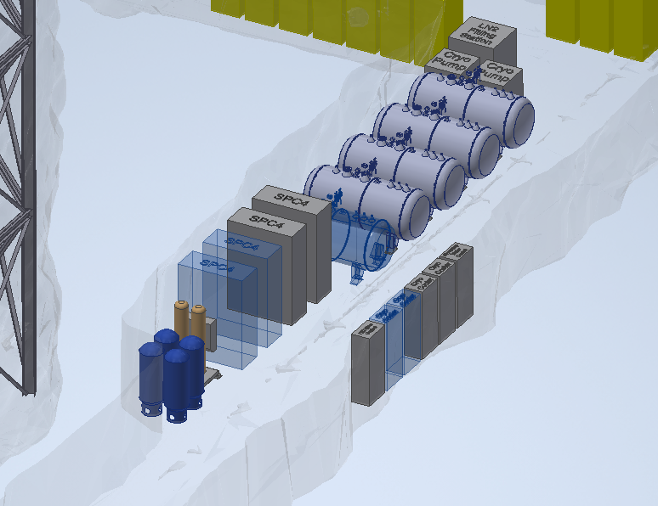
LN₂ production at SNOLAB
Engineering
LN₂ enables:
  Detector cooling
  Radon removal
  Xenon recovery
N₂ system = Generation + Cooling + Energy Buffer
Produced in 2 locations (redundancy + distribution)
Distributed storage acts as thermal battery
Boil-off GN₂ reused across subsystems
Cryocoolers reliquefy boil-off in closed-loop (4 kW each)
Based on commercial + SNOLAB-proven systems
New LN₂ Production rate: 18 L/h
Space available for a total of 30 000 L of LN₂
Ancillary LN Equipment
Storage dewars
3 000 liters each
Cryocoolers
4 kW each
N2 Generation Components
Spare Dewar
Cryocoolers Power Control (VFD)
Space for Future Cryocoolers
CUD Equipment Layout
(Equipment Allocation Shown)
Frédéric Girard
XLZD Collaboration Meeting - Zürich 2026
Notes:
The short answer is: "we don't know". The wrong answer is: "we have no idea".
In fact it’s existence is supported by cosmological and astrophysical observations. For example, during the merger of galaxy clusters, the intergalactic gasses highlighted in pink, interacted, slowing down and warming up, emitting x-ray radiation. Stars and dark matter on the other hand passed through unaffected. The technique of weak gravitational lensing can be used to determine the mass distribution of non-luminous matter, highlighted in blue. With this we can show that dark matter accounts for 85% of the total mass of the clusters.
In fact it is known from cosmic microwave background models that there should exist 5x more dark matter than baryonic matter.

Slide 6
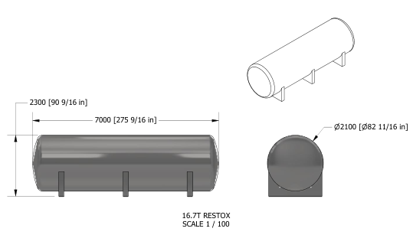
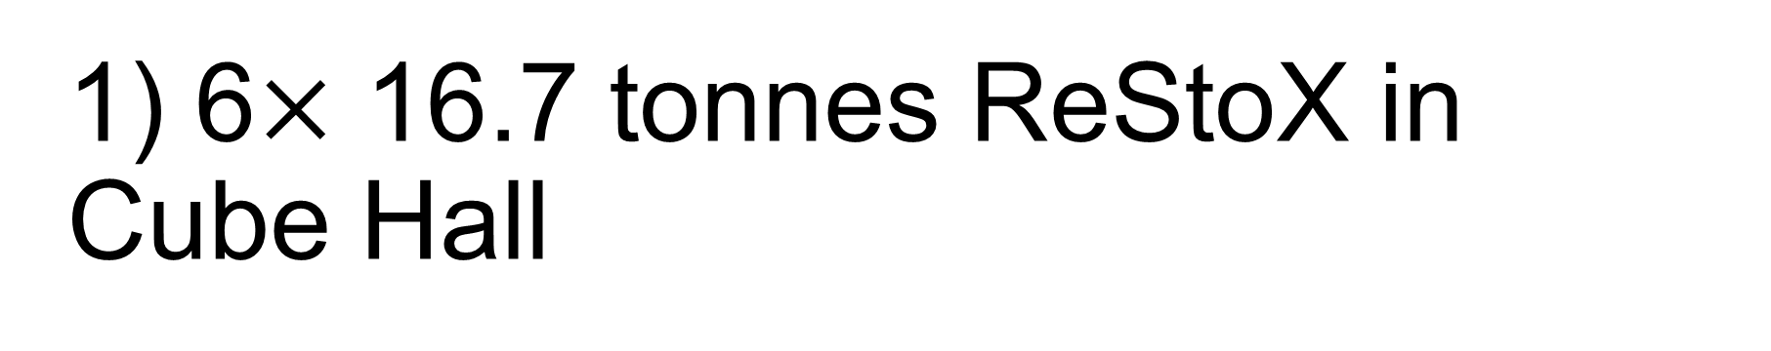
1) 6$×$ 16.7 tonnes ReStoX in Cube Hall
Conceptual
Array of six cryo-capable ReStoX
Installed on the ground floor of the Cube Hall
Capacity of 16.7 tonne of Xe each at room temperature
No production drawings yet
Need for cryo-engineering and input from commercial partners
Underground fabrication needed
Frédéric Girard
XLZD Collaboration Meeting - Zürich 2026
Notes:
The short answer is: "we don't know". The wrong answer is: "we have no idea".
In fact it’s existence is supported by cosmological and astrophysical observations. For example, during the merger of galaxy clusters, the intergalactic gasses highlighted in pink, interacted, slowing down and warming up, emitting x-ray radiation. Stars and dark matter on the other hand passed through unaffected. The technique of weak gravitational lensing can be used to determine the mass distribution of non-luminous matter, highlighted in blue. With this we can show that dark matter accounts for 85% of the total mass of the clusters.
In fact it is known from cosmic microwave background models that there should exist 5x more dark matter than baryonic matter.

Slide 7
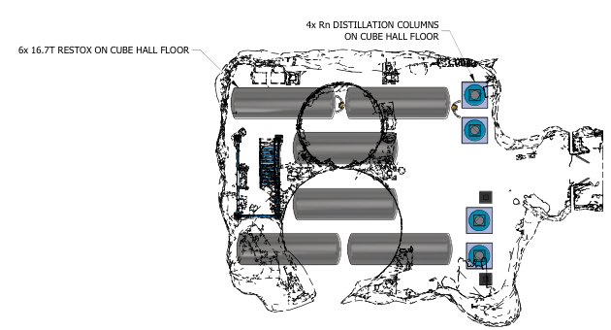
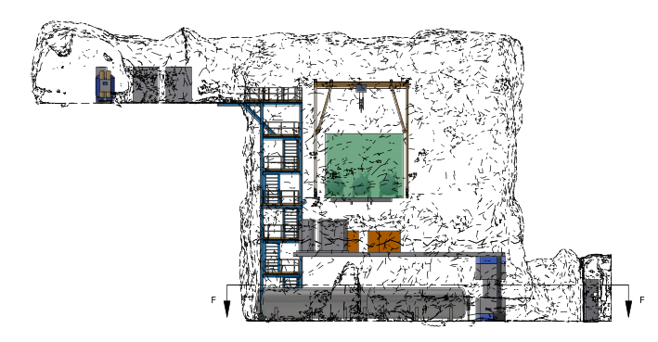
1) 6$×$ 16.7 tonnes ReStoX in Cube Hall
Engineering
Array of six cryo-capable ReStoX
Installed on the ground floor of the Cube Hall
Capacity of 16.7 tonne of Xe each at room temperature
No production drawings yet
Need for cryo-engineering and input from commercial partners
Underground fabrication needed
Frédéric Girard
XLZD Collaboration Meeting - Zürich 2026
Notes:
The short answer is: "we don't know". The wrong answer is: "we have no idea".
In fact it’s existence is supported by cosmological and astrophysical observations. For example, during the merger of galaxy clusters, the intergalactic gasses highlighted in pink, interacted, slowing down and warming up, emitting x-ray radiation. Stars and dark matter on the other hand passed through unaffected. The technique of weak gravitational lensing can be used to determine the mass distribution of non-luminous matter, highlighted in blue. With this we can show that dark matter accounts for 85% of the total mass of the clusters.
In fact it is known from cosmic microwave background models that there should exist 5x more dark matter than baryonic matter.

Slide 8
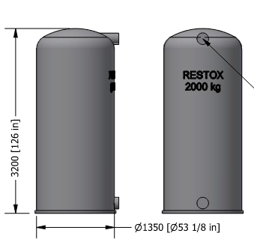
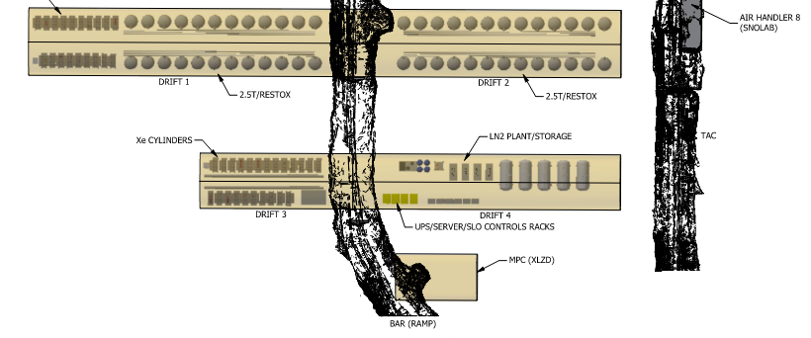
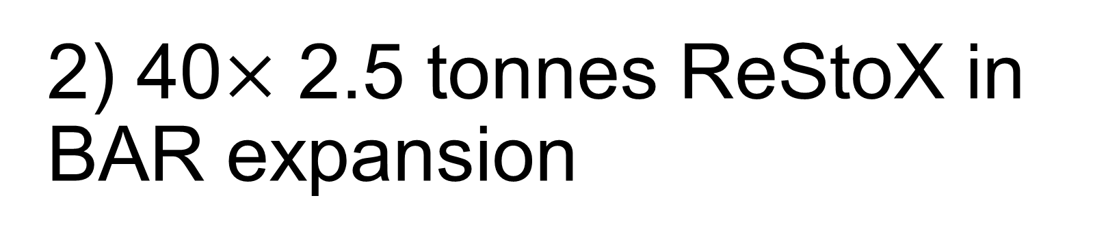
2) 40$×$ 2.5 tonnes ReStoX in BAR expansion
Engineering
Array of 40 cryo-capable ReStoX
Space available for up to 50 vessels
Installed in the BAR expansion drifts (planned)
Capacity of 2.5 tonne each
Originally designed for nEXO
“In principle” production-ready
325 Xe High Pressure Cylinders
2.5 tonne Vessel
BAR Drifts
Dedicated LN2 plant + storage for recovery
Frédéric Girard
XLZD Collaboration Meeting - Zürich 2026
Notes:
The short answer is: "we don't know". The wrong answer is: "we have no idea".
In fact it’s existence is supported by cosmological and astrophysical observations. For example, during the merger of galaxy clusters, the intergalactic gasses highlighted in pink, interacted, slowing down and warming up, emitting x-ray radiation. Stars and dark matter on the other hand passed through unaffected. The technique of weak gravitational lensing can be used to determine the mass distribution of non-luminous matter, highlighted in blue. With this we can show that dark matter accounts for 85% of the total mass of the clusters.
In fact it is known from cosmic microwave background models that there should exist 5x more dark matter than baryonic matter.

Slide 9
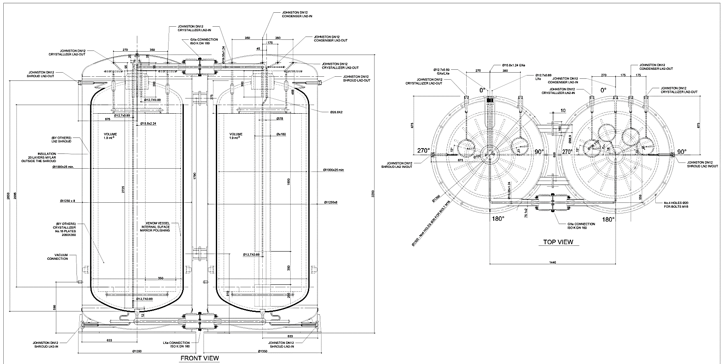
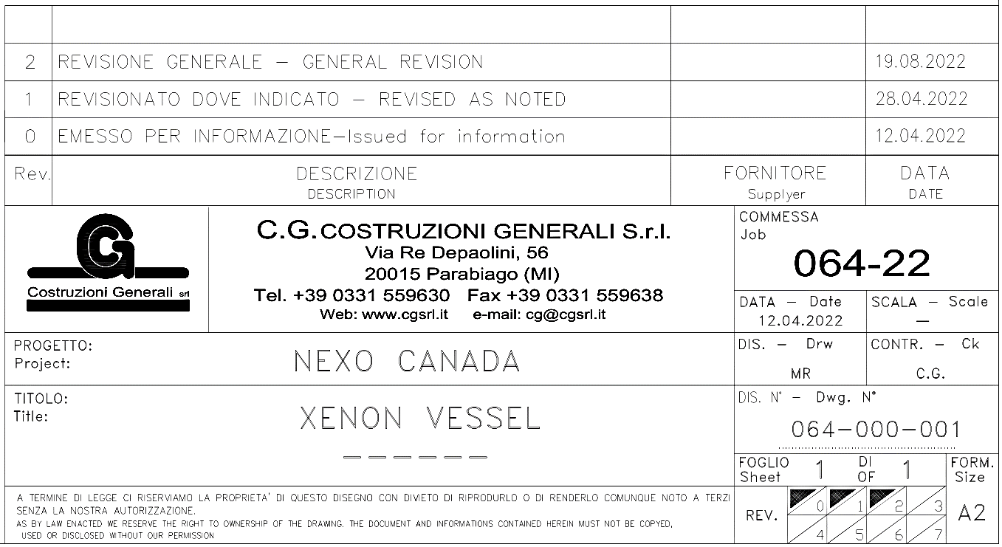
2) 40$×$ 2.5 tonnes ReStoX in BAR expansion
Pre-production
Frédéric Girard
XLZD Collaboration Meeting - Zürich 2026
Notes:
The short answer is: "we don't know". The wrong answer is: "we have no idea".
In fact it’s existence is supported by cosmological and astrophysical observations. For example, during the merger of galaxy clusters, the intergalactic gasses highlighted in pink, interacted, slowing down and warming up, emitting x-ray radiation. Stars and dark matter on the other hand passed through unaffected. The technique of weak gravitational lensing can be used to determine the mass distribution of non-luminous matter, highlighted in blue. With this we can show that dark matter accounts for 85% of the total mass of the clusters.
In fact it is known from cosmic microwave background models that there should exist 5x more dark matter than baryonic matter.

Slide 10
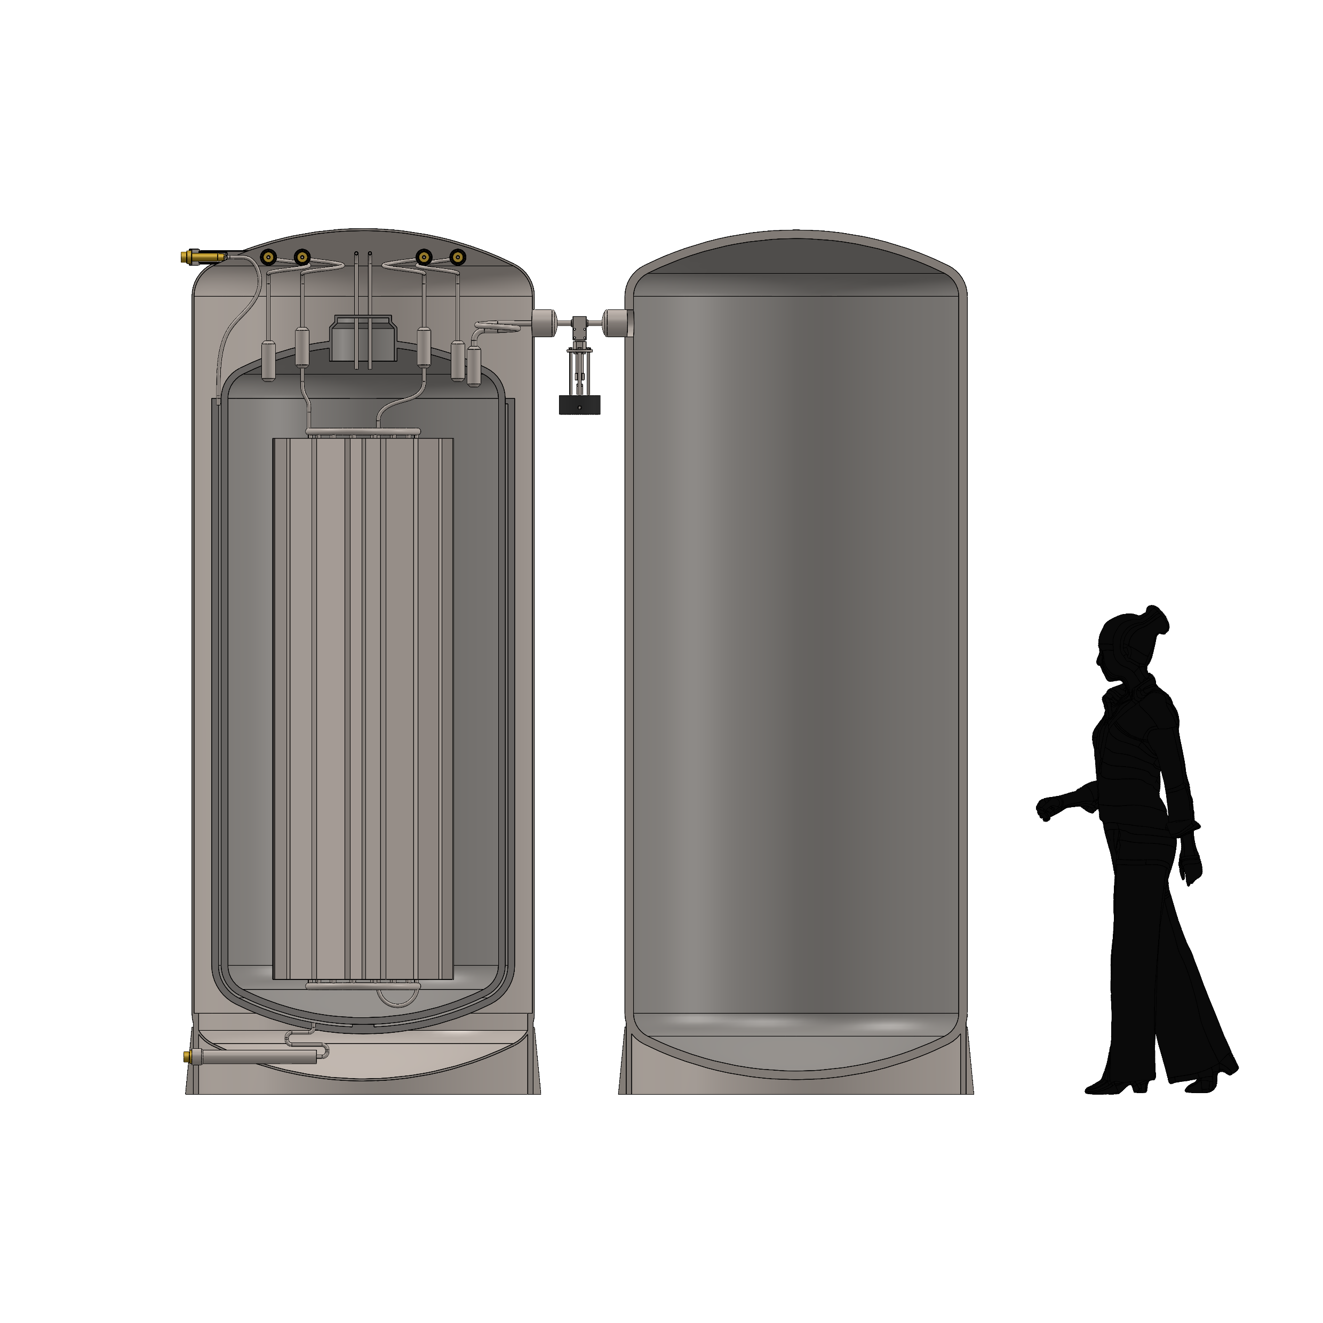



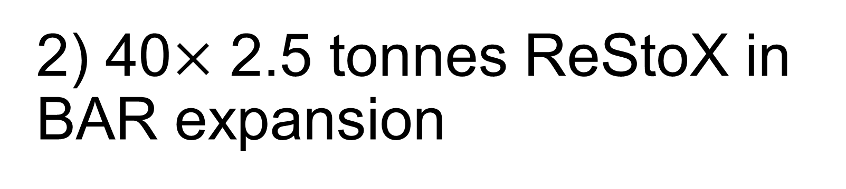
2) 40$×$ 2.5 tonnes ReStoX in BAR expansion
Conceptual
1.26 m
Xe Connections
LN₂ and Boil-off Connections
20 pairs of ReStoX
Design driven by maximum size and weight that can be transported in the cage
Volume: 1.9 m³, 2.5 tonne Xe at room temperature each (73 bar + full vacuum)
Crystalliser: 8 kW cooling power
  nEXO required two for redundancy
Shroud: keeps inner vessel cold using 0.1 kW of cooling power (LN₂)
One vessel with condenser for Xe liquefaction
Outer Vessel
Condenser
(Not shown, no drawing available)
3.2 m
Inner Vessel
Shroud
Crystallizer
Frédéric Girard
XLZD Collaboration Meeting - Zürich 2026
Notes:
The short answer is: "we don't know". The wrong answer is: "we have no idea".
In fact it’s existence is supported by cosmological and astrophysical observations. For example, during the merger of galaxy clusters, the intergalactic gasses highlighted in pink, interacted, slowing down and warming up, emitting x-ray radiation. Stars and dark matter on the other hand passed through unaffected. The technique of weak gravitational lensing can be used to determine the mass distribution of non-luminous matter, highlighted in blue. With this we can show that dark matter accounts for 85% of the total mass of the clusters.
In fact it is known from cosmic microwave background models that there should exist 5x more dark matter than baryonic matter.

Slide 11
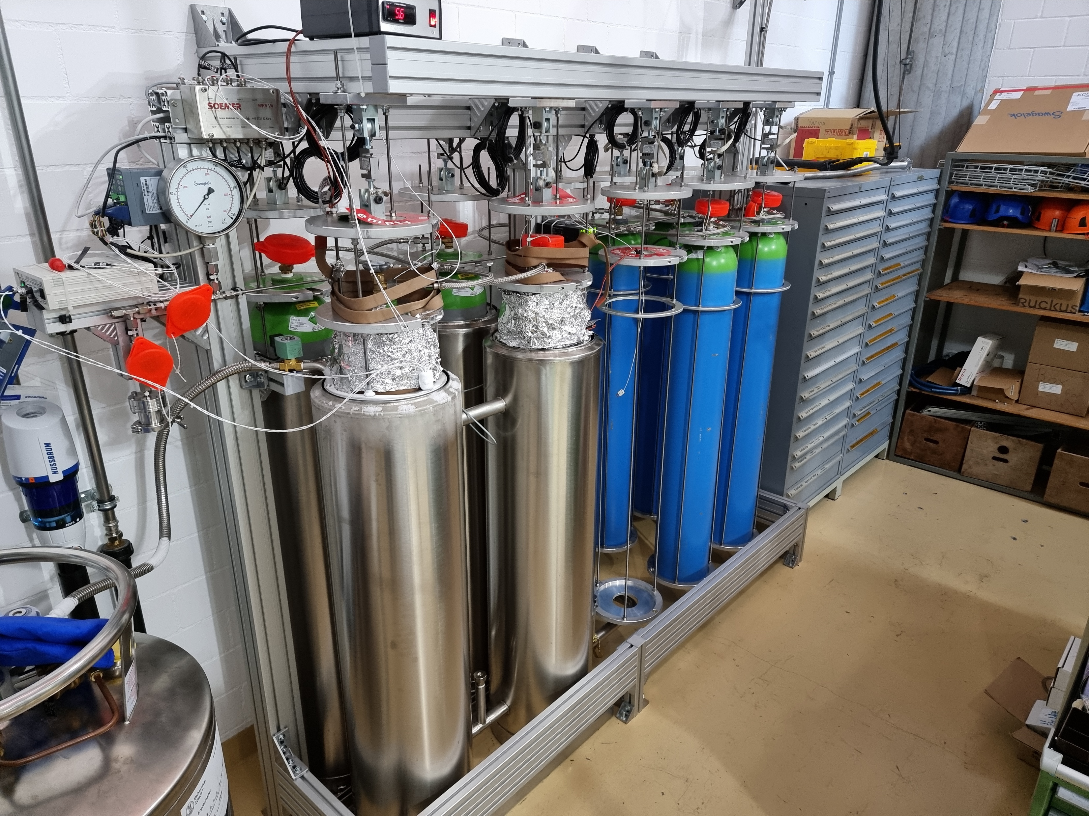
4) Hybrid Scheme
Built
Inspiration: Gas cylinder recuperation in Xenoscope
Capacity: ~400 kg
Cryopump all the xenon in up to 4 cylinders (frozen)
  Overfills cylinders!
After recuperation is complete, redistribute all the xenon into a total of 9 cylinders
Lower cost than all cylinders cryo-capable
Design by Kevin Thieme
Frédéric Girard
XLZD Collaboration Meeting - Zürich 2026
Notes:
The short answer is: "we don't know". The wrong answer is: "we have no idea".
In fact it’s existence is supported by cosmological and astrophysical observations. For example, during the merger of galaxy clusters, the intergalactic gasses highlighted in pink, interacted, slowing down and warming up, emitting x-ray radiation. Stars and dark matter on the other hand passed through unaffected. The technique of weak gravitational lensing can be used to determine the mass distribution of non-luminous matter, highlighted in blue. With this we can show that dark matter accounts for 85% of the total mass of the clusters.
In fact it is known from cosmic microwave background models that there should exist 5x more dark matter than baryonic matter.

Slide 12

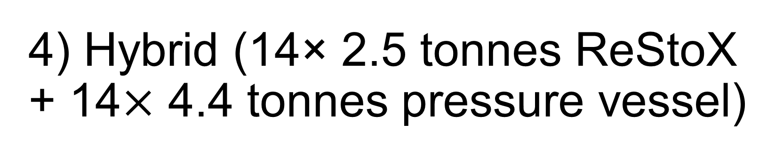
4) Hybrid (14× 2.5 tonnes ReStoX + 14$×$ 4.4 tonnes pressure vessel)
Very Conceptual
Two types of vessels, same dimensions, same pressure rating (74 bara at room temperature)
15 pairs → 103 320 kg GXe
Xe Connections
LN₂ and Boil-off Connections
Outer Vessel
Condenser
(Not shown, no drawing available)
Single-walled PV
 | ReStoX | Pressure Vessel | Total (pair)
Pressure rating at 295 K [bara] | 74 | 74 | 74
Tare weight (est.) [kg] | 4 200 | 3 500 | 7 700
GXe capacity [kg] | 2 500 | 4 388 | 6 888
LXe capacity [kg] | 5 590 | --- | 5 590
SXe capacity [kg] | 6 916 | --- | 6 916
Cooling Power (Crystallizer) [kW] | 8 | --- | 8
Cooling Power (Shroud) [kW] | 0.1 | --- | 0.1
Cost | $$$$ | $ | $$
Inner Vessel
Shroud
Crystallizer
Frédéric Girard
XLZD Collaboration Meeting - Zürich 2026
Notes:
The short answer is: "we don't know". The wrong answer is: "we have no idea".
In fact it’s existence is supported by cosmological and astrophysical observations. For example, during the merger of galaxy clusters, the intergalactic gasses highlighted in pink, interacted, slowing down and warming up, emitting x-ray radiation. Stars and dark matter on the other hand passed through unaffected. The technique of weak gravitational lensing can be used to determine the mass distribution of non-luminous matter, highlighted in blue. With this we can show that dark matter accounts for 85% of the total mass of the clusters.
In fact it is known from cosmic microwave background models that there should exist 5x more dark matter than baryonic matter.

Slide 13
4) Hybrid (14× 2.5 tonnes ReStoX + 14$×$ 4.4 tonnes pressure vessel)
Very Conceptual
Xe Connections
LN₂ and Boil-off Connections
Recuperation scheme:
  Receive LXe from TPC in ReStoX
  Freeze LXe with crystallizer
    Pressure in ReStoX → 0 bar
    Pressure difference drives the recuperation
  When ReStoX full, isolate from the system and switch to another ReStoX
Outer Vessel
Condenser
(Not shown, no drawing available)
Single-walled PV
Inner Vessel
Shroud
Crystallizer
Frédéric Girard
XLZD Collaboration Meeting - Zürich 2026
Notes:
The short answer is: "we don't know". The wrong answer is: "we have no idea".
In fact it’s existence is supported by cosmological and astrophysical observations. For example, during the merger of galaxy clusters, the intergalactic gasses highlighted in pink, interacted, slowing down and warming up, emitting x-ray radiation. Stars and dark matter on the other hand passed through unaffected. The technique of weak gravitational lensing can be used to determine the mass distribution of non-luminous matter, highlighted in blue. With this we can show that dark matter accounts for 85% of the total mass of the clusters.
In fact it is known from cosmic microwave background models that there should exist 5x more dark matter than baryonic matter.

Slide 14
4) Hybrid (14× 2.5 tonnes ReStoX + 14$×$ 4.4 tonnes pressure vessel)
Very Conceptual
Xe Connections
LN₂ and Boil-off Connections
Recuperation scheme:
  Receive LXe from TPC in ReStoX
  Freeze LXe with crystallizer
    Pressure in ReStoX → 0 bar
    Pressure difference drives the recuperation
  When ReStoX full, isolate from the system and switch to another ReStoX
  After isolation from the recuperation line, open the connection to the pressure vessel and let the SXe warm up and distribute gas between the PV and ReStoX
Outer Vessel
Condenser
(Not shown, no drawing available)
Single-walled PV
Inner Vessel
Shroud
Crystallizer
Frédéric Girard
XLZD Collaboration Meeting - Zürich 2026
Notes:
The short answer is: "we don't know". The wrong answer is: "we have no idea".
In fact it’s existence is supported by cosmological and astrophysical observations. For example, during the merger of galaxy clusters, the intergalactic gasses highlighted in pink, interacted, slowing down and warming up, emitting x-ray radiation. Stars and dark matter on the other hand passed through unaffected. The technique of weak gravitational lensing can be used to determine the mass distribution of non-luminous matter, highlighted in blue. With this we can show that dark matter accounts for 85% of the total mass of the clusters.
In fact it is known from cosmic microwave background models that there should exist 5x more dark matter than baryonic matter.

Slide 15
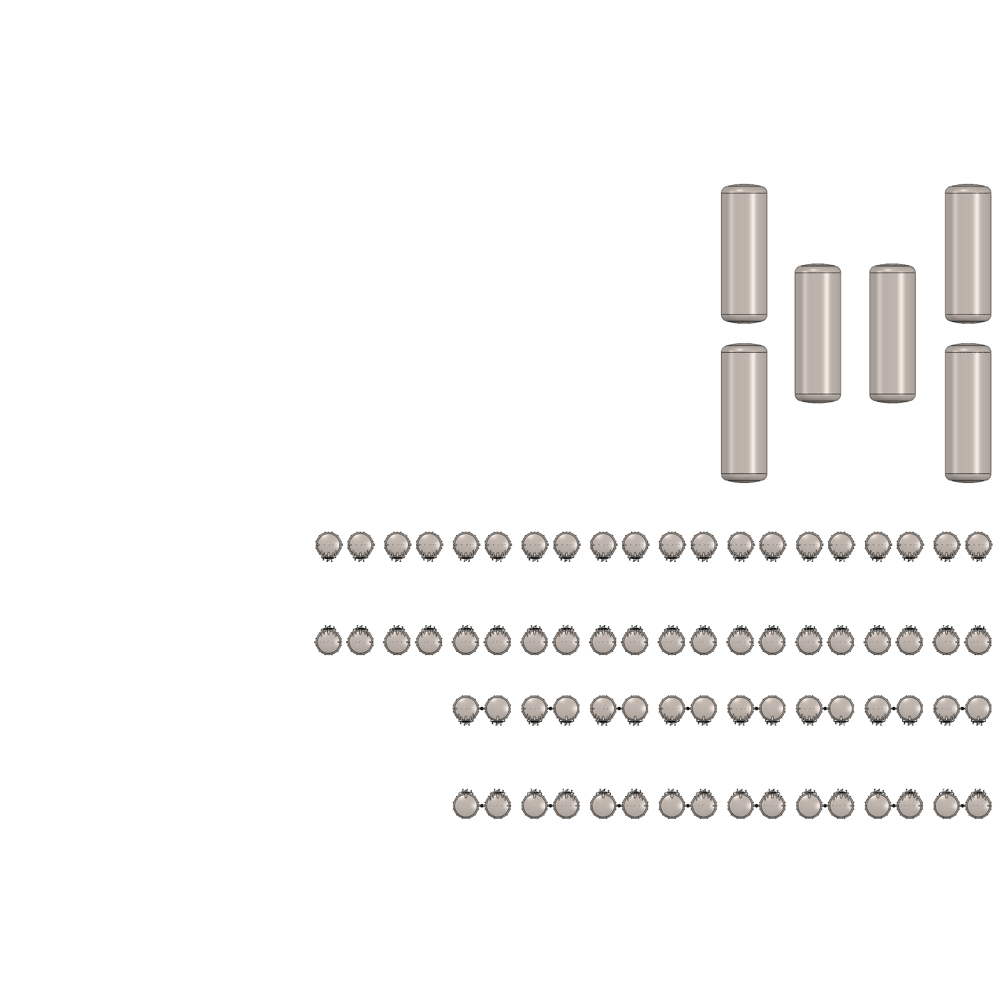
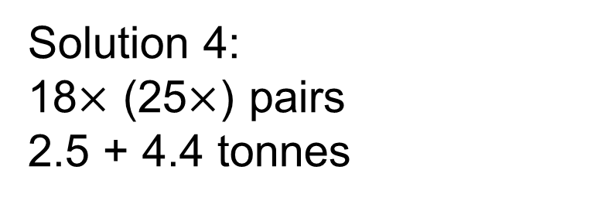
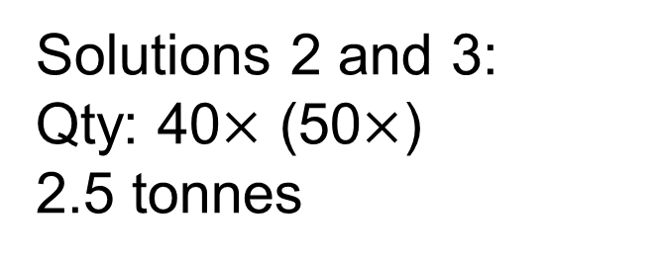
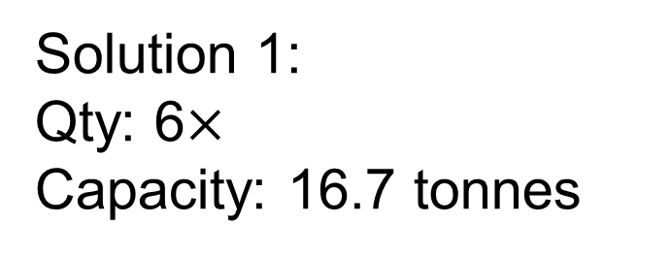
Footprint
Conceptual
15 m
Space available for extra
Solution 1:
Qty: 6$×$
Capacity: 16.7 tonnes
15 m
Solutions 2 and 3:
Qty: 40$×$ (50$×$)
2.5 tonnes
33 m
10 m
Solution 4:
18$×$ (25$×$) pairs
2.5 + 4.4 tonnes
26 m
17 m
Frédéric Girard
XLZD Collaboration Meeting - Zürich 2026
Notes:
The short answer is: "we don't know". The wrong answer is: "we have no idea".
In fact it’s existence is supported by cosmological and astrophysical observations. For example, during the merger of galaxy clusters, the intergalactic gasses highlighted in pink, interacted, slowing down and warming up, emitting x-ray radiation. Stars and dark matter on the other hand passed through unaffected. The technique of weak gravitational lensing can be used to determine the mass distribution of non-luminous matter, highlighted in blue. With this we can show that dark matter accounts for 85% of the total mass of the clusters.
In fact it is known from cosmic microwave background models that there should exist 5x more dark matter than baryonic matter.

Slide 16
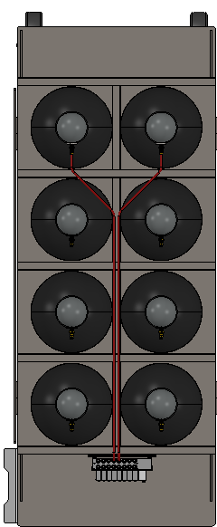
Conceptual
Footprint
15 m
Space available for extra
Solution 1:
Qty: 6$×$
Capacity: 16.7 tonnes
15 m
Solutions 2 and 3:
Qty: 40$×$ (50$×$)
2.5 tonnes
33 m
10 m
Solution 4:
18$×$ (25$×$) pairs
2.5 + 4.4 tonnes
26 m
17 m
Solution 5:
1 820 cylinders
54 m (?)
Frédéric Girard
XLZD Collaboration Meeting - Zürich 2026
Notes:
The short answer is: "we don't know". The wrong answer is: "we have no idea".
In fact it’s existence is supported by cosmological and astrophysical observations. For example, during the merger of galaxy clusters, the intergalactic gasses highlighted in pink, interacted, slowing down and warming up, emitting x-ray radiation. Stars and dark matter on the other hand passed through unaffected. The technique of weak gravitational lensing can be used to determine the mass distribution of non-luminous matter, highlighted in blue. With this we can show that dark matter accounts for 85% of the total mass of the clusters.
In fact it is known from cosmic microwave background models that there should exist 5x more dark matter than baryonic matter.

Slide 17
Xenon Recovery and Storage at SNOLAB
SNOLAB was awarded money to conduct feasibility studies for xenon storage solutions
We must determine requirements, define recuperation schemes, find commercial partners to inform on standards, design, costs and conduct pre-production analysis
Is the SNOLAB solution compatible with ReStoX at Boulby?
If you think you want to/can help this effort, please join us!
  1.03-1.04 meetings (L2: Christian Weinheimer, Lutz Althüser, Frédéric Girard)
  Recovery task force (TF chair: Carter Hall)
  Or contact me, David or Chris
Frédéric Girard: frederic.girard@mcgill.ca
Christian Weinheimer: weinheim@uni-muenster.de
Lutz Althüser: l.althueser@uni-muenster.de
David Hawkins: david.hawkins@snolab.ca
Chris Jillings: chris.jillings@snolab.ca
Carter Hall: crhall@umd.edu
Frédéric Girard
XLZD Collaboration Meeting - Zürich 2026
Notes:
The short answer is: "we don't know". The wrong answer is: "we have no idea".
In fact it’s existence is supported by cosmological and astrophysical observations. For example, during the merger of galaxy clusters, the intergalactic gasses highlighted in pink, interacted, slowing down and warming up, emitting x-ray radiation. Stars and dark matter on the other hand passed through unaffected. The technique of weak gravitational lensing can be used to determine the mass distribution of non-luminous matter, highlighted in blue. With this we can show that dark matter accounts for 85% of the total mass of the clusters.
In fact it is known from cosmic microwave background models that there should exist 5x more dark matter than baryonic matter.

Slide 18
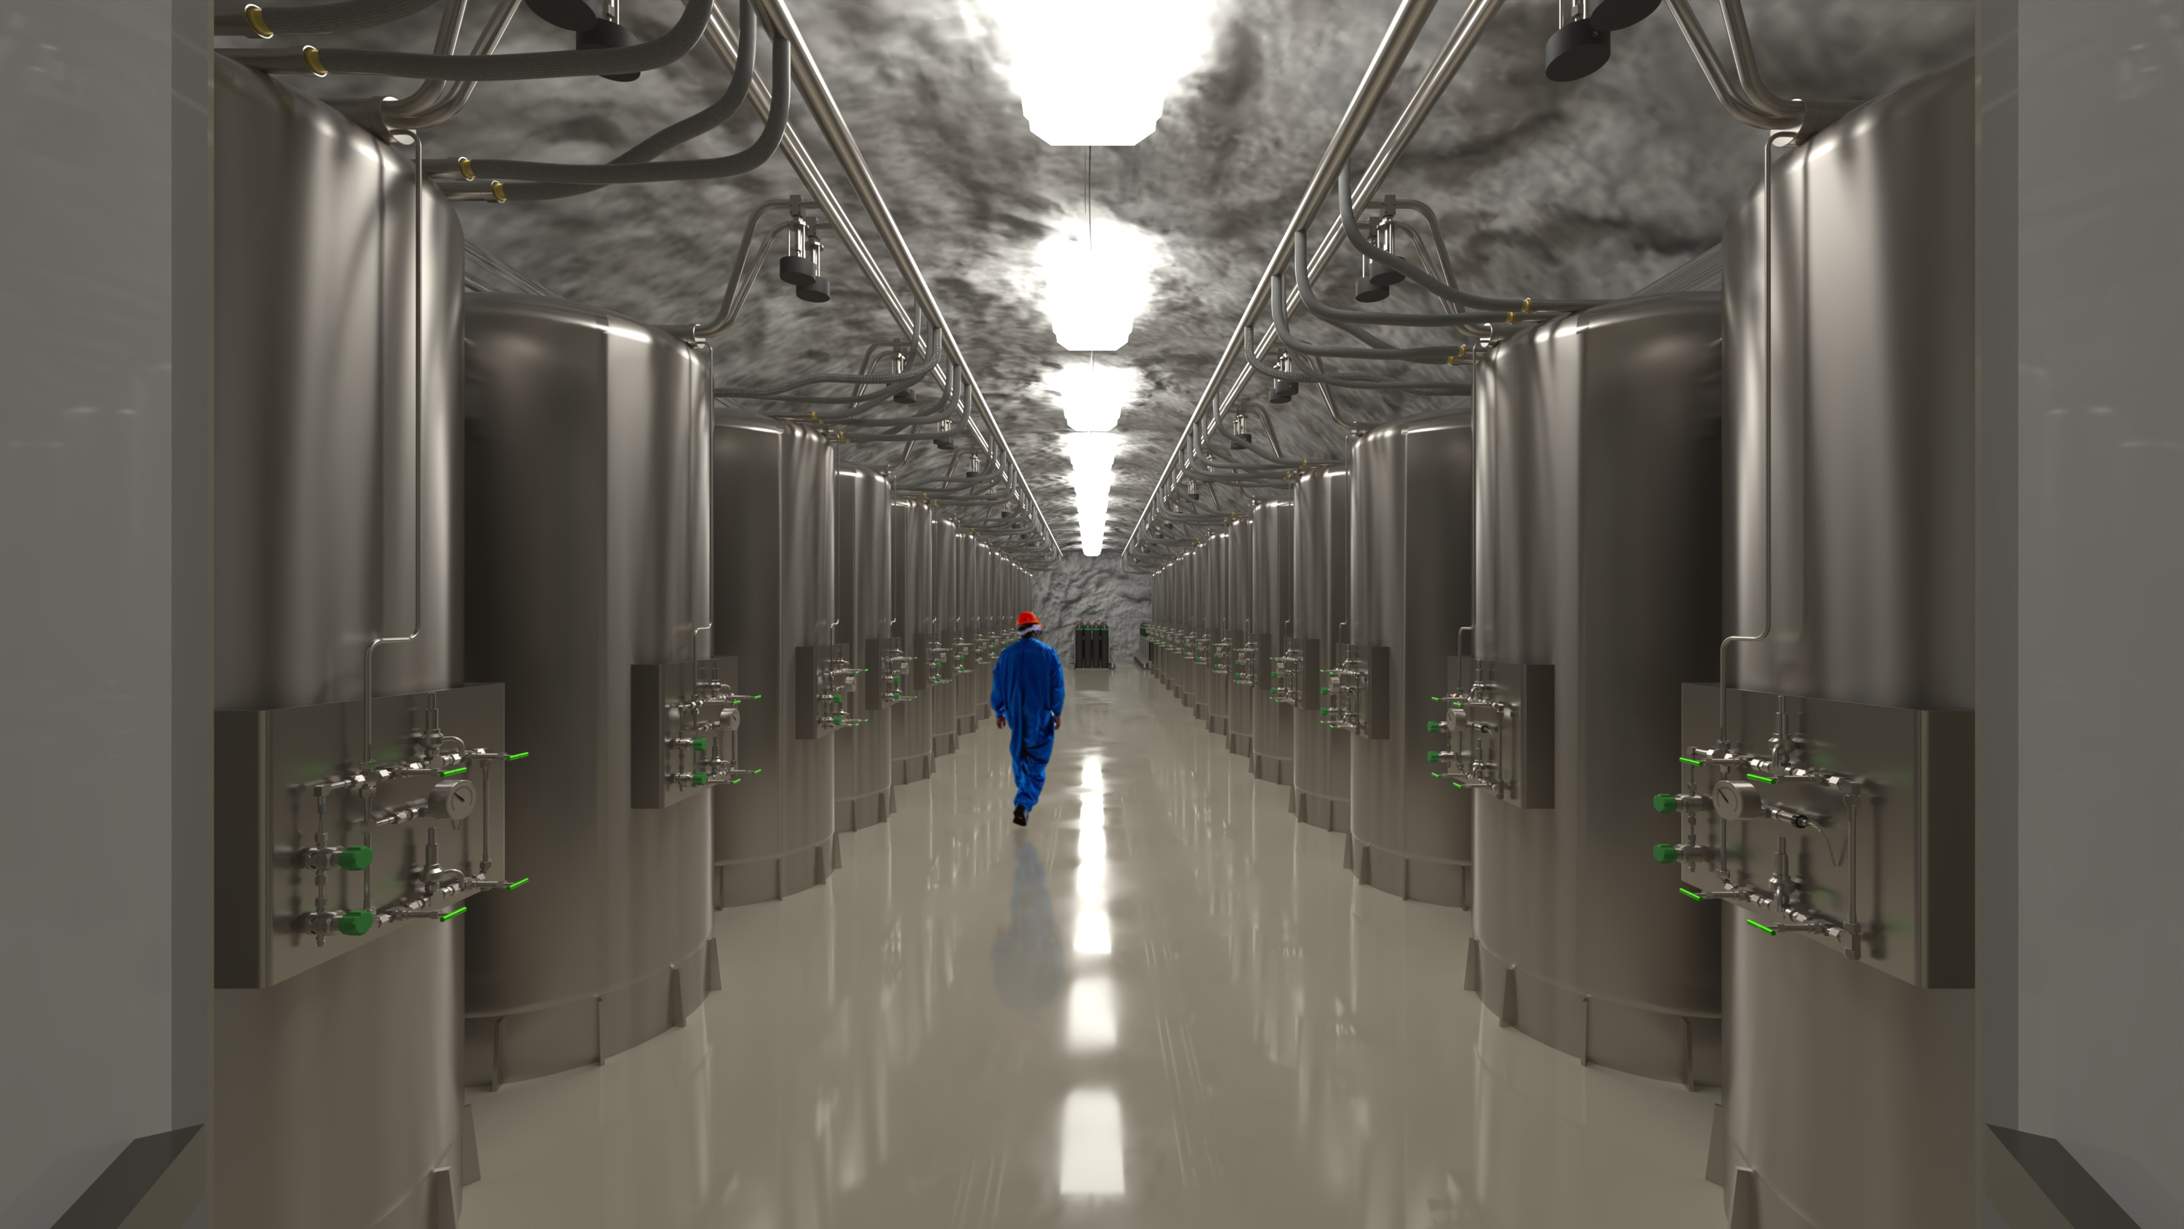


Frédéric Girard
XLZD Collaboration Meeting - Zürich 2026
Notes:
The short answer is: "we don't know". The wrong answer is: "we have no idea".
In fact it’s existence is supported by cosmological and astrophysical observations. For example, during the merger of galaxy clusters, the intergalactic gasses highlighted in pink, interacted, slowing down and warming up, emitting x-ray radiation. Stars and dark matter on the other hand passed through unaffected. The technique of weak gravitational lensing can be used to determine the mass distribution of non-luminous matter, highlighted in blue. With this we can show that dark matter accounts for 85% of the total mass of the clusters.
In fact it is known from cosmic microwave background models that there should exist 5x more dark matter than baryonic matter.

Slide 19
#notAI
#solidworksvisualize
Frédéric Girard
XLZD Collaboration Meeting - Zürich 2026
Notes:
The short answer is: "we don't know". The wrong answer is: "we have no idea".
In fact it’s existence is supported by cosmological and astrophysical observations. For example, during the merger of galaxy clusters, the intergalactic gasses highlighted in pink, interacted, slowing down and warming up, emitting x-ray radiation. Stars and dark matter on the other hand passed through unaffected. The technique of weak gravitational lensing can be used to determine the mass distribution of non-luminous matter, highlighted in blue. With this we can show that dark matter accounts for 85% of the total mass of the clusters.
In fact it is known from cosmic microwave background models that there should exist 5x more dark matter than baryonic matter.

