Slide 1



Working in multidisciplinary teams: From Particle physics to oncology
Fernando P. Cossío
The University of the Basque Country (EHU)
Manchester (Old Trafford), 14-18 September 2026

Slide 2

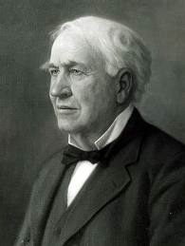
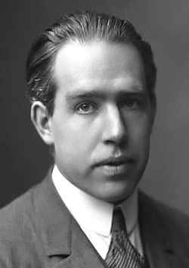
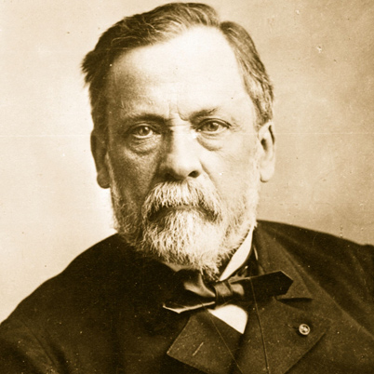
Considerations of use?
NO
YES
Uh…
Pure applied research
(Edison)
NO
Quest for fundamental understanding?
Pure basic research
(Bohr)
Use-inspired basic research
(Pasteur)
YES

Slide 3
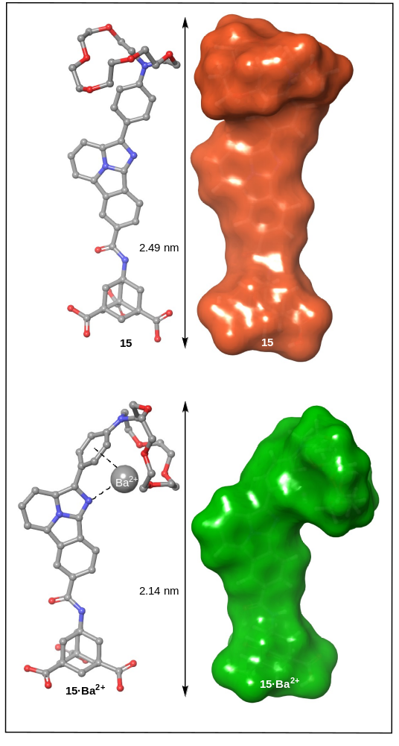
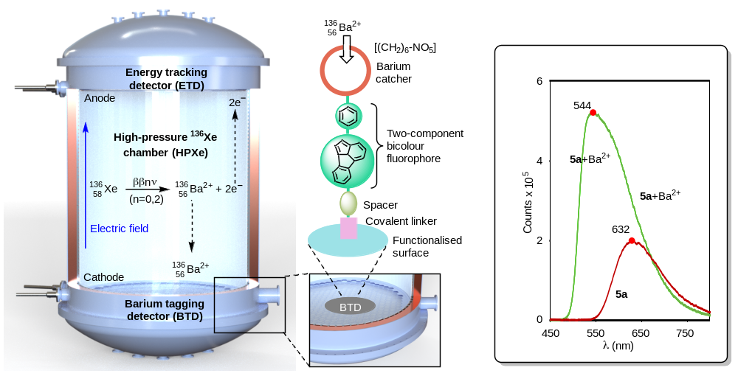
Barium Tagging for 0νββ: The BOLD Project

Slide 4
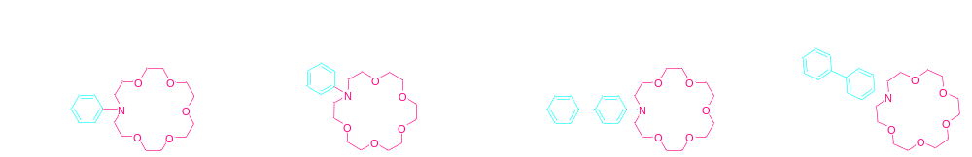
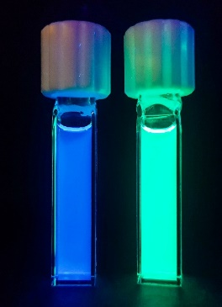
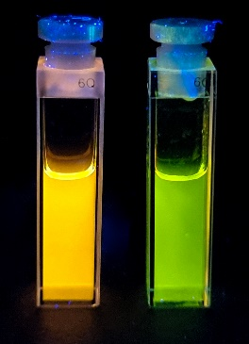
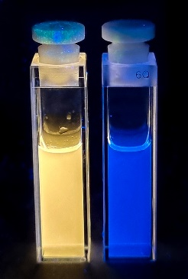
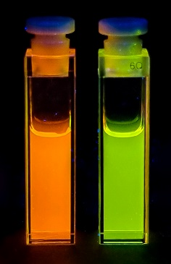
The situation is hopeless, but not serious
FBI·G1
FBI·G2
FBI·G3
FBI·G4
Nature 2020, 583, 48
Phys. Chem. Chem. Phys. 2021, 23 , 15440
Nat. Commun. 2022, 13, 7741
Nat. Commun. 2024, 15, 10595
RSC Applied Interfaces 2024, 2, 185
ACS Sensors 2025 ,10, 2487
Beilstein J. Org. Chem. 2025, 21, 162

Slide 5
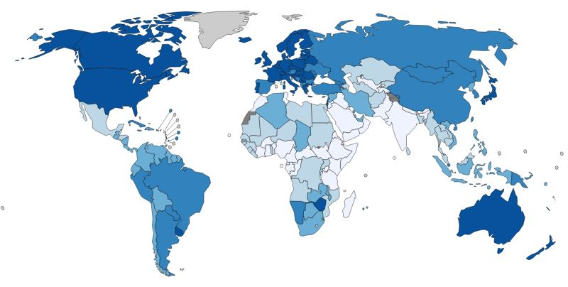
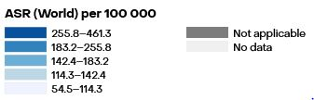
1. The challenge
“The Big C”: Age-Standardized Rate (World) per 100 000, Incidence, both sexes, in 2024
334.6
344.5
305.8
243.4
299.8
358.5
255.0
207.7
211.1
Cancer is a leading cause of death worldwide, accounting for nearly 10 million deaths and 21 million new diagnoses annually.
461.3
https://gco.iarc.who.int/en

Slide 6
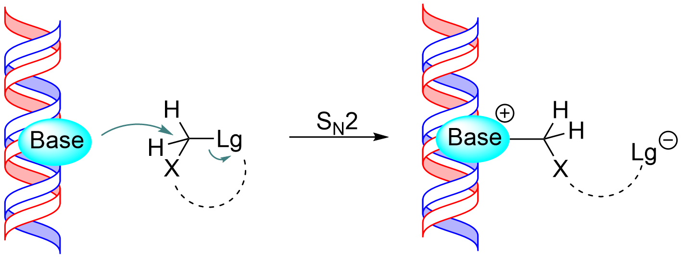
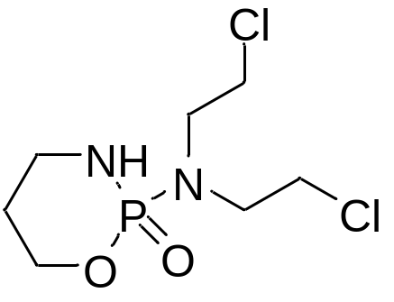
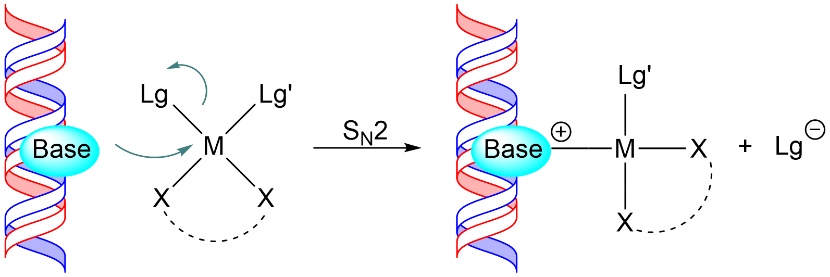
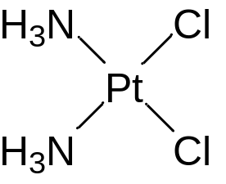
Current chemotherapy: platins and nitrogen mustards
Nucleophilic substitution reaction (S_{N}2) of DNA
  Carbon electrophiles (inversion)
  Square planar electrophiles (retention)
Cyclophosphamide
Cisplatin
ChemPhysChem 2017, 18, 3390-3401
O. Larrañaga, A. de Cózar, F. P. Cossío, ChemPhysChem 2017, 18, 3390-3401

Slide 7


Current chemotherapy is not enough
High toxicity
~70%
develop resistance
1 in 2
However, …
cancer patients receives
platinum-based therapy
Around 70% of patients either exhibit intrinsic resistance or eventually develop resistance to these drugs, limiting their long-term effectiveness
URGENT NEED TO DEVELOP NEW CHEMOTHERAPEUTIC AGENTS WITH
MORE ACTIVITY AND ABLE TO OVERCOME CISPLATIN RESISTANCE

Slide 8
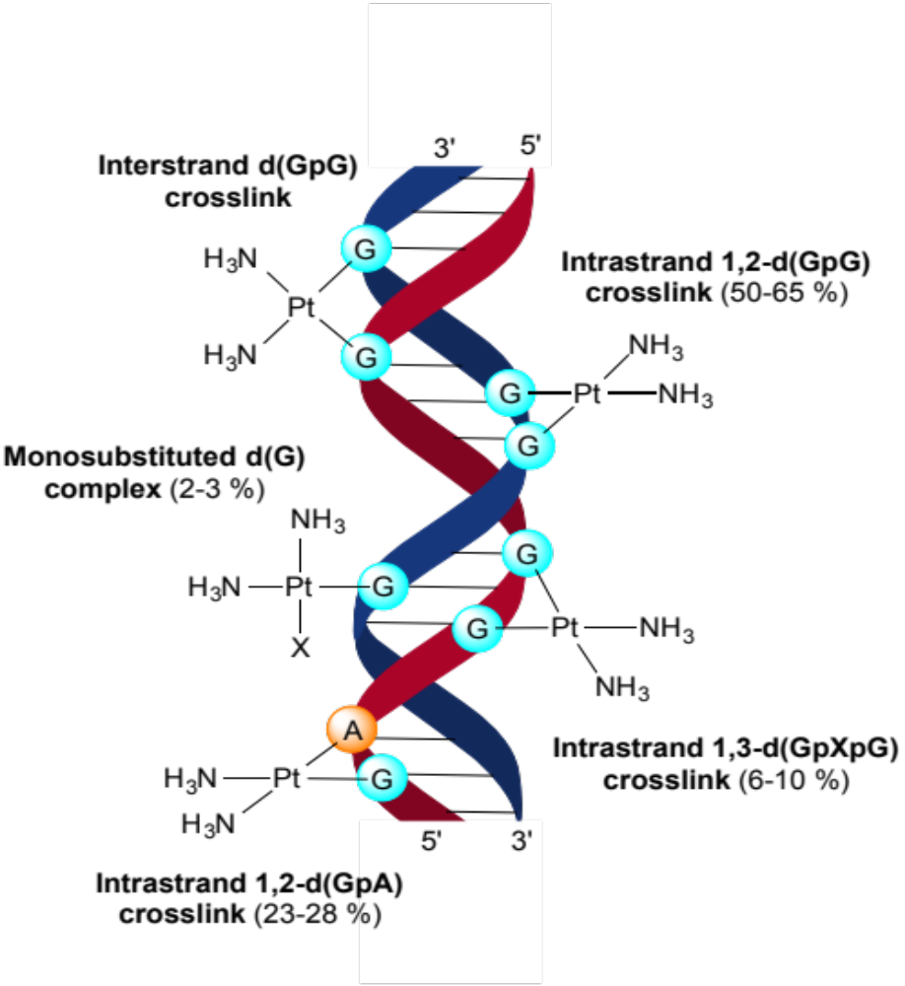
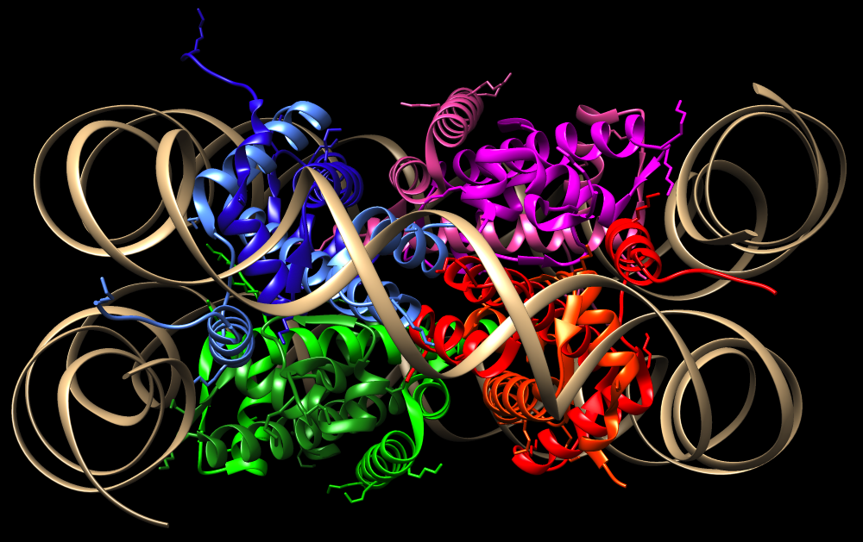
3. On the road: Cisplatin as starting point
(ca. 5%)
ChemPhysChem 2016, 17, 3932
Lu, X. et al. Nat. Struct. Mol. Biol. 2008, 15, 1122-1124

Slide 9
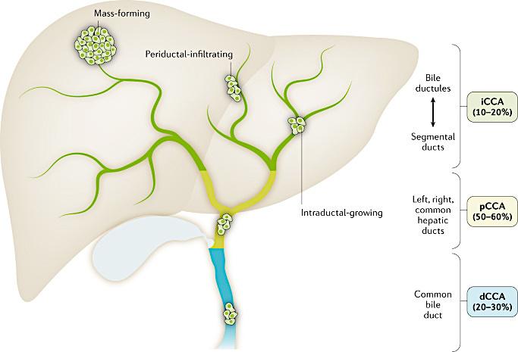
Even worse: cholangiocarcinoma
¹ World Health Organization. International Classification of Diseases 11th Revision. Version 02/2022
² Banales JM, et al. Nat Rev Gastroenterol Hepatol. 2020

Slide 10
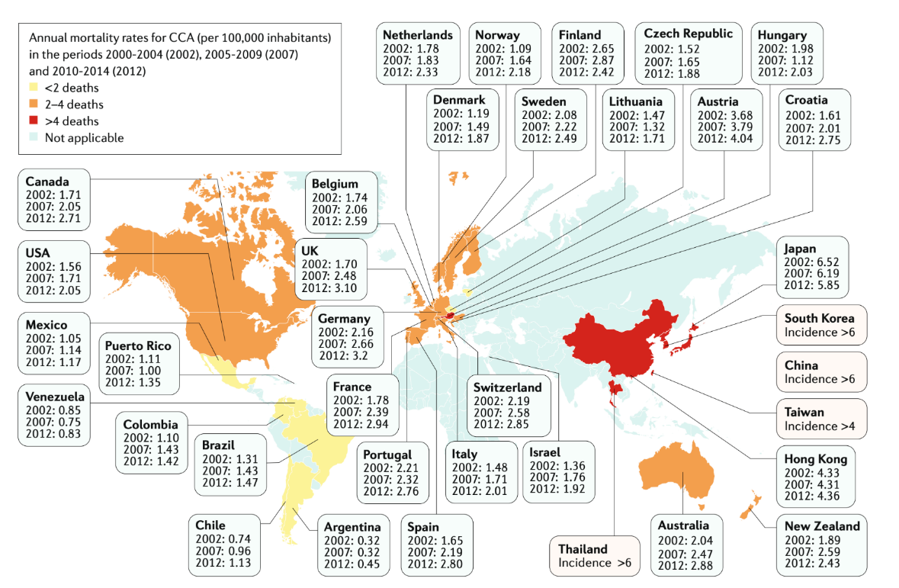
Annual mortality rate associated with cholangiocarcinoma
¹ Banales JM, et al. Nat Rev Gastroenterol Hepatol. 2020
² Bertuccio P, et al. J Hepatol. 2019

Slide 11
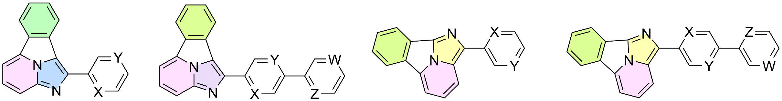
2. The BOLD solution (I)
We have obtained diverse families of fluorescent polyheterocycles that can interact with metals
Can we apply this expertise to the synthesis of novel chemotherapeutic agents?
Requirements:
  High potency -binding constants (K_{i})
  Favorable photophysics
    Biological probes
    Application to dynamic cancer phototherapy
  Low toxicity
  Good ADMETox profile

Slide 12
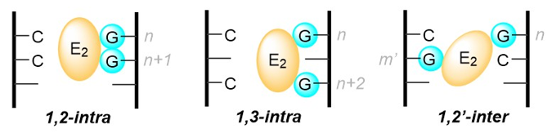
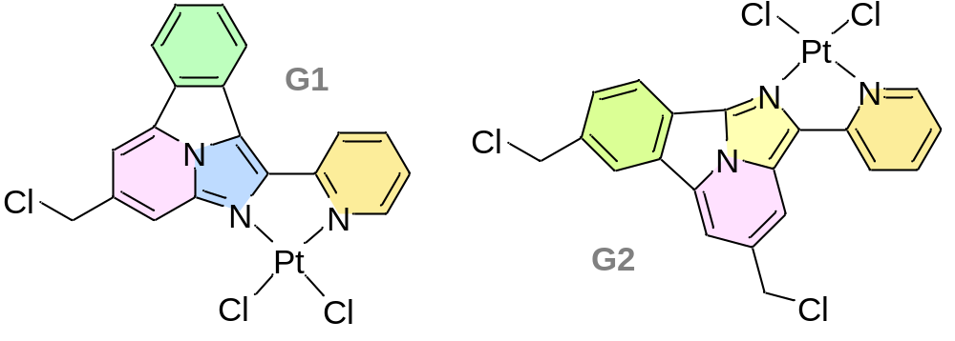
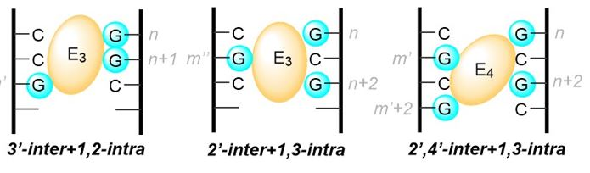
2. The BOLD solution (II)
Aurkitu = to find
Aurka = against
Aurki = quickly
Cisplatin
Aurkines

Slide 13
2. The BOLD solution (II)
Design criteria:
  Increasing the number n of electrophilic positions (chlorine atoms) of the reagent by making n>2.
  Inclusion of intercalating (π−stacking) moieties.
  Inclusion of basic centres to make the molecule accessible in vivo to organic cationic transporters.
  Generation of fluorophores that could facilitate the monitoring of the distribution of the molecules within cellular organelles, thus combining chemotherapeutic activity of these molecules and their use as molecular probes.
Aurkines

Slide 14
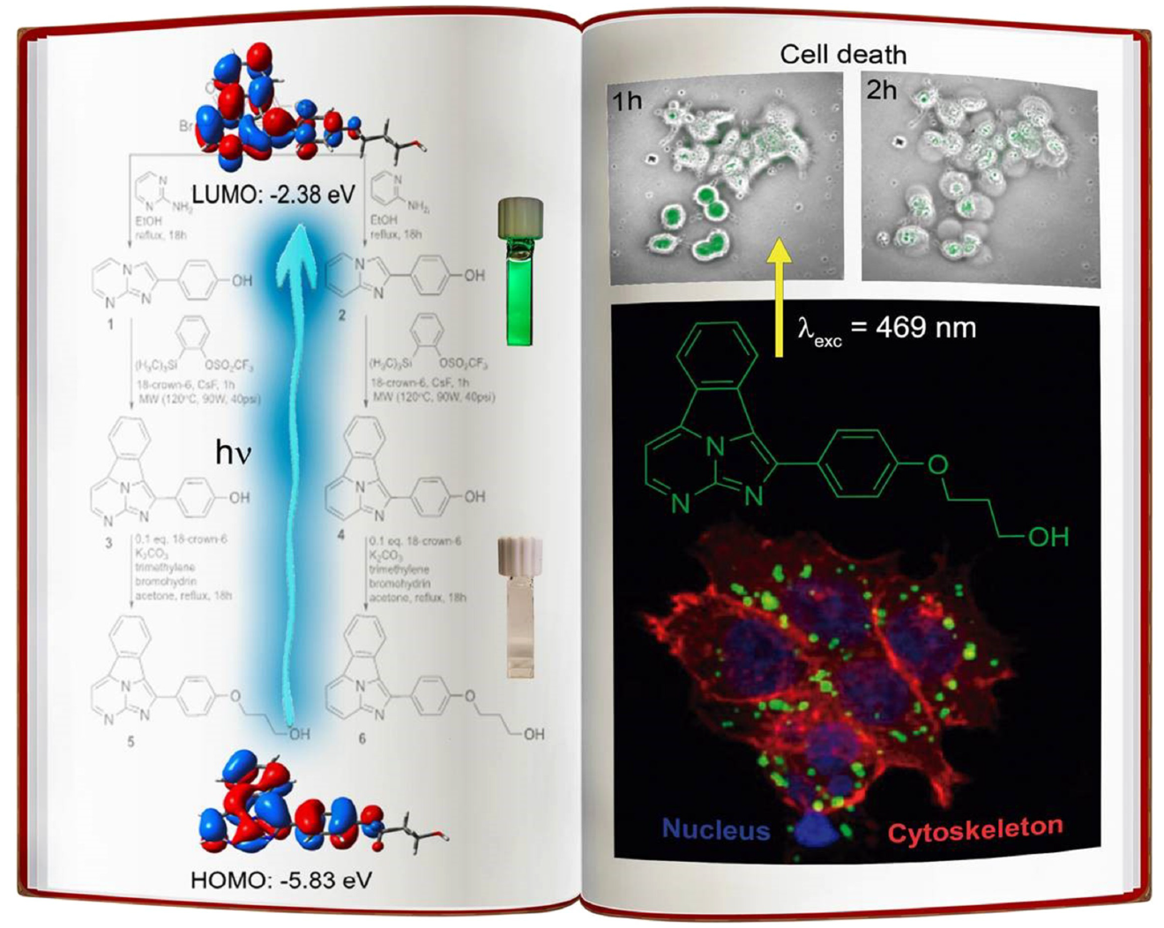
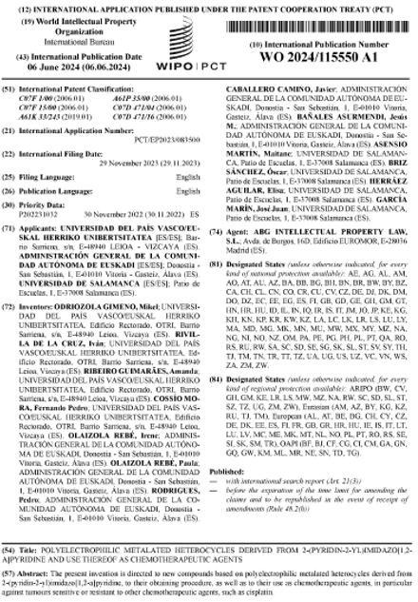
Chem. Eur J. (Hot Paper) 2021, 27, 6213-6222

Slide 15
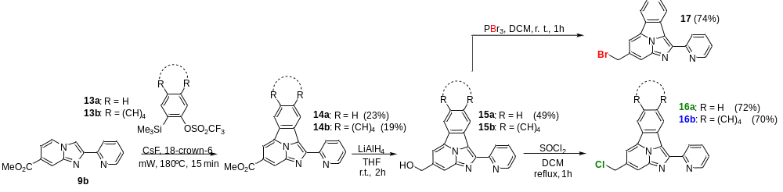
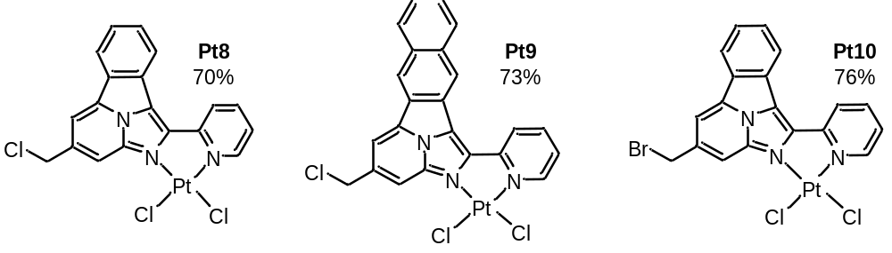
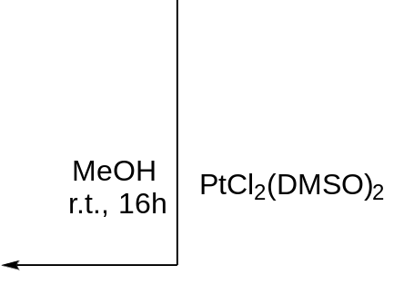
2. The BOLD solution (II): platinum complexes

Slide 16
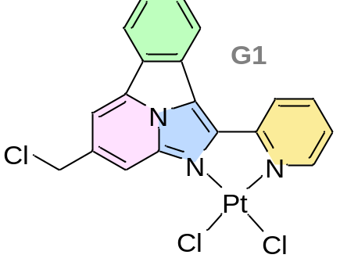
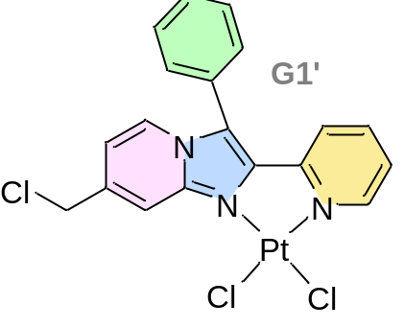

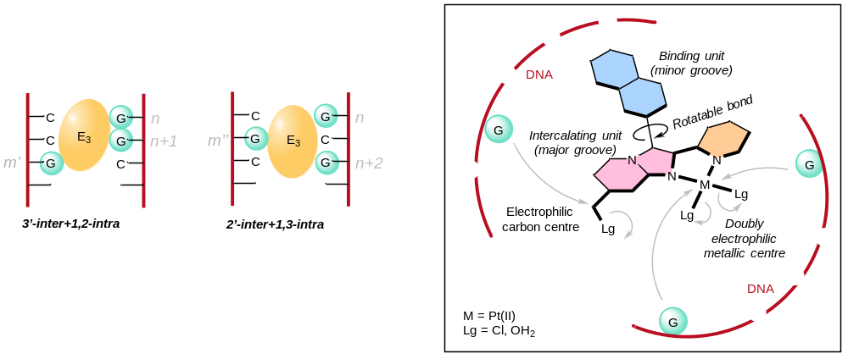
2. The BOLD solution (III): a new design
J. Hepatology 2025, 83, 1077–1091, DOI: 10.1016/j.jhep.2025.04.034

Slide 17
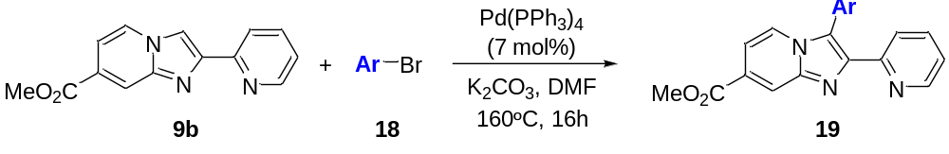
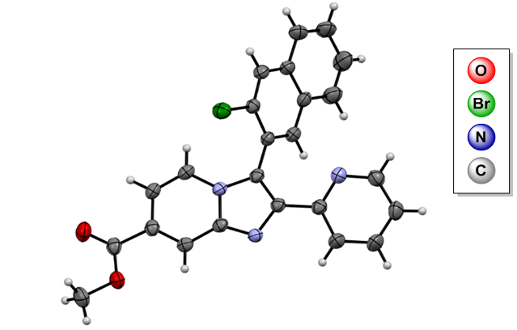
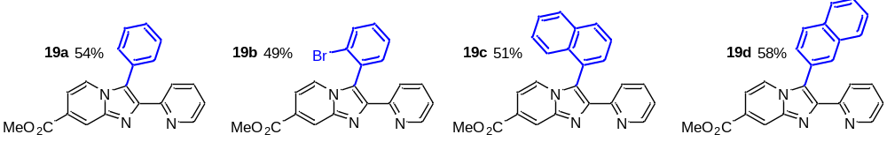

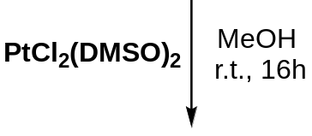
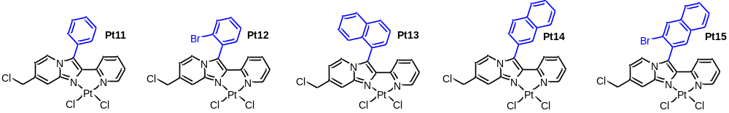
2. The BOLD solution (III): chemical synthesis

Slide 18
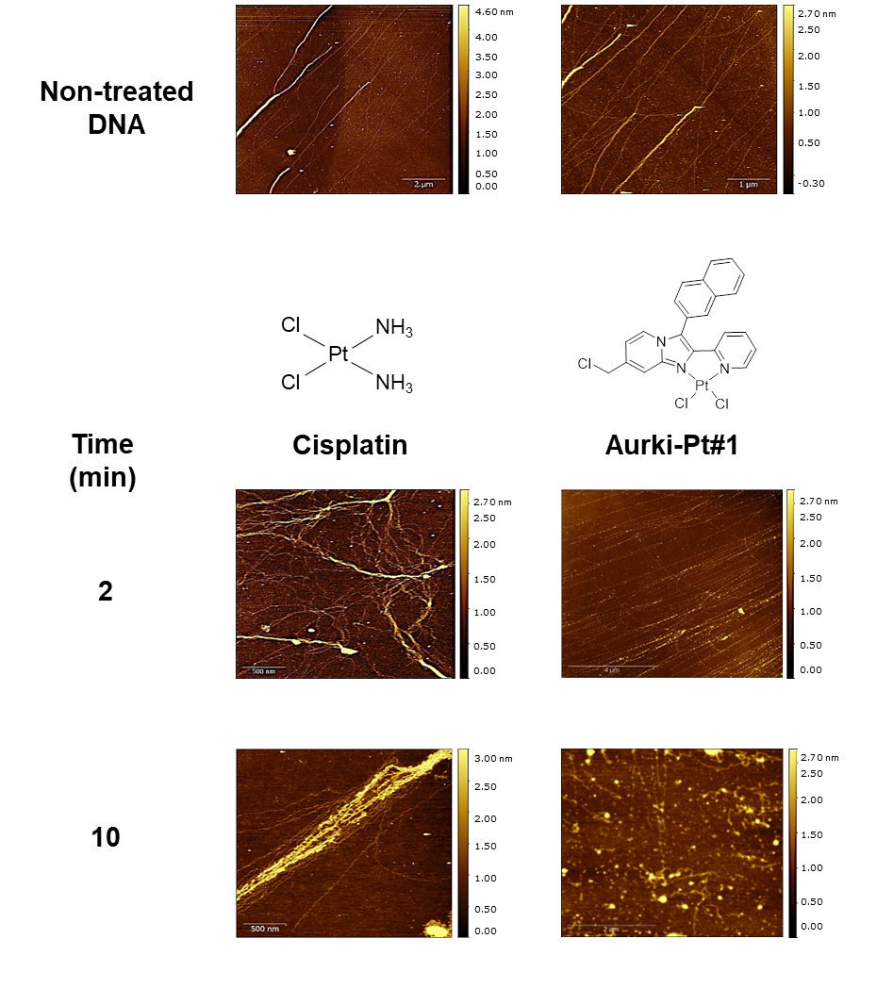
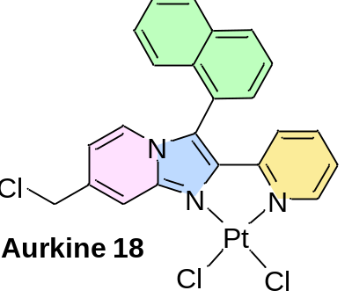
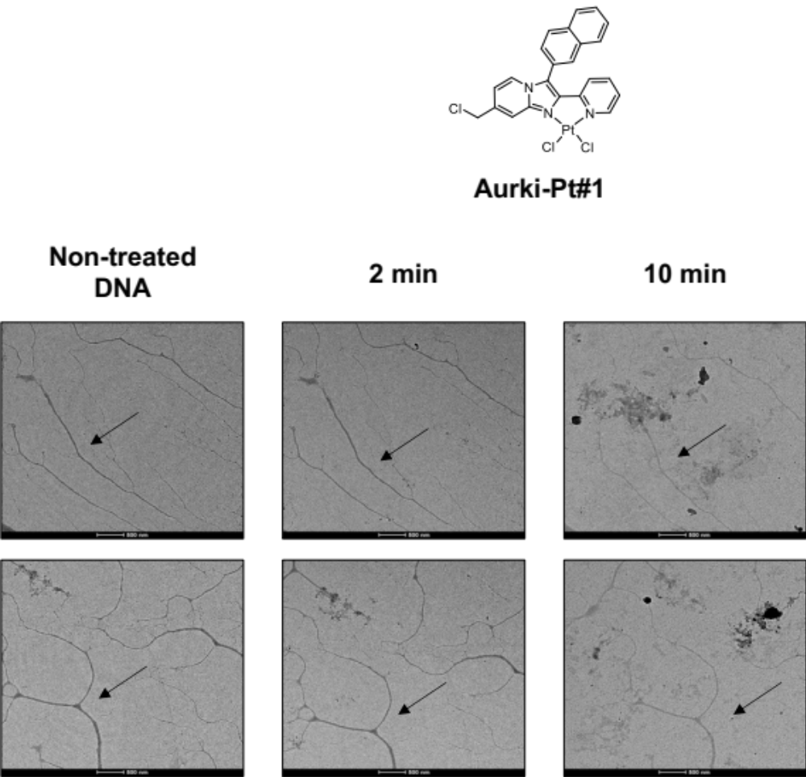
The BOLD solution (IV): results in naked DNA
AFM
TEM
Cisplatin
Aurkine 18
Cisplatin
Aurkine 18

Slide 19
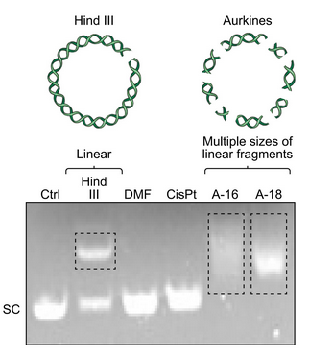
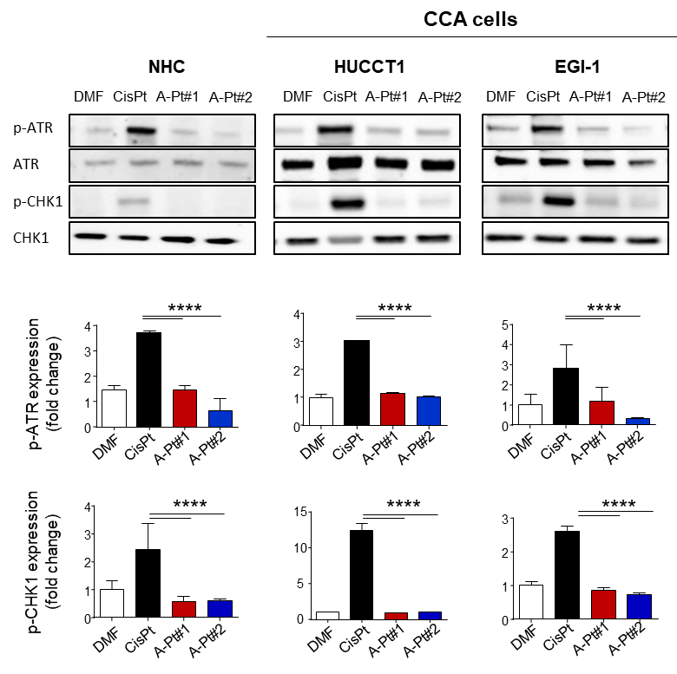
The BOLD solution (IV): results in plasmids
pUC18 plasmid mobility

Slide 20
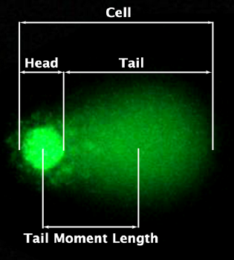
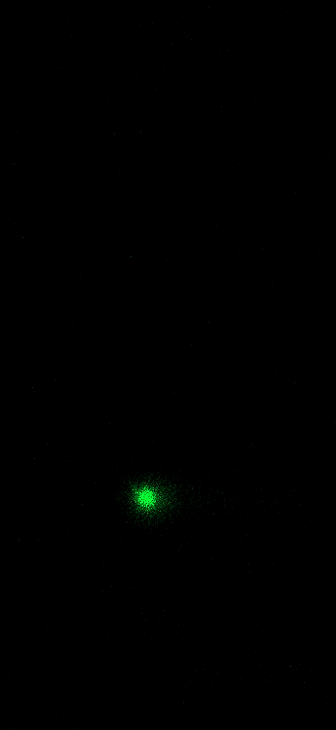
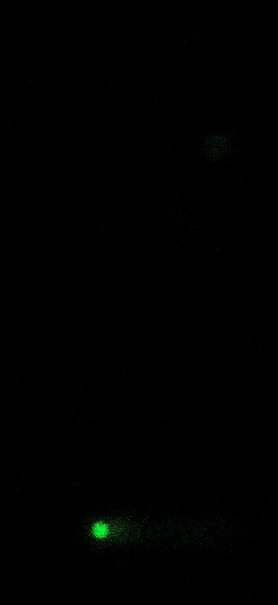
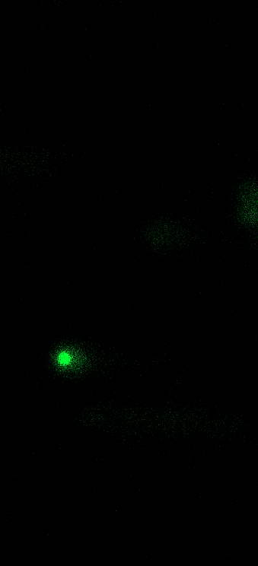
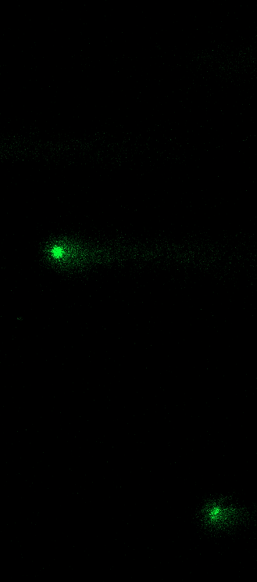
The BOLD solution (IV): results in cells
Comet assay
NHC: Normal human cholangiocytes
CCA cells
HUCCT1
EGI-1
DMF
CisPt
DMF
CisPt
DMF
CisPt
A-Pt#2
A-Pt#1
A-Pt#1
A-Pt#1 A-Pt#2
A-Pt#2
3
****
****
3
3
****
Tail moment
(fold change)
****
A-Pt#2
****
2
****
Tail moment
(fold change)
Tail moment
(fold change)
2
2
1
1
1
0
0
0
DMF
CisPt
A-Pt#1
A-Pt#2
DMF
CisPt
A-Pt#1
A-Pt#2
DMF
CisPt
A-Pt#1
A-Pt#2

Slide 21

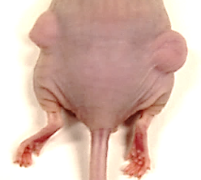
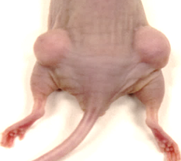
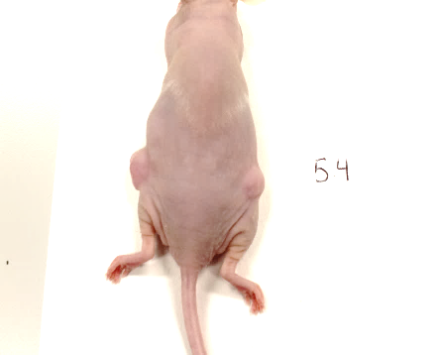

The BOLD solution (IV): results in cells (xenographts)
Dose: 0.5mg/kg
2000
EGI-1
1x10⁶
DMF
*
1500
#
CisPt
*
A-16
Tumour volume (mm³)
*
#
1000
*
#
#
*
A-Pt#2
#
500
DMF
CisPt
A-16
0
0
3
7
10
14
17
21
24
28
31
35
38
42
Days
##
40
4000
**
DMF
35
CisPt
3000
Mouse weight (g)
A-16
Tumour volume (mm³)
30
2000
1000
25
0
20
DMF
CisPt
A-16
0
7
14
21
28
35
42
Days

Slide 22



The BOLD solution (V): computational studies
Journal of Chemical Information and Modeling 2026, 66, 668-683 DOI: 10.1021/acs.jcim.5c01654

Slide 23






The BOLD solution (V): computational studies
DNA intercalation
Aurkine16
3-'inter+1,2-intrastrand
Intercalation or covalent bond compromises the DNA structure
Aurkine16 with the Nucleosome core particle
Aurkine16 does not permeate into the histones and do not compromise the nucleosome core particle

Slide 24




3. The BOLD solution: dynamic phototherapy
CYTOTOXICITY
Photosensitizer
(Nontoxic @ S₀)
hν
Free radicals
hν
Type I
Biomolecules
Tumor cells
³O₂
Type II
¹O₂
ROS
HO·, O₂^{·-} , …
Normal cells
Photosensitizer

Slide 25





From BOLD to Chemotherapeutic photosensitizers

Slide 26






Cholangiocarcinoma models: intrahepatic CCA + extrahepatic CCA
CCLP-1 (iCCA)
SNU-1196 (eCCA)
Dr. Pilar Acedo Nuñez
María Rosado Rodríguez
A
B
University College London
100 µm
100 µm
CCA cells cultured in DMEM media supplemented with 10% FBS and 1% penicillin-streptomycin. Incubated at 37ºC in a humidified atmosphere with 5% CO₂

Slide 27


JCP-67
JCP 67
ROS: 75%-80%

Slide 28

MTT assay
ILDH lamp (blue light): 7min 35s = 5J/cm2
Very low toxicity
Very low toxicity
Metabolic activity (%)
Metabolic activity (%)
Concentration (μM)
Concentration (μM)
EC₅₀ = 10 nM
EC₅₀ $≈$ 15 nM
CCLP cells
SNU cells

Slide 29

JCP-490
Lifetime λexc_{max} 485nm λem_{max} 670nm :
τ_{O2} = 454 ns
τ_{Ar} = 2.97μs
Excitation spectrum
Emission spectrum (λ_{exc}=375 nm)
515
JCP-490
ROS: 56%
460
670

Slide 30
MTT assay
ILDH lamp (blue light): 7min 35s = 5J/cm2
MTT JCP-490 24h + 24h post illumination - High concentrations
Very low toxicity
Very low toxicity
Metabolic activity (%)
Metabolic activity (%)
Concentration (μM)
Concentration (μM)
EC₅₀ < 5 nM
EC₅₀ = 5 nM
CCLP cells
SNU cells

Slide 31
Conclusions
  BOLD G1-G4 generation-derived from 1-(pyridin-2-yl)benzo[a]imid-azo[5,1,2-cd]indolizine molecules are efficient molecular probes in cancer cells.
  These molecules exhibit promising properties in photodynamic therapy of cancer.
    Batochromic absorption shifts are still necessary for the treatment of internal tumors.
  Aurkines are very promising new chemical entities for the treatment of platinum-resistant cholangiocarcinoma.
    These molecules show very low toxicity in normal cholangiocytes
The situation is serious, but not hopeless

Slide 32




















Iván Rivilla
Ikerbaque. R. Assoc. Prof.
Fernando Auria Luna
Postdoc Associate
Jesús (Txus) Bañales, Irene Olaizola
Amanda Ribeiro PhD
Óscar Rodríguez PhD
Mikel Odriozola PhD
Amaia Larumbe PhD
Virginia
San Nacianceno PhD

