Slide 1
Closeout
BJPJ

Slide 2
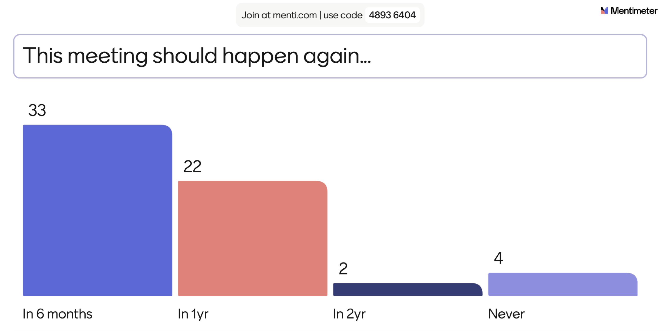

Slide 3


Slide 4
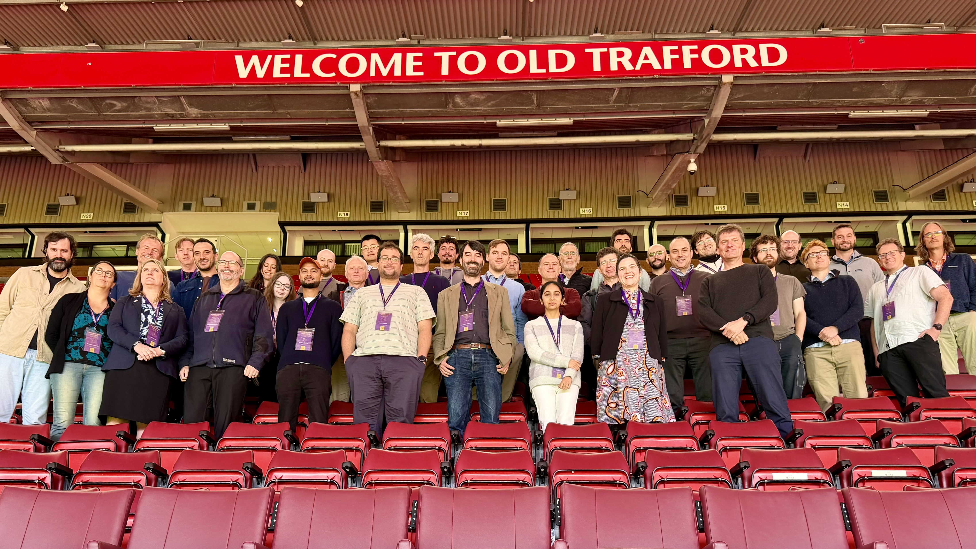

Slide 5
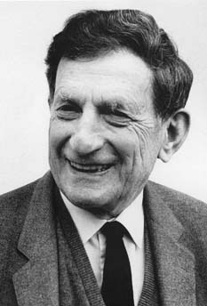
Did we actually achieve anything, though?
This meeting, we tried to understand peoples visions for the direction of our field through the pathfinder discussions, rather than through mentimeter polls.
This gives more opportunity for dialog.
"In Nature nothing remains constant. Everything is in a perpetual state of transformation, motion and change." ~ David Bohm

Slide 6
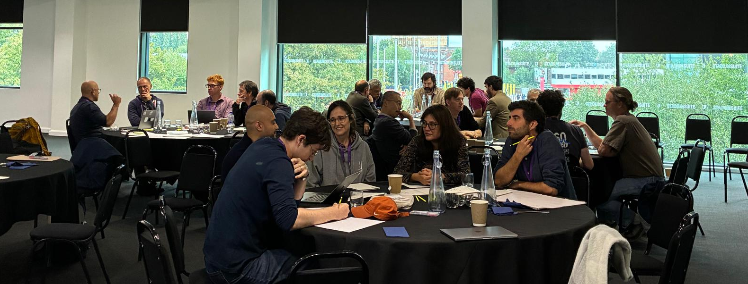
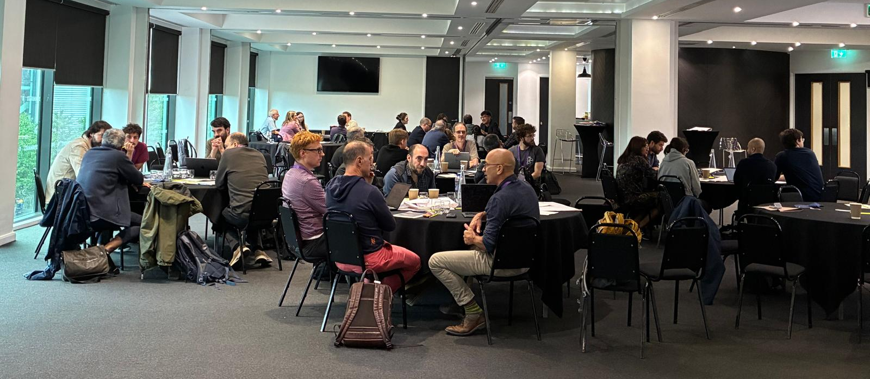

Slide 7
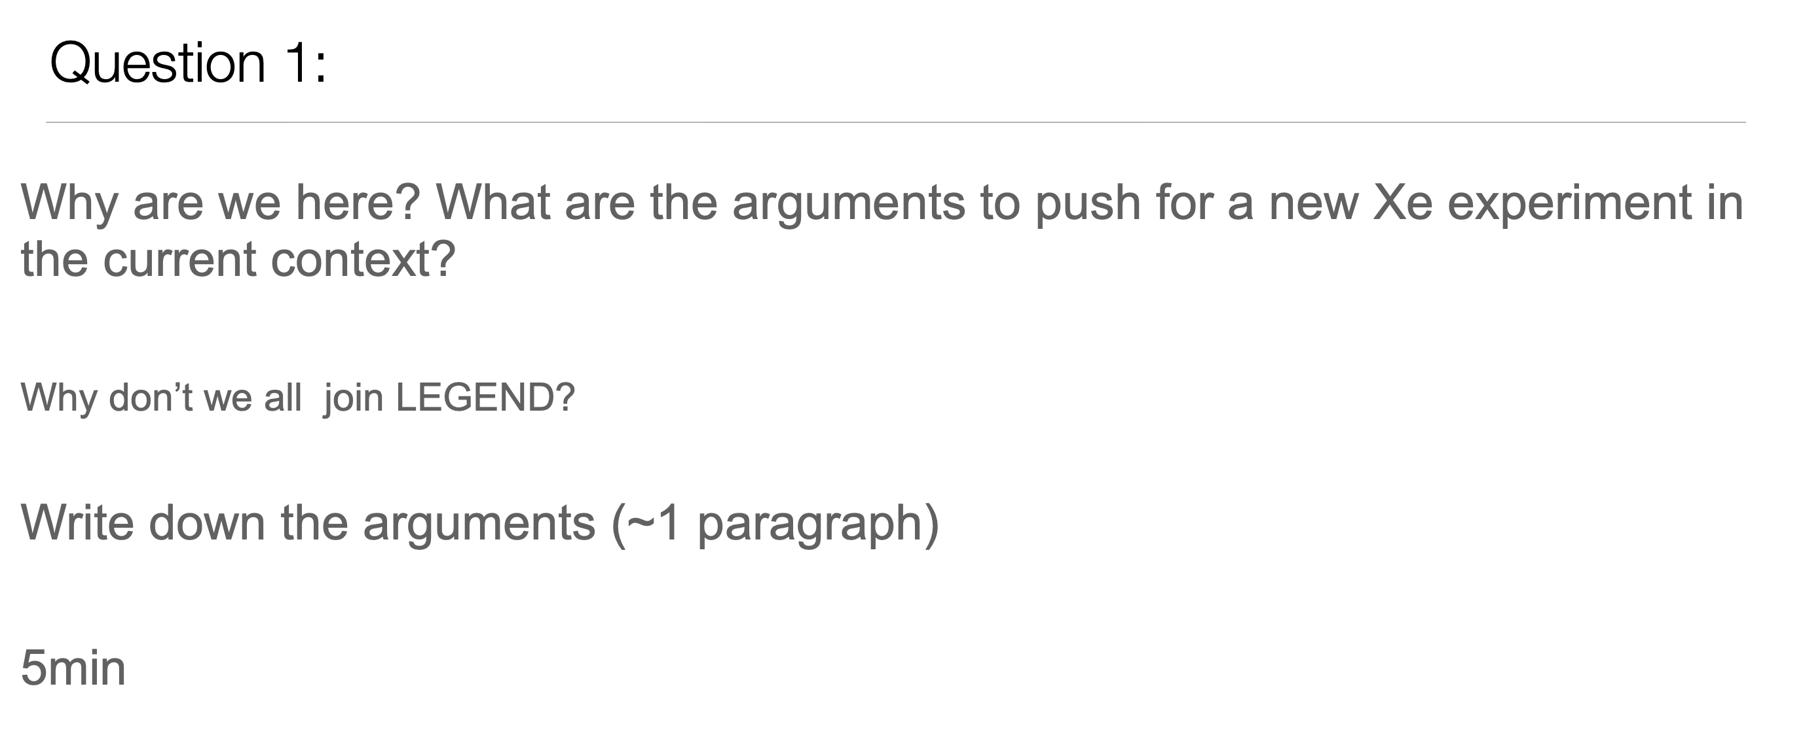

Slide 8
Groups answering

Slide 9
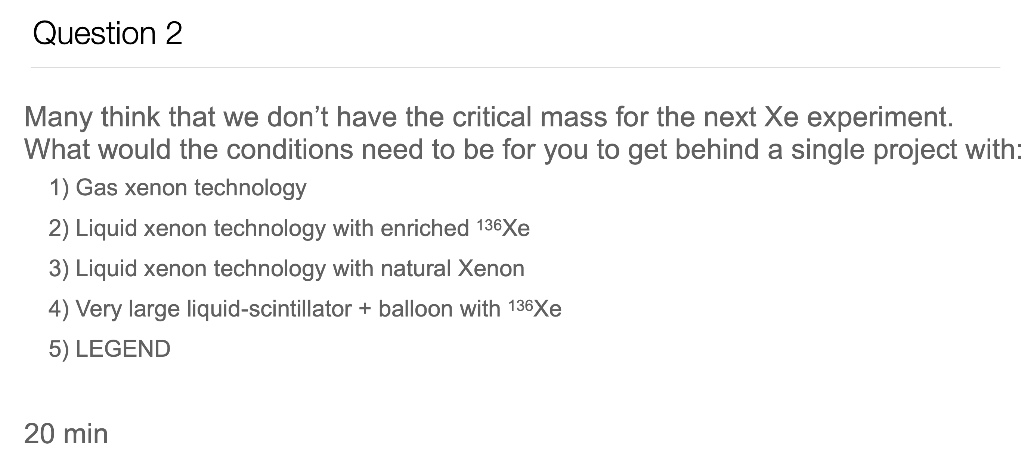

Slide 10
We all know the technical pro’s and con’s, though we mostly agree that technically all approaches can in principle reach 10²⁸ yr (per vote last meeting)
Preferences are motivated by 1) sociological factors and 2) perceptions about which program is more likely to successfully proceed for the long haul, without hitting the chopping block.
Most groups did not engage with the “what would it take” question directly, but several outlined some of the sociological points they think are important.

Slide 11
Key “non-technical” factors highlighted:
Major physics goal needs to be compelling (in this context, we mostly agree 10^28 yr is so) (2~3 groups).
Timeliness of delivery of primary physics goal is important (3 groups)
Intermediate timescale scientific milestones needed to maintain engagement for the long period and many generations of trainees required for delivery (2 groups).
Scientists are motivated by having something interesting to do in an experiment, and opportunity to apply their skills in meaningful ways (3 groups)
Need an engaging project with leadership opportunities for young scientists, and paths for promotion within the collaboration and the field (2 groups).
The experiment needs to be part of a program that has R&D opportunities and a pathway to the future (2 groups).

Slide 12
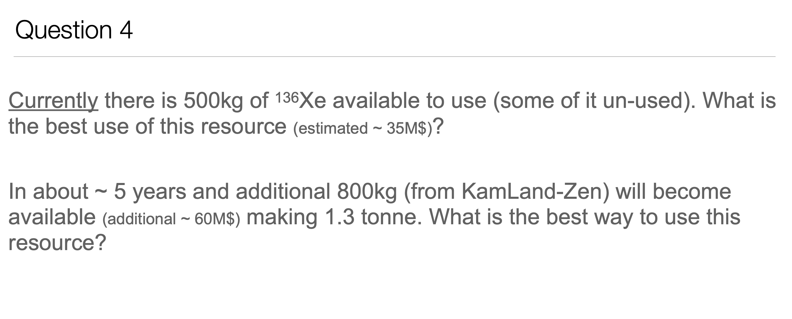

Slide 14
(”discussion of” = groups thought about it but questioned background environment in LZ and identified that resulting enrichment in XLZD would be small.)

Slide 15
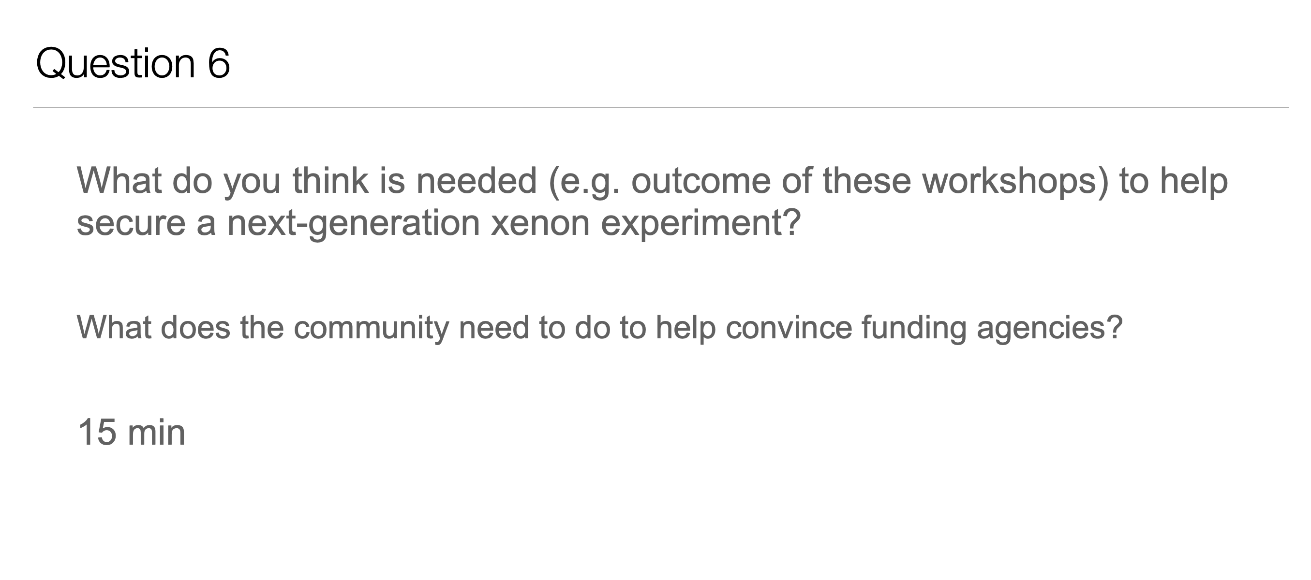

Slide 16
Answers to this question are all over the map.
Clear both from Q6 responses and from informal chats at this meeting that we don’t have consensus about whether we should even aim for consensus.
Answers to Q6 ranged over:
  Aim to build a large consortium with sufficient person power to field a 10^28 yr experiment.
  Determine a single experiment for everyone to join
  Develop mutually supportive / synergistic R&D programs
  Outline a coherent program that supports all national interests, not necessarily within a single experiment
  Make another community statement
  Change perception that community does not want to / does not work together
  Advocate to governments (funding agencies aren’t the ones who need convincing)

Slide 17
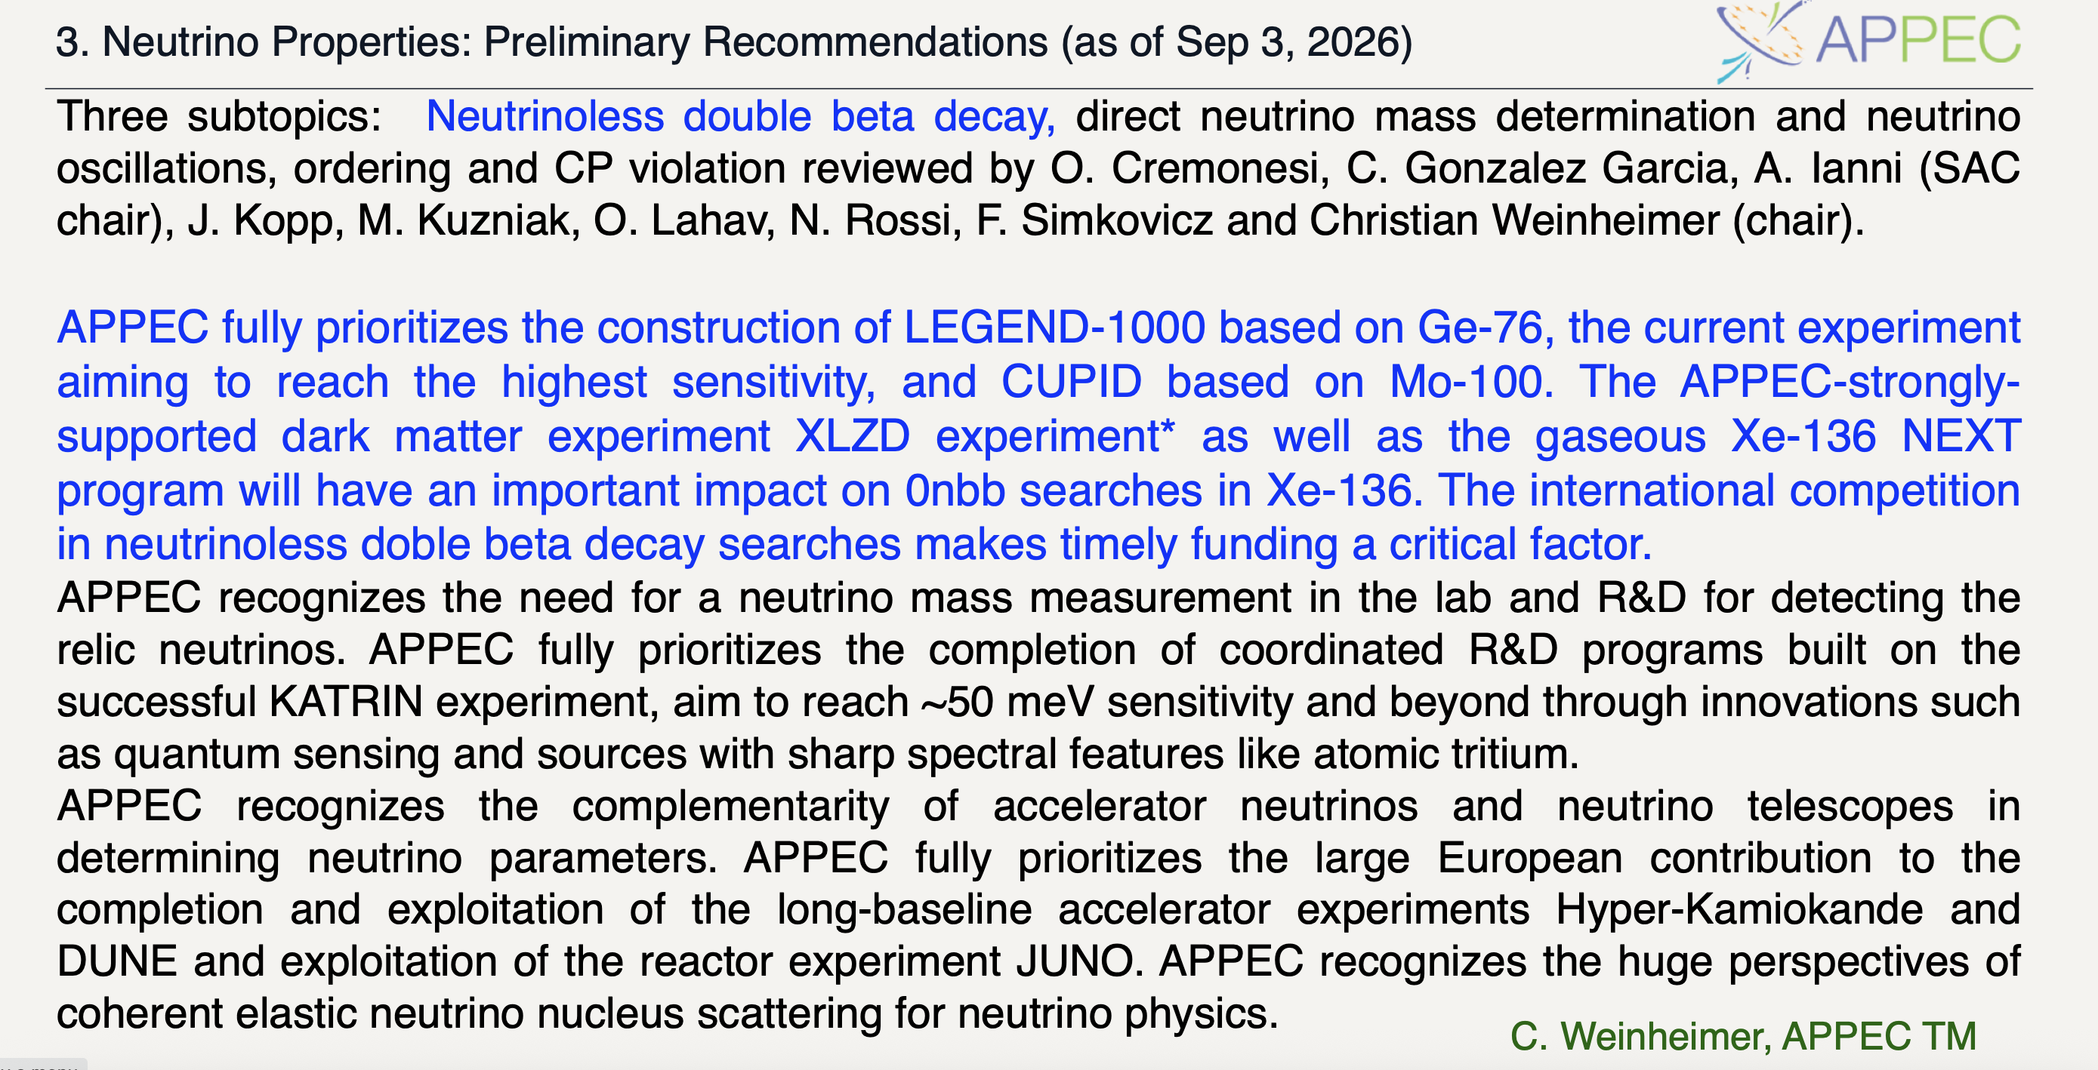
Could we have been better reflected in documents like this one, by being more coherent?

Slide 18
Answers to this question are all over the map.
Clear both from Q6 responses and from informal chats at this meeting that we don’t have consensus about whether we should even aim for consensus.
Answers to Q6 ranged over:
  Aim to build a large consortium with sufficient person power to field a 10^28 yr experiment.
  Develop mutually supportive / synergistic R&D programs
  Outline a coherent program that supports all national interests, not necessarily within a single experiment
  Determine a single experiment for everyone to join
  Make another community statement
  Change perception that community does not want to / does not work together
  Advocate to governments (funding agencies aren’t the ones who need convincing)
Lets talk about this. Do we want another workshop? Do we want more documents? Is there hope to converge on a consistent vision? Do we need one?

