Slide 1
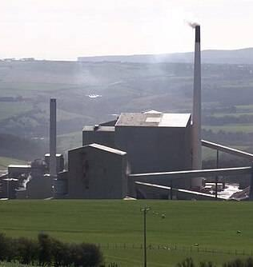
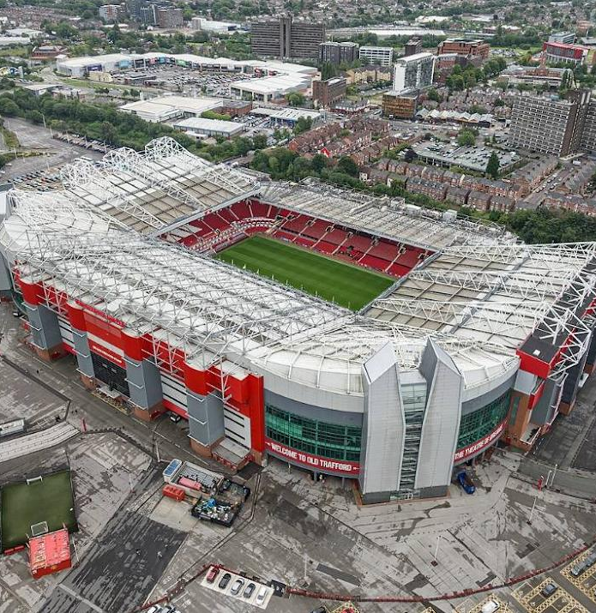
Status of PandaX
and Xe DBD Program(s) in China
Jianglai Liu 刘江来
Tsung-Dao Lee Institute and School of Physics & Astronomy
Shanghai Jiao tong university
Sep 15, 2026, Xenon DBD workshop, Manchester

Slide 2
A difficult task
Email from Thomas Brunner
However, we have a specific and deliberate ask: we would like you to set aside the standard project overview you might give at a conference, and instead offer a more reflective talk — one that honestly addresses how your project fits within the current scientific and political landscape, and how your plans might evolve in response to it. These presentations will serve as the foundation for several structured community discussions, and their value will depend directly on speakers approaching the exercise with openness towards the broader field, rather than advocacy for their own project alone.
Apologies for the extremely simple/blunt messages in this talk

Slide 3
Outline
History of PandaX
Reflections
Plan for the future
From Liangjian Wen: JUNO DBD program

Slide 4
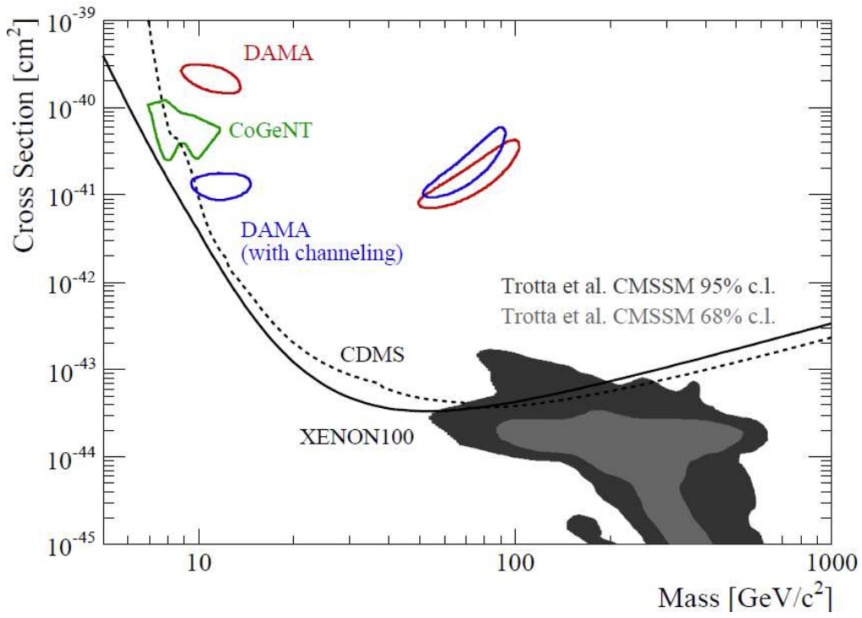
2010: DM - Low Hanging Fruit?
2010

Slide 5
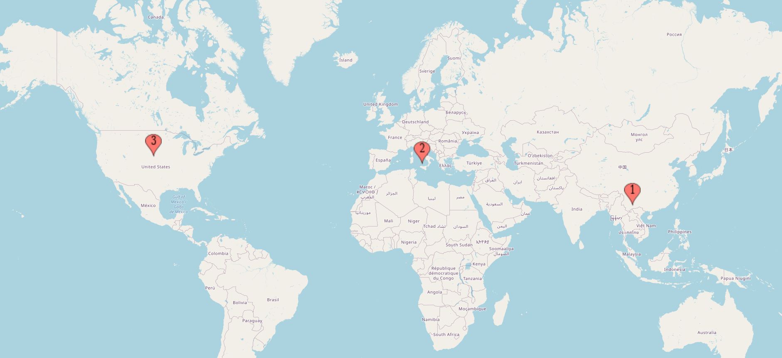
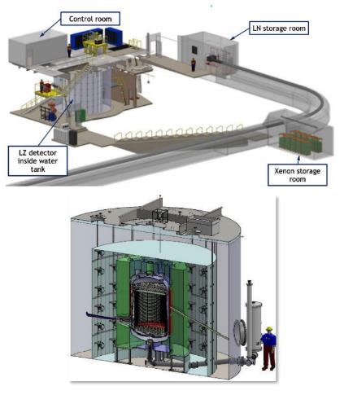
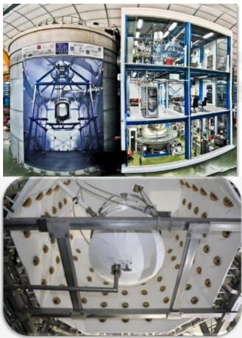
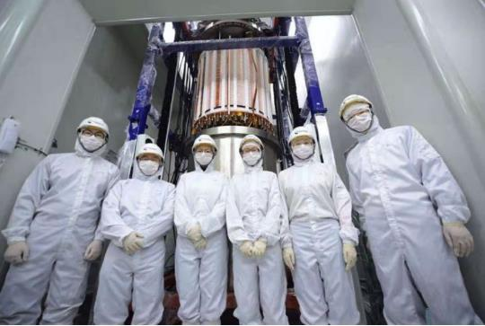
The big three
LZ
XENON
PandaX

Slide 6
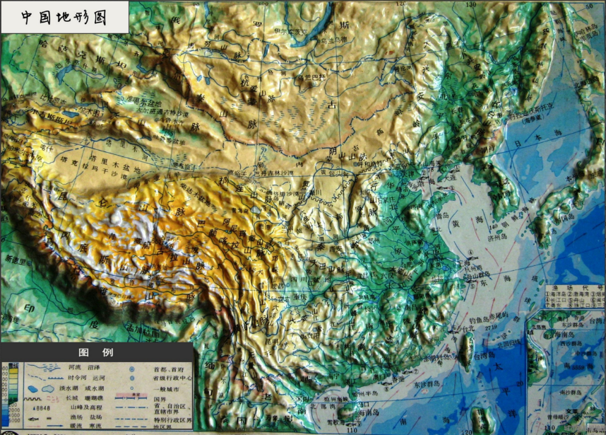
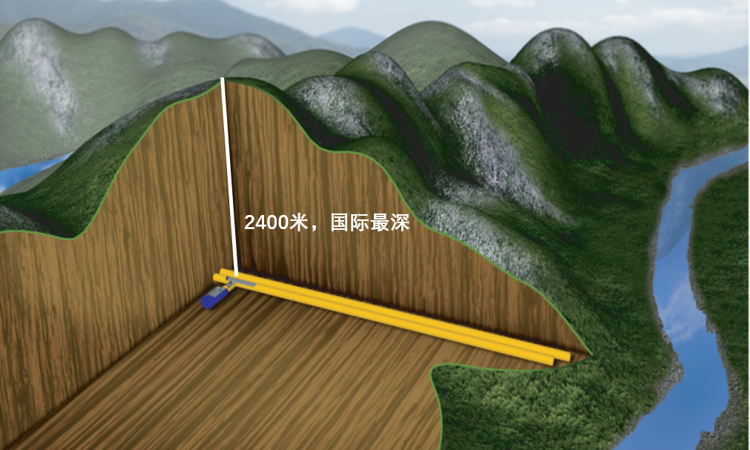
China Jinping Underground Laboratory (CJPL, 2009-)

Slide 7
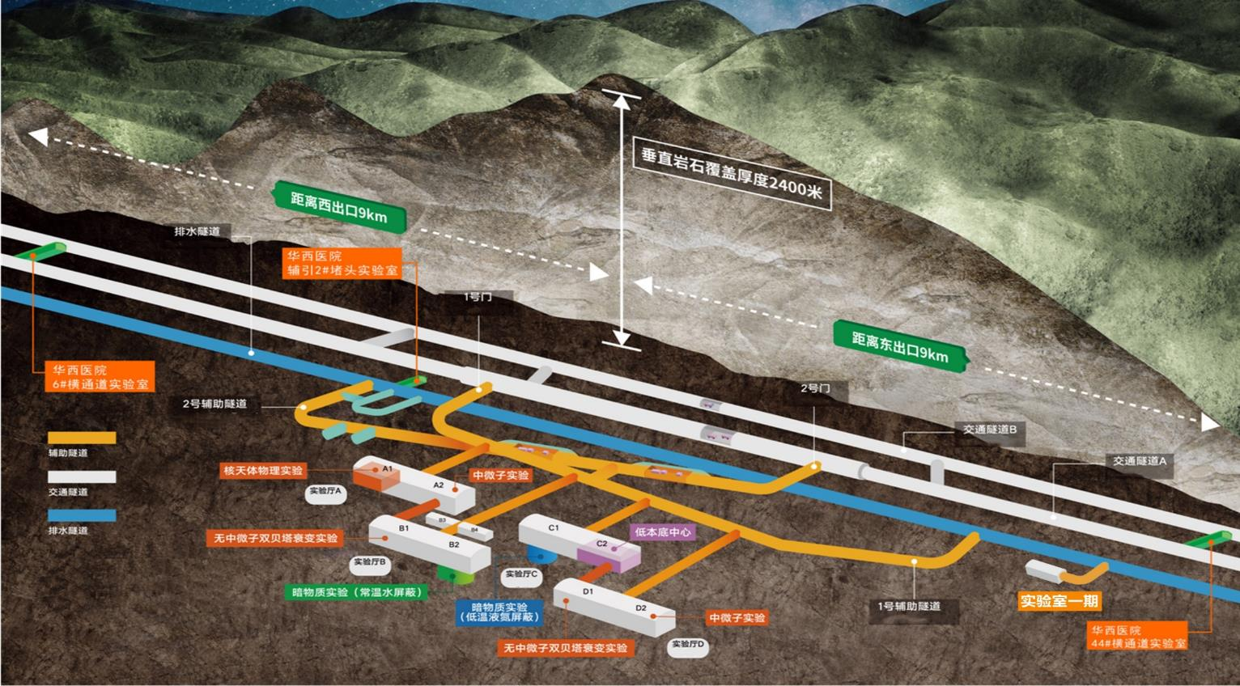
CJPL-II: National Major Facility (2024-now)

Slide 8
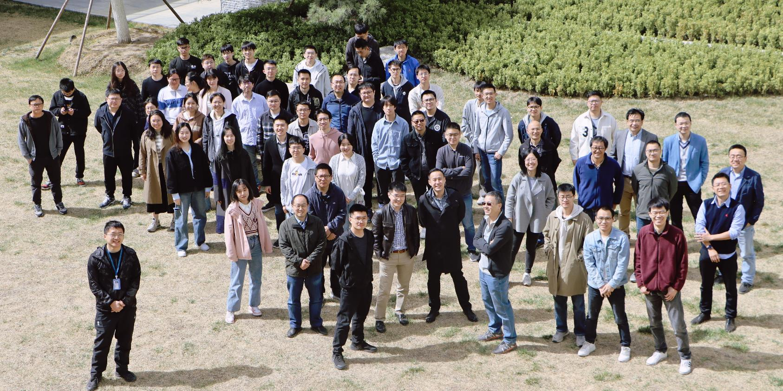
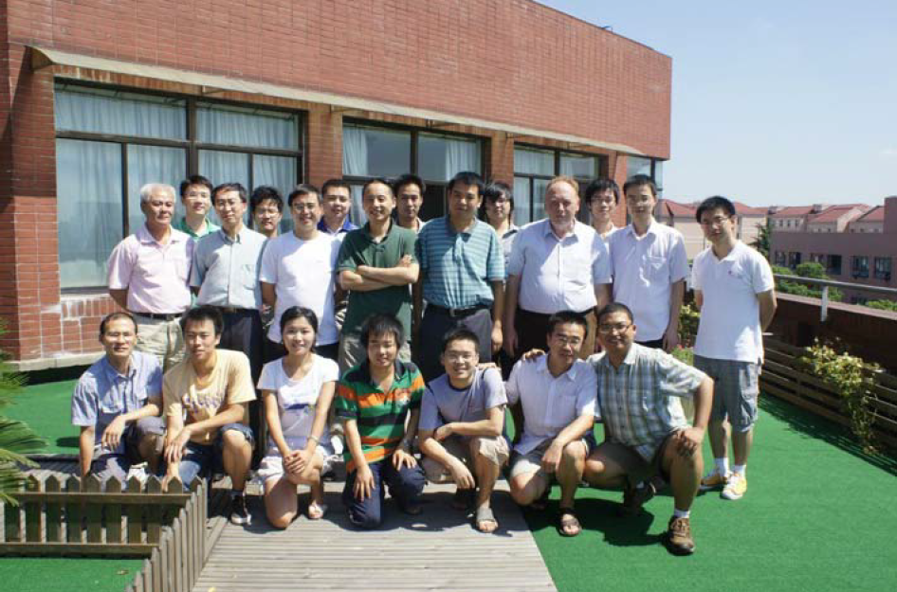

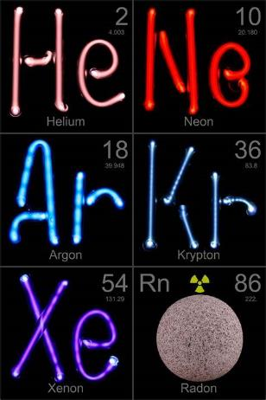
Particle and Astrophysical Xenon Experiment

Slide 9
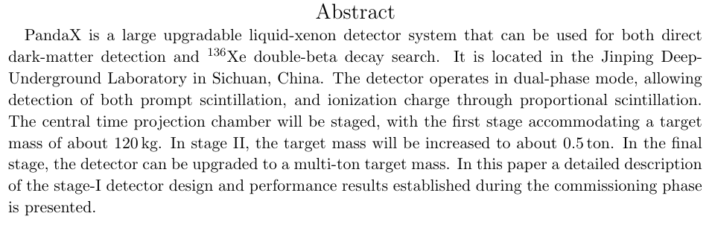
PandaX scientific mission: dark matter and neutrinos
PandaX-I design report, SCPMA 57, 1476-1494 (2014)

Slide 10

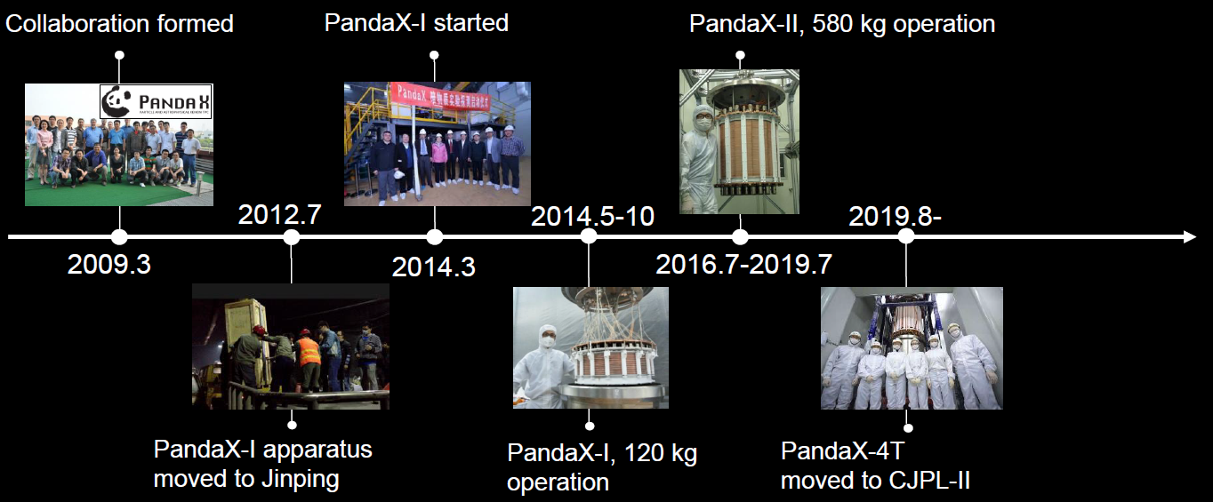
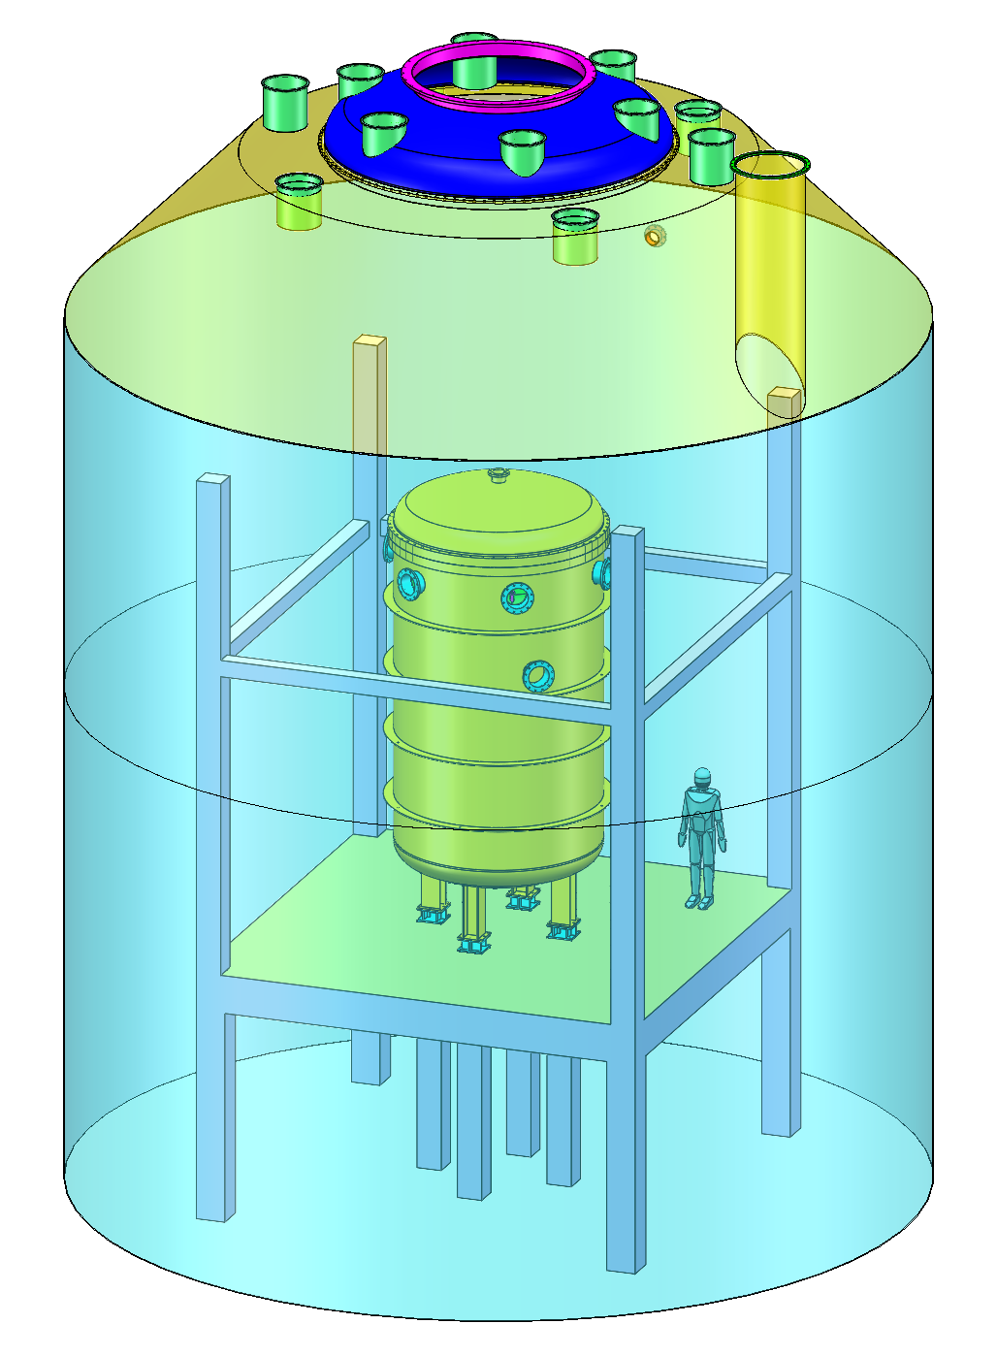
Particle and Astrophysical Xenon observatory
2026.4
2026.4-
PandaX-20T

Slide 11
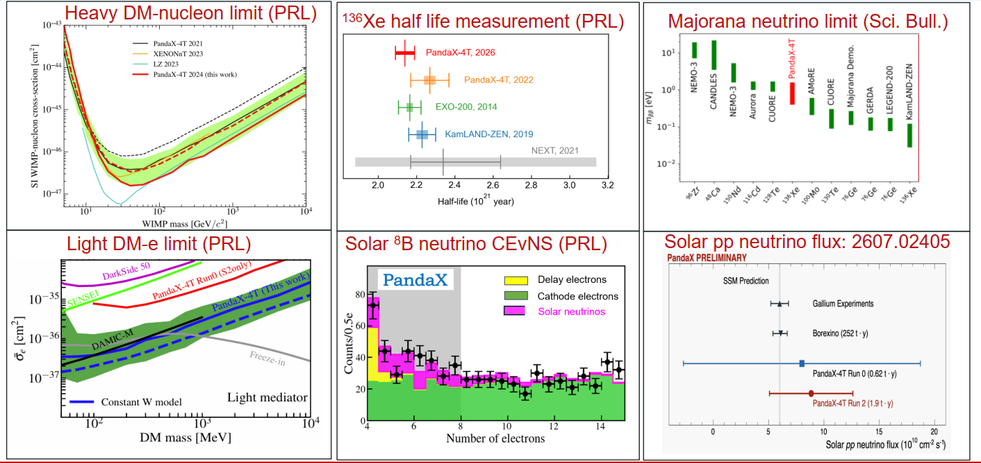
Recent highlights

Slide 12
Outline
History of PandaX
Reflections
Plan for the future
From Liangjian Wen: JUNO DBD program

Slide 13
Difficulty in this business (and particle physics, in general)
Pro: scientific questions (DM, Fundamental v properties) are important, even to outsiders
Cons (facts we cannot do much):
  Discovery come very slowly
    Non-discovery are “anticipated” in both DM and 0vDBD fields
  Investment are getting larger, but the “story line” stay the same
    One could certainly argue “how large is large”, but not when resource is scarce
  In China, “innovation in scaling up” is frequently being challenged
  Remote story of technological innovations in this field (e.g. www story) do not work well nowadays
  …
⇒ Funding challenge for the “ultimate” experiment

Slide 14
Honest assessment of PandaX
Pragmatic strategy
Stage-wise plan (according to resource)
Eggs in multi-baskets
Features (double-edged):
Single-institute dominant
No single (main) funding agency except the hosting institute (SJTU) ⇔ flexibility
Competition=>speed=>insufficient technological R&D=>learning hard lessons along the way
Small collaboration, with very limited international collaborators

Slide 15
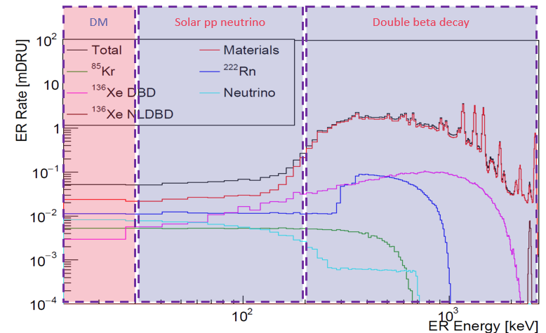
Three pillars in PandaX-4T
Traditionally, three different communities (with some competitions)
Since PandaX-4T, intentionally recruit/arrange personnel/effort so three pillars are “evenly” weighted
Background is the ultimate common denominator!

Slide 16
Funding situation in China
CJPL is a major national research facility that just started operation
PandaX has to be sited in CJPL, but unlikely to receive one-shot funding for the “ultimate” experiment
Chinese teams are also encouraged to participate in international projects, e.g.
  IHEP is a long-term EXO-200/nEXO collaboration
  All XENON university groups in China are receiving funding from NSFC

Slide 17
Outline
History of PandaX
Reflections
Plan for the future
From Liangjian Wen: JUNO DBD program

Slide 18
PandaX-20T/40T

Slide 19
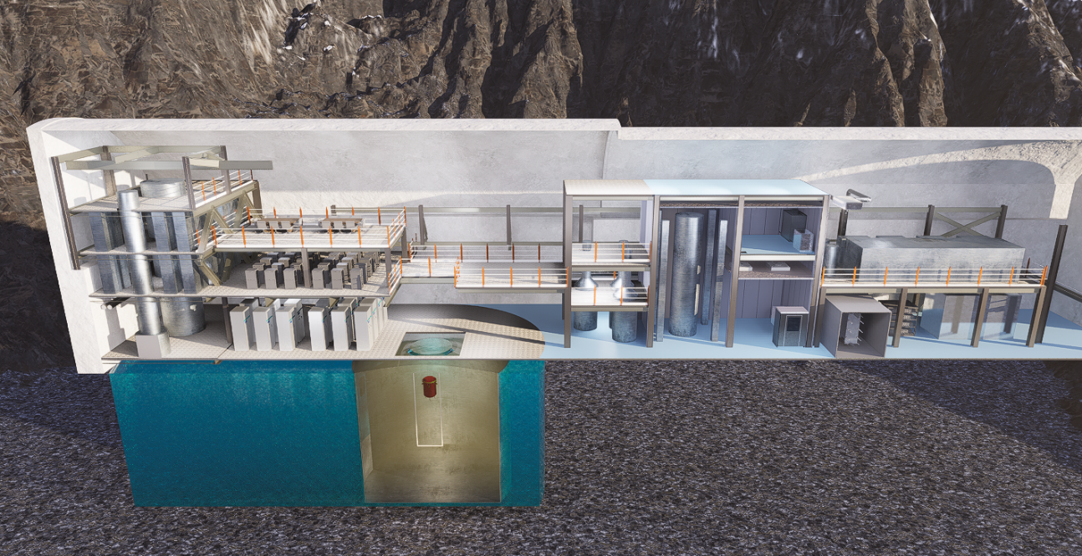

Slide 20
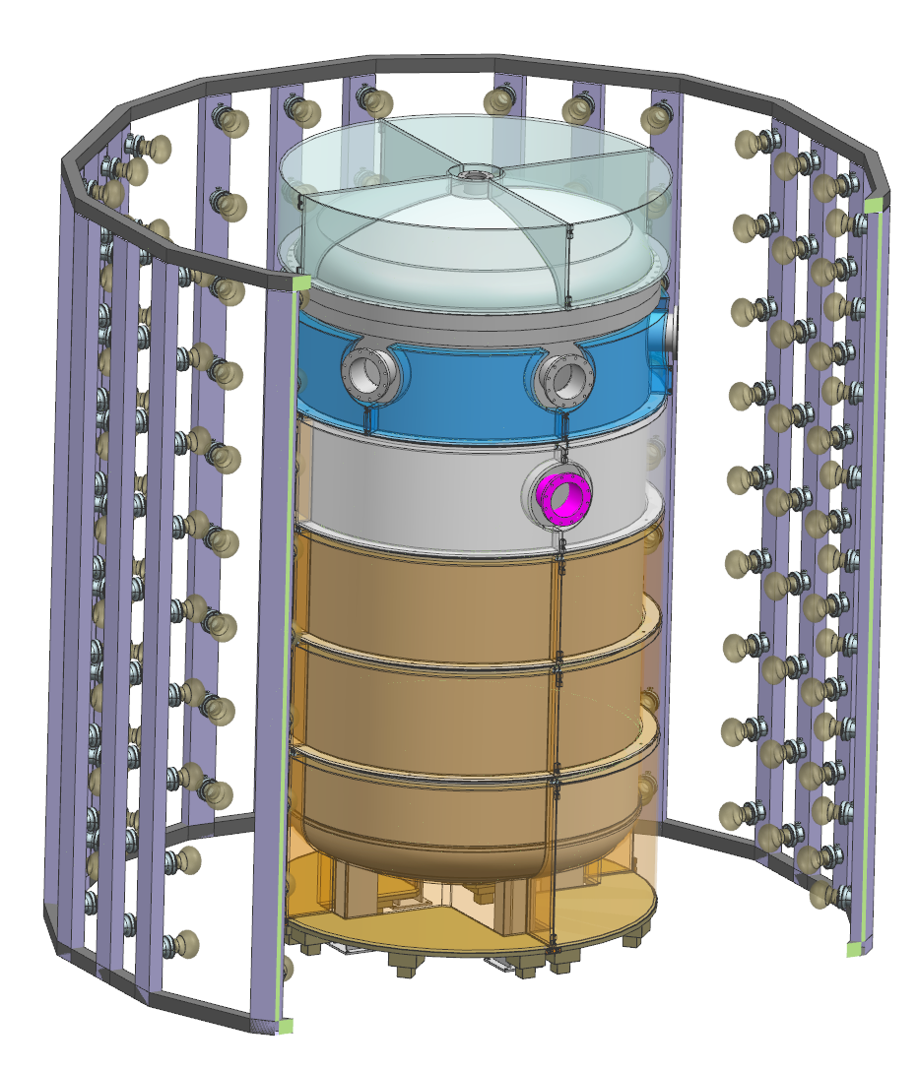
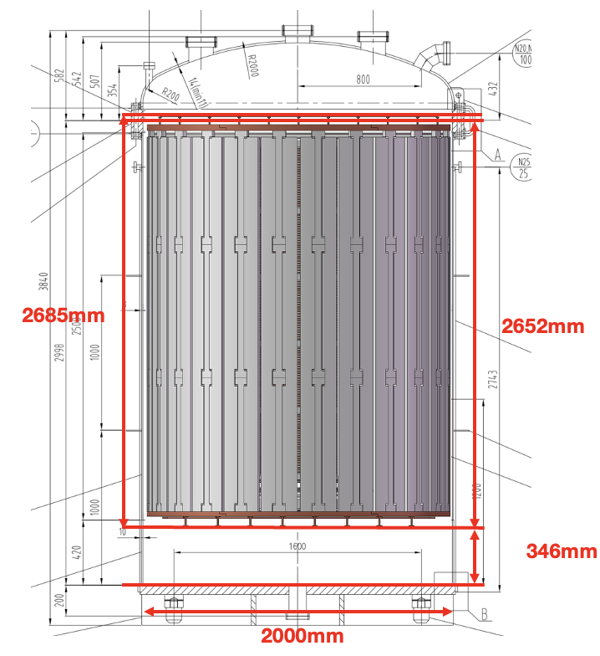
PandaX-20T basics
IV
ID 2000mm, height 3000mm
Barrel thickness 8mm
0.1~0.45MPa
OV
ID 2400mm
Barrel thickness 10 mm
Water shield
10m diameter and 13m height
Scintillator boxes with 10 cm thickness
5.6 m
2.6 m

Slide 21
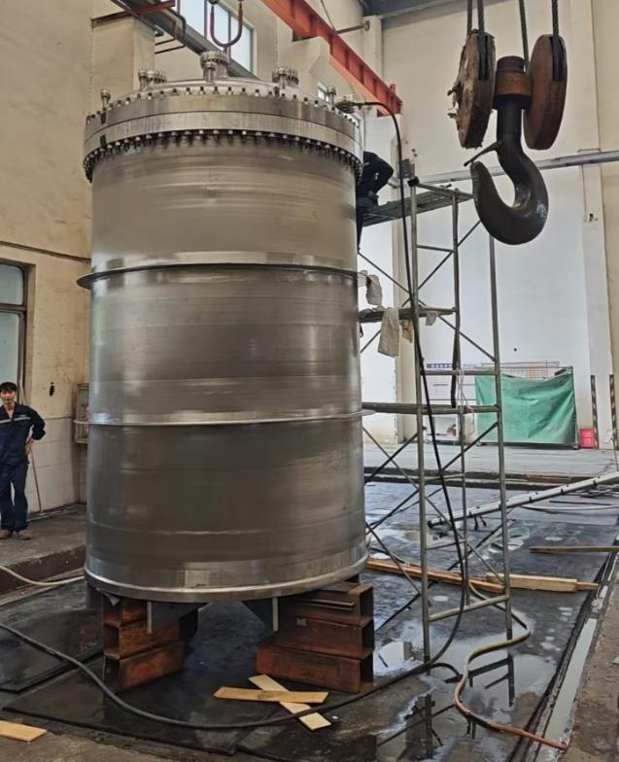
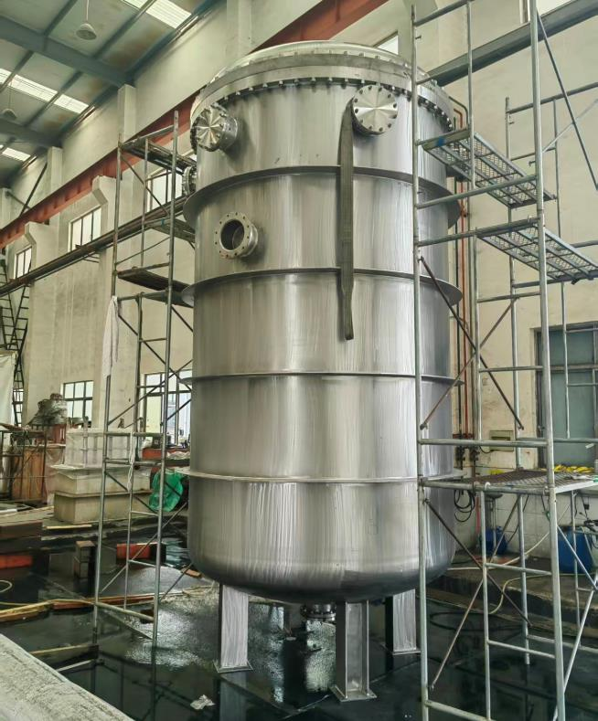
Ti Cryostat
Inner vessel (24-ton capacity)
Outer vessel

Slide 22
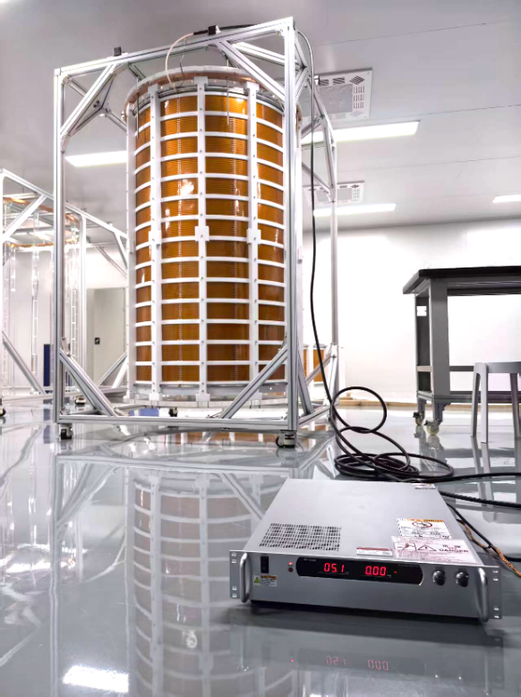
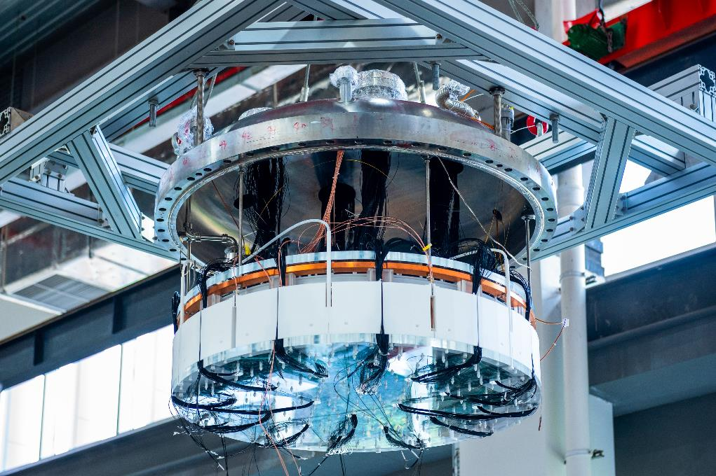
Time projection chamber(s)

Slide 23
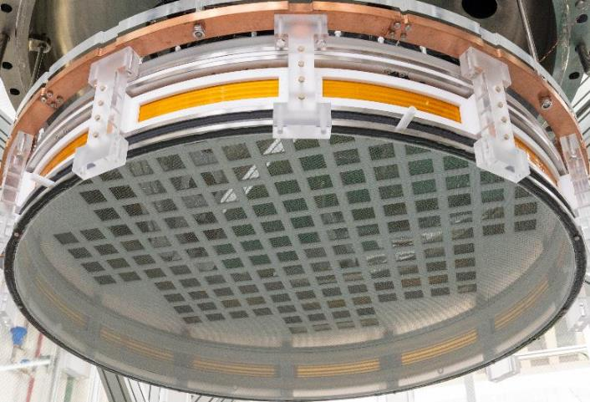
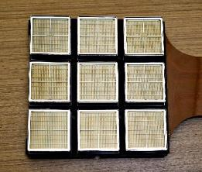
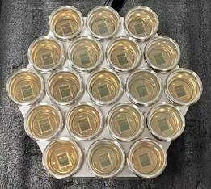
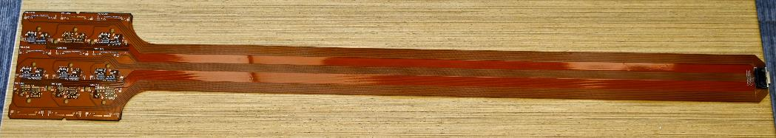
Photosensors
Top and bottom PMT array design finalized
Low-radioactivity R12699 PMTs under production, with delivery scheduled for 2026
Assembly and system-level testing in progress

Slide 24
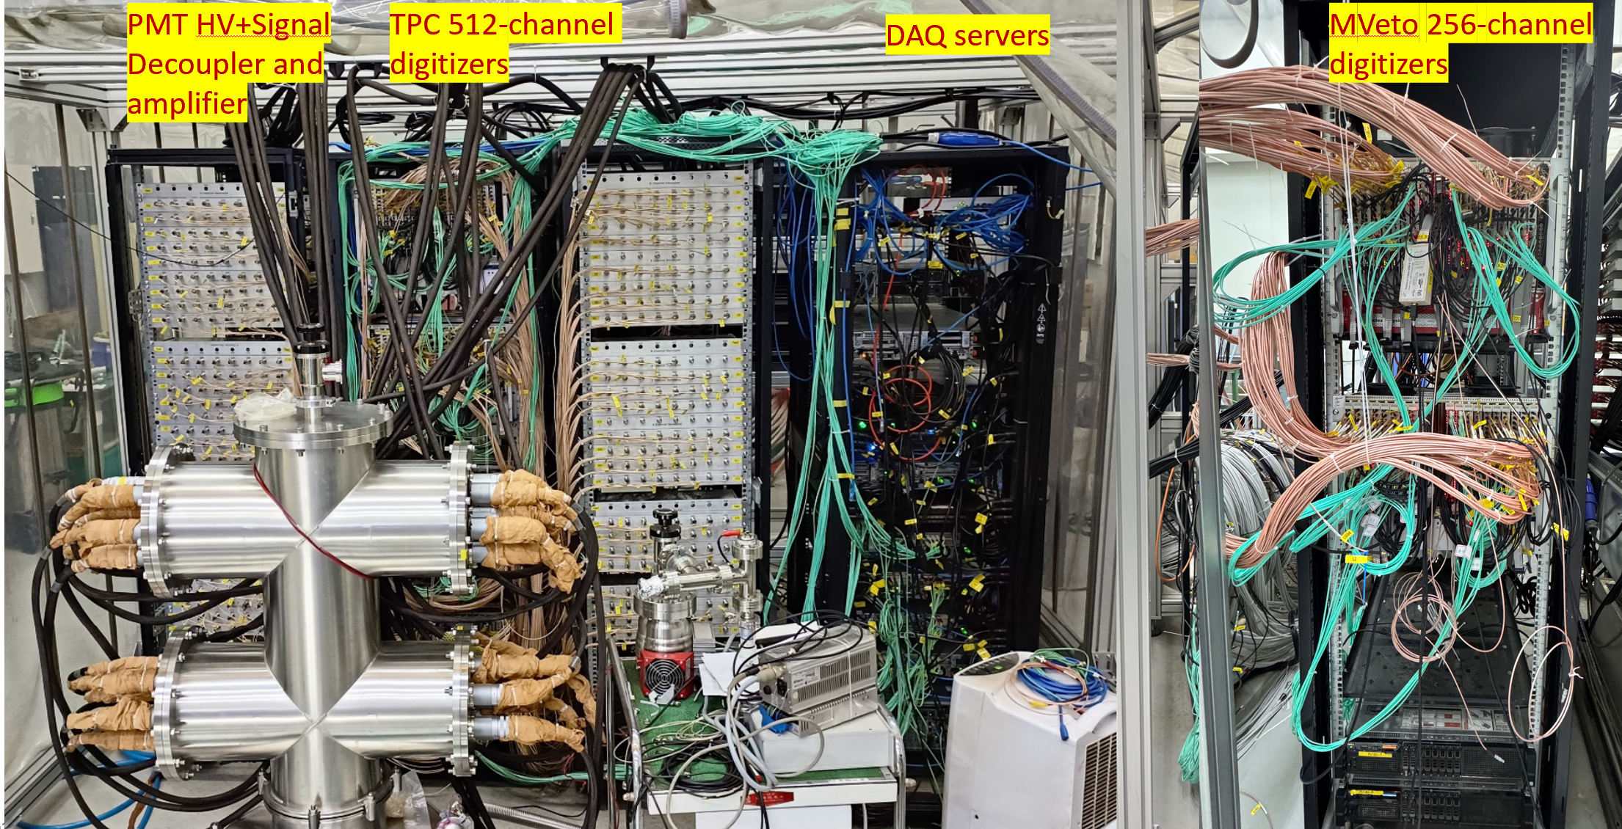
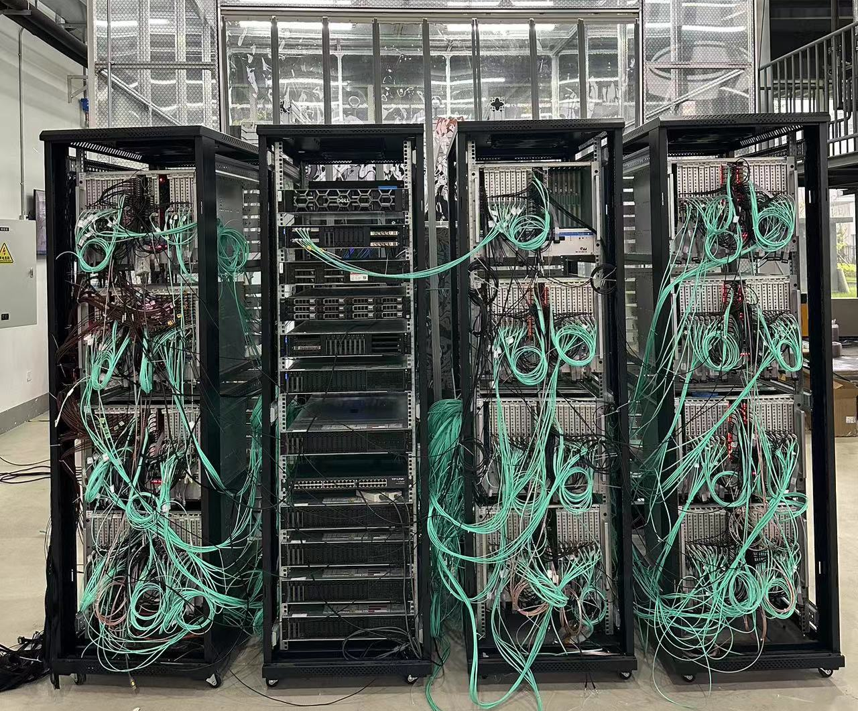
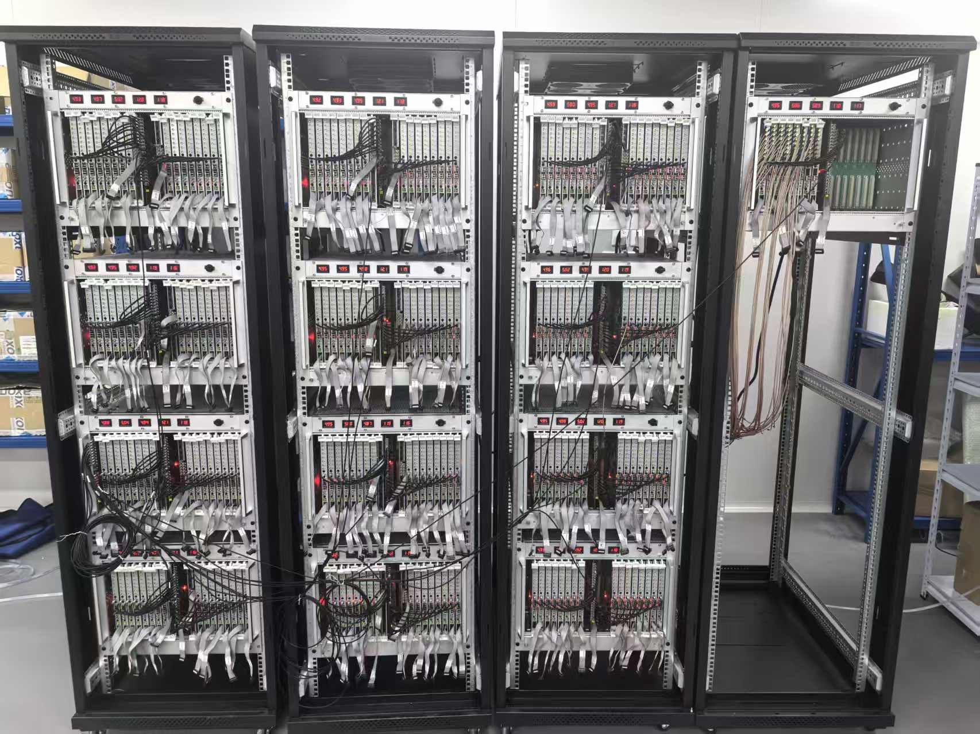
500 MS/sDigitizers
768-channel in PandaX-4T CJPL
3000-channel in TDLI

Slide 25
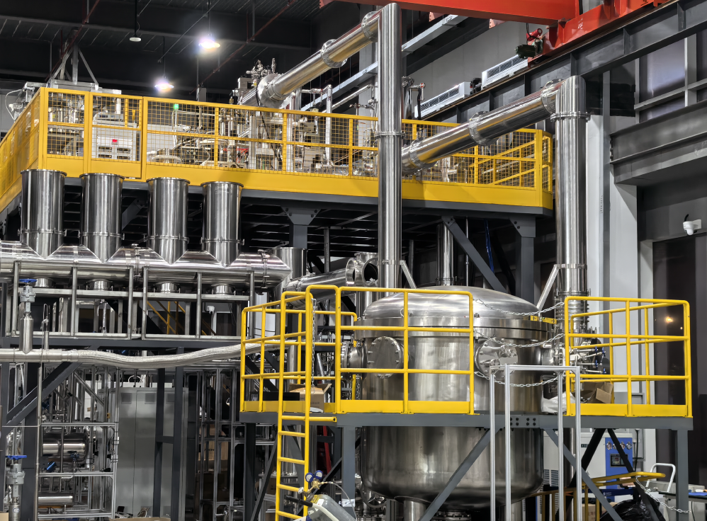
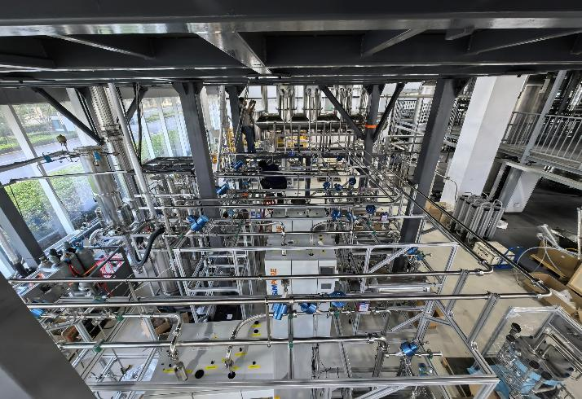
Cryogenics and recirculation

Slide 26
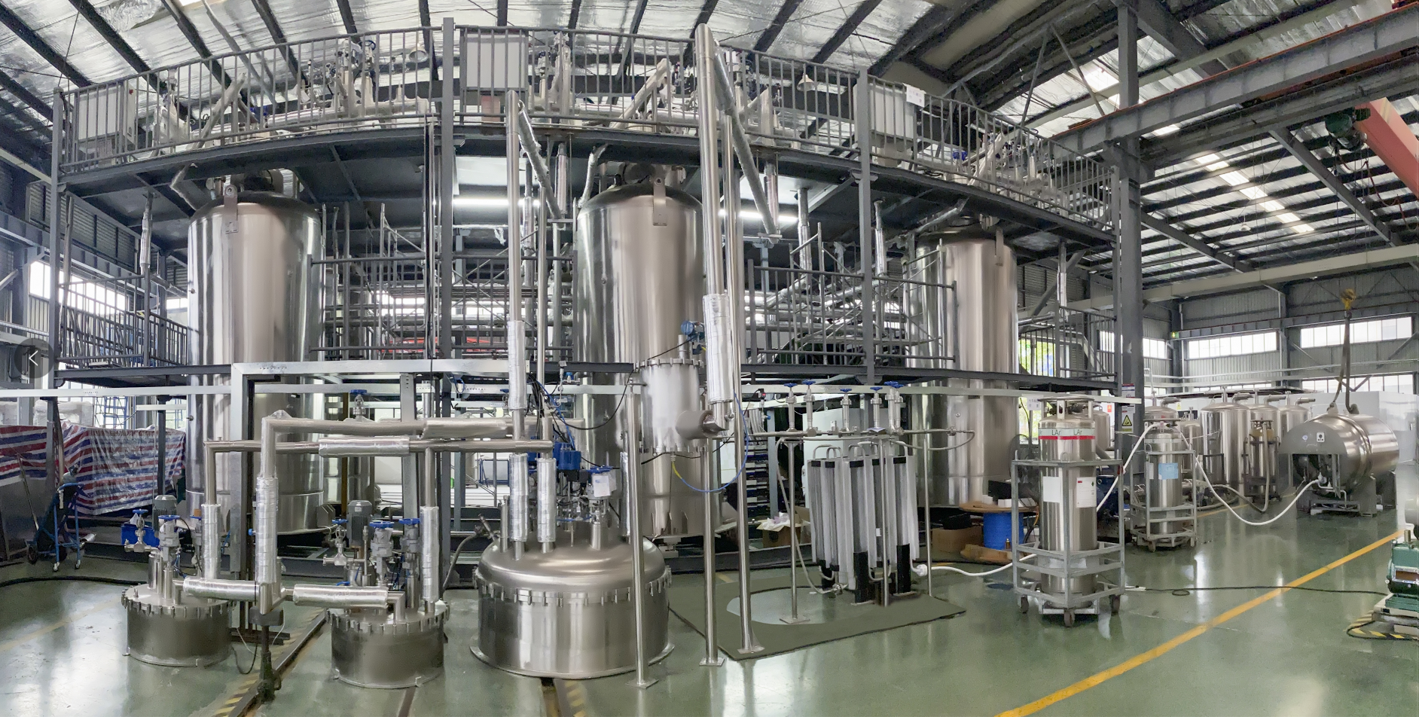
Liquid xenon storage and handling
Each storage tank: 6-m³ (maximum 18 ton) of LXe
Cryogenic pump: filling/emptying detector @ 1.5 ton/hour.

Slide 27
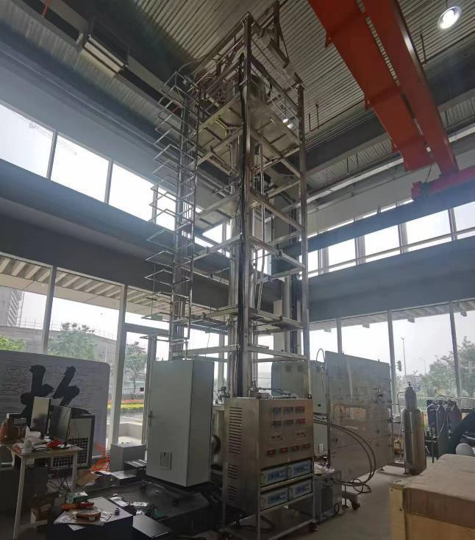
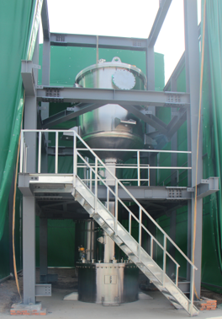
Distillation towers (Kr/Ar, Rn)
Kr distillation tower : 30 kg/hour.
Target Kr concentration in Xe: 0.1 ppt
Rn distillation tower : 850 kg/hour.
Target: 0.5 μBq/kg

Slide 28
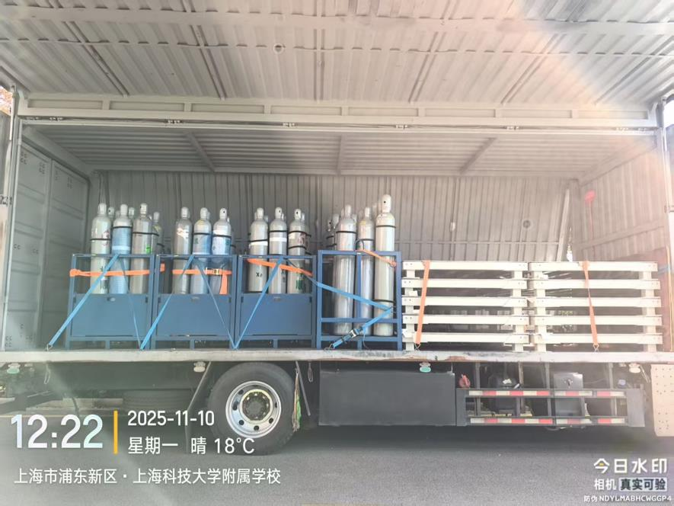
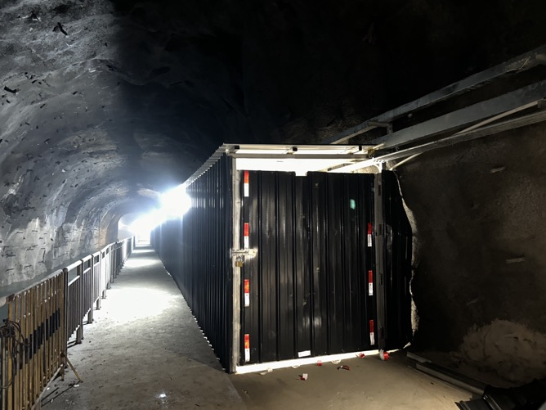
Transporting xenon to CJPL

Slide 29
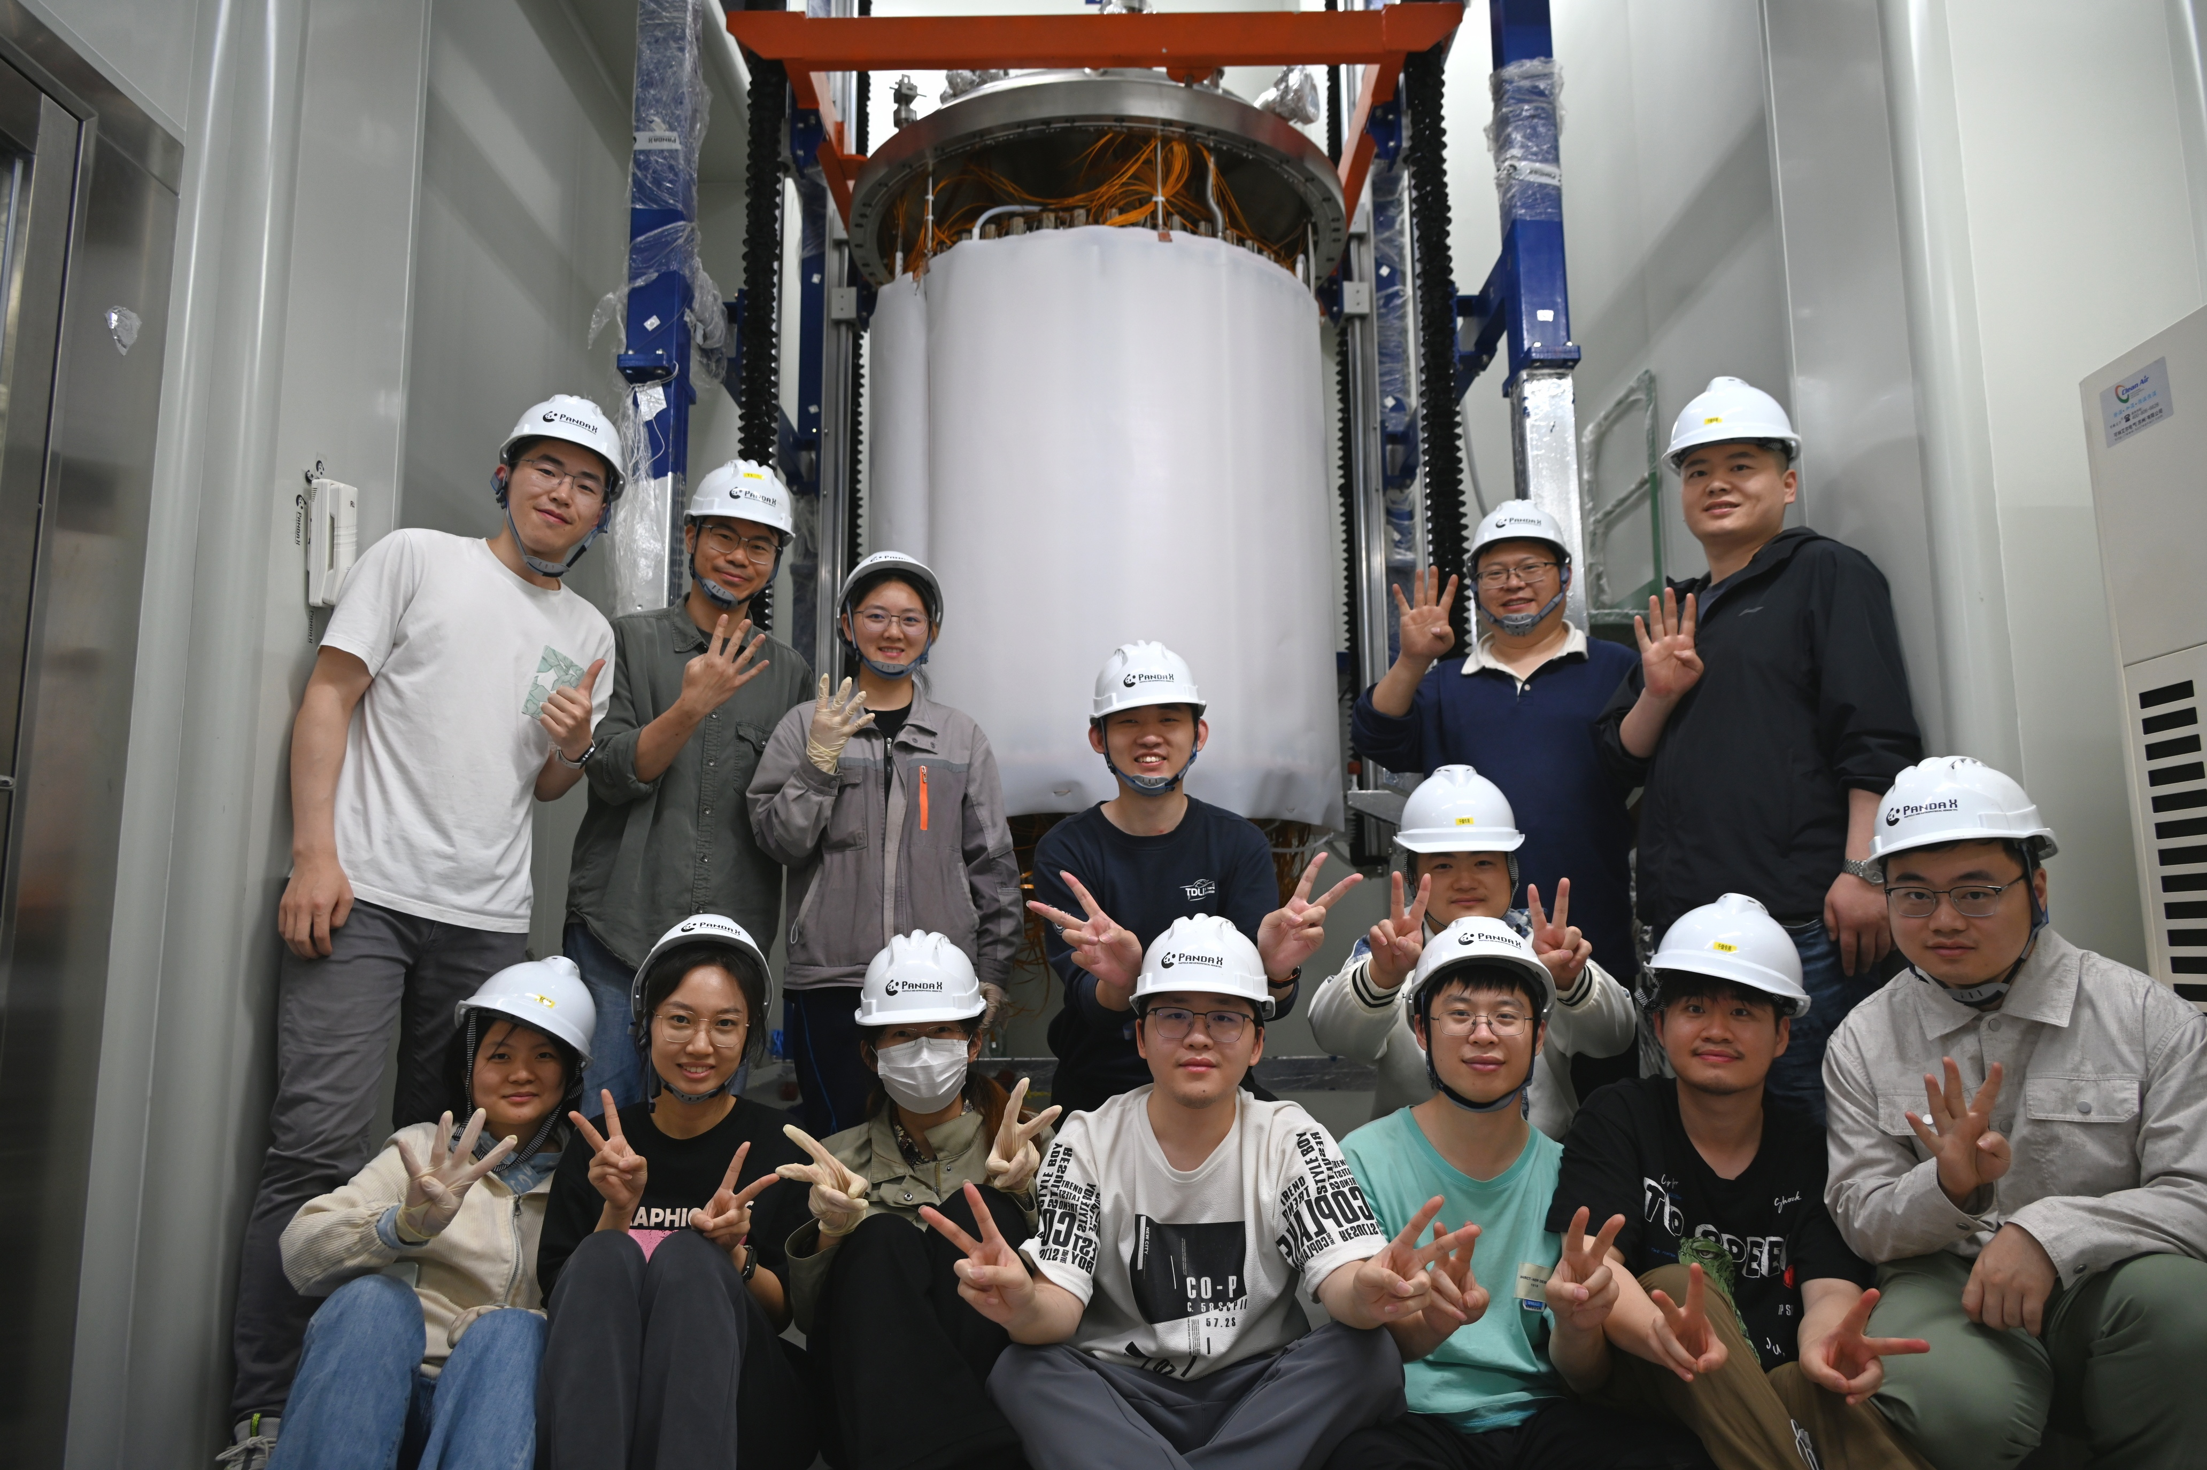
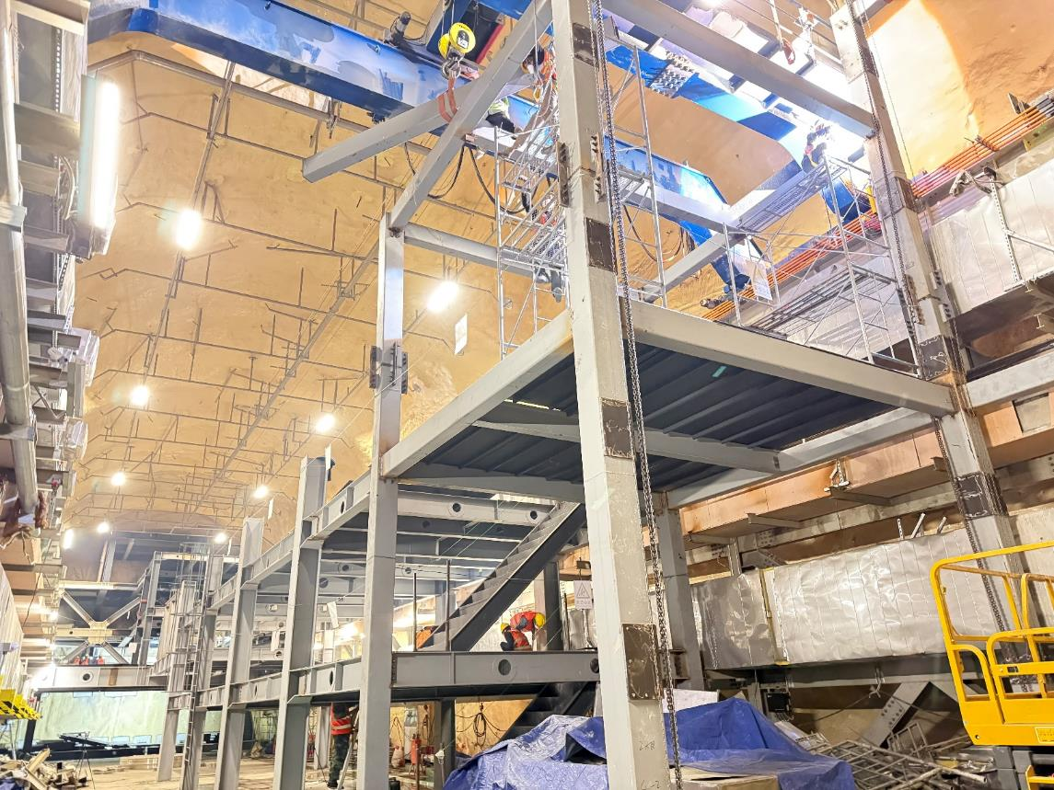
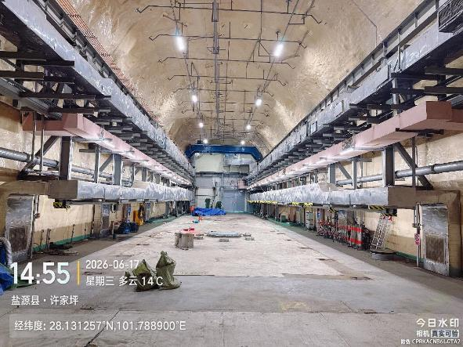
Lab infrastructure construction
2026.09.13
2026.04.27
2026.06.17

Slide 30

Near future
2026.4-6 PandaX-4T decommissioning
2026.6-12 PandaX-20T infrastructure construction
2027.1-2027.6 PandaX-20T installation
2027.7-2027.12 PandaX-20T commissioning
2028.1- Physics operation

Slide 31
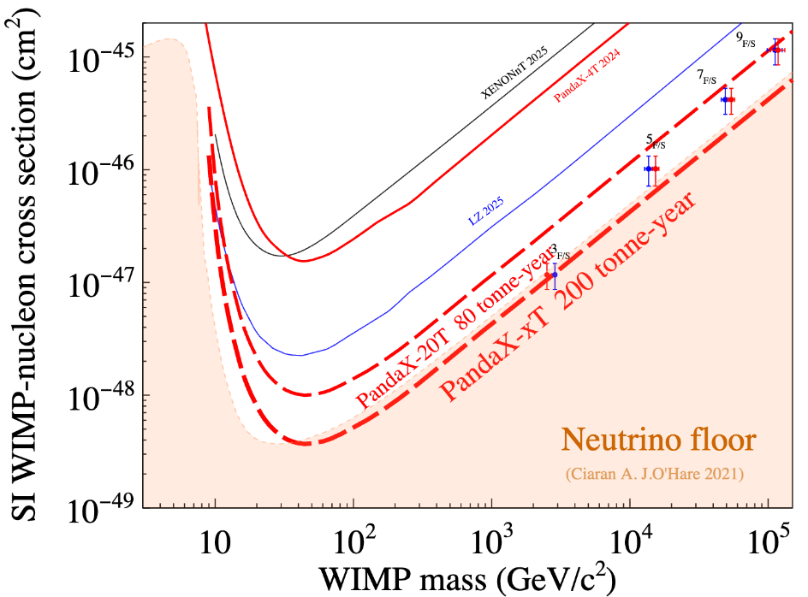
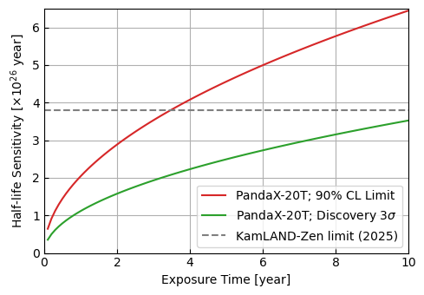
Baseline scientific potential of 20T
FV 13 ton, ROI 1-10 keVee, 99.7% ER rejection
FV 2.4 ton natural, 1% resolution
See executive summary submitted to APPEC

Slide 32
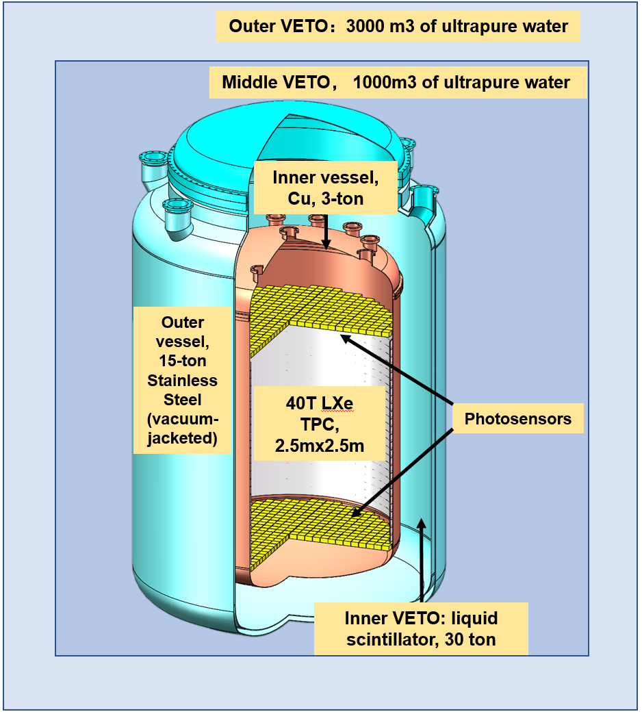
PandaX-40T
Eventually, 47-ton xenon, including 40-ton sensitive volume
  TPC 2.5 meters in diameter and height
  Cold LS veto right outside Cu cryostat
  3.5 ton of Xe136 within
Ultimate challenges:
  Purity of Cu vessel+photosensors
  Noble gas background (Kr,Ar,Rn)

Slide 33
Possible points of international collaboration (20T+)
PandaX-20T (20T+) is likely a 5-year project (2027-2032)
The first phase of PandaX-20T hardware scope is mostly covered
Scopes of collaboration: 20T+, 40T?
  More xenon! (current vessel holds 24-T in total)
  Cleaner vessels (smaller cost in comparison to everything else)
  Background suppression techniques/scheme/tools
  Veto upgrades and hermetic cold veto
  Calibration
  PMT sensors: future options
  Analysis/simulation/slow control in the AI era
  …
PandaX-20T designed to have quick turn-around time. Upgrade “easy”

Slide 34
Beyond 20T (personal wild thoughts)
Naturally go with x2 upgrade to ~40T (2032?)
XLZD fully under construction/commissioning
Possibilities
  Remain (friendly) competing
  GERDA-Majorana type of joint force
    Information sharing through joint-workshop
    Collaboration on specific technical areas, e.g. common simulation software, Rn techniques, etc
    Flow of people, particularly younger generations
    High-level joint analysis
  3. Some middle ground in between?

Slide 35
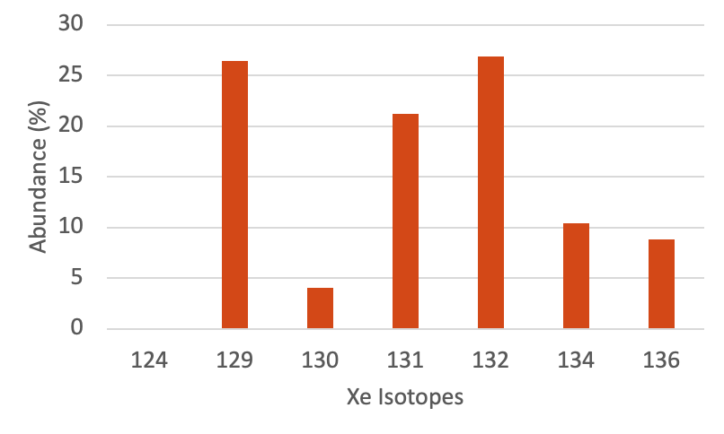
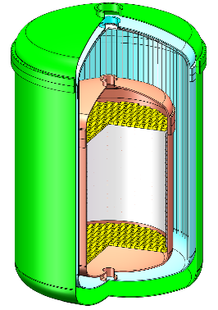
Isotopic enrichment?
AMIA1
AMIA2
Discovery smoking gun！
Shall we do it? Many drivers
  Scientific findings in the natural detector
  Cost
  Can we get the background budget for vessel/sensors down
  International landscape

Slide 36
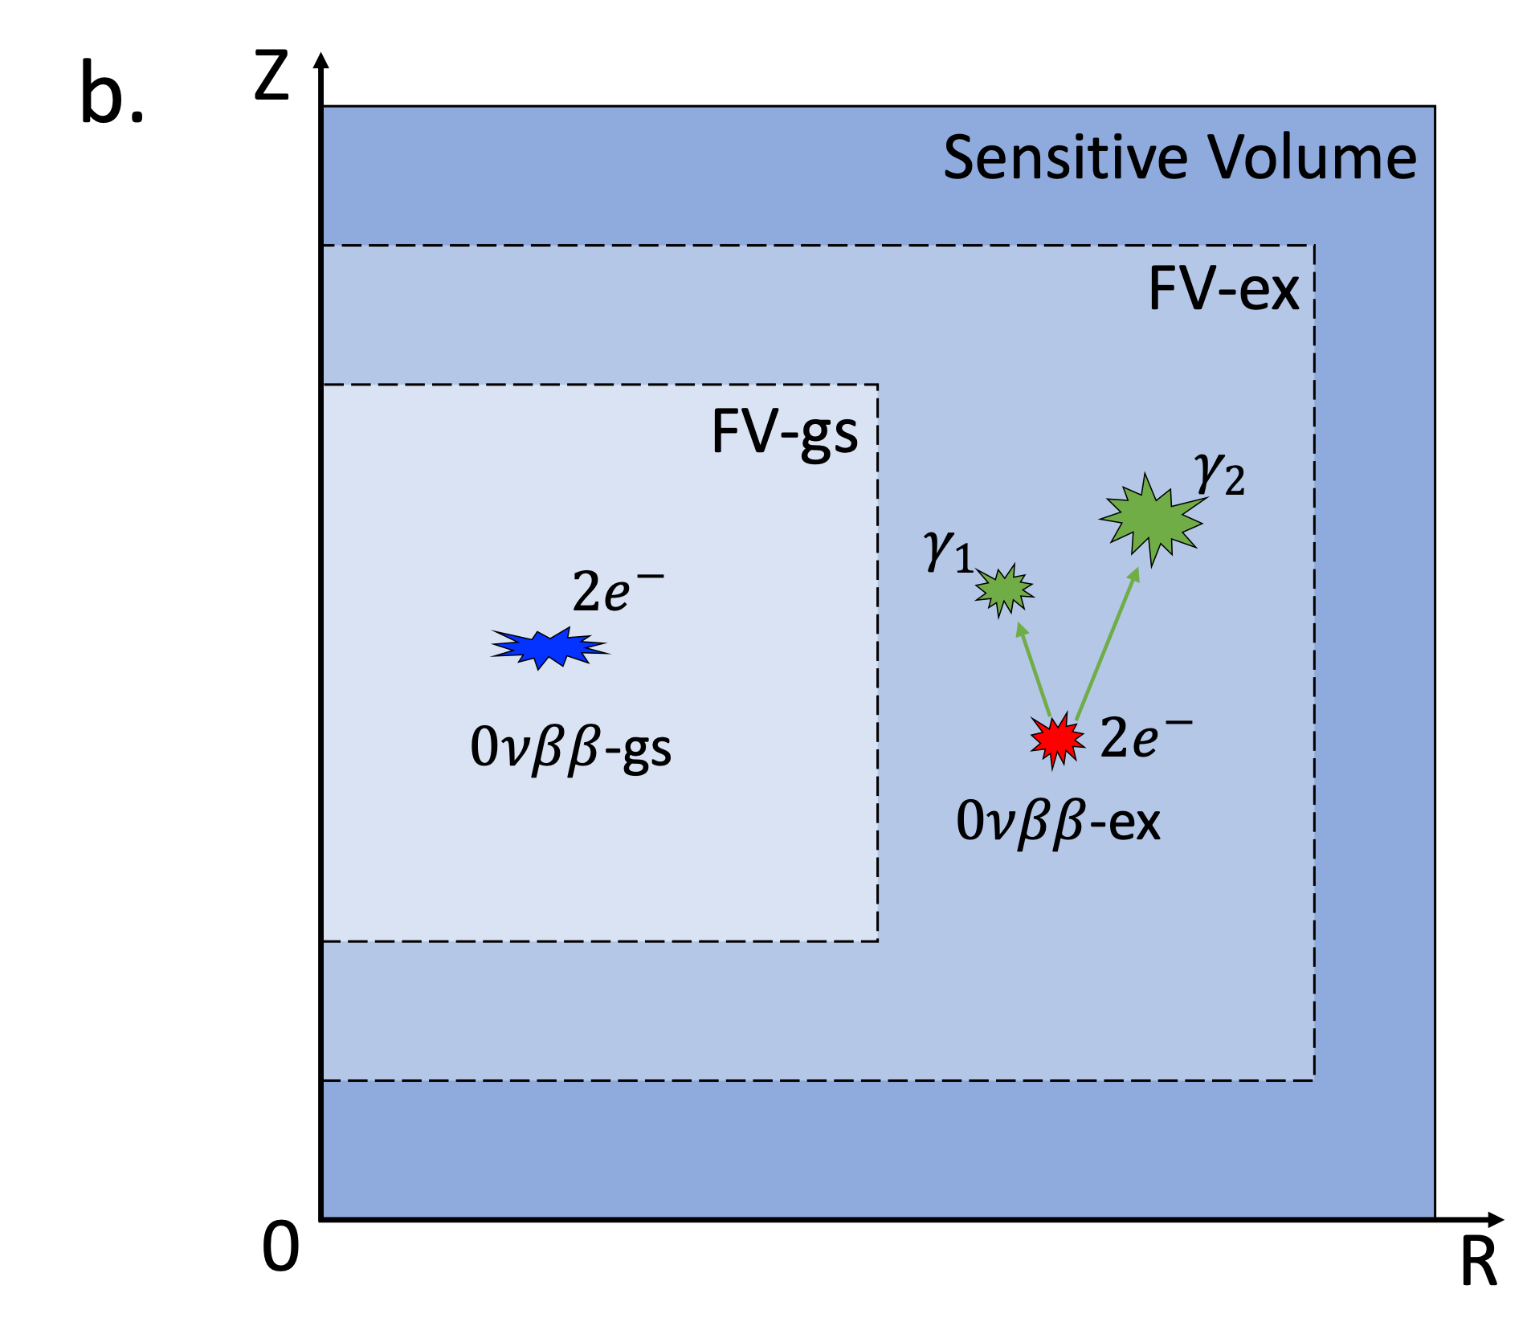
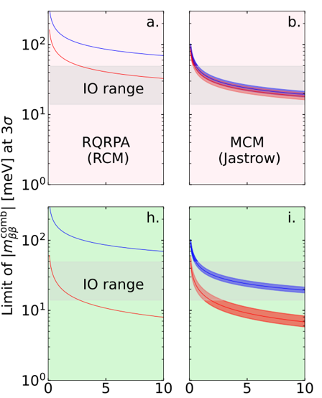
Unique advantage of natural xenon detector: Xe136->Ba136*
Cheap and pure cold LS veto
Interior: thin Cu vessel, push interior radio-cleanliness
60t
100t
arXiv:2508.17413, Ke Han, Shaobo Wang, Jiangmin Yao et al.

Slide 37
Outline
History of PandaX
Reflections
Plan for the future
From Liangjian Wen: JUNO DBD program

Slide 38
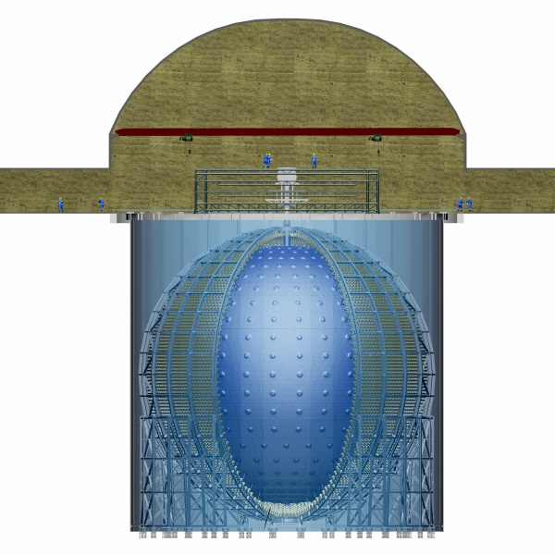
JUNO-ββ
JUNO will be upgraded for ββ-decays after mass ordering determination (~2030), in addition to existing capabilities
Potential to explore normal mass ordering parameter space of Majorana neutrino mass
Good progress on R&D of Te loaded LS and suppression of cosmogenic background
Te-LS
or
Xe-LS
 | Isotope | Mass(t) | <m_{bb}>,meV
SNO+ | ¹³⁰Te | 8 | 19-46
KamLAND2-Zen | ¹³⁶Xe | 1 | ~20
NEXT-HD | ¹³⁶Xe | 1 | 14-40
nEXO | ¹³⁶Xe | 5 | 7-22
XLZD/PandaX-xT | ¹³⁶Xe | 3-5 | 7-22
LEGEND-1000/CDEX-1t | ⁷⁶Ge | 1 | 10-40
AMoRE-II | ¹⁰⁰Mo | 0.1 | 12-22
CUPID | ¹⁰⁰Mo | 0.24 | 12-20
CUPID-1T | ¹⁰⁰Mo | 1 | 4-7
JUNO-bb | ¹³⁶Xe | 50 | 4-10
 | ¹³⁰Te | 100 | 3-14
¹³⁶Xe-LS (or ¹³⁰Te) loaded into the JUNO detector
Zhao et al., arXiv: 1610.07143, CPC 41（2017）5

Slide 39

JUNO’s potential on 0νββ searches
JUNO offers a unique opportunity to search for 0νββ
  Large target mass: 20 kton LS → allow 100-ton scale isotope loading (Te or Xe)
  Low background (<10⁻¹⁶ g/g U/Th)
  Excellent energy resolution ~3% @ 1 MeV
  ➔ Potential to explore normal mass ordering parameter space of Majorana neutrino mass
Critical R&D in progress
  Te loaded LS technology
    Challenge: high transparency, light yield, and solubility and stability
  Background rejection
    Comprehensive evaluation of Te (Xe) muon-spallation background using FLUKA/GEANT4
    ML-based rejection strategy currently under development
Chin.Phys.C 50 (2026) 4, 043001
Chin. Phys. C 41 (2017) 053001

Slide 40




Development of Te-LS based on JUNO LS Formulation at IHEP
Two approaches:
  Azeotropic Distillation Approach (NIM A 1049 (2023) 168111)
  No added water + constant water removal → STABLE Te-diol product
  Room-Temperature Synthesis (NIM A 1088 (2026) 171531 )
  Methanol-mediated synthesis at R.T., safer, low energy consumption
A one-step synthesis：
TeA + HD → Te-HD + H₂O
  TeA: Telluric Acid ; HD: 1,2-hexanediol
  Six-carbon chain enables Te-HD to be fully miscible with LAB
Promising performance of Te-LS
  High Te Solubility: > 5% Te loading in JUNO LS
  Favorable Transparency: Attenuation Length of 1% Te-LAB = 20.1 ± 1.1 m
  Solid Long-Term Stability: Spectral stability confirmed for > 3 years (0.6% loading) and > 1 year (1% and 3% loading) to date
  Relative Light Yield: 80% ± 2% at 0.5% Te loading (vs. unloaded LS, new development ongoing)
Future plan
  Continue to improve light yield
  Radio-purification of raw materials
  20 ton Te-LS pilot detector in future: JUNO-OSIRIS (Eur. Phys. J. C (2021) 81:973)

Slide 41




Spallation backgrounds evaluation and rejection
Crucial bkg at JUNO: Muon spallation isotopes from Te
Isotope yield calculation with FLUKA and GEANT
  Variations among models
  Identification of major long lived isotopes
ML background rejection techniques development using muon, spallation products & event topology info
Same evaluation for Xe-loading ongoing
Plan to update sensitivity evaluation with latest detector understanding

Slide 42
Thank you!

Slide 43
Technological matureness
Item | Need | Best now | Challenge level
Low bkg cryostat | Cu | Low background SS | ***
LXe TPC | 2.7 m x 2.7 m | 1.2 m x 1.2 m | **
Photosensor array | 10 m², high QE, low noises, fast | 3 m², R11410 3” PMT | *
Readout electronics | Cold and low background | Custom digitizers 500 MS/s | ***
Energy res. @ 2.5 MeV | 1% | 1.9% | **
⁸⁵Kr background | 0.1 ppt | 0.3 ppt | ***
²²²Rn background | 0.5 uBq/kg | 4 uBq/kg | ***
Cryogenics & recirculation | 500 slpm | 150 slpm | **
Key advantage: PandaX will be continuously upgraded, so technological levels will be improved along the way and be tested in real experiment!

