Slide 1
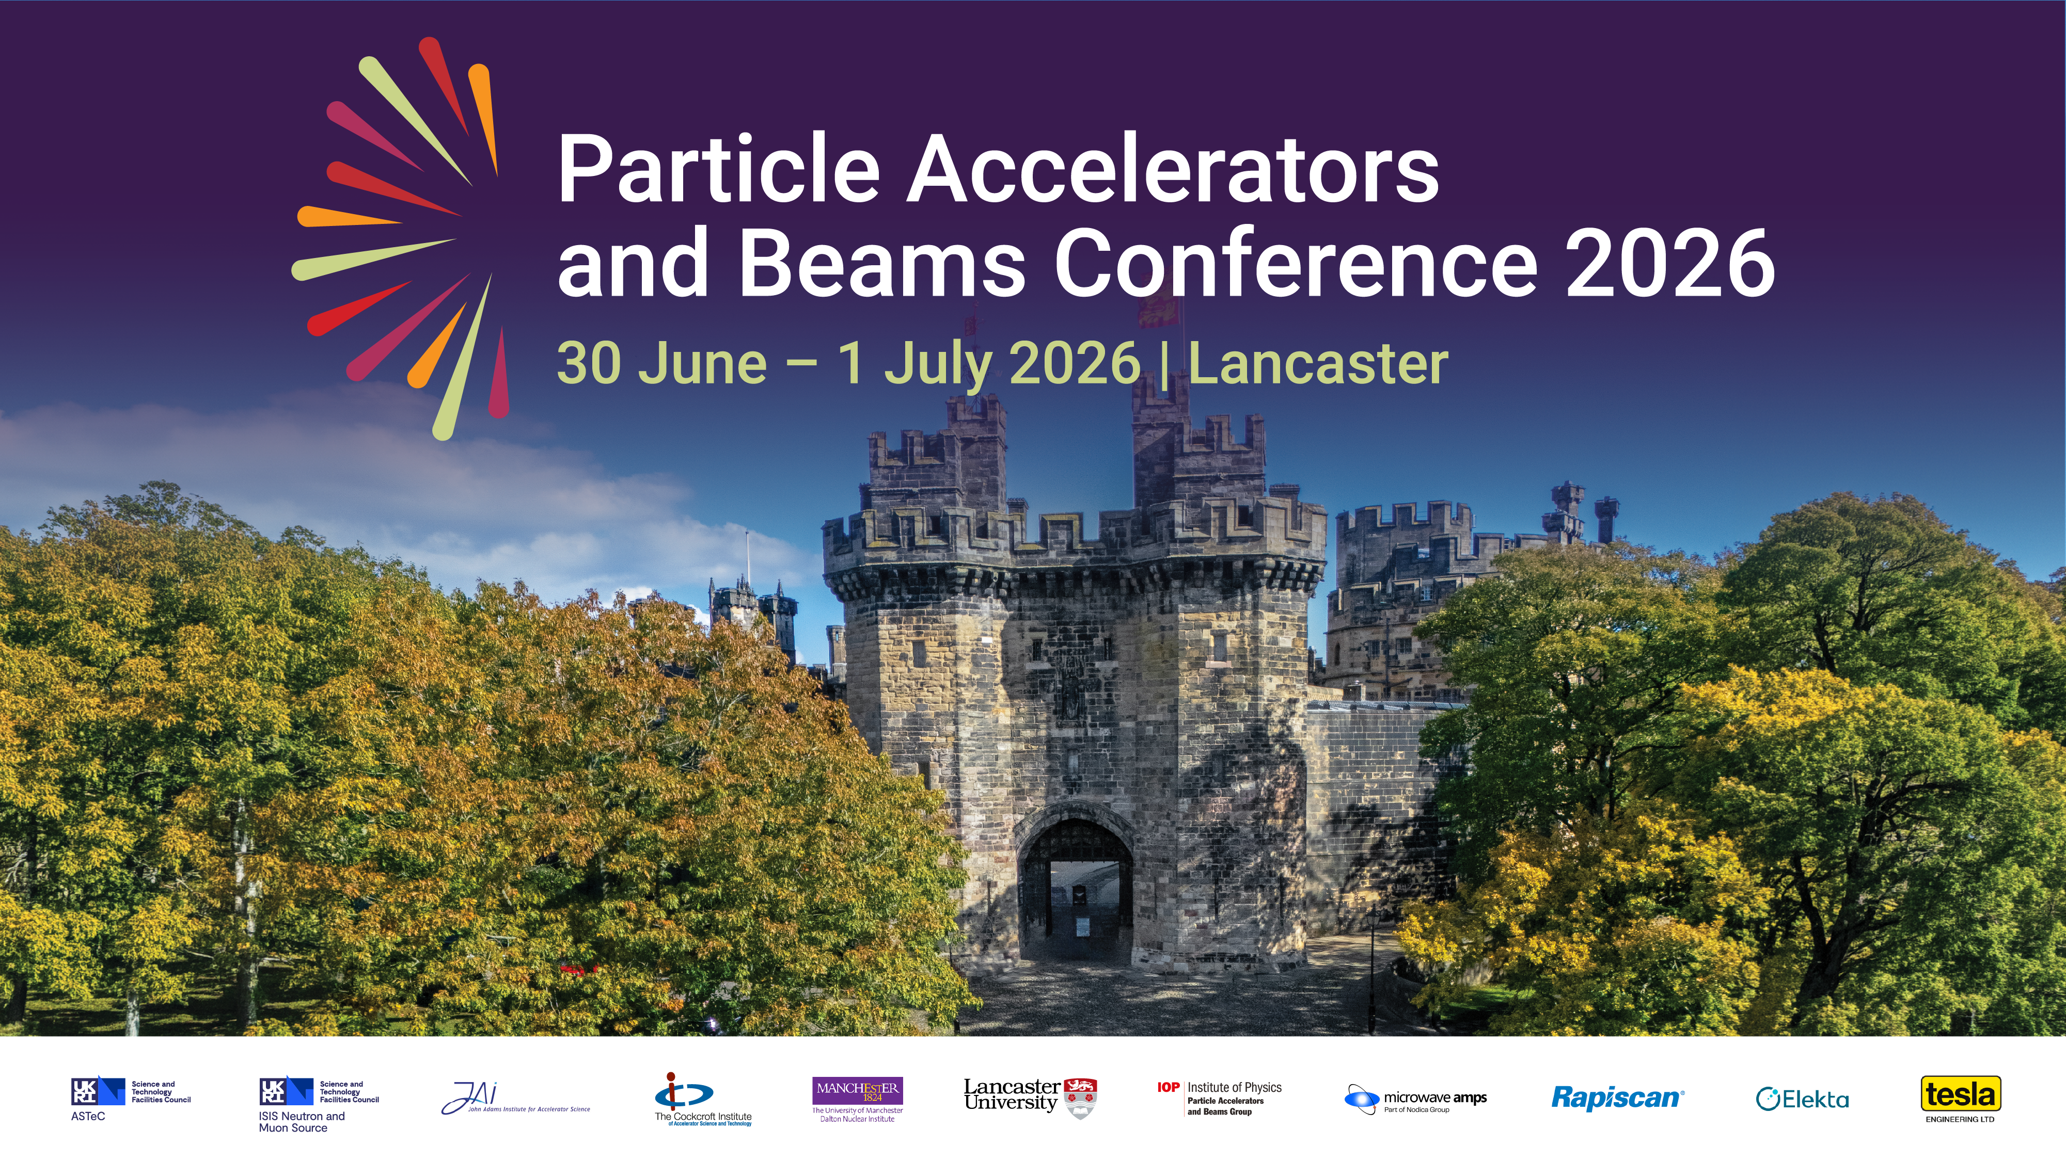

Slide 2

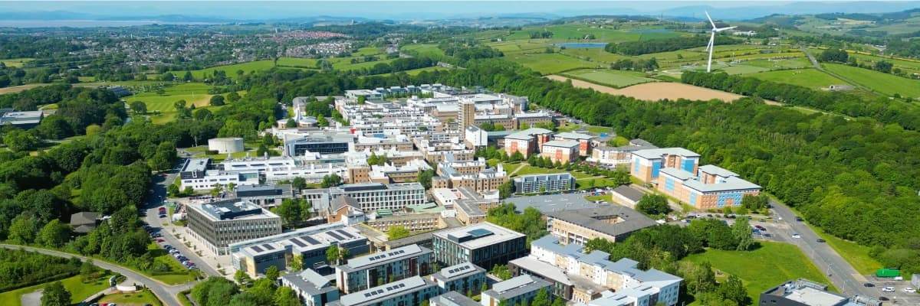
Established 1964
Students: 18,000 (5,000 postgraduates)
In top 10 of most league tables

Slide 3
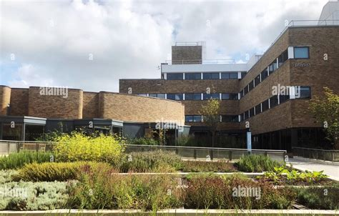
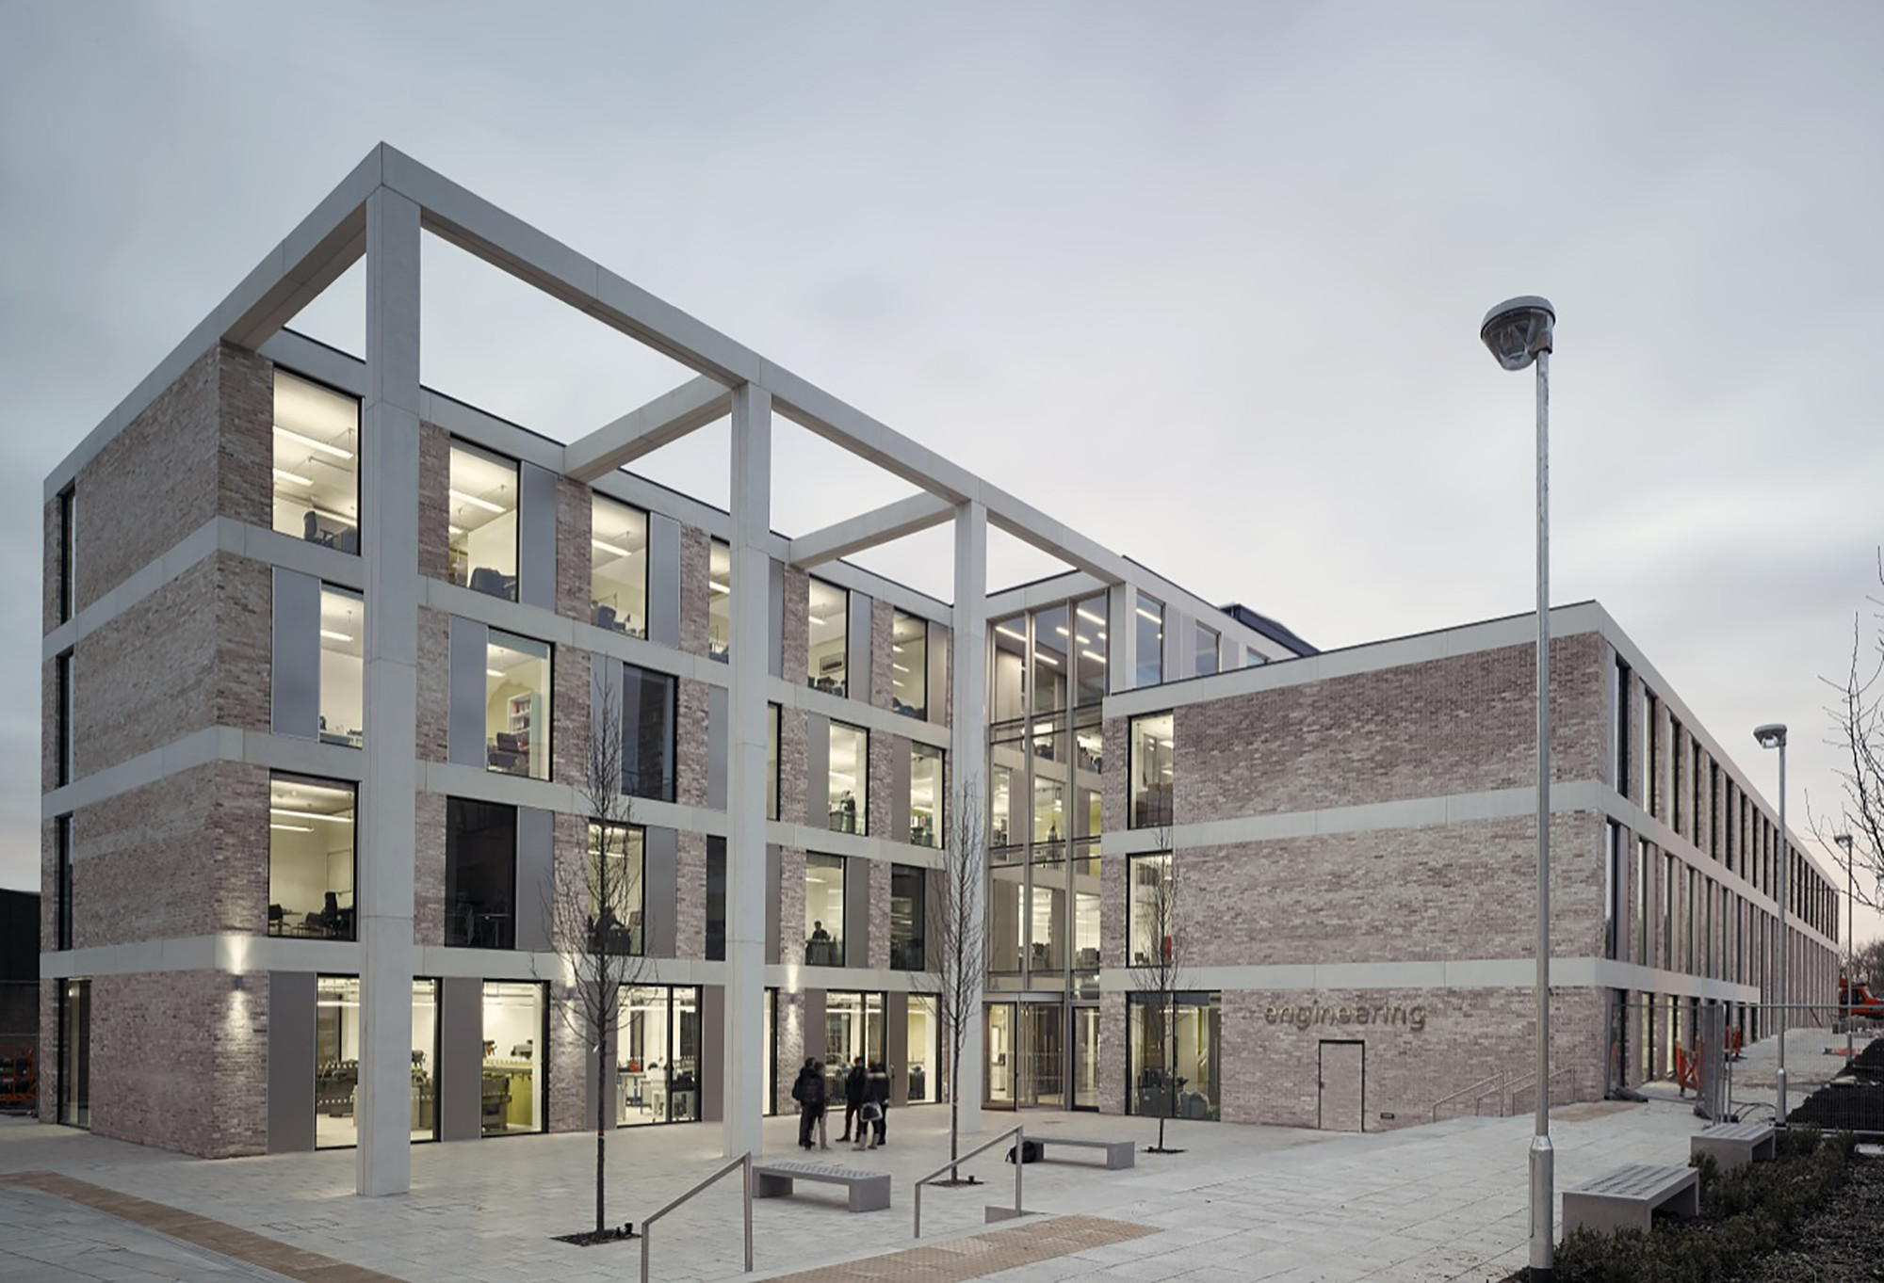
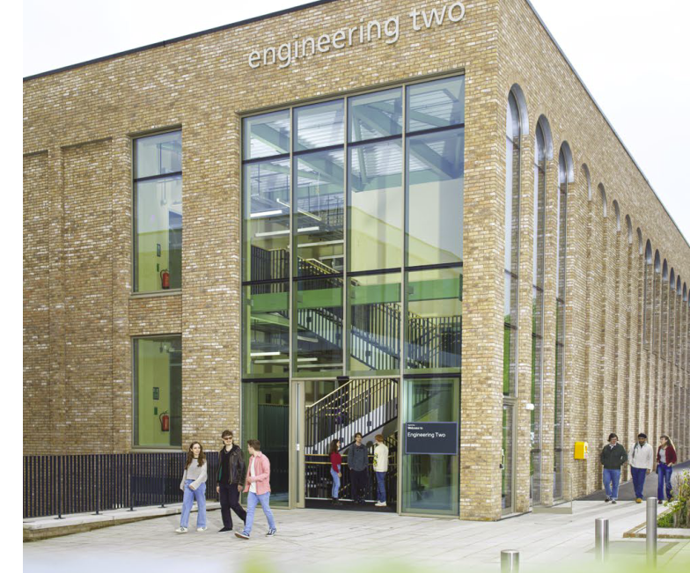
School of Physics and Astronomy
School of engineering
Experimental Particle Physics
Accelerator Physics
Observational Astrophysics
Theoretical Cosmology
Space and Planetary physics
Low temperature Physics
Quantum Nanotechnology
Nonlinear and Biomedical Physics
Quantum Theory
Mathematical Physics
55 Academics
170 undergraduate intake each year
£10-12M research income p.a.

Slide 4
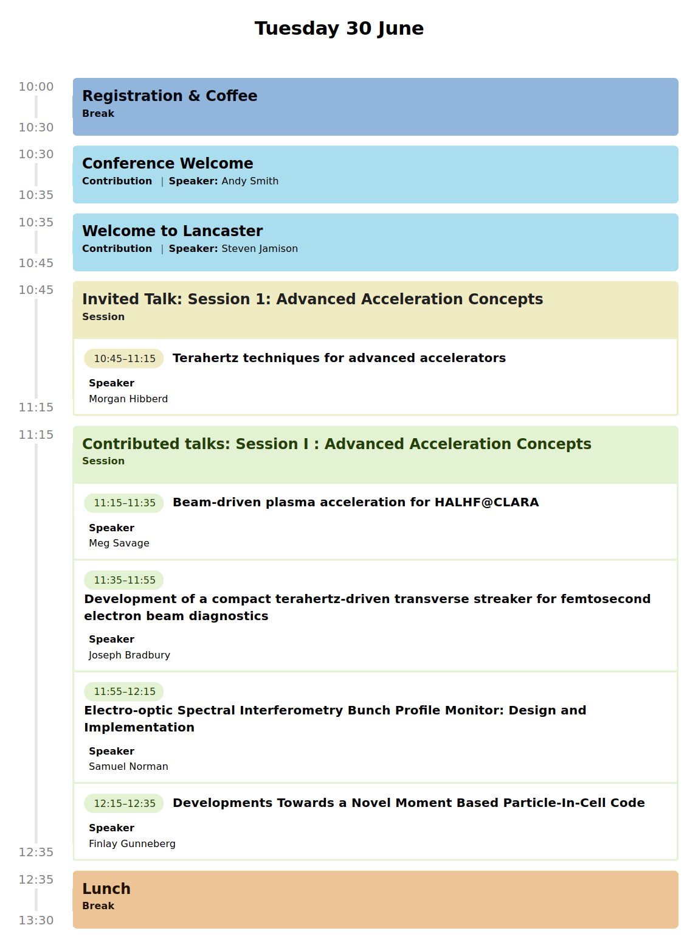
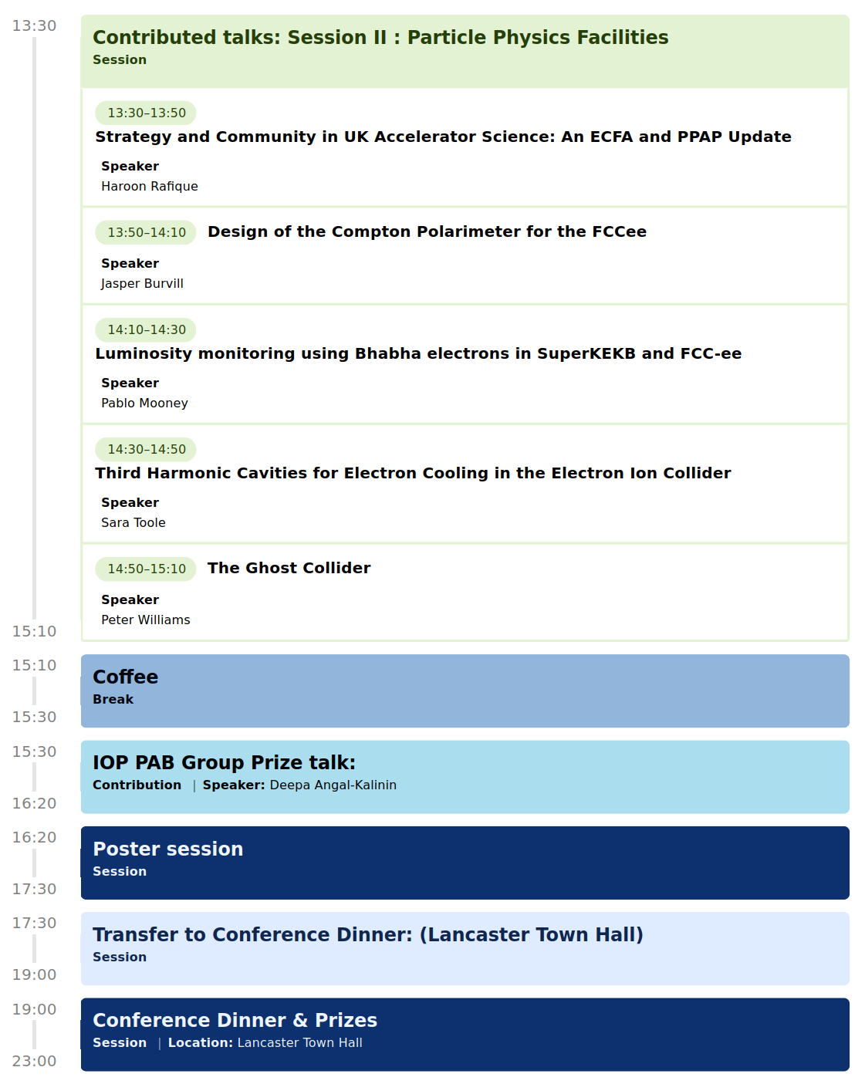

Slide 5
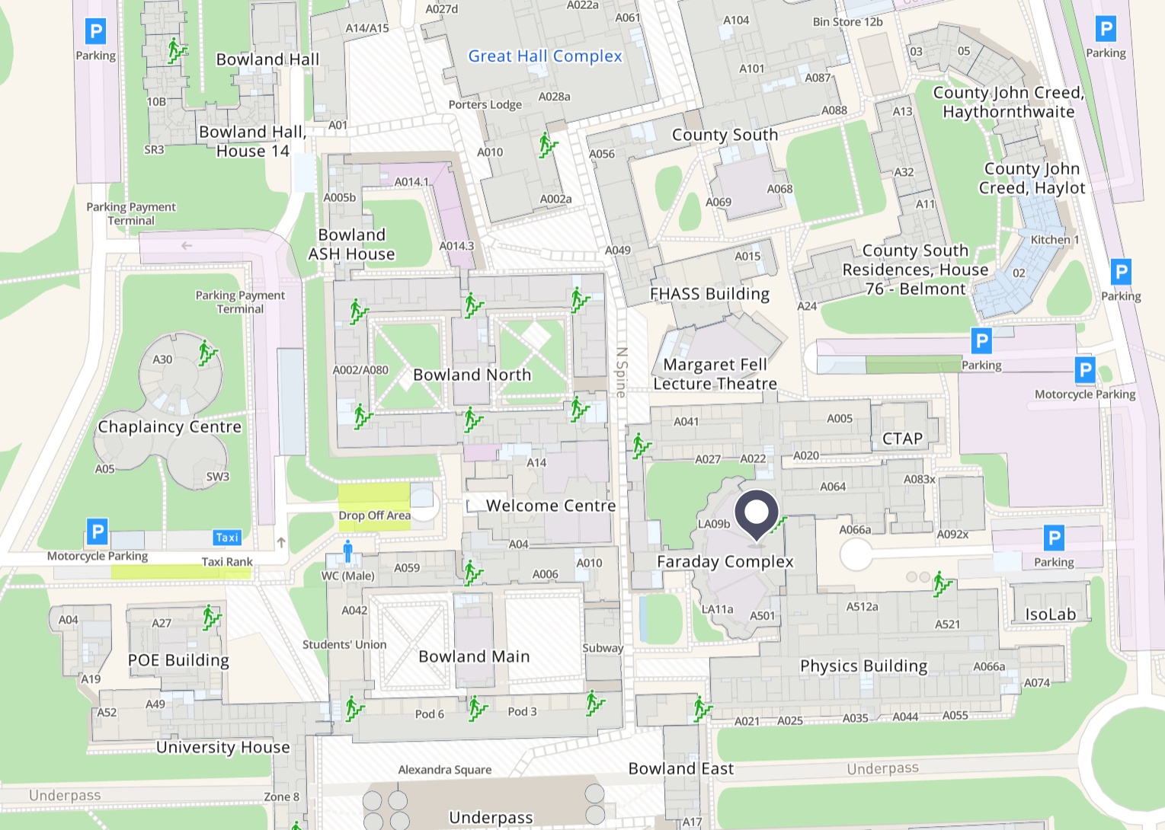
Lunches served in separate building
Lunches

Slide 6
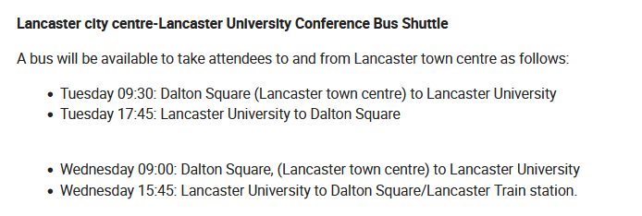
Tickets issues for our tracking of numbers wishing to use the bus.

Slide 7
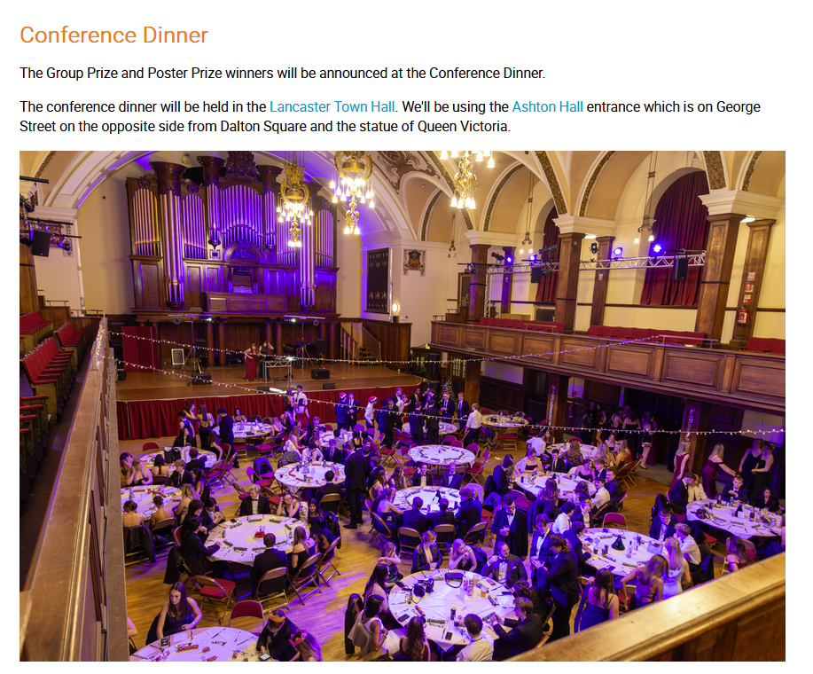
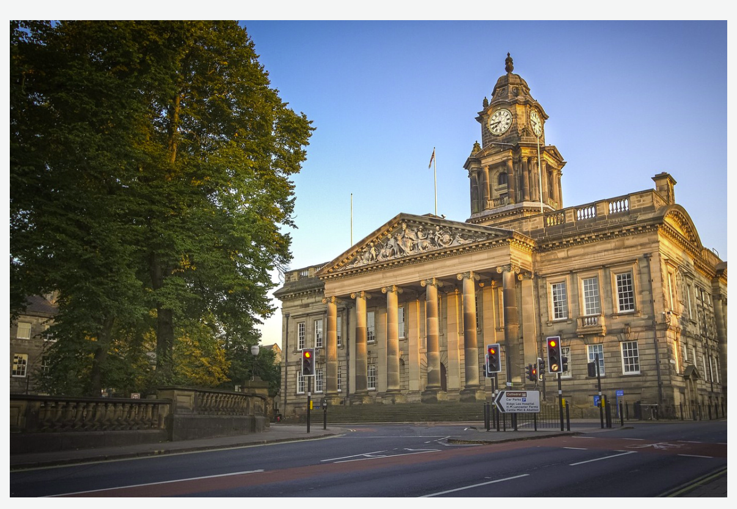
Conference dinner
Lancaster Townhall
Entry on the side entrance,
Thurnham street
Please arrive for 7:00pm

Slide 8
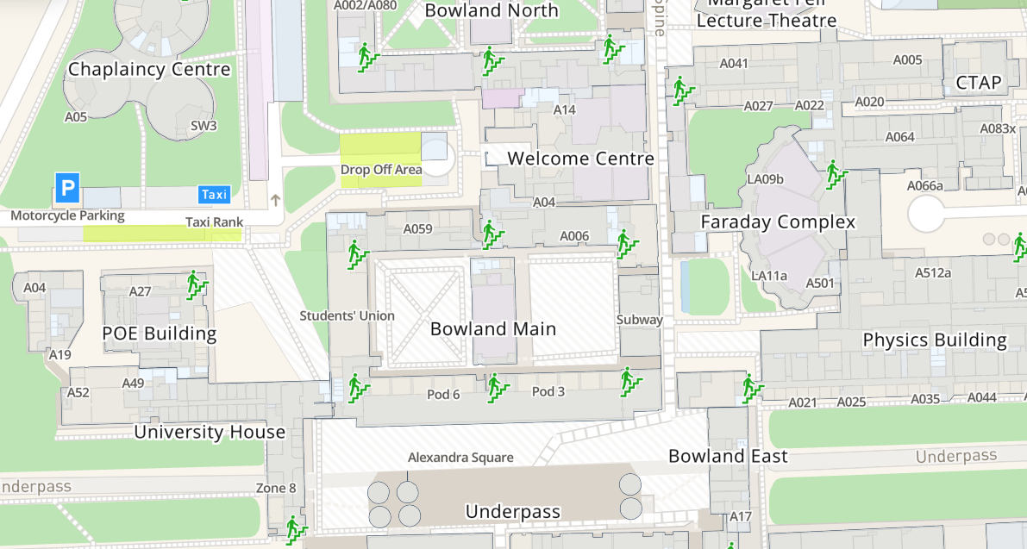
Bus to town center
Depart 5:30pm

