Slide 1




Results from the
HEPTO Combined Function Permanent Magnet
Alex Hinton, Ben Shepherd (STFC Daresbury Laboratory)
Dušan Topalović (Kyma S.p.A.)
Abolfazl Shahveh (Diamond Light Source)
Particle Accelerators and Beams Conference
Lancaster
01/07/2026

Slide 2
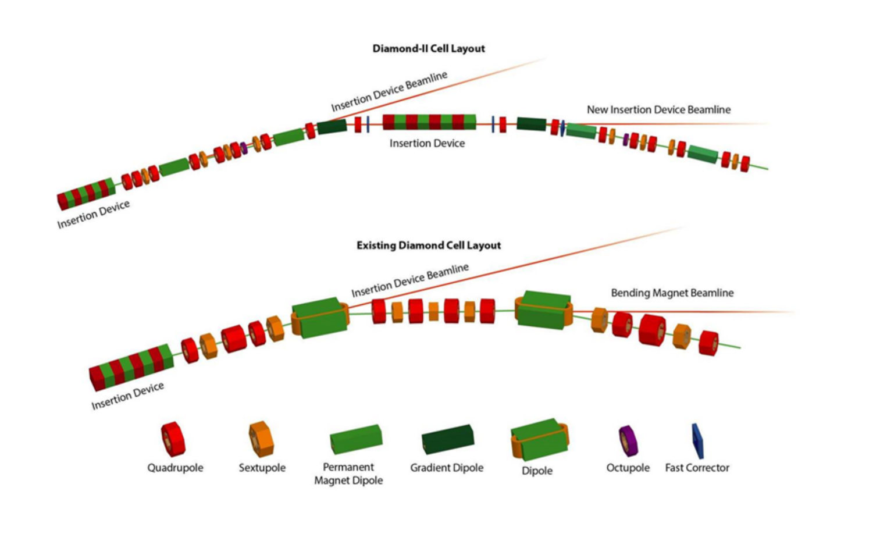
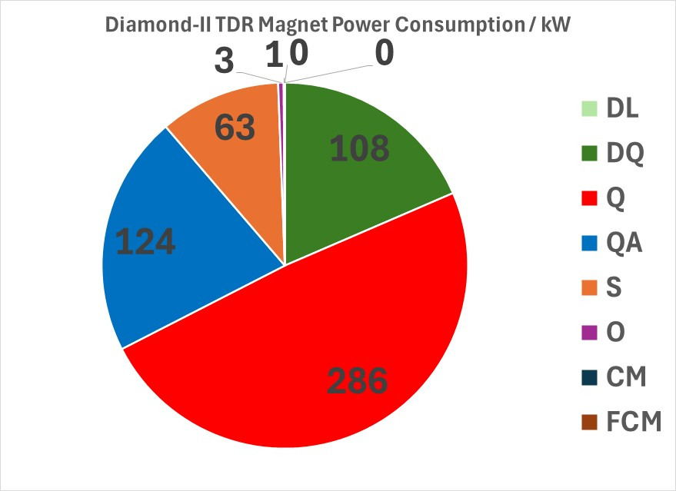
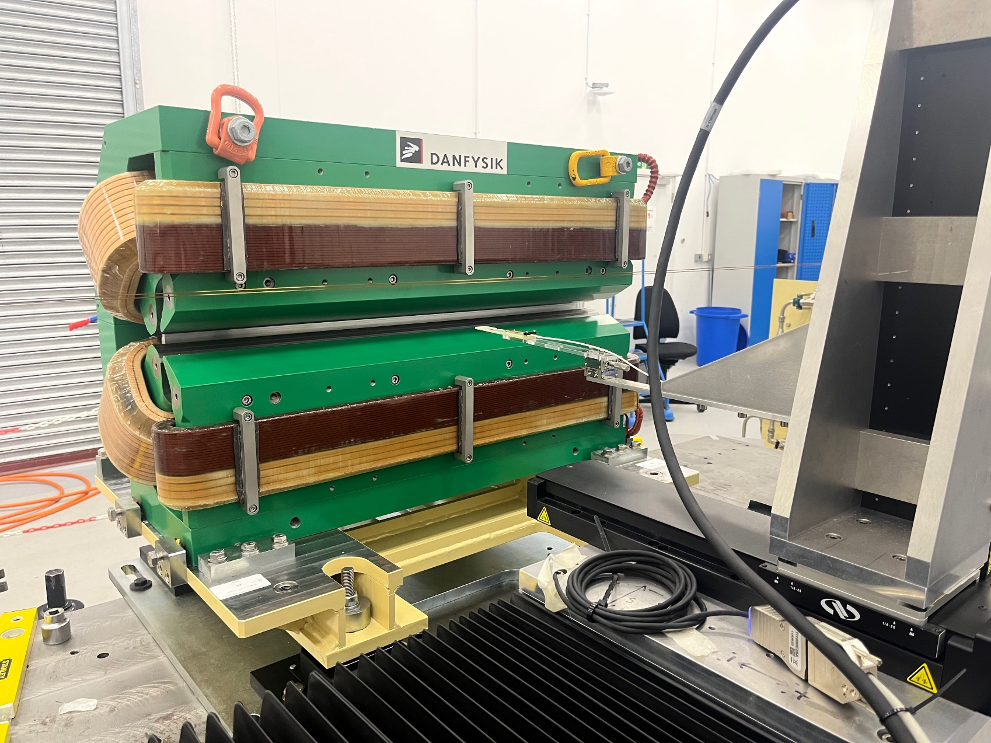
Introduction
I.FAST: EU funded project to develop new sustainable accelerator technologies and favour partnerships with industry.
Fourth generation synchrotron light sources make use of multi-bend achromat lattices to reduce beam emittance and increase radiation brightness.
Diamond-II: upgrade from double bend to 6-bend achromat.
Lattice includes 48 transverse gradient (DQ) magnets: ~108 kW.
Task 11.3 – Manufacture and test prototype permanent magnet (PM) based DQ magnet as energy saving alternative to Diamond-II design.
Upgrade
2.3 kW main coils + water cooling
80 W trim coils

Slide 3

HEPTO (Hybrid Electromagnet-Permanent Magnet Tuneable Optics)
Grade 1010 steel yoke and poles
Parameter | Value | Units
Central dipole field | -0.6951 | T
Central gradient | 33.179 | T/m
Effective dipole magnetic length | 870 | mm
Effective gradient magnetic length | 850 | mm
Integrated dipole field | -0.6047 | T.m
Integrated gradient | 28.1857 | T
Bending radius | 16.795 | m
Good field radius (GFR) | 7 | mm
Integrated field quality (ΔB/B) in GFR | 0.05 | %
Gradient tuning range | ±2.5 | %
Temperature stability (3°C range) | ±0.01 | %
45M6 NdFeB permanent magnet blocks
FeNi thermal shunt alloy
Auxiliary trim coil pair
Main trim coil pair

Slide 4

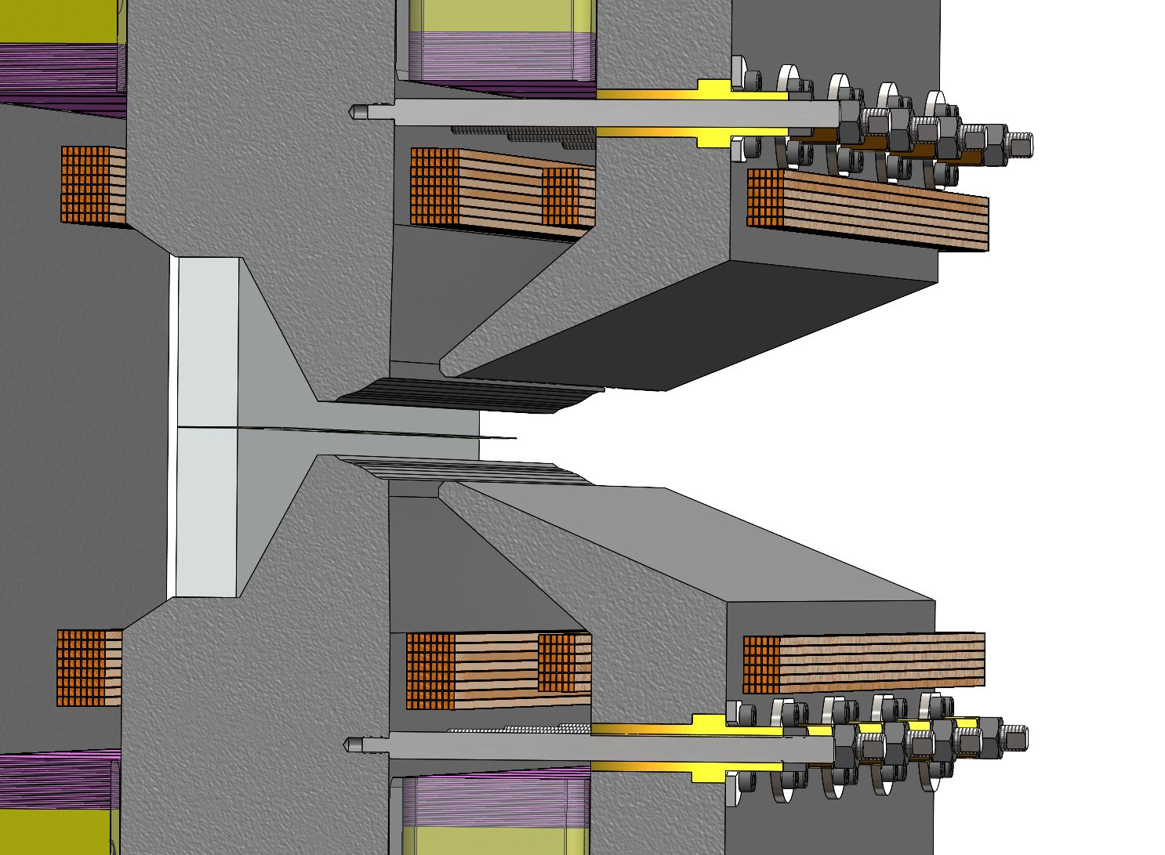
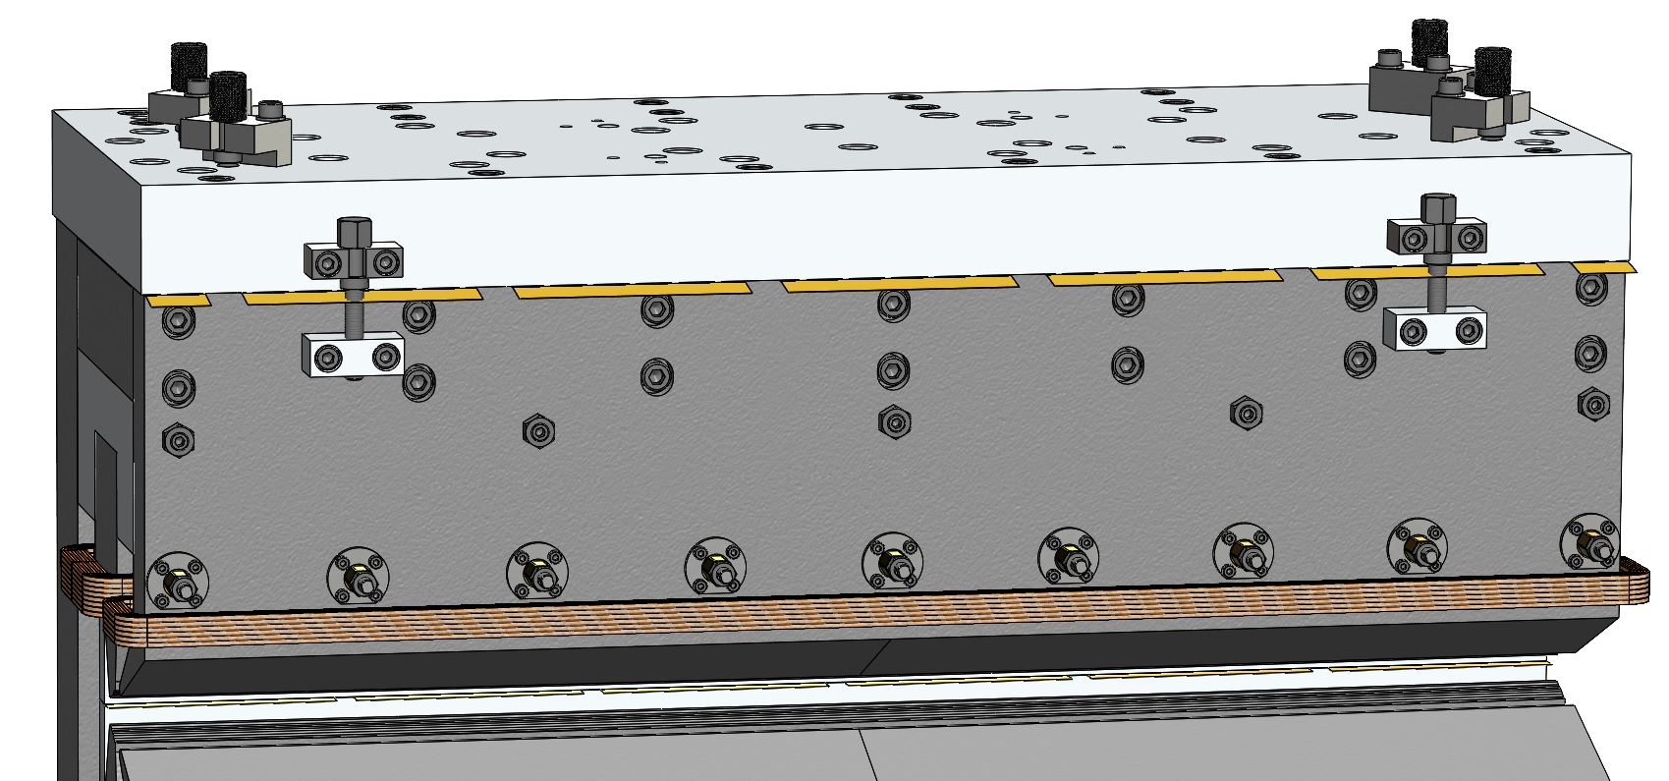
Mechanical Design Completed by Kyma
2. Two screws for opening gap between auxiliary pole and aluminium plate. Brass shims can be added/removed to adjust vertical position of auxiliary pole.
Gap is pre-shimmed with 300 µm thickness.
Shim thicknesses in range 10-200 µm.
In-built mechanical shimming methods allow adjustment of field strength and homogeneity.
Vertical gap between main poles defined by pre-shimmed spacer.

Slide 5
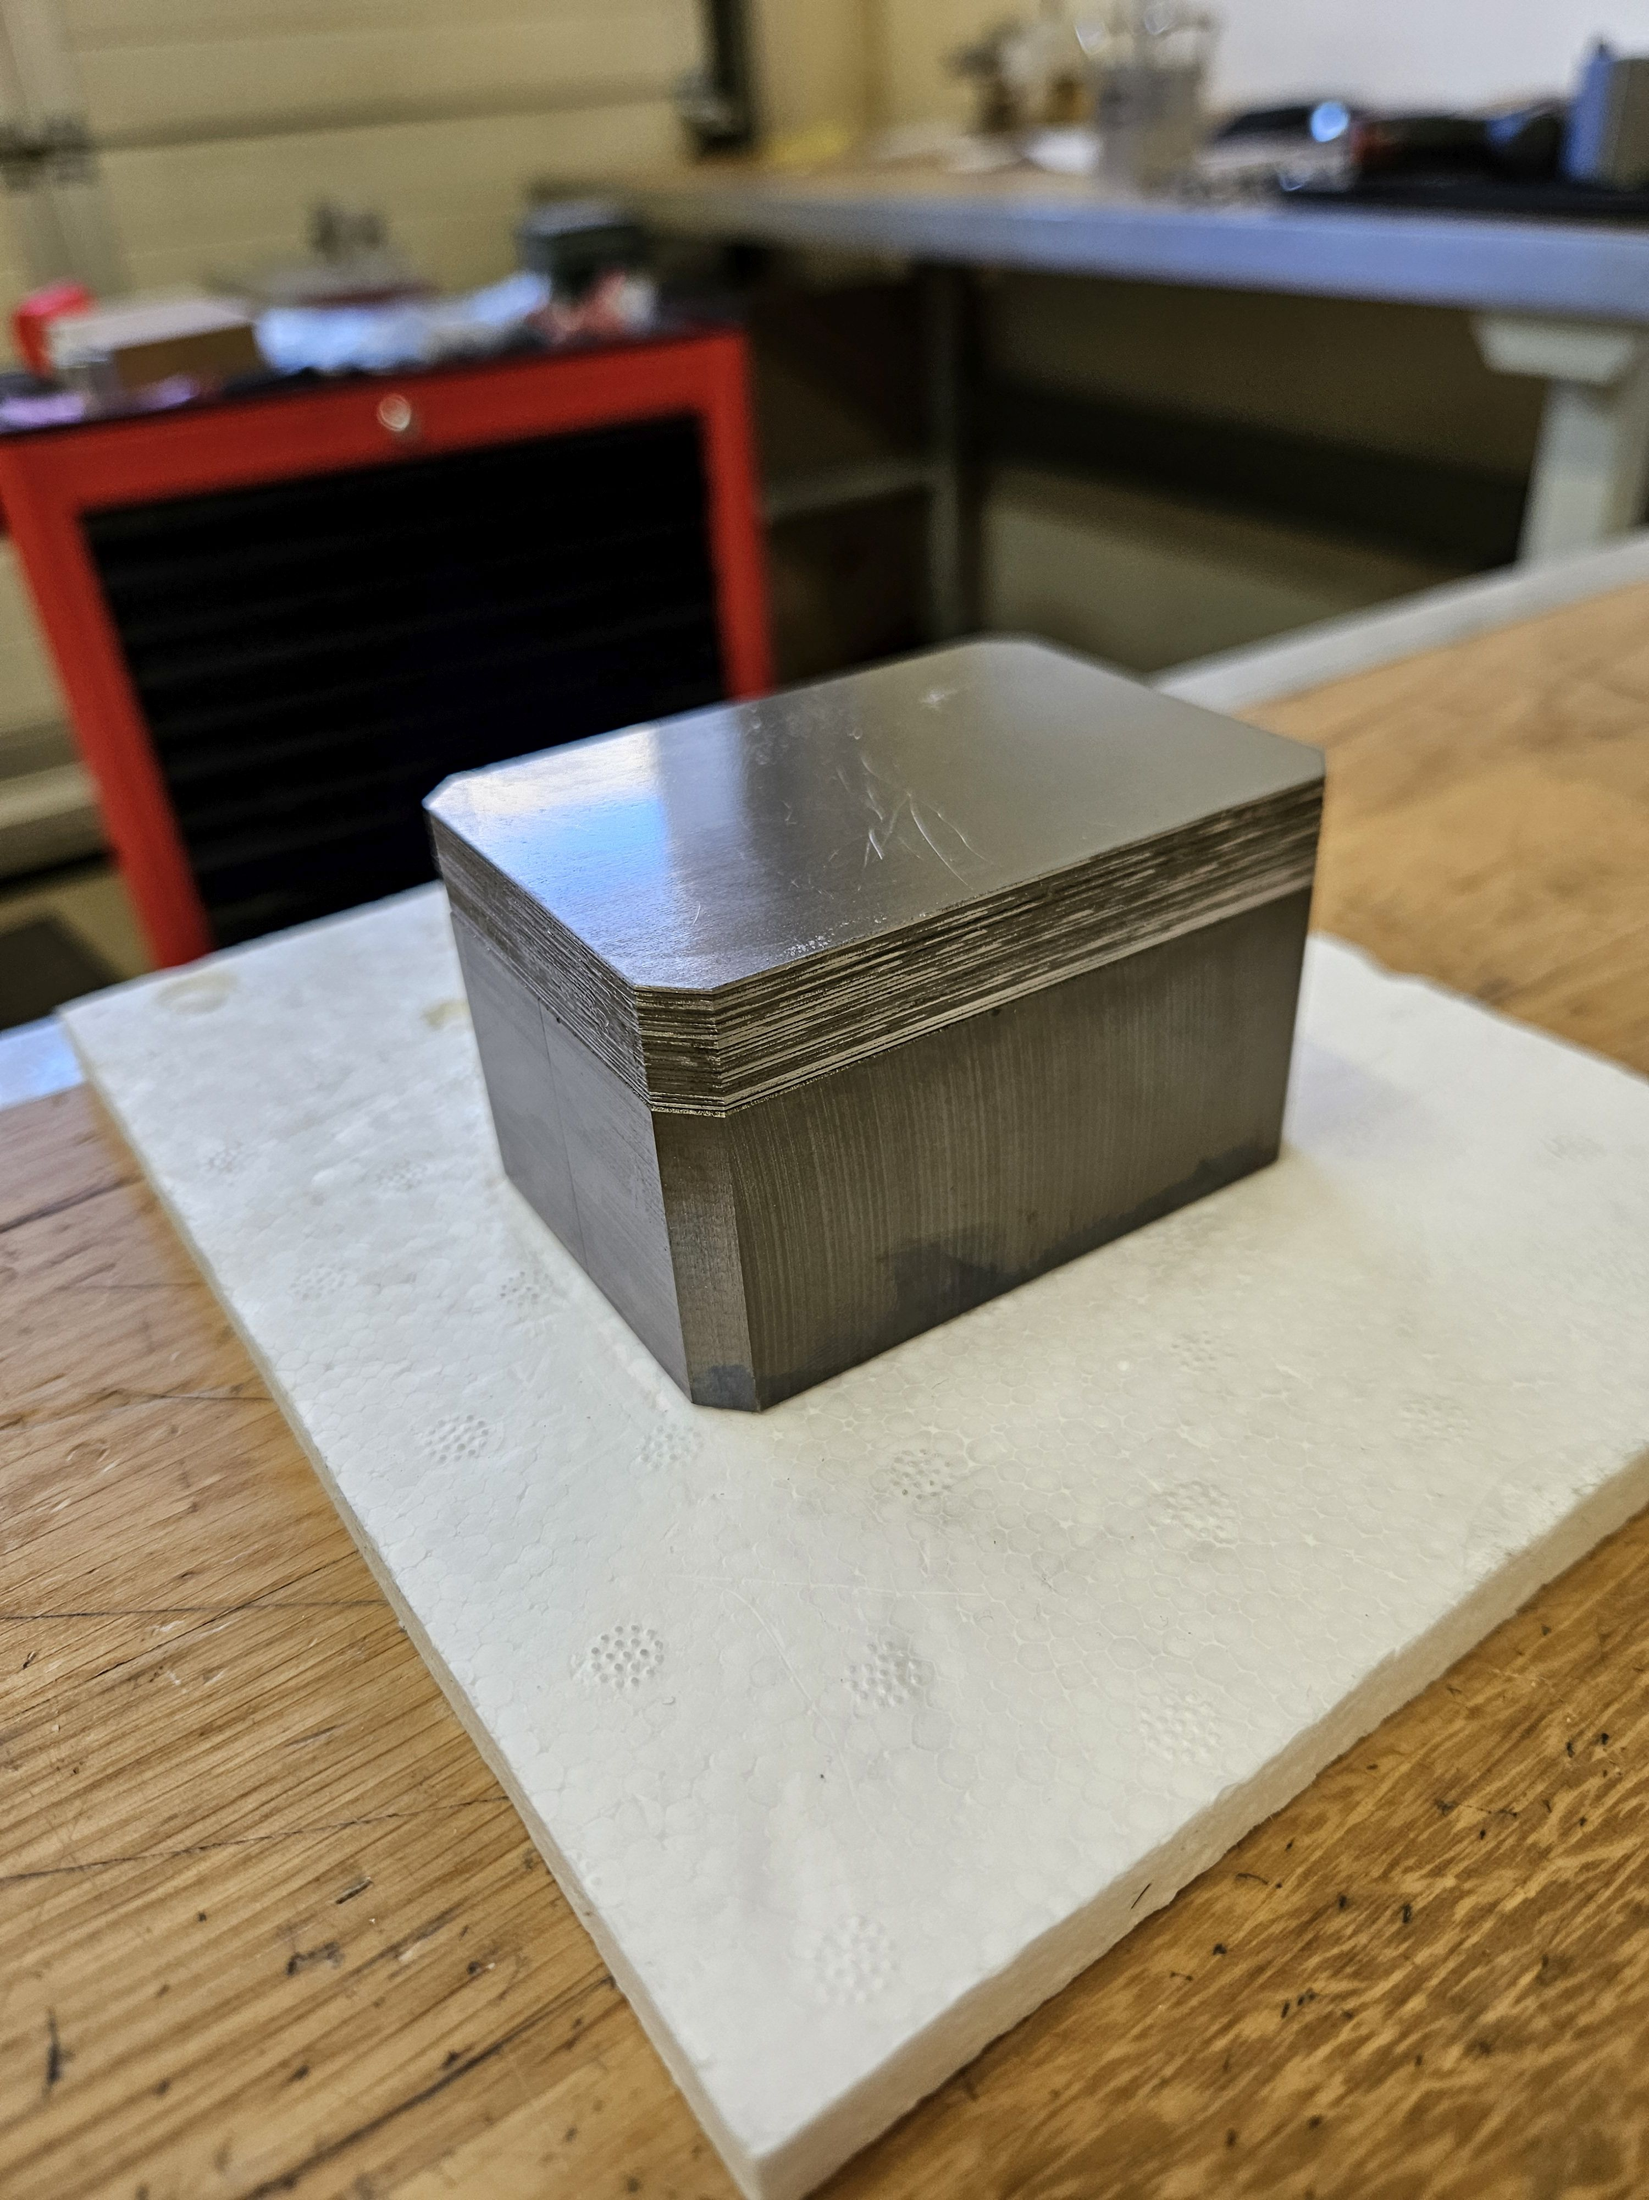
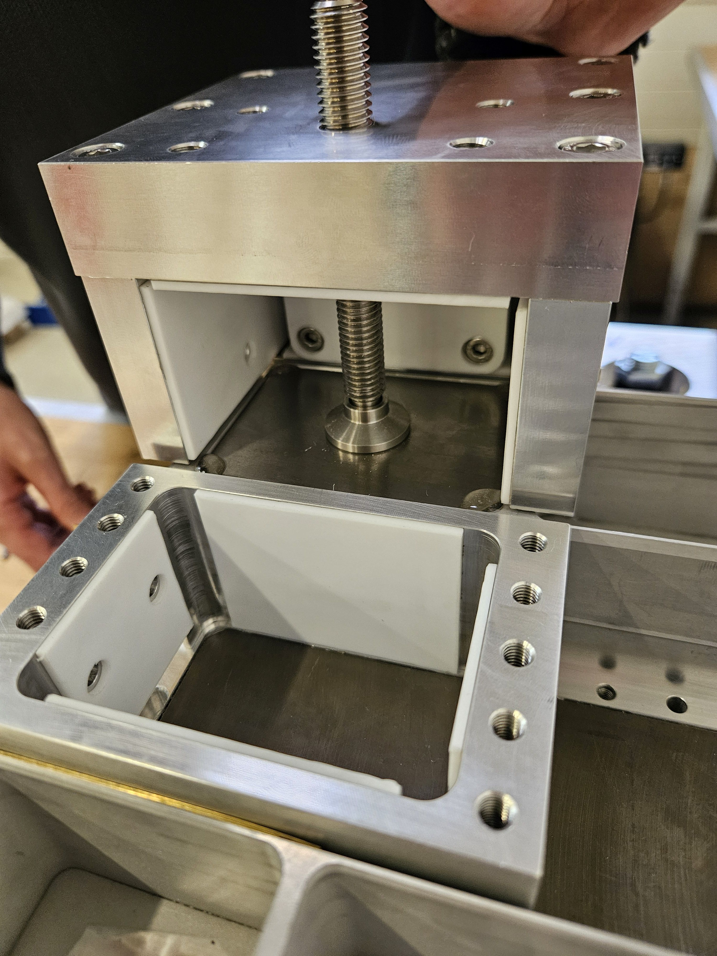
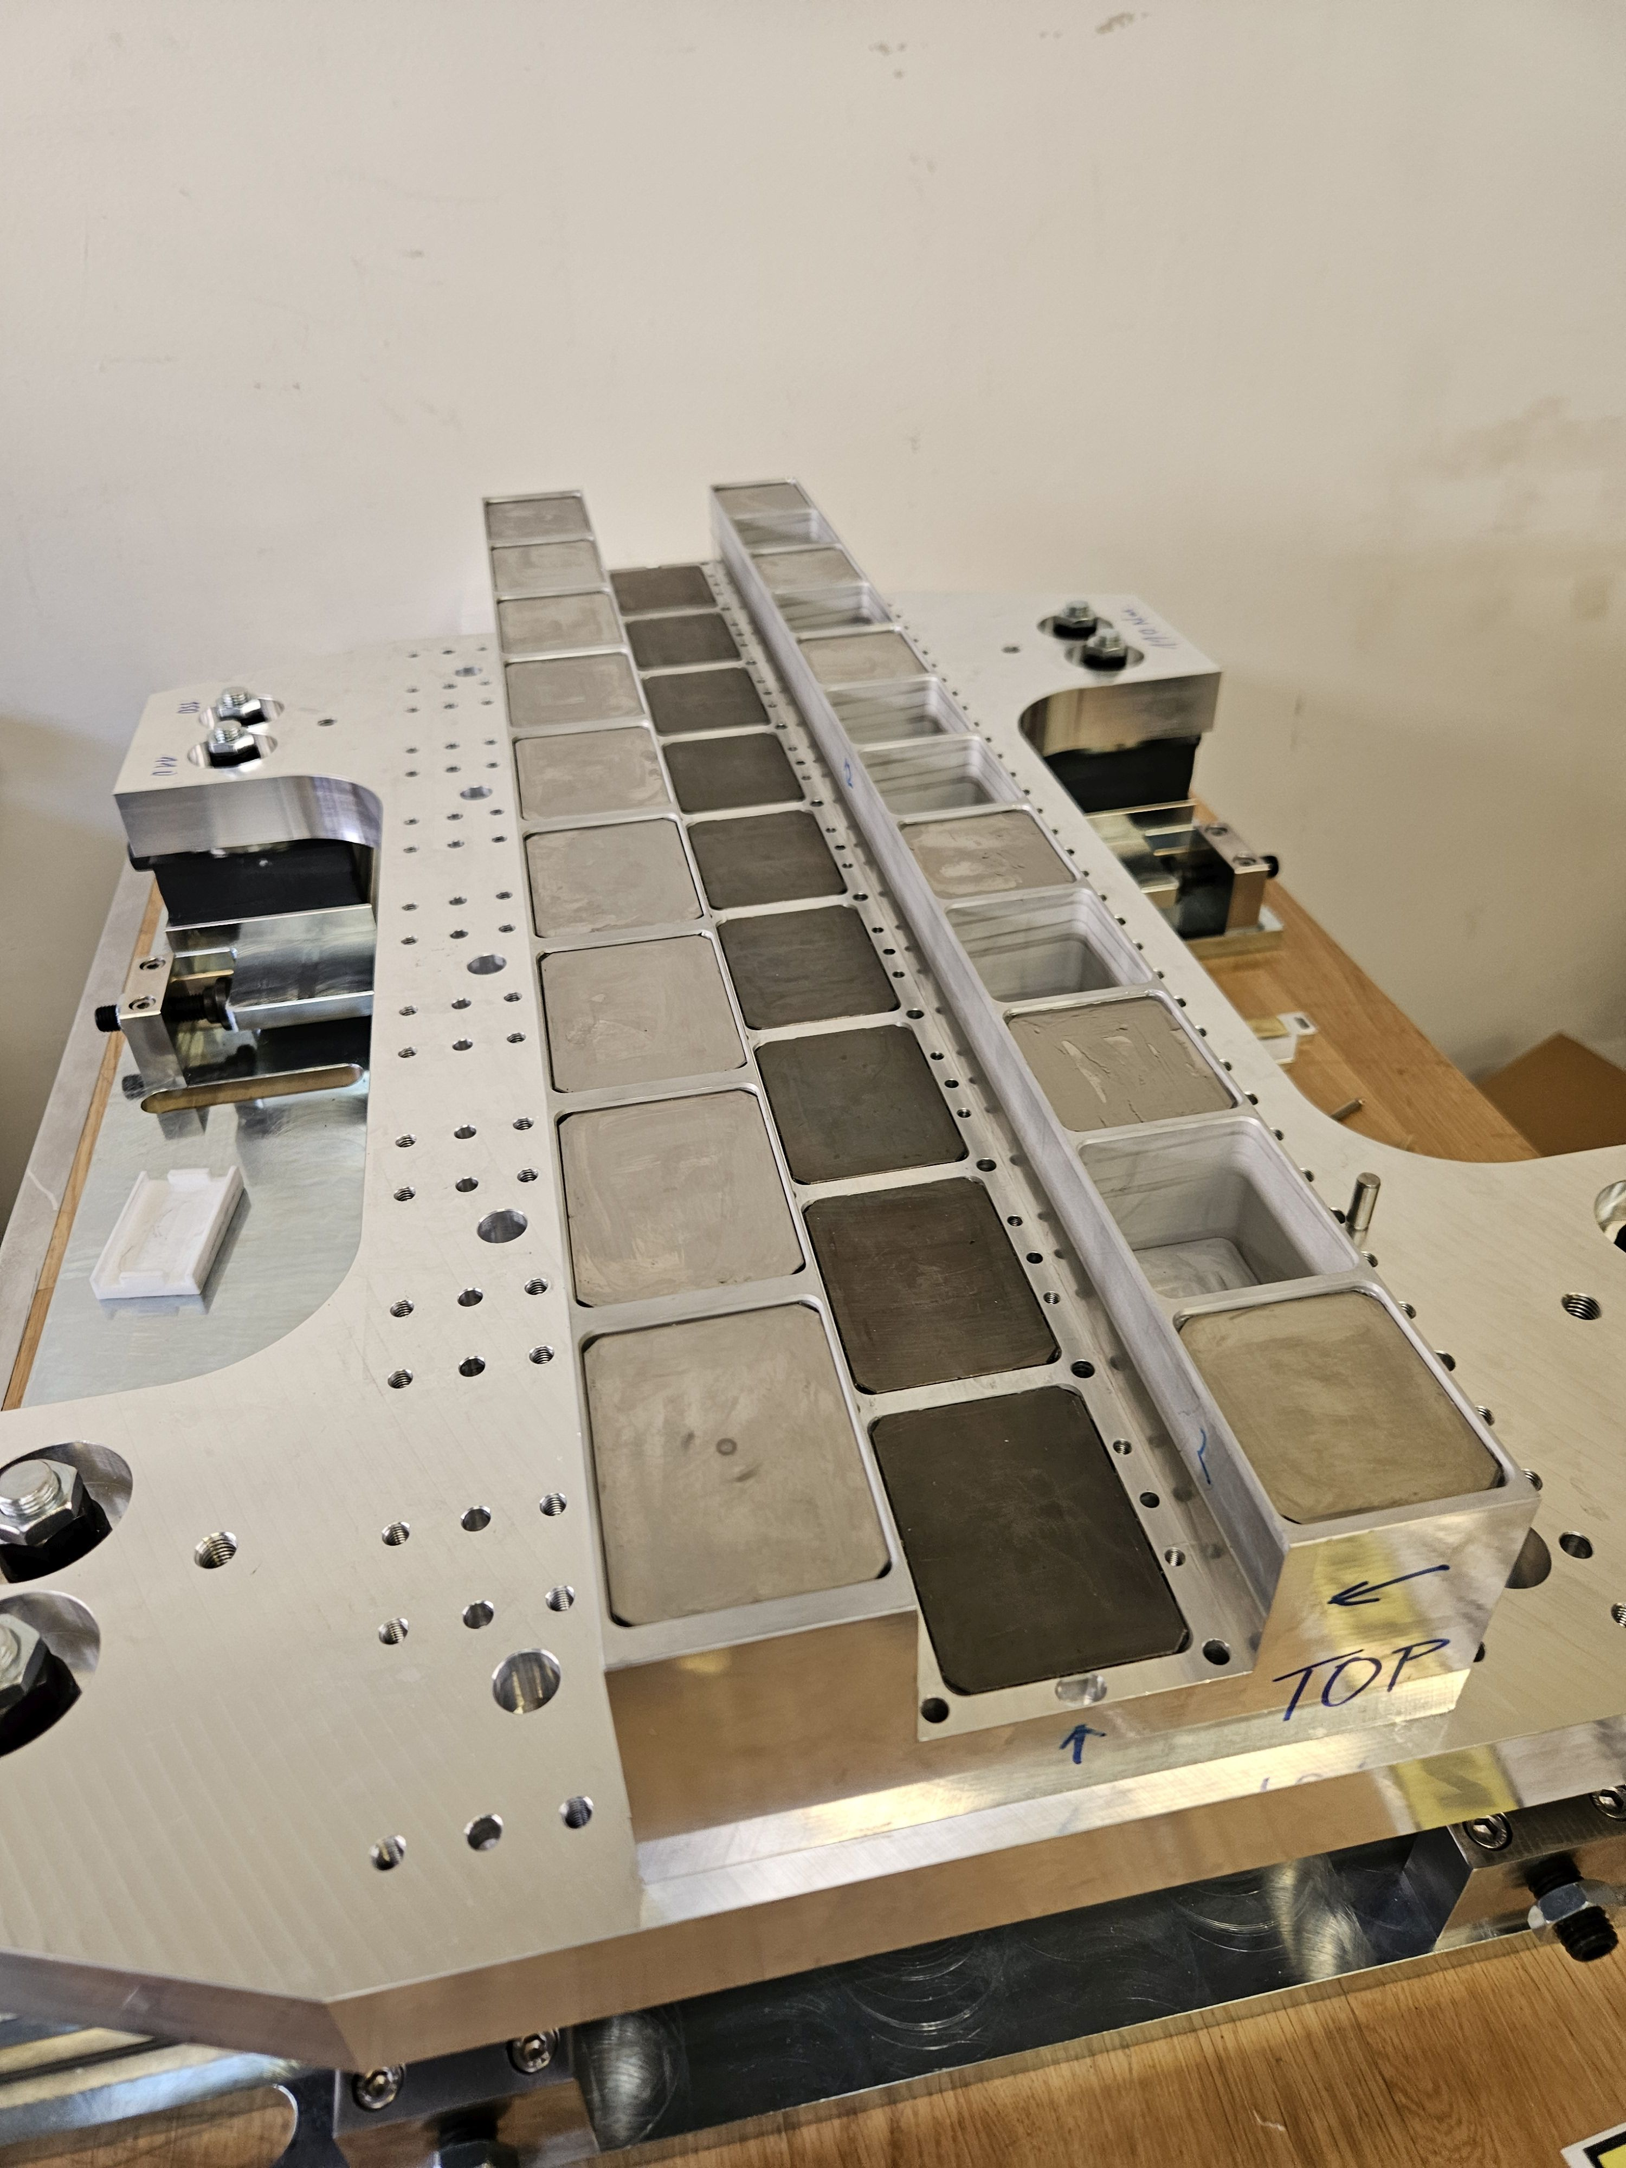
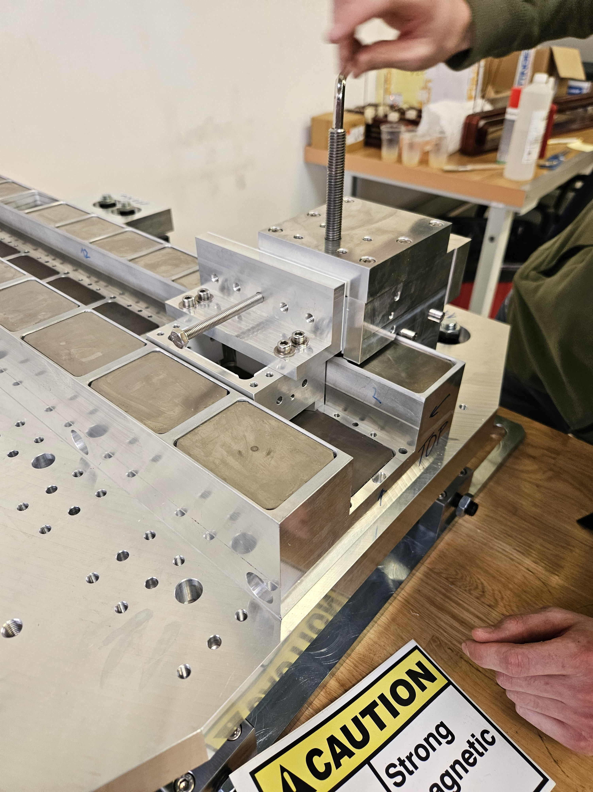
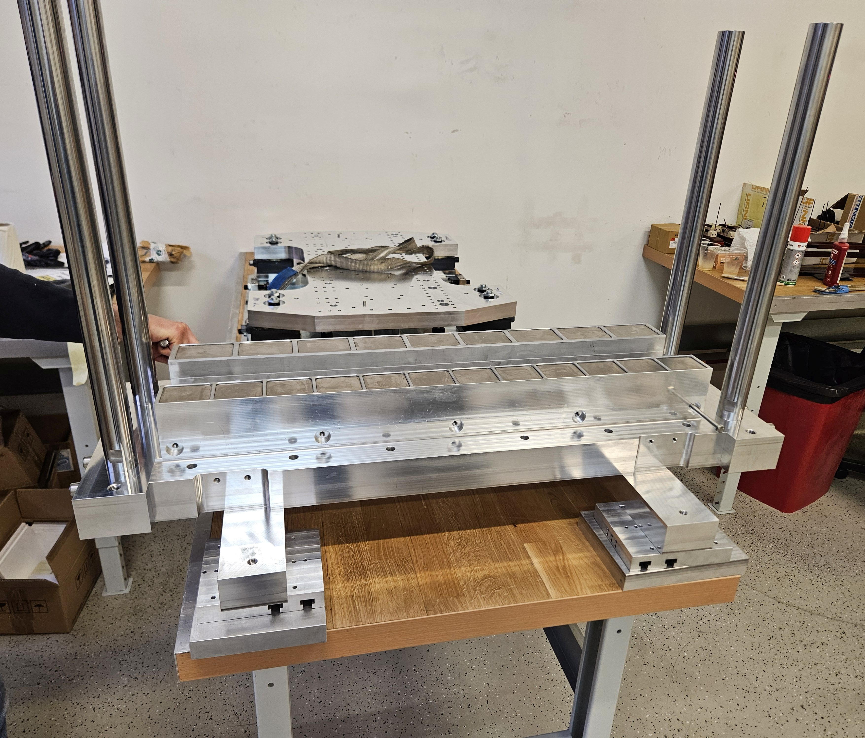
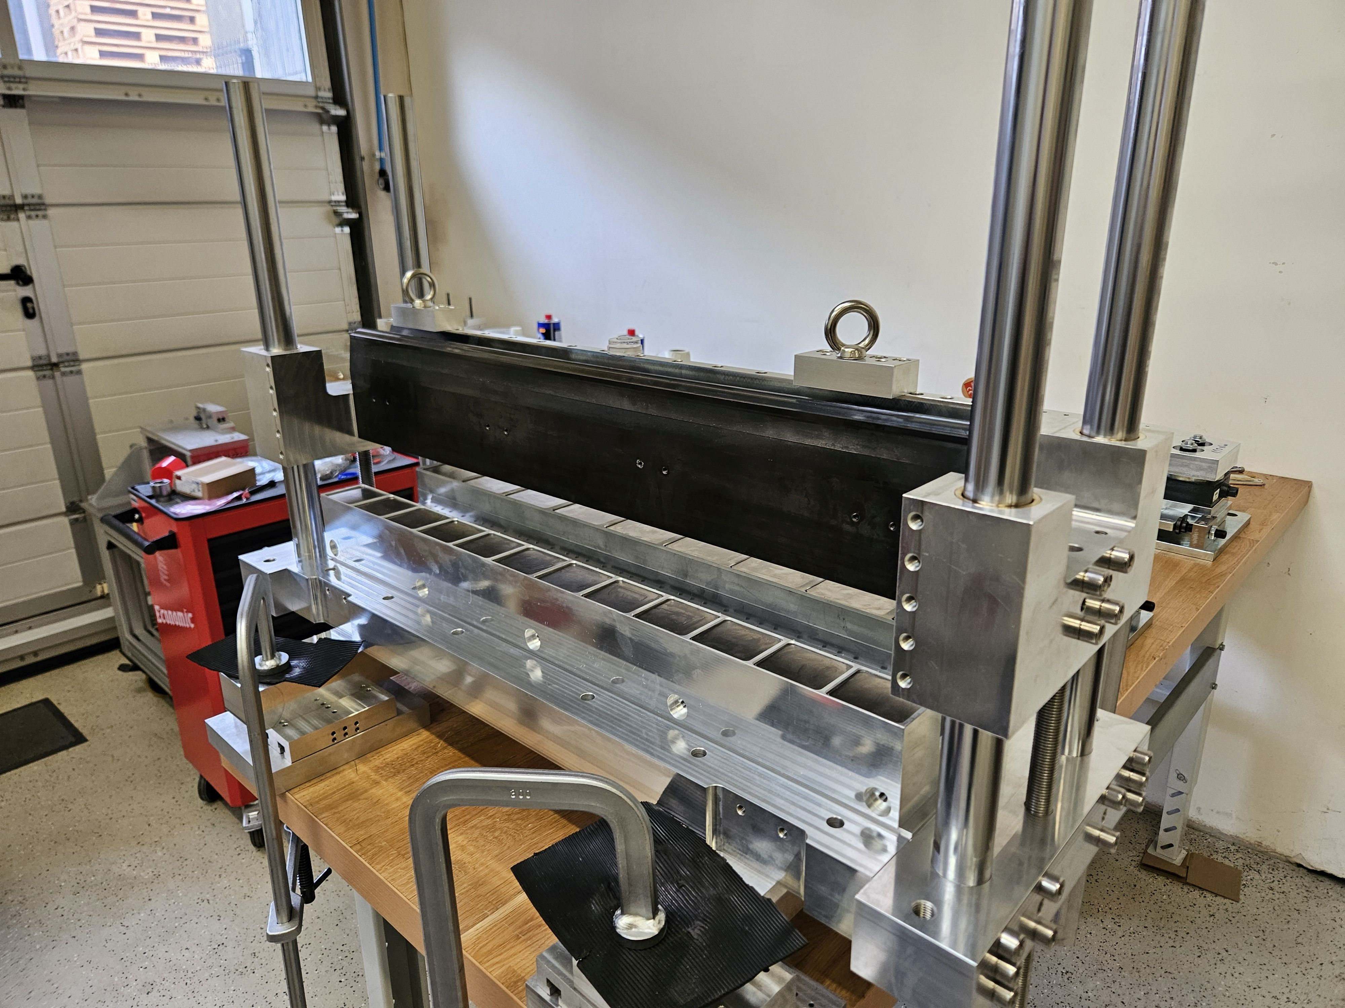
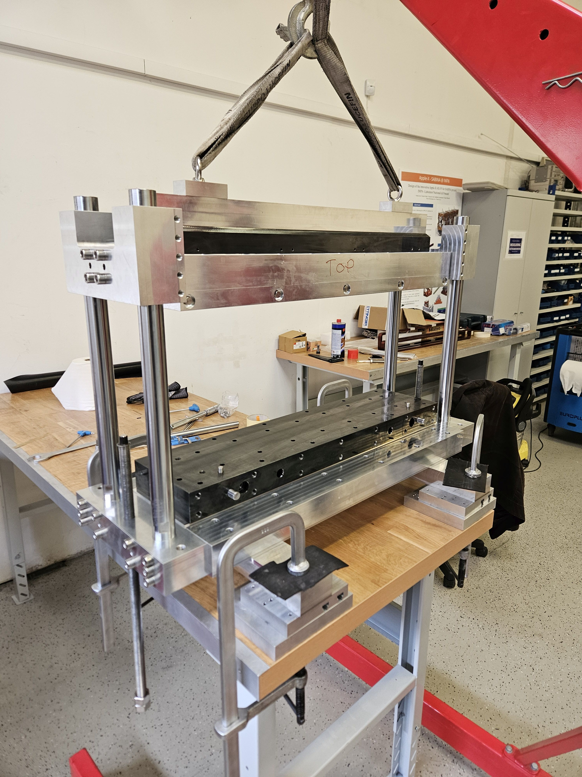
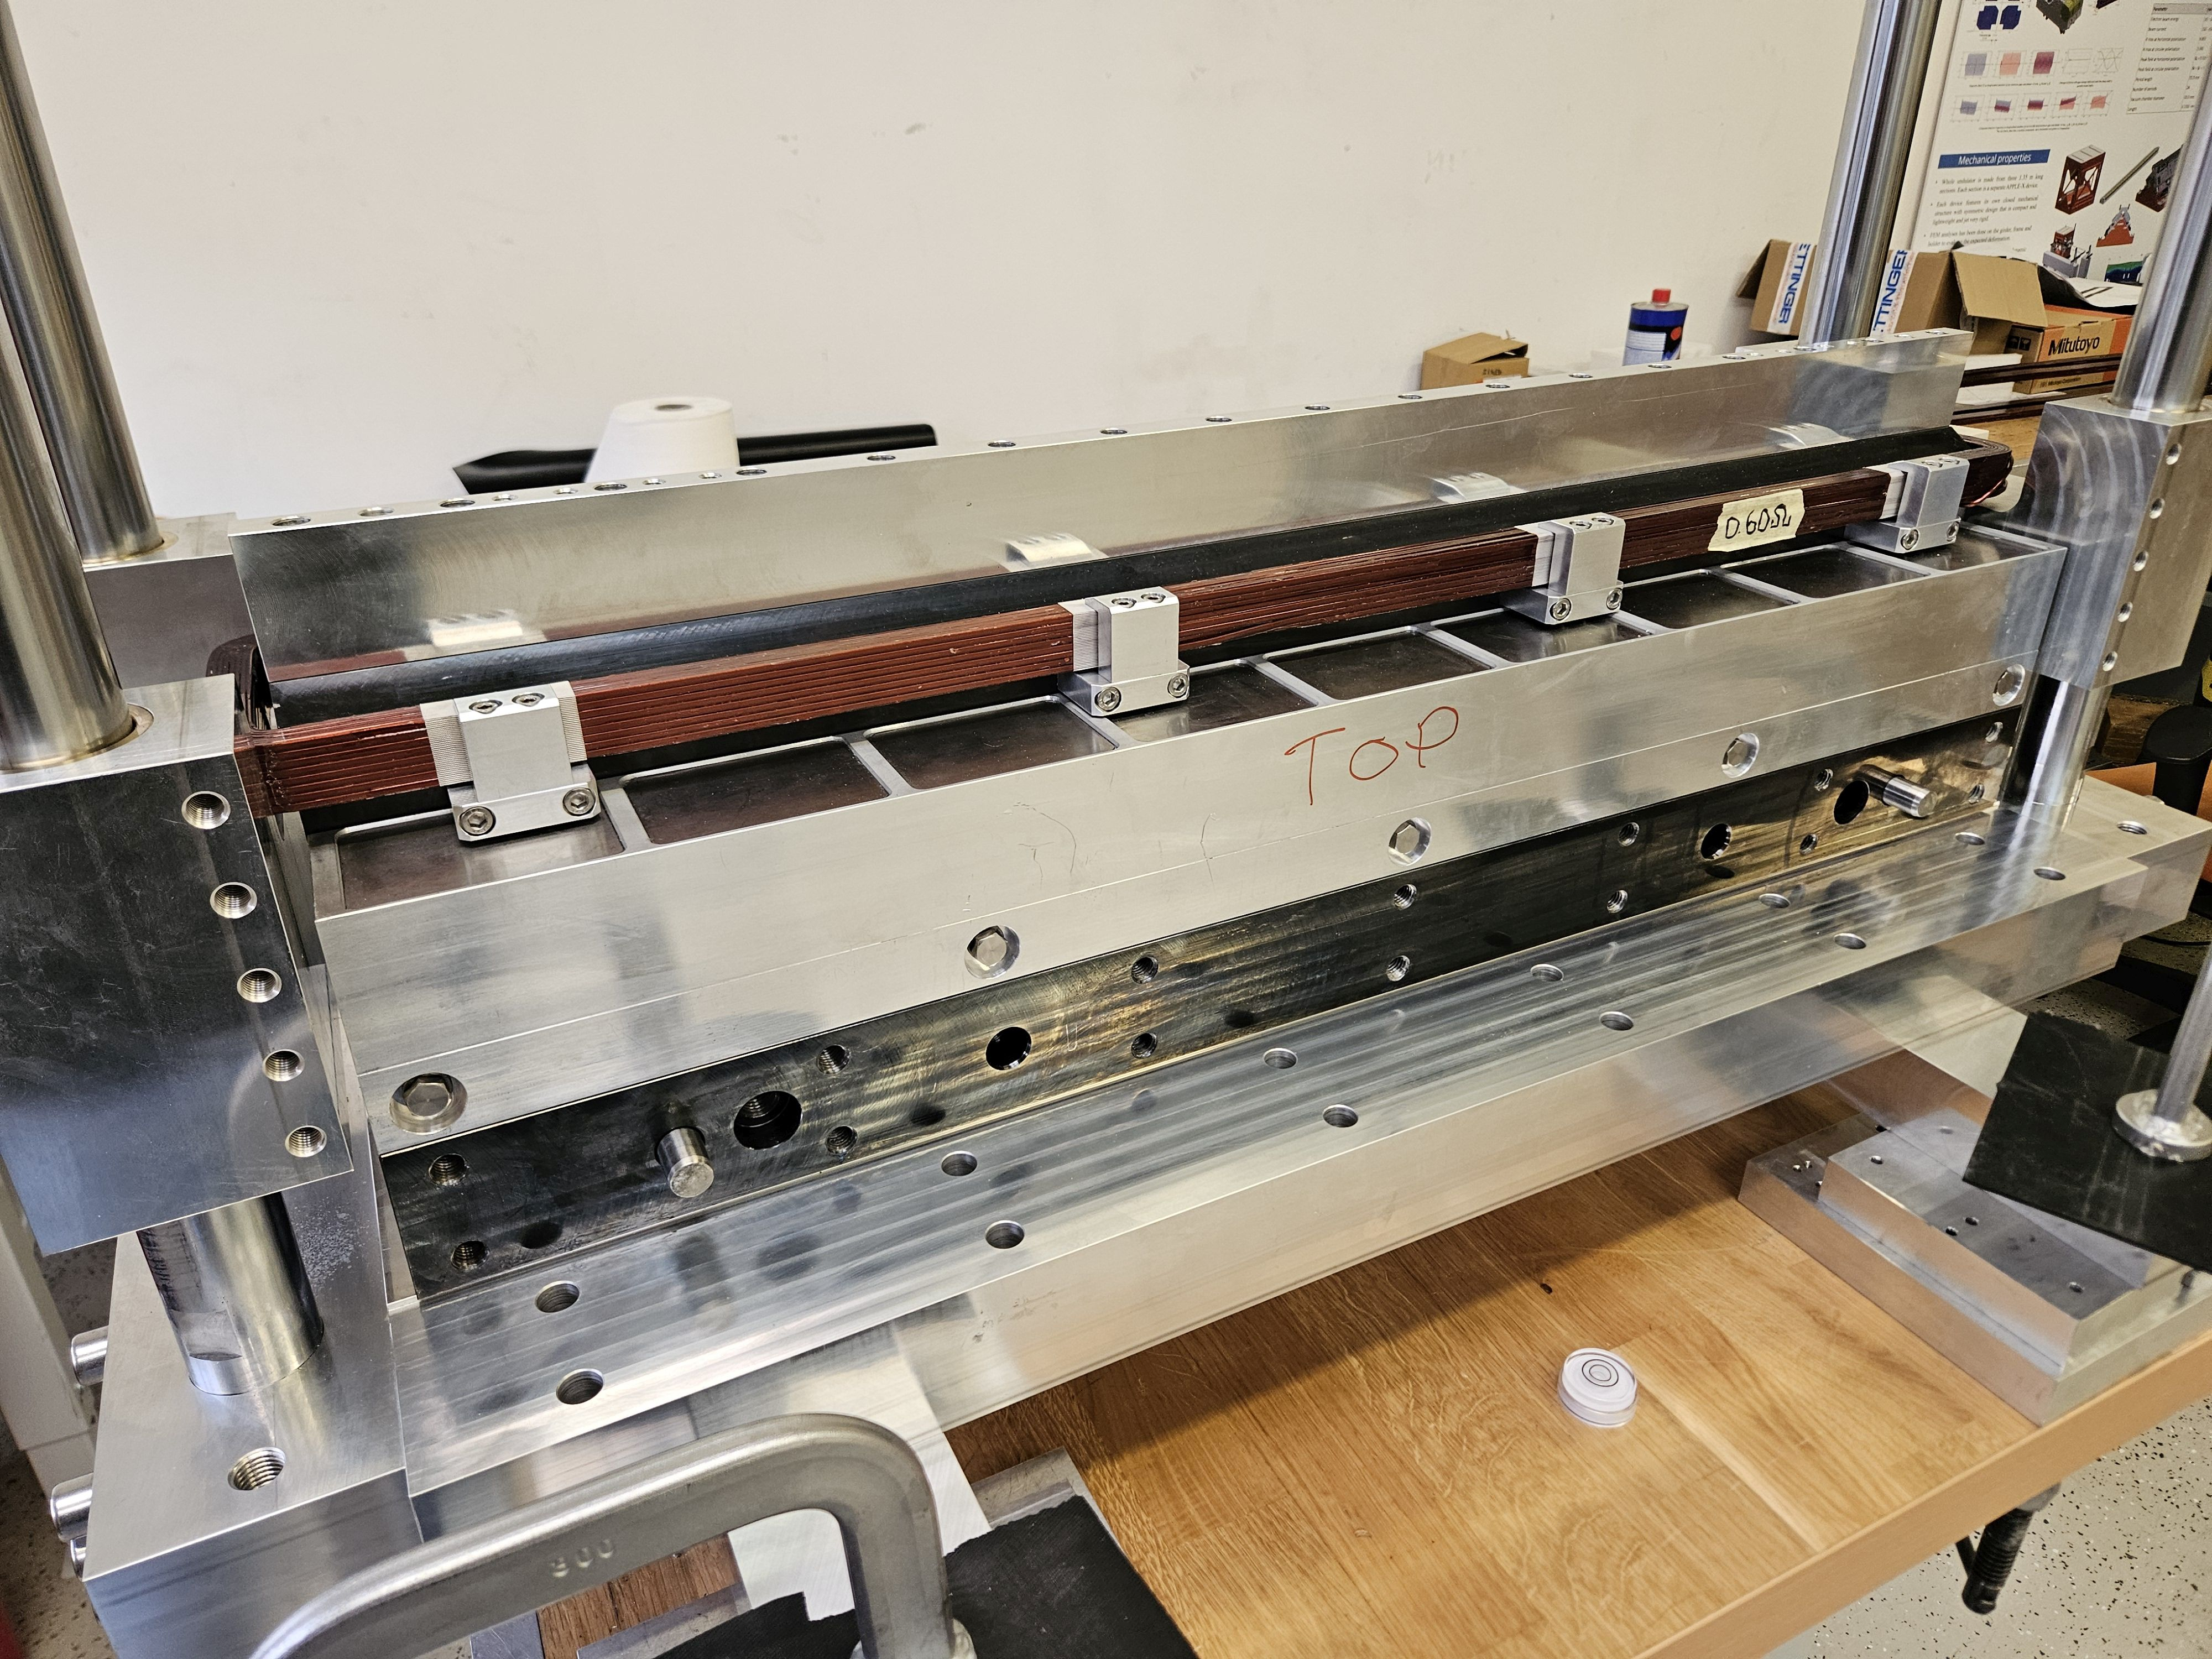
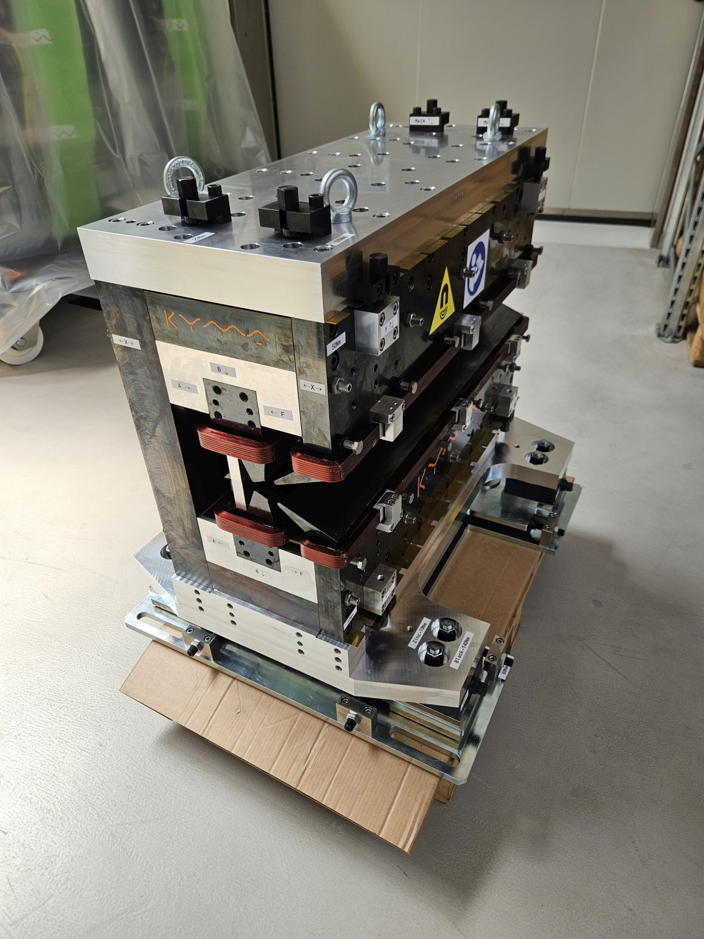
Magnet Assembly
60 kg peak force
2000 kg peak force

Slide 6
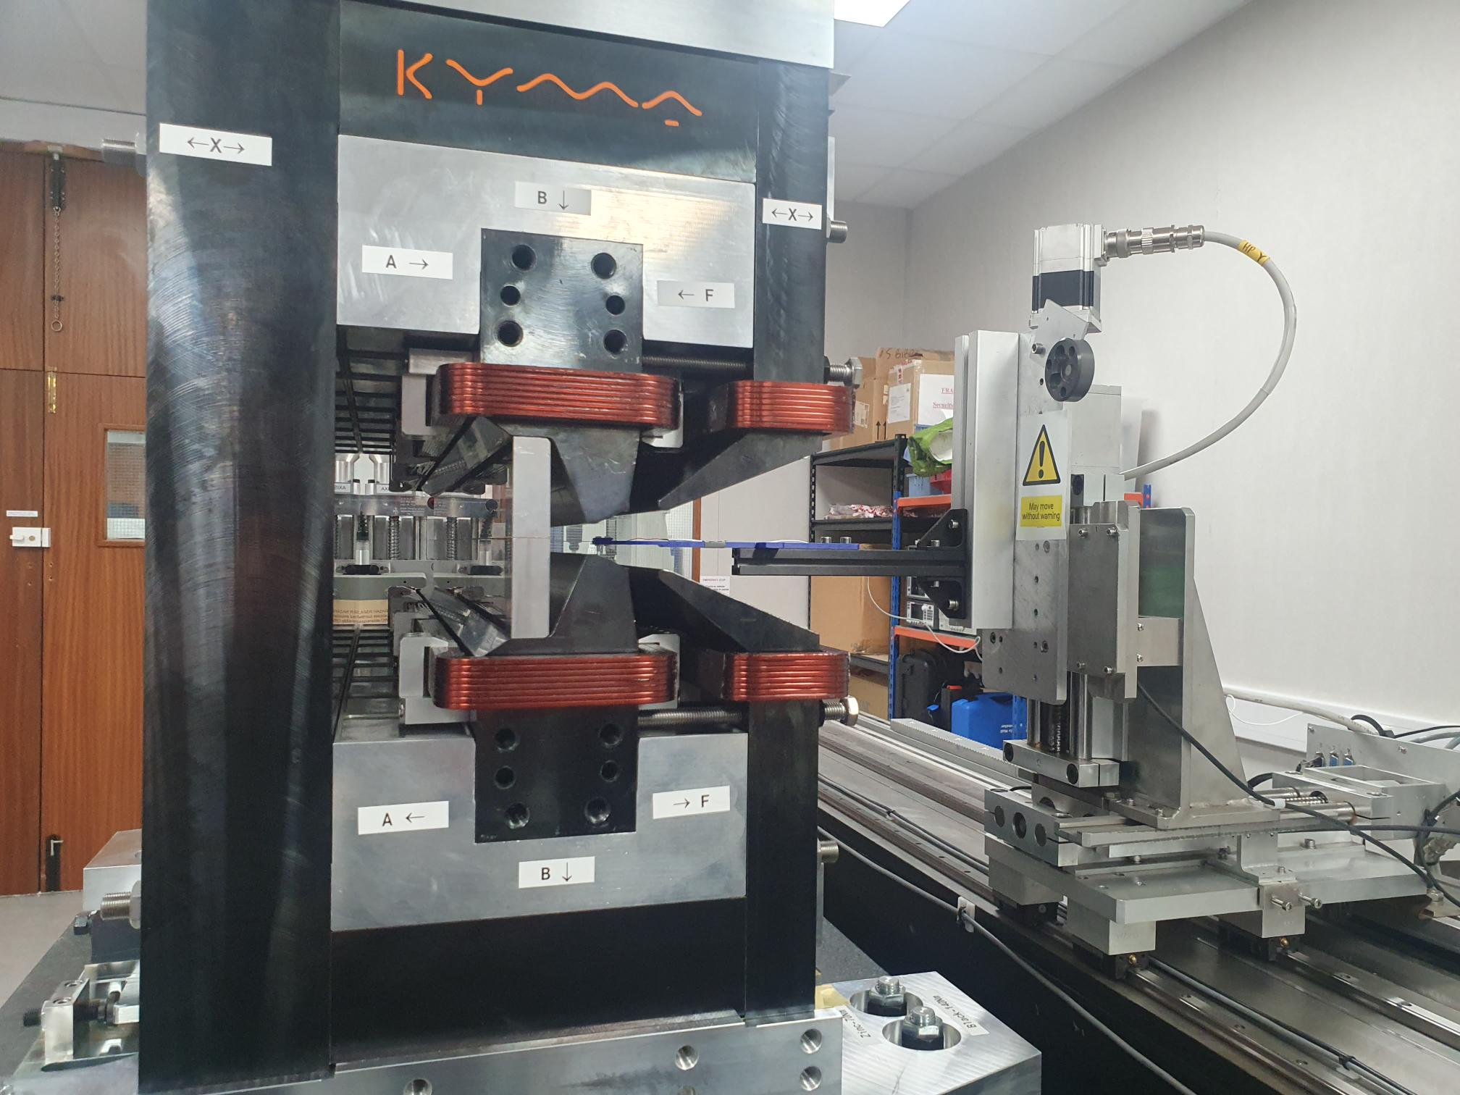
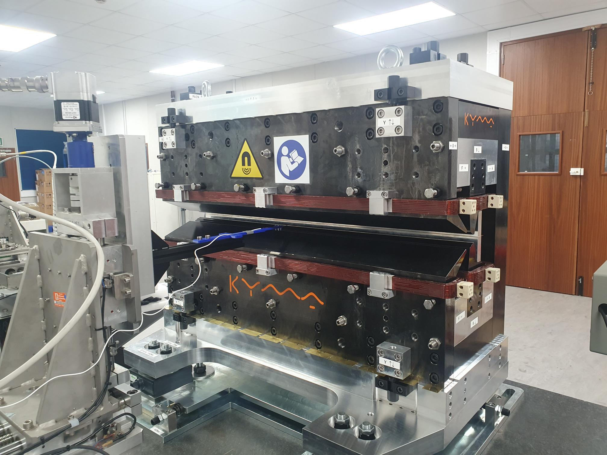
Magnetic Measurements
Field measurements performed in dedicated magnet measurement laboratory at Daresbury.
Senis Type-H Hall probe
3-axis motion stage

Slide 7
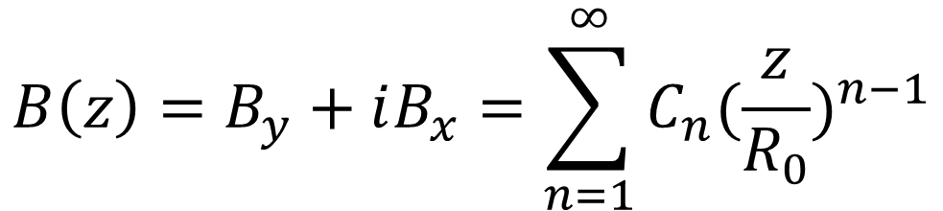
Field Multipoles
Complex multipole coefficients
n | Name | Function
1 | Dipole | Bending
2 | Quadrupole | Focussing
3 | Sextupole | Chromatic aberrations
≥4 | Higher order | Field errors
Magnetic fields described in terms of “multipoles”.
$$B\left(z\right)=B_{y}+iB_{x}=\sum_{n=1}^{∞}{C_{n}{(\frac{z}{R_{0}})}^{n−1}}$$
HEPTO pole tips curved – dipole constant along trajectory.
Multipoles evaluated by measuring points around circular good field region and integrating over curved nominal electron beam trajectory.
Complex representation of magnetic field
Complex representation of point in magnet aperture
Reference radius

Slide 8
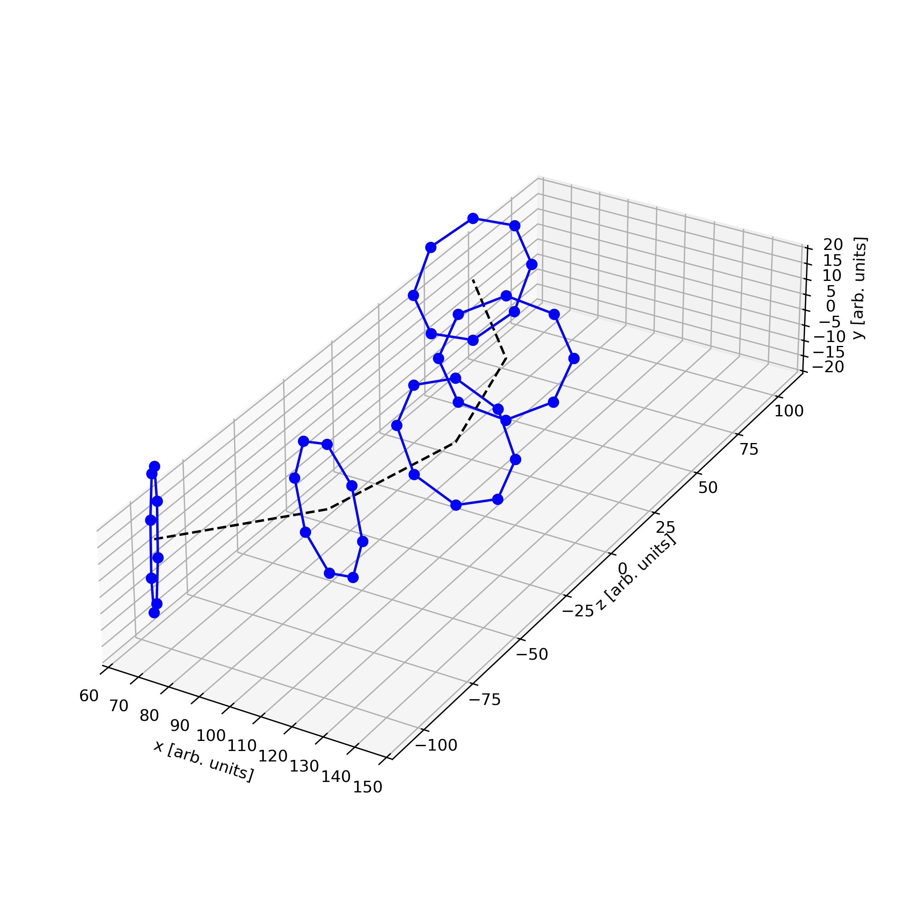
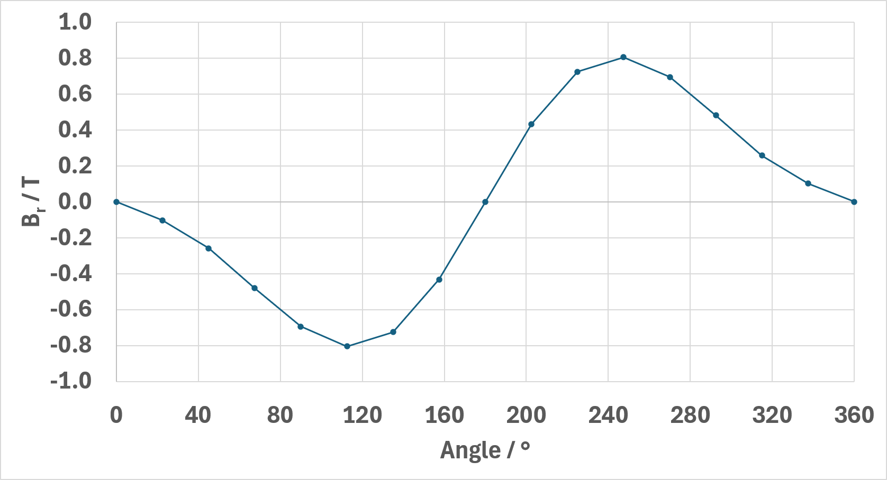
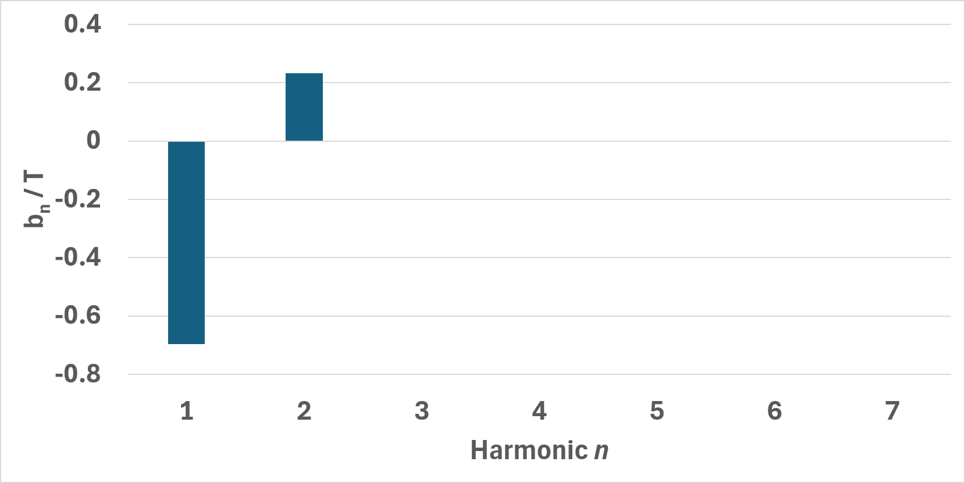
Hall probe point measurement
Nominal beam trajectory
Fourier transform
B_{r}

Slide 9
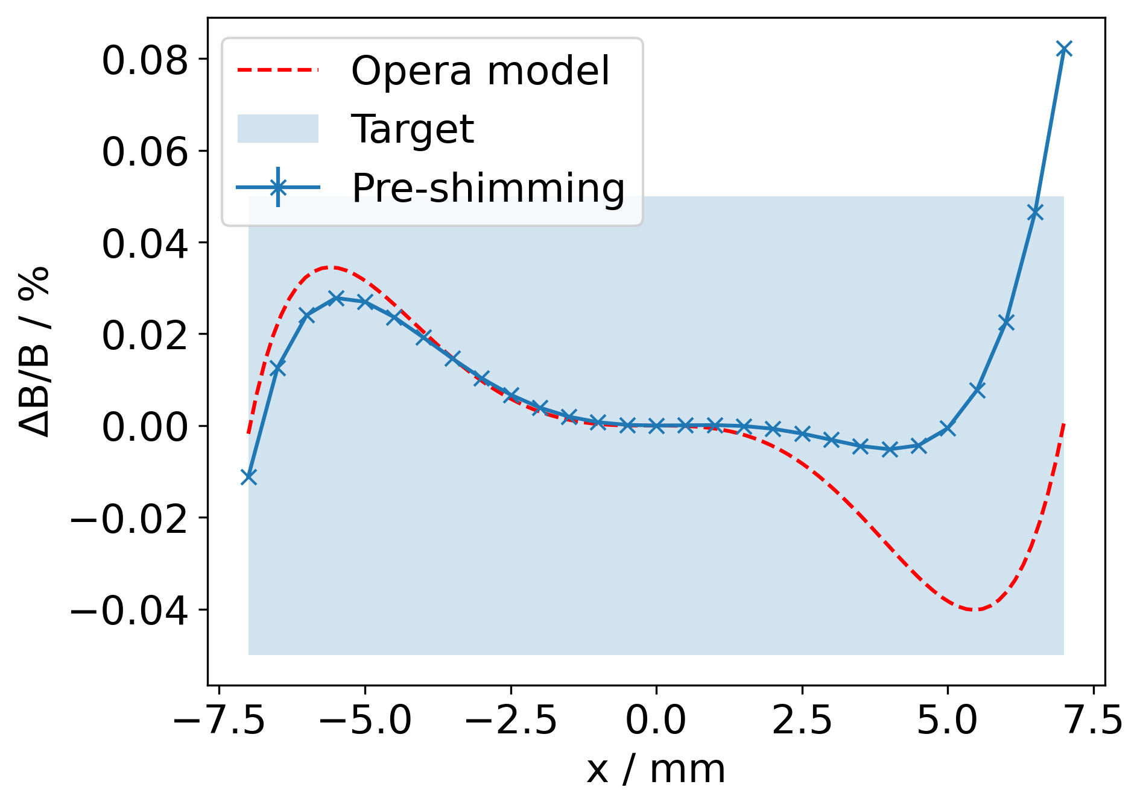
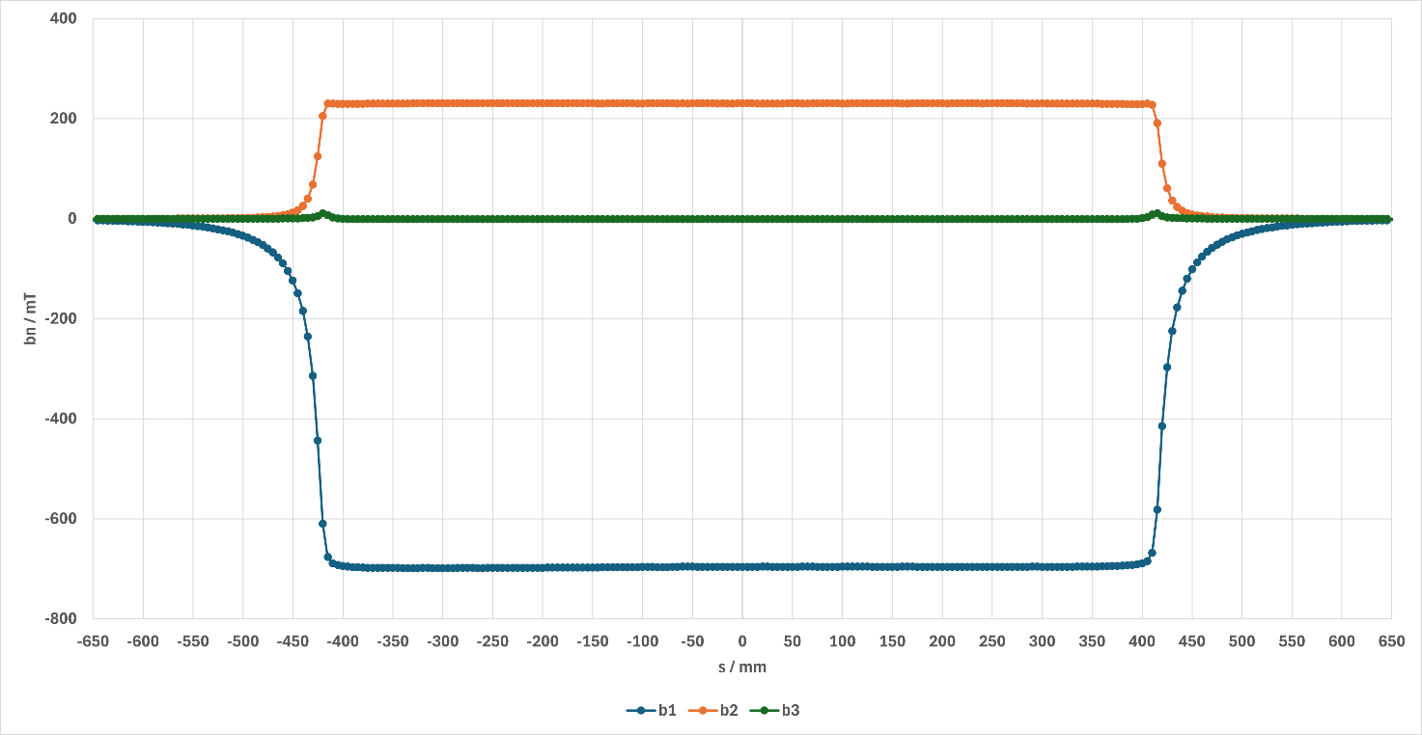
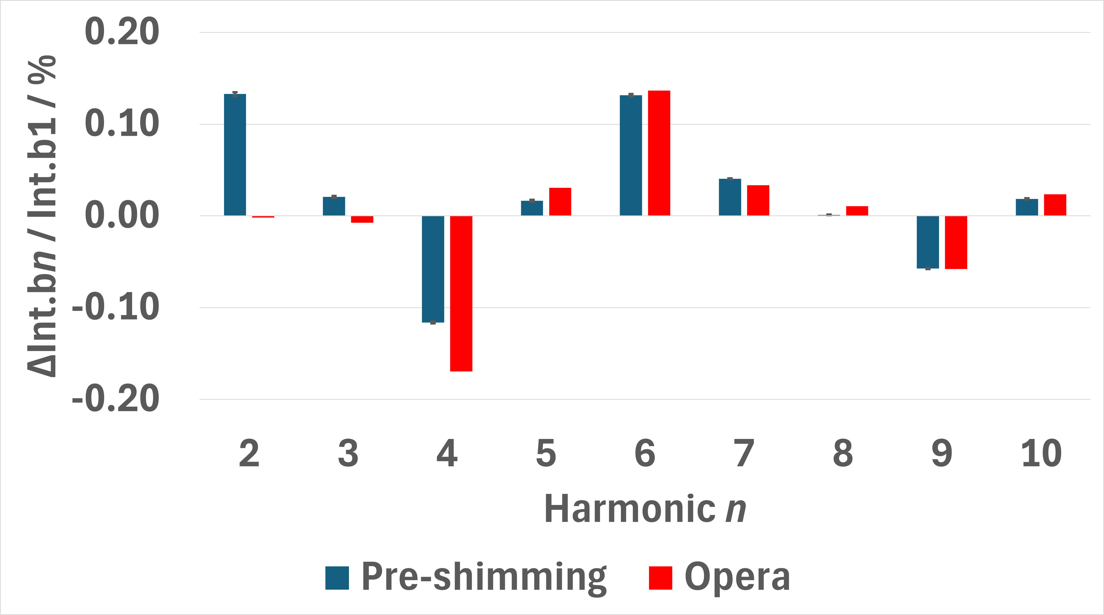
Initial Measurements
QUADRUPOLE
SEXTUPOLE
DIPOLE
 | Integrated Gradient / T | Integrated gradient error / % | Integrated Homogeneity ΔB/B / %
Requirement | 28.1857 |  | 0.05
Measured | 28.070 ± 0.002 | -0.41 | 0.082±0.005

Slide 10
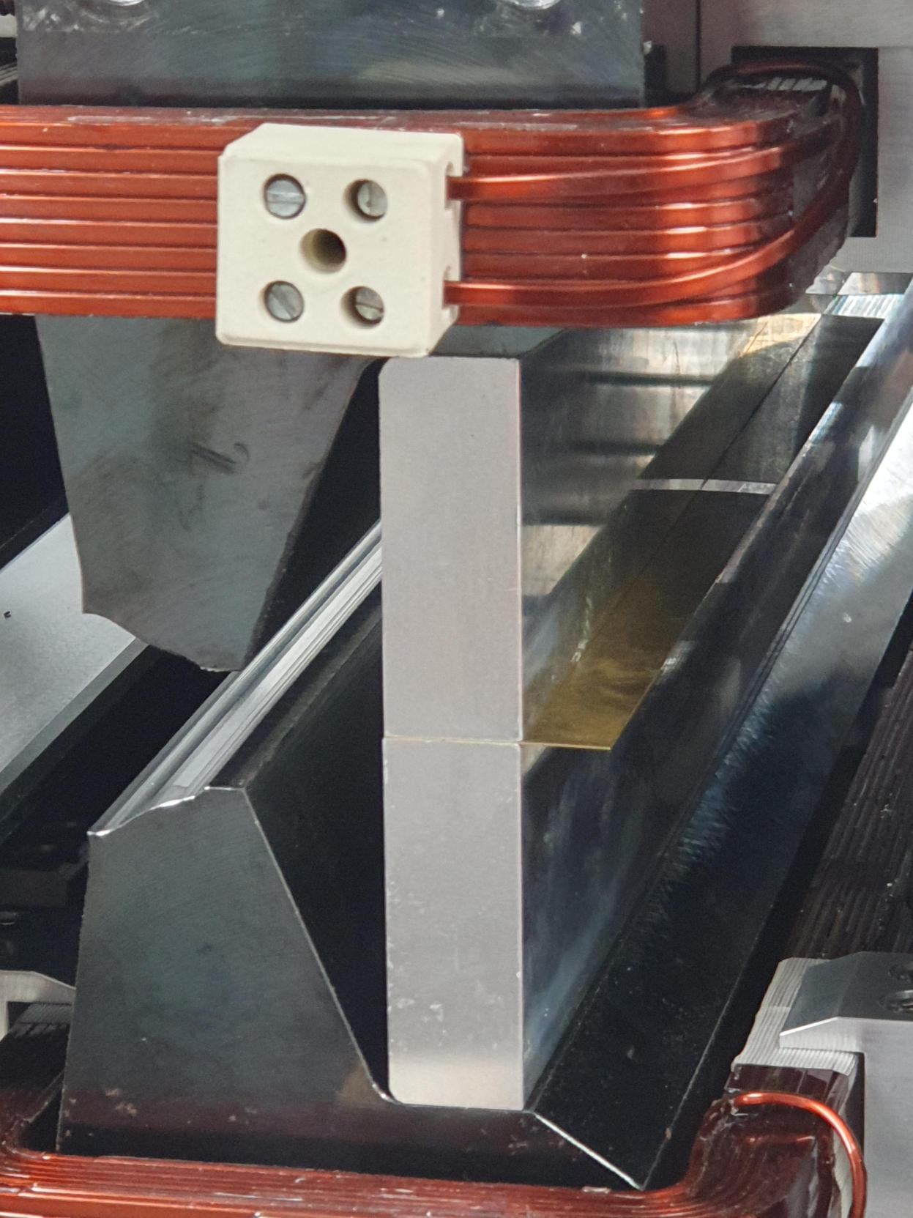
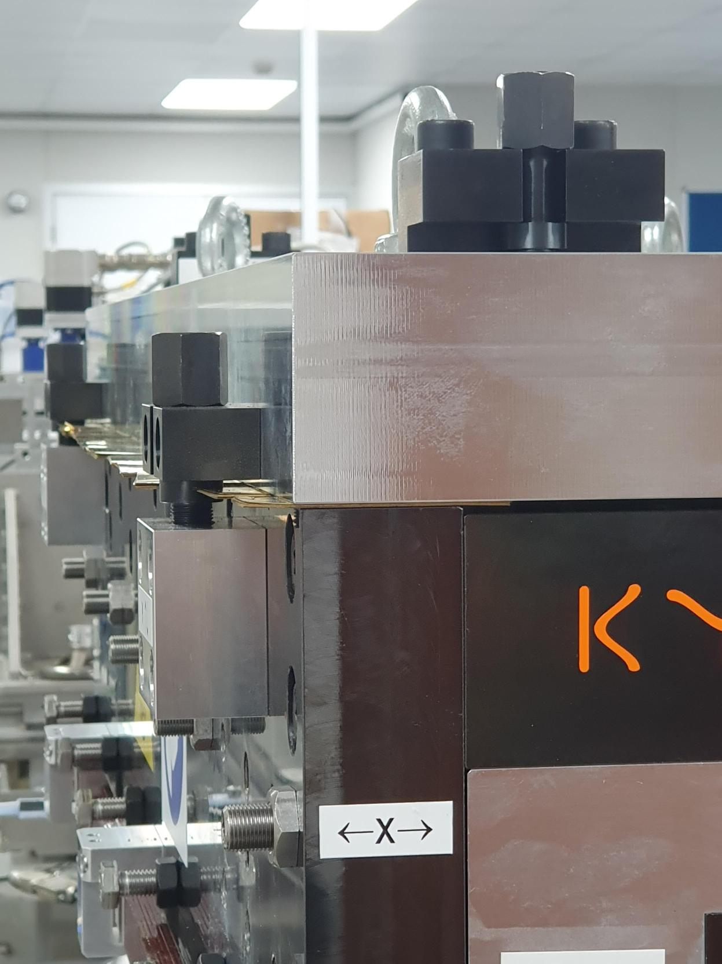
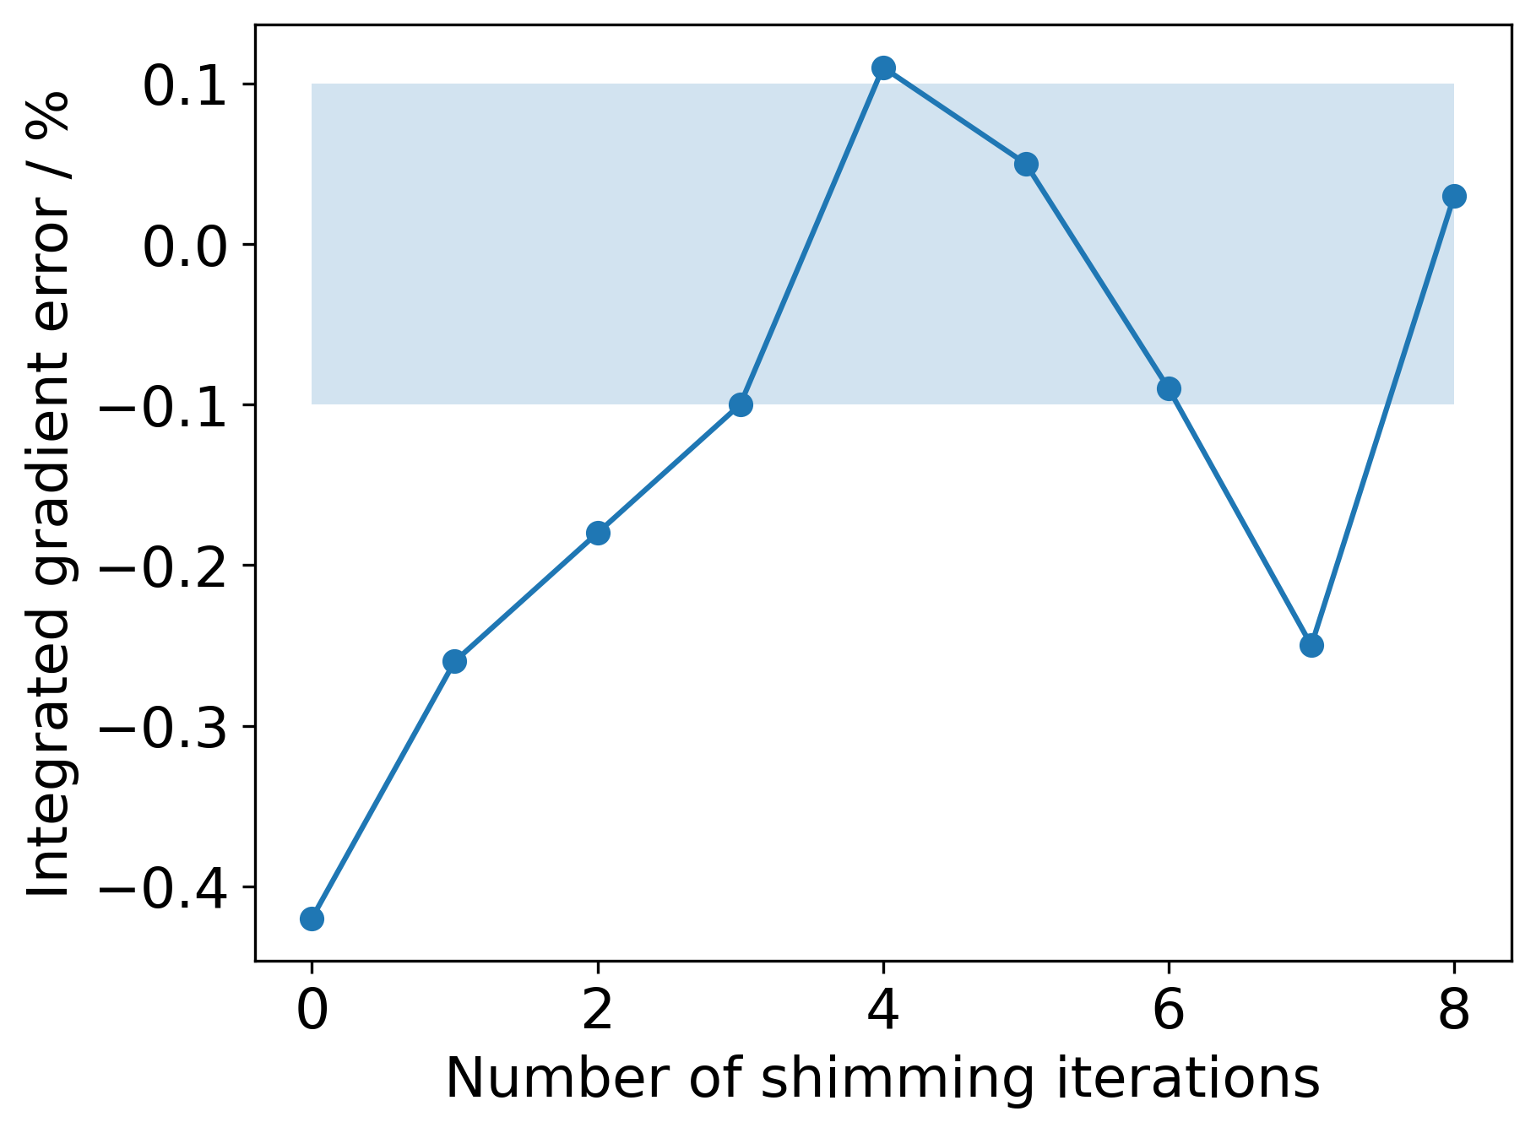
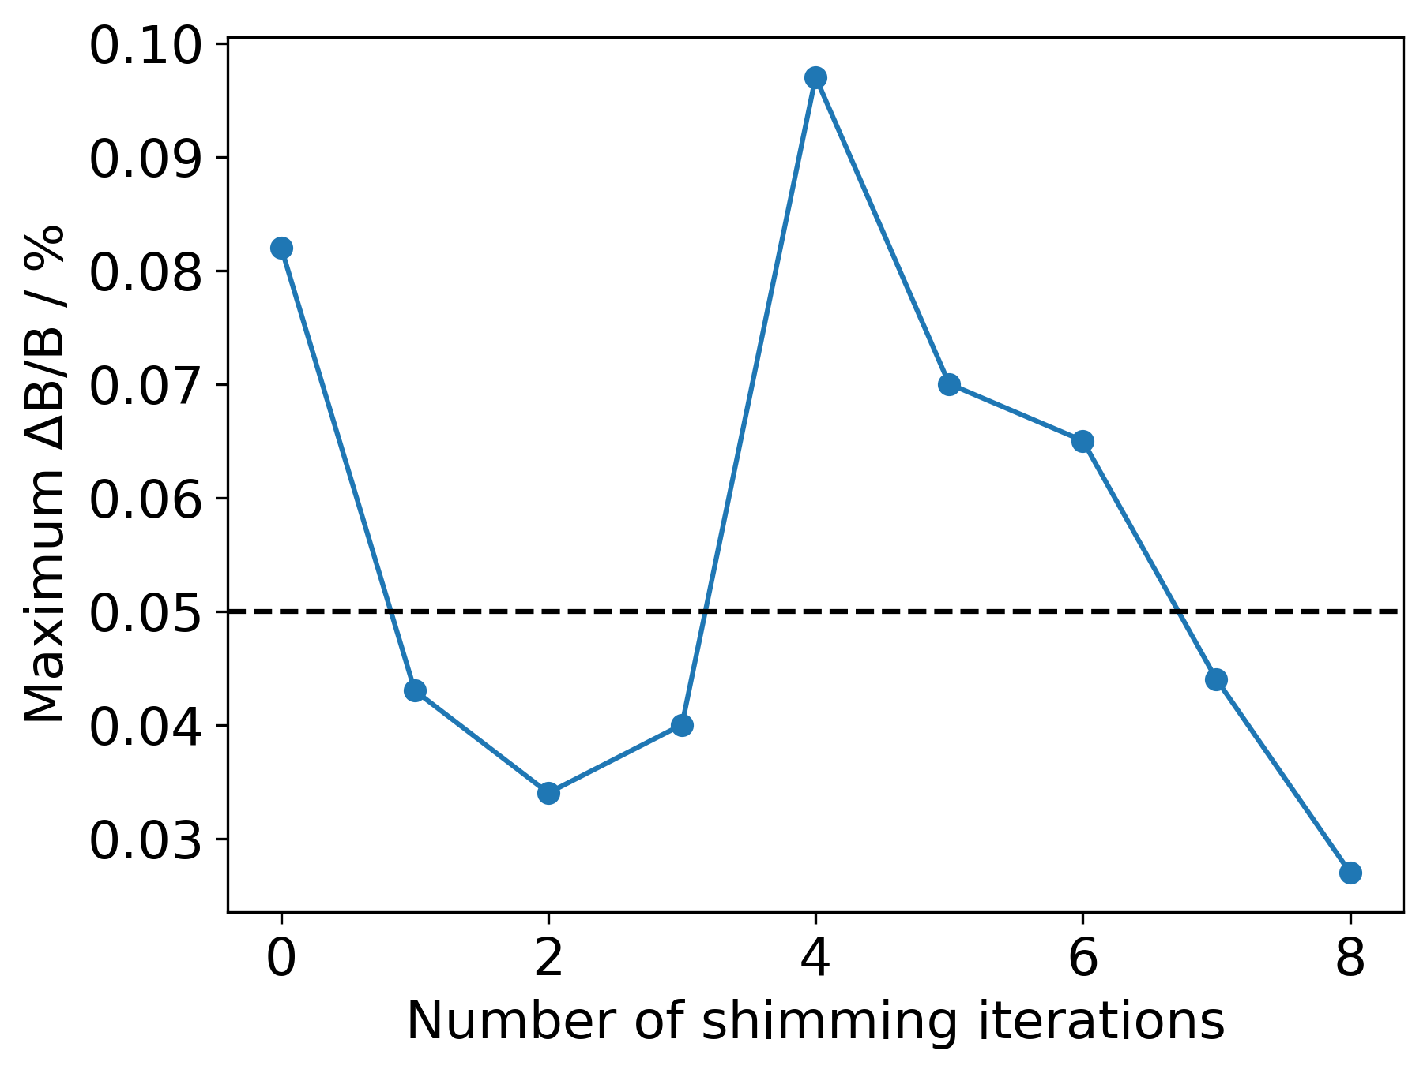
Shimming
Vertical gaps between main and auxiliary poles adjusted via addition / removal of brass shims.

Slide 11
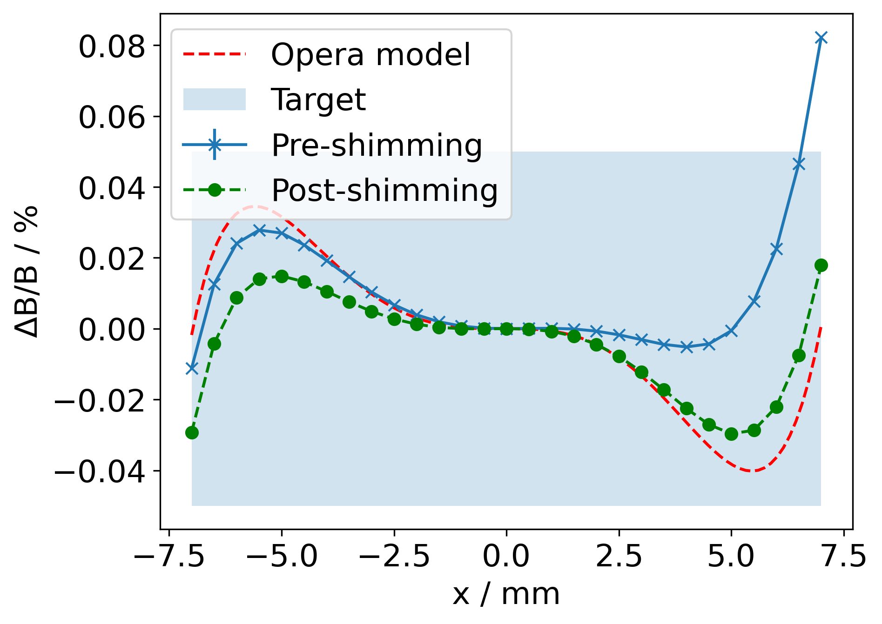
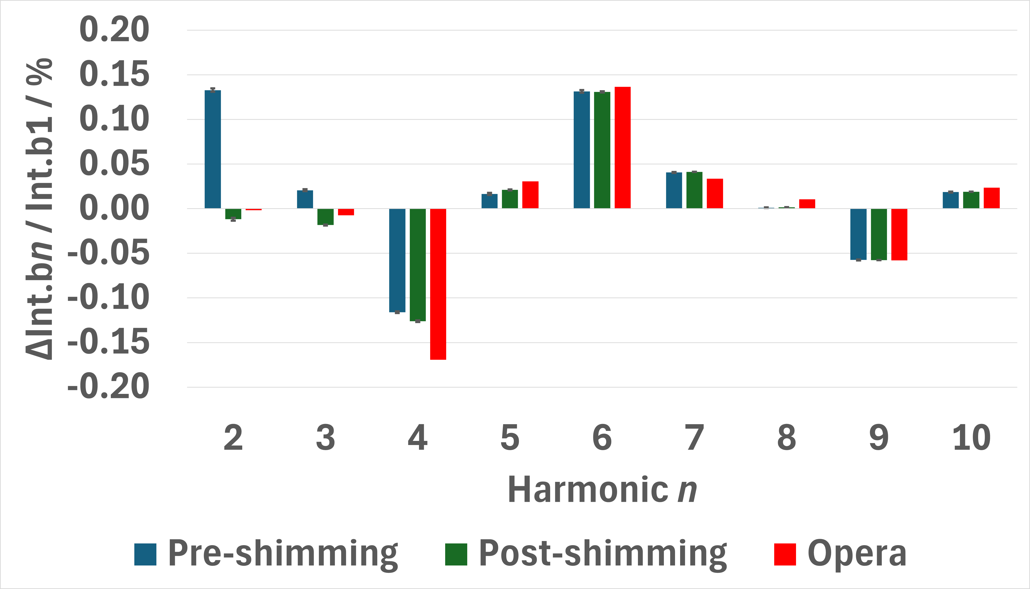
Post-shimming
 | Integrated Gradient / T | Integrated gradient error / % | Integrated Homogeneity ΔB/B / %
Requirement | 28.1857 |  | 0.05
Pre-shimming | 28.070 ± 0.002 | -0.41 | 0.082±0.005
Post-shimming | 28.196 ± 0.001 | +0.04 | 0.029±0.001

Slide 12
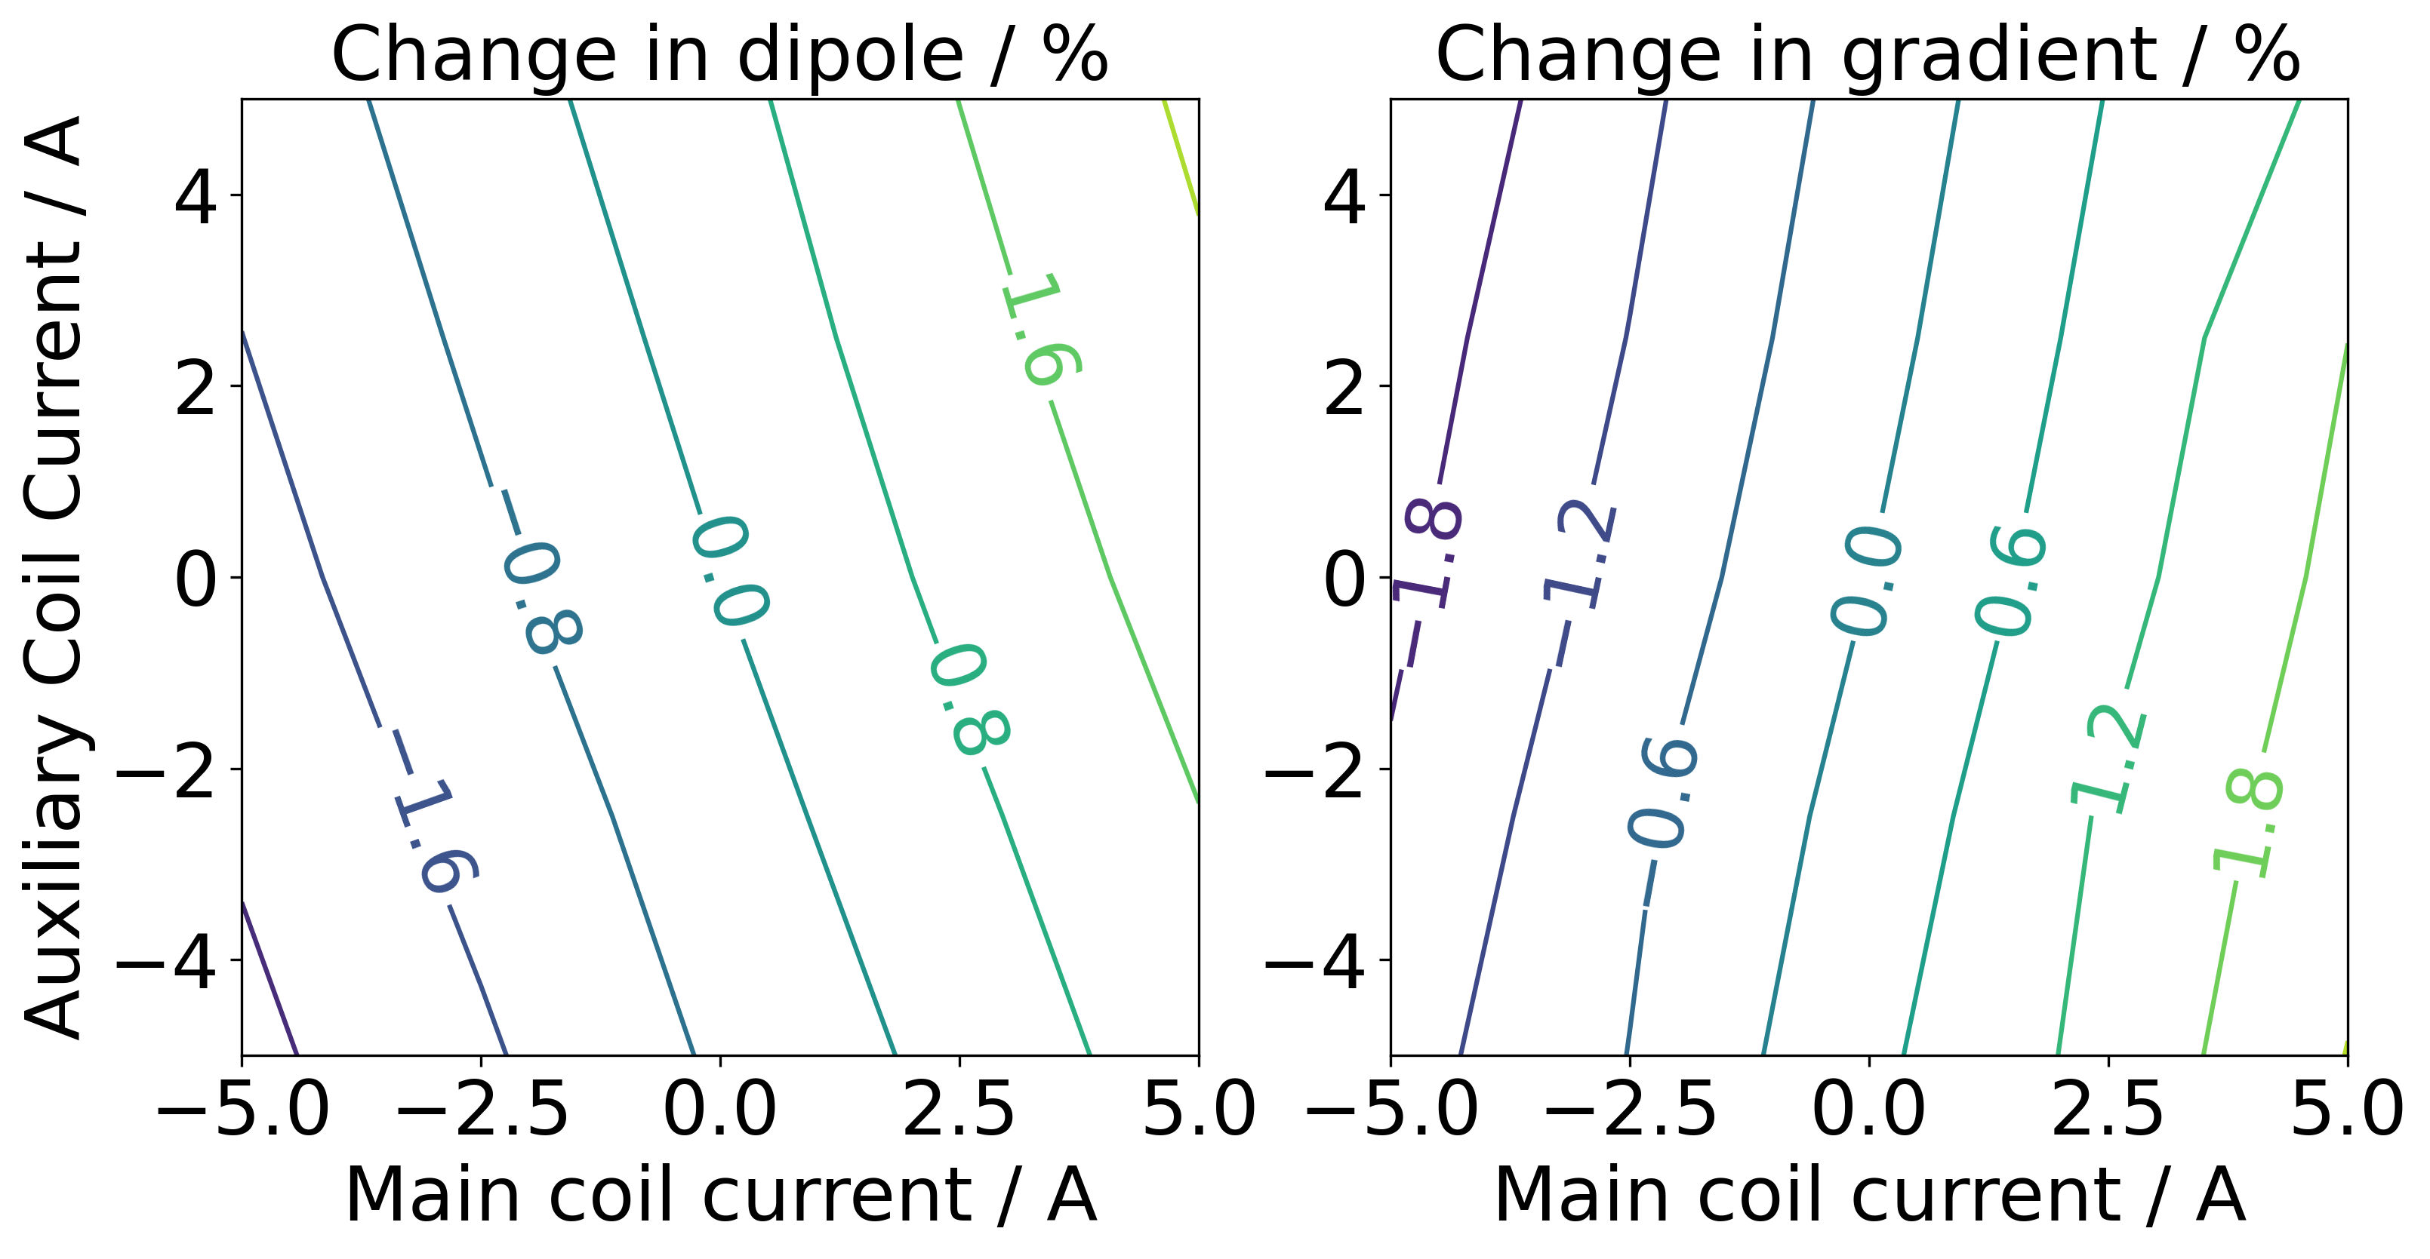
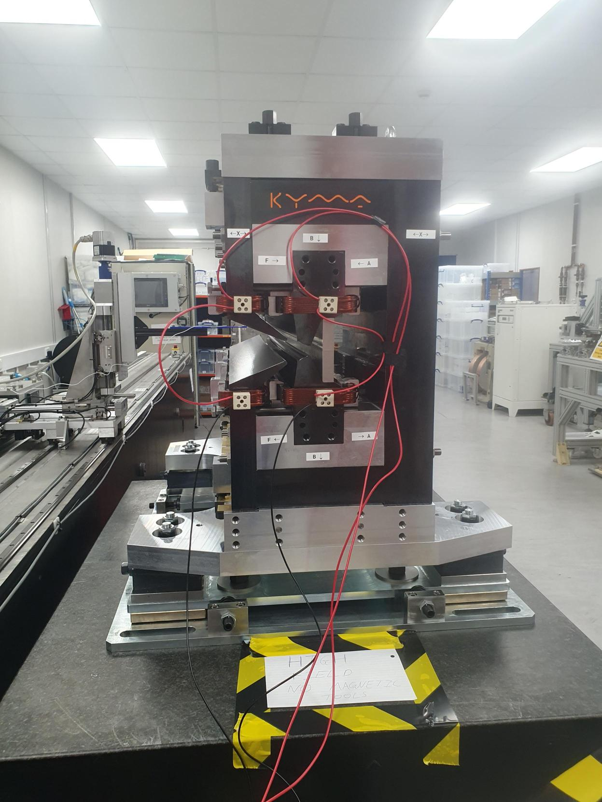
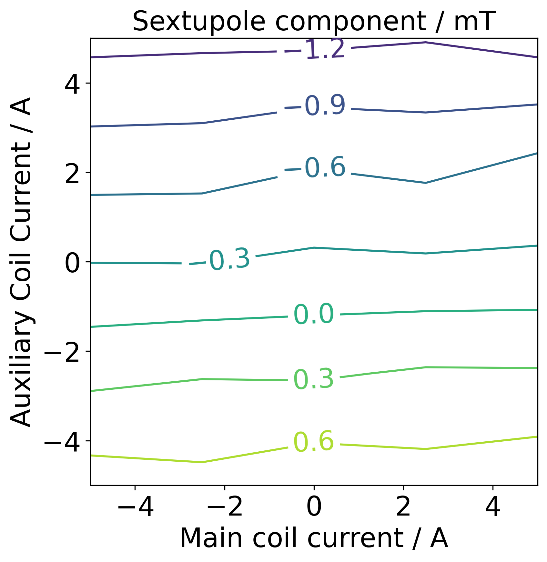
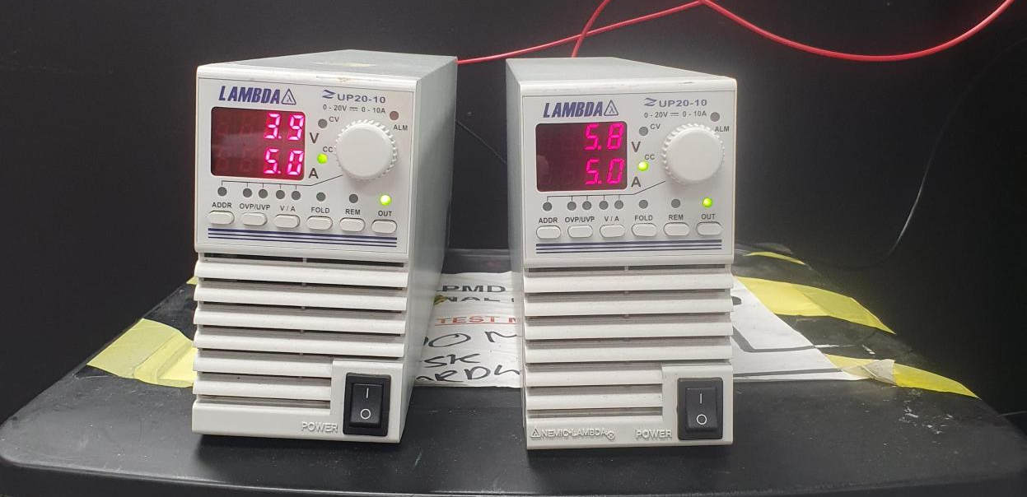
Trim coils
Target = independent tuning of dipole and quadrupole by ±2.5 %
19.5 W
29 W

Slide 13
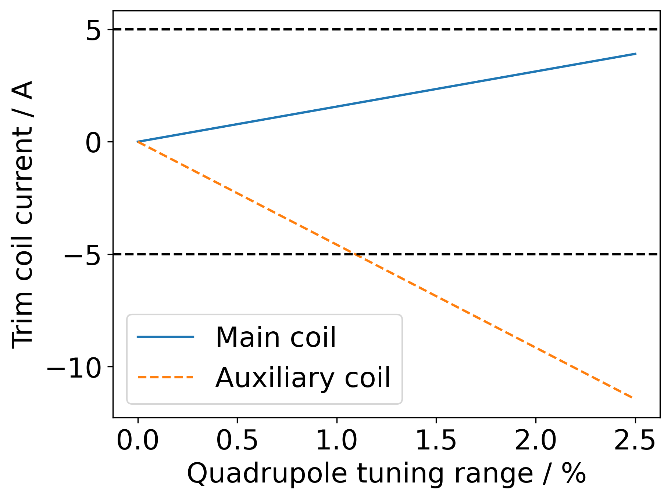
Tuning Range
Trim coil currents limited to ±5 A.
Quadrupole tuned whilst keeping dipole field constant – emittance measurements.
Maximum achievable tuning range is ±1.1 %.
Less than target range of ±2.5 %.
Electromagnet tuning is inefficient due to low magnetic permeability of permanent magnets in the magnetic circuit.

Slide 14
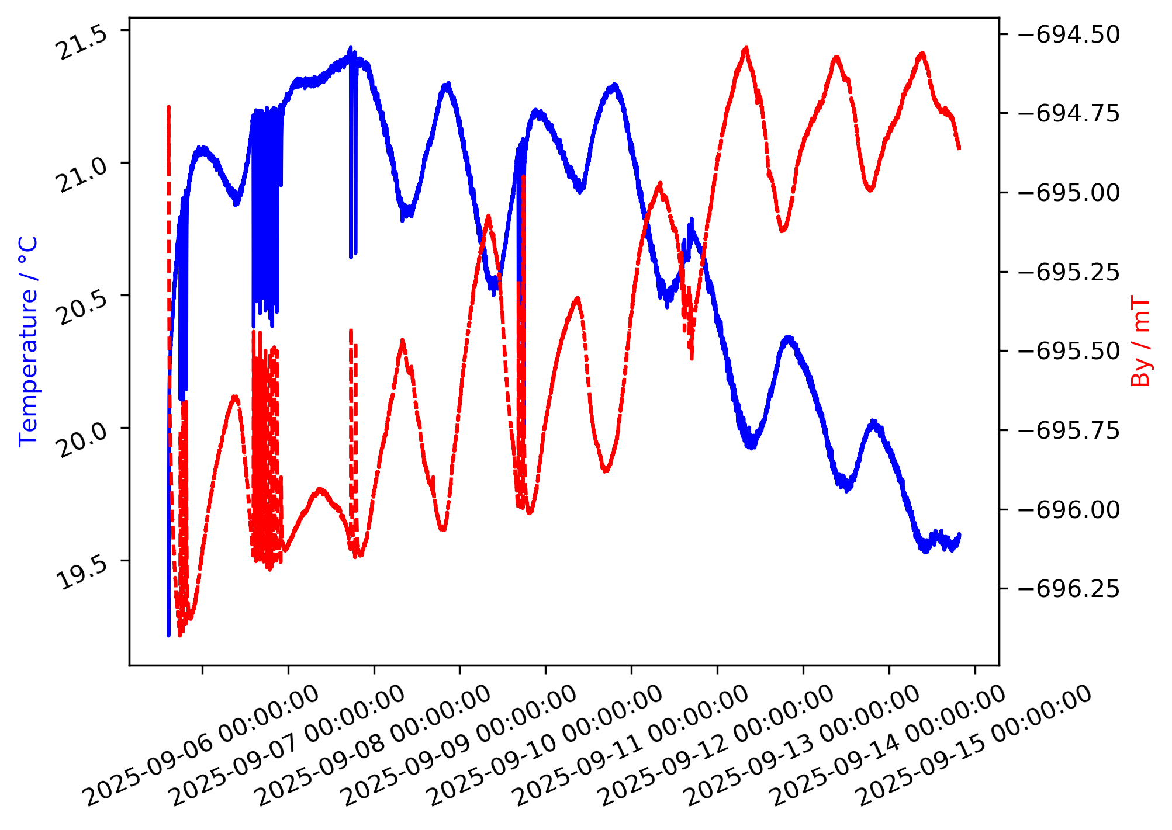
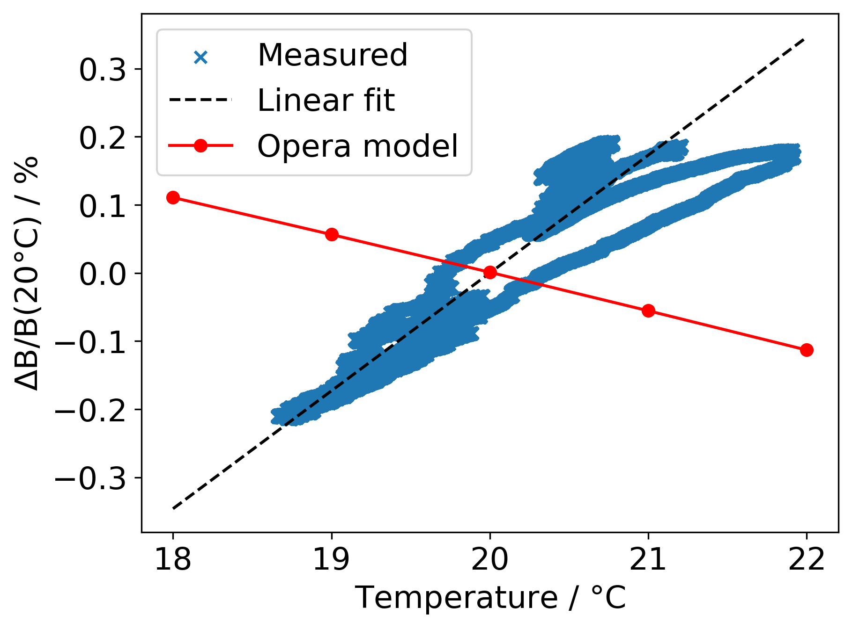
Thermal Stability
FeNi thermal shunt alloy glued to PM blocks
-0.06 % / degree
+0.17 % / degree

Slide 15
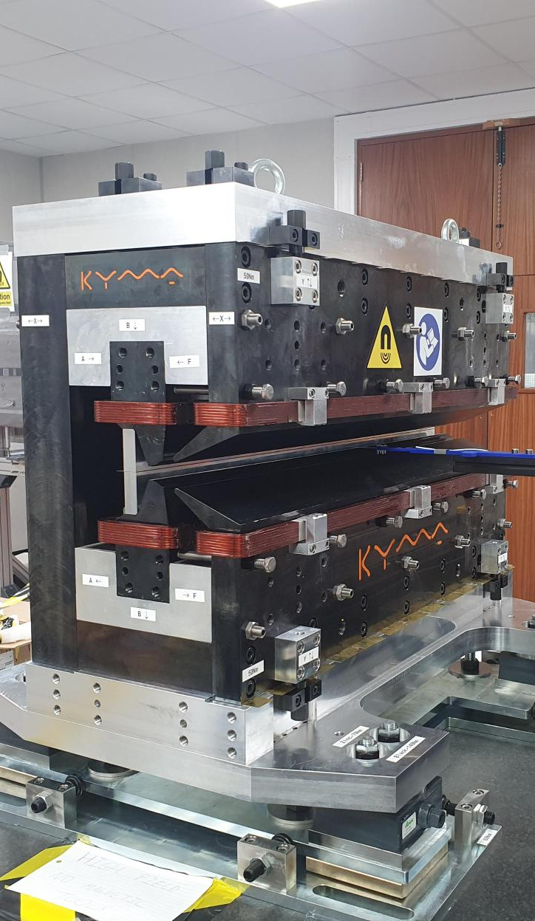

Conclusion
HEPTO magnet built and measured as part of I.FAST WP11.3.
Demonstrator of sustainable alternative to electromagnets.
Parameter | Target | Achieved | Units
Integrated gradient | 28.1857 | 28.196 ± 0.001 | T
Integrated field quality (ΔB/B) in GFR | 5E-4 | (2.9±0.1)E-4
Gradient tuning range | ±2.5 | ±1.1 | %
Trim coil power | <2.3 | 0.05 | kW
Temperature stability (3°C range) | ±0.01 | +0.51 | %
Next steps: further collaboration between STFC and Kyma through EPITA.
Development of scalable ZEPTO tuneable permanent magnet technology.
Image © STFC John Dawson

Slide 16



Notes:
The abstract pattern can be removed or repositioned if required. Be careful to ‘Send to Back’ so that it does not obscure any important information.

Slide 17






Acknowledgements:
Ben Shepherd (STFC)
Alfie Shahveh (Diamond Light Source)
Dušan Topalović, Tadej Milharcic, Mirko Kokole, Jure Počkar (Kyma S.p.A.)
Science and Technology Facilities Council
@STFC_matters
Science and Technology Facilities Council
Notes:
The abstract pattern can be removed or repositioned if required. Be careful to ‘Send to Back’ so that it does not obscure any important information.

