Slide 1

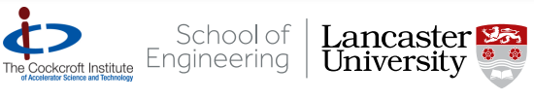
Third Harmonic Cavity Design for the Electron-Ion Collider
IOP PAB 2026
30th June 2026
S. Toole s.j.toole@lancaster.ac.uk
G. Burt, Z. Conway, R. Rimmer

Slide 2
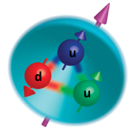
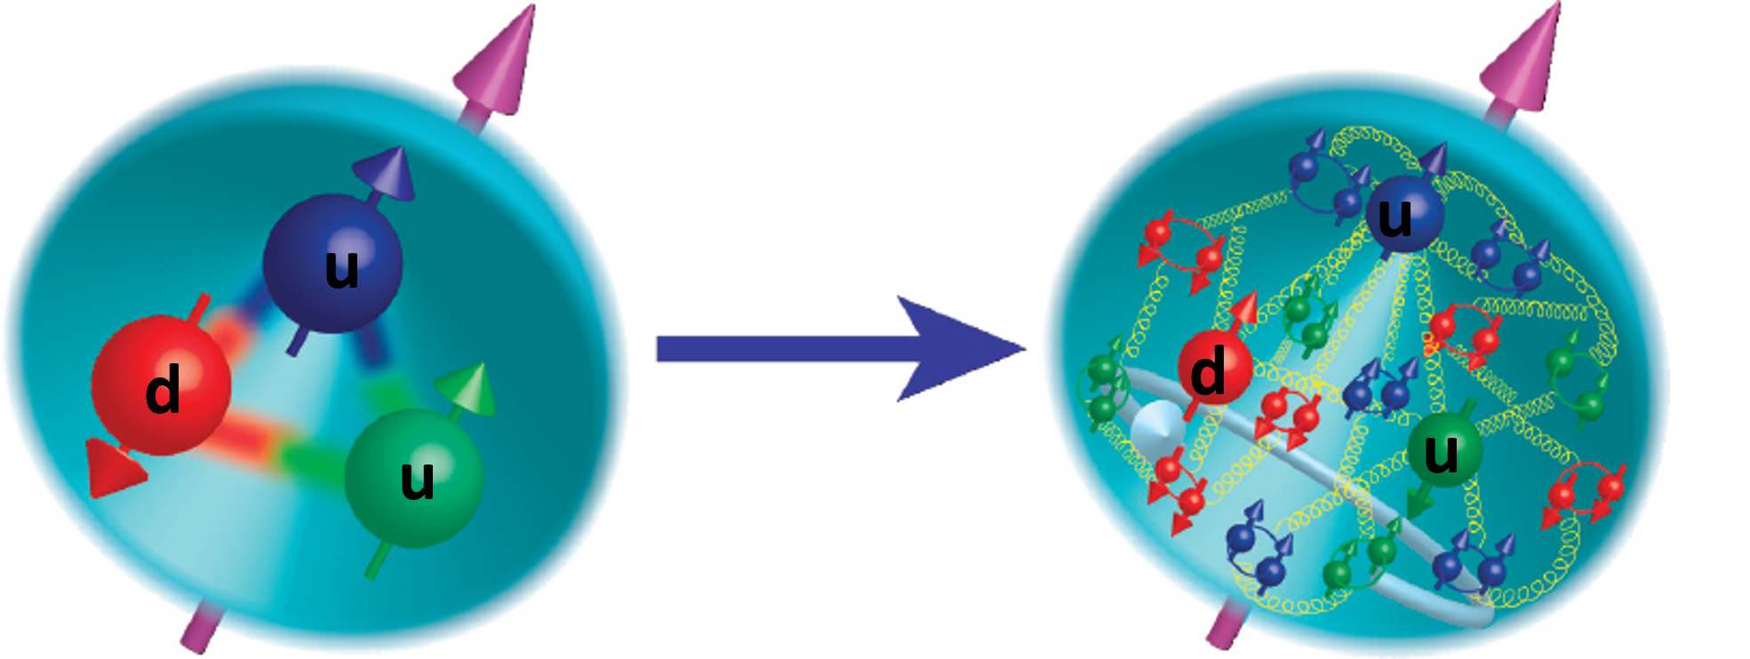
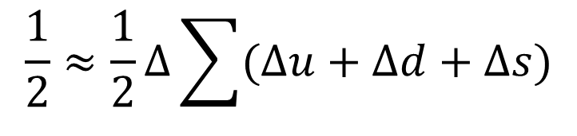


Motivation for an Electron-Ion Collider
Quark and gluon orbital angular momentum
Protons, were thought to derive their ½ spin primarily from their constituent valence quarks, uud
$$\frac{1}{2}≈\frac{1}{2}Δ\sum{(Δu+Δd+Δs)}$$
Gluon spin
$$+ΔG+L_{Q}+L_{G}$$
Valence quark spin
In 1988, deep inelastic scattering (DIS) experiment revealed valence quarks contribute less than 30% of proton spin¹
$$= \frac{1}{2}$$
Figure 1: Evolving understanding of proton spin origin. (Left) proton was composed of three valence quarks, with total spin ½. (Right) proton contains quarks, as well as a gluonic sea of quark-antiquark pairs; the total spin is composed of that of the elementary spins².
¹“Lipkin, Harry J. 1988. “Flavor Symmetry, EMC Results and the Spin Content of the Proton.” Physics Letters. B 214 (3): 429–33; ²White Paper on the Electron-Ion Collider in Preparation for the NSAC Long Range Plan.” 2023
1

Slide 3
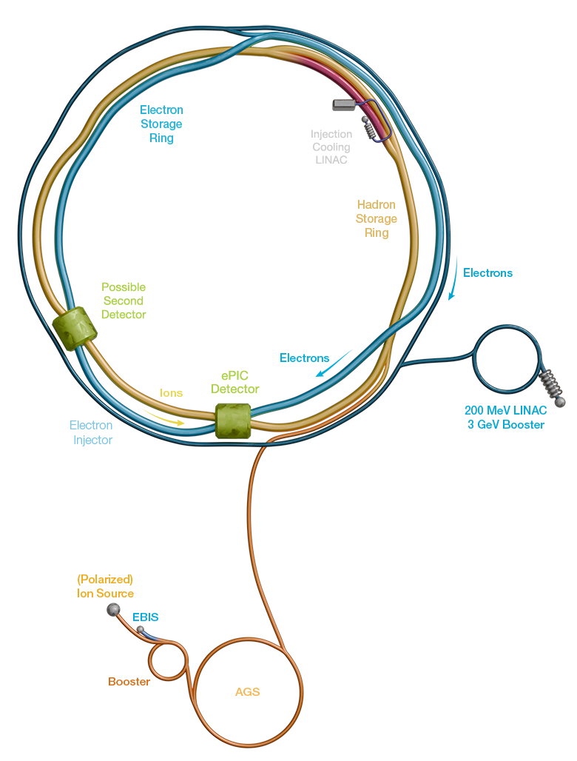
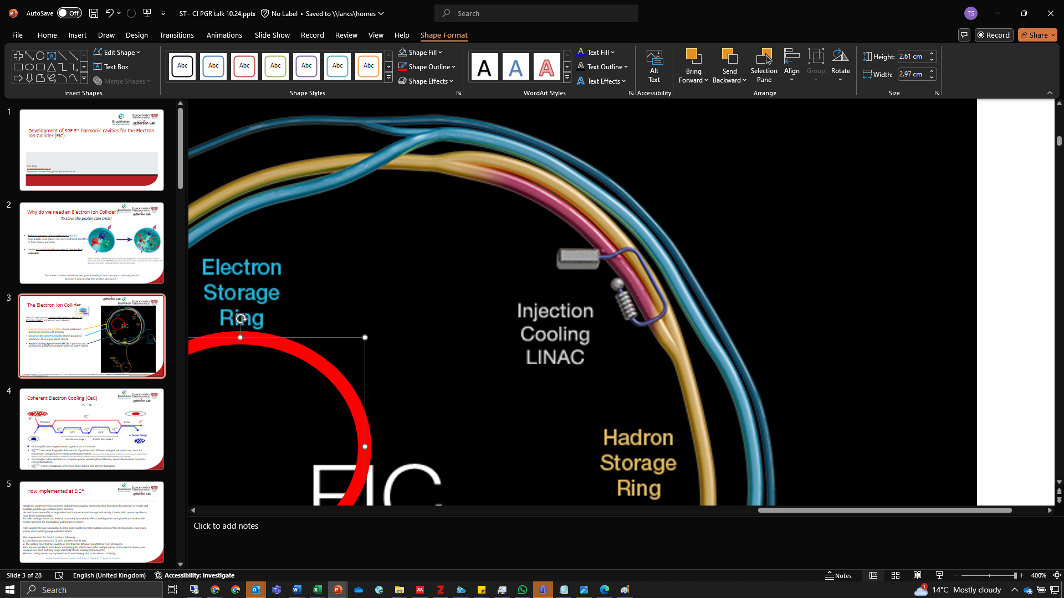
The Electron Ion Collider
The existing 3.4km rings of the Relativistic Heavy Ion Collider are used to build:
Hadron Storage Ring (HSR): storing polarised protons at energies 41-275 GeV.
Electron Storage Ring (ESR): storing polarised electrons at energies 5 GeV -18 GeV.
Rapid-Cycling Synchrotron (RCS): a pre-injector to accelerate polarised electrons from 200MeV to 5 GeV-18 GeV⁴.
Beam parameters operating at maximum luminosity⁴.
Parameter | e⁻ | p⁺
Beam energy [GeV] | 10 | 275
Beam current [A] | 2.5 | 1
Spin polarisation [%] | ≥70
Luminosity [10³⁴cm⁻²s⁻¹] | 1
Two interaction regions
³Bnl.gov. (2017). The EIC Machine., Satogata, T. (2023). ⁴EIC Parameter List Summary. [online] EIC.JLAB. Available at: https://eic.jlab.org/Documents/EIC-General/EIC_ParameterList.pdf.
2

Slide 4
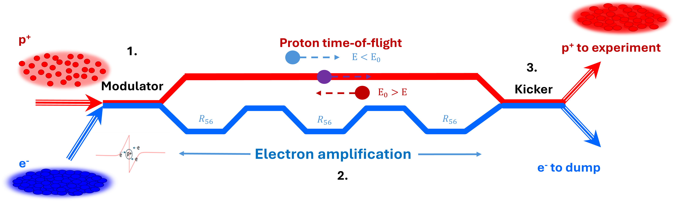
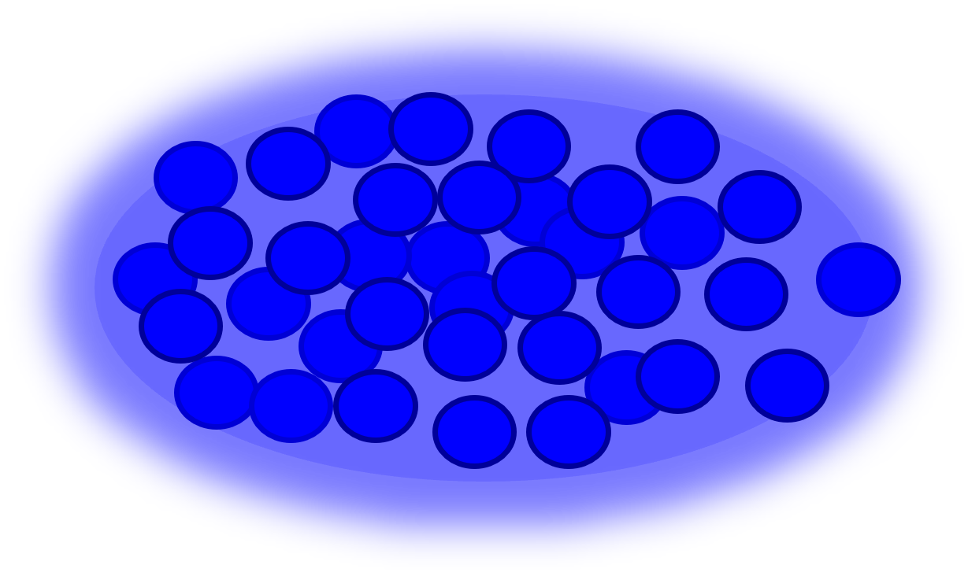
Coherent Electron Cooling
A future upgrade
Heavy ions do not have an intrinsic damping mechanism to counteract emittance growth when subjected to long stores in collider rings
Emittance growth occurs due to: Intra Beam Scattering → Degrades luminosity
Vertical emittance grows from $0.3μm$ to $2.5μm$ in 2 hours⁵
External fast cooling mechanism required to counteract this⁶
18 - 275 GeV
50 - 150 MeV
⁵COHERENT ELECTRON COOLING PHYSICS FOR THE EIC. doi:https://doi.org/10.18429/JACoW-IPAC2024-THYD1
⁶Ratner, D. (2013). Microbunched Electron Cooling for High-Energy Hadron Beams. Physical Review Letters, 111(8). Bergan, W.F., Mayes, C., Wang, N. and Stupakov, G. (2024).
3

Slide 5
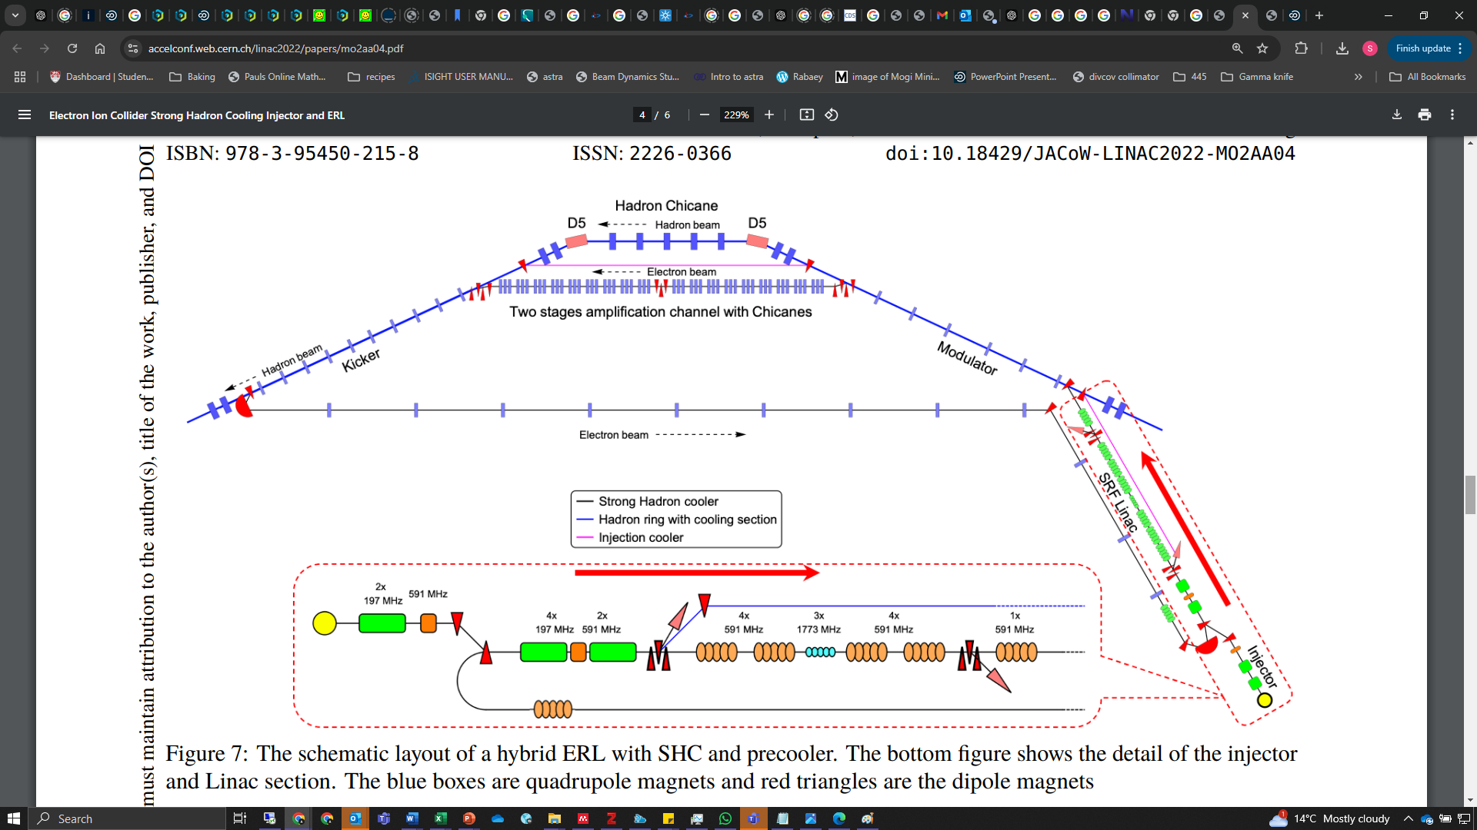
Cooling at the EIC
Hadron Chicane
Latest schematic – 2022⁷
Two stage amplification with chicanes
p⁺ to HSR
Kicker
Modulator
P⁺
e⁻ to ERL
⁷Wang, E, W Bergan, F Willeke, S Benson, K Deitrick, Thomas Jefferson, C Mayes, D Douglas, C Gulliford, and N Taylor. n.d. “ELECTRON ION COLLIDER STRONG HADRON COOLING INJECTOR and ERL.
4

Slide 6
Cooling at the EIC
Primary electron cooler accelerating cavities
Third harmonic cavities
⁷Wang, E, W Bergan, F Willeke, S Benson, K Deitrick, Thomas Jefferson, C Mayes, D Douglas, C Gulliford, and N Taylor. n.d. “ELECTRON ION COLLIDER STRONG HADRON COOLING INJECTOR and ERL.
5

Slide 7
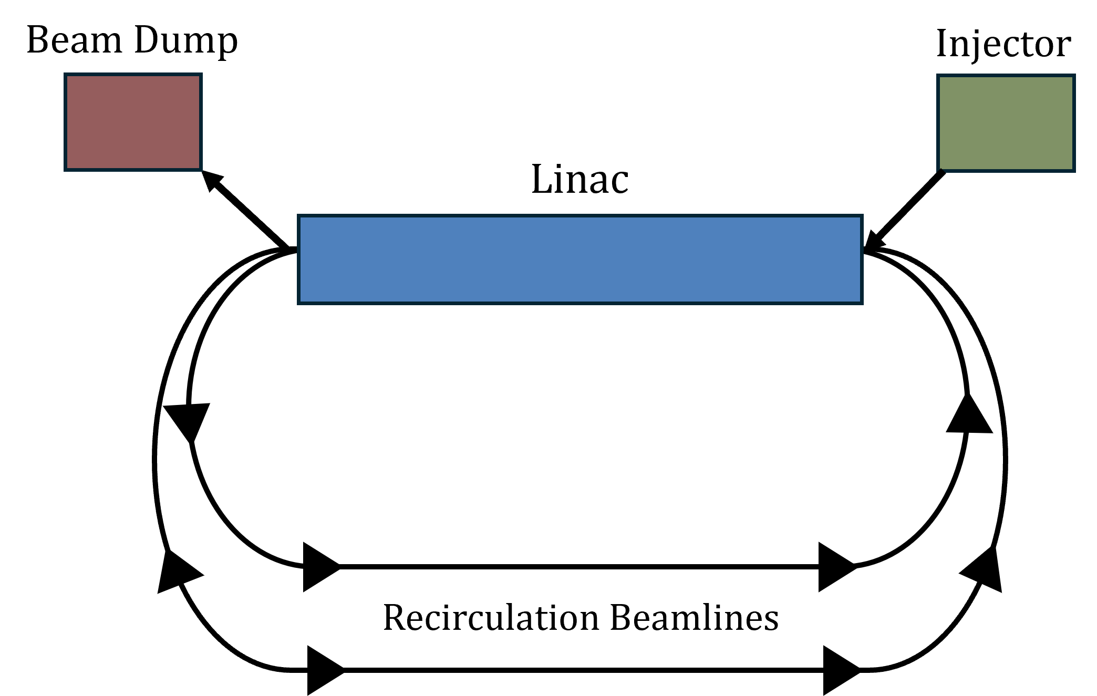
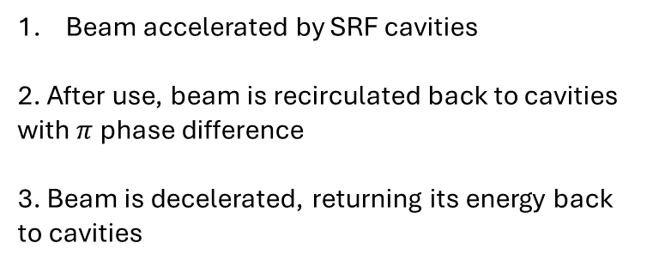
Energy Recovery Linacs & BBU
ERL operation
Beam accelerated by SRF cavities
2. After use, beam is recirculated back to cavities with $π$ phase difference
3. Beam is decelerated, returning its energy back to cavities
Beam Break Up Instability
Bunch enters cavity off axis
Deflecting HOM is excited
Bunch experiences transverse kick
Limits maximum operable beam current
Compromises complete energy recovery
Positive feedback loop
Bunch decelerated, HOM energy grows
Bunch receives another transverse kick
Bunch returns to cavity with larger transverse offset
Deflecting modes must be sufficiently damped
6

Slide 8

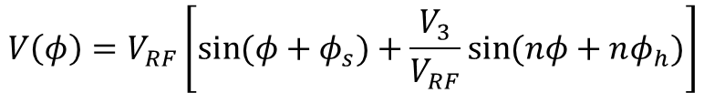

Motivation for Third Harmonic Cavities
Cooler electron bunch length is 4-5 cm, occupying 36 degrees of 591 MHz RF voltage
1st harmonic
$$V\left(φ\right)=V_{RF}\left[\sin{(φ+φ_{s})}\right]$$
$$φ=\frac{ω_{RF}}{c}z+φ_{s}$$
1st + 3rd harmonic
Curved electron bunch
Poor cooling efficiency
$$V\left(φ\right)=V_{RF}\left[\sin{(φ+φ_{s})}+\frac{V_{3}}{V_{RF}}\sin{(nφ+nφ_{h})}\right]$$
1st harmonic + 3rd harmonic
1st harmonic
Bunch head, centre, and tail see different voltages
Causes curved bunch
Total voltage is flat across bunch centre
linearity restored
⁸Byrd, J.M., Baptiste, K., De Santis, S., Kosta, S., Lo, C.C., Plate, D., Rimmer, R.A. and Franks, M. (2000). Design of a higher harmonic RF system for the Advanced Light Source. Nuclear Instruments and Methods in Physics Research Section A: Accelerators, Spectrometers, Detectors and Associated Equipment, [online] 439(1), pp.15–25. doi:https://doi.org/10.1016/s0168-9002(99)00892-x.
7

Slide 9
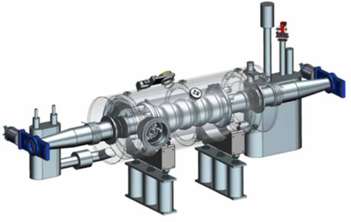

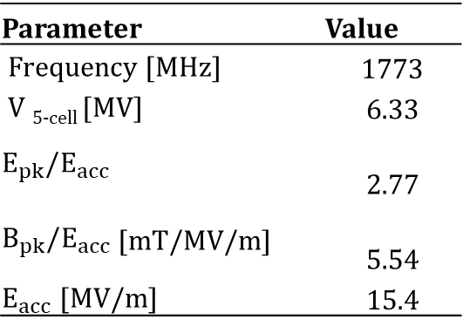
1773MHz Cavities: The Spec
Electron beam current in cooler is 100 mA : HOM impedance is a major issue
Minimum aperture radius, $R_{a}$: 30 mm
  Maximise HOM propagation by lowering cut-off frequency
All SRF cavities adopt maximum allowable surface fields of 40 MV/m (E_{pk}) and 80 mT (B_{pk})⁹
- 19 MV provided to 3 cavities, 6.33 MV per cavity
5-cells per cryomodule, three cryomodules
591MHz SRF 5-cell cavity module for the ERL cooler¹⁰
Parameter | Value
Frequency [MHz] | 1773
V _{5-cell} [MV] | 6.33
$$E_{pk}/E_{acc}$$ | 2.77
$B_{pk}/E_{acc}$ [mT/MV/m] | 5.54
$E_{acc}$ [MV/m] | 15.4
How large can the aperture be while satisfying cavity specification?
⁹ Rimmer, R. (2021). An Overview of RF Systems for the EIC. JaCoW. doi:https://doi.org/10.18429/JACoW-IPAC2021-MOPAB385
¹⁰Rimmer, R. and Daly, E. (2022). CAVITY AND CRYOMODULE DEVELOPMENTS FOR EIC. JaCoW. doi:https://doi.org/10.18429/JACoW-eeFACT2022-WEXAS0101
8
Notes:
[1]
R. Rimmer et al., “CAVITY AND CRYOMODULE DEVELOPMENTS FOR EIC * OVERVIEW OF SRF SYSTEMS FOR EIC.” Accessed: Nov. 14, 2024. [Online]. Available: https://accelconf.web.cern.ch/eefact2022/papers/wexas0101.pdf
High current ERL beams are susceptible to multibunch instabilities arising from Higher Order Modes (HOMs). Operating at 100mA, the ERL benefits from reduced short range wakefields due to large beamholes reducing impedance.
Optimisation of SRF cavities considers limits imposed by thermal breakdown ($B_{p}/E_{acc}$), field emission, and multipacting ($E_{p}/E_{acc})$while maximising the accelerating gradient ($E_{acc})$ for a given stored energy ($Q_{0})$.

Slide 10
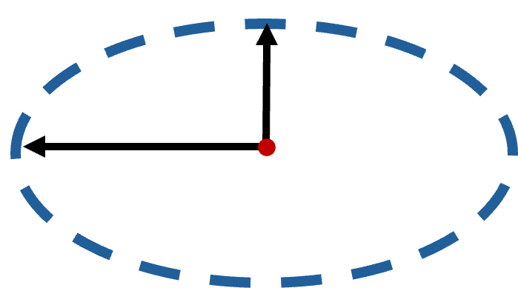
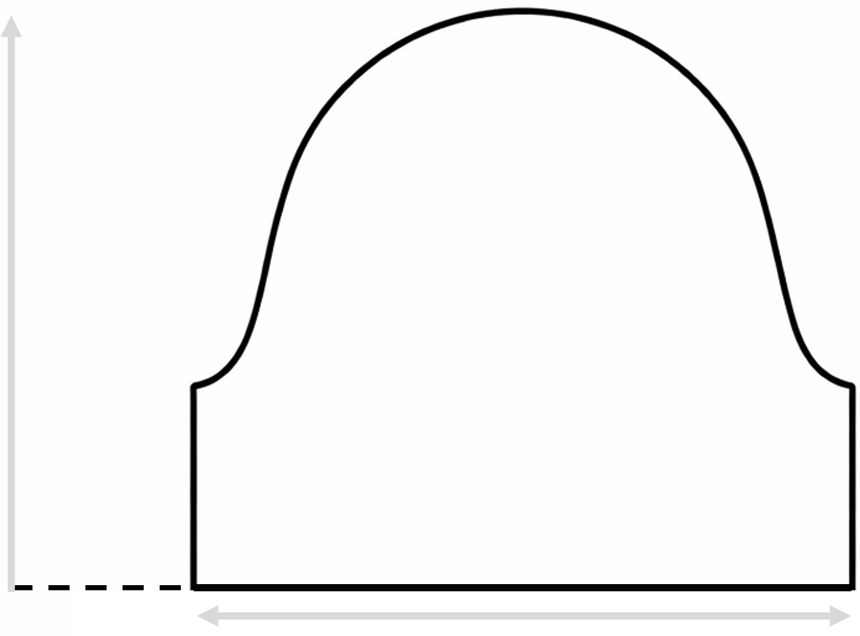
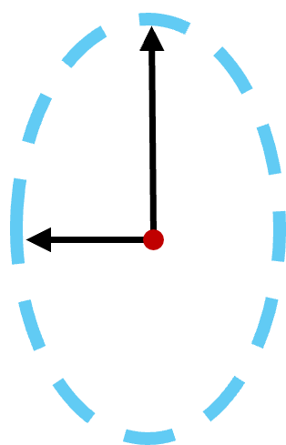

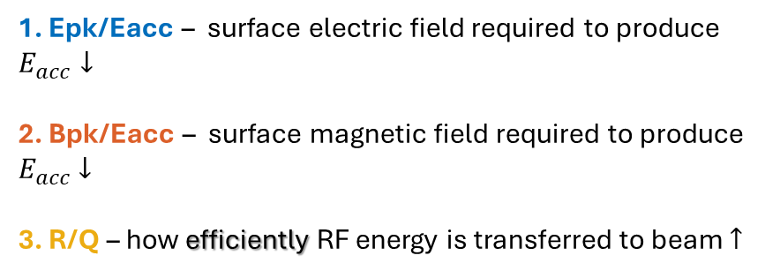






Single Cell Optimisation
CAVITY OPTIMISATION GOALS
1. Epk/Eacc – surface electric field required to produce $E_{acc}↓$
2. Bpk/Eacc – surface magnetic field required to produce $E_{acc}$ $↓$
3. R/Q – how efficiently RF energy is transferred to beam $↑$
$$r_{y2}$$
Inductive region
$$r_{x2}$$
$$r_{y1}$$
$$r_{eq}$$
$$r_{x1}$$
Cavity geometry is optimised by balancing competing objectives
Capacitive region
$$r_{a}$$
$$λ/2$$
9
Notes:
Limitations of manual optimisation:
Cavity geometry produces conflicting RF objectives
Improving one figure of merit often degrades another
Difficult to manually produce a vast, exotic set of non-dominated solutions

Slide 11
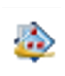
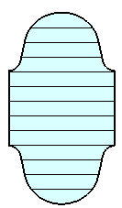
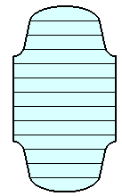
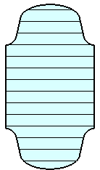
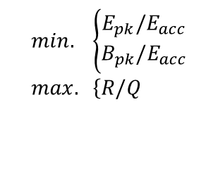
Multi-Objective Optimisation
Cavity design requires simultaneous optimisation of conflicting objectives
A design is Pareto-optimal if one objective cannot be improved without degrading another.
Design objectives:
$$min. \left\{\begin{aligned}E_{pk}/E_{acc} \\ B_{pk}/E_{acc}\end{aligned}\right. \\ max. \left\{R/Q\right.$$
Multi-objective genetic algorithm is used to identify a set of Pareto-optimal geometries satisfying objectives
Each point is an individual design candidate from the optimisation process, where cell elliptical parameters were varied with increasing aperture radius.
Candidate geometries
30 mm
35 mm
40 mm
10
Notes:
Multi-objective optimisation proves time consuming it is difficult to manually produce a set of non-dominated solutions to explore the design space
Optimisation of SRF cavities considers limits imposed by thermal breakdown ($B_{p}/E_{acc}$), field emission, and multipacting ($E_{p}/E_{acc})$while maximising the accelerating gradient ($E_{acc})$ for a given stored energy ($Q_{0})$.
Pareto optimisation anual design space exploration and producing a set of non-dominated, varied solutions is a challenging, time demanding task for thousands of simulations – particularly when they are conflicting!

Slide 12
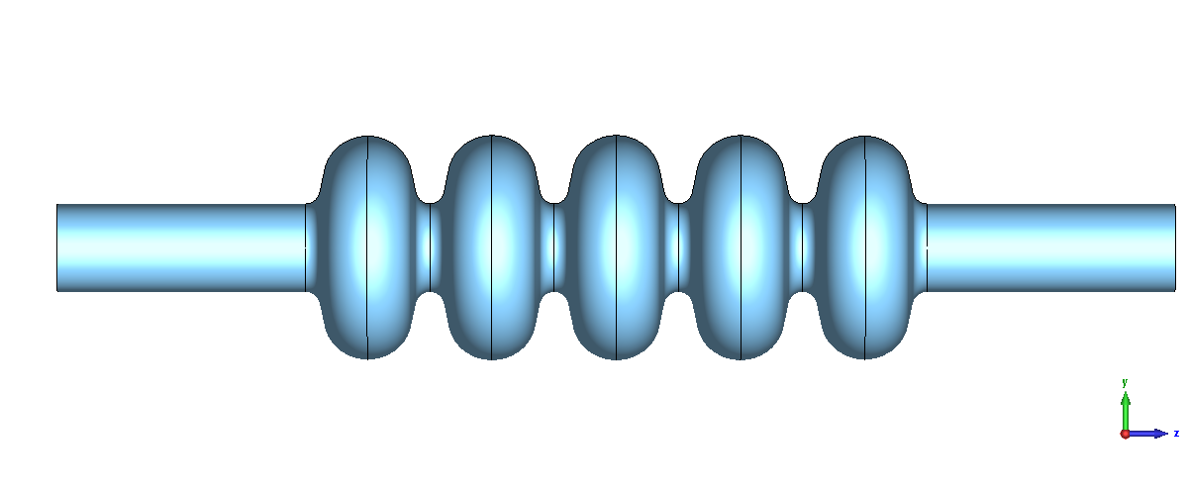
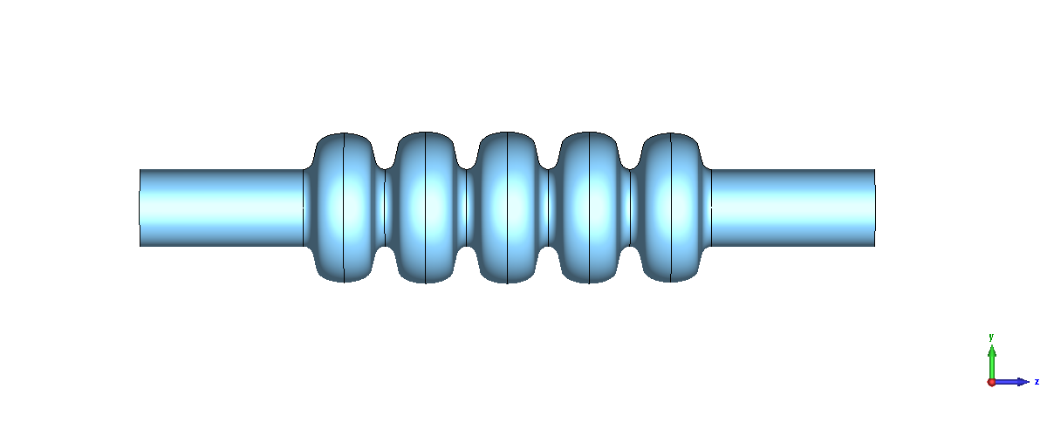
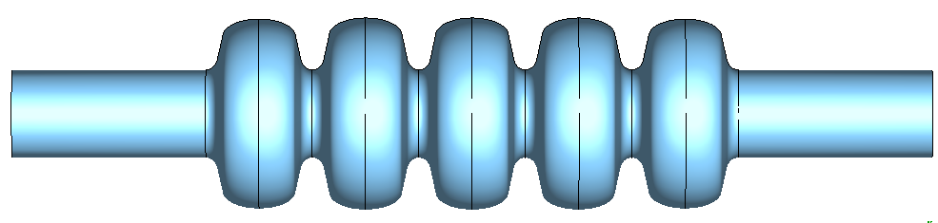
Trapped Mode Analysis
Beampipe radius sets TE11 cut-off frequency
Initial studies of dipole behaviour begins with a standard 5-cell structure
cavity aperture radius = beampipe radius
TE11 cut-off frequency in circular waveguide
Propagation region
TE11 above cut-off
30 mm
Propagation region
All cavity candidates require a larger beampipe to propagate dipoles
35 mm
40 mm
TE11 below cut-off
Lowest HOM frequency is trapped within all candidates
Trapping region
Each 5-cell configuration satisfies
Field Flatness ≥98%
Transit Time Factor ≥ 0.7
Evenly distributed surface fields across all cells (close to 1:1)
11
Notes:
Enlarged beampipes can decrease the TE11 cut-off below the TE111 resonance, at the cost of moving the TE111 resonance closer to the TM010 frequency
This increases the difficulty in sufficient HOM suppression without coupling to the TM010 mode

Slide 13
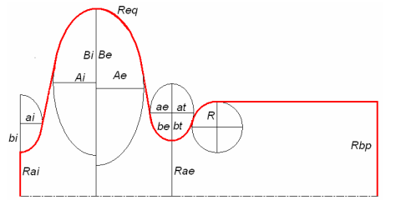
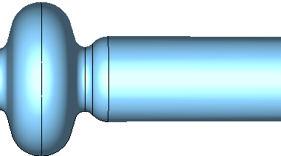
Trapped Mode Analysis
Using a larger beampipe requires an optimised ‘lip’ transition between cavity and beampipe
propagation
Cavity
Lip
Beampipe
example
Maximum aperture limited by:​
Evanescent decay of TM010 mode into beampipe​
TM010 cut-off​
Cavity sandwiched between 591 MHz cavities –beampipe will have to taper down
trapping
11
Notes:
Enlarged beampipes can decrease the TE11 cut-off below the TE111 resonance, at the cost of moving the TE111 resonance closer to the TM010 frequency
This increases the difficulty in sufficient HOM suppression without coupling to the TM010 mode

Slide 14
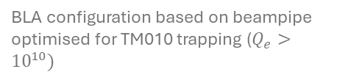
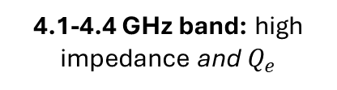
Baseline HOM Spectrum
BLA configuration based on beampipe optimised for TM010 trapping ($Q_{e}>{10}^{10})$
Requires broadband damping
2 GHz band: high impedance modes
4.1-4.4 GHz band: high impedance and $Q_{e}$
Narrowband damping
~5.3 GHz: single high impedance monopole
12

Slide 15
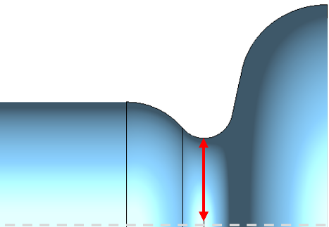



Lowest Dipole Frequency Propagation
Key Takeaway
Beampipe ${TE}_{11}$ cut-off
Lip radius determines whether the first dipole is trapped or propagates
  Using a smaller lip increases dipole frequency to push above cut-off
30 mm and 32 mm lip shows promise for damped $Q_{e}$ however,
$Q_{e}$ and impedance dipole response to lip radius 2.0GHz – 5.4 GHz must be evaluated
Beampipe cut-off frequency
Lip radius defined from beamline axis
$$r_{lip}$$
HOM trapped
HOM propagation
2
13

Slide 16
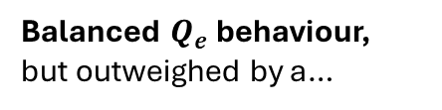

Mode Trapping in Bottleneck Geometry
Balanced $Q_{e}$ behaviour, but outweighed by a…
Same improvement seen with 4 GHz band
A huge impedance improvement GHz band with larger lip
Improvement in $Q_{e}$ of 2 GHz band dipoles
14

Slide 17
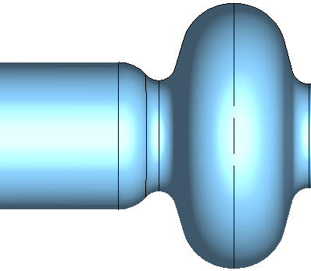
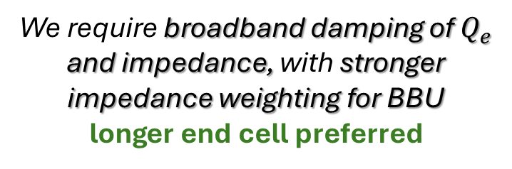
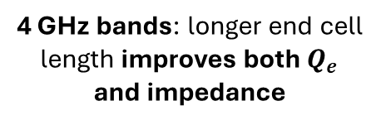
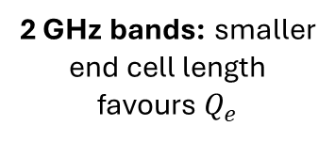
End Cell Optimisation for Dipole Damping
First Dipole Passband
End cell length
2 GHz bands: smaller end cell length favours $Q_{e}$
4 GHz Dipole Bands
4 GHz bands: longer end cell length improves both $Q_{e}$ and impedance
~4.15 GHz band favours longer end cell
We require broadband damping of $Q_{e}$ and impedance, with stronger impedance weighting for BBU
longer end cell preferred
15

Slide 18






Beam Break-Up Instability
Minimum beam current to drive regenerative beam break up for each cavity¹¹ (I_{b}= 100 mA)
All modes stable at operating current
Horizontal Dipole Polarisation, $M_{12}$
Vertical Dipole Polarisation, $M_{34}$
$$I_{th}>1 A \\ (stable)$$
$$I_{th}>1 A \\ (stable)$$
High impedance modes
High impedance modes
Smallest threshold current is 2A, x20 safety margin
$$I_{th}<1 A \\ (unstable)$$
$$I_{th}<1 A \\ (unstable)$$
Threshold currents calculated using cavity $R_{t}/Q$, $Q_{L},$ HOM frequency, and lattice recirculation optics ($M_{12}, M_{34})$
¹¹ S. Sentiyaz (2025) BBU Parameters for EIC-ERL, Private communication,
16

Slide 19
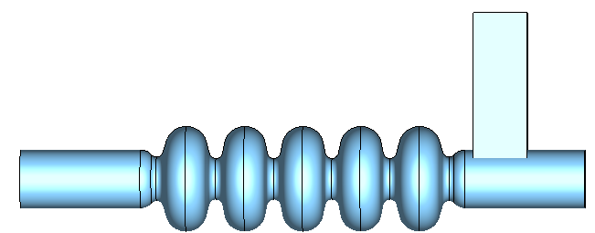
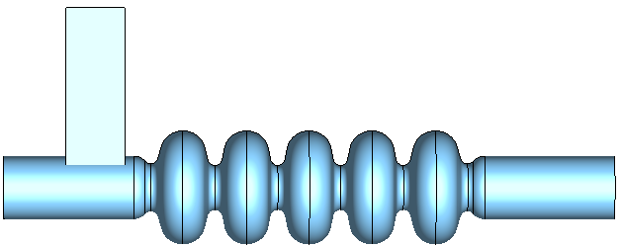
Waveguide Consideration
Beampipe absorber shows good promise for damping dipole modes
In a recirculatory machine, available beamline real estate is limited
Beamline absorber requires warm section
Requires more space
however,
Can adding a waveguide provide equivalent or improved HOM damping than a BLA?
Possible configuration
BLA – CAV – WG
WG – CAV – WG
Break rotational symmetry → introduce hybrid modes → complex WG system
Local field enhancement around beampipe-WG interface
Multipacting
17

Slide 20
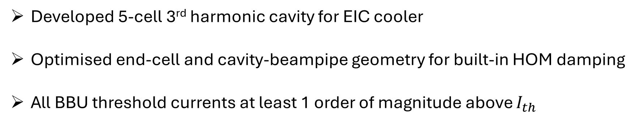
Summary
Developed 5-cell 3rd harmonic cavity for EIC cooler
Optimised end-cell and cavity-beampipe geometry for built-in HOM damping
All BBU threshold currents at least 1 order of magnitude above $I_{th}$
Future Work
Evaluate if a waveguide provides improved damping for optimisation of space utility
Perform thermal simulations of BLA with ferrite HOM loads
Change of direction – coaxial coupler for EIC crab cavity
18

Slide 21
Thank you for listening
IOP PAB 2026
S. Toole s.j.toole@lancaster.ac.uk
G. Burt, Z. Conway, R. Rimmer
19

Slide 22
Back-up Slides
IOP PAB 2026
S. Toole s.j.toole@lancaster.ac.uk
G. Burt, Z. Conway, R. Rimmer
20

Slide 23
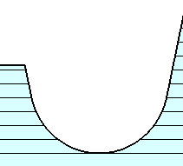
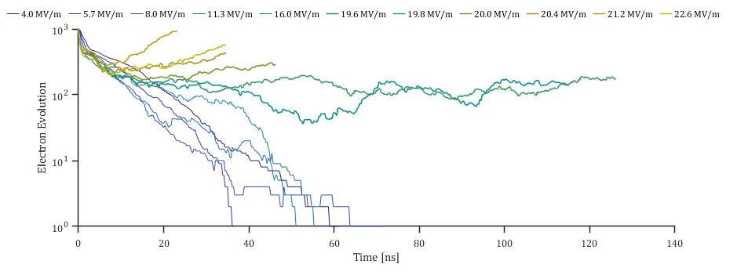
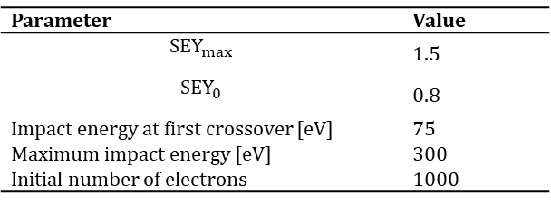

Multipacting in the Beampipe
Table X: SEY parameters of high purity Nb following 300˚C bakeout.
Unoptimised lip (cavity-beampipe interface)
Parameter | Value
$${SEY}_{max}$$ | 1.5
$${SEY}_{0}$$ | 0.8
Impact energy at first crossover [eV] | 75
Maximum impact energy [eV] | 300
Initial number of electrons | 1000
Multipacting field levels
Operating $E_{pk}=35MV/m$
Figure 10: Electron evolution starting from a homogenous distribution of 1000 electrons as a function of rising E_{P} surface fields on 5-cell cavity with no lip optimisation. Nb (2K) SEY curve: 300˚C bakeout.
21

Slide 24
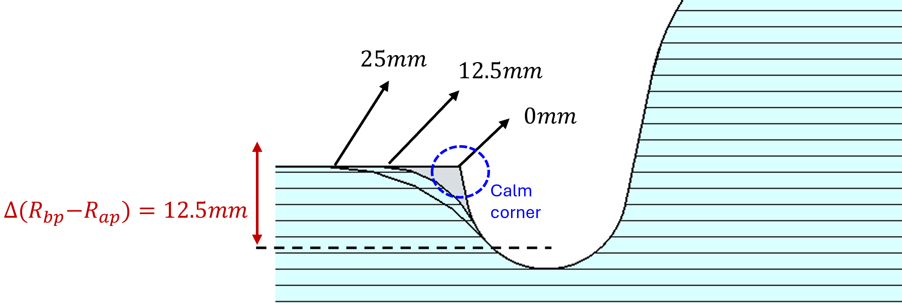
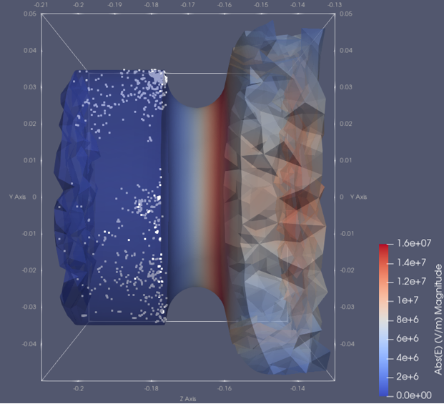
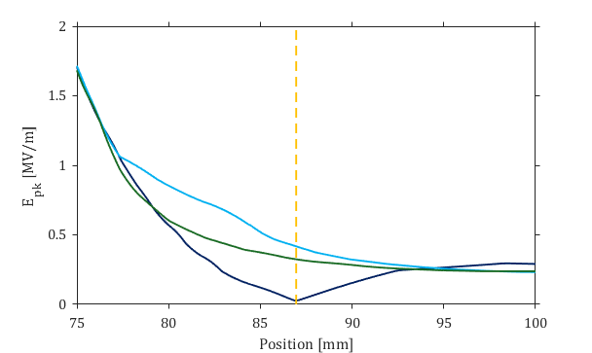


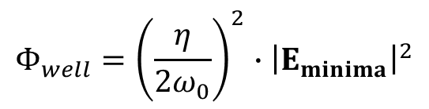

Diagnosing MP in the Beampipe
It is energetically favourable for electrons to exist in a local electric minima due to the associated lower potential $\left(Φ\right)$, which attracts electrons
‘Calm corners’ are eliminated by encouraging electron drift in the direction of the decaying field.
$$Φ_{well}={\left(\frac{η}{2ω_{0}}\right)}^{2}∙{\left|E_{minima}\right|}^{2}$$
$$η=\frac{e_{e}}{m_{e}}r_{0}(t)$$
Miller force
$$\ddot{r_{0}}\left(t\right)=−∇Φ$$
Figure 12: (top) Blend at beampipe-lip transition region of 0mm, 12.5mm, and 25mm (bottom) Elimination of electric field minima at MP location.
¹Sergey Belomestnykh, and Valery Shemelin. 2008. “Multipacting-Free Transitions between Cavities and Beam-Pipes.” Nuclear Instruments and Methods in Physics Research Section a Accelerators Spectrometers Detectors and Associated Equipment 595 (2): 293–98. https://doi.org/10.1016/j.nima.2008.05.041
22

Slide 25


BBU ERL Parameters
$$I_{th}=\frac{−2E}{\left(\frac{ω}{c}\right)\left(\frac{R_{⊥}}{Q_{0}}\right)Q_{l}M_{12}sin⁡(ωT_{r})}$$
Cavity | Energy [MeV] | $$M_{12}$$ | Energy [MeV] | $$M_{34}$$
1st | 25.052 | -2.40998727 | 25.025 | 5.47015190
2nd | 26.462 | -1.79034846 | 26.462 | 4.32234179
3rd | 27.899 | 0.9118264 | 27.889 | 3.61400521
4th | 29.336 | 2.89340006 | 29.336 | 3.77933567
Revolution time = 2.526298722343194e-06 s
23

Slide 26


EIC DIS data
$Q^{2}$- negative squared four momentum transfer carried by the exchanged virtual photon during scattering event
x -fraction of proton momentum carried by a struck quark or gluon (Bjorken scaling variable)
Achieving this region requires maximising total available energy at collision point
24

