Slide 1
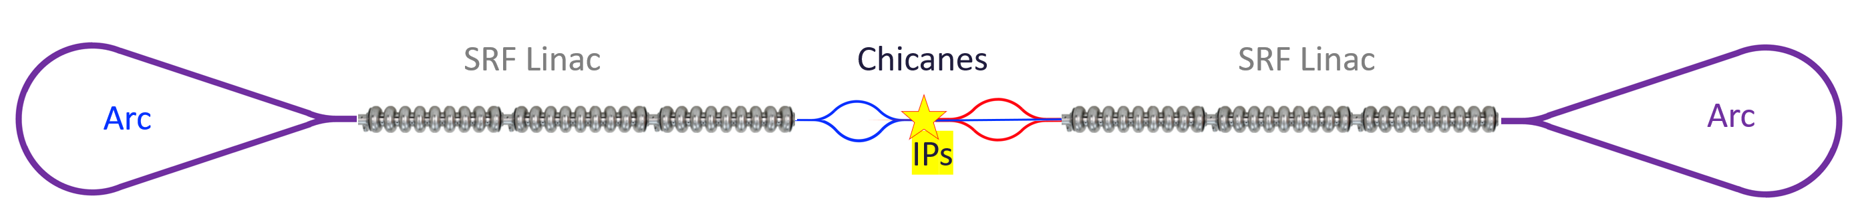
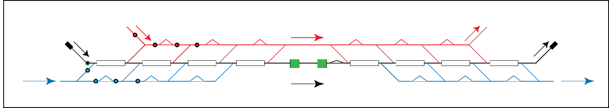


The Ghost Collider & Linear Ghost Collider
An Efficient Path to a High Luminosity Linear Collider
Peter Williams (STFC Daresbury Lab & Cockcroft Inst., U. Liverpool)
on behalf of the Ghost Collider consortium:
A. Hutton¹, P. Williams^{2,4}, R. Apsimon^{3,4}, B. R. Gamage¹, M. Joshi^{3,4}, K. Yokoya⁵
¹Jefferson Lab, 12000 Jefferson Ave., Newport News, VA, USA
²STFC, Accelerator Science and Technology Centre, Daresbury, UK
³Lancaster University, Lancaster, LA1 4YW, UK
⁴Cockcroft Institute, Daresbury Laboratory, Daresbury, UK
⁵KEK, Tsukuba, Japan
Peter.williams@stfc.ac.uk
Cavendish HEP Seminar, 30th June 2026

Slide 2

2026 Update of the European Strategy for Particle Physics
CERN Council resolution 22nd May 2026:
FCC-ee is the preferred option for the possible next flagship project at CERN.
CERN management invited to … develop a financially feasible funding plan … to ensure that Council is in a position by 2028 to take a decision on the FCC-ee.
My commentary:
This decision is envisioned as a "go / no-go" decision on FCC-ee, not a decision between different projects. To inform the decision-making process, several Member States have requested an "options analysis" based on documentation at a suitable level.
In this context, CERN management is considering LEP3 and a Linear Collider to be studied at the level required for the "options analysis".

Slide 3
Addressing the Drawbacks of FCC-ee Alternatives…
Excerpts from the European Strategy Group recommendations - Section 3:
Linear Collider Facility (LCF) … would offer competitive programmes in Higgs and top-quark physics. Compared to circular colliders, they have significantly lower luminosities at lower energies, leading to limited precision in electroweak physics and non-competitive flavour physics programmes … LCF would initially operate at 250 GeV and could be extended up to 550 GeV. The construction cost of the 550 GeV collider would be at the same level as that of the FCC-ee.
LEP3, an electron–positron collider operating at energies up to 230 GeV, would offer improvements in Higgs physics with respect to the HL-LHC, strong electroweak and flavour physics programmes, but no top-quark run.
Our work concentrates on significantly increasing LCF luminosity … without significant power consumption increase.
Notes:
LCF operational cost?

Slide 4
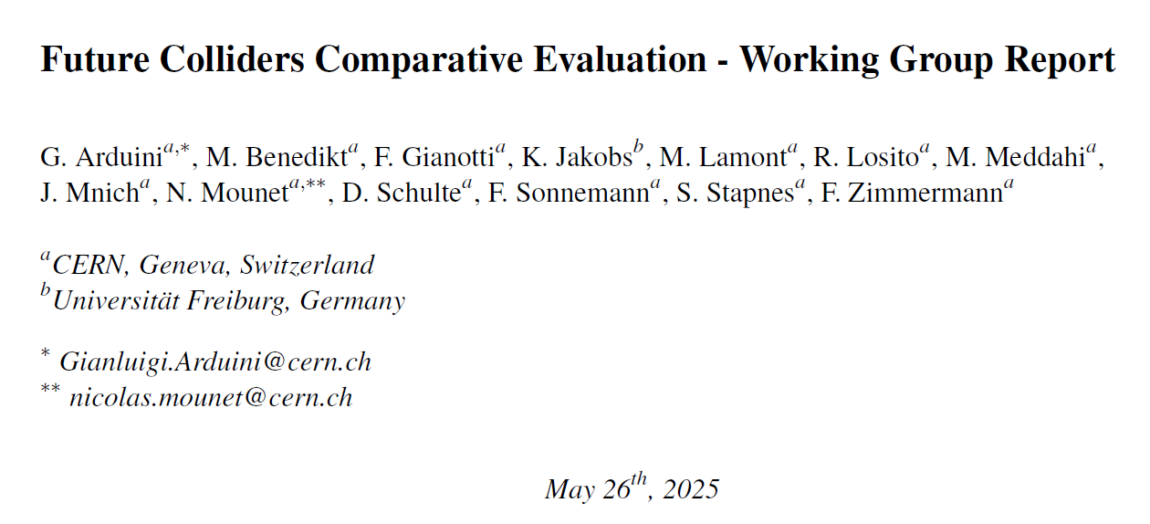
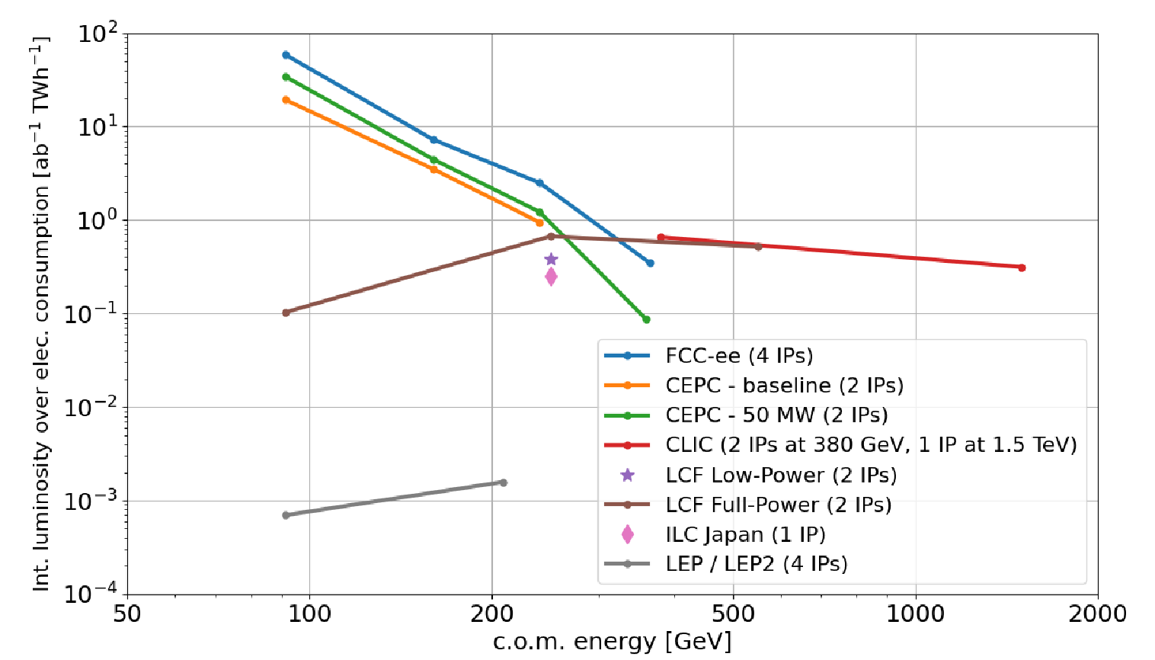
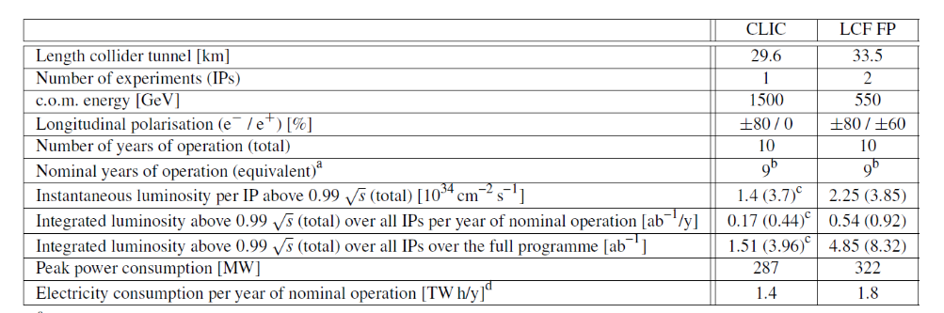
Addressing the Drawbacks of FCC-ee Alternatives…
Plot shows as a function of CoM energy the: “Integrated luminosity over all experiments per year of nominal operation, per unit of electricity consumption”
We choose to improve this point = LCF @ 550 GeV
Motivation from ESPP: “A particularly interesting prospect is to design and possibly build an energy efficient, ultra-high luminosity ERL-based electron-positron collider, which would enable the exploration of the Higgs vacuum potential with a precise measurement of the tri-linear Higgs coupling. The e+e- → ZH → HH production cross-section is maximal near 500 GeV collision energy with a value of about 0.1 fb. For percent-level measurements, a luminosity of 10³⁶ cm⁻²s⁻¹ is required.”

Slide 5
Why Energy Recovery Linacs?
Linear
Accelerator
Recirculating
Linac
Energy Recovery
Linac
Ring
Excellent beam quality
Beam disruption tolerant
High average beam current
Average beam current limited
Lower cost than linac
SR limit on energy reach dependent on topology
Beam quality limited
Beam disruption limited
Energy reach limited by SR
High average beam current
Beam start
Excellent beam quality
Beam disruption not limited
Energy reach not limited by SR
Average beam current limited
Beam end
Accelerating cavity

Slide 6
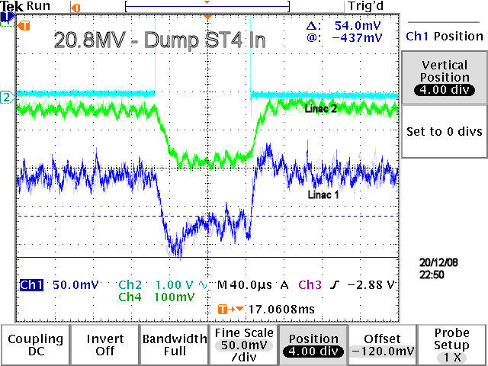
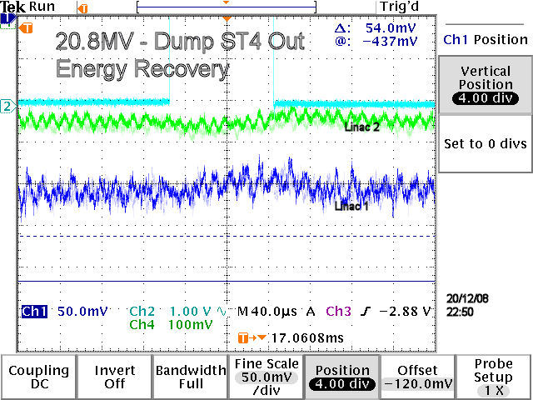
Why Energy Recovery Linacs?
accelerating
E_{z}(z)
decelerating

Slide 7
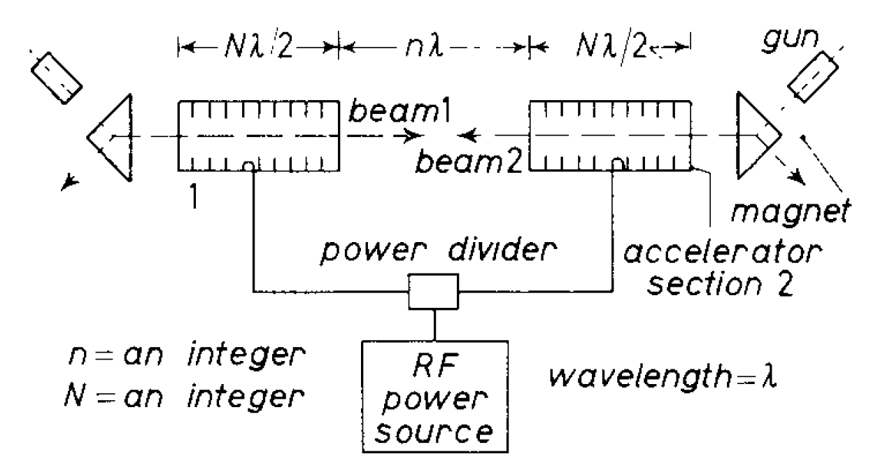
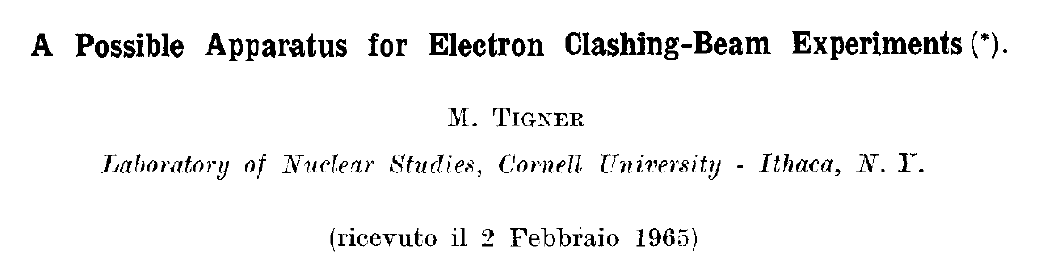
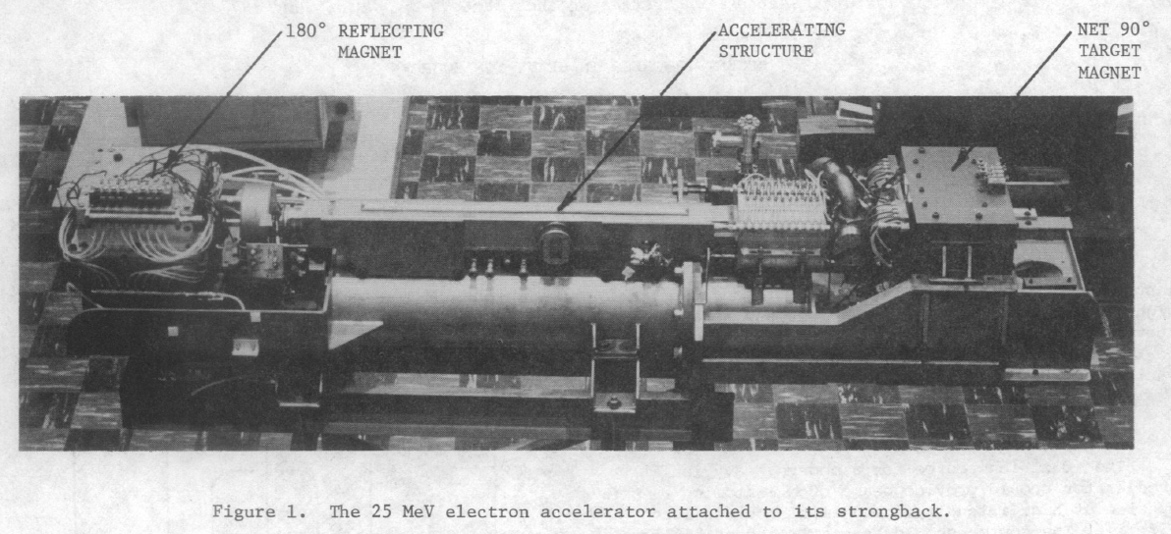
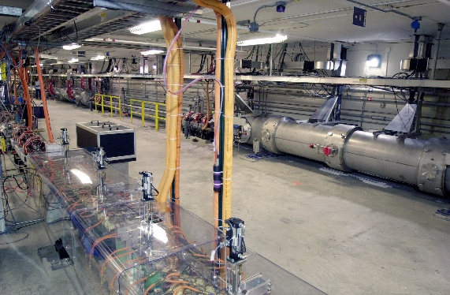
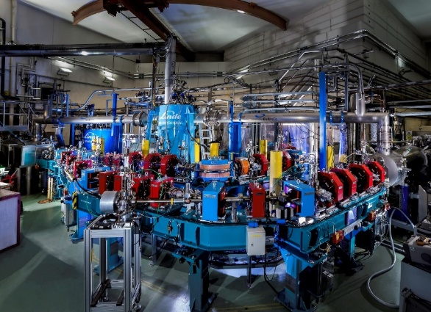
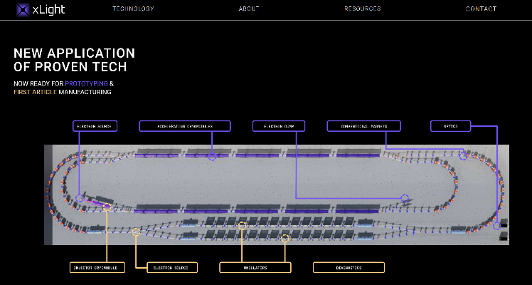
History of Operational ERLs
1965: Maury Tigner conceives ERLs as a possibility with Superconducting RF
1977: NC RF demonstration at AEC, Chalk River
1987: First demonstration of SRF-ERL at Stanford High Energy Physics Lab
1987: First use of an ERL – NC Los Alamos Free Electron Laser
1999: First CW SRF – Jefferson Lab IR Demo FEL
2000: First ERL in Asia – JAERI FEL
2003: 1 GeV SC-ERL demo at CEBAF
2003: NovoFEL NC ERL at Novosibirsk
2007: 9mA CW at 150 MeV demonstrated at Jlab IR Upgrade
2008: First ERL in Europe – ALICE at Daresbury Lab
2013: cERL at KEK
2018: CBETA at Cornell
2026: PERLE at IJCLab, Orsay
2028?: xLight at Albany Nanotech, NY? World’s first commercial ERL system – EUV Light source for semiconductor lithography https://www.xlight.com/

Slide 8
Energy Recovery Linacs for Linear Colliders
By using both particle and energy recycling, luminosities up to two orders of magnitude higher than LCF can be achieved without large penalty in facility power consumption, why?:
  Spent collided bunches are decelerated, power is returned to SC cavities for reuse = higher collision repetition rate, and elimination of MW-scale dumps.
  Spent collided and decelerated positrons re-damped = eliminate need for high intensity positron source.
Dominant power consumption becomes cryogenics – left shows a Sankey diagram for ERLs.
  Andrew Hutton, Energy-recovery linacs for energy-efficient particle acceleration. Nat Rev Phys 5, 708–716 (2023). https://doi.org/10.1038/s42254-023-00644-6
Original ERL proposal by Maury Tigner (1965) was a collider, further developed by Ugo Amaldi (1975), Gerke & Steffen (1979)… see Valery Telnov talk at LCWS 2025. https://agenda.linearcollider.org/event/10594/contributions/57325/attachments/40724/64941/telnov-ERLC-LCWS-2025.pdf
Modern ERLs (and people!) are mostly in fields other than colliders – chiefly Free-Electron Lasers, but also nuclear physics, Compton gamma sources, electron coolers …

Slide 9
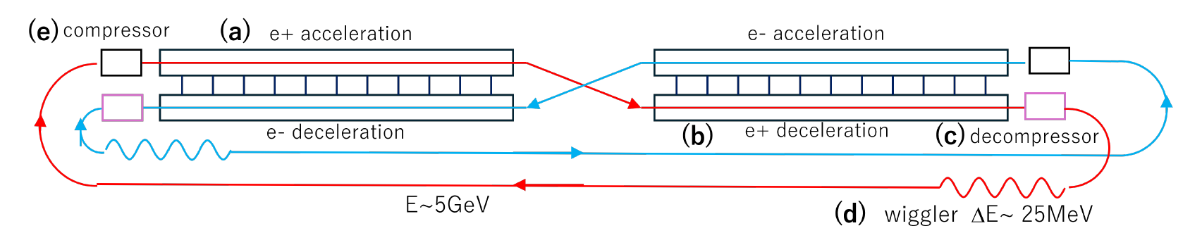
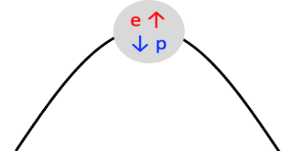
Initial Ghost Collider Idea Inspired by Telnov’s ERLC
In 2021, Valery Telnov (BINP) revisited the Gerck / Steffen scheme in the context of modern SRF. His concept (ERLC) utilises twin-axis linacs with RF coupling to separate the e+ and e- beams. Problem 1: Power consumption too high! Dominated by need to damp higher order modes generated in twin axis cavities due to the very high current needed. Problem 2: Need to develop new technology (twin-axis) … Context: TESLA SC cavities took 40 years to perfect.
ERL workshop 2022 – Erk Jensen (CERN) asks: Why not dispense with twin-axis by making an ERL where energy exchanged between e- and e+ occurs at the same RF phase? …
This would comprise an entirely new class of ERL, one where energy recovery occurs intra-bunch. Bunches in the linac would be comprised of equal numbers of e- and e+, creating electrically neutral bunches. We refer to these as “ghost bunches”.
At the same RF phase location, electrons are accelerated and positrons decelerated, or vice-versa

Slide 10
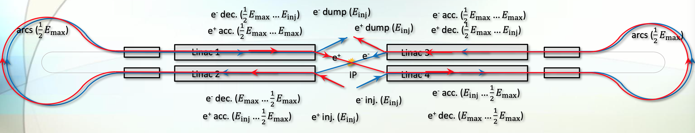
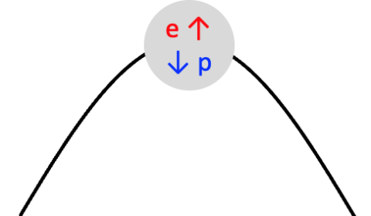
The Ghost Collider – Initial Idea
At the same RF phase location, electrons are accelerated and positrons decelerated, or vice-versa
But, but, but … Don’t they annihilate?! Yes they do – less than 10 in a bunch population of 10¹⁴ ☺… There is no time for more because they are always ultra-relativistic. If the electrons and positrons relativistically slipped fully through each other it would be much higher, but slippage is negligible, e.g. 1 micron in a 15 km linac for our parameters.
(Actually intra-beam scattering dominates over annihilation – but this is no different to regular bunches…)
But, but, but … Don’t the bunches explode?! Absolutely not – that is the space-charge force, which is relativistically suppressed by 1/γ³ and gamma is always in the 10,000’s at least.

Slide 11
The Ghost Collider – Concept 1: Intra-bunch Energy Recovery
We take spent electrons (positrons) from the IPs at 275 GeV and partner them with an injected bunch of positrons (electrons) at 5 GeV.
In the linacs, energy is transferred between electrons and positrons in the resulting composite ghost bunch, decelerating one type of particle and using the energy to accelerate the other – intra-bunch energy recovery – this implies within the linac, to first order … No electromagnetic wakes are generated = no higher-order modes are excited in the cavities.
Injection must occur at the centre (adjacent to, and directed away from, the IPs) in order for ghost bunches to be formed, this implies turn-around arcs at half collision energy (140 GeV) are necessary at both ends – a drawback!
Upon exiting the linac we split the now 275 GeV positrons (electrons) from the spent 5 GeV electrons (positrons). High energy bunches are sent to the IPs, low energy bunches extracted and sent to damping rings for re-use in a later collision cycle (which implies only a low intensity positron source needed).

Slide 12

The Ghost Collider – Concept 2: Ghost Bunch Collisions
We can do even better … to enable efficient energy recovery of spent bunches we must minimize the disruption caused to the bunches by the beam-beam force at the IPs.
In our collider, we choose that each ghost bunch with high energy electrons on right (positrons on left) is followed half an RF-cycle later by a ghost bunch with high energy positrons on right (electrons on left).
Between the linac and the IPs let us place half RF-cycle delay chicanes. Here the low energy ghost partners are separated and directed to damping rings, the high energy electrons (positrons) are delayed to become coincident with their following opposite charge, creating a second type of ghost bunch – where all particles have collision energy.
Collisions then occur between two counter-propagating neutral bunches – historically called beam-beam charge compensation, this implies at the IPs to first order …
  Beamsstrahlung does not occur = no need for a crossing angle.
  Bunches are not disrupted, multiple IPs may be arranged in SERIES, and particles energy recovered.
Only left-going particles in right linac shown.
Up arrows indicate accelerating, down decelerating.
e ↑
e ↑
p ↑
p ↓
e ↓
p ↑
p ↓
e ↓
Linac

Slide 13
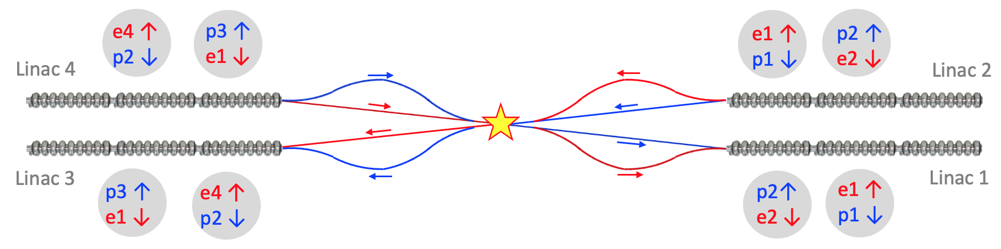
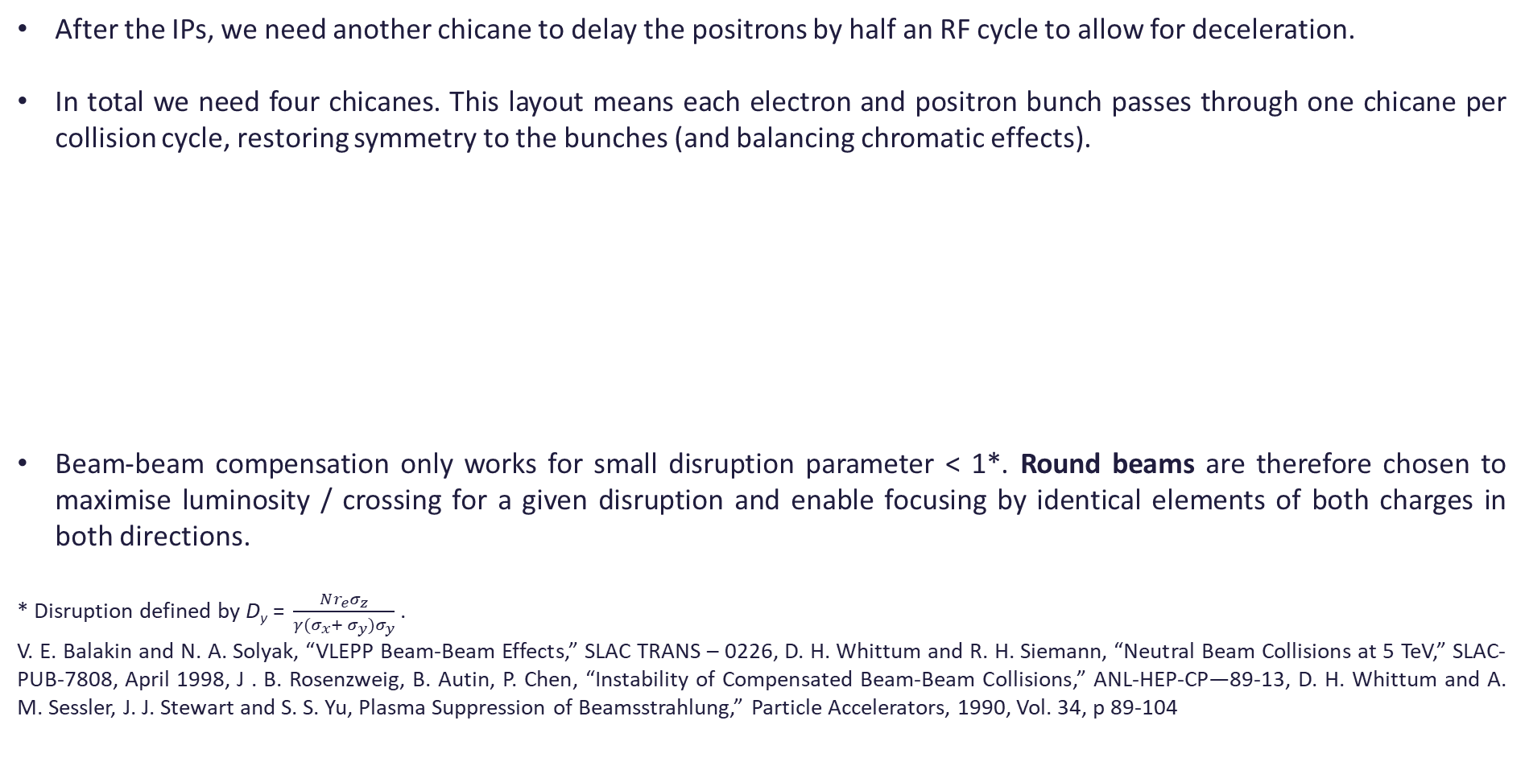
The Ghost Collider – Concept 2: Ghost Bunch Collisions
After the IPs, we need another chicane to delay the positrons by half an RF cycle to allow for deceleration.
In total we need four chicanes. This layout means each electron and positron bunch passes through one chicane per collision cycle, restoring symmetry to the bunches (and balancing chromatic effects).
Beam-beam compensation only works for small disruption parameter < 1*. Round beams are therefore chosen to maximise luminosity / crossing for a given disruption and enable focusing by identical elements of both charges in both directions.
* Disruption defined by $\text{D}\text{y}\text{ = }\frac{Nr_{e}σ_{z}}{γ(σ_{x}+ σ_{y})σ_{y}}$.
V. E. Balakin and N. A. Solyak, “VLEPP Beam-Beam Effects,” SLAC TRANS – 0226, D. H. Whittum and R. H. Siemann, “Neutral Beam Collisions at 5 TeV,” SLAC-PUB-7808, April 1998, J . B. Rosenzweig, B. Autin, P. Chen, “Instability of Compensated Beam-Beam Collisions,” ANL-HEP-CP—89-13, D. H. Whittum and A. M. Sessler, J. J. Stewart and S. S. Yu, Plasma Suppression of Beamsstrahlung,” Particle Accelerators, 1990, Vol. 34, p 89-104

Slide 14

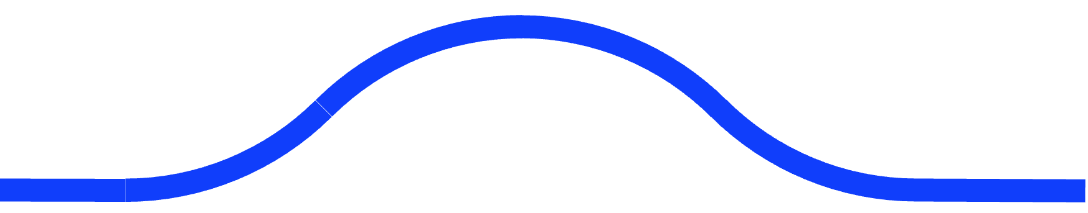

The Ghost Collider – Concept 3: Single Linac / Counter-propagation of Ghosts
SRF Linac
Chicanes
SRF Linac
Arc
Arc
IPs
We can do even, even better … ghost bunches have much reduced electromagnetic interaction compared to their bare constituents … implying they may “pass straight through” counter-propagating ghost bunches! This allows for a major simplification: single, bi-directional linacs on each side of the IPs.
There will be head-on ghost collisions within the linacs, but we choose the beam sizes to be large: the hard interaction luminosity will be negligible, and the electromagnetic disruption parameter will be small.
Electrons and positrons now accelerated AND decelerated in both directions in both linacs. Further implies each linac would only need to be half the length of LCF linac.
Caveat: Counter-propagating ghost bunches have, to first order, no quadrupolar beam-beam focusing. A second order dipolar charge separation instability exists, which is currently under study.

Slide 15
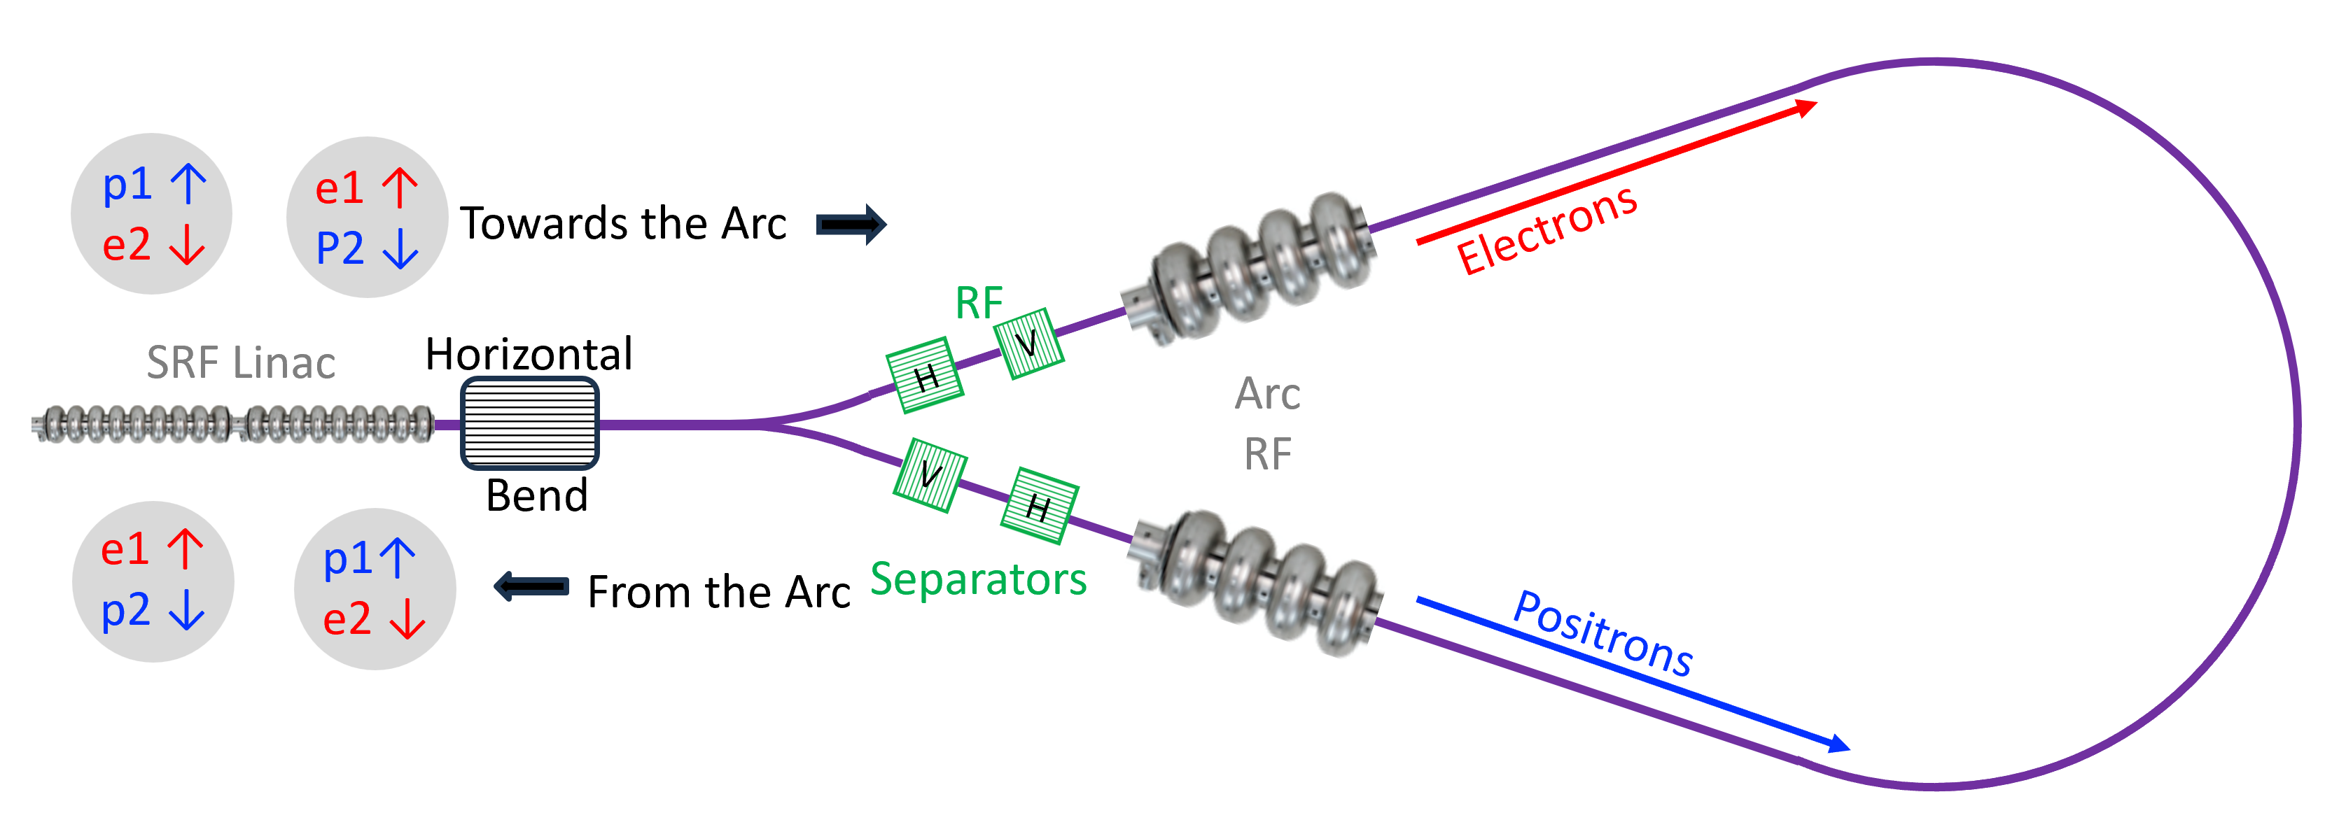
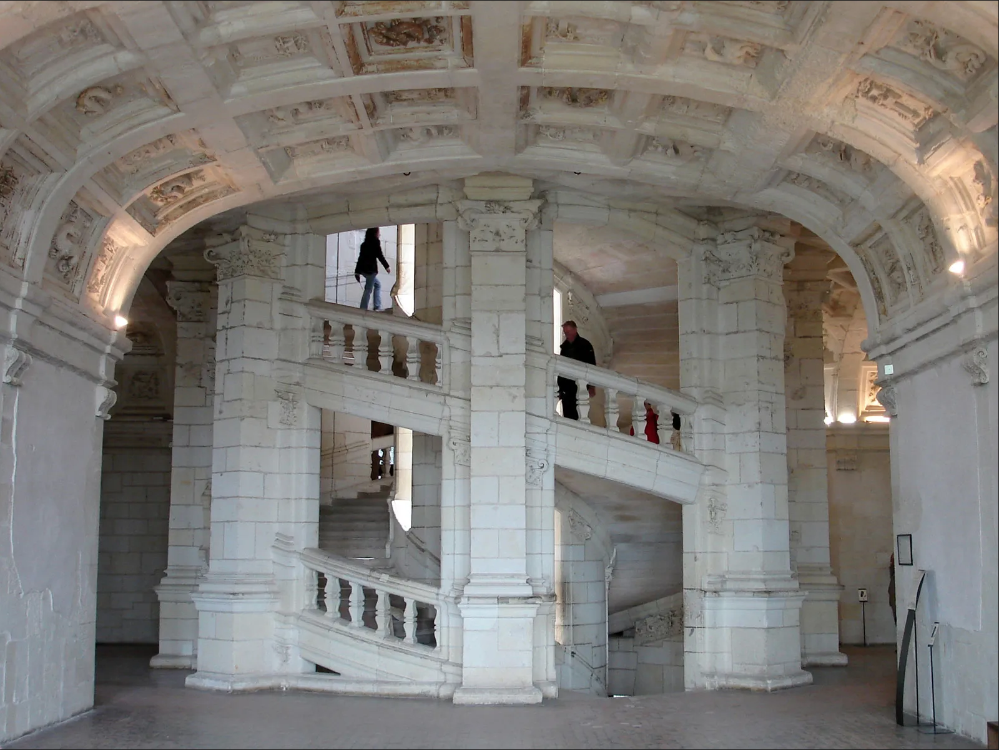
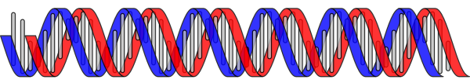
The Ghost Collider – Dealing with Separation & Arcs
Ghost bunches cannot exist in arcs! Furthermore, we can choose to transport counter-rotating electrons and positrons within a single arc vacuum chamber.
They are separated on exit of the linacs with a dipole, then RF separators used to establish helical trajectories through the arcs, allowing counter-propagating bunches to avoid each other.
This is actually one of the least novel aspects of GC. The Tevatron operated in this way for many years.
Electron and positron trajectories follow paths akin to strands of DNA, or the famous double staircase at the Chateau de Chambord in France, designed by Leonardo da Vinci

Slide 16
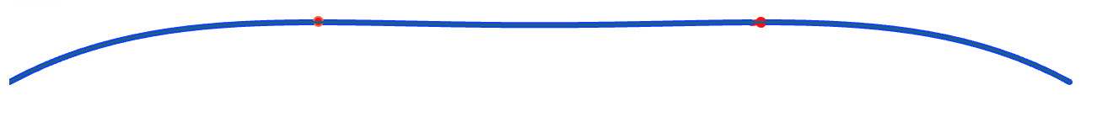
The Ghost Collider – Dealing with Separation & Arcs
Arcs are large – LEP-sized assumed. Nevertheless, synchrotron radiation is our sworn enemy for two reasons:
  P_{SR} ∝ E⁴ / ρ² and this power loss must be replaced. Even though we have half-energy arcs, so the loss is 1/16th of a full energy arc, this dominates the GC power consumption. SR loss per arc is 8.2 GeV.
  Δε_{SR} ∝ E⁵ / ρ² and this increase in the emittance limits luminosity at IPs, and more importantly, must be damped before re-injection. The time lost doing this reduces luminosity again just by waiting. Emittance increases from 6 to 12 mm-mrad per arc.
Low frequency RF is required to replace SR lost in arcs for all bunches, because opposite pairs are half an RF cycle behind. This costs more: we actually need to provide 11 GV / arc, to replace the 8.2 GeV lost.
Proposed solution: RF system at 325 MHz plus a second harmonic RF system at 650 MHz, 180° out of phase.

Slide 17
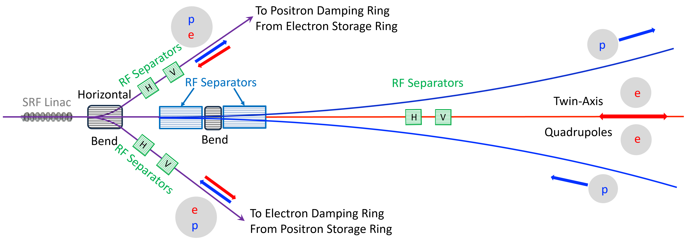
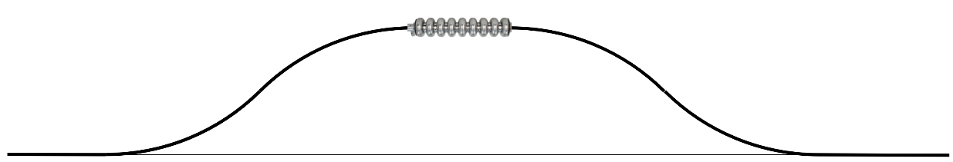
The Ghost Collider – Full Energy Delay Chicanes
To interface a linac to a delay chicane we must separate all 8 beams. Achieved with Wien-filter like system combining RF separators and dipoles.
To maintain identical collision energies at IPs we should replace SR lost in chicane, but low frequency RF not needed here as bunches have been split. For 12 km bend radius, we have a 1.4 km chicane with an SR loss of 1 GeV.
But: we could choose to not replace some of this loss. Why? Remember we have all of e+e-, e+e+ and e-e- collisions:
  Question (Graham Wilson, U. Kansas): How do we poor detector physicists determine the initial state???
  Answer (Vladimir Litvinenko, BNL, and ourselves): Choose the relative ordering of the bunches of left vs right linacs with appropriate path length between them. Do not fully compensate for SR loss in chicane. Remember only one partner sees a chicane before IPs. Then either unlike-charge collisions are in the CM frame and like-charge collisions are Lorentz boosted in the direction of the bunch that did not yet traverse a chicane, or vice-versa ☺.
Again, use helical trajectories within the chicanes to avoid counter-propagating bunch collisions.

Slide 18
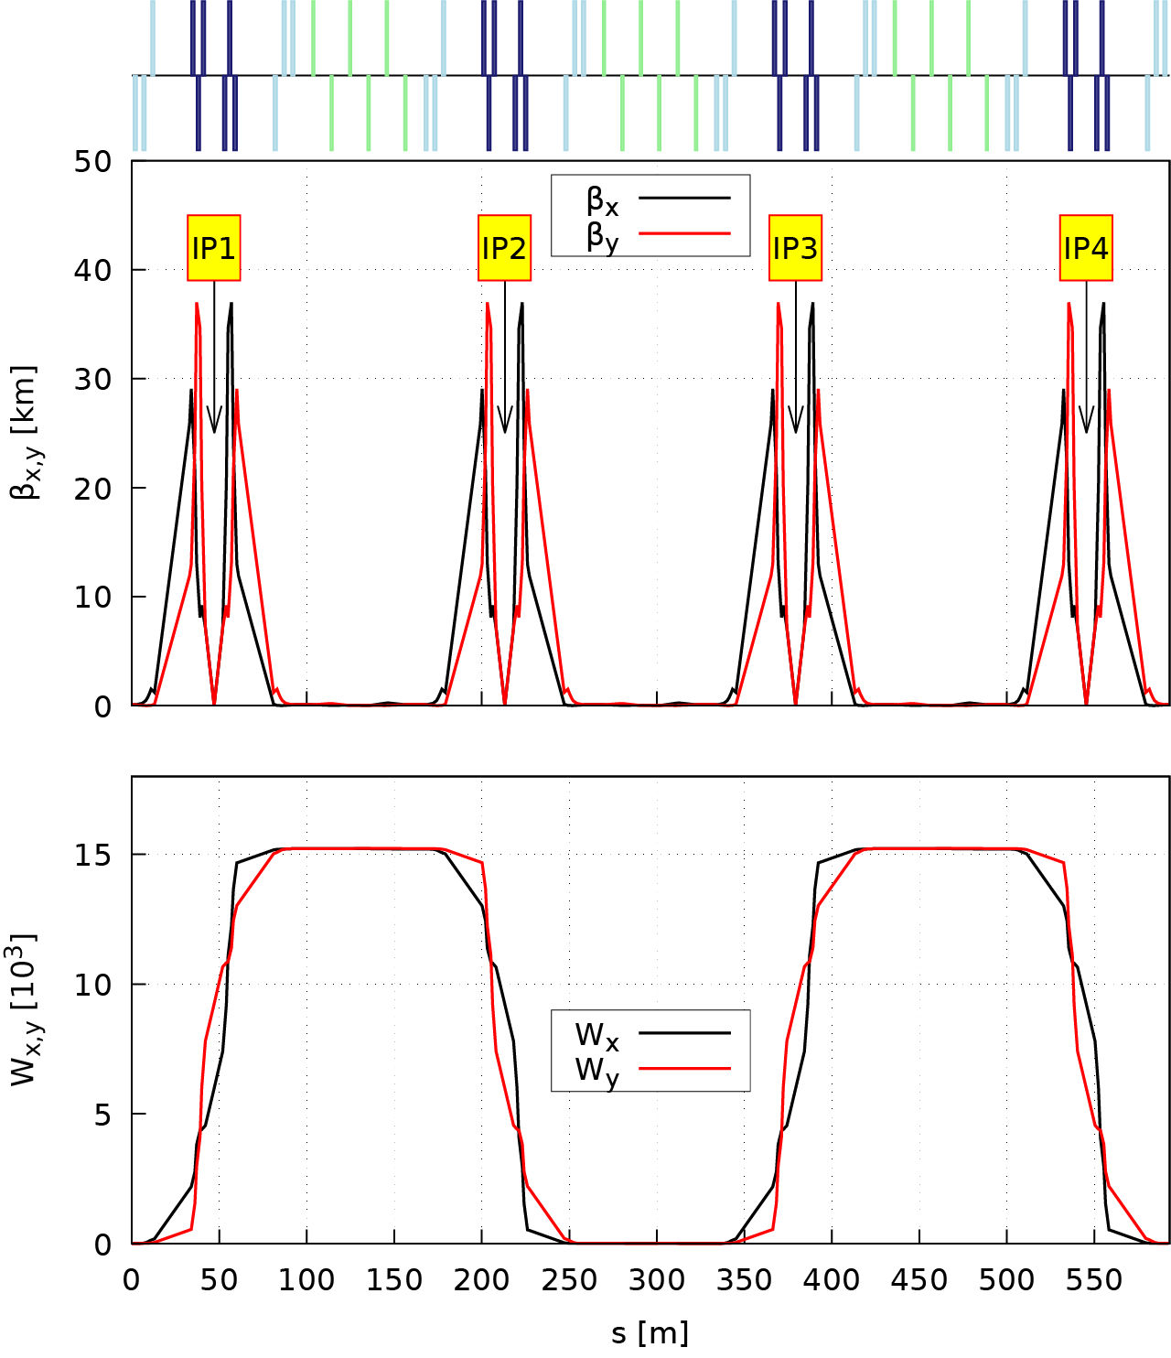
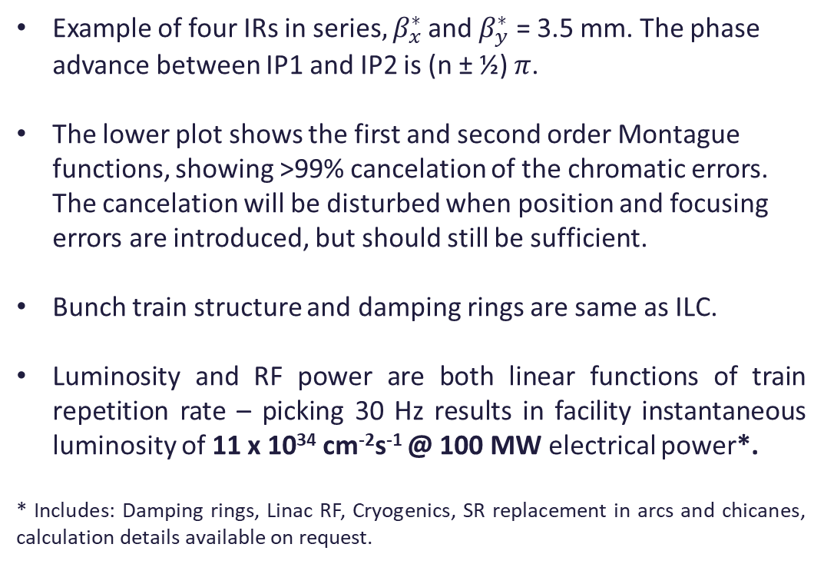
The Ghost Collider – Concept 4: Four IP’s in Series
SRF Linac
Chicanes
SRF Linac
Arc
Arc
IPs
Example of four IRs in series$, β_{x}^{∗}$ and $β_{y}^{∗}$ = 3.5 mm. The phase advance between IP1 and IP2 is (n ± ½) $π$.
The lower plot shows the first and second order Montague functions, showing >99% cancelation of the chromatic errors. The cancelation will be disturbed when position and focusing errors are introduced, but should still be sufficient.
Bunch train structure and damping rings are same as ILC.
Luminosity and RF power are both linear functions of train repetition rate – picking 30 Hz results in facility instantaneous luminosity of 11 x 10³⁴ cm⁻²s⁻¹ @ 100 MW electrical power*.
* Includes: Damping rings, Linac RF, Cryogenics, SR replacement in arcs and chicanes, calculation details available on request.

Slide 19
Can The Ghost Collider Proposal Be Improved?
SRF Linac
Chicanes
SRF Linac
Arc
Arc
IPs
The facility instantaneous luminosity is 11 x 10³⁴ cm⁻²s⁻¹ @ 100 MW electrical power, short of our goal by an order of magnitude ☹
There are two primary limitations leading to this luminosity per unit power:
  Replacing the power lost to synchrotron radiation in the turn-around arcs.
  The time required to damp the bunches after collision: this is required due to the degradation caused by synchrotron radiation in the turn-around arcs.
  … it also better enables consideration as upgrade of a pre-built LCF, which has no arcs. Really this is just restating the usual case for linear vs circular machines – to abolish SR!
Suggests abolishing the turn-around arcs!

Slide 20
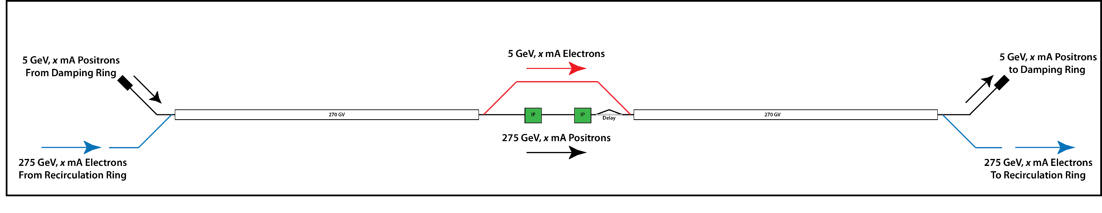
Removing the Arcs from the Ghost Collider ⇒ The “Linear Ghost Collider”
Instead of both charge companions in a ghost bunch undergoing collision, split their purposes: each ghost bunch comprises colliding particles of one charge, partnered with drive particles of the other.
Colliding companions progress straight-through this ghost collider, never experiencing a turn-around arc, so energy is not lost and emittance / energy spread not degraded.
Build this up step-by-step (only 2 IPs shown for brevity)…
Start by “unfolding” the original GC, and for right-going particles, take the decelerated drive companion from the left linac, bypass the IPs, then use it to decelerate the colliding companion by re-accelerating it.

Slide 21
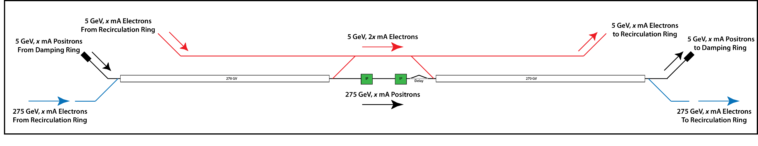
Removing the Arcs from the Ghost Collider ⇒ The “Linear Ghost Collider”
Instead of both charge companions in a ghost bunch undergoing collision, split their purposes: each ghost bunch comprises colliding particles of one charge, partnered with drive particles of the other.
Colliding companions progress straight-through this ghost collider, never experiencing a turn-around arc, so energy is not lost and emittance / energy spread not degraded.
Build this up step-by-step…
Now instead of using the decelerated drive companion of that acceleration cycle, use instead one from a previous cycle that we have stored somewhere. This allows us to de-couple the timing of left linac vs right linac drive bunches…

Slide 22
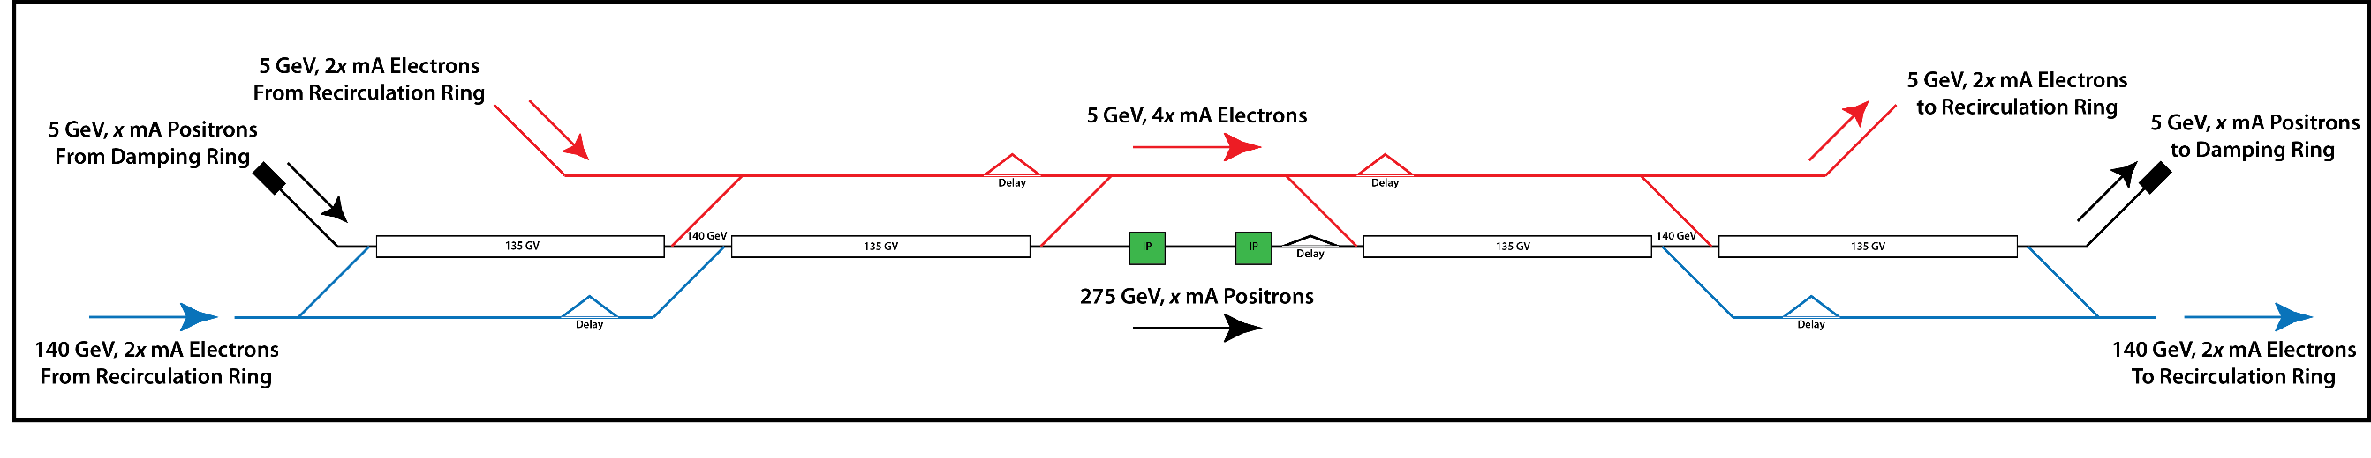
Removing the Arcs from the Ghost Collider ⇒ The “Linear Ghost Collider”
Instead of both charge companions in a ghost bunch undergoing collision, split their purposes: each ghost bunch comprises colliding particles of one charge, partnered with drive particles of the other.
Colliding companions progress straight-through this ghost collider, never experiencing a turn-around arc, so energy is not lost and emittance / energy spread not degraded.
Build this up step-by-step…
Because the companions need only have matching velocities, not energies, it is only necessary to accelerate one companion to full energy. Therefore, split the linac into n stages and ensure the drive companion for each stage only attains a top energy of collision energy divided by n. Below we show 2 stages, note the drive beam is now only 140 GeV, and its current has doubled.

Slide 23
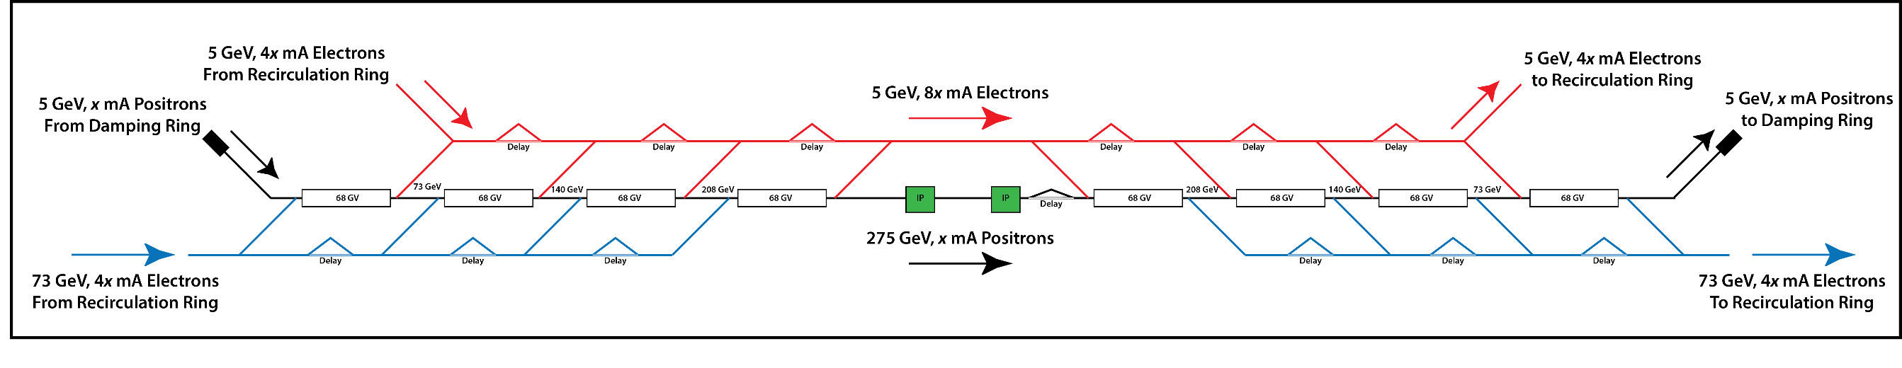
Removing the Arcs from the Ghost Collider ⇒ The “Linear Ghost Collider”
Instead of both charge companions in a ghost bunch undergoing collision, split their purposes: each ghost bunch comprises colliding particles of one charge, partnered with drive particles of the other.
Colliding companions progress straight-through this ghost collider, never experiencing a turn-around arc, so energy is not lost and emittance / energy spread not degraded.
Because the companions need only have matching velocities, not energies, it is only necessary to accelerate one companion to full energy. Therefore, split the linac into n stages and ensure the drive companion for each stage only attain a top energy of collision energy divided by n.
Drive companions must be recirculated in arc(s), but as SR power goes as E⁴ and emittance degradation as E⁵ , the power loss and degradation rapidly becomes negligible as we increase n. Now we show n = 4, with 73 GeV drive.

Slide 24
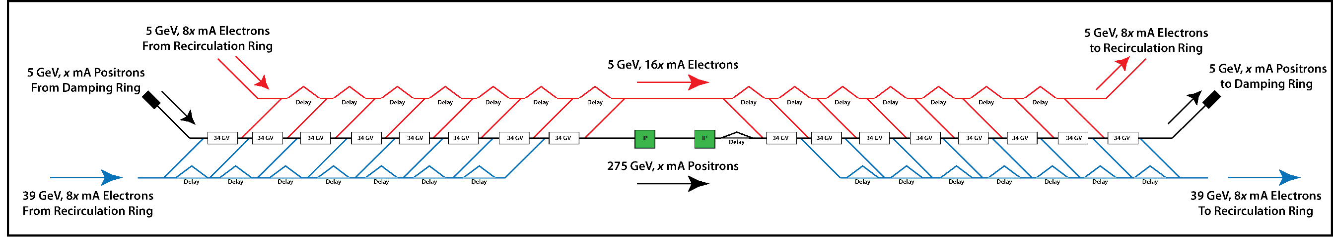
Linear Ghost Collider – “Just” a Transformer!
Now we show n = 8, implying drive beam of only 39 GeV …
We observe that the Linear Ghost Collider is really just a 34km long current transformer!
… instead of the transformer medium being magnetic flux linkage through a ferromagnetic core, it is intra-bunch energy recovery within superconducting RF cavities. ☺

Slide 25
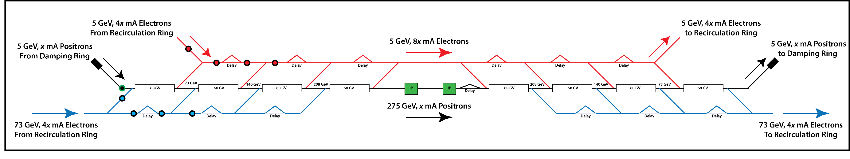
Example Linear Ghost Collider With 4 Stages
Colliding particles (only right-going positrons shown here, there are still both left-going positrons and left and right-going electrons – i.e. three more drawings like this) accelerated from 5 to 275 GeV, go through multiple IPs, then decelerated from 275 to 5 GeV.
Drive particles are accelerated by a decelerating collided bunch after the IPs. Each from 5 to 73 GeV only (= 5 + 275 / 4 ). These drive bunches are shown in red as they start at 5 GeV. The 4 sets of now 73 GeV particles are then recirculated in an arc off to the right and return to the linac propagating left-going. In blue at 73 GeV initially are drive bunches previously accelerated by a left-going colliding bunch, then recirculated in an arc off to the left so they are now right-going. These are decelerated in 4 stages to 5 GeV, by doing so accelerating the colliding particles. And so on.
Disadvantage: We are back to the original LCF linac length as we “unfolded” the original Ghost Collider.

Slide 26
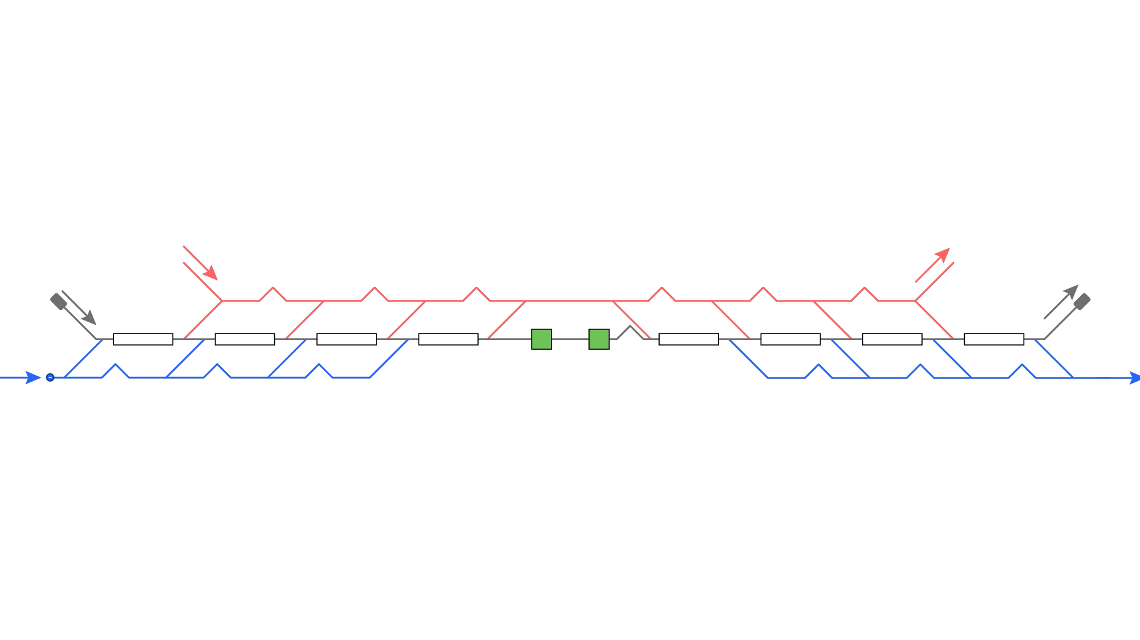
LGC Timing – Animation of Right-Going Colliding Positrons
Showing the 4-stage example to illustrate.
Colliding bunch in black with green outline (remember only right-going positrons shown here).
Drive bunch timing: Every drive bunch initially is ahead of the colliding bunch and is progressively delayed to be coincident, so we need 2n drive bunches in one accelerate-collide-decelerate cycle, but over n mod 2 cycles we only need n bunches (each set of n either only decelerates or accelerates in each cycle, not both).
e-
e+
e-

Slide 27
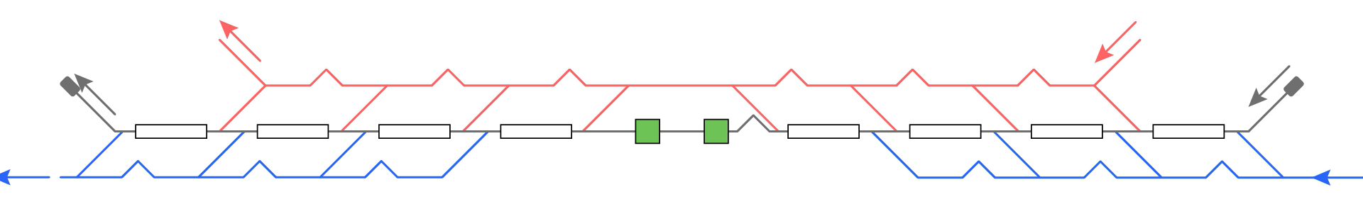
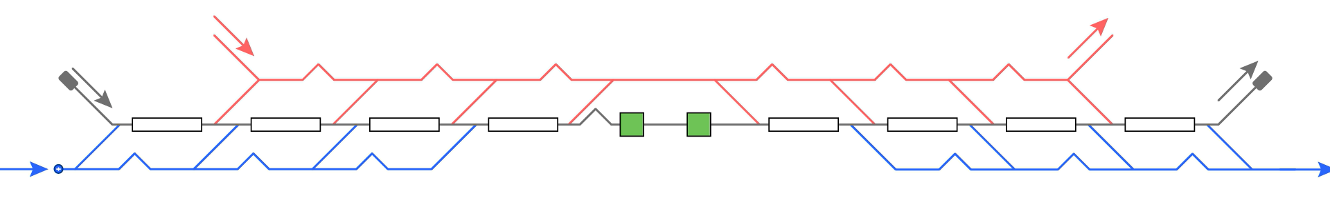
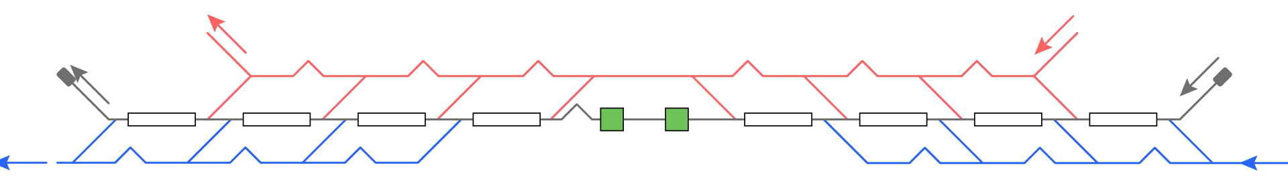
LGC Timing – Animation of All Particles
e-
e+
e-
e-
e+
e+
e-
e-
e+
e+
e-
e+

Slide 28
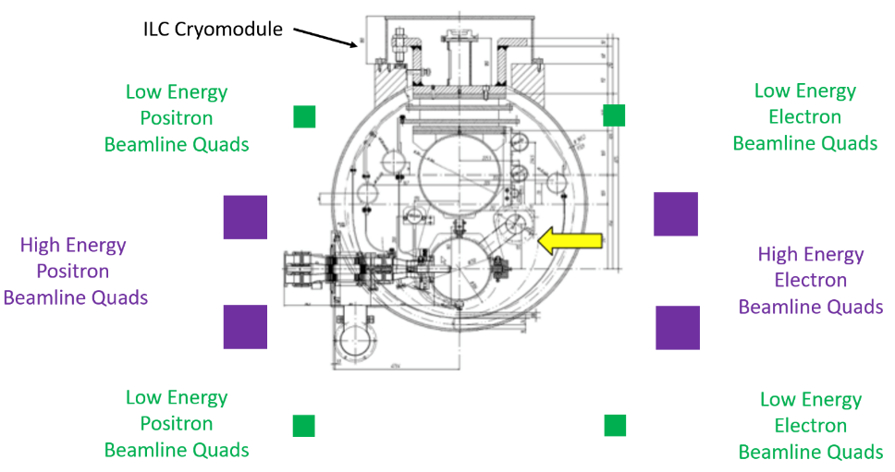
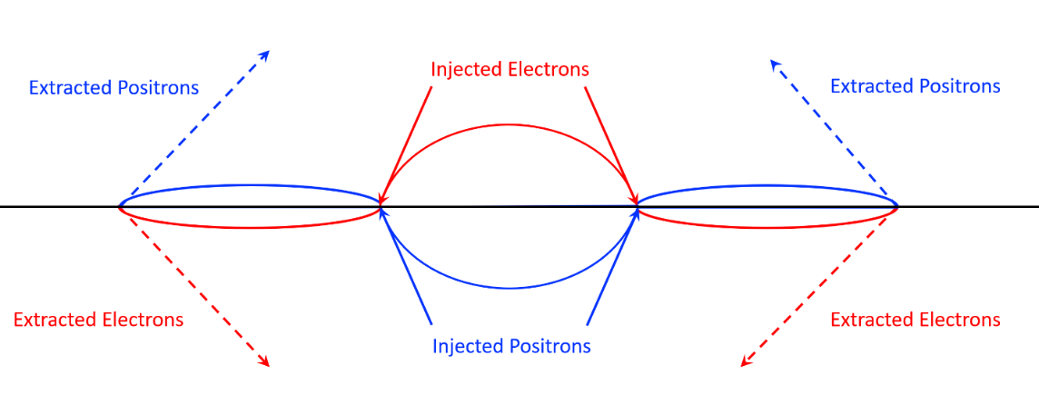
LGC – Octagonal Bypass Layout & 3-Bump Changeover Zones
The high energy (E_{drive} in blue on animations) and low energy (5 GeV in red on animations) bypass lines must avoid cryomodule support structure and RF input waveguides yet fit in the 7.5 m diameter tunnel.
Cheapest option: rotate the injection / extraction lines by ±45° wrt horizontal, provides for 4 axes for the 8 beams … Difficult – put off for now. Easiest option: rotate beamlines by ±15°, ±45°, provides 8 separate axes for the 8 beams. Positrons on the left, electrons on the right, high-energy beamlines at ±15°, low-energy beam lines at ±45°.
Injection / extraction lines in vertical plane.
High-energy drive bunches bent up or down less, so locate closer to linac axis, low-energy are bent up or down more so are further from the linac axis.
Then bent left or right to the correct charge bypass beamline.
Transverse view of bypass lines and linac.
Changeover zones comprise three closed orbit bumps.
Outer bumps are weak to extract 5 GeV beams.
Central bump strong to inject at E_{drive}.
Longitudinal view of changeover zone between linac sections.

Slide 29
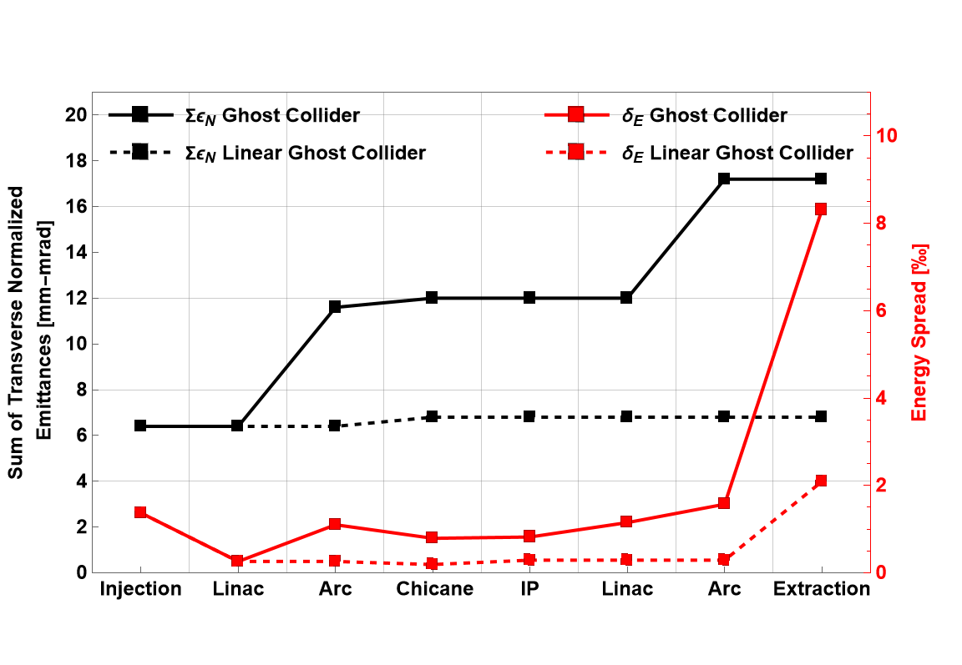
LGC Degrades Beams Less Than GC
Advantage: Emittance & energy spread degradation is less before collision ⇒ higher luminosity per bunch crossing.
Advantage: Emittance & energy spread degradation is less after collision ⇒ less damping required (1.3 ms rather than 8.0 ms) ⇒ higher bunch repetition rate possible ⇒ higher instantaneous luminosity.

Slide 30
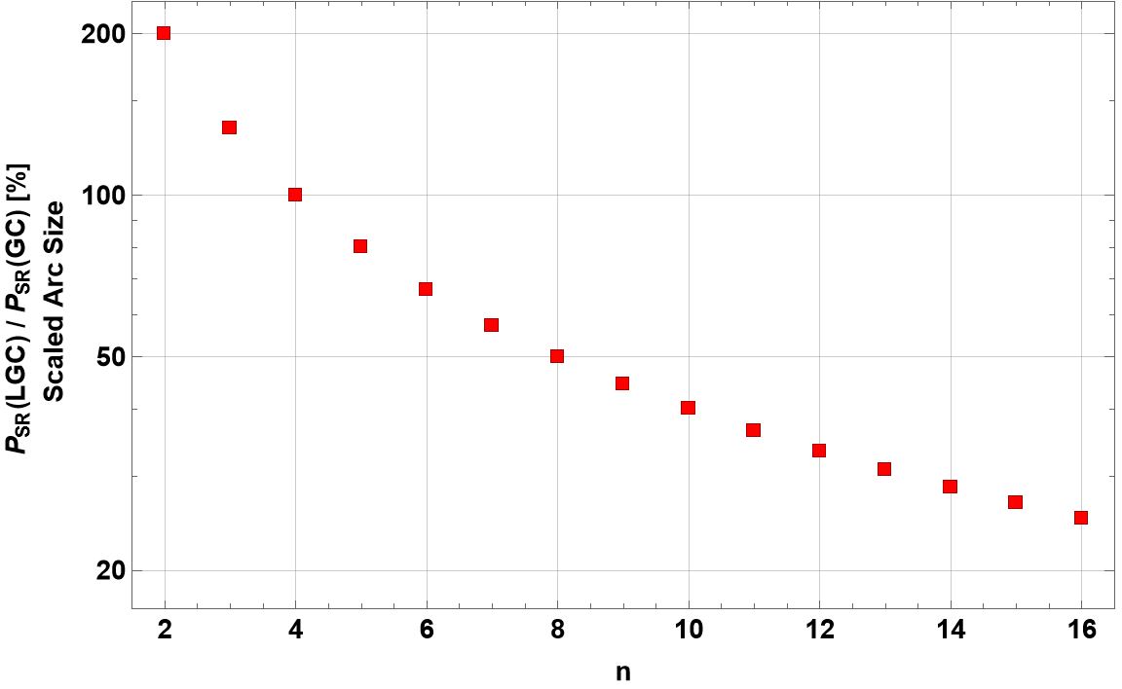
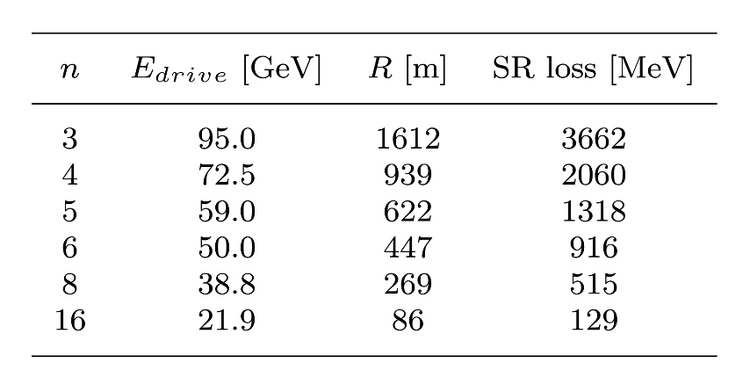
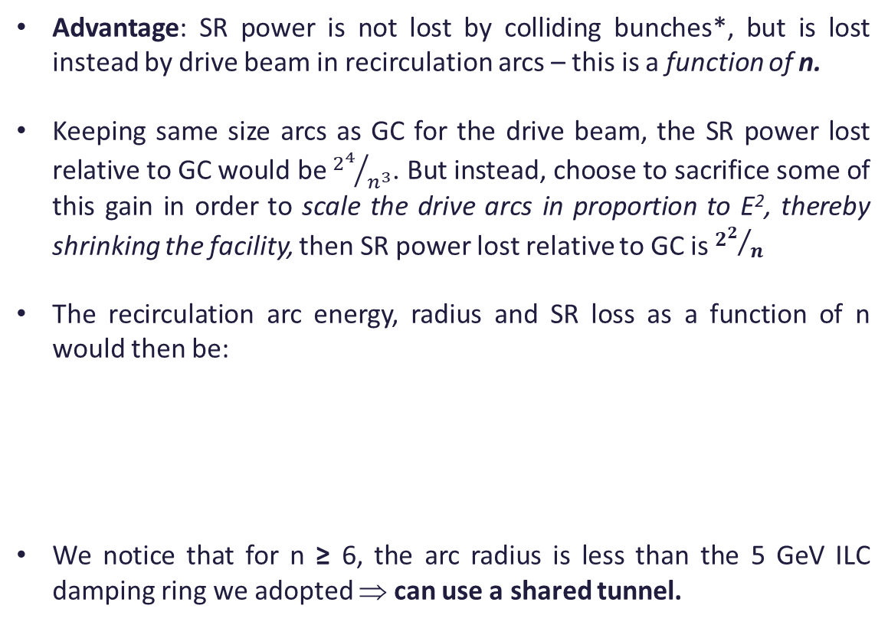
LGC Uses Less RF Power Than GC: How Much Less?
Advantage: SR power is not lost by colliding bunches*, but is lost instead by drive beam in recirculation arcs – this is a function of n.
Keeping same size arcs as GC for the drive beam, the SR power lost relative to GC would be ${2^{4}}/{n^{3}}$. But instead, choose to sacrifice some of this gain in order to scale the drive arcs in proportion to E², thereby shrinking the facility, then SR power lost relative to GC is ${2^{2}}/n$
The recirculation arc energy, radius and SR loss as a function of n would then be:
We notice that for n ≥ 6, the arc radius is less than the 5 GeV ILC damping ring we adopted ⇒ can use a shared tunnel.
Choose 5 GeV ILC damping rings with R = 515 m ⇒ n ≥ 6
* Apart from the full energy delay chicane – it’s a relatively small contribution for pulsed RF, becomes power limitation for CW

Slide 31
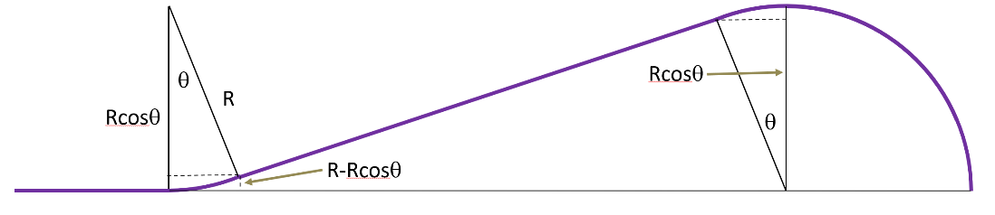
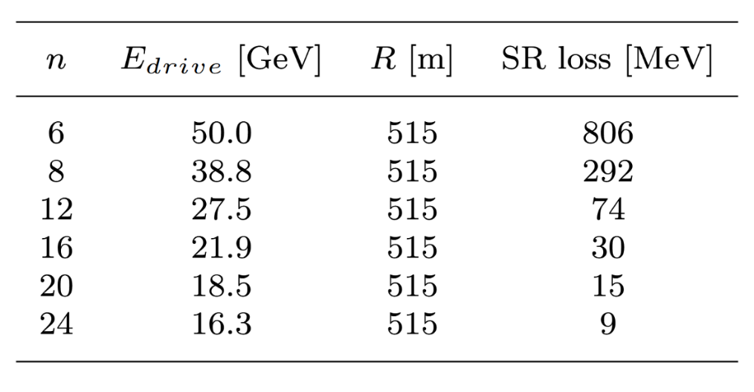
LGC - Share Damping Rings Tunnels With Recirculation Arcs
If we choose n > 6, but use a tunnel shared with the damping rings, we regain the E⁴ dependence and lose even less power to SR.
For drive beam recirculation adopt original GC improved geometry arc shown with θ = 22.5°. In GC at 140 GeV this had SR loss / turn = 8.24 GeV, but it was then necessary to replace energy loss with lower frequency RF, leading to voltage of 11 GV required. LGC does not need this so SR loss is just ¾ of a full arc:
Power consumption and luminosity are estimated both for pulsed operation with ILC / XFEL cavities cooled to 2K, and for CW operation with projected parameters for thin-film Nb3Sn-on-Cu cooled to 4K …
5 GeV colliding bunches
5 GeV drive bunches
E_{drive} drive bunches
515 m

Slide 32
Pulsed Facility Proposal Comparison
 | LCF Baseline | TWLC | CLIC | C3 s.u. | GC | LGC (n = 8)
CoM [GeV] | 550 | 550 | 550 | 550 | 550 | 550
# IPs | 2 | 2 | 2 | 2 | 4 | 4
Gradient [MeV / m] | 31.5 | 60 | 72 | 120 | 31.5 | 31.5
Total machine length [km] | 34 | 21 | 15 | 8 | 22 | 35
Cavity Q₀ [10¹⁰] | 2.0 | 1.4 | NC | NC | 2.7 | 2.7
Bunch population [10¹⁰] | 2.0 | 2.0 | 0.52 | 0.63 | 2.0 + 2.0 | 2.0 + 2.0
Bunches / train | 1312 | 1312 | 352 | 150 | 1312 | 1312
Macropulse rep rate [Hz] | 10 | 10 | 100 | 60 | 30 | 140
Bunch spacing [ns] | 554 | 554 | 0.5 | 1.65 | 554 | 277
ε_{N x / y} [mm-mrad] | 5 / 0.035 | 5 / 0.035 | 2.2 / 0.006 | 0.9 / 0.020 | 6.5 / 6.5 | 3.75 / 3.75
β*_{x / y} [mm] | 13 / 0.41 | 13 / 0.41 | 8.0 / 0.1 | 12 / 0.12 | 2 / 2 | 2 / 2
Sigma [nm] | 348 / 5.2 | 348 / 5.2 | 124 / 1.7 | 142 / 6.7 | 155 / 155 | 118 / 118
D_{y} | 34.5 | 34.5 | 12.5 | 6.6 | 1.30 | 2.25
Facility Lumi [10³⁴ cm⁻²s⁻¹] | 3.9 | 3.9 | 6.5 | 2.5 | 11.2* | 34.6*
Power [MW] | 250 | 225 | 210 | 125 | 100 | 100
LCF, TWLC, CLIC & C3 numbers taken where possible from “A linear collider vision for the future of particle physics” Eur. Phys. J. Spec. Top. 235, 1641–1796 (2026) https://doi.org/10.1140/epjs/s11734-026-02153-w
* Indicates luminosity for sum of e+e-, e-e- and e+e+.
GC and LGC propose existing 1.3 GHz structures with proven parameters. Why so much more lumi / power in GC / LGC? Higher pulse rep rate because no power penalty in linac RF = ERL, more IPs, more particles, very little SR.

Slide 33
CW Facility Proposal Comparison
 | ReLiC | ERLC | LGC (n = 16)
CoM [GeV] | 550 | 500 | 550
Gradient [MeV / m] | 27.6 | 40 | 31.5
Cavity Q_0 | 4.0 | 3.0 | 5.4
Bunch population [10¹⁰] | 2.5 | 0.081 | 2.0 + 2.0
Collision frequency [MHz] | 1.5 | 1300 | 1.45
Linac beam current [mA] | 12 | 169 | 9.3
ε_{N x / y} [mm-mrad] | 4 / 0.001 | 10 / 0.035 | 5.7 / 5.7
β*_{x / y} [mm] | 4000 / 0.36 | 40 / 0.89 | 2 / 2
Sigma [nm] | 6000 / 0.9 | 900 / 7.4 | 146 / 146
D_{y} | 88 | 1.14 | 1.48
Facility Lumi [10³⁴ cm⁻²s⁻¹] | 153 | 102 | 348*
Power [MW] | 250 | 250 | 160
ReLiC & ERLC numbers taken where possible from “A linear collider vision for the future of particle physics” Eur. Phys. J. Spec. Top. 235, 1641–1796 (2026) https://doi.org/10.1140/epjs/s11734-026-02153-w
* Indicates luminosity for sum of e+e-, e-e- and e+e+
All assume Nb3Sn thin-film SRF. LGC & ReLiC do not require twin axis cavities
Why so much more lumi / power for LGC? …No HOMs, no drive beam power, little SR, little damping

Slide 34
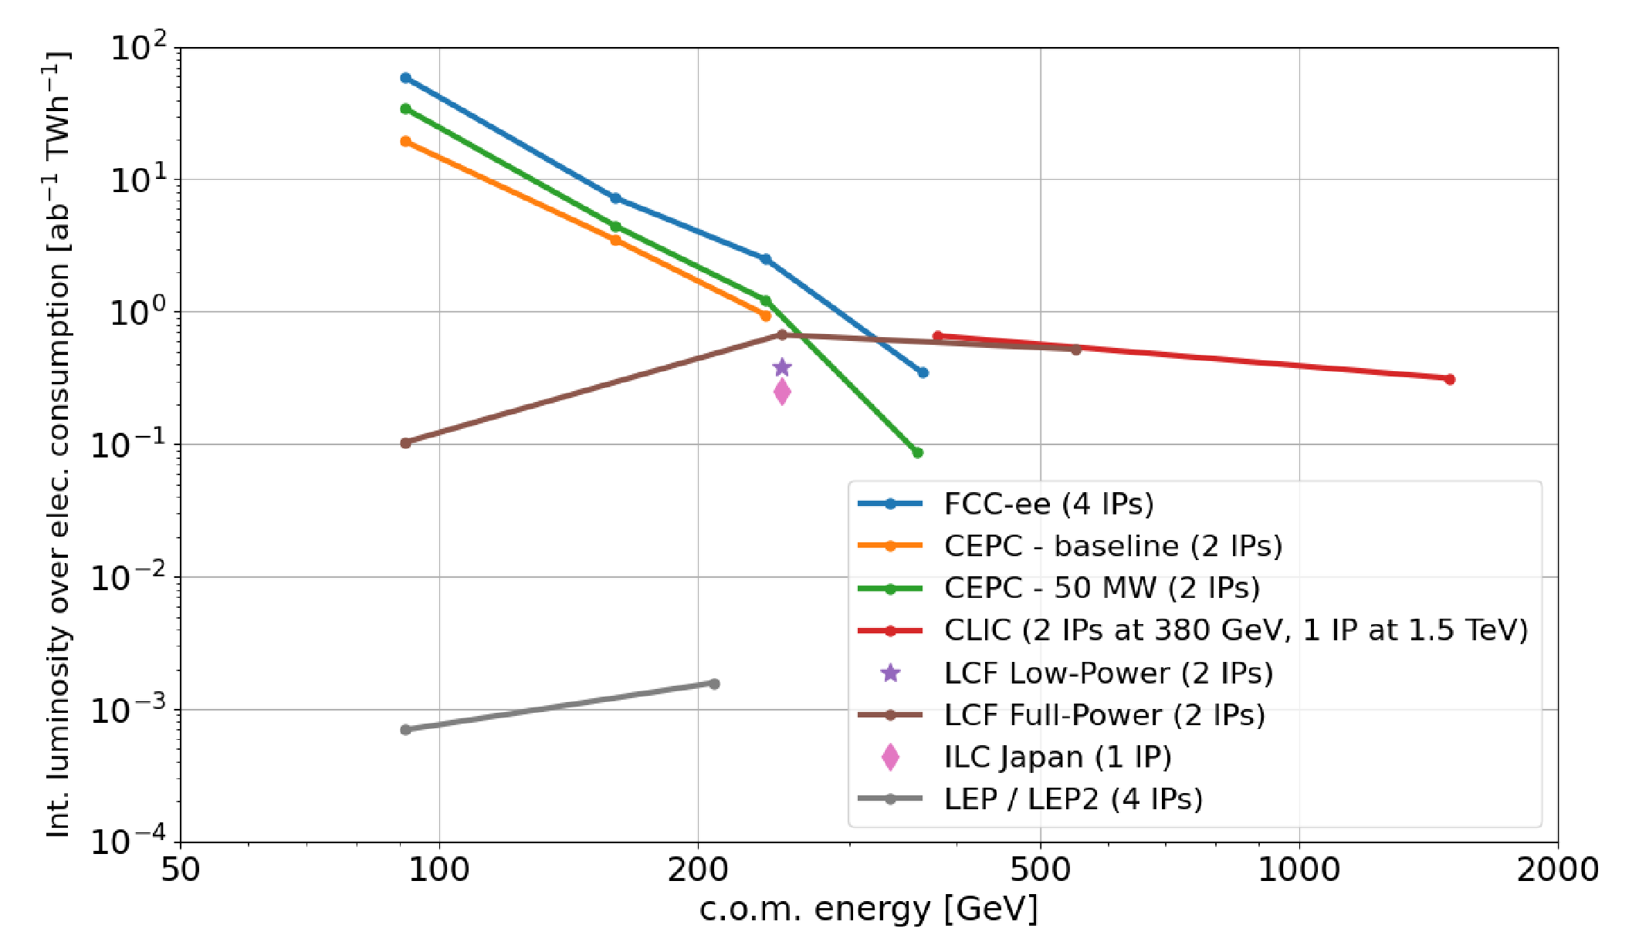
How GC and LGC Compare in Future e+e- Colliders Comparison

Slide 35
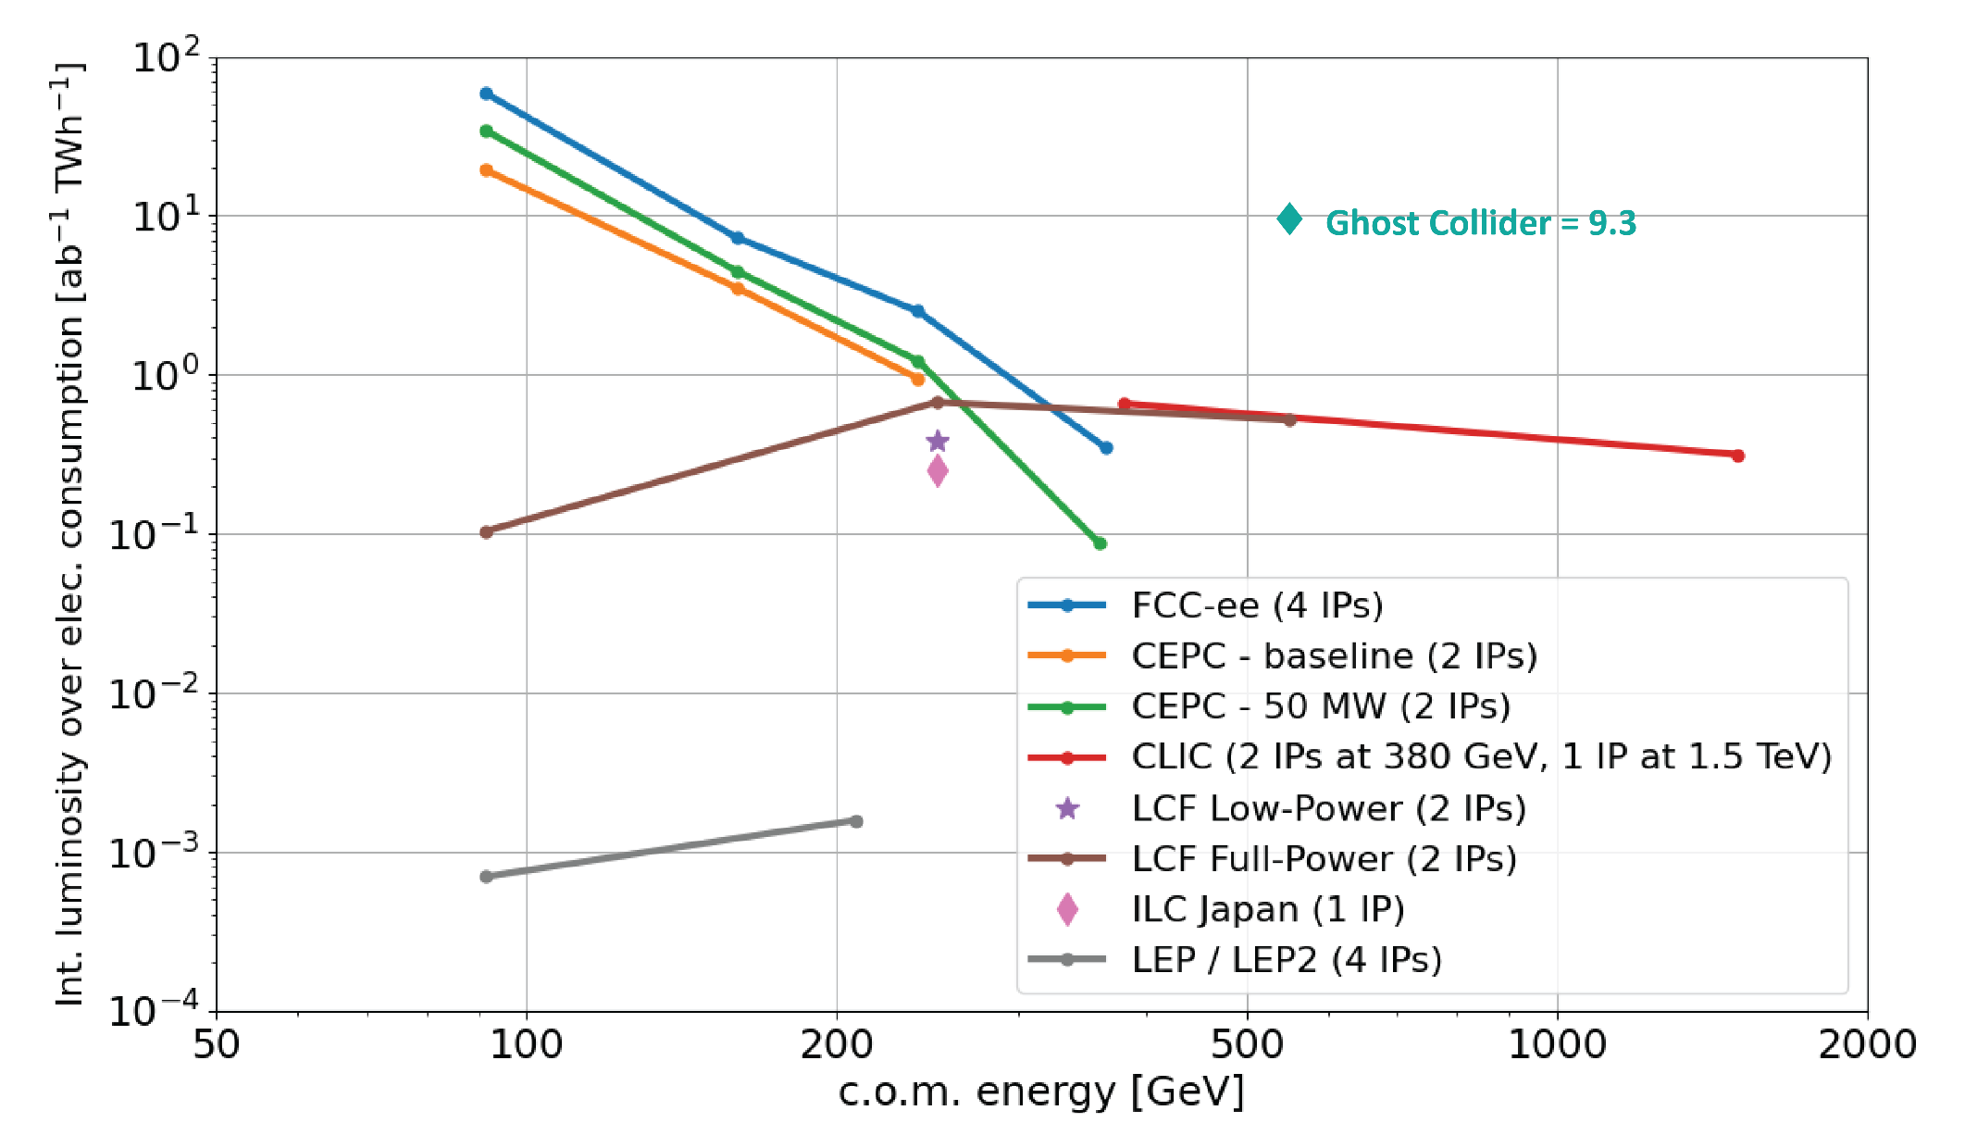
How GC and LGC Compare in Future e+e- Colliders Comparison

Slide 36
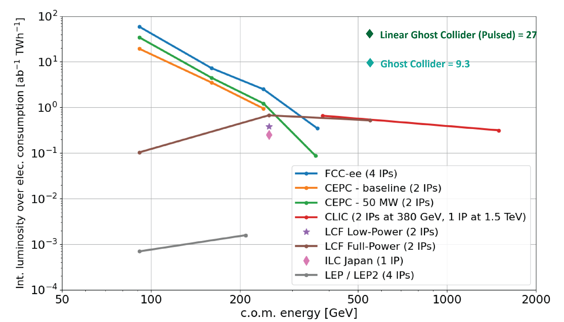
How GC and LGC Compare in Future e+e- Colliders Comparison

Slide 37
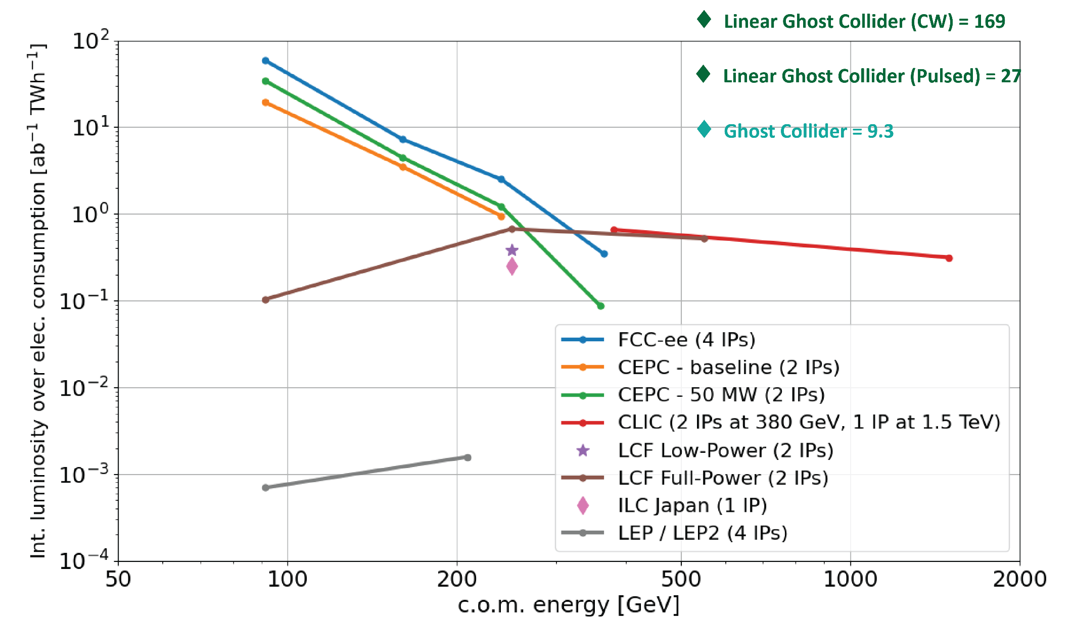
How GC and LGC Compare in Future e+e- Colliders Comparison

Slide 38

LGC Differences to LCF – Considerations for Upgrade
Below is schematic of LCF from LC Vision document submitted to ESPPU. Not to scale. How does LGC as conceived differ?
Instead of centrally located damping rings there are one at each end – to minimize bending of E_{drive}
In each DR tunnel there is also a recirculation ring at E_{drive}
Space is left within the linacs for n changeover zones – adding about 1 km
Instead of 1 bypass line parallel to the linacs, 8 are arranged octagonally
BDS includes one 1 km delay chicane either side of IPs
Instead of two detectors in parallel, there are 4 in series
Positrons are recycled = no need for high intensity source
No crossing angle, beamsstrahlung charge compensation instead
MW scale dumps not required – energy recovered instead
… not an exhaustive list!

Slide 39


Conclusion: GC & LGC – Efficient & High Luminosity Linear Colliders
Ghost Collider introduces ghost bunches – net neutral within linacs (high-low for energy recovery), and at collision (high-high for charge compensation of beam-beam). Parasitic collisions are allowed, but interactions (hard and e-m) negligible – need demo! HOMs eliminated to first order – need demo! Charge separation instability avoided through use of small disruption – need demo! Allows IP’s to be arranged in series without crossing angle. Power consumption dominated by SR loss and degradation in half-energy turn around arcs.
Linear Ghost Collider adopts ghost bunches as above. Turn around arcs eliminated by: altering topology, using ghost partners as drive bunches, and employing linac staging – need demo! SR loss and degradation thereby nearly eliminated resulting in greater efficiency.
An LGC based upgrade of LCF comprises a viable path to luminosity of 10³⁶ cm⁻²s⁻¹ in e+e- at 550 GeV with estimated power consumption of 160 MW (comfortably within CERN site power limits). This would allow exploration of the Higgs vacuum potential with percent-levels measurement of the tri-linear Higgs coupling.
LGC will scale to lower CoM energies similarly to other linear colliders.

Slide 40

Acknowledgements
Further details in the following IPAC 2026 pre-press proceedings, journal articles to follow:
  The Ghost Collider: An Innovative Higgs Factory
  https://www.ipac26.org/prepress/doi/jacow-ipac2026-moo1t02/index.html
  The Linear Ghost Collider: An Efficient Higgs Factory
  https://www.ipac26.org/prepress/doi/jacow-ipac2026-mop1022/index.html
  Chromaticity compensation of a ghost collider
  https://www.ipac26.org/prepress/doi/jacow-ipac2026-wep1313/index.html
Thanks to my co-authors:
Andrew Hutton, Bamunuvita (Randy) Gamage (JLab)
Rob Apsimon, Mohit Joshi (Lancaster)
Kaoru Yokoya (KEK)
Also thanks to the following for support & encouragement:
Todd Satogata (JLab), John Dainton (Lancaster), Hywel Owen, Bruno Muratori, Deepa Angal-Kalinin, Peter McIntosh, Jim Clarke (Daresbury), Andy Wolski (Liverpool), Erk Jensen (CERN), Valery Telnov (BINP), Vladimir Litvinenko (BNL)

Slide 41
Additional Slides

Slide 42

LGC Timing – Frame 1
Showing the 4-stage example to illustrate.
Colliding bunch in black with green outline (remember only right-going positrons shown here).
Drive bunch timing: Every drive bunch initially is ahead of the colliding bunch and is progressively delayed to be coincident, so we need 2n drive bunches in one accelerate-collide-decelerate cycle, but over n mod 2 cycles we only need n bunches (each set of n either only decelerates or accelerates in each cycle, not both).

Slide 43

LGC Timing – Frame 2
Showing the 4-stage example to illustrate.
Colliding bunch in black with green outline (remember only right-going positrons shown here).
Drive bunch timing: Every drive bunch initially is ahead of the colliding bunch and is progressively delayed to be coincident, so we need 2n drive bunches in one accelerate-collide-decelerate cycle, but over n mod 2 cycles we only need n bunches (each set of n either only decelerates or accelerates in each cycle, not both).

Slide 44

LGC Timing – Frame 3
Showing the 4-stage example to illustrate.
Colliding bunch in black with green outline (remember only right-going positrons shown here).
Drive bunch timing: Every drive bunch initially is ahead of the colliding bunch and is progressively delayed to be coincident, so we need 2n drive bunches in one accelerate-collide-decelerate cycle, but over n mod 2 cycles we only need n bunches (each set of n either only decelerates or accelerates in each cycle, not both).

Slide 45

LGC Timing – Frame 4
Showing the 4-stage example to illustrate.
Colliding bunch in black with green outline (remember only right-going positrons shown here).
Drive bunch timing: Every drive bunch initially is ahead of the colliding bunch and is progressively delayed to be coincident, so we need 2n drive bunches in one accelerate-collide-decelerate cycle, but over n mod 2 cycles we only need n bunches (each set of n either only decelerates or accelerates in each cycle, not both).

Slide 46

LGC Timing – Frame 5
Showing the 4-stage example to illustrate.
Colliding bunch in black with green outline (remember only right-going positrons shown here).
Drive bunch timing: Every drive bunch initially is ahead of the colliding bunch and is progressively delayed to be coincident, so we need 2n drive bunches in one accelerate-collide-decelerate cycle, but over n mod 2 cycles we only need n bunches (each set of n either only decelerates or accelerates in each cycle, not both).

Slide 47

LGC Timing – Frame 6
Showing the 4-stage example to illustrate.
Colliding bunch in black with green outline (remember only right-going positrons shown here).
Drive bunch timing: Every drive bunch initially is ahead of the colliding bunch and is progressively delayed to be coincident, so we need 2n drive bunches in one accelerate-collide-decelerate cycle, but over n mod 2 cycles we only need n bunches (each set of n either only decelerates or accelerates in each cycle, not both).

Slide 48

LGC Timing – Frame 7
Showing the 4-stage example to illustrate.
Colliding bunch in black with green outline (remember only right-going positrons shown here).
Drive bunch timing: Every drive bunch initially is ahead of the colliding bunch and is progressively delayed to be coincident, so we need 2n drive bunches in one accelerate-collide-decelerate cycle, but over n mod 2 cycles we only need n bunches (each set of n either only decelerates or accelerates in each cycle, not both).

Slide 49


LGC Parameter Details and Power Estimates
Table right shows LGC beam parameters for pulsed RF with proven 2K SRF; and for CW RF with predicted 4K TF-SRF technology. Power consumption is split into: damping rings, compensation of SR losses, linac RF system, cryogenics and provision of initial drive beam in the case of pulsed RF
Scaling comparison below LCF@550 GeV (Future Colliders Comparative Evaluation arXiv:251120417) using same operational pattern implies …
Pulsed LGC = 0.6 TWh/yr, and CW LGC = 0.9 TWh/yr

Slide 50
Addressing the Drawbacks of FCC-ee Alternatives…
Selected excerpts from the European Strategy Group recommendations section 6: Technologies
Accelerator Science & Technology … my emphasis
In order to realise the visionary plan presented, the highest priority must be the development and industrialisation of key technologies: advanced superconducting and normal-conducting RF structures, efficient RF power sources and accelerator-quality magnets in the 14–20 T range, including those based on high-temperature superconductors.
Demonstration of high-current multi-turn energy recovery in linacs constitutes an important step towards power-efficient lepton accelerators for a broad range of applications and should be pursued.
The longer-term development of advanced technologies, such as high-gradient wakefield acceleration and those underpinning bright muon beams, should be supported at an appropriate level. Synergies with the US initiative on muon collider R&D should be exploited.
Notes:
LCF operational cost?

Slide 51
ERLC*
* Valery Telnov, A high-luminosity superconducting twin e+e- linear collider with energy recovery 2021 JINST 16 P12025 https://doi.org/10.1088/1748-0221/16/12/P12025, https://doi.org/10.48550/arXiv.2302.09758
ERLC proposes twin-axis linacs in order to avoid parasitic collisions. Electrons in one axis, counter-propagating positrons in the other with RF coupling between them. These cavities are the primary R&D requirement. Variations of linac parameters have been assessed – bulk Nb, thin-film SRF, travelling wave, both for pulsed and CW operation. In this talk I show numbers for Nb3Sn TF-SRF CW operation
Collisions occur with low disruption parameter and high repetition rate, similar to a circular collider
The low disruption allows partial damping using wigglers between each bunch collision with fractional energy loss 1/200

Slide 52

ERLC – Critical Issues / Necessary R&D
Can the weak damping in ERLC cope with degradation from SR in a necessarily large crossing angle final focus system?
Low disruption implies low luminosity per crossing, recover average lumi with 1300 MHz repetition rate, high resultant linac currents (100’s mA) lead to significant higher-order mode powers. Efficient damping and extraction of these modes in a twin-axis cavity is key R&D.
There is a relatively small effort (so far) in the design / construction / validation of twin-axis, none yet with HOM considerations – in particular how to deal with the heat load?
A promising recent concept is to observe that only the wave travelling in the direction of propagation contributes to acceleration leading to the HELEN travelling wave structure concept. ERLC could further exploit this by replacing the HELEN return waveguide with another cavity for the counter propagating beam…
Concept of a twin-axis cavity of TW type. The TW propagates only in the clockwise direction in this figure. The upper cavity accelerates the electron beam going to the right and the lower cavity decelerates the positron beam going to the left
Would these cavities fit in LCF tunnel?

Slide 53

ReLiC*
* V. Litvinenko, T. Roser et al. The ReLiC: Recycling Linear e+e− Collider (2022), https://arxiv.org/abs/2203.06476
ReLiC utilizes a single linac with counter-propagating electrons and positrons – no twin-axis so ILC type structures could be used
Parasitic collisions are avoided using Wien-filter-like separators interspersed throughout (adding about 6% to total length). Accelerating bunches are undeflected, decelerating bunches deflected according to charge
Moderate current and collision rate, but high disruption collisions because pulse structure restricted by separators, therefore require ultra-flat beams and strong cooling in DRs in top-up mode to replace lost particles
A high degree of polarization is possible
Large crossing angle not necessary

Slide 54

ReLiC – Critical Issues / Necessary R&D
Separators (c. 60m) restricts the timing structure as they are short compared to linac sections, and all bunches must pass within them - this necessitates high disruption collisions at IP’s, and consequently strong damping
At t = 0 trains of N_{bunch} accelerating and decelerating bunches are separated horizontally in two separators
At t = T_{train} / 4 beams propagating towards (coming from) the IP accelerate (decelerate) on-axis in linacs
At t = T_{train} / 2, the counter-propagating beams are separated again
At t = 3T_{train} / 4 beams accelerate and decelerate on-axis in opposite linacs. Then the process repeats
Ultra-flat beams with 2000 to 4000 emittance ratios
Damping rings – two-fold damping required, so survival of collective effects is not a concern, but power is - 140 MW quoted in LC Vision for 500 GeV CoM

