Slide 1




Design of the Compton polarimeter for the FCC-ee
Jasper Burvill, Robert Kieffer, Stewart Boogert, Robert Appleby, on behalf of the FCC EPOL working group

Slide 2
Overview
The Future Circular Collider
The Polarimeter
Simulating The Polarimeter
Polarimeter Performance
Summary and Next Steps

Slide 3
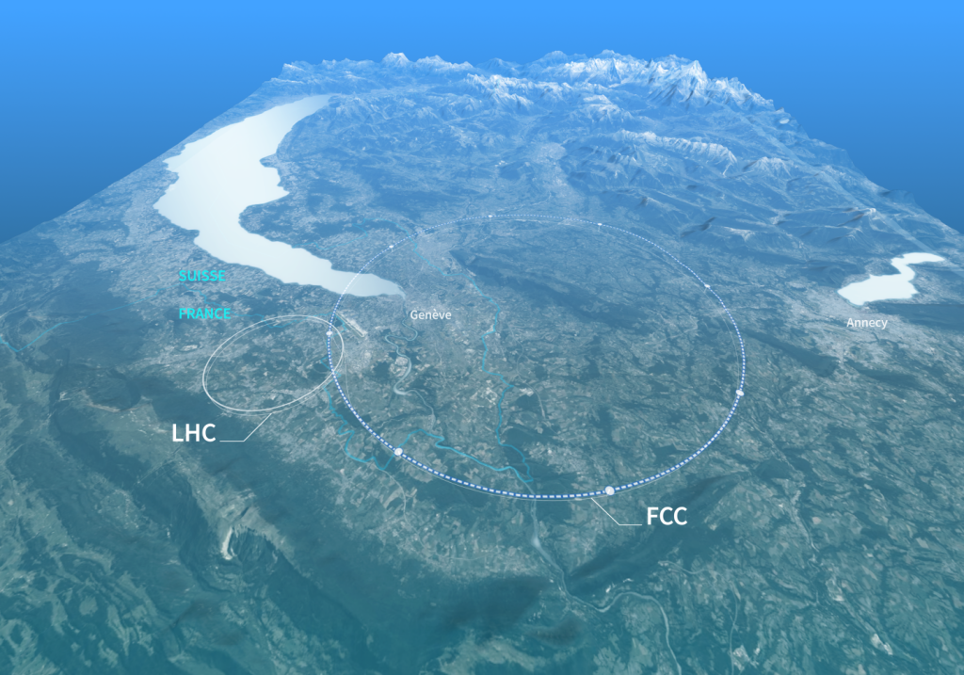
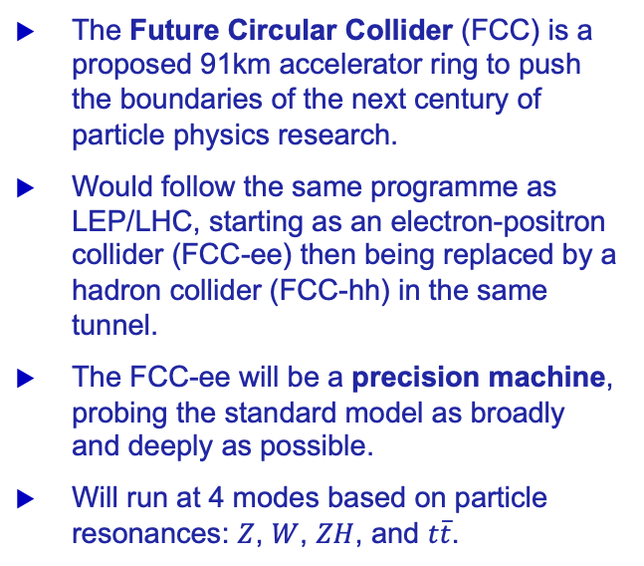
The Future Circular Collider
The Future Circular Collider (FCC) is a proposed 91km accelerator ring to push the boundaries of the next century of particle physics research.
Would follow the same programme as LEP/LHC, starting as an electron-positron collider (FCC-ee) then being replaced by a hadron collider (FCC-hh) in the same tunnel.
The FCC-ee will be a precision machine, probing the standard model as broadly and deeply as possible.
Will run at 4 modes based on particle resonances: $Z$, $W$, $ZH$, and $t\overline{t}$.

Slide 4
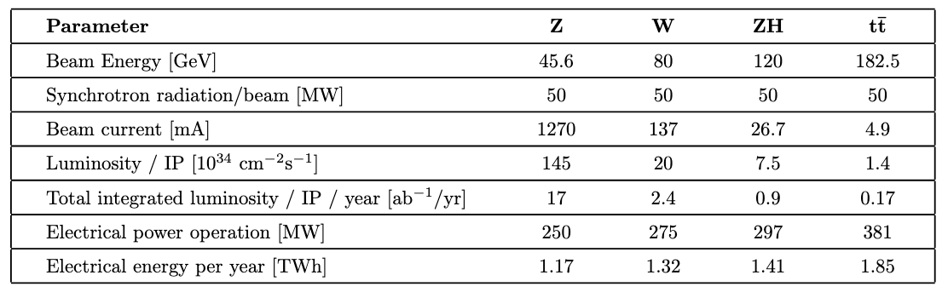
The Future Circular Collider
The FCC feasibility study concluded in 2025, and consolidated the following parameters for the four modes of operation:

Slide 5

The Future Circular Collider
The FCC feasibility study concluded in 2025, and consolidated the following parameters for the four modes of operation:
$1.45 × {10}^{36} \text{c}{\text{m}}^{−2}{\text{s}}^{−1}$ instantaneous luminosity at Z mode.

Slide 6

The Future Circular Collider
The FCC feasibility study concluded in 2025, and consolidated the following parameters for the four modes of operation:
$1.45 × {10}^{36} \text{c}{\text{m}}^{−2}{\text{s}}^{−1}$ instantaneous luminosity at Z mode.
Maximum Z mode luminosity at LEP was ~$3 × {10}^{31} \text{c}{\text{m}}^{−2}{\text{s}}^{−1}$.
  ~${10}^{5}$ increase in luminosity for FCC-ee
  FCC-ee will exceed the total number of Z mode collisions in the 6-year run at LEP in ~2 minutes.

Slide 7

The Future Circular Collider
The FCC feasibility study concluded in 2025, and consolidated the following parameters for the four modes of operation:
$1.45 × {10}^{36} \text{c}{\text{m}}^{−2}{\text{s}}^{−1}$ instantaneous luminosity at Z mode.
Maximum Z mode luminosity at LEP was ~$3 × {10}^{31} \text{c}{\text{m}}^{−2}{\text{s}}^{−1}$.
  ~${10}^{5}$ increase in luminosity for FCC-ee
  FCC-ee will exceed the total number of Z mode collisions in the 6-year run at LEP in ~2 minutes.
Pressure on detectors and instrumentation to make the most of this!

Slide 8
The Future Circular Collider
FCC-ee as a high-precision machine includes a very precise energy calibration.

Slide 9
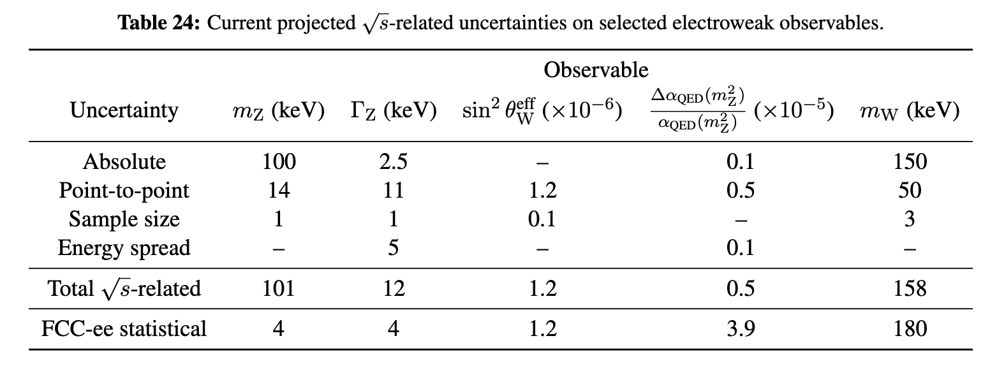

The Future Circular Collider
FCC-ee as a high-precision machine includes a very precise energy calibration.
Table from the Feasibility Study Report giving estimates on $E_{CM}$-related uncertainties for FCC-ee at Z and W modes:

Slide 10
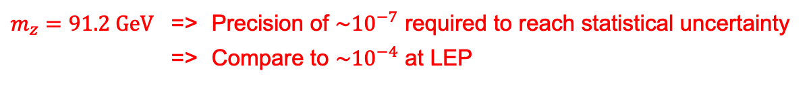
The Future Circular Collider
FCC-ee as a high-precision machine includes a very precise energy calibration.
Table from the Feasibility Study Report giving estimates on $E_{CM}$-related uncertainties for FCC-ee at Z and W modes:
$m_{z}=91.2 \text{GeV}$ => Precision of $\sim {10}^{−7}$ required to reach statistical uncertainty
=> Compare to $\sim {10}^{−4}$ at LEP

Slide 11
Resonant Depolarisation
The precise energy calibration required by FCCee can be achieved via resonant depolarisation (RDP).

Slide 12
Resonant Depolarisation
The precise energy calibration required by FCCee can be achieved via resonant depolarisation (RDP).
A beam is polarised if there is an average alignment in the spins of the individual particles in a given direction.

Slide 13
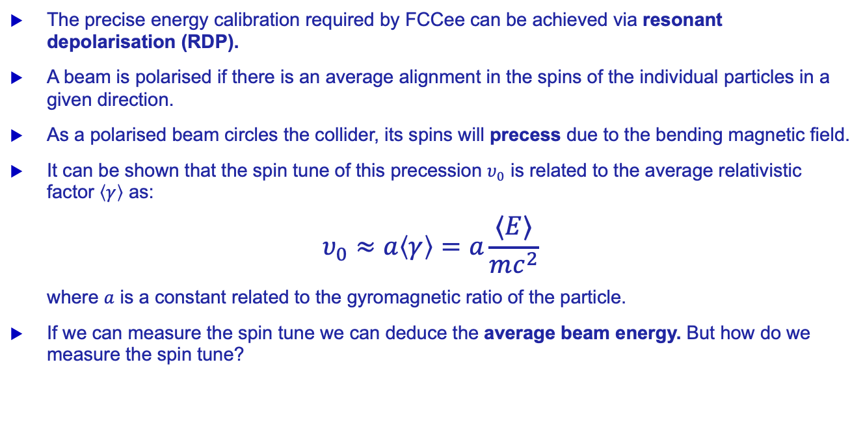
Resonant Depolarisation
The precise energy calibration required by FCCee can be achieved via resonant depolarisation (RDP).
A beam is polarised if there is an average alignment in the spins of the individual particles in a given direction.
As a polarised beam circles the collider, its spins will precess due to the bending magnetic field.
It can be shown that the spin tune of this precession $υ_{0}$ is related to the average relativistic factor $\left\langle γ\right\rangle$ as:
$$υ_{0}≈a\left\langle γ\right\rangle =a\frac{⟨E⟩}{mc^{2}}$$
where $a$ is a constant related to the gyromagnetic ratio of the particle.
If we can measure the spin tune we can deduce the average beam energy. But how do we measure the spin tune?

Slide 14
Resonant Depolarisation
If a horizontal dipole ‘kick’ is applied at a frequency in resonance with the spin tune, the beam will rapidly depolarise.

Slide 15
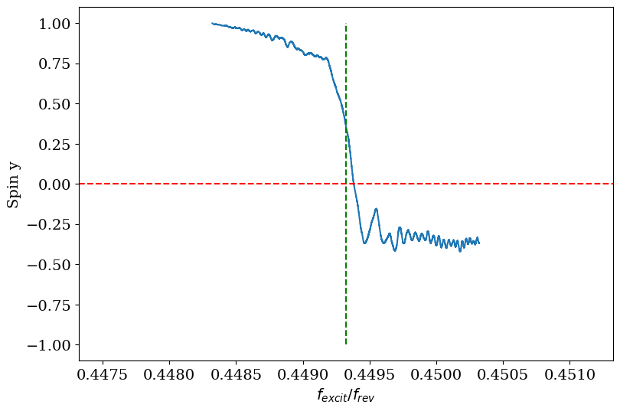
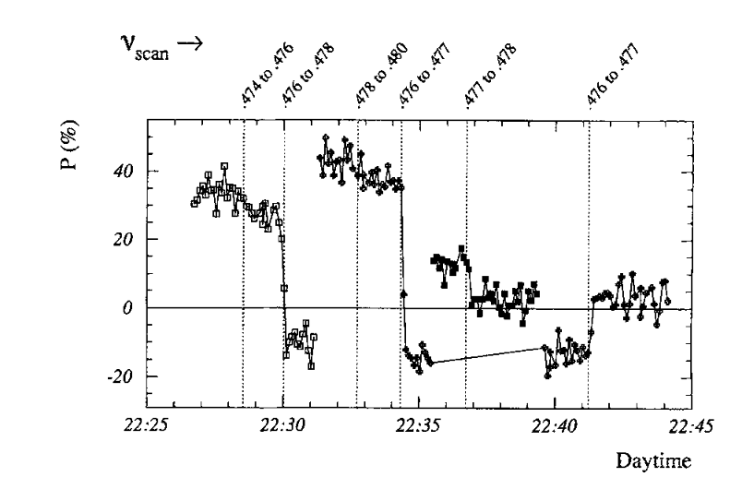


Resonant Depolarisation
If a horizontal dipole ‘kick’ is applied at a frequency in resonance with the spin tune, the beam will rapidly depolarise.
By scanning across kicker frequencies and measuring the point of depolarisation, we can measure the spin tune and thus the average energy.
RDP scan simulated in XSuite
RDP scan data from LEP
Polarisation
$$ν_{\text{scan}}$$
G. Iadarola, et al, “Spin tracking and equilibrium polarization
computation in Xsuite: implementation and benchmarks”,
presented at the IPAC’26, Deauville, France, May 2026, paper
Arnaudon, L., et al. "Accurate determination of the LEP beam energy by resonant depolarization." Zeitschrift für Physik C Particles and Fields 66.1 (1995): 45-62.

Slide 16
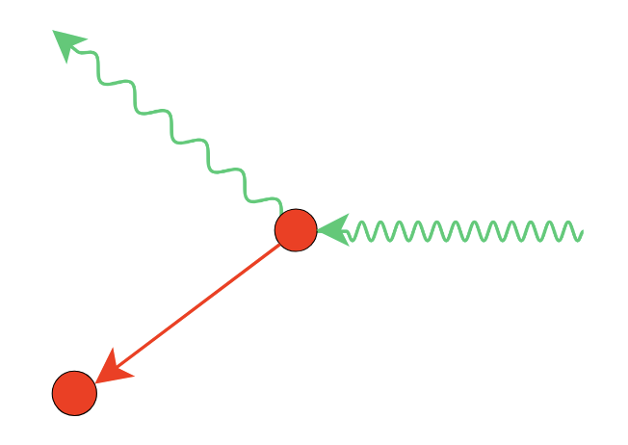
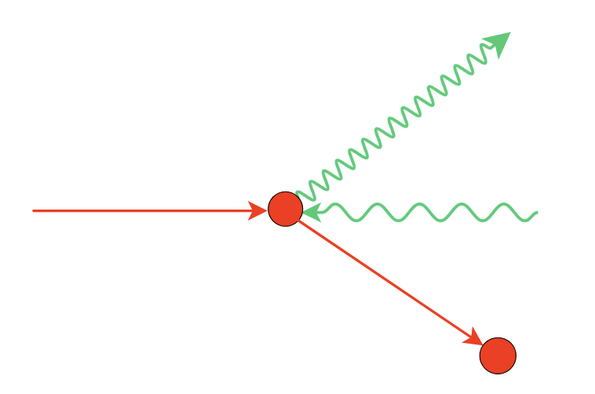
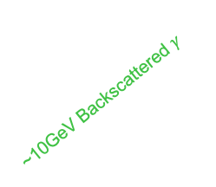



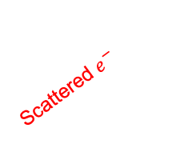
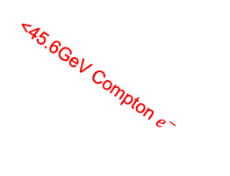
How to measure polarisation?
The key process behind the polarimeter is Compton scattering between electrons and photons.
The direction of the scattered particles depends on the polarisation of the electrons and the helicity (circular polarisation) of the photons.
~10GeV Backscattered $γ$
Scattered $γ$
Incoming $γ$
45.6GeV e- beam
2.3eV incoming $γ$
Scattered $e^{−}$
<45.6GeV Compton $e^{−}$
Electron rest frame
FCC-ee lab frame

Slide 17
How to measure polarisation?
The key process behind the polarimeter is Compton scattering between electrons and photons.
The direction of the scattered particles depends on the polarisation of the electrons and the helicity (circular polarisation) of the photons.
Can measure polarisation from the distributions of Compton products by colliding a laser with the beam.
Colliding bunches should not be polarised => run RDP scan on polarised pilot bunches.
~10GeV Backscattered $γ$
Scattered $γ$
Incoming $γ$
45.6GeV e- beam
2.3eV incoming $γ$
Scattered $e^{−}$
<45.6GeV Compton $e^{−}$
Electron rest frame
FCC-ee lab frame

Slide 18
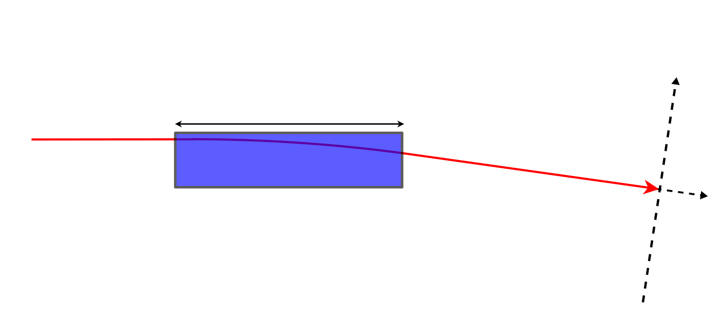
Polarimeter layout
Positioned at dipole 1040m downstream from the experimental IP.
45.6GeV e- beam
40m
45.6GeV e- beam
Bending Dipole

Slide 19
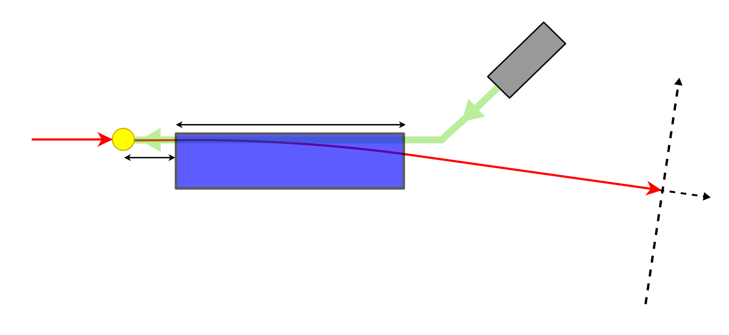
Polarimeter layout
Positioned at dipole 1040m downstream from the experimental IP.
Laser directed to collide at a shallow angle to the beam.
532nm
laser source
Laser
45.6GeV e- beam
Laser IP
40m
1m
45.6GeV e- beam
Bending Dipole

Slide 20
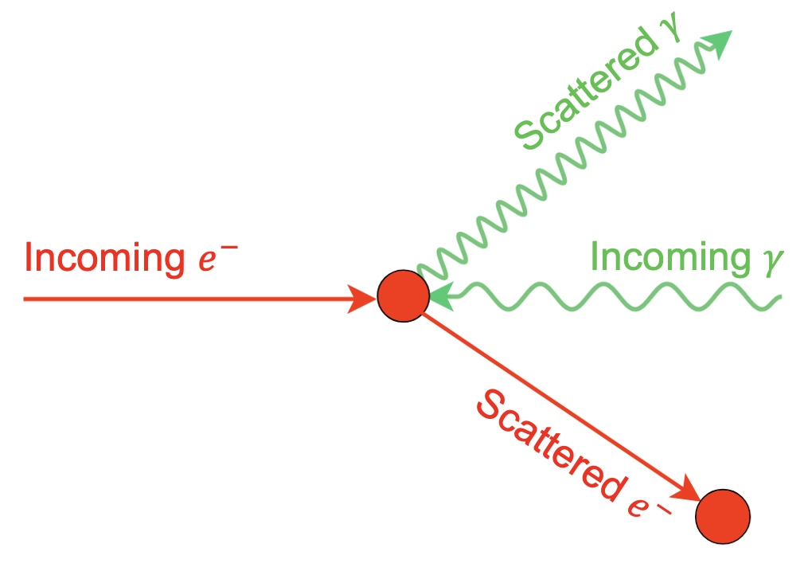
Polarimeter layout
Positioned at dipole 1040m downstream from the experimental IP.
Laser directed to collide at a shallow angle to the beam.
Compton scattering at laser IP, direction depends on beam polarisation.
532nm
laser source
Laser
45.6GeV e- beam
Laser IP
40m
1m
45.6GeV e- beam
Bending Dipole
Compton Scattering

Slide 21
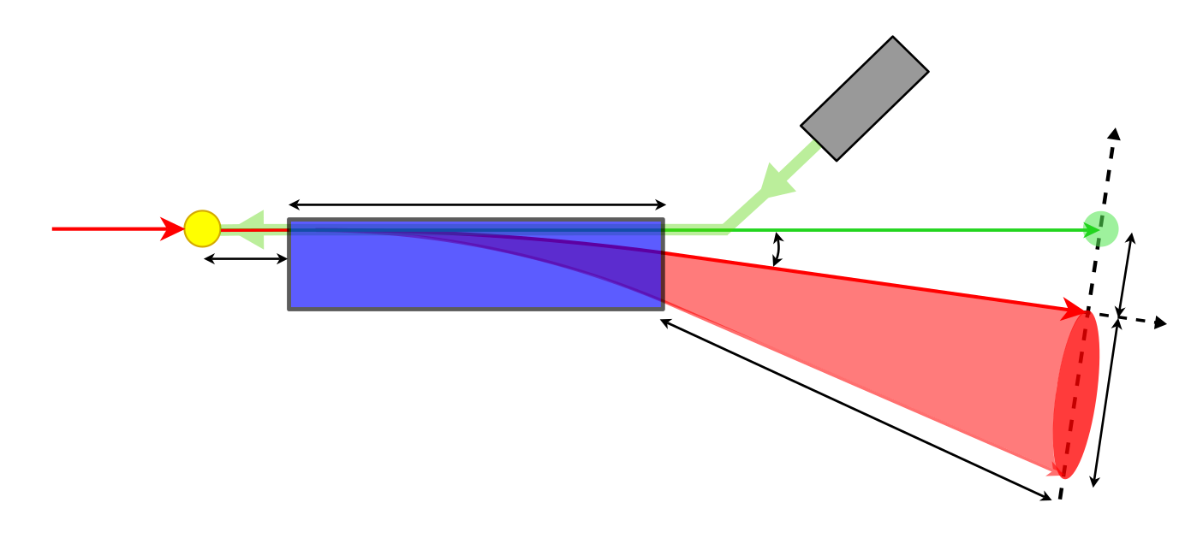

Polarimeter layout
Positioned at dipole 1040m downstream from the experimental IP.
Laser directed to collide at a shallow angle to the beam.
Compton scattering at laser IP, direction depends on beam polarisation.
Dipole separates scattered Compton particles.
532nm
laser source
Laser
45.6GeV e- beam
Laser IP
40m
~10GeV Backscattered $γ$
184mm
2.31 mrad
1m
45.6GeV e- beam
Bending Dipole
300mm
<45.6GeV Compton e-
51m
Compton Scattering

Slide 22
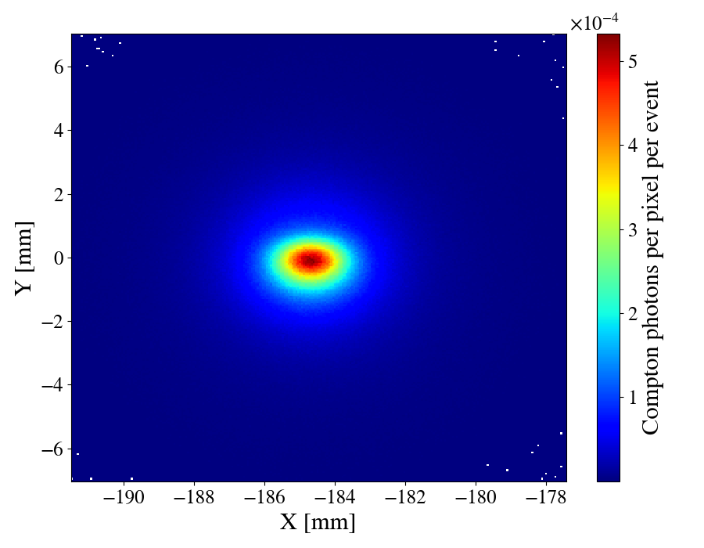
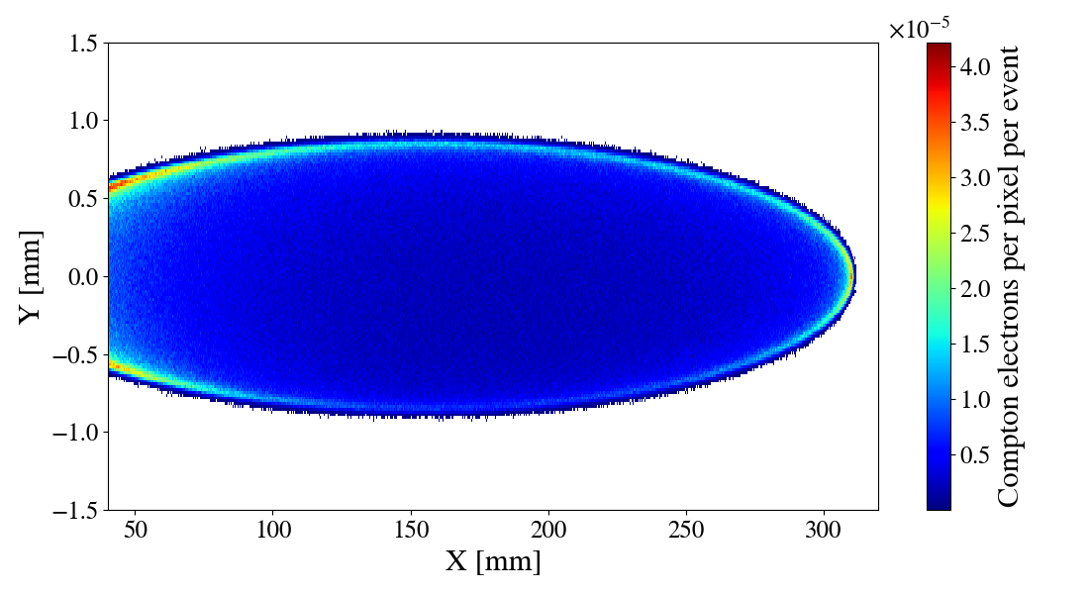
Polarimeter layout
Positioned at dipole 1040m downstream from the experimental IP.
Laser directed to collide at a shallow angle to the beam.
Compton scattering at laser IP, direction depends on beam polarisation.
Dipole separates scattered Compton particles.
Silicon pixel sensors measure Compton distributions.
532nm
laser source
Silicon Pixel Sensor
Laser
45.6GeV e- beam
Laser IP
40m
~10GeV Backscattered $γ$
184mm
2.31 mrad
1m
45.6GeV e- beam
Bending Dipole
300mm
<45.6GeV Compton e-
51m
Silicon Pixel Sensor
Compton Scattering

Slide 23
Polarimeter layout
Positioned at dipole 1040m downstream from the experimental IP.
Laser directed to collide at a shallow angle to the beam.
Compton scattering at laser IP, direction depends on beam polarisation.
Dipole separates scattered Compton particles.
Silicon pixel sensors measure Compton distributions.
532nm
laser source
Silicon Pixel Sensor
Laser
45.6GeV e- beam
Laser IP
40m
~10GeV Backscattered $γ$
Key FCCee parameters:
~1000 Compton events per bunch crossing
1 pilot bunch per turn for RDP
3000 turns per second in the FCCee
So expect ~3M Compton events per second in RDP scan
184mm
2.31 mrad
1m
45.6GeV e- beam
Bending Dipole
300mm
<45.6GeV Compton e-
51m
Silicon Pixel Sensor
Compton Scattering

Slide 24
Simulating the polarimeter
100% Vertically Polarised Beam
Simulations were performed using BDSIM (Beam Delivery Simulation), a Geant4-based 3D radiation transport model designed for simulating accelerators and beamlines.
BDSIM is capable of simulating the Compton scattering process, the interaction of the scattered particles with matter, and the energy deposition in the silicon sensors.
Electron Sensor
Photon Sensor

Slide 25
Simulating the polarimeter
100% Vertically Polarised Beam
Simulations were performed using BDSIM (Beam Delivery Simulation), a Geant4-based 3D radiation transport model designed for simulating accelerators and beamlines.
BDSIM is capable of simulating the Compton scattering process, the interaction of the scattered particles with matter, and the energy deposition in the silicon sensors.
Electron Sensor
Project onto Y-axis
Photon Sensor
Project onto Y-axis

Slide 26
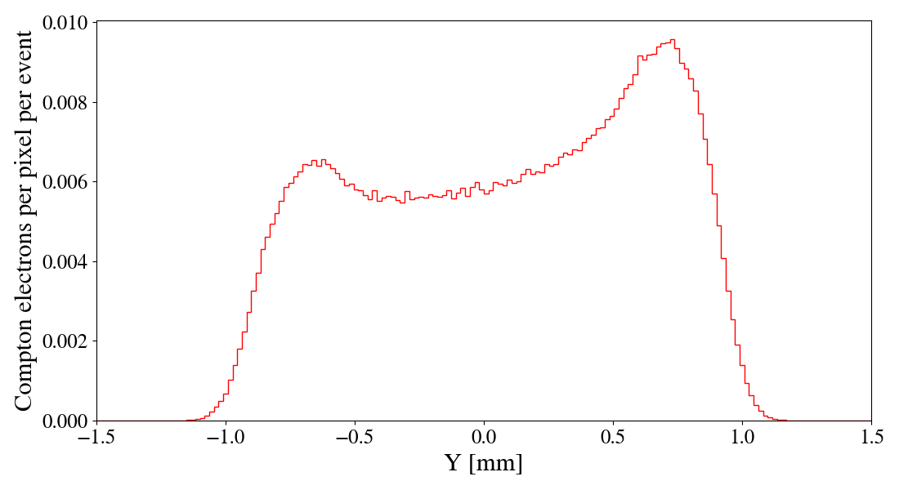
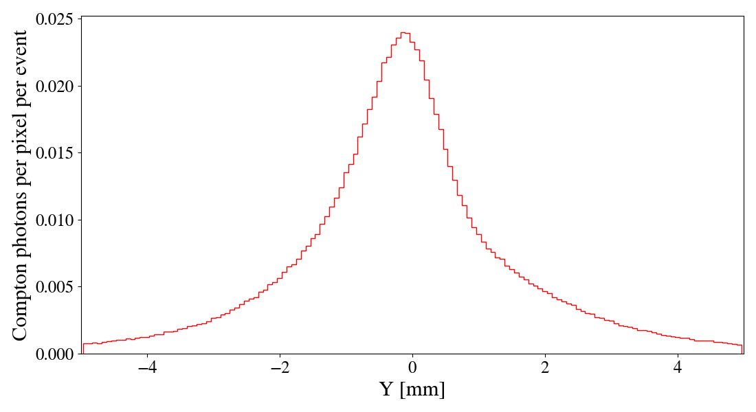
Simulating the polarimeter
100% Vertically Polarised Beam
(a)
Simulations were performed using BDSIM (Beam Delivery Simulation), a Geant4-based 3D radiation transport model designed for simulating accelerators and beamlines.
BDSIM is capable of simulating the Compton scattering process, the interaction of the scattered particles with matter, and the energy deposition in the silicon sensors.
(b)
Simulated prediction of polarimeter (a) electron and (b) photon profile

Slide 27
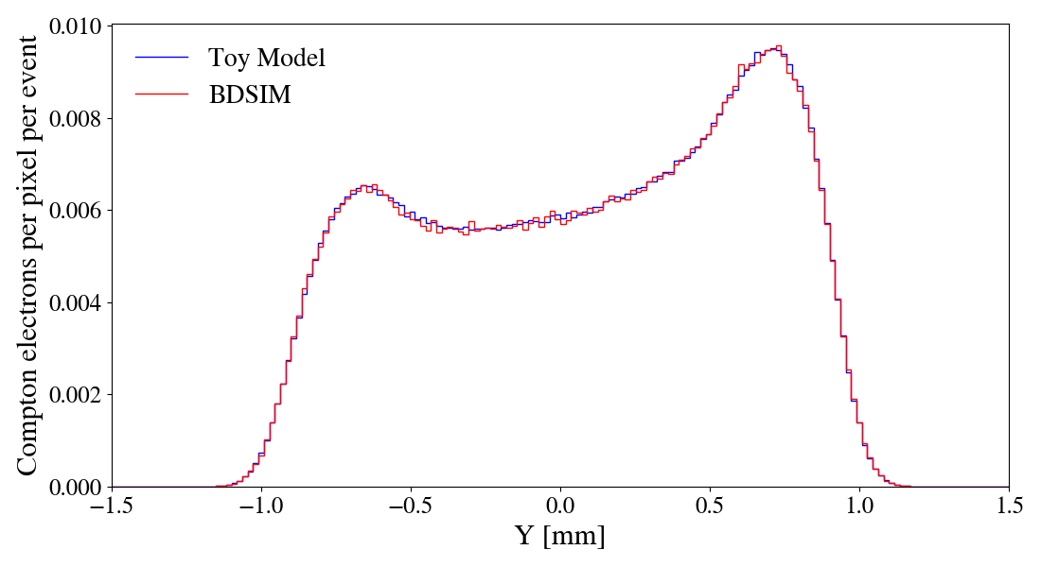
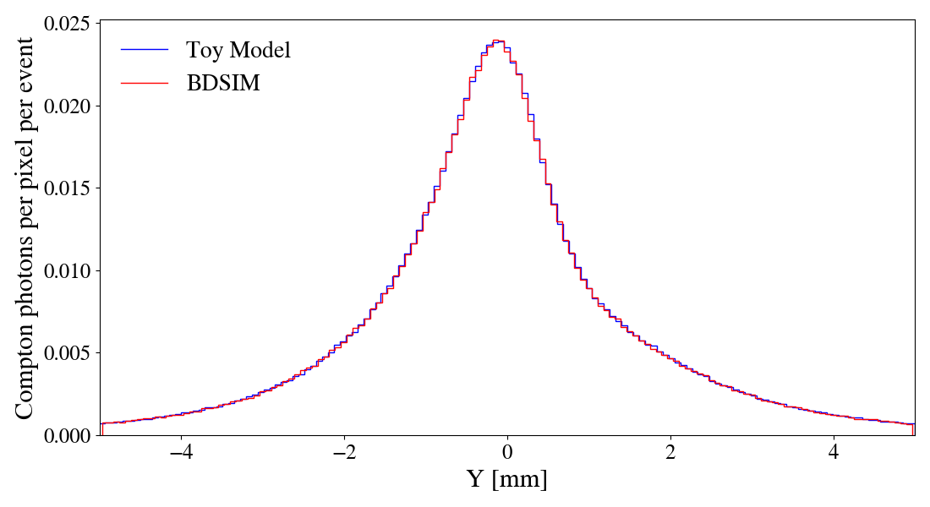
Simulating the polarimeter
100% Vertically Polarised Beam
(a)
Simulations were performed using BDSIM (Beam Delivery Simulation), a Geant4-based 3D radiation transport model designed for simulating accelerators and beamlines.
BDSIM is capable of simulating the Compton scattering process, the interaction of the scattered particles with matter, and the energy deposition in the silicon sensors.
The BDSIM model has been benchmarked against a Toy Monte Carlo (ToyMC) model built specifically to model the polarimeter.
Can use these simulation results to estimate the performance of the polarimeter.
(b)
Simulated prediction of polarimeter (a) electron and (b) photon profile

Slide 28
Polarimeter performance
With the model constructed, we can make estimates of the precision of the polarimeter.

Slide 29
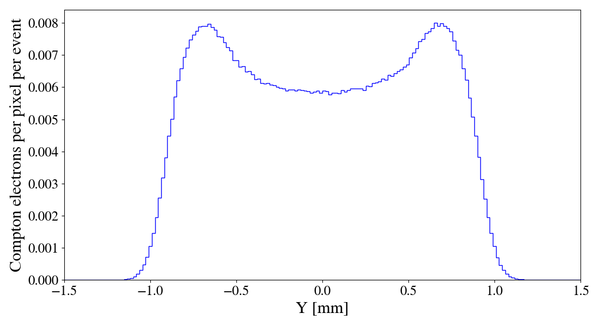
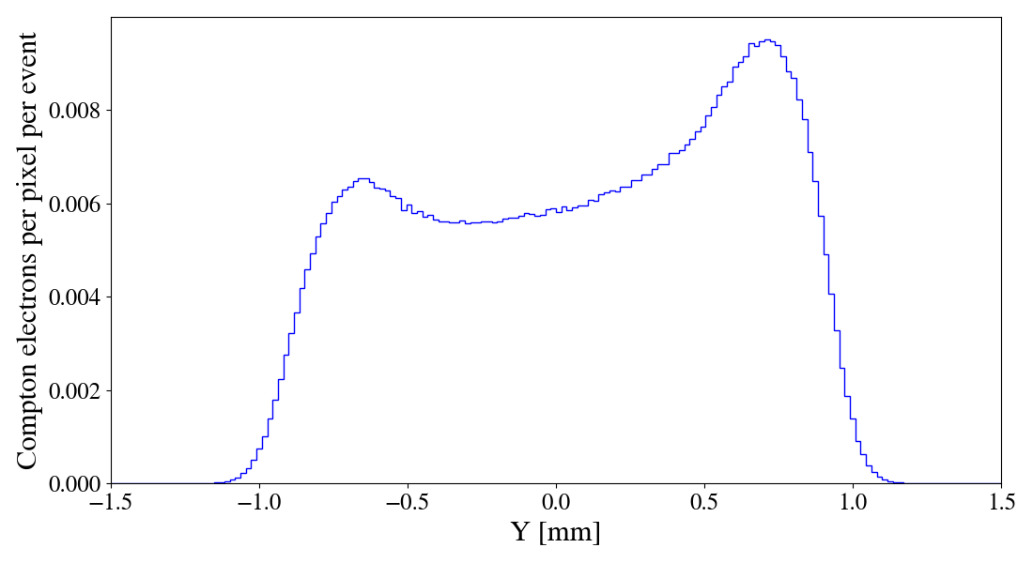


Polarimeter performance
With the model constructed, we can make estimates of the precision of the polarimeter.
In the case of the electron sensor, we can quantify the effect of polarisation on the distribution with the asymmetry:
This is a useful measure as it is directly proportional to the polarisation of the beam.
$$\text{Asymmetry}\text{ = }\frac{N_{+}−N_{−}}{N_{+}+N_{−}} \text{where} N_{+/−} \text{is} \text{the} \text{number} \text{of} \text{electrons} \text{above}\text{/}\text{below} y=0$$
$$N_{−}$$
$$N_{+}$$
$$N_{−}$$
$$N_{+}$$
Unpolarised
100% Vertically Polarised

Slide 30
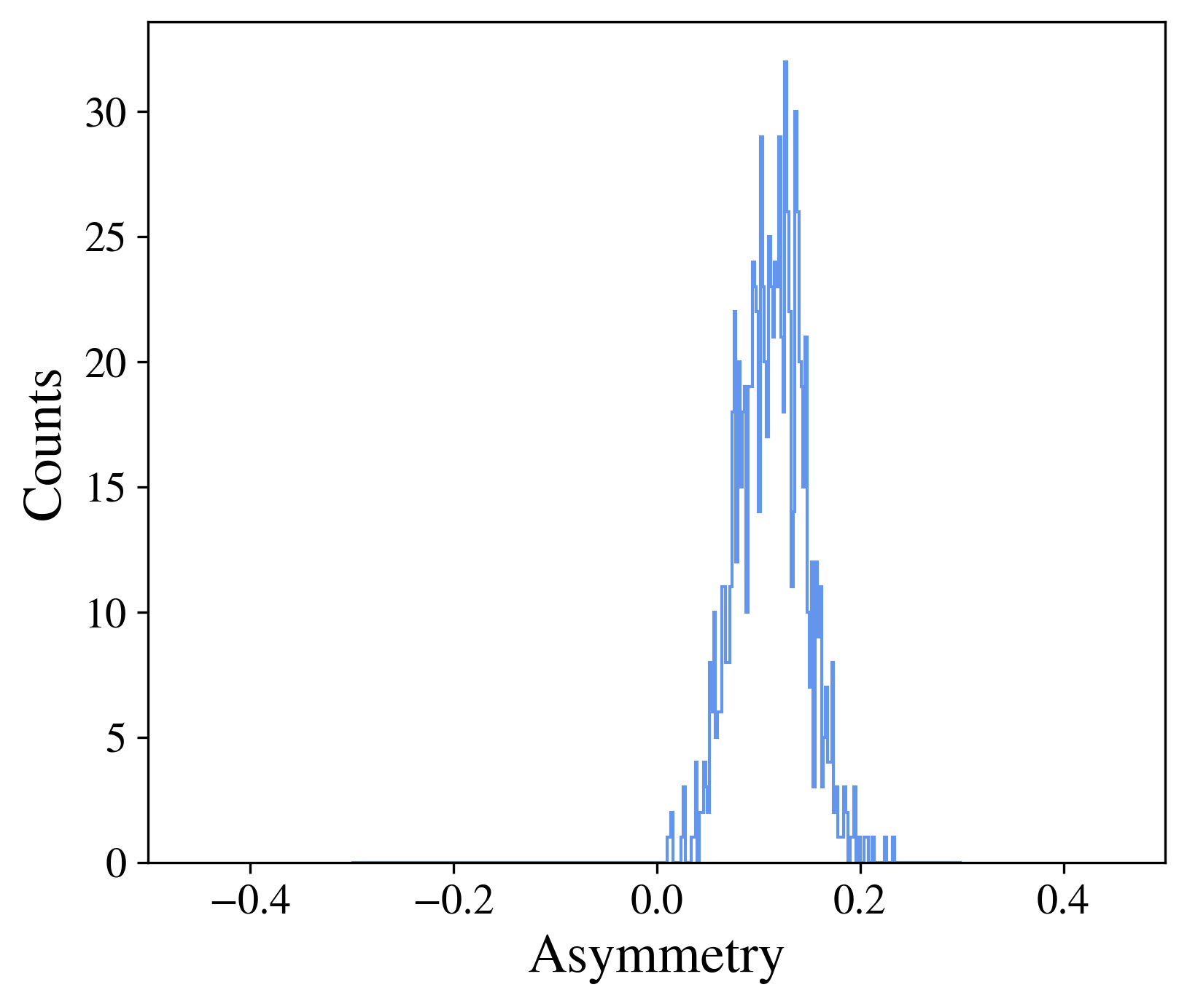
Polarimeter performance
100% Polarised Beam
Performed analysis of the electron sensor at a bunch-by-bunch (1000 Compton events) measurement, found relative error on the polarisation of ~29%.
Far too high to be useful for RDP, however we can predict that to reach a 1% error would take ~0.28s, which is well within our requirements.
Entries: 1000
Mean: 0.1123
Std Err: 0.0327
Histogram displaying the asymmetry in the Compton electron distribution for a single bunch crossing i.e. 1000 events

Slide 31
Polarimeter performance
100% Polarised Beam
Performed analysis of the electron sensor at a bunch-by-bunch (1000 Compton events) measurement, found relative error on the polarisation of ~29%.
Far too high to be useful for RDP, however we can predict that to reach a 1% error would take ~0.28s, which is well within our requirements.
A similar analysis for the photon sensor yielded a ~23% relative error on a bunch-by-bunch measurement, and ~0.17s data taking time to reach a 1% error.
Entries: 1000
Mean: 0.1123
Std Err: 0.0327
Histogram displaying the asymmetry in the Compton electron distribution for a single bunch crossing i.e. 1000 events

Slide 32
Polarimeter performance
100% Polarised Beam
Performed analysis of the electron sensor at a bunch-by-bunch (1000 Compton events) measurement, found relative error on the polarisation of ~29%.
Far too high to be useful for RDP, however we can predict that to reach a 1% error would take ~0.28s, which is well within our requirements.
A similar analysis for the photon sensor yielded a ~23% relative error on a bunch-by-bunch measurement, and ~0.17s data taking time to reach a 1% error.
However, this analysis was performed for a 100% polarised beam with no backgrounds considered, so the true time is expected to be higher.
Entries: 1000
Mean: 0.1123
Std Err: 0.0327
Histogram displaying the asymmetry in the Compton electron distribution for a single bunch crossing i.e. 1000 events

Slide 33
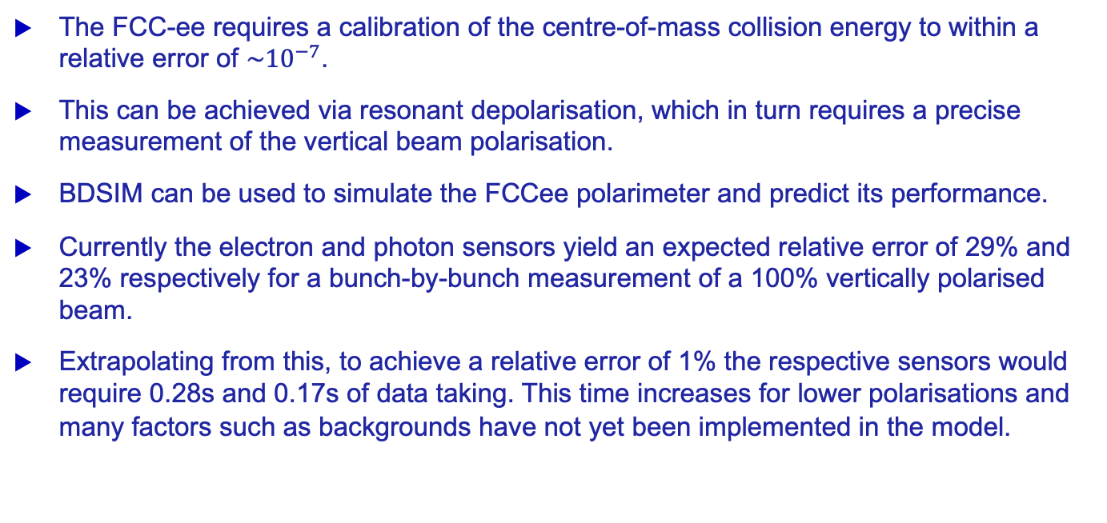
Summary
The FCC-ee requires a calibration of the centre-of-mass collision energy to within a relative error of $\sim {10}^{−7}$.
This can be achieved via resonant depolarisation, which in turn requires a precise measurement of the vertical beam polarisation.
BDSIM can be used to simulate the FCCee polarimeter and predict its performance.
Currently the electron and photon sensors yield an expected relative error of 29% and 23% respectively for a bunch-by-bunch measurement of a 100% vertically polarised beam.
Extrapolating from this, to achieve a relative error of 1% the respective sensors would require 0.28s and 0.17s of data taking. This time increases for lower polarisations and many factors such as backgrounds have not yet been implemented in the model.

Slide 34
Next steps for the polarimeter design
A careful evaluation of the expected background rates and their impact on the polarimeter performance needs to be made, this is likely the biggest factor impacting the uncertainties that we have not considered.
Investigation of simulation methods to more completely model the sensor behaviour and digitisation is ongoing e.g. Allpix-squared. Possible benefit to having multiple layers of sensors, also to be investigated.
First hardware tests with TimePix sensors are expected to be performed in the coming year.
Investigate performance at longitudinal polarisation measurement on colliding bunches.
=> an even bigger challenge!

Slide 35
Thank you for your attention.
35

Slide 36
Backup slides
36

Slide 37
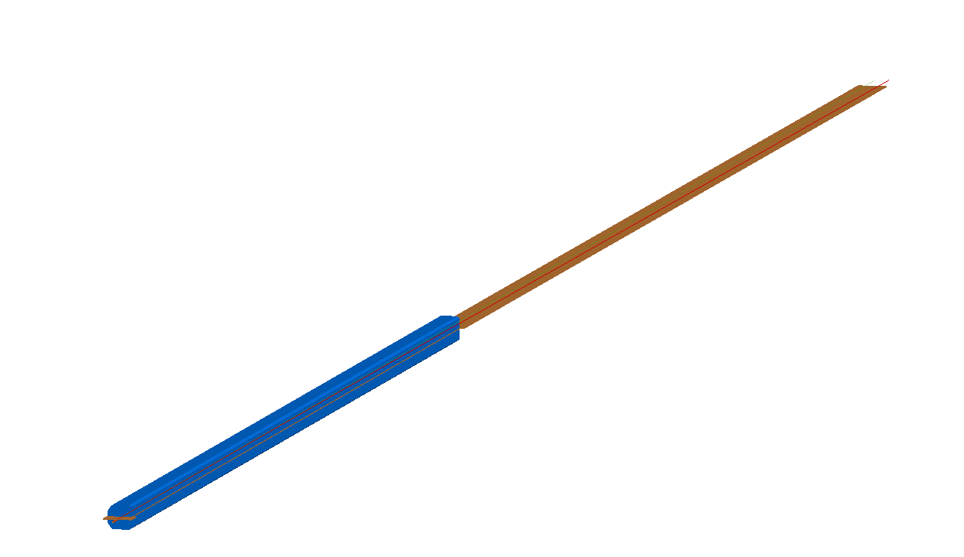
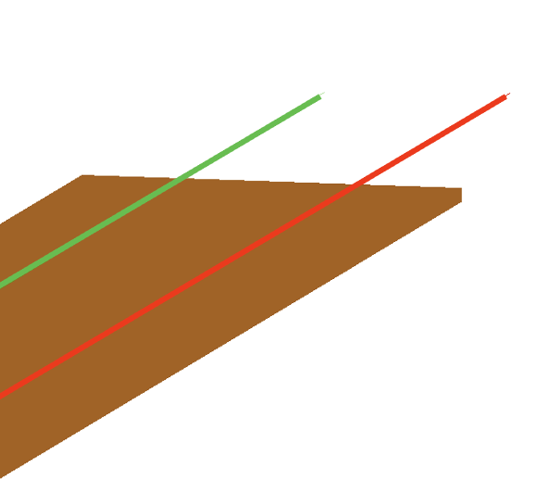
Simulating the polarimeter
Simulations were performed in two stages:
51m separation chamber
40m dipole
1) Compton interaction and dipole

Slide 38
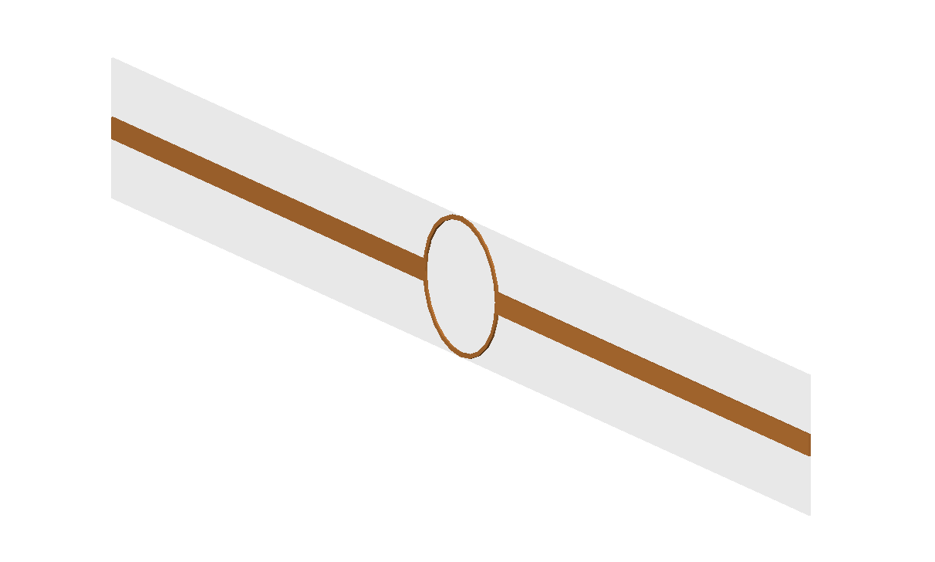
Simulating the polarimeter
Simulations were performed in two stages:
51m separation chamber
Compton Photons
Electron Beam
Compton Electrons
40m dipole
1) Compton interaction and dipole
2) Extraction window and sensors

Slide 39
Electron Sensor

Slide 40

Measuring the polarisation (100% beam polarisation)
100% Polarised Beam (ideal)
Error on the polarisation measurement taken bunch-by-bunch:
Ran 1M Compton scattering events.
For every 1000 events (1 bunch crossing), calculated the asymmetry of the incident Compton electrons.
Repeated 1000 times, the error on the asymmetry histogram gives the relative error on the polarisation measurement.
Can then estimate error for longer measurement times.
Entries: 1000
Mean: 0.1123
Std Err: 0.0327
Assuming $σ_{A} ∝ \frac{1}{\sqrt{N}}$
$$\text{Relative} \text{Error}= \frac{0.0327}{0.113}=29.1\%⇒ \text{To} \text{achieve}\text{ 1\% }\text{error}\text{: }\frac{{29.1}^{2}}{1^{2}}∙1000≈8.5e5 \text{evts}⇒0.\text{28}\text{s} \text{data} \text{taking}$$

Slide 41
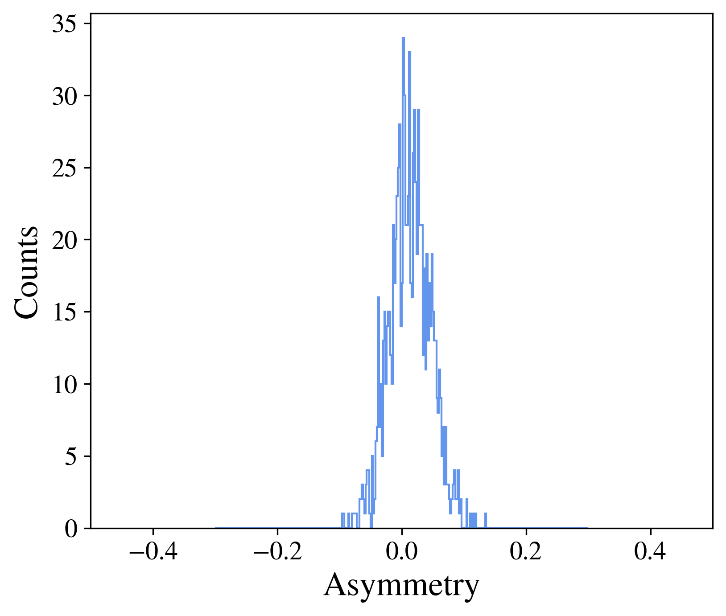
Measuring the polarisation (10% beam polarisation)
10% Polarised Beam (more realistic)
Error on the polarisation measurement taken bunch-by-bunch:
Ran 1M Compton scattering events.
For every 1000 events (1 bunch crossing), calculated the asymmetry of the incident Compton electrons.
Repeated 1000 times, the error on the asymmetry histogram gives the relative error on the polarisation measurement.
Can then estimate error for longer measurement times.
Entries: 1000
Mean: 0.0135
Std Err: 0.0331
Assuming $σ_{A} ∝ \frac{1}{\sqrt{N}}$
$$\text{Relative} \text{Error}= \frac{0.0331}{0.0135}=245\%⇒ \text{To} \text{achieve}\text{ 1\% }\text{error}\text{: }\frac{{245}^{2}}{1^{2}}∙1000≈6.0e7 \text{evts}⇒\text{20}\text{s} \text{data} \text{taking}$$

Slide 42
Photon Sensor

Slide 43
Photon Sensor Structure
Silicon detectors can’t measure the high-energy photons directly, so we need to first convert them into charged particles using a layer of dense material e.g. lead, tungsten.
BDSIM is able to simulate the required particle-matter interactions to predict the showers of secondary particles.

Slide 44
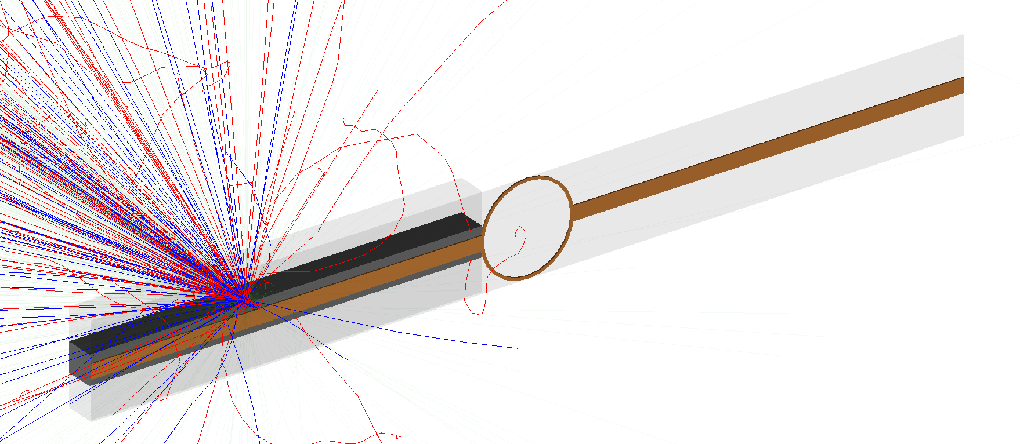
Photon Sensor Structure
Silicon detectors can’t measure the high-energy photons directly, so we need to first convert them into charged particles using a layer of dense material e.g. lead, tungsten.
BDSIM is able to simulate the required particle-matter interactions to predict the showers of secondary particles.
For the following results a 20mm layer of tungsten was used to convert the photons to charged particles.

Slide 45
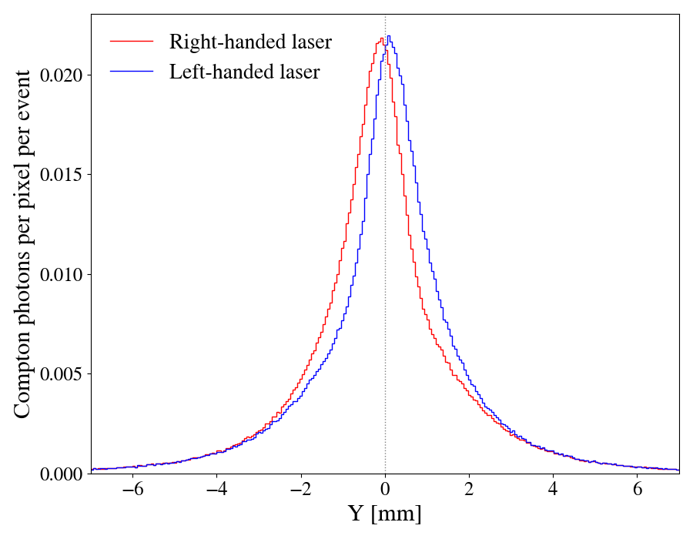

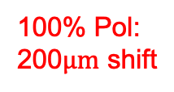
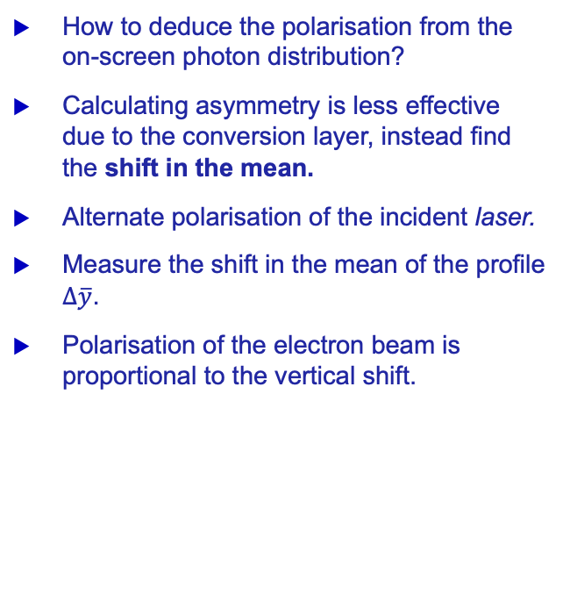


Measuring the polarisation
How to deduce the polarisation from the on-screen photon distribution?
Calculating asymmetry is less effective due to the conversion layer, instead find the shift in the mean.
Alternate polarisation of the incident laser.
Measure the shift in the mean of the profile $∆\overline{y}$.
Polarisation of the electron beam is proportional to the vertical shift.
100% Pol: 200$\text{μ}\text{m}$ shift
$$∆\overline{y}$$
$$∆\overline{y}$$

Slide 46

Measuring the polarisation (100% beam polarisation)
Error on the polarisation measurement taken bunch-by-bunch:
Ran 1M Compton scattering events for both a left-handed (LH) and right-handed (RH) laser.
For every 1000 LH events (1 bunch crossing), made a Gaussian fit to find the mean of the profile, then did the same for 1000 RH events and subtracted one from the other to find $∆\overline{y}$.

Slide 47
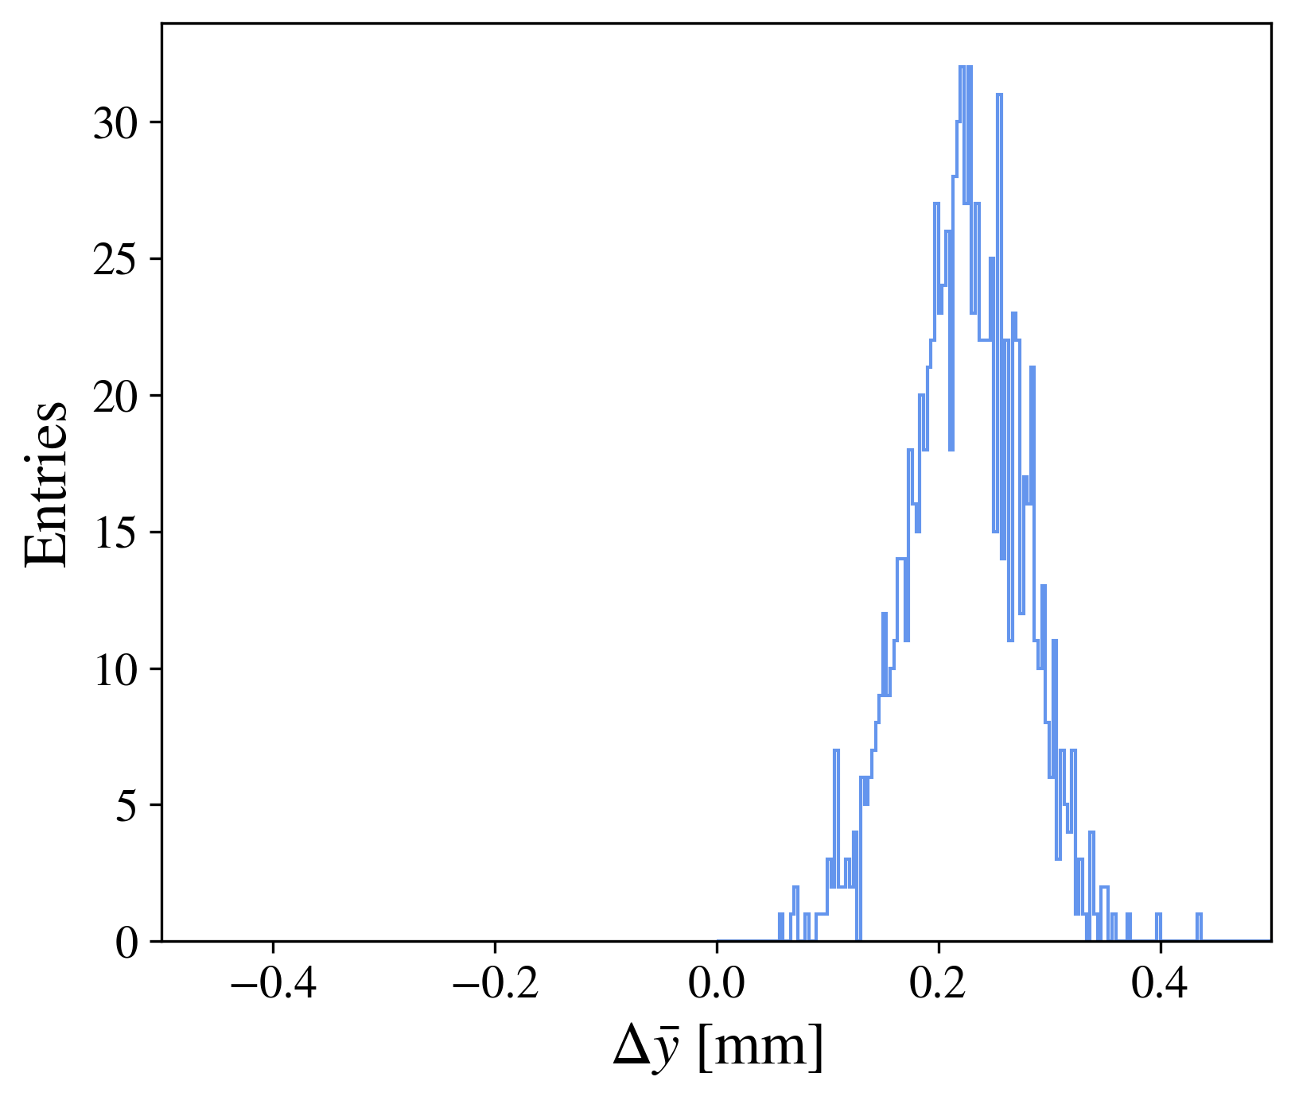
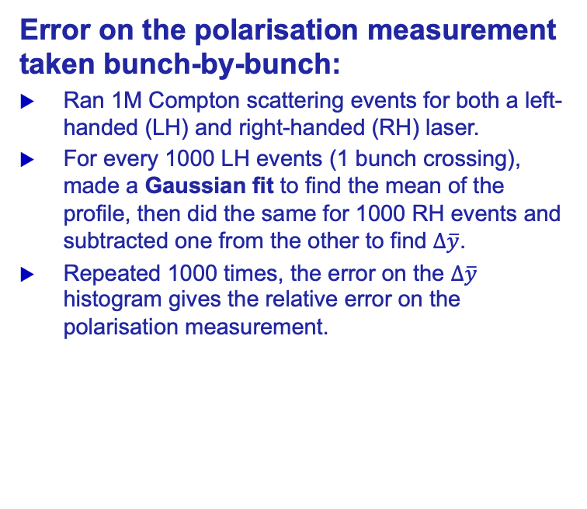
Measuring the polarisation (100% beam polarisation)
100% Polarised Beam (ideal)
Error on the polarisation measurement taken bunch-by-bunch:
Ran 1M Compton scattering events for both a left-handed (LH) and right-handed (RH) laser.
For every 1000 LH events (1 bunch crossing), made a Gaussian fit to find the mean of the profile, then did the same for 1000 RH events and subtracted one from the other to find $∆\overline{y}$.
Repeated 1000 times, the error on the $∆\overline{y}$ histogram gives the relative error on the polarisation measurement.
Entries: 1000
Mean: 0.224
Std Err: 0.051
$$\text{Relative} \text{Error}= \frac{0.051}{0.224}=22.8\%$$

Slide 48
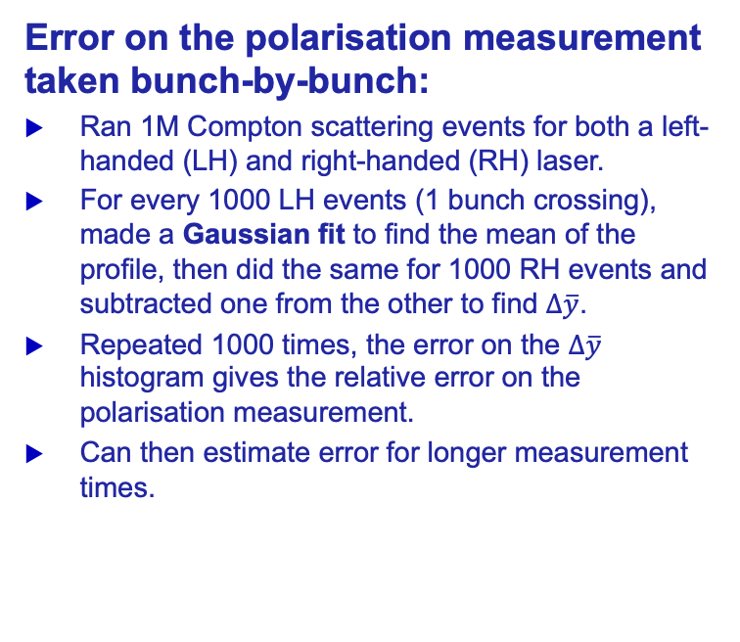

Measuring the polarisation (100% beam polarisation)
100% Polarised Beam (ideal)
Error on the polarisation measurement taken bunch-by-bunch:
Ran 1M Compton scattering events for both a left-handed (LH) and right-handed (RH) laser.
For every 1000 LH events (1 bunch crossing), made a Gaussian fit to find the mean of the profile, then did the same for 1000 RH events and subtracted one from the other to find $∆\overline{y}$.
Repeated 1000 times, the error on the $∆\overline{y}$ histogram gives the relative error on the polarisation measurement.
Can then estimate error for longer measurement times.
Entries: 1000
Mean: 0.224
Std Err: 0.051
Assuming $σ_{Δ\overline{y}} ∝ \frac{1}{\sqrt{N}}$
$$\text{Relative} \text{Error}= \frac{0.051}{0.224}=22.8\%⇒ \text{To} \text{achieve}\text{ 1\% }\text{error}\text{: }\frac{{22.8}^{2}}{1^{2}}∙1000≈5.2e5 \text{evts}⇒0.17\text{s} \text{data} \text{taking}$$

Slide 49
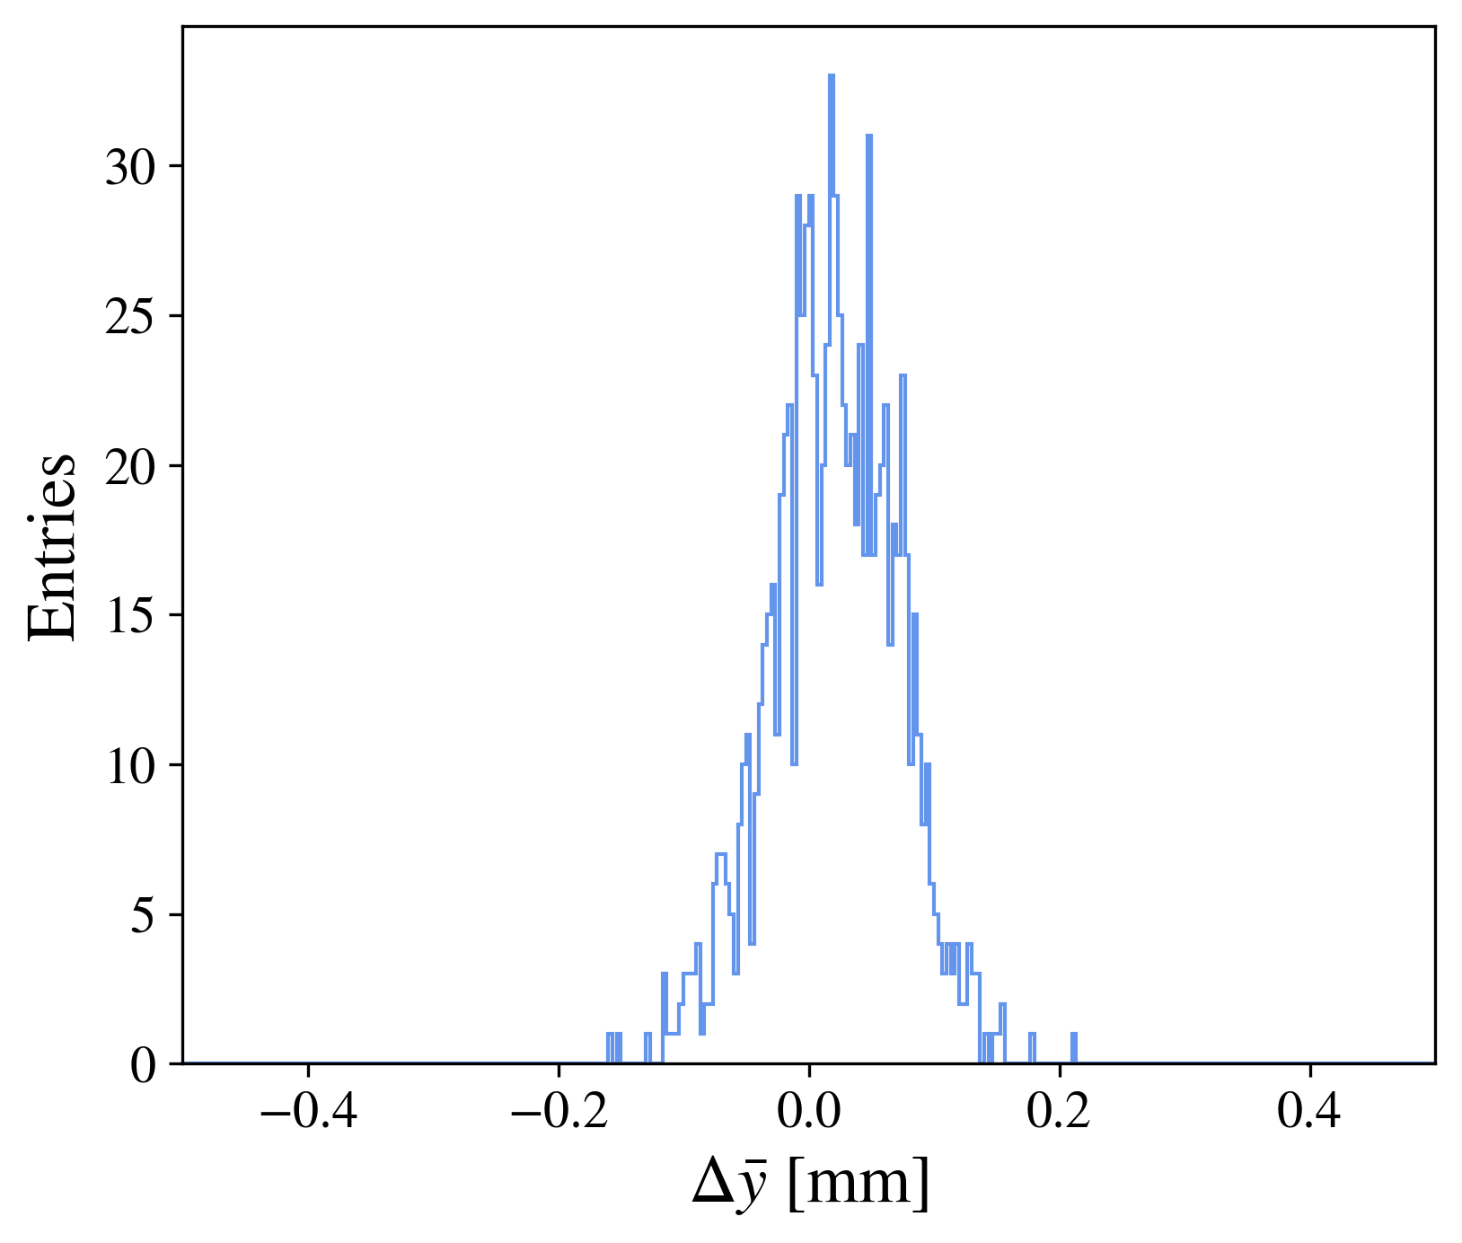
Measuring the polarisation (10% beam polarisation)
10% Polarised Beam (more realistic)
Error on the polarisation measurement taken bunch-by-bunch:
Ran 1M Compton scattering events for both a left-handed (LH) and right-handed (RH) laser.
For every 1000 LH events (1 bunch crossing), made a Gaussian fit to find the mean of the profile, then did the same for 1000 RH events and subtracted one from the other to find $∆\overline{y}$.
Repeated 1000 times, the error on the $∆\overline{y}$ histogram gives the relative error on the polarisation measurement.
Can then estimate error for longer measurement times.
Entries: 1000
Mean: 0.0203
Std Err: 0.051
Assuming $σ_{Δ\overline{y}} ∝ \frac{1}{\sqrt{N}}$
$$\text{Relative} \text{Error}= \frac{0.051}{0.0203}=251\%⇒ \text{To} \text{achieve}\text{ 1\% }\text{error}\text{: }\frac{{251}^{2}}{1^{2}}∙1000≈6.\text{3}\text{e}7 \text{evts}⇒21\text{s} \text{data} \text{taking}$$

Slide 50
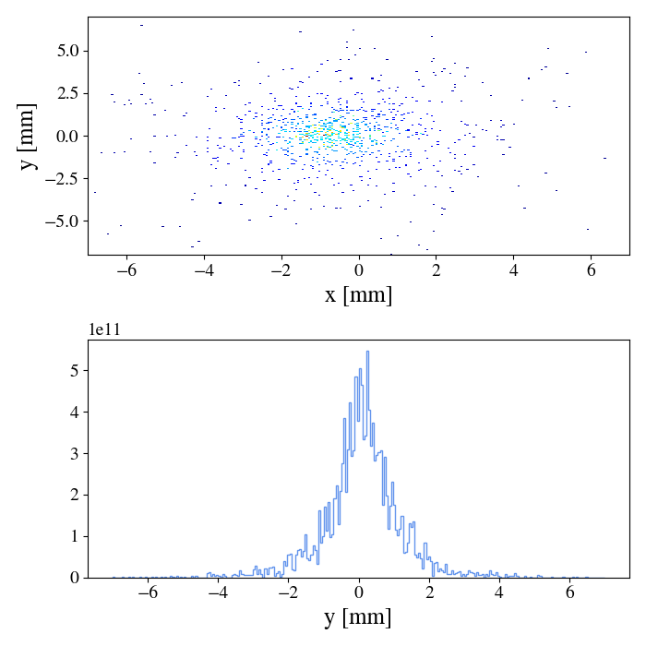
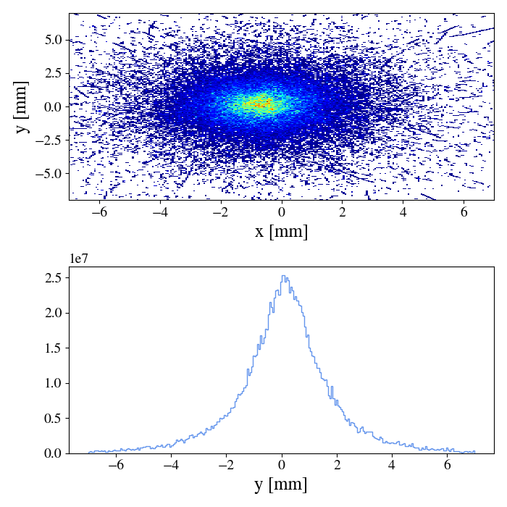

Comparison to sampler
Placed a sampler before the tungsten layer to compare performance of sensor to recording the photon positions directly.
For timepix3 layout of 256x256 pixels, observed a higher error in $∆\overline{y}$ with the sampler than with the more realistic sensor. A brief investigation revealed that it was clear this was merely a result of the sparse binning in the sampler:
Sampler before tungsten
Sensor after tungsten

Slide 51
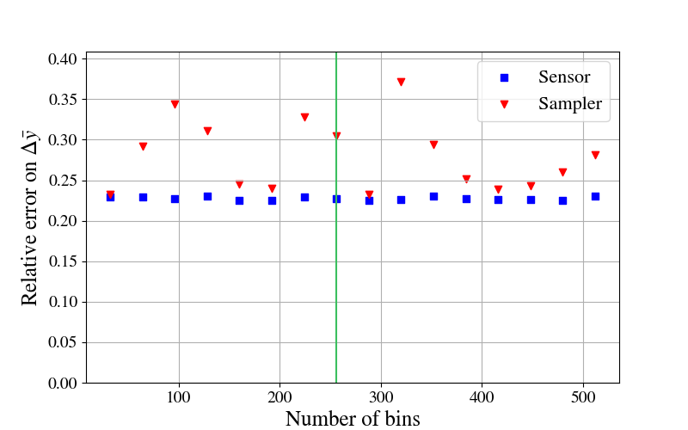
Comparison to sampler
Investigated the effect of changing the number of pixels in the sensor/sampler, looking at a range from 32x32 to 512x512:
Pixel size not a limiting factor for bunch-by-bunch measurements.
Convertor layer actually reduces error for bunch-by-bunch case due to improved statistics.
Timepix3 256x256
100% Pol

Slide 52






Analysis of the profile mean position
Want to choose thickness of tungsten that minimises jitter in the secondary particles profile.
We take the average charged particle position from an unpolarised bunch crossing relative to the average Compton photon position, and bin it to a histogram. Repeat this across many bunch crossings, and find the standard error in this average position.
$$y$$
$$N$$
$$x$$
$$\overline{y}$$

Slide 53

Analysis of the profile mean position
Want to choose thickness of tungsten that minimises jitter in the secondary particles profile.
We take the average charged particle position from an unpolarised bunch crossing relative to the average Compton photon position, and bin it to a histogram. Repeat this across many bunch crossings, and find the standard error in this average position.
$$y$$
$$N$$
$${\overline{y}}_{1}$$
$$x$$
$$\overline{y}$$

Slide 54

Analysis of the profile mean position
Want to choose thickness of tungsten that minimises jitter in the secondary particles profile.
We take the average charged particle position from an unpolarised bunch crossing relative to the average Compton photon position, and bin it to a histogram. Repeat this across many bunch crossings, and find the standard error in this average position.
$$y$$
$$N$$
$${\overline{y}}_{1}$$
$${\overline{y}}_{2}$$
$$x$$
$$\overline{y}$$

Slide 55


Polarisation error assumption
100% Polarised Beam (ideal)
We want to check that the assumption:
$$σ_{Δ\overline{y}} ∝ \frac{1}{\sqrt{N}}$$
is valid.
For measurements of 1000 Compton events at 100% polarisation we found $σ_{Δ\overline{y}}=0.051$.
If the assumption holds then for 10000 Compton events we should get:
$$σ_{Δ\overline{y}}=0.051×\sqrt{\frac{1000}{10000}}=\frac{0.051}{\sqrt{10}}=0.0161$$
When generating a histogram of 1000 samples of 10000 events each, we find that $σ_{Δ\overline{y}}=0.0164$
Assumption appears to hold up to 10000 events, equivalent to 3ms data taking.
Entries: 1000
Mean: 0.230
Std Err: 0.0164

Slide 56

Analysis of the profile mean position
Want to choose thickness of tungsten that minimises jitter in the secondary particles profile.
We take the average charged particle position from an unpolarised bunch crossing relative to the average Compton photon position, and bin it to a histogram. Repeat this across many bunch crossings, and find the standard error in this average position.
$$y$$
$$N$$
$${\overline{y}}_{3}$$
$${\overline{y}}_{1}$$
$${\overline{y}}_{2}$$
$$x$$
$$\overline{y}$$

Slide 57


Analysis of the profile mean position
Want to choose thickness of tungsten that minimises jitter in the secondary particles profile.
We take the average charged particle position from an unpolarised bunch crossing relative to the average Compton photon position, and bin it to a histogram. Repeat this across many bunch crossings, and find the standard error in this average position.
Repeat across each layer to find the thickness of tungsten with the smallest error.
$$y$$
$$N$$
$${\overline{y}}_{3}$$
$${\overline{y}}_{1}$$
$${\overline{y}}_{2}$$
$$x$$
$$σ_{\overline{y}}$$
$$\overline{y}$$

