Slide 1



Strategy and Community in Accelerator Science: An ECFA and PPAP Update
Haroon Rafique
ISIS Accelerator Physics Group – Plenary ECFA (UK) – PPAP
IOP PAB Conference, Lancaster
30 July – 1 August 2026

Slide 2
Contents
What is ECFA?
European Strategy for Particle Physics Update²
What is PPAP?
PPAP Role in STFC PPAN Funding Crisis
STFC Engagement with CERN Update
ECR and Student Opportunities
CERN Jobs
Notes:
Update² = update * update

Slide 3


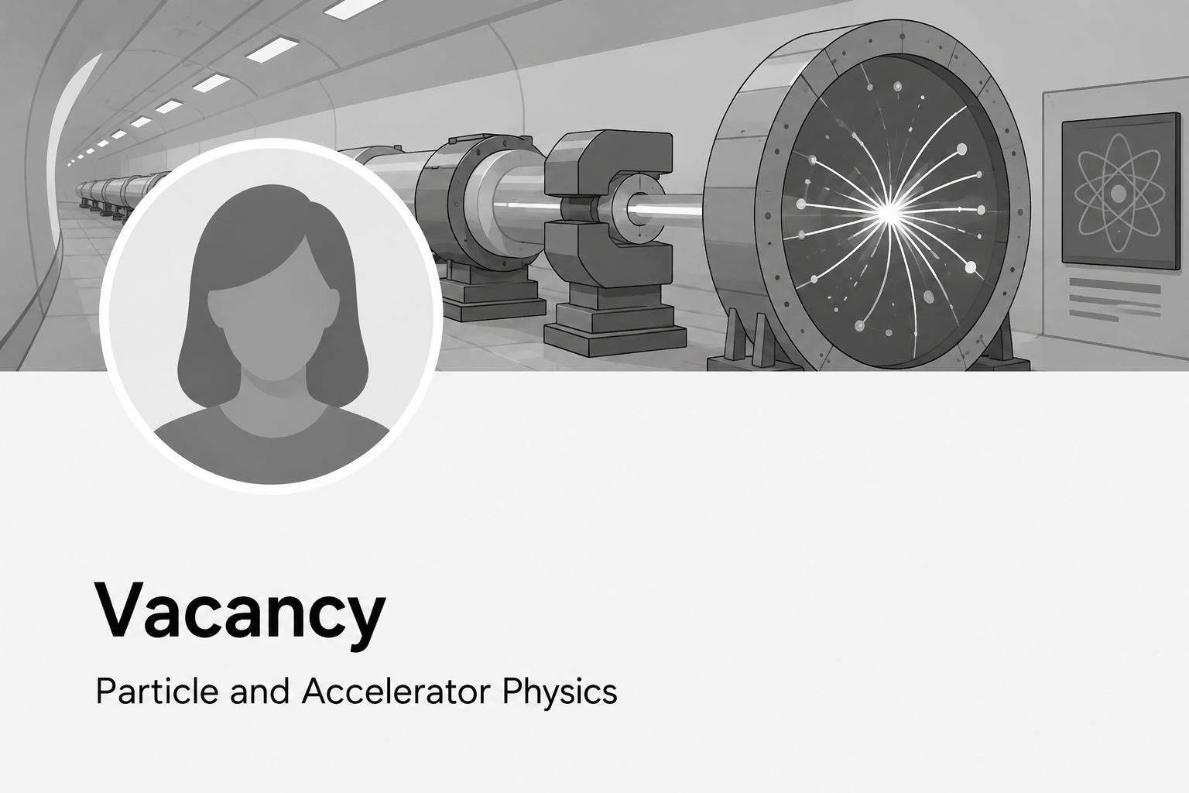
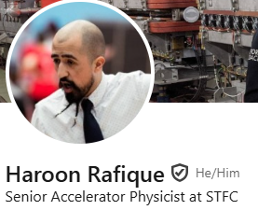
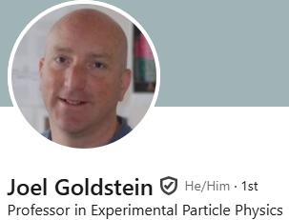
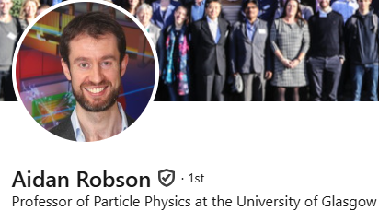
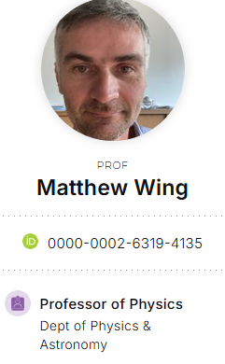
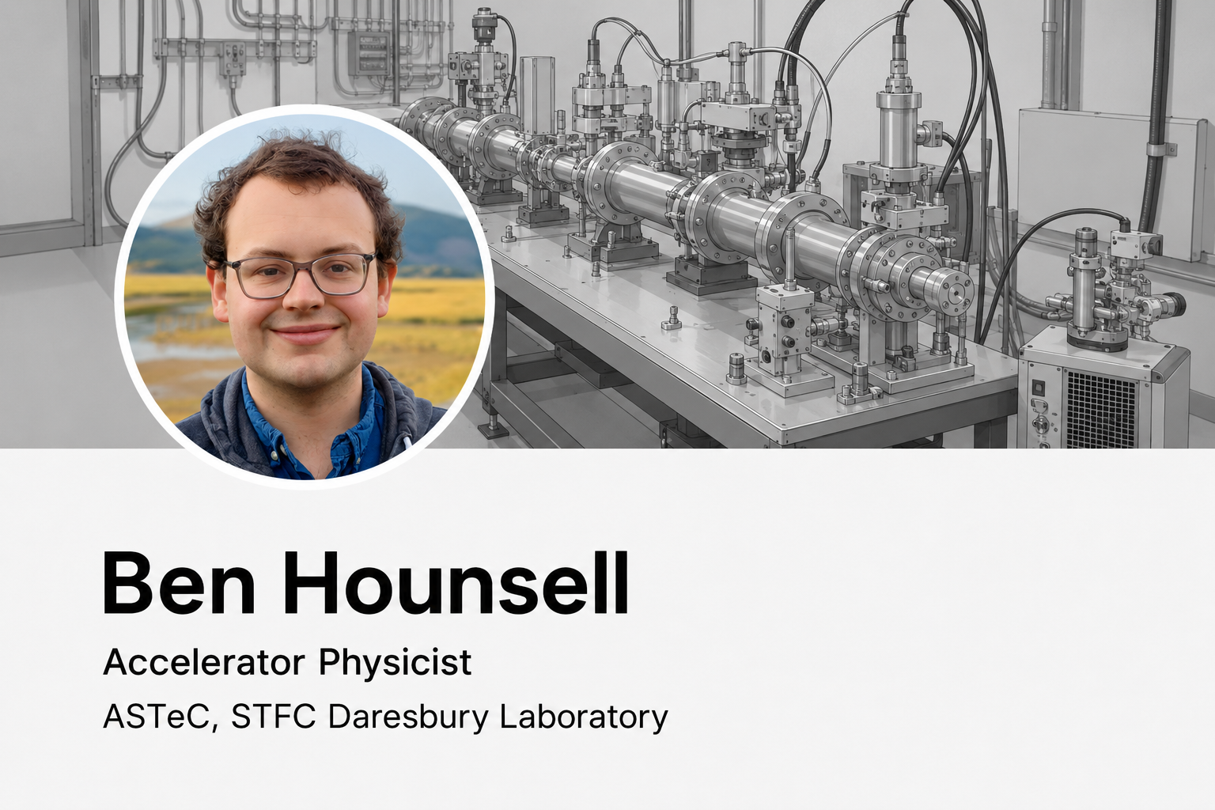

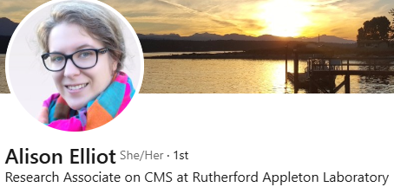
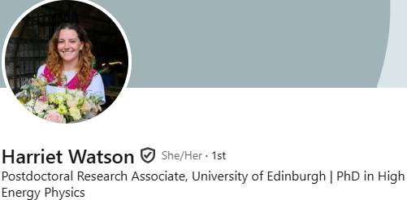
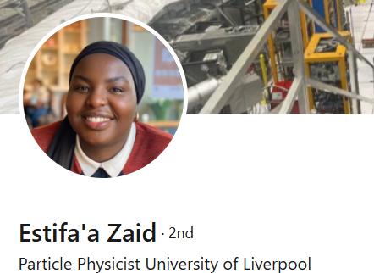
What is ECFA?
Founded 1963 by CERN DG & CERN Scientific Policy Committee to co-ordinate planning of next-generation high-energy accelerators in Europe.
Regular meetings (Plenary & Restricted) to formulate and recommend strategic actions.
Organising symposia and conferences.
Forming ad hoc study groups for specific challenges.
Country visits – issuing recommendations to governments and physics community.
Monitoring strategic plans (European Particle Physics Strategy and its Updates)
A few ‘plenary’ delegates per members state, one RECFA delegate
UK RECFA Delegate
UK Plenary ECFA Delegates
UK ECR ECFA Delegates
Notes:
ECFA functions as the strategic steering committee for Europe’s high-energy accelerator projects—guiding long-range planning, fostering equitable international collaboration, balancing research infrastructure, and ensuring alignment with broader European strategy through continual review and engagement.

Slide 4
2026 Update to the European Strategy for Particle Physics (ESPPU)
4 Nov 2024
UK Drafting Meeting
@ Daresbury Laboratory
14 Nov 2025
Deadline for submission of final community input
26 May 2025
Deadline for submission of additional community input
Sep 2024
CERN Council appoint PPG
Decide on Venice for open symposium
31 Mar 2025
Deadline for submission of main community input
September 2025
PPG submits the ‘Briefing Book’ to ESG
End Jan 2025
ESG submitted draft strategy to CERN Council
23 – 26 Sep 2024
UK Kick-Off Meeting @ Durham University
28 April 2025
UK Drafting Meeting
@ Rutherford Appleton Laboratory
29 October 2025
UK Plan B Meeting
Online
Jun 2026
CERN Council updated the strategy
9 Jan 2025
UK Drafting Meeting
@ University College London
23 -27 June 2025
Open Symposium in Venice
1 – 5 Dec 2025
ESG Strategy Drafting Session in Ascona, Switzerland
ESPPU Timeline
UK Timeline
Notes:
What will CERN build next? What experiments are needed to answer the big questions in physics?
The ESPP is Europe's long-term plan for particle physics. It sets scientific priorities, guides investments in accelerators, experiments, and R&D, and aligns national efforts with global projects.
The ESPPU is the periodic update of the ESPP—typically every 7–8 years. It collects community input, evaluates progress, and recommends future directions.

Slide 5

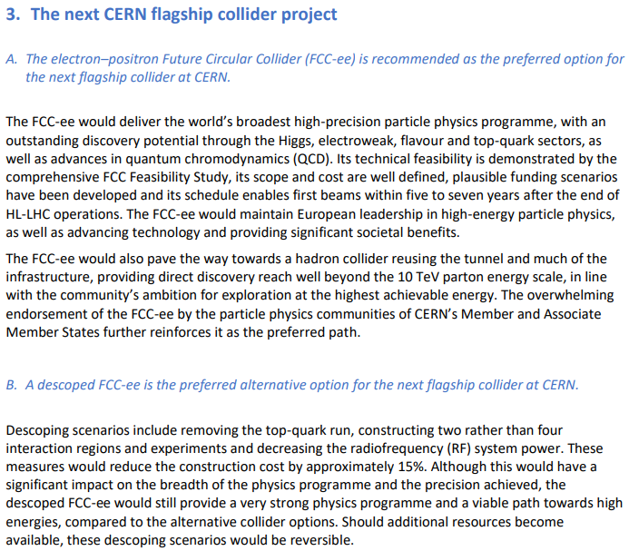
2026 ESPPU

Slide 6
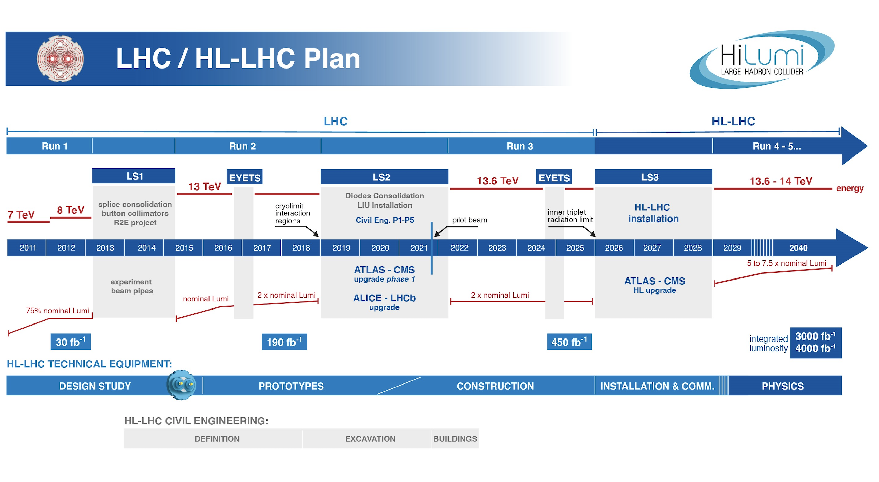
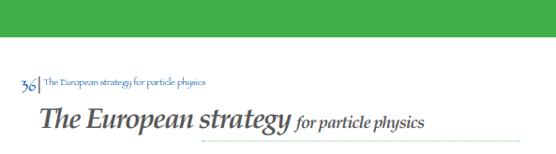
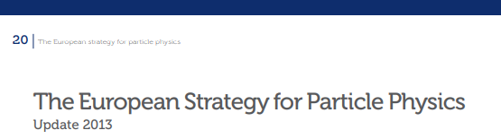

CERN Flagship Timeline
6
2005
ESPP
ESPPU
#1
ESPPU
#2
ESPPU
#3

Slide 7
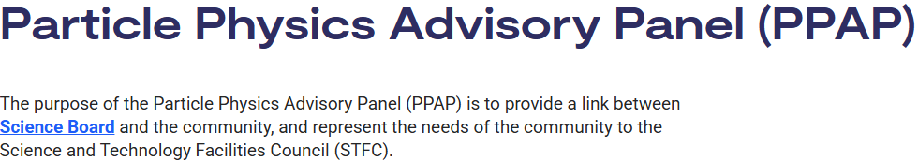
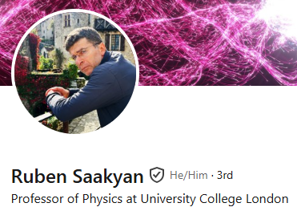
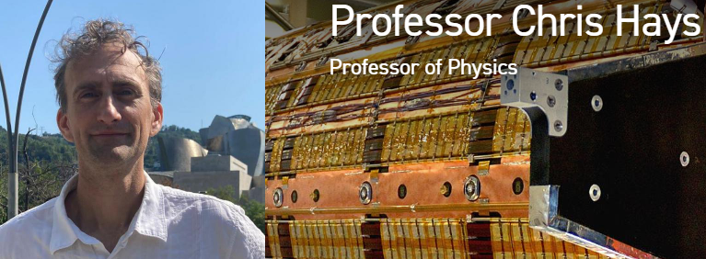

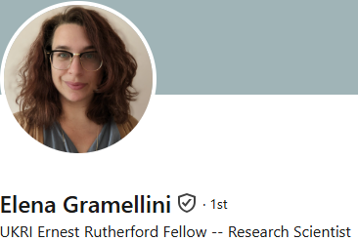



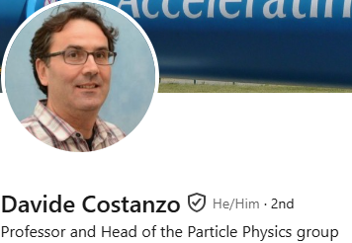
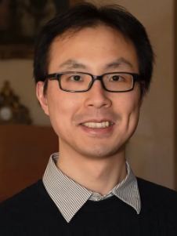

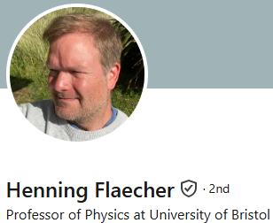


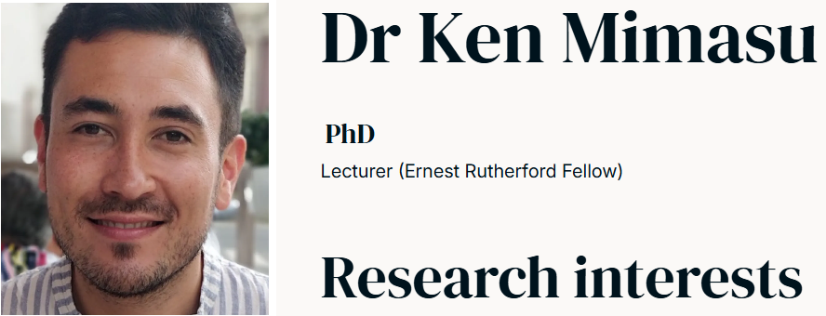
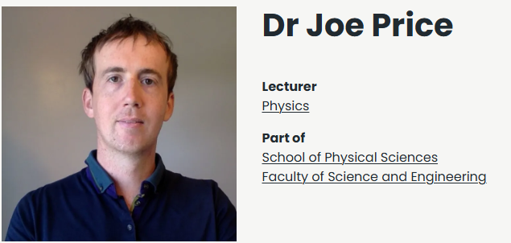
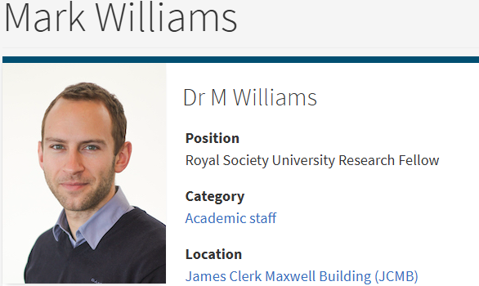



The advisory panel is tasked to:
maintain an overview of activities within the area
develop and maintain a science vision and long term strategy or roadmap by assessing the merit of current and future science opportunities
develop and maintain a technology roadmap for their area of research
consult and interact with the community to ensure its views are canvassed and there is an appropriate and effective route for communication with STFC on strategic programmatic issues
provide advice to Science Board on specific questions as requested
liaise with other advisory panels when appropriate
report on its activities to Science Board on a regular basis using the process set out below: the science strategy developed by the advisory panel will be used by Science Board as input to ongoing strategy development and in future programmatic reviews
consist of a chair and deputy and up to 12 other members, the panel size depending on the size of the community and the need to ensure that the panel membership fully reflects the breadth of the community.
PPAP Members
Notes:
PPAP functions as a link between the Particle Physics Community (+ Acc, + Computing) and STFC Science Board, lately we’ve been doing a lot of communicating and consulting

Slide 8
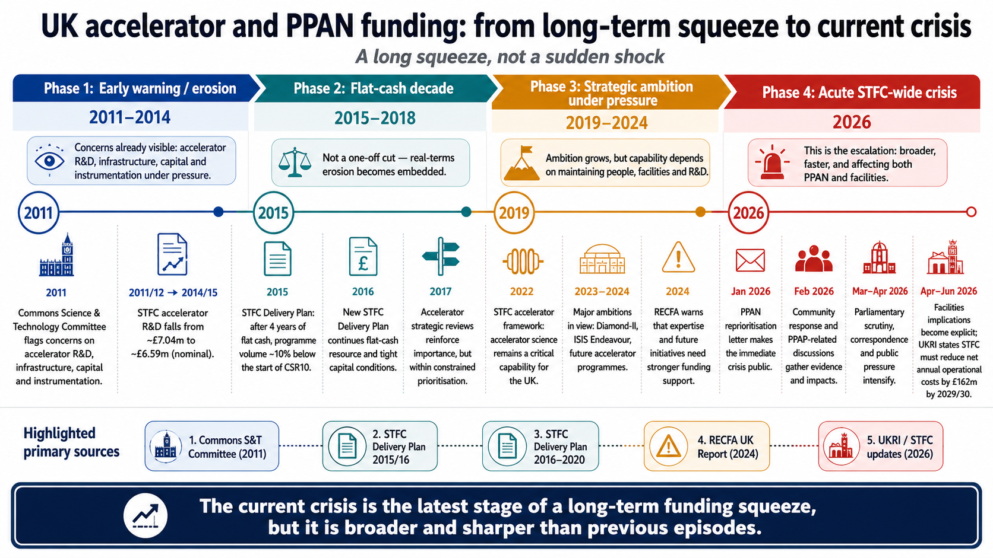

Slide 9
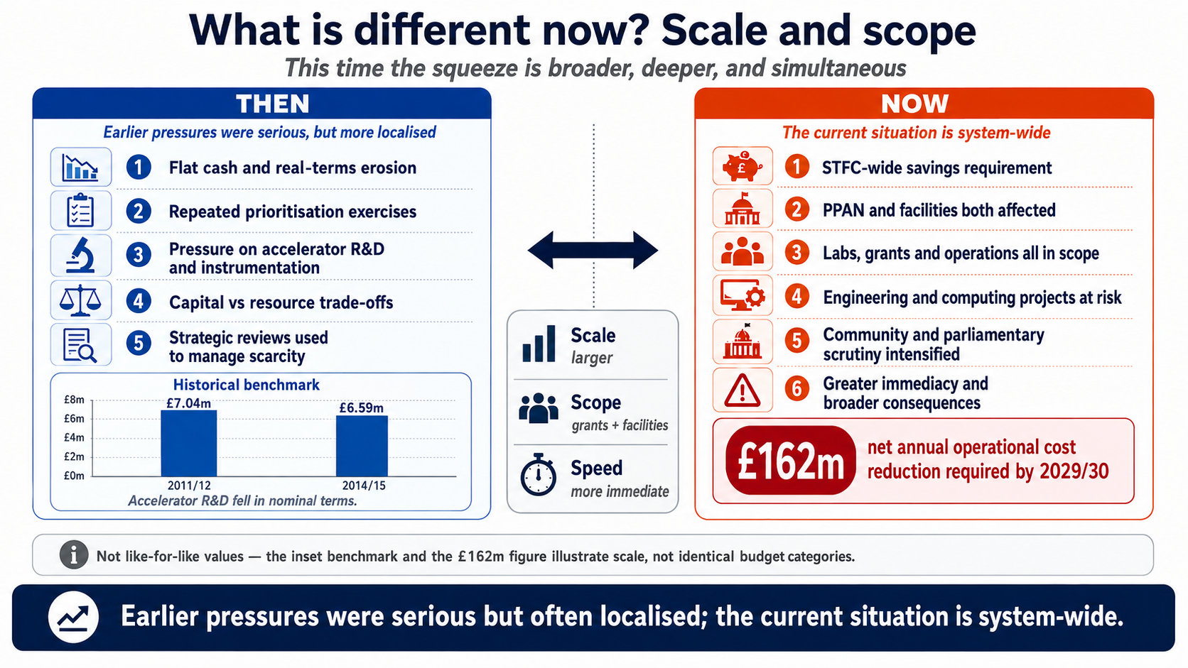

Slide 10
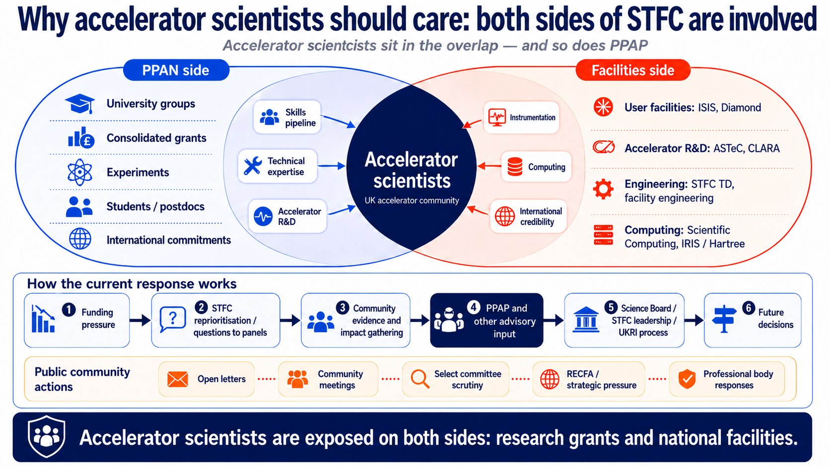

Slide 11


UK Engagement with CERN
UKatCERN@stfc.ukri.org

Slide 12
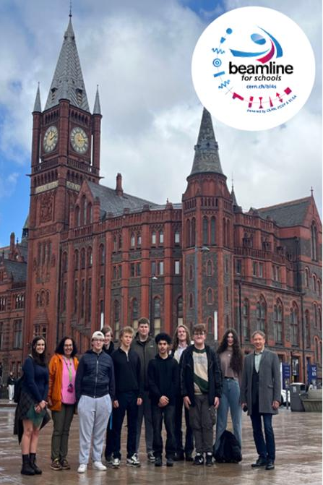
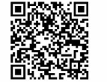
Recent Progress
Beamlines for Schools – UK win
UK representation in key positions at CERN and its governance (DG, Chair of SPC, TREF, ILO Forum, etc.)
Improvements in skills return with UK ranked 2nd for new hires (13.4%) in 2025 driving shift from ‘poorly’ to ‘moderately’ balanced status.
A UK school has been successful in CERN’s Beamlines for Schools programme. The team, from Liverpool University School for Maths will get access to DESY beamline to carry out their experiments.
Scientific Computing: theory and practice – University of Liverpool (23rd August – 5th September)
Skills at CERN
Strong UK Representation
Opportunities for Students – CERN schools
Thematic CERN School of Computing on Security – STFC, Abingdon (27th September – 3rd October) – Applications open until 1st July

Slide 13
CERN ECR and Student Opportunities
ECR:
Are you a recent graduate from a university, technical college, or vocational programme with less than two years of post-graduation experience?
The Origin Programme offers early-career technicians, engineers, and physicists the chance to work in a world-class research environment, gaining hands-on experience and building a strong foundation for the future.
Open year-round
Opportunities across multiple disciplines
Know someone who’d be a great fit? Share this with them! Full vacancy list here
Students:
Find out more about the opportunities available to students on the CERN website:
Technical Student Programme
Doctoral Student Programme
Administrative Student Programme
Applications open next in early October for early 2027 start dates.

Slide 14
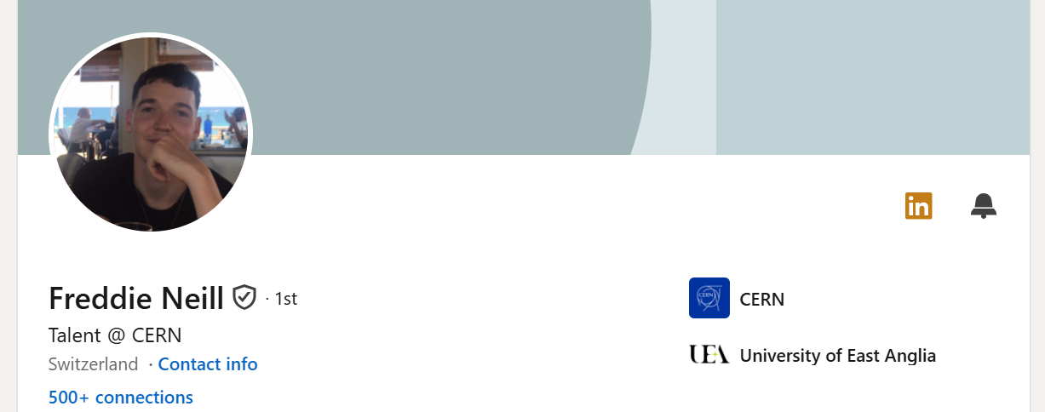
CERN Staff Opportunities
Reach out to Freddie on LinkedIn to discuss opportunities at CERN

Slide 15

Please share:
Really exciting to see the CERN Introduction to Accelerator Physics School being hosted here in the UK!
The two-week course, held in Peebles, is a collaboration between CERN and the Institute for Particle and Nuclear Physics at the University of Edinburgh.
Open to postgraduate students and those working across accelerator labs, academia, and industry, this is a brilliant opportunity to gain core knowledge in accelerator physics and connect with the wider community.
Definitely worth a look if you’re in the field - or know someone who is.
https://indico.cern.ch/event/1622828/

Slide 16
Get Involved
🌟 Share Your CERN Success Stories
Have a great CERN-related achievement or impact story? Help us showcase the value of UK investment in CERN by sharing it with us!
👥 Become a UK CERN Champion
Support CERN HR by promoting studentships, fellowships, ORIGIN, and QUEST opportunities in UK universities.
📧 Contact: career.events@cern.ch
Contact:
UKatCERN@stfc.ukri.org
Science and Technology Facilities Council
@STFC_matters
Science and Technology Facilities Council

Slide 17
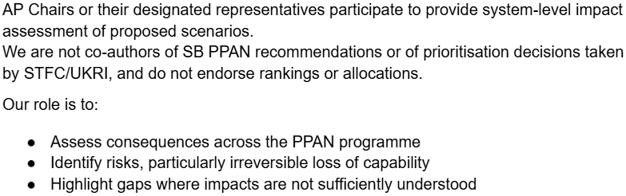
Summary
ECFA:
  European Strategy for Particle Physics aims for an FCC-ee flagship at CERN
PPAP:
  Communicating with the Particle Physics (+ enabling tech: Accelerators, Computing, Detectors…) community to assess/identify the impact of funding changes
CERN:
  ECR and Student opportunities
  Staff positions
  CERN Accelerator School @ Edinburgh
Role of advisory panels in PPAN prioritisation

Slide 18
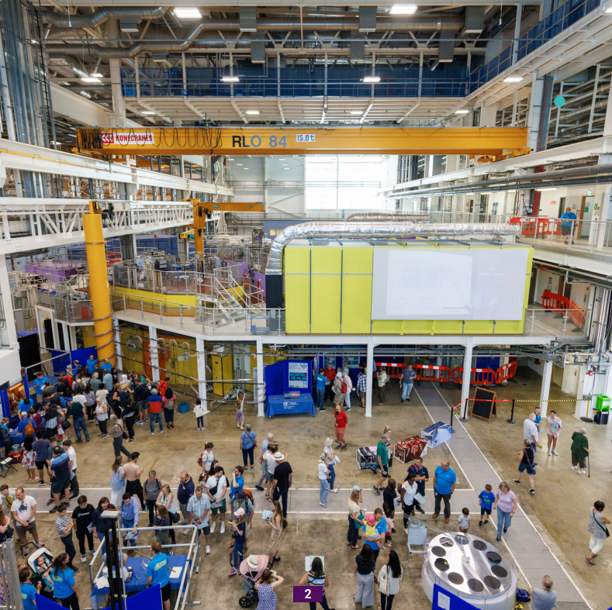
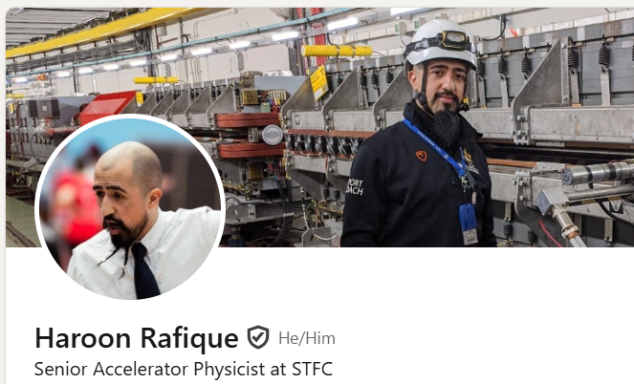
Haroon.Rafique@stfc.ac.uk
Thank you
Questions?
2024 RAL Open Days: ISIS Target Station 2 Accelerator Zone #WheresWally #WheresWaldo
Connect with me on LinkedIn

