Slide 1





Electro-Optic Spectral Interferometry as a longitudinal bunch profile monitor
Samuel Norman^{1,2}, Collette Pakuza³, Thibaut Lefevre³, Michele Bergamaschi³, David Walsh^{2,4}, Morgan Hibberd^{1,2}
¹The University of Manchester
²Cockcroft Institute
³CERN
⁴STFC Accelerator Science and Technology Centre

Slide 2
Desirable Profiler Qualities
100-200 fs resolution
Compact
Low “facility footprint”
Non-destructive
Single Shot
High measurement rate (e.g. FELs operate at MHz)
Transverse Deflecting Cavity
Wall Current Monitor
Samuel Norman
PAB 2026
Slide 2

Slide 3
Electro-Optic Mechanism
Bunch Coulomb Field Profile
[001]
[-110]
Electron Bunch
Chirped Laser Pulse
EO Crystal
Samuel Norman
PAB 2026
Slide 3

Slide 4

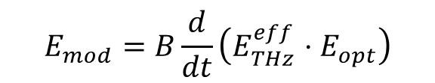
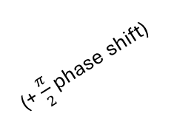
Electro-Optic Mechanism
[001]
[-110]
$$E_{mod}=B\frac{d}{dt}\left(E_{THz}^{eff}⋅E_{opt}\right)$$
$$E_{mod}∝E_{THz}^{eff}⋅E_{opt}$$
(+ $\frac{π}{2}$ phase shift)
S. P. Jamison et al. “Temporally resolved electro-optic effect”, Optics Letters, 2006
Samuel Norman
PAB 2026
Slide 4

Slide 5
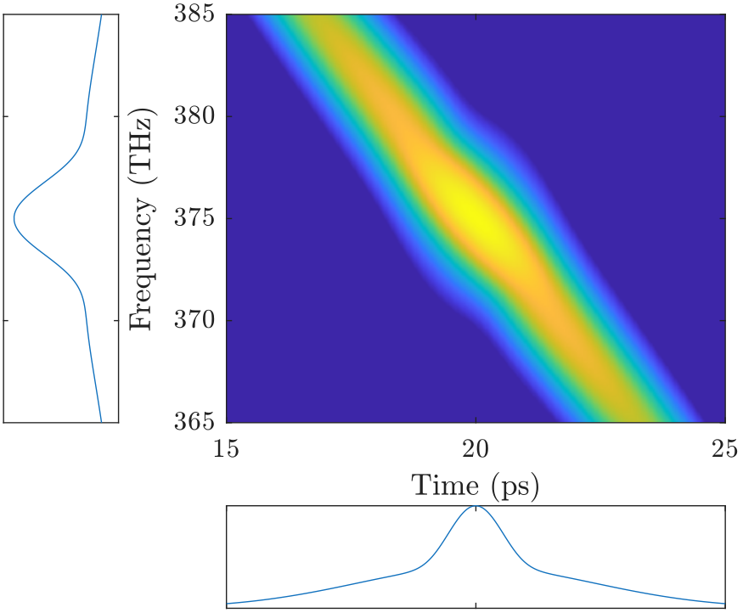
Electro-Optic Mechanism
Samuel Norman
PAB 2026
Slide 5

Slide 6
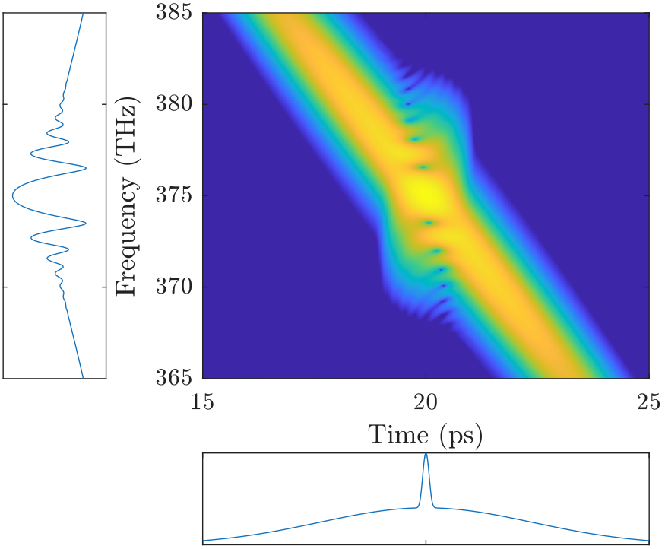

Electro-Optic Mechanism
$$T_{min}≈\sqrt{T_{trans−limited}⋅T_{chirped}}$$
Samuel Norman
PAB 2026
Slide 6

Slide 7
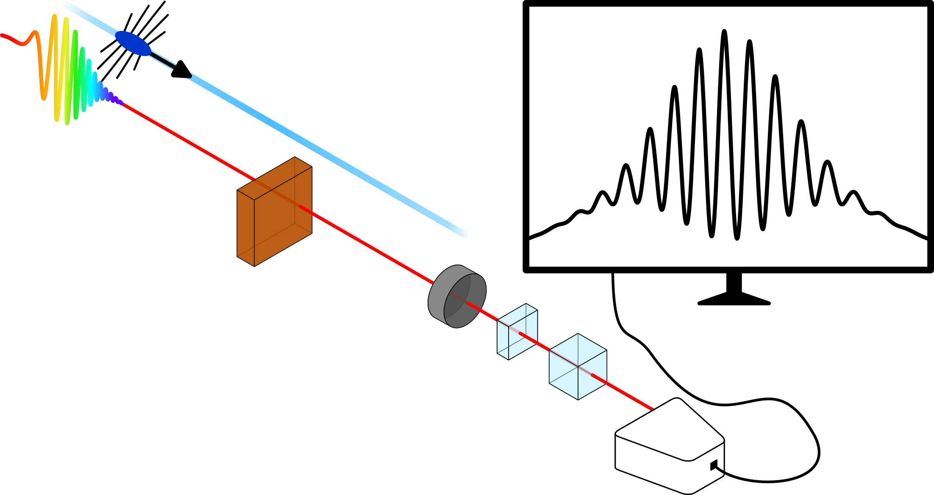
Layout
Electron Bunch
Chirped Laser Pulse
EO Crystal
QWP
α-BBO
Polariser
Spectrometer
Samuel Norman
PAB 2026
Slide 7

Slide 8
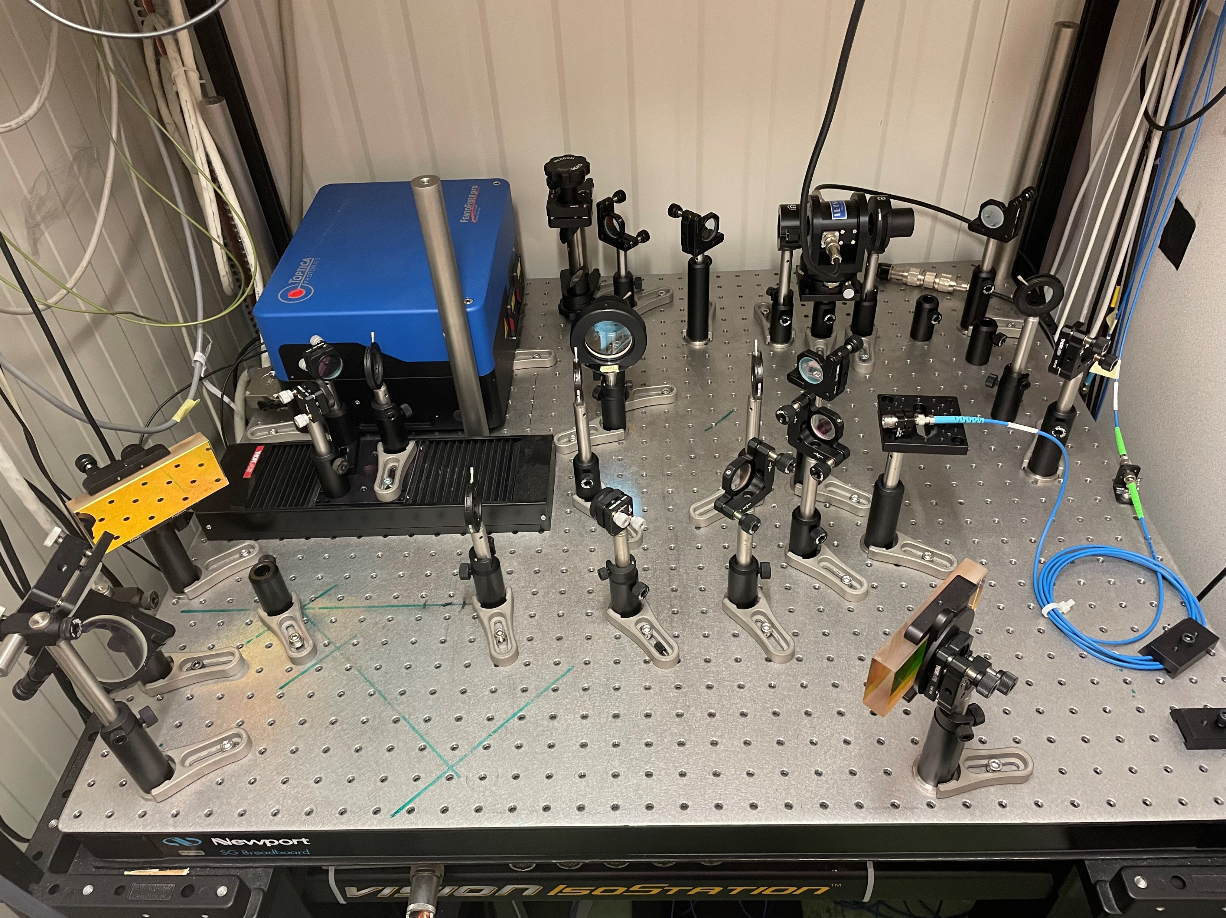
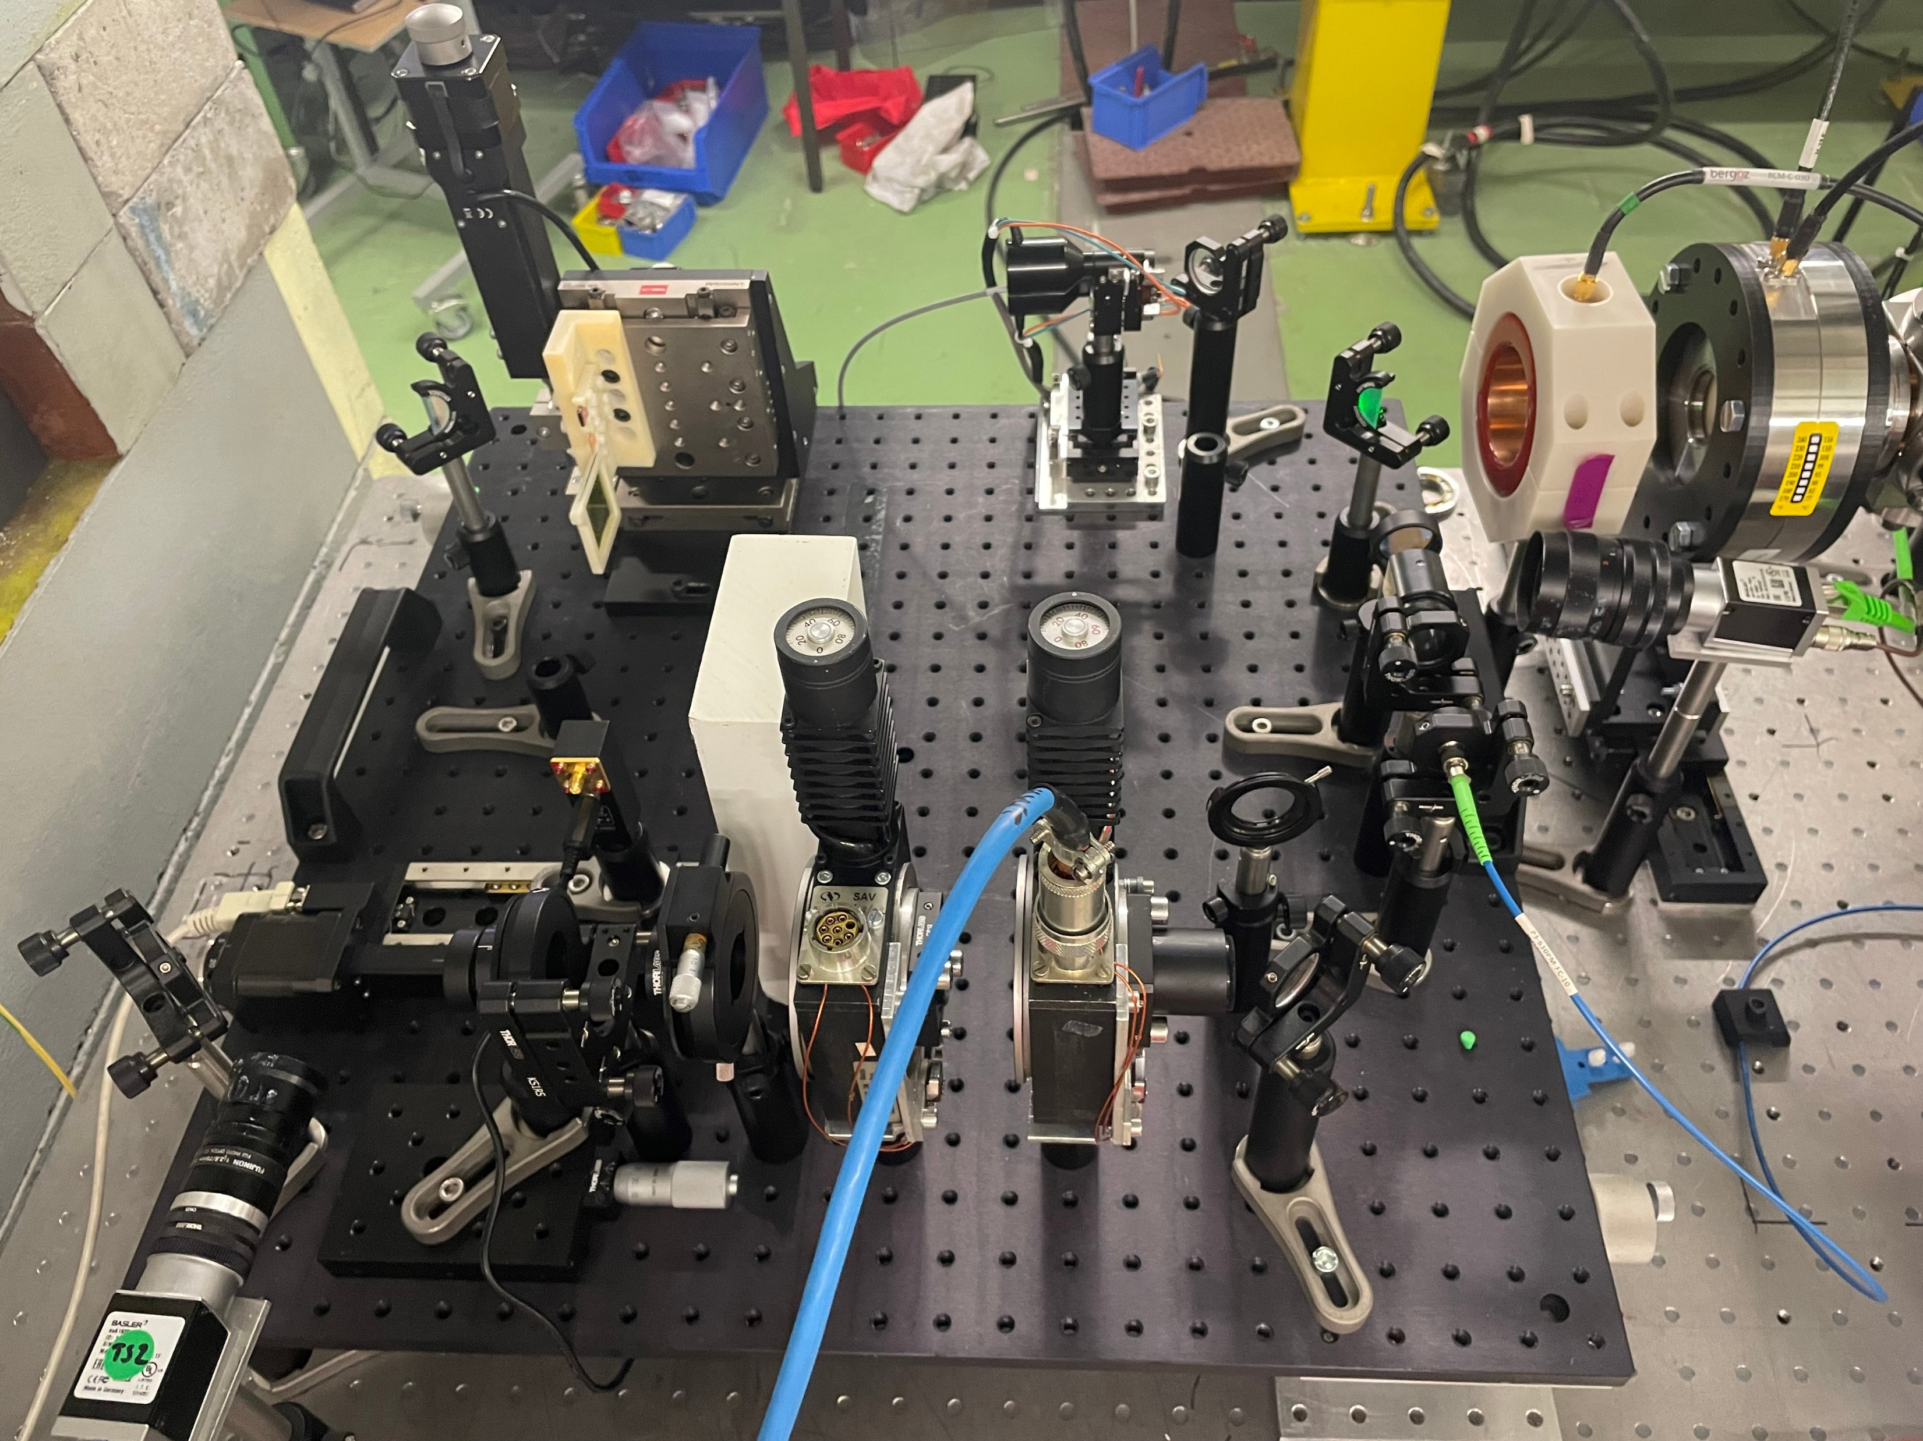
Layout
Samuel Norman
PAB 2026
Slide 8

Slide 9
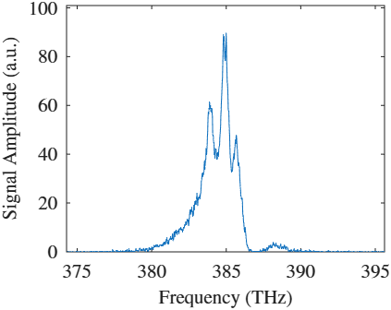
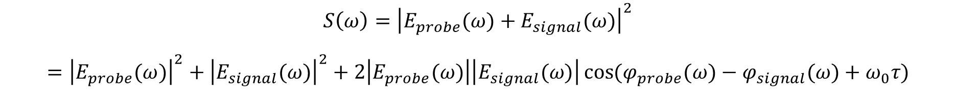
EOSI – The Process
$$S\left(ω\right)={\left|E_{probe}(ω)+E_{signal}(ω)\right|}^{2}$$
$$={\left|E_{probe}(ω)\right|}^{2}+{\left|E_{signal}(ω)\right|}^{2}+2\left|E_{probe}(ω)\right|\left|E_{signal}(ω)\right|\cos{(φ_{probe}(ω)−φ_{signal}(ω)+ω_{0}τ)}$$
Samuel Norman
PAB 2026
Slide 9

Slide 10
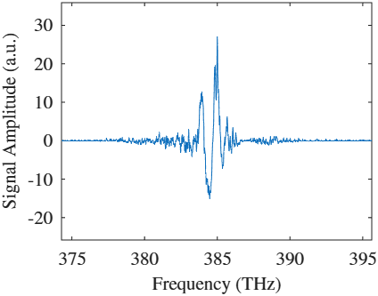
EOSI – The Process
$$S\left(ω\right)={\left|E_{probe}(ω)\right|}^{2}+{\left|E_{signal}(ω)\right|}^{2}+2\left|E_{probe}(ω)\right|\left|E_{signal}(ω)\right|\cos{(φ_{probe}(ω)−φ_{signal}(ω)+ω_{0}τ)}$$
Samuel Norman
PAB 2026
Slide 10

Slide 11
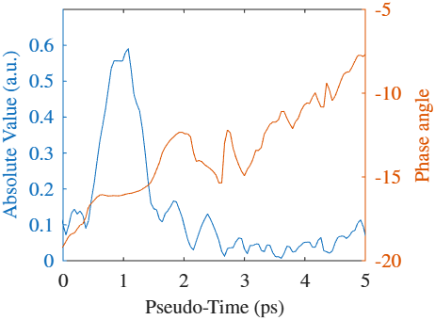
EOSI – The Process
$$S\left(ω\right)={\left|E_{probe}(ω)\right|}^{2}+{\left|E_{signal}(ω)\right|}^{2}+2\left|E_{probe}(ω)\right|\left|E_{signal}(ω)\right|\cos{(φ_{probe}(ω)−φ_{signal}(ω)+ω_{0}τ)}$$
Samuel Norman
PAB 2026
Slide 11

Slide 12
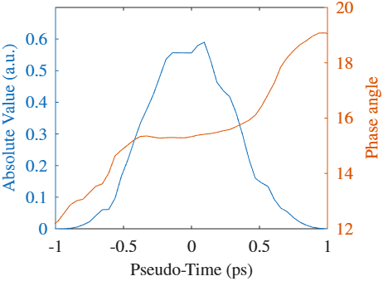
EOSI – The Process
$$S\left(ω\right)={\left|E_{probe}(ω)\right|}^{2}+{\left|E_{signal}(ω)\right|}^{2}+2\left|E_{probe}(ω)\right|\left|E_{signal}(ω)\right|\cos{(φ_{probe}(ω)−φ_{signal}(ω)+ω_{0}τ)}$$
Samuel Norman
PAB 2026
Slide 12

Slide 13
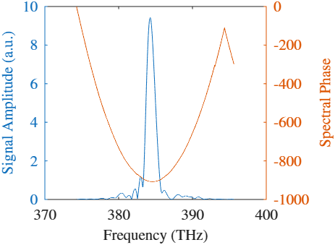
EOSI – The Process
$$S\left(ω\right)={\left|E_{probe}(ω)\right|}^{2}+{\left|E_{signal}(ω)\right|}^{2}+2\left|E_{probe}(ω)\right|\left|E_{signal}(ω)\right|\cos{(φ_{probe}(ω)−φ_{signal}(ω)+ω_{0}τ)}$$
Samuel Norman
PAB 2026
Slide 13

Slide 14
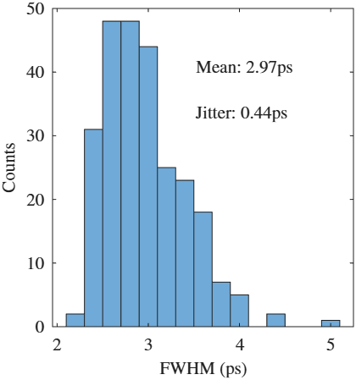
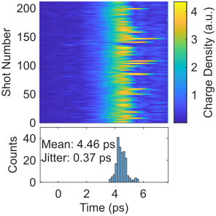
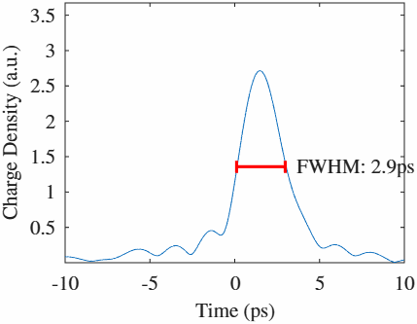
EOSI – CLEAR Results
Bunch: 1.3 ps RMS (3 ps FWHM), 70 pC, 160 MeV
S. N. O. Norman et al. “Fibre-Coupled Oscillator-Driven Electro-Optic Spectral Interferometry as a Longitudinal Bunch Profile Monitor”, IBIC’25, WEPCO40
Samuel Norman
PAB 2026
Slide 14

Slide 15
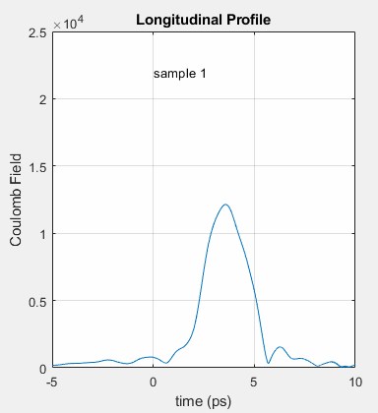
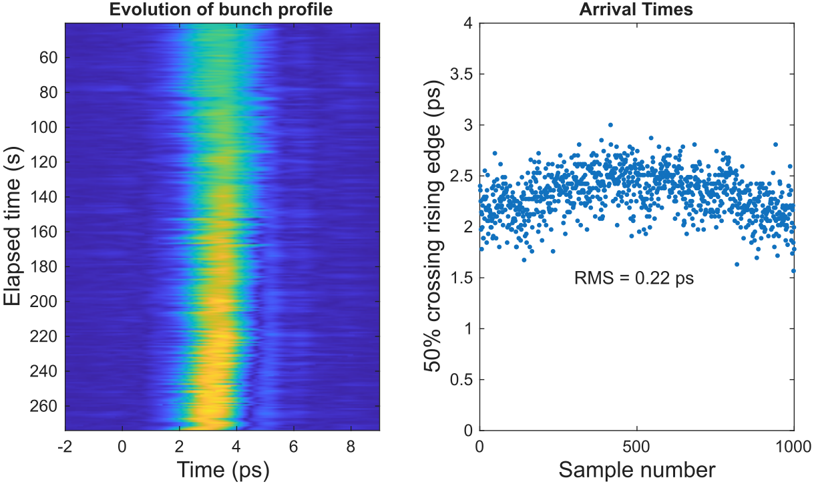
EOSI – CLARA Results
Demonstration of an Electro-Optic Spectral Interferometry Longitudinal Profile Monitor at Clara – D. Walsh et al., IPAC 2023, THPL171
Samuel Norman
PAB 2026
Slide 15
Notes:
Add note that this was at CLARA
Bunch variation was due to thermal instability and associated RF phase/power drift

Slide 16
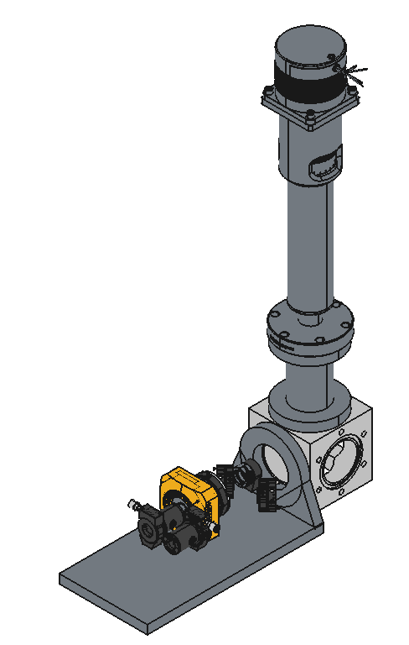
The Future - Implementation
AWAKE – CERN
  Measure and monitor the 200 fs witness bunch prior to injection
CLARA – Daresbury
  Use EOSI as experimental diagnostic to observe reduction in timing jitter as well as bunch profile
40 cm
7 cm
e⁻
Laser
20 cm
Samuel Norman
PAB 2026
10 cm
Slide 16

Slide 17
Desirable Profiler Qualities
100-200 fs resolution
Compact
Low “facility footprint”
Non-destructive
Single Shot
High measurement rate (e.g. FELs operate at MHz)
Samuel Norman
PAB 2026
Slide 17

Slide 18
Summary – EOSI Capabilities
100-200 fs resolution – 195 fs measured on CLARA
Single Shot – Each profile measured independently
Compact – Just a few centimetres of beamline
Non-destructive – electrons are not intercepted
High measurement rate – Trivial computer calculations allow for live monitoring at 10+ Hz
Low facility footprint – small laser pulses used
Laser Synchronisation – Arrival times provided relative to a laser
Samuel Norman
PAB 2026
Slide18

Slide 19
Any Questions?
Our Publications:
D. Walsh et al. “Demonstration of an Electro-Optic Spectral Interferometry Longitudinal Profile Monitor at Clara”, IPAC 2023, THPL171
S. N. O. Norman et al. “Fibre-Coupled Oscillator-Driven Electro-Optic Spectral Interferometry as a Longitudinal Bunch Profile Monitor”, IBIC’25, WEPCO40

