Slide 1






Development of a compact terahertz-driven transverse streaker for femtosecond electron beam diagnostics
Joseph T. Bradbury^{1,2}
Postdoctoral researcher
j.bradbury3@lancaster.ac.uk
THz beam manipulation systems STFC ESR project
Laurence J. R. Nix^{1,2}, Christopher T. Shaw^{1,2}, Matt Beardsley⁴, Peter Huggard⁴, Robert B. Appleby^{1,3}, Darren M. Graham^{1,3}, Rosa Letizia^{1,2}, Graeme Burt^{1,2}, Steven P. Jamison^{1,2}
1
2
3
4

Slide 2
Contents
Introduction
  Our research group
  Transverse streaking, and why use terahertz (THz)?
Device overview
  Accelerator requirements
  Constituent parts
Contextual literature on THz-driven deflecting structures
Deflection in dielectric-lined waveguides (DLWs)
  DLW geometry
  Dispersion
  THz source
  EM fields
DLW optimisation
  Figures of merit
  Beam size and field uniformity
  Manufacturing tolerances and tuning
  Multi-objective optimisation
Conclusions
Questions
Institute of Physics Particle Accelerators and Beams conference, 30th June 2026, Lancaster, Joseph Bradbury

Slide 3
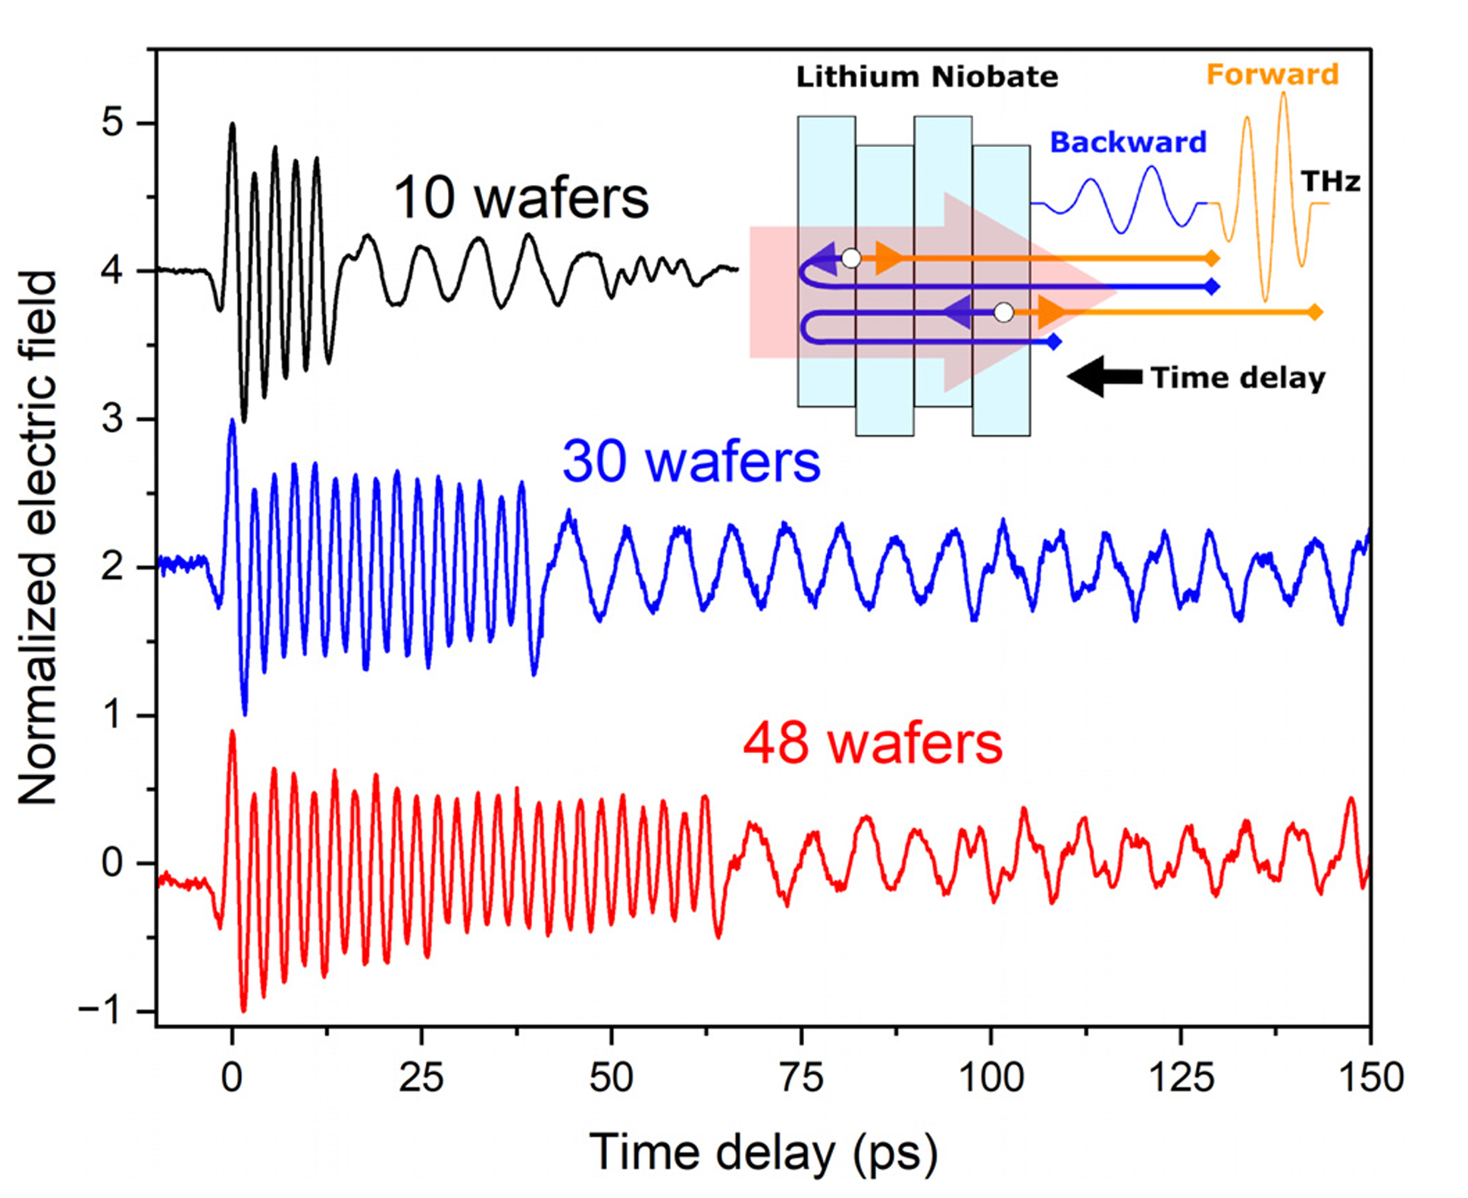
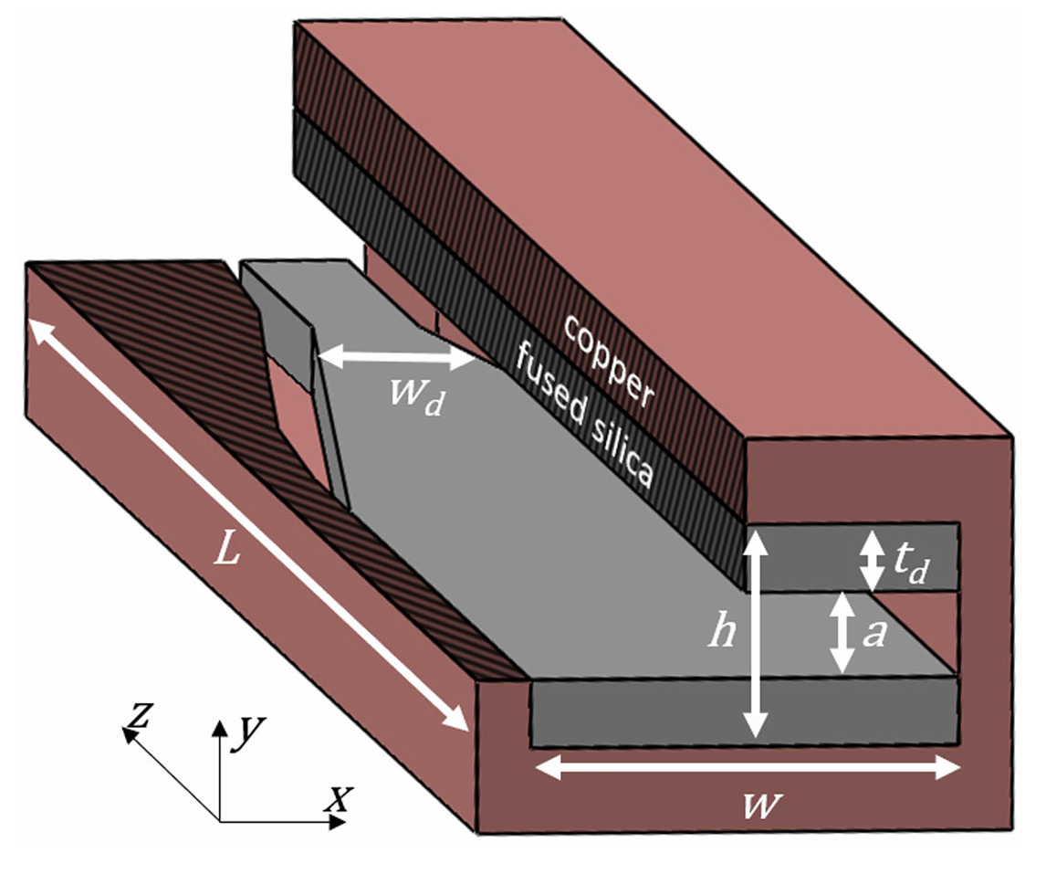
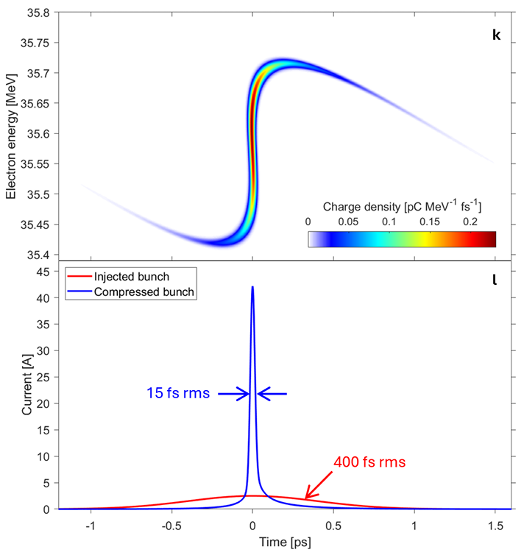
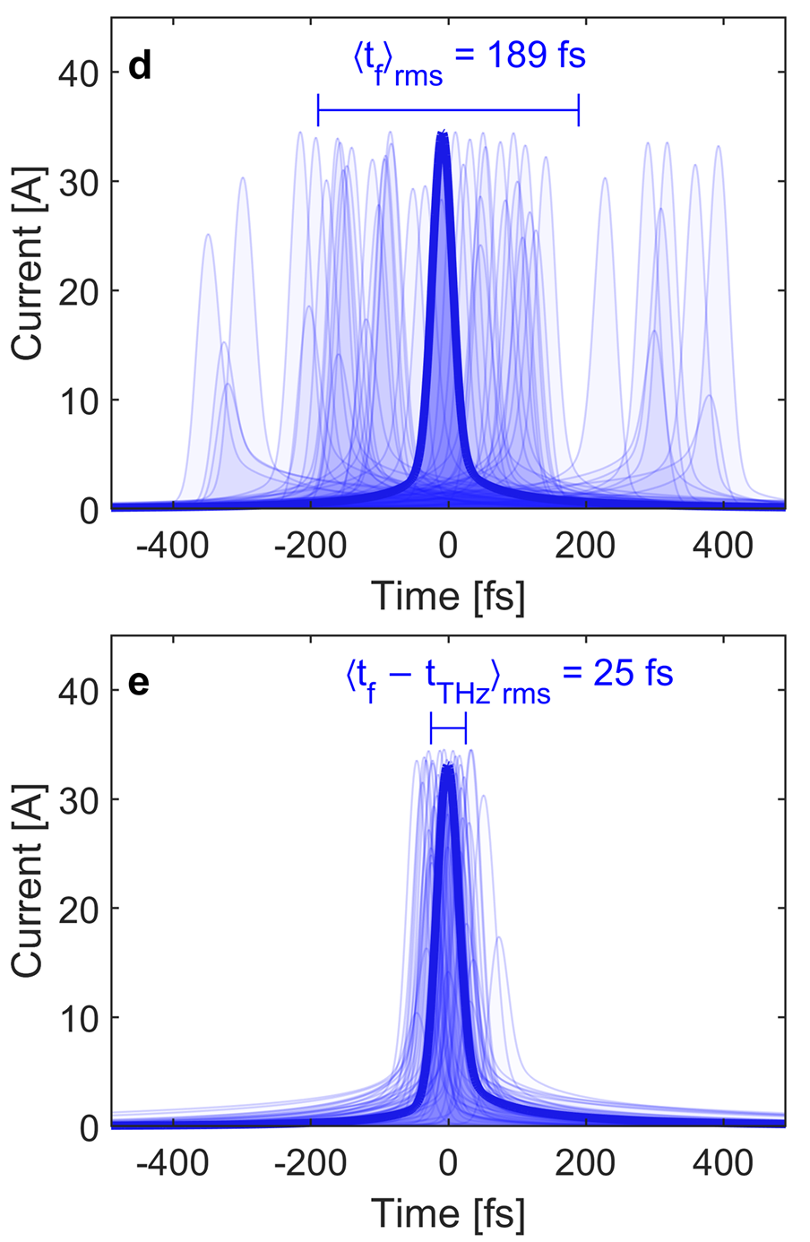
Introduction
The Terahertz Acceleration Group at The Cockcroft Institute
Laser-driven THz generation
THz-driven interaction structures
THz-control of electron beams
Bunch compression
Laser synchronisation
P.J. Dalton et al. “Cryogenically cooled periodically poled lithium niobate wafer stacks for multi-cycle terahertz pulses” Appl. Phys. Lett. 125, 141101 (2024)
L. J. R. Nix et al. “Terahertz-driven acceleration of subrelativistic electron beams using tapered rectangular dielectric-lined waveguides” Phys. Rev. Accel. Beams 27 041302 (2024)
Hibberd, Morgan T., et al. "Terahertz control of relativistic electron beams for femtosecond bunching and laser-synchronized temporal locking" arXiv preprint arXiv:2508.20685 (2025).
Institute of Physics Particle Accelerators and Beams conference, 30th June 2026, Lancaster, Joseph Bradbury

Slide 4
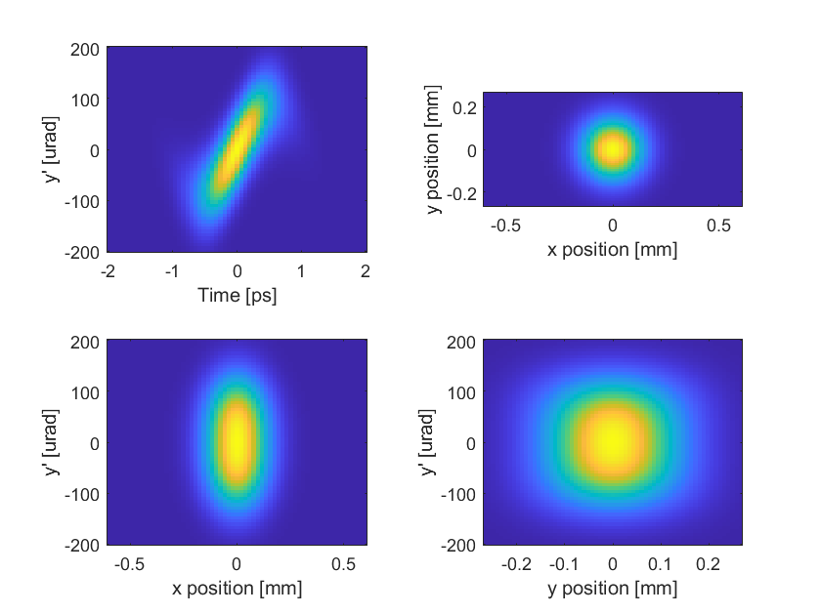
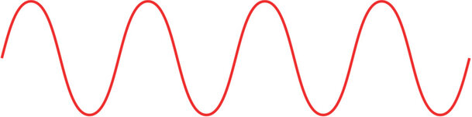
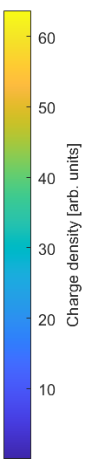
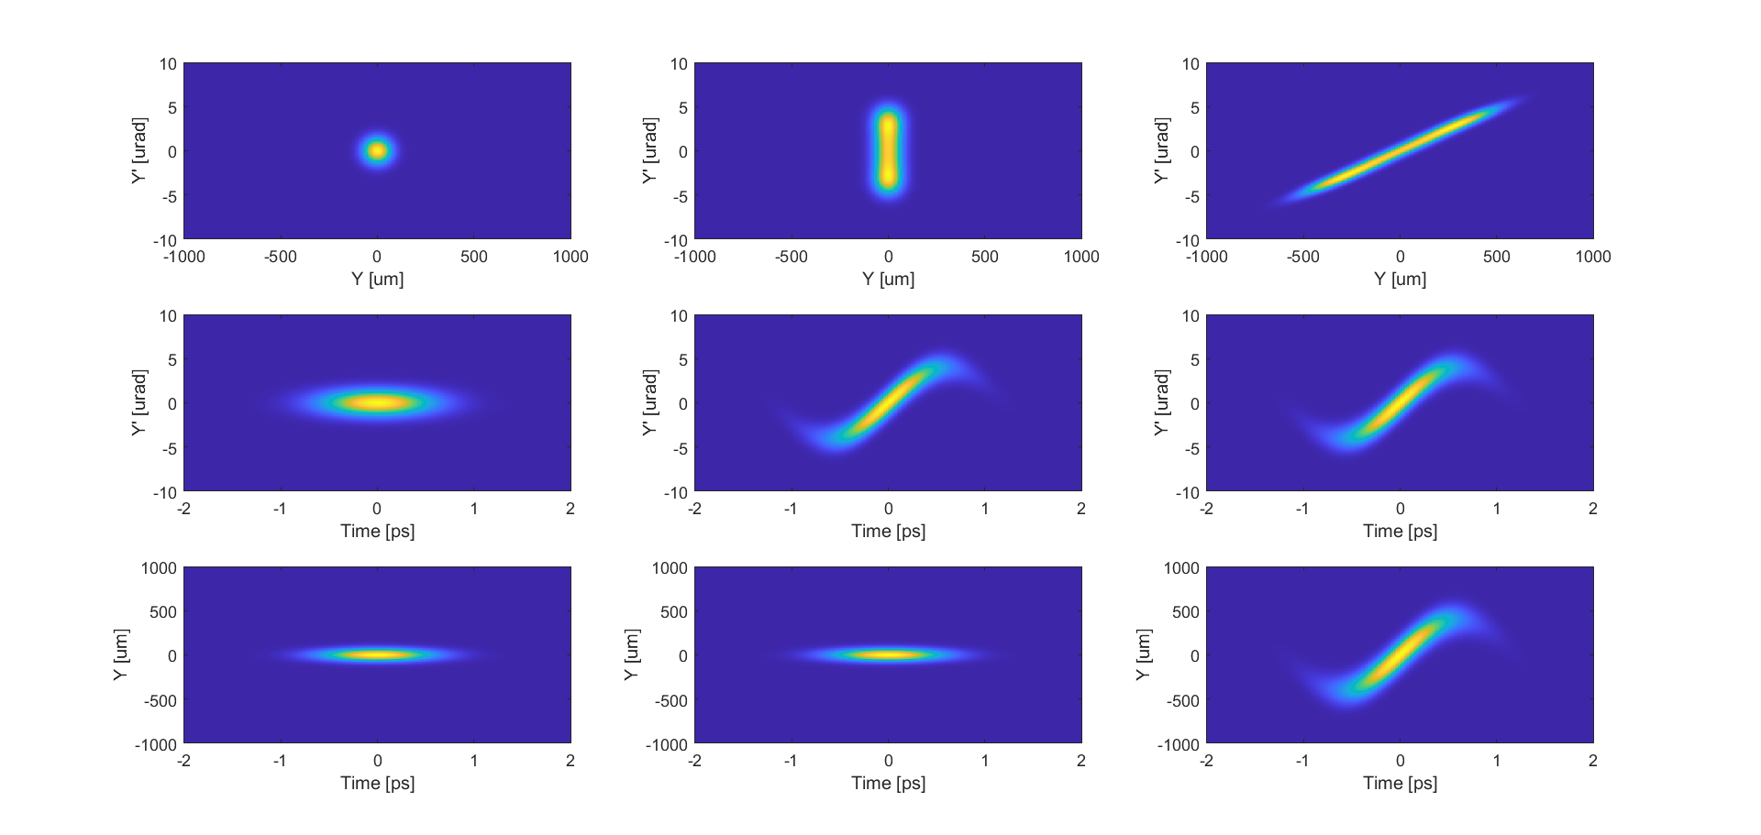
Introduction
Introduction to transverse streaking
Incoming bunch
THz streaker
Detection screen
No significant transverse momentum correlations
Imparts longitudinally dependent transverse momentum
Longitudinal coordinate is mapped transversely onto detection screen
Beam diagnostics utilising transverse streaking
Bunch duration / profile
Bunch arrival time
Longitudinal phase space
Slice measurements
  Emittance
  Energy spread
  Beam size
  + more…
Why use terahertz?
RF-driven: f = 3 GHz – 12 GHz
THz-driven: f = 0.4 THz
Compact cm-scale structures
No costly and bulky klystrons
Intrinsically laser-synchronized
Temporal resolution is proportional to streaking frequency
Institute of Physics Particle Accelerators and Beams conference, 30th June 2026, Lancaster, Joseph Bradbury
4

Slide 5
Device overview: facility requirements
Accelerator facility requirements
Fully relativistic 100 MeV+ electrons
Bunch duration < 1 ps
Emittance ≲ 1mm-mrad
Quadrupole magnets
Beam imaging capability
Quadrupole
magnets
Quadrupole
magnet
Detection
screen
Incoming electron beam
Camera
Ultrafast laser amplifier
10 mJ NIR laser pulses
< 1 ps pulse duration
Incoming laser beam
Institute of Physics Particle Accelerators and Beams conference, 30th June 2026, Lancaster, Joseph Bradbury

Slide 6
Device overview: commercial THz streaker
Accelerator facility requirements
Fully relativistic 100 MeV+ electrons
Bunch duration < 1 ps
Emittance ≲ 1mm-mrad
Quadrupole magnets
Beam imaging capability
Quadrupole
magnets
THz-electron interaction chamber
Quadrupole
magnet
Detection
screen
Incoming electron beam
Camera
DLW interaction structure
Pre-vacuum laser control box
Alignment camera
PPLN THz source
Ultrafast laser amplifier
10 mJ NIR laser pulses
< 1 ps pulse duration
DLW mounting assembly
Incoming laser beam
Optical delay stage
Telescope lenses
Institute of Physics Particle Accelerators and Beams conference, 30th June 2026, Lancaster, Joseph Bradbury

Slide 7
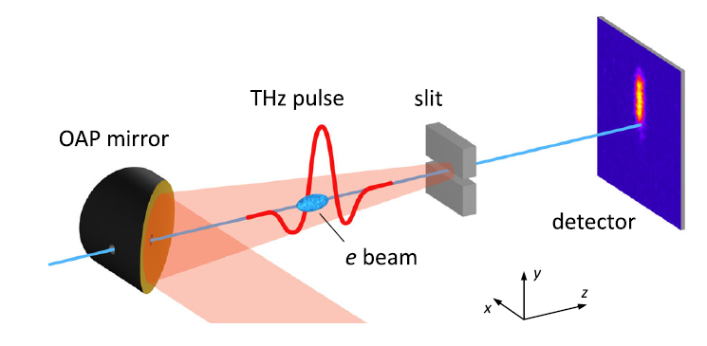
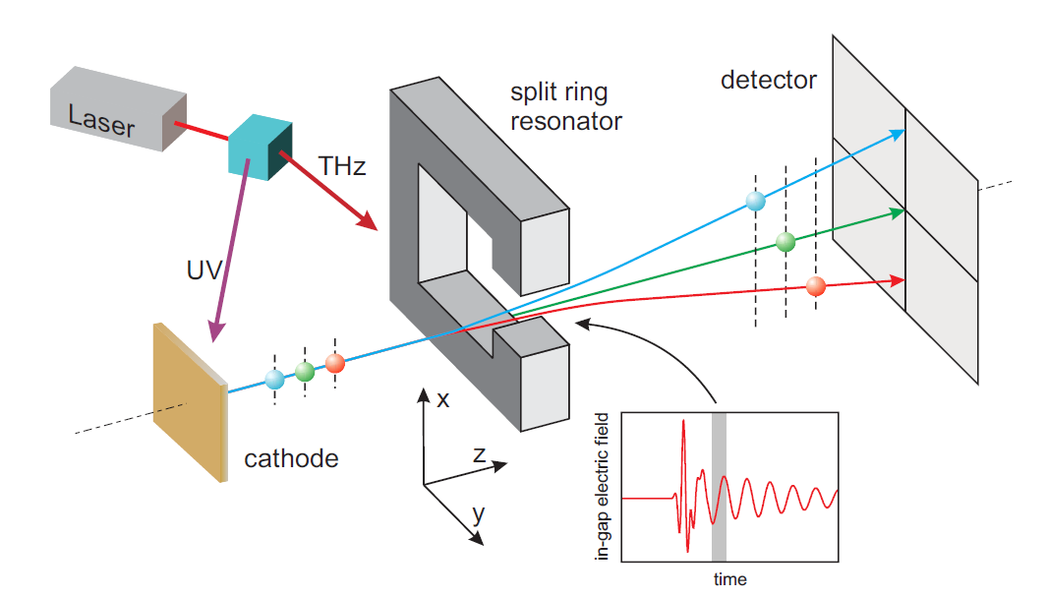
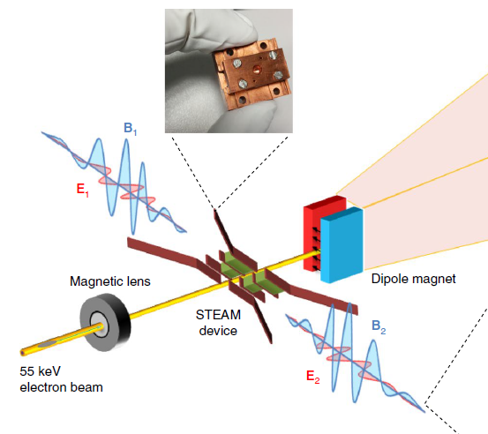
THz-driven deflection structures: literature context
Metallic slits
Split-ring resonators
Segmented dielectric structures
[1]
[2]
Field enhancing metallic slits
Resonant antennae
Dual-feed transversely coupled dielectric structures
Broadband THz pulses provide strong deflecting fields, but limited interaction lengths
[3]
References
[1] Fabiańska, Justyna, Günther Kassier, and Thomas Feurer. "Split ring resonator based THz-driven electron streak camera featuring femtosecond resolution." Scientific reports 4.1 (2014): 5645.
[2] Li, R. K., et al. "Terahertz-based subfemtosecond metrology of relativistic electron beams." Physical Review Accelerators and Beams 22.1 (2019): 012803.
[3] Zhang, Dongfang, et al. "Segmented terahertz electron accelerator and manipulator (STEAM)." Nature photonics 12.6 (2018): 336-342.
Institute of Physics Particle Accelerators and Beams conference, 30th June 2026, Lancaster, Joseph Bradbury

Slide 8
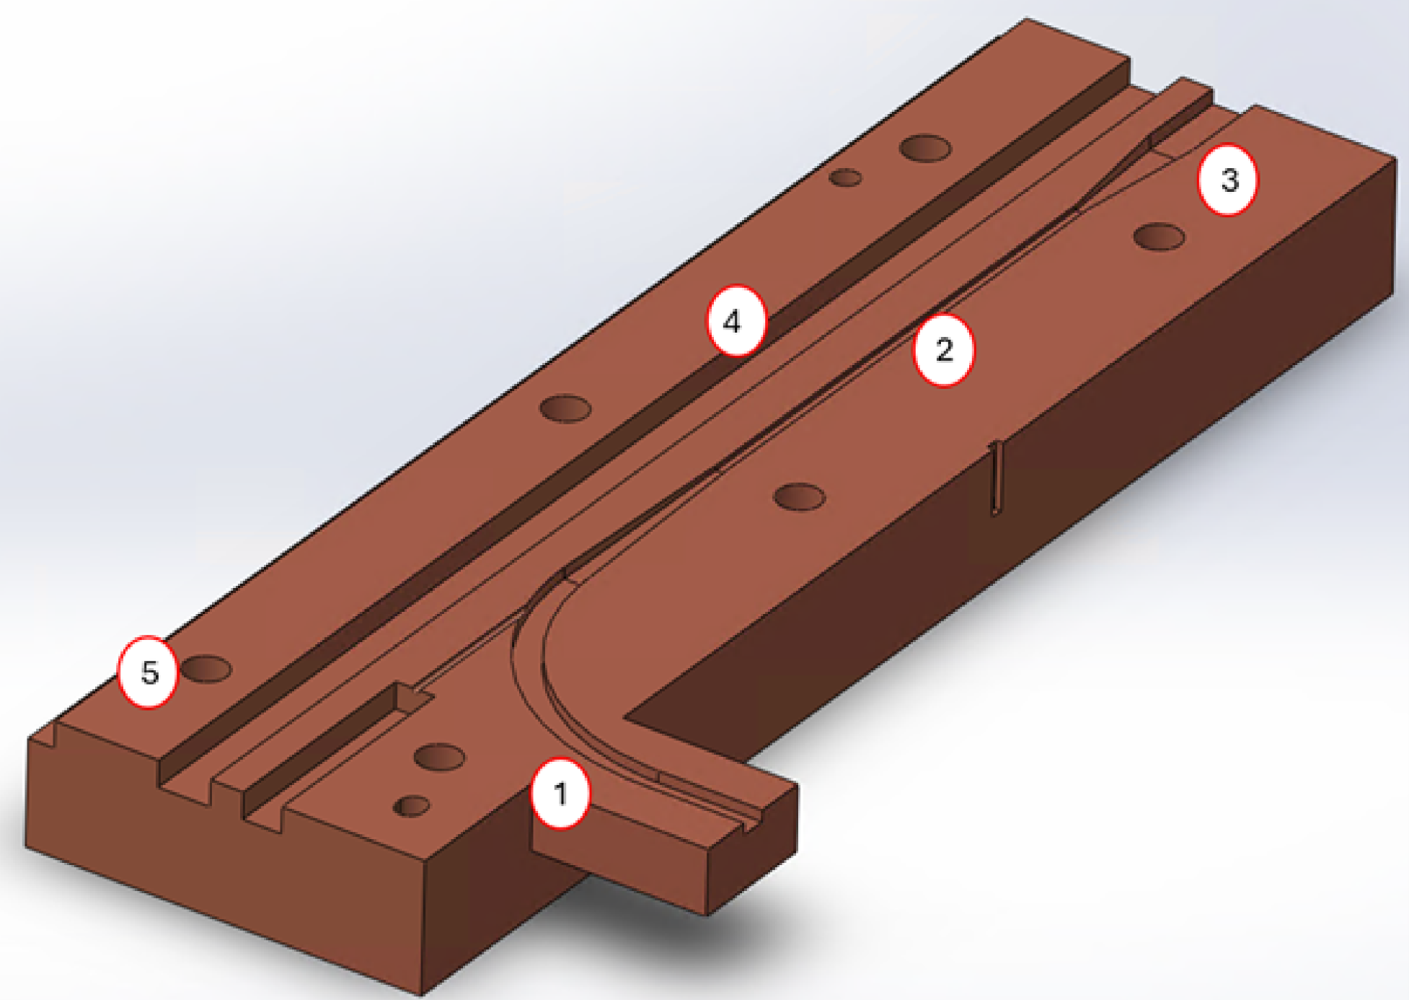
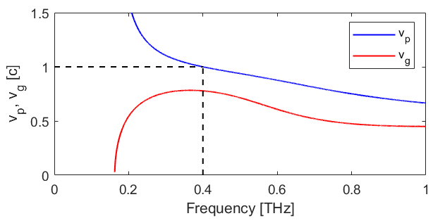
Terahertz dielectric-lined waveguides (DLWs)
Key features:
Copper block
Rectangular vacuum channel
Interior lined with slabs of dielectric material
Supports hybrid longitudinal-section modes (LSM01)
Dispersion set by cross-sectional geometry
Internal view of one half of the DLW structure
Phase and group velocities vs THz frequency for the deflecting LSM₀₁ mode.
Institute of Physics Particle Accelerators and Beams conference, 30th June 2026, Lancaster, Joseph Bradbury

Slide 9
Terahertz dielectric-lined waveguides (DLWs)
Key features:
Copper block
Rectangular vacuum channel
Interior lined with slabs of dielectric material
Supports hybrid longitudinal-section modes (LSM01)
Dispersion set by cross-sectional geometry
Outgoing electron bunch
Internal view of one half of the DLW structure
Inactive alignment channel
Alignment pins and screw holes
Output coupler
Active region
dielectric-lined waveguide
Incoming electron bunch
Generated THz pulse
Phase and group velocities vs THz frequency for the deflecting LSM₀₁ mode.
Input coupler
Incoming laser pulse
PPLN wafer stack
Institute of Physics Particle Accelerators and Beams conference, 30th June 2026, Lancaster, Joseph Bradbury

Slide 10
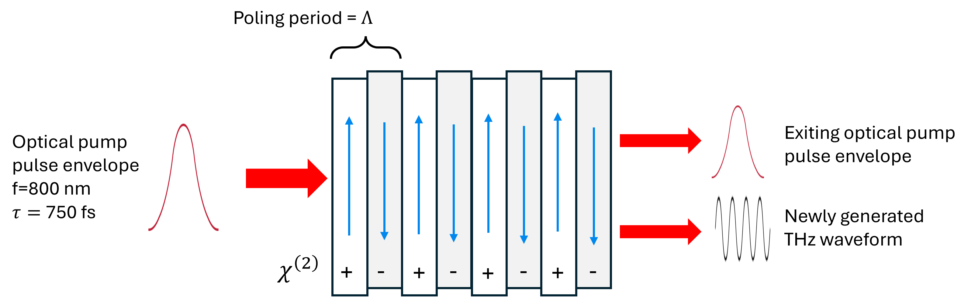
THz source
Periodically-poled lithium niobate wafer stacks (PPLN)
Hand made by layering wafers of lithium niobate
Alternating orientation of polarization axis for quasi-phase matching
THz generation via non-linear optical rectification
THz electric fields of >10 MV/m
Narrowband THz emission extends interaction length
THz central frequency set by wafer thickness (poling period)
Adding two wafers adds one THz cycle
Illustrative diagram of a PPLN wafer stack
Institute of Physics Particle Accelerators and Beams conference, 30th June 2026, Lancaster, Joseph Bradbury

Slide 11
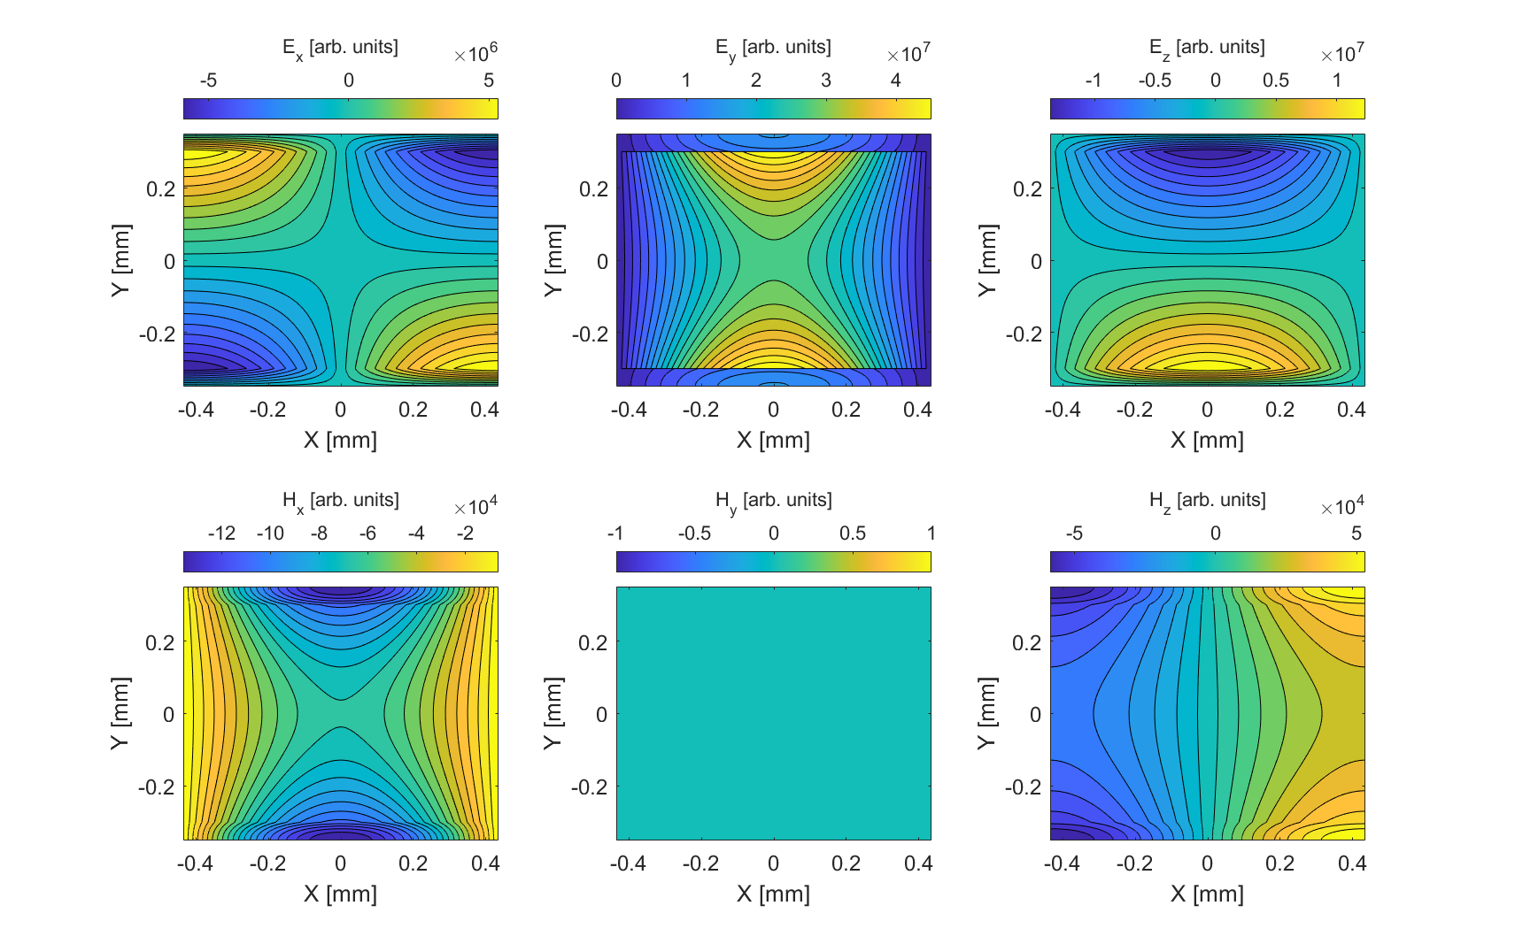
Terahertz dielectric-lined waveguides (DLWs)
Field components of the LSM₀₁ mode
Transverse electric fields
Longitudinal electric field
E_{x}
E_{y}
E_{z}
Dielectric lining
Central vacuum region
Transverse magnetic fields
Longitudinal magnetic field
H_{x}
H_{y}
H_{z}
LSM modes defined by H_{y} =0
Institute of Physics Particle Accelerators and Beams conference, 30th June 2026, Lancaster, Joseph Bradbury

Slide 12
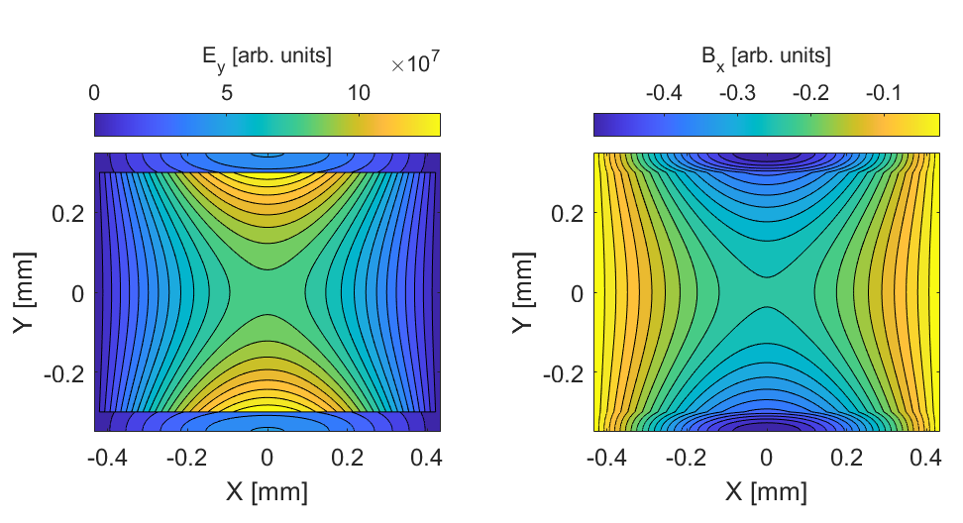

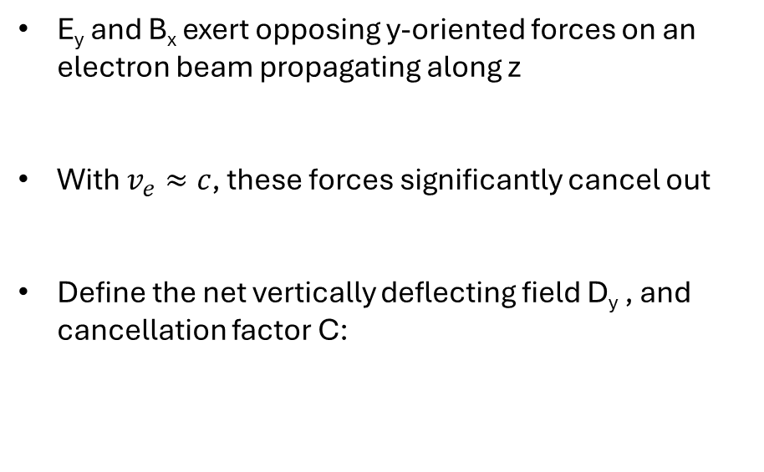
Terahertz dielectric-lined waveguides (DLWs)
Cancellation of transverse forces
E_{y} and B_{x} exert opposing y-oriented forces on an electron beam propagating along z
With $v_{e}≈c$, these forces significantly cancel out
Define the net vertically deflecting field D_{y} , and cancellation factor C:
Institute of Physics Particle Accelerators and Beams conference, 30th June 2026, Lancaster, Joseph Bradbury

Slide 13

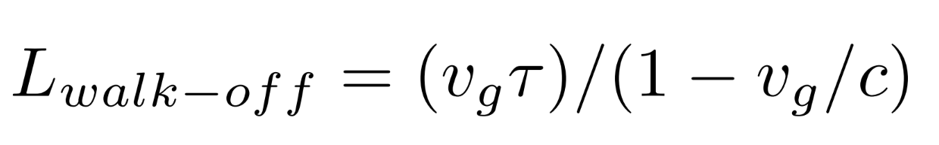
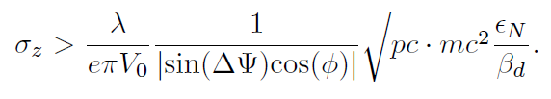
DLW optimisation
Figures of merit
Cancellation factor
Power-normalized deflecting field
Walk-off length
Longitudinal resolution
Beam momentum
Beam emittance
Beta function at deflector
Wavelength
Transverse voltage
Betatron phase advance
Deflecting phase
Institute of Physics Particle Accelerators and Beams conference, 30th June 2026, Lancaster, Joseph Bradbury

Slide 14
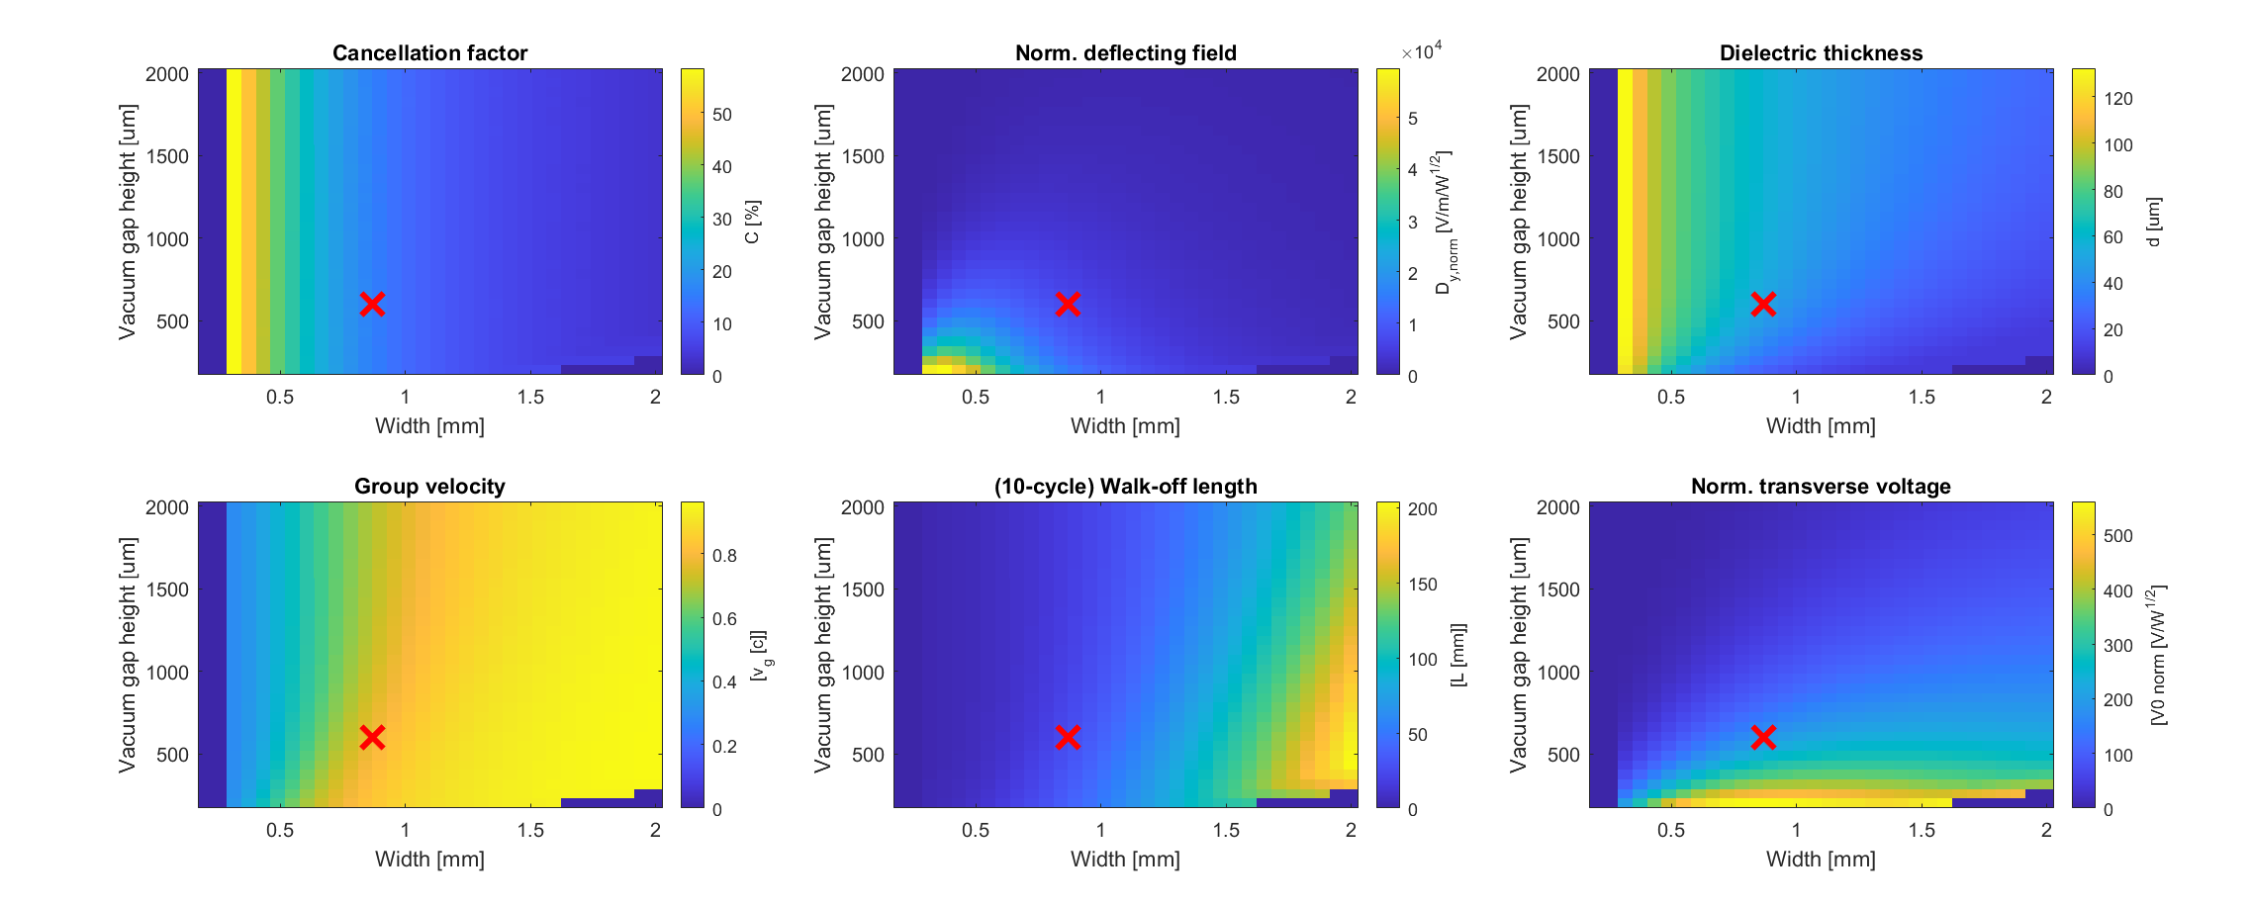
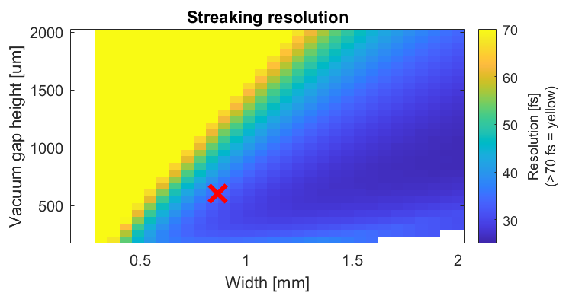
DLW optimisation
Comparing DLW geometries at f = 0.4 THz
Indicates the optimised design
Trade-off between field strength and interaction length
Institute of Physics Particle Accelerators and Beams conference, 30th June 2026, Lancaster, Joseph Bradbury

Slide 15
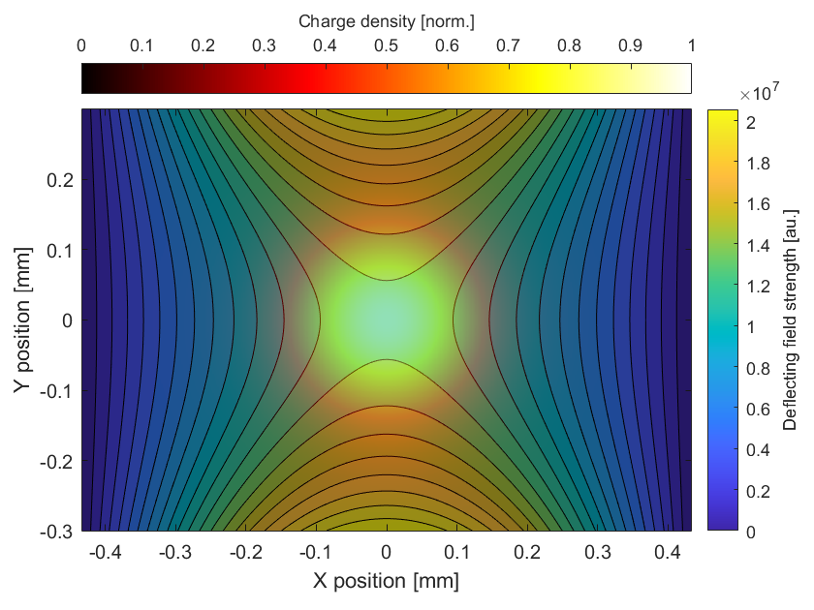
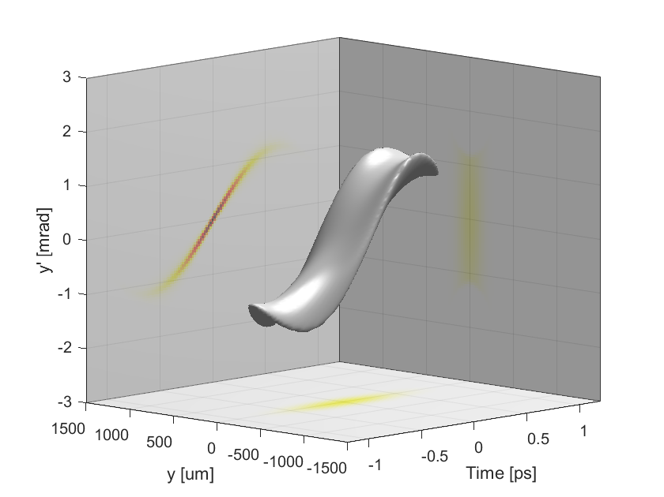
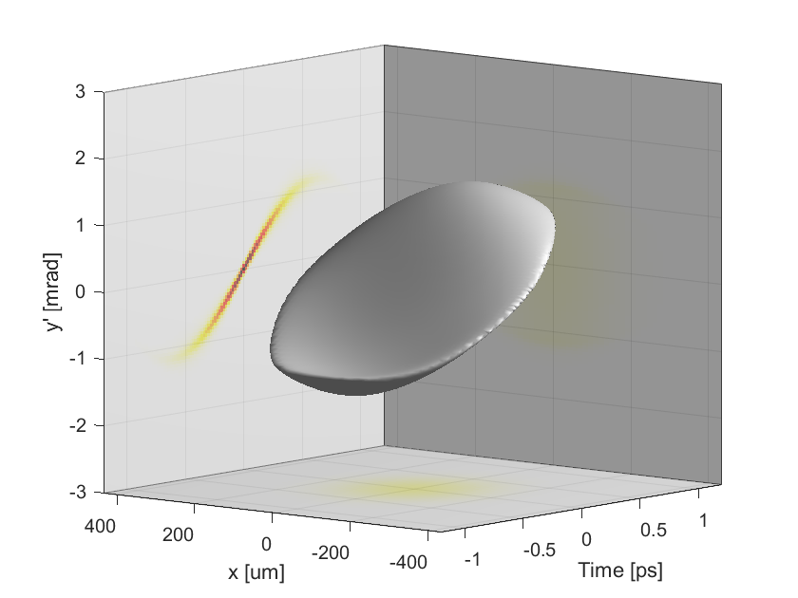
Beam size and field uniformity
A 100 um rms radius beam, overlaid onto the total y-deflecting field.
Phase space density in (y,y’,t)
Phase space density in (x,y’,t)
2D phase space density
y’ is correlated with time
3D projected phase space density
y’ is correlated with transverse position as well as time
Institute of Physics Particle Accelerators and Beams conference, 30th June 2026, Lancaster, Joseph Bradbury

Slide 16
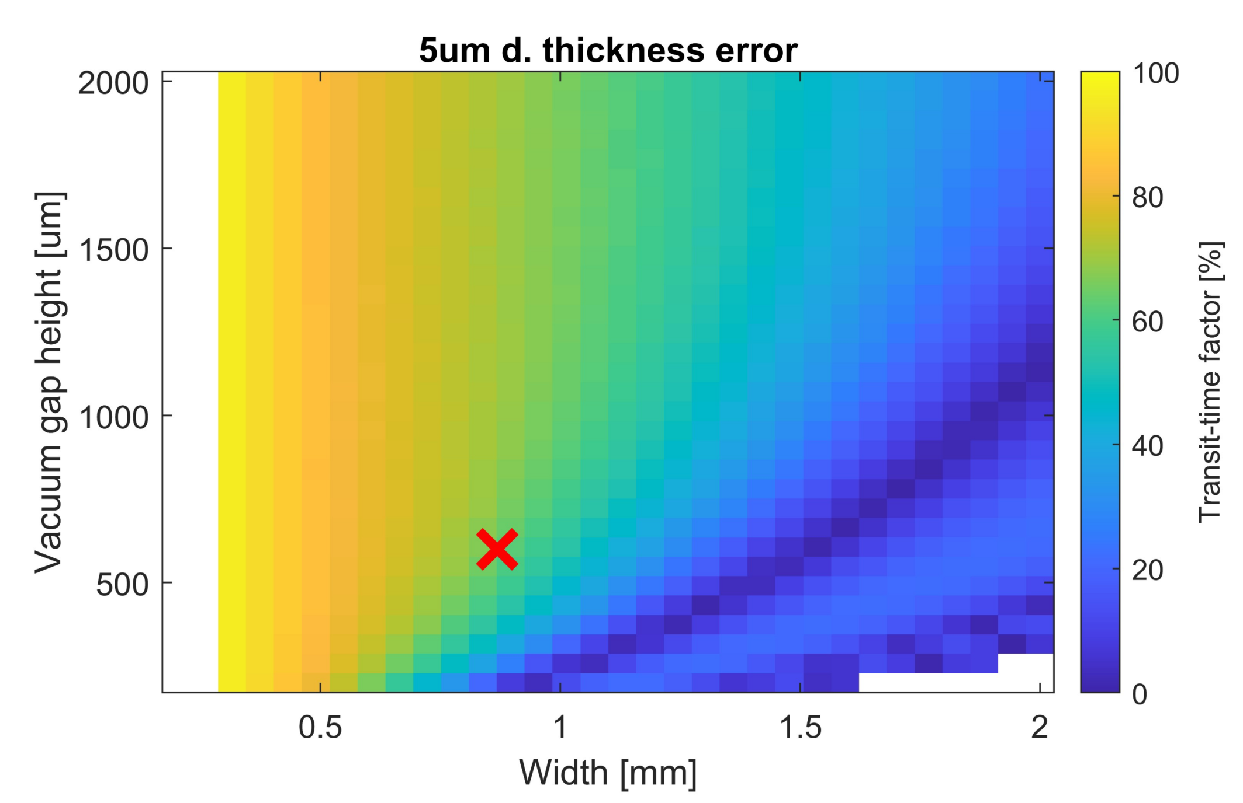
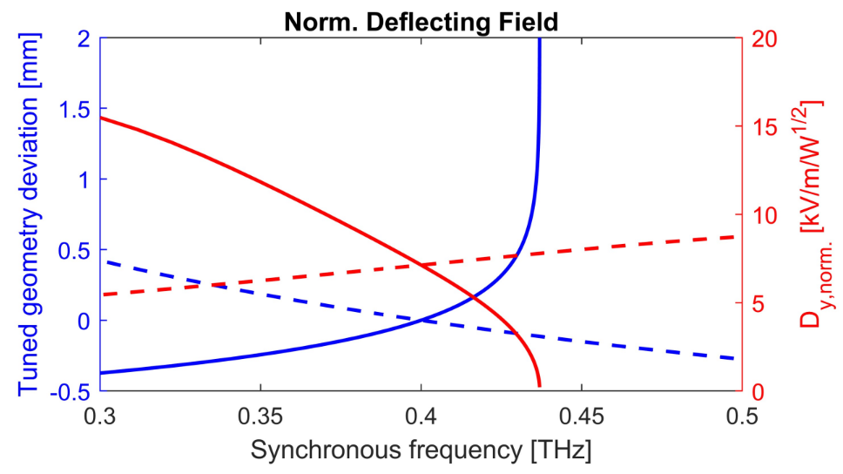
DLW optimisation
Manufacturing tolerances and tuning
Manufacturing tolerances
Phase velocity mismatch
Phase slippage accumulates
Effective transverse voltage
is reduced (transit-time factor)
Transit time factor for 0.4 THz DLWs with + 5 um dielectric thickness error
Width and gap height tuning for a 0.4 THz DLW.
Tuned width deviation
Tuned gap height deviation
Dy (width tuning)
Dy (gap-height tuning)
Institute of Physics Particle Accelerators and Beams conference, 30th June 2026, Lancaster, Joseph Bradbury

Slide 17
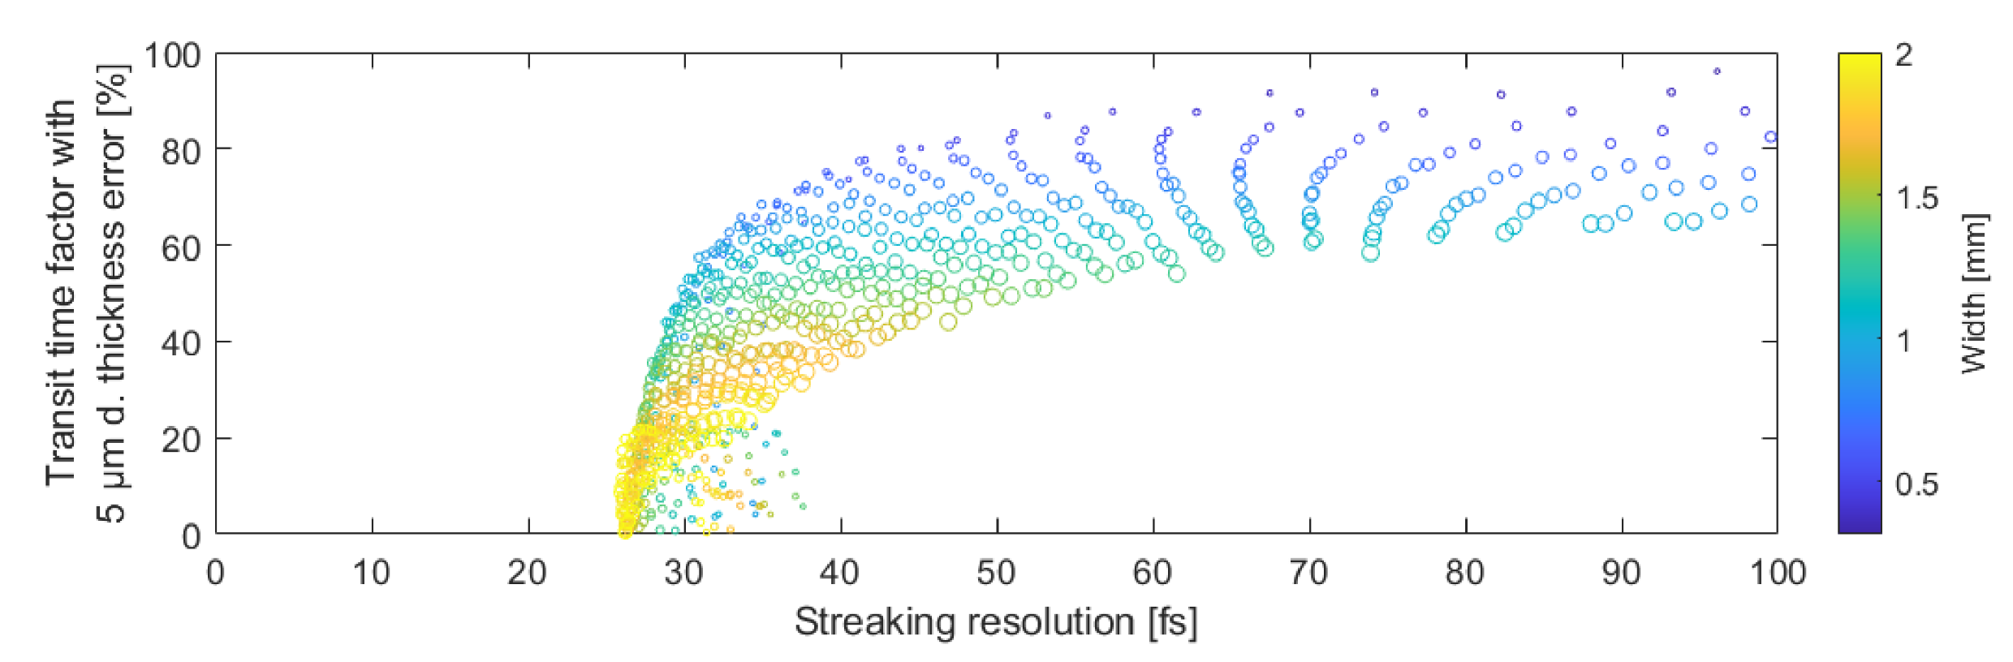
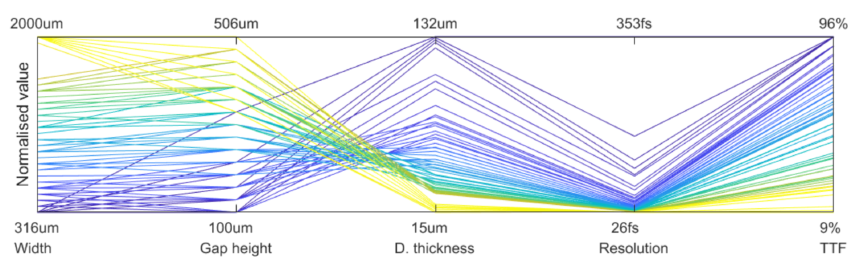
DLW optimisation
Multi-objective optimisation
Two key objectives:
Streaking resolution
Sensitivity to dielectric thickness errors (transit-time factor for + 5 um tolerance)
Pareto front in 2D objective space.
Each point represents one design geometry.
Resolution = 34 fs
TTF = 65%
Parallel coordinates plot showing the cross sectional parameters, and two key objectives.
Each line represents one design geometry.
Institute of Physics Particle Accelerators and Beams conference, 30th June 2026, Lancaster, Joseph Bradbury

Slide 18
Conclusions
We have designed an early-stage commercial prototype THz-driven streaking system
In-depth optimization of the DLW interaction structure was carried out
A resolution of 34 fs is predicted using a 1 mm-mrad, 100 MeV beam, with 10 mJ of laser pulse energy
Fabrication is now underway at Rutherford Appleton Laboratory
Plans to conduct experimental tests in the near future
Institute of Physics Particle Accelerators and Beams conference, 30th June 2026, Lancaster, Joseph Bradbury

Slide 19
Thanks for listening!
Any questions?
Joseph T. Bradbury
j.bradbury3@lancaster.ac.uk
THz beam manipulation systems STFC ESR project
Laurence J. R. Nix^{1,2}, Christopher T. Shaw^{1,2}, Matt Beardsley⁴, Peter Huggard⁴, Robert B. Appleby^{1,3}, Darren M. Graham^{1,3}, Rosa Letizia^{1,2}, Graeme Burt^{1,2}, Steven P. Jamison^{1,2}
1
2
3
4
19

Slide 20
Extra slides

Slide 21
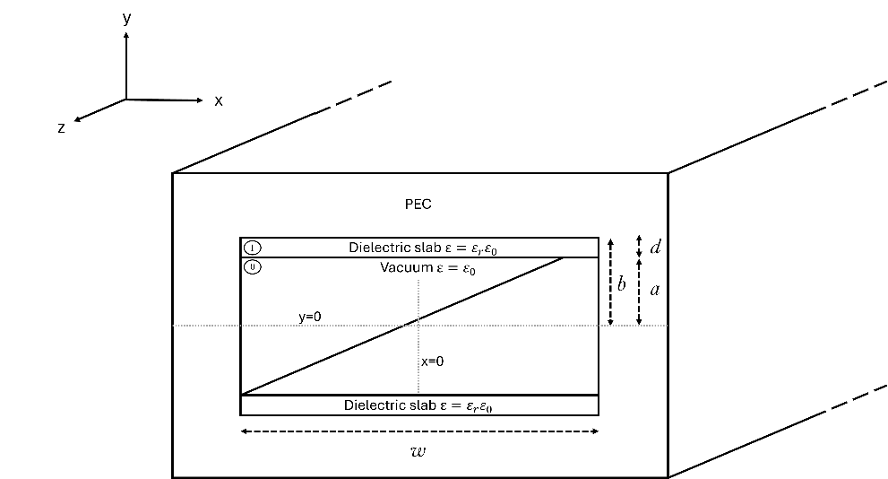
DLW optimisation
General approach
Choose a target synchronised interaction frequency
Consider all possible combinations of DLW width and gap height
For each combination, solve the dispersion relation to determine the dielectric thickness, d, required to synchronise (v_p=c) the frequency to electrons
Set of synchronised geometries determined (w,a,d)
Calculate figures of merit
Repeat for other interaction frequencies
Schematic diagram showing the cross section of a rectangular dielectric-lined waveguide
Institute of Physics Particle Accelerators and Beams conference, 30th June 2026, Lancaster, Joseph Bradbury

Slide 22
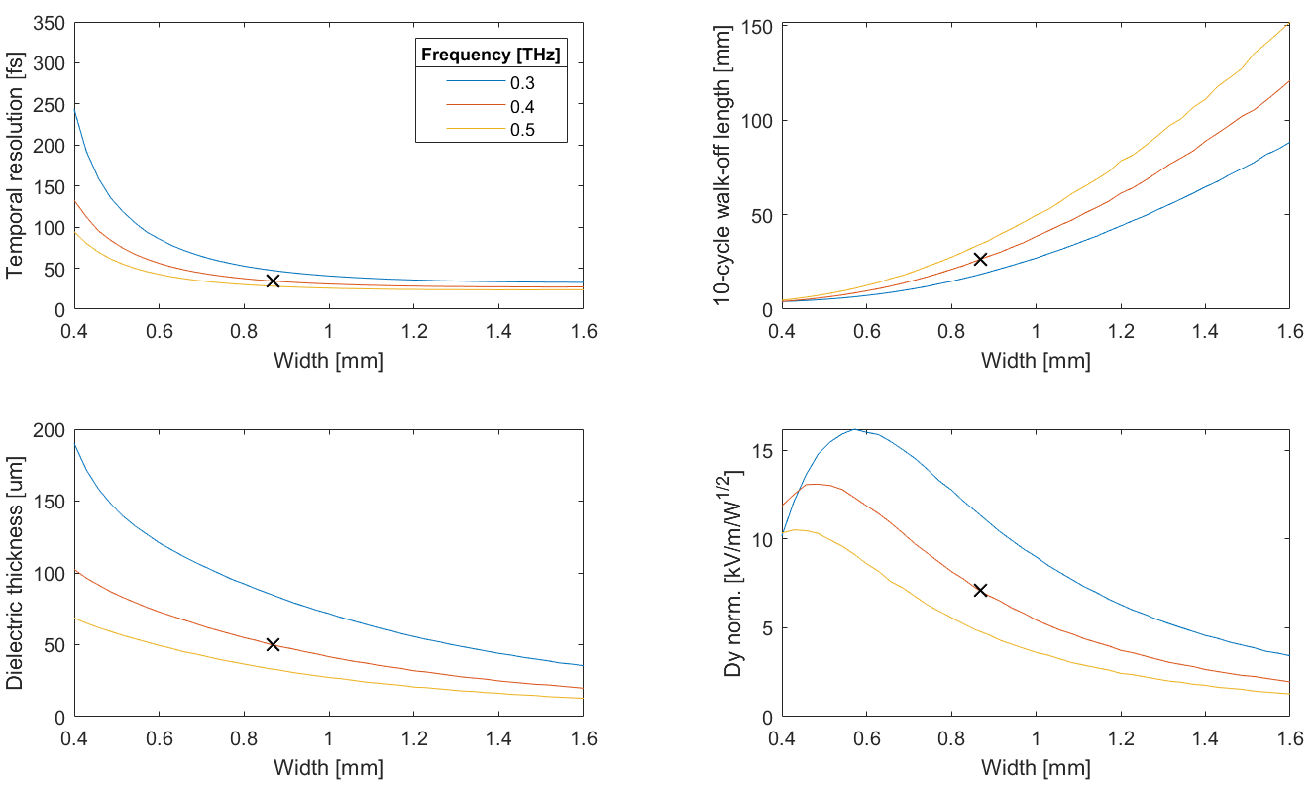
DLW optimisation
Interaction frequency choice
Higher interaction frequencies come with:
Improved resolution
Longer walk-off length
Thinner dielectric requirement
Decreased deflecting field strength
Institute of Physics Particle Accelerators and Beams conference, 30th June 2026, Lancaster, Joseph Bradbury

Slide 23
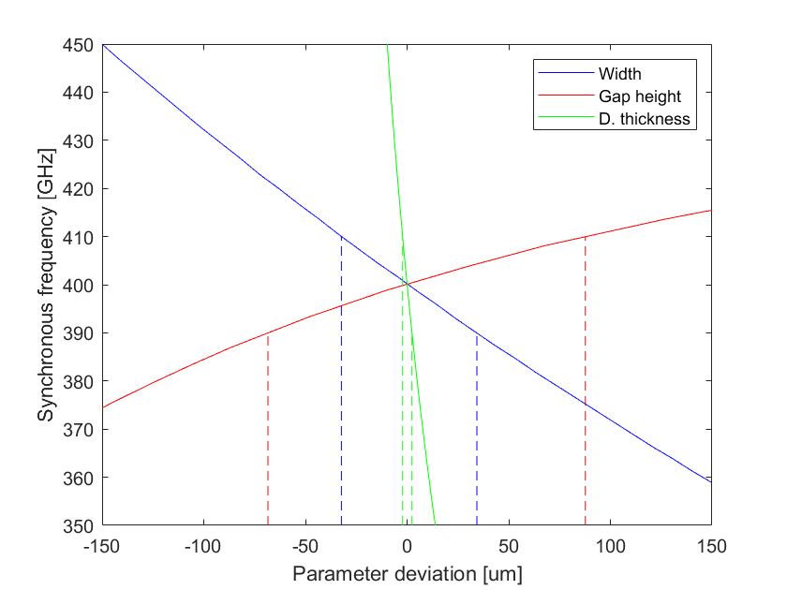
DLW optimisation
Manufacturing tolerances and tuning
If the width, gap height, or dielectric thickness are altered, the synchronous interaction frequency can be adjusted.
We use discretised width tuning to adjust the synchronous frequency.
DLW tuning compensates for manufacturing tolerances in the structure, as well as the PPLN wafer stack THz source.
Institute of Physics Particle Accelerators and Beams conference, 30th June 2026, Lancaster, Joseph Bradbury

