Slide 1


CLARA Commissioning and First Friendly User Experiments
mark.johnson@stfc.ac.uk
deepa.angal-kalinin@stfc.ac.uk
Mark Johnson*, Deepa Angal-Kalinin, James Jones
and Thomas Pacey, on behalf of the CLARA Team

Slide 2
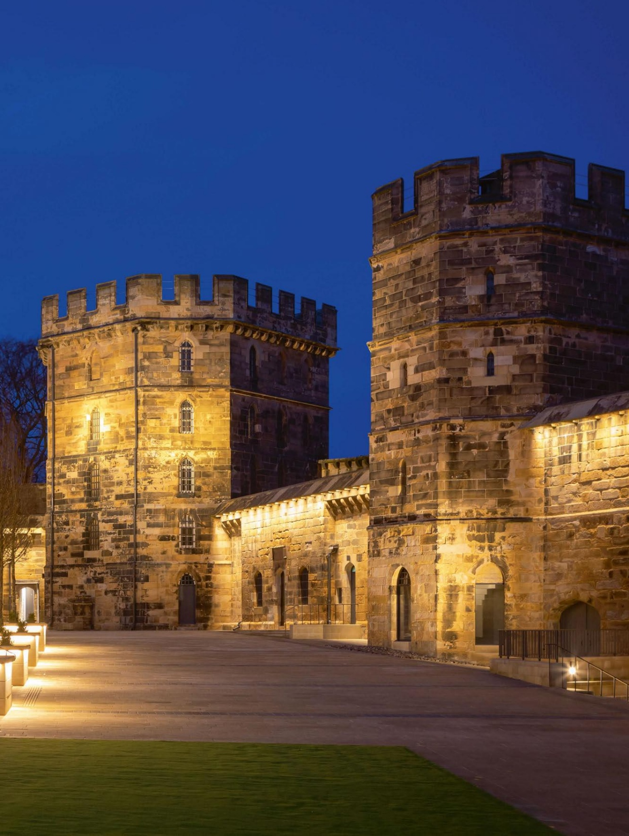
Outline
Below: Lancaster Castle
1. Introduction to CLARA
Accelerator overview, layout, and beam parameters
2. Commissioning Highlights
Commissioning timeline and key physics measurements
3. First User Experiments
Science themes, and an overview of the experiments

Slide 3
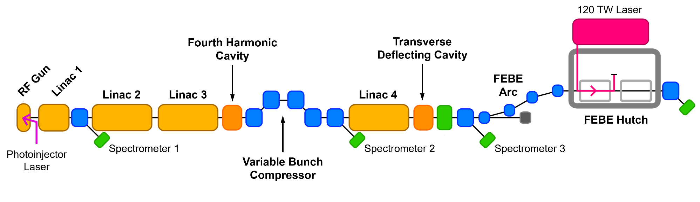
Introduction
J.A. Clarke et al., JINST 9 T05001 (2014)
D. Angal-Kalinin et al., PRAB 23, 044801 (2020)
E.W. Snedden et al., PRAB 27, 041602 (2024)
CLARA is a 250 MeV high-brightness electron
beam facility at STFC Daresbury Laboratory (UK)
CLARA will deliver high-quality, ultra-short electron
bunches to a wide variety of user experiments
The CLARA front end (~35 MeV) was previously
operated as a successful user facility until 2022
The accelerator has recently undergone commissioning
after installation of a major upgrade (2022 – 2025)
Parameter | Low Charge | High Charge
Repetition Rate [Hz] | 1 - 100
Bunch charge [pC] | 5 | 250
Bunch length [fs] | 50 | 100
Energy spread [%] | < 1 | < 5
Spot Size at IP [μm] | 20 | 100
Norm. Emittance [μm] | 2.0 | 5.0
Above: Design CLARA beam parameters for user experiments
Below: Simplified schematic showing the layout of the CLARA accelerator

Slide 4
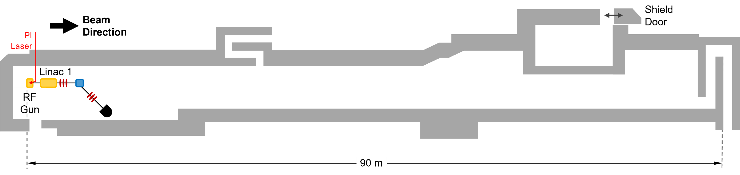
CLARA Front End Layout
D. Angal-Kalinin et al., PRAB 23, 044801 (2020)
Example Technical System | CLARA Front End (35 MeV)
RF Structures | 2
Magnets | 22
Diagnostic Systems | 13
Vacuum Gauges and Pumps | 57
The CLARA front end was
successfully operated as a separate user facility
(2018 – 2022)

Slide 5
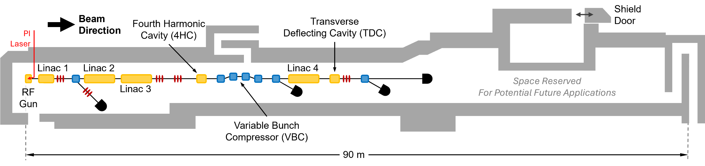
CLARA Layout
Example Technical System | CLARA Front End (35 MeV) | CLARA (250 MeV)
RF Structures | 2 | 7
Magnets | 22 | 77
Diagnostic Systems | 13 | 65
Vacuum Gauges and Pumps | 57 | 109

Slide 6
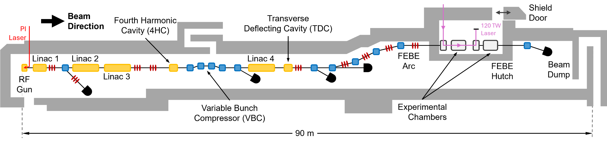
CLARA FEBE Layout
Example Technical System | CLARA Front End (35 MeV) | CLARA (250 MeV) | CLARA FEBE (250 MeV)
RF Structures | 2 | 7 | 7
Magnets | 22 | 77 | 126
Diagnostic Systems | 13 | 65 | 94
Vacuum Gauges and Pumps | 57 | 109 | 155
First experiments in the
Full Energy Beam Exploitation (FEBE) user area took place
in early 2026

Slide 7
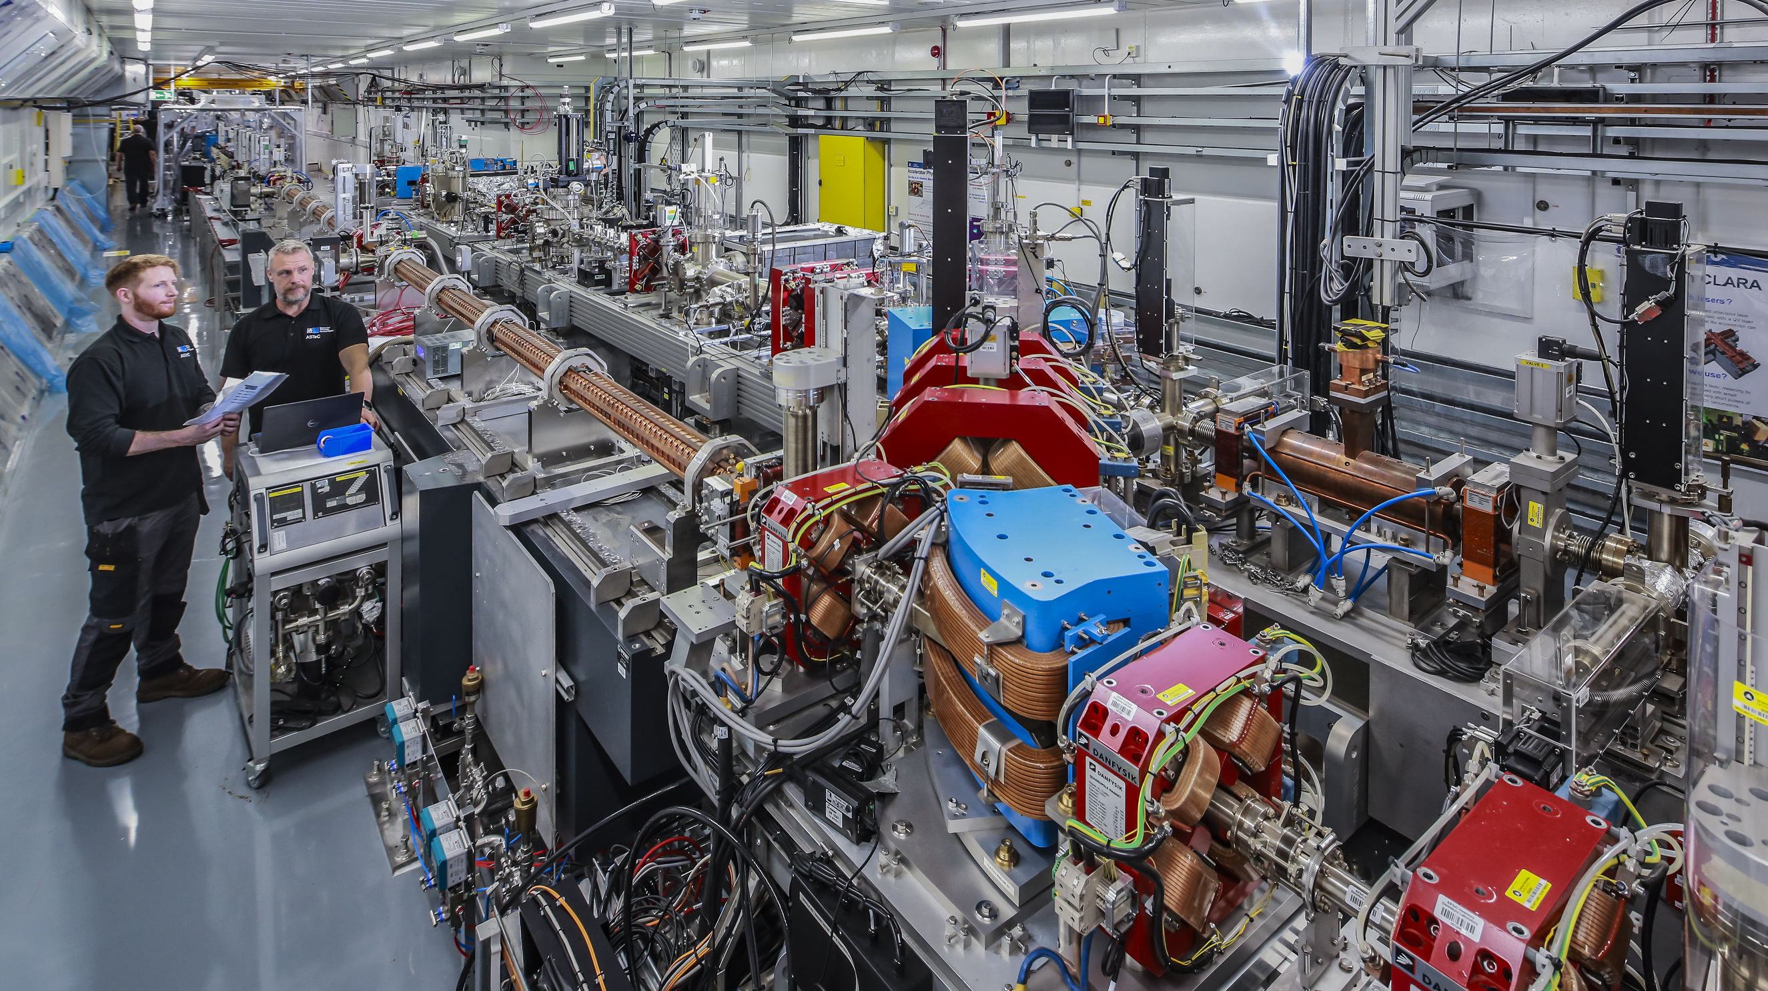

CLARA Installation
View of the CLARA bunker in 2024, looking
out from the accelerator’s front end
towards Linac 2 and Linac 3

Slide 8
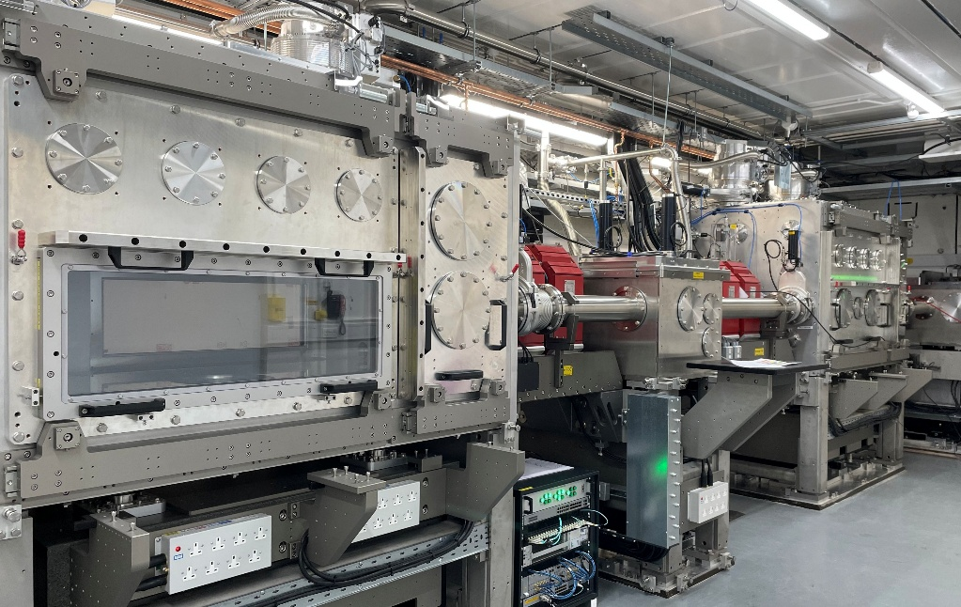
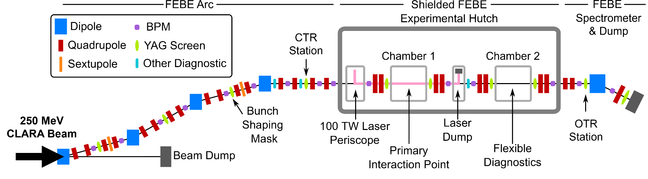
FEBE User Area on CLARA
E.W. Snedden et al., PRAB 27, 041602 (2024)
The Full Energy Beam Exploitation (FEBE) beamline includes a dedicated user area in a separately-shielded enclosure
Two large (~2 m³) experimental chambers can be configured for a wide range of experiments (both in air and under vacuum):
  Novel acceleration,
  Advanced diagnostics,
  New radiotherapy modalities,
A 120 TW laser will be available in late 2026,
for applications requiring synchronized
photon and electron beams
Beam
Direction

Slide 9
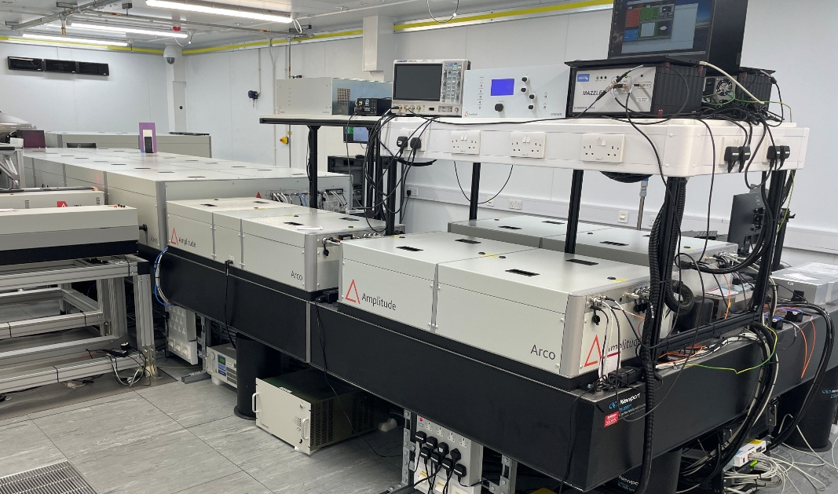
FEBE Laser System
The FEBE laser is based on a commercial system
(Amplitude Arco) system running at 5 Hz and 120 TW
Combining the CLARA electron beam with high-power laser pulses will provide access to unique experimental regimes
Potential applications include:
  Inverse Compton scattering (ICS) studies,
  Laser wakefield acceleration (LWFA)
Laser Parameter | Value
Wavelength [nm] | 800
Energy per pulse [J] | 2.6
Pulse duration (FWHM) [fs] | 23
Beam size at waist [μm] | 30
Peak laser intensity [W cm⁻²] | 6.5 x 10¹⁸
Normalised vector potential | 1.75
Above: Laser system installed in a room above the FEBE hutch
Left: Estimated laser properties at the FEBE interaction point for a co-linear geometry
Laser transport into the FEBE area is currently
being installed. Commissioning expected to be
complete by Autumn 2026.

Slide 10
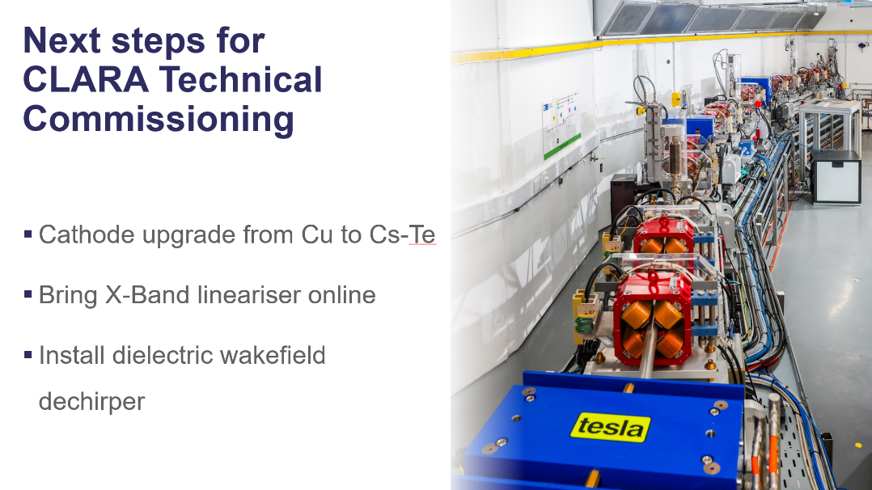
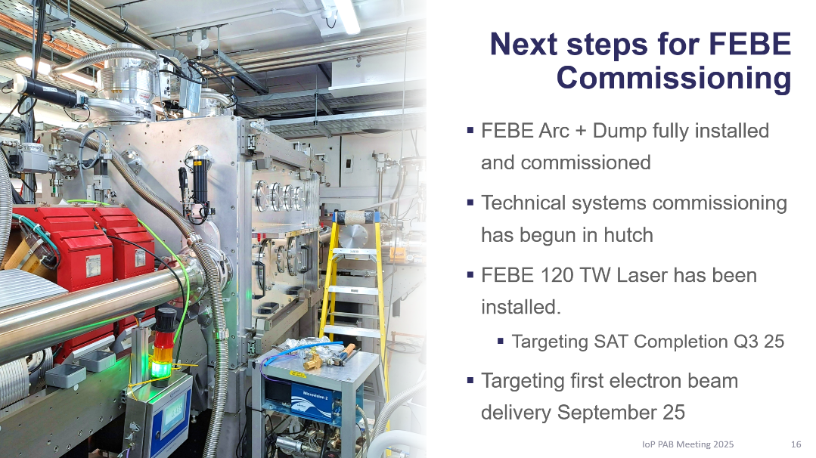

A Look Back…
Tom Pacey Talk
“First High Energy Beam from the CLARA
Electron Accelerator and Commissioning Progress”
IOP PAB 2025
Since July 2025:
  Successful upgrade to Cs₂Te cathode
  Dielectric wakefield structure commissioned
  Extensive beam dynamics studies
  Beam transport to FEBE user area
  X-band (4th harmonic) cavity delayed until Q3 2026
  First user experiments
✅
✅
✅
✅
✅

Slide 11
Commissioning Timeline
The majority of CLARA commissioning was completed in 2025, often in parallel
with RF conditioning and/or FEBE installation work
A machine development (MD) period is currently underway,
for detailed optimisation of the beam parameters
September 8th, 2025
First 250 pC beam after
Cs₂Te cathode installation
January 29th, 2026
First beam delivered
to user experiments
April 2nd, 2025
First 250 MeV beam
Nov.
2025
Jan.
2026
March
2026
RF Conditioning (from 2024)
Technical Commissioning with Beam
June 27th, 2025
First bunch compression
Beam to FEBE
Shutdown
Jan.
2025
March
2025
May
2025
July
2025
Sep.
2025
User Experiments

Slide 12
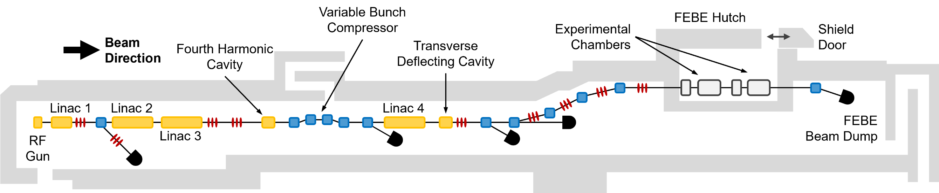
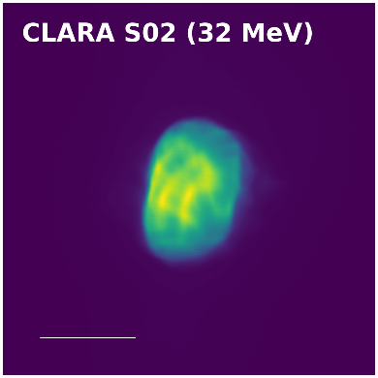
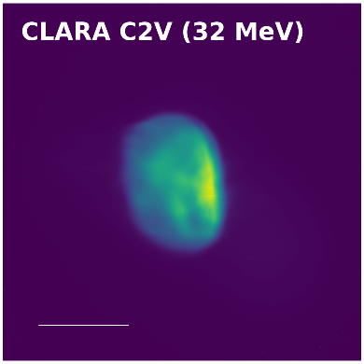
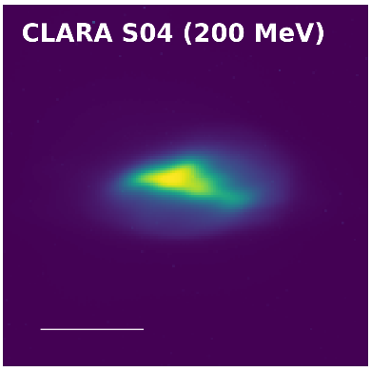
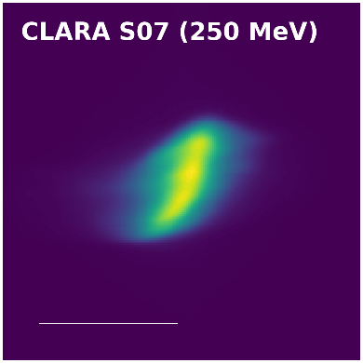
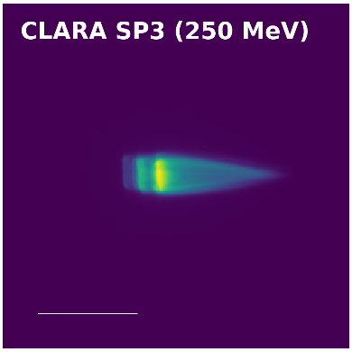
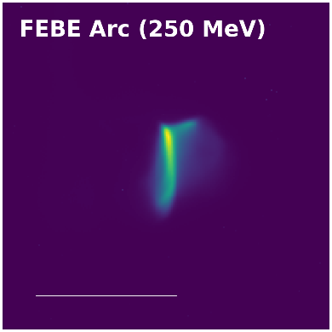
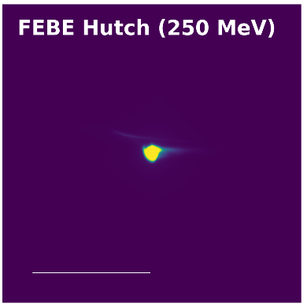
Beam Images (250 pC)
3 mm
5 mm
1 mm
1 mm
2 mm
2 mm
2 mm

Slide 13
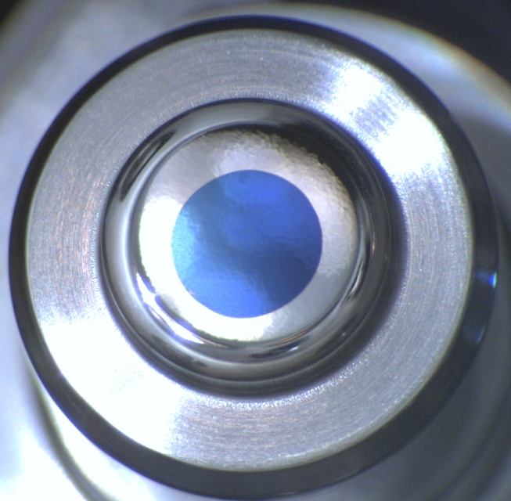
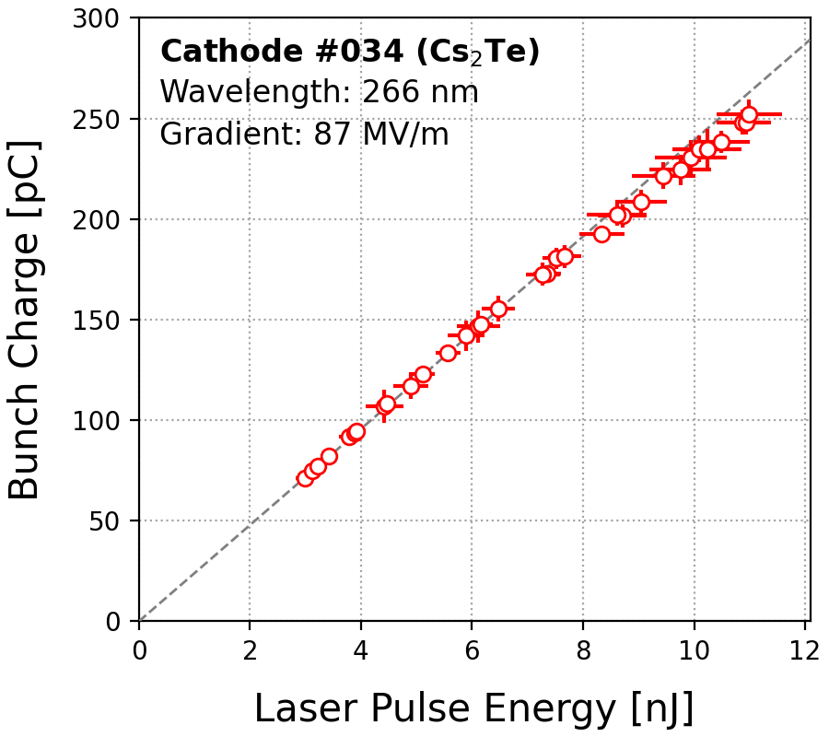
Cs₂Te Photocathodes
Molybdenum
Cathode Plug
Caesium telluride (Cs₂Te) photocathodes for CLARA
were developed in-house at Daresbury
Installation of the first Cs₂Te cathode (Sept. 2025)
facilitated an increased bunch charge up to 250 pC
Stable effective quantum efficiency (QE) of ~10%
measured under operational conditions in the CLARA gun
Laser energy now available for longitudinal
pulse shaping in future
Cs₂Te
Coating
Above: Photocathode surface, with
Cs₂Te coating on the active area
Left: Typical QE measurement
for a CLARA photocathode

Slide 14
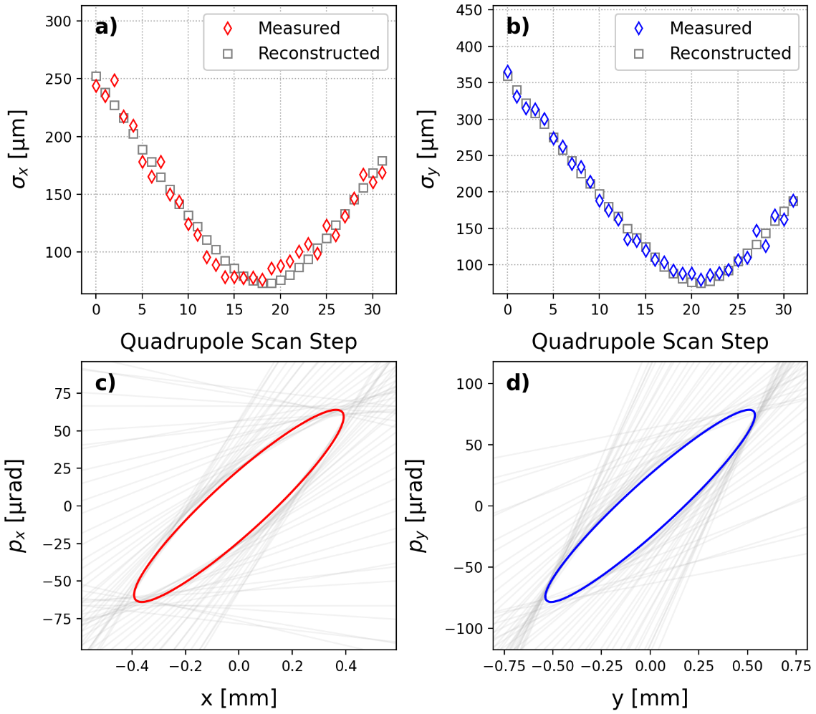
Emittance Measurements
Emittance measurements are based on quadrupole
scans throughout the CLARA beamline
We routinely achieve emittances of < 1 μm in the low-energy (35 MeV) section immediately after the CLARA injector
Work is ongoing to mitigate emittance growth, which is
most likely due to transverse wakefields in the linac cavities
Beam Setup (250 pC) | Horizontal Normalised Emittance [μm]
Post-injector (35 MeV) | 0.7
Uncompressed (250 MeV) | 2.3
Compressed (250 MeV) | ~5.0
Above: Results of a typical quadrupole scan in the low-energy
section after the CLARA injector
Left: Emittance measurements for a 250 pC compressed beam.
High-energy measurements were made immediately after the final linac

Slide 15
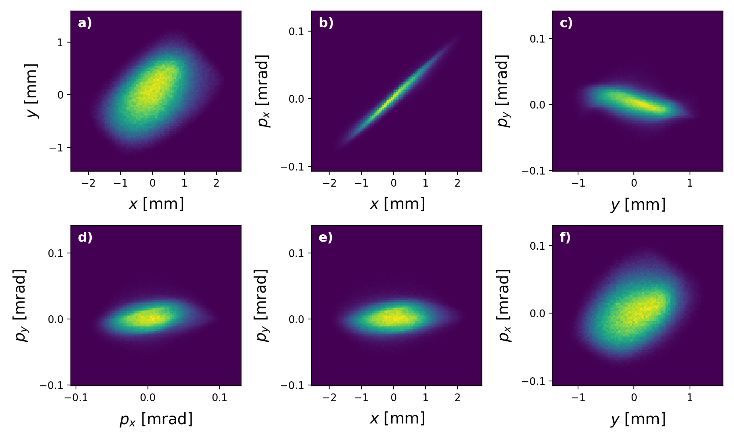
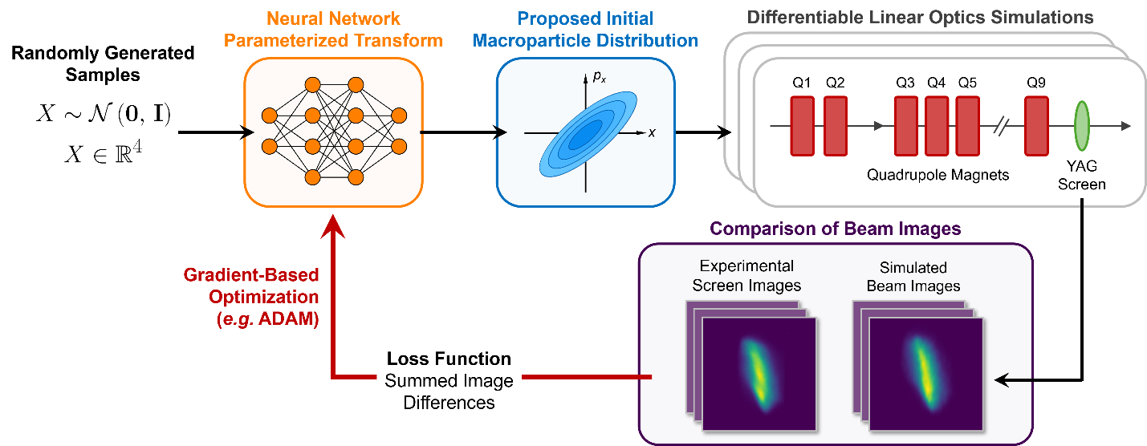
Phase Space Tomography
R. Roussel et al., PRL 130, 145011 (2023)
R. Roussel et al., PRAB 27, 094601 (2024)
We also use generative Machine Learning (ML) for high resolution measurements of the transverse phase space
The ML technique accurately reconstructs the beam’s
charge distribution, including any substructure
The method provides an accurate representation of the beam that can be used for analysis of user experiments
Above: 4D transverse phase space, reconstructed for an uncompressed
30 pC beam immediately after the final linac
Left: Diagram showing the generative phase space reconstruction (GPSR)
method for reconstructing a charge distribution from experimental data

Slide 16
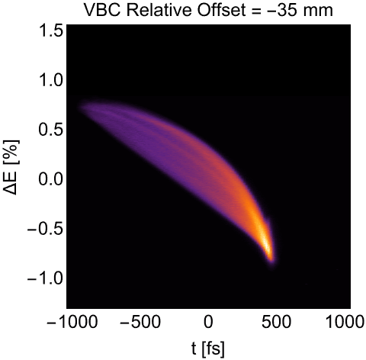
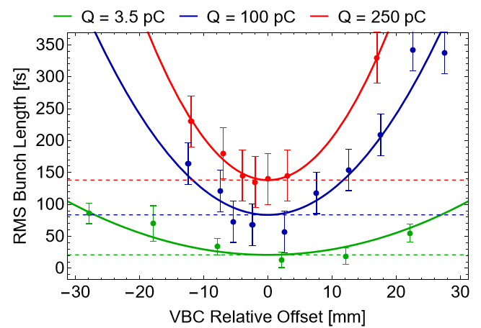
Longitudinal Dynamics
The CLARA lattice allows measurement and manipulation
of the beam’s longitudinal phase space:
  Variable bunch compressor (VBC)
  Transverse deflecting cavity (TDC)
  Passive dielectric dechirper
The 250 pC CLARA beam can be compressed to
a minimum RMS bunch length of ~150 fs
Commissioning of the fourth harmonic cavity
will facilitate highly compressed beam modes
100 pC
Above: Animation showing measurements of the longitudinal
phase space for different VBC offsets
Left: Measured RMS bunch length
as a function of VBC offset

Slide 17
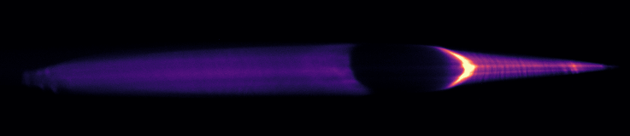
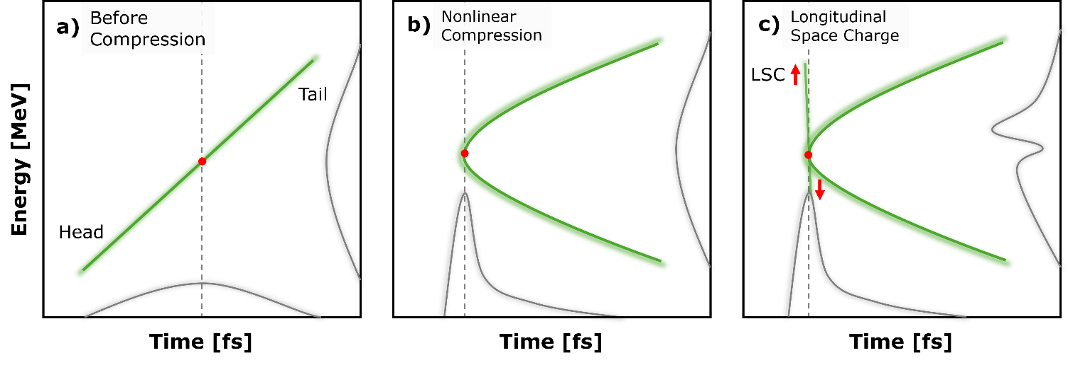
Longitudinal Space Charge
K. Yasutome et al., in Proc.
IPAC26, THO3T03 (2026)
During commissioning, we noticed a strong modulation of the beam energy spectrum near maximum bunch compression
Recent experimental studies revealed that the effect is
caused by strong longitudinal space charge (LSC)
LSC is driven by a current spike at the head of the bunch, which forms due to its non-linear longitudinal phase space.
The effect has been reproduced in start-to-end simulations,
and can be mitigated with the fourth harmonic cavity
LSC modulation
y
p_{z}
CSR modulation
Above: Spectrometer images showing the energy spectrum
of the 250 MeV CLARA beam near maximum compression
Observed at any bunch charge
between 5 – 250 pC
Above: Simplified diagram showing the effect of LSC on the CLARA beam. Adapted from Yasutome et al. (2026)

Slide 18
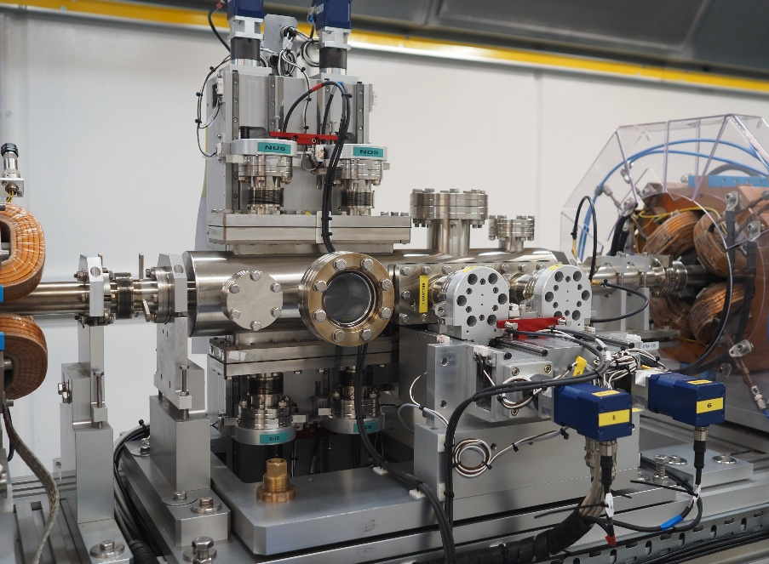
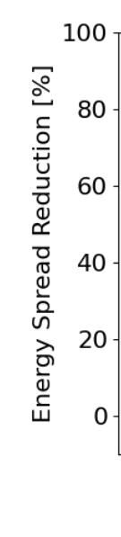
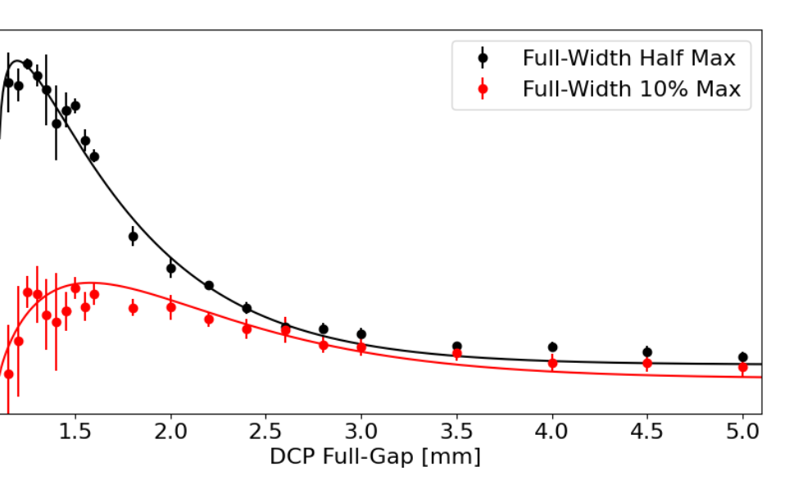
Passive Wakefield Structure
T. Overton et al., in Proc.
IPAC26, WEP6091 (2026)
A passive wakefield structure has been installed in
the final section of CLARA (250 MeV/c)
The device uses wakefields excited by the beam itself to
manipulate the longitudinal phase space. It can be used as a:
  Dechirper to remove correlated energy spread,
  Streaker to infer the time structure of the bunch
Commissioning of the device as a dechirper
has demonstrated:
  Reduction of the beam energy spread,
  Preservation of the transverse emittance
Motion control for
variable DLW gap
Beam
Direction
Planar dielectric
lined waveguides (DLW)
Above: Passive wakefield structure installed on the CLARA beamline
Left: Measurements
of energy spread as a function of dechirper gap, for a 250 pC beam

Slide 19
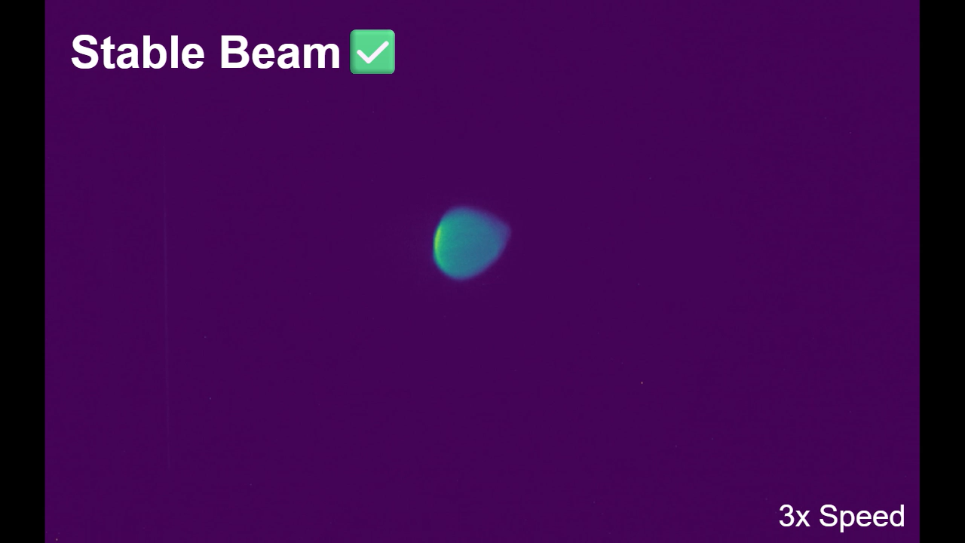
Beam Stability
The CLARA electron beam benefits from stable operation
across a wide range of timescales:
  Shot-to-shot jitter (10 - 100 Hz),
  Recovery from an RF trip (seconds)
  Slow drifts (minutes to hours),
  Reproducibility between shifts (days)
Multiple CLARA users gave feedback indicating that their experiments would not have been possible without this stability
Above: Video showing the 250 MeV/c CLARA beam in a spectrometer line. The beam recovers from an RF trip within a few seconds.
“The stability and beam quality at CLARA is…
comparable to other state-of-the-art facilities”
“The robust and stable beam allowed
for rapid irradiation [of samples]”
“The working point provided excellent
stability compared to similar facilities”
– Anonymised User Feedback

Slide 20
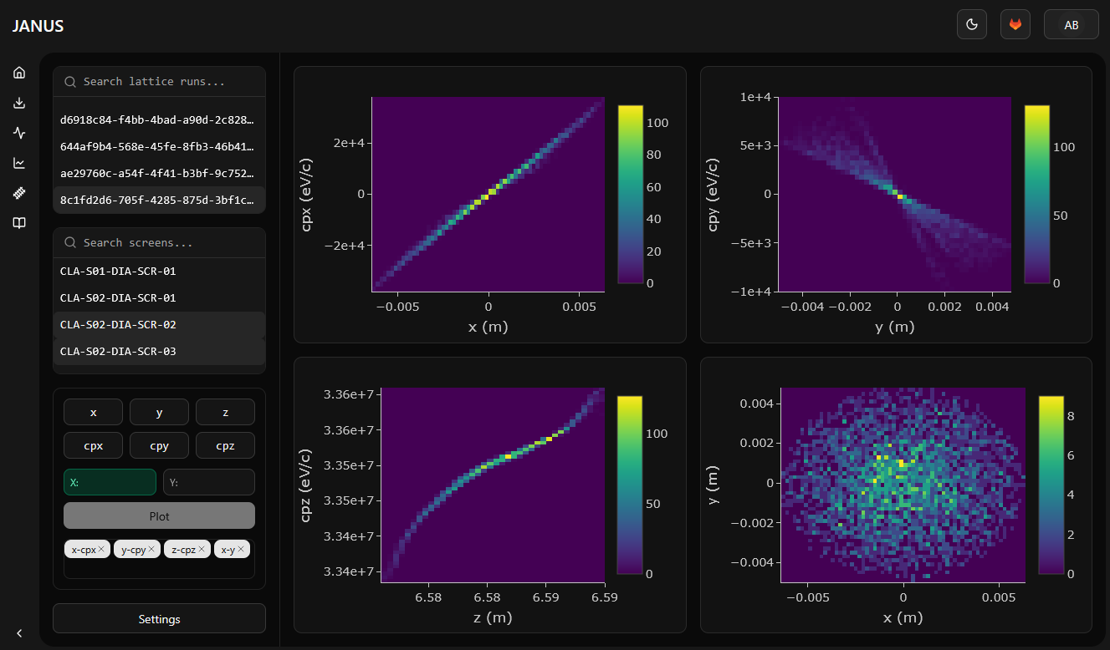
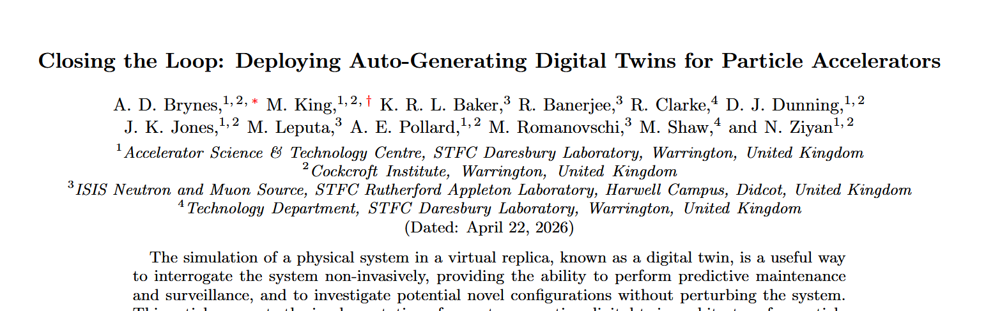
Software and Machine Learning
M. King et al., arXiv:2509.19794 (2025)
A.D. Brynes et al., arXiv:2604.19101 (2026)
J. Jones et al., in Proc. IPAC26, WEV6003 (2026)
Most high-level CLARA software is based on CATAP, a python-based
middle layer that simplifies interactions with the accelerator hardware
A simulation-based digital twin has recently been deployed on CLARA,
for online modelling of the accelerator and setup optimization
CLARA is an ideal test facility for machine learning (ML) and
artificial intelligence (AI). Many applications are in development:
  Photoinjector laser pulse shaping
  Magnet hysteresis modelling,
  Reinforcement learning,
  Virtual diagnostics,
  Agentic control,
Above: Web interface for the simulation-based CLARA digital twin

Slide 21

User Science Themes
Advanced
Diagnostics
Medical
Applications
Compact
Accelerators
AI for
Accelerators
Laser Based
Accelerators
Examples:
Optical Transition Radiation (OTR),
Coherent Transition
Radiation (CTR)
Examples:
FLASH dosimetry,
VHEE beam delivery,
Radiobiology studies
Examples:
Beam driven
plasma acceleration,
Active plasma lenses
Examples:
Virtual diagnostics,
Reinforcement learning optimisation
Examples:
Laser-plasma acceleration,
Inverse Compton scattering
First Friendly User Run
(Q1 2026)
Planned
Friendly User Run
(Q2 2026)
After FEBE Laser
Commissioning
(Q3 2026)

Slide 22





Comparison with European Facilities
D. Angal-Kalinin et al., in Proc. IPAC23, MOZG1 (2023)
Updated from IPAC23 talk:
“Electron Beam Test
Facilities for Novel Applications”
 | CLARA | ARES | CLEAR | FLUTE | PITZ | SPARC Lab
Accelerator Components R&D | ✔ | ✔ | ✔ | ✔ | ✔ | ✔
Beam Diagnostics R&D | ✔ | ✔ | ✔ | ✔ | ✔ | ✔
Novel Acceleration (DWA, DLA) | ✔ | ✔
Novel Acceleration Using High Power Lasers (PWFA, LWFA*, THz) | ✔ |  |  |  |  | ✔
Radiation Sources |  |  |  | ✔ | ✔ | ✔
Plasma Lens Development | ✔ |  | ✔
VHEE FLASH Radiotherapy | ✔ |  | ✔
Other Medical Applications |  | ✔ |  | ✔
Irradiation Experiments† |  |  | ✔
* External injection into laser wakefield acceleration (LWFA)
† Excluding radiotherapy applications

Slide 23



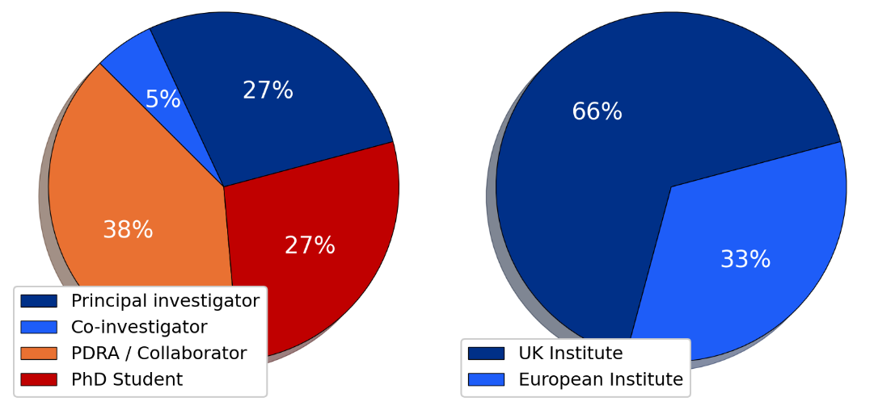

Friendly User Programme
Below: Map showing the home institutes of the first CLARA users
The first CLARA user experiments took place
between January – April 2026
Experiments were specifically selected to:
  Deliver high-impact science,
  Cover a wide range of science themes,
  Build on successful experiments at other facilities,
  Exploit the full capabilities of the CLARA accelerator,
  Complement ongoing commissioning work

Slide 24
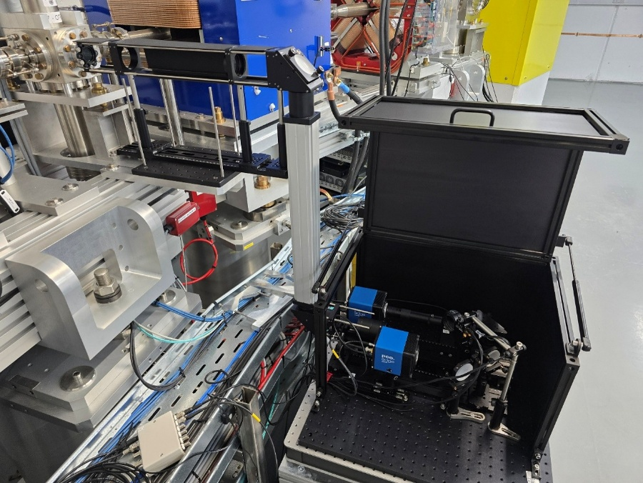
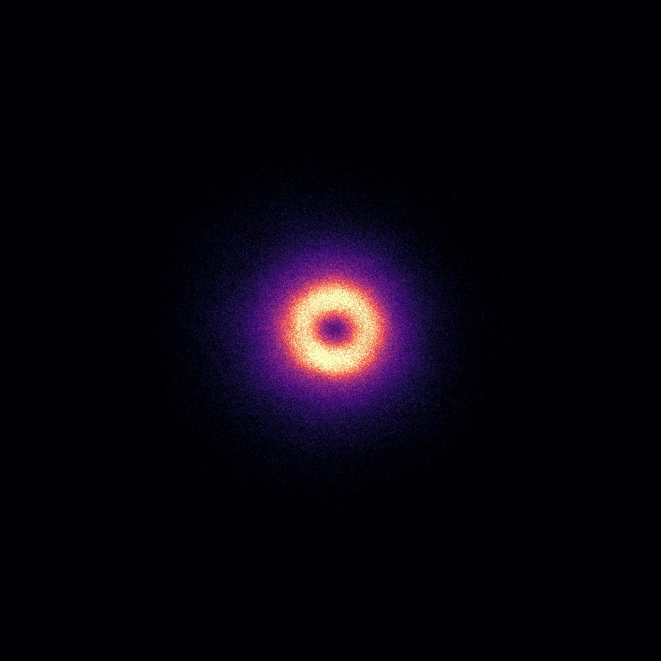
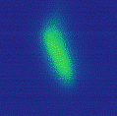
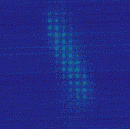
Optical Transition Radiation (OTR)
Lead Investigator: J. Wolfenden (Liverpool University)
Experiment involved measurements of the transverse beam
optics, using an OTR target located after the FEBE hutch
Aimed to characterize the resolution of single-shot emittance
measurements, made via an optical pepper pot technique
The FEBE beamline was used to:
  Benchmark OTR measurements
  against quadrupole scans,
  Deliver specific Twiss parameters
  to the OTR target
OTR
target
Periscope
Light box with optical paths for:
Direct imaging of OTR light
OTR imaging via a multi-lens array (MLA)
Spatially Coherent OTR
Beam Size < 50 μm at 250 pC
Direct
MLA

Slide 25
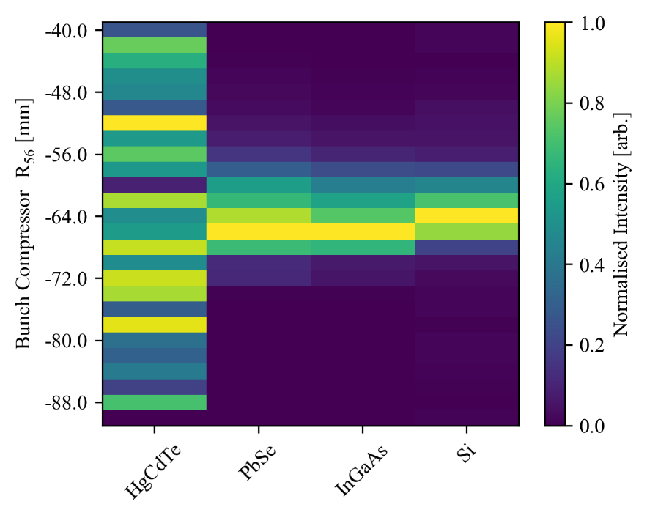
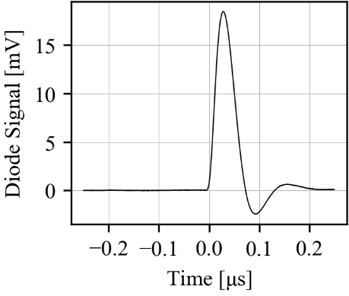
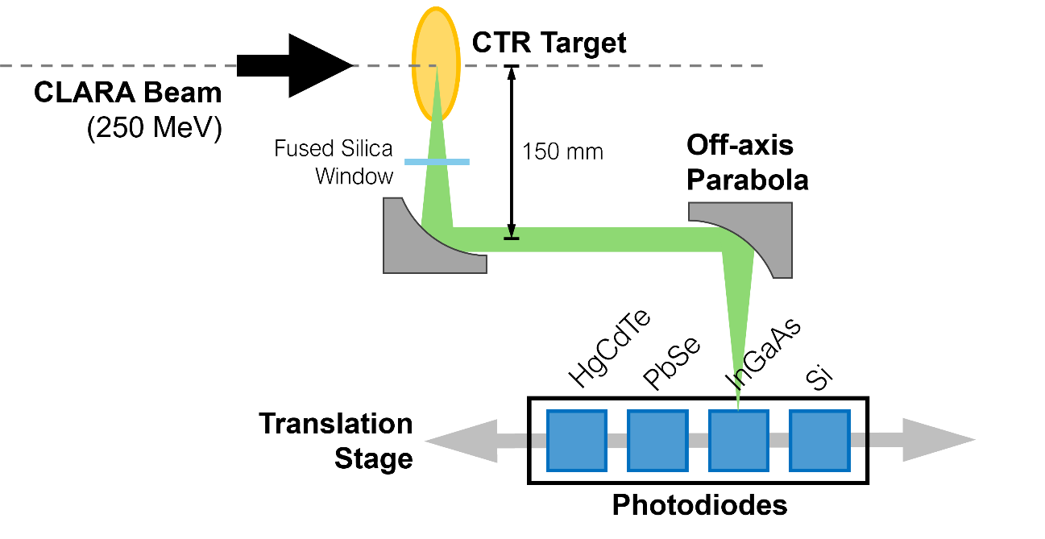

Coherent Transition Radiation (CTR)
Lead Investigator: W. Kuropka (DESY ARES)
Experiment aimed to demonstrate a CTR-based compression diagnostic for ultra-short (< 10 fs), low charge (< 5 pC) beams
Signals were measured with several photodiodes, mounted
next to a CTR target just before the FEBE hutch
Minimized the bunch length by adjusting the VBC R₅₆
to maximize the CTR signal at short wavelengths
Delivered ultra-short electron bunches:
≲ 5 fs duration at ~3.5 pC

Slide 26
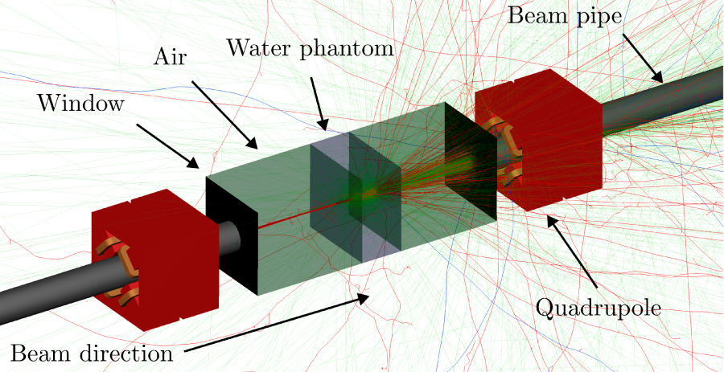
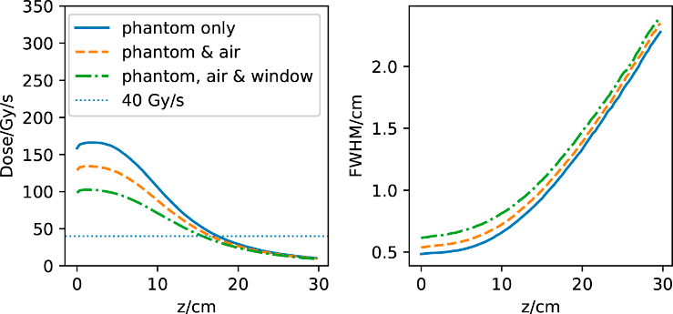
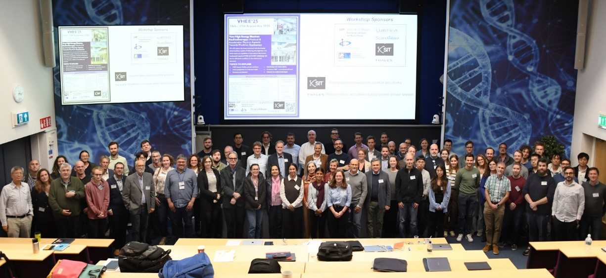
Medical Applications
D. Angal-Kalinin et al.,
Front. Phys. 12, 1496850 (2024)
Left: Visualisation of Monte Carlo dose rate calculations with the
250 MeV CLARA beam
CLARA is a valuable test facility for new radiotherapy
methods using very high energy electrons (VHEE)
Simulation studies have indicated that CLARA can deliver
FLASH dose rates (> 40 Gy/s) to the FEBE user area
FLASH dose rates are of interest due to evidence that they deliver similar tumour control while sparing healthy tissue
The VHEE’25 workshop was held at Daresbury in Sept. 2025
See Roger Jones’ talk about VHEE radiotherapy
after the coffee break
Above: Participants of the VHEE’25 workshop

Slide 27
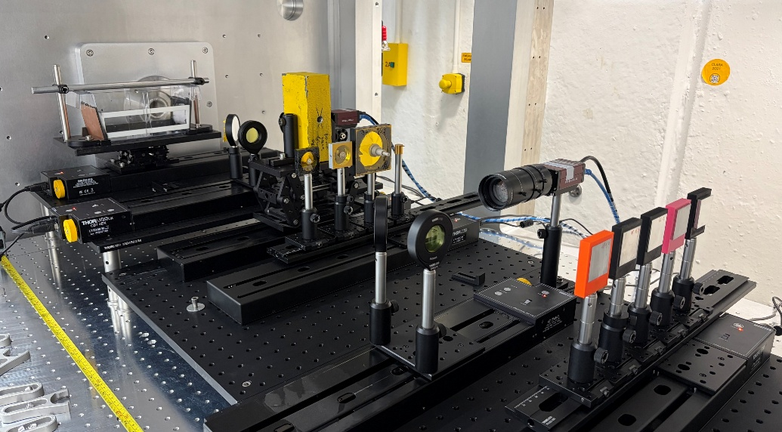
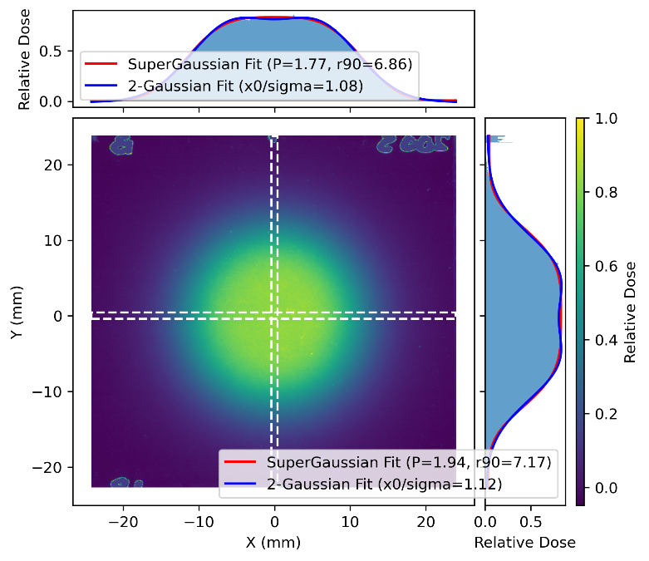
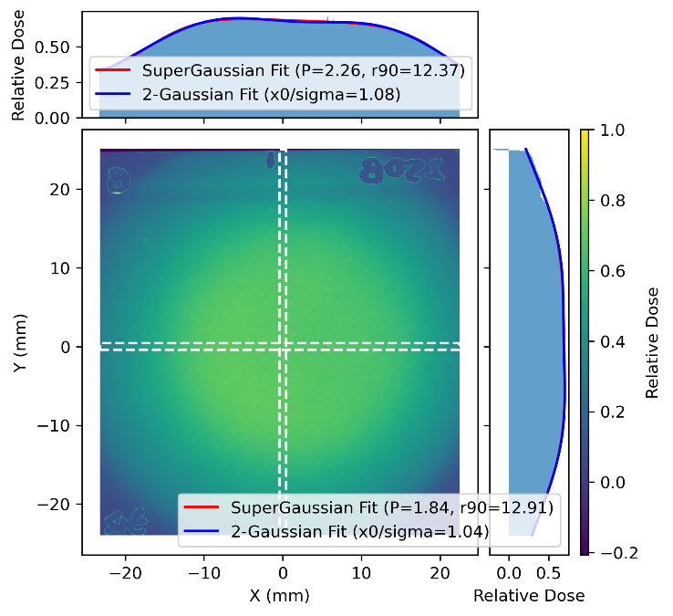

VHEE Scatterers
C. Robertson et al.
NIM A 1082, 170943 (2026)
Lead Investigator: M. Dosanjh (Oxford University and CERN)
The first in-air experiment carried out in either
of the FEBE experimental chambers
Aimed to generate large (~1 cm), uniform beam profiles
suitable for Very High Energy Electron (VHEE) radiotherapy
Successfully produced uniform beams at energies up
to 250 MeV, using various scatterer configurations
Builds on previous work with 200 MeV beam
at CLEAR (CERN)
Beam
Direction
Water
Phantom
Collimator
Conical
Scatterers
Top Right: Photo of the experimental setup inside the second FEBE chamber
Bottom Right: Analysis of RCF films
showing uniform electron beam profiles

Slide 28
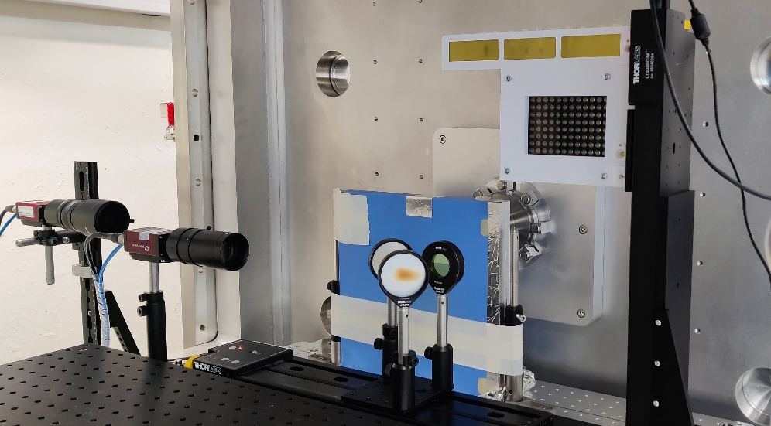
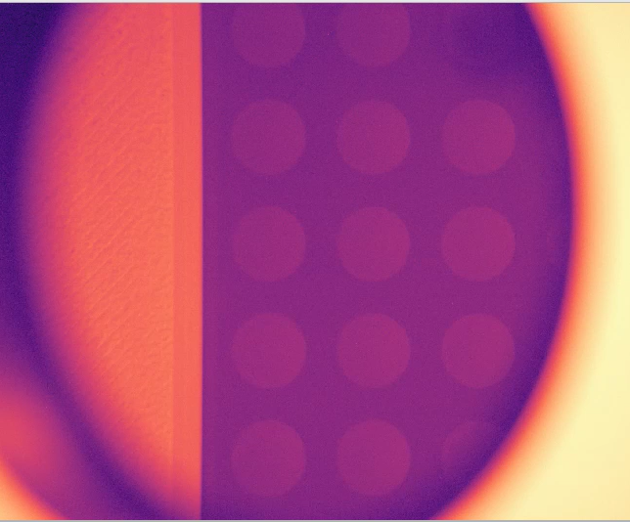

VHEE Cell Irradiation
K.L. Small et al., Sci. Rep 11, 3341 (2021)
D. Angal-Kalinin et al., Front. Phys. 12 1496850 (2024)
K. Small et al., NIM B 565, 165752 (2025)
Lead Investigator: R.M. Jones (Manchester University)
Dosimetry studies to establish the electron beam parameters
required to achieve FLASH dose rates (> 100 Gy/s) at CLARA
Experiment will study cell survival and DNA damage after VHEE irradiation at conventional and FLASH dose rates
Builds on previous studies at CLARA,
ARES (DESY) and CLEAR (CERN)
European first: VHEE FLASH irradiation of cancer cells
(A549 lung adenocarcinoma) with the 250 MeV electron beam
96-Well
Cell Plate
Above: Photo of the experimental setup inside the FEBE chamber
Left: Video showing delivery of the
CLARA electron beam to samples
held in a 96-well cell plate
Beam
Axis
10 mm
See talk by Kristina Small
at 11:20 today

Slide 29








Plasma Acceleration - Goals
Lead Investigator: R. D’Arcy (Oxford University)
The HALHF Collaboration plan to explore concepts for novel accelerator
staging (for high energy) and repetition rates (for high luminosity) at CLARA
  Plan benefits from unique, flexible, modular infrastructure
  To be carried out in a multi-year phased approach
Experimental goals (this beam time):
  Prove plasma-accelerator infrastructure at CLARA,
  and generate plasma with a discharge capillary
  Drive a plasma wake with the CLARA beam
  Goal: Generate GV/m (decelerating) fields
  Focus CLARA beams with an active plasma lens
  Goal: Generate >100 T/m (focussing) fields
Above: Plasma cell in the
FEBE experimental chamber
Left: First (argon) plasma generation
arXiv:2503.19880

Slide 30


Plasma Acceleration - Results
Lead Investigator: R. D’Arcy (Oxford University)
All goals achieved!
  ~GV/m electric fields
  ~150 T/m magnetic fields
Next steps (in subsequent beam times)
  Novel interstage optics scheme
  (for staging of plasma-accelerated beams)
  Plasma acceleration of bunch trains with
  HALHF properties (~10 ns separation, 100 Hz)
  Energy-mapping studies and high average
  power plasma sources
Milestone: First beam-driven plasma “accelerator” in
the UK, and the first active plasma lensing at CLARA
See talk by Meg Savage
Tuesday at 11:15
Courtesy of C.A. Lindstrøm

Slide 31


Future Plans
CLARA is delivering high-brightness electron
beams to high-impact user experiments
More milestones are expected over the coming months…
  Commissioning of the fourth harmonic cavity,
  120 TW laser transport into the FEBE hutch,
  First experiments combining the
  CLARA electron beam and FEBE laser
Above: Fourth harmonic cavity
installed on the CLARA beamline
Left: 120 TW laser installed
in a room above the FEBE hutch
Further user experiments, involving
machine learning and the FEBE laser,
are planned for later this year

Slide 32







CLARA at IPAC26
www.ipac26.org/prepress
TUP3075 | In-situ cathode measurements (A. Pollard)
TUP3076 | Dark current measurements (F. Jackson)
WEV6003 | High-level software (J. Jones)
WEP6091 | Dechirper commissioning (T. Overton)
WEP6092 | Phase space tomography (M. Johnson)
WEP6104 | High-level RF interfaces (N. Joshi)
WEP6171 | Automated RF conditioning (M. King)
THP2100 | Compression and linearisation (J. Jones)
THP2143 | Cs₂Te cathode production (H. Churn)
THP2144 | High-power RF conditioning (A. Gilfellon)
Thank You
for Listening!
Questions are Very Welcome

