Slide 1
ISIS Machine Intensity Limitations and Recovery Following the Long Shutdown
H. Cavanagh on behalf of ISIS Accelerator Beams & Technology Divisions
Particle Accelerator and Beams Conference 2026
1st July 2026

Slide 2
Outline
1.
Re-cap/introduction to ISIS
Beam status before the long shutdown
Long-shutdown works
Recovery following the long shutdown…
Lessons learnt
Next steps

Slide 3
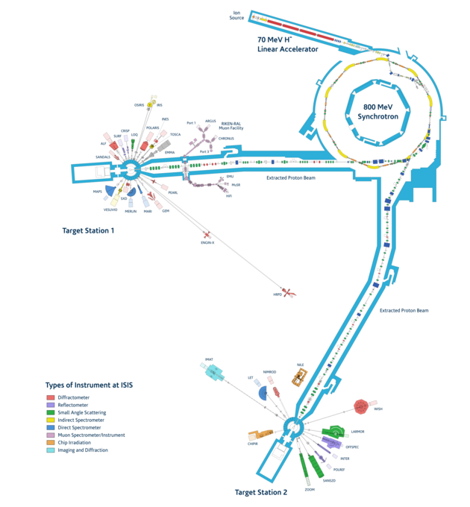
The ISIS Facility Overview
2.
World-leading centre for research in the physical and life sciences, began operations in 1984
Suite of 37 instruments served by three targets
  Two neutron spallation targets (tungsten)
  One intermediate muon target (graphite)
Annually
  Host ~3,000 UK and international researchers
  Conduct ~1,200 experiments
  Produce ~600 publications
Run 24/7 for ~140-180 days per year, in four/five cycles

Slide 4
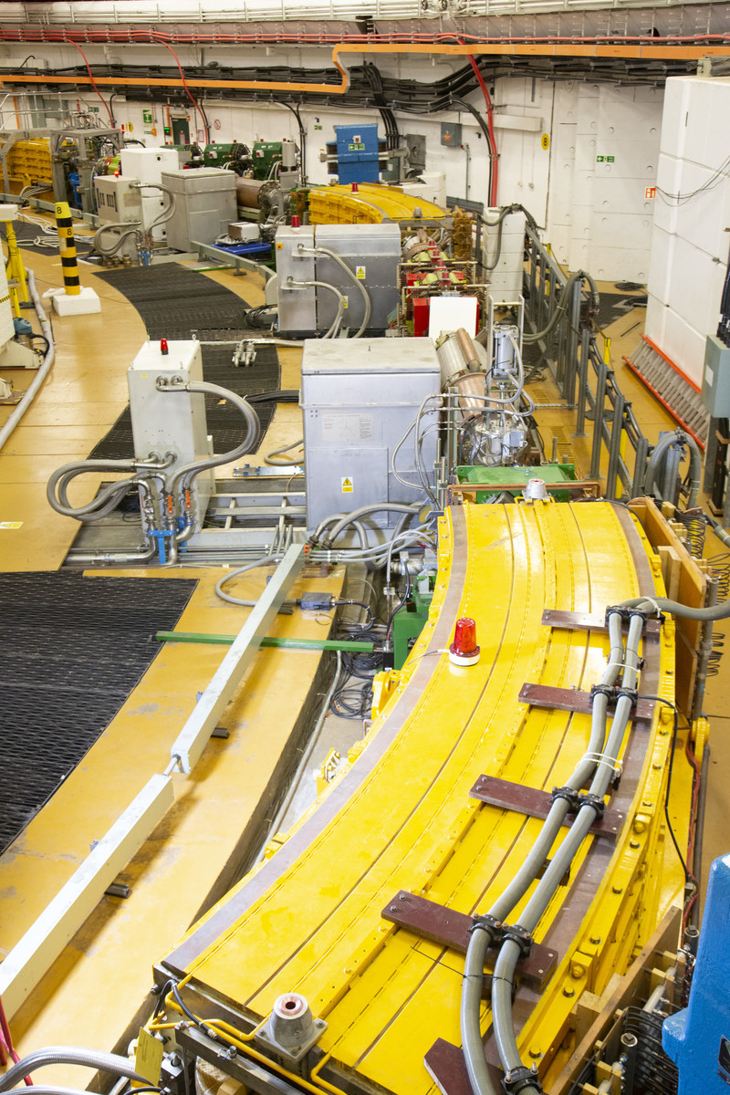
ISIS Accelerator Parameters
3.
35 keV H_ penning ion source
665 keV RFQ
70 MeV DTL
200 µs multi-turn charge-exchange injection
  Horizontal painting from dispersive closed orbit on falling main magnetic field
  Vertical painting achieved using an upstream programmable dipole
163 m, 800 MeV RCS
Up to 3x10¹³ ppp, 50 Hz, 240 µA (192 kW)
x10 super-period structure: dipole, quadrupole doublet and singlet
  x20 programmable trim quadrupoles
  x14 programmable dipole correctors
x1 straight used for injection
x1 straight used jointly for collimation and vertical extraction
x6 fundamental and x4 second harmonic RF cavities
x2 extracted proton beamlines (154 m and 144 m)

Slide 5
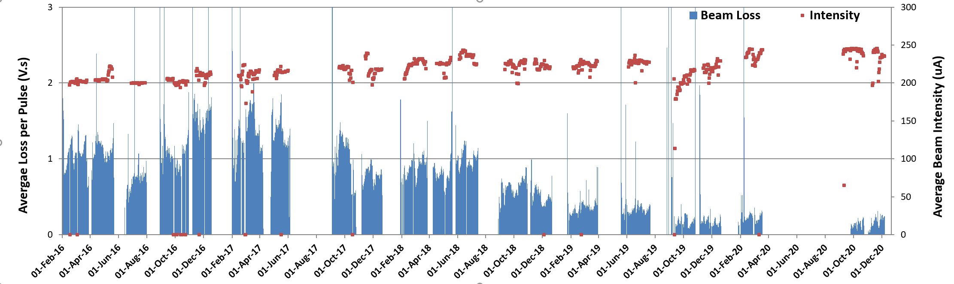
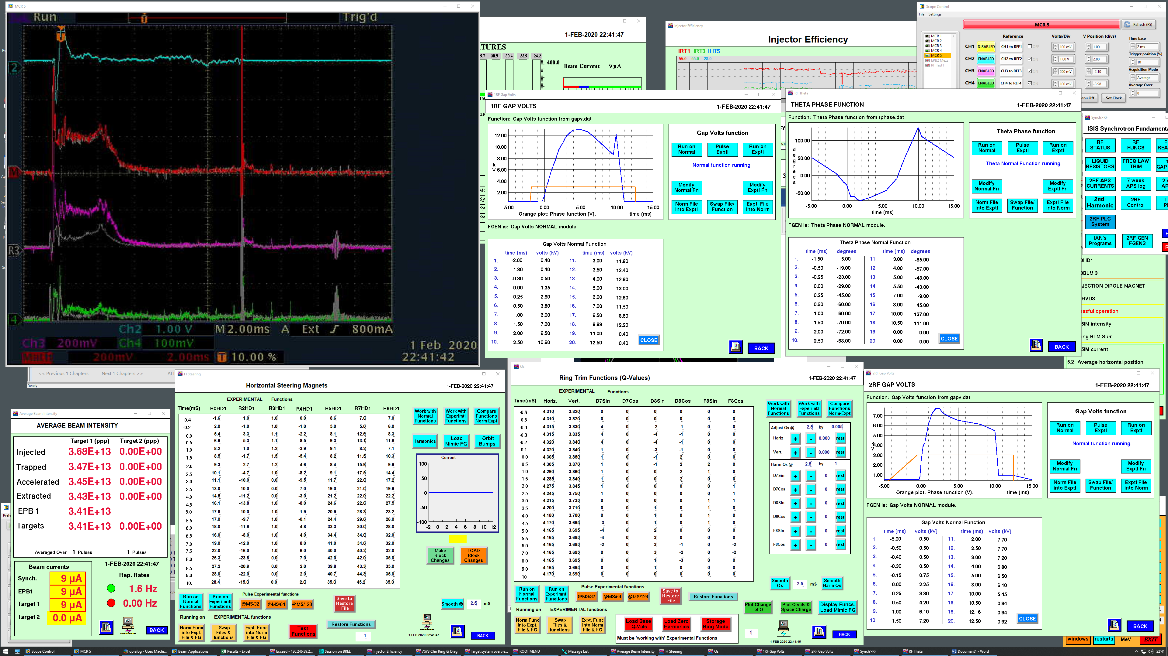
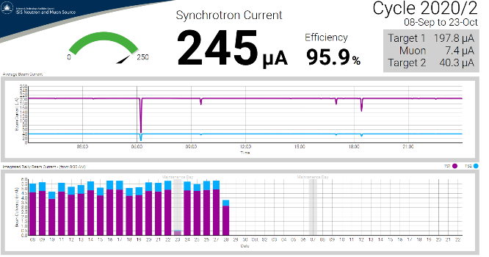
2020 Beam Status
4.
Machine setup campaigns and accelerator developments from 2009-2020 facilitated increased beam intensity and efficiency
Record Day:
September 27th 2020, 5.87 mAh, maximum beam of 245 µA for 24 hrs (2 minutes off!)
In 2020, 78/107 scheduled days received >5mAh beam
Record Performance:
275 µA equivalent beam demonstrated during February 2020 machine physics
~245 µA reference
Sum of all synchrotron beam loss monitors (BLM Sum)
BLM Sum -SP1&SP2

Slide 6
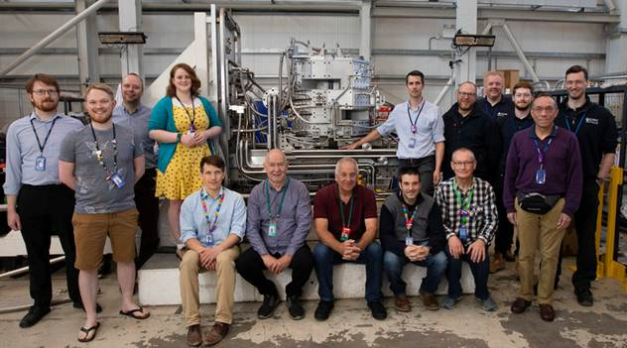
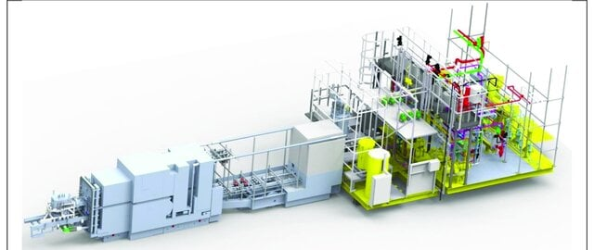
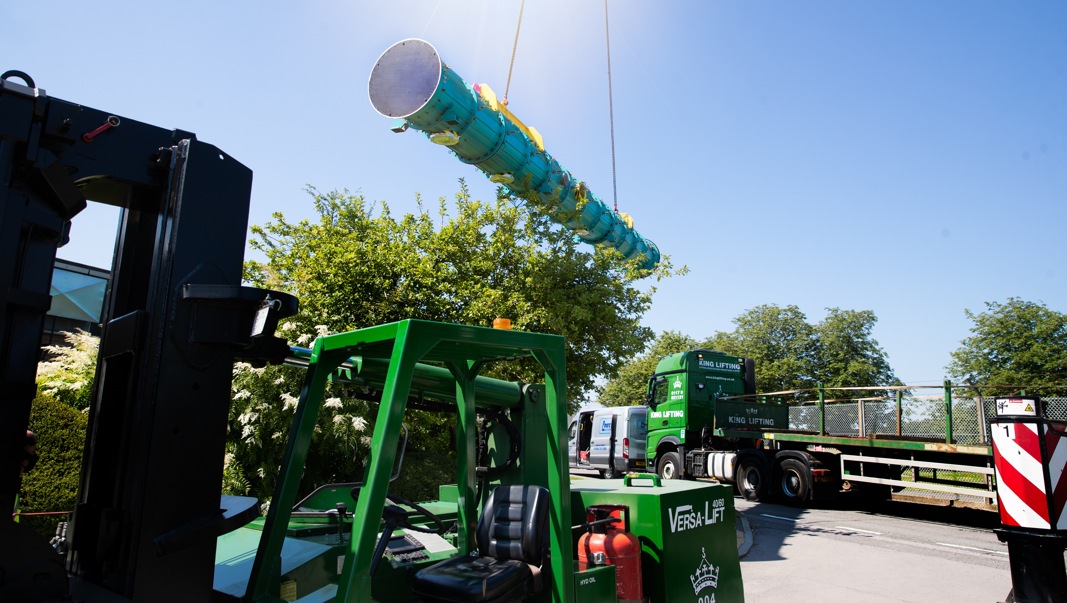
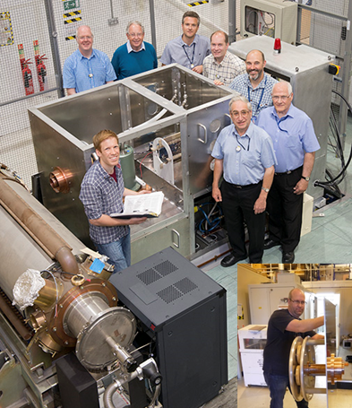
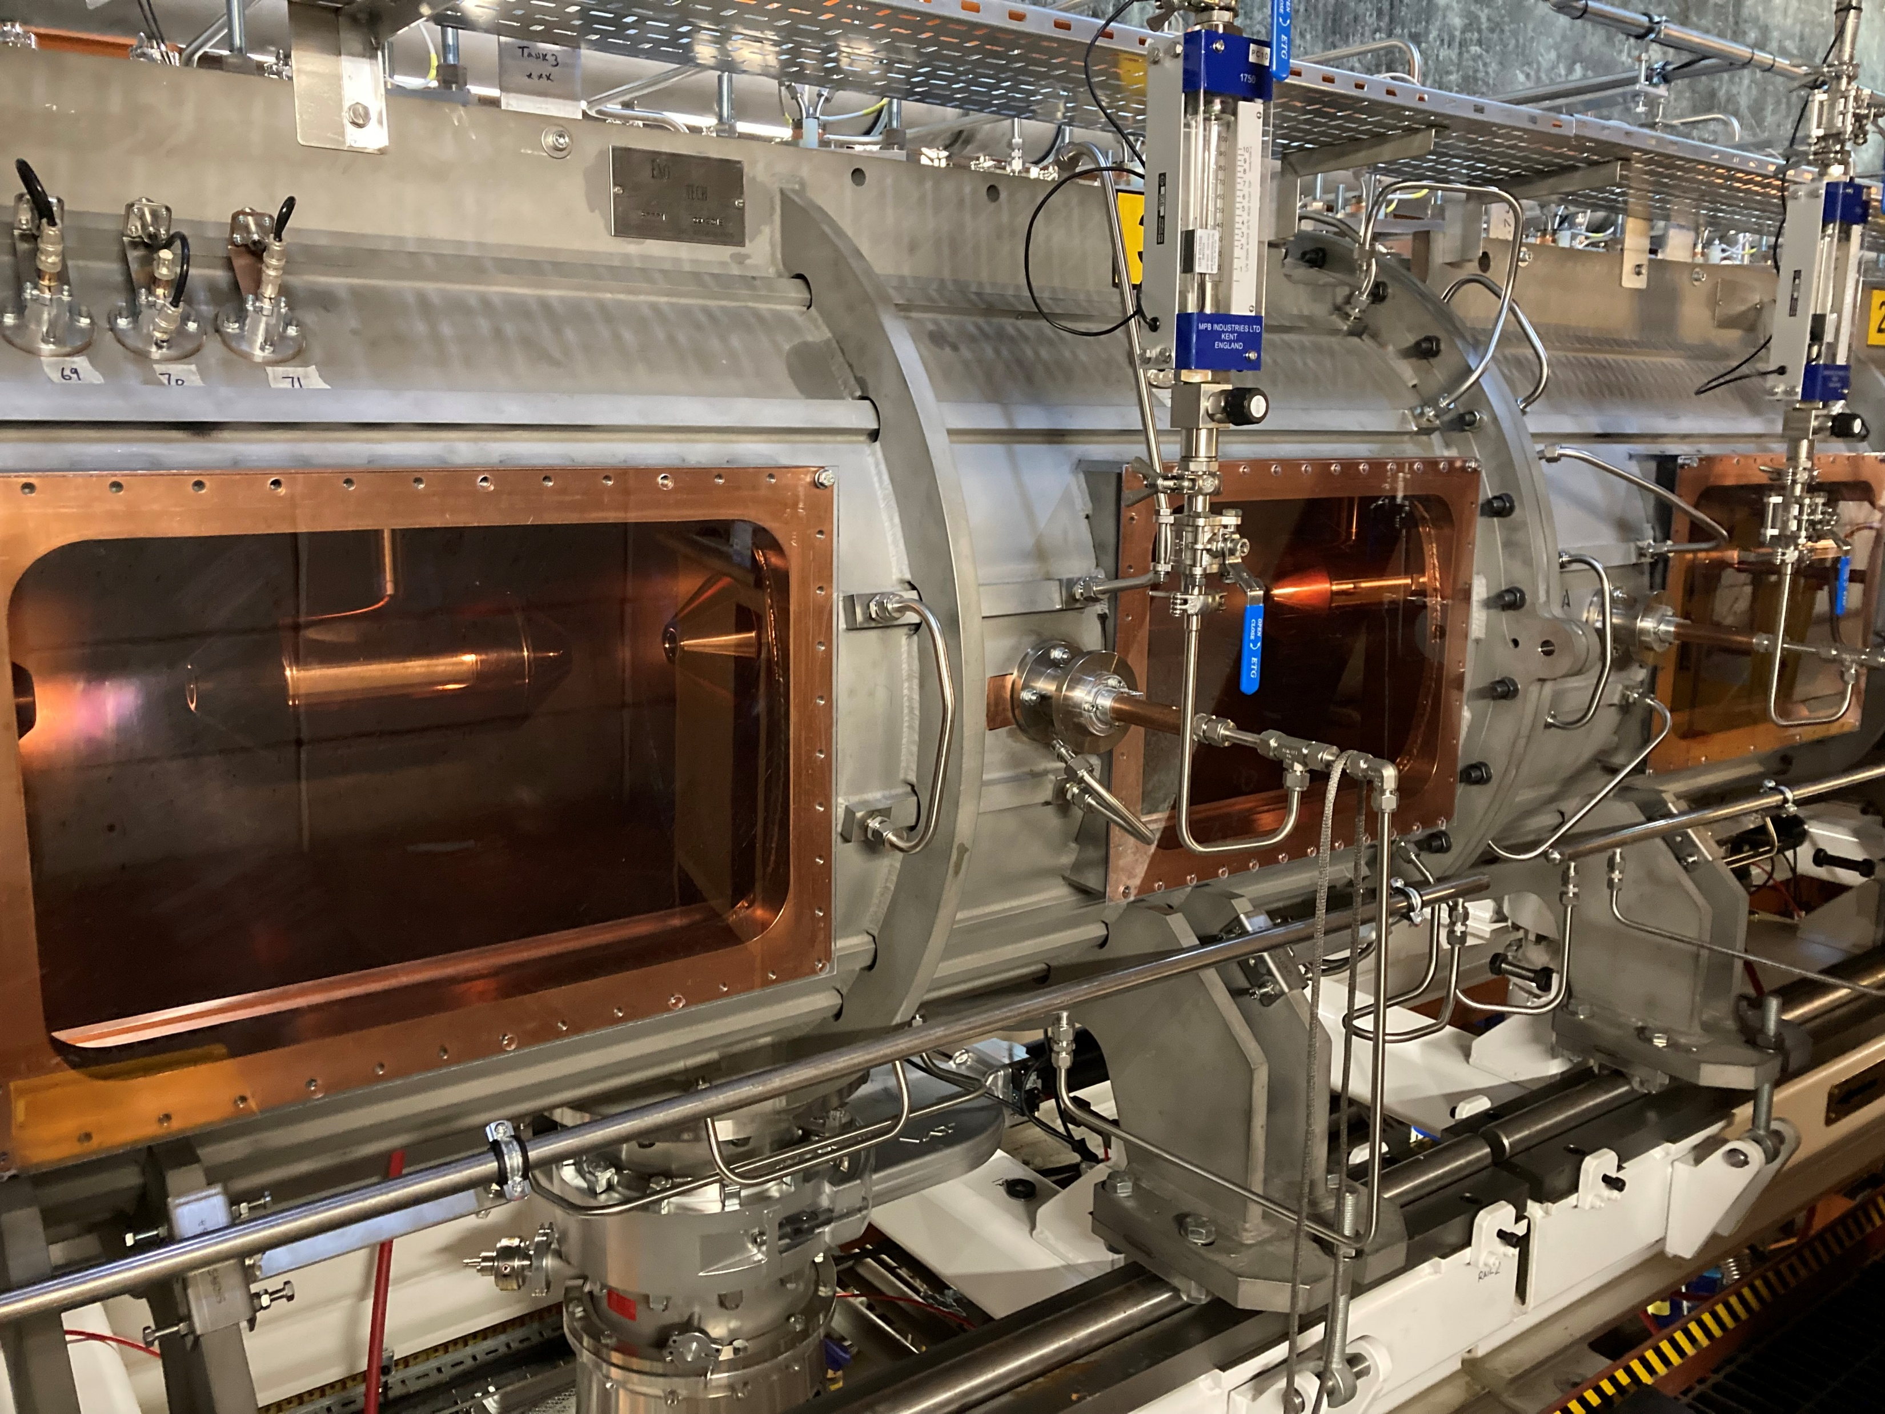
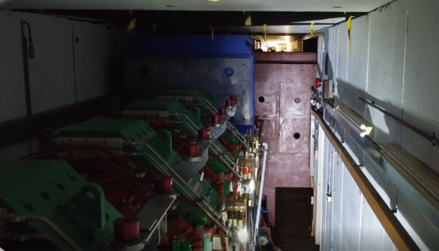
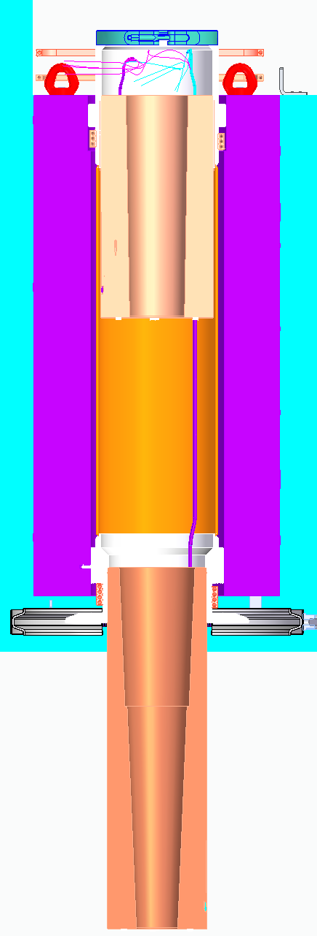
Long Shutdown
5.
Installation of new TS-1 target, reflector and moderator assembly
Linac Tank 4 replacement
Upgrades of all synchrotron fundamental RF high power drives
Muon collimator replacement

Slide 7
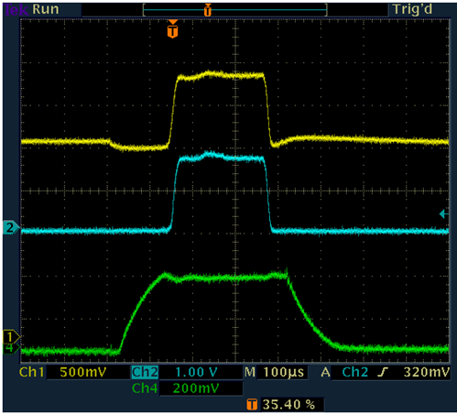
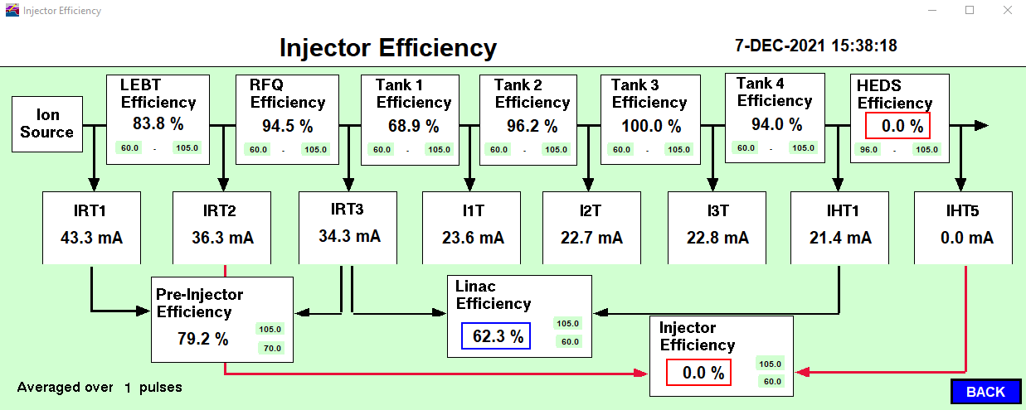
6.
First Beam Through Tank 4
I3T
7th Dec 2021 – First Tank 4 beam, 94% transmission
No tuning attempts, just demonstrate transmission to give confidence before the start-up after Christmas
IHT1
T4 Field

Slide 8
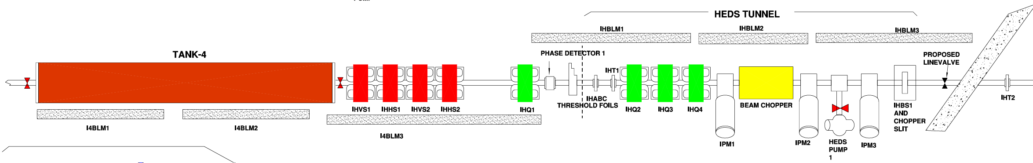
Initial beam after the long shutdown
7.
“It’s only 40 µA to TS2, it’s a doddle” soon came back to bite as we worked to re-establish beam…
7th Dec 2021 – First Tank 4 beam, 94% transmission
11th Jan 2022 – Tank 4 transmission not quite as good, Tank 4 wrong phase - easy to solve
12th Jan 2022 – 24 mA at IHT1 but 0 at IHT2, IHQ2 wrong polarity - easy to solve
…
...
…
…
4th Feb 2022
  still struggling with synchrotron losses and circulating a diluted beam
  could only inject on the inside of the ring with 20-40% injection efficiency but then get 90% of this diluted beam accelerated
  used beam loss monitors (BLMs) to establish that beam survives few turns but lost somewhere between R0BLM4 and R1BLM1, and by changing the main magnet current expected a possible 20 mm aperture restriction…
IHT1
IHT2
Steering Magnets
IHQ2
Beam
Injector Profile Monitors

Slide 9
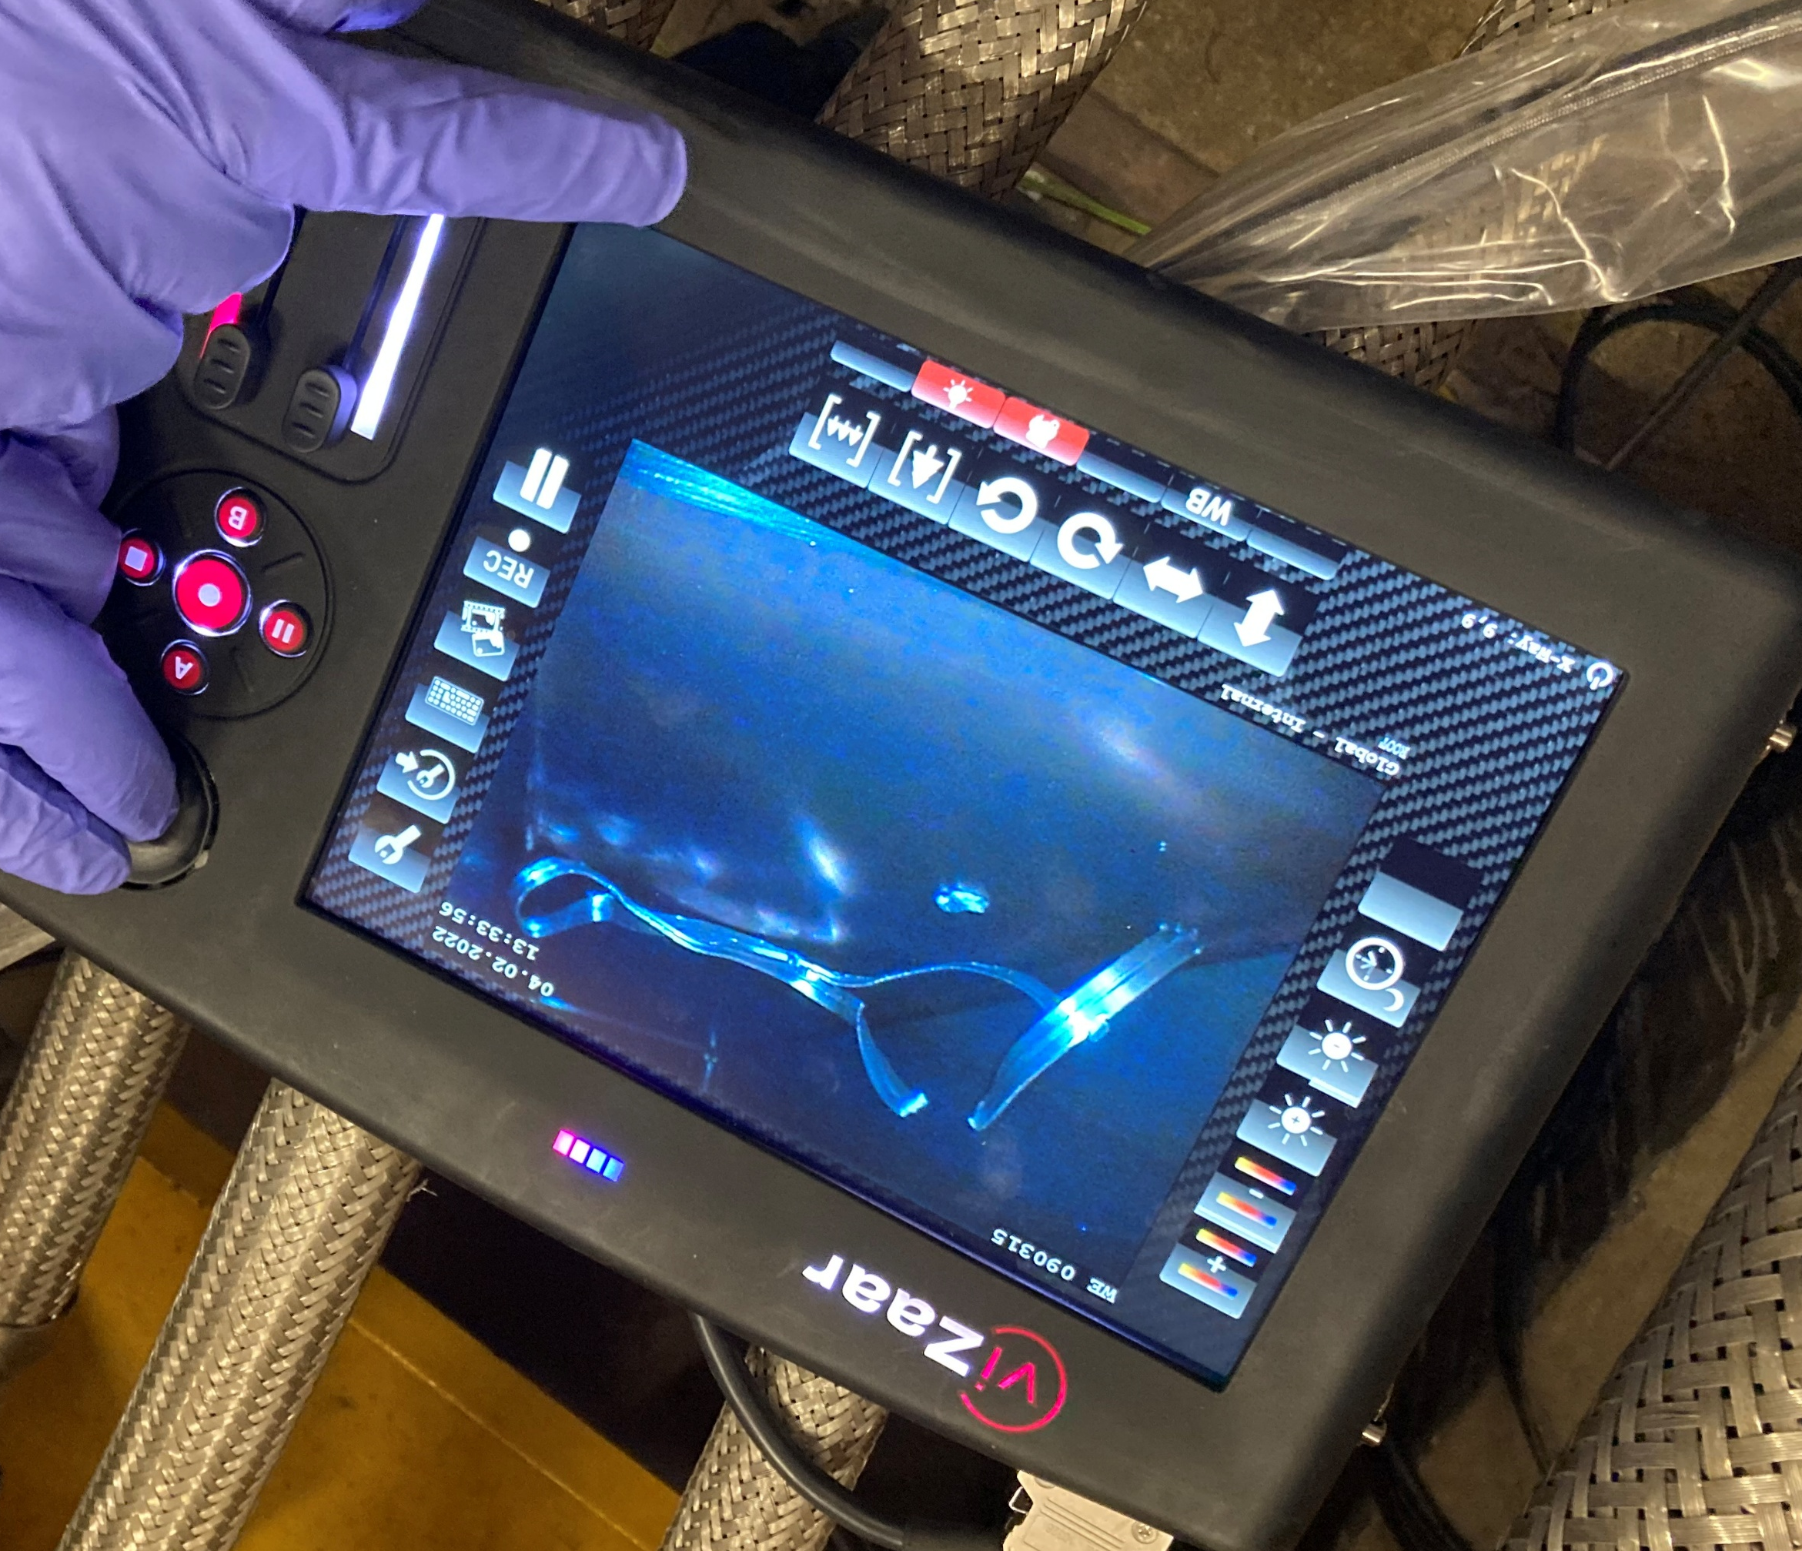
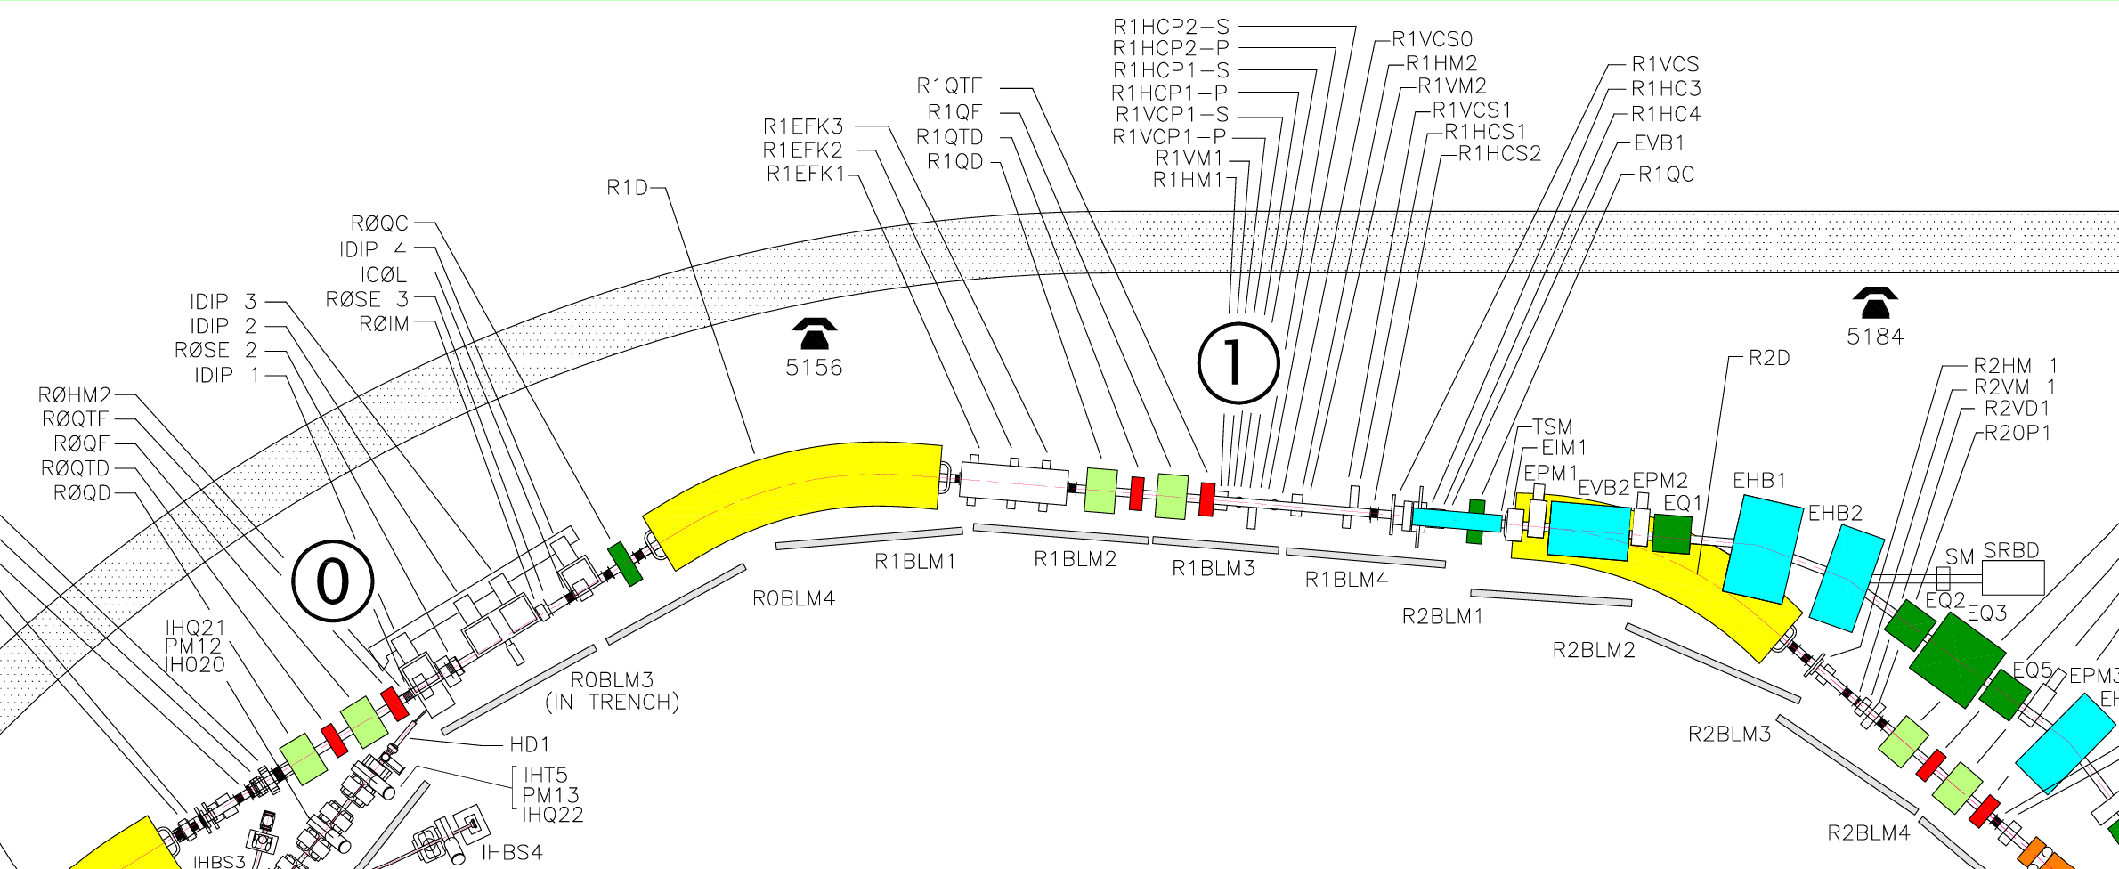
Aperture restriction
8.
Upon inspection found an aluminium vacuum seal found in the extract kicker bay
  type of seal found in EPB1, so the hypothesis is this came from SRBD during refurbishment in the shutdown
  some concern that to get this far into the kicker bay would have had to travel through the extract septum and collector straight
Synchrotron Room Beam Dump (SRBD)
Vacuum Seal
Extract Kickers
Extract Septum
SP0 Singlet
Dipole 1
SP1 Doublet
Collectors
Beam loss observed after few turns
Beam

Slide 10
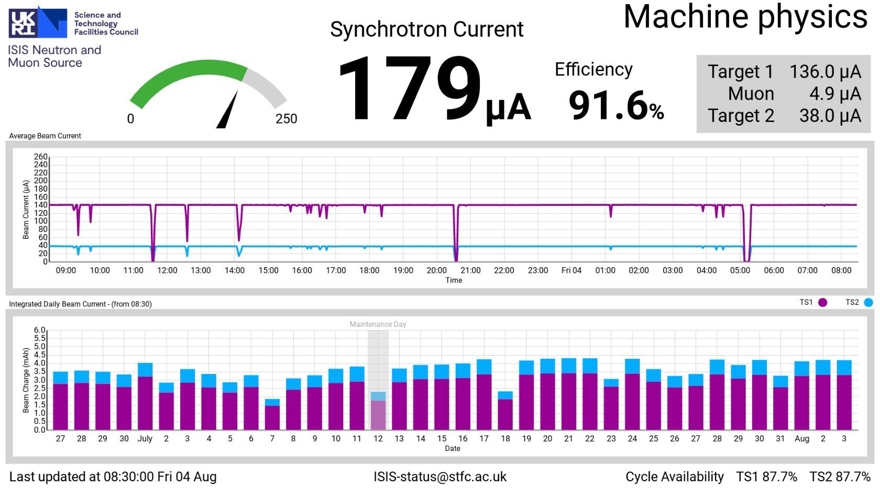
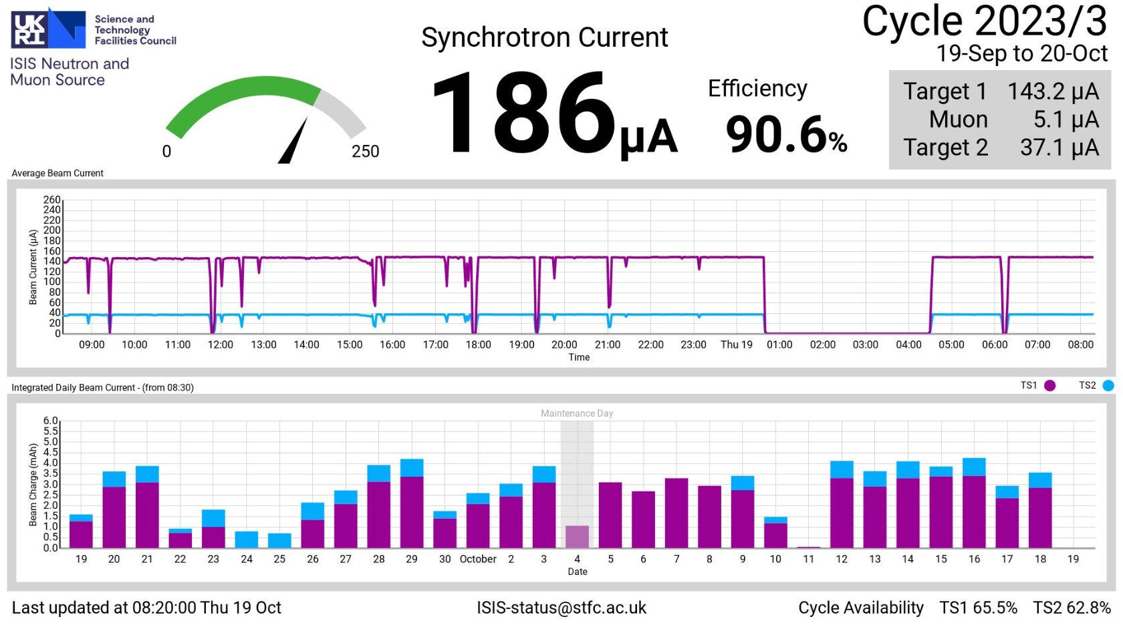
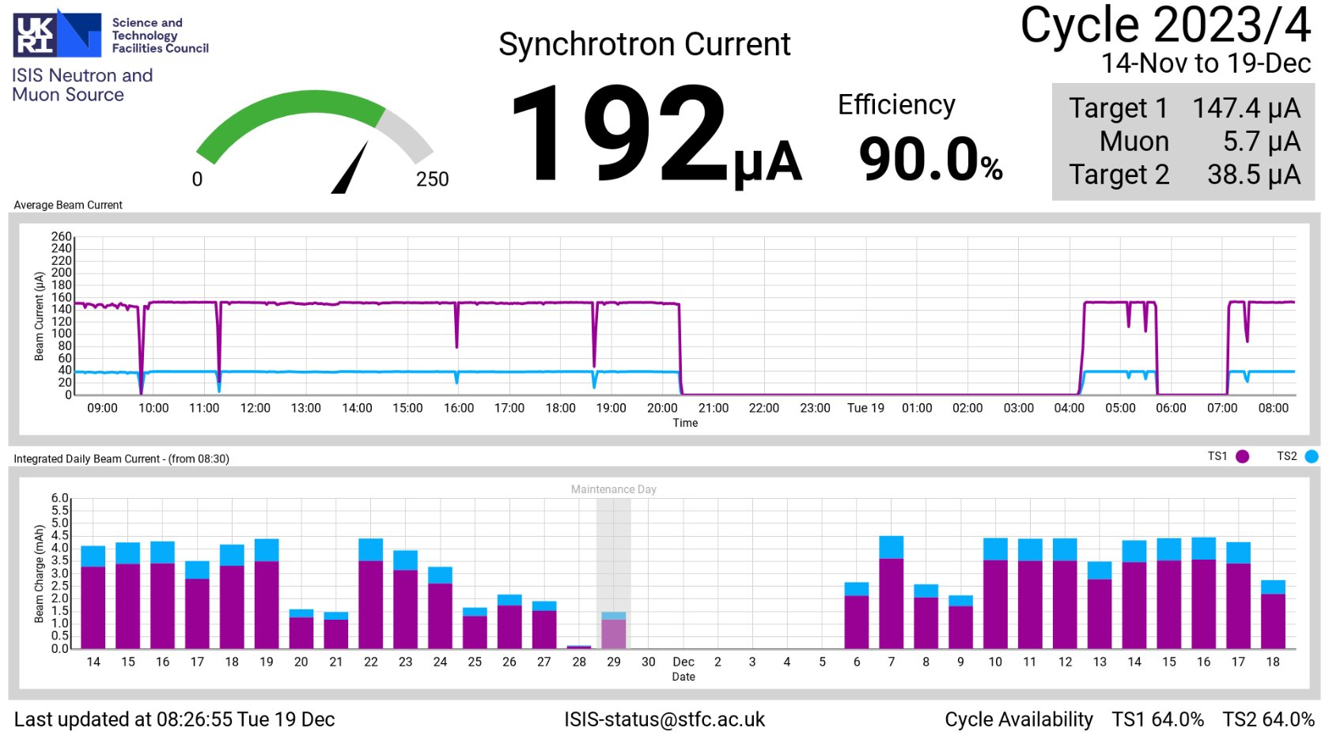
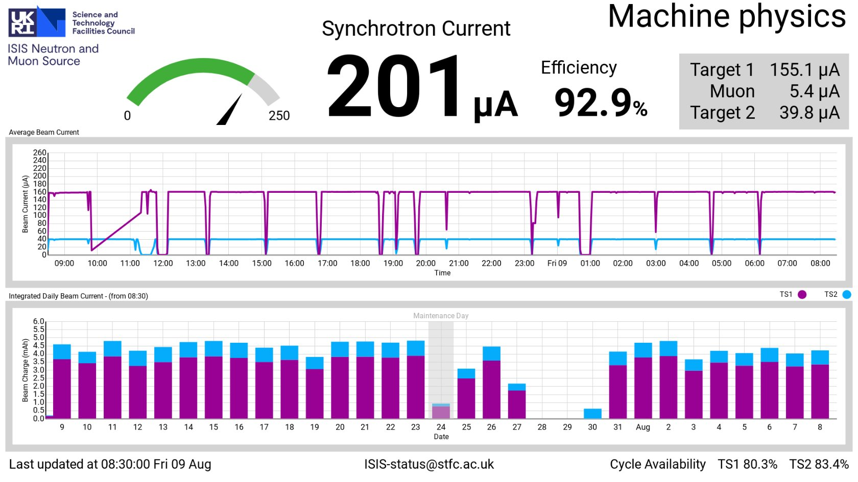
Running, but with lower intensity and higher beam losses
9.
Priority to maintain operations with acceptable loss levels
Investigations conducted to understand these problems 2022-2024
  Orbits
  Envelopes
  Chopped beam
  Injection
  Longitudinal
  Collimation
Longitudinal pulse shapes

Slide 11
10.
Orbits and alignment
Initially identified discrepancy with bare orbit measurements in both planes (no programmable steering correction)
  MAD model showed no obvious matches to kicks at dipoles, doublets, singlets or combinations
  looking for phase advance dis-continuities highlighted areas of interest
Re-aligned Dipoles 2, 3, 4, 5
  no noticeable change in bare orbit measurements
Dipole 3
Sp4 doublet
Dipole 4
Sp5 doublet
Sp6 doublet
Dipole 2
Checked alignment of Dipole 9 from the long-shutdown
  identified and corrected a 2 mm longitudinal offset, improved scintillator losses in SP8/9
Trading losses between SP1 and SP6, particularly vertically. Opened up SP6 to search for obstruction
  no obstruction identified

Slide 12
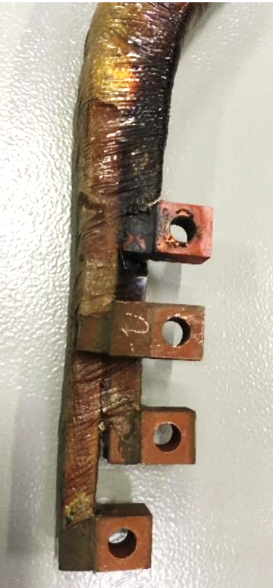
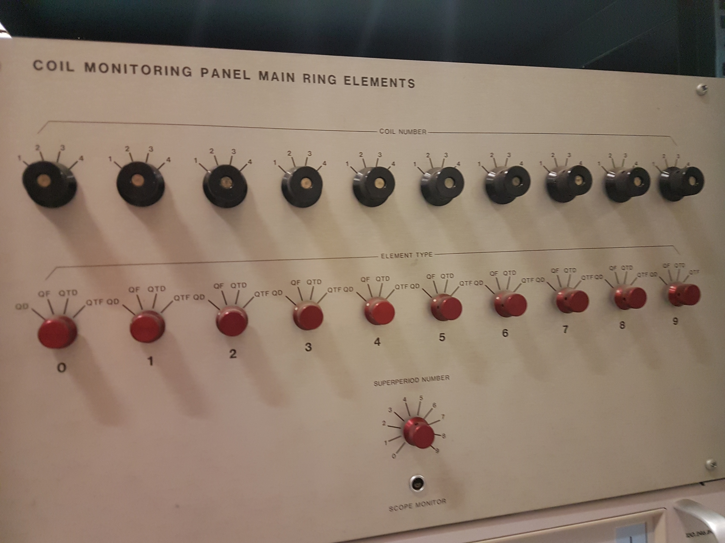
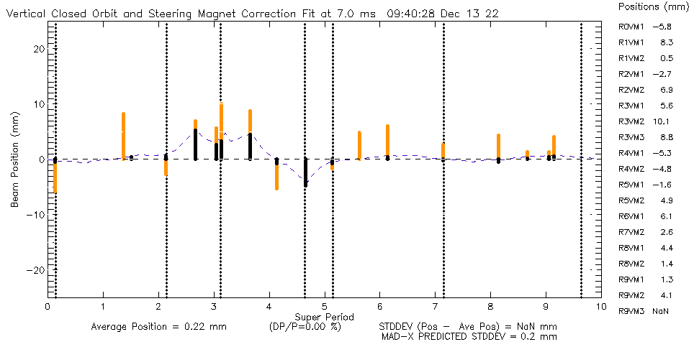
11.
Damaged electrical connections on R0QD and R3QF
Orbits and alignment
Voltage drop measurements on all main elements made
  repairs made to R0QD and R3QF, no measurable change to orbits
Checked doublets and trim quadrupoles with search coils
  no coil errors identified
SP6 Doublet comparison to 2018
Search coil multiplexer in the inner synchrotron
Checked polarity of all programmable steering magnets
  identified polarity issue on (unused) R3HD1 and x2 sign errors within controls for R2VD1 – resolved
  orbit response matrices show correct response of all individual steering magnets
  orbit bump check measurements correct (minor query on response of R7HM1 BPM)
Proved steering magnet bumps and single kicks

Slide 13
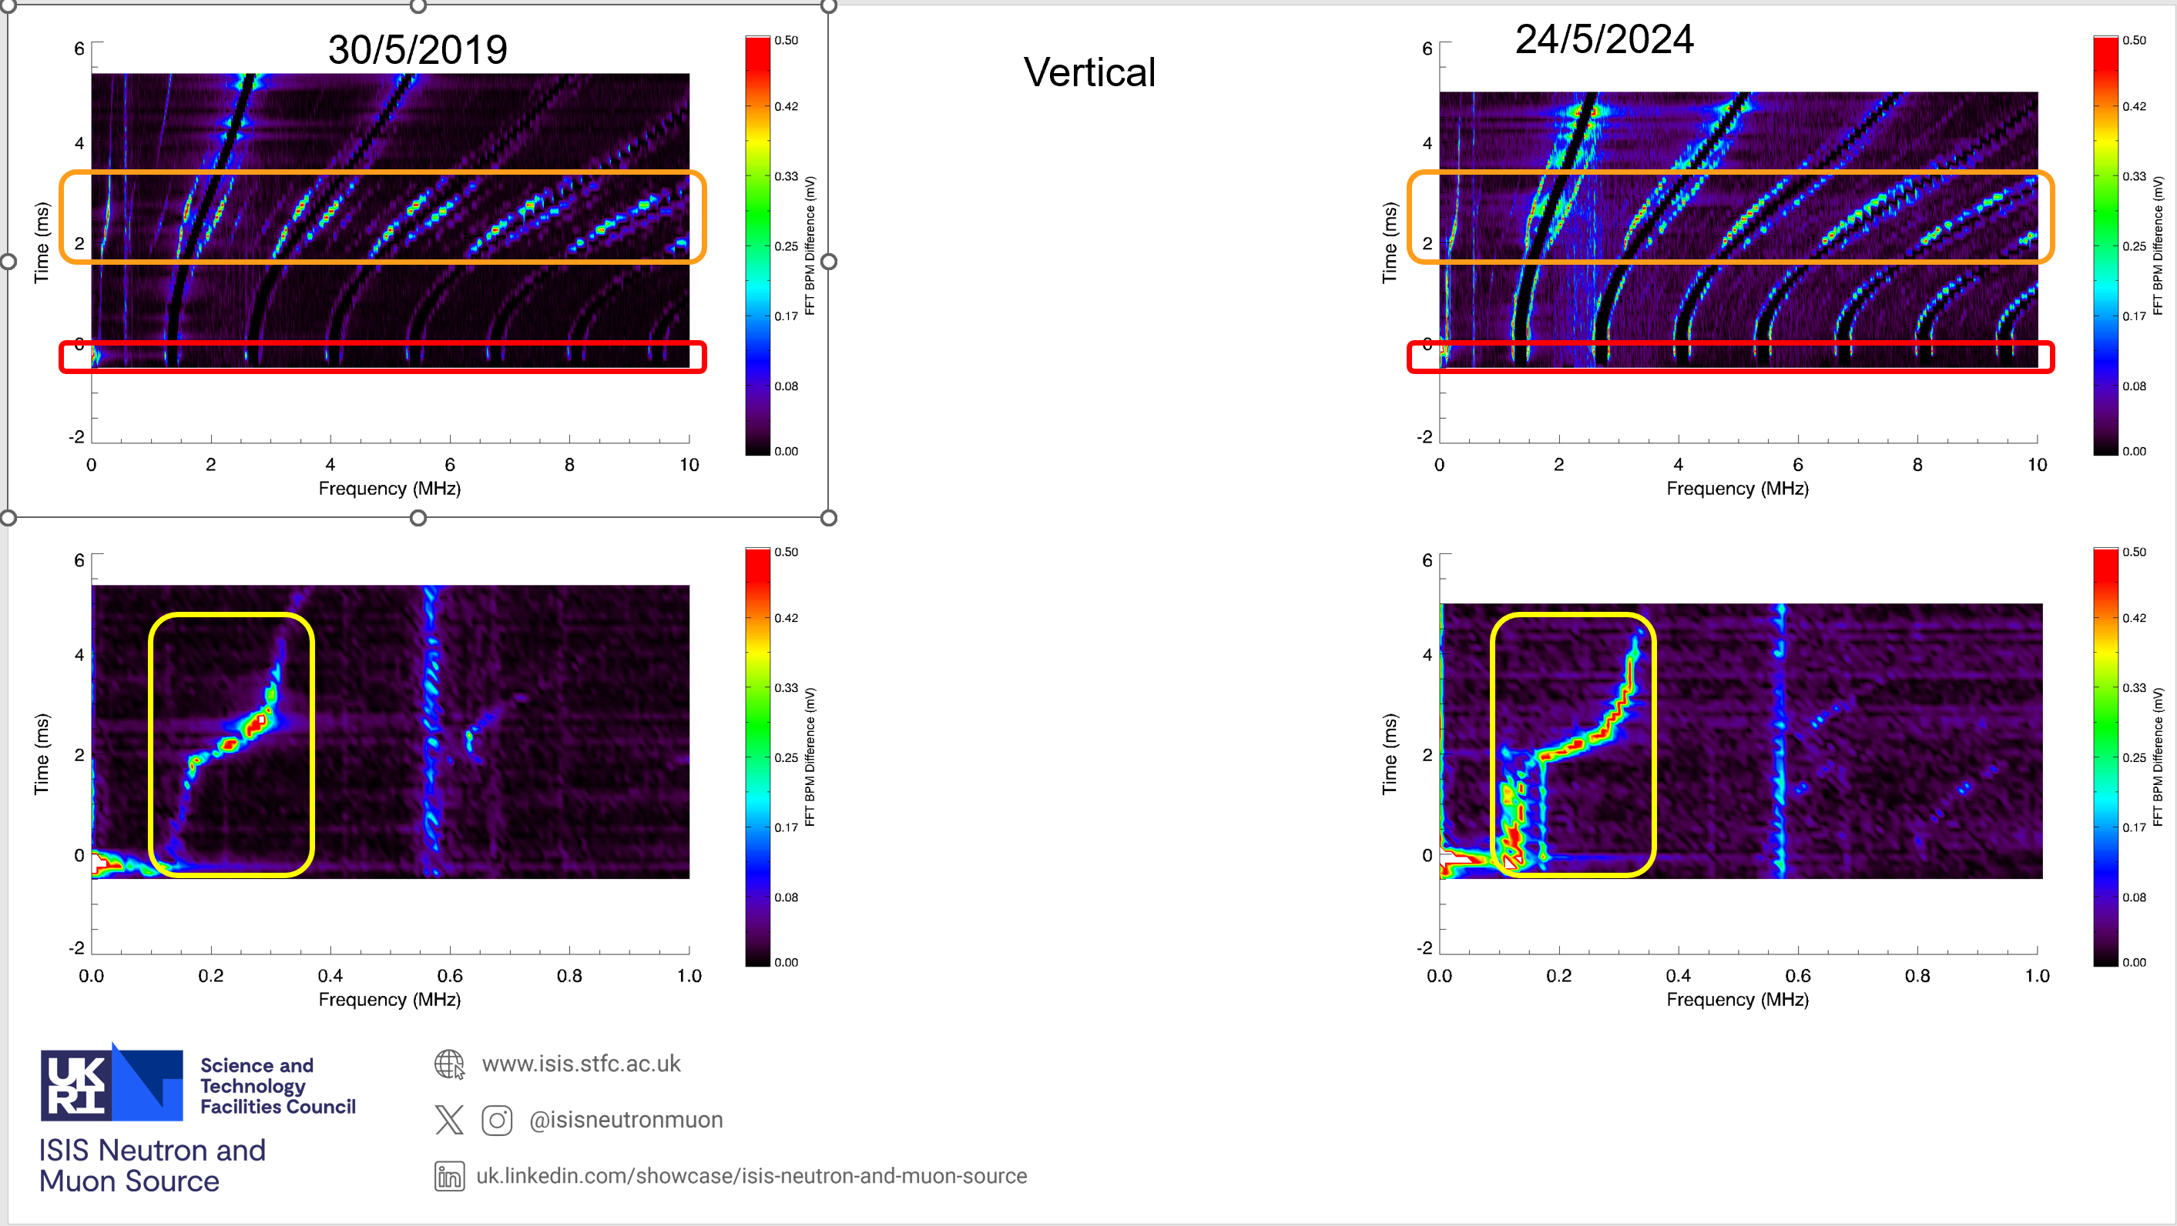
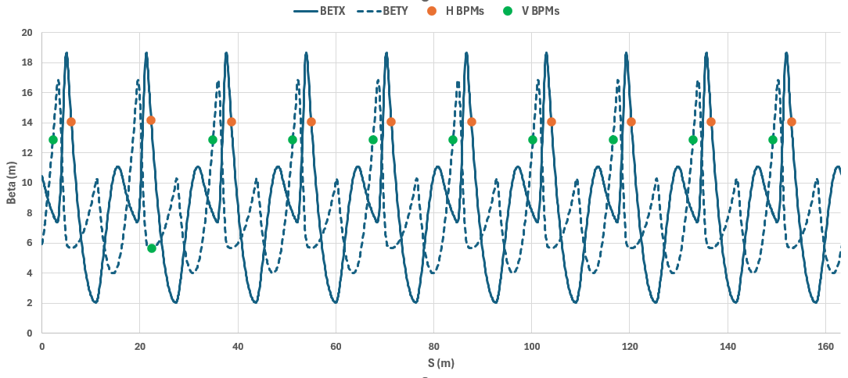
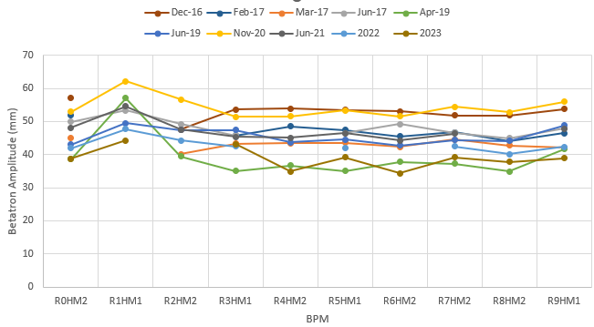
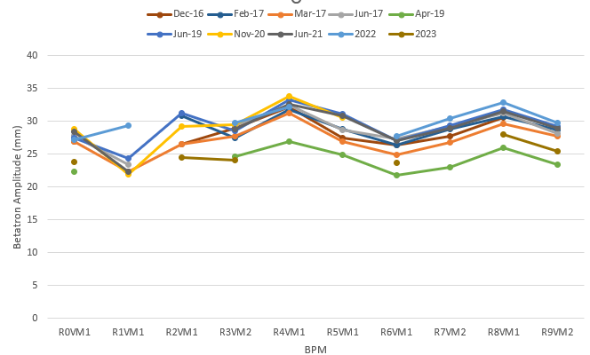
12.
Prominent side-bands throughout the cycle
Envelopes
2019
2024
BPM spectra measured
  observed increased side-bands, tuned losses empirically - resolved through PSU filter replacements
Checked polarity of all programmable trim quadrupoles
  dQ/dI measurements, no errors identified
Increase in side-bands at injection
2019
2024
Betatron amplitudes measured from chopped beam data
  consistent with data back to 2016
Horizontal Betatron Amplitude
Vertical Betatron Amplitude
Beta at BPM locations (MAD)

Slide 14
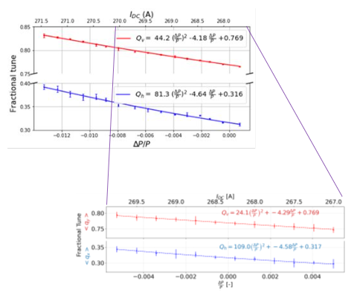
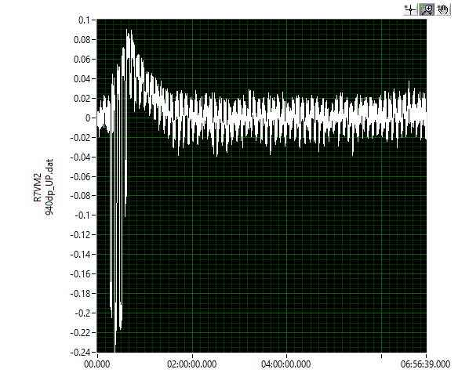
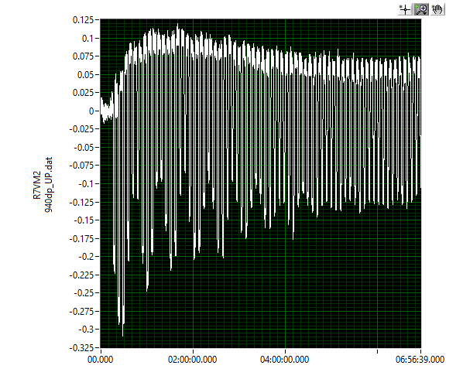
Chopped beam measurements
13.
Circulation and turn-by-turn measurements
  running with all programmable steering magnets off could only circulate ~4 turns of beam
  turning off all programmable trim quadrupoles as well restored full circulation
  full circulation also could also achieve by varying injection angle and local orbit bumps
  unable to reconstruct turn-by-turn trajectories; not a coil or polarity error, but what else?
Chromaticity
  agrees with previous measurement
2023
Turn 1
Turn 2
Turn 3
Chromaticity comparison
2019
R7VM2 UP Electrode
Steering Magnets and Trim Quadrupoles off

Slide 15
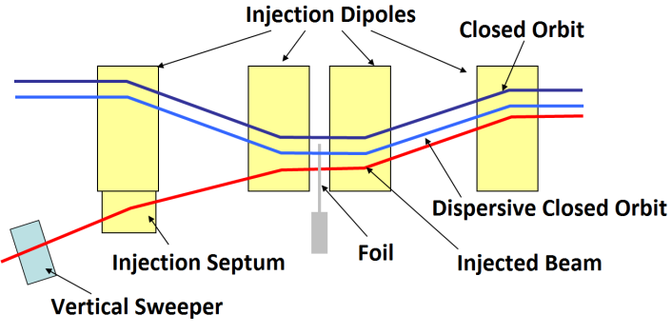
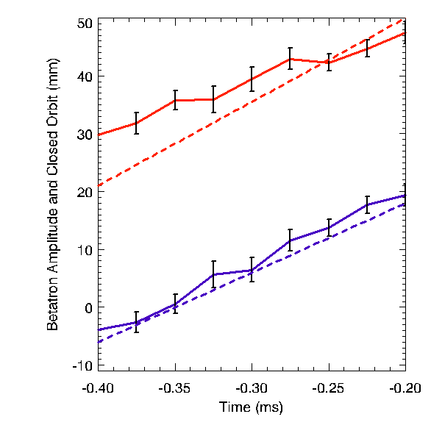
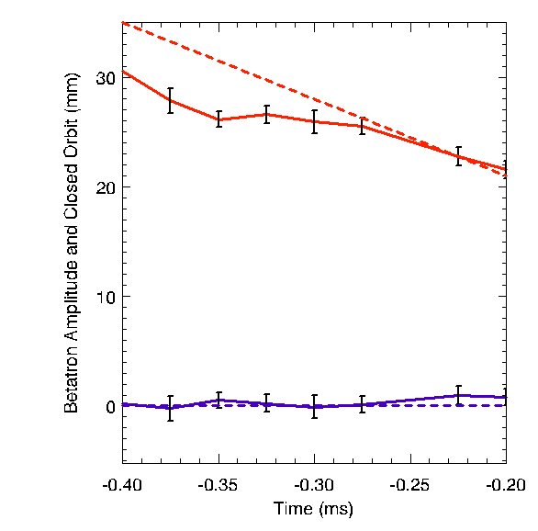
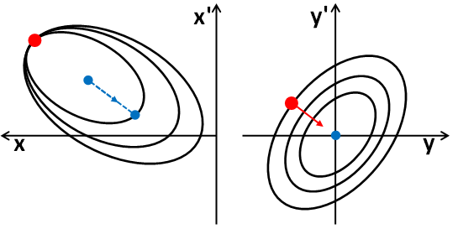
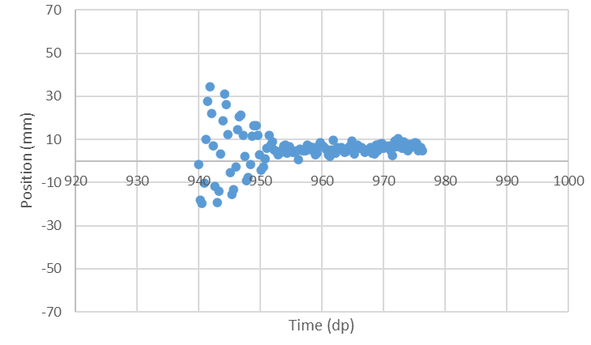
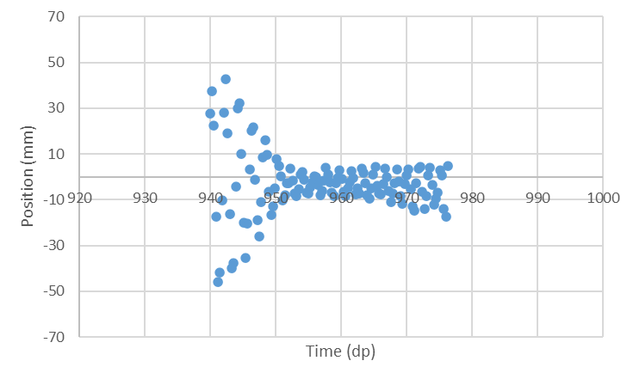
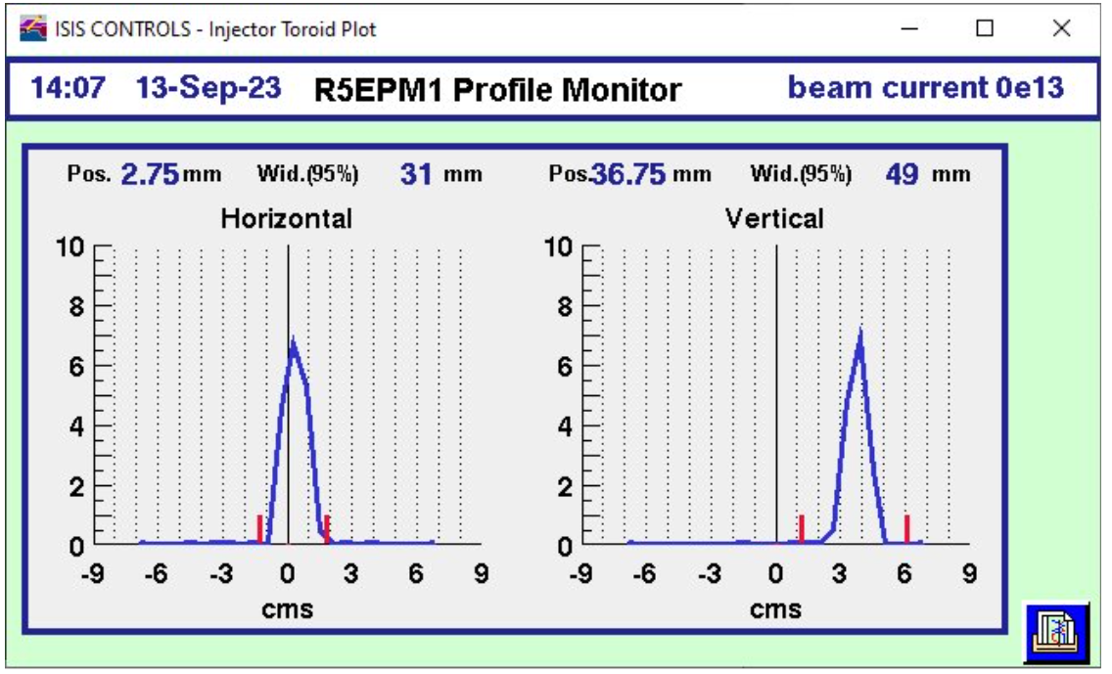
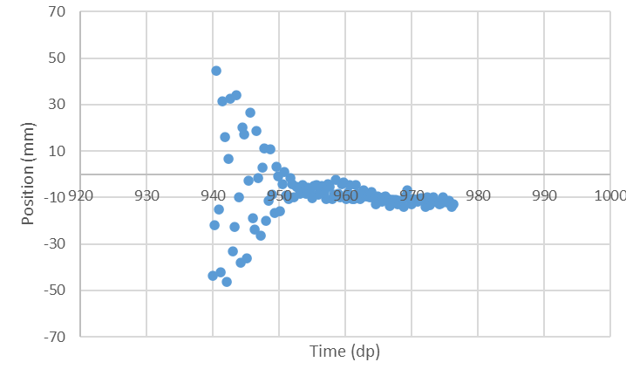
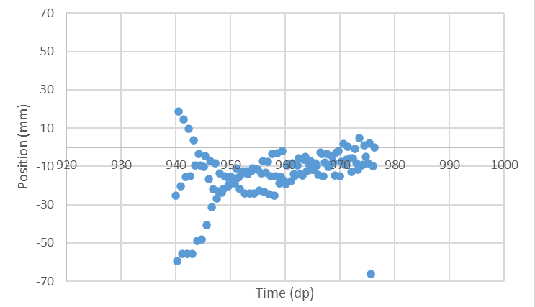
Injection
14.
Empirically arrived in a correlated painting regime
  unable to inject with large vertical betatron amplitudes
  empirically having to move the vertical trajectory through injection to combat losses
Injection and Painting Schematics
2024
2008
Horizontal
Vertical
Injection Dipole Scans
2016
2024
R4VM1
R5EPM1 Profiles (Run to SP8)
Single turn to SP8 tests
  beam unexpectedly high at injection
R8HM2
Injection dipole scans
  show extent of poor orbit control in both planes

Slide 16
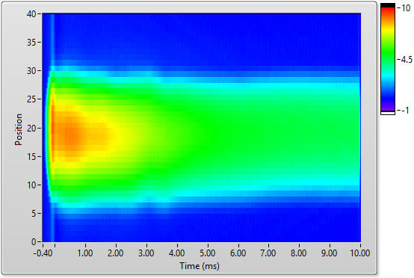
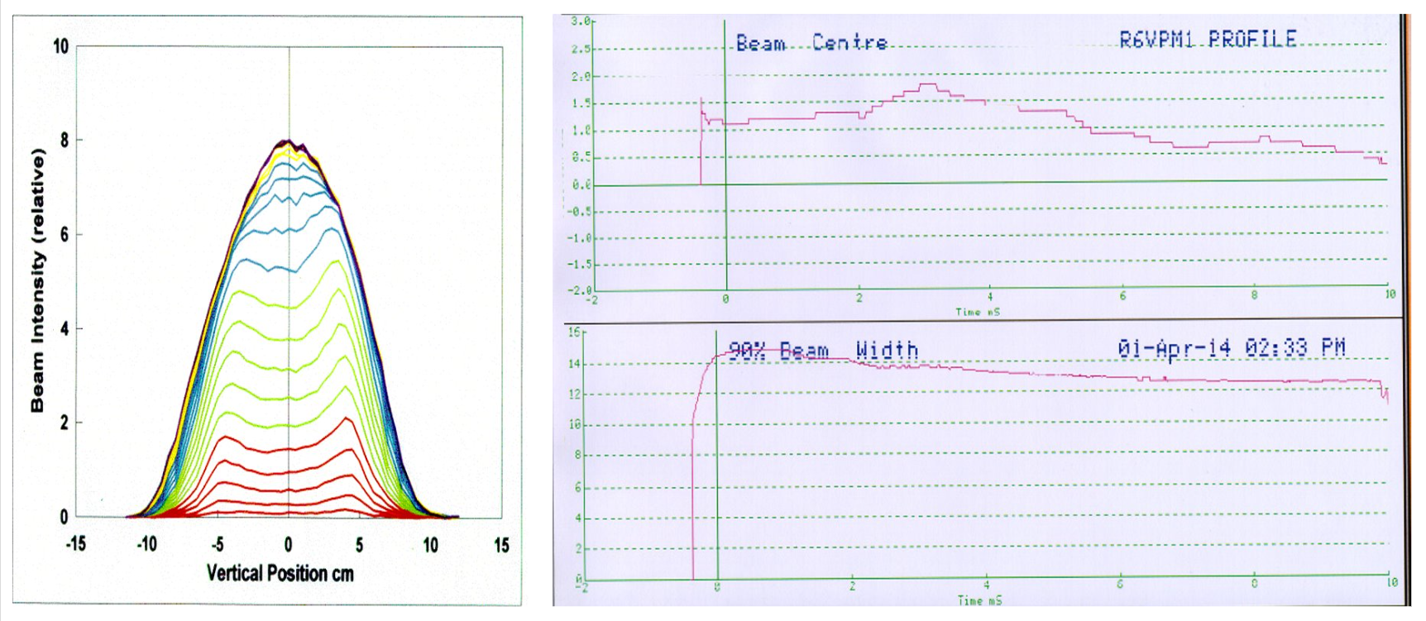
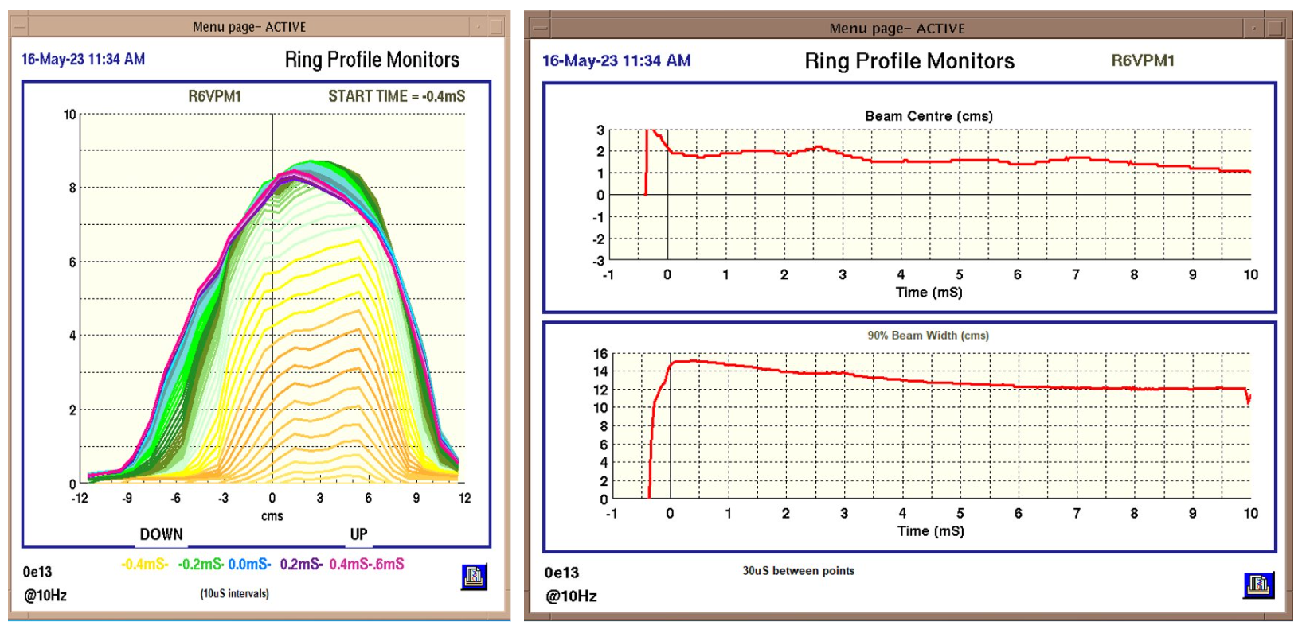
Injected Profile
15.
Multi-channel profile monitor measurement, blow up at injection, real?
Measured profiles over injection
  show same vertical movement over injection and inability to inject large betatron amplitudes
  multi-channel profile monitors show large blow up over injection
    Initially thought this was present without beam, but can be reduced with setup changes (eg vertical sweeper)
  horizontal profiles as expected
Inductance measurements on IHQ19-22
  no errors identified
2014
Single-channel profile comparisons
2023

Slide 17
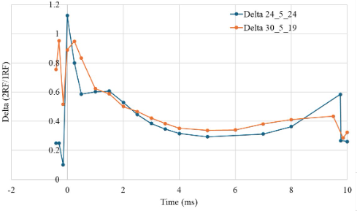
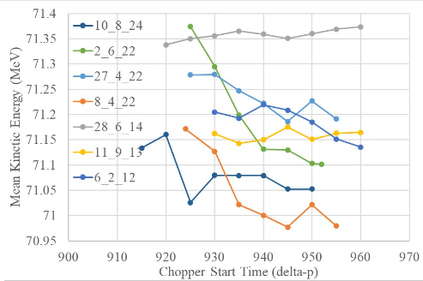
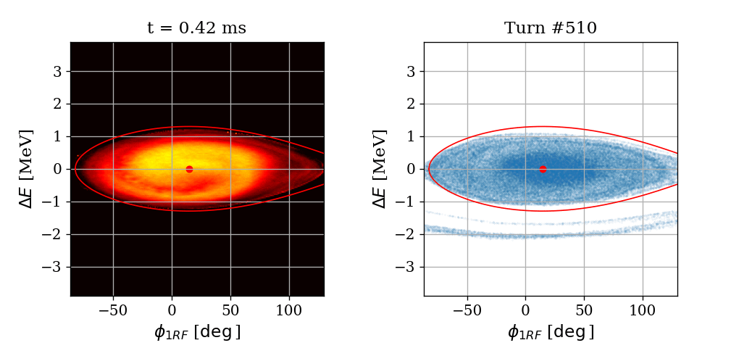
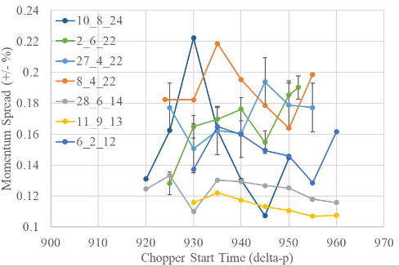
16.
Delta function throughout the cycle
Longitudinal
Delta and theta differences
  running high delta over injection
  theta difference within control system
Energy and momentum spread measurements through injection
Momentum spread and kinetic energy measurements
  consistent with previous measurements
Run on fundamental only RF systems
  all seemed reasonable loss wise and on BPM sum signals
1RF only tomographic reconstruction and simulation

Slide 18
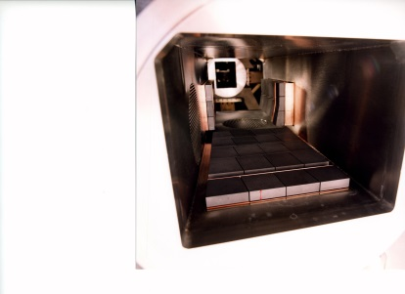
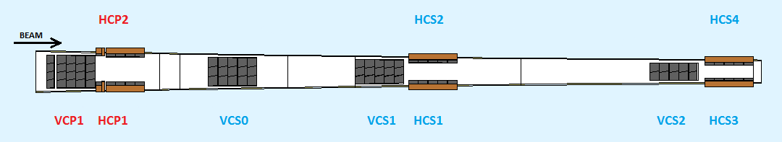
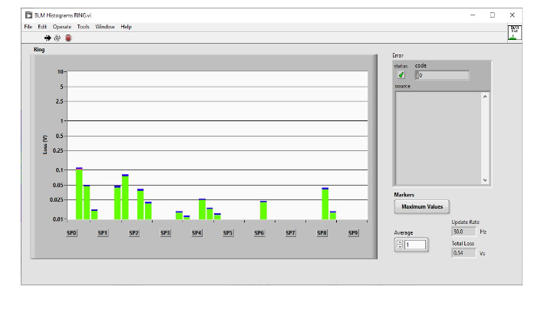

17.
Collimation
SP1 collector schematic and photograph
Insert collectors further to reduce available aperture
  better distribution of losses ins SP1/2 (doesn’t necessarily mean all on collectors!)
  VCP1B biggest effect on loss distribution and consistent with setup studies from 2018
Experiment with collectors completely withdrawn
  losses distributed increase around the ring (as expected)
  scaled RF volts to check response and nothing concerning
Loss distribution around the ring, not constrained to SP1/2 as usual

Slide 19
18.
Running, but with lower intensity and higher beam losses
Normal operational issues ongoing that required to be overcome…
  Required to switch running between 700-800 MeV due to main magnet power supply (2/3/4 UPS’s and trench choke vs NINA)
  Main magnet power supply instability (+/- 1 A)
  Extract septum instability (+/- 100 A)
  65 µs offset in field minimum timing
  SP7 ceramic support break on RF screen
  HEDS Chopper non-operational for ~18 months
  45º shift in RF theta after long shutdown
  Periods of running on 3 out of 4 dual harmonic RF cavities
  Operating on 5 out of 6 fundamental RF cavities for half a cycle
  Low LEBT efficiencies due to misaligned ion source cold-box
  Removal of vertical secondary collector (VCS0) due to water leak
  Setting up to synchrotron room beam dump when no targets available
  Step changes in synchrotron performance (cured with vertical beam setup) corresponding to power dips and/or extract septum trips?

Slide 20




SP0 Singlet, SP1 Doublet and SP1 Dipole
19.
Acute beam loss issue at R0BLM4 in December 2024, with associated vacuum rise
  Suspect clipping RF screen in SP0 Singlet or upstream in SP1 Dipole
  Able to limp to last few days of cycle by pushing beam to the outside of the ring and reducing repetition rate
Inspected in the shutdown and identified damage in SP1 Dipole and SP0 Singlet RF Screens
When replacing Dipole 1 took a good long look in SP1 Doublet and identified another issue with this RF screen and significant blackening - SP1 Doublet screen replaced in the subsequent shutdown
Dipole 1 RF Screen Damage
SP0 Singlet Damage
(although intact on original inspection)
SP1 Doublet Damaged Wire
SP1 Doublet Blackening

Slide 21



Dipole 2 RF Screen
20.
Dipole Scintillators
Dipole 2 upstream scintillators replaced 2022, these showed increased loss levels compared to downstream, prompting investigations into scintillator calibration and degradation
Further inspection showed that one scintillator in-particular in the dipole was responding differently, over time its losses began to grow with intensity and repetition rate and Dipole 2 became a tuning constraint
Requested inspection of Dipole 2 RF screen in December 2025
Dipole 2 RF Screen Damage
Scintillator 2:3
Loss (mV)
Scintillators 2:1 and 2:2
Scintillators 2:4 2:5, 2:6
Time (ms)

Slide 22






Loss evolution
21.
September 2023, extraction sorted, losses still distributed and fast ramp to 2 ms
August 2024, losses still high, but more controlled
October 2022, high losses throughout injection, peak trapping and extraction, not all on the collectors
March 2026, losses equivalent to 2020 levels after Dip 2 RF screen works
May 2025, losses much reduced after SP1 doublet works (500 – 200 mV scale change)
November 2024, still high losses but able to change distribution through tuning
Average Horizontal Beam Position
Sum of all synchrotron beam loss monitors (BLM Sum)
BLM Sum -SP1&SP2

Slide 23
Questions raised
22.
Do we know the exact sequence of events?
  were all the issues related?
  time to resolution exacerbated by degraded scintillators?
  all damage in intentionally high loss areas – needle in a haystack!
  errors not magnetic, or alignment, so not present in modelling
Synchrotron Room Beam Dump (SRBD)
Extract Kickers
Extract Septum
SP0 Singlet
Dipole 1
SP1 Doublet
Collectors
Dipole 2
Beam

Slide 24

Lessons learnt / questions raised
23.
Importance of committed, talented staff with years of knowledge and experience
  Accelerator physics, operational crew, diagnostics, RF, injector, ion source, controls, mechanical engineering, vacuum, magnet power supplies…
What/where is the threshold for opening up?
  4/5 to the good! Should we have limped on? Or systematically opened-up? Risks?
Was too much changed in the shutdown?
Can we do less invasive inspections?
  Or other types of in-situ magnet measurements?
Review the RF screen design?
  J-Parc’s are outside of the vacuum vessel….
Potentially too complacent at 245 µA?
  Improve suite of comparative measurements?
  How can we make our approach/models more robust since the identified issues weren’t necessarily items we have in lattice (magnetic) models….
ISIS Accelerator (Beams) Division, January 2026

Slide 25

Next steps
24.
Ran Cycle 2025/5 and 2026/1 at peak of 212 µA (94-95% efficiency), limited mainly by target levels
228 µA equivalent (base-rate) beam achieved during start-up/machine physics periods
Continue to increase beam intensity and efficiency
  Injection painting, RF setup
  Improving measurements and models
Push for 300 µA capability following installation of MEBT
Thank you for listening
Any questions?

