Slide 1


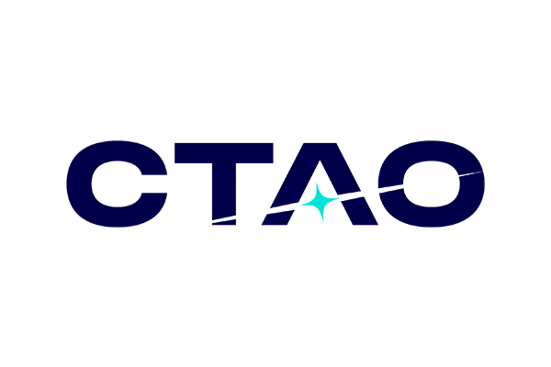
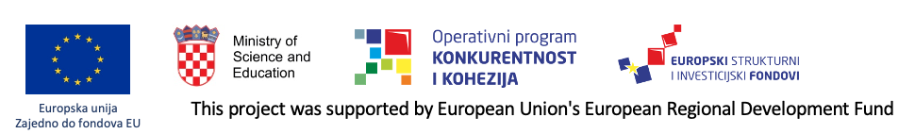

VHE 𝜸 - News
Nikola Godinović, University of Split, FESB
CROHEP Meeting
Zagreb, February 17, 2026

Slide 2
Croatian VHE 𝜸 team (MAGIC & CTAO-LST)
Split – FESB (2):
Nikola Godinović, Toni Šarić (PhD)
Rijeka – Faculty of Physics (5):
Dijana Dominis Prester , Marina Manganaro, Karlo Mrakovčić (PhD), Josiah Olumuyiwa Faniyi (PhD), Tomislav Terzić
Zagreb (3):
FER: Ana Babić, Željka Bošnjak, Petra Maruševec (PhD)
(Tihomir Surić /placeholder !?)
Osijek - Department of Physics (3):
Dario Hrupec, Jelena Štrišković, Mario Pecimotika - (Dr. Franjo Tuđman Defense and Security University →IRB (?))
Currently: 9 researches and 4 PhD students, in total 13
Over 16 years 6 PhD thesis defended

Slide 3
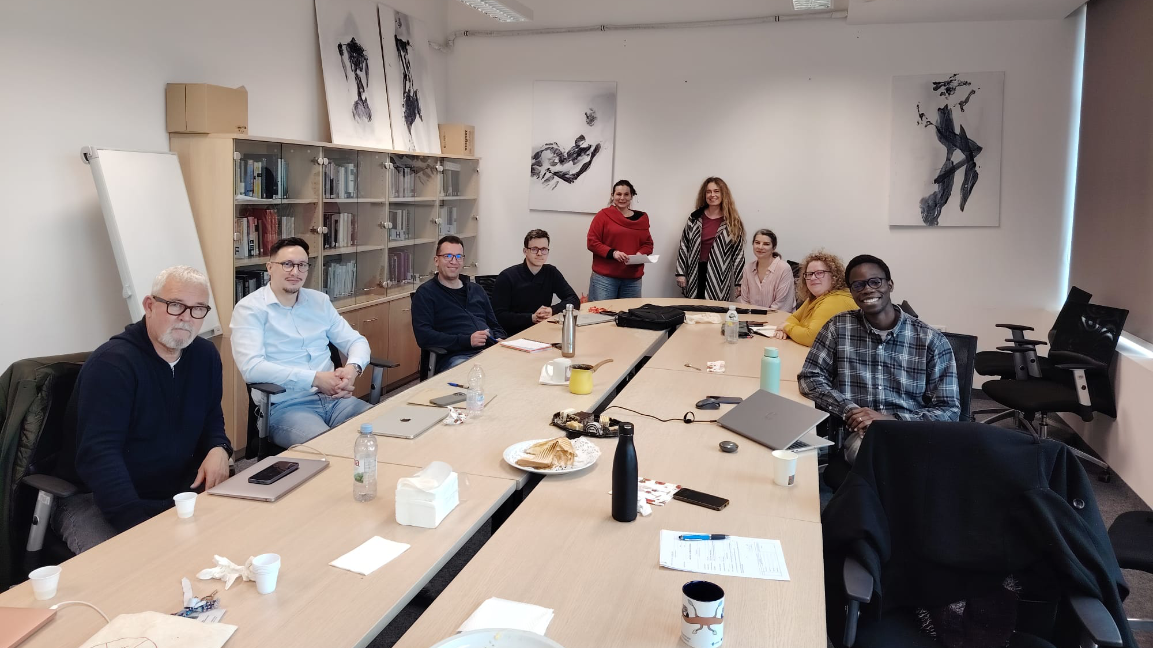
Rijeka, February 2026

Slide 4
Duties & responsibilities in MAGIC/CTAO
CTAO-LST WG:
Toni Šarić - pointing for LST1
Nikola Godinović - national coordinator of CTAO ERIC
Tomislav Terzić – CTAO-LST Deputy Physics Coordinator (from 2025)
Dijana Dominis Prester - CTAO SAPO Co-Chair from January 2026
Jelena Strišković – CTAO-LST Outreach
Mario Pecimotika – CTAO-LST SAPO member
MAGIC
Ana Babić – Deputy Software Coordinator
Jelena Strišković – convener of Astroparticle and Fundamental physics WG
Željka Bošnjak – convenor – Transient Physics WG
Marina Manganaro - PI of HrZZ Project, deputy Outreach and DEI coordinator

Slide 5
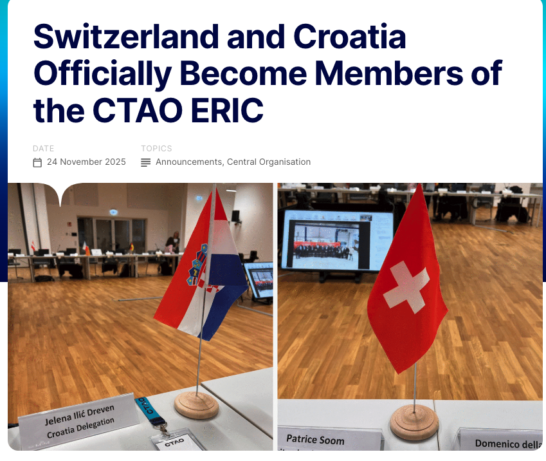
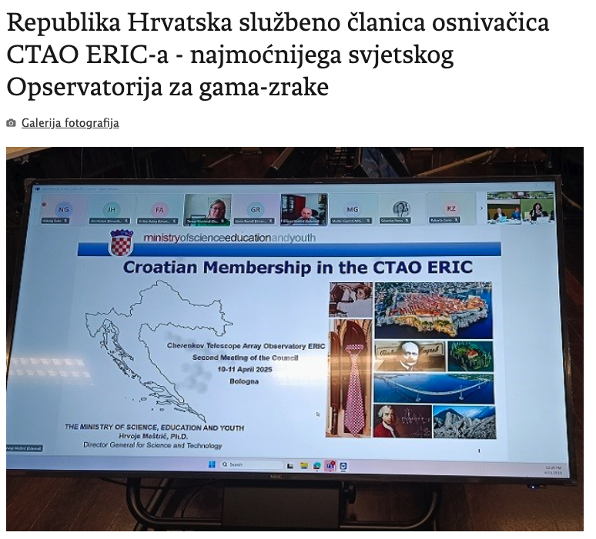
Process started July 1, 2022.
MZO – Strateški odbor za istraživačku infrastrukturu
From 19 to 21 November 2025, the CTAO ERIC Council convened at the CTAO Science Data Management Centre (SDMC) in Zeuthen, Berlin, for its fifth meeting. During the session, the Council unanimously approved a revision of the CTAO ERIC Statutes to formally include Switzerland and Croatia as full members, granting them corresponding voting rights.
Switzerland and Croatia were initially endorsed as members by the CTAO ERIC Council in June 2025. Following internal approval, the European Commission was formally notified, allowing the Statutes to be updated to reflect their membership. The modification approved at November’s meeting not only confirms their status as Founding Members—joining within 18 months of the ERIC’s establishment—but also grants both countries full membership rights.
Republika Hrvatska službeno je 26. lipnja 2025. godine potvrđena kao članica CTAO ERIC-a, dvije godine nakon što je prvi put zatražila razmatranje statusa članice.

Slide 6
ERIC – what is it?
ERIC (European Research Infrastructure Consortium) is a special legal entity created by the European Union to establish, operate, and govern large international research infrastructures in a stable, long-term, and legally unified way. (CTAO ERIC, KM3Net ERIC, ESS ERIC, …)
ERIC is similar to CERN - legal structure, but easier to establish
ERIC provides: stable governance, guaranteed operation, protection from short-term political changes, ensuring continuity over decades
One single legal entity governs everything: funding, hiring, procurement, operations, VAT exemption, …
It is essentially a European-level legal framework for operating large scientific facilities.

Slide 7
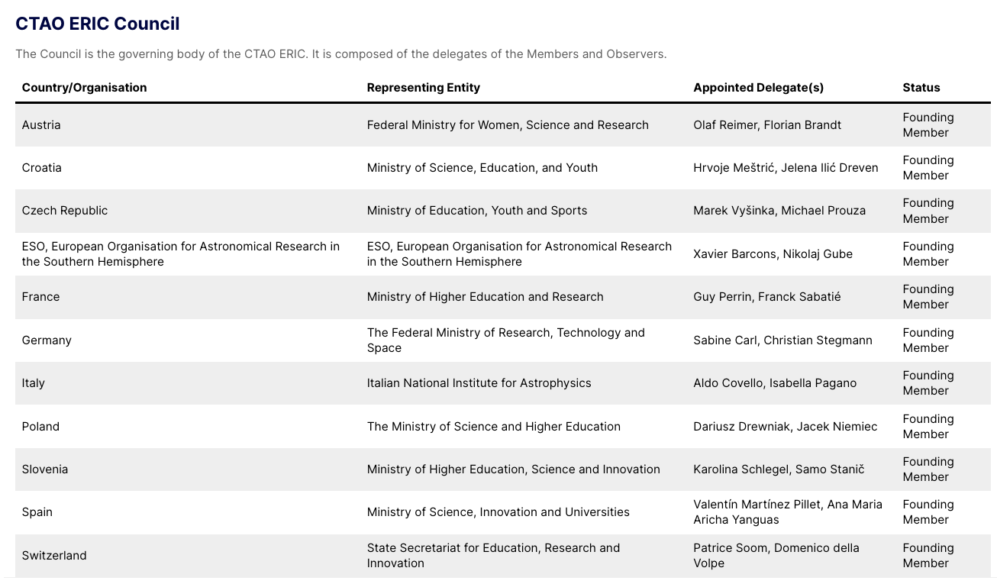
https://www.ctao.org/news/the-ctao-becomes-an-eric/
Nikola Godinović – national coordinator for CTAO ERIC; Many thanks to Jelena Ilić Dreven

Slide 8
Why CTAO ERIC Membership & Cost?
Modest financial contribution with very high strategic return
Croatian Cash Contribution:
€80,000 per year (2025–2029)
Total: €400,000
Equivalent to only €0.02 per citizen per year
In-kind contribution
Approximately €40,000 per year
Delivered through Croatian scientific institutions (instrumentation, observation shifts, scientific and technical personnel)
Exceptional scientific and technological return
Full access to CTAO data over the entire 30-year operational lifetime
CTAO-ERIC membership positions Croatia as a full partner in a major global research infrastructure, ensuring scientific competitiveness, technological advancement, and international collaboration for the next 30 years.

Slide 9
CTAO ERIC - Outcomes
Participation in discoveries in:
origin of cosmic rays
black holes and relativistic jets
extreme astrophysical phenomena
fundamental physics beyond the Standard Model
With a total contribution of approximately €600,000 over 5 years, Croatia gains:
Access to a research infrastructure worth over €400 million
Participation in the world’s leading gamma-ray observatory
Opportunities for Croatian industry and high-tech development
Training and retention of highly skilled scientists
Increased international visibility and scientific leadership

Slide 10
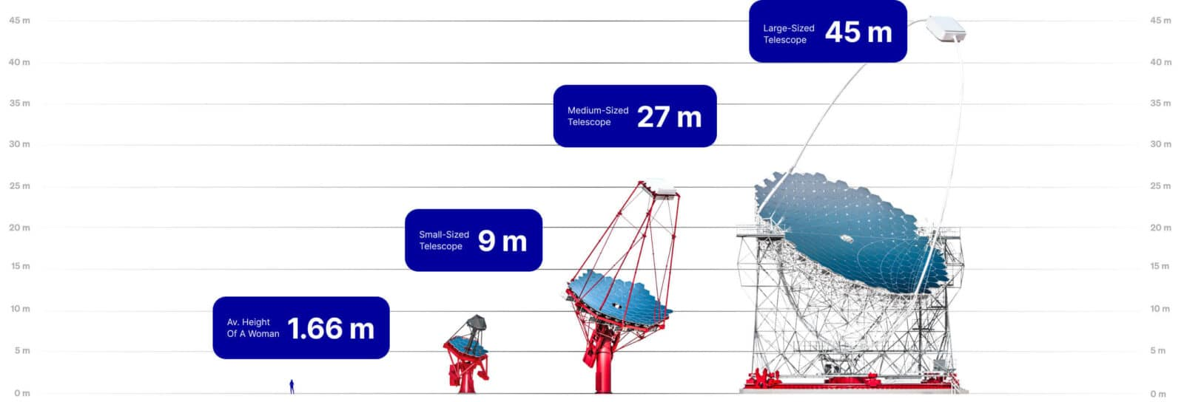
CTAO - Cherenkov Telescope Array Observatory
MST: 80 GeV to 50 TeV. A total of 23 MSTs, 14 on the CTAO-South array site and nine on CTAO-North,
LST: 20 GeV and 3 TeV.
Four at the core of north CTAO
SST: 2 TeV and 300 TeV
37 Over several km²

Slide 11
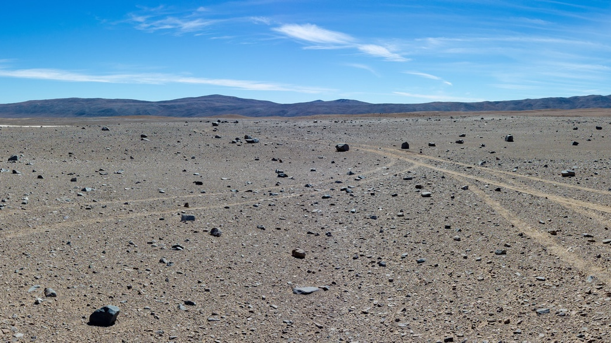
CTAO South - Paranal Observatory in the Atacama Desert, Chile, close to ESO - Now

Slide 12
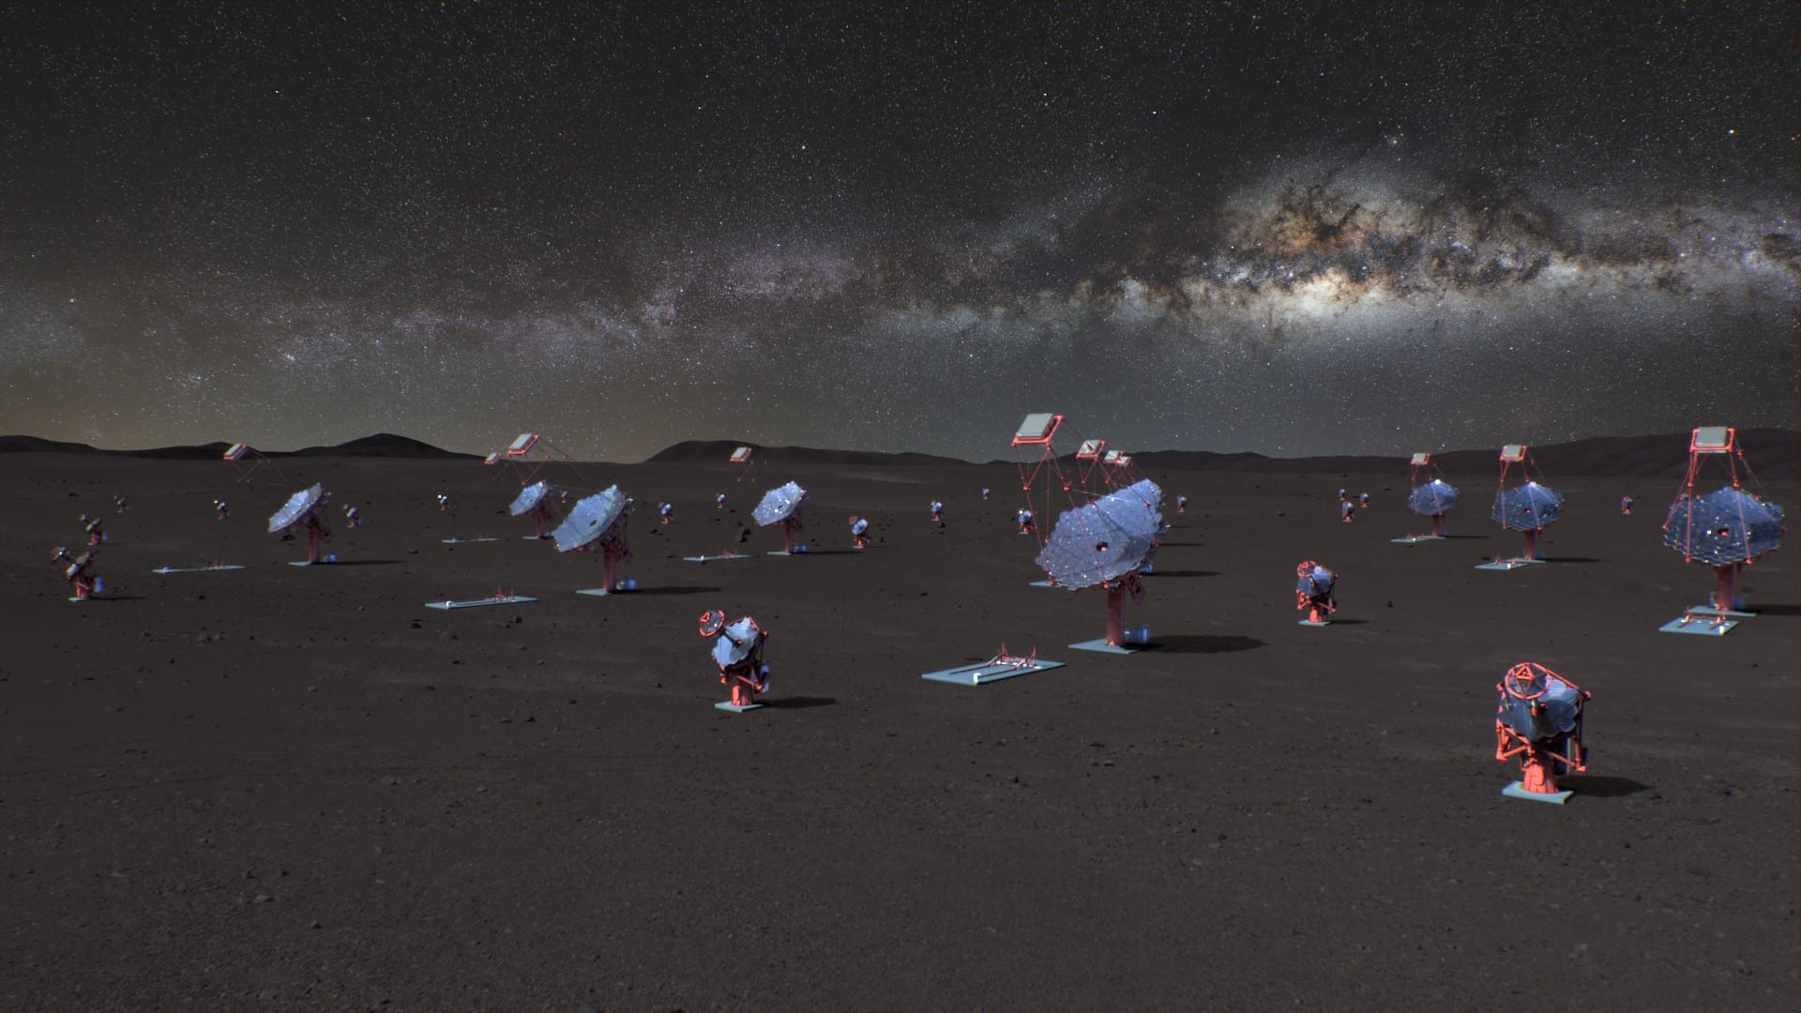
CTAO South - Paranal Observatory in the Atacama Desert, Chile, close to ESO - 2030

Slide 13
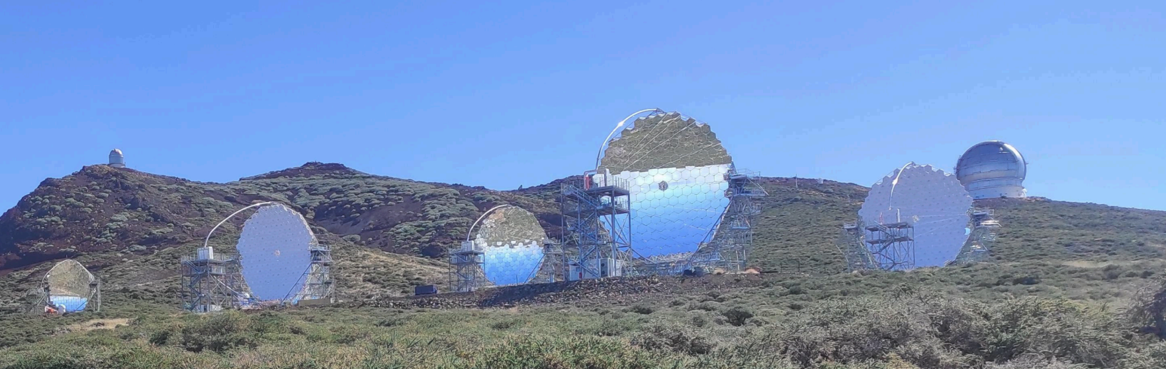
North CTAO - Observatory ORM @ La Palma (Canary island)
LST1 in operation since 2018 & LST2-4 inauguration in October 2026 (?)
Croatian contribution to the design, construction and commissioning:
Pointing system for all four LST telescope, very modest funding but and essential part

Slide 14
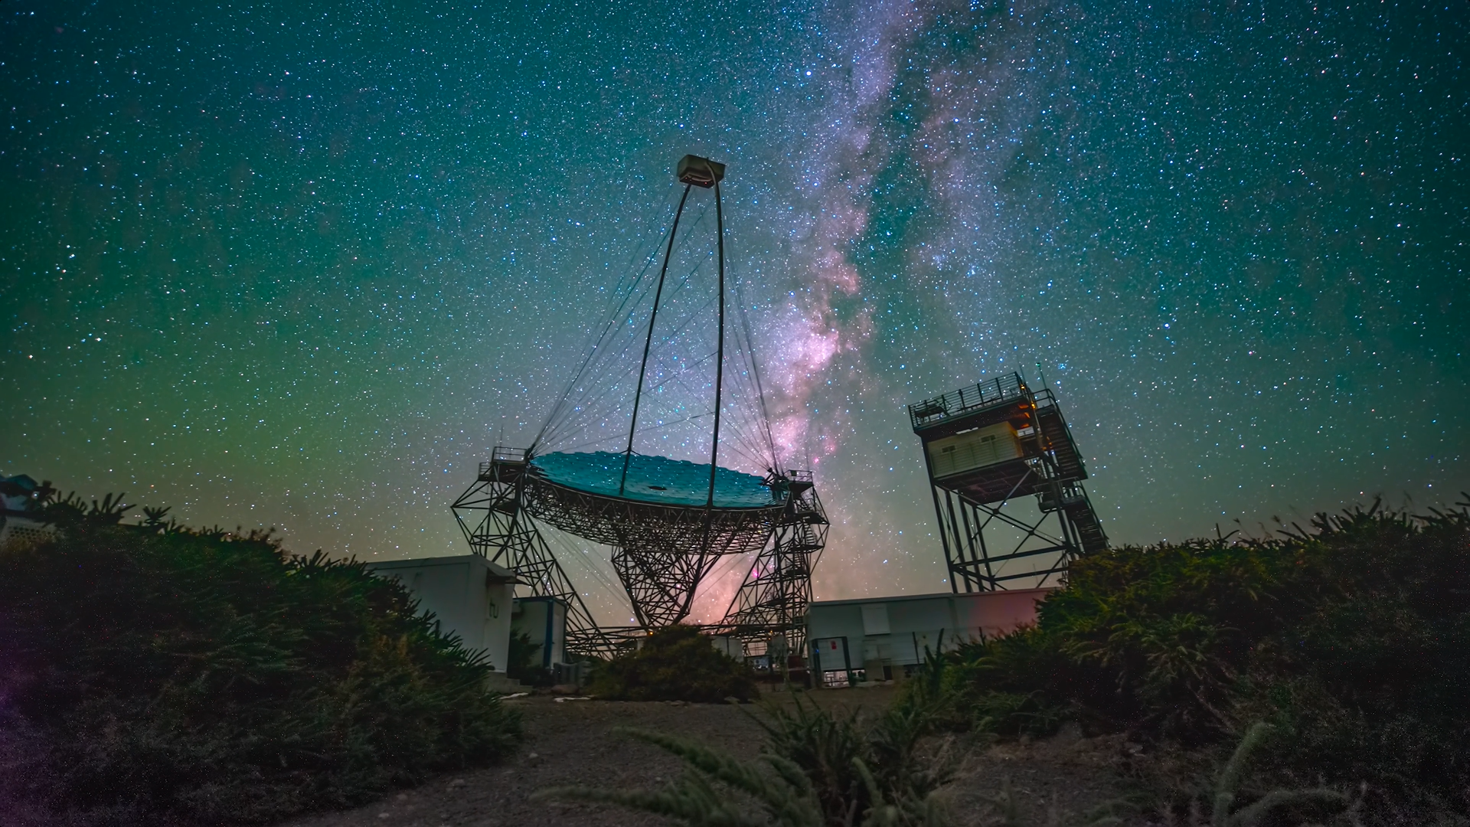
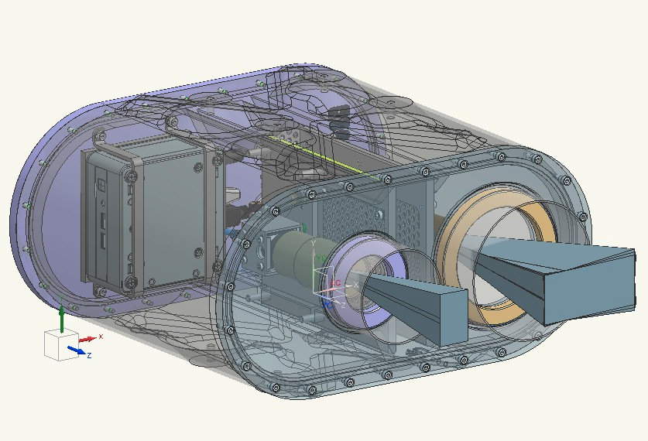
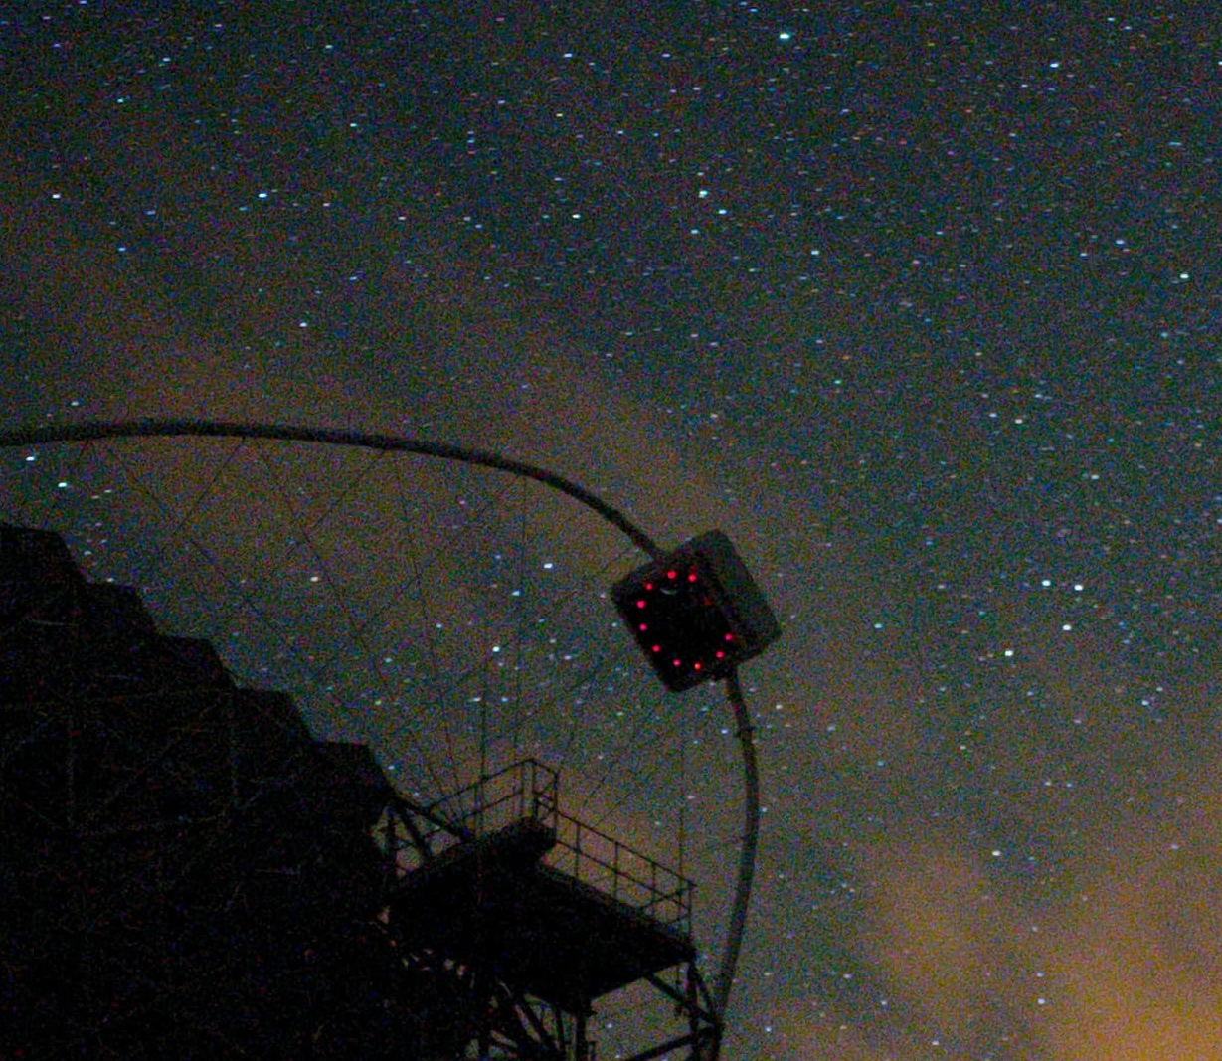
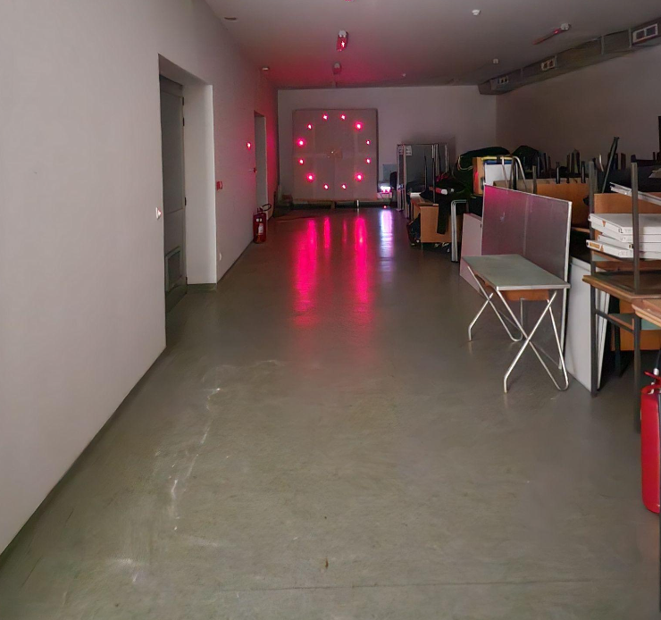
Precise pointing measurements and correction
LST 1 – during observation
StarGuide camera observes stars + LED ring → provides true telescope pointing.
Every second, the sky coordinates of the LED ring (1.6 m) — i.e. the Cherenkov camera centre — must be measured to 14 arcsec precision.

Slide 15
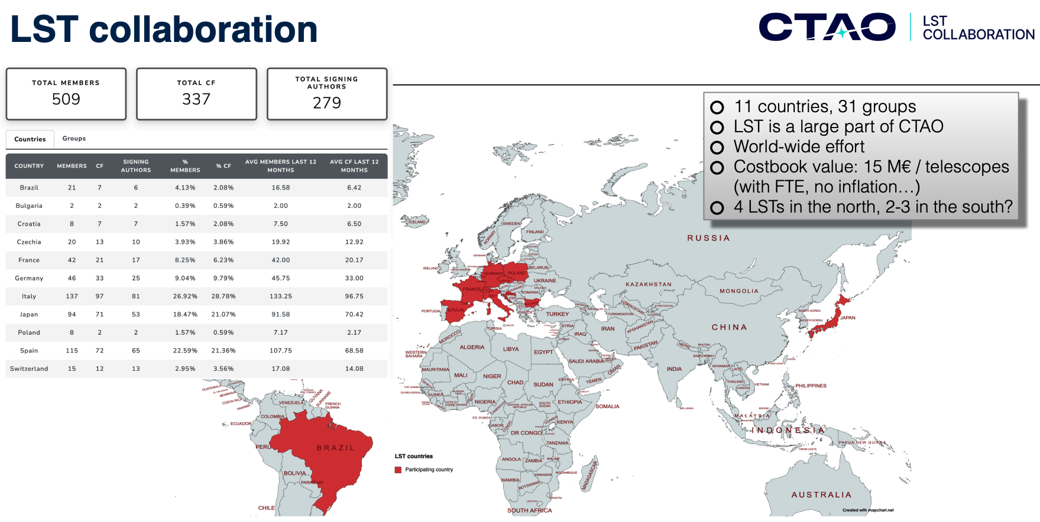

Slide 16
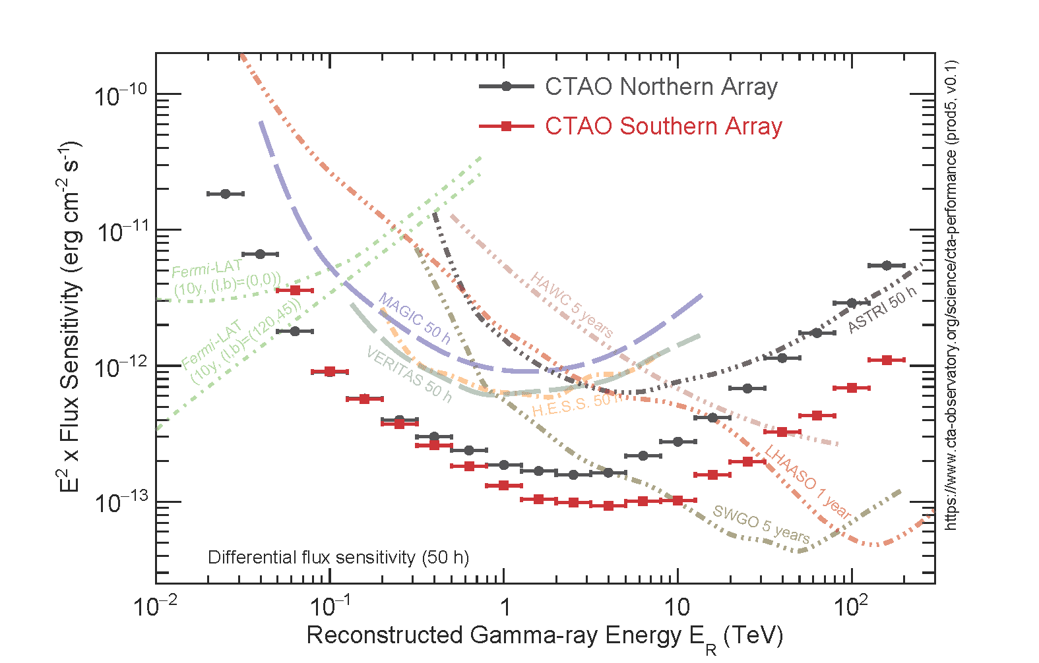
The differential sensitivity - minimum flux needed by the CTAO to obtain a 5-standard-deviation detection of a point-like source
CTAO improves the sensitivity by approximately one order of magnitude compared to current instruments: MAGIC, H.E.S.S., and VERITAS

Slide 17
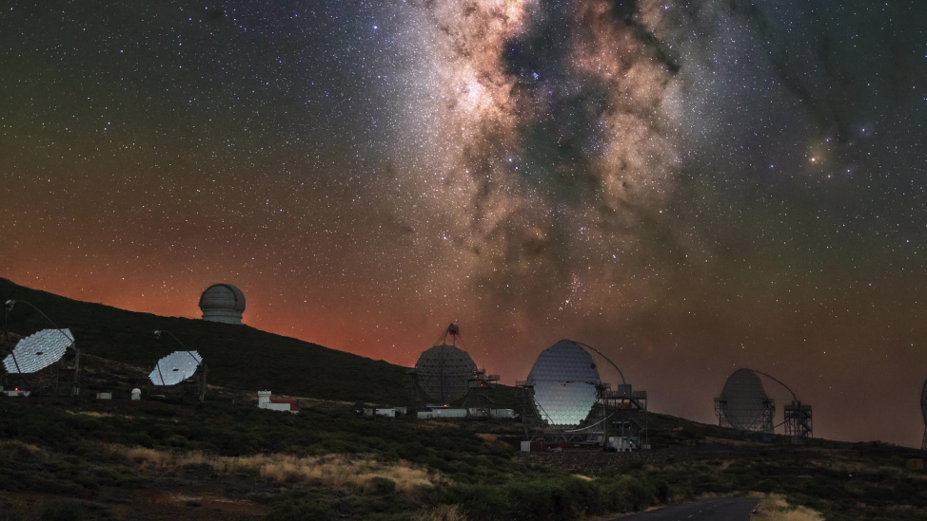

Slide 18
CTAO
CTAO aims to image the most energetic processes in the Universe, revealing the structure and dynamics of extreme cosmic accelerators and the non-thermal Universe.
CTAO is an essential facility for complementing both the multiwavelength astronomy and the multimessenger astronomy.
CTAO is a versatile instrument also for studying fundamental physics and cosmology, including:
the origin of cosmic rays
the nature of dark matter
tests of fundamental physics
the study of the extragalactic background light (EBL) and cosmic evolution.
CTAO operates as an open observatory. Scientists worldwide can apply for observing time, while member-state scientists benefit from full access to data and participation in the scientific program.
CTAO provides Croatian scientists and institutions with long-term access to a world-leading research infrastructure and opportunities for scientific leadership over the next 30 years. You are welcome to join …

