Slide 1
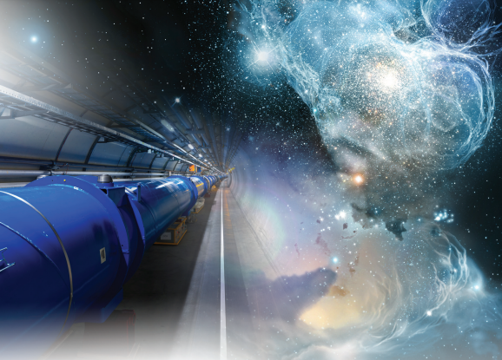
opmd
Oxford physics microstructure detector laboratory
Notes:
.

Slide 2
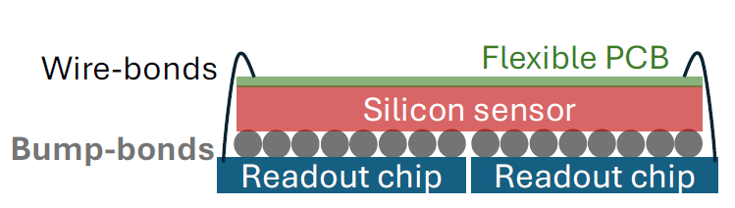
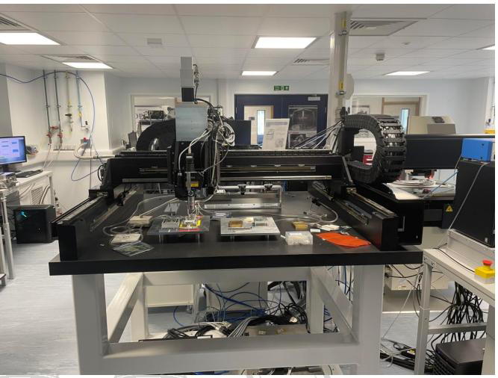
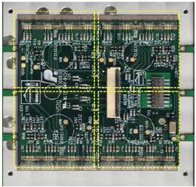
ATLAS ITk
Building over 500 pixel modules for ATLAS ITk

Slide 3
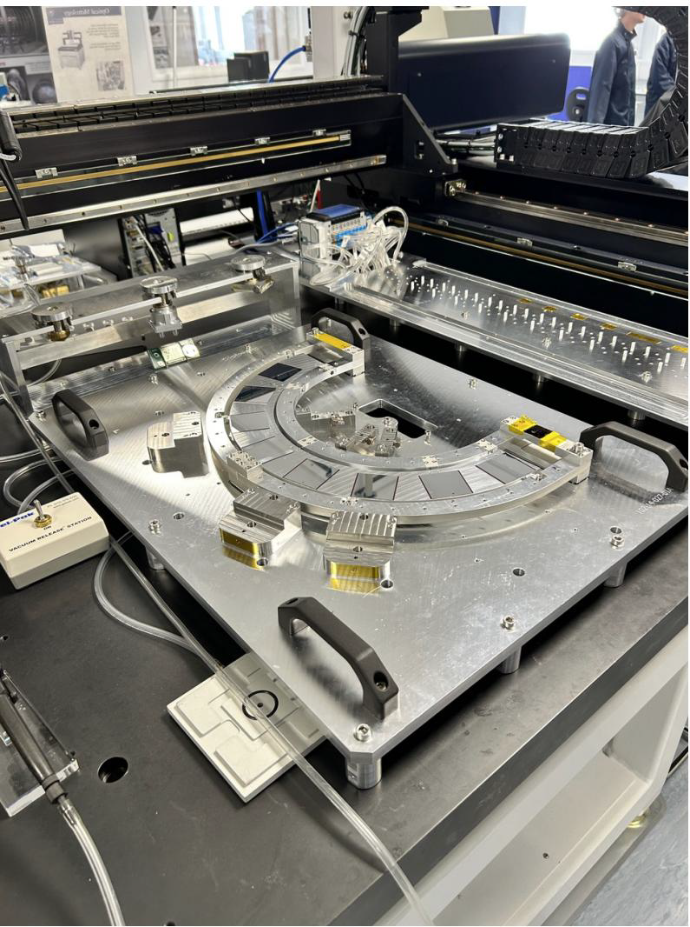
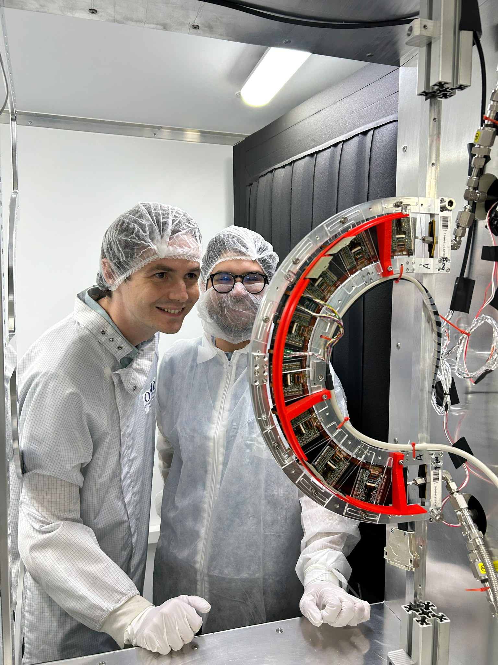
ATLAS ITk
Loading modules on end caps half-rings

Slide 4
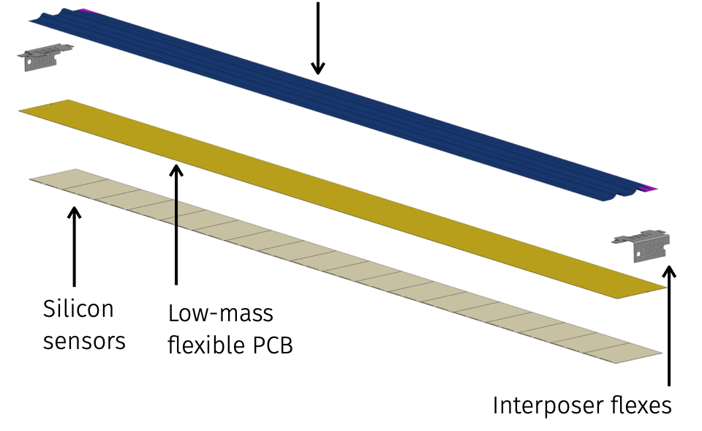
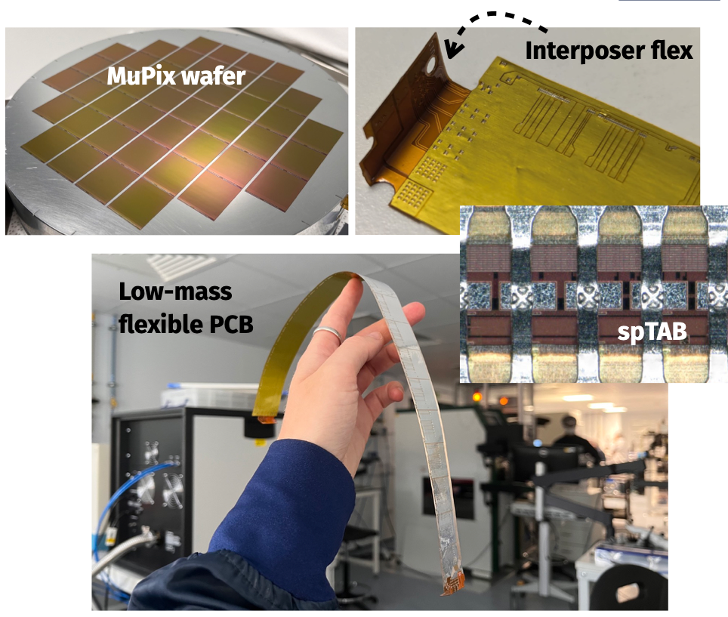
Mu3e Tracker
Building 156 ladders for the Mu3e pixel tracker
Sensors:
  MuPix11 thinned to 50-70µm
  6/ladder (Vertex: L1 & L2)
  17-18/ladder (Tracker L3/L4)
Aluminium/polymide film low-mass flex (HDI) produced by LTU (Kharkiv, UKR), 75µm thin
Ultra-thin Carbo-fiber mechanical support for long ladder
Ladder weighs 2 grams and is 36.7cm long

Slide 5
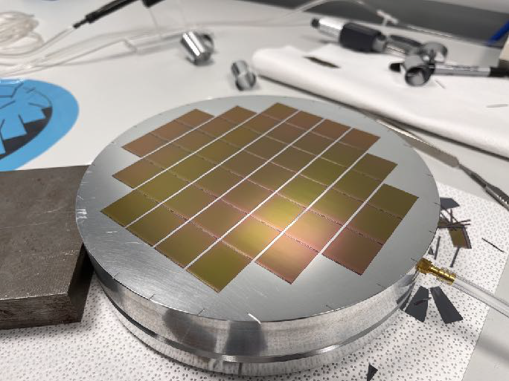
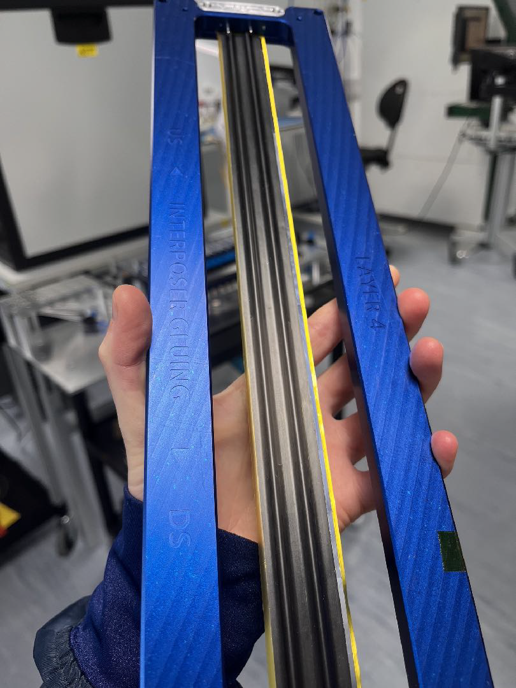
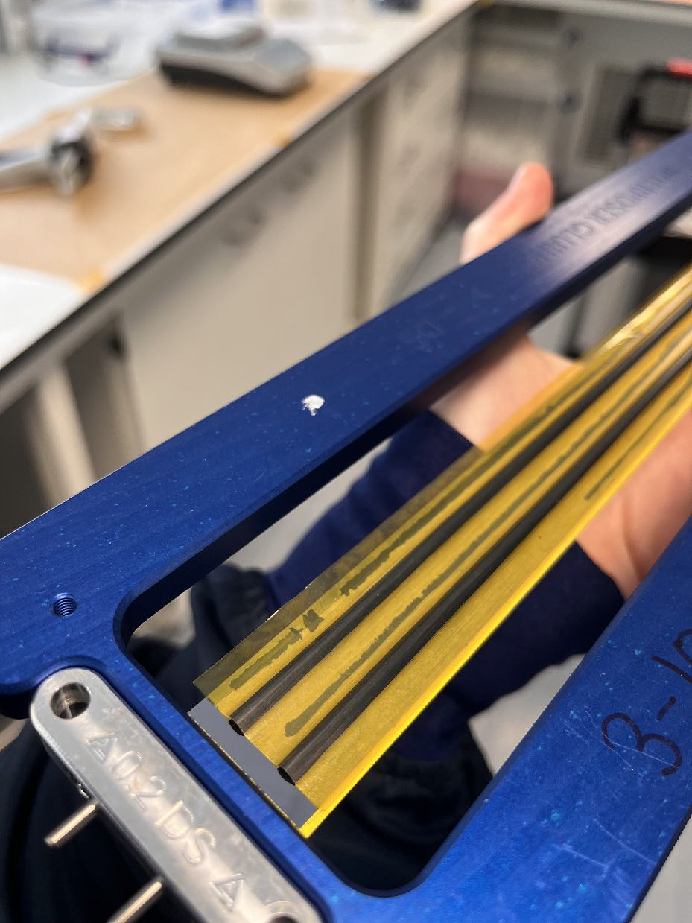
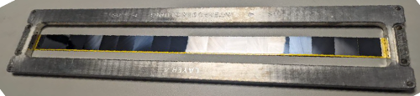
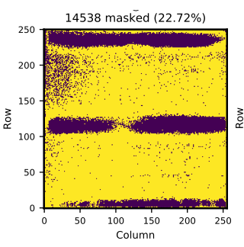
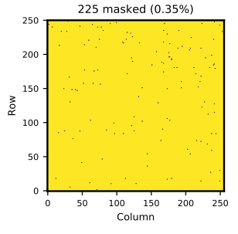


Composites & Low Mass Structures
Mu3e Tracker
Monolithic detectors 70 $μm$ thin
Aluminum Kapton flex
Ultra thin composite structures
  25 um thick Carbon Fibre
  12 um thick Kevlar
  CF/Kevlar Metamaterial
  8 μm kapton co-cured underneath

Slide 6
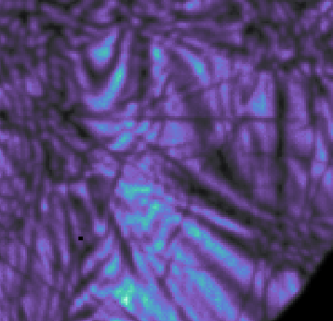
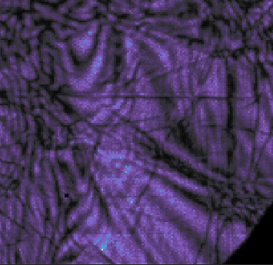
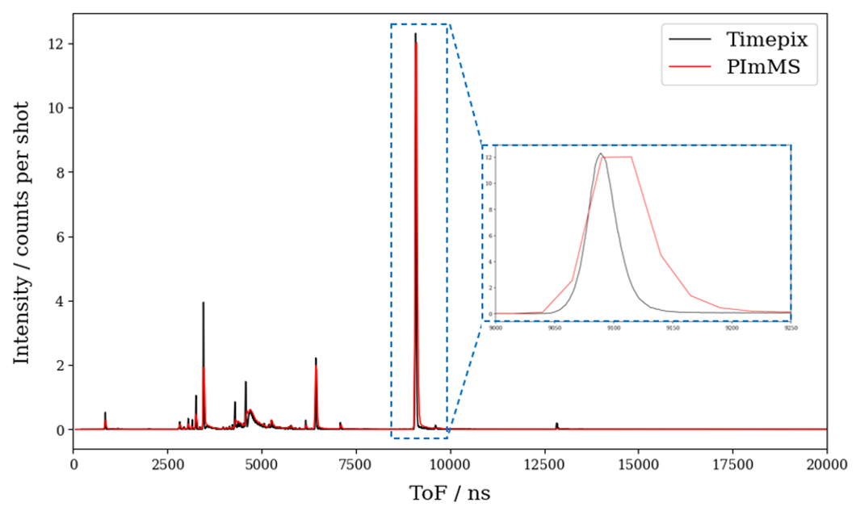
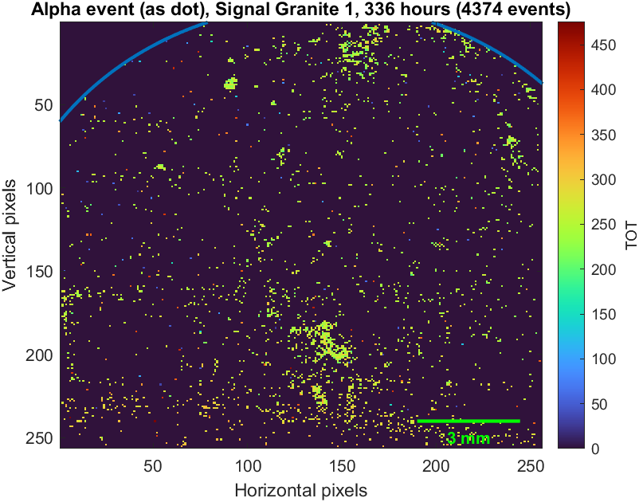
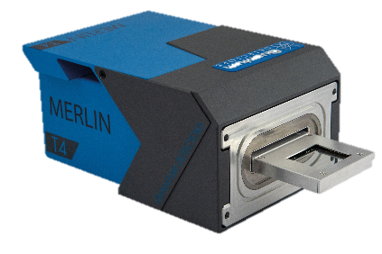
Timepix4 applications
4DSTEM (4- dimensional scanning transmission electron microscopy)
Higher-resolution electron microscopy (PP, RFI, Materials)
Time of Flight Mass Spectrometry
Time resolution: 25 ns → 200 ps (Chemistry)
Radiological Sample imaging system
Tissue and/or sample analysis (Archaeology, Oncology)
Raw data
Processed data
Quantum Detectors Merlin T4 system TEM detector system

Slide 7
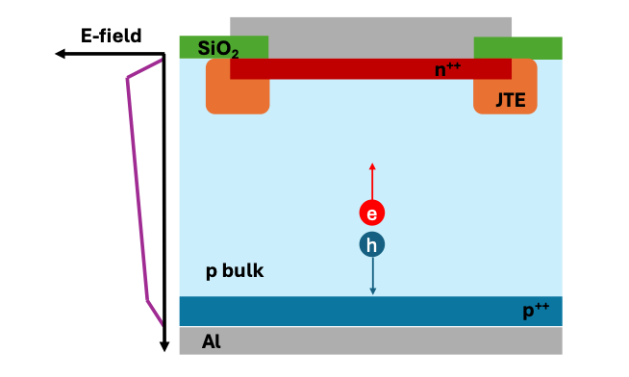
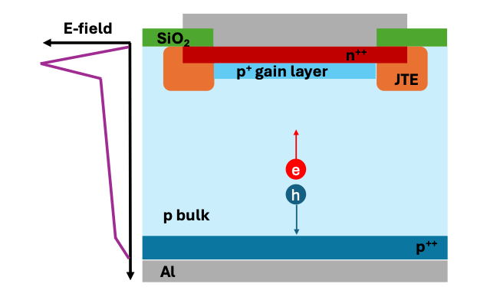
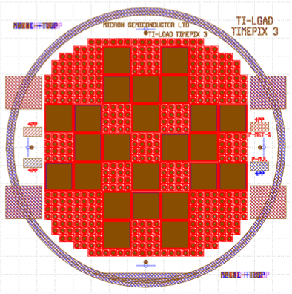
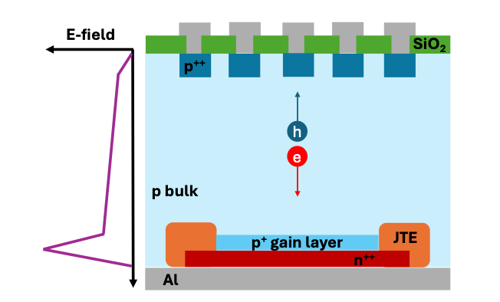
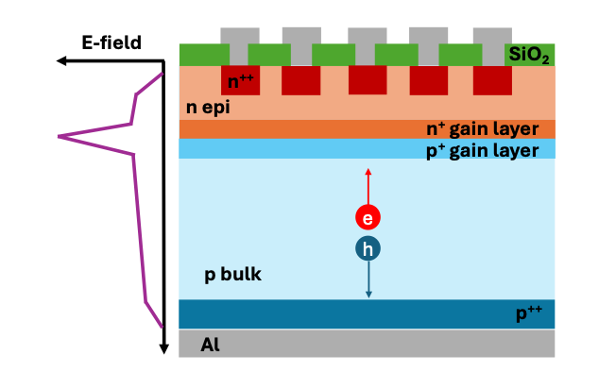
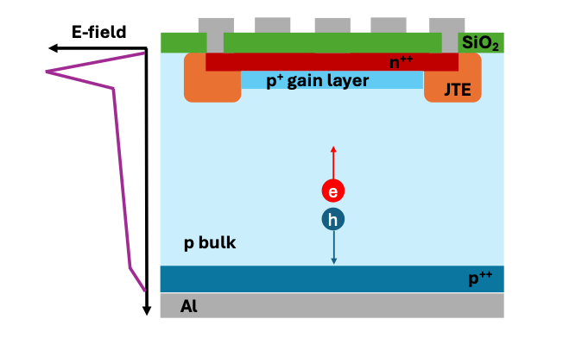
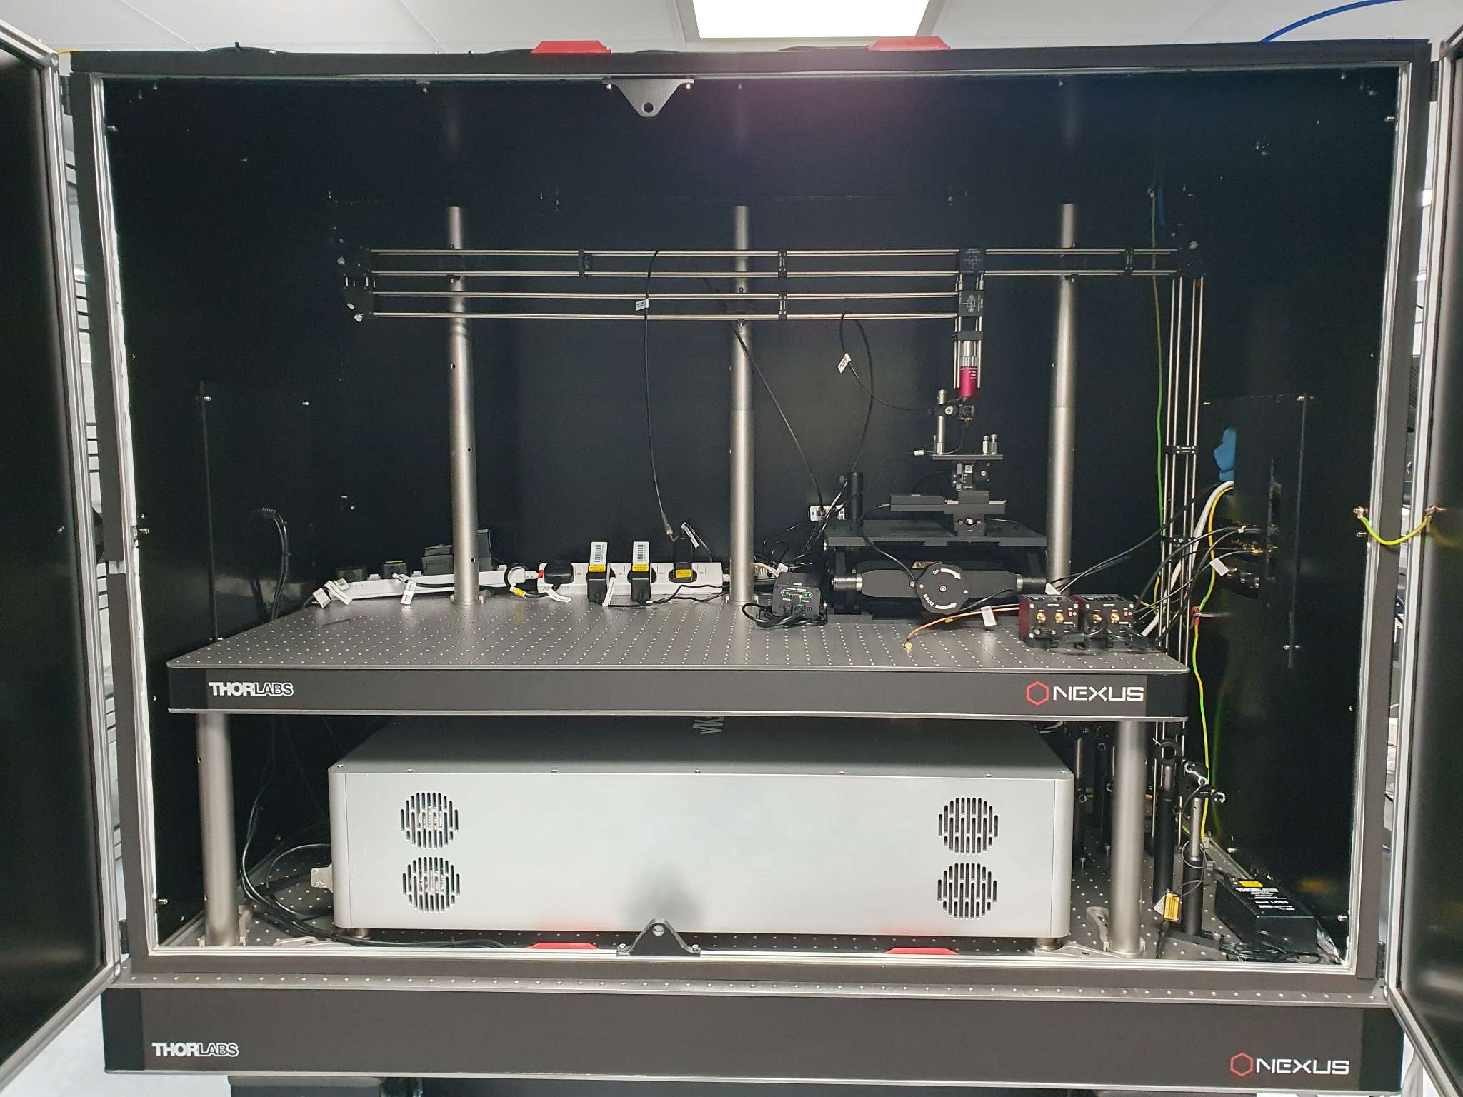
R&D on new devices
PIN
LGAD
Fabrication with Micron
i-LGAD
Buried gain
AC-LGAD
TPA-TCT

