Slide 1
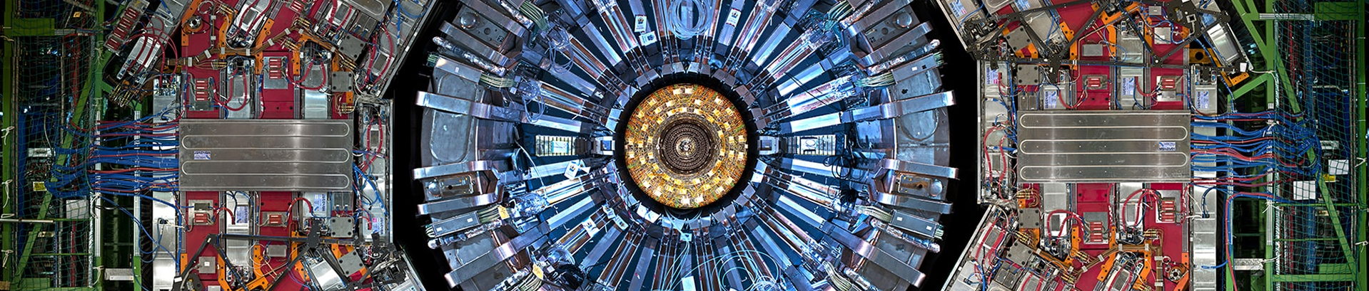
Highlights
R. Schöfbeck (Mariette Blau Institute for Particle Physics, Vienna)
for the CMS Collaboration
QCD@LHC, 2026, University of Oxford

Slide 2
LHC is over!
25 fb⁻¹ at 7 & 8 TeV
138 fb⁻¹ at 13 TeV
308 fb⁻ at 13.6 TeV
Run 1
2009–2012
Run 2
2015–2018
Run 3
2022–2026
12 data taking years – Run 2 analyses done; 0.5 ab⁻¹ recorded; Run 3 analyses in progress
Next stop HL-LHC: 3 ab⁻¹ with more powerful detector and trigger
Notes:
https://twiki.cern.ch/twiki/bin/view/CMSPublic/LumiPublicResults

Slide 3
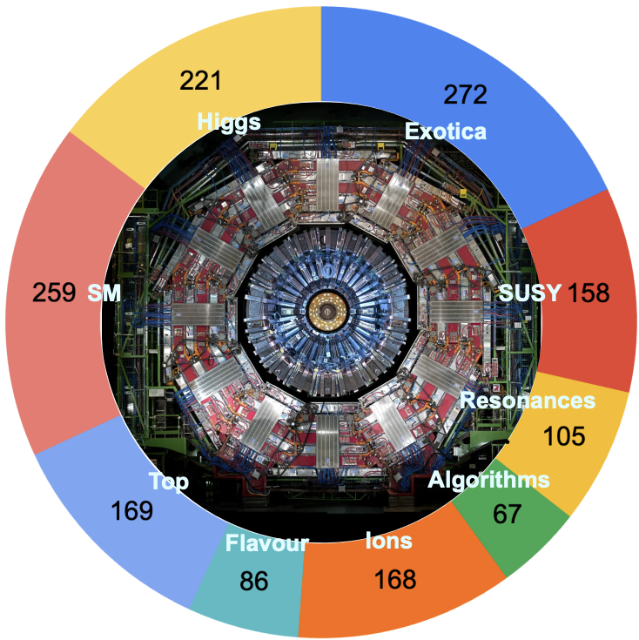
Strengthened frontiers & diverse data sets
Strengthened frontiers in Run 3
Run 3: Diverse data
Standard model
Precision · QCD, electroweak & top · Higgs properties
 | √s [TeV] | lumi / PU | year
pp | 13.6 | 326 fb⁻¹ | 22–26
low-PU | 13.6 | 2 fb⁻¹ μ≈5 | 26
high-PU | 13.6 | μ≈150 | 25
pp | 2.4 | 3.5 pb⁻¹ | 26
pp | 5.36 | 483 pb⁻¹ | 24
PbPb | 5.36 | ≈8 nb⁻¹ | 23–26
pO | 9.62 | 46.5 nb⁻¹ | 25
OO | 5.36 | 9.0 nb⁻¹ | 25
NeNe | 5.36 | 0.90 nb⁻¹ | 25
Search frontiers
Energy · luminosity · long lifetime · low mass · anomaly detection · trigger-less data taking
Flavour factory
Spectroscopy · fragmentation · CP violation · Rare decays
Heavy- & light-ion physics
Medium response & quark–gluon plasma · ultra-peripheral collisions
Detector, technology & algorithms
Physics performance · Machine learning · Statistical techniques
Explore >1,500 CMS physics papers ↗

Slide 4
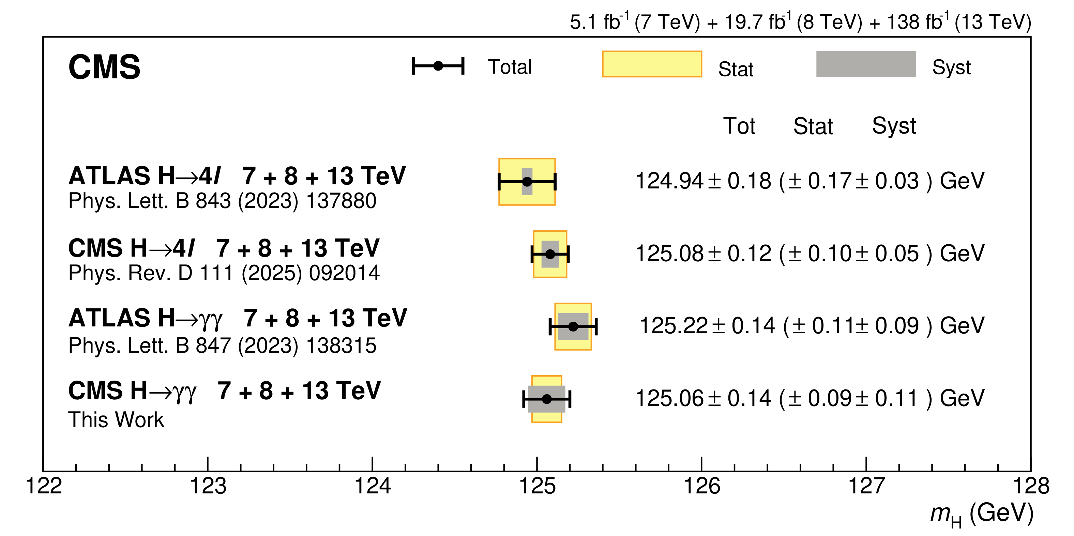
Run 2 legacy: Higgs boson measurements
Comprehensive Run 1+2 Higgs mass combination in ɣɣ channel
  M_{H}(ɣɣ) = 125.07 ± 0.09 (stat) ± 0.11 (syst) GeV [HIG-24-007]
Cross sections/couplings/2HDM constraint combination [HIG-21-018]
  32 kinematic regions encompassing ggH, VBF, WH, ZH: μ = 1.014 ^{+0.055}_{-0.053}
  Couplings follow the mass-proportional SM pattern
Part of Run 2 legacy: 2nd generation lepton-couplings [HIG-19-006]
Higgs mechanism over
3 orders of magnitude

Slide 5
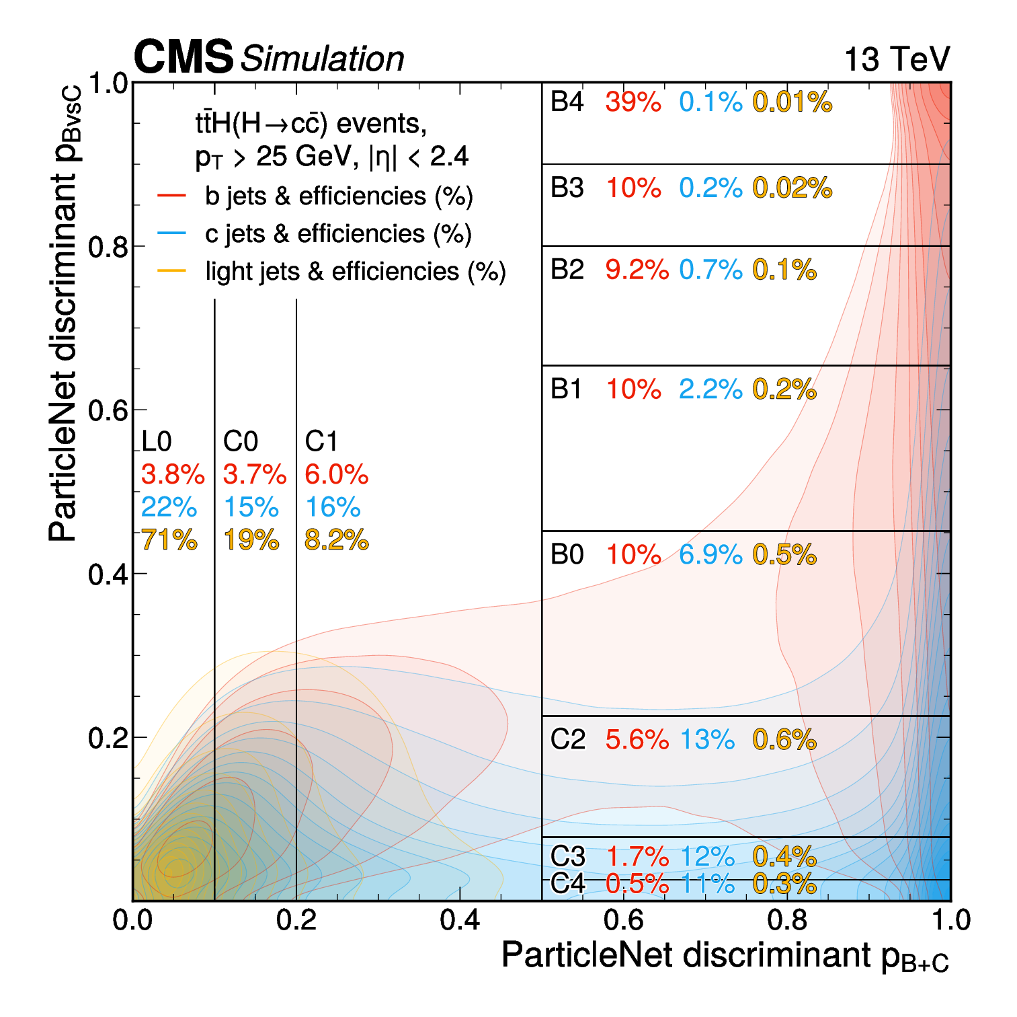
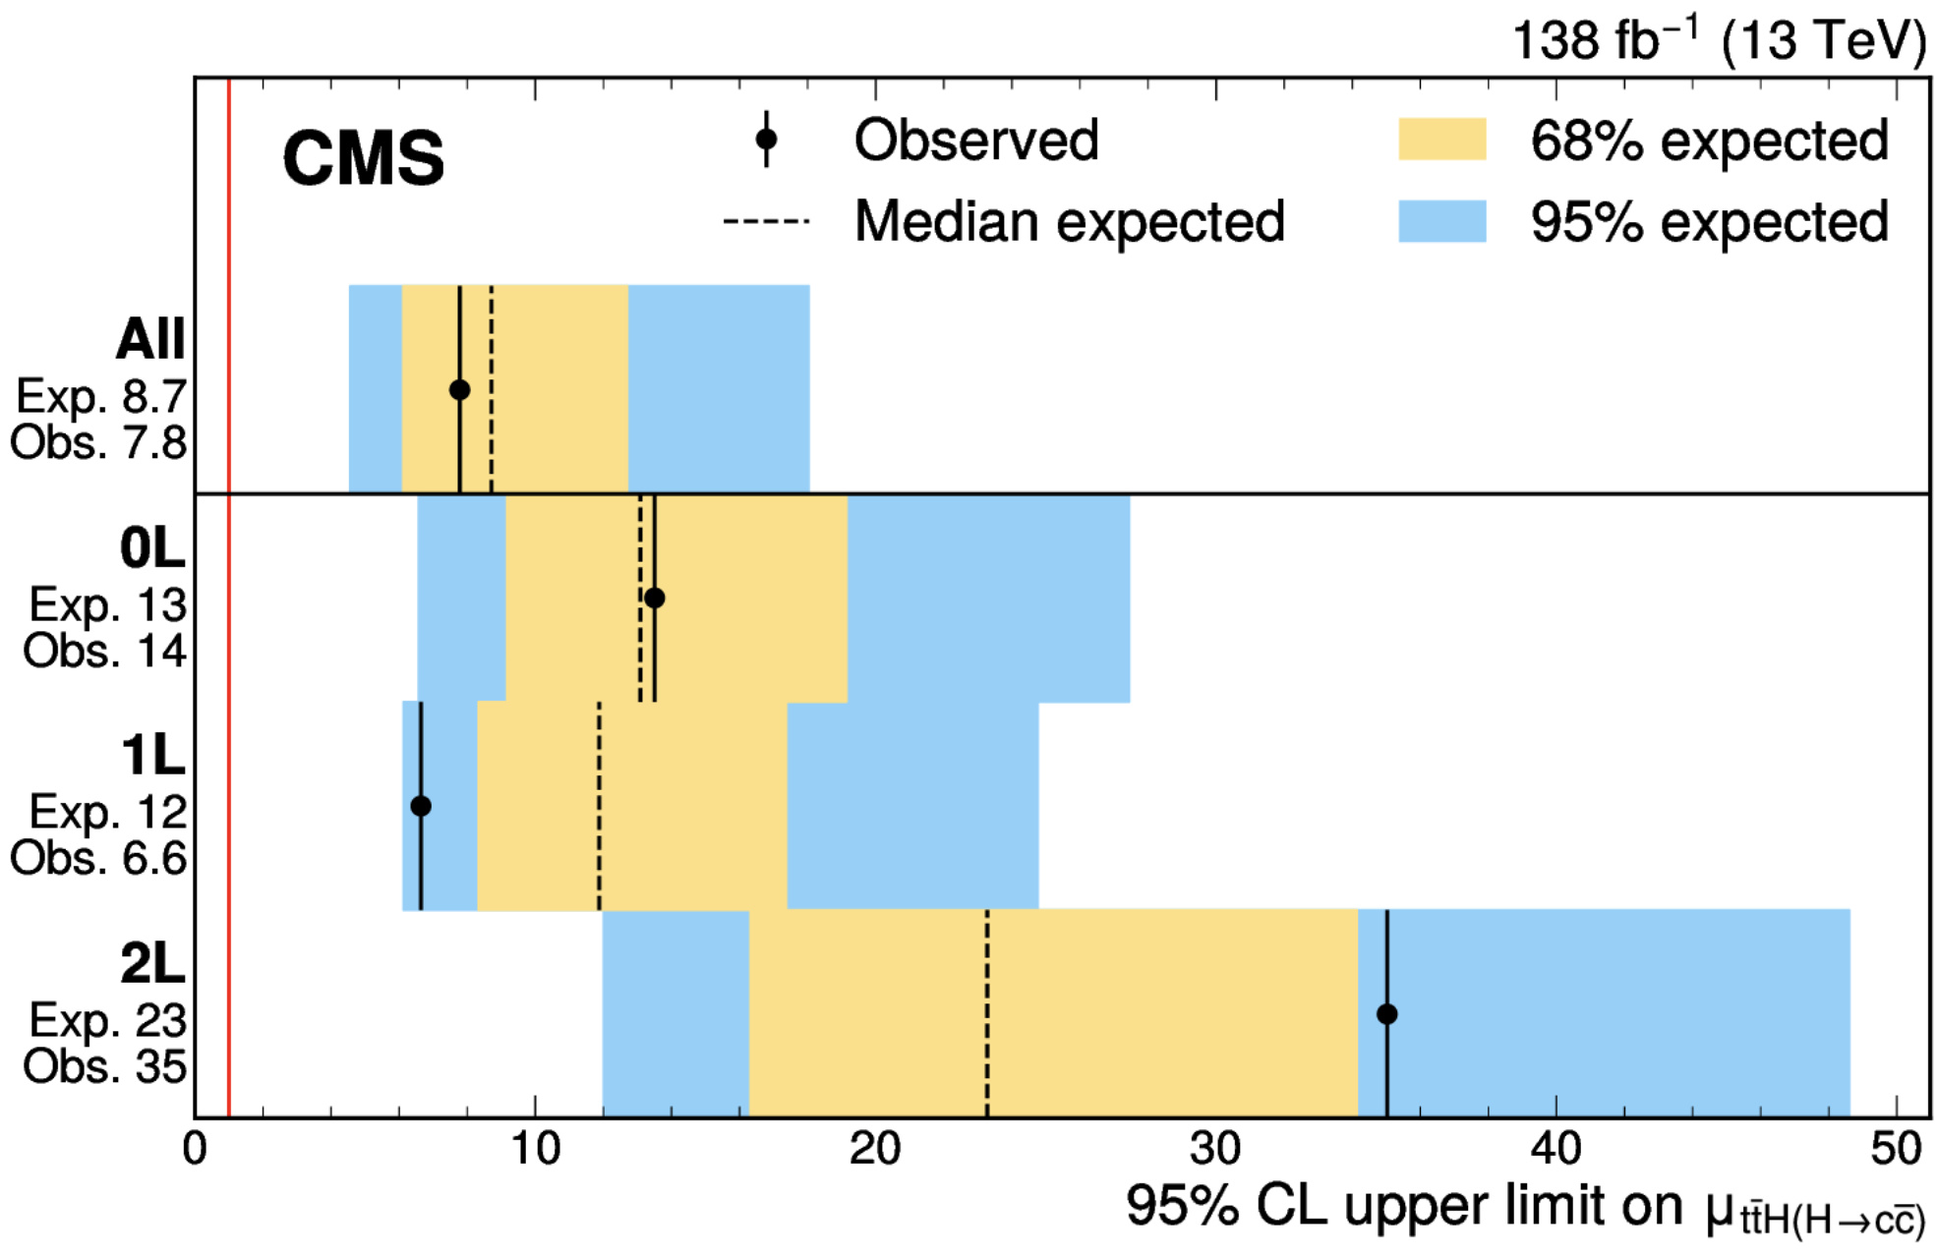
Higgs coupling to charm [HIG-24-018]
2nd quark generation: H→cc; considered infeasible at the LHC
  c tagging and QCD backgrounds
ParticleNet (dGCNN) separates b, c, and light jets, enabling a dedicated ttH(H→cc) Run 2 search [HIG-24-018]
  138 fb⁻¹ at 13 TeV: μ(ttH(H→cc)) < 7.8 (8.7 expected) at 95% CL
Combining with VH (H→cc): |κ_{c}|< 3.5 (2.7) obs. (exp.) [HIG-21-008]
Expect further improvements with attention-based algorithms
Coupling meas. combination

Slide 6
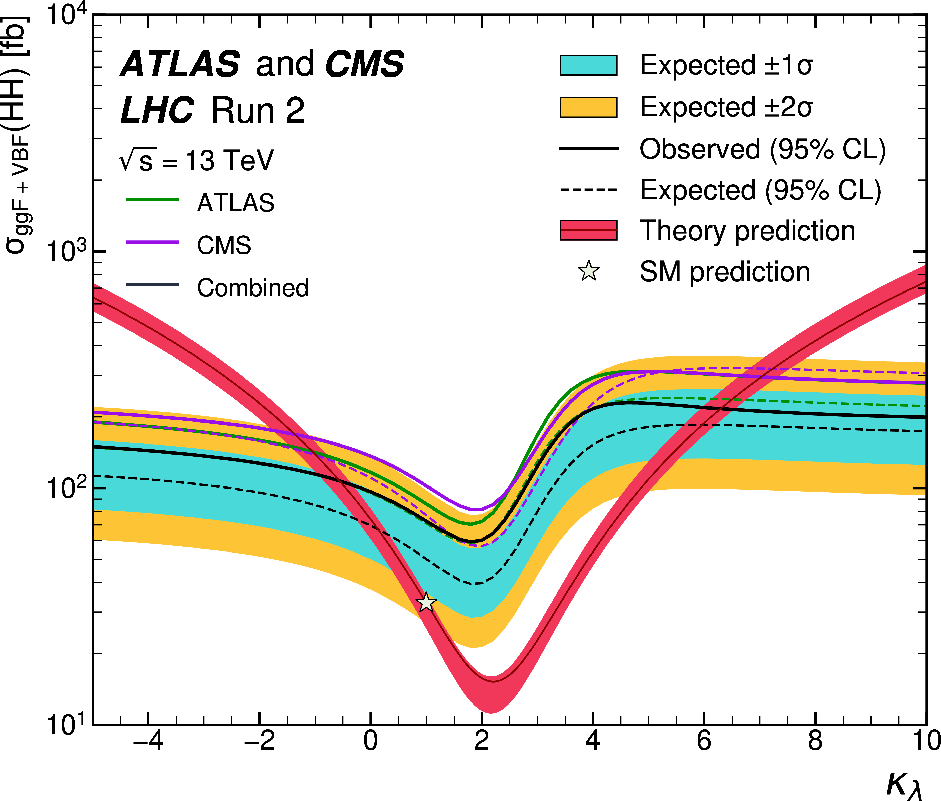
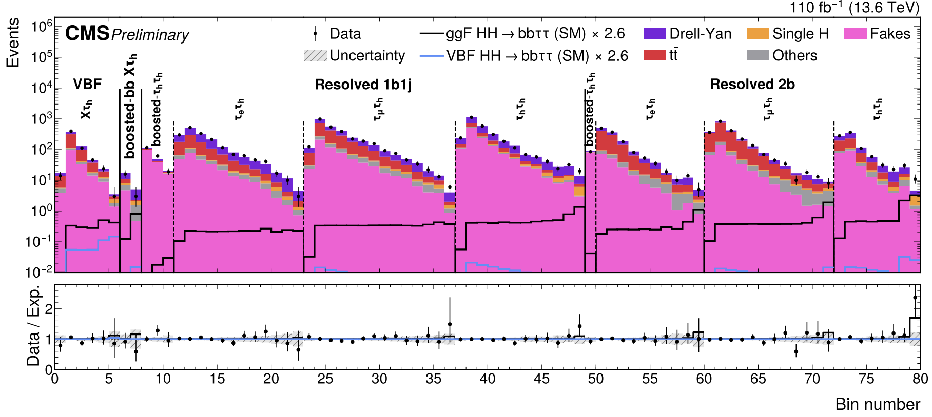
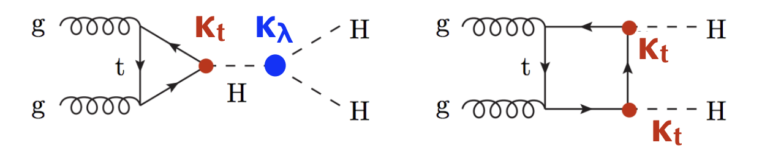
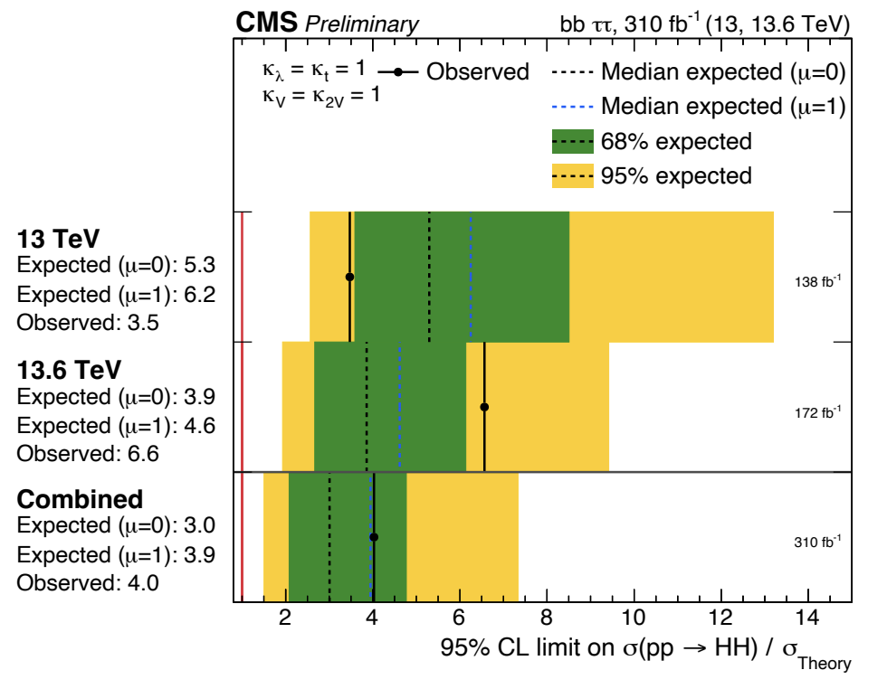
HH production: Run 2 to Run 3 [HIG-25-008]
κ_{λ} is the SM test because we little is known about the Higgs potential
  Interference with top Yukawa coupling
  ATLAS+CMS Run 2 μ_{HH}=0.8^{+0.9}_{-0.7}
  CMS results with partial Run 3 data
  in many channels (4b, 2b2ɣ, 2b2l2ν)
Run 2 + Run 3 combination 0.3 ab⁻¹
  µ(ΗΗ→bbττ) < 4.0 (3.0 exp) x SM at 95% CL
ATLAS+CMS
μ_{HH}=0.8^{+0.9}_{-0.7} [HIG-25-014]

Slide 7
Stairway to discovery
precision
measurement
observation
new physics
BSM – or SM
Run 2 legacy complete; From precision measurements on SM candles to rare processes.
√ℒ luminosity scaling does not dominate sensitivity! The stairway’s rungs are theory/experimental interplay.

Slide 8
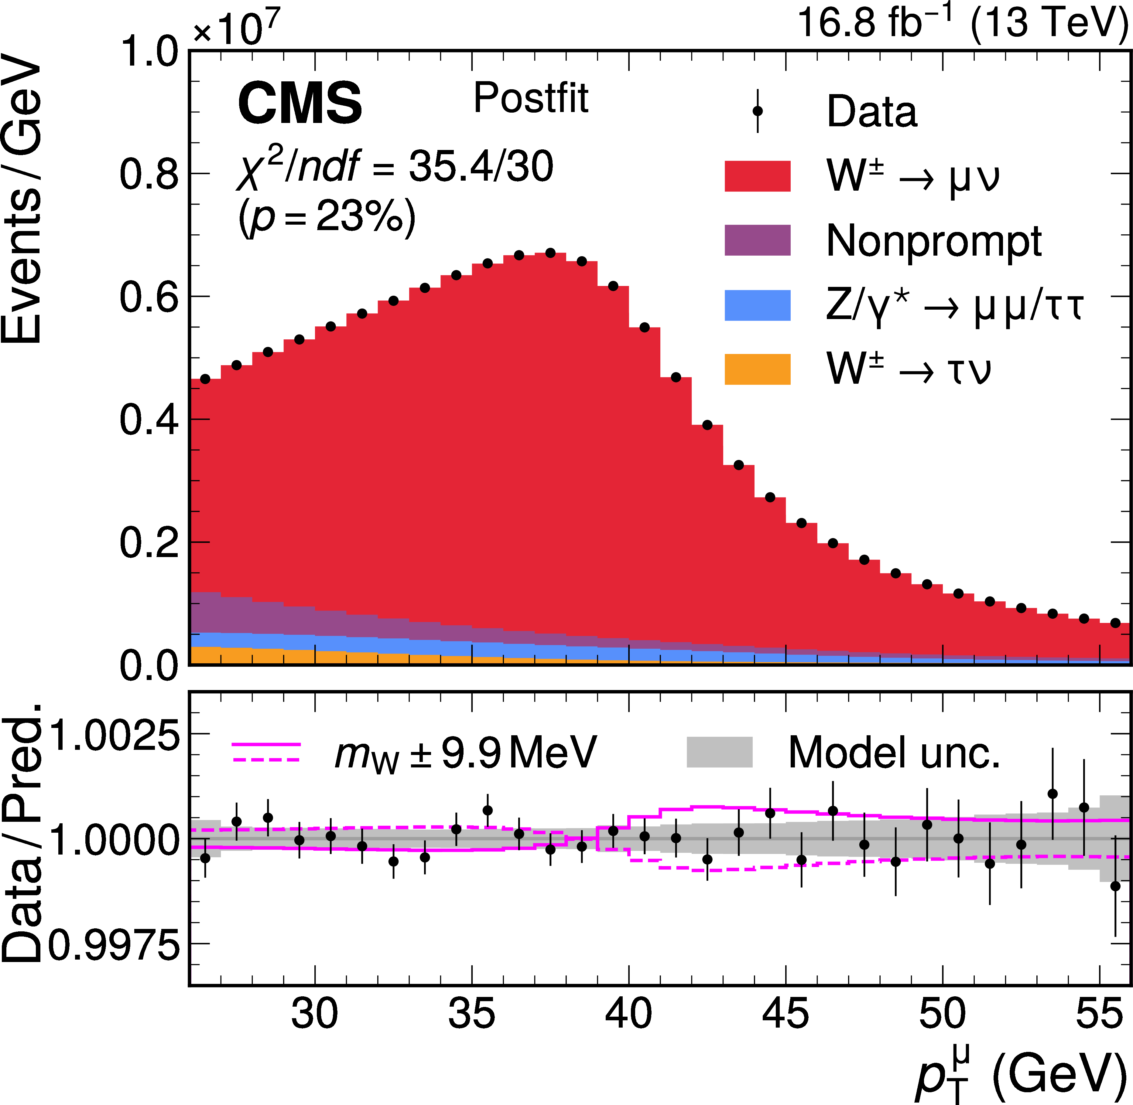
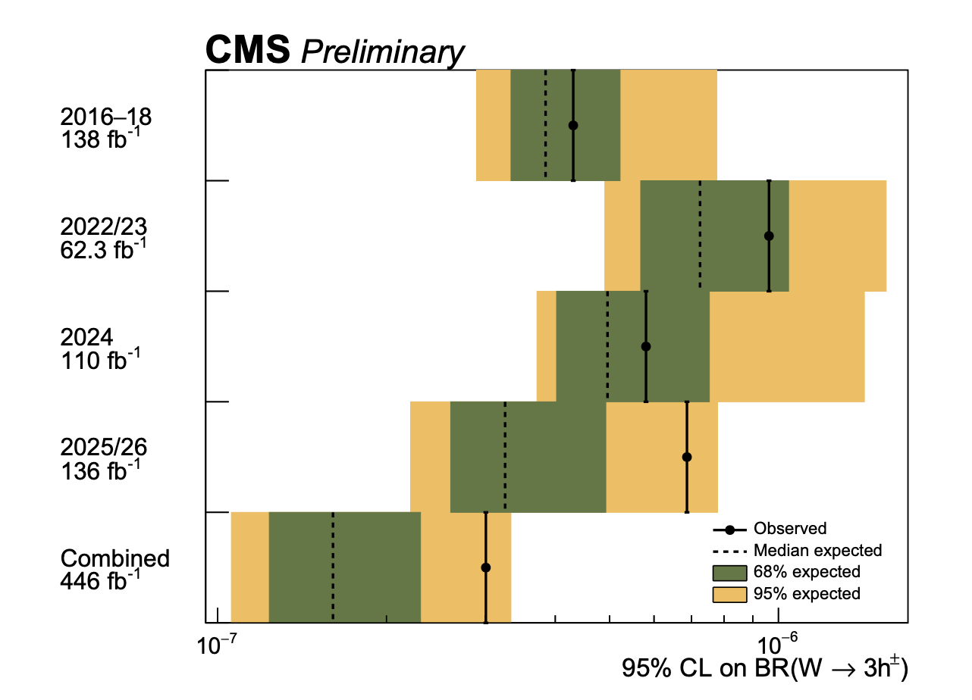
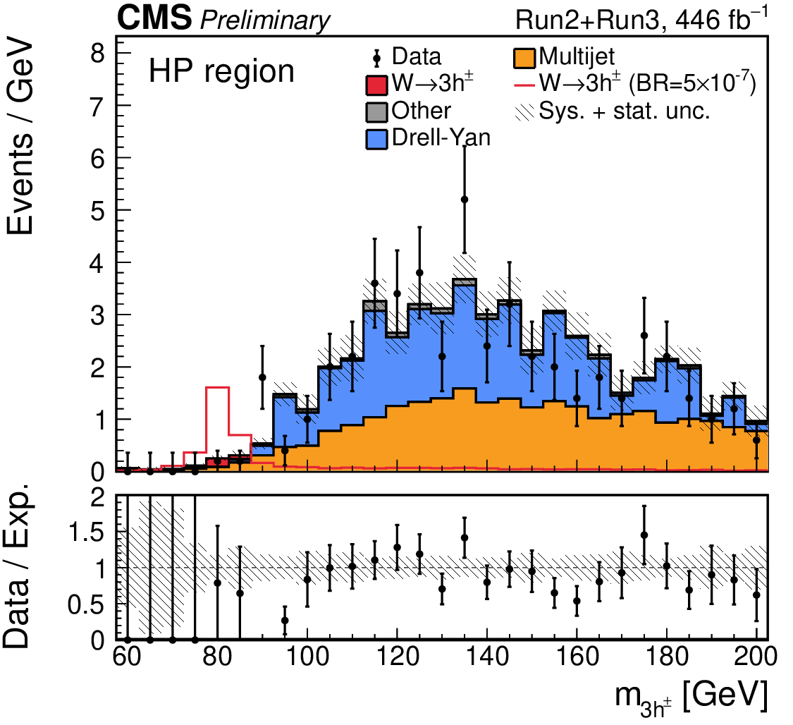
W boson measurements
W mass measurement
[Nature 652, 321–327 (2026)]
Search for W→3h [SMP-25-011]
Full Run 2 + Run 3 data set: 446 fb⁻¹
B(W→3h) < 2.4 × 10⁻⁷ (95% CL)
  B(W± → 3π±) ∼ O(10⁻⁷–10⁻⁵ ) from PYTHIA
  No dedicated calculation
Accurate predictions for the exclusive decay would access a QCD probe at HL-LHC
M_{W} = 80 360.2 ± 9.9 MeV (Run 2 legacy)
Systematic accuracy: muon scale & PDFs
PDFs profiled to 4.4 MeV, 11 MeV unprofiled

Slide 9
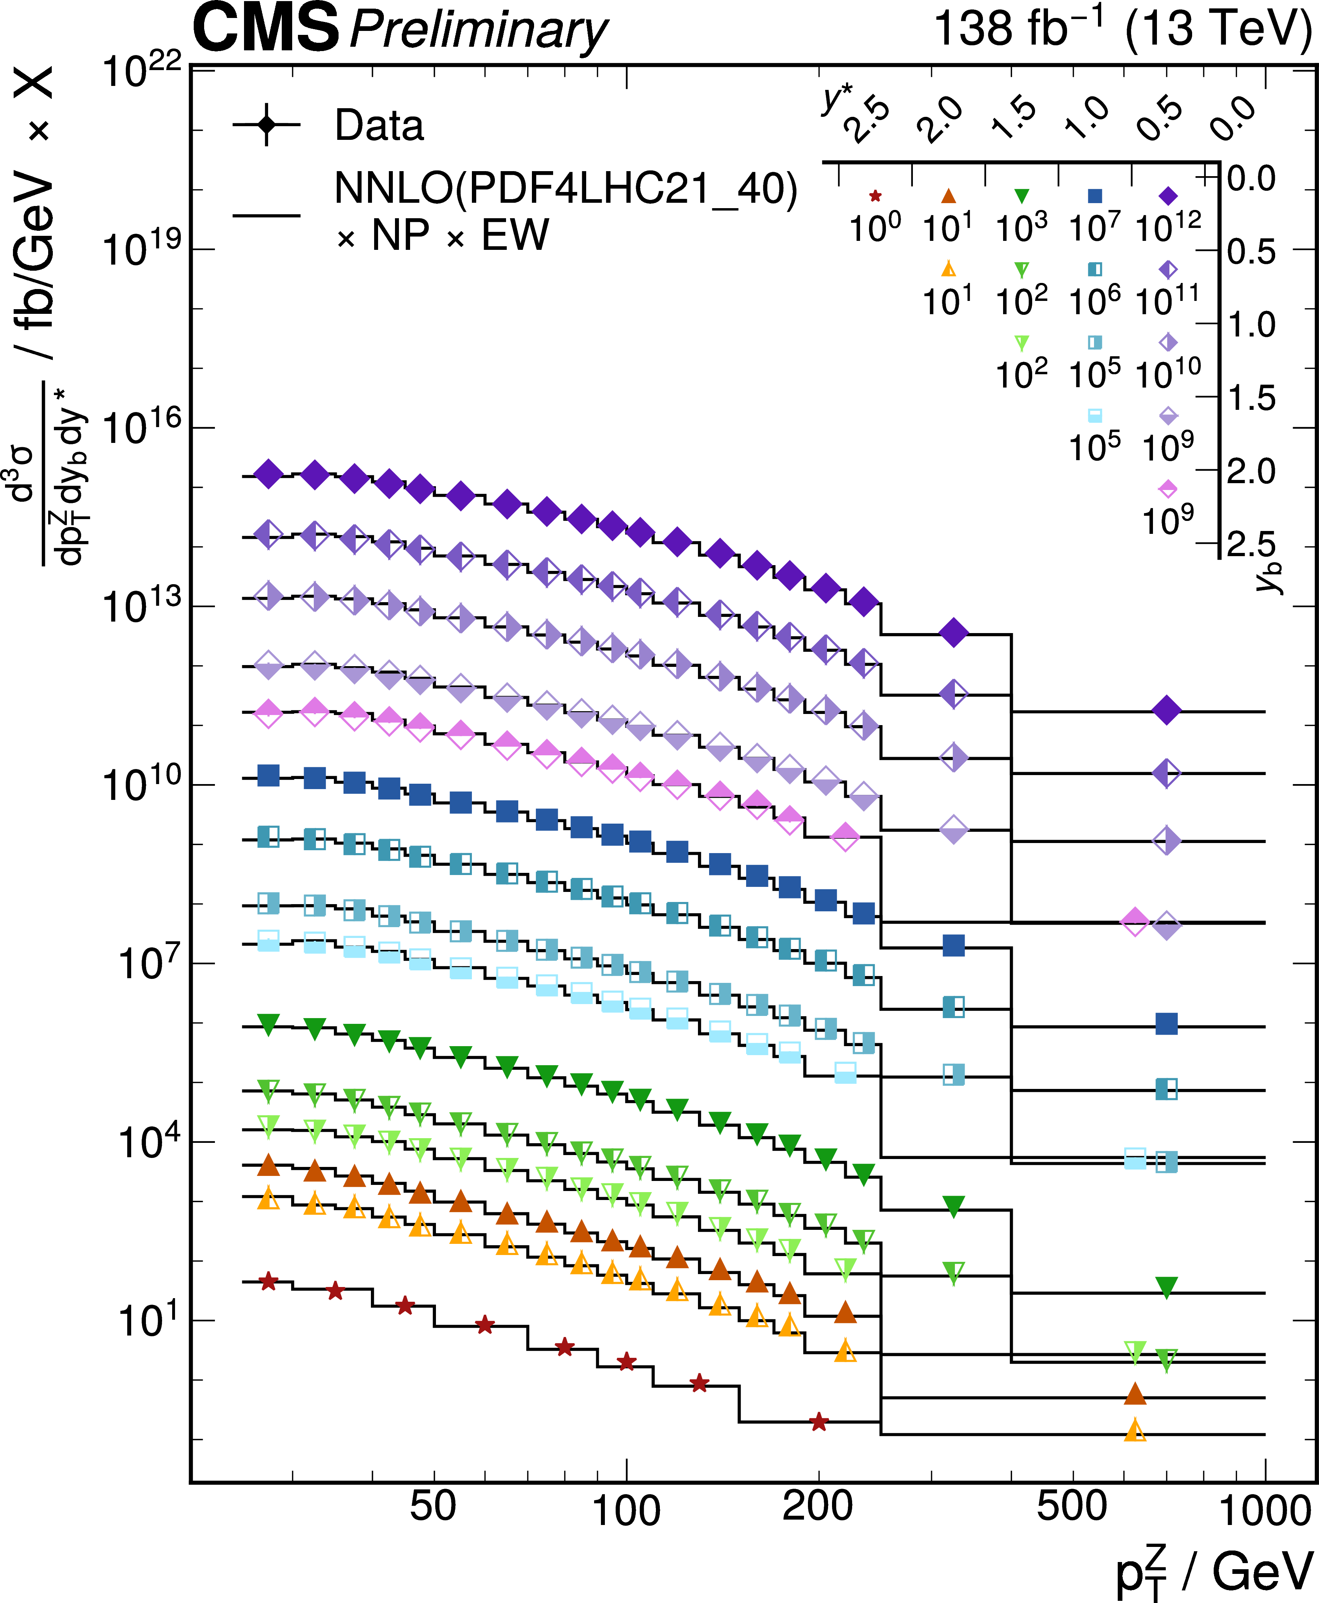
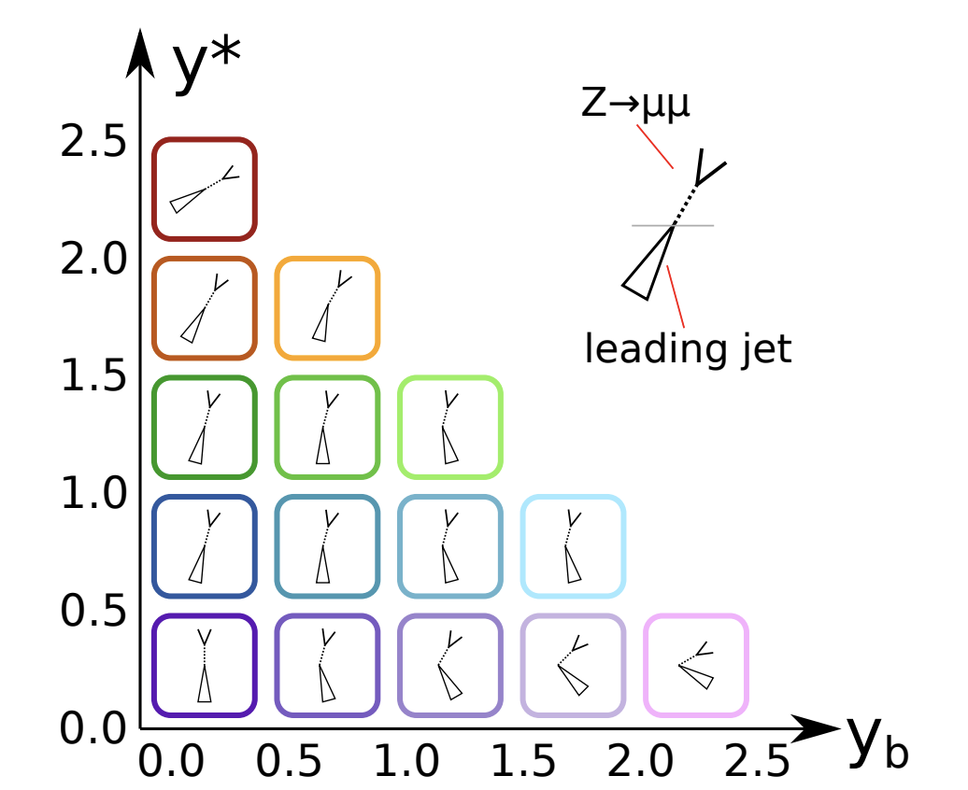
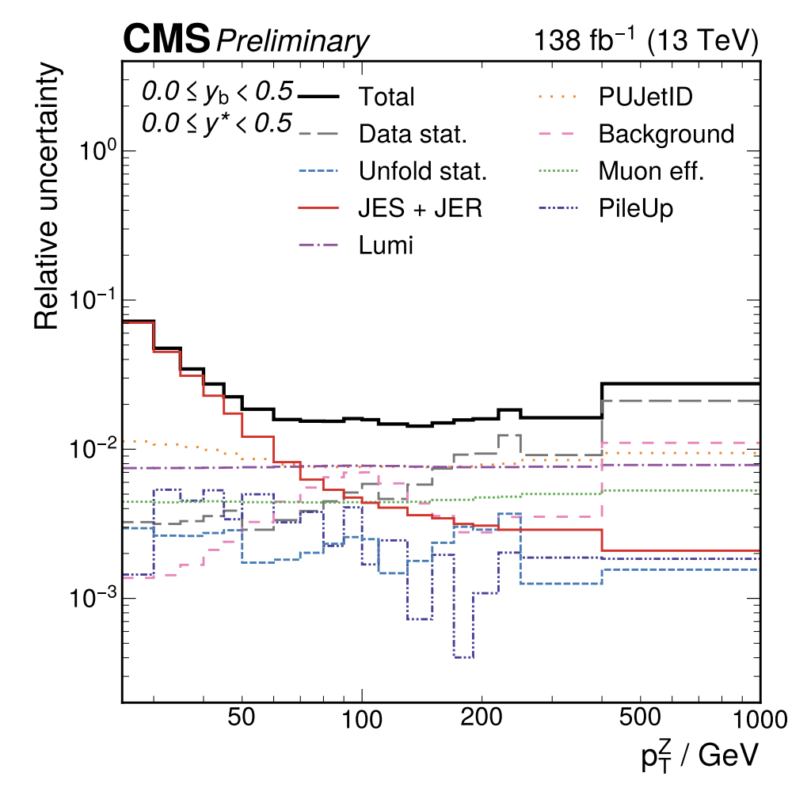
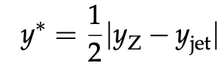
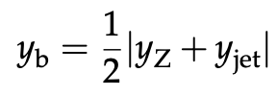
Triple-differential Z+jets cross section [SMP-24-010]
Bulk uncertainty: 1.5%
Run 2 lumi uncertainty 0.73%
[LUM-20-001]
Precise qq luminosities
Unfolded in pₜ(Z), y_{b}, and y*
Constrains parton density distributions
Complementary to jet cross sections
See tomorrow’s talk by Cedric Verstege

Slide 10
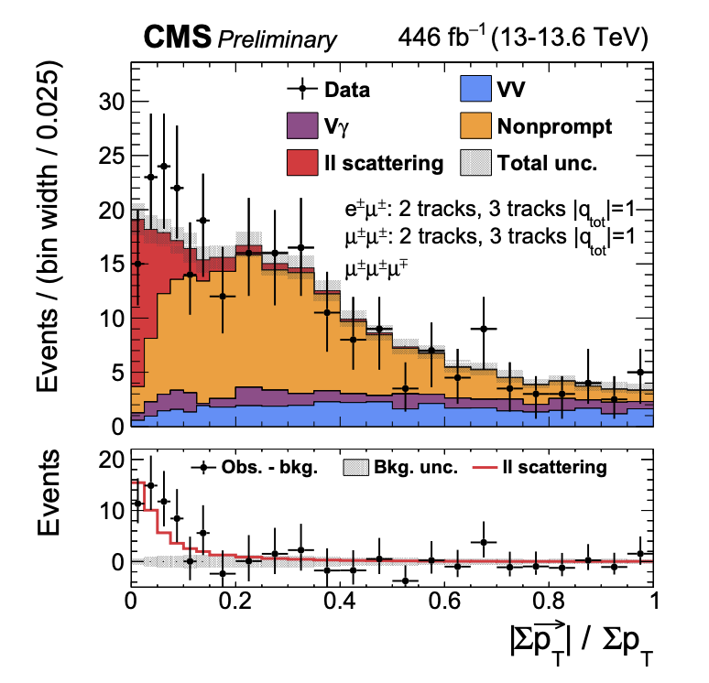
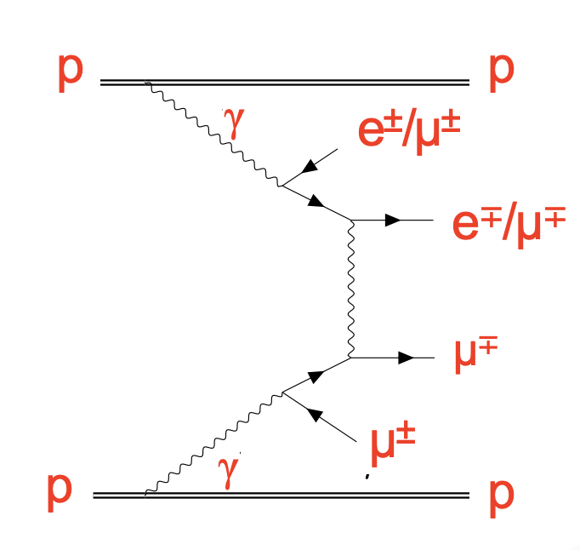
Photon mediated lepton scattering [SMP-26-008]
Probe QED partonic structure: γ-induced ℓ±ℓ± scattering
  446 fb⁻¹ at √s = 13 and 13.6 TeV
Signal: Same-sign e±μ± and μ±μ± pairs scatter in ɣ exchange
Elastic+single-dissociative: quiet multilepton vertex
  ≤4 tracks and small pₜ balance, simulated with SFGen [PRD (104) 073002]
  Categories e±μ±, μ±μ±, μ±μ±, μ±μ±μ∓
  Systematics: Nonprompt/PU, survival probability at low N_{track}
  [Eur.Phys.J.C 80 (2020) 10]
First observation of scattering between
leptons radiated from the incoming protons
  5.4 σ (μ±μ± at 4.0 σ)
Protons are not tagged

Slide 11
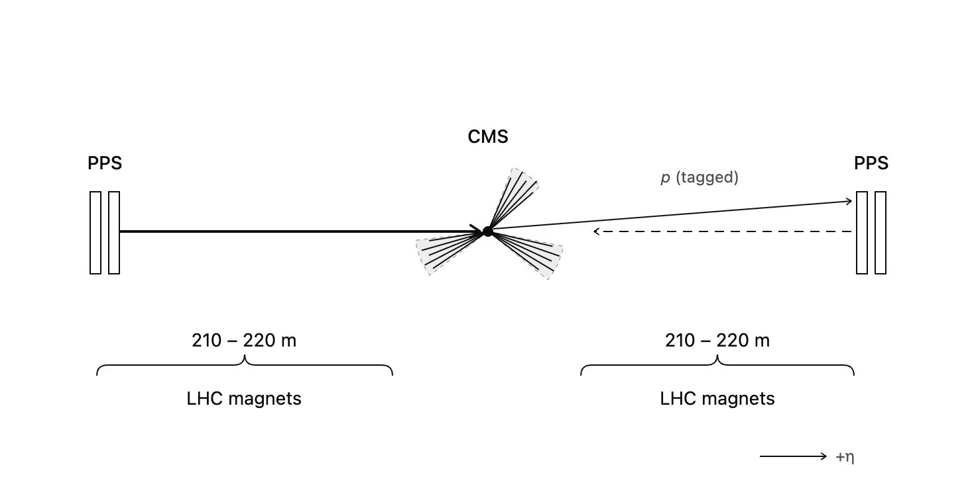
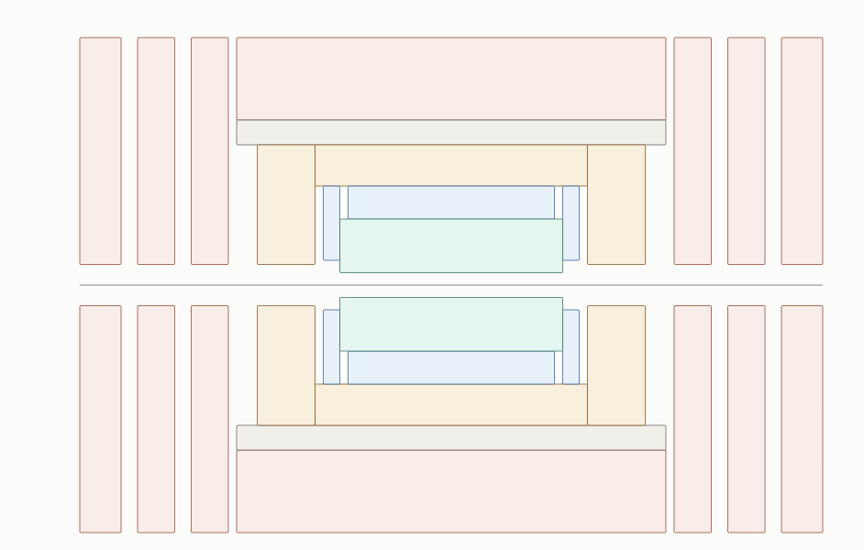
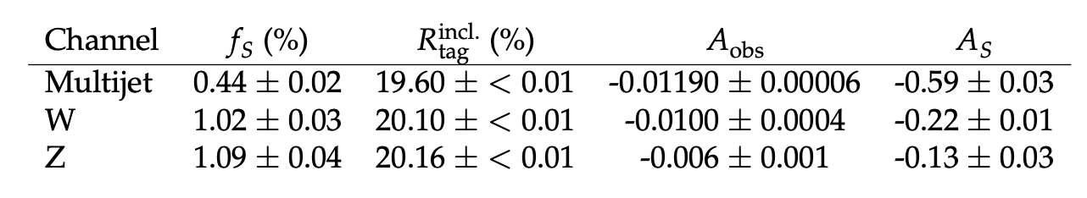
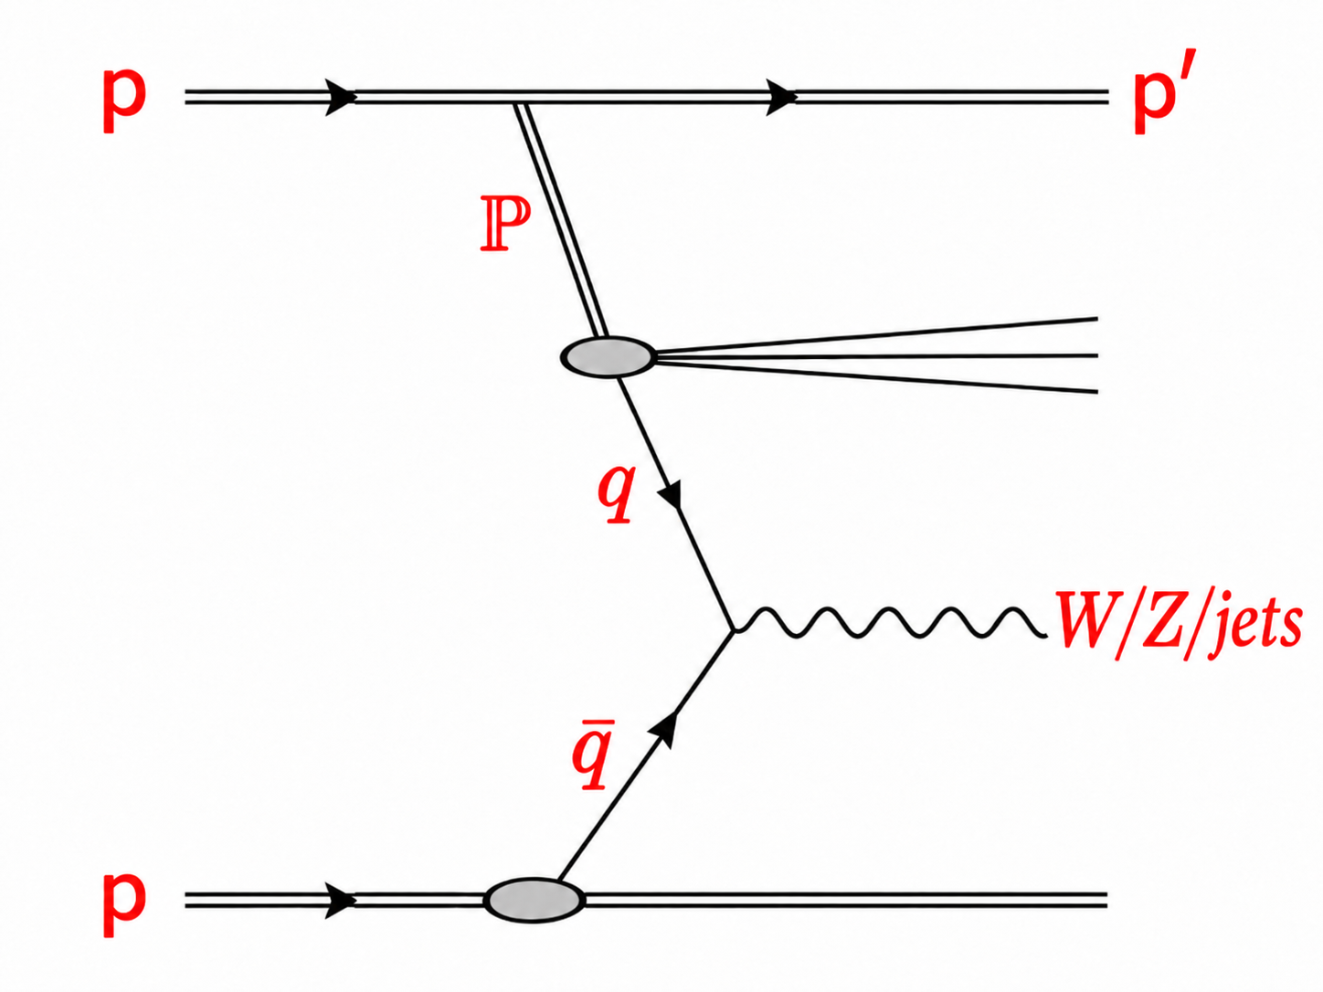
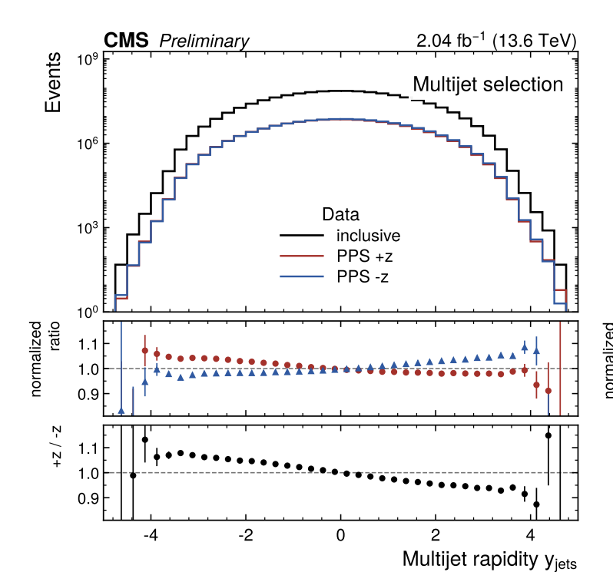
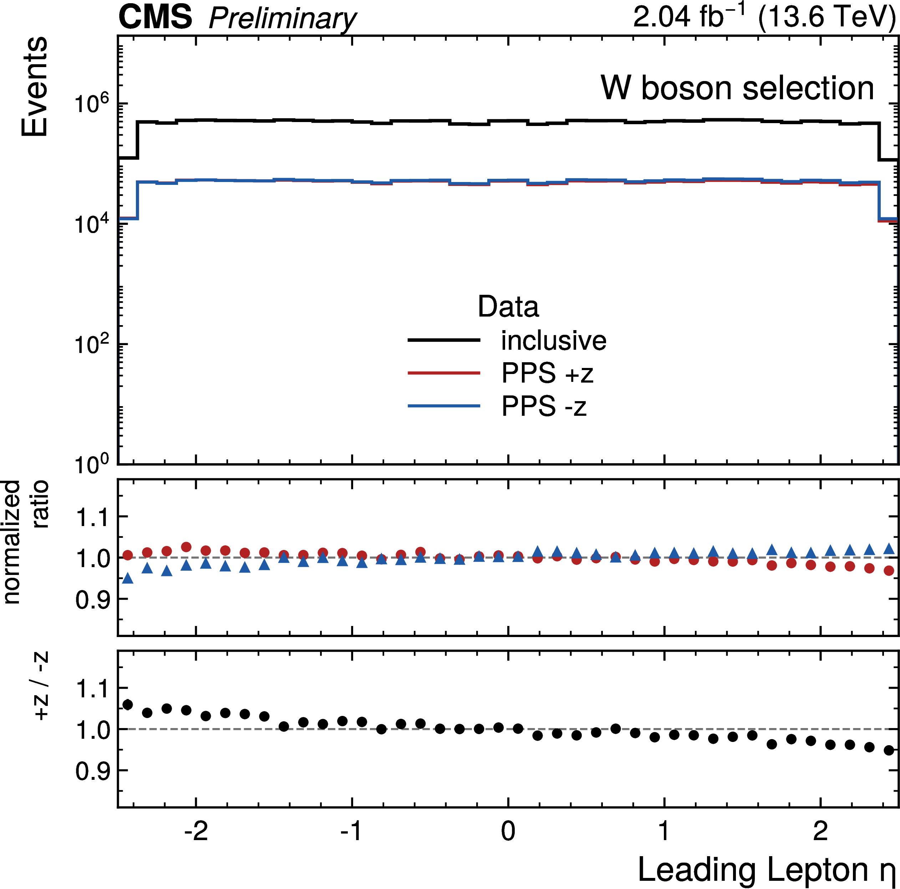
Diffraction at hard scales [SMP-26-015]
New CMS analysis: tagged p + jets/W/Z
CMS Precision Proton Spectrometer
  +/- 220m from the central detector
  PPS acceptance 3% < ξ < 13%
  ξ ≡ 1 − p′/p — proton momentum loss
Exploit low-PU run <μ> = 5, L = 2 fb⁻¹
  20% tagging efficiency, purity 1-2%
Rapidity gap & tagged proton establish coherent color-singlet QCD at high scales
Talk by Elisabetta Manca

Slide 12
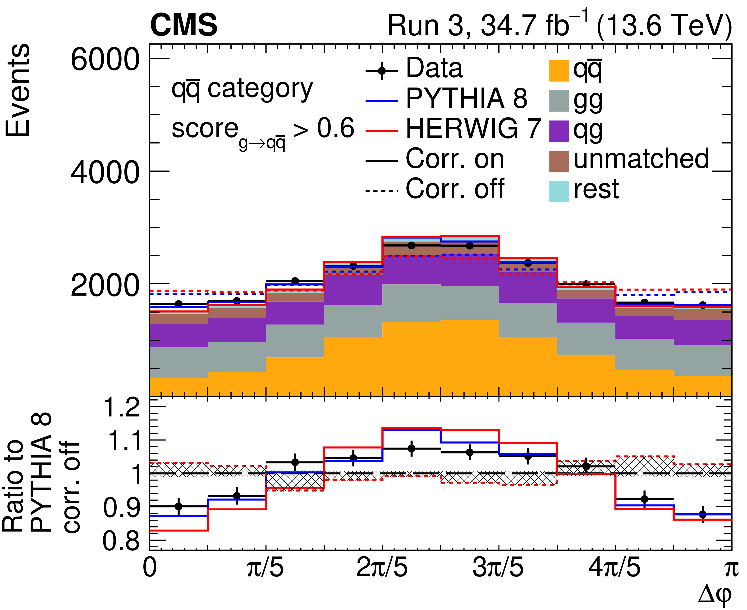
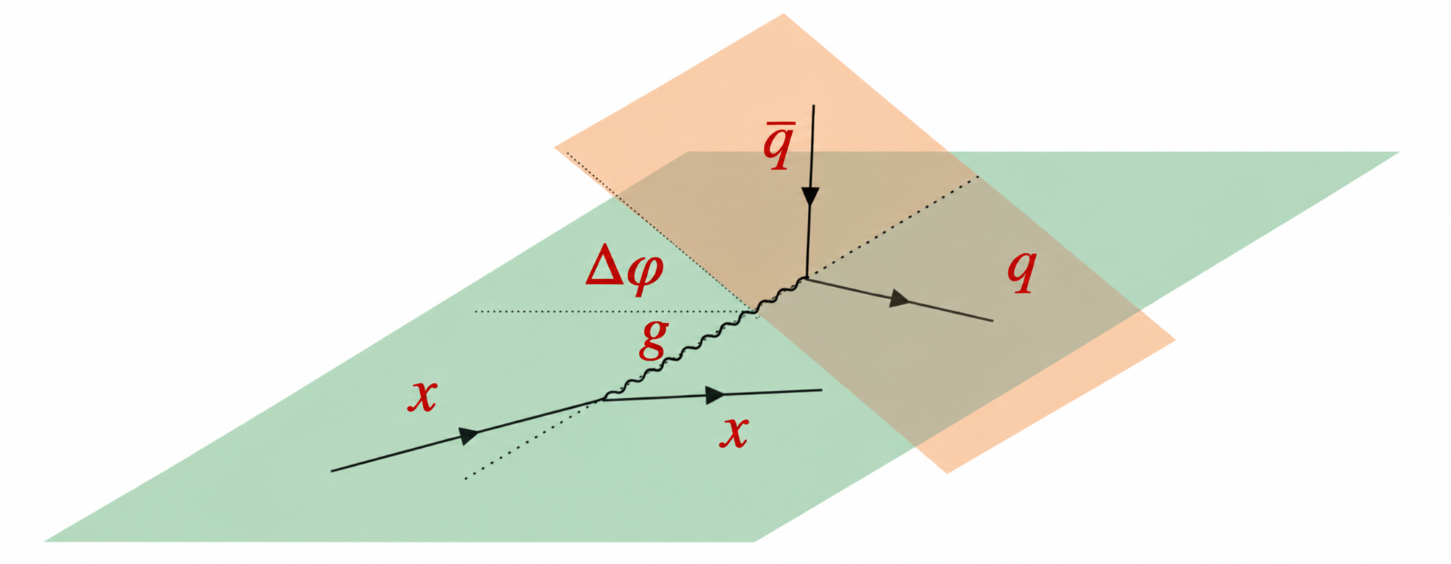
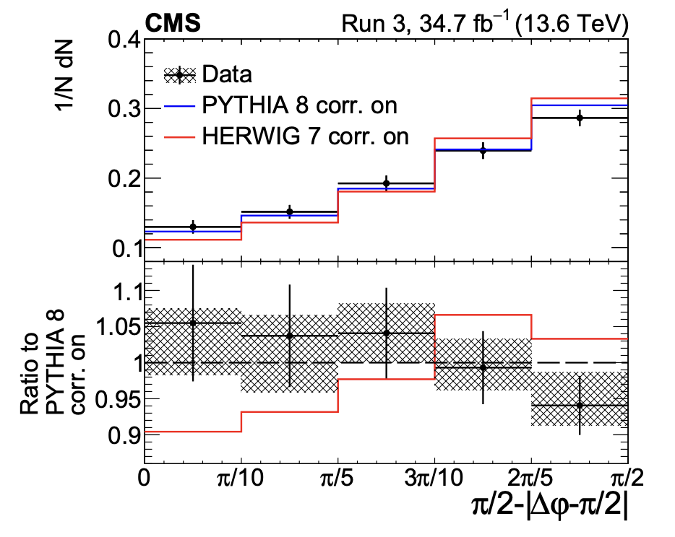
Gluon spin correlations within jets [SMP-25-006]
Select p_{t} > 700 GeV AK8 jets, CA declustering
  Observable: Δφ between successive splitting planes
  Run 3 (2022): 34.7 fb⁻¹ at √s = 13.6 TeV
  ML isolates g→qq̄ splittings, where the modulation is largest
  “No correlations” is disfavored by 6.8σ;
  Pythia within unc. (Collins–Knowles: adds modulation to the opening angle)
  Herwig (=spin density matrix) predicts stronger effect
One step towards precision of boosted hadronic Higgs decays

Slide 13
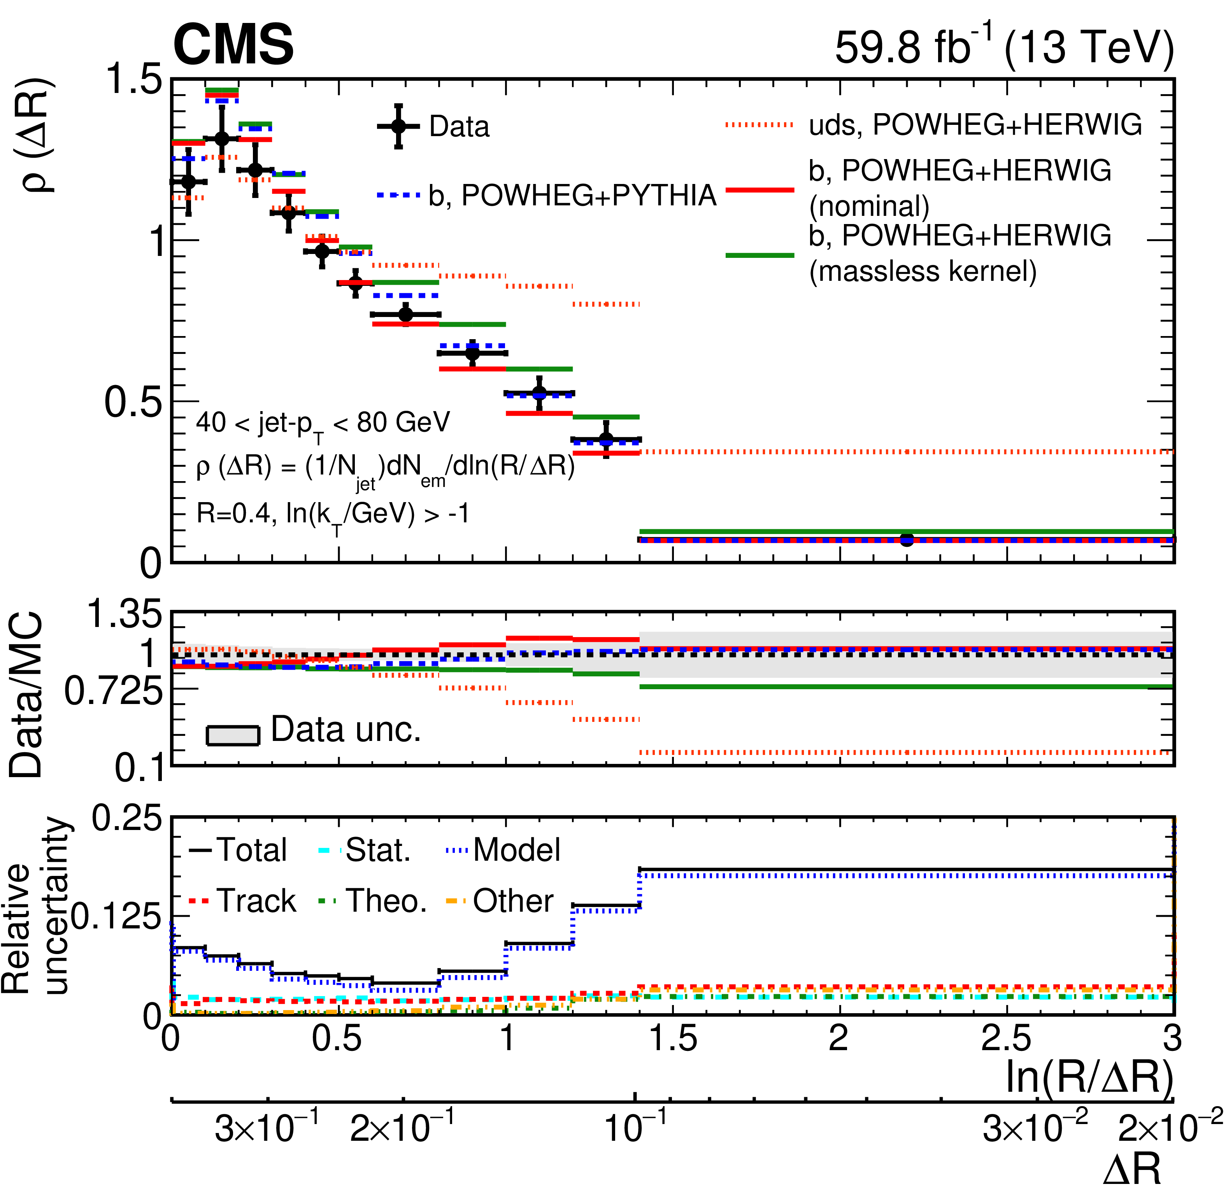

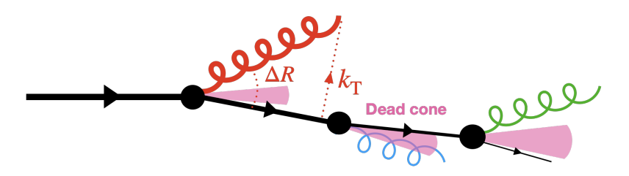
Dead cone effect in b jets from tops [SMP-25-008]
Quark mass suppresses collinear gluon radiation within θ ≲ m_{b}/E_{b}= θ_{d} — the dead cone
  Harder fragmentation, fewer intrajet constituents
Top quark pairs in eμ decay channel
Backwards traversing angular-ordered CA clustering history
  measures the angular emission density of b jets
A massless parton shower is disfavored by 4.3σ in the most sensitive pₜ range
Massless emission
probabilities are higher
and disfavoured
More collinear

Slide 14
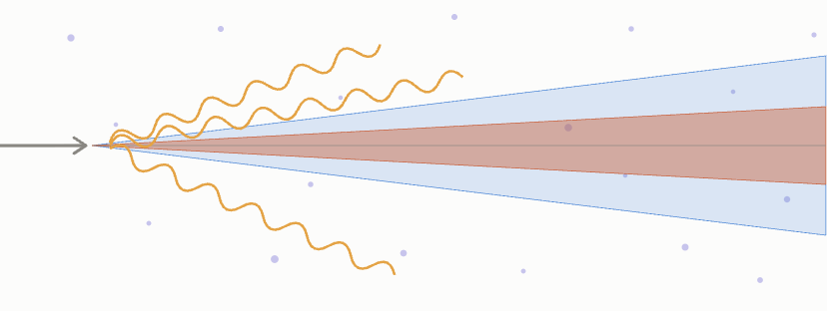
Dead cone of charm quarks in PbPb [HIN-25-013]
Does the medium induce radiation that fills the dead cone of a heavy (charm) quark?
  QGP medium can not resolve angular structure below a decoherence angle
PbPb data: 1.7 nb⁻¹ at √sₙₙ = 5.02 TeV (2018)
Charm quarks are identified via D⁰ tags
The small-angle suppression persists: the PbPb/pp double ratio is consistent with unity
Dead-cone
of D⁰-tagged
radiation
(would-be)
Bottom dead cone
Medium induced
gluon emissions
charm
Decoherence angle
Charm dead cone
Same as
in pp
More collinear

Slide 15
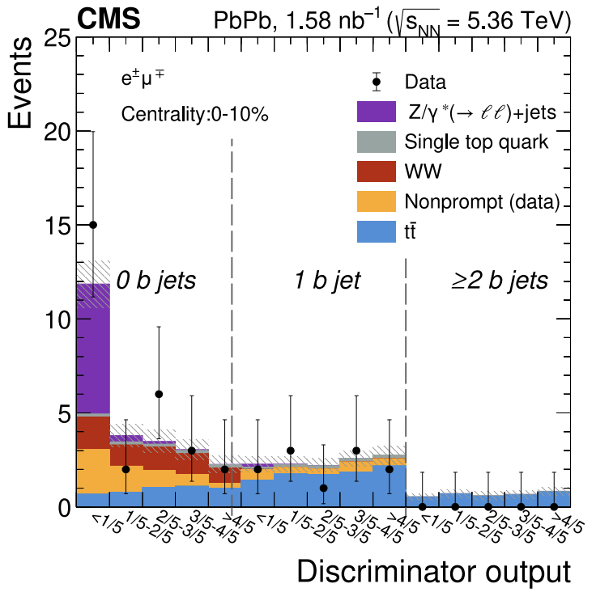
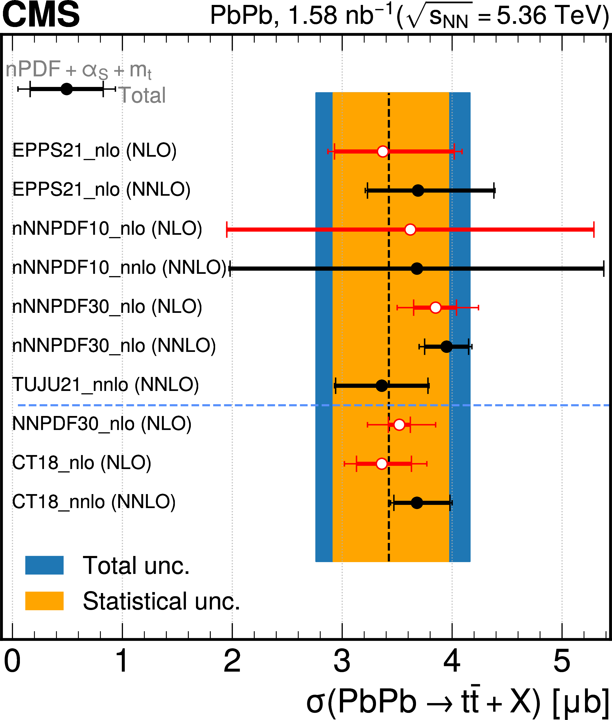
Top quark pairs in PbPb [HIN-24-021]
First measurement of tt̄ production in PbPb collisions
  PbPb data: 1.6 nb⁻¹ at √sₙₙ = 5.36 TeV (2023)
Dilepton events and b-jet multiplicity separate tt̄ from Drell–Yan and other backgrounds
New techniques developed
  electron ID (BDT)
  lepton isolation (SoftKiller)
  Jet energy scale calibration
  Heavy-flavor jet identification (UPart)
σ(tt̄) = 3.42^{+0.54}_{-0.51} (stat) ^{+0.50}_{-0.43} (syst) μb
  consistent with nuclear-PDF calculations
tt/Z sensitive to gluon/quark nPDF ratio
  Can discriminate nPDF sets with more data

Slide 16
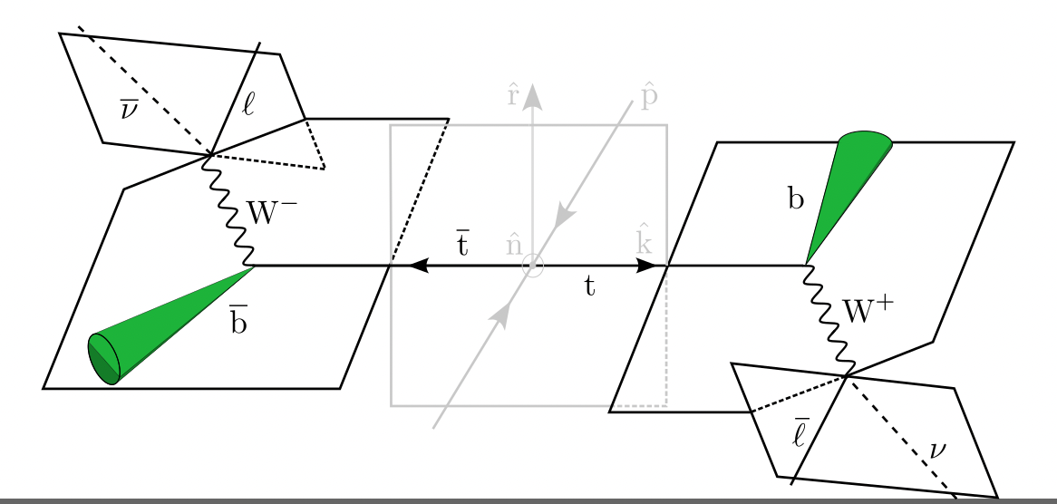
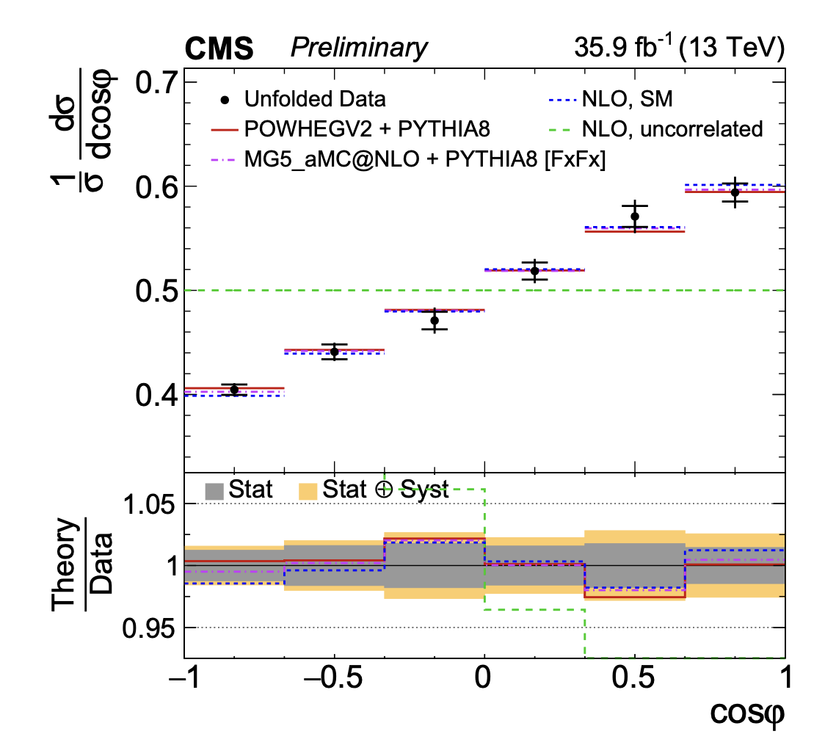
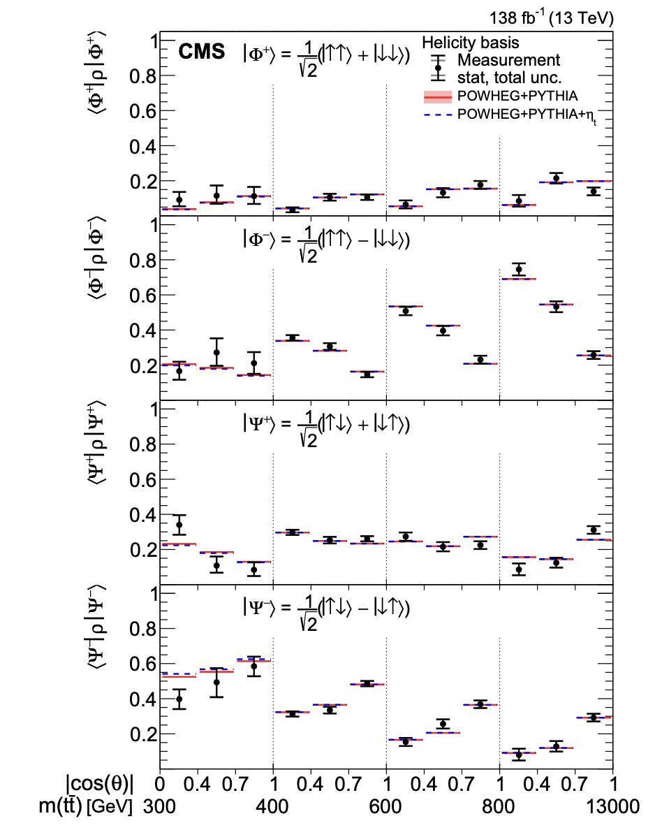

Top quark pairs – steps to precision
Quantum state of ttbar [TOP-25-017]
Spin-correlation matrix in the tt rest-frame [Bernreuther et al. , 1508.05271]
  Systematic description replaced earlier ad-hoc measures
  Transform observables so the parameter enters linearly
    Experimentally: slope of the unfolded distribution
    Curvature regularization: 2nd derivative; regulator → ∞ → χ² fit
    Much smaller theory/modeling uncertainties than in the lab frame
Enables quantum tomography in top quark pairs [TOP-25-017]
Rest-frame
  D = -1/3Tr[C] = -(C_{nn}+C_{rr}+C_{kk})/3

Slide 17
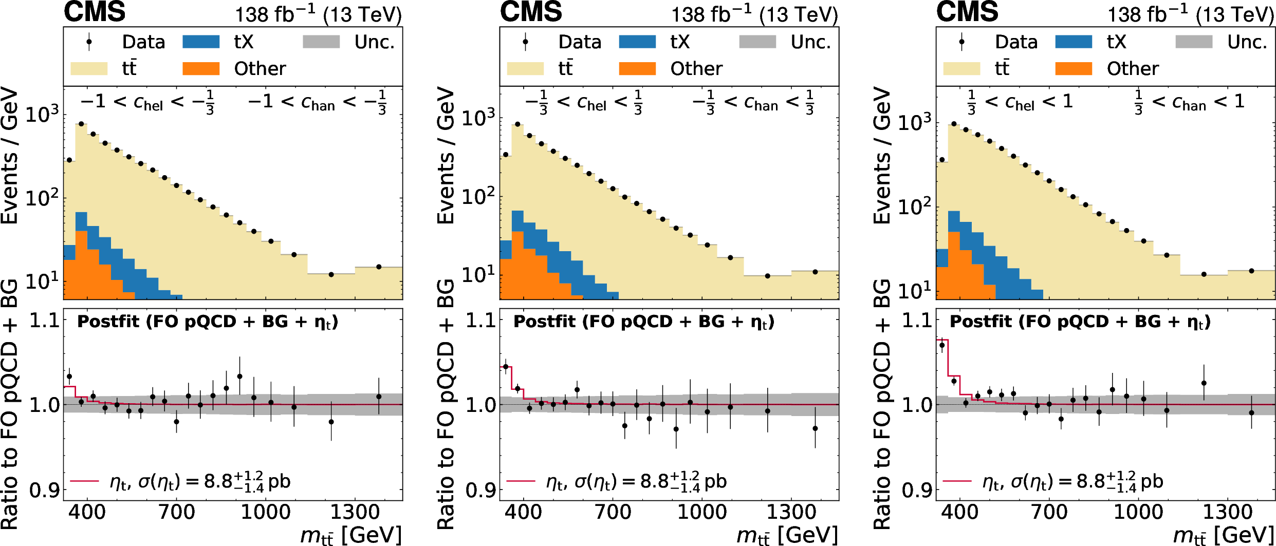
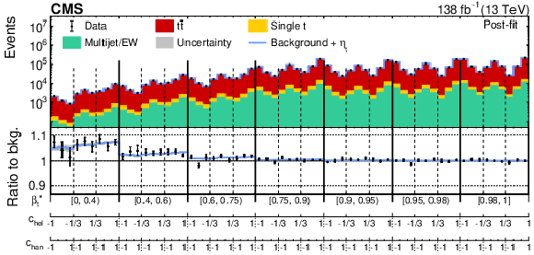
Excess in tt̄ production at threshold
Observed excess; pseudo-scalar enhancement close to the tt̄ threshold, first in 2ℓ events
Confirmed in single-lepton events using M(tt̄), β* and the spin observables cₕₑₗ and cₕₐₙ
Results favor pseudoscalar ηₜ “toponium”: 8.8^{+1.2}_{-1.4} pb (2ℓ) and 5.3 ± 0.9 pb (1ℓ)
A theoretical challenge beyond LO; Consistent matching, shower, decay, resummation,…
Dilepton channel [TOP-24-007]
Single-lepton channel [TOP-25-002]

Slide 18
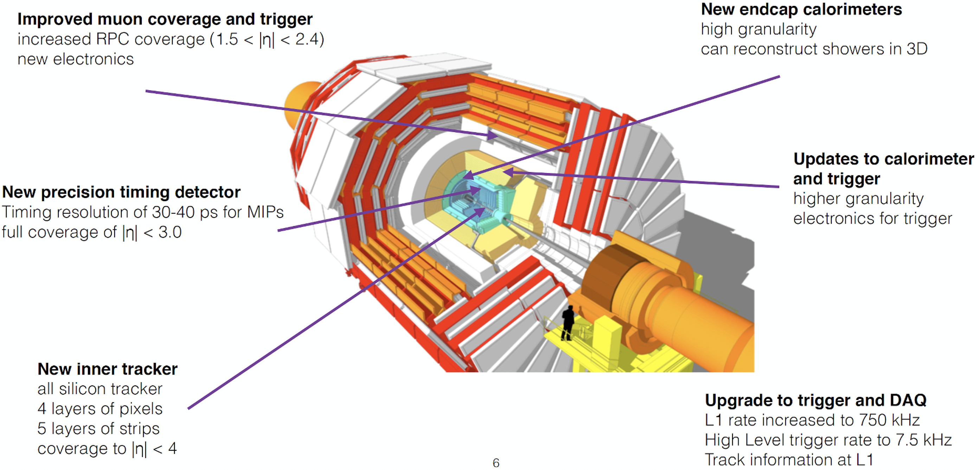

CMS upgrades for HL-LHC
[CMS-TDR-016]
CMS-TDR-019
[CMS-TDR-020]
[L1: CMS-TDR-021]
[DAQ/HLT: CMS-TDR-022]
[CMS-TDR-014]

Slide 19
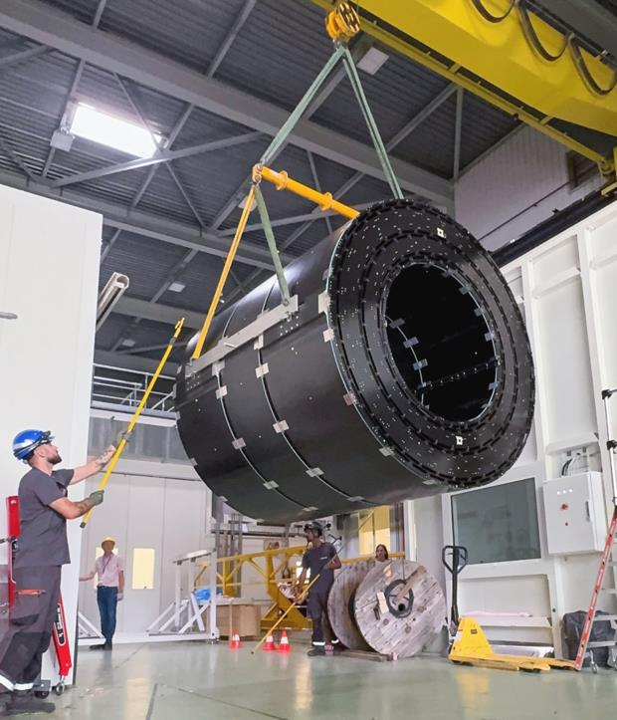
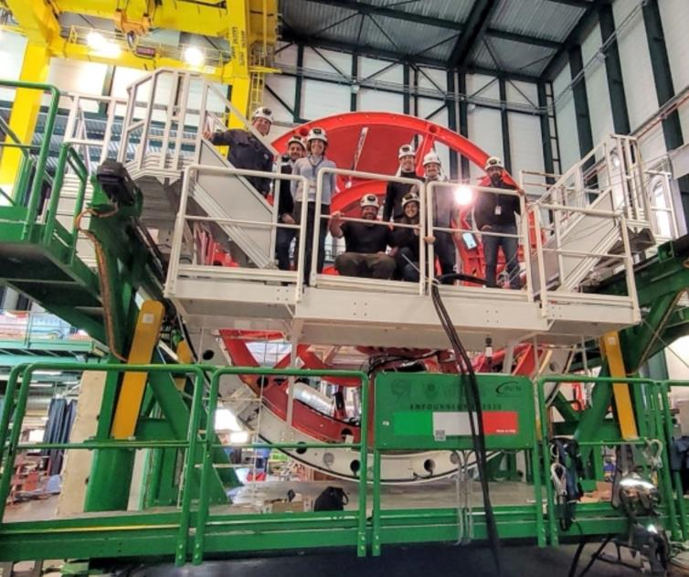
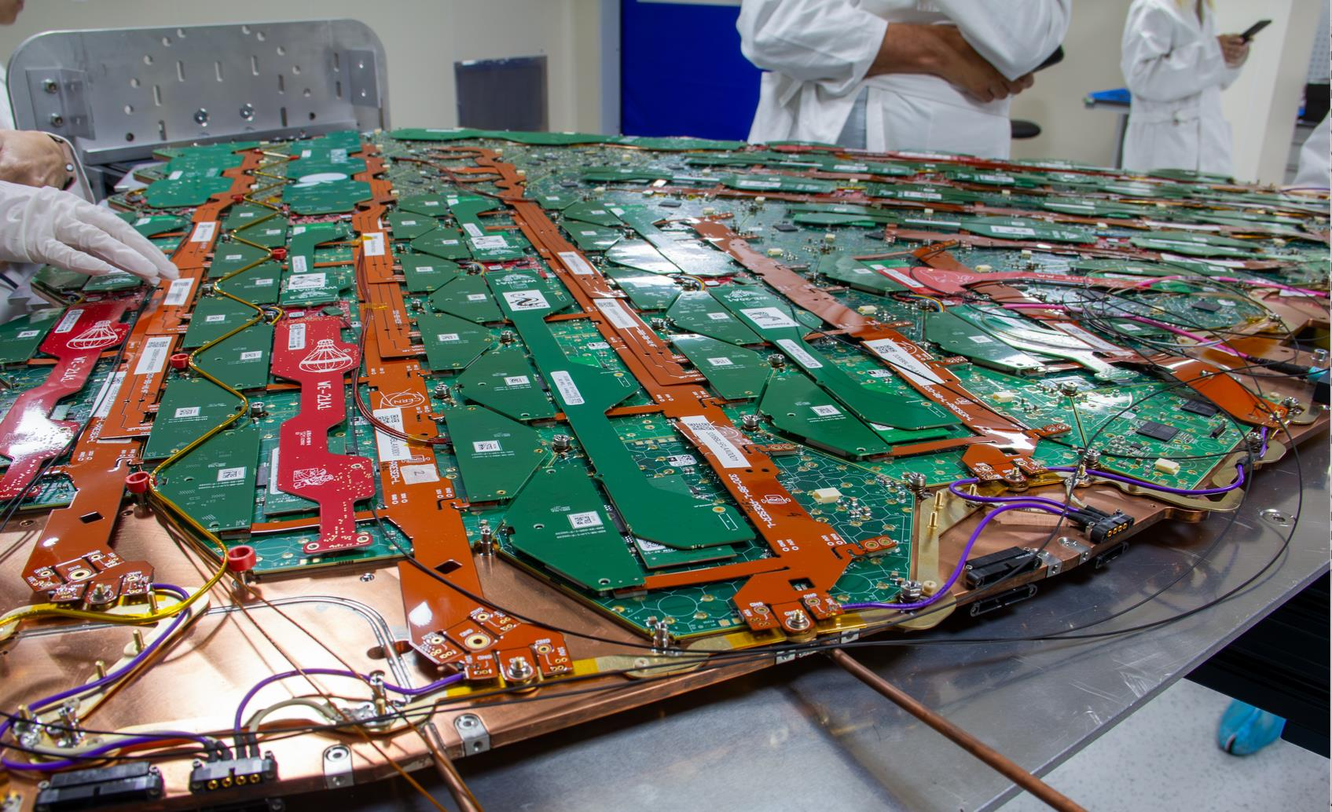
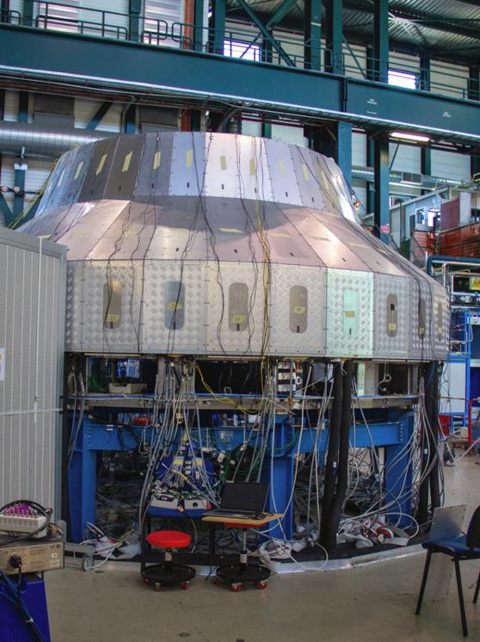
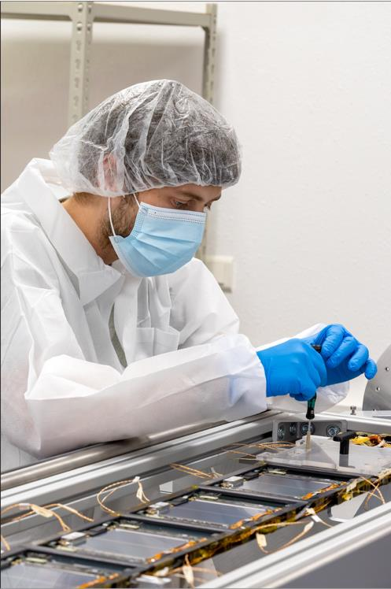
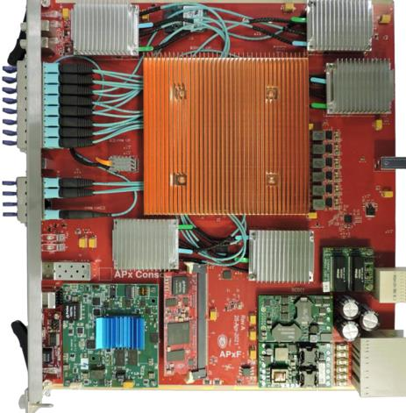
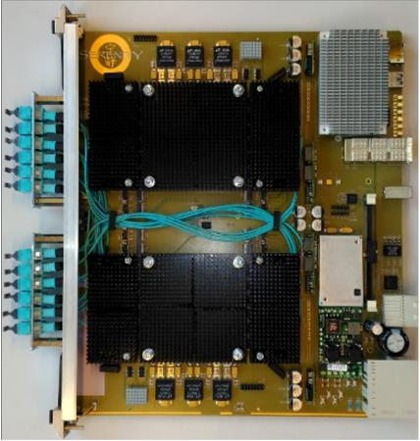
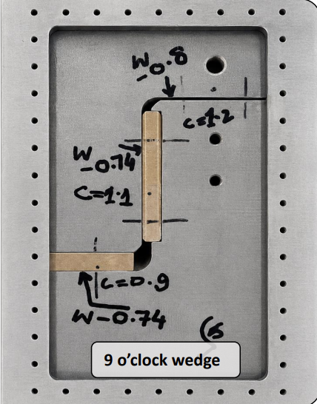
CMS Phase-2 construction is under way
Tracker barrel integration
ECAL supermodule insertion tooling
HGCAL cassette assembly
HGCAL cold tests
Precision module assembly
BTL trays assembly
L1 trigger-board prototype
L1 trigger-board prototype

Slide 20
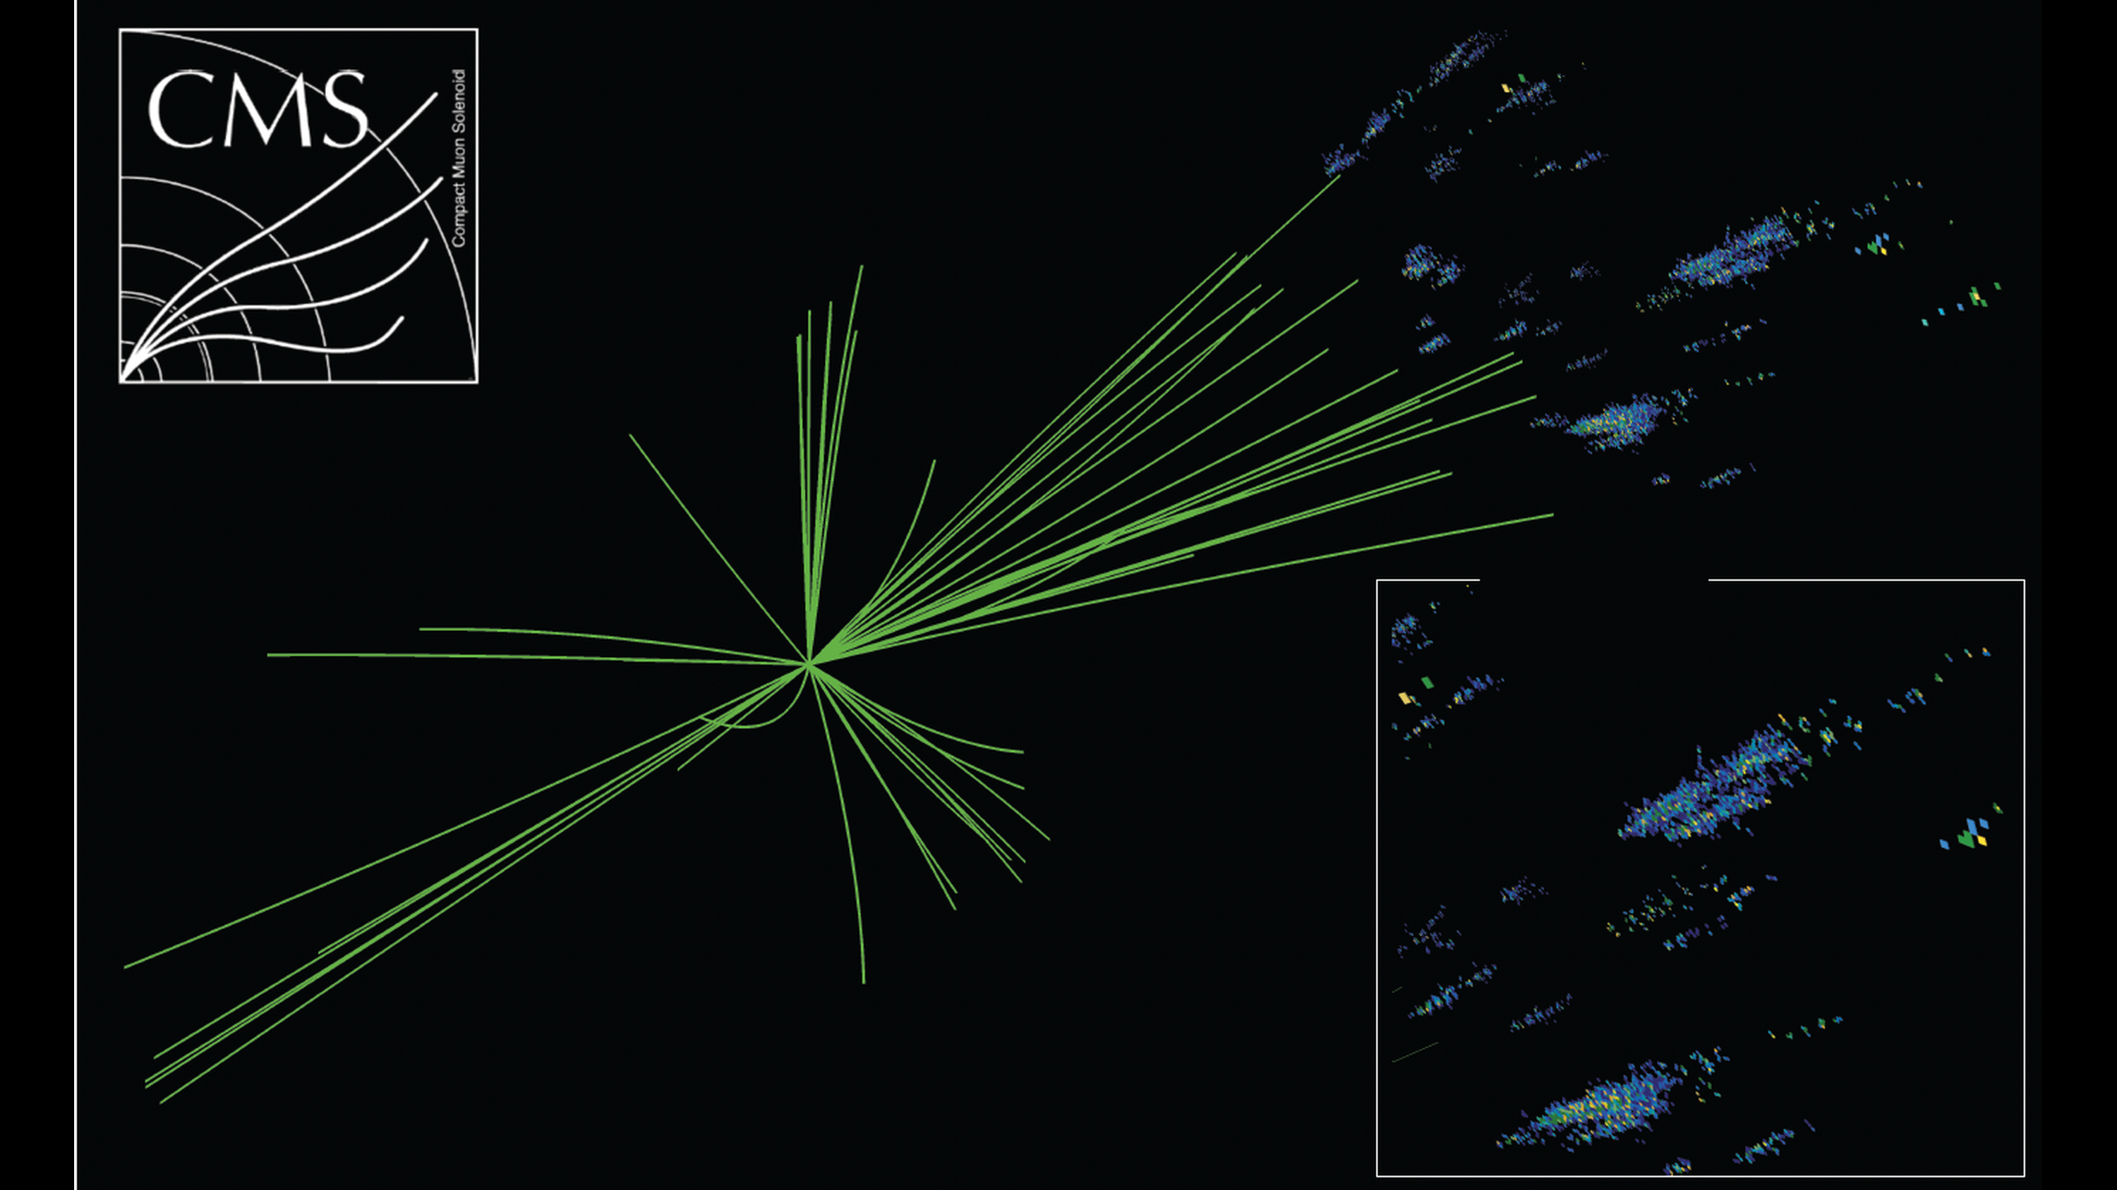
The Level-1 trigger at the HL-LHC
HGCal
Tracker
zoom
Muons
Adapted from A. Meyer (ICHEP26)

Slide 21


The Level-1 trigger today
Calorimetry
Muons
Adapted from A. Meyer (ICHEP26)

Slide 22
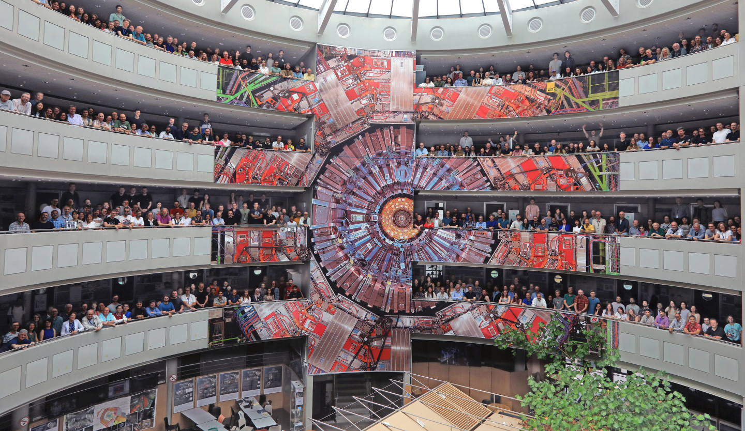
Summary
Notes:
https://twiki.cern.ch/twiki/bin/view/CMSPublic/LumiPublicResults

Slide 23
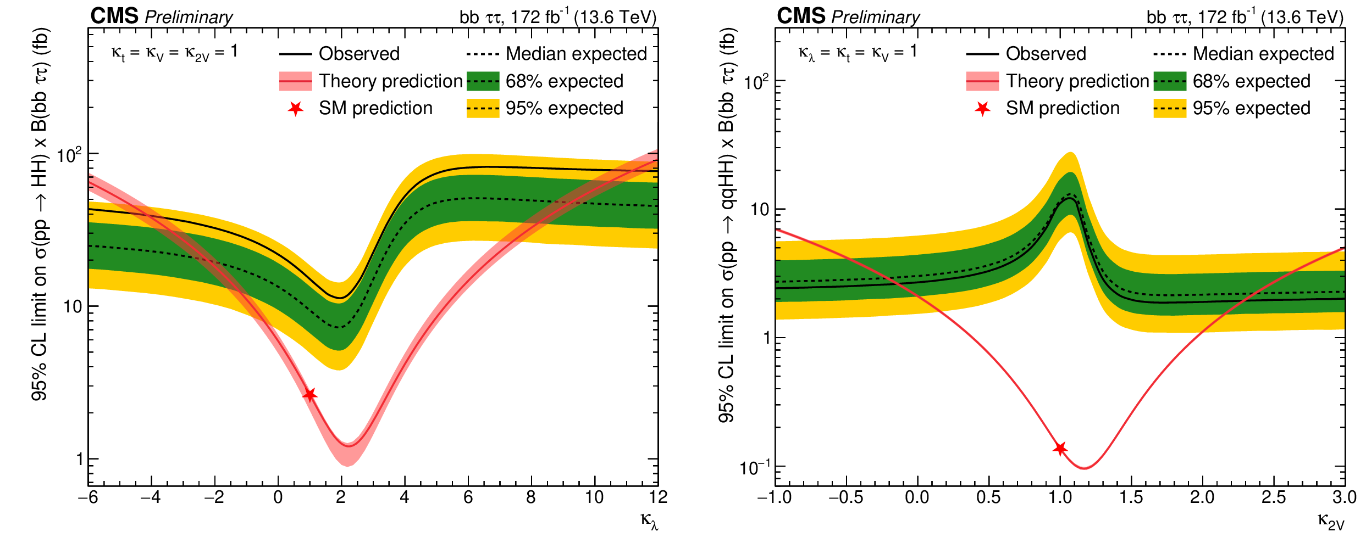
Higgs-pair production in bbττ [HIG-25-008]
ATLAS and CMS both updated HH self-coupling constraints
172 fb⁻¹ at 13.6 TeV: σ(HH) < 6.6 (3.9) × SM at 95% CL
Run 2 + Run 3: −2.5 < κλ < 9.4 at 95% CL
QCD lever arms: b tagging sets acceptance; ggF HH theory normalisation shapes κλ limits
16

Slide 24


Differential H → ZZ → 4ℓ [HIG-25-015]
Differential H → ZZ → 4ℓ
  171 fb⁻¹ at 13.6 TeV from 2022-24: σ_{fid}(H → ZZ → 4ℓ) = 3.11 ± 0.26 fb (SM: 3.05)
  Fiducial pₜᴴ, jet, dijet and VBF measurements map the production kinematics
  pₜᴴ directly tests resummation and the ggF calculation; NNLOPS agrees (p = 0.84)
17

Slide 25





HH production: Run 2 to Run 3 [HIG-20-011]
κ_{λ} is the SM test because the Higgs potential is accessible and largely unconstrained
In ggF, the κ_{λ} triangle and κ_{t} box amplitudes interfere: HH is the direct handle on the Higgs self-coupling
ATLAS+CMS μ_{HH}=0.8^{+0.9}_{-0.7}
[HIG-25-014]

Slide 26

CMS Phase-2 upgrade for the HL-LHC
3 ab⁻¹ by 2041, at up to 7.5 × 10³⁴ cm⁻² s⁻¹
5D reconstruction: tracker to |η| ≈ 4, 30 ps timing, and high-granularity calorimetry
Trigger at 40 MHz: tracks, vertexing, b tagging and ParticleFlow pileup suppression
New L1 scouting makes the full collision rate available for selected low-threshold signatures
Notes:
Q: Find the references for each of these statements please
A: 3 ab⁻¹ and 7.5×10³⁴ cm⁻²s⁻¹: HL-LHC Design Report, https://cds.cern.ch/record/2284929; tracker to |η|≈4: Tracker TDR, https://cds.cern.ch/record/2272264; 30 ps timing: MTD TDR, https://cds.cern.ch/record/2667167; high-granularity calorimetry: HGCAL TDR, https://cds.cern.ch/record/2293646. 40 MHz tracks/vertexing/b tagging/ParticleFlow: L1 Trigger TDR, https://cds.cern.ch/record/2714892; L1 scouting/full-rate readout: DAQ/HLT TDR, https://cds.cern.ch/record/2759072. These are the primary technical references for the five slide statements.

