Slide 1
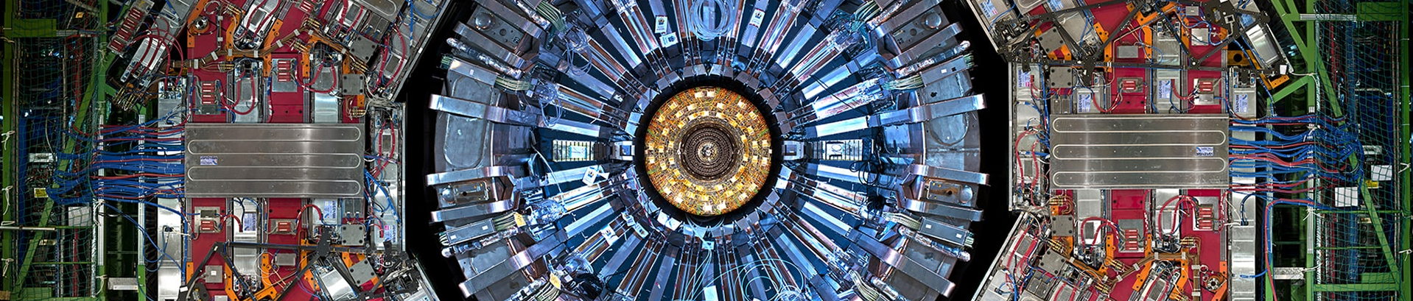
Proton structure with neural simulation based inference (+ implementation in global fits) [2604.13157]
R. Barrue (MBI, Vienna), L. Benato (MBI, Vienna), A. K. Guven (MBI, Vienna), E. Hammou (Nikhef, Amsterdam), J. t. Hoeve (JCMB, Edinburgh),
C. Krause (MBI, Vienna), A. Li (MBI, Vienna), L. Mantani (IFIC, Valencia), J. Rojo (Nikhef, VU, Amsterdam), S.S. Cruz (ICTEA, Oviedo),
R. Schoefbeck (MBI, Vienna), M Ubiali (DAMTP, Cambridge), and D. Wang (MBI, Vienna)

Slide 2

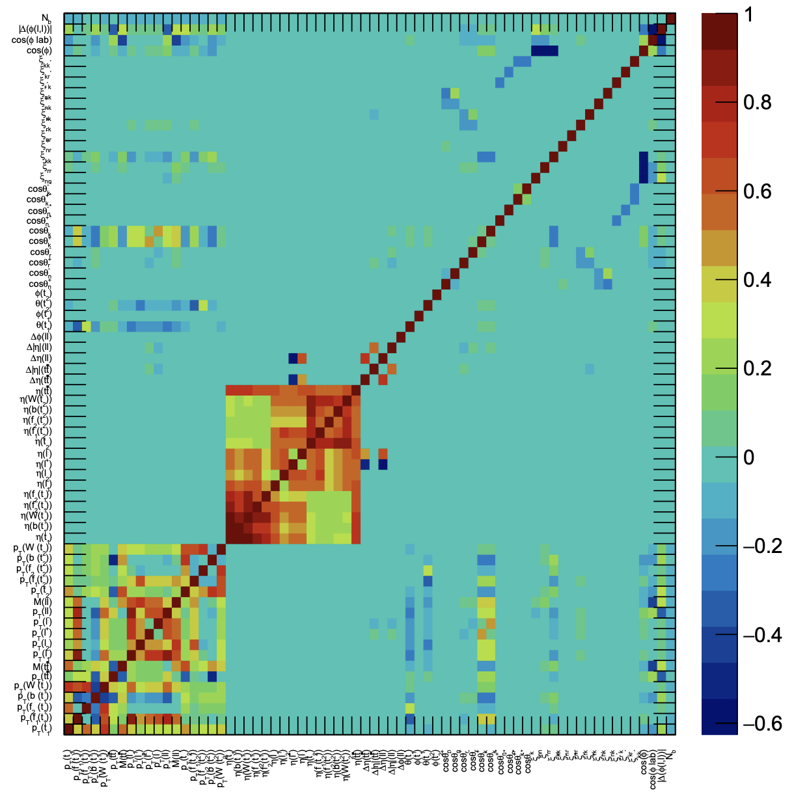
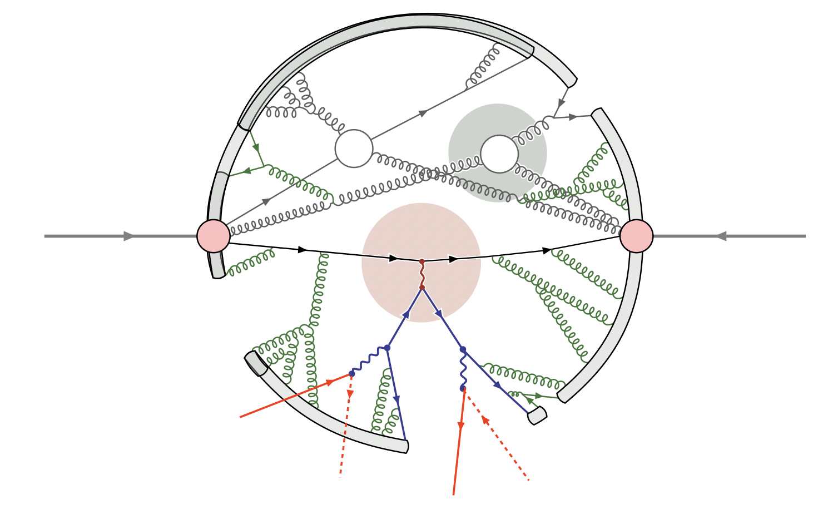
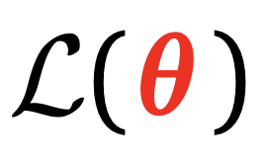


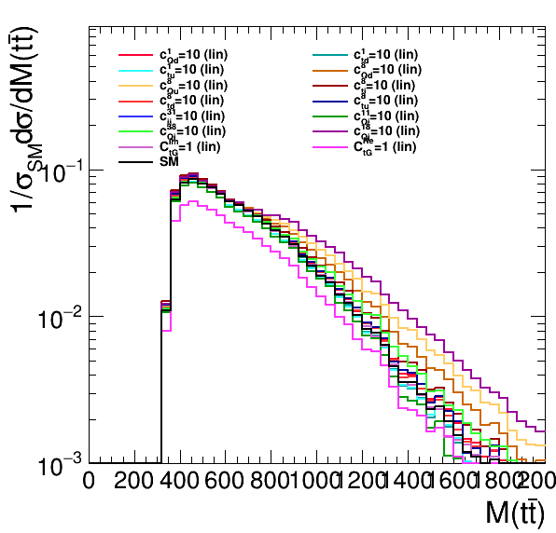
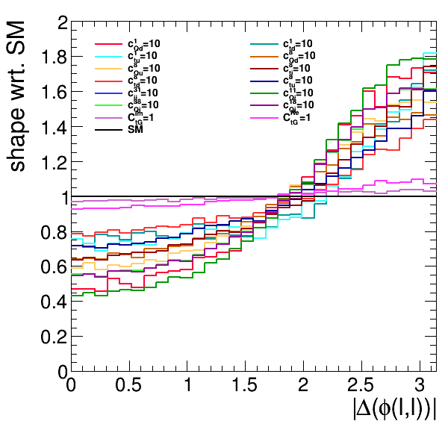
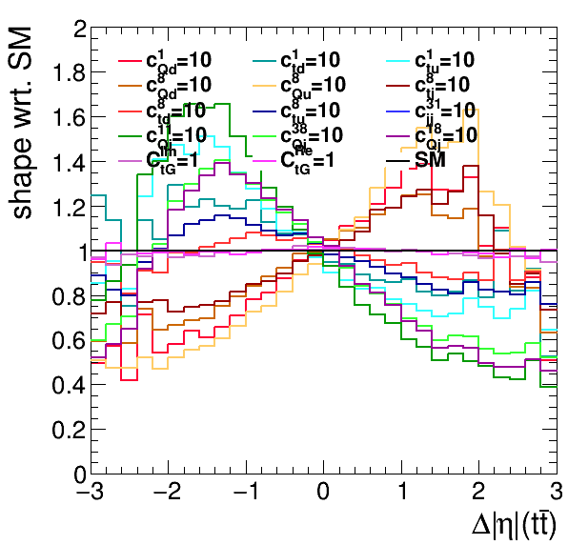
A different angle: and SMEFT
: Clean probe in the messy LHC environment
spin correlation
p
p
polarisation
charge asymmetries
ℓ
rapidities
𝛎
ℓ
𝛎
momenta/
masses
energetic
observables
spin correlation
  ≳ 72 features
  Used to constrain ≳ 15-25 SMEFT Wilson coefficients θ
charge asymmetry
linear feature correlation in tt(2ℓ)

Slide 3


PDFs also enter quadratically
p
p
Linear PDF model [Ubiali et al. 2507.16913]
ℓ
𝛎
ℓ
𝛎
SMEFT: quadratic predictions
Quadratic structure exploited in ML
Madminer [1805.00013] [1805.00020] [1805.12244]
BIT [2107.10859], [2205.12976]
ML4EFT [2211.02058] ”Refinable” [2406.19076]

Slide 4
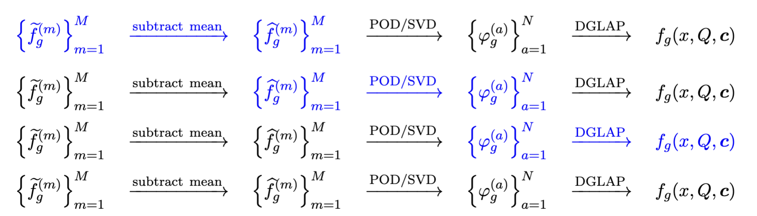
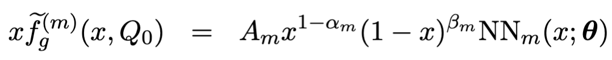
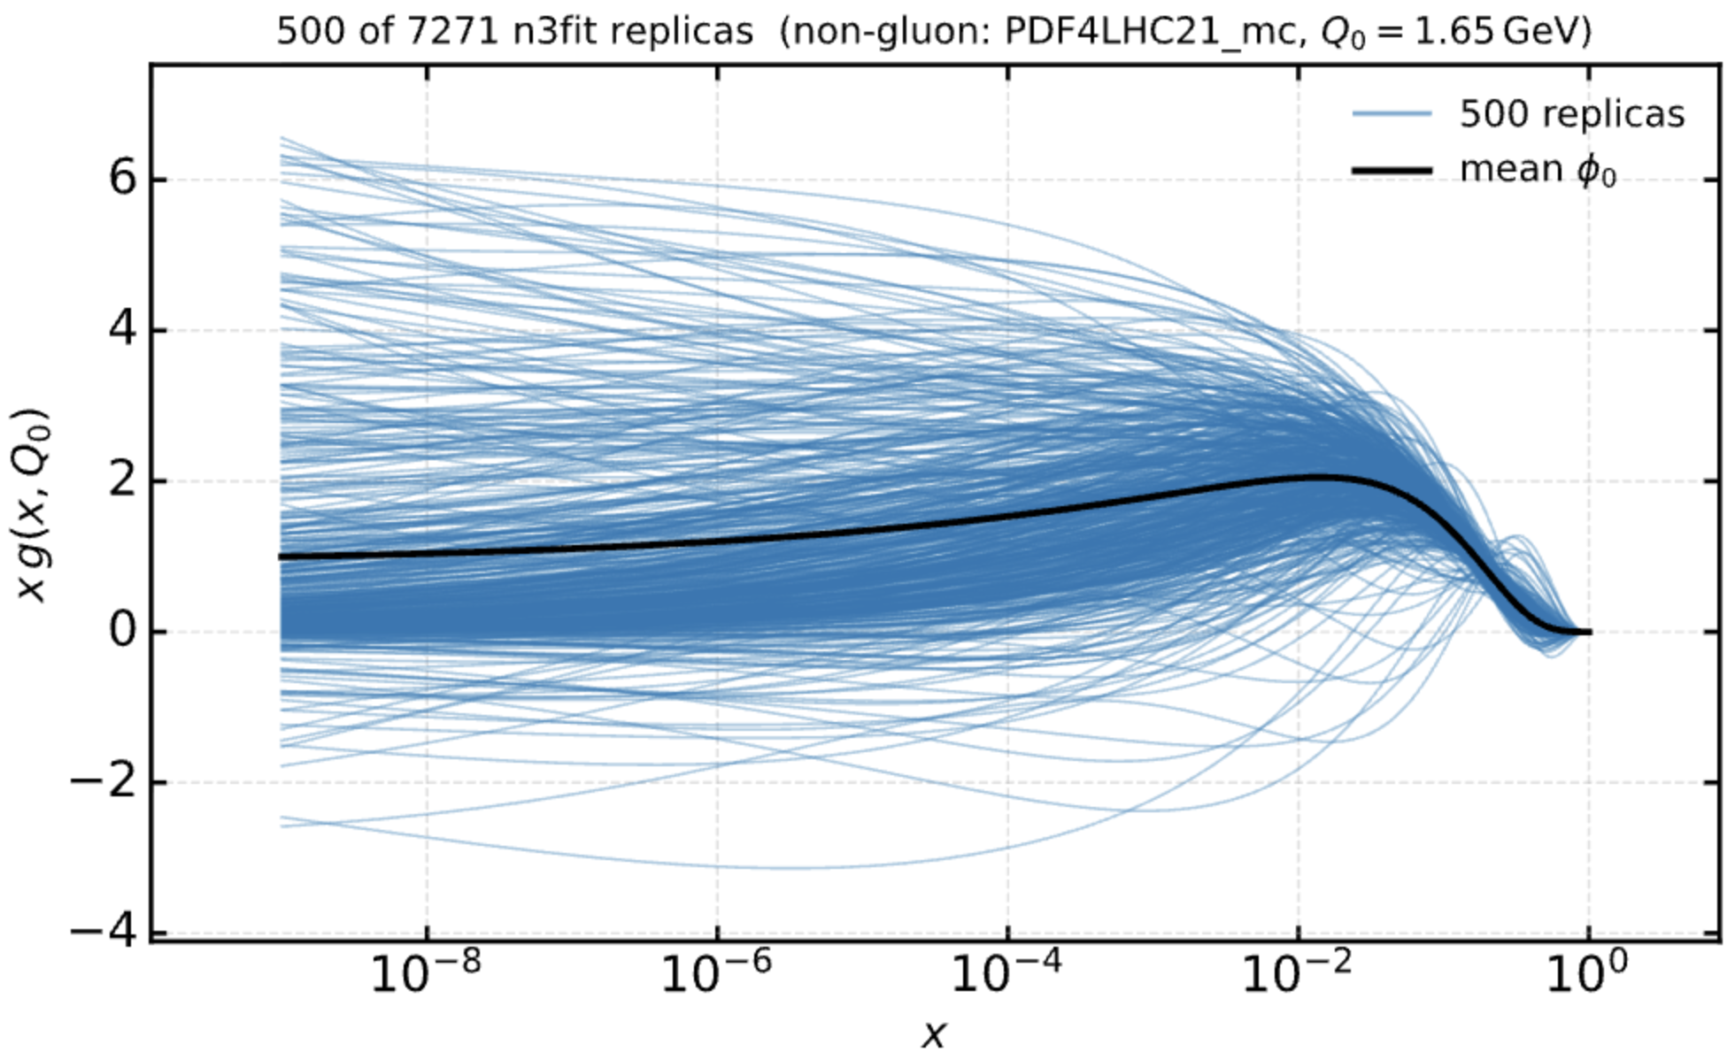
A linear PDF model [2507.16913]
Define ”admissible functions”
  Sample gluon PDF with
  NNPDF4.0 parametrization
  Keep quark PDF fixed at NNPDF4.0 or PDF4LHC21

Slide 5
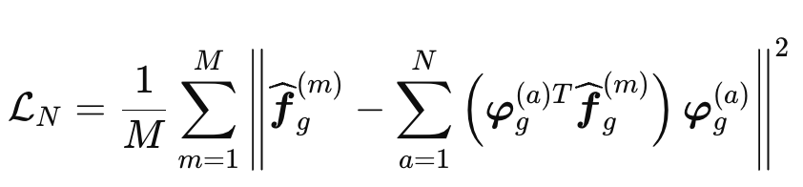
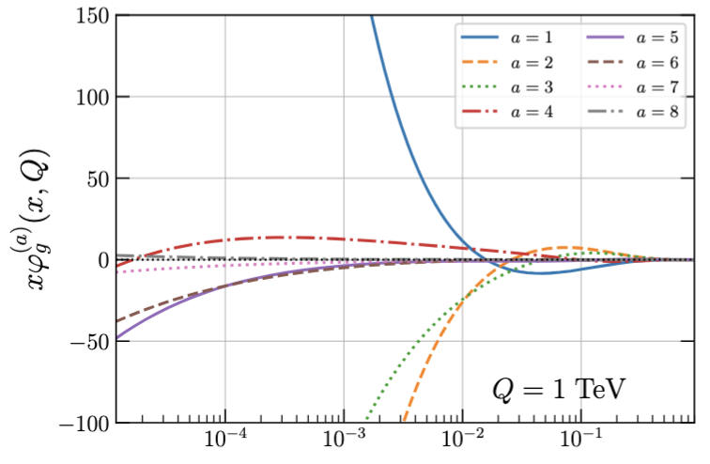
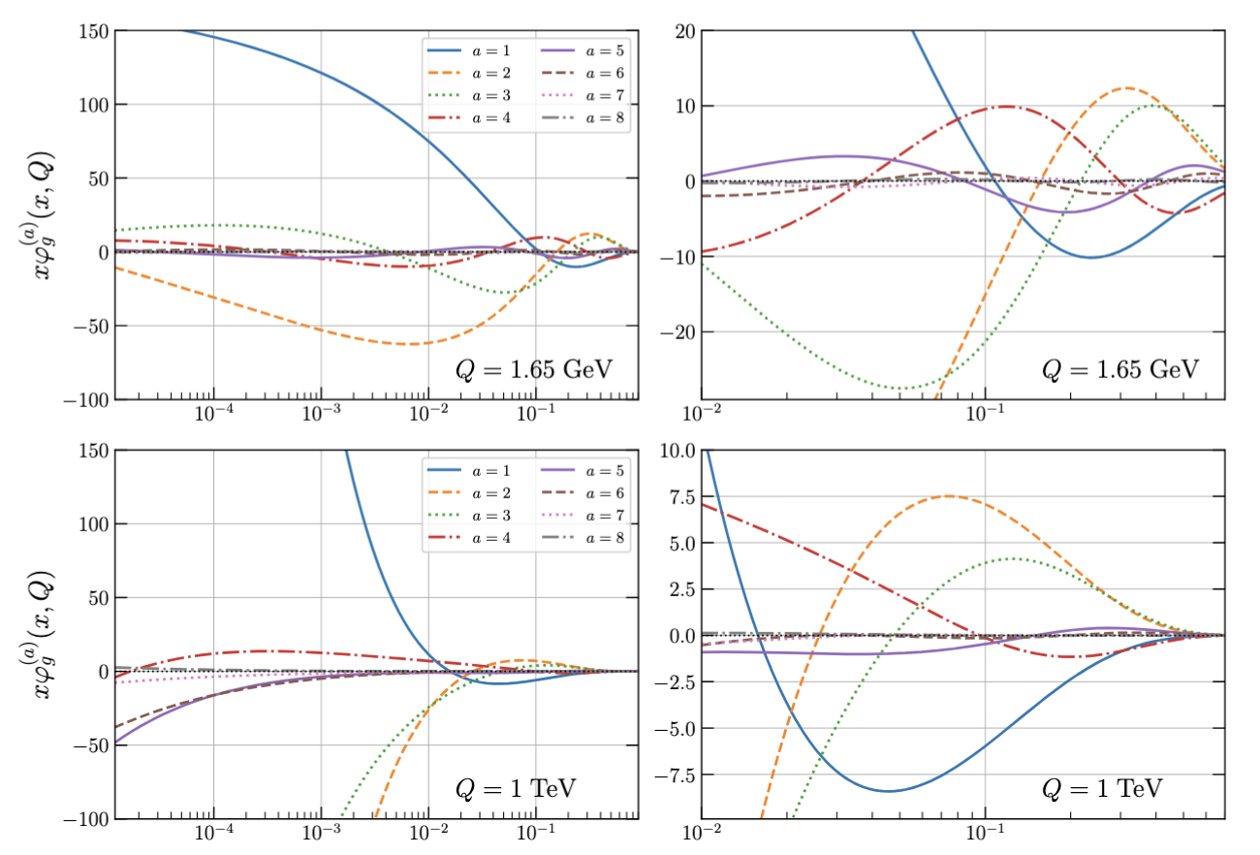
A linear PDF model [2507.16913]
Define ”admissible functions”
  Sample gluon PDF with
  NNPDF4.0 parametrization
  Keep quark PDF fixed at NNPDF4.0 or PDF4LHC21
2. Identify leading modes
“Proper Orthogonal
Decomposition - POD”
projection

Slide 6
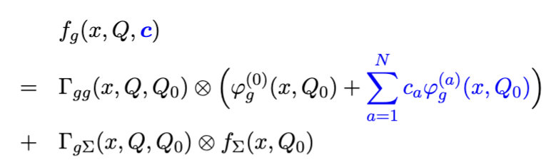
A linear PDF model [2507.16913]
Define ”admissible functions”
  Sample gluon PDF with
  NNPDF4.0 parametrization
  Keep quark PDF fixed at NNPDF4.0 or PDF4LHC21
2. Identify leading modes
“Proper Orthogonal
Decomposition - POD”
3. DGLAP evolution
NNLO with kernels via EKO
projection

Slide 7
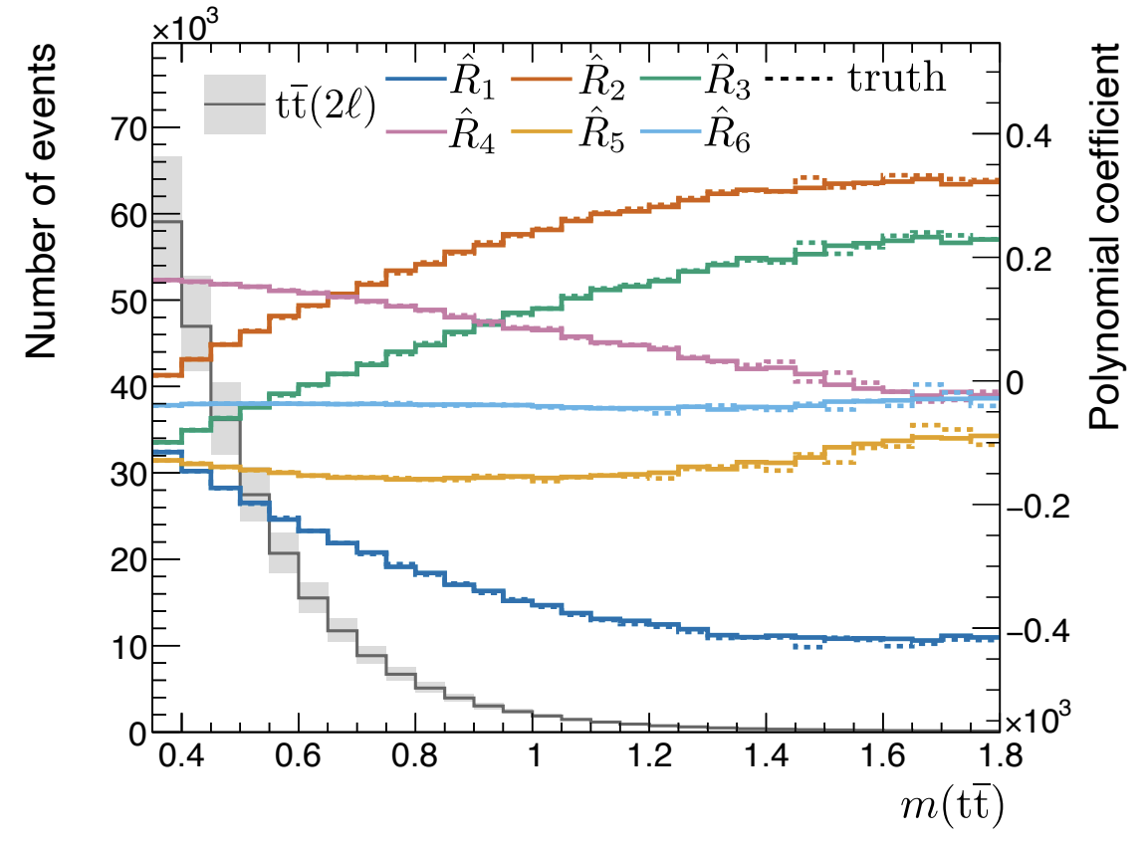
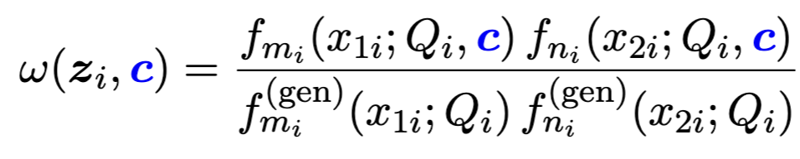
Detector level simulation
Top quark pairs tt(2𝓁) POWHEG+Pythia
  Integrated luminosity 137/fb
  Simulated with DELPHES at the CMS detector level
  Purity >95% → neglect backgrounds
  Detector-level top quark reconstruction
PDF affects predictions via parton-level reweighting
Induces shape- and normalization effects at the detector level
→ How to constrain coefficients optimally with unbinned inference?
~𝓞(c²)

Slide 8
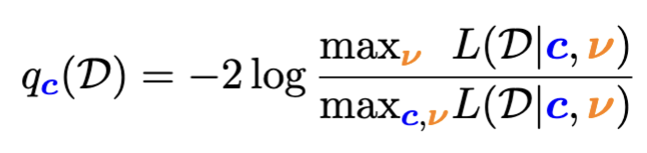
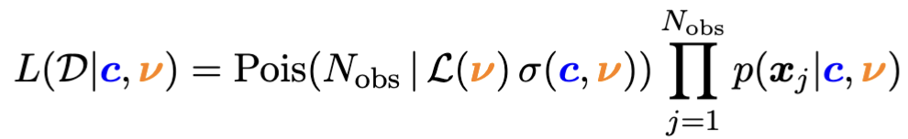
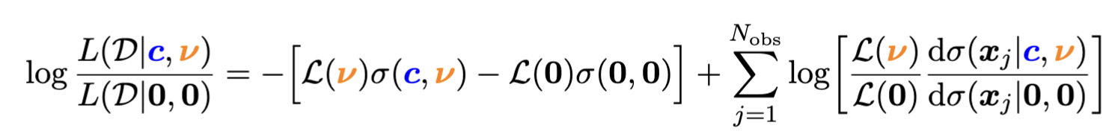
Unbinned inference
Profile log-likelihood test statistic
Extended likelihood
Write LL with differential cross section ratio
  Need to evaluate the differential cross section ratio (DCR) for unseen data ( 𝓓 ) and as a function of c (=POIs) and 𝜈 (=nuisances) → ML
→ Profile systematic
nuisances 𝜈

Slide 9
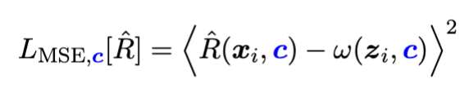

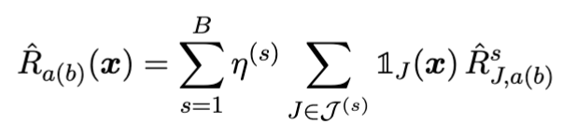
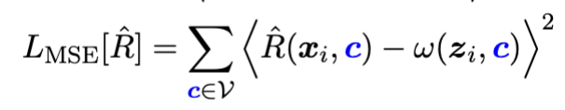
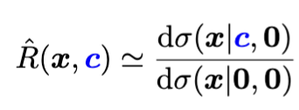
Machine learning POIs
“Likelihood ratio trick”
Parametric ansatz
Implement coefficients R_{a}(x), R_{ab}(x) as trees:
Sum over base points
Training data ~𝓞(c²)
Boosted Information tree
[2604.13157, 2107.10859, 2205.12976]

Slide 10
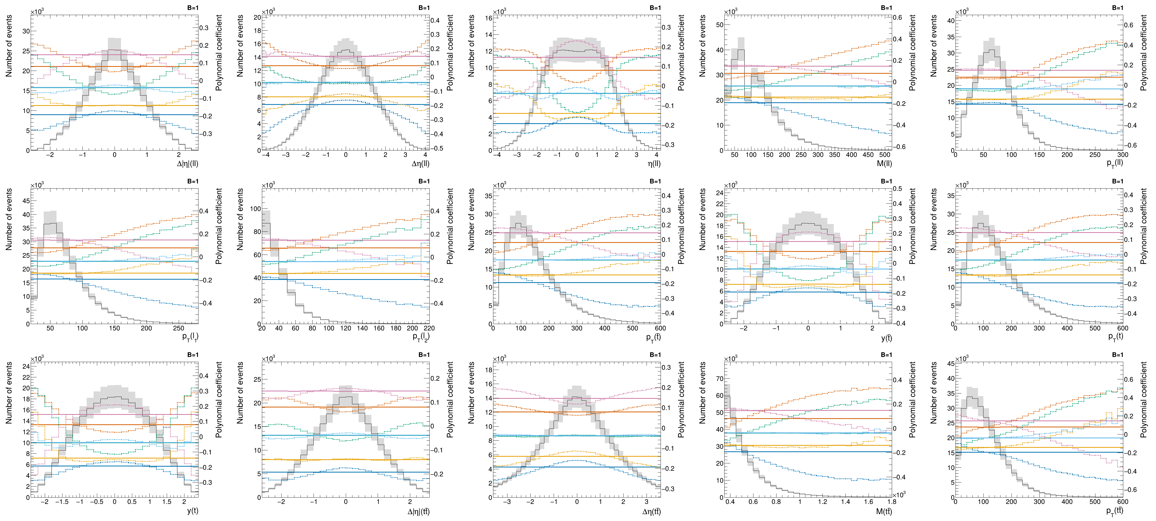
High-dimensional data
ℝ¹⁶ → ℝ³⁵

Slide 11
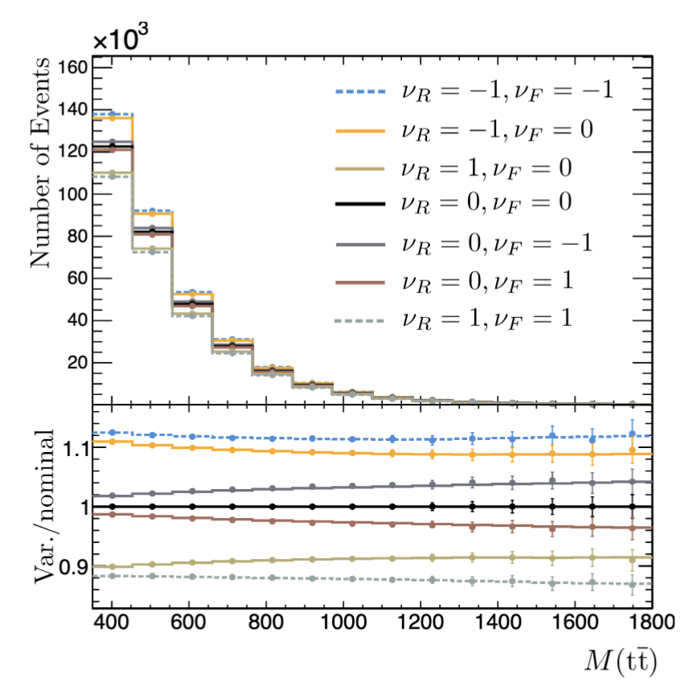
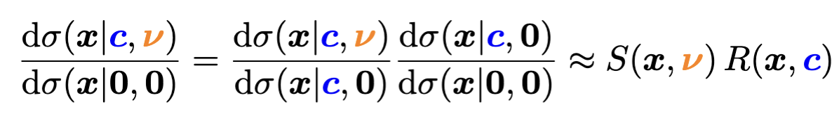
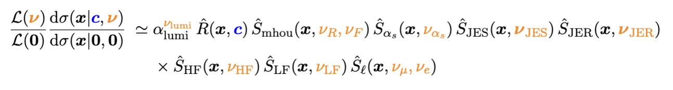
Systematic uncertainties
Assume factorization in
nuisances and POIs
[MLST 6 015007 (2025)]
Same as in binned analyses
→ Learn every effect separately
Nuis. POIs
Systematic variations
  Recipes from CMS open data [https://cms-opendata-guide.web.cern.ch/]
    Ren. & fac. scale (2 nuis.)
    b-tagging (heavy- and light, 2 nuis.)
    Jet energy scale (6 nuis.)
    Jet energy resolution (6 nuis.)
    Lepton scale factors (2 nuis.)
    Strong coupling ɑ_{s} (1 nuis.)
    Luminosity (1 nuis.)
6 POIs, 20 Nuisances
Fit?

Slide 12
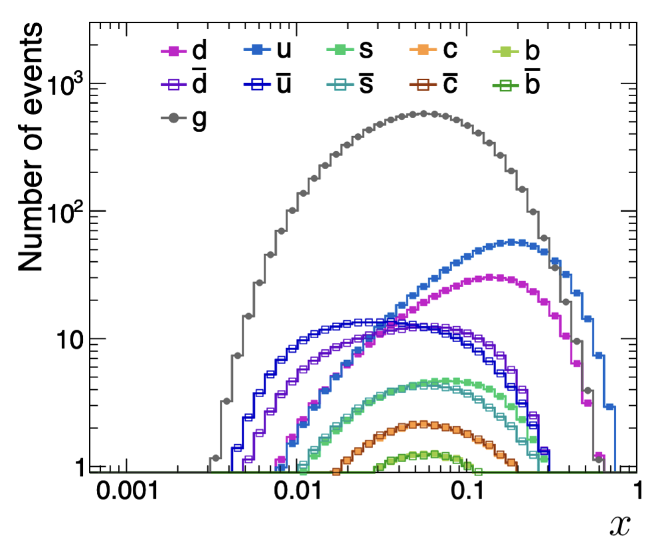
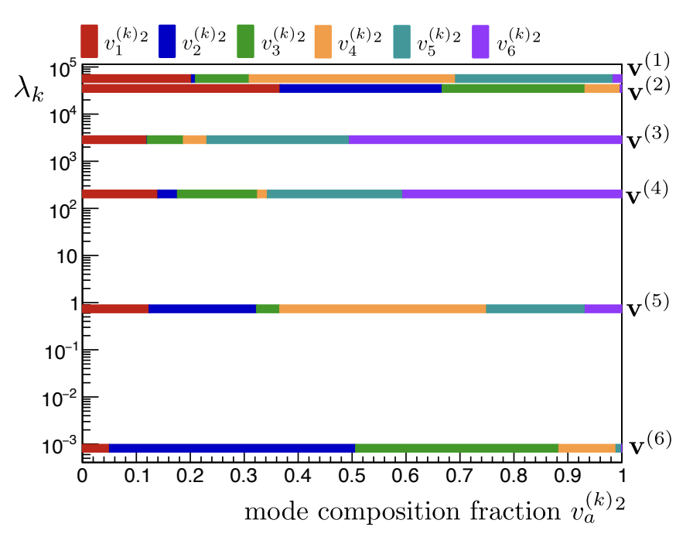
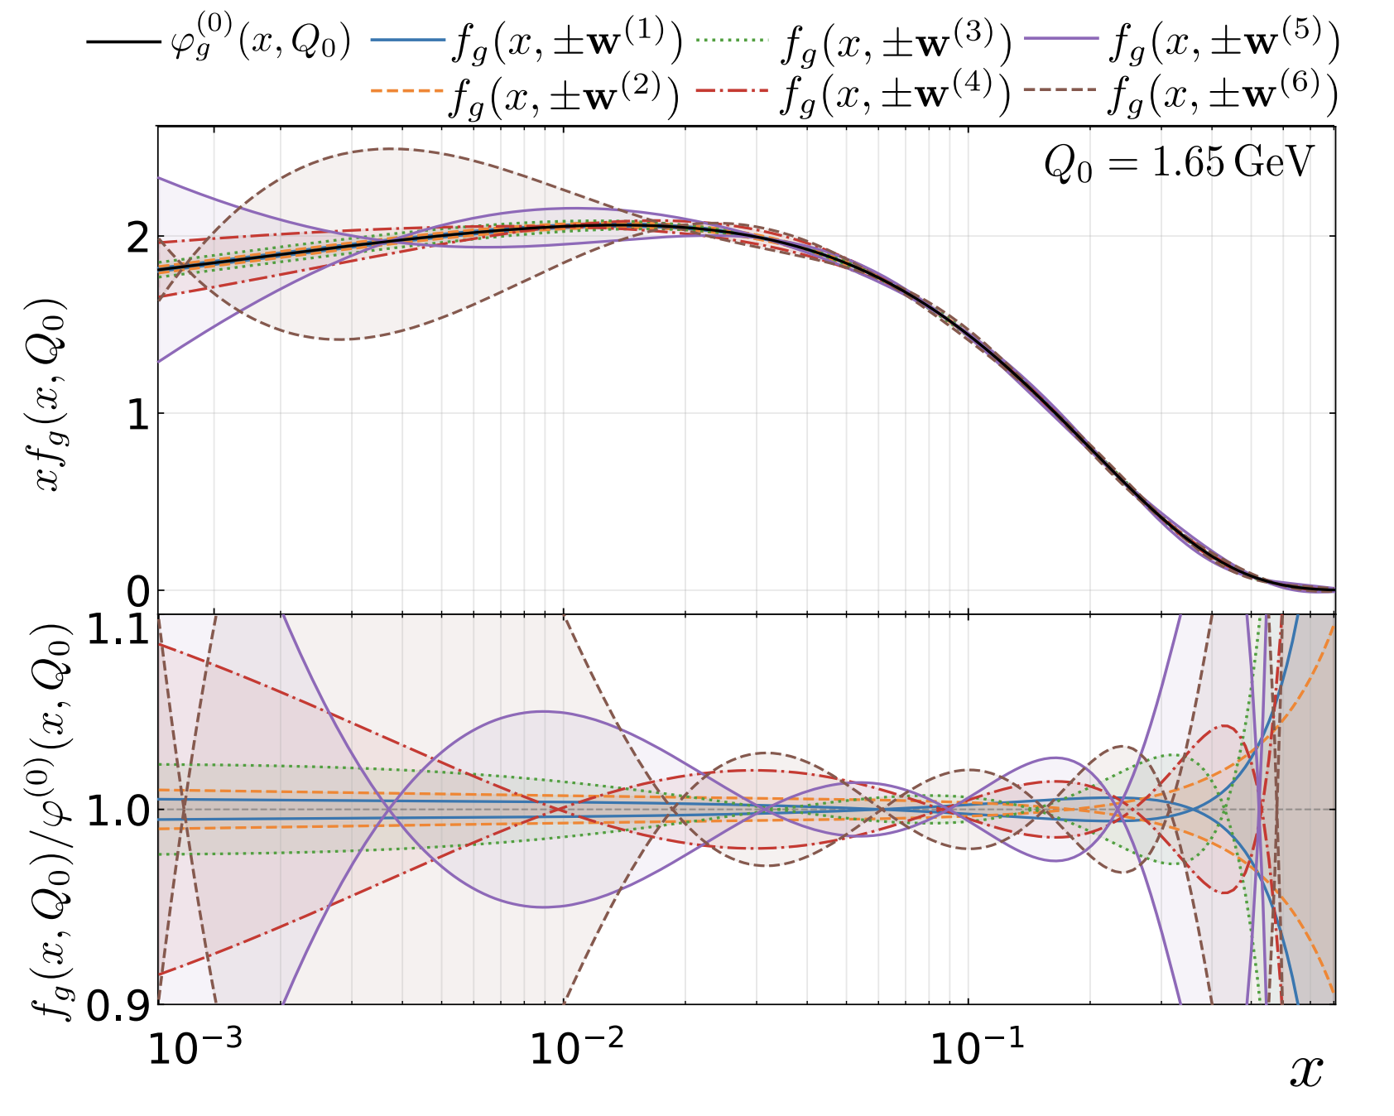
Flat directions
Well constrained →
Partonic coverage of tt(2𝓁): 0.02 < x < 0.3
  POD basis has not seen data
  Some directions in c-space are not constrained
With unbinned L(𝒟|c,𝜈) defined → Expected (Fisher) sensitivity
  Rank POI directions in expected sensitivity L(𝒟_{exp}|𝜆^{-1/2}) = ±1
  Rotation in c-space; Beyond N=8, “flat directions” must be removed
Gluon PDF “wiggles”
in the fit

Slide 13
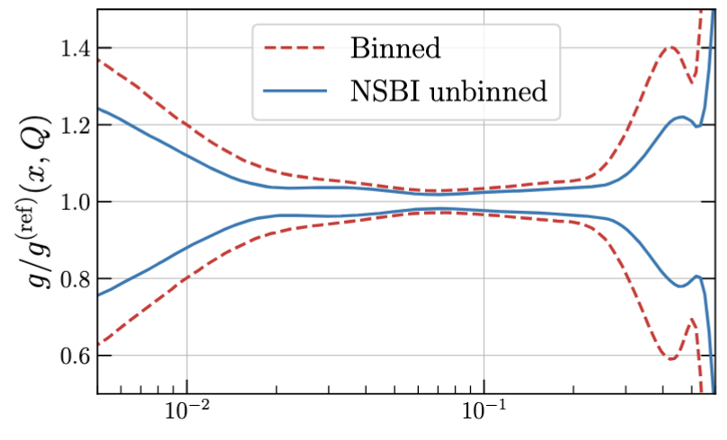
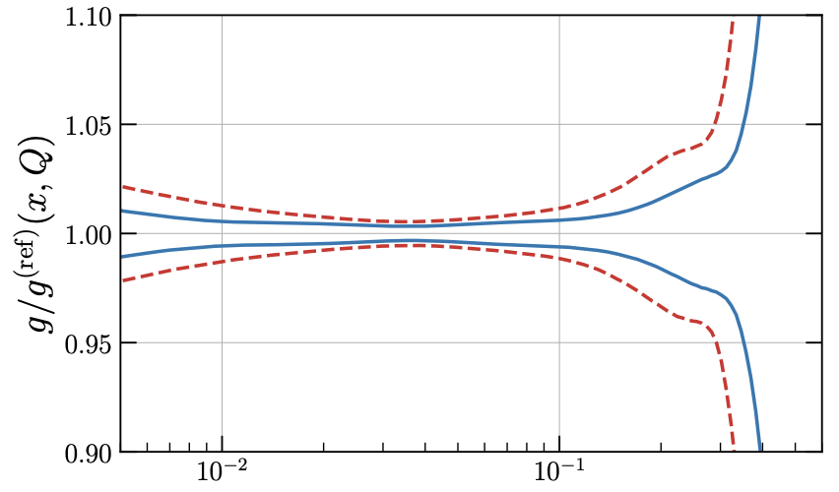
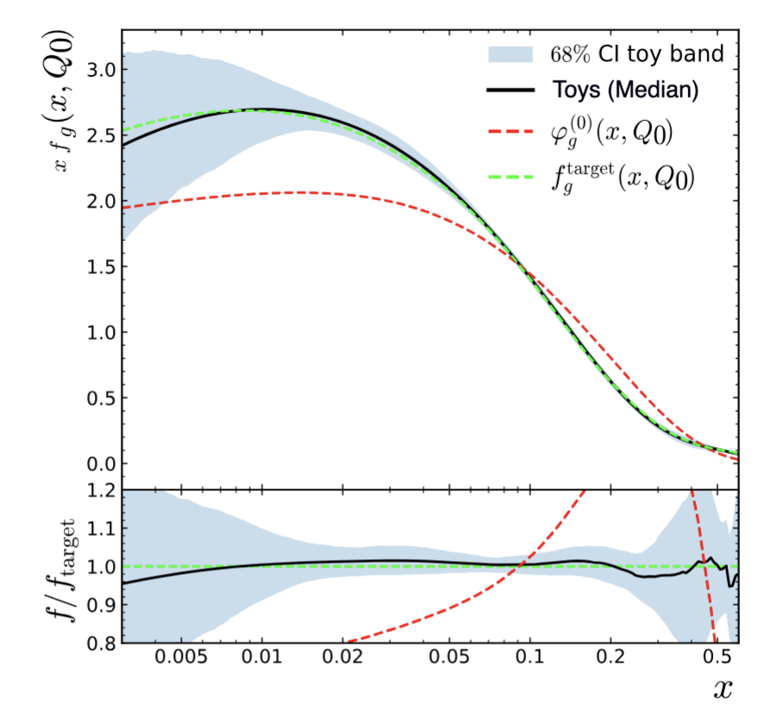
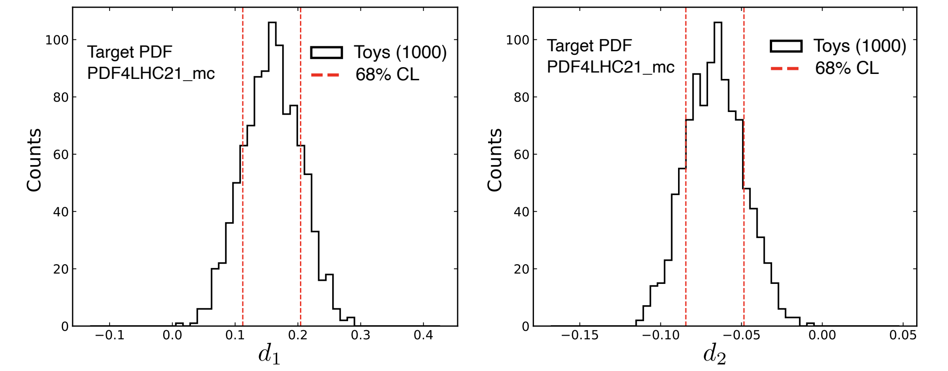


Fit results (Simulation)
Q = 1.65 GeV
Q = 175 GeV
Fit to toy data sampled from PDF4LHC21
  Very good agreement! Gaussian toy distributions
Binned benchmark comparison [EPJC 80 (2020) 658]
Use 16 bins in m(tt) and y(tt) from CMS meas.
  Significant improvement at high- and low x

Slide 14
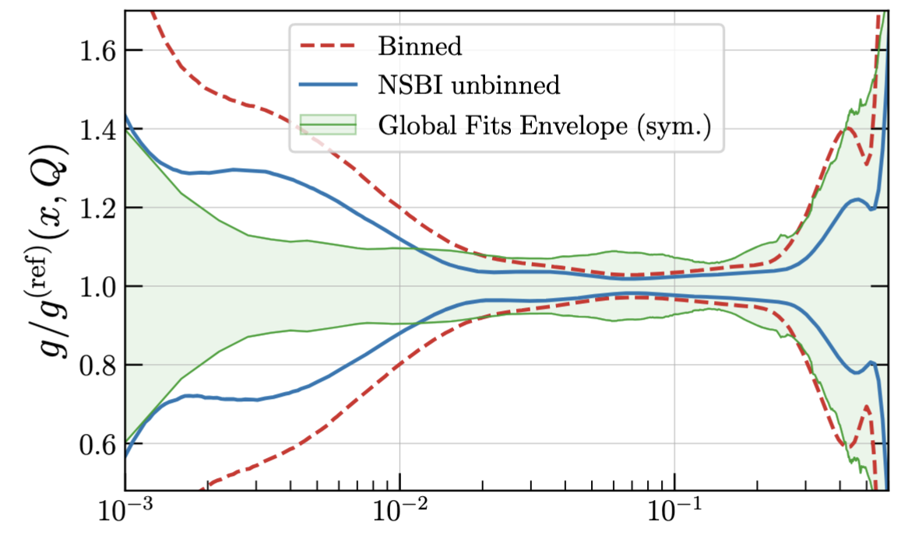
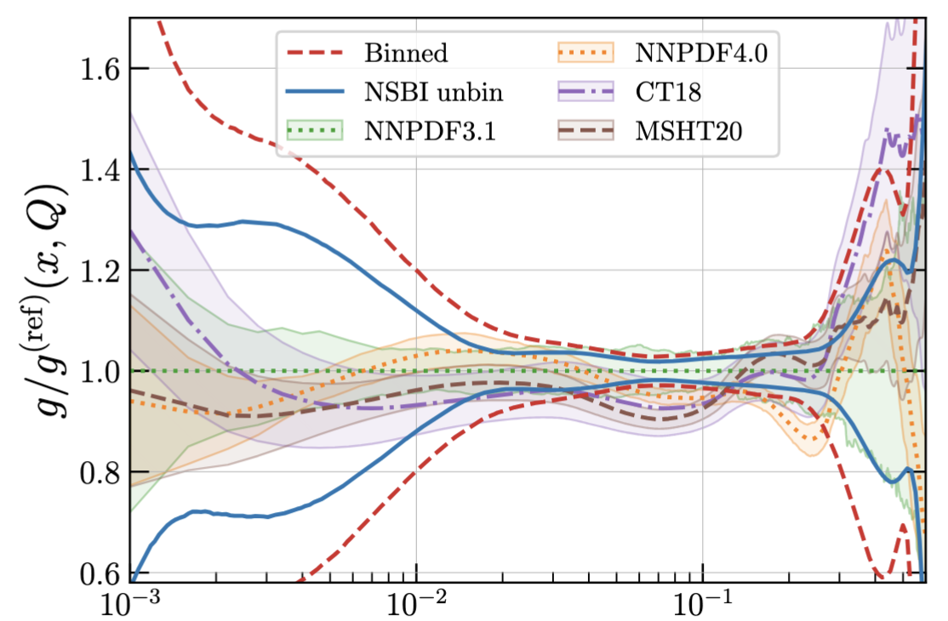
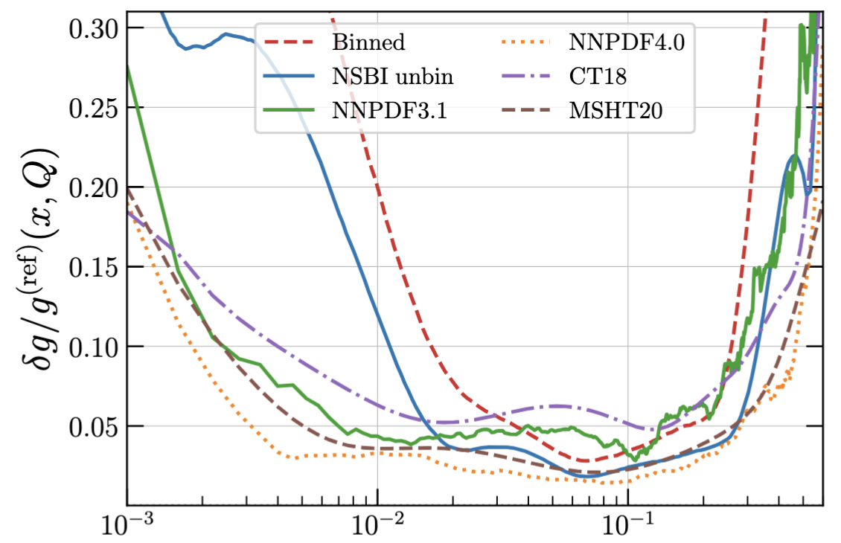
Global fit comparison
Compare to NNPDF3.1, NNPD4.0, CT18, MSHT20
  Competing with Inclusive Jets, DIS, W/Z, unfolded top quark data, etc.
  Region 0.02<x<0.3: better than at least one; unbinned better than binned
  For x~0.08: Comparable to NNPDF4.0
Unbinned detector-level data may improves PDF inference in a global fit

Slide 15
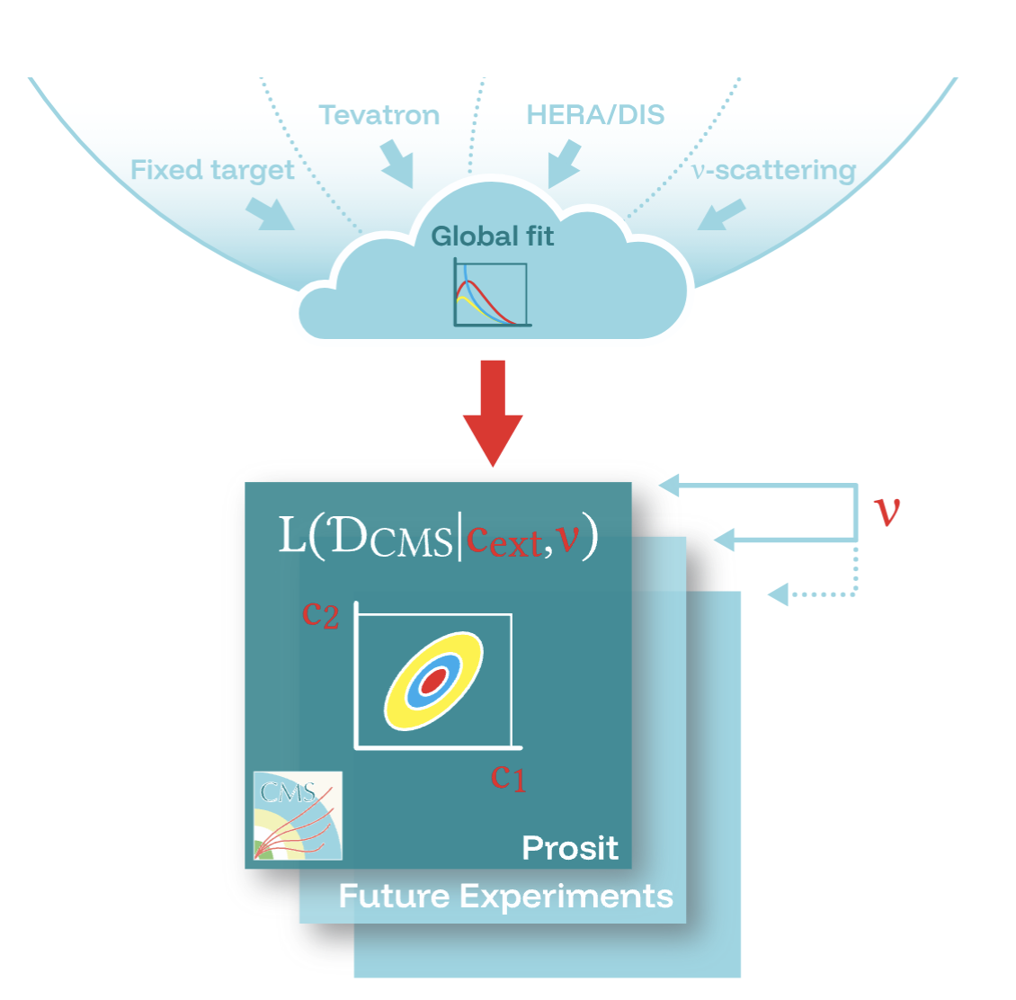
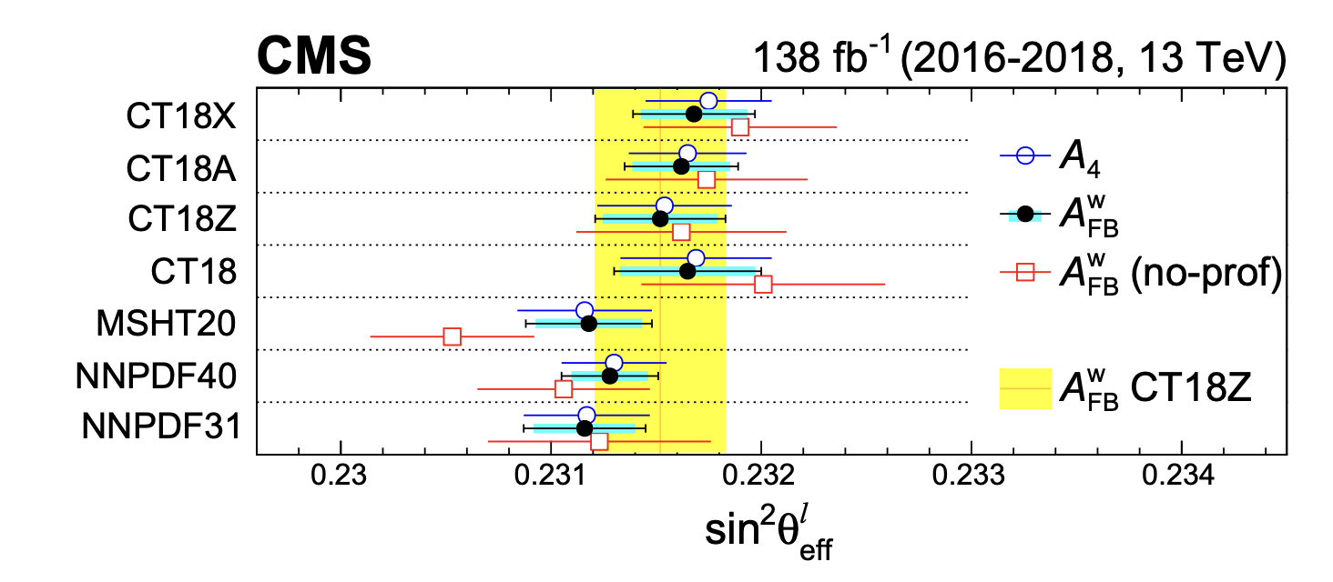

Incorporate unbinned likelihoods in global fits?
Unbinned measurements provide full L(D|c, 𝜈)
  What to do with c when every global fit has its own parametrization?
POD lives in Hilbert space → project PDFs
  An external set maps to c, Σ in a O(ms) projection
  If a measurement provides a POD result,
  then L(D|c_{ext}[CTEQ/NNPDF/MSHT…], 𝜈) is evaluable
    Bases can be different across measurements – no community challenge
  This works both ways; experiments can project on any external PDFs
    An external PDF constraint becomes a prior – no PDF bookeeping
  Recover detector-level information beyond the Gaussian approximation
  Experiments don’t see the gradient of the global fit
    ”Flavor dependent JEC? b/g corrections? Bias from JER in the crack region?” Or cone-size?
  Assembly. N_{bin} ~ O(100), covariances scale with N_{bin}² x N_{nuis}
POD - projection

Slide 16
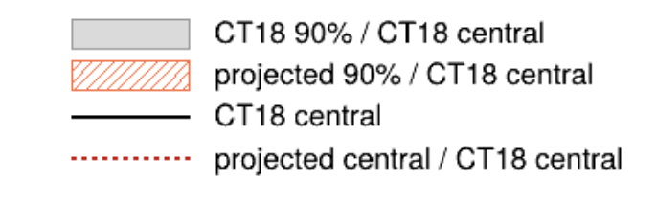
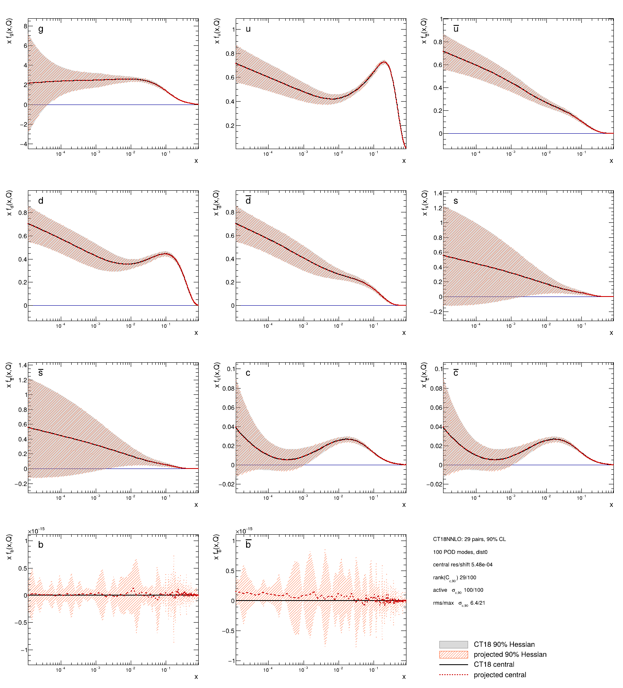
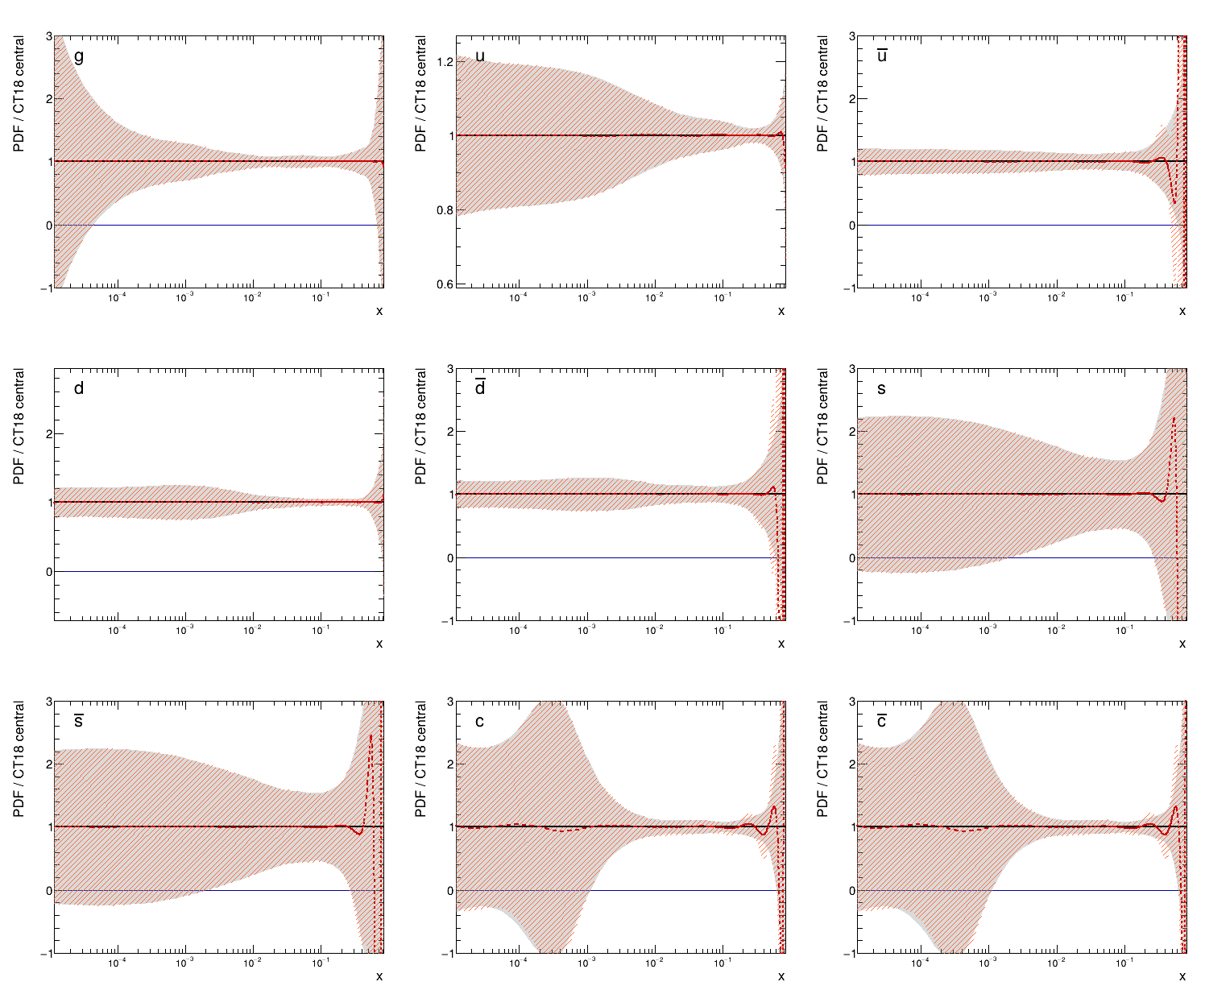
Reproducing CT18NNLO with POD
Projecting CT18NNLO onto all-flavor POD → c_{POD}, 𝚺_{POD}
Excellent closure.

Slide 17
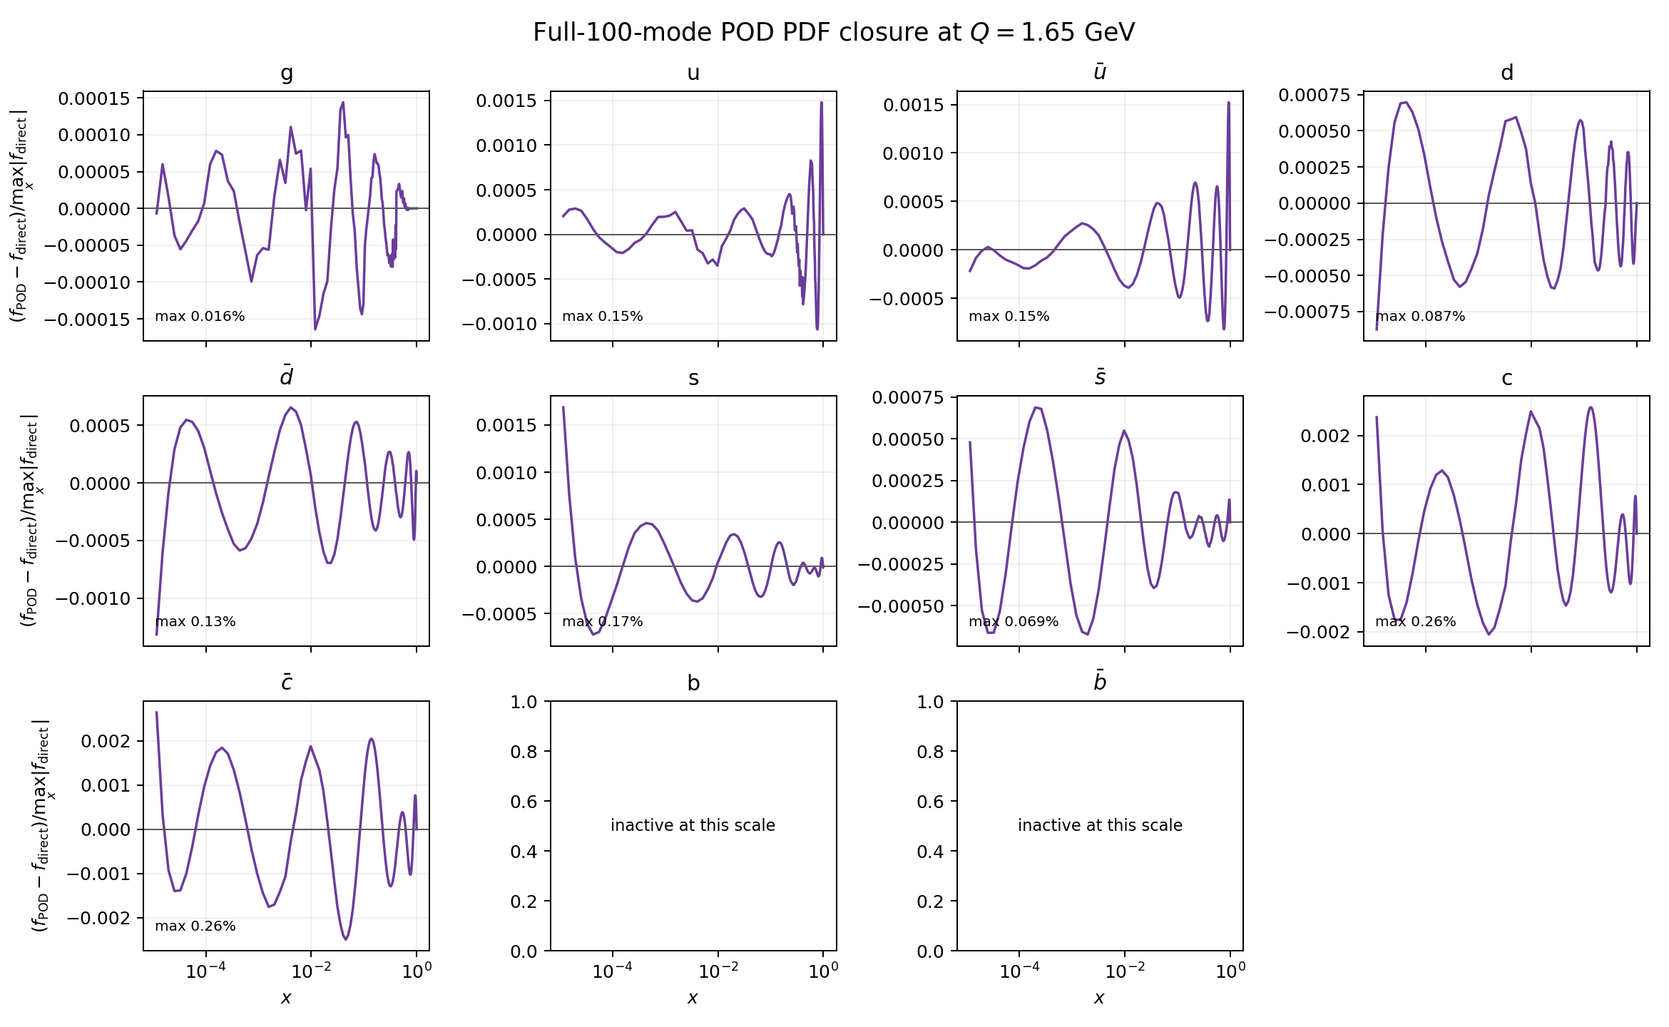
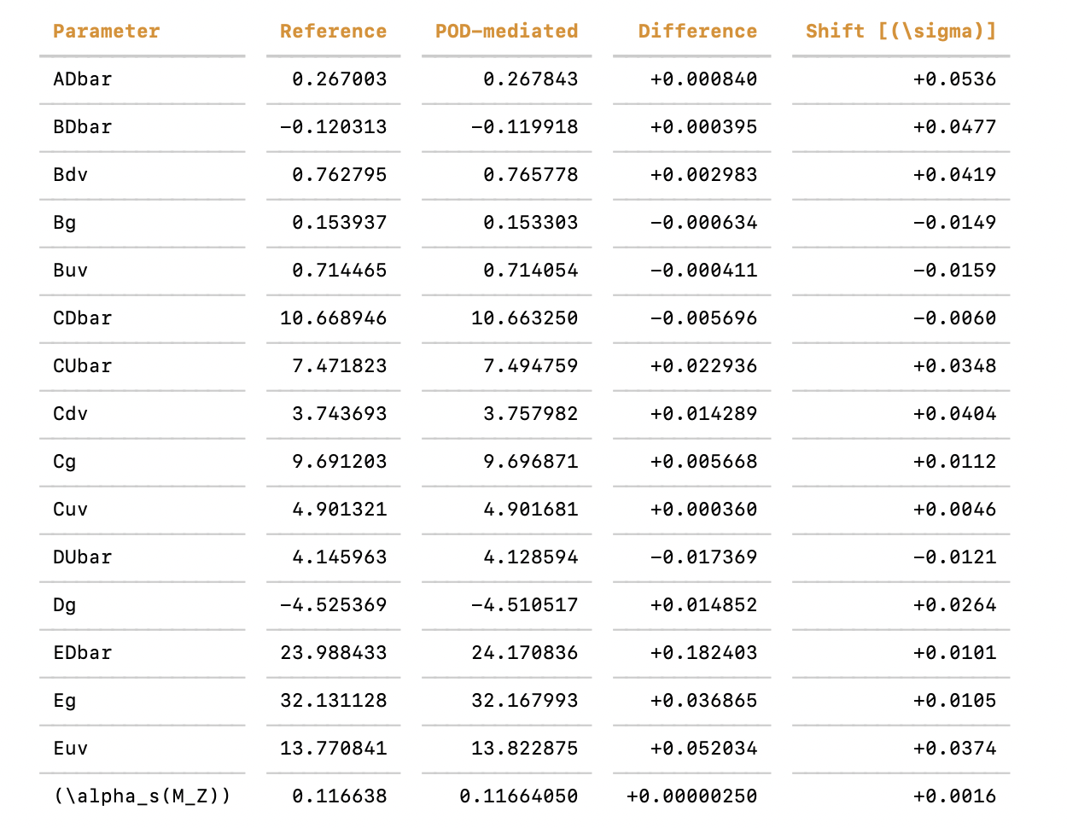
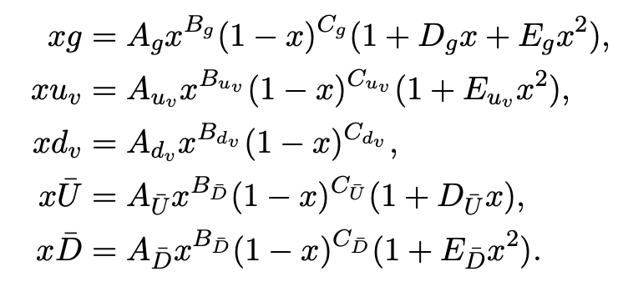
A first test
Example: CMS inclusive jets [JHEP 12 (2022)035] in xFitter
Compare:
  Analytic model → fastNLO → 𝜒² → fit
  Analytic parametrization → POD → fastNLO → 𝜒² → fit
Analytic model with 16 parameters
  Fit in POD basis projection has negligible bias
Next step: A real analysis
Full list in backup

Slide 18
Summary
Unbinned top quark data has extra PDF constraining power [2604.13157]
  Strong case (and vehicle) for publishing finer non-profiled experimental likelihoods
  Demonstrated simulation-based PDF inference is feasible
  Author team Members from NNPDF + Experimental top (CMS) + Machine learning/SBI
Workhorses
  Linear PDF model [2507.16913] & workflows
  Boosted Information tree [2604.13157, 2107.10859, 2205.12976]
  “Refinable” modeling of systematics [2406.19076]
POD reduces the need for community wide organization of PDF likelihoods
  Would like to begin set it up

Slide 19
Backup

Slide 20
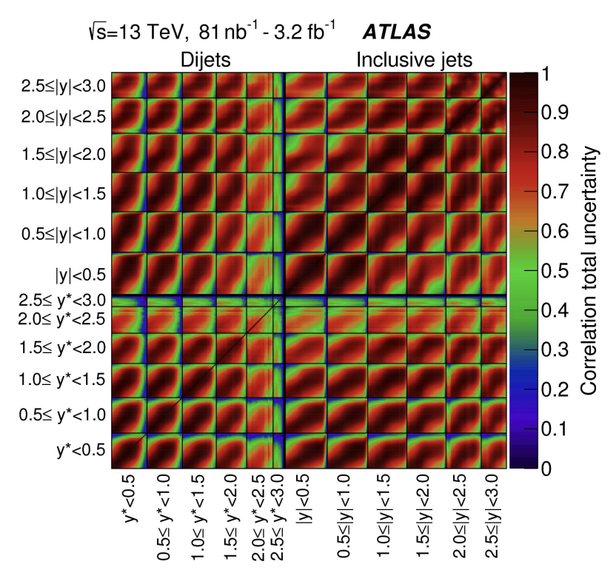
Full likelihoods in global fits
How can we incorporate unbinned detector-level likelihood L(D|c, 𝜈) in global fits?
Staging: First, take unfolded, binned 𝜒²-based measurement → Recast with POD → global fits
  Followed by, possibly → Binned full likelihood with POD
  Example: CMS inclusive jets (13 TeV) [JHEP 12 (2022)035]
  NNLO theory predictions are binned. No point for NSBI. Jet-based measurements are indispensable for f_{g}
Why could the full likelihood be useful on nuisance side?
  Recover detector-level information in L(D|c, 𝜈)
    “When jets and top quarks don’t agree [in a global PDF fit], what do you do?” (June 19th)
    → What’s the postfit result on 𝜈?
  Experiments don’t see the gradient of the global fit
    ”Flavor dependent JEC? b/g corrections?
    Bias from JER in the crack region?” Or cone-size?
    We compress the full information when results are made public
  Assembly. N_{bin} ~ O(100), covariances scale with N_{bin}² x N_{nuis}
POD lives in Hilbert space → PDF projections can be exploited
[Bogdan Malaescu, LHC EW WG meeting]

Slide 21
Reproducing CT18NNLO with POD
Projecting CT18NNLO onto all-flavor POD → c_{POD}, 𝚺_{POD}
Excellent closure. Apply within experiment as a prior.

Slide 22
Summary
Unbinned top quark data has extra PDF constraining power [2604.13157]
  Strong case (and vehicle) for publishing finer non-profiled experimental likelihoods
  Demonstrated simulation-based PDF inference is feasible
  Author team Members from NNPDF + Experimental top (CMS) + Machine learning/SBI
Workhorses
  Linear PDF model [2507.16913] & workflows
  Boosted Information tree [2604.13157, 2107.10859, 2205.12976]
  “Refinable” modeling of systematics [2406.19076]
POD reduces the need for community wide organization of PDF likelihoods
  Would like to begin set it up

Slide 23
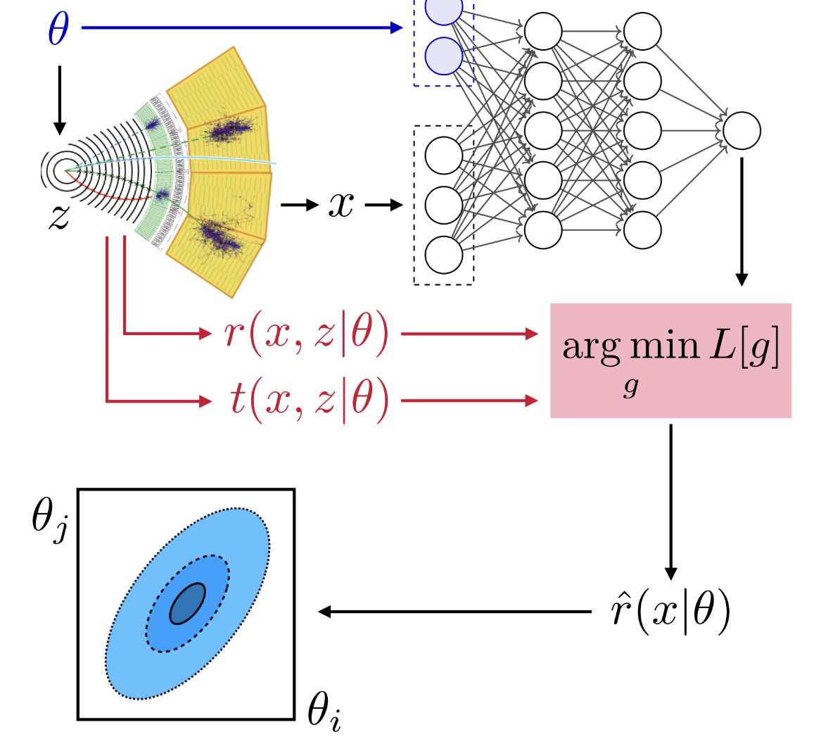
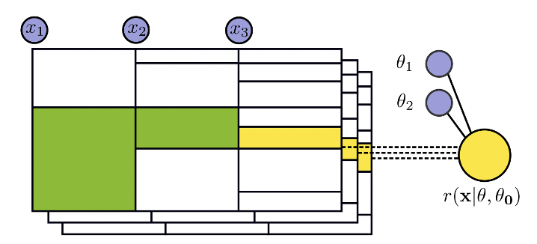
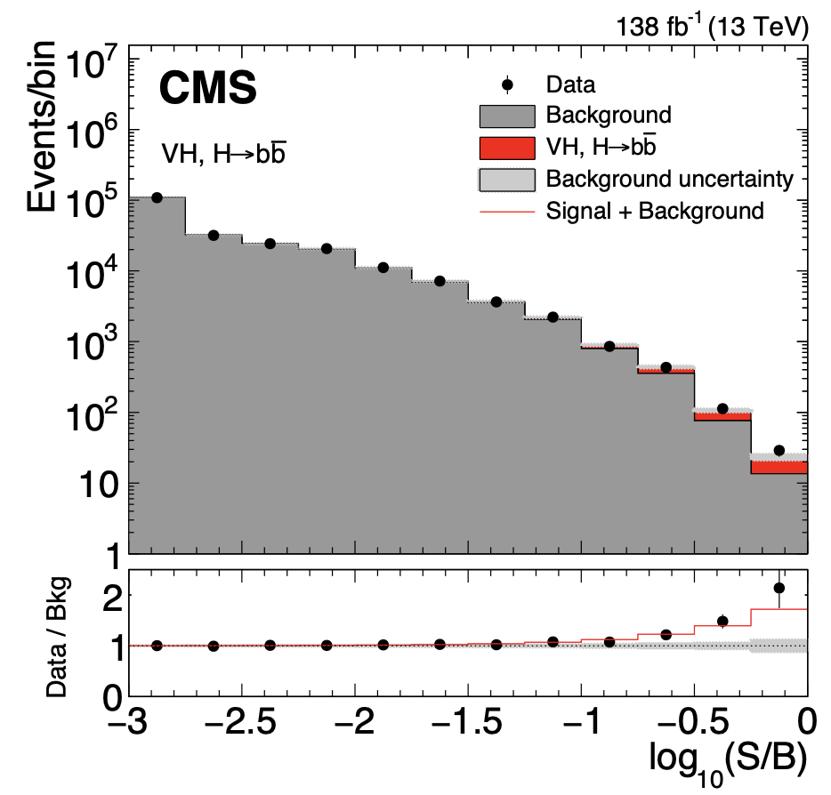
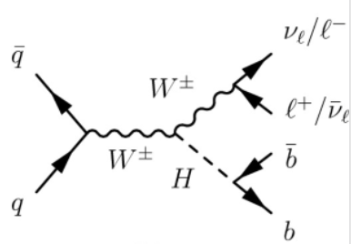



H+W/Z interpretation with ML
|M_{SM} + θ M_{BSM}|²
“ML optimal obsevable”
0ℓ/1ℓ/2ℓ
high dim!
  48 features
  6 BSM effects
up to x8 sensitivity
[2411.16907]
H unitarizes SM at high energy
cancellations over many orders of magnitude ⟶ BSM probes
Six CP-even/odd effects modify angular distributions & induce
E-growth
Developed ML algorithm fully aware of |M_{SM} + θ M_{BSM}|²
[MLST 2025, 2205.12976, CPC 2022]

Slide 24



Starting point: simulation based inference
``Refinable modeling for unbinned SMEFT analyses``[MLST 6 015007 (2025)]
  Stage-wise unbinned model building for SMEFT
  Statistical footing of “systematics recipes”
  Dissect the effect of (groups of) systematics & POIs
  Machine-learn the components (with trees)
Contribution to [FAIR-HUC Challenge] preprint [arXiv:2505.05544]
  Cross section measurement of H→𝝉𝝉 in DELPHES simulation
Our approach
  Classic unbinned SBI
  Build all known dependencies into the profiled test statistic
  Arbitrarily accurate models for systematics; fully refinable
[RS, Mach. Learn. Sci. Technol. 6 015007 (2025)]
  [RS et al., arXiv:2505.05544]

Slide 25





What to do with
dσ(x|c, 𝛎) encodes the
field’s knowledge about how
phenomena depend on model
parameters.
  Extract from the bottom of a river (of wikis)
Wield its power to our advantage:
Expand dσ(x|c, 𝛎) into sub-processes
and encode analytic dependencies,
as if you had the power to evaluate
  Can’t keep it, though.
Get rid of dσ(x|c, 𝛎)
by forming ratios, which we do evaluate
with ML surrogates

Slide 26


Modeling across the fields
Mathematical statistics: dσ(x| μ,𝛎)
A measure on a probability space
  Random variable x takes values
  in a “set”
  dσ maps unions and intersactions of subsets of this space (σ-field) to ℝ
  DCR = Radon-Nikodym derivative
Technically relevant for overflow bins, Fisher information, etc.
  And when you ask yourself “can
  I do this?”
What is dσ(x|c,𝛎) ?
Physics: dσ(x|c,𝛎) dx
Unbinned differential cross section
(detector-level, fiducial, total)
Access to dσ(x|c,𝛎) via expensive sampling
Machine-learning: dσ(x|c,𝛎) defines a pdf
  The inclusive model is not particularly useful.
c … POI ∊ ℝ^{N}
𝛎 … nuisance parameters ∊ ℝ^{M}
x … observation (1 event)

Slide 27


Why does nobody like tree boosting?
Boosted Parametric Tree
A tree node is a bin.
Same parametrization as in [combine paper]
implements
x-dependent model
of cross section ratio

Slide 28







Examples!
1D projections for a few values of 𝛎. Available parametrically as g_{𝛎}(x).
Semi-realistic toy study (Delphes) with publicly available information
ME scales
JES Flavor QCD
PDF #12
mis-btag
btag
efficiency
Drell-Yan
classifier
JES Abs Scale

Slide 29



Learning SMEFT in TT(2ℓ)
From the playbook:
Quadratic
SMEFT model
Learn with “Boosted Information Tree (BIT)”
[2107.10859], [2205.12976] [MLST 6 015007 (2025)]
  5 POIs, 20 functions simultaneously learned
  35 features top quark pairs (2ℓ)
  300 trees, D=5, ~9 hrs of training
(Systematics-free) Unbinned analysis shows
~x5 sensitivity gain in profiled limits
ML4EFT R. Ambrosio, J. Hoeve, M. Madigan, J. Rojo, V. Sanz [2211.02058]

Slide 30

Linear basis & fit quality
Resulting basis elements define ”wiggles” in PDF space
  Orthogonal in function space
With 6 basis elements, achieve sufficient precision
  10% of PDF4LHC21 uncertainty
Quark PDFs: PDF4LHC21 at Q₀=1.65 GeV
  DGLAP at NNLO with EKO [Eur.Phys.J.C 82 (2022) 10, 976] and m_{b/c} as in NNPDF4.0
How can we constrain the coefficients in the linear basis?

Slide 31







Machine learning systematics
“Likelihood ratio trick”
[PRD112 (2025) 5, 052006]
Parametric ansatz:
Implement coefficient functions Δ(x) as NNs:
Sufficiently many synthetic data sets

Slide 32
Full likelihoods in global fits
How can we incorporate unbinned detector-level likelihood L(D|c, 𝜈) in global fits?
Staging: First, take unfolded, binned 𝜒²-based measurement → Recast with POD → global fits
  Followed by, possibly → Binned full likelihood with POD
  Example: CMS inclusive jets (13 TeV) [JHEP 12 (2022)035]
  NNLO theory predictions are binned. No point for NSBI. Jet-based measurements are indispensable for f_{g}
Why could the full likelihood be useful on nuisance side?
  Recover detector-level information in L(D|c, 𝜈)
    “When jets and top quarks don’t agree [in a global PDF fit], what do you do?” (June 19th)
    → What’s the postfit result on 𝜈?
  Experiments don’t see the gradient of the global fit
    ”Flavor dependent JEC? b/g corrections?
    Bias from JER in the crack region?” Or cone-size?
    We compress the full information when results are made public
  Assembly. N_{bin} ~ O(100), covariances scale with N_{bin}² x N_{nuis}
POD lives in Hilbert space → PDF projections can be exploited
[Bogdan Malaescu, LHC EW WG meeting]

Slide 33
Reproducing CT18NNLO with POD
Projecting CT18NNLO onto all-flavor POD → c_{POD}, 𝚺_{POD}
Excellent closure. Apply within experiment as a prior.

Slide 34

CMS inclusive jets, 13 TeV [JHEP 12 (2022)035]
CMS 13 TeV (36fb⁻¹) and HERA DIS data
  𝜒² approx. is in xFitter, public
  Parametrization (16 parameters)
  Reproduce paper result to rounding error
  Implemented POD basis in xFitter [repo]
Exposes systematics; useful testbed; In HEPData,
therefore in CT18 [Phys.Rev.D 111 (2025) 3, 036033]
Compare:
  Analytic parametrization → fastNLO → 𝜒² → fit
  Analytic parametrization → POD → fastNLO → 𝜒² → fit
  CMS uncertainties
  lumi, JER, PU, miss, fake, AbsoluteScale, AbsoluteMPFBias, Fragmentation, SinglePionECAL, SinglePionHCAL, FlavorQCD, TimePtEta, RelativeJEREC1, RelativeJEREC2, RelativePtBB, RelativePtEC1, RelativePtEC2, RelativeBal, RelativeSample, RelativeFSR, RelativeStatFSR, RelativeStatEC, PileUpDataMC, PileUpPtRef, PileUpPtBB, PileUpPtEC1, PileUpPtEC2, model, NP + HERA uncertainties (162)

Slide 35
CMS inclusive jets, recasted
Project analytic model
on the POD
Needed to specify
x-range, scale of the
projection, active flavors,
DGLAP, etc.
Needed to
upweight up high-x
Bias of POD projection
~ 10⁻³ – 10⁻⁴ on xf
Sub-% level differences
in predicted cross-
sections

Slide 36

CMS inclusive jets, recasted
Scan likelihood and fit
  Analytic parametrization → POD → fastNLO → 𝜒² → fit
  POD bias <0.05 σ

Slide 37



PDF uncertainty in H production
For central rapidity, top quarks pair production gives better precision than NNPDF 3.1

Slide 38





A linear PDF model in detail
1. Make the gluon PDF variable & sample
NNs with hidden layers 25/20
[JHEP 04 (2026) 068]
2 x 10⁴ random samples
A_{m} frozen by momentum sum rule
ɑ, β … respect High-/low-x asymptotic
Quark PDFs fixed NNPDF 3.1
[J.Phys.G 49 (2022) 8]
2. Subtract the mean
3. Assume a grid on x and orthonormal modes
Equivalent to PCA of grid x grid matrix
4. DGLAP of
projection
Many variations
M = 2x10⁴
Few basis elements
a = 1…N ≪ M

