Slide 1


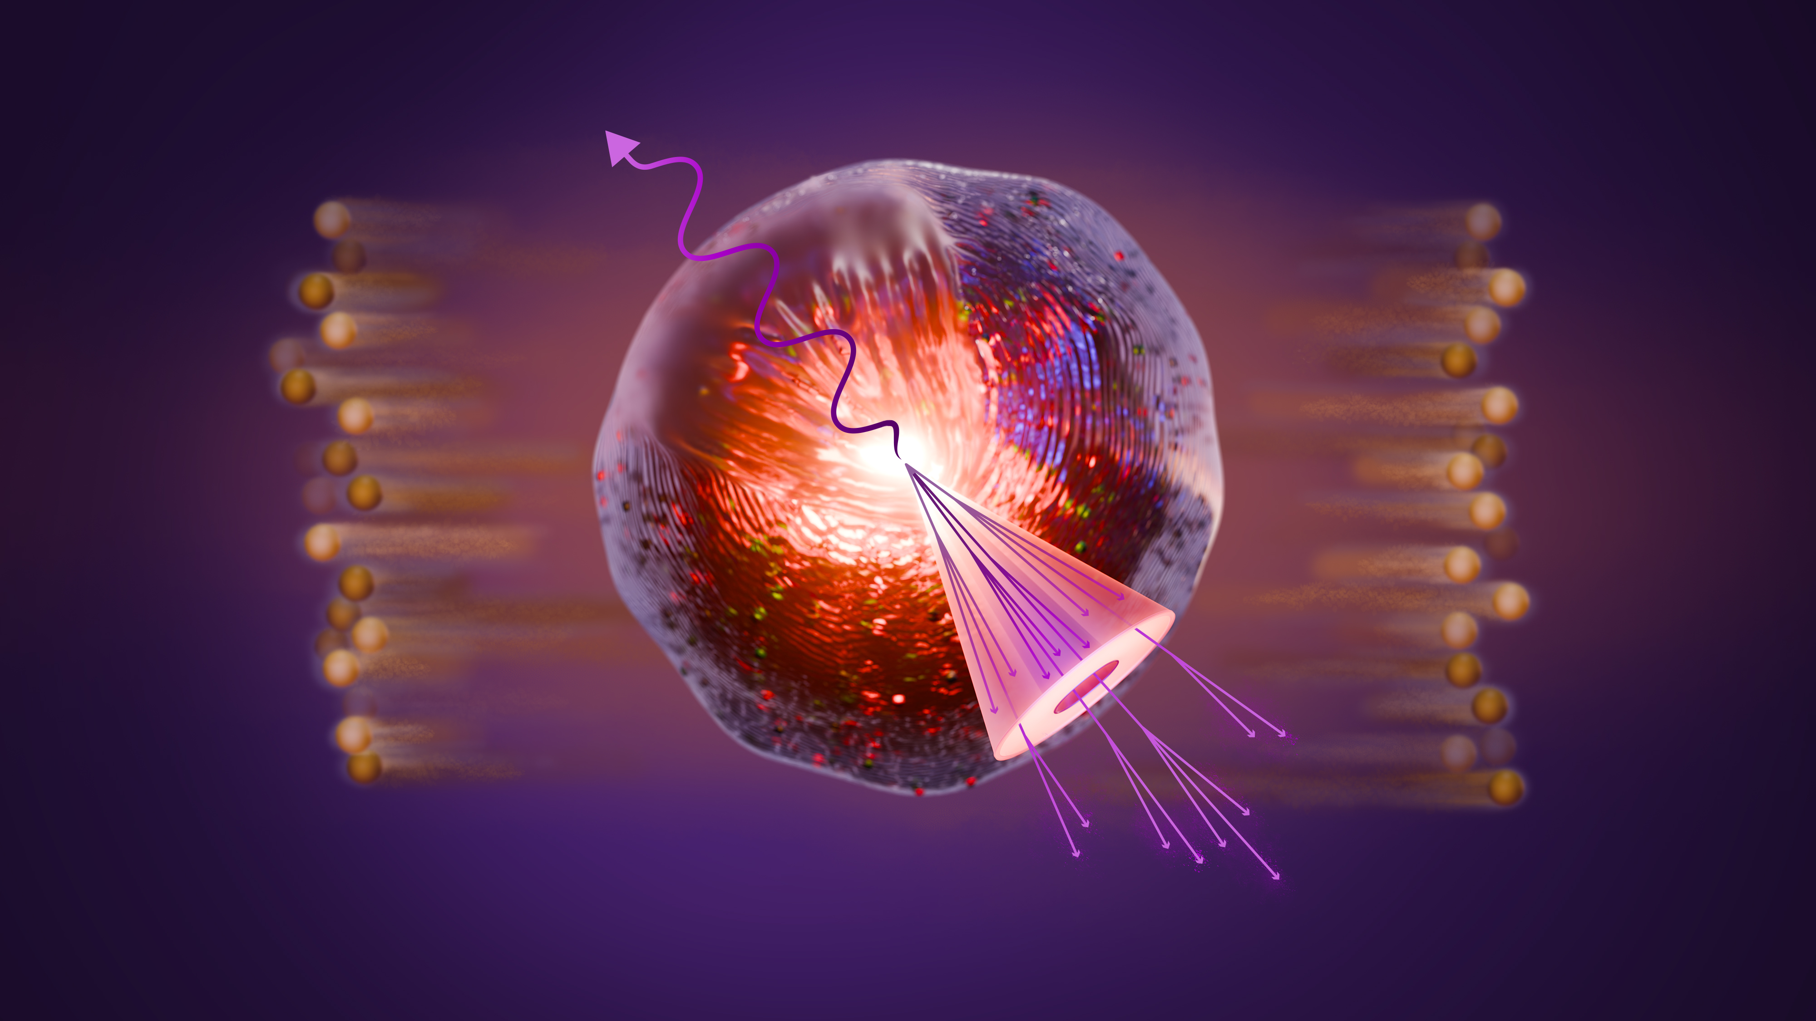


How to actually measure jet quenching in heavy-ion collisions
Peter Jacobs
Lawrence Berkeley National Laboratory
University of Liverpool
QCD@LHC 2026
University of Oxford

Slide 2
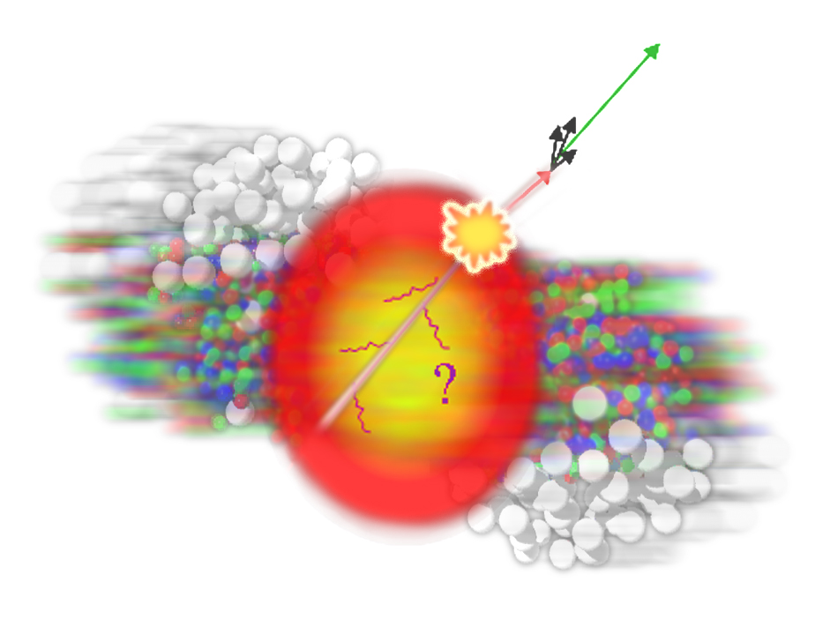
Jet quenching in one slide
Jet shower in-medium
Jet shower in vacuum
Highly virtual parton evolves via gluon radiation
Quantum interference → angle-ordering
hardest radiation is most collinear with jet axis
Precise understanding in pQCD
Accurately calculable with QCD-based Monte Carlo models
Superposition of
vacuum shower
medium-induced gluon emission
These processes happen simultaneously and interfere
Angle-ordering is modified or destroyed

Slide 3
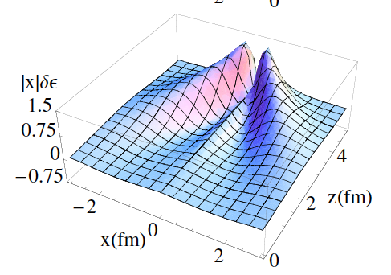
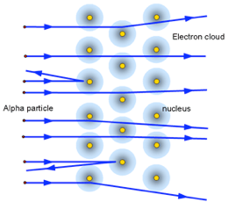
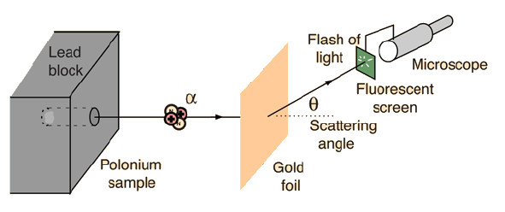

What can we learn about the Quark-Gluon Plasma from jet quenching ? Consider two limits…
Resolve discrete scattering centers: QGP quasi-particles
Excite a continuous medium and observe its response

Slide 4
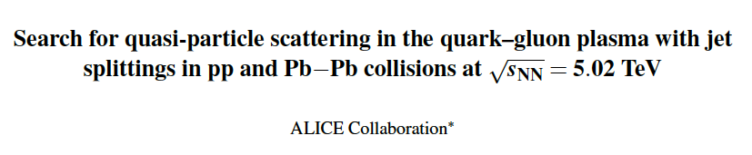
Phys. Rev. Lett. 135 (2025) 031901

Slide 5
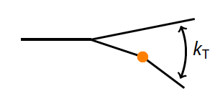
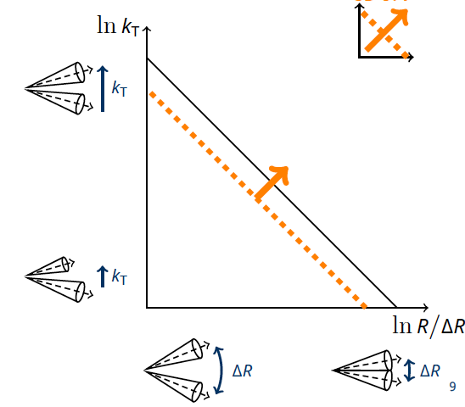
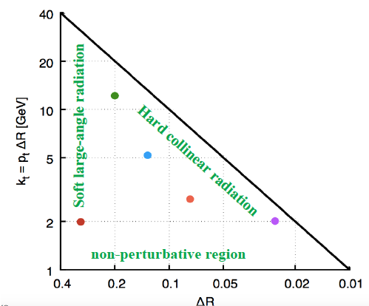
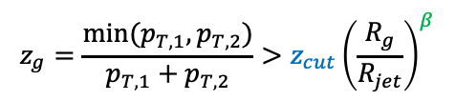
Quasi-particle scattering via jet splitting
PRL 135 (2025) 031901
Use jet grooming to isolate hard k_{T} splittings
  → enhanced yield at high k_{T} in Pb+Pb?
$$z_{g}=\frac{min⁡(p_{T,1},p_{T,2})}{p_{T,1}+p_{T,2}}>z_{cut}{\left(\frac{R_{g}}{R_{jet}}\right)}^{β}$$
groom
SoftDrop

Slide 6
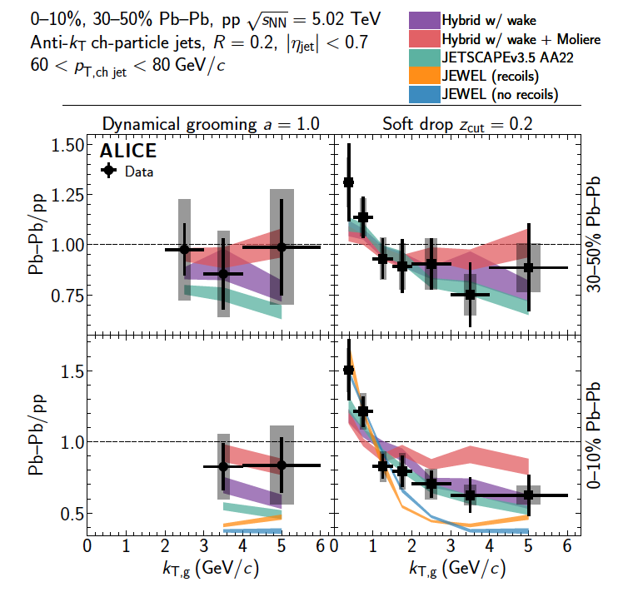
Quasi-particle scattering via jet splitting
PRL 135 (2025) 031901
Quasi-particle scattering corresponds to yield enhancement at large k_{T}
??
Not seen. Why?
Wrong kinematics
Signal obscured by jet selection bias

Slide 7
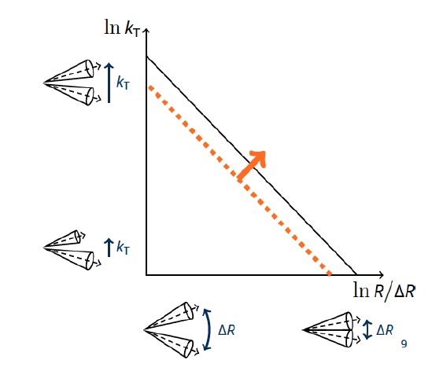
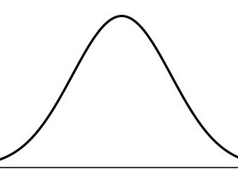
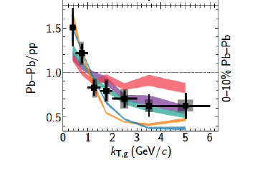

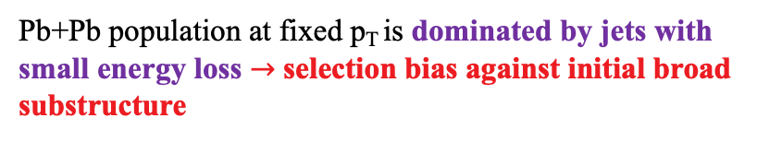


Jet quenching $→$selection bias
ΔE
Conjecture:
large energy loss
log(rate)
$$⨂$$
incl. jet production
small energy loss
Actually a wide distribution, not
a line
p+p
Pb+Pb
p_{T}
$60<p_{T,ch jet}$<80 GeV/c
Energy loss due to quenching is a distribution
Jet spectrum falls with increasing p_{T}
We compare jets in Pb+Pb and p+p at the same value of observed p_{T}
Pb+Pb population at fixed p_{T} is dominated by jets with small energy loss $→$ selection bias against initial broad substructure
The p_{T} threshold is the fundamental issue. Can we do this differently?

Slide 8
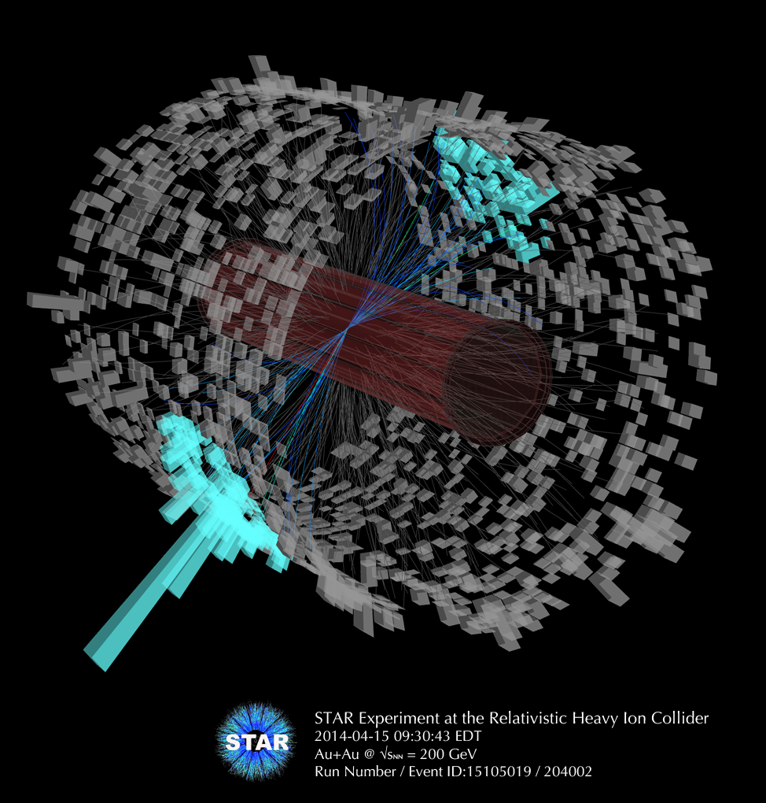

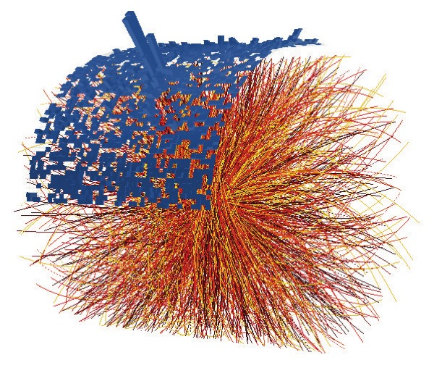
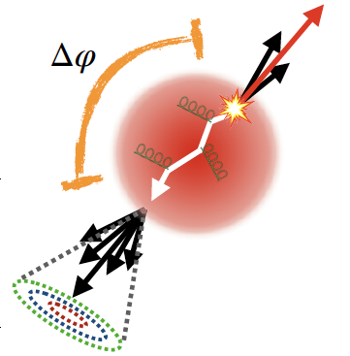
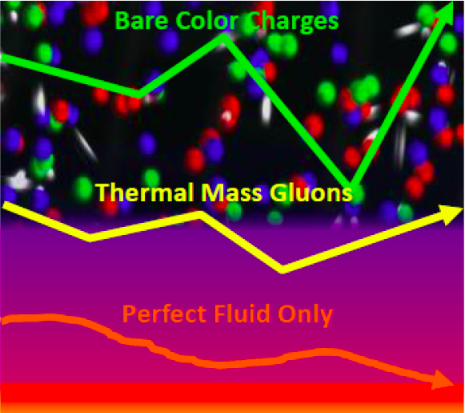
Step back: heavy-ion jet measurement challenge
Very complex experimental environment
Huge background of particles not correlated with jet shower
Particles do not come labelled “jet” or “background”
Coincidence observables:
cannot be certain that a given recoil hadron arises from the same high-Q² process as the trigger
“uncorrelated background” strictly has meaning only for ensemble-averaged (“statistical”) distributions
p_{T,jet}
R
Low p_{T}^{jet}/large R: tiny signal/background
→ requires “statistical” approach to uncorrelated background yield

Slide 9
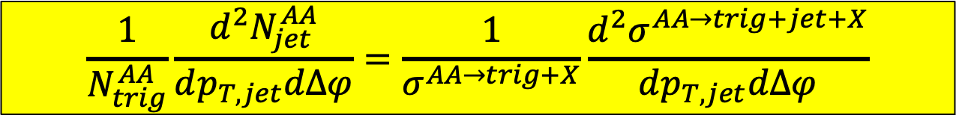
Semi-inclusive measurement
Trigger: γ/Ζ, π⁰, ch hadron
Event selection: hard processes trigger
  γ/Z, π⁰, charged hadron (not jet, too messy)
Jet reconstruction on full event
Count number of recoil jets, normalize per trigger
p_{T,jet}
R
Recoil jet
If no uncorrelated background $→$ ratio of hard cross sections
$$\frac{1}{N_{trig}^{AA}}\frac{d^{2}N_{jet}^{AA}}{dp_{T,jet}dΔφ}=\frac{1}{σ^{AA→trig+X}}\frac{d^{2}σ^{AA→trig+jet+X}}{dp_{T,jet}dΔφ}$$

Slide 10
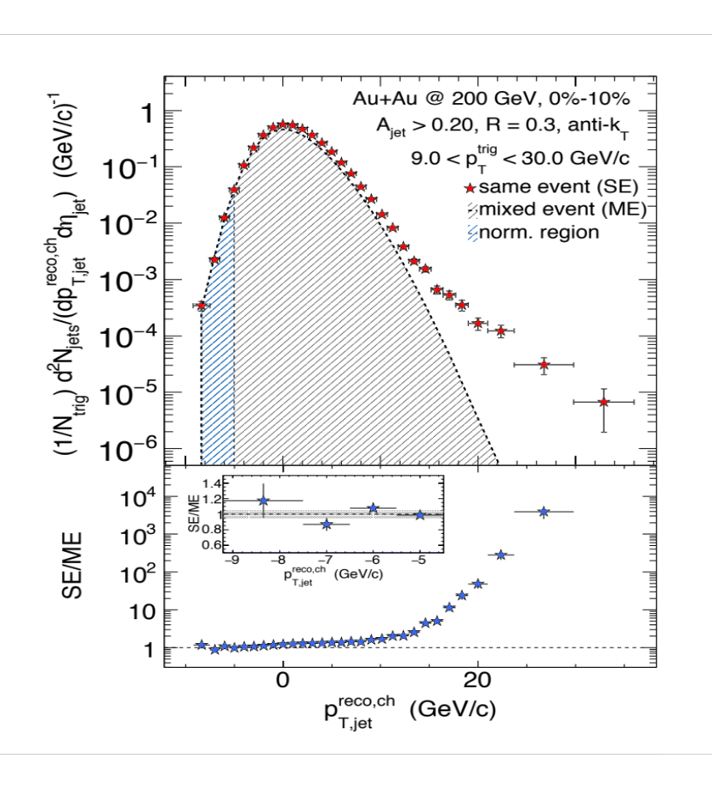

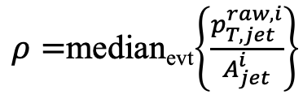
Recoil jet distribution: h+jet
Phys. Rev. C 96 (2017) 024905
No recoil jets are discarded. Two components:
Correlated: arisies from same high Q² interaction as trigger
Uncorrelated:
  MPI (different high Q² interaction)
  Combinatorial (random association of tracks/towers)
$p_{T,ch jet}^{reco}$=$p_{T,ch jet}^{raw}$-$ρA$
$ρ=$median_{evt}$\left\{\frac{p_{T,jet}^{raw,i}}{A_{jet}^{i}}\right\}$
(first approx. to p_{T}-smearing, refined later by unfolding)

Slide 11
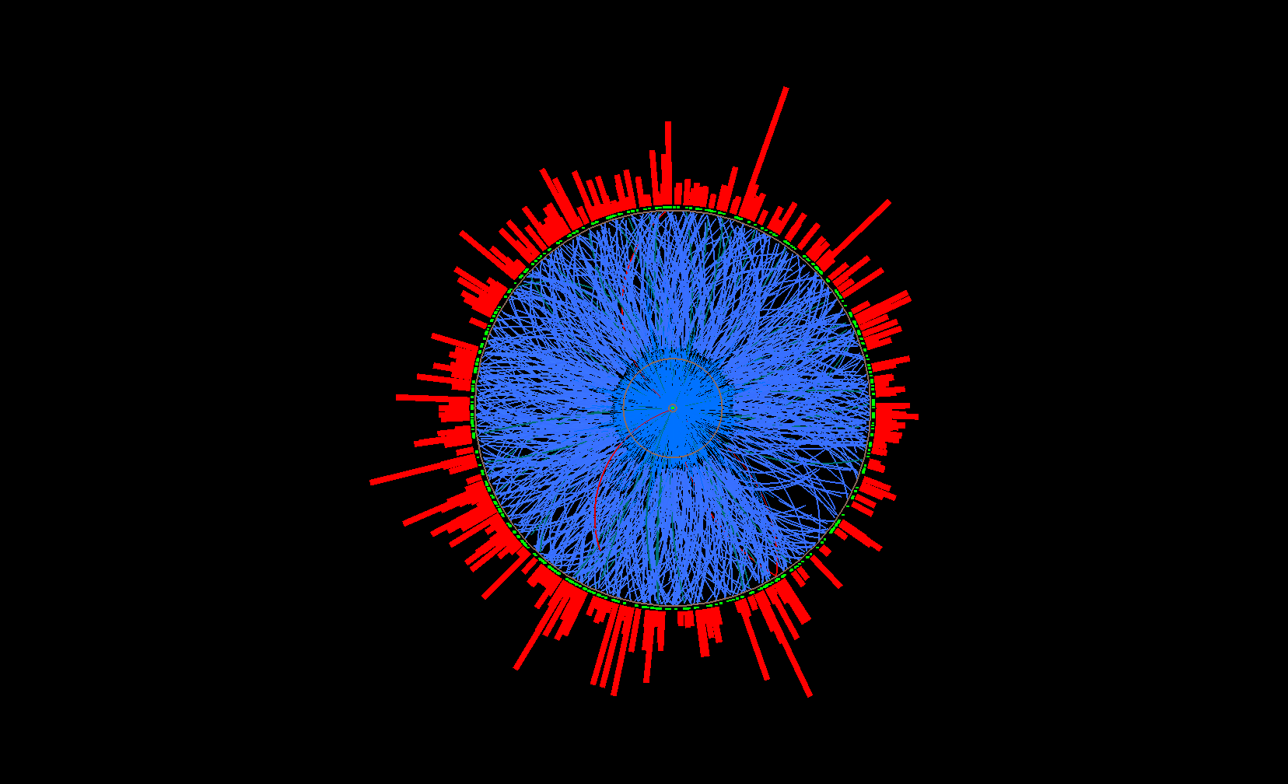
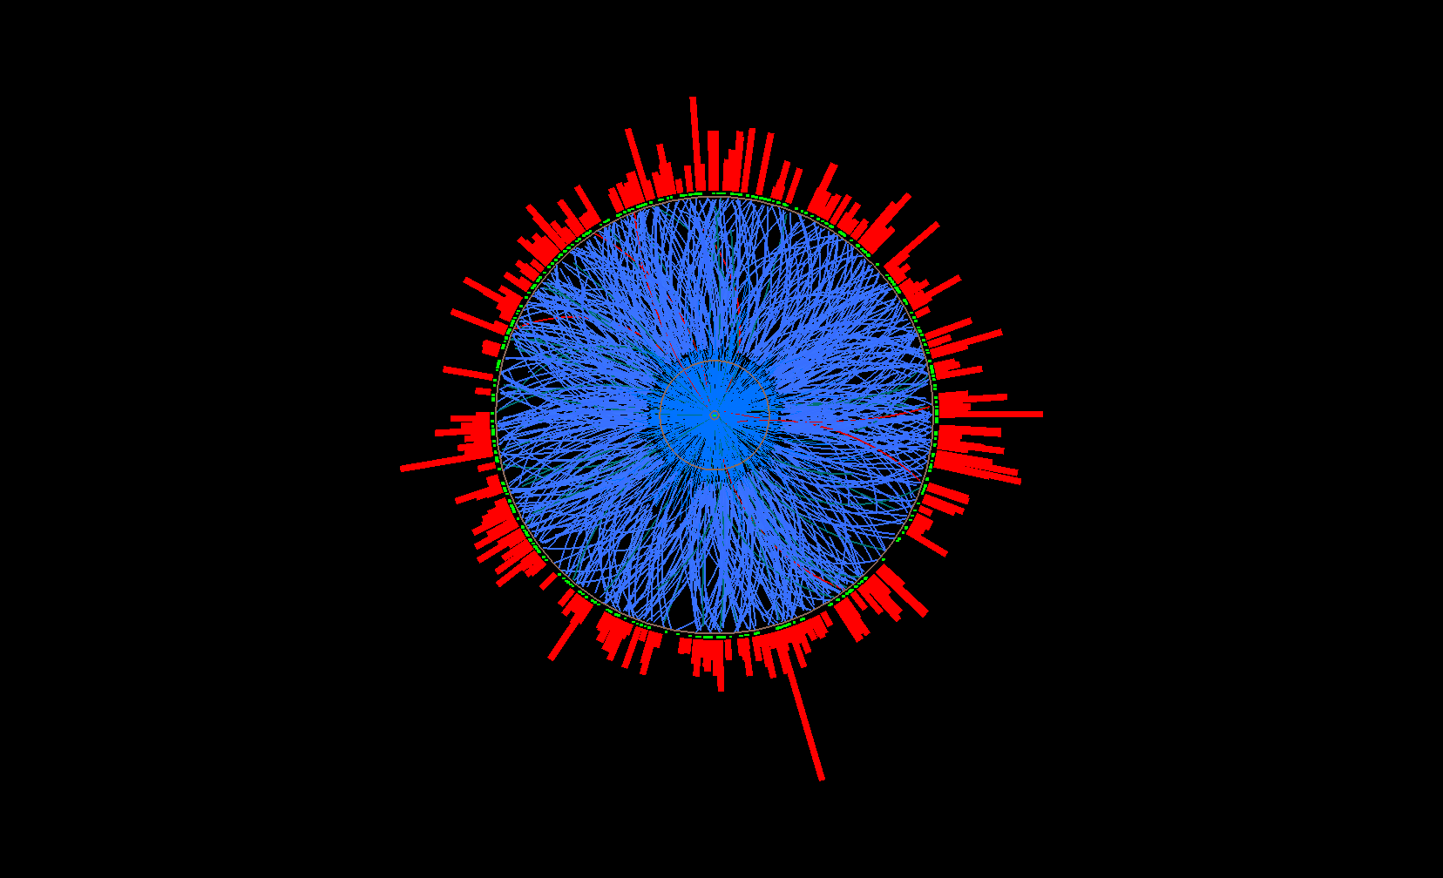
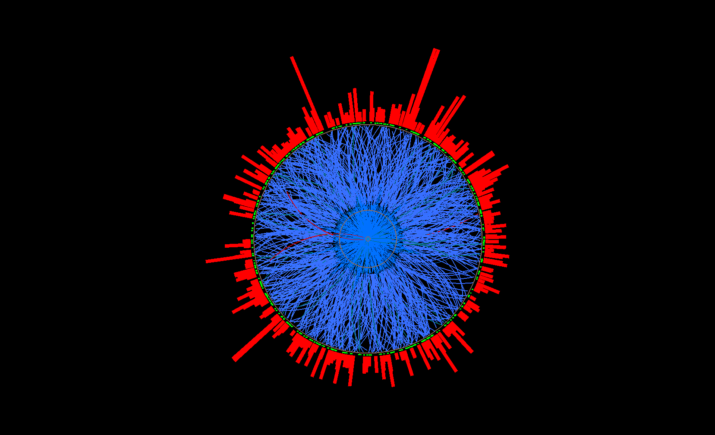
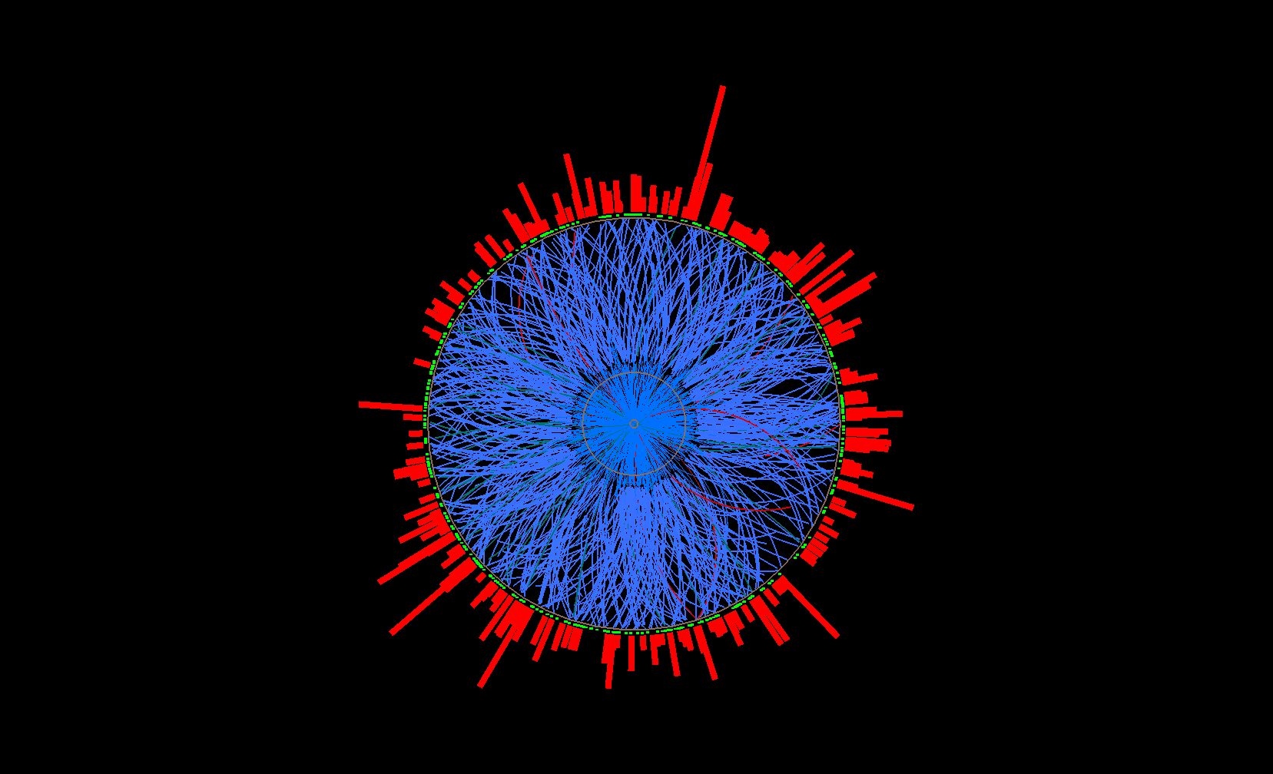
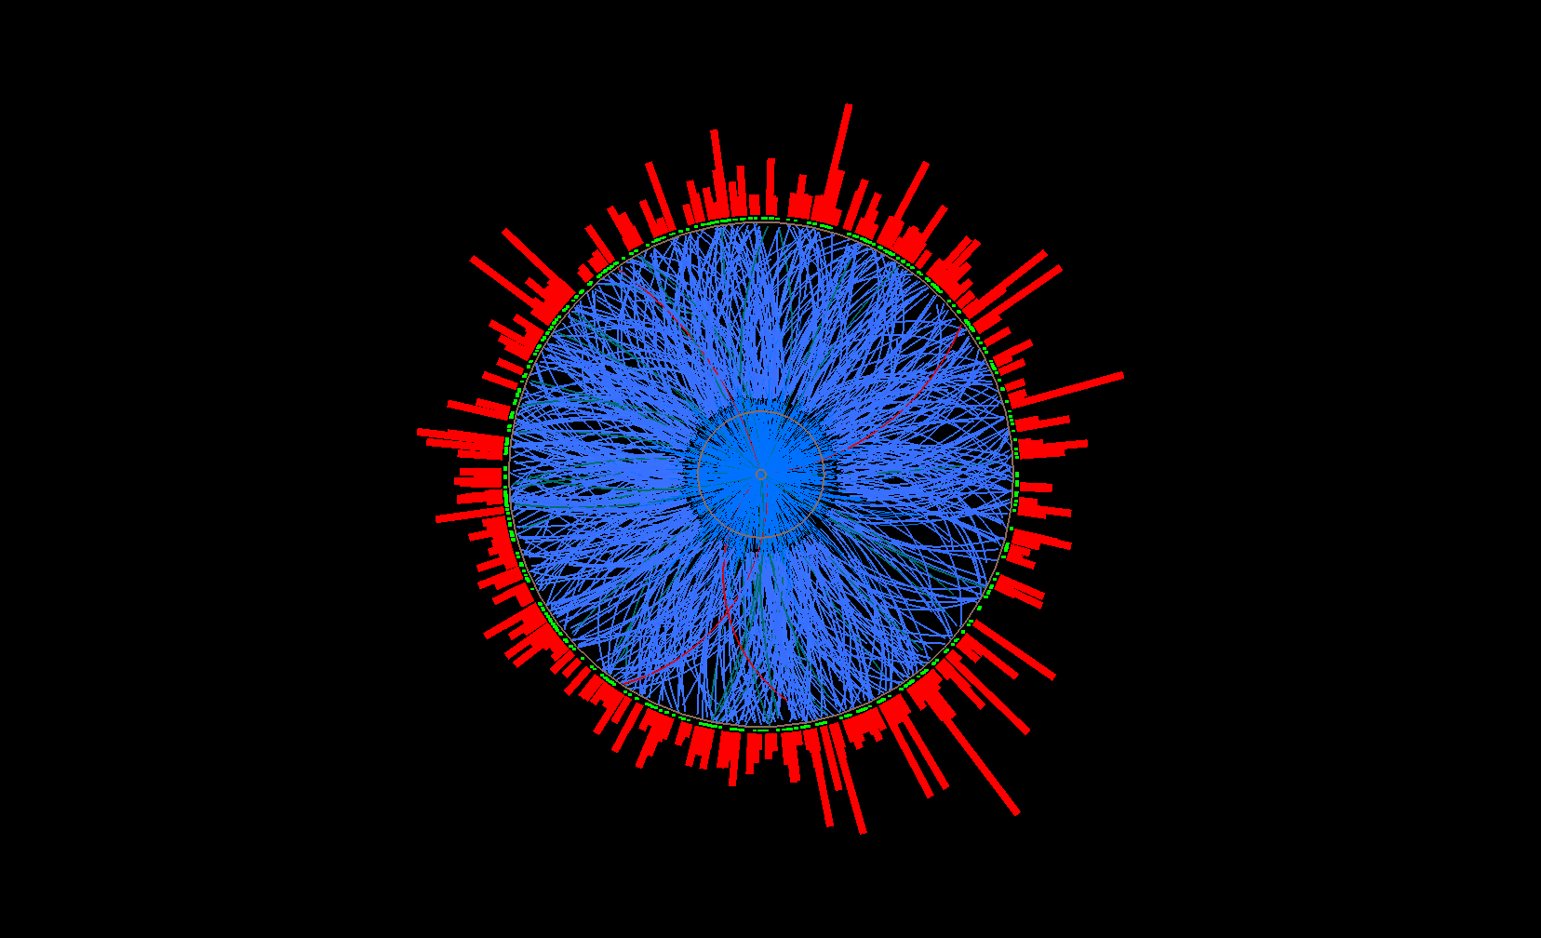
Constructing uncorrelated background
via event mixing
STAR Collaboration,
Phys. Rev. C 96 (2017), 024905
Destroys all multi-hadronic correlations, including jets
Mixed event
Mix only similar centrality, Ψ_{EP} ,
z-vertex position
Pick one random
track per real event
→ add to mixed
event
Carry out jet reconstruction on ensemble of mixed events
…
Ev. 1
Ev. 2
Real events
Ev. 3
Ev. 765

Slide 12
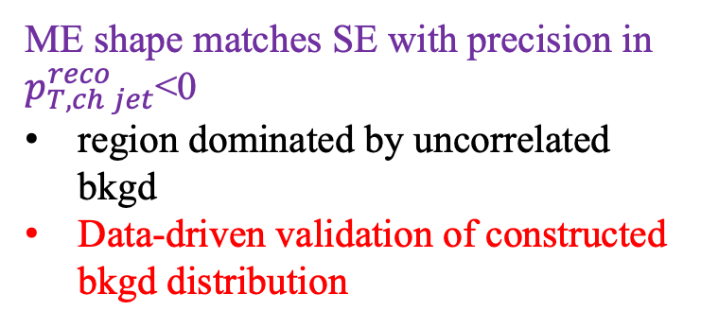
Background yield and p_{T}-smearing corrections
ME shape matches SE with precision in $p_{T,ch jet}^{reco}$<0
region dominated by uncorrelated bkgd
Data-driven validation of constructed bkgd distribution
Two distinct corrections:
vertical: subtract uncorrelated recoil yield
horizontal: embedding/unfolding to correct residual p_{T}-smearing + JES

Slide 13
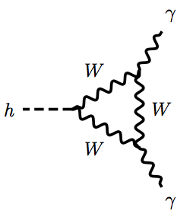
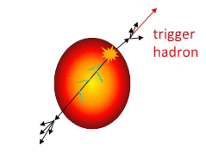
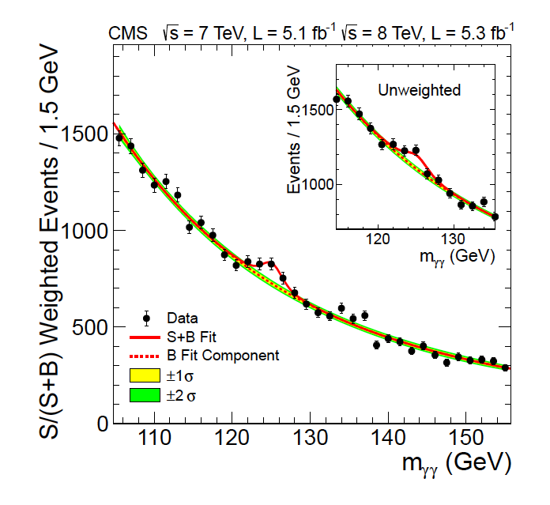
Statistical background correction
pp → Higgs → γγ
Au+Au → hadron + jet
signal+bkgd
signal+bkgd
bkgd only
bkgd only
Two distributions:
S+B: Signal + background
B: Background only
Normalize in B-dominated region
→ Subtract B from S+B
Jets in A+A: precise (<0.1%) data-driven correction of uncorrelated bkdg yield over full jet p_{T} range w/ large R

Slide 14
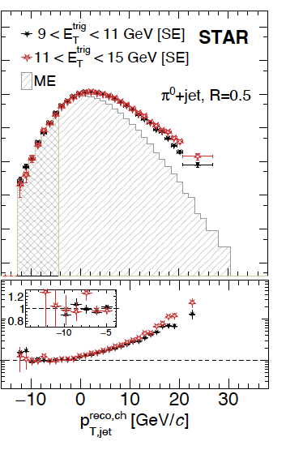
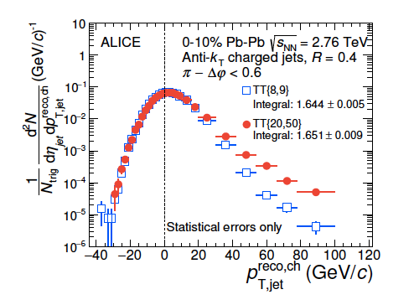
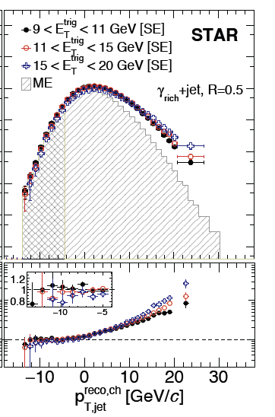
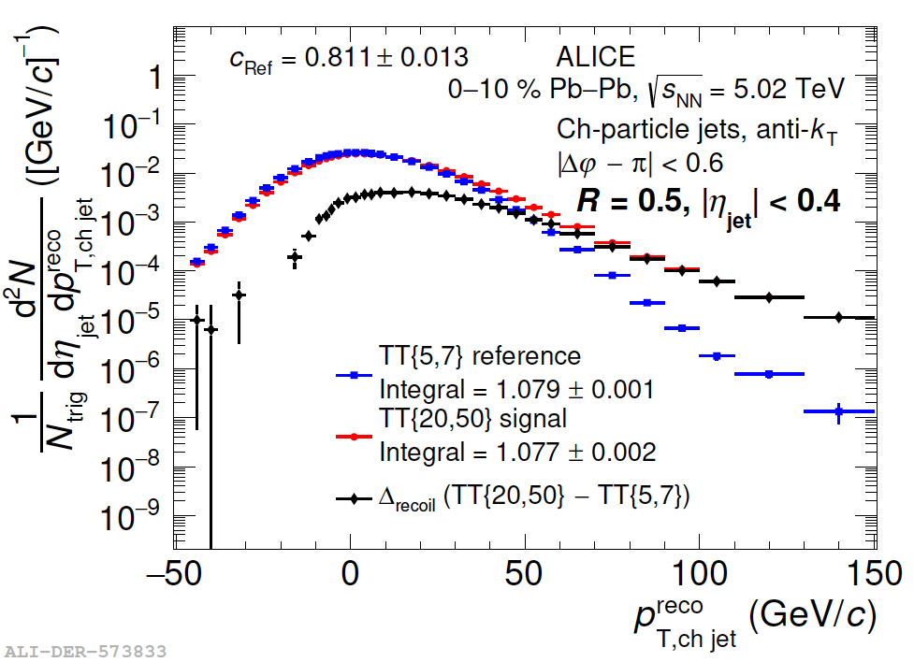
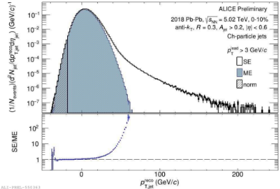
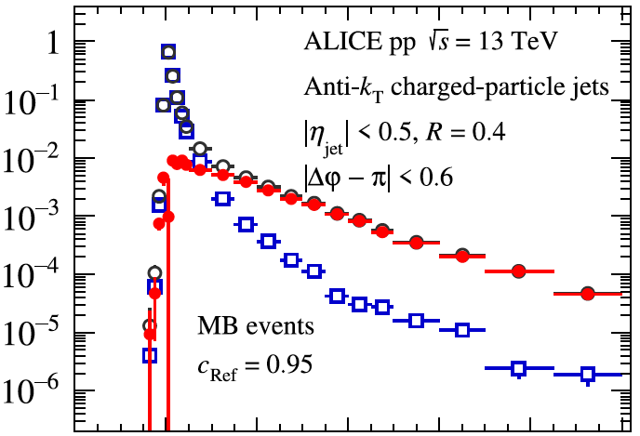
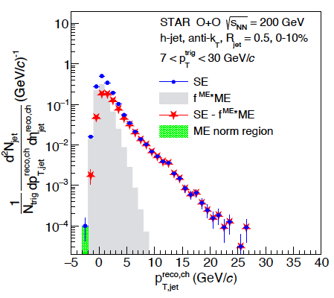
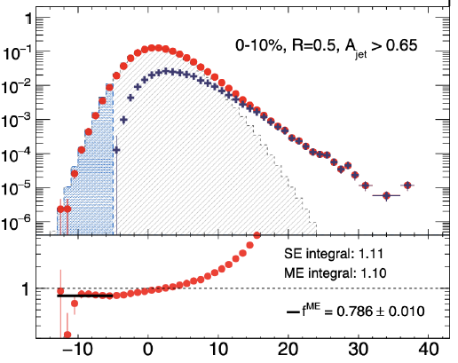

Statistical jet quenching analysis: current results
PbPb, pp; h+jet
JHEP 09 (2015) 170
Phys.Rev.Lett. 133 (2024) 2, 022301
Phys.Rev.C 110 (2024) 1, 014906
Pb+Pb; inclusive jet
EPJ Web Conf. 296 (2024) 11005
p+Pb, HM pp; h+jet
JHEP 05 (2024) 229
Phys.Lett.B 783 (2018) 95-113
O+O; h+jet
in progress
Au+Au; h+jet
Phys. Rev. C 96 (2017) 024905
Au+Au, p+p; γ/π⁰+jet
Phys.Rev.Lett. 134 (2025) 232301
Phys.Rev.C 111 (2025) 064907
Phys.Rev.C 113 (2026) 014902
Zr+Zr, Ru+Ru; h+jet
arXiv:2606.00973
O+O; h+jet
arXiv:2604.13935

Slide 15
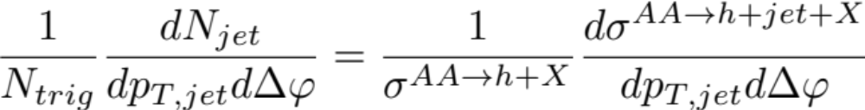
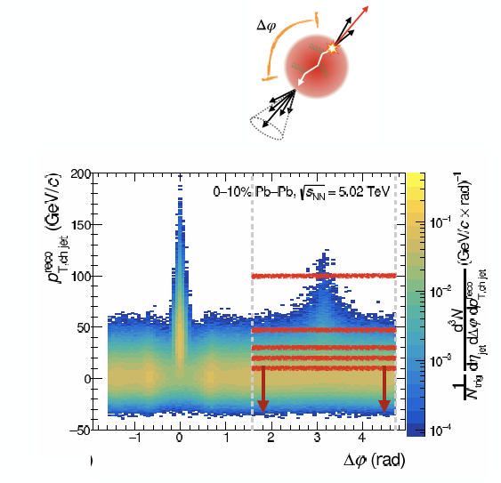
In-medium jet scattering: acoplanarity
Phys.Rev.Lett. 133 (2024) 2 022301
Phys.Rev.C 110 (2024) 014906
Expectation: scattering in the QGP broadens the acoplanarity distribution

Slide 16
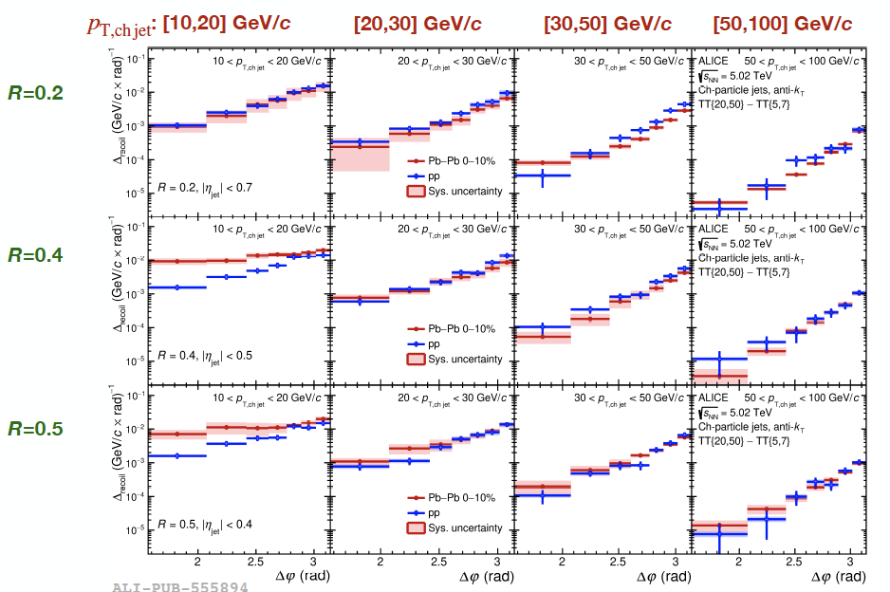
Acoplanarity: h+jet in central Pb+Pb @ LHC
Phys.Rev.Lett. 133 (2024) 2 022301
Phys.Rev.C 110 (2024) 014906
R
Large medium-induced azimuthal broadening
Only for large-aperture recoil jets at low p_{T}^{jet}

Slide 17
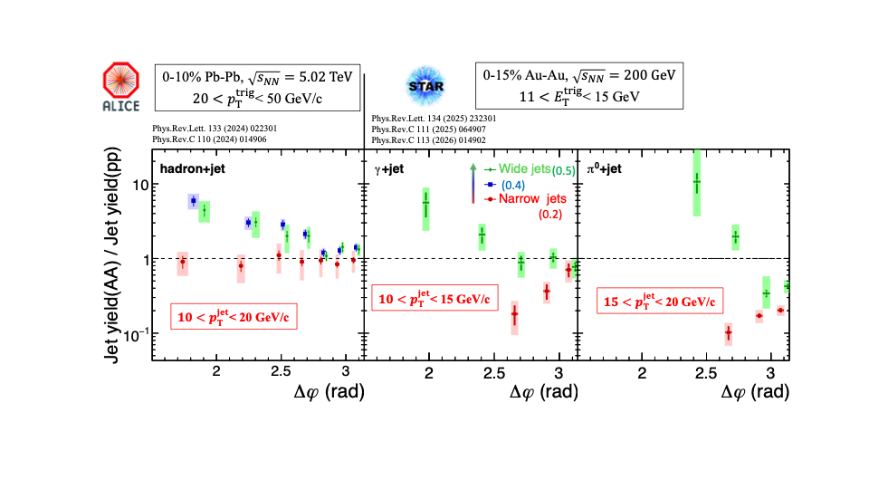

Medium-induced acoplanarity broadening at RHIC and the LHC
R
Factor 6
Factor 20$(\sim 10$σ$)$
Large medium-induced azimuthal broadening
Only for large-aperture recoil jets at low p_{T}^{jet}

Slide 18
What is a “jet” with R=0.5 at p_{T}=10 GeV/c?
Anti-k_{T} used operationally as clusterizer - no reference to physical origin
Low p_{T}: may not be a “jet” in the perturbative sense, with angle-ordered substructure
rather: just correlated energy-momentum flow within the aperture
Analysis procedure smoothly tracks the fate of jets in the QGP, from out-of-equilibrium at high p_{T} to partial or complete thermalization at low p_{T}

Slide 19
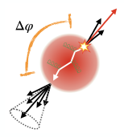
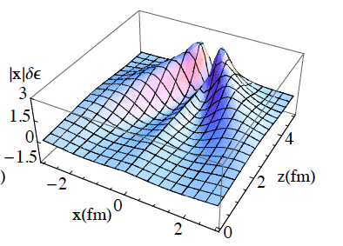
Acoplanarity broadening: interpretation
?
X
Why broadening only for large aperture recoil jets?
not compatible with Rutherford scattering (should also affect small R jets)
Rather: characteristic of diffuse large-angle flow of QGP excited by the passage of an energetic recoil (“jet” p_{T}~R²)
Probes QGP response to jet excitation

Slide 20
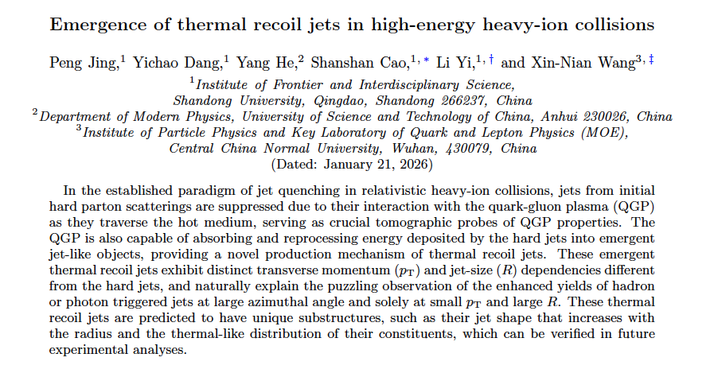
Phys.Rev.Lett. 137 (2026) 10, 102301

Slide 21
Phys.Rev.Lett. 137 (2026) 10, 102301
Linear Boltzmann Transport (LBT) model
3+1 dimensional hydrodynamics
elastic and inelastic jet-medium scattering in Higher Twist (HT) approach
generation of radiative and thermal recoil partons; further scattering and QGP back-reaction
Most comprehensive model of QGP response to jet excitation

Slide 22
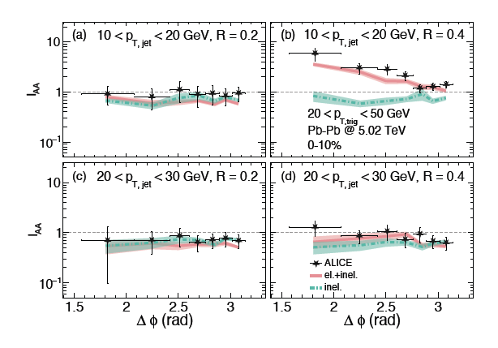
Phys.Rev.Lett. 137 (2026) 10, 102301
Calculations reproduce measurements, but only if “medium response” is included
Additional evidence for “thermal jets” or jet wake
arXiv:2512.12715

Slide 23
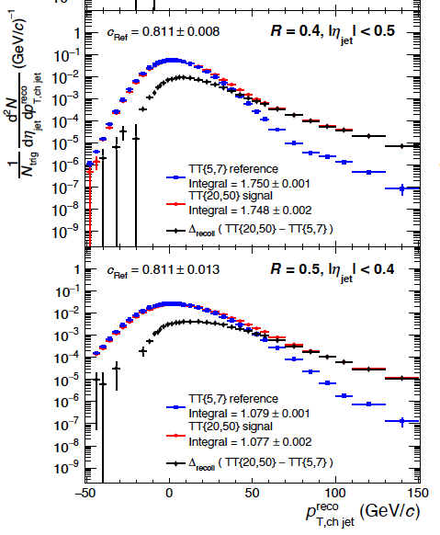
Summary
How to characterize a new material? Excite it and see how it responds
R
p_{T,jet}
p_{T} ^{jet}
First direct measurement of the jet wake in the Quark-Gluon Plasma
requires statistical approach to measure low p_{T}^{jet}/large R, where the signal lies

Slide 24
Extra slides

Slide 25
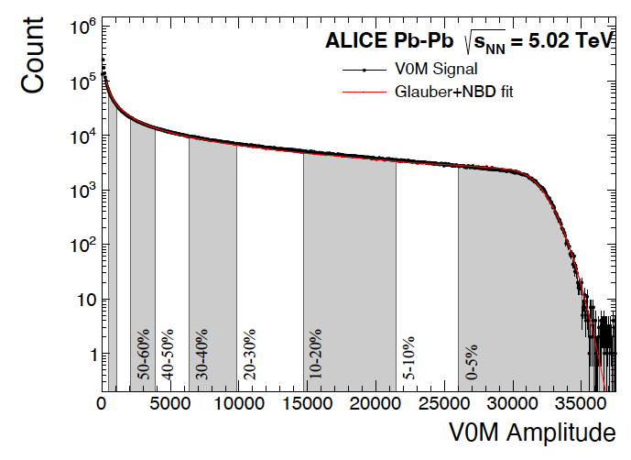
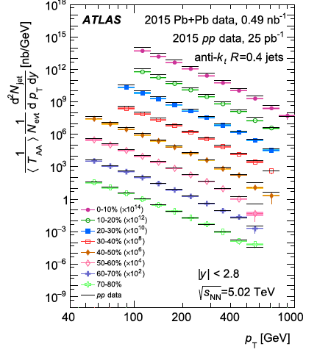






Comment on $ρ$ and biases
$ρ=$median_{evt}$\left\{\frac{p_{T,jet}^{raw,i}}{A_{jet}^{i}}\right\}$
$p_{T,ch jet}^{reco}$=$p_{T,ch jet}^{raw}$-$ρA$
Definition of $ρ (and similar factors)$ is arbitrary:
why exclude some specific number of jets?
why median and not some other metric?
No unique definition $→$not a physical quantity
But still very useful:
E-by-e estimate of multiplicity variation in a given centrality bin
Reduces the challenge to the unfolding task
    $→$ only needs to correct residual fluctuations
However: beware any cut on $p_{T}^{reco}$
bakes in arbitrary $ρ$ definition
biases the jet population near threshold $→$ large effects!
Bias at threshold
No bias
Theorem: if no $p_{T}^{reco}$cut, effects of arbitrary choices in definition of $ρ$are precisely undone by embedding/unfolding
    $→$no bias

Slide 26
Semi-inclusive approach mitigates selection bias
Select for hard-process trigger
Count number of recoil jets
Trigger: γ, π⁰, ch hadron
ΔE
log(rate)
$$⨂$$
X
p_{T,jet}
p_{T}
R
Recoil jet
No requirements on p_{T}^{jet}
No selection bias → unbiased recoil jet distributions

Slide 27


Semi-inclusive hadron+jet measurements
Phys.Rev.Lett. 133 (2024) 2 022301
Phys.Rev.C 110 (2024) 014906
p_{T} ^{jet}
20<p_{T}^{jet}<30 GeV/c
p_{T}

Slide 28
In-medium acoplanarity: what do we expect?
Phys.Rev.Lett. 133 (2024) 2 022301
Phys.Rev.C 110 (2024) 014906
Expectation: scattering in the QGP should broaden the azimuthal acoplanarity distribution

Slide 29


STAR: event-mixed bkgd
ALICE: trigger-difference bkgd
STAR Phys.Rev.C 111 (2025) 6, 064907
ALICE Phys.Rev.C 110 (2024) 1, 014906
Signal+bkgd (SE)
Difference
SE-ME
Mixed-event bkgd (ME)
Good shape agreement in bkgd-dominated region →normalize

Slide 30

Acoplanarity: γ/π⁰+jet in central Au+Au @ RHIC
Phys.Rev.Lett. 134 (2025) 232301
Phys.Rev.C 111 (2025) 064907
Phys.Rev.C 113 (2026) 014902
R
Large medium-induced azimuthal broadening
Only for large-aperture recoil jets at low p_{T}^{jet}

Slide 31

Hybrid model predictions
Appendix of STAR paper:
Phys.Rev.C 113 (2026) 014902
Qualitatively: predicts the large-R enhancement seen in data but only with wake switched on
Quantitatively: only for lower p_{T}^{jet}, smaller effects than in data
Effect is present, model needs tuning

Slide 32


Outlook
Kudinoor et al., 2603.23596
CMS 2602.19431
We now have the tools to disentangle QGP responses to jet excitation:
primary wake
diffusion wake
Moliere scattering

