Slide 1
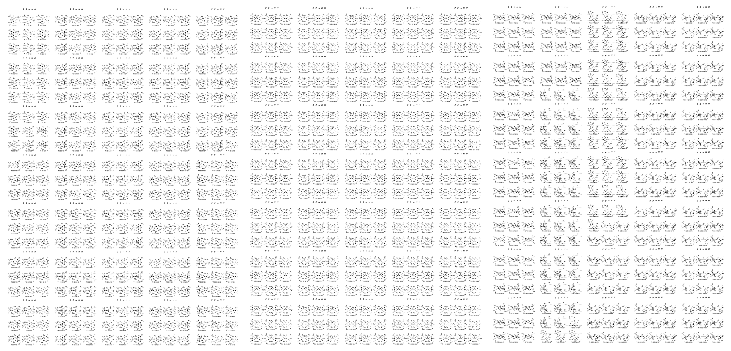
Higgs-Pair Production via Gluon Fusion: 2-Loop Top-Yukawa- and Light-Quark-Induced Electroweak Corrections and Beyond
Jamie Chang
In collaboration with A. Bhattacharya, L. Biermann, F. Campanario, S. Carlotti, J. Mazzitelli, M. Mühlleitner, J. Ronca and M. Spira [JHEP 07 (2026) 057]

Slide 2
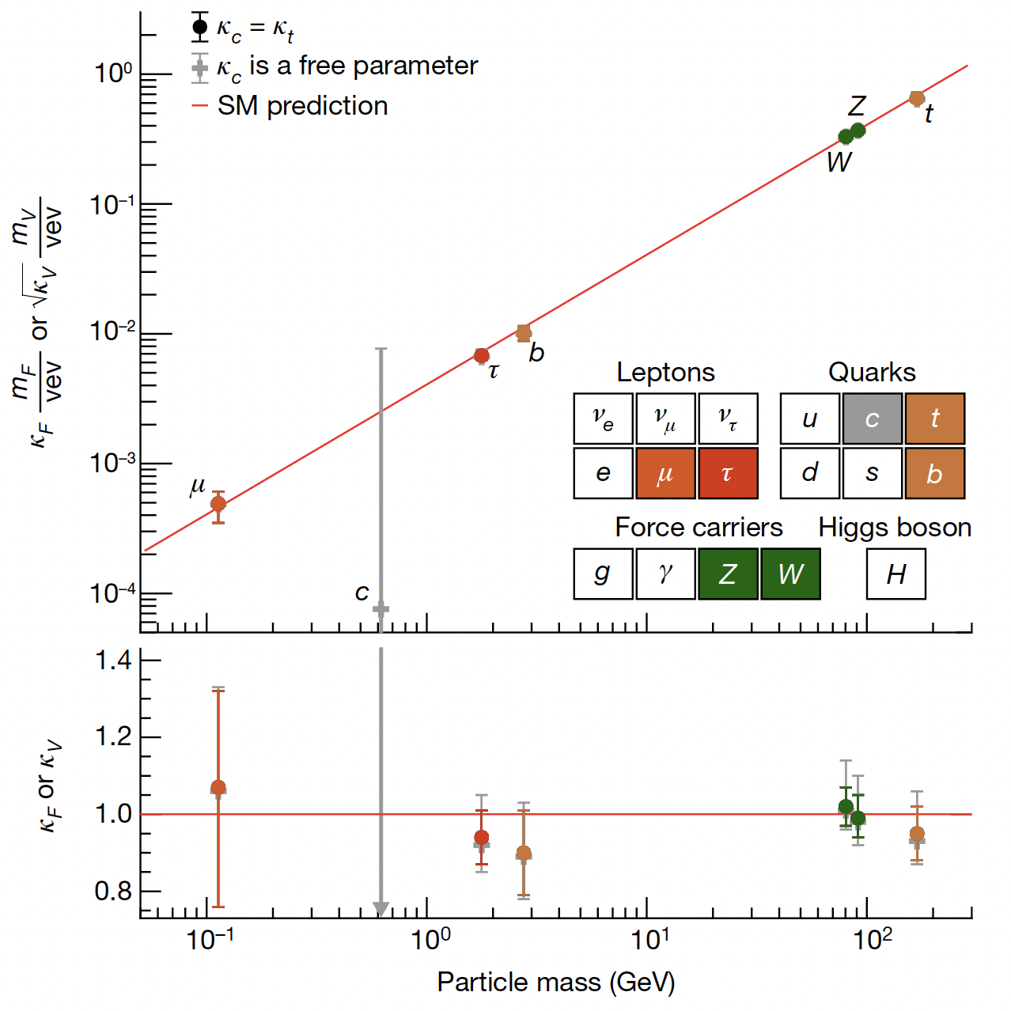
What is already known?
Is this the SM Higgs?
[ATLAS, Nature 607, pages 52-59 (2022)]

Slide 3
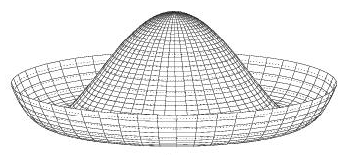
What is already known?
Is this the SM Higgs?
[ATLAS, Nature 607, pages 52-59 (2022)]
Yukawa & gauge couplings ☺
Higgs self-interactions?:

Slide 4
What is already known?
Is this the SM Higgs?
[ATLAS, Nature 607, pages 52-59 (2022)]
Yukawa & gauge couplings ☺
Higgs self-interactions?:
Measurable at (HL-)LHC
Direct search via multiple-Higgs (>2) production – goal for a future collider

Slide 5
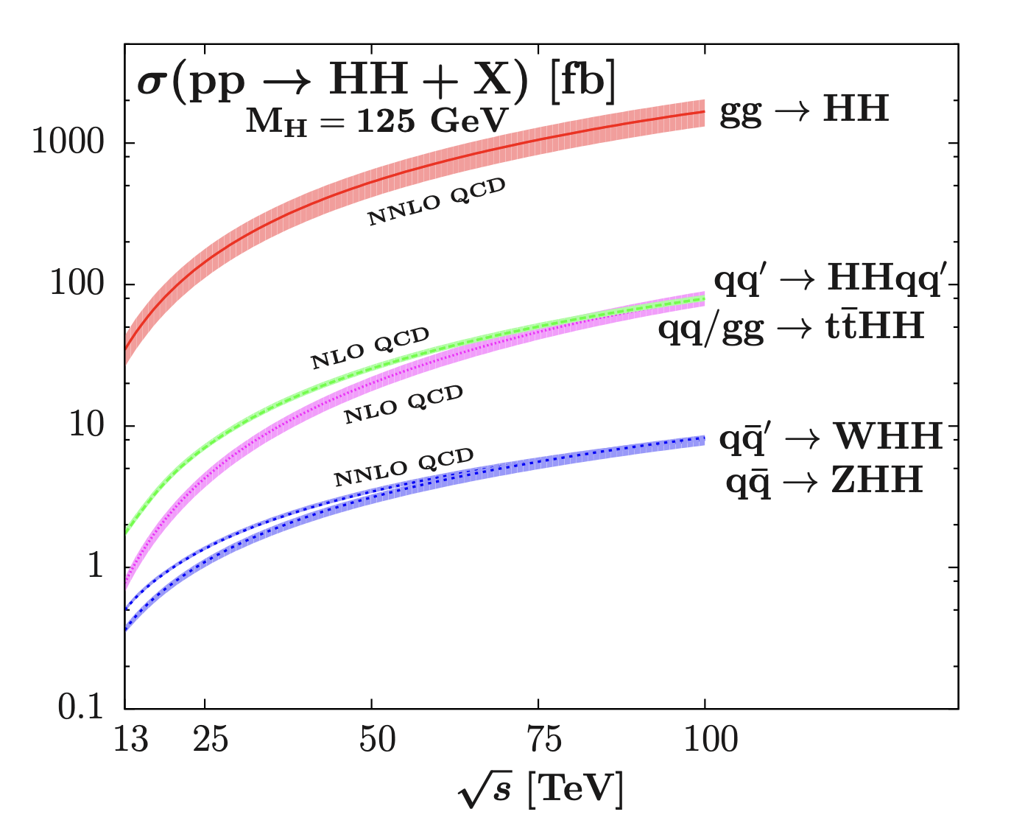
Why this process in particular?
[Baglio et al. Rep. Prog. Phys. 79 (2016) 116201]
Dominant production mechanism at hadron colliders

Slide 6
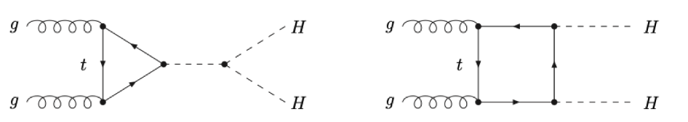
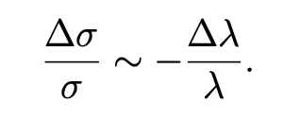
Why this process in particular?
Destructive interference of triangles + boxes
[Baglio et al. Rep. Prog. Phys. 79 (2016) 116201]
2
Valid for
Dominant production mechanism at hadron colliders

Slide 7
Why this process in particular?
Destructive interference of triangles + boxes
[Baglio et al. Rep. Prog. Phys. 79 (2016) 116201]
2
Valid for
Typical hierarchy : LO ~ NLO QCD > NLO EW
HL-LHC aims for ~O(30%) precision of
Need computation of NLO EW contributions!
Dominant production mechanism at hadron colliders

Slide 8
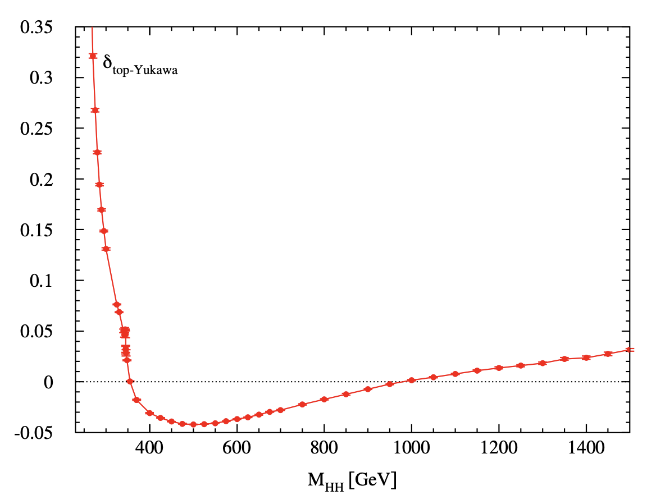
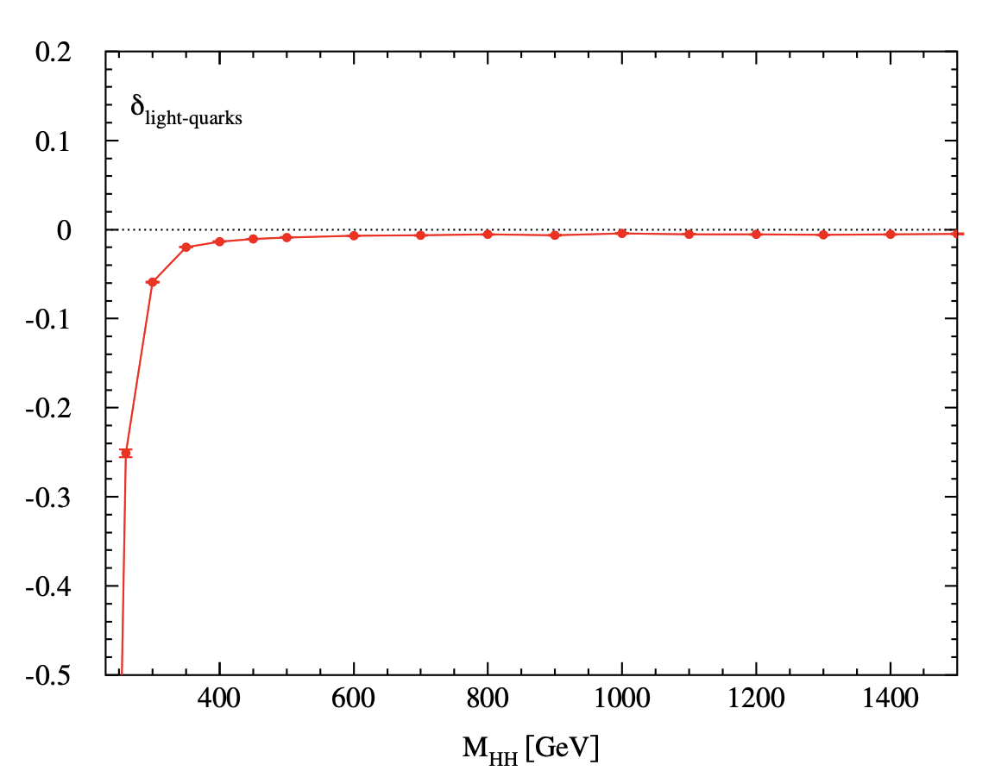
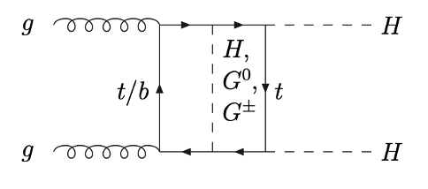
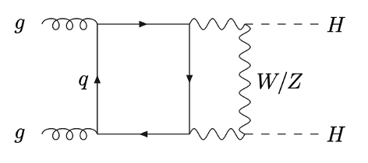
Top-Yukawa and Light-Quark Results
[JHEP 07 (2026) 057]
Top-Yukawa: -1.9% correction to
Light-Quark: -1.5% correction to
In agreement with HTL analysis of
In agreement with
[Mühlleitner et al. JHEP 10 (2022) 185]
[Bonetti et al. JHEP 07 (2025) 024]

Slide 9
Computational details

Slide 10
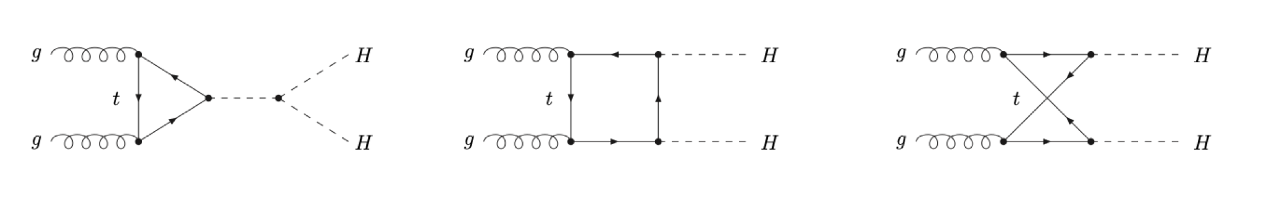
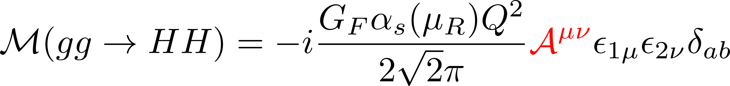
Returning to the problem at hand
Leading order takes form:
Amplitude decomposition into two orthogonal spin structures
At NLO: EW corrections IR and collinear finite:
Relative NLO/LO correction

Slide 11
Okay, okay – some planning involved here!
LO ~ O(10) diagrams → NLO EW ~ O(1000) diagrams
Systematic approach needed
Divide and conquer - separate into classes with similar topologies
…

Slide 12
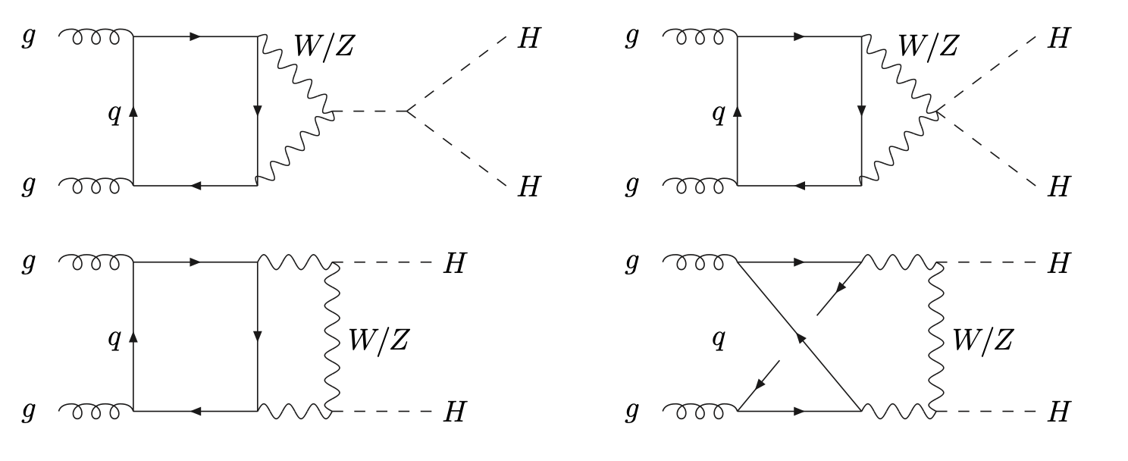
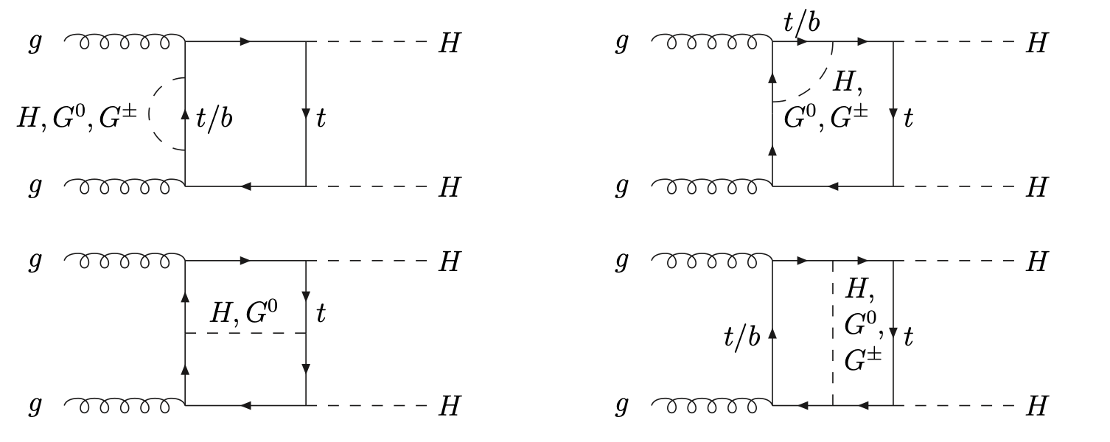
First steps : Light-quark and top-Yukawa induced corrections
Light-quark topologies
2. Top-Yukawa (box) topologies

Slide 13

First steps : Light-quark and top-Yukawa induced corrections
Light-quark topologies
2. Top-Yukawa (box) topologies
Feynman gauge:
Gaugeless limit:
[Brignole et al. Nucl.Phys.B 631 (2002) 195-218]
[Espinosa et al. Nucl.Phys.B 586 (2000) 3-38]

Slide 14
Workflow
Workflow Overview
Numerical method
  Many mass scales
  Feynman parameters + phase space ~ 7-dimensions
Fully symbolic
  Working diagram-by-diagram: no need to enforce ratio of masses to simplify calculation
  No tensor reduction or reduction to master integrals
  Instead, project onto F₁/ F₂
MC integrations
  Main challenges come from stabilising integrands
Generate Diagram
Assign Momenta
Feynman Parameters
Monte-Carlo Methods
Loop Integration

Slide 15
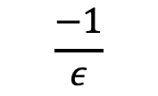
Workflow
Stability problems → Employ some tactics!
Generate Diagram
Assign Momenta
Feynman Parameters
1. End-point singularities
Thresholds and Endpoints
Monte-Carlo Methods
Loop Integration
Regular in y
$$\frac{−1}{ε}$$
Regular in y
Extract hidden pole structure
Increase stability of numerical integration

Slide 16
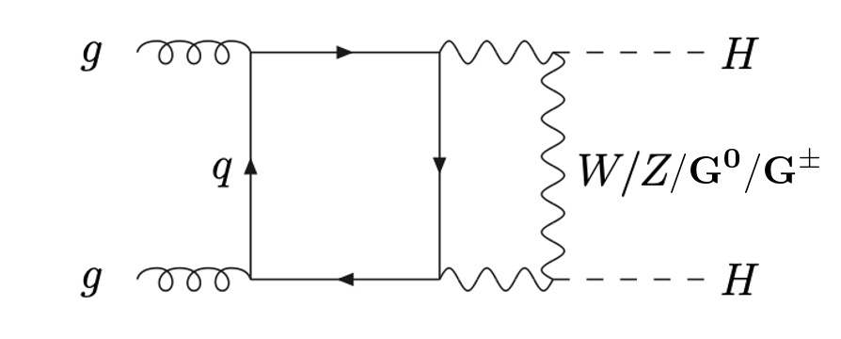
Workflow
Generate Diagram
Assign Momenta
Feynman Parameters
2. Virtual Thresholds
Singularities occur when Virtual Thresholds are reached
e.g.
Thresholds and Endpoints
Monte-Carlo Methods
Loop Integration
Analytic continuation of propagator masses:
Then, send close to zero ~ approx. true value of integral

Slide 17
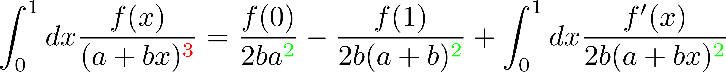
Workflow
Generate Diagram
Assign Momenta
Feynman Parameters
2. Virtual Thresholds
Monte-Carlo Methods
Thresholds and Endpoints
Monte-Carlo Methods
Loop Integration
Lessen severity of these singularities via integration by parts (IBPs)
e.g.
Trade off: Increase size of form factor

Slide 18
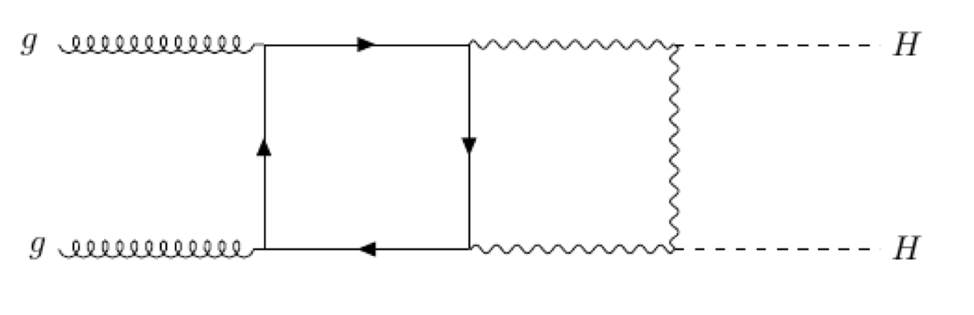
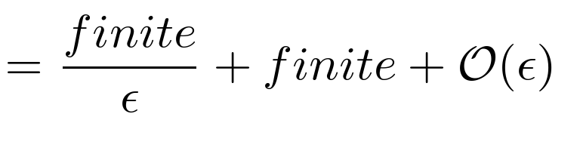
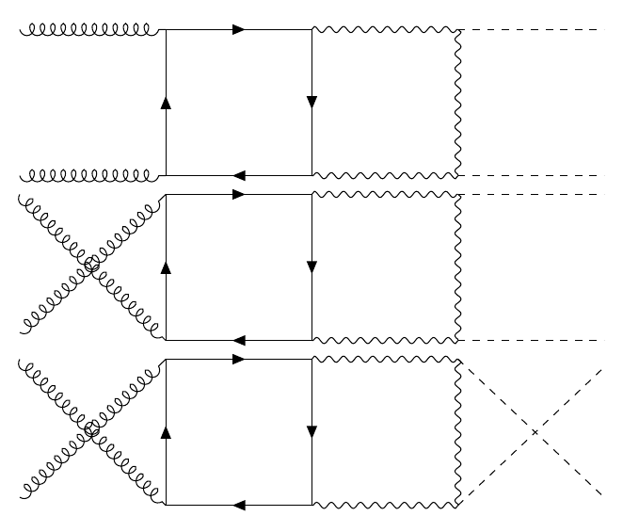
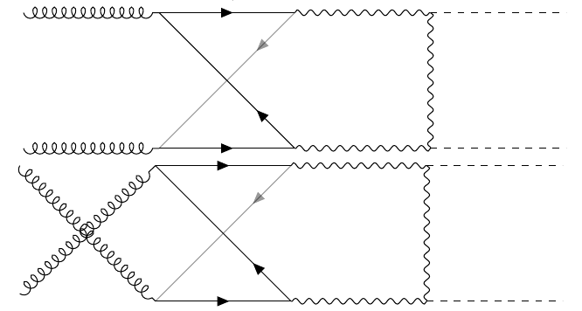
Workflow
Sanity Check:
Generate Diagram
Assign Momenta
Feynman Parameters
Then, the sum:
Thresholds and Endpoints
Monte-Carlo Methods
Loop Integration
Expand in powers of Epsilon
Monte-Carlo Methods
As expected, no renormalisation required for the light-quark loops
No (hidden) singularities missed!

Slide 19
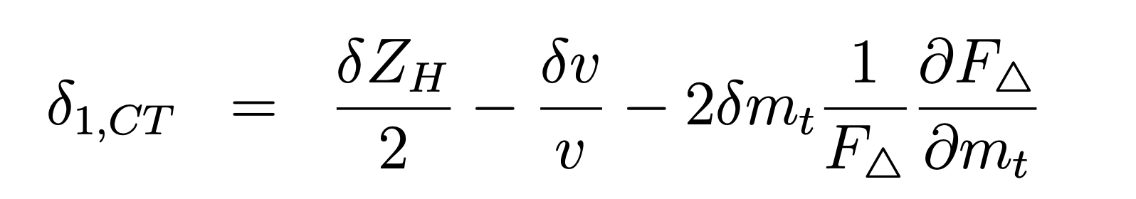
Renormalisation Rundown: Top-Yukawa
Triangles:
2-loop triangles
1-loop x 1-loop
Results from
[Mühlleitner et al. JHEP 10 (2022) 185]
OS
OS
Muon decay in G_{F} scheme

Slide 20
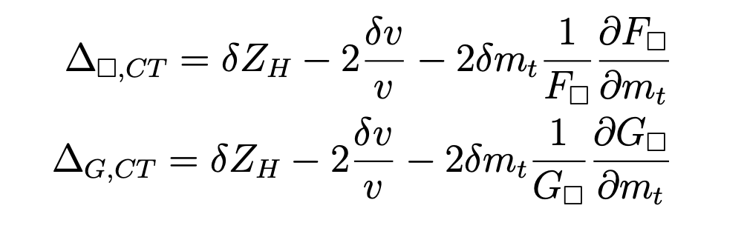
Renormalisation Rundown: Top-Yukawa
Triangles:
2-loop boxes:

Slide 21
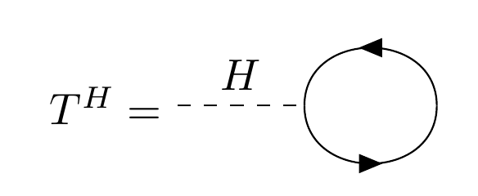
Tadpole Renormalisation Schemes
[Denner Fortschr. Phys. 41 (1993) 307–420]
[Fleischer, Jegerlehner, PRD 23 (1981) 2001]
Tadpole Schemes | Parameter-renormalised (PR) | Fleischer-Jegerlehner (FJ)
Origin of | Renormalisation of tadpole parameter t in Higgs potential | Shift of Higgs field
Tadpole diagrams? | Cancel against ; dropped everywhere | Kept explicitly in all 2-point functions and 3-point bosonic vertices
Consequences to counterterms | Mass CTs gauge dependent | Gauge independent
Physical result | Gauge independent | Gauge independent
Requirement:

Slide 22
Tadpole Renormalisation Schemes
[Denner Fortschr. Phys. 41 (1993) 307–420]
[Fleischer, Jegerlehner, PRD 23 (1981) 2001]
Tadpole Schemes | Parameter-renormalised (PR) | Fleischer-Jegerlehner (FJ)
Origin of | Renormalisation of tadpole parameter t in Higgs potential | Shift of Higgs field
Tadpole diagrams? | Cancel against ; dropped everywhere | Kept explicitly in all 2-point functions and 3-point bosonic vertices
Consequences to counterterms | Mass CTs gauge dependent | Gauge independent
Physical result | Gauge independent | Gauge independent
Requirement:
FJ in practice:
Renormalized amplitude identical in FJ and PR schemes: tadpole-dependent counterterm pieces cancel

Slide 23
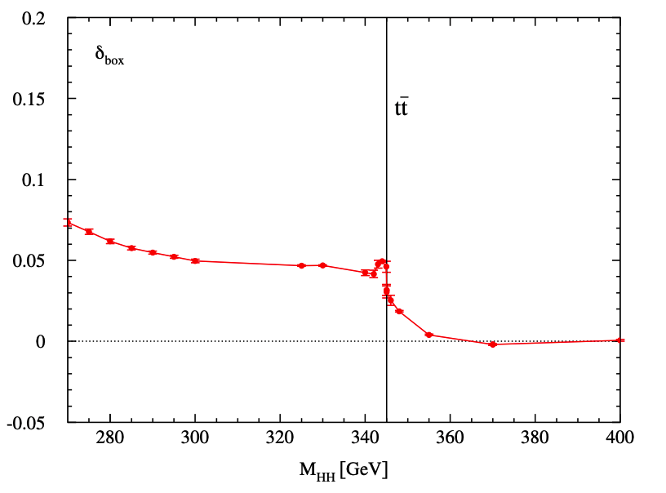
Looping back…
Bin-free: resolves individual points, not finite width-histograms
Detailed structure of virtual thresholds
Cross check: Shoulder-like shape indicative of p-wave ttbar threshold – in agreement with single Higgs production
Dominant contributions from F₁
Finite slope in large M_{HH}

Slide 24

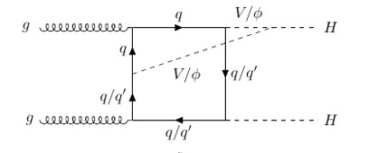
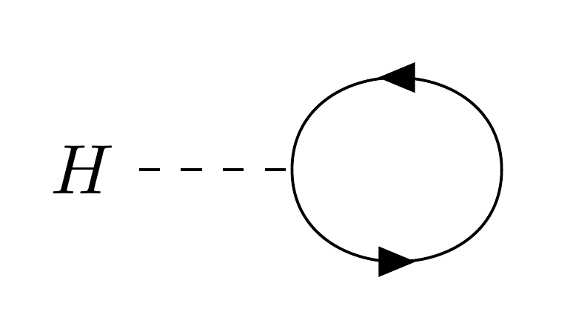
Full NLO Electroweak Calculation
Heavy-quark loops
  Top/bottom loops with non-zero quark masses
Triple and Quartic gauge interactions
  New topology types
Massive gauge boson extension of top-Yukawa corrections
  Gaugeless limit Full EW theory
Renormalisation
  More mass scales, counterterms and tadpoles
  Use both FJ and PR tadpole schemes as cross check
Full NLO EW corrections to complement existing NLO QCD corrections

Slide 25
Conclusion
Trilinear coupling is the primary target: HL-LHC aims for ~O(30%) precision for — requiring improved theory uncertainties
Light-quark (-1.5%) and top-Yukawa (-1.9%) corrections computed and contribute at the percent level — non-negligible at HL-LHC precision targets
Goal: Compute the remaining 2-loop EW contributions
With QCD corrections complete, full EW corrections would provide a pathway to develop this method into a community tool for cutting-edge loop calculations

Slide 26
Backup slides

Slide 27
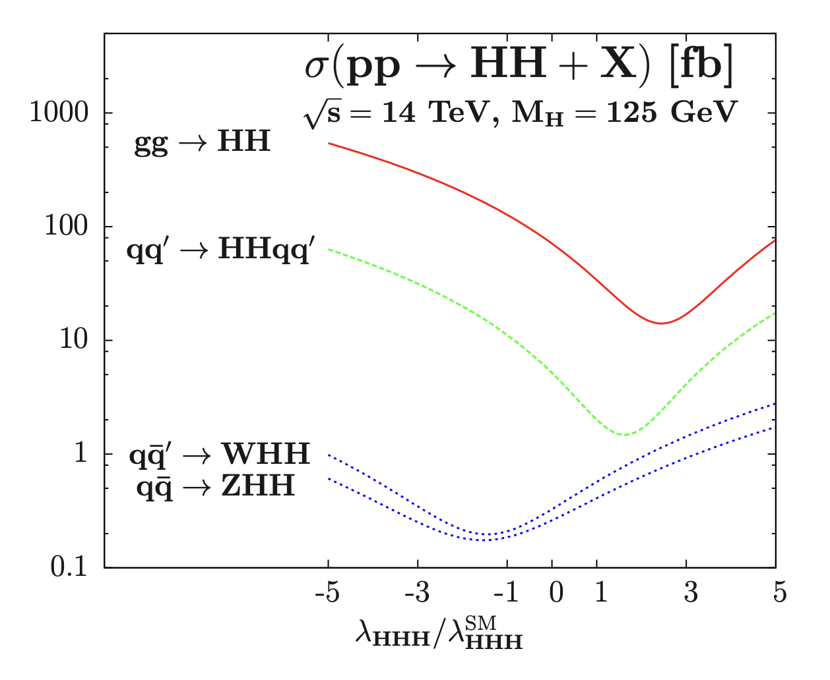
How does this help?
[Baglio et al. JHEP 1304 (2013) 151]

Slide 28
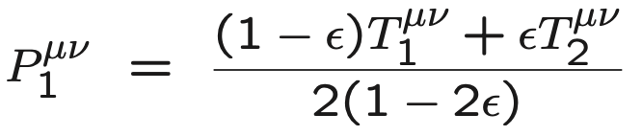
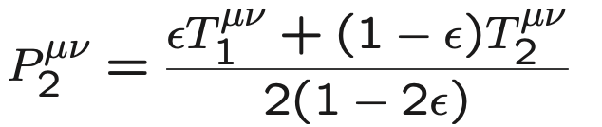
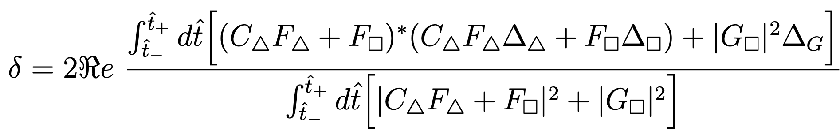
Further decomposition
Spin tensors:
transverse momentum of each final state Higgs
Projectors cast in D dimensions

Slide 29
First steps : Light-quark and top-Yukawa induced corrections
Gaugeless limit:
2. Top-Yukawa box topologies
[Brignole et al. Nucl.Phys.B 631 (2002) 195-218]
[Espinosa et al. Nucl.Phys.B 586 (2000) 3-38]

Slide 30
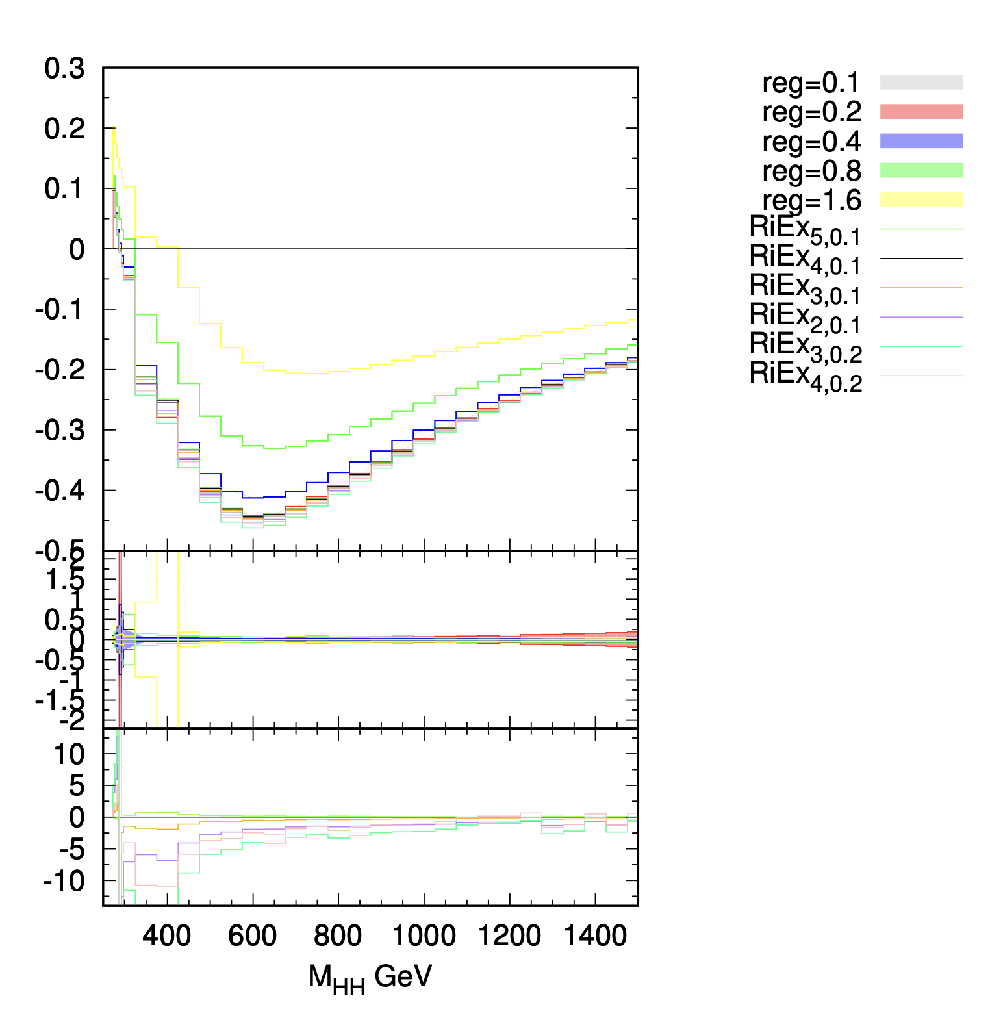
Stabilising the MC Integration: Richardson Extrapolation
[Glaus. PhD Thesis]
Feynman integrals are now regulator dependent:
Generate iterative function defined as:
…

Slide 31
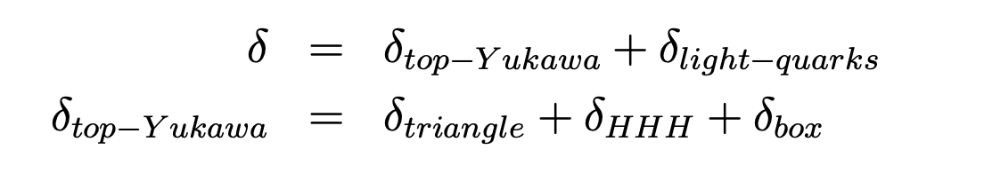
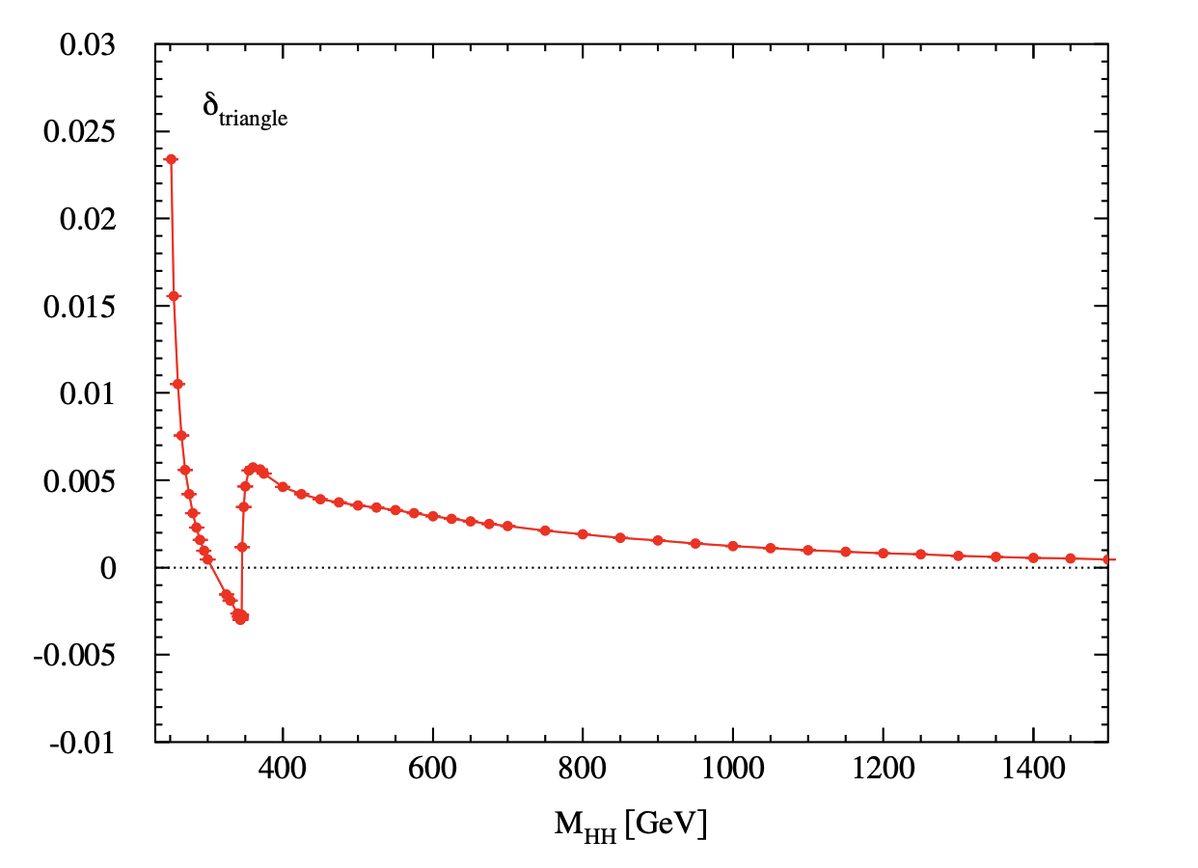
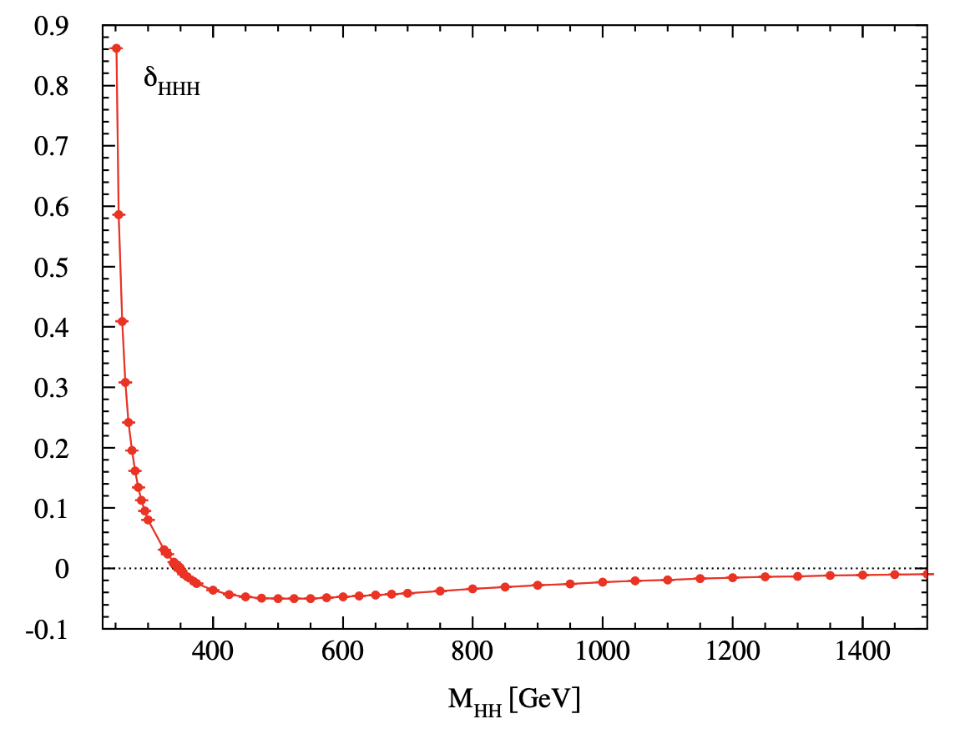
Top-Yukawa contribution decomposition

Slide 32
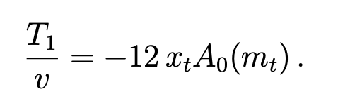
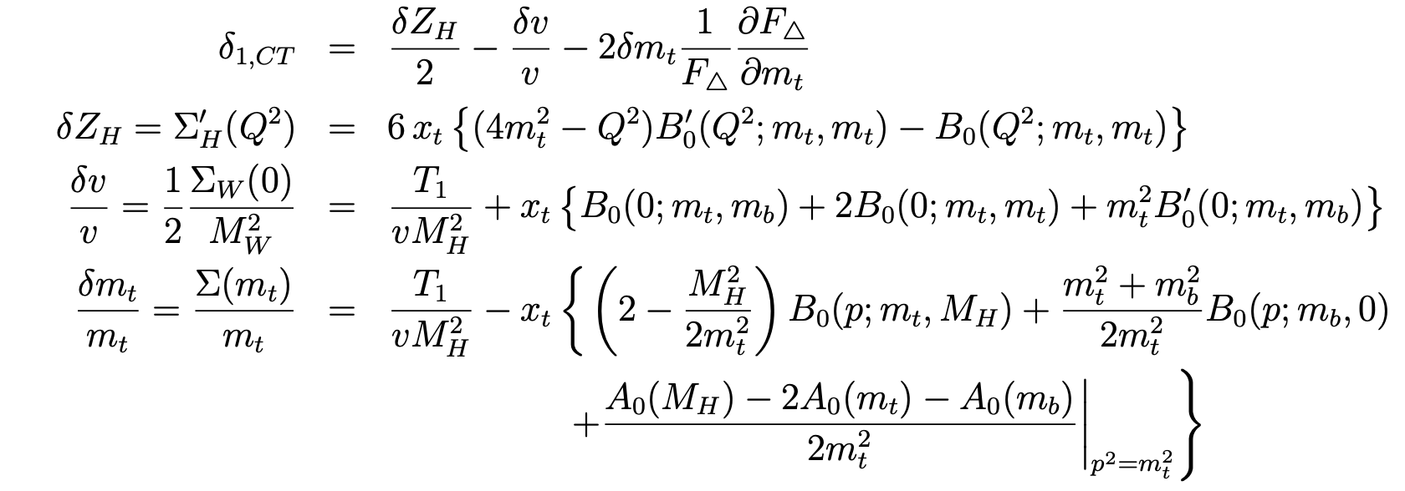
Renormalisation details – Top Yukawa
Tadpoles:
Counterterms:

Slide 33
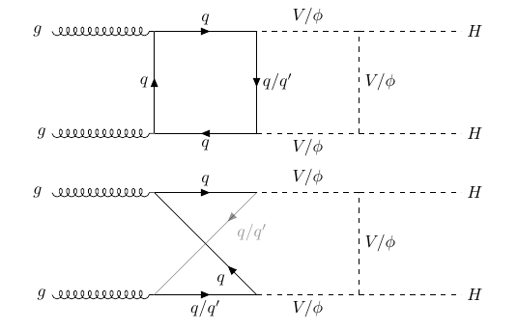
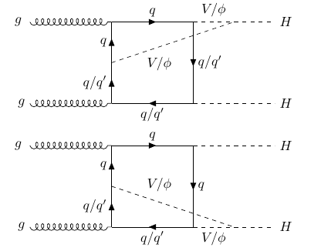
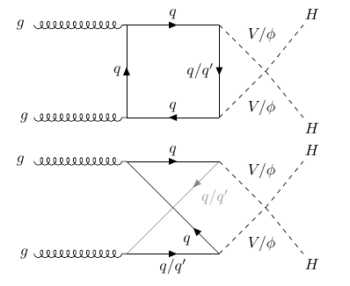
Full NLO Electroweak Calculation
Heavy-quark loops
2. Triple gauge interactions
3. Quartic gauge interactions

