Slide 1
CEPC Beam Instrumentation
Yanfeng Sui，Junhui Yue
On behalf Beam Instrumentation Group
Accelerator Center, IHEP
CEPC workshop-EU Edition, April 15-17, 2019. Oxford.

Slide 2
Outline
Principle of design
Beam instrumentation of CDR
R&D of beam instrumentation
The plan to TDR
Summary

Slide 3
Principle of CDR
BI system provides precise and sufficient information of the beam
Improves the injection efficiency, optimizes the lattice parameters, monitors the beam behaviors and increases the luminosity
The main design philosophy is listed:
  To satisfy the requirement of long-term stable operation
  Appropriate precision and speed for the parameter measurement with large dynamic range
  Coupling impedance must be as small as possible
  The home-made products should be used as much as possible to reduce budget
  New technologies for future machine

Slide 4
Detailed information of sub-systems
 | Item |  | Method | Parameter | Amounts
Storage ring | Beam position monitor | Closed orbit | Button electrode BPM | Measurement area (x × y)：±20mm×±10mm Resolution：<0.002mm Measurement time of COD：< 4 s | 2900
 |  | Bunch by bunch | Button electrode BPM | Measurement area (x × y)：±40mm×±20mm Resolution：0.1mm | 2900
 | Bunch current |  | BCM | Measurement range：10mA / per bunch Relatively precision：1/4095 | 2
 | Average current |  | DCCT | Dynamic measurement range：0.0~1.5A Linearity：0.1 % Zero drift: <0.05mA | 2
 | Beam size |  | Double slit interferometer x ray pin hole | Resolution:0.2 µm | 4
 | Bunch length |  | Streak camera Two photon intensity interferometer | Resolution:1ps | 2
 | TUNE measurement |  | Frequency sweeping method | Resolution:0.001 | 2
 |  |  | DDD | Resolution:0.001
 | Beam loss monitor |  | PIN-diode | Dynamic range:120 dB Maximum counting rates≥10 MHz | 5800
 | Feedback system |  | TFB | Damping time<=rise time | 2
 |  |  | LFB | Damping time<=rise time | 2

Slide 5
Detailed information of sub-systems
 | Item |  | Method | Parameter | Amounts
Booster | Beam position monitor | Closed orbit | Button electrode BPM | Measurement area (x × y)：±20mm×±10mm Resolution：<0.002mm Measurement time of COD：< 4 s | 1808
 |  | Bunch by bunch | Button electrode BPM | Measurement area (x × y)：±40mm×±20mm Resolution：0.1mm | 1808
 | Bunch current |  | BCM | Measurement range：10mA / per bunch Relatively precision：1/4095 | 2
 | Average current |  | DCCT | Dynamic measurement range：0.0~1.5A Linearity：0.1 % Zero drift: <0.05mA | 2
 | Beam size |  | Double slit interferometer x ray pin hole | Resolution:0.2 µm | 2
 | Bunch length |  | Streak camera Two photon intensity interferometer | Resolution:1ps | 2
 | TUNE measurement |  | Frequency sweeping method | Resolution:0.001 | 2
 |  |  | DDD | Resolution:0.001
 | Beam loss monitor |  | optical fiber | Space resolution:0.6m | 400
 | Feedback system |  | TFB | Damping time<=rise time | 2

Slide 6
Detailed information of sub-systems
Beam position monitor
Beam current monitor
Beam loss monitor
Beam profile and length measurement
Tune measurement system
Feedback systems
Other

Slide 7
Beam Position monitor
To provide the beam position and orbit
To calculate machine parameters related to beam position
Apart from specific BPMs, there are 4708 BPMs in booster and storage ring.
Along the entire tunnel, auxiliary short tunnels can be used as the local station to install electronics of BPMs. Two layer of shielding are adopted, polyethylene and lead.
Button type electrode will be adopted, for its good high frequency response and small beam impedance
The resolution of BPM will be ~2um level

Slide 8
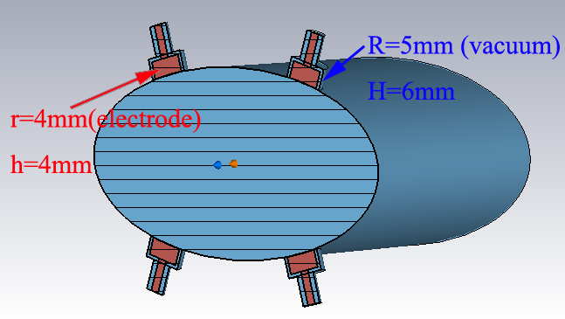
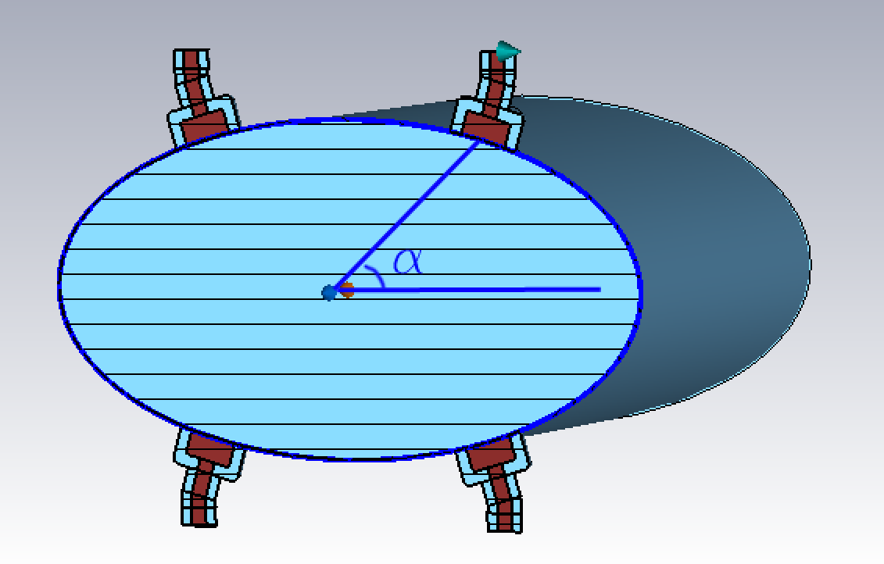
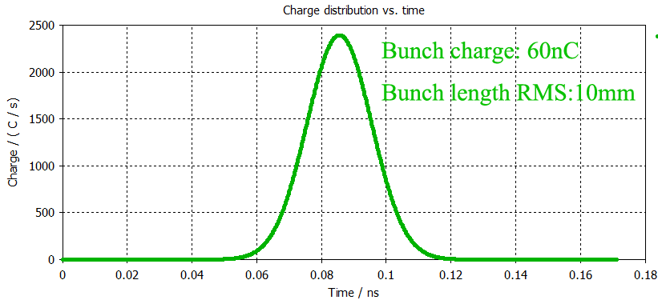
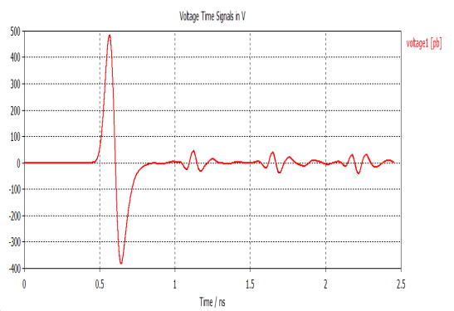
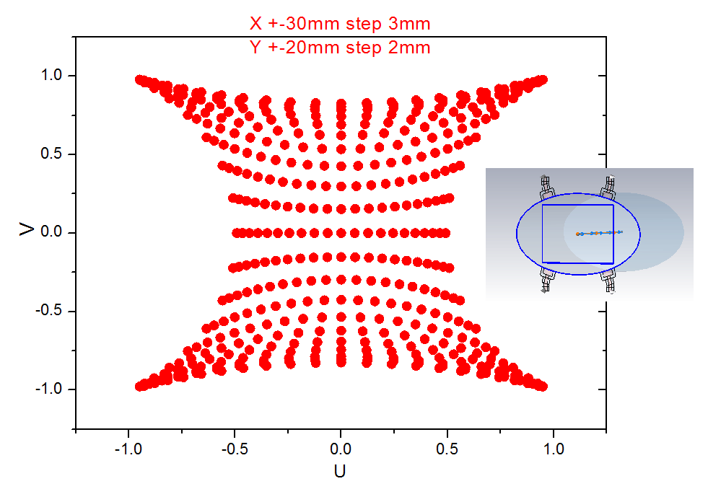
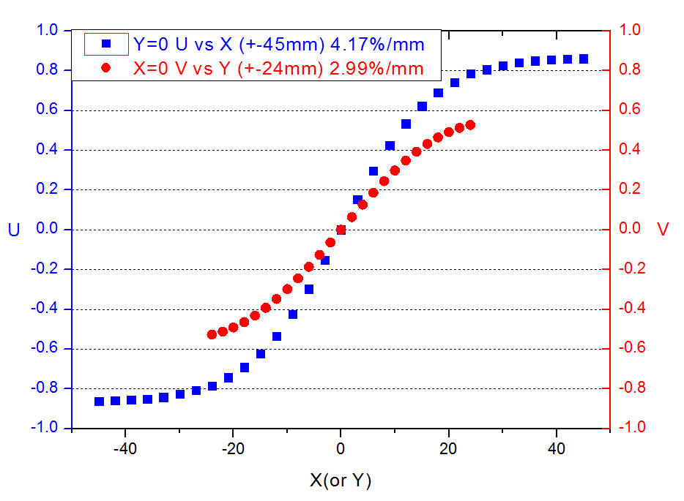
BPM simulation
Voltage getting on the pickup is more than 100V when button diameter is 8mm
Sensitivity be simulated at the different angle

Slide 9
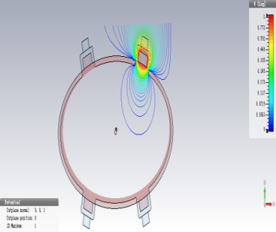
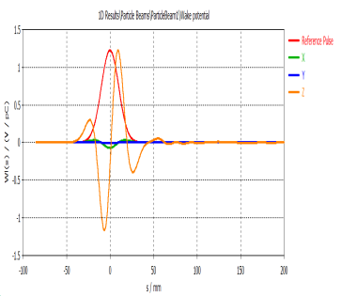
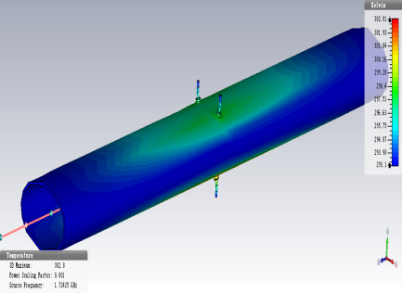
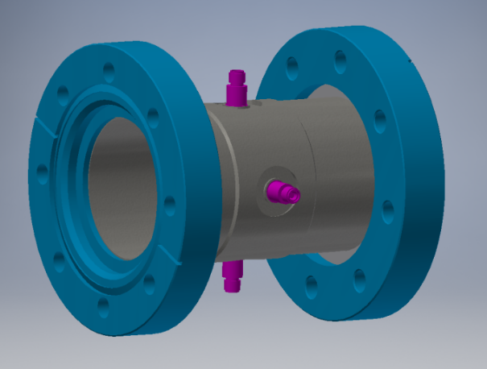
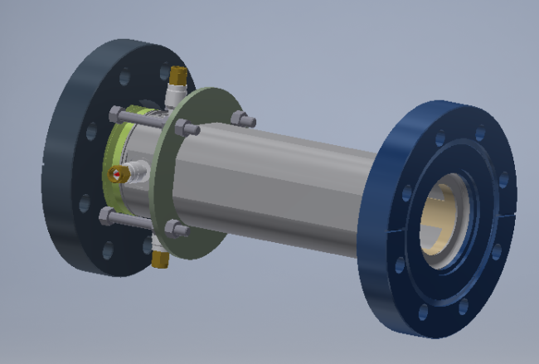
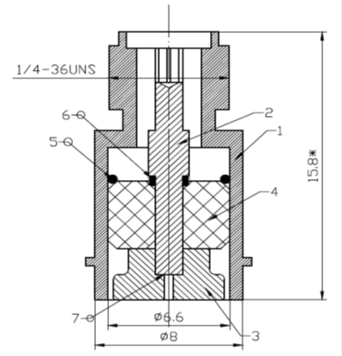
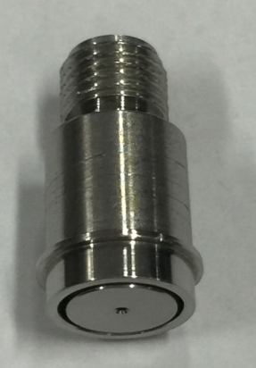
BPM simulation
Heat of pickup induced by beam is simulated
The highest temperature is 303K near the pick-ups
The BPM of storage ring
The BPM of Linac and BT
BPM feed through

Slide 10
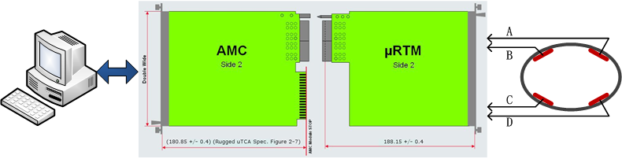
Electronics design
Adopt MicroTCA.4 standard
Electronics including three parts: RF Frontend board, Digital board, Timing module

Slide 11
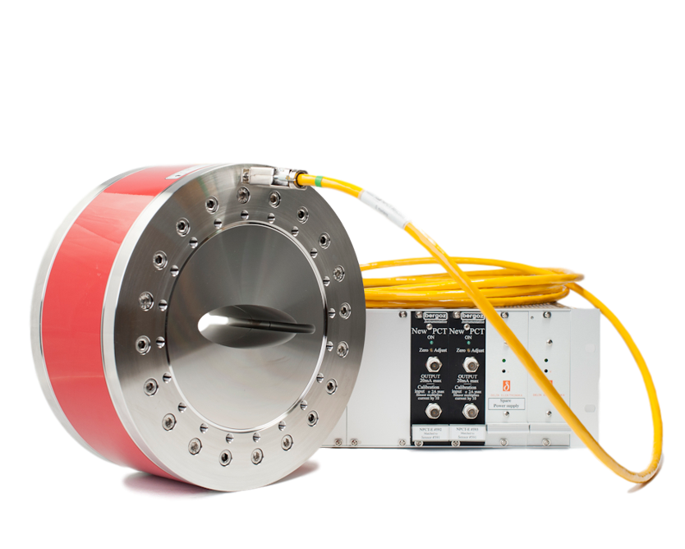
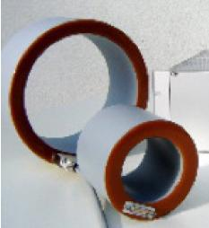
Beam current monitor
Including DCCT (for average current) and BCM (bunch current monitor)
Using Bergoz-type DCCT to measure the average current of the beam and to calculate the life time of beam. The resolution will be µA level;
Bunch current monitor can give current of every bunch, we can use Fast ADC to measure the sum signal of BPM.

Slide 12
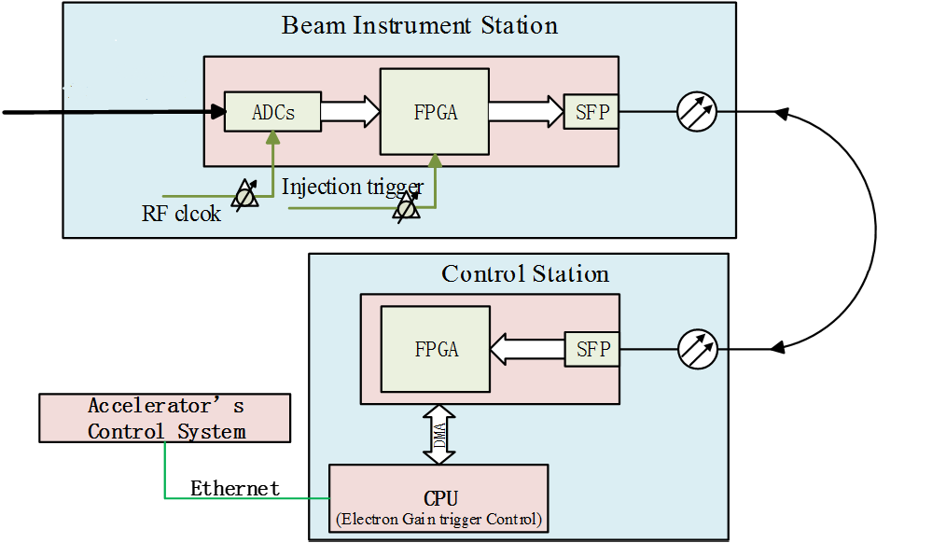
Bunch current monitor
Picking up signal from the BPM
High speed digital signal acquiring and processing module
The bucket selection program

Slide 13
Beam loss monitor
This system can be used to study the beam loss and to understand the beam behavior.
The following important factors are focused for selecting the right type of BLM for a specific application in CEPC: intrinsic sensitivity, dynamic range, radiation hardness, response time and sensitivity to synchrotron radiation (SR).
The improved PIN-photodiode in storage ring and the Quartz Fiber in booster for large range of beam energy

Slide 14
Beam profile and length measurement
Beam size measurement based on synchrotron light, Double Slit Interferometer and x ray pinhole will be used；
Streak camera can be used to measure the bunch length, the resolution will be 1ps , Hamamatsu and Optronis both have precision streak cameras.
Two photon intensity interferometer can be used to measure the bunch length(very shortly)
Four beam line is needed, visible light and x ray beam line separately for positron and electron.
Thermal loading of first mirror should be considered.

Slide 15
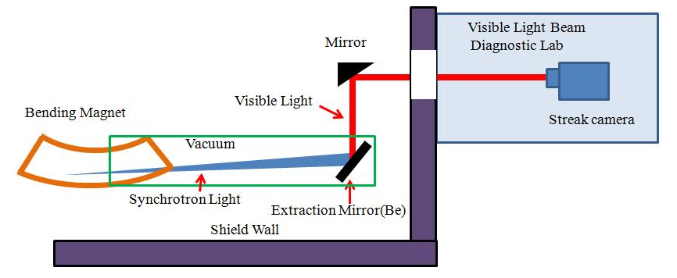
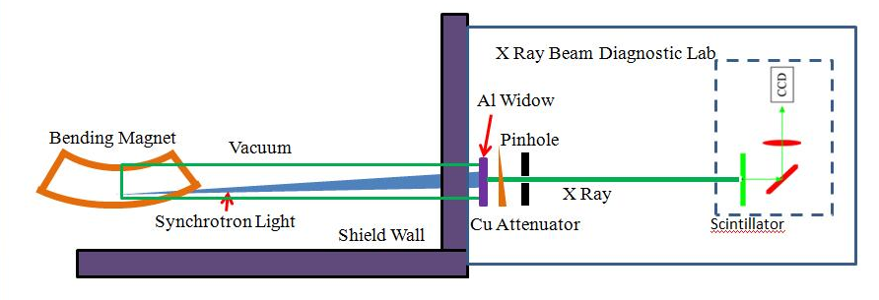
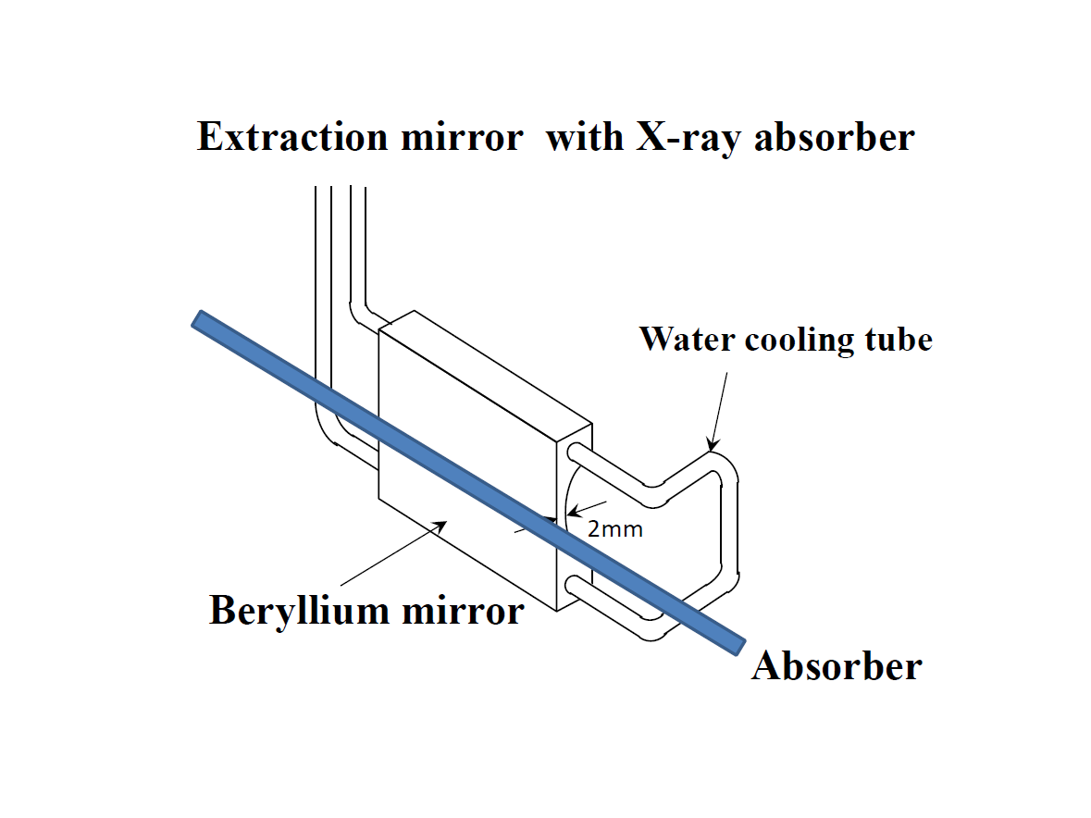
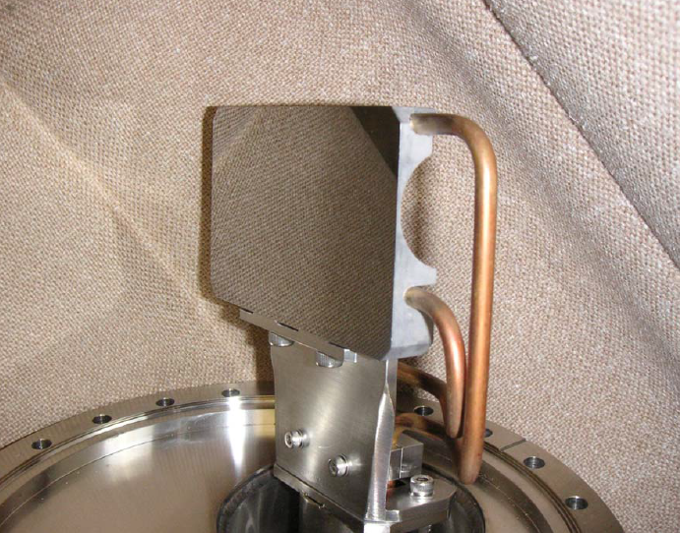
Special diagnostic beam line
Visible light beam line
X ray beam line
KEK type Be extracted mirror

Slide 16
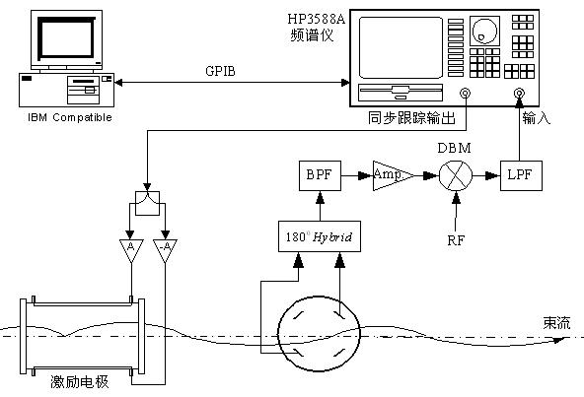
Tune measurement system
Frequency sweeping method with gated pulse or FFT analyzing to the data from the digital BPM.
The BPM monitor, signal processing unit and the kicker form the entire system.
Direct Diode Detection（3D）is another choice for tune monitor

Slide 17
Feedback system
Coupled bunch instabilities may occur due to the HOMs, the nature damping time is not enough to damp the beam.
feedback systems are for x/y/z directions.
Beam pickup signal can be used for both transverse direction and longitudinal direction.
Multi feedback system in same ring can be used to reduce damping time. The beam test have been done in BEPCII.
Multi-pickups for feedback system can decrease the time delay of the system.

Slide 18
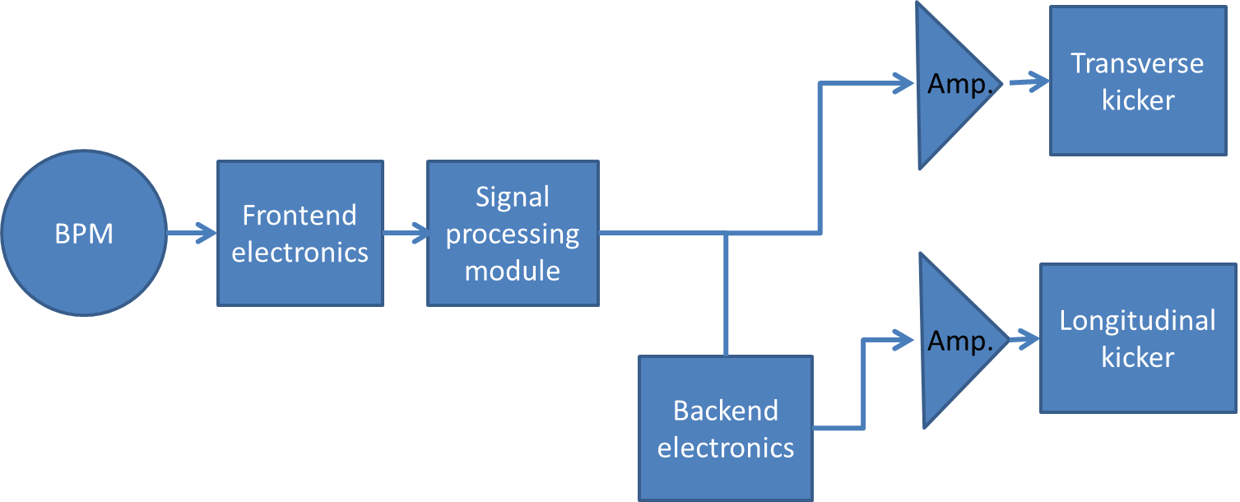
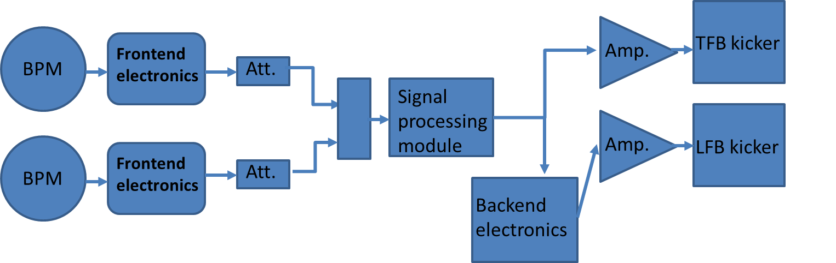
Two topologies of FB design
One BPM and One kicker, 90 degree phase shift and DC filter both are got in FPGA.
The tap number is always more than 2.
Two BPMs and One kicker, 90 degree phase shift can got by adjusting the amplitude of two BPMs signal and DC filter are got in FPGA.
The tap number is 2.

Slide 19
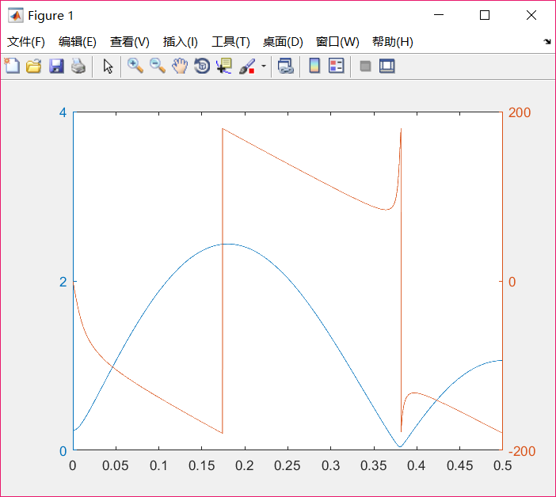
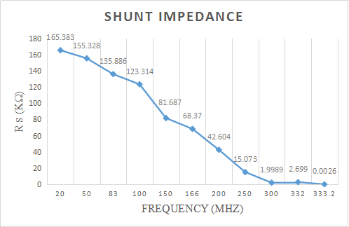
TFB system of CEPC booster ring
parameter | Value
tune | 263.2/261.2
Beta function（m） | 120
Energy（GeV） | 10
Rising time（ms） | 3.1
Revolution time（ms） | 0.33
Bunch spacing（ns） | 25
Bunch frequency（MHz） | 40
Kicker shunt impedance（kΩ） | 125@40MHz
Damping time（ms） | 1.78
Amplitude of oscillation（mm） | 0.3
4-tap filter response
Taking E=10GeV，β_{m}=β_{k}=120m，Δx=0.3mm, τ_{FB} =1.45 ms，so ΔV_{FB⊥}＝9.27kV, P=344w.

Slide 20
Parameters of CEPC main ring
parameter | Higgs | W | Z
nus | 0.065 | 0.04 | 0.028
Nux/nuy | 363.10 / 365.22
Energy（GeV） | 120 | 80 | 45.5
alphp | 1.11E-5
Rising time（ms） | 51.6 | 19.6 | 2.3
Natural damping time(ms） | 46.5 | 156.4 | 850
Revolution time（ms） | 0.33
Bunch number | 242 | 1524 | 12000
Bunch spacing（ns） | 680 | 210 | 25
current（mA） | 17.4 | 88 | 461
Z is the most dangerous mode which need feedback system.
Fast beam ion instability is dominant.
Damping time requirement for transverse feedback : <2.3ms

Slide 21
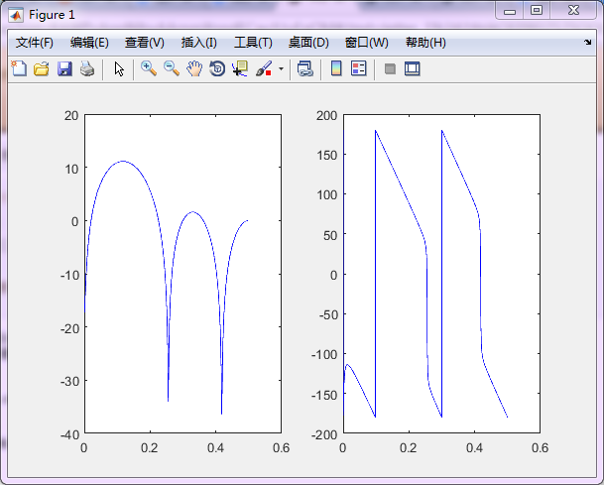
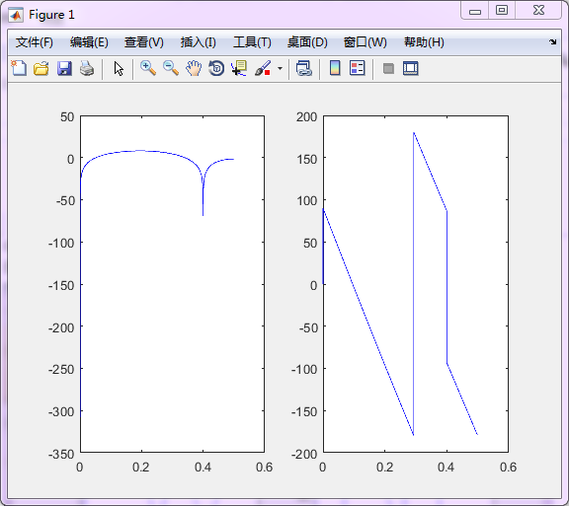
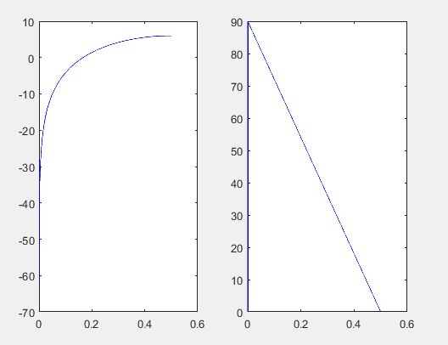
Digital filter design
6 tap filter(0.1)
5 tap filter (0.2)
2 tap filter (0.1/0.2)

Slide 22
Calculation result of TFB on main ring
1，two BPMs, one kicker.
2，2-tap filter, total processing time is about 2 turn，0.66ms
3，Damping time should be smaller than 1.64ms.
For CEPC main ring，E=45.5GeV，β_{m}=225m，β_{k}=225m，Δx=0.2mm, take τ_{FB} =1.60ms，so ΔV_{FB⊥}＝16.7kV, P=898w.
AR 500A250A, the output power is 500w.
Optional choice：using multi-TFBs to shorter the damping time.

Slide 23
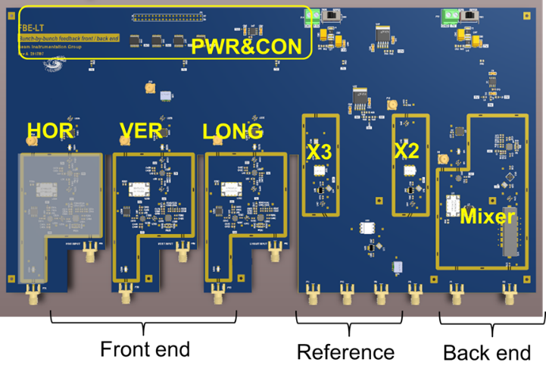
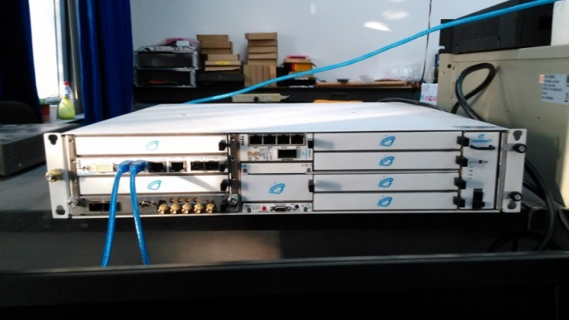
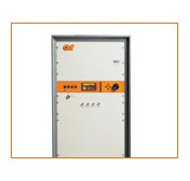
Hardware for TFB system

Slide 24
R&D of Beam instrumentation of CEPC
BPM electronics
DDD(3D) tune measurement
Multi-feedback systems

Slide 25
R&D Motivation
To reduce the budget of BI system, due to a large number of beam position monitors and the high price of commercial products.
Customized for different part of CEPC，just as Linac, Booster and storage ring.
Easy to maintain and upgrade.

Slide 26
The BPM electronics
The R&D of BPM electronics founded by seed money of IHEP and other funding（HEPS-TF etc.）
Kicked off in the start of 2015

Slide 27
The BPM electronics
RF front-end (RTM)
Digital electronics(AMC)
Signal processing and algorithm
Software

Slide 28
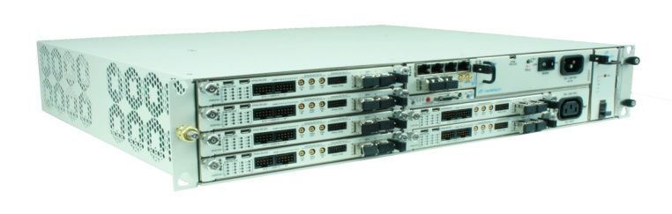
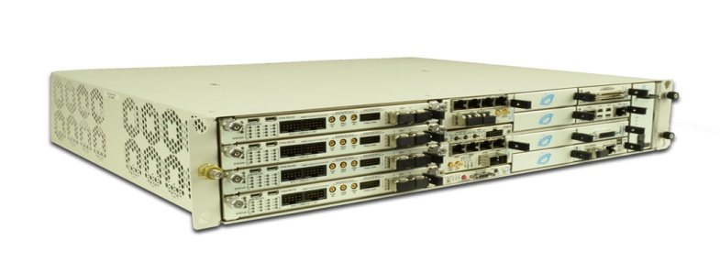
The BPM electronics
Micro TCA.4
“AMC+RTM”
DBPM_AMC
DBPM_RTM

Slide 29
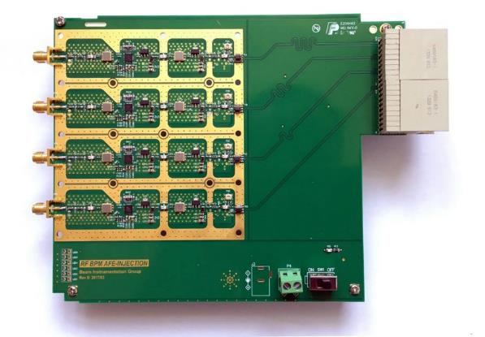
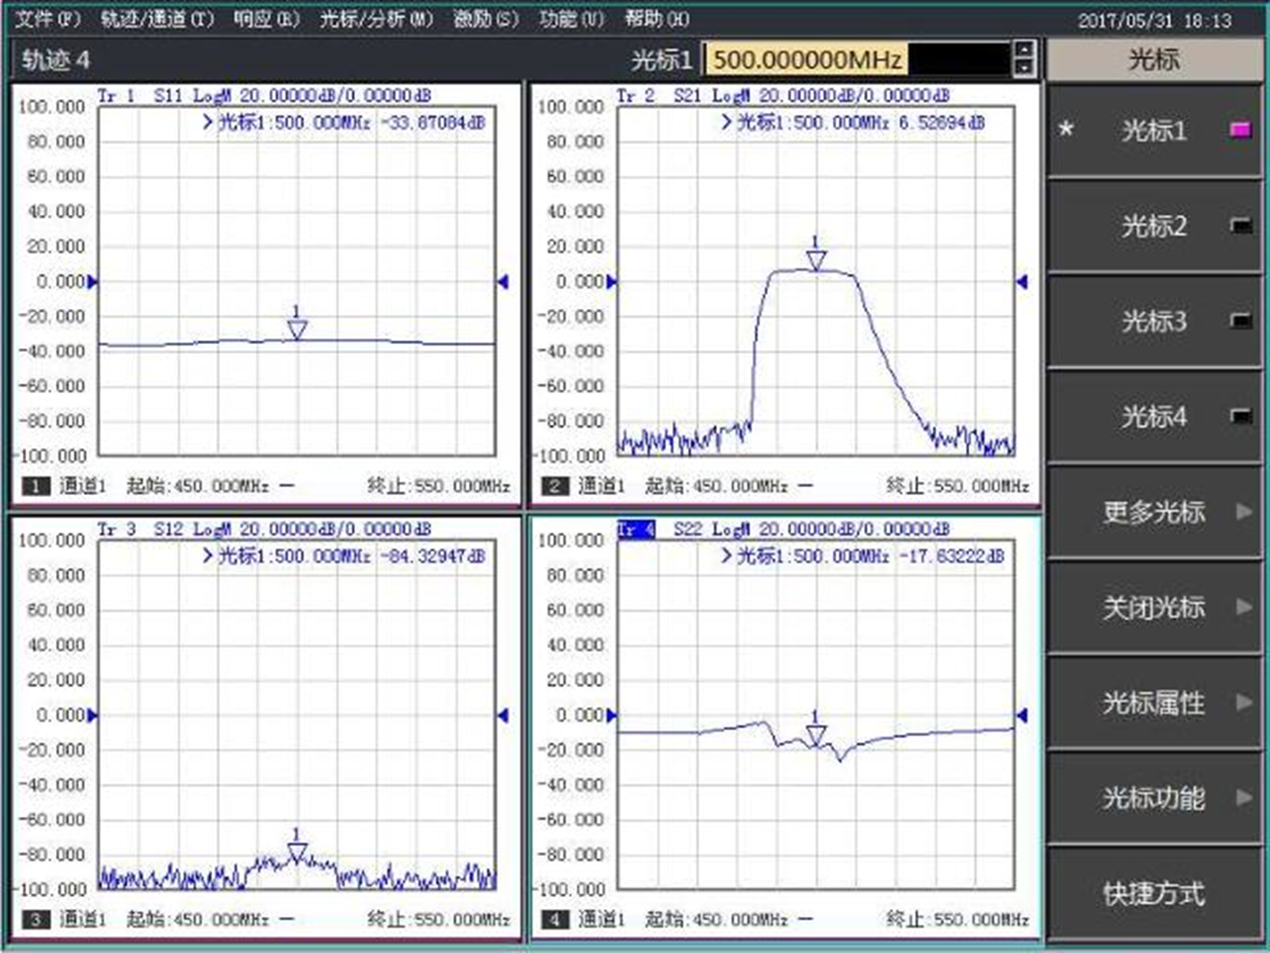
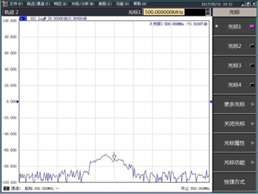
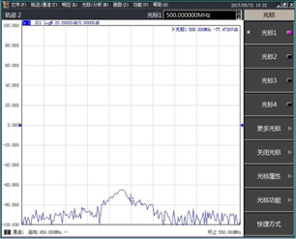
The RTM electronic
S11
S21
The performance of band pass filter is good!
S12
S22
Receiver S-Parameter Characterization
--78.824dBm
--77.473dBm
-60dBm
-60dBm
A→B 6.5dBm→-78.8dBm
B→A6.5dBm→-77.47dBm

Slide 30
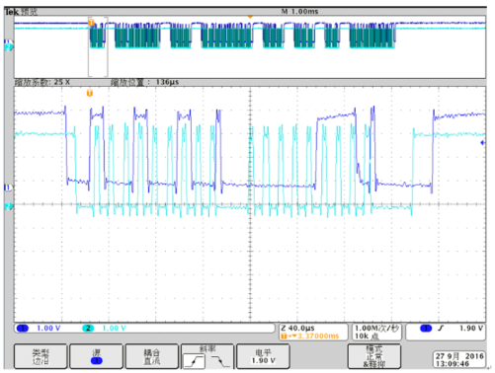
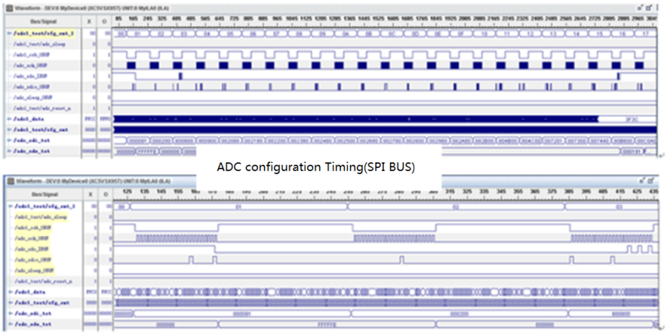
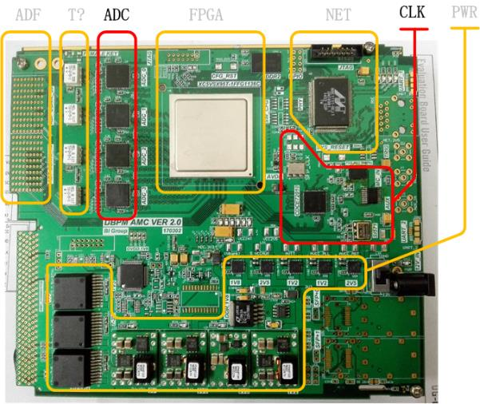
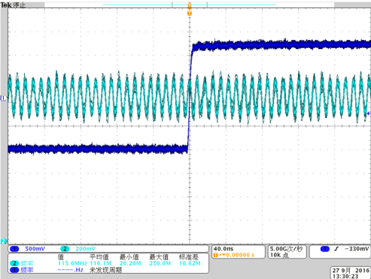
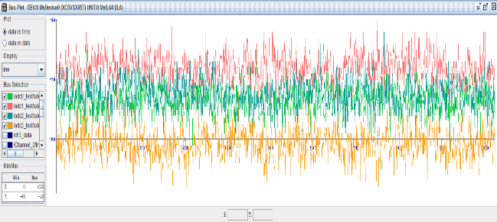
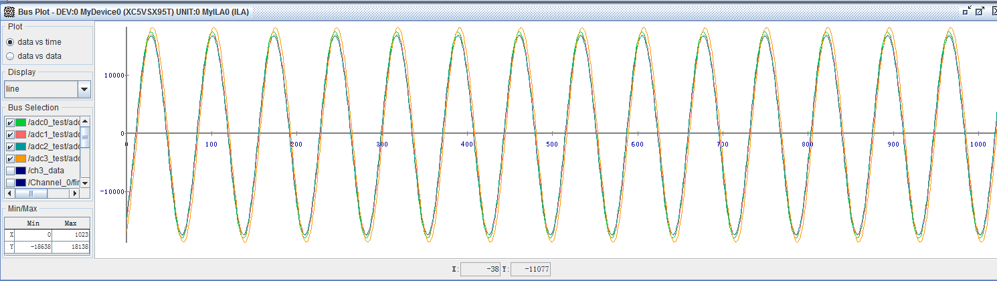
The BPM electronics
AMC electronic
Clock logic
ADC logic

Slide 31
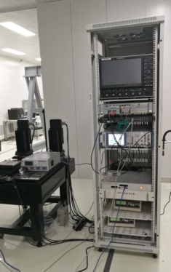
Test in lab

Slide 32
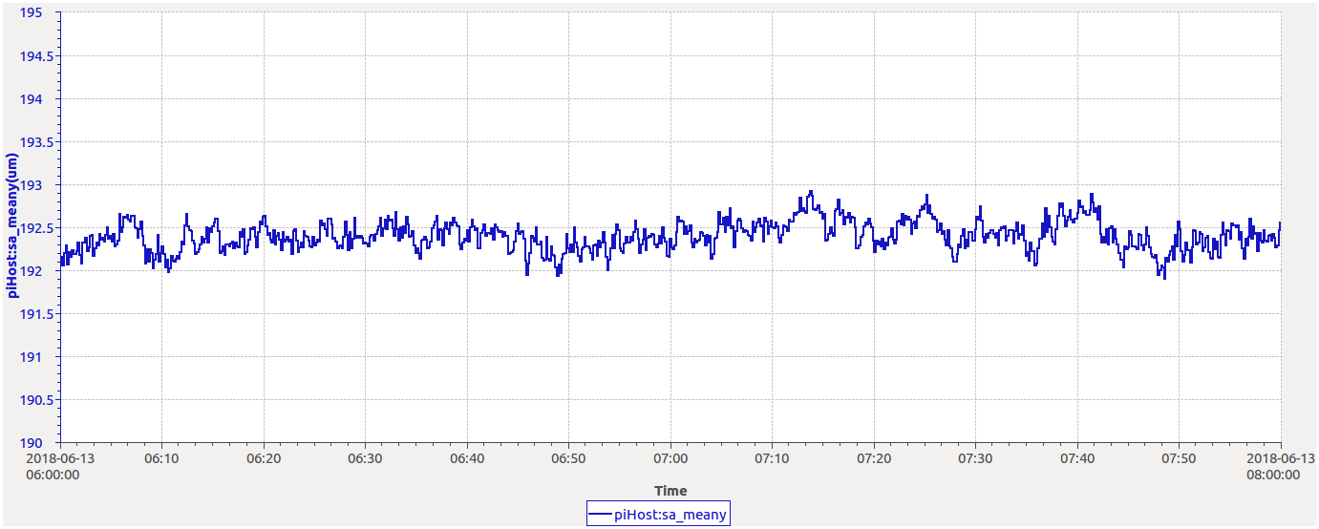
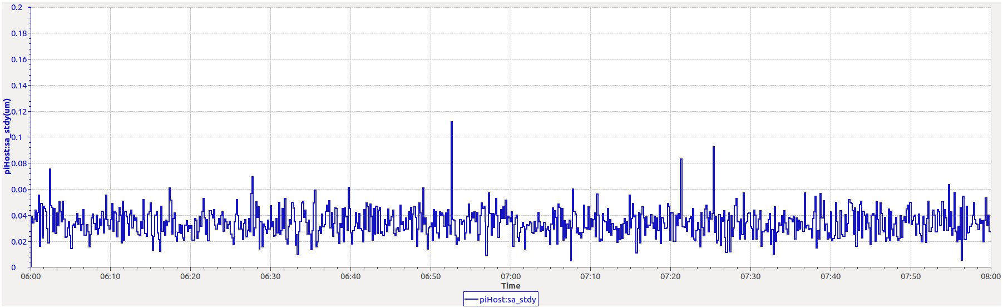
The test results in lab
The beam position test result of home-made electronics in lab
The resolution of home-made BPM electronics is 20~60nm

Slide 33
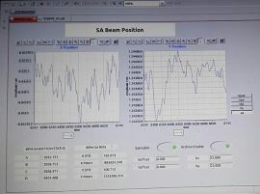
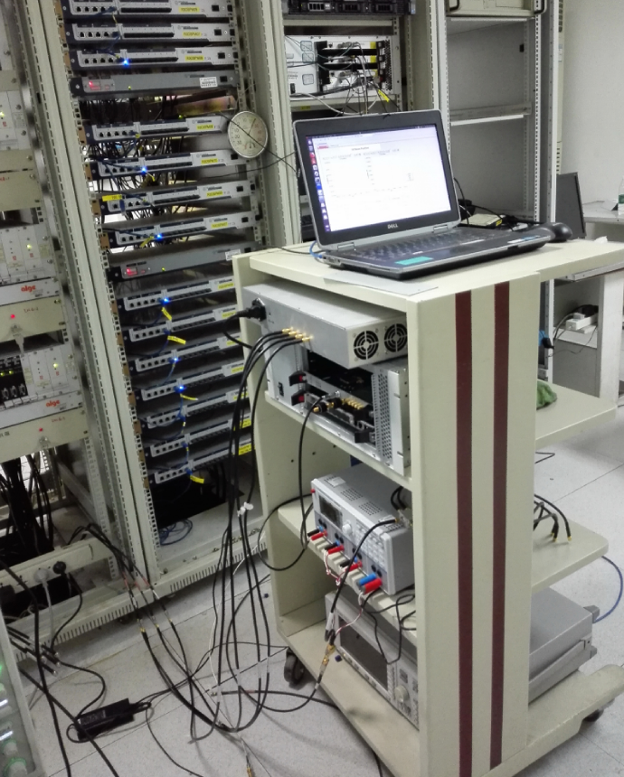
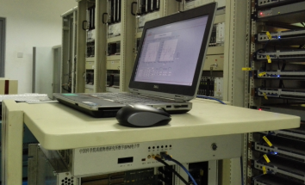
Beam test in BEPCII

Slide 34

Beam test in BEPCII
The beam position result of commercial BPM（Blue）@ R2O-BPM11
The beam position result of home-made BPM（Red） @ R2O-BPM10

Slide 35

The performance is as good as the commercial product
Commercial BPM ：
Beam position:1.3997mm，
Resolution :4.6µm。
Home-made BPM：
Beam position:1.1009mm，
Resolution:3.2µm。

Slide 36


Other systems
The Direct Diode Detect (DDD) tune measurement tested in BEPCII
The multi-feedback systems tested with beam in BEPCII
The result of DDD tune measurement system
The damping time of two TFBs

Slide 37
The plan to TDR
The BPM electronics
  Long time stability: Pilot tone, temperature control
  Large dynamic range
  Radiation hardness
  Industrialization
Transverse Profile Measurements R&D
  Cooling of SR extraction mirror
  X-ray interferometer, Gas jet scanner
Beam loss monitor
The beam instrumentation in interaction point(IR)
  Beam Orbit
  Arrival time

Slide 38
summary
Finished the beam instrumentation CDR and moved to TDR
Digital BPM electronics tested in lab and BEPCII with real beam. The test results shows that the in-house electronics is almost as good as commercial products.
Finished The DDD tune measurement and multi-feedback system beam test.
Longitudinal feedback system will be studied in future.
Much work and critical technologies to be done towards TDR

Slide 39
Thanks for your attention !

