Slide 1


CEPC MDI
Sha Bai
for CEPC MDI group
Workshop on the Circular Electron-Positron Collider, EU Edition 2019,
Oxford, April 15-17, 2019.
2019-04-16

Slide 2
Outline
MDI layout and IR design
IR Superconducting magnets
Synchrotron radiation
Beam loss background
Collimator design
HOM absorber
RVC
Mechanics and assembly
IP BPM
Summary

Slide 3
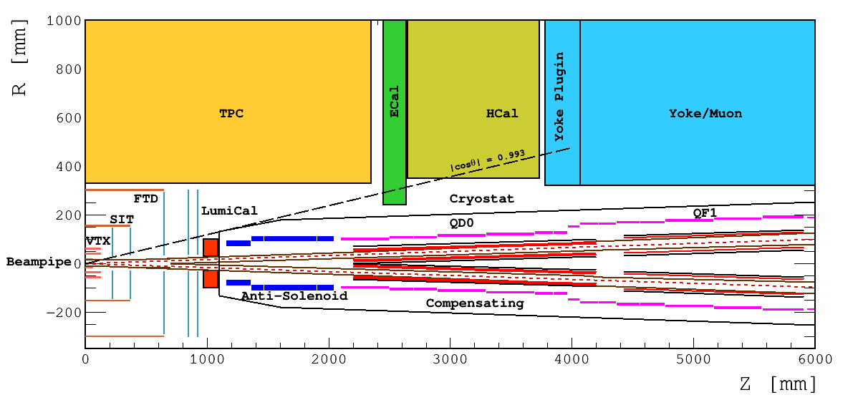
MDI layout and IR design
With Detector solenoid
Without Detector solenoid
~cryostat in detail
The accelerator components inside the detector without shielding are within a conical space with an opening angle of cosθ=0.993.
The e+e- beams collide at the IP with a horizontal angle of 33mrad and the final focusing length is 2.2m
Lumical will be installed in longitudinal 0.95~1.11m, with inner radius 28.5mm and outer radius 100mm.
The Machine Detector Interface (MDI) of CEPC double ring scheme is about ±7m long from the IP
The CEPC detector superconducting solenoid with 3T magnetic field and the length of 7.6m.

Slide 4
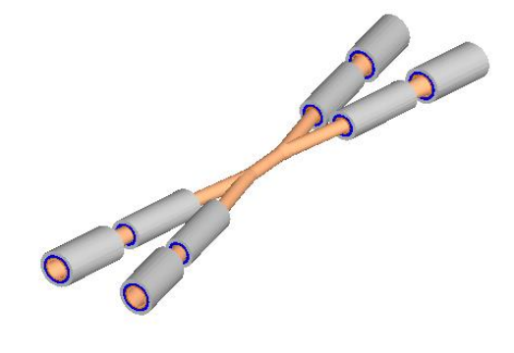
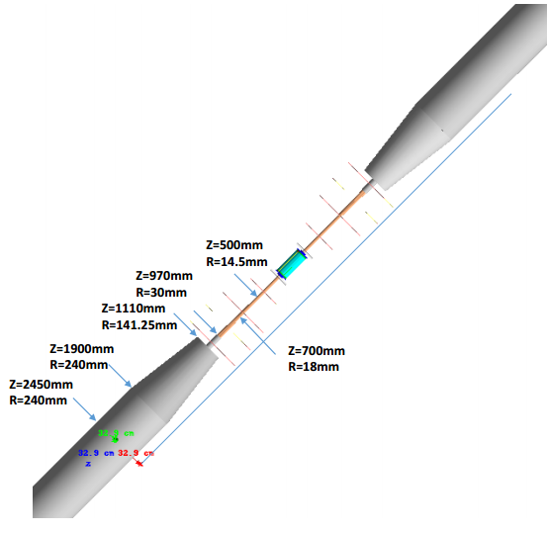
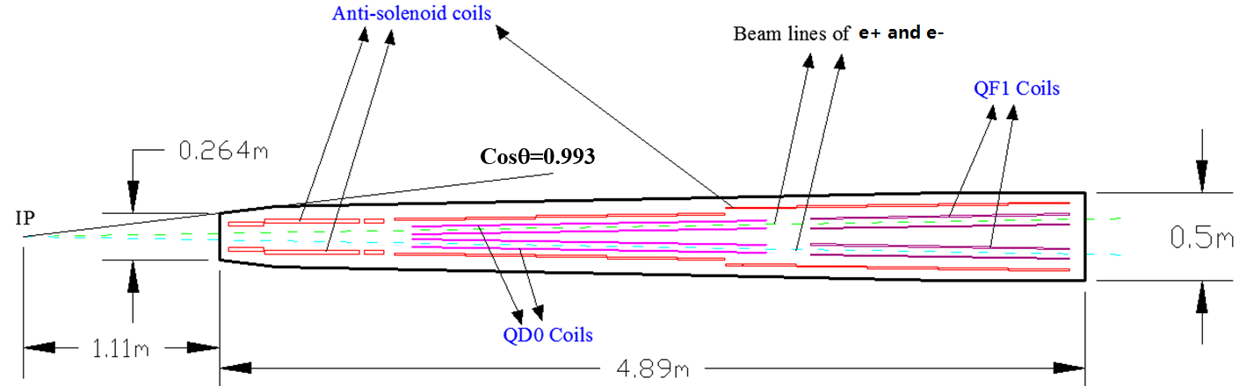
The design of interaction region
The inner diameter of the beryllium pipe is 28mm with the length of ±7cm.
Without tungsten shield.

Slide 5
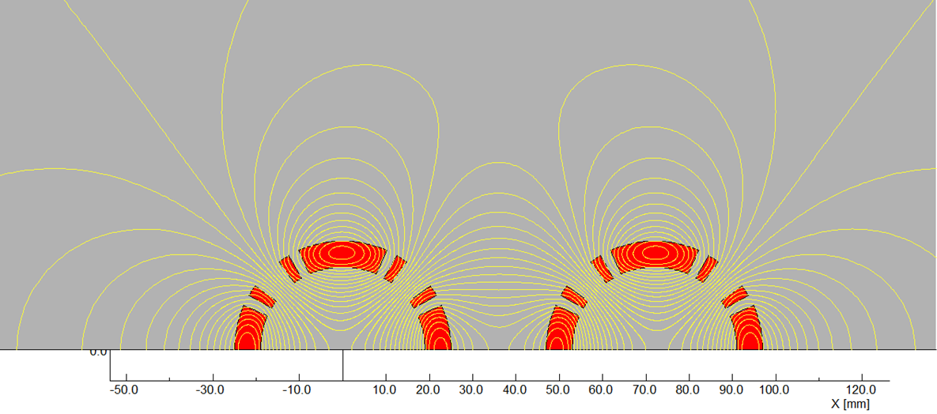
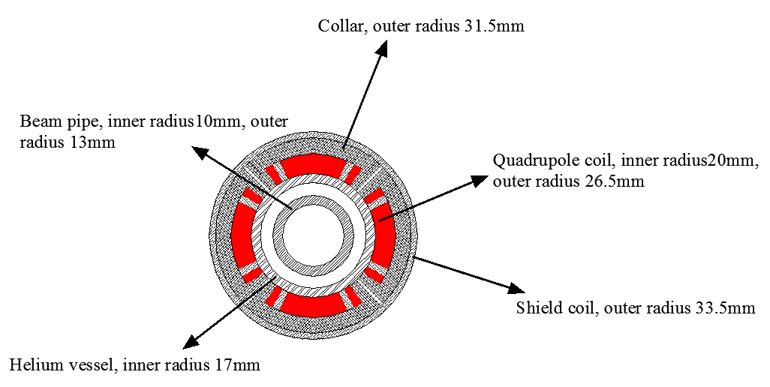
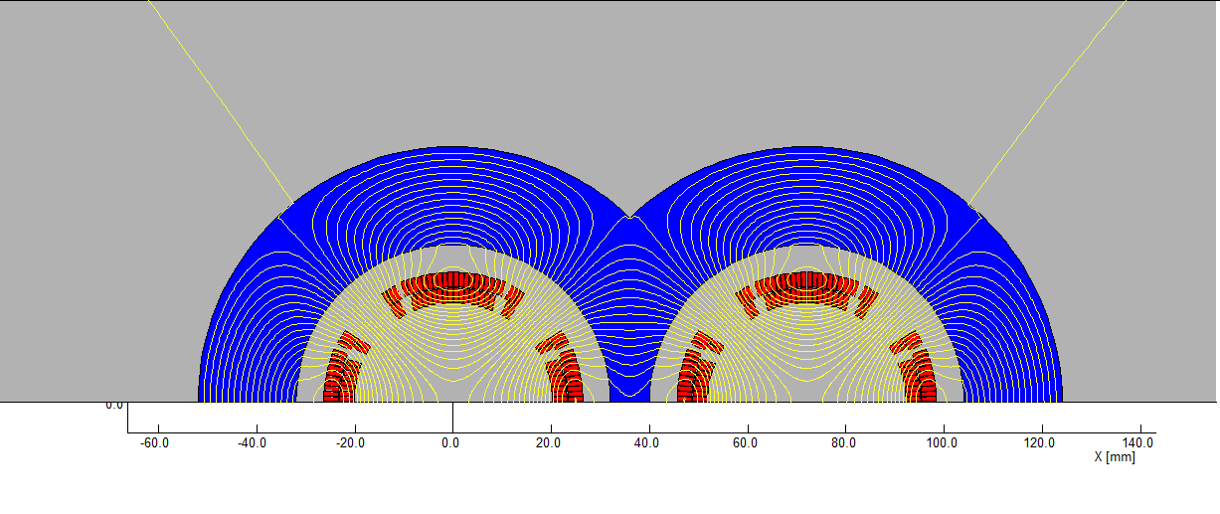
IR Superconducting magnets
Superconducting QD coils
Rutherford NbTi-Cu Cable
Two options w/o iron yoke.
Single aperture of QD0
(Peak field 3.2T)
Iron option for QD0 is investigated.
Room-temperature vacuum chamber with a clearance gap of 4 mm
*10⁻⁴
Magnet | Central field gradient (T/m) | Magnetic length (m) | Width of Beam stay clear (mm) | Min. distance between beams centre (mm)
QD0 | 136 | 2.0 | 19.51 | 72.61

Slide 6
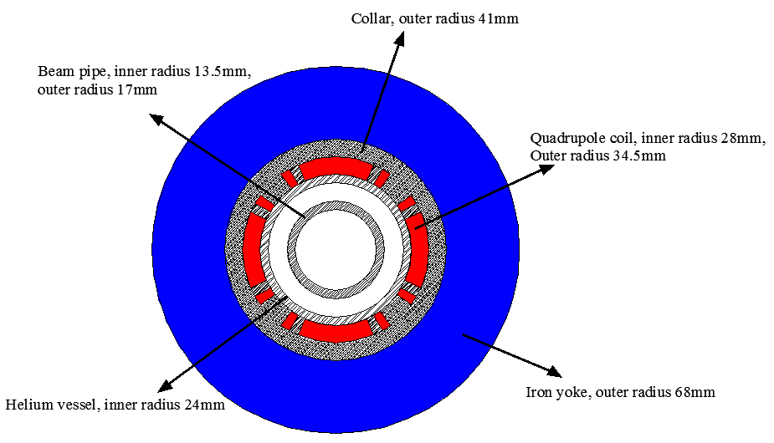
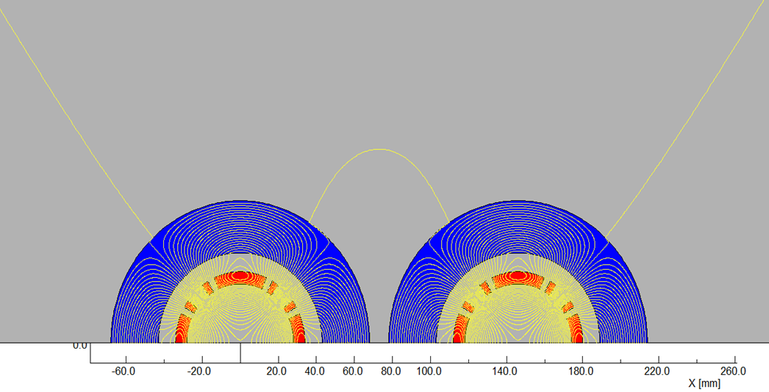
IR Superconducting magnets
Superconducting QF coils
There is iron yoke around the quadrupole coil for QF1. Since the distance between the two apertures is larger enough and there is iron yoke, the field cross talk between two apertures of QF1 can be eliminated.
One of QF1 aperture
(Peak field 3.8T)
Rutherford NbTi-Cu Cable
Room-temperature vacuum chamber with a clearance gap of 7 mm
Integral field harmonics with shield coils（×10⁻⁴）
n | B_{n}/B₂@R=13.5mm
2 | 10000
6 | 1.08
10 | -0.34
14 | 0.002
Magnet | Central field gradient (T/m) | Magnetic length (m) | Width of Beam stay clear (mm) | Min. distance between beams centre (mm)
QF1 | 110 | 1.48 | 27.0 | 146.20

Slide 7
Solenoid compensation
3T & 7.6m
Specification of Anti-Solenoid
Anti-solenoid | Before QD0 |  | Within QD0 |  | After QD0
Central field（T） | 7.2 |  | 2.8 |  | 1.8
Magnetic length（m） | 1.1 |  | 2.0 |  | 1.98
Conductor (NbTi-Cu, mm) | 2.5×1.5
Coil layers | 16 | 8 |  | 4/2
Excitation current（kA） | 1.0
Inductance（H） | 1.2
Peak field in coil (T) | 7.7 | 3.0 |  | 1.9
Number of sections | 4 | 11 |  | 7
Solenoid coil inner diameter (mm) | 120
Solenoid coil outer diameter (mm) | 390
Total Lorentz force F_{z} (kN) | -75 | -13 |  | 88
Cryostat diameter (mm) | 500
∫B_{z}ds within 0~2.12m. Bz < 300Gauss away from 2.12m
The skew quadrupole coils are designed to make fine tuning of Bz over the QF&QD region instead of the mechanical rotation.

Slide 8
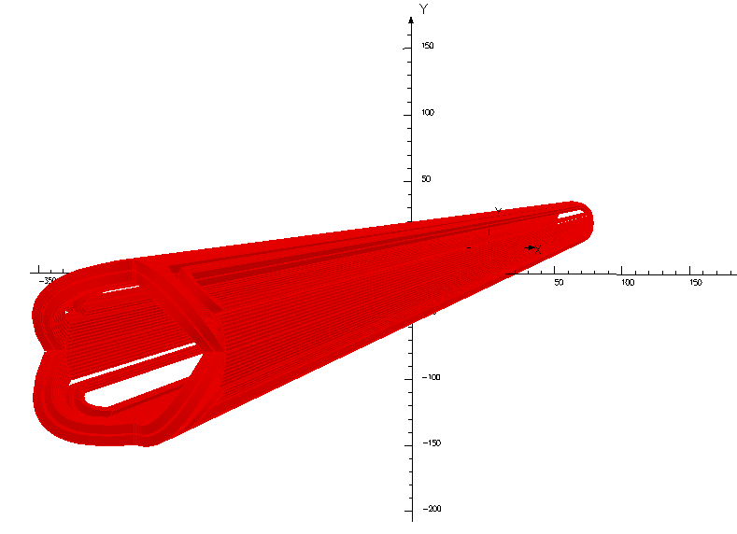
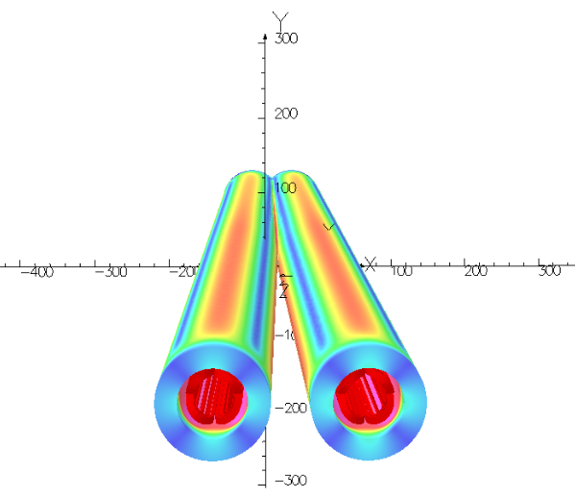
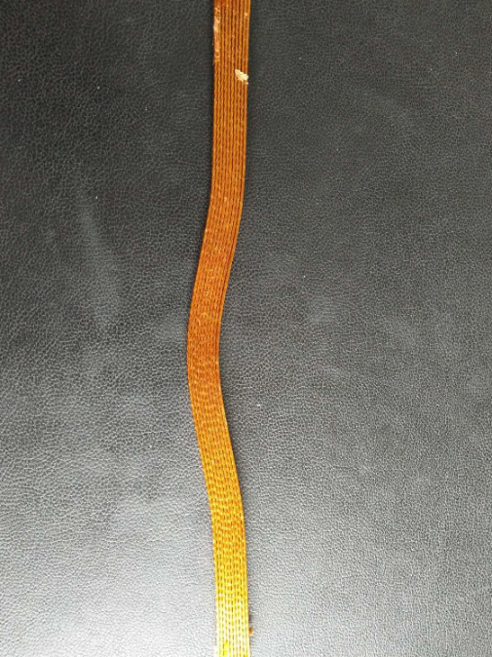
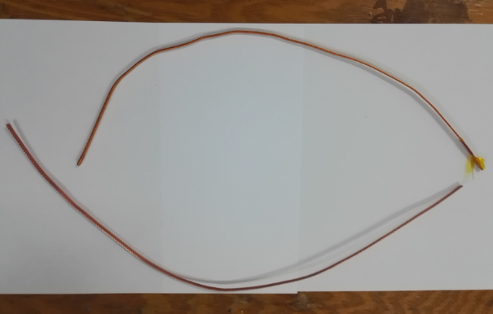
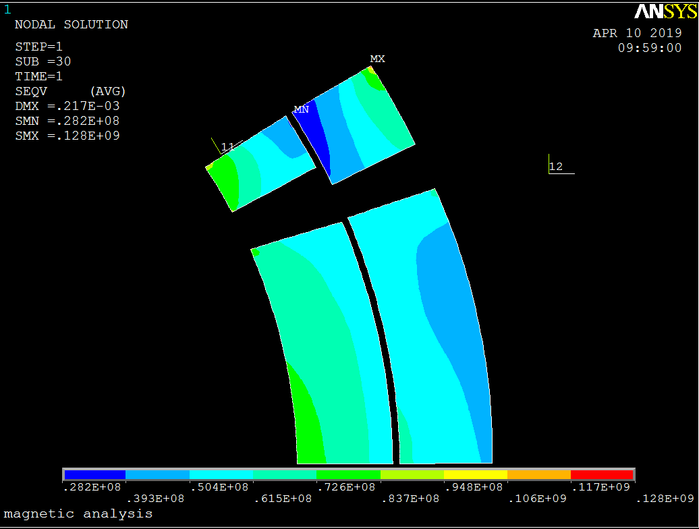
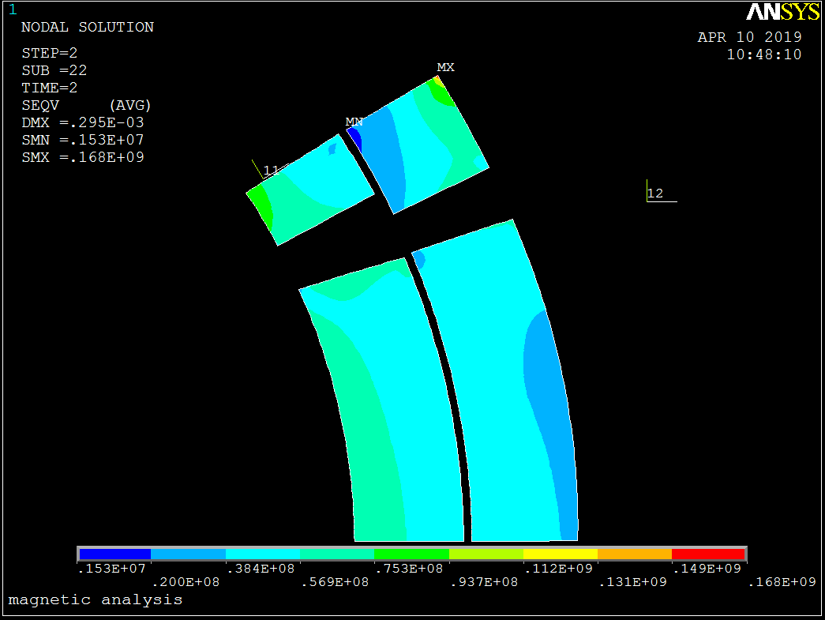
SC magnet prototype
3D model and field simulation of QD0
Specifications on superconductor strand and cable:
Strand:
NbTi/Cu, 0.5mm in diameter,
Cu/Sc=1.3, Filament diameter < 8μm,
@4.2K, Ic≥340A@3T，Ic≥280A@4T，Ic≥230A@5T.
Rutherford Cable:
Width: 3mm, mid thickness: 0.93 mm,
keystone angle: 1.9 deg, No of stands: 12.
Ordered: NbTi/Cu Strand, Rutherford Cable.
Mechanical and stress analysis of QD0 are in progress
Stress after assembled
Stress after cool down to 4.2K

Slide 9
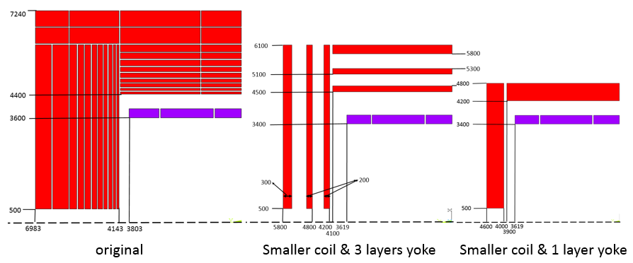
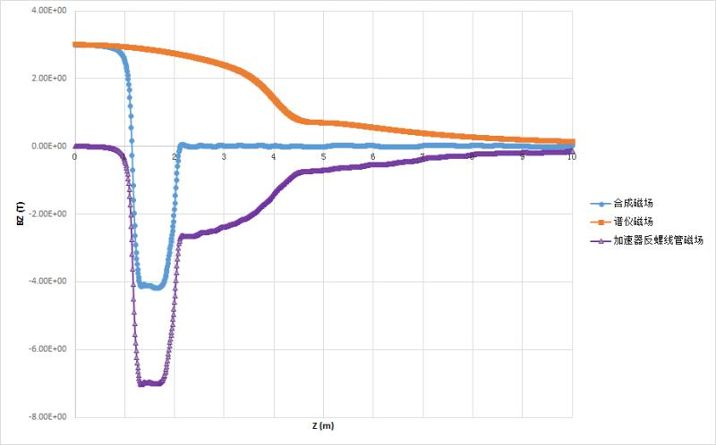
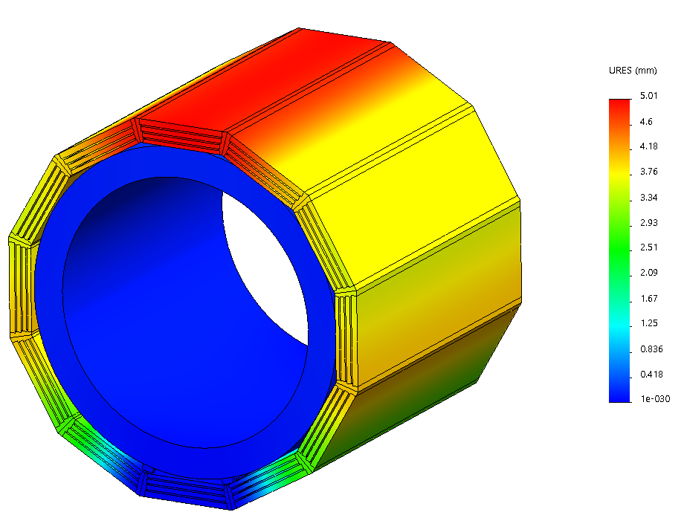
Detector magnet yoke decrease
 | CEPC original | CEPC 3 layers yoke | Smaller coil & 1 layer yoke
Central field (T) | 3 | 3 | 3
Diameter of coil (mm) | 7200 | 7200 | 6800
Length of coil (mm) | 7606 | 7606 | 7238
Barrel yoke inner diameter (mm) | 8800 | 9000 | 8400
Barrel yoke outer diameter (mm) | 14480 | 12200 | 9600
Total length of yoke (mm) | 13966 | 11600 | 9200
Weight of barrel yoke (t) | 6122 | 1608 | 1125
Weight of each end cap (t) | 3419 | 678 | 405
Total weight of yoke (t) | 12573 | 2874.5 | 1935
Shape and size comparison: purple part is the coil, red part is the yoke.
The original design of detector magnet has a very thick yoke. Reduces the thickness and total weight by 70% and 85% w.r.t the original design.
Benefits: weight reduced to ¼, cost reduced a lot.
End cap edge reduced to 4.6m from IP, supporting system design easier.
Combined field distribution of anti-solenoid and detector solenoid magnet meets the design requirements.

Slide 10
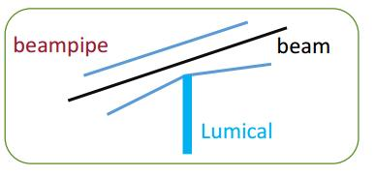
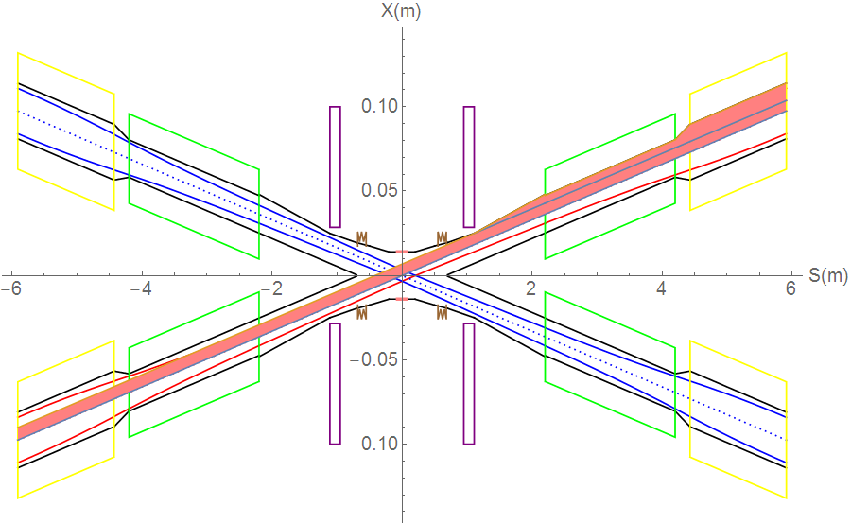
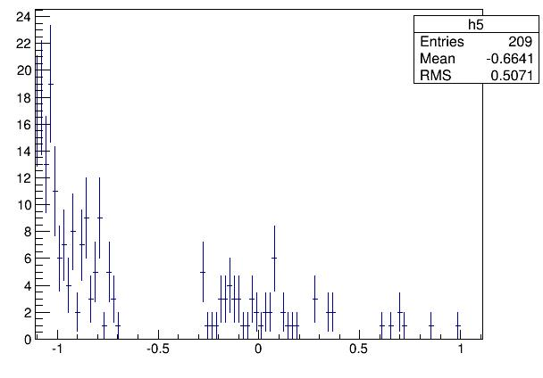
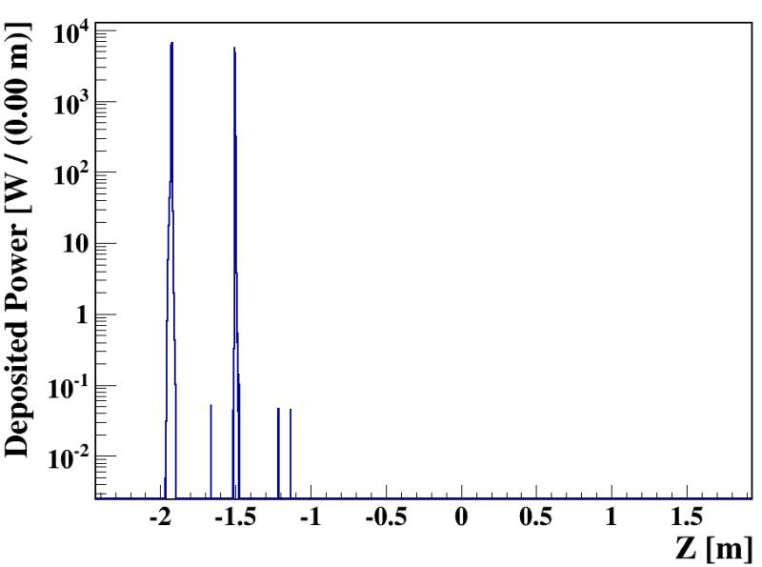
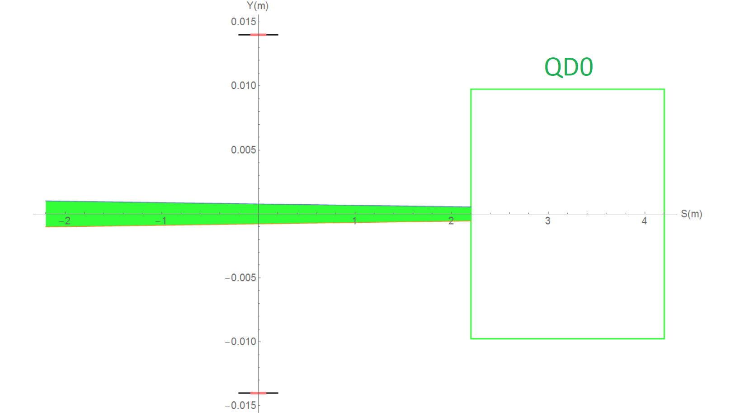
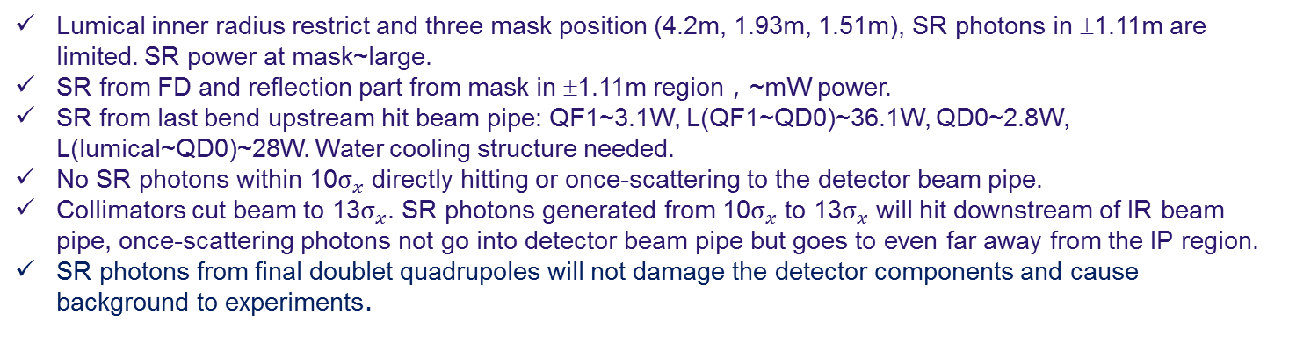
Synchrotron radiation
SR from
last bend upstream
Lumical inner radius restrict and three mask position (4.2m, 1.93m, 1.51m), SR photons in ±1.11m are limited. SR power at mask~large.
SR from FD and reflection part from mask in ±1.11m region，~mW power.
SR from last bend upstream hit beam pipe: QF1~3.1W, L(QF1~QD0)~36.1W, QD0~2.8W, L(lumical~QD0)~28W. Water cooling structure needed.
No SR photons within 10$σ_{x}$ directly hitting or once-scattering to the detector beam pipe.
Collimators cut beam to 13$σ_{x}$. SR photons generated from 10$σ_{x}$ to 13$σ_{x}$ will hit downstream of IR beam pipe, once-scattering photons not go into detector beam pipe but goes to even far away from the IP region.
SR photons from final doublet quadrupoles will not damage the detector components and cause background to experiments.
SR from FD

Slide 11
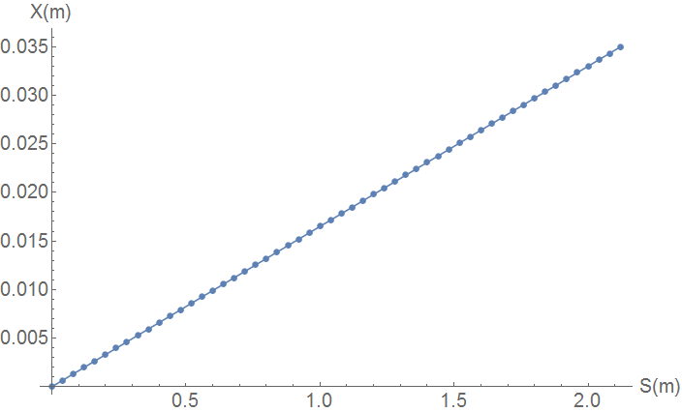
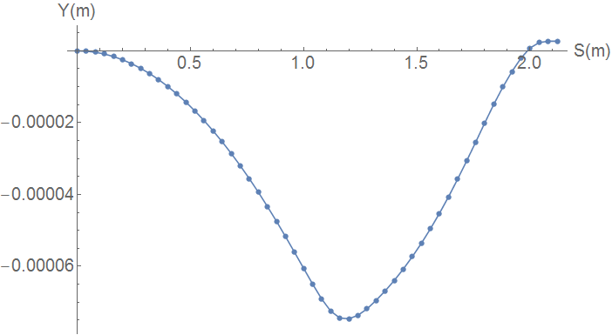
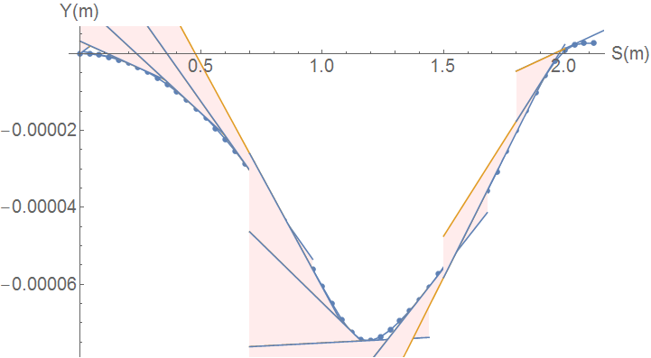
SR from solenoid combined field
Horizontal trajectory will coupled to the vertical.
Due to the sol+anti-sol field strength quite high, maximum~4.24T, transverse magnetic field component is quite high.
SR from vertical trajectory in sol+anti-sol combined field should be taken into account.

Slide 12
SR critical energy and power distribution
Maximum: 670keV
Maximum: 31W

Slide 13
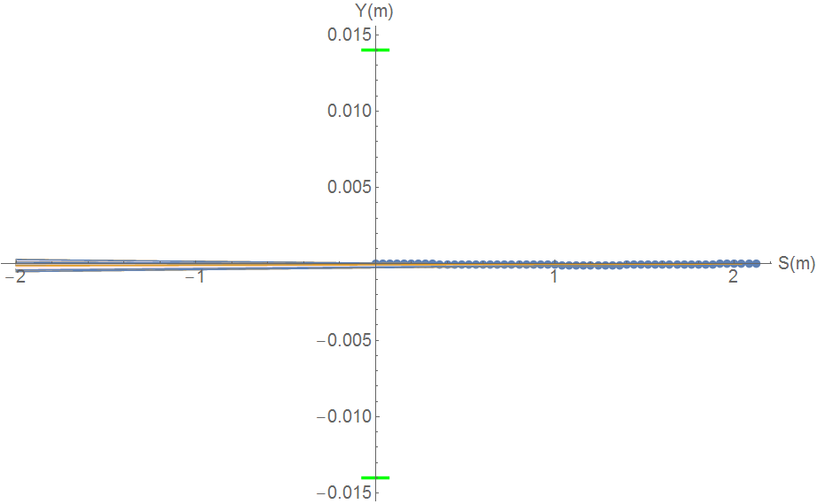
SR from solenoid combined field
SR sector is focused in a very narrow angle from
-116urad to 131urad
SR will not hit Berryllium pipe, and not background to detector.
SR will hit the beam pipe ~213.5m downstream from IP
Water cooling is needed.
Berryllium pipe

Slide 14
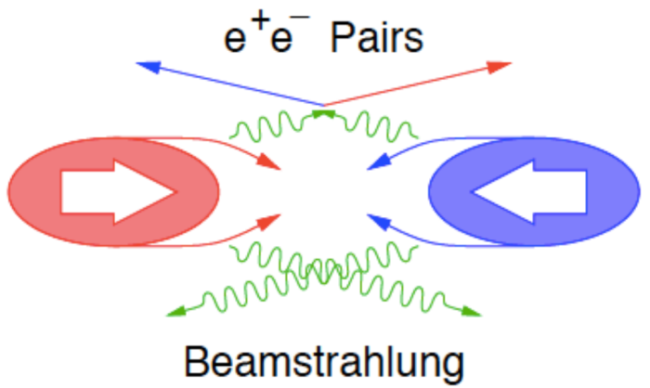
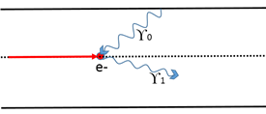
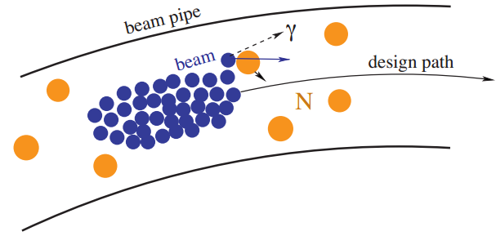
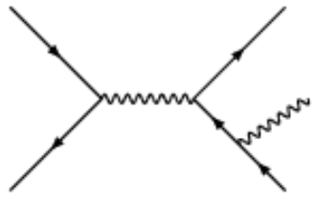
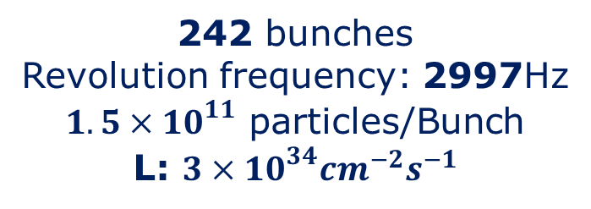
Beam loss Backgrounds at CEPC
IP1
Beam-Thermal photon
scattering
Beamstrahlung
242 bunches
Revolution frequency: 2997Hz
$1.5×{10}^{11}$ particles/Bunch
L: $3×{10}^{34}{cm}^{−2}s^{−1}$
Beam Lost Particles
Energy Loss > 1.5%
(energy acceptance)
IP3
Beam-Gas
Scattering
Radiative Bhabha
scattering

Slide 15
CEPC beam lifetime
 | Beam lifetime | others
Quantum effect | >1000 h
Touscheck effect | >1000 h
Beam-Gas（Coulomb scattering） | >400 h | Residual gas CO，10⁻⁷Pa
Beam-Gas（bremsstralung） | 63.8 h
Beam-Thermal photon scattering | 50.7 h
Radiative Bhabha scattering | 74 min
Beamstrahlung | 80 min

Slide 16
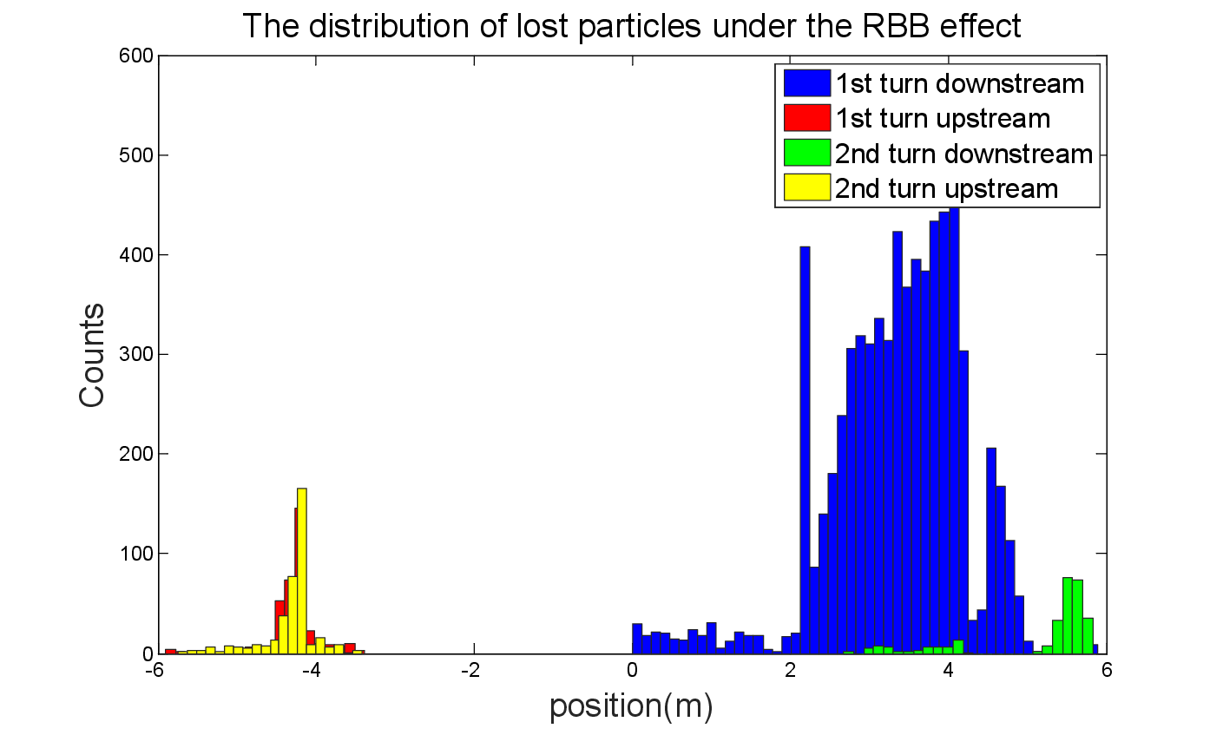
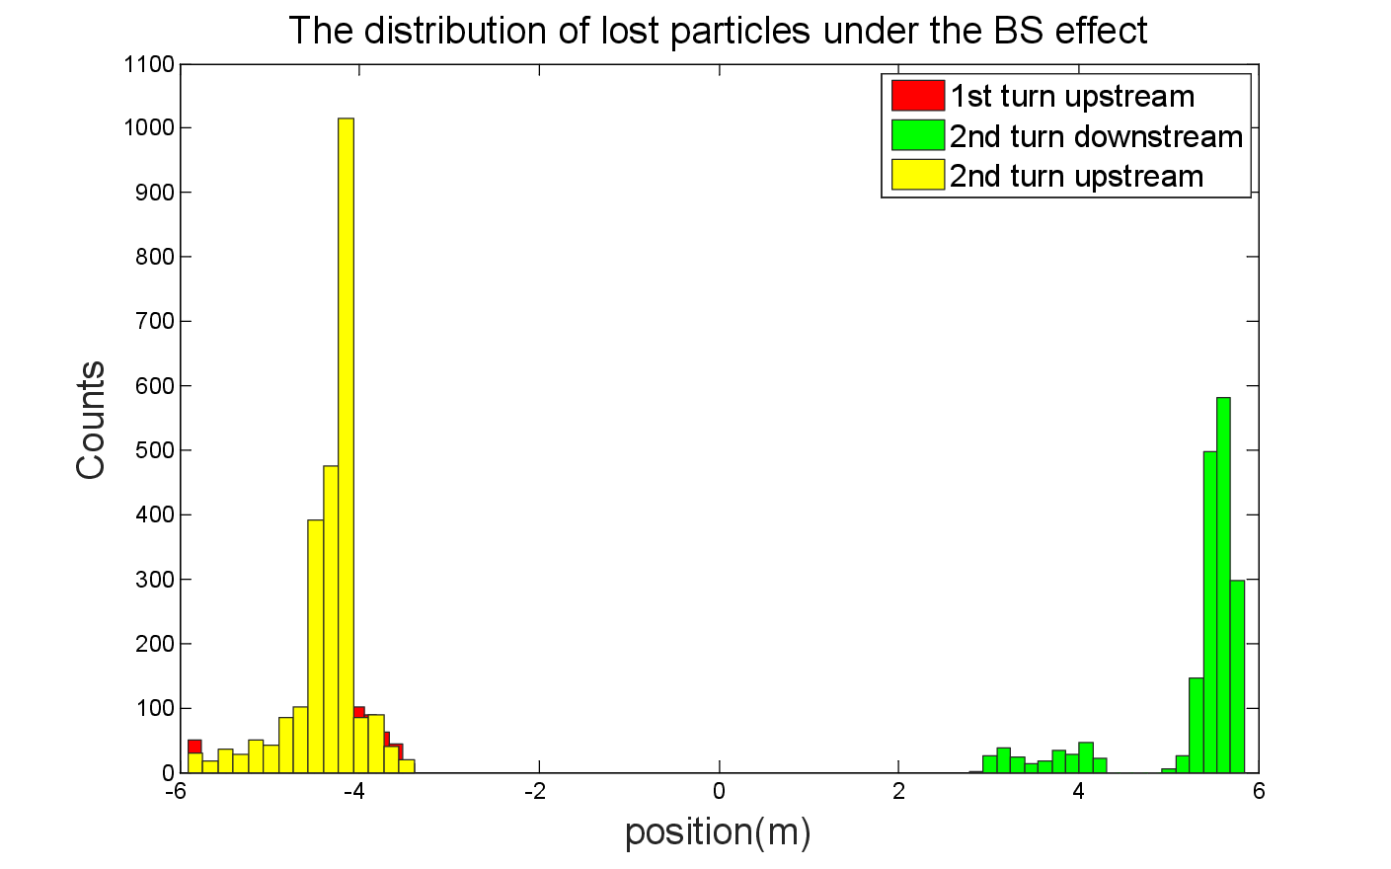
Loss particles due to RBB & BS
For RBB, most the events lost in the detector immediately. A few particles with high energy will lost near the IP after one revolution for a small energy loss.
For BS, energy spread distribution close to the energy acceptance, the beam loss particles not appeared in the downstream of first turn.
Compared to the one turn’s tracking, more particles get lost in the upstream region of the IR.
Although pretty large fraction of events lost in the downstream region, the radiation damage for detector component is tolerable.
The events lost in the upstream region are more dangerous for they are likely permeate into the detector components, even with the small flying angle respect to the longitudinal direction considered.
Collimators are needed.

Slide 17
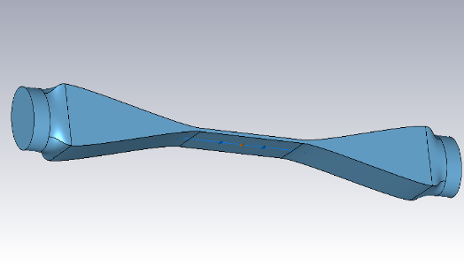
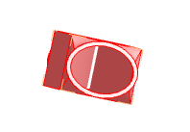
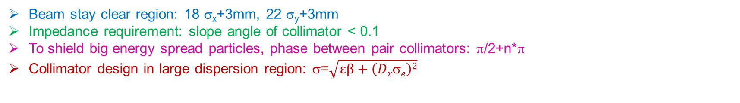
Collimator design
Beam stay clear region: 18 σ_{x}+3mm, 22 σ_{y}+3mm
Impedance requirement: slope angle of collimator < 0.1
To shield big energy spread particles, phase between pair collimators: π/2+n*π
Collimator design in large dispersion region: σ=$\sqrt{εβ+\left(Dxσe\right)2}$
name | Position | Distance to IP/m | Beta function/m | Horizontal Dispersion/m | Phase | BSC/2/m | Range of half width allowed/mm
APTX1 | D1I.1897 | 2139.06 | 113.83 | 0.24 | 356.87 | 0.00968 | 2.2~9.68
APTX2 | D1I.1894 | 2207.63 | 113.83 | 0.24 | 356.62 | 0.00968 | 2.2~9.68
APTX3 | D1O.10 | 1832.52 | 113.83 | 0.24 | 6.65 | 0.00968 | 2.2~9.68
APTX4 | D1O.14 | 1901.09 | 113.83 | 0.24 | 6.90 | 0.00968 | 2.2~9.68
Only horizontal collimator are selected, vertical collimators are not needed.
Vertical collimators are usually placed very close to the beam, no vertical collimators to avoid transverse mode coupling instability.

Slide 18
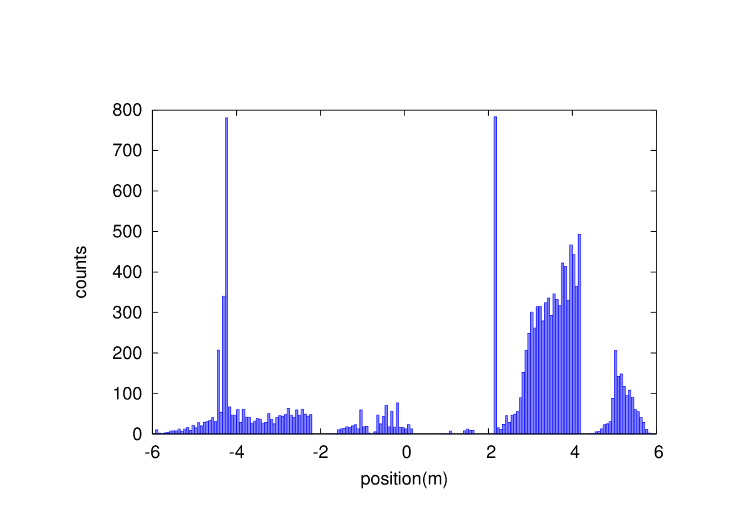
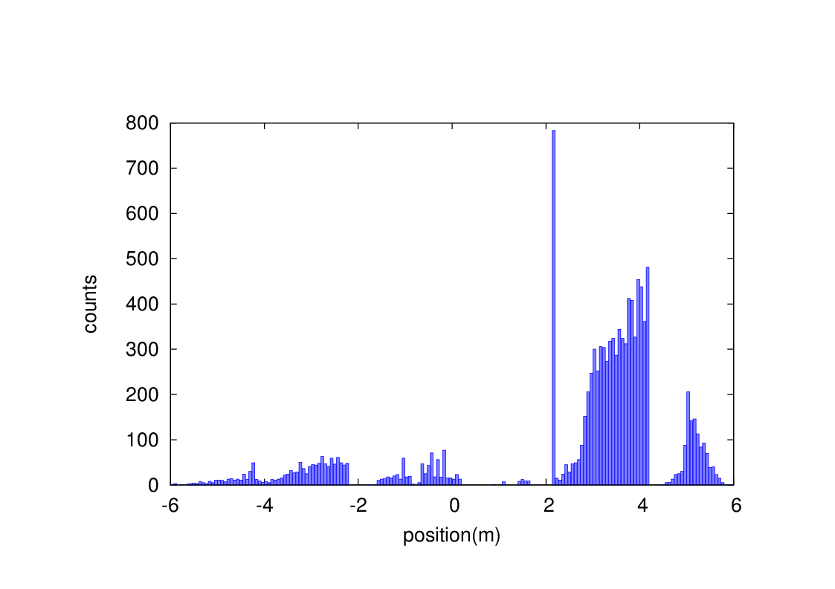
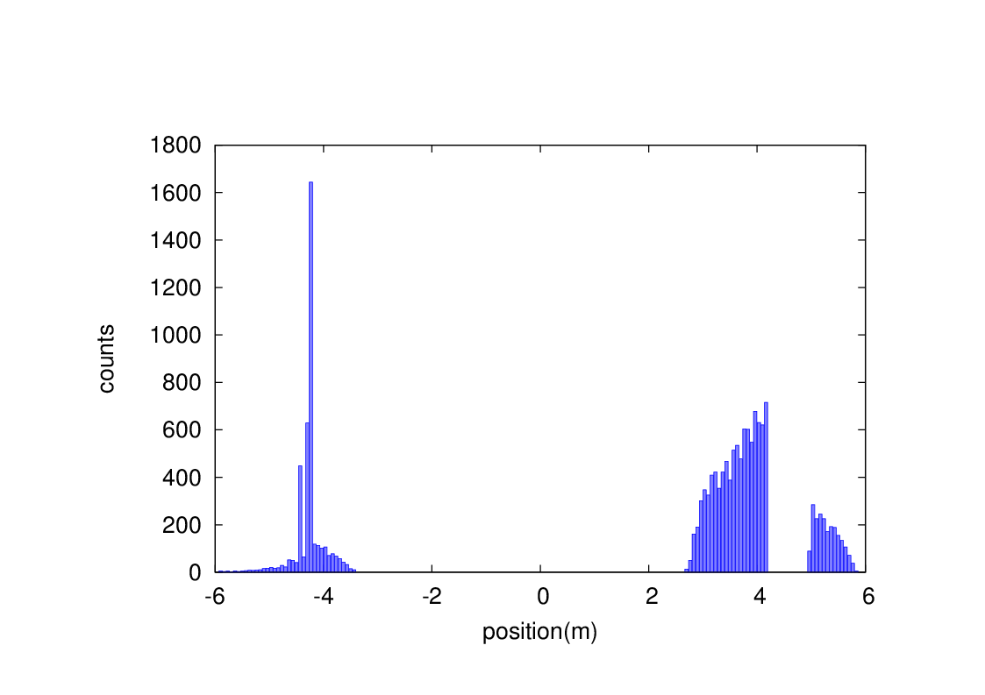
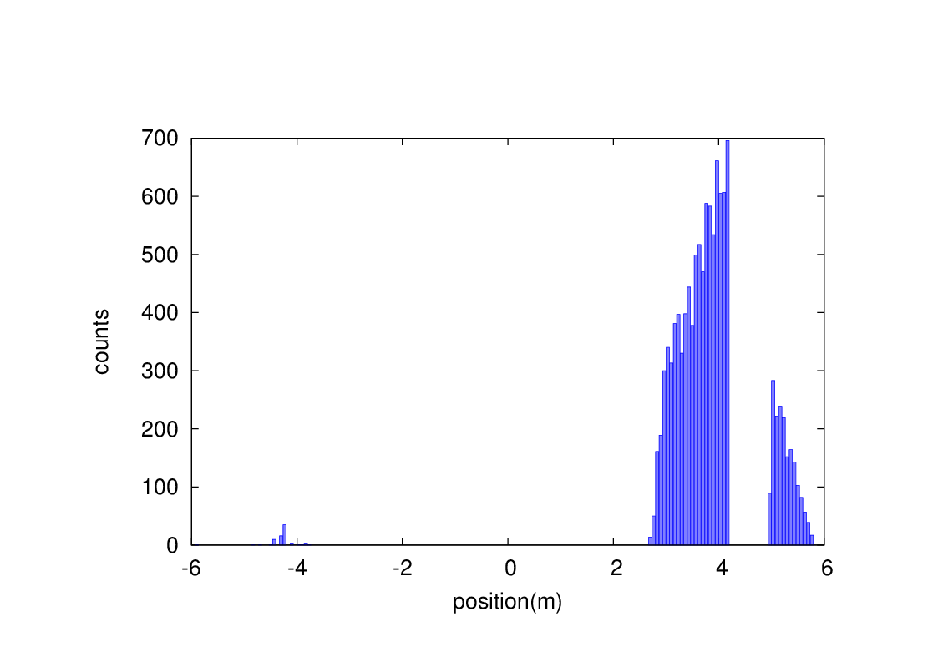
Beam-Gas bremsstrahlung and Beam-Thermal photon scattering loss particles
Without collimators
With collimators
The lost particles has been reduced to a very low level with collimators, especially in the upstream of the IP, can be accepted by the detector.
Although the beam loss in the downstream of the IP is still remained, the radiation damage and the detector background are not serious, since the direction is leaving the detector.
Beam-Gas bremsstrahlung
Beam-Thermal photon scattering

Slide 19

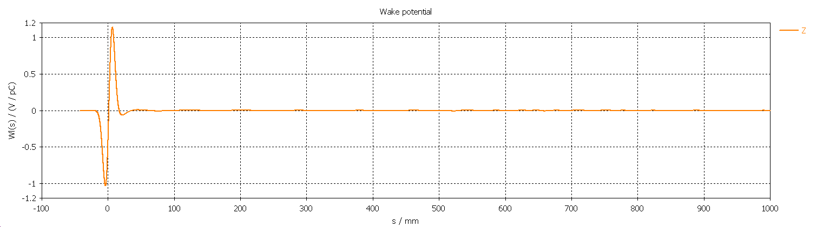
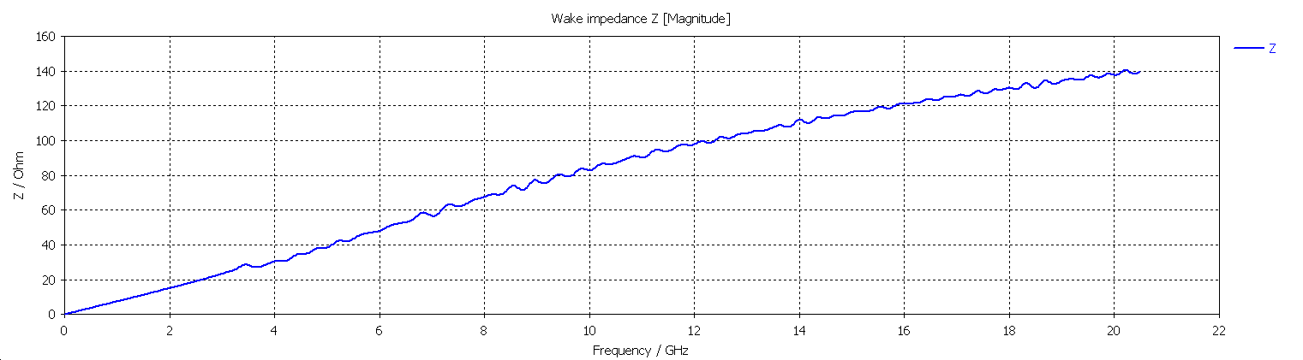
Collimator impedance
Wake Integration type : Indirect Interfaces
Simulated wake length : 1000 mm
Wake shift x : 0 mm
Wake shift y : 0 mm
Wake-Loss-Factor : 1.403765e-001 V/pC
Entry interface at z-coordinate: -3.851471e+002 mm (grid-index: 102)
Exit interface at z-coordinate : 3.851471e+002 mm (grid-index: 4681)

Slide 20
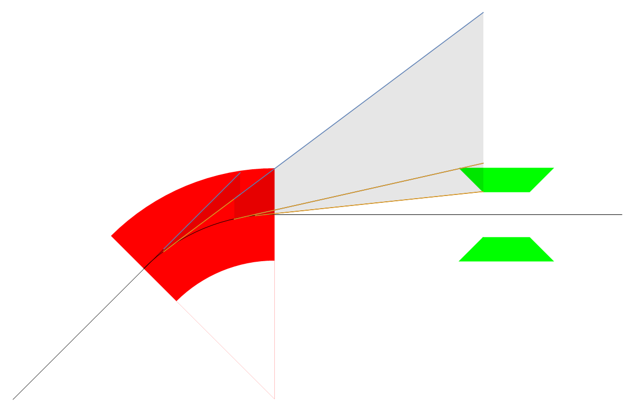
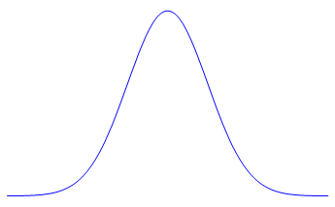

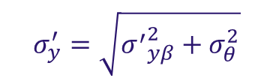
Synchrotron radiation at collimator
Horizontal plane
Synchrotron radiation from the upstream bending magnet in the ARC can contribute to the heat load of the collimators.
SR hit collimators: critical energy~357keV, power~7.7kW.
SR uniform distribution in horizontal plane and Gaussian distribution in vertical plane.
Total vertical angular divergence of SR photon beam~ 8.52urad.
Bend
Collimator
Vertical plane
beam
$$\sim ±\frac{1}{γ}$$
$$σ_{y}^{′}=\sqrt{{σ^{′}}_{yβ}^{2}+σ_{θ}^{2}}$$

Slide 21
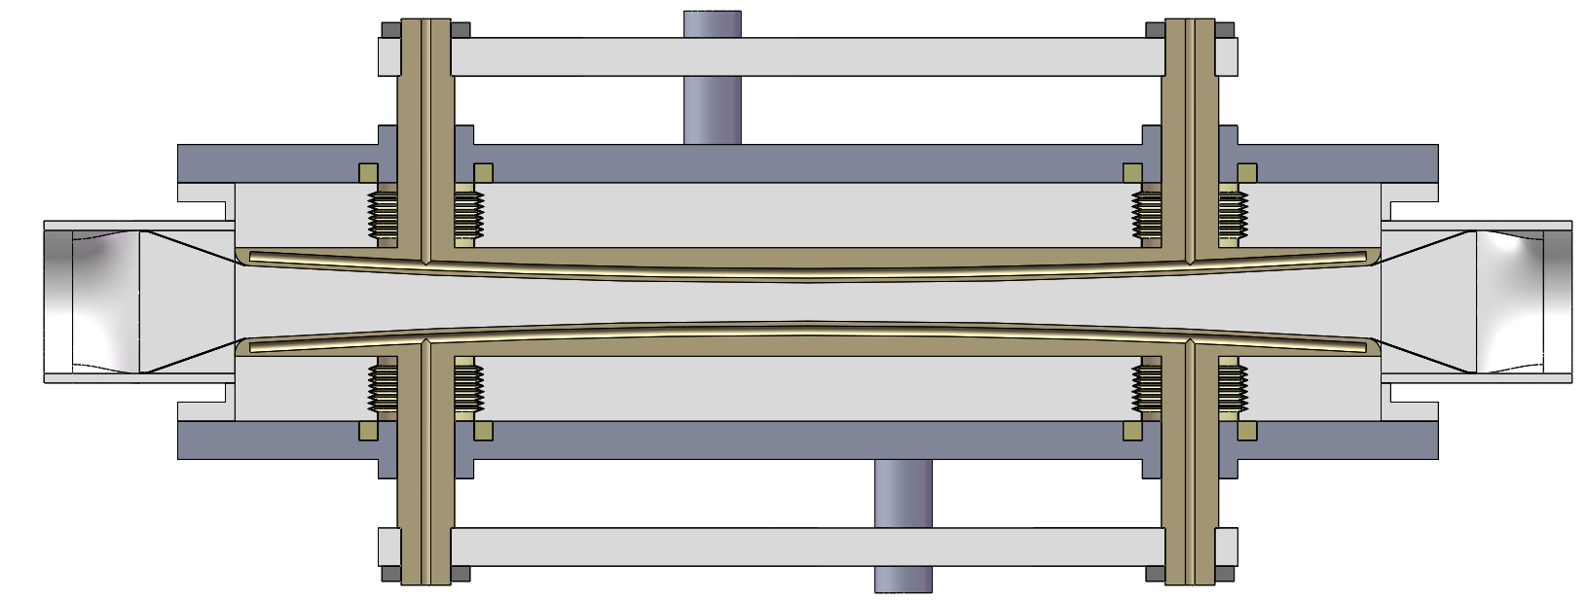
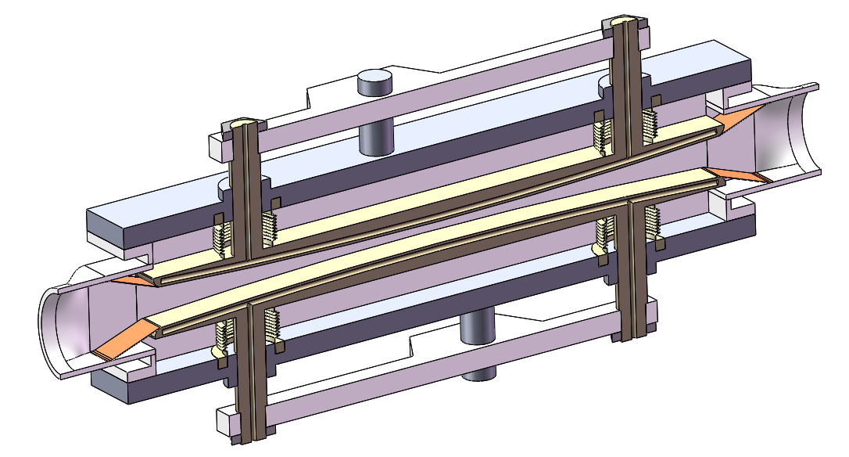
Collimator design structure
Cooling water entrance
Cooling water exit
Beam
Transition spring sheet
Movable baffle
Considering the collimation section, the movable baffle can not protrude the step between the vacuum pipe and the collimator section. The vacuum pipe in the collimator section transits from elliptical section to rectangular section.
During the moving process of the movable baffle, the spring sheet is always pressed on the baffle to realize the gradual transition of the moving process.
Structural design and refinement (including machinery, vacuum, etc.); drive scheme design (drive, control, etc.); material selection (considering physical requirements, heat dissipation, strength, etc.); finite element simulation (thermal-structural).

Slide 22



HOM absorber
HOM at crotch point（z~±700mm）
HOM frenquency 10GHz, close to cut-off frequency (decided by beam pipe aperture).
HOM power ~3kW.
This mode is trapped mode.
HOM absorber is needed，water cooling system considered.
HOM absorber design refer to FCC, under development
Distance from IP is around 70cm just before the crotch point, no space conflict with RVC and IP BPM.
Impedance
Synchrotron radiation from Final doublet magnets and reflection part from mask，~mW power.
SR resistance acceptable for HOM absorber

Slide 23





IR mechanics assembly
Helicoflex
RVC head and drive gear
cutaway view of RVC head
RVC tail/handwheel structure
Cutaway view of moving part
IR mechanics assembly typical point is remote vacuum connection.
The sealing point is 6m away from the operation point.
Ultrahigh vacuum sealing, Helicoflex.

Slide 24

IR mechanics assembly
CEPC MDI Lumical and accelerator components conflict in both position and alignment accuracy has been fixed: Lumical can be separated into 2 parts, one part with high precision installed and aligned with Be vacuum chamber, the other part 50~100kg can be installed and aligned with cryostat. And can be calibrated with IP BPM(<1um), Be pipe installed with detector.
Lumical high accuracy part
Detector
Lumical main part
IP
Beam pipe
RVC
SC magnet and cryostat

Slide 25




IR mechanics assembly
1：IP beam pipe and detector(VX. Silicon) assembly in TPC and aligned, Lumical high accuracy part installed with detector beam pipe.
2：Cryostat with SC magnet installed on supporting system, SC magnet relative to supporting system pre-aligned in room temperature. Lumical IPBPM assembly with RVC，and aligned。
3：components in the second step with supporting system move to the setting position.
4：Beam pipe one side connected with cryostat using RVC. SC magnet aligned. Alignment accuracy ~30um.
5：Repeat the 2~4 step in the other side. Yoke installed.
6：technical detection，alignment, completed.

Slide 26

IP BPM
Considering response time and calibration difficulty, two 4 button electrodes BPM at each side of CEPC IR is adopted.
Most of CEPC IR beam pipe are cylinder or conic, only the part from 70cm to 95cm is special shape.
There is a bellows for the requirements of installation in the crotch region, located about 0.7 m from the IP. IP BPM will be installed at 80cm from the IP in the double pipe part.
Beam pipe size：diameter 18.74mm
Bunch length：2.68mm
Single bunch charge：24nC

Slide 27



4 button electrodes BPM
Electromagnetic field at electrodes
Electrodes signal(bunch length 2.68mm)
Due to the short bunch length, signal has many resonance hump, signal amplitude proportional to the bunch charge.
Signal intensity can be satisfied by CEPC MDI requirement.

Slide 28





4 button electrodes BPM
4 button electrodes structure
4 button electrodes size
Electrode diameter:11.4mm
Inner conductor diameter: 6mm
Electrode pole to beam line:19.4mm
Space conflict for the inside two buttons
Monitoring the time when two beams arrive at the collision point, it is better to be consistent strictly.
Looking for solutions

Slide 29
Summary
The finalization of the beam parameters and the specification of special magnets have been finished. The parameters are all reasonable.
The detector solenoid field effect to the beam can be compensated.
The most importance beam loss background is radiative Bhabha scattering and beamstrahlung for the Higgs factory.
Collimators are designed in the ARC which is about 2km far from the IP to avoid other backgrounds generation. Beam loss have disappeared in the upstream of IP for both Higgs and Z factory.
HOM of IR beam pipe has been simulated, water cooling and synchrotron radiation were considered and HOM absorber is under design.
Synchrotron radiation and impedance are taken into account for collimators, collimator machanics structure preliminary designed.
RVC preliminary design finished, next step will go to experiment and review meeting.
Mechanics assembly procedure is finalized with detector group.
IP BPM under design.

Slide 30
Thanks

