Slide 1
Progress on CEPC High Efficiency Klystron Development
Zusheng Zhou
On behalf of High Efficiency RF Source R&D Collaboration
Institute of High Energy Physics
Apr. 16, 2019
Oxford, UK

Slide 2
Outline
Plan and goal
650MHz/800kW meets CEPC project demands
80% efficiency
1st prototype tube
Mechanical design and manufacture
Plant and infrastructure preparation
High efficiency design
2nd prototype optimization
Multi-beam klystron consideration

Slide 3
Strategy and plan (2016 to 2021)
3 or more klystron prototypes
2016 | 2017 | 2018 | 2019 | 2020 | 2021
Prototypes
Step1
1st
4th
Step2
2nd
5th
Step3
3rd
6th
more
Efficiency: 60%
70%
80%

Slide 4
1st prototype tube
Conventional method based on 2nd harmonic cavity in order to investigate the design and manufacture technologies for high power CW klystron.
Design Parameters
Main parameters | Goal
Freq. (MHz) | 650
Vk (kV) | -81.5
Ik (A) | 15.1
Perveance (µP) | 0.65
Efficiency (%) | >60
Output power (kW) | 800
1dB bandwidth (MHz) | ±0.5

Slide 5
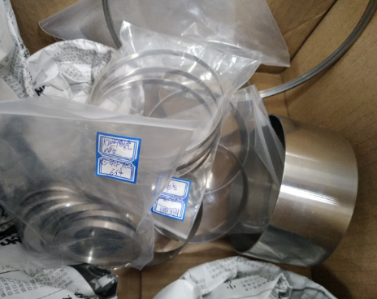
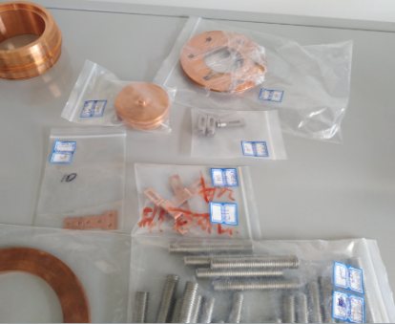
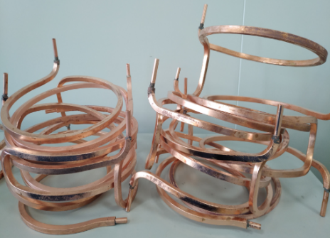
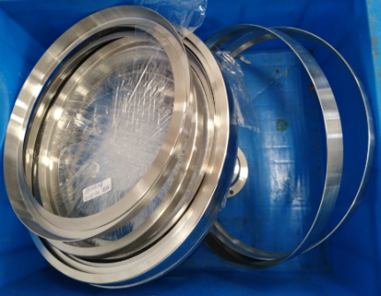
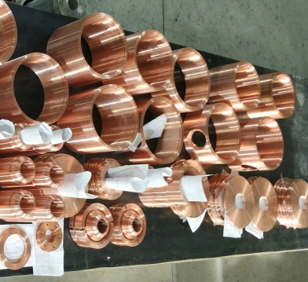
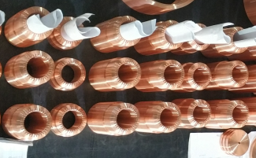
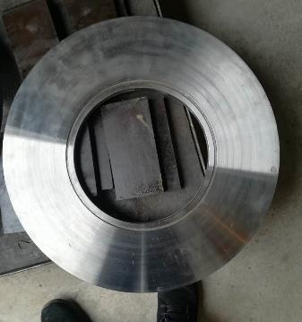
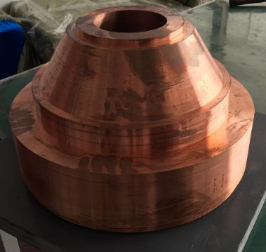
Components manufacture
Modulator anode
Input coupler
Cooling pipe
Gun welding edge
Cavity body
Cavity nose
Coil
Collector

Slide 6
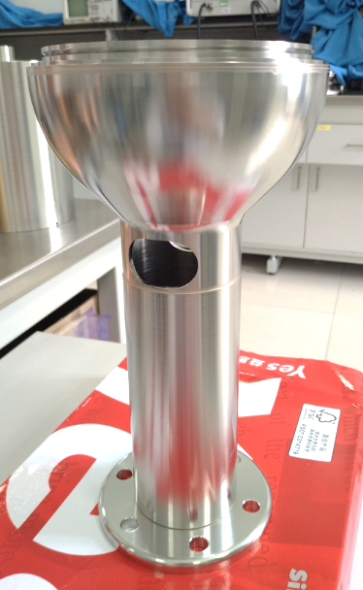
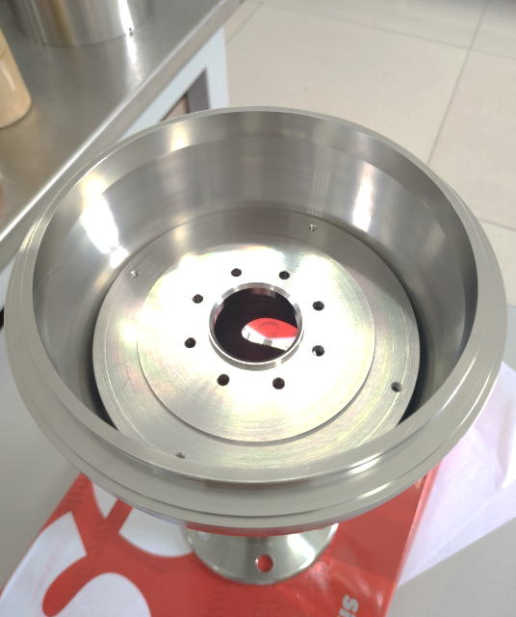
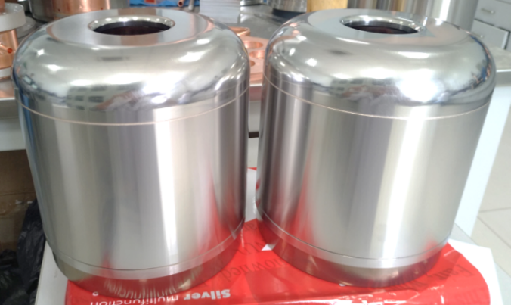
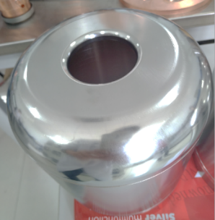
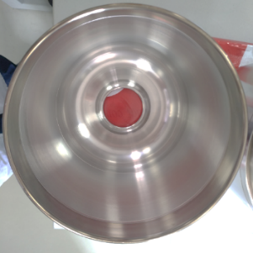
Assembly unit
Focusing electrode and support assembly
Modulator anode assembly

Slide 7
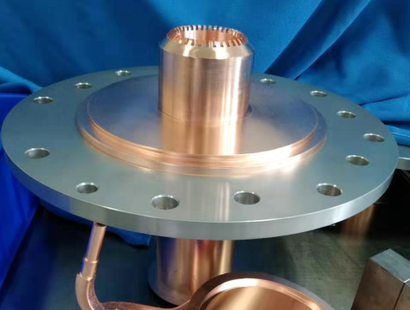
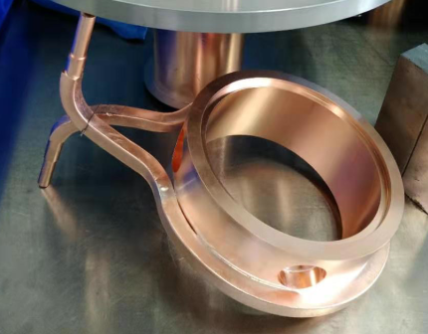
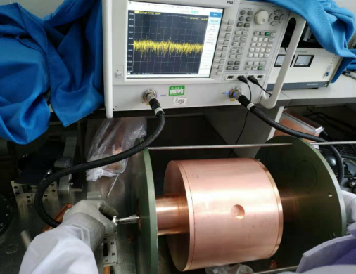
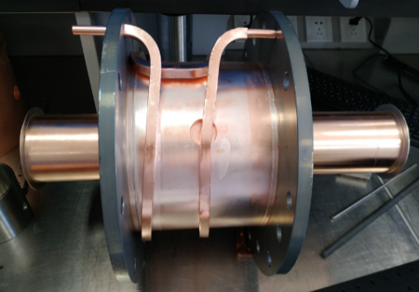
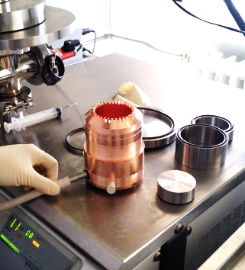
Cavity brazing and cold test
2nd cavity brazing
3th cavity and cooling pipe brazing
Cold test
Cold test for CAV2, 3&4 is finished and frequency value is within the design scope.
4th cavity and cooling pipe brazing
6th cavity and cooling pipe brazing

Slide 8
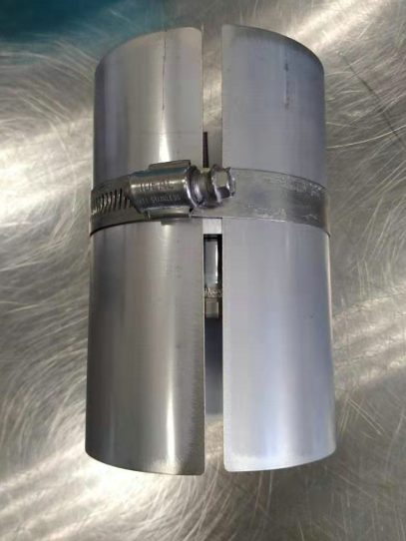
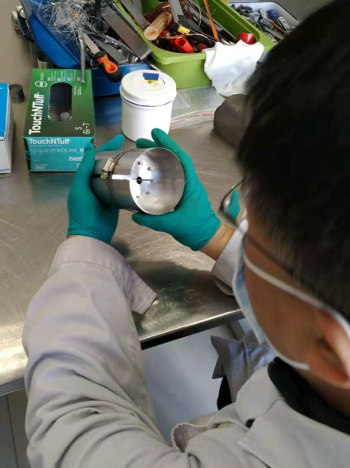
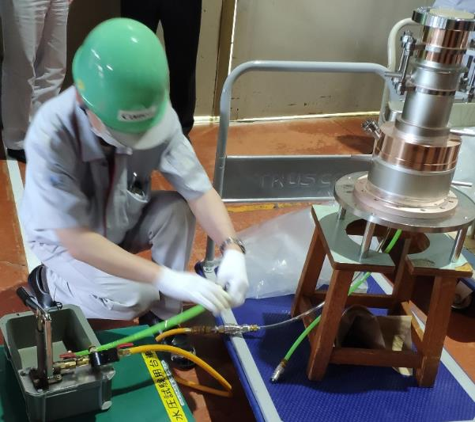
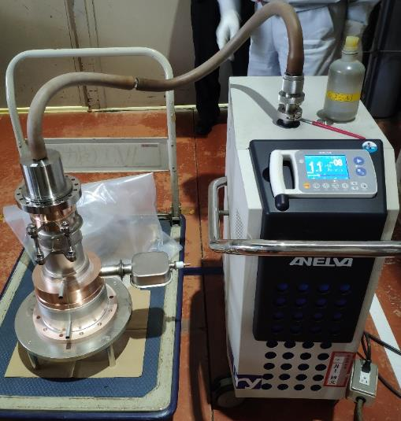
Cathode and output window
Cathode opening
Window water pressure test
Window vacuum leak detection

Slide 9
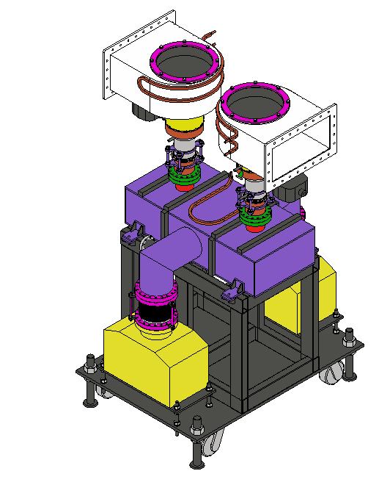
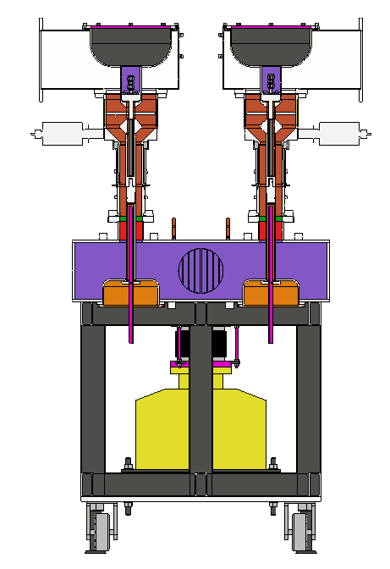
Window test stand preparation
W.G
Vacuum evacuate port
Window
Support
Ion pump
Vacuum W.G

Slide 10
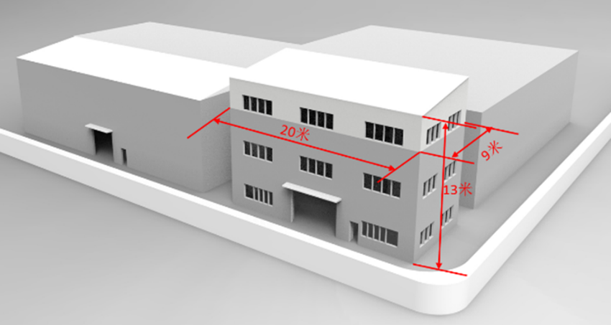
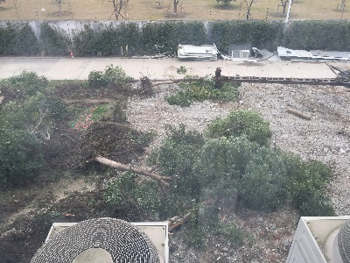
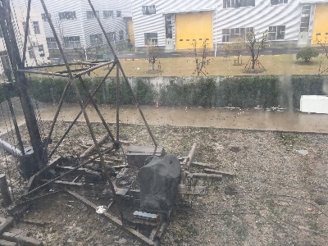
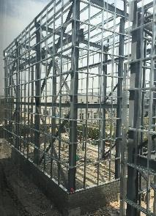
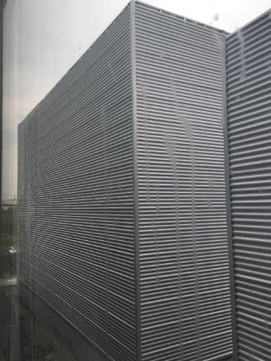
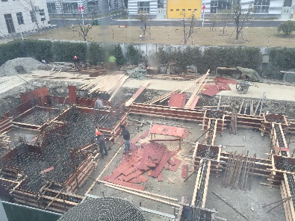
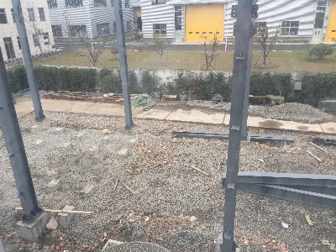
Plant construction
Dec. 29, 2018
Jan. 10, 2019
Dimension of new building
Jan. 28, 2019
Mar. 3, 2019
Mar. 27, 2019
Apr. 12, 2019

Slide 11
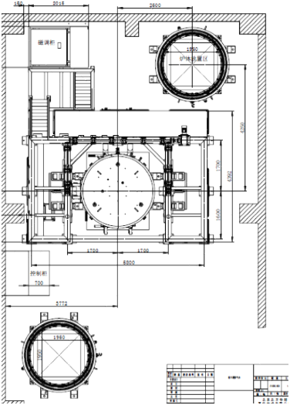
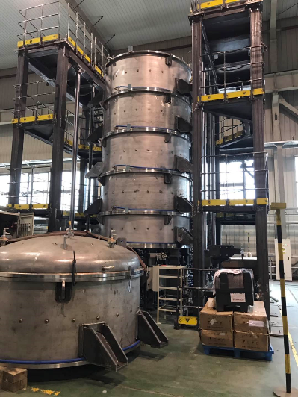
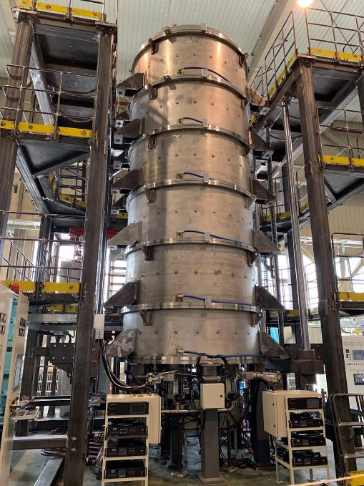
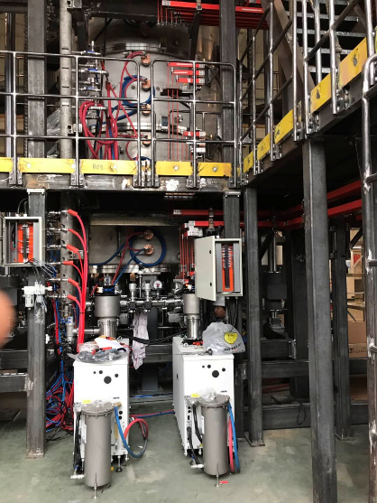
Baking furnace preparation
Furnace cover and body
Factory testing
Top view
Vacuum system

Slide 12
High efficiency design
Original plan
Scheme 1：Optimize cavity chain by using the same gun as 1st tube
Scheme 2: With high voltage gun (110 kV/9.1 A), low perveance
Scheme 3：MBK, 54 kV/20A electron gun
Parameter | Scheme1 | Scheme2 | Scheme3
Freq. (MHz) | 650 | 650 | 650
Voltage (kV) | 81.5 | 110 | 54
Current (A) | 15.1 | 9.1 | 20(2.5×8)
Beam No. | 1 | 1 | 8
Perveance (µP) | 0.65 | 0.25 | 1.6(0.2×8)
Efficency (%) | >70 | ~80 | >80
Power(kW) | 800 | 800 | 800(100×8)

Slide 13
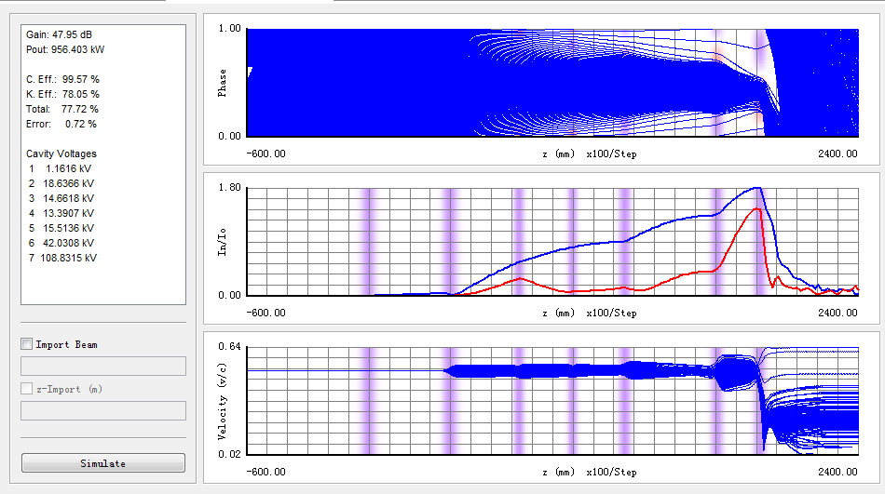
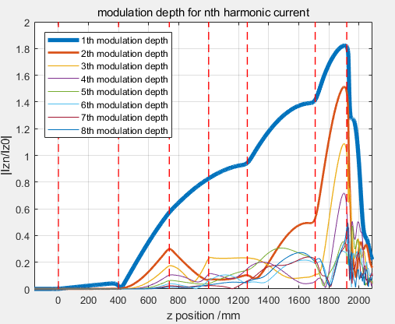
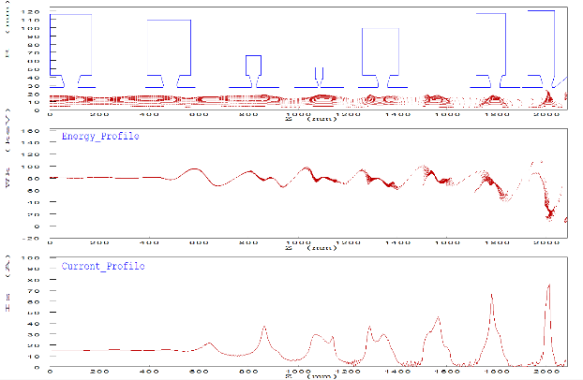
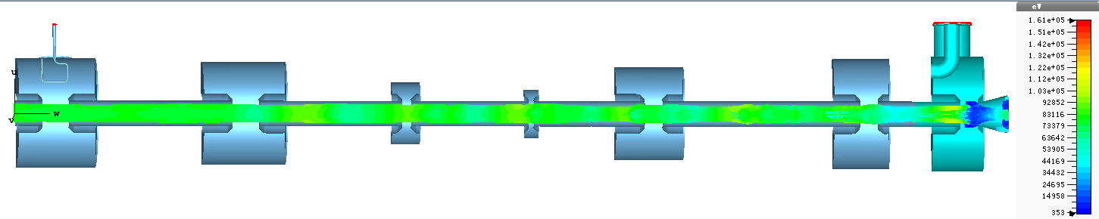
Scheme 1
Gun, collector, focusing magnet and tube length are same with 1st prototype and optimization cavity chain with CSM method.
CST(3D) EFF: 68.5%, ~3.5% higher than 1st prototype
Efficiency improvement is unacceptable, future work will be concentrated on Scheme 2 and 3.

Slide 14
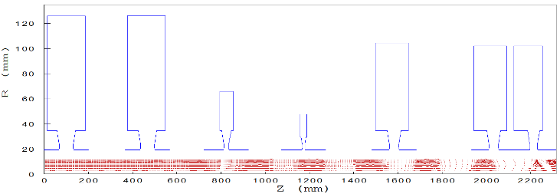
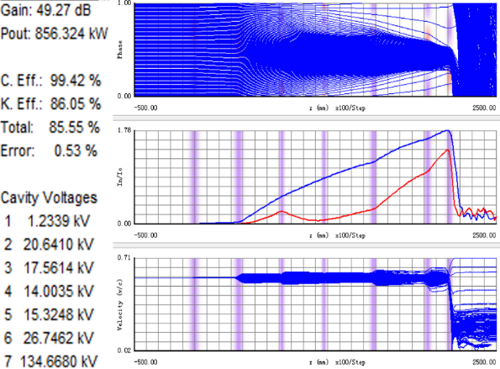
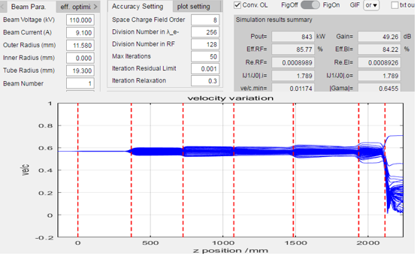
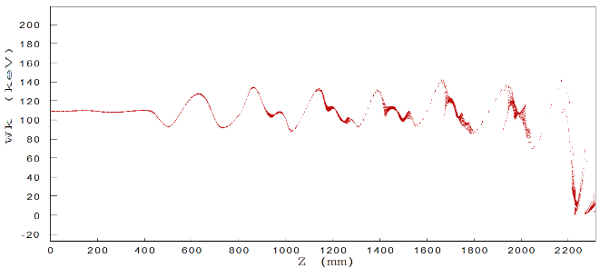
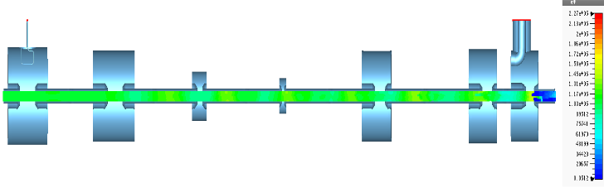
Scheme 2
Tentative
High efficiency design
AJDISK(1D) EFF: 85.6%
KLYC(1D) EFF: 85.6%
EMSYS(2.5D) EFF: 81.4%
3D simulation on symmetrical output cavity is in progress.
CST(3D) EFF(asymmetrical output): 78%

Slide 15
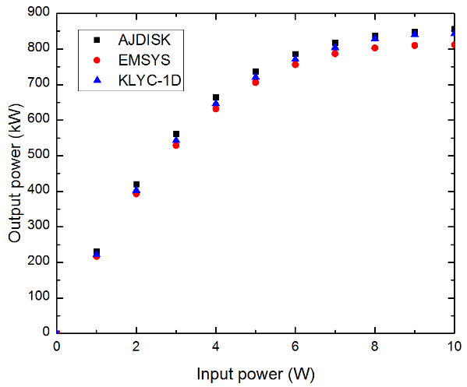
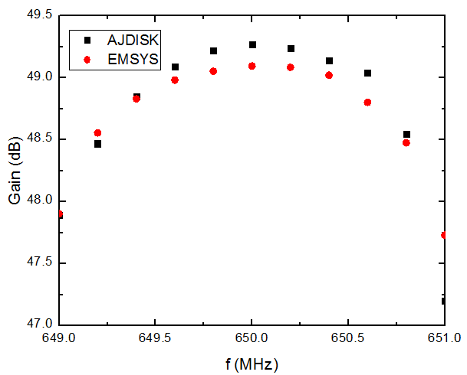
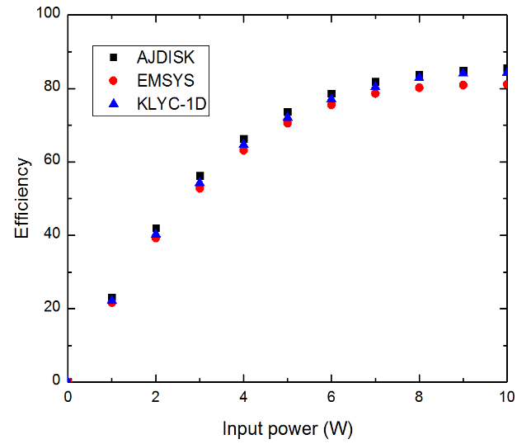
Scheme 2
Tentative
High efficiency design
Transfer curve
Bandwidth
Gain curve

Slide 16
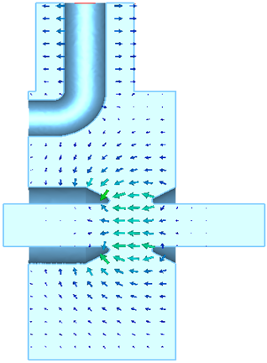
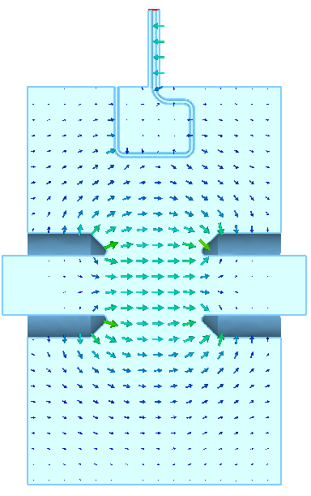
Scheme 2
Tentative
RF Cavity design
The design of other cavities is also in progress.
Input cavity
Output cavity

Slide 17
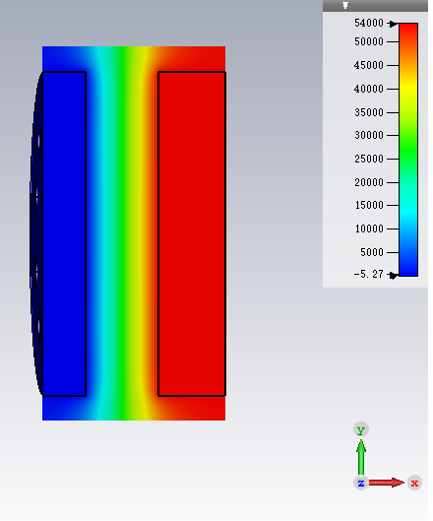


Scheme 3
Tentative
Gun design
Gun pootentials in CST
Gun beam trajectories in CST
Klystron beam trajectory in DGUN

Slide 18




Scheme 3
Tentative
Cavities design
Input cavity
Output cavity
Cavity chain optimization

Slide 19

Scheme 3
Tentative
High efficiency design
More than 80% efficiency in CST

Slide 20
Summary
The components machining, brazing, welding and assembly are in progress in collaboration company.
Pursuing 1st prototype processing and manufacturing and it will be completed at the end of June 2019.
The high efficiency design is concentrated on high voltage klystron and multi-beam klystron.
The design work of 1st high efficiency klystron will end in this June and then 2nd prototype (1st high efficiency klystron) will be processed and manufactured in June next year.
The multi-beam klystron design are ongoing simultaneously.

Slide 21
Thanks for your attention!

