Slide 1
CEPC Vacuum System
Dong Haiyi
2019/04/16

Slide 2
Outline
Basic requirements to the vacuum system
    2. Synchrotron radiation power and gas load
Vacuum chamber
Bellows Module with RF Shielding
Pumping system
    Vacuum measurement and control
    Summary

Slide 3
1. Basic requirements to the vacuum system
A vacuum in the lower than 3×10⁻⁹ Torr is required when a beam is circulating in the collider. It can be shown that the beam lifetime would exceed 20 h if only losses due to Interactions between beam and gas.
A pressure of 3×10⁻¹⁰ Torr or lower must be achieved in the interaction regions to minimize detector backgrounds from beam-gas scattering.
Good beam lifetime must be achieved soon after the initial startup with a stored beam.
The system must be capable of quick recovery after the sections are vented for maintenance.
The chamber wall is designed as smooth as possible to minimize the electromagnetic fields induced by the beam.
Sufficient cooling to safely dissipate the heat load associated with both synchrotron radiation and higher-order-mode (HOM) losses.
Capability to shield outer ring components from synchrotron radiation.

Slide 4
Comparison of vacuum-related parameters in several storage rings
Parameter | PEPII (USA) |  |  | KEKB (Japan) |  | LEP2 (CERN) | CEPC (China)
 | e⁺ | e⁻ |  | e⁺ | e⁻ | e⁺ e⁻ | e⁺ | e⁻
Energy [GeV] | 3.11 | 9.00 |  | 3.5 | 8.0 | 96 | 120
Beam current [A] | 2.14 | 0.95 |  | 2.6 | 1.1 | 2×0.007 | 2×0.0174
Circumference [m] | 2199.32 |  |  | 3016.26 |  | 26700 | 100000
Bending radius [m] | 13.75 |  | 165 | 16.31 | 104.46 | 3096.18 | 10700
Arc beam pipe material | Extruded aluminum, TiN coating |  | Extruded copper | Extruded copper |  | Extruded aluminum, Lead shielding | Extruded copper, NEG coating (e⁺); Extruded aluminum (e⁻); Lead blocks shielding
Arc beam pipe shape | Ellipse with antechamber 95×55 |  | Octagon 90×50 | Circle 94 | Racetrack 104×50 | Ellipse 131×70 | Ellipse 75×56
Pump type in arcs | TSP, IP |  | Ion Pump | NEG, IP | NEGs, IP | NEGs, TSP, IP | NEGs, IP

Slide 5
    2. Synchrotron radiation power and gas load
In the design of the storage ring vacuum system, two issues produced by the synchrotron radiation must be considered. One is the heating of the vacuum chamber walls owing to the high thermal flux and another is the strong gas desorption (both photon-desorption and thermal desorption). The dynamic pressure induced by synchrotron radiation can rise by several orders of magnitude once a beam starts circulating.

Slide 6
      2.1 Synchrotron radiation power

Slide 7
      2.2 Gas load
Chamber material
Material fabrication and preparation
Amount of prior exposure to radiation
Photon angle of incidence
Photon energy

Slide 8
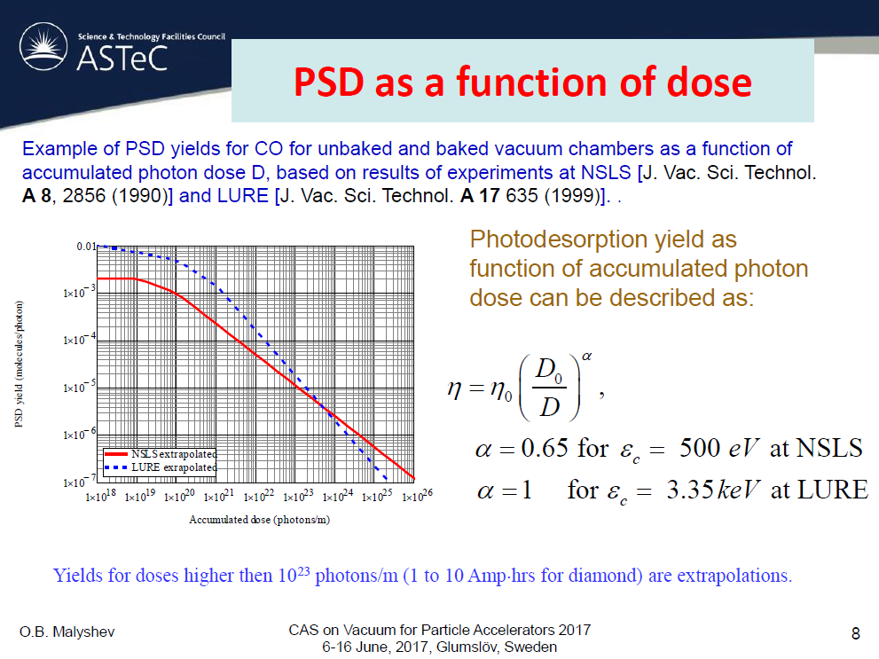

Slide 10
    3. Vacuum chamber
The synchrotron radiation power deposited on the arc chamber wall would entail using a water-cooled high electrical conductivity chamber material (aluminum or copper);
Copper is preferred in the CEPC dipole chamber design for the positron ring because of its naturally lower molecular yields, lower secondary electron yields, lower electrical resistance, higher thermal conductivity, good radiation self-shielding, and resistant to deformation for the NEG activation temperature of 200 °C;
Considering the cost of manufacture, the dipole vacuum chambers of the electron ring will be fabricated from the aluminum alloy.

Slide 12
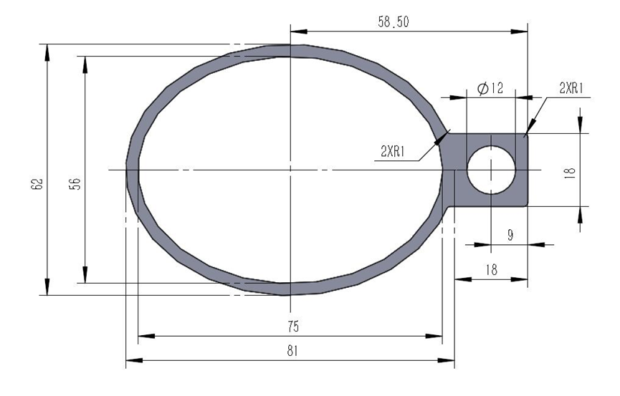
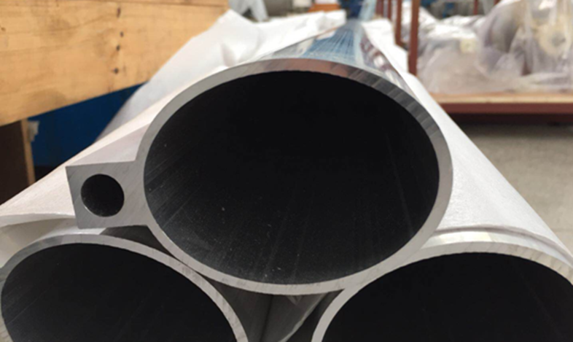
The dipole vacuum chamber of electron storage ring
The aluminum chamber manufacturing procedure is:
Extrusion of the chambers,
Machining of the components to be welded,
Chemical cleaning,
Welding of the water connections and flanges,
Leak detections.
Aluminum vacuum chamber
(elliptic 75×56, thickness 3, length 6000)

Slide 13
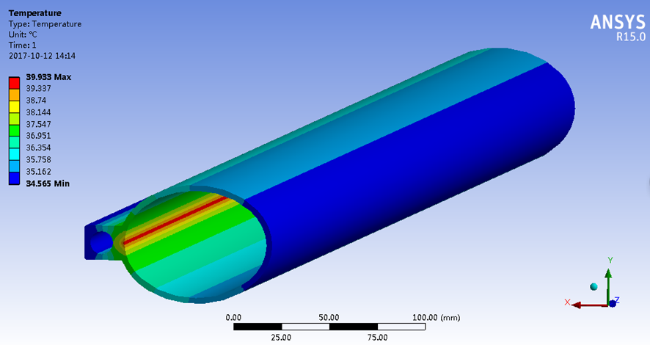
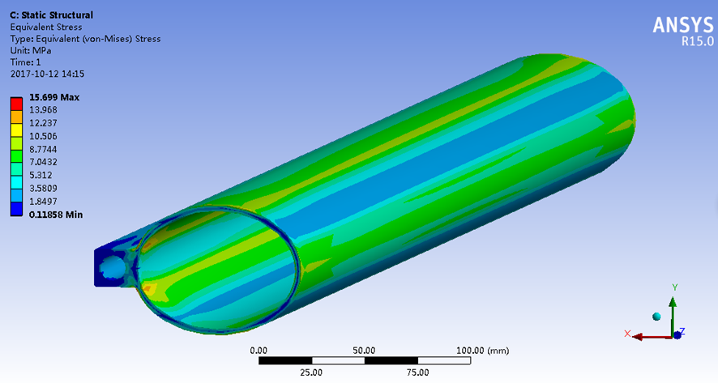
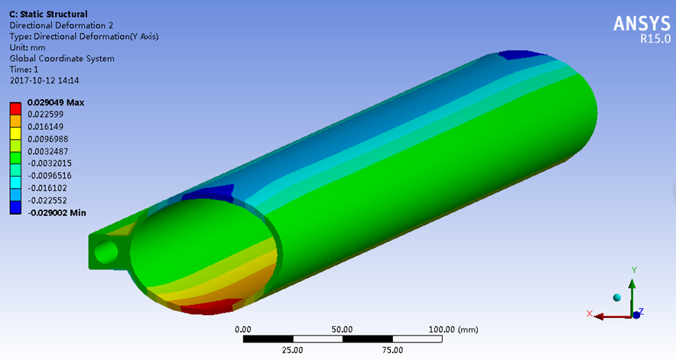
Finite element analysis for aluminum vacuum chamber
E=120GeV, I=17.4mA, h=1x10⁻³w/mm²⋅°C
The highest temperature reaches to 39.9 °C;
The maximum stress is 15.7 MPa;
The maximum deformation of X, Y and Z directions are 0.06 mm, 0.029 mm and 0.53 mm/m.

Slide 14
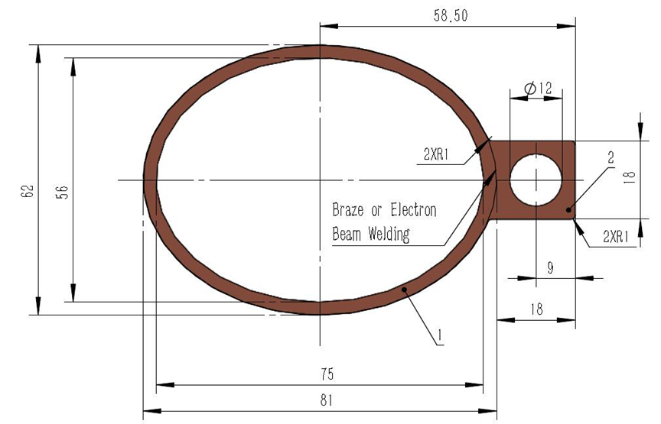
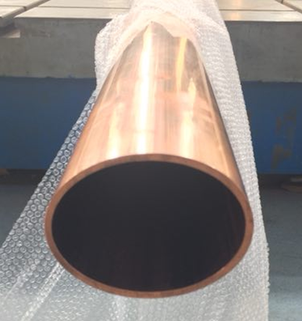
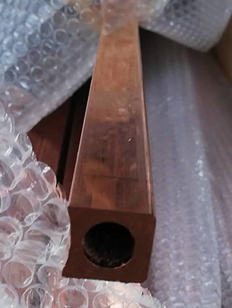
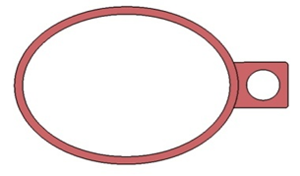
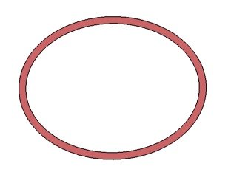


The dipole vacuum chamber of positron storage ring
The copper chamber manufacturing procedure follows these steps:
Extrusion of the beam pipe and cooling channel,
Machining of the components to be welded,
Chemical cleaning,
Electron-beam welding,
Welding of the end flanges and water connections,
Leak checks,
NEG coating inside chamber.
Copper vacuum chamber
(elliptic 75×56, thickness 3, length 6000)

Slide 15
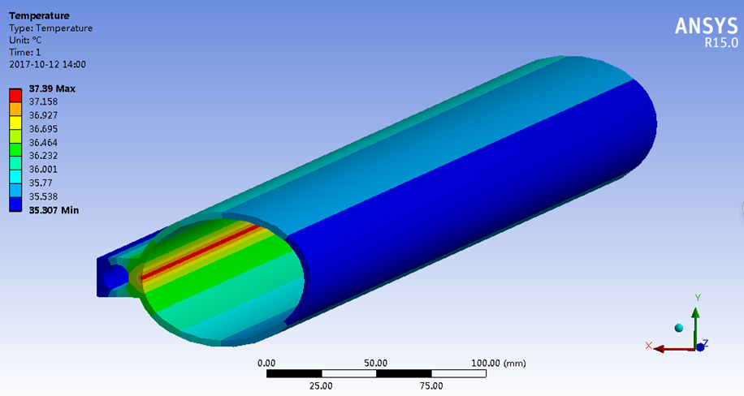
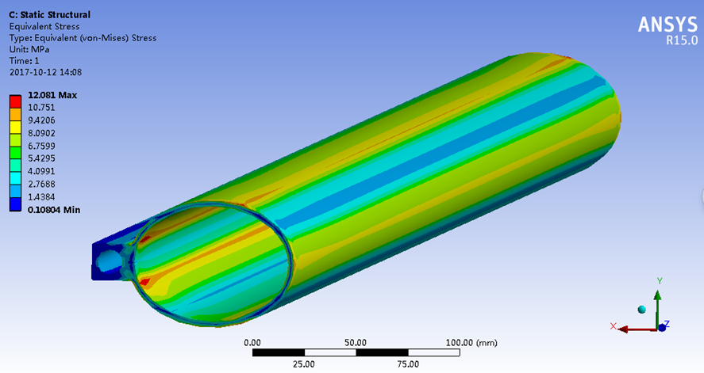
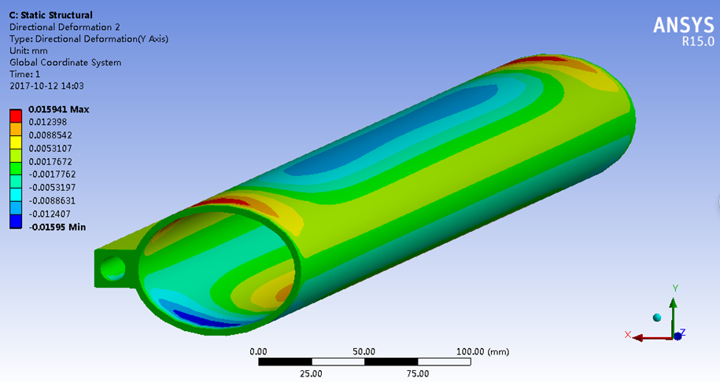
Finite element analysis for copper vacuum chamber
E=120GeV, I=17.4mA, h=1x10⁻³w/mm²⋅°C
The highest temperature reaches to 37.4 °C;
The maximum stress is 12.1 MPa;
The maximum deformation of X, Y and Z directions are 0.033 mm, 0.016 mm and 0.25 mm/m.

Slide 16
Lead shielding
Synchrotron Radiation Shielding

Slide 17
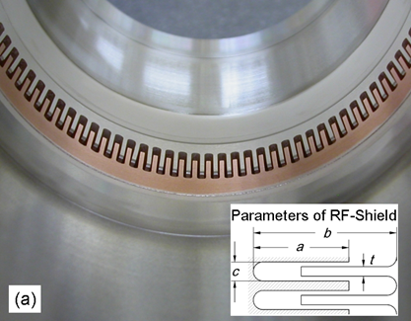
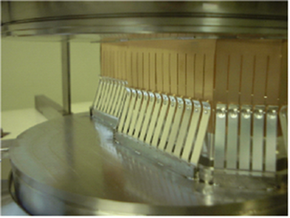
    4. Bellows Module with RF Shielding
The primary function of the bellows module is to allow for thermal expansion of the chambers and for lateral, longitudinal and angular offsets due to tolerances and alignment, while providing a uniform chamber cross section to reduce the impedance seen by beam.
The usual RF-shield is done with many narrow Be-Cu fingers that slide along the inside of the beam passage as the bellows is being compressed.
Comb-type (Supper KEKB)
High thermal strength
Low impedance, no sliding point
Limited stroke (±4 mm), small bending angle (±30 mrad )
Double-fingers type(usual)
Shielding finger + spring finger
Large expansion and contraction
Offset (±2mm), bending angle (±50 mrad )

Slide 18
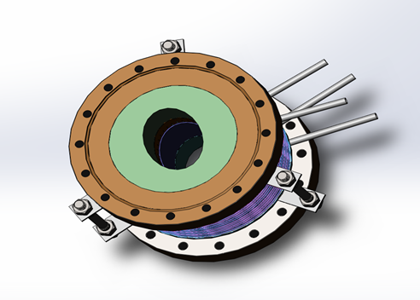
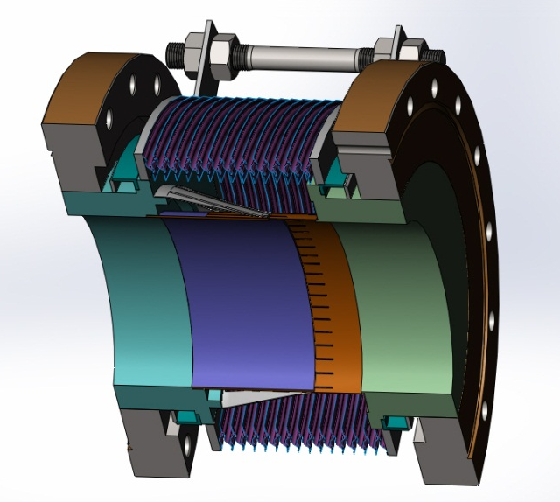
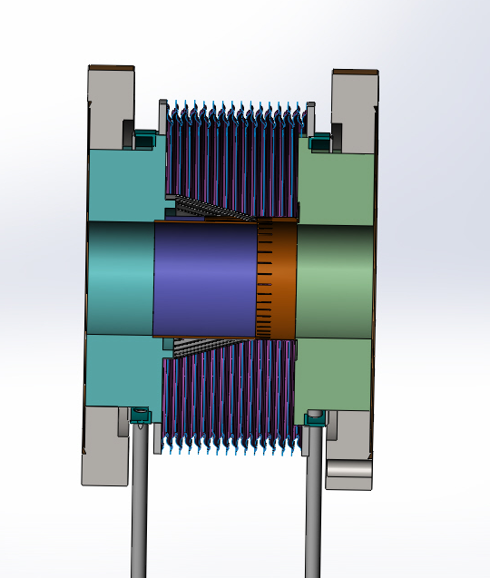
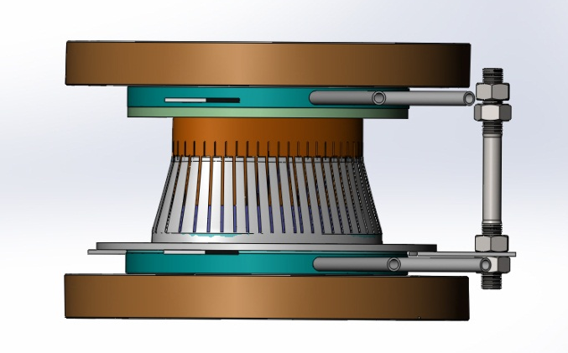
For CEPC, the fingers are designed to maintain a relatively high contact pressure of 150±10g/finger. The RF-shield should absorb the maximum expansion of 10 mm and contraction of 20 mm, allowing for the offset of 2 mm. The step at the contact point is limited to less than 1mm. The cooling water channel is attached considering the reflecting power of the synchrotron radiation, Joule loss and HOM heat load on the inner surface, and the leaked HOM power inside the bellows.
RF shielding bellow module

Slide 19
    5. Pumping system
The circumference of the CEPC storage ring is 100 km. It will be subdivided into about 520 sectors by means of the RF all metal gate valves, which allow all vacuum work such as pumping down from atmosphere pressure, leak detecting, bakeout, and vacuum interlock protection, to be done in sections of manageable length and volume.
Roughing down to approximately 10⁻⁷ Torr will be achieved by the oil free turbo-molecular pump group.
The main pumping is preferably achieved with Non Evaporable Getter(NEG)-coated copper chambers in the positron ring, the ion pumps will be used to maintain pressure and pump off CH₄ and noble gases that can’t be pumped off by the NEG pump.
The aluminum chambers of the electron ring are evacuated by the ion pumps at a spacing of about 6m.
For the pumping system of the interaction regions where the detectors are located, depending on the space available, NEG pumps, sublimation pumps and ion pump will be used.

Slide 20
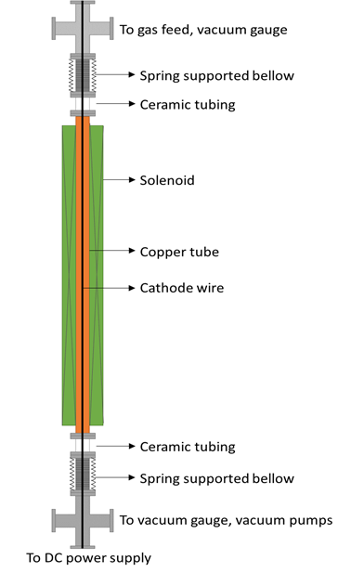
NEG coating of the inside chamber
NEG coating suppresses electron multipacting (SEY < 1.2) and beam-induced pressure rises, as well as provides extra linear pumping.
The NEG coating is a titanium, zirconium, vanadium alloy, deposited on the inner surface of the chamber through sputtering.
Each dipole chamber will be fitted with three cathodes (made of twisting together Ti, Zr and V metal wires) mounted along the chamber axis to achieve uniform thickness distribution.
All related parameters (plasma gas pressure, substrate temperature, plasma current, and magnetic field value) will be recorded and suitably adjusted to ensure the stability of the deposition process.
Minimum effective thickness of NEG films (such as 1 μm to 200 nm) or part of NEG coating inside the inner surface of a vacuum chamber need to be studied for decreasing the resistive wall impedance.

Slide 21
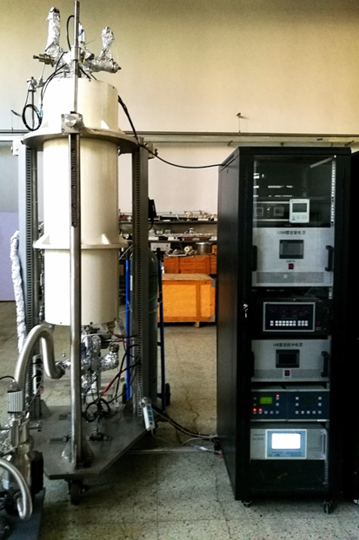
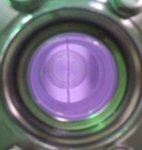
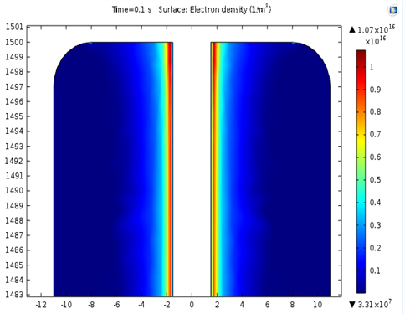
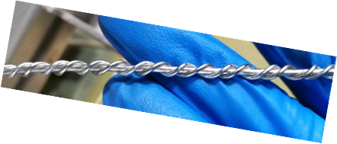
NEG Coating Setup

Slide 22
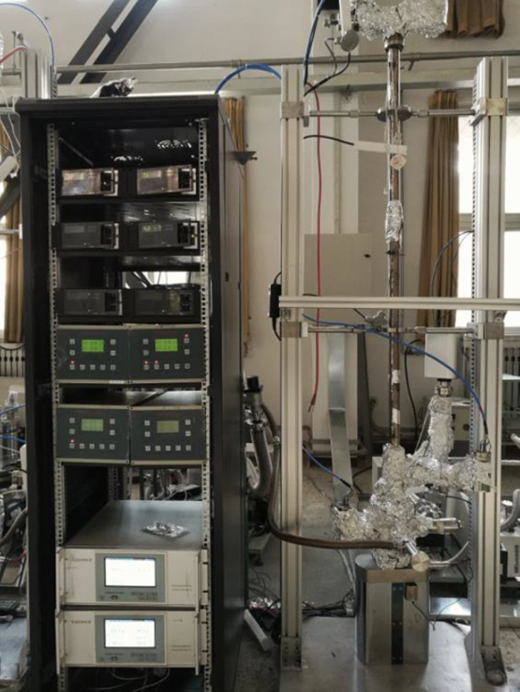
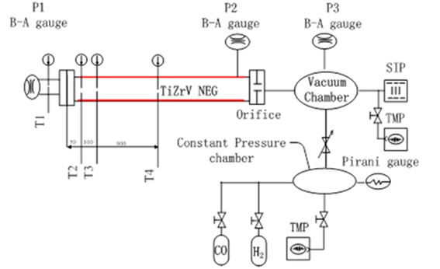
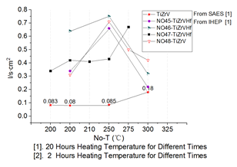
Pumping speed measurements of NEG films

Slide 23
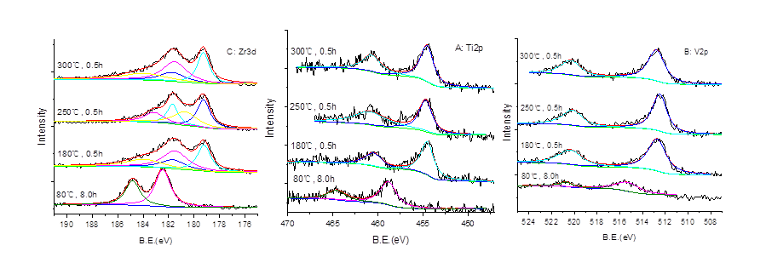
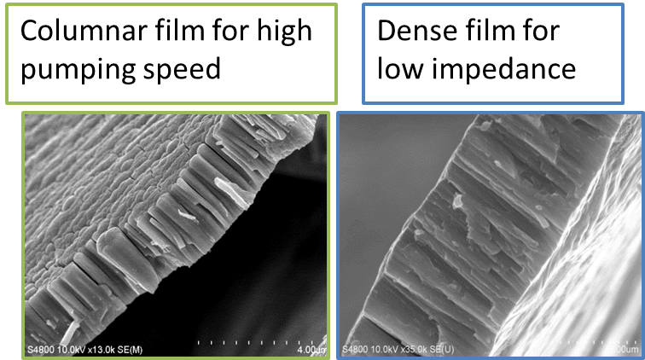
XPS & SEM Analysis

Slide 24
    6. Vacuum measurement and control
The size of CEPC excludes the installation of vacuum gauges at sufficiently short intervals, some special sections such as injection regions, RF cavities and interaction regions are equipped with cold cathode gauges and residual gas analyzers.
The current of the sputter ion pumps, which are placed at the spacing of 6～18m, will be monitored continuously and should provide adequate pressure measurements down to 10⁻⁹ Torr.
Some mobile diagnosis equipment can be brought to the place of interest during pumpdown, leak detection and bakeout when the machine is accessible.
The control of the vacuum system will be part of the general computer control systems; it includes the control of the sputter ion pumps, vacuum gauges, sector valves, and the monitoring of the temperature of the vacuum chambers.

Slide 25
7. Summary
Basic requirements of the CEPC vacuum system are presented.
Synchrotron radiation power and gas load are calculated.
The materials and shapes of the vacuum chambers are analyzed and compared, and the aluminum alloy will be chosen for the electron ring and the copper for positron ring to reduce SEY.
A three-dimensional drawings of RF bellows are designed.
Pumping system, vacuum measurement and control are considered.
The conventional vacuum technology will be used for the LINAC and Booster vacuum system.

Slide 26
Thanks!

