Slide 1

Development of the CEPC Collider Magnets
Mei Yang ,Fusan Chen, Xianjing Sun
IHEP, CAS
Workshop on the Circular Electron-Positron Collider - EU edition
15 April – 17 April 2019,Oxford, UK

Slide 2
Outline
Overview
Development of the dual aperture dipole
Development of the dual aperture quadrupole
Design of the sextupole magnet
Summary

Slide 3
Collider Magnets Overview
CDR
Over 80% of collider ring is covered by conventional magnets. All these magnets are worked at DC mode.
The most important issues are Cost & Power Consumption.
  Make the magnets compact and simple.
  Use aluminum for the coils.
  Dual aperture magnets save nearly 50% power.
  Consider the combined function magnets.
  Increase the coil cross section and decrease the operating current.
 | Dipole | Quad. | Sext. | Corrector | Total
Dual aperture | 2384 | 2392 | - | - | 13742
Single aperture | 80*2+2 | 480*2+172 | 932*2 | 2904*2
Total length [km] | 71.5 | 5.9 | 1.0 | 2.5 | 80.8
Power [MW] | 7.0 | 20.2 | 4.6 | 2.2 | 34

Slide 4
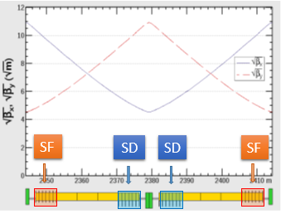
Development of the Dual Aperture Dipole(DAD)
Length: 28.7m, divided into 5 segments.
Combine sextupoles in the first and last segments.
  Different polarities in different apertures.
  Reduce the strength of individual sextupoles.

Slide 5
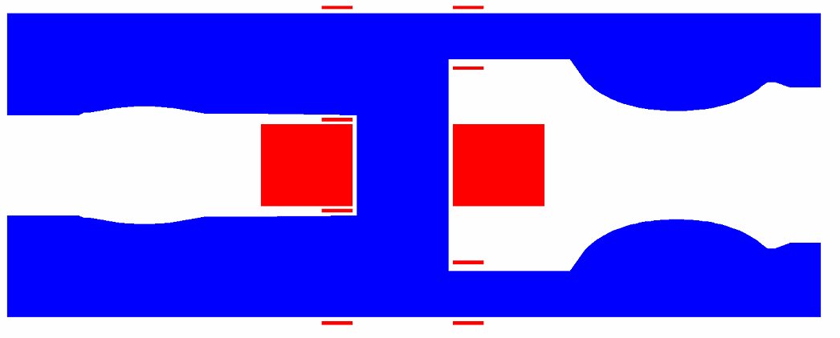
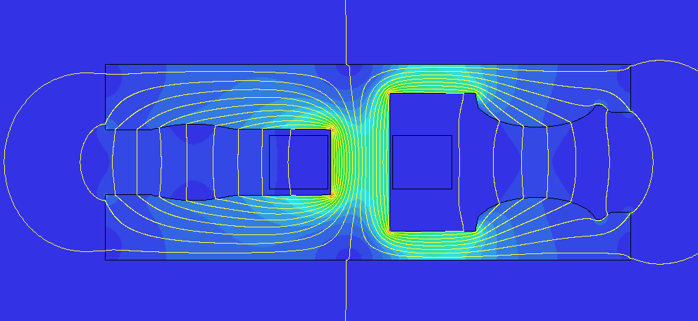
Prototype of DAD with sextupole component
Requirements of the 1m prototype
  Center field B1：141Gs @45GeV to 373Gs @120GeV
  Difference of B_{cen} in the two apertures<0.5%
  Harmonics <5×10⁻⁴ @R=13.5mm(except the sextupole component b3)
  Correct coil:±1.5% adjust capability
2D design of the combined dipole
  Solid iron: L_{iron}=1m;
  Main Coil: Aluminum Bars,4turns, Air cooled.
  Correct coil: Copper.
350mm

Slide 6
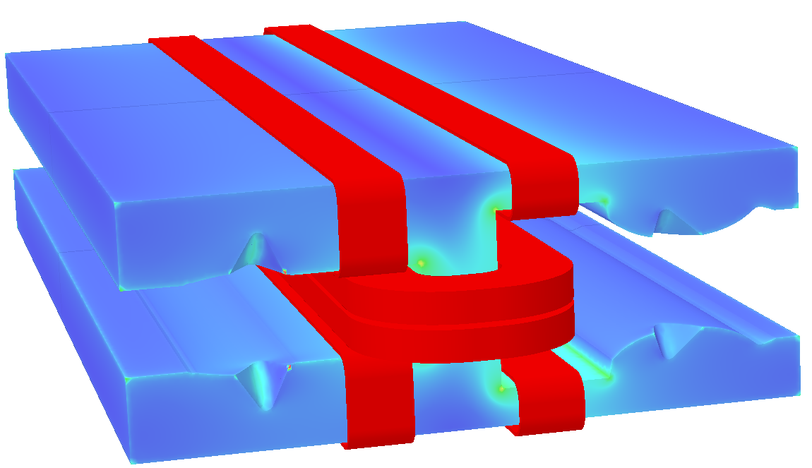
Prototype of DAD with sextupole component
2D simulation results of 1m prototype
  Other harmonics <3.5units@R=13.5mm
3D Results after chamfer
  Integral strength：BL_{left}=41.452T.mm，BL_{right}=41.305T.mm
 | Left | Right
B(T) | 0.03732 | 0.03733
S(T/m²) | 4.888 | -7.023
 | Left | Right
1 | 10000 | 10000
2 | 2.72 | 1.06
3 | 113.60 | -155.236
4 | 2.83 | -1.92
5 | -3.11 | 2.0

Slide 7
Prototype of DAD with sextupole component
Other simulations
  Main coil position error and trim coil effect are studied.
  The cross talk between the two apertures can be ignored.
  The sextupole component varies almost linearly with the field strength of the dipole field.
  Take the field in the left aperture for example.
 | B | B+1.5% | B-1.5%
BL(T.mm) | 41.4527 | 42.074 | 40.831
 | Harmonics(Bn/B1×10000)
1 | 10000 | 10000 | 10000
2 | -2.72 | -2.51 | -1.83
3 | 113.60 | 113.80 | 113.85
4 | 2.28 | 2.35 | 2.38
5 | -3.11 | -3.09 | -3.08

Slide 8
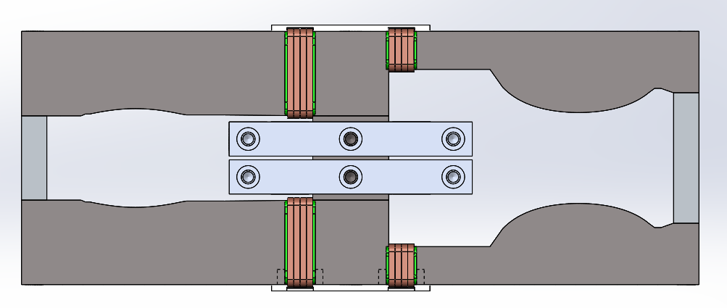
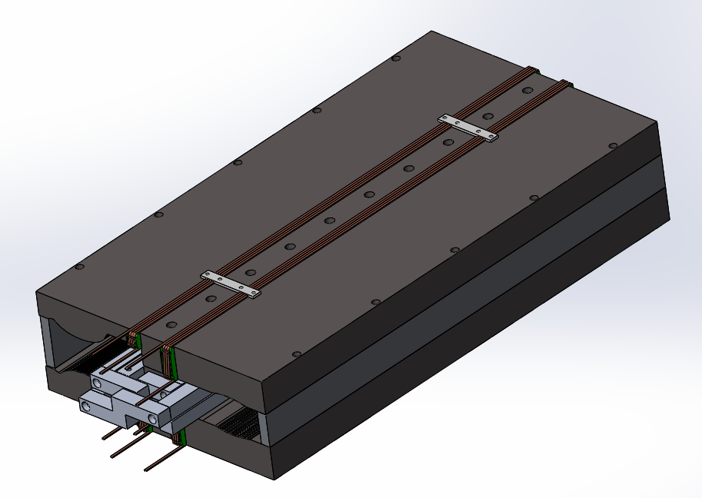
Prototype of DAD with sextupole component
The physical parameters of the prototype are summarized as follows.
The mechanical design is under progress.
Magnetic strength [T] |  | 0.037
Aperture [mm] |  | 70
Main coil | Turns | 4
 | Material | Aluminum
 | Current [A] | 563
 | Current density [A/mm²] | 0.7
 | Power consumption [kW] | 0.12
Trim coil | Turns | 1×4
 | Material | Copper
 | Current [A] | 16.7
 | Current density [A/mm²] | 0.093
 | Power consumption [kW] | 0.0005

Slide 9
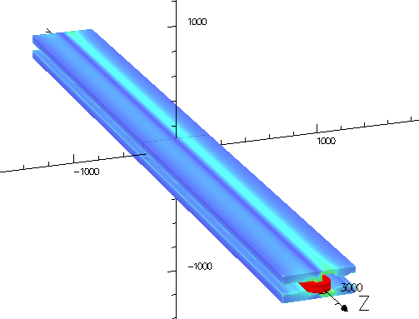
Design of long Dual Aperture Dipole magnet
As the magnetic length is up to 28.7m, the long section of 5.7m modular will be built to check the field quality, mechanical strength and deformation.
Using the same cross section of 1m long model, without end chamfering, the 5.7m model can meet the field uniformity requirement. All the other harmonics are less than 5 units.
 | Left | Right
BL(T.mm) | 108.5917 | 108.5032
 | Harmonics(Bn/B1×10000)
1 | 10000 | 10000
2 | 2.87 | -1.34
3 | 116.55 | -169.29
4 | -0.97 | 0.79
5 | --3.31 | 2.76

Slide 10
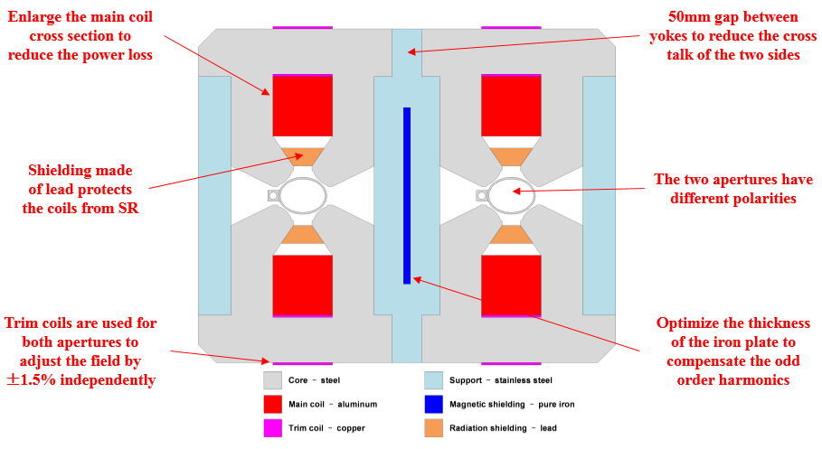
Design of Dual Aperture Quadrupole (DAQ)
Basic parameters of DAQ
  Apertures:76mm
  Effective length: 1m or 2m
  Gradient：3.2T/m@45GeV to 8.42T/m @120GeV, FD polarity
  Good field region: 5×10⁻⁴@Rref=12.2mm

Slide 11
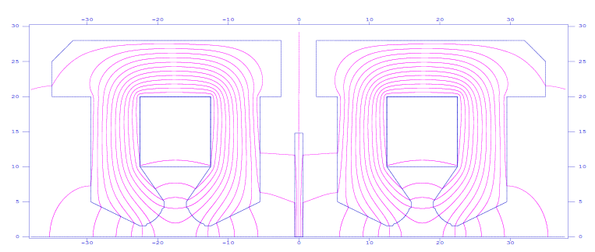
Design of Dual Aperture Quadrupole(DAQ)
2D simulation:
  By optimizing the profile of the pole, the systematic harmonics are suppressed to less the 3×10⁻⁴. However, field coupling introduces non systematic harmonics, especially the b1 and b3 component.
  A pure iron shielding plate is inserted between the two apertures to compensate the harmonics.
Bn/B2 | Before shielding | After shielding
1 | -2132.7 | -0.2
3 | -169.9 | 0.0
4 | 0.4 | 0.5
5 | -2.3 | 0.0
7 | 0.2 | 0.0
10 | 0.0 | 0.0
14 | 0.0 | 0.0
Magnetic flux distribution

Slide 12
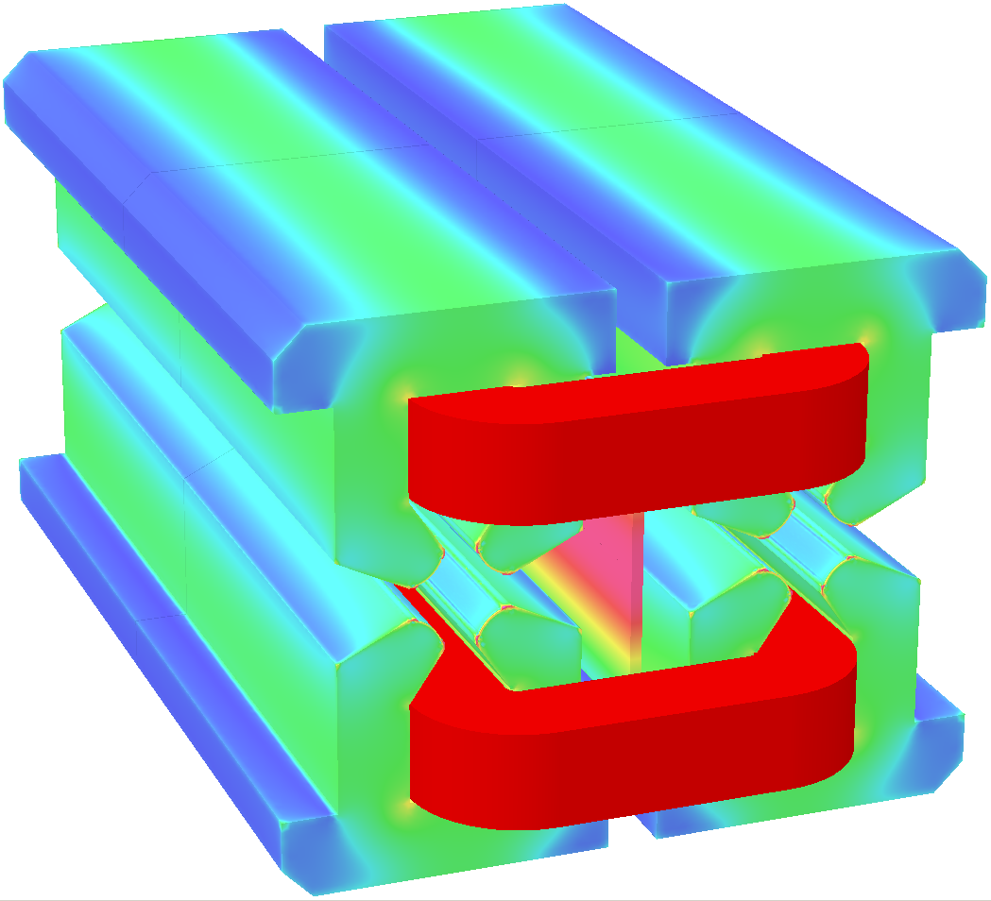
Design of Dual Aperture Quadrupole
3D simulation
  The iron plate can not compensate the b1 & b3 at once.
  Prototype will be developed for further study.
Gradient [T/m] |  | 8.42
Aperture [mm] |  | 76
Main coil | Turns | 64×2
 | Material | Aluminum
 | Current [A] | 154
 | Current density [A/mm²] | 1.89
 | Power consumption [kW] | 5.3
Trim coil | Turns | 20×4
 | Material | copper
 | Current [A] | 7.2
 | Current density [A/mm²] | 0.9
 | Power consumption [kW] | 0.04
Cooling water | Velocity [m/s] | 1.3
 | Flux [l/s] | 0.201
 | Temperature rise [°C] | 6.3

Slide 13
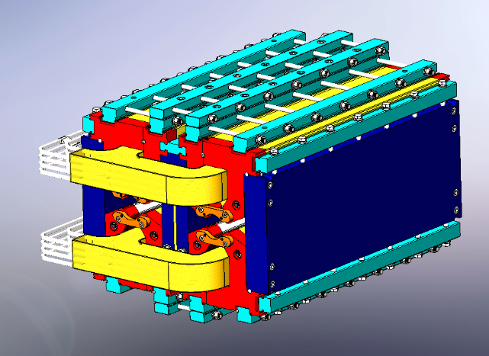
Design of Dual Aperture Quadrupole
A 1m long DAQ prototype is in mechanical design.
  The iron is a laminated one. In order to assemble the coil, the core is divided into 10 parts and has two kinds of punching sheet.
  Field cross talk between two apertures while changing trim current.
  Compensation effect of the middle iron plate with different shape.

Slide 14
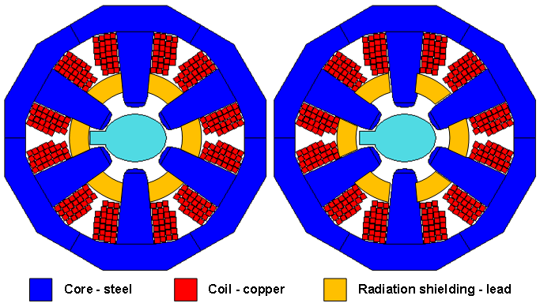
Design of the Sextupole Magnet
Two single aperture sextupoles are installed side by side.
  Core size is limited by the 350mm beam center separation.
  Use copper for coils & enlarge the cross section as much as possible.
  10mm gap between two magnets but the cross talk can be ignored.

Slide 15
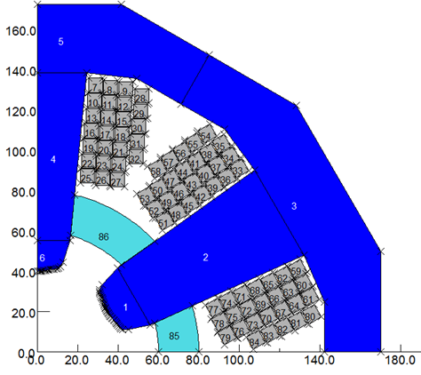
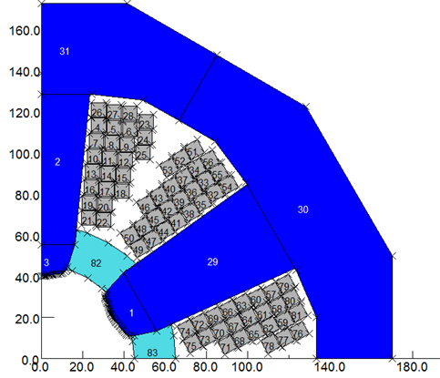
Design of the Sextupole Magnet
Basic parameters:
  Aperture：80mm
  Magnetic length:0.7m and 1.4m
  Field Strength: 191T/m² @45GeV to 506T/m² @120GeV
  Good field region: 3×10⁻⁴@R=14mm
Optimization
  Rearrangement of the wire layout and enlarge the yoke from 28mm to 37mm.
Wire layout

Slide 16
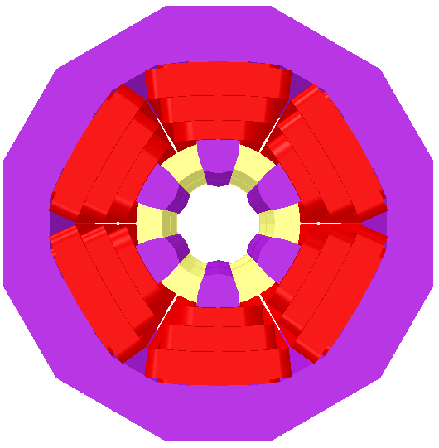
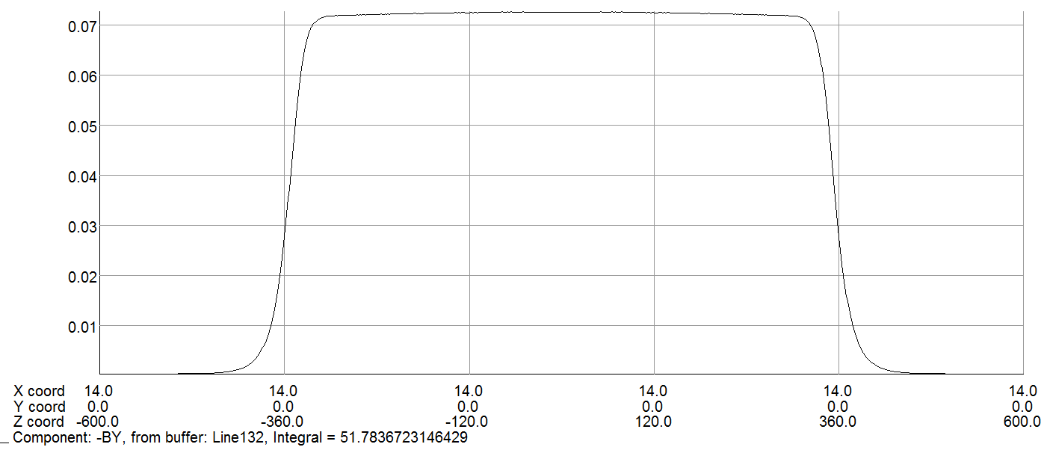
Design of the Sextupole Magnet
Opera simulation：
Main parameters:
 | Bn/B3*10000
3 | 10000
9 | 1.0
15 | -0.5
21 | -0.1
3D model
Type |  | SF | SD
Magnetic length [m] |  | 0.7 | 1.4
Gradient [T/m²] |  | 506
Aperture [mm] |  | 80
Coil | Turns | 26×6
 | Material | Copper
 | Current [A] | 168.4
 | Current density [A/mm²] | 4.1 | 4.7
 | Power consumption [kW] | 3.3 | 7.0
Cooling water | Velocity [m/s] | 2.1 | 1.8
 | Flux [l/s] | 0.175 | 0.269
 | Temperature rise [°C] | 4.5 | 6.2

Slide 17
Summary
We are now building short prototypes as proofs of concepts, in particular to assess the magnetic performance with respect to the requirements, and as a basis for a future manufacturing optimization.
The design of dual aperture dipole and dual aperture quadrupole short prototypes has been finished and the manufacturing contract has been signed with the workshop.
The short prototypes are now in mechanical design and will be measured at the end of 2019. The rotating coil and stretched wire system will be used to measure the field quality and reproducibility. The low field effect and the cross talk between the two apertures will be studied.
The dual aperture dipole prototype with dipole field only will also be produced. And the long model will be researched.
A sextupole magnet prototype is in plan.

Slide 18
Thanks for your attention!

Slide 19
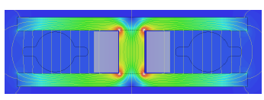
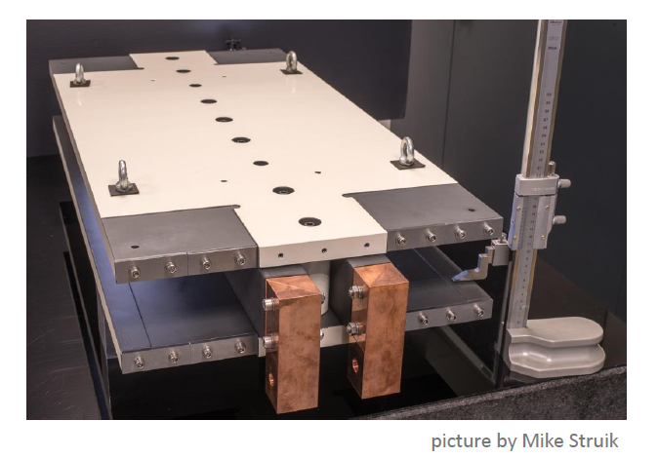
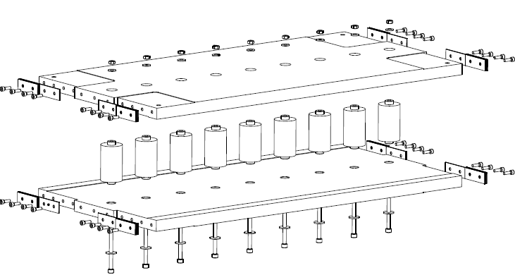
FCC-ee: dual aperture dipole prototype

Slide 20
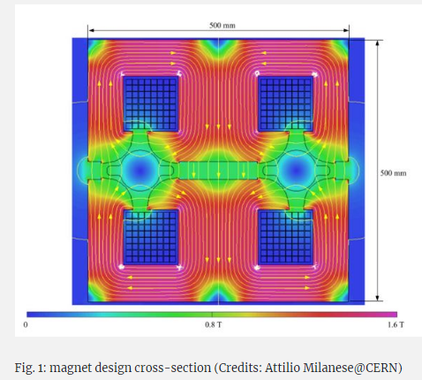
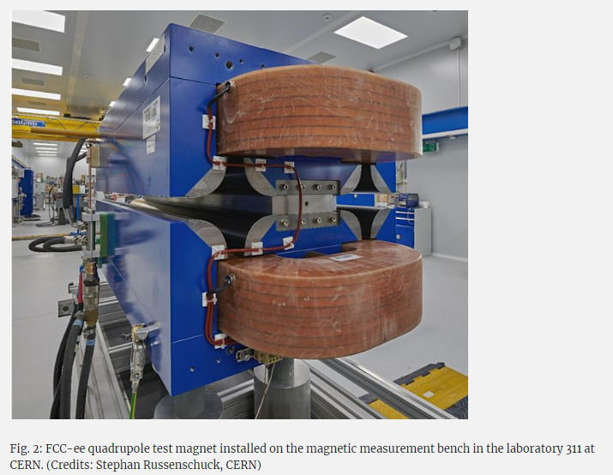
FCC-ee: dual aperture quadrupole magnet
https://acceleratingnews.web.cern.ch/tags/quadrupole-magnets

