Slide 1
Development of the prototype dipole magnet for CEPC Booster
Wen Kang
Workshop on the CEPC EU Edition 2019
Oxford, UK, April 15 - 17, 2019

Slide 2
Contents
Introduction
Specifications and challenges
Development of the prototype magnets
  The dipole magnet with iron core
  The dipole magnet without iron core
Summary

Slide 3
Introduction
CEPC is an circular e-e+ collider with a 100-km circumference. The Booster will be in the same tunnel with collider, and has the same circumference
In order to realize full energy injection to the collider, the Booster will accelerate the e-e+ beam from 10GeV to 120GeV or 175GeV.
There are nearly 16320 dipole magnets with length of 4700mm in the Booster, so the total length of all dipole magnets will be 75km.
The field of the dipole magnets will change with the beam energy, of which the min. working field is 29Gs whereas max. field is 338Gs or 492Gs.

Slide 4
Specifications and challenges
Specifications of CEPCB dipole magnets
 | BST-63B
Quantity | 16320
Minimum field (Gs) | 29
Maximum field (Gs) | 492
Gap (mm) | 63
Magnetic Length (mm) | 4700
Good field region (mm) | 55
Field uniformity | 0.1%
Field reproducibility | 0.05%
Challenges
Total length of the dipoles ~75km how to reduce cost
Field error <29Gs*0.1%=0.029Gs how to design
Field reproducibility<29Gs*0.05%=0.015Gs how to measure
Magnet length ~4700mm how to fabricate

Slide 5
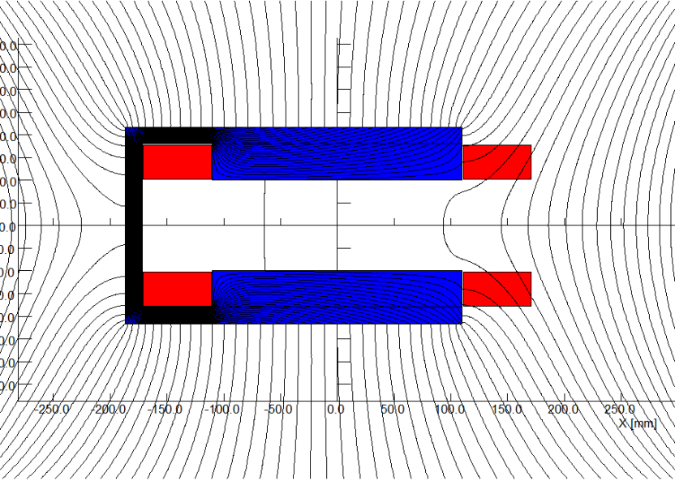
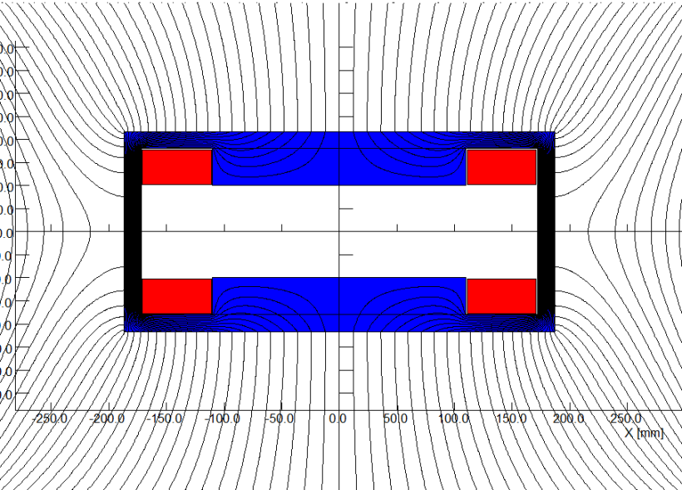
Dipole magnet with iron core
1 Design of the dipole magnet with iron core
In order to get a better shielding of earth field, a H-type rather than C-type core is selected for the design of the CEPC booster dipole magnets.
By taking the same technology of core dilution as the low field dipole magnets of the LEP and LHeC, the cores of CEPCB dipole magnets will be stacked by silicon steel laminations and aluminum laminations with the ratio of 1:2.

Slide 6
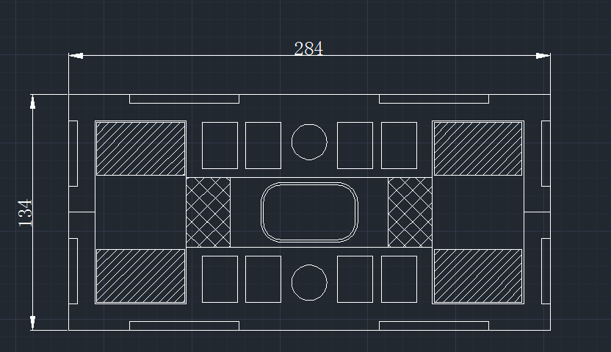
Dipole magnet with iron core
In order to reduce the weight of the cores and increase the field in the cores further, the core dilution in transversal direction were proposed.
  The return yokes were designed as thin as possible.
  In the pole areas of the laminations, some holes were stamped.
The technologies of the core dilution will not only reduce the weight of the magnets, but also increase the field in the cores and decrease the influence of the remnant field.
Each coil of the magnets is only one turn, which is simply made by aluminum bars.

Slide 7
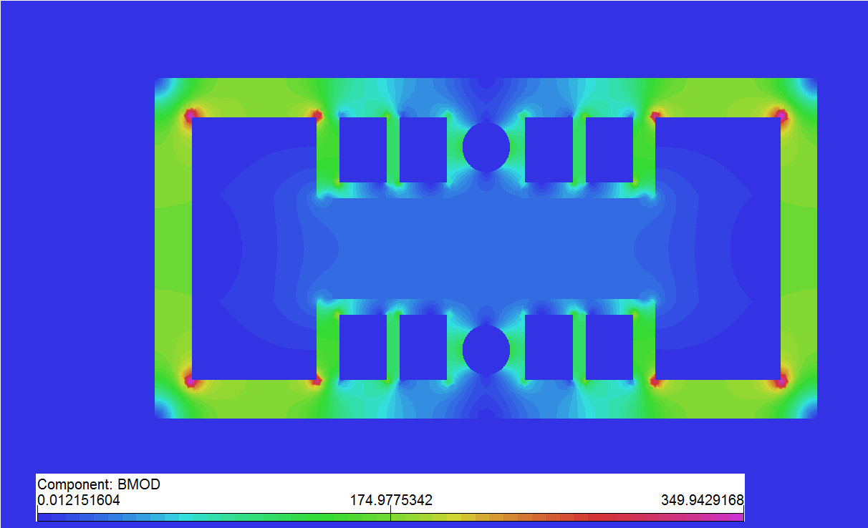
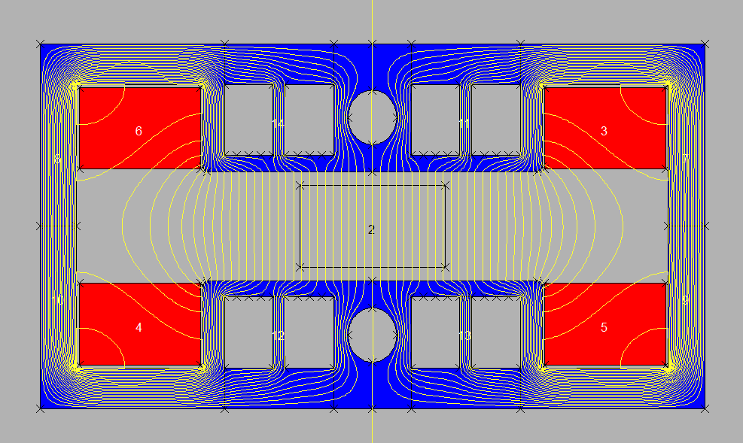
Dipole magnet with iron core
The simulation results show that field intensity in most areas of the laminations can be increased to 150Gs while field in the gap is 29Gs.
The magnetic fluxes are flowing in the laminations as expected and the holes in the pole areas have a function to adjust the flux flowing .
The field error in the good field region both at high field and low field is better than 5E-4.

Slide 8
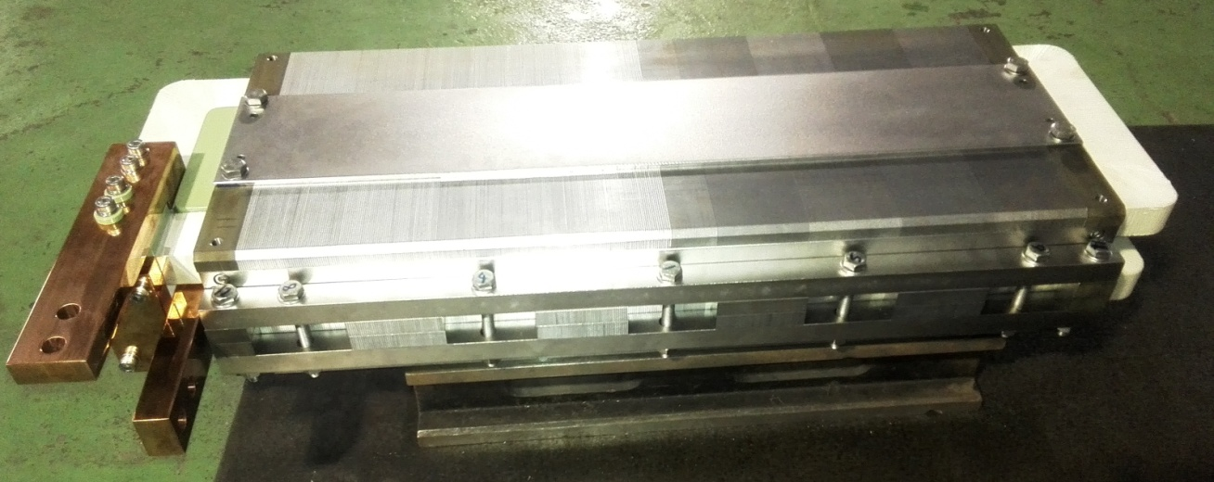
Dipole magnet with iron core
2 Production of a subscale prototype dipole magnet
In order to verify the design of the dipole magnet with iron core, a 1m long subscale prototype magnet was produced and tested in CEPC Pre-CDR stage.
One half of the magnet is stacked by the pure steel laminations, another half is stacked by the steel laminations and the aluminum laminations with the thickness ratio of 1:2.

Slide 9
Dipole magnet with iron core
3 Test of a subscale prototype dipole magnet
The field of the prototype magnet was measured by Hall probe measurement system in the lab. of IHEP.
The remnant field in the magnet gap is about 4-6Gs, which is 13%-20% of the low field of 29Gs.
Due to the remnant field in the core, the field uniformity at low field becomes 10 time worse than that at high field
The field reproducibility at low field becomes 40 time worse than that at high field.

Slide 10
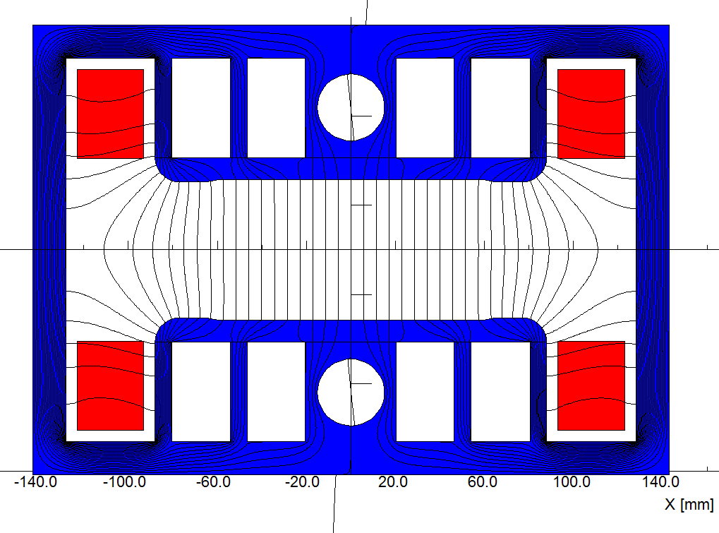
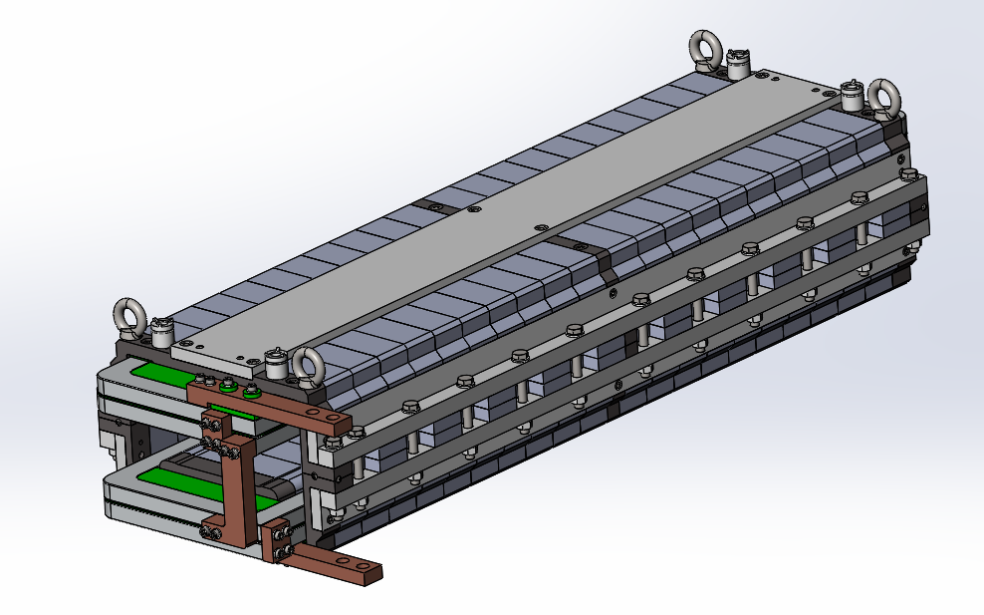
Dipole magnet with iron core
4 Improved design of the dipole magnet with iron core
The dipole magnet with iron core is re-designed according to the new requirements of the CDR.
The design of the magnet keeps the technologies of core dilution.
1) The cores will be stacked by silicon steel and aluminium laminations with ratio of 1:1.
2) The return yoke of the cores will be made as thin as possible.
3) In the pole areas of the laminations, some holes will be stamped.

Slide 11
Dipole magnet with iron core
To compensate simulation errors of the magnet modelization at low field level, the simulated field uniformity of the magnet at high field level is optimized to be 10 time better than the requirements.
Because the oriented silicon steel laminations have 10 time lower coercive force than non-oriented laminations, they will be used to stack the cores of the magnet to reduce the influence of the remnant field at low field level.
A new Hall probe with high precision at low field level will be developed to measure its field.
 | Hc// | Hc┴
Conventional low carbon steel | 56A/m | 56A/m
Grain oriented steel | 4A/m | 12A/m

Slide 12
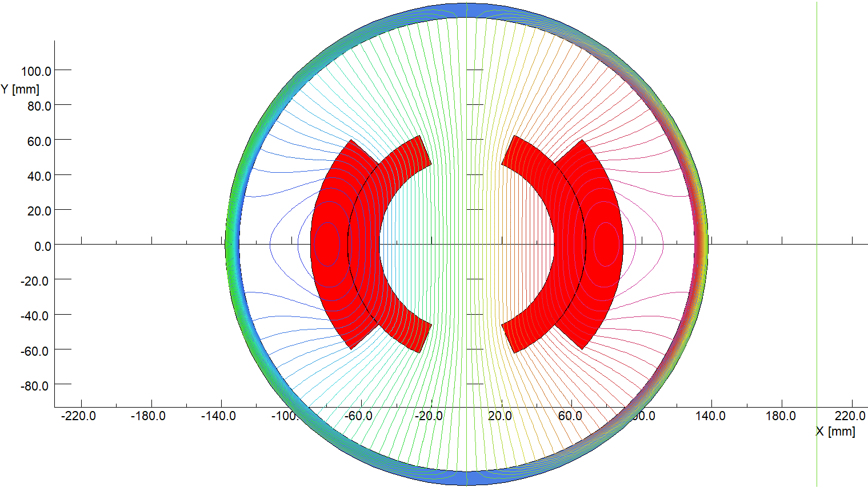
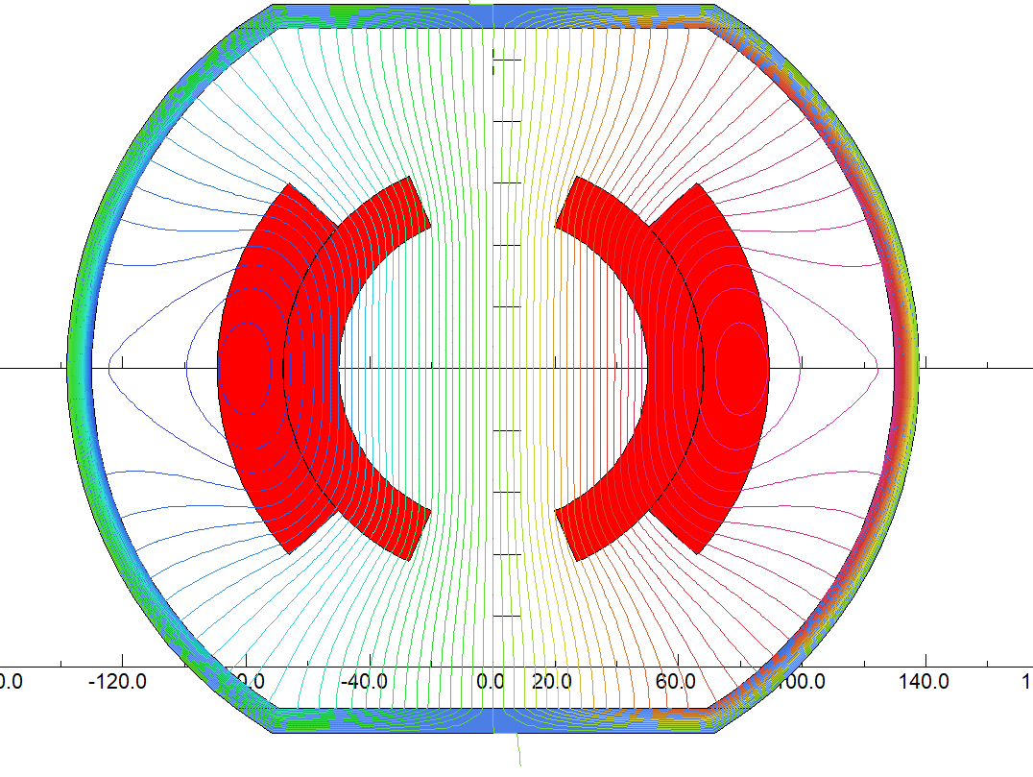
Dipole magnet without iron core
1. Design of dipole magnet without the core (CT coil)
Because the remnant field of the iron cores is the key element that destroys the field quality at low field level, the dipole magnet designs without iron core are considered.
Firstly, the dipole magnet with cosθ type coils is designed and optimized to reach the field quality at both high and low field levels.
To improve the excitation efficiency of the magnet, the top and bottom of the shielding cylinder can be flatted, the simulation results show that it can increase the efficiency by 5%.

Slide 13
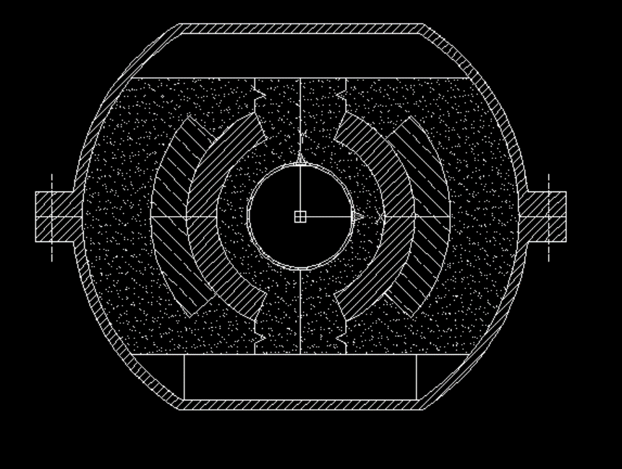
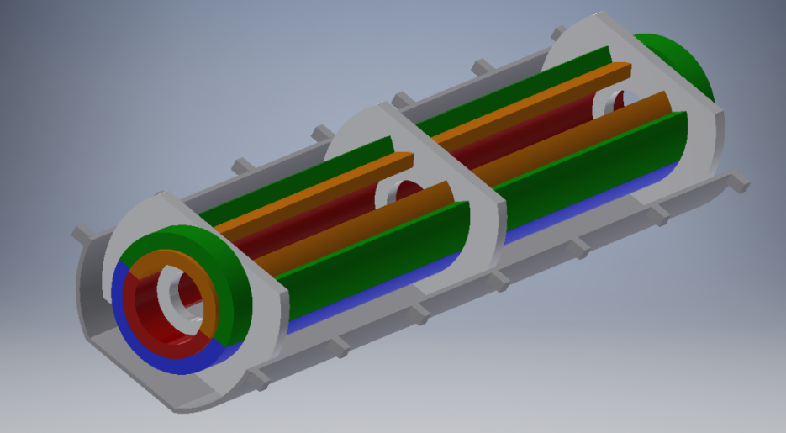
Dipole magnet without iron core
In addition, the flat top and bottom of the cylinder have a function to adjust the field distribution and then to improve field quality.
The upper and lower coils of the magnet are formed by two aluminum bars with the same cross section areas, and each coil has two layers and two turns.
Because of low field and small force, for 1m long subscale prototype magnet, the supporters at three positions in the longitudinal direction are strong enough to fix the bars of coils.

Slide 14
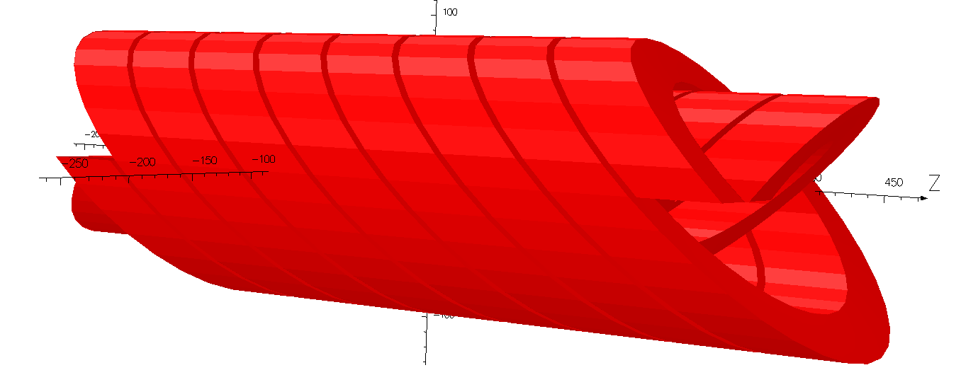
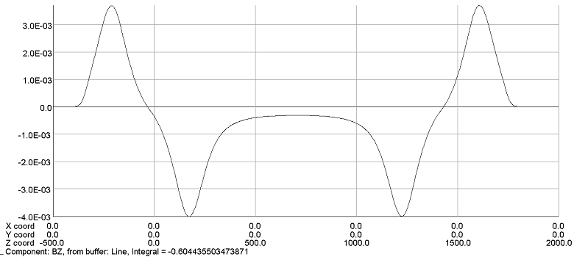
Dipole magnet without iron cores
2. Design of dipole magnet without the core (CCT coil)
Alternatively, the dipole magnet with canted cosθ coils (CCT) is also designed.
The dipole magnet with CCT coils is composed of two or four canted solenoids, of which the excited currents have different direction. The By field in the magnet center is By=μ₀I/(w*tan(α)), in which w is the distance between two turns, α is canted angle. The Bz field is compensated to nearly zero.

Slide 15
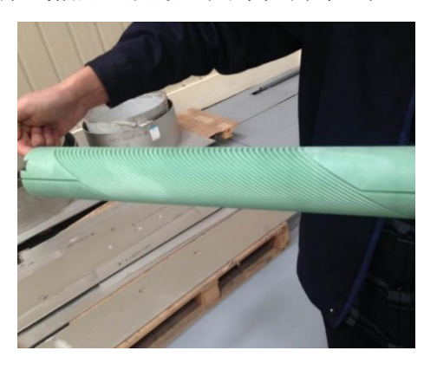
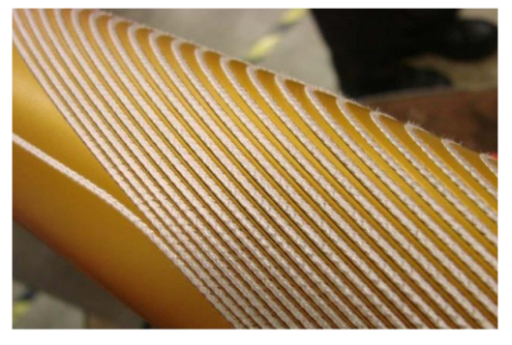
Dipole magnet without iron cores
In the case of superconducting magnets, the CCT coils are made by insert the conductors into the grooves that are fabricated on the surfaces of the supporting cylinders.
The paths of the grooves on the cylinders are precisely determined by the equations of CCT’s curves so that the conductors in the groove can produce the expected field.

Slide 16
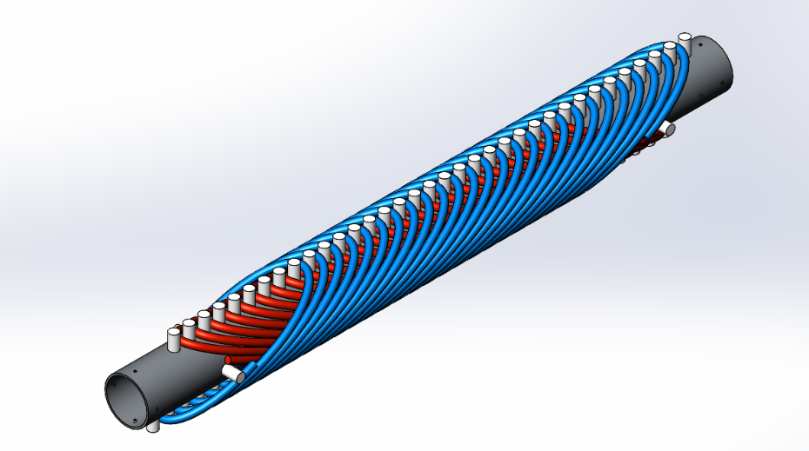
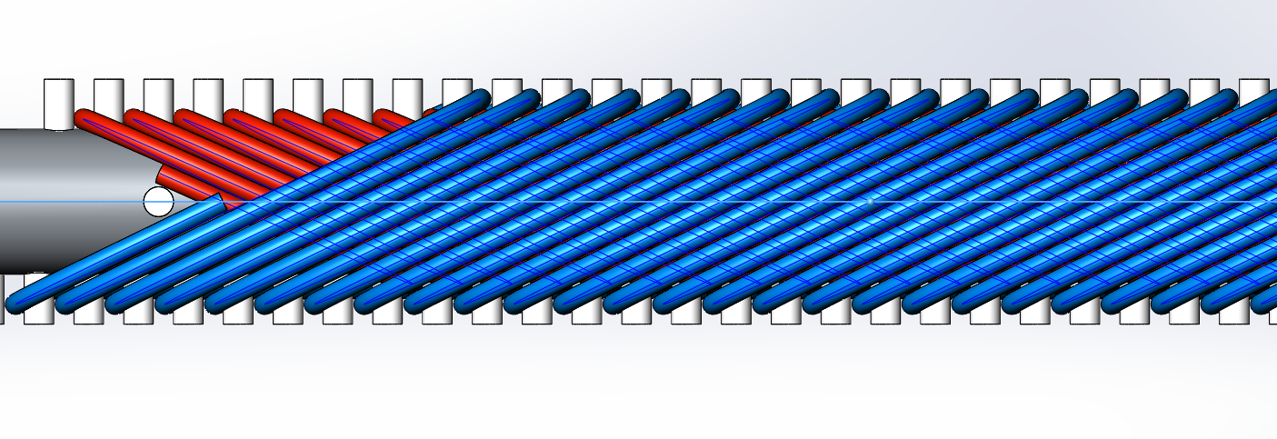
Dipole magnet without iron cores
In the case of the dipole magnets of CEPCB, to reduce the cost of the magnet production, one simple way is to directly wind the conductor on the supporting cylinders.
To fix the conductors in their right position, some small positioning cylinders are made on the surface of the supporting cylinder according to the equations of CCT’s curves.

Slide 17
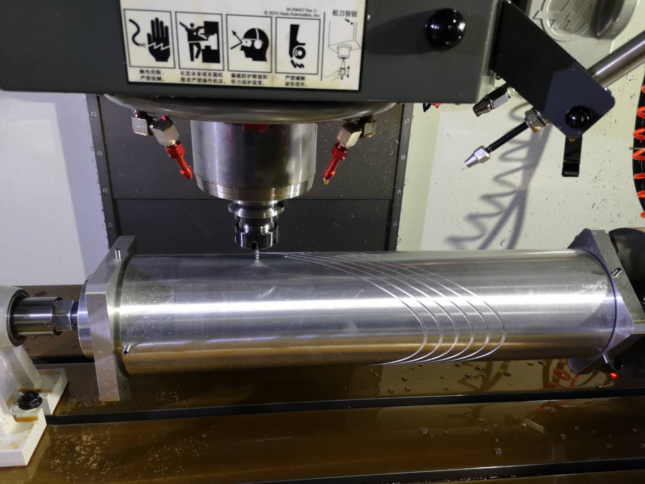
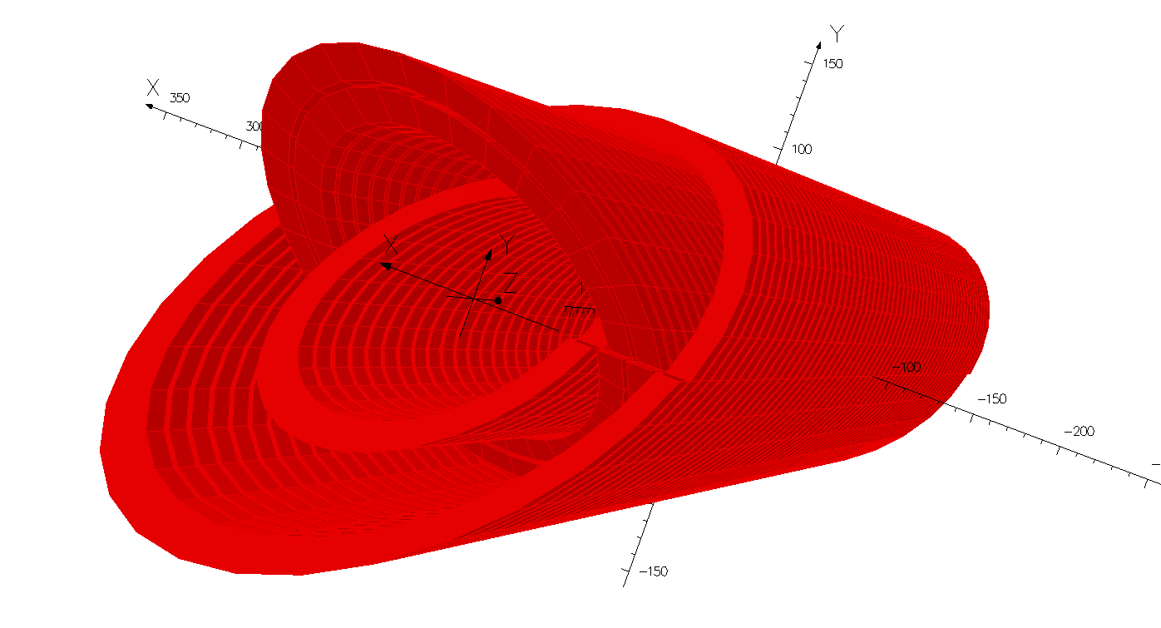
Dipole magnet without iron cores
However, the position errors directly winding the conductor on the supporting cylinders are probably not small enough to meet the field precision requirement.
To ensure the field precision, the alternative way to make CCT coils is to directly fabricate them from the aluminum cylinders.
The CCT coils of the dipole magnet have four layers, so four aluminum cylinders with the different diameters are used to fabricate the CCT coils.

Slide 18
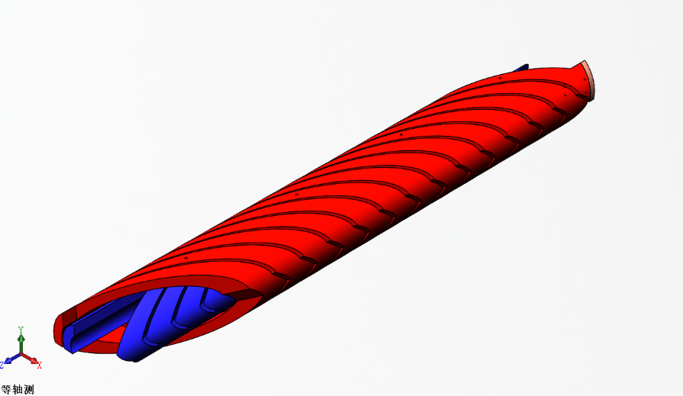
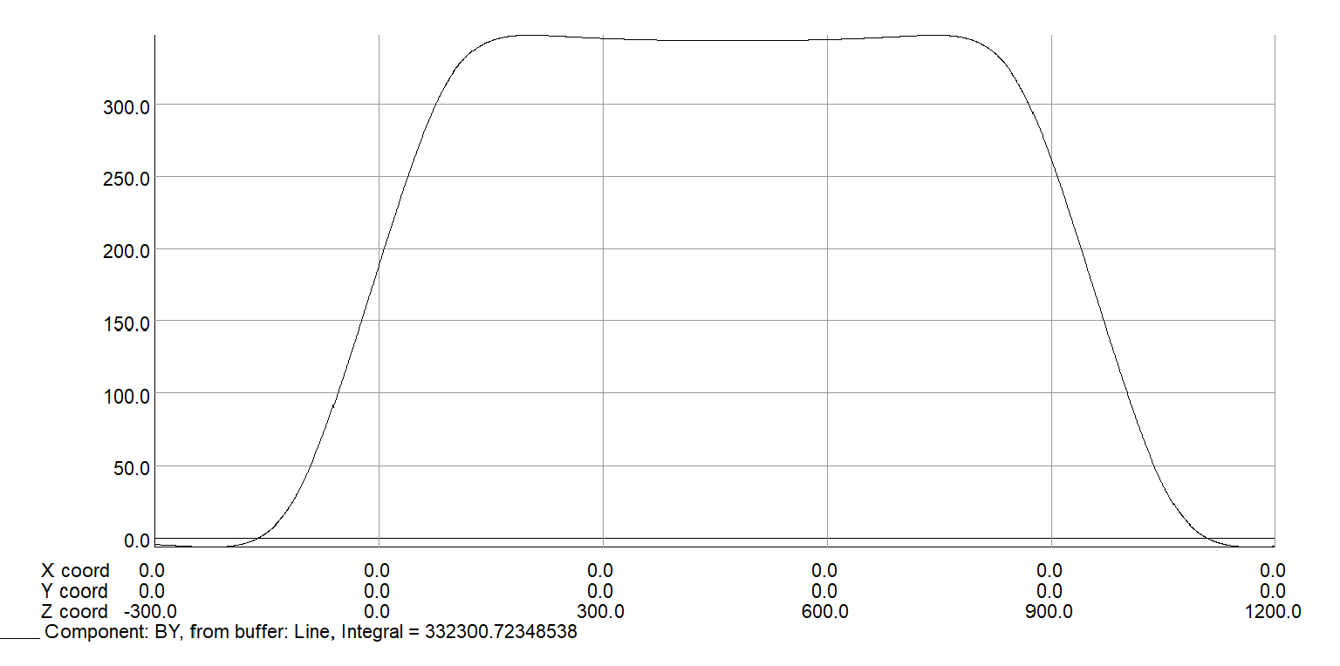
Dipole magnet without iron cores
The inner diameter of the first layer is 90mm, which is determined by the good field region. The inner diameters of other layers are determined by the thickness of the layers and the gap between the layers.
To control the eddy current in each turn of the coils that is induced by the field ramping, the thickness of the layers is less than 30 mm whereas the width of each turns is less than 15mm.
To improve the excitation efficiency, the canted angle of the CCT is 25 degree instead of 30 degree as in superconducting magnet case.

Slide 19
Comparison of the three designs
The main parameters of the three designs.
 | Iron Yoke | CT | CCT
Max. field [Gs] | 338 | 338 | 338
Min. field [Gs] | 29 | 29 | 29
Good field region (mm) | 55 | 55 | 55
Field uniformity | 0.1% | 0.1% | 0.1%
Turns per magnet | 2 | 4 | 234
Max.current (A) | 856 | 1275 | 481
Min.current (A) | 73 | 109 | 41
Conductor area (mm²) | 1200 | 1945 | 900
Max.current density(A/mm²) | 0.71 | 0.66 | 0.53
Max. power loss (W) | 425 | 1320 | 1665
Avg. power loss (W) | 170 | 528 | 666
Inductance (mH) | 0.08 | 0.36 | 1.5
Magnet size（mm） | 330 | 300 | 360
Magnet length (mm) | 4650 | 4632 | 4865
Magnet weight (ton) | 1.4 | 0.6 | 0.65

Slide 20
Summary
From the view of the excitation efficiency at high field level, the design of the dipole magnet with iron cores is the best, but the remnant field in the iron cores may spoil the field quality at low field level.
The two designs (CT and CCT) of the dipole magnets without iron cores can meet the requirement of the field uniformity at low field level, but they have lower excitation efficiency at high field level and will consume more electricity power.
Compared with the design of CT, the design of CCT is less sensitive to the mechanical tolerance, so the prototype dipole magnet of the CCT will be firstly developed and tested.
The dipole magnet with iron cores is easier to be produced than the dipole magnets without iron cores, so the former is cheaper to be produced than the latter ones.

Slide 21
Preliminary design of kicker and septum magnets

Slide 22
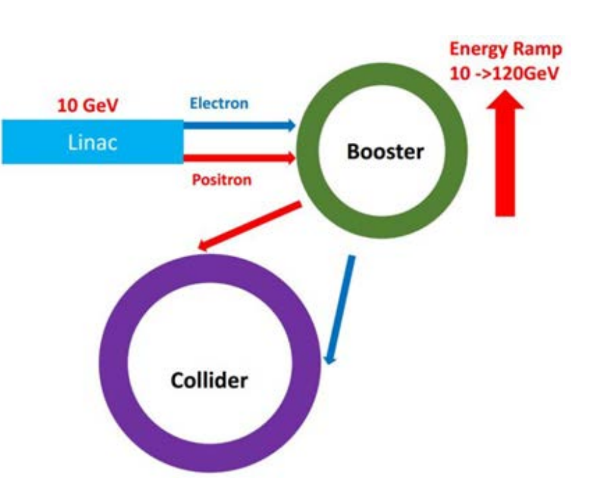
Introduction
The CEPC accelerators consist of a double-ring collider, a booster and a linac. To inject and extract the electron and positron beam into and out of these accelerators, some special kicker and septum magnets will be needed.

Slide 23
Preliminary design of kicker magnets
The main parameters of the kicker magnets for injection and extraction of the accelerators.
Magnet name | Kicker-DR-Inj-Ext. | Kicker-BST-Inj. | Kicker-BST-Ext. | Kicker-MR-Inj.
Quantity | 2 | 8 | 4 | 8
Gap [mm] | 60 | 40 | 40 | 20
Max. Field [Gs] | 100 | 280 | 600 | 600
Field Waveform | Half-sine | Half-sine | Trapezoid | Trapezoid
Rise time [ns] | 100 | 30 | 200 | 200
Fall time [ns] | 100 | 30 | 200 | 200
Top time [us] | - | - | 300 | 300
Effective Length [mm] | 500 | 300 | 700 | 700
Good Field Region [mm] | 60 | 40 | 40 | 20
Field Uniformity | 1.5% | 1.5% | 1.5% | 1.5%
Turn of Coil | 1 | 1 | 1 | 1
Inductance [nH] | 942 | 470 | 1100 | 990
Max. Current [A] | 480 | 895 | 1915 | 1625
Max. Voltage [kV] | 7.1 | 22 | 10.5 | 8.2

Slide 24
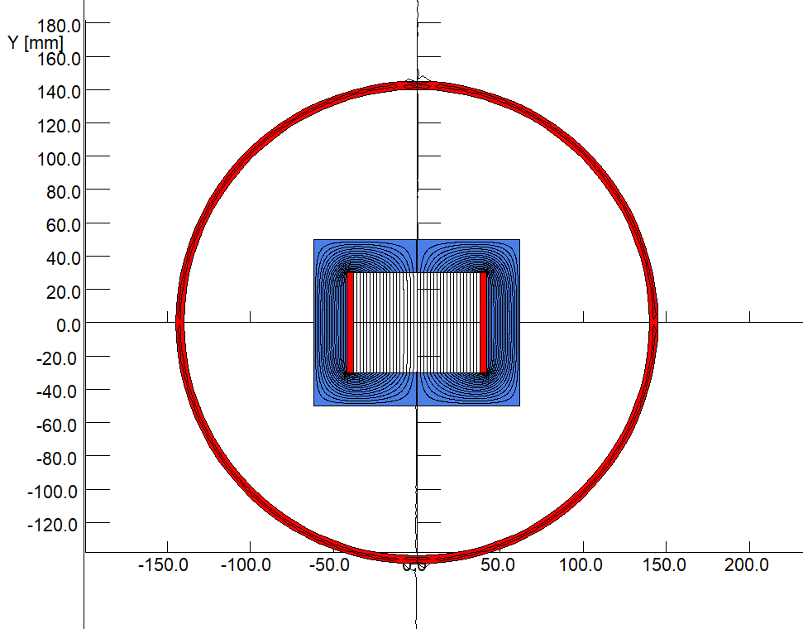
Preliminary design of kicker magnets
To get an high excitation efficiency, all the kicker magnets will have a window type cores made by two C-type ferrite blocks.
All the kicker magnets will be put inside the vacuum tanks so that the fast pulsed field can directly kick the beam without time delay and amplitude attenuation.
To avoid the coupling between particle beam and the ferrite blocks, two thin copper plates will be inserted between the touched surfaces of two C-type blocks.

Slide 25
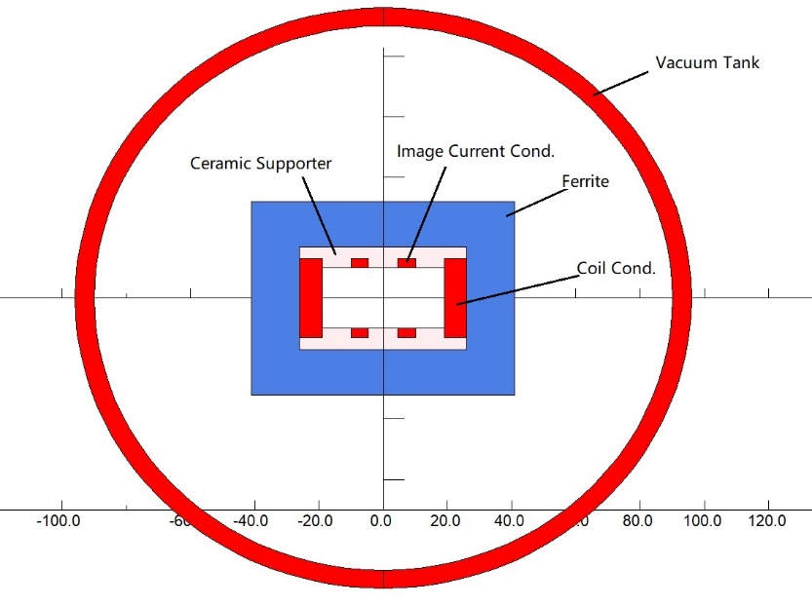
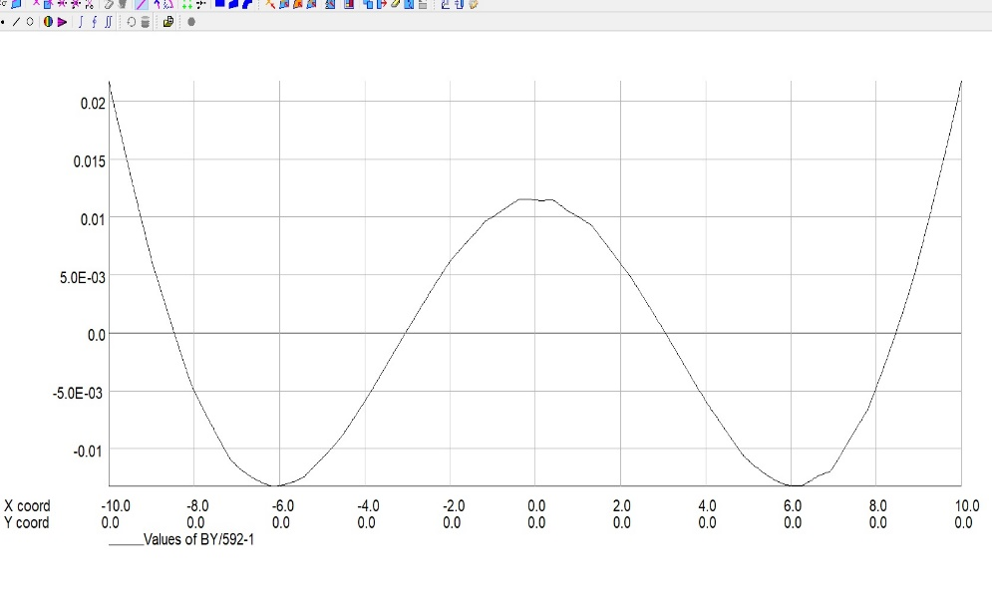
Preliminary design of kicker magnets
For the collider and booster, the beam impedance of the kicker magnets is required to be as low as possible.
one way to reduce the beam impedance is to put the metal bars conducting the image current in the magnet gap as shown in figure. However, the metal bars will shield the pulsed field and destroy the field quality.

Slide 26
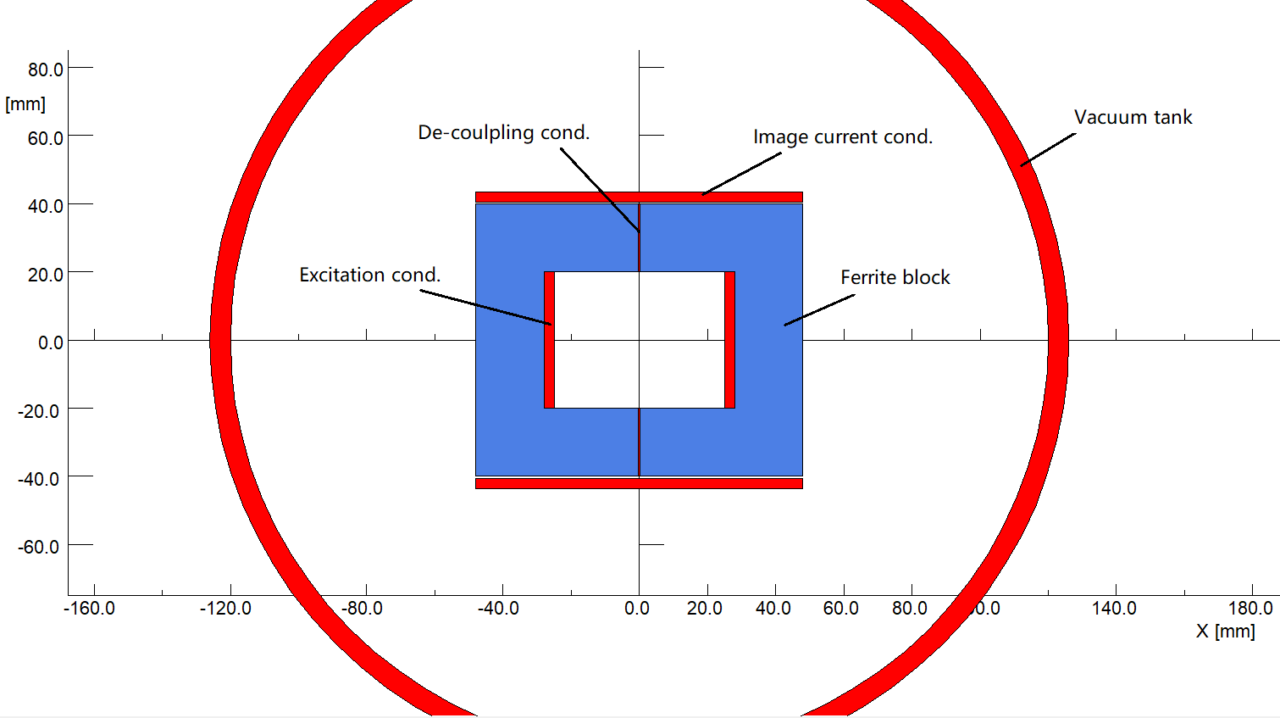
Preliminary design of kicker magnets
Another way to reduce the beam impedance is to put the image current conductors on the top and bottom surfaces of the ferrite blocks outside the magnet gap. But the effects to reduce the beam impedance should be studied carefully.

Slide 27
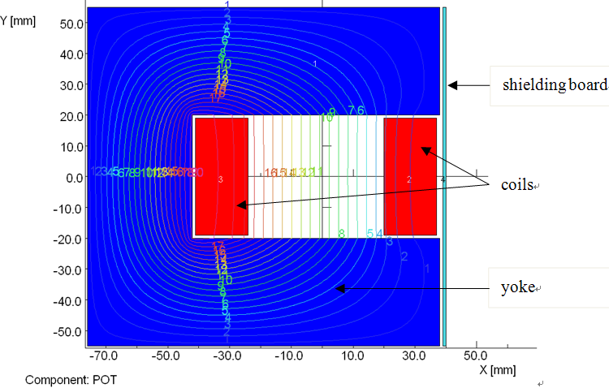
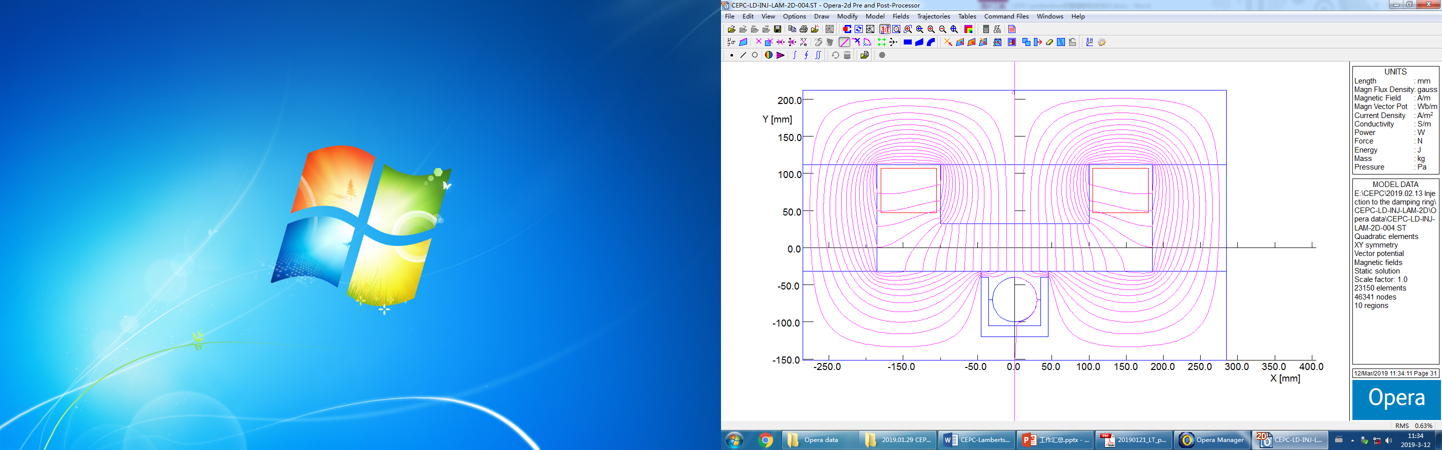
Preliminary design of septum magnets
There are two types of septum magnets often used for beam injection and extraction of accelerators. One is C-type septum magnet, another is Lambertson type septum magnet.
Due to high reliability and stability, Lambertson magnets are selected as the septum magnet for the beam injection and extraction of all the CEPC accelerators.

Slide 28
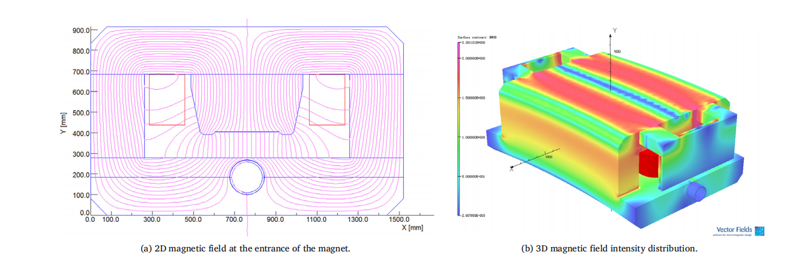
Preliminary design of septum magnets
By using several shielding measures, the leakage field along the orbit of the circulating beam can be reduced down to 5E-4 of the main field in the magnet gap.

Slide 29
Preliminary design of septum magnets
The main parameters of the Lambertson magnets
 | DR-INJ-EXT-LAM | BST-INJ-EXT-LAM | BST-EXT-LAM | MR-EXT-LAM-01 | MR-EXT-LAM-02
Number | 2 | 2 | 16 | 20 | 20
Eff. length（m） | 2 | 2 | 1.875 | 1.75 | 1.75
Max. field（T） | 0.18 | 0.366 | 0.58 | 0.64 | 0.32
Septa thick(mm) | 10 | 10 | 10 | 10 | 4
Gap（mm） | 64 | 44 | 44 | 24 | 24
GFR（mm） | 60 | 40 | 40 | 20 | 20
Leakage field | ＜0.001 | ＜0.001 | 0.1% | 0.1% | 0.1%
Amp. turns（AT） | 9442 | 13200 | 20917 | 12590 | 6295
Current (A) | 472 | 440 | 581 | 420 | 393
Jc（A/mm2） | 3.27 | 3.04 | 4.02 | 2.9 | 2.72
Resistance（Ω） | 0.011 | 0.016 | 0.019 | 0.014 | 0.007
Voltage（V） | 5.26 | 7.16 | 10.8 | 5.9 | 2.9
Power loss（kW） | 2.48 | 3.15 | 6.30 | 2.47 | 1.15
ΔP（kg/cm2） | 6 | 6 | 6 | 6 | 6
Water flow（l/s） | 0.52 | 0.79 | 0.73 | 0.86 | 0.66
ΔT（℃） | 1.13 | 1 | 2 | 1 | 1
L/W/H（m） | 2.2/0.7/0.4 | 2.2/0.5/0.4 | 2.1/0.5/0.4 | 2.0/0.4/0.3 | 1.9/0.3/0.3
Weight（t） | 2.9 | 2.5 | 2.5 | 1.7 | 1.0

Slide 30
Thanks for your attention.

