Slide 1
Radiation Protection Design Progress for CEPC
Zhongjian MA, Yadong DING, Mingyang YAN
16/04/2019
On behalf of Radiation people in IHEP, CAS
Workshop on the Circular Electron-Positron Collider, EU Edition 2019

Slide 2
Content
Radiation protection design criteria recall
Radiation shielding for synchrotron radiation
Preliminary design progress for beam dump
Summary

Slide 3
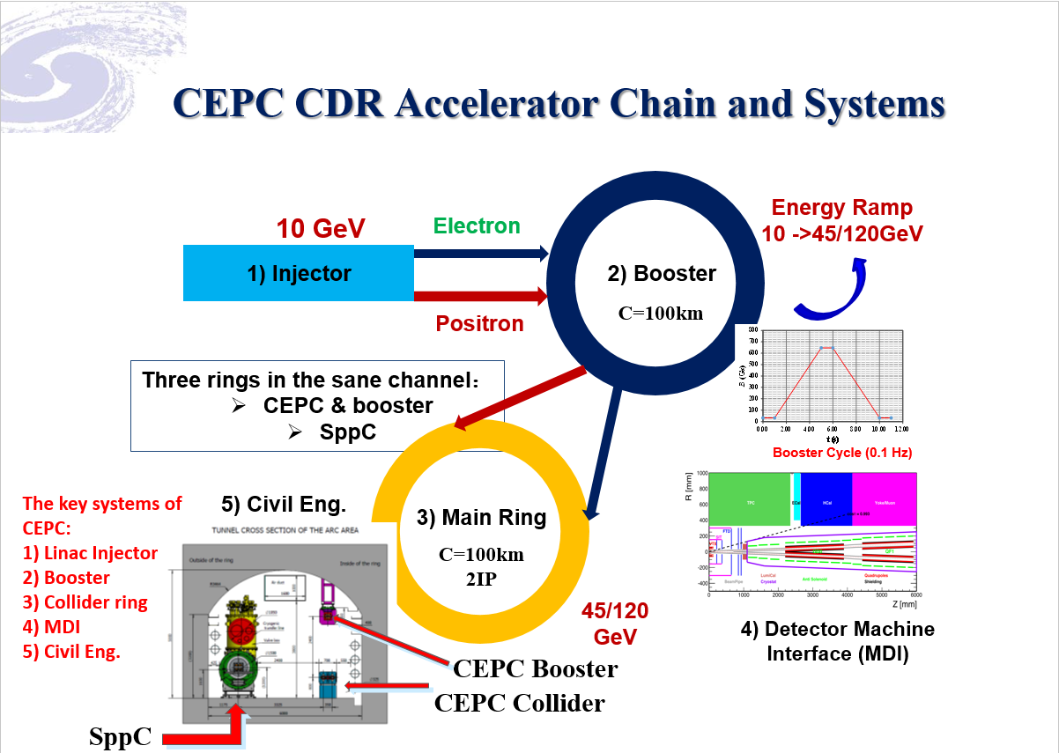
From: gaoj@International Assessment 2018

Slide 4
Content
Radiation protection design criteria recall
Radiation shielding for synchrotron radiation
Preliminary design progress for beam dump
Summary

Slide 5
1. Shielding Design Criteria
Dose limitation in regulations
  The national standard of the People’s Republic of CHINA, “Basic standards for protection against ionizing radiation and for the safety of radiation Source”, GB 18871-2002.
  The national standard of the people’s republic of china, “The rule for radiation protection of particle accelerators”, GB 5172 1985.
  ICRP publication 103, “The 2007 Recommendations of the International Commission on Radiological Protection”.
Radiation dose limit for person in the regulations
 |  | Worker | Public
Effective Dose | Average in 5 years | 20mSv/year | 1mSv/year
 | Max. in single year of the 5 years | 50mSv/year | 5mSv/year
Equivalent Dose | Lens eye | 150mSv/year | 15mSv/year
 | Skin | 500mSv/year | 50mSv/year

Slide 6
1. Shielding Design Criteria
Limits for shielding design of CEPC-sPPC
  1. Prompt dose rate limit
Area | Design Value | example
Radiation monitored area | < 2.5 μSv/h | registered radiation workers can enter freely any time Such as facilities halls, the surface of concrete shielding
Radiation controlled area | < 25 μSv/h | access this area is limited and permissions and the entering procedures are required. Such as auxiliary tunnel;
Forbidden area | >>1mSv/h | access to this area is in principle forbidden. Such as tunnel while the beam is running.
Site boundary | 0.1 mSv/year
  2. Residual dose rate limit: < 1mSv/h for the workers to get into the tunnel ( 30cm, 4 h down ) (refer SNS)

Slide 7

1. Shielding Design Criteria
Limits for shielding design of CEPC
  3. Concentration limit of induced activity
      According to GB18871-2002: “if there are more than one kind of radionuclide, only if the ratio of activity (or specific activity) to its exempt value of each kind of the radionuclide was less than 1, it is exemptible.”
      Convenient method to soil and ground water activation: The prompt dose rate is ~5.5mSv/h in the thickness of 1m soil to ensure it is below the exempt value of above. (refer J-PARC)
$$\sum_{i=1}^{n}{\frac{S_{i_}}{S_{i_exempt}}<1}$$

Slide 8
2. Shielding Calculation Methods
For Magnets、bulk shielding、Beam-Dump and Collimators：
CEPC：FLUKA + MCNP + Empirical formula
For streaming：
DUCT-III（Shin’s equation) + FLUKA
For skyshine：
Stapleton’s equation
For activity calculation and residual dose rate :
FLUKA + Empirical formula

Slide 9
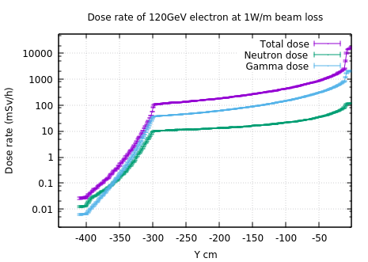
3. Radiation shielding design for main tunnel
Simulation result for thickness of the main tunnel for CEPC
Beam loss parameter: 1W/m for 120GeV electrons, the material of the beam pipe is Fe and 1 cm thickness
  Radiation levels caused by other beam loss parameters can be deduced through proper conversion coefficient

Slide 10
3. Radiation shielding design for main tunnel
Average beam loss parameter
  According to the cumulated number of particles and the lifetime of the beam
Beam loss calculation
  Beam energy:120GeV; Lifetime:1h; circumference:100km;
  For CEPC: ~0.004 W/m
So, the dose rate in the arc tunnel is about several hundreds μSv/h

Slide 11
4. Radiation dose monitor system
  Goal: guarantee the radiation level of workplace and the environment around complies with relevant regulations.
  State of the art system: once radiation level exceeds the set critical value, monitors would sound the alarm.
  Main includes:
  Data acquisition program
  Workplace monitoring program
  Environmental monitoring program
  Personal dose monitoring program
  Management of radioactive components

Slide 12
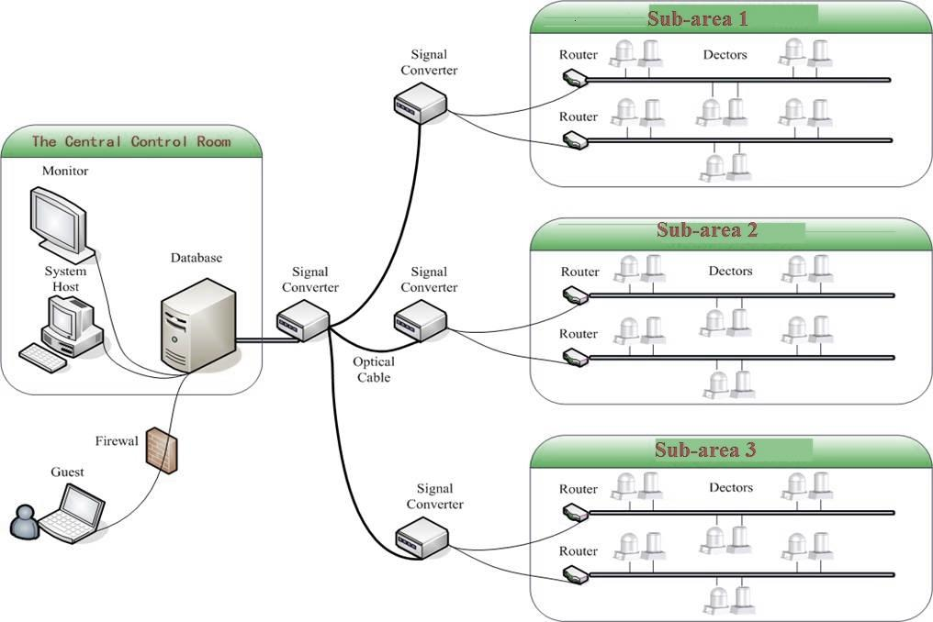
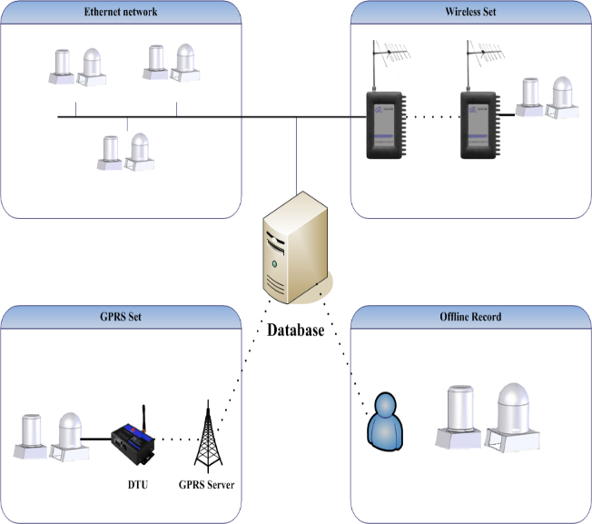
4. Radiation dose monitor system
  Frame diagram of the radiation monitor system
  provides remote supervision, long term database storage and off-line data analysis
  The monitored areas can divided into different parts
System framework
Date communication methods

Slide 13
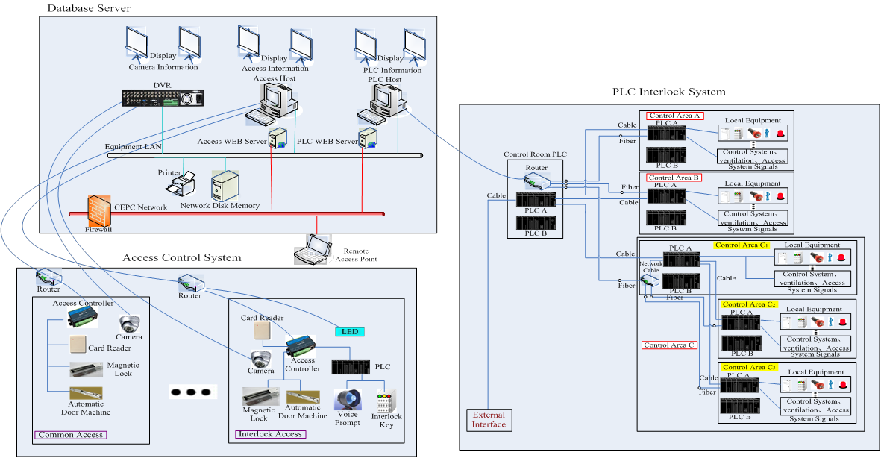
5. Personal Protection System (PPS)
  Schematic diagram of the PPS
  Including PLC system, access control system, database server
  PPS system will be designed mainly by control staff

Slide 14
Content
Radiation protection design criteria recall
Radiation shielding for synchrotron radiation
Preliminary design progress for beam dump
Summary

Slide 15
Radiation shielding design for Synchrotron Radiation
Theory and parameters
Parameters determining synchrotron radiation in CEPC
Parameters |  | Energy in GeV
 |  | 45.5 | 80 | 120
I (per beam) | mA | 183.1 | 88.1 | 17.4
Critical energy | keV | 19.7 | 107.1 | 361.6
Radiated power | W/m | 98 | 452 | 452
Parameters of synchrotron radiation at 120 GeV
Parameters | Symbols | Values | Units
Beam energy | E | 120 | GeV
Beam current | I | 17.4 | mA
Bending radius | ρ | 10600 | m
Power per unit length | P | 452 | W/m
Critical energy | E_{c} | 361.6 | keV
Bending angle | θ | 2.844 | mrad
Opening angle | φ | 4.258 | μrad

Slide 16
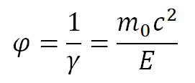
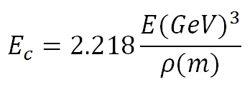
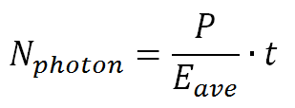
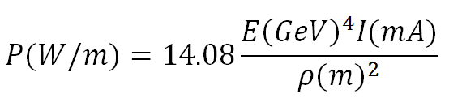
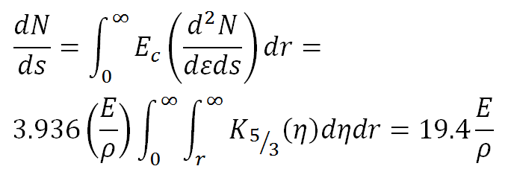
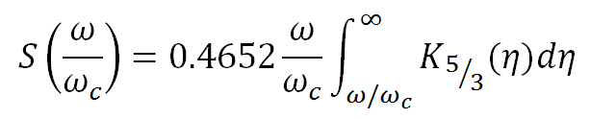
Radiation shielding design for Synchrotron Radiation
Theory and parameters
SR critical energy
Solid degree
Number of photons (Method 1)
SR Power
Number of photons (Method 2)：
SR spectrum

Slide 17
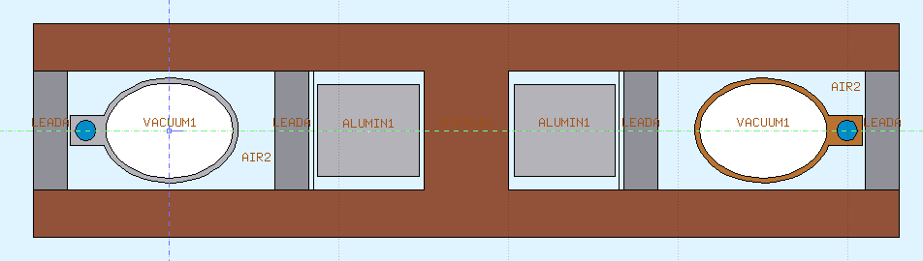
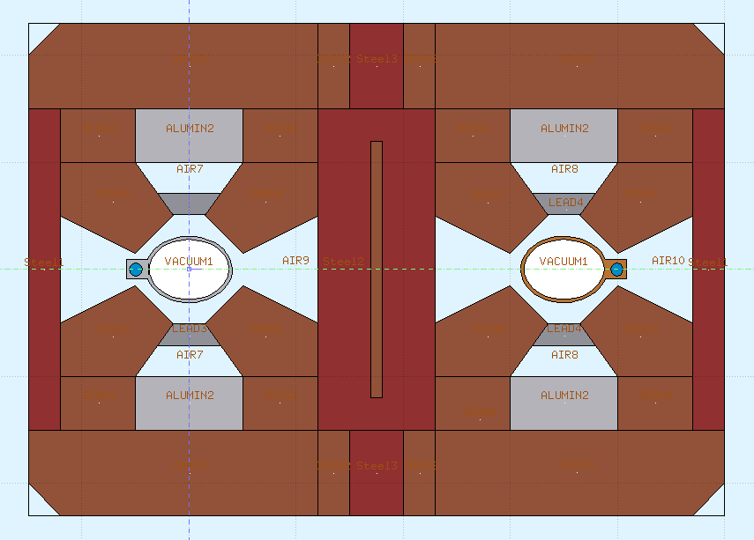
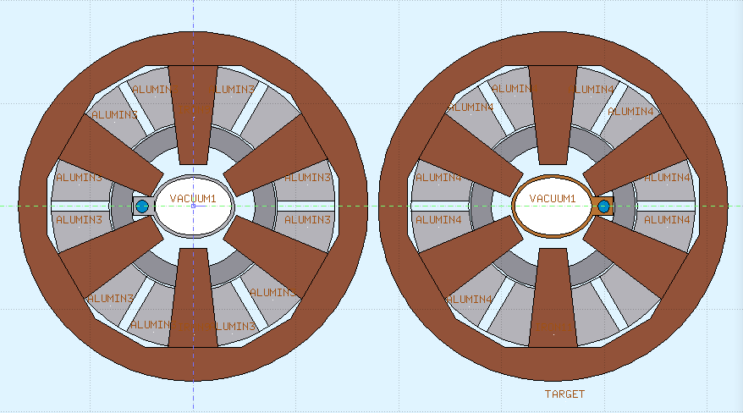
Radiation shielding design for Synchrotron Radiation
Shielding structure for magnets
Magnet coils are wrapped around by massive organic materials, which are especially sensitive to radiation.
20 mm lead is used for protecting the coils of magnets.

Slide 18
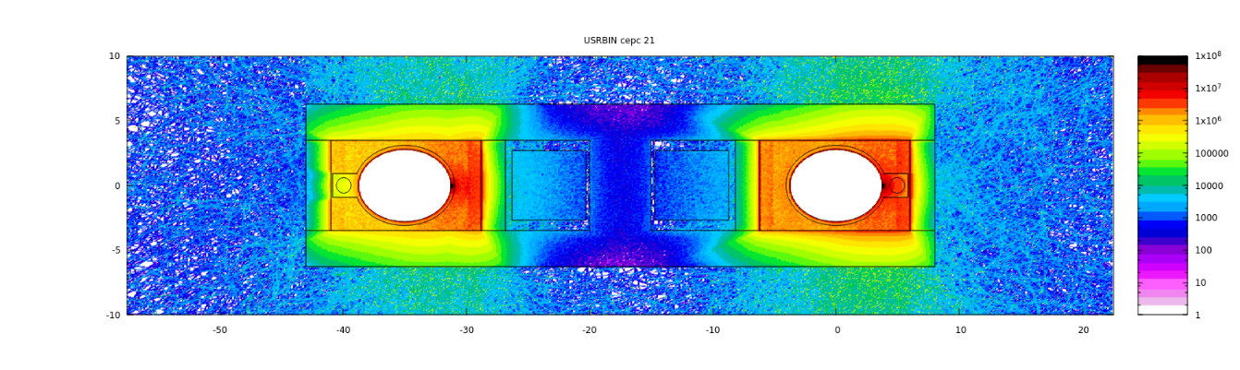
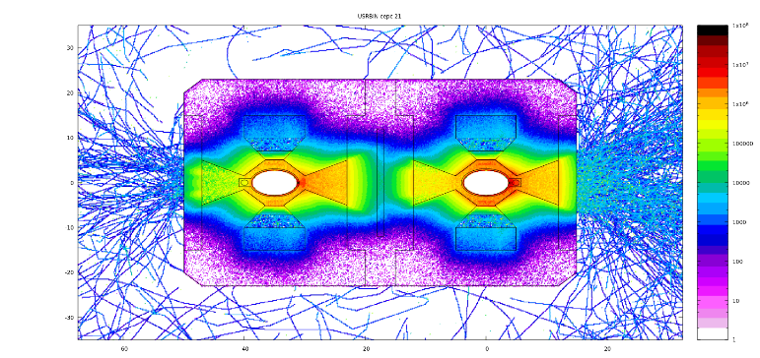
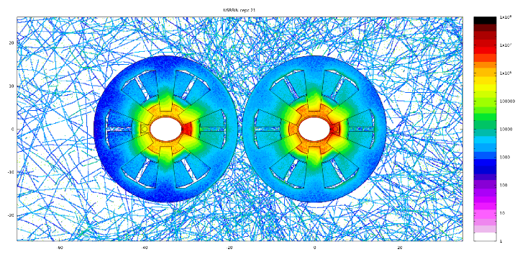
Radiation shielding design for Synchrotron Radiation
Radiation dose around the coils
Shielding for about 10 years operation;
The upper dose limit of materials is from LEP design report;
With and without lead shielding
2cm lead can reduce the maximum dose by at least 10 times
Different beam direction
Almost the same for the opposite direction
May be changed with time
The cooling water pipes are now in the same side

Slide 19
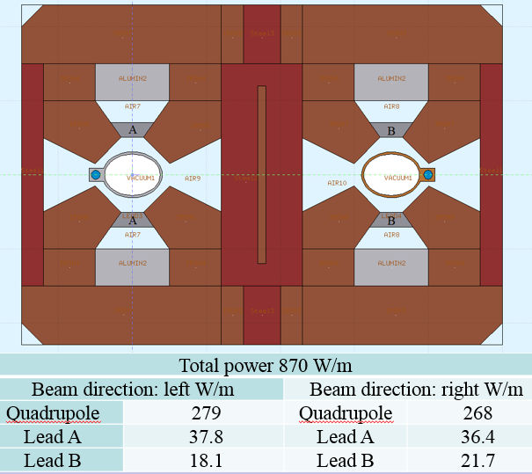
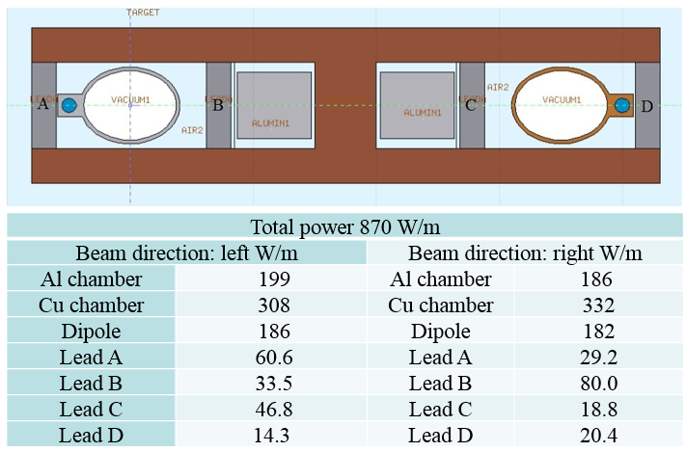
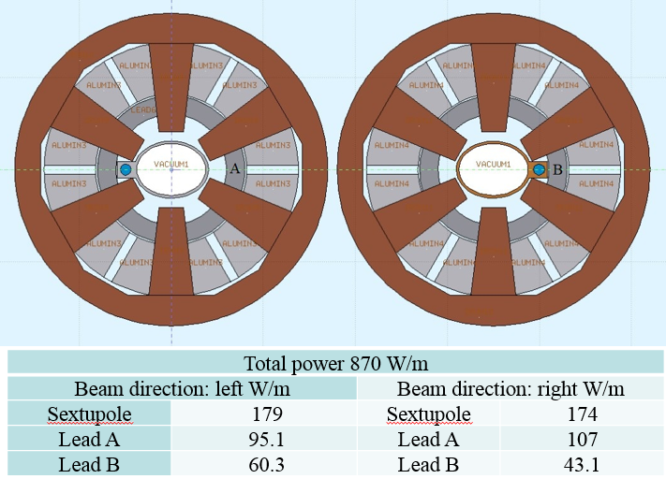
Radiation shielding design for Synchrotron Radiation
Energy deposition in different part of magnet
Heat load in the tunnel
Heat can induced heavy load for ventilation system
Lead shielding is also used for move away as much heat as possible
For 2cm Pb shielding, the heat deposited in the tunnel is less than 5% of total energy

Slide 20
Content
Radiation protection design criteria recall
Radiation shielding for synchrotron radiation
Preliminary design progress for beam dump
Summary

Slide 21
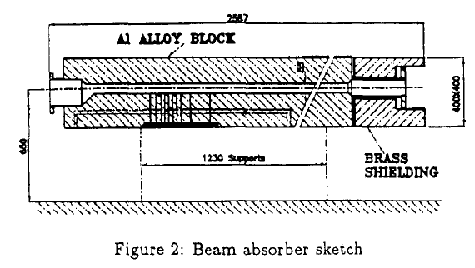
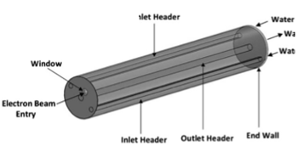
Preliminary radiation shielding design for Beam dump
Radiation shielding design, energy deposition and heat transfer analysis are still on going
Beam dump for ILC and LEP2 are adopted as reference
Graphite, aluminum, iron and tungsten are considered as collect materials
Machine | Shape | Size | Material
LEP2 | Cube | 2.5*0.4*0.4 m^3 | Aluminum, brass
ILC | Cylinder | Length:11m;dimeter:3.6m | Water
Operation Model | Energy/ GeV | Bunch number | Bunch charge/nC | Beam dementions: X/Y
Higgs | 120 | 242 | 24 | 0.5mm/0.02mm
W | 80 | 1524 | 19.2 | 0.33mm/ 0.02mm
Z | 45.5 | 12000 | 12.8 | 0.19 mm/0.02mm
LEP2
ILC
CEPC beam parameters for dumps

Slide 22
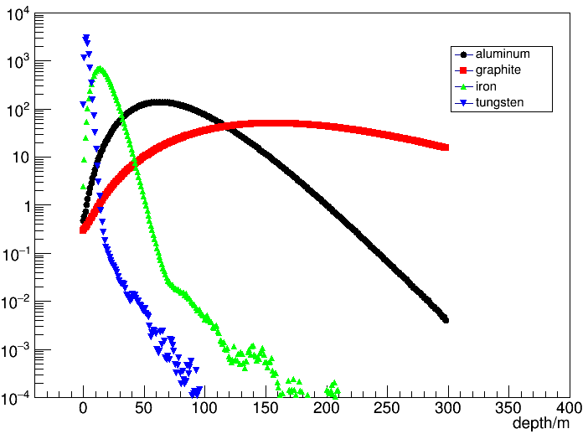
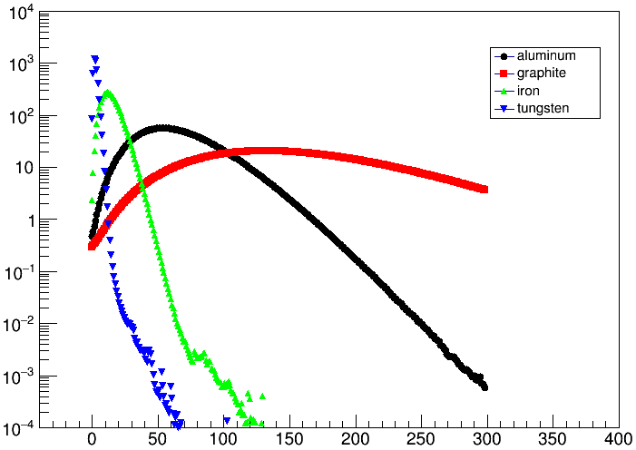
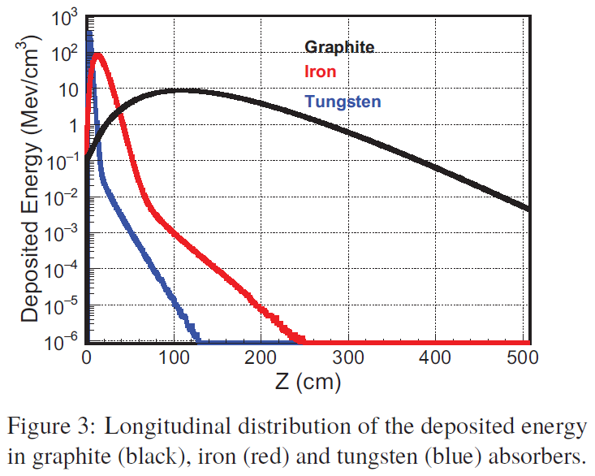
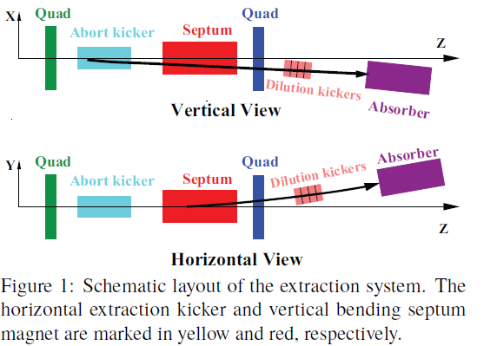
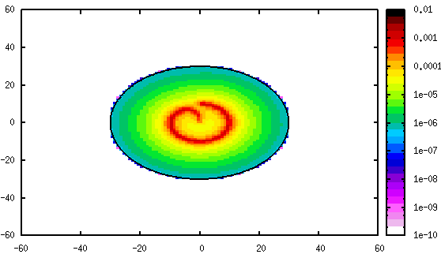
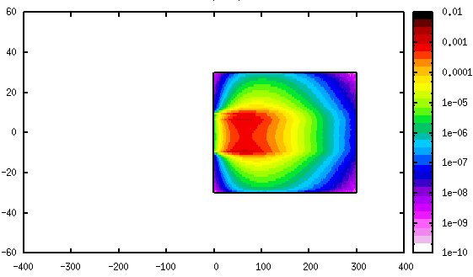
Preliminary radiation shielding design for Beam dump
Energy deposition in cylindrical materials were simulated
120GeV
45GeV
Longitudinal energy deposition
Energy deposition color map
Ref:DOI: 10.18429/JACoW-eeFACT2016-WET3AH3
A dedicated extraction line, include abort kicker/dilution kicker/beam window/absorber is still under designing.

Slide 23
Summary
Radiation shielding design for CEPC must be more careful for its big scale and influence.
Design for synchrotron radiation, beam dump and radiation to environment and public is the main concern in the next steps.
Looking forward to receive your evaluation, comments and suggestions.

Slide 24
Thanks !
马忠剑， Zhongjian MA，00 86 13810439249，mazhj@ihep.ac.cn

Slide 25
Back up

Slide 26
The upper dose limit of materials
Materials | Upper dose limit in Gy
Acylic scintillator | 10²-10⁴
Butyl rubber | 5×10⁴
Electronics components (active) | 10²-10³
Optical fibre | 10-10²
Perfluoro ethylene-propylene | 5×10⁴
Phenolic resin, unfilled | 10⁴
Polyacryl (Plexiglas) | 10⁵
Polyamide (Nylon) | 10⁵
Polyester resin, unfilled | 5×10⁴
Silicone oil | 5×10⁵
Silicone rubber | 5×10⁵
Teflon (PTFE) | 10³
Viton | 1-2×10⁵
Araldite D (epoxy resin, cured at ambient temperature)
Chlorosulfonated PE (Hypalon, CSP)
Cross-linked PE (XLPE)
Ethylene-acylate rubber (EAR)
Ethylene-propylene rubber (EPR)
Ethylene vinyl acetate (EVA)
Flamtrol (polyolefin) | 1-2×10⁶
Halar (CTFE)
Hytrel (PETP copolymer)
Lupolen (PE)
Polychloroprene (Neoprene)
Polyolefin
Polyvinyl chloride (PVC)
Materials | Upper dose limit in Gy
Araldite B (epoxy resin)
Araldite F (epoxy resin)
Epikote (epoxy resin)
Epoxy Novolac
Epoxy resin, aromatic hardener
Glass-fibre reinforced EPR-hoses
Mineral oil | 1-2×10⁷
Paints based on epoxy or polyurethane resins
Polyimide resin
Special radiation resistant lubricants
Special radiation resistant motors
Cerium-doped glass
Ryton (PPS)
Inorganic filled resins:
-Epoxy, aromatic hardener
-Phenolic | 1×10⁸
-Polyester
-Polyimide
-Polyurethane
-Silicone
Aluminium oxide
Magnesium oxide
Metals | >10⁸
Mica
Glass fibre
Quartz

