Slide 1



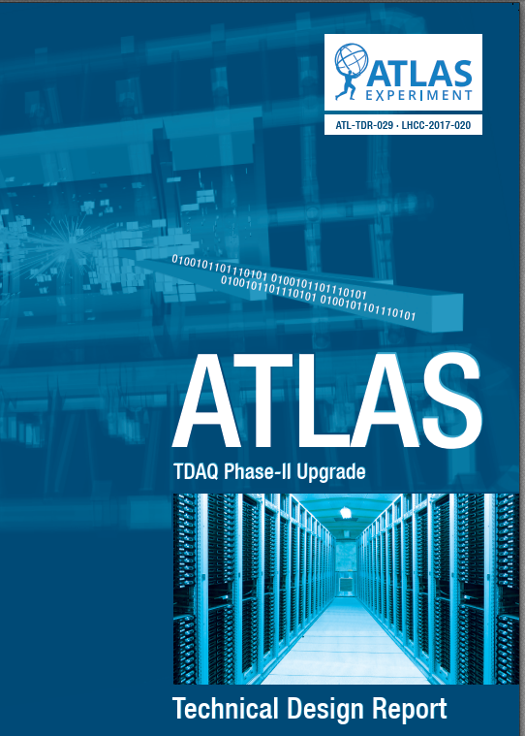
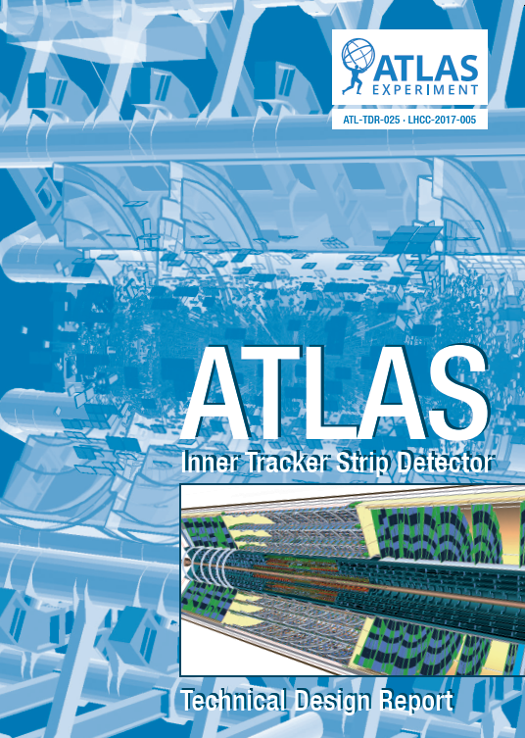

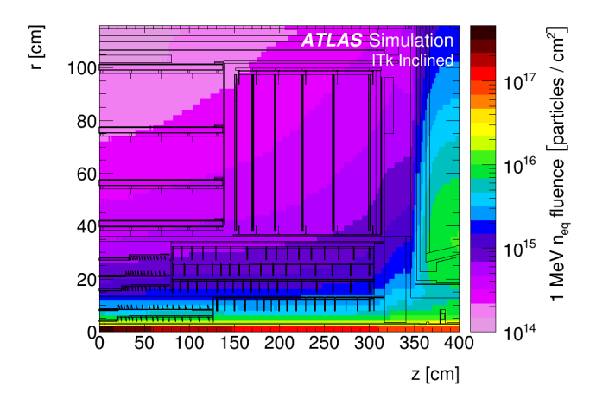
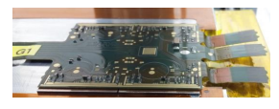
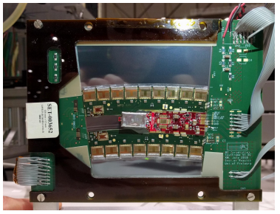

Design and Production of the ATLAS upgrade tracker
Steve McMahon
Rutherford Appleton Laboratory & Oxford University
CEPC Workshop, St Anne’s College, April 15-17 2019

Slide 2
The organisers brief:
Talk about the production of the ATLAS tracker and, in particular, where you anticipate problems

Slide 3
The organisers brief:
Talk about the production of the ATLAS tracker and, in particular, where you anticipate problems
Instead, and because we have a few problems in the past, I am going to talk about what actions we are taking to avoid these situations in the future.

Slide 4
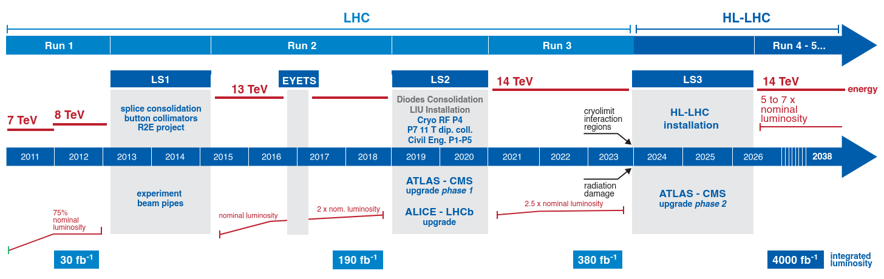
HL-LHC Upgrade: The Timeline
Now
ITk-Strips
Muons
ITk-Pixels
LAr Calo
TDAQ
Tile Calo

Slide 5
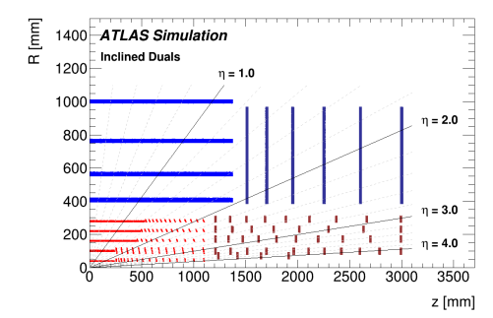
Upgraded Tracker : General Design Considerations
Design based on ~10 years of operation with existing tracker
Monolithic all silicon design
5 barrel pixel layers & forward disks to high η
4 barrel strip layers & 6 end cap discs on each side
Designed for
low mass, high tracking efficiency tracks P_{T} > 1 GeV,
low fake rake, primary & secondary reconsruction
fault tolerant against limited component losses
accommodate timing detector at high η
1 MHz readout L0 Only, 4 MHz L0-L1
Where possible reused existing services HV, LV cable & dry gas
New C02 cooling
Rapidity reach extended to |η| = 4
Total Integrated luminosity up to 4,000 fb⁻¹
Inner Pixel section replaced after 2,000 fb⁻¹
Instantaneous luminosity up to 7.5 x 10³⁴ cm⁻² s⁻¹
200 inelastic proton-proton collisions per crossing
10 years of operational lifetime
2017 The Strip tracker Technical Design Report https://cds.cern.ch/record/2257755/files/ATLAS-TDR-025.pdf
2018 The Pixel tracker Technical Design Report https://cds.cern.ch/record/2285585/files/ATLAS-TDR-030.pdf

Slide 6
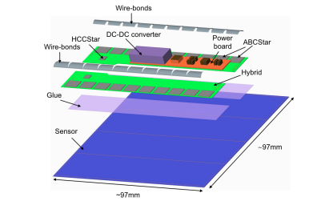
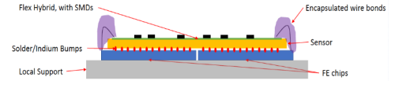
Some ITk Challenges
PIXELS
  Active area of 12.7 m² of silicon
  > 10,000 installed hybrid modules
  Unit cell size 50 x 50 μm² or 25 x 100 μm²
  Sensors
    Layer 0: thin edge 3D, radius 39mm up to 1.3 x 10¹⁶ n_{eq}/cm²
    Layer 1: 100 μm thin-planar n-in-p technology
    Layers 2, 3 & 4: thick-planar, 150μm to 4,000fb⁻¹
    Multiple vendors, choices based on performance, cost & capacity
FE Readout
  Realized in 165 nm TSMC technology, Chip size ~2x2cm with 160k pixels. 4 x 1.18 Gb/s links with data compression. Occupancy up to 223 hits/chip/BC
  Demonstrator chip based in RD53A
  Serial powering – Thermal management important (-35ºC)
STRIPS
  Active area of 165 m² of silicon
  17,888 installed modules
  Modules ~10cm² (1 sensor/module)
  Short (long) strips in barrel close to (far from) IP
  Strip pitch ~70μm, > 59 M channels, AC coupled n⁺-in-p FZ
  Tolerance up to 8.1 x 10¹⁴ n_{eq}/cm² with 33 Mrad up to 700V
  Highly modular, designed for ease of construction
  Truly global construction
FE Readout - binary
  GF 130nm technology, 640 MB/s

Slide 7
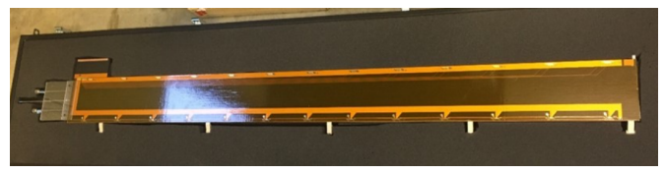
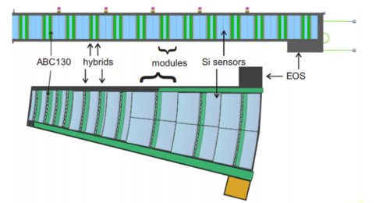
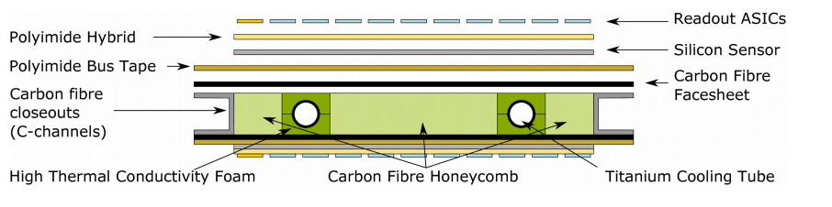
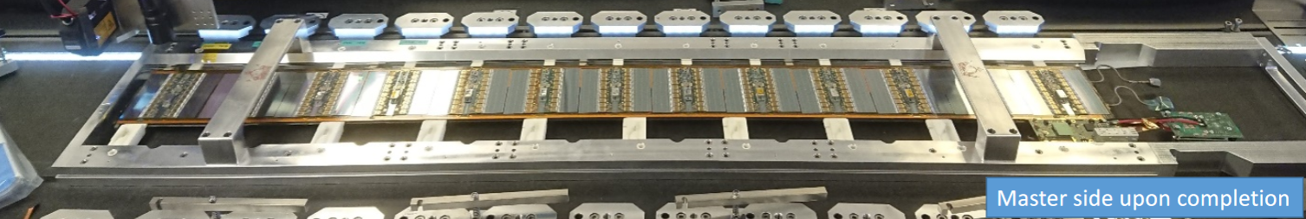
…Strip Mechanics local support concepts and realization

Slide 8
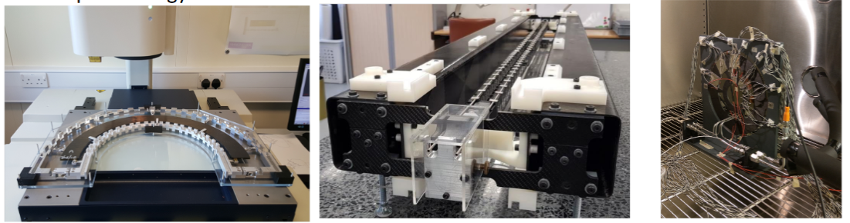
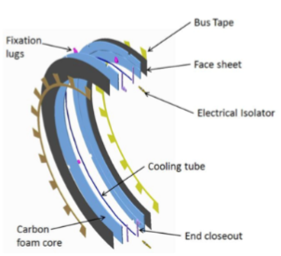
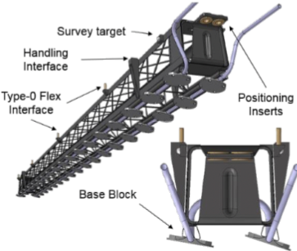
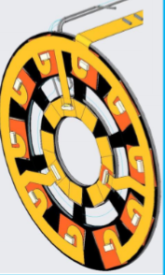
…Pixel local support concepts
End Cap
Outer Barrel
Inner System

Slide 9

Where will the problems come from ?
What does one think of when one thinks of potential problems?
Past construction experience can be useful, but only up to a point.
One should be aware that problems can occur everywhere …… Hope for the best, plan for the worst
One needs to differentiate, at some level, between large volume and small volume production items. Everything is relative and we are talking about HL-LHC scales. Large volume includes, modules (and all parts therein, sensors, ASICs, power boards), local supports, services ...etc
The 4 stage - ATLAS review process (all items), helps a lot.
  Specification Review SR
  Preliminary Design Review PDR No submissions before successful PRR
  Final Design Review FDR
  Production Readiness Review PRR
These formal, robust reviews help minimize development time and reduce schedule and cost risk in production
Doing a lot of prototyping, including system level testing, also helps give confidence in the final product

Slide 10

Minimize problems in production
General features of the different production periods
Start with a pre-production period
  Approximately 1 year in duration
  After the Final Design Review and before the Production Readiness Review
  Not all items, but about 5% of the bulk production items
  The cost of pre-production built into the total costs
  Helps establish and qualify production sites and procedures
    All production sites are required to qualify before being allowed to go into production – Qualify = build a fixed number of good modules
    Helps establish component performance in volume
    Qualification is required for multiple parts of the project, includes site visits and swapping components between sites (good if it is blind)
  Start to learn about vendor quality and production rates (but this is not primary goal)
  Shake down transport issues and tracking
Bulk production after PRR
  Bulk component production times 2.5 – 3.5 years
  Staged ramp up, feeding a pipeline
  Local Support loading with modules is happening in parallel to the module production
  Need to be able to receive components from some vendors and qualify for radiation tolerance (in contracts)
  Integration of local supports into global supports also starts in this period.
  Understanding the required resources for a large build is very important. It is also complex.
  Understanding the build model (including timing and yields) is very important to control schedule & costs.

Slide 11
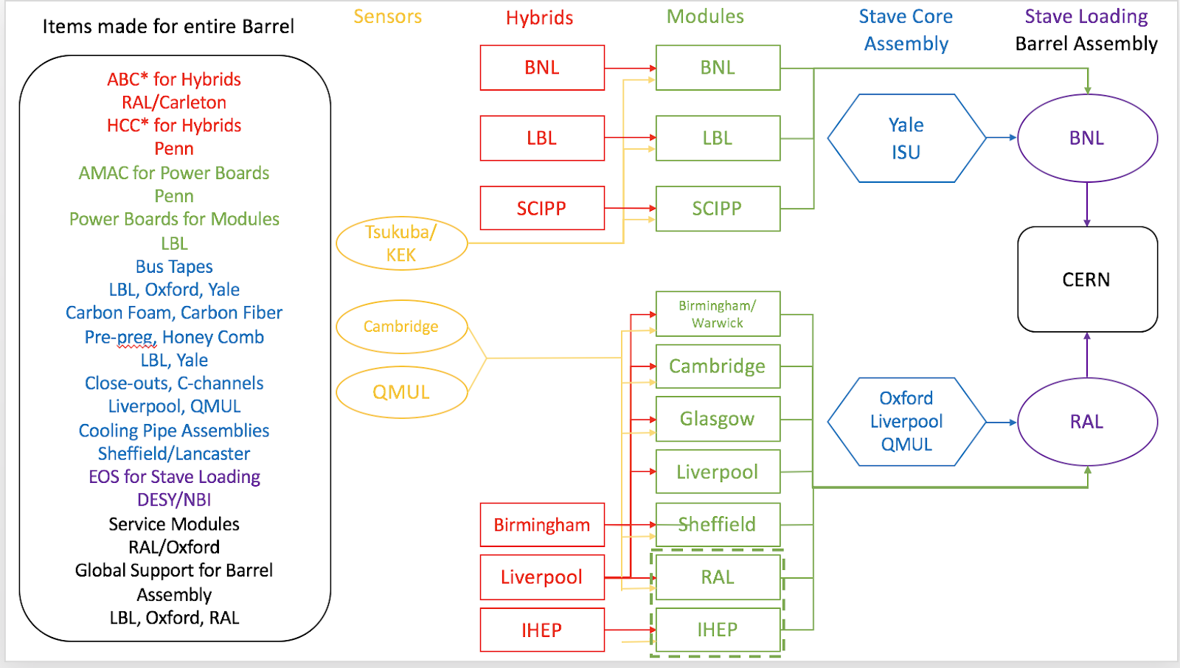
Distributed Production for Strip Modules & Local Supports

Slide 12
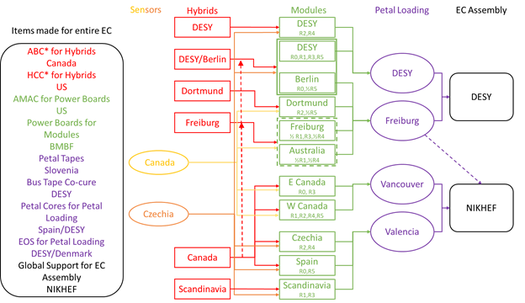
Distributed Production Map

Slide 13
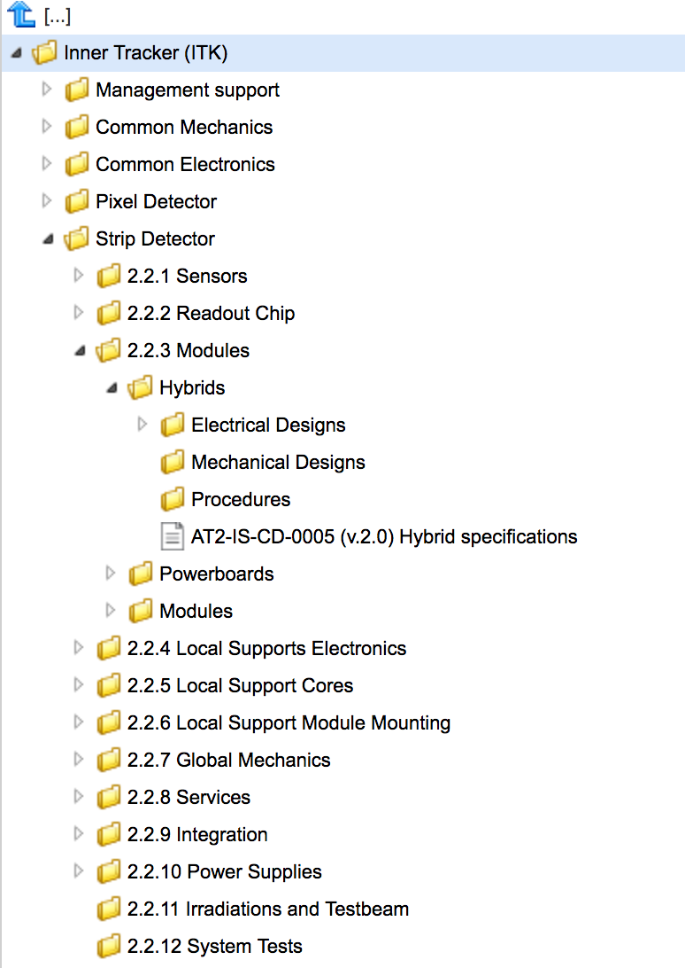
Develop Quality Assurance & Quality Control Plans
Important to develop a clear well defined strategy for Quality Assurance and Quality Control.
This is then built into the development and production cycles, from the start.
Process kicked off with QA/QC workshops
Also important to document the procedures for all parts of the project and propagate to the collaboration.
It is challenging but absolutely critical to maintain a uniform and high level of quality accross all production sites. Regular site vists, and central monitoring and cross-checks are important.

Slide 14
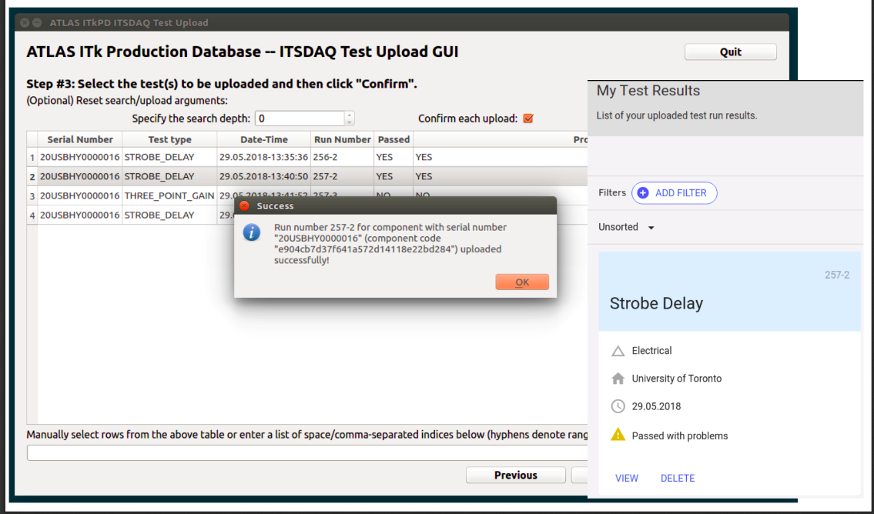
Develop a production database
ITk have put significant effort and resources into the development of
a production database.
We record….
details of key components at all stages of reception, testing & production
details of physical locations, yields, associations to other components
Produce reports on the performance of production sites
store test results from same item at multiple stages of production
eg for a given ASIC, noise on: wafer, hybrid, module stave…
Produce reports on production rates and where modules are failing
which production sites are failing and why
How are the different external suppliers (vendors, CERN,…) performing
Relate production rates to production milestones
Help the production manager streamline the production flow.
Production database needs to know about deliveries and batches

Slide 15
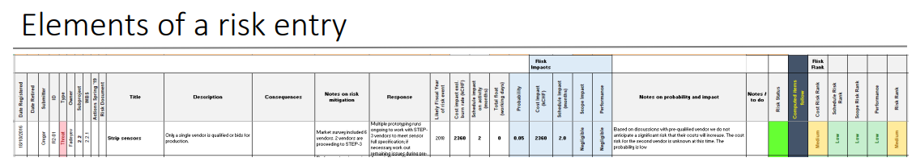
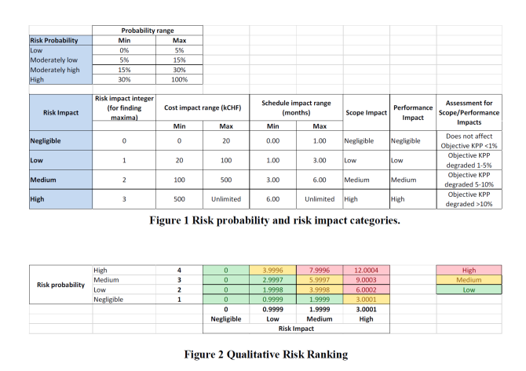
Develop the Risk Register & Risk management strategy
Establish a risk (and opportunity) management team early in the process.
A bottom up process with input from activity coordinators
Need: identifier, owner, description, consequences, schedule and
cost impact.
Use risks in Monte Carlo simulations of probabilities of certain outcomes.
For significant (High impact) risks develop risk mitigations strategies and
document them. The risks must be reviewed 2-3 times per year.

Slide 16

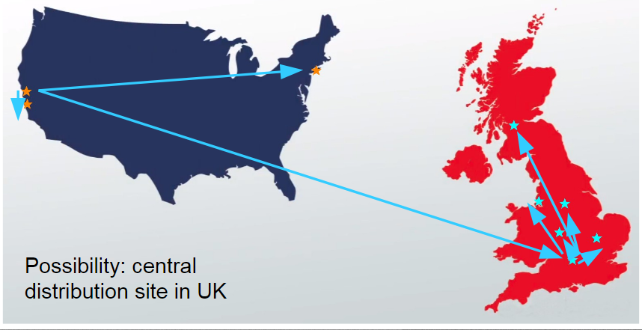
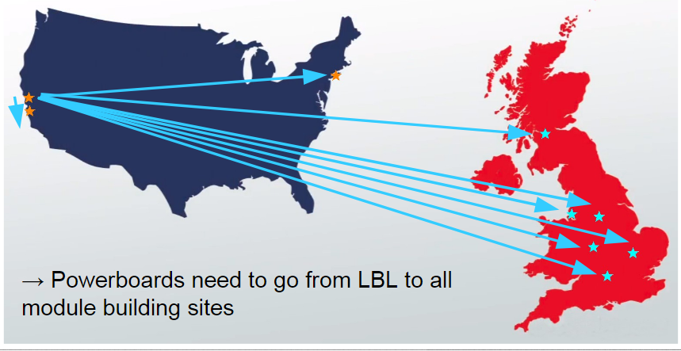
Understand part flow
Streamline the process
Where are all of the components
Which components need to be where and when
Global distribution to all sites OR send components to local cluster for local distribution
How to understand the parts flow for industrial partners.
Understand the restrictions that might be placed on the shipment to and from various countries of dual-use electronics. For us this includes Global Foundaries

Slide 17

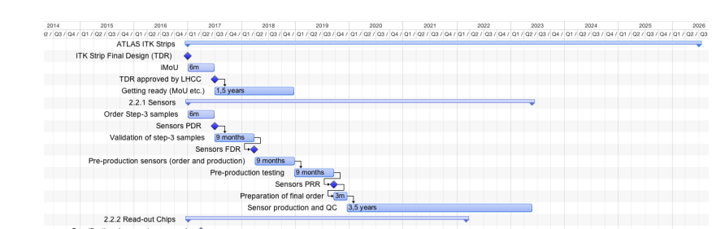
Build a robust schedule
Putting effort into defining and maintaining a robust schedule with sufficient float (sufficient is defined by the level of risk)
Assuring that, as far as possible, that the schedule/process is fault/delay tolerant and components can be redirected. This is especially true in bulk production
Include a lot of preparation and understanding of the “interfaces”
Process is owned by the Activity Coordinators
Do not make pipelines too long or risk loss of control of quality.
Build in sufficient time for integration and surface testing
Minimize times in «hot» areas.

Slide 18

Complex Purchases
The preparataion for the purchase and delivery of high value, (high) volume, complex parts, or services, that involve radiation qualification as part of the process is a very time consuming process, which can, literaly take years.
This complexity is frequently underestimated.
This is frequently made complex because:
  We usually have very demanding requirements
  Our production volumes are large but contracts infrequent –Niche markets.
    We occupy these vendors for 2-3 years and then, next to, nothing for 10-15 years.
    “Interest” from vendors evaporates as one gets closer to production – unstable situation
  We typically work with a small number of vendors during R&D phase and are legally obliged to open up to other vendors for Market Surveys. This is expensive and time consuming as the qualifications take time and resourcess.
  The purchases are frequently collaborative with their own special interests
  It is frequently difficult to guage bulk production rates from R&D campaigns
  This is of particular concern when preparing for a long duration production
Purchases accross experiments can have financial and organisational advandatages

Slide 19

In-house or Industry
How should we approach production .. A complex choice
What we do is often bespoke and requires highly skilled construction
In house
  Staff costs dominate the total project costs.
  A variety of “models” from country to country, including: no or very limited long term technical resources in physics departments, applied physicists permanently on staff. Applied physicists augmented by technicians available from centrally resourced technology departments. Staff hired “off the street as required”.
  Understand the needs of the Funding Agencies and "what constitutes" success for them.
  Design for ease of construction
  ….
In Industry
  It should be a goal to outsource the easier bulk productions.
  Engaging in joint R&D can be expensive, shake down the process in house first
  …

Slide 20

Conclusions
The technical development phase for the ATLAS tracker is nearing an end.
It builds on 10 years of operational experience and a similar amount of time on R&D for the new tracker.
After the TDRs the schedules have been re-examined and baselined for long term-tracking
We are now entering the sequence of Final Design Teviews and starting the pre-production period.
We have put in place tools for monitoring and control during production.
We are aiming to keep the surprises to a minimum.

Slide 21
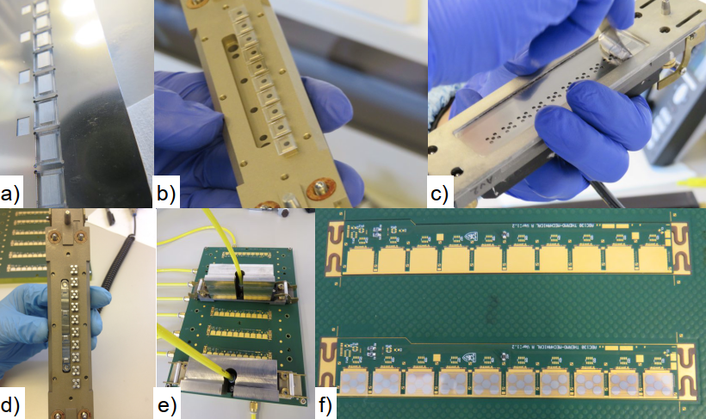
The end

