Slide 1
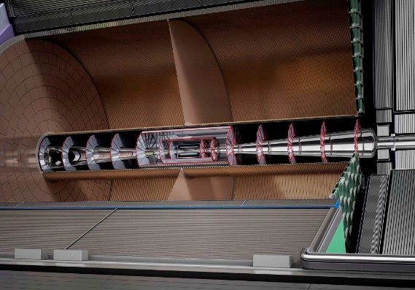
TPC technological challenges
Paul Colas, CEA/Irfu U. Paris Saclay

Slide 2
A TPC is an ideal main tracker, but challenging and slow, and can work only in a suitable environment.
 | LINEAR | CIRCULAR
EUROPE | CLIC | FCC-ee
ASIA | ILC | CEPC
 | New technology + : polarization possible Upgradable in energy | Standard technology + : high luminosity Limited in energy Large tunnel Perspective : hh

Slide 3
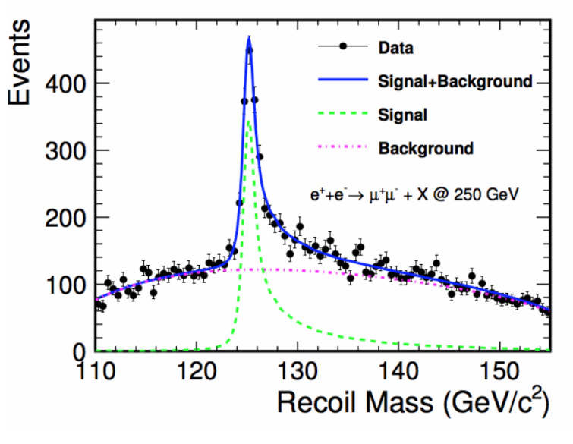
Resolution challenge
To perform model-independent measurement of the Higgs branching fractions, the main tracker must have a momentum resolution of 2x10⁻⁵ (p/GeV)2
This implies O(100µm) space resolution with ~200 measurement points, O(20 µm) systematics on sagitta, with matching module alignment and mechanics quality

Slide 4
Resolution challenge
T. Ogawa, F. Müller
Micromegas
The resolution goal is now proven with all technologies (GEM, Micromegas and Pixels)
For GEMs, it requires ~1mm pads with enough diffusion in the amplification device.
For Micromegas, it requires charge spreading by a resistive-capacitive anode.
For pixels, it requires <300µm pitch digital readout.

Slide 5
RESOLUTION vs AZIMUTH
The resolution dependence on angle has been measured and the ‘track-angle effect’ is well understood (The aspect ratio of the pads is 7/3)

Slide 6
Optimal voltage for the resolution

Slide 7
Mechanical challenges
The mechanical design must ensure small enough deformations under weight and pressure, and electric field homogeneity at the 10⁻⁴ level.
This imposes tough constraints on the field cage rigidity, on the design (mirror stips), and on the suspension
Julie Elman
Deformation of the inner field cage
Peter Schade

Slide 8
The distortion challenges : 1) Module flatness
The modules have to be extremely flat. they can be deformed by the pressure if they are not rigid enough. This gives rise to ExB effects.

Slide 9
The distortion challenges : 2) field cage quality
A simple short between two field shaping rings (as happened in ALEPH due to a tiny carbon fiber) can make a sizeable distortion
- Correct for distortion
- Remove the fiber
Ron Settles, Werner Wiedenmann

Slide 10
The distortion mitigation challenge :
3) module edges
T. Ogawa, S. Ganjour
By grounding the mesh and encapsulating the anode at a positive potential, the amplification plane is an almost perfect equipotential, which allows the E-field to be very uniform, even close to the module boundary.
A reduction by an order of magnitude of the ExB distortions is observed.

Slide 11
The dE/dx challenge
dE/dx is an essential tool for particle identification, necessary in b physics and in Higgs physics.
It has been proven to be possible with the 3 technologies (Micromegas, GEM and pixels)
Pixel allow cluster counting, which improves the achiveable resolution.
For 1.35 m electron tracks, we obtain:
4.6 % for Micromegas
4.5 % for GEMs
3.5 % for pixels

Slide 12
The power consumption challenge
The total power consumption is estimated to be about 6 kW per endplate, which can be provided easily with a sufficient number of 32A copper cables. However the supplies must be as close as possible to the detector : for 50 m cables, the same power is dissipated in the cables.
To meet the low consumption requirement, 65 nm electronics at low voltage has to be developed, with a low-consumption ADC (9 bits are enough?)

Slide 13
The integration challenge
Integrate the readout of 2000 channels per module (8000 in the future) so that the only connections to outside are:
A low voltage
A HV
A signal fiber
A CO2 cooling pipe

Slide 14
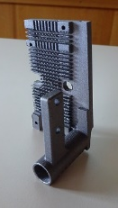
The cooling challenge
2-phase CO2 cooling meets it. It allows removing heat at nearly room temperature in a pipe at 50-60 bar
A 3D-printed cooling plate with an integrated serpentine is being made
Connectors to 2P CO2 loop
Fins for backup air-cooling
Integrated serpentine
M. Riallot, Y. Jan
CO2 phase diagram

Slide 15
The ion backflow challenge
The possibility of gating exists only at ILC. For other colliders (continuous beam or high rate bunch crossings) gating is not possible.
There is a natural ion backflow suppression in Micromegas, but not sufficient at the Z.
Other possibilities are Double meshes (??), or a new anode microstructure with hole by hole defocusing amplification field : NEEDS R&D!
More with ALICE upgrade and TPC at RHIC. More at MPGD19 at La Rochelle.

Slide 16
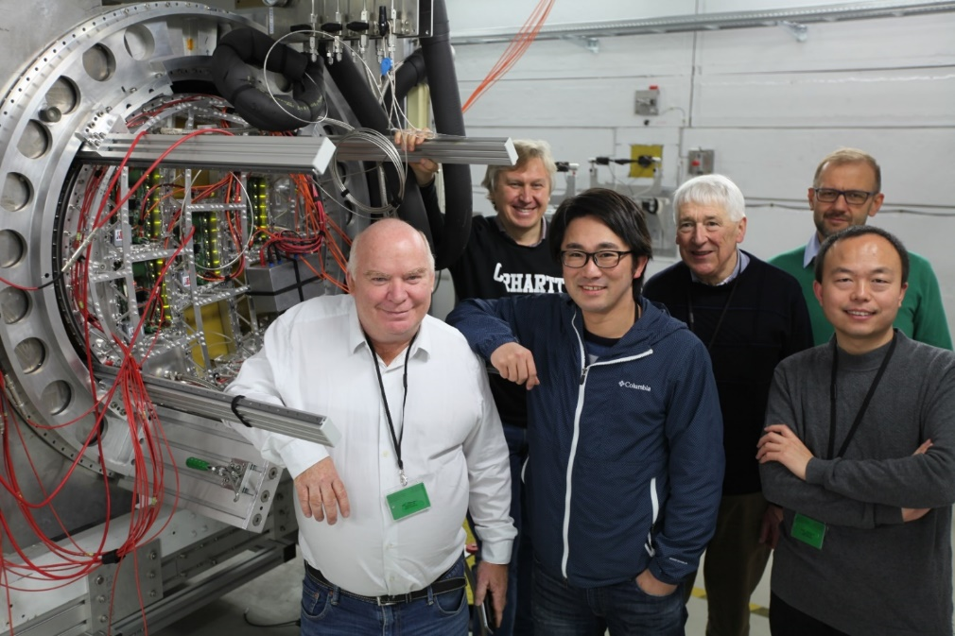
Conclusion
Many of the challenges have been met.
However specific R&D is needed to cope with the huge backflow in high luminosity continuous machines (CEPC, FCC, and CLIC). At ILC, the beam time structure allows gating between train crossings.
Thanks to my colleagues D. Attié, S. Ganjour, T. Ogawa, M. Riallot, X. Coppolani, S. Emery, Huirong Qi, J. Timmermans, M. Titov, R. Diener, V. Prahl and O. Schäfer

